Slide 1
MDI design progress and the studies for a narrower IP chamber
Sha Bai
On behalf of CEPC MDI group
CEPC Day
2022-4-22

Slide 2
Machine parameters
 | Higgs | W | Z | ttbar
Number of Ips | 2
Circumference [km] | 100.0
SR power per beam [MW] | 30/50
Half crossing angle at IP [mrad] | 16.5
Bending radius [km] | 10.7
Energy [GeV] | 120 | 80 | 45.5 | 180
Energy loss per turn [GeV] | 1.8 | 0.357 | 0.037 | 9.1
Piwinski angle | 5.94 | 6.08 | 24.68 | 1.21
Bunch number | 249/415 | 1297/2162 | 11951/19918 | 35/58
Bunch population [10^10] | 14 | 13.5 | 14 | 20
Beam current [mA] | 16.7/27.8 | 84.1/140.2 | 803.5/1339.2 | 3.3/5.5
Momentum compaction [10^-5] | 0.71 | 1.43 | 1.43 | 0.71
Beta functions at IP (bx/by) [m/mm] | 0.33/1 | 0.21/1 | 0.13/0.9 | 1.04/2.7
Emittance (ex/ey) [nm/pm] | 0.64/1.3 | 0.87/1.7 | 0.27/1.4 | 1.4/4.7
Beam size at IP (sigx/sigy) [um/nm] | 15/36 | 13/42 | 6/35 | 39/113
Bunch length (SR/total) [mm] | 2.3/3.9 | 2.5/4.9 | 2.5/8.7 | 2.2/2.9
Energy spread (SR/total) [%] | 0.10/0.17 | 0.07/0.14 | 0.04/0.13 | 0.15/0.20
Energy acceptance (DA/RF) [%] | 1.6/2.2 | 1.2/2.5 | 1.3/1.7 | 2.3/2.6
Beam-beam parameters (ksix/ksiy) | 0.015/0.11 | 0.012/0.113 | 0.004/0.127 | 0.071/0.1
RF voltage [GV] | 2.2 | 0.7 | 0.12 | 10
RF frequency [MHz] | 650 | 650 | 650 | 650
HOM power per cavity (5/2/1cell)[kw] | 1/0.4/0.2 | -/1.8/0.9 | -/-/5.8 | 0.4/0.2/0.1
Qx/Qy/Qs | 0.12/0.22/0.049 | 0.12/0.22/ | 0.12/0.22/ | 0.12/0.22/0.078
Beam lifetime (bb/bs)[min] | 39/18 | 60/717 | 80/182202 | 81/23
Beam lifetime [min] | 12.3 | 55 | 80 | 18
Hour glass Factor | 0.9 | 0.9 | 0.97 | 0.89
Luminosity per IP[1e34/cm^2/s] | 5.0/8.3 | 16/26.6 | 115/191.7 | 0.5/0.83

Slide 3
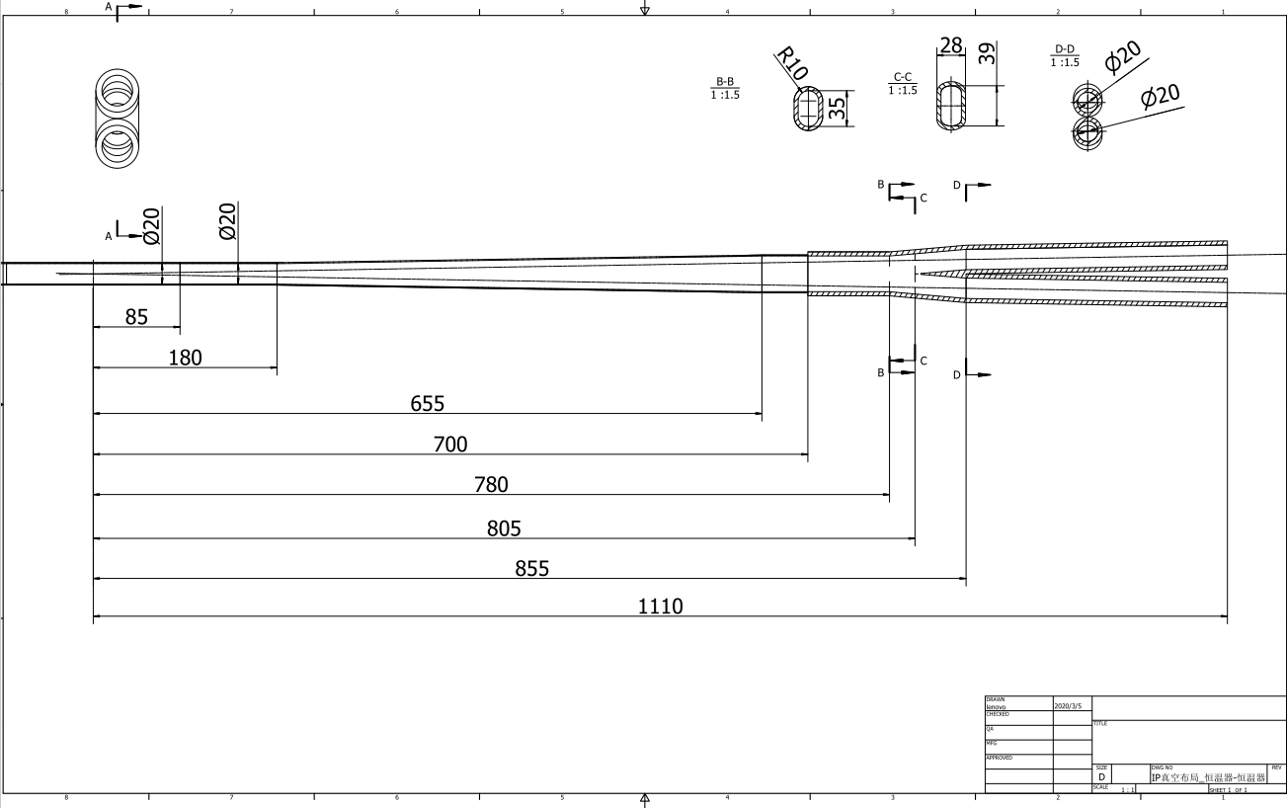
The new central beampipe design
开叉点805，有斜坡，叉管起始点855，锥形，接口700

Slide 4
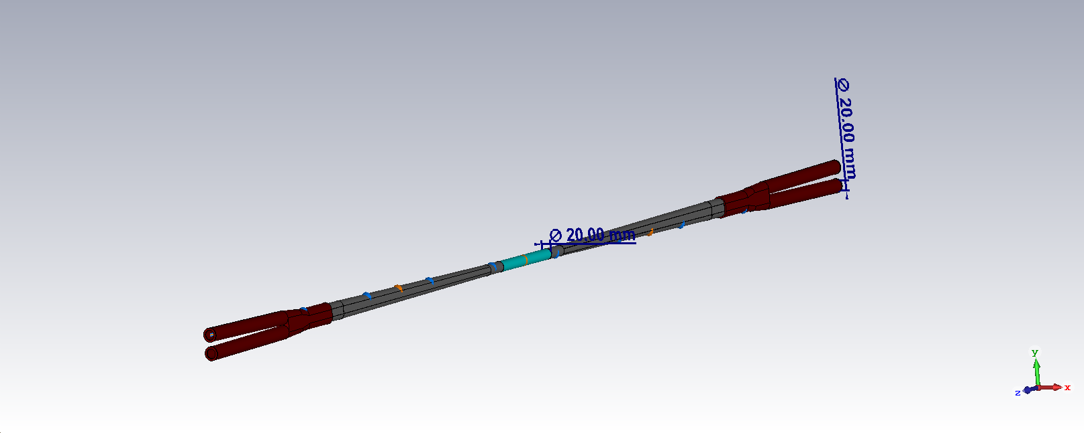
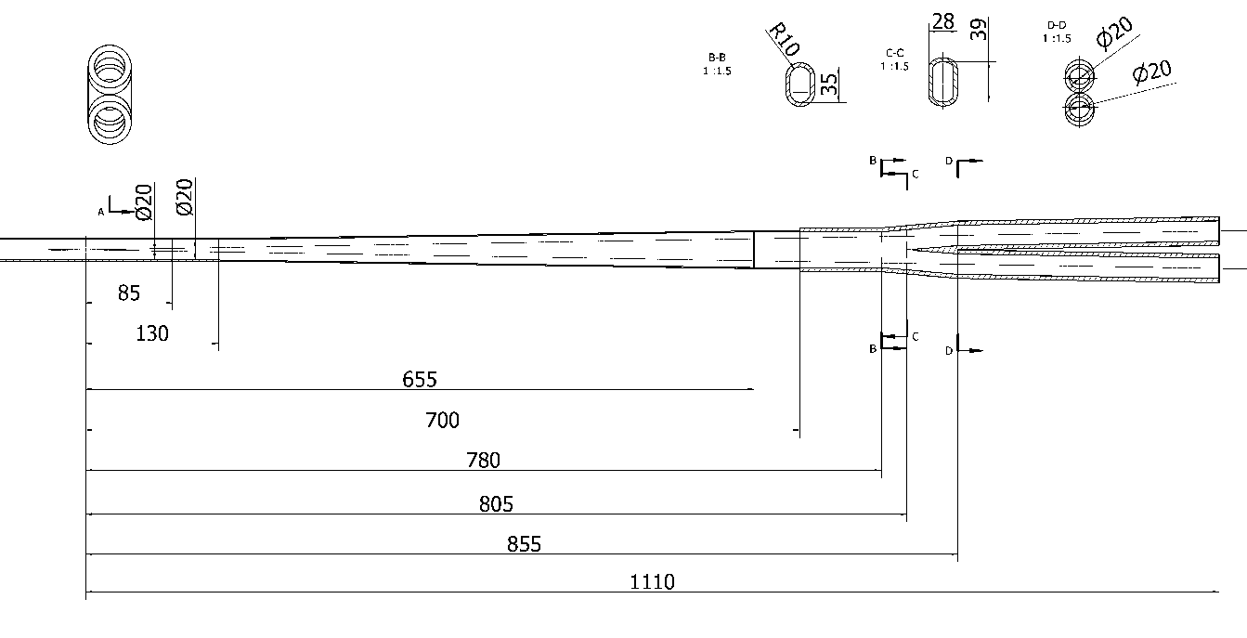
HOM power distribution
results for MDI 20mm-20mm
Transition region: Racetrack (including materials)
σ_{z}=5mm: Two beam in the IR
Loss factor Trap in IR @k_trap: 0.032v/pc
P_{trap}: H/W/Z/tt: 23.8w/116.1w/1150.1w/6.61w
Position | Position Start-end（mm） | material | Length (mm) | Higgs(w) & (w/cm²) | W (w) & (w/cm²) | Z(w) & (w/cm²) | ttbar（w） & (w/cm²)
Be pipe (w) | 0-85 | Be | 85 | 1.12 & 0.02 | 5.535 & 0.104 | 54.781 & 1.02 | 0.31 & 0.005
Be pipe transition(w) | 85-130 | Al | 45 | 0.61 & 0.02 | 2.923 & 0.104 | 29.008 & 1.02 | 0.17 & 0.007
Transition pipe (w) | 130-655 | Al | 525 | 6.99 & 0.017 | 34.16 & 0.085 | 338.39 & 0.83 | 1.94 & 0.005
Transition （w） | 655-700 | Al | 45 | 0.61 & 0.014 | 2.923 & 0.069 | 29.008 & 0.69 | 0.17 & 0.003
RVC bellows（w） | 700-780 | Cu | 80 | 0.52 & 0.007 | 2.508 & 0.035 | 24.77 & 0.33 | 0.14 & 0.002
Transition on Y-crotch | 780-805 | Cu | 25 | 0.16 & 0.007 | 0.778 & 0.031 | 7.7492 & 0.31 | 0.05 & 0.002
Y- crotch (w) | 805-855 | Cu | 50 | 0.33 & 0.005 | 1.557 & 0.024 | 15.481 & 0.24 | 0.09 & 0.002
Quadrupole pipe(w) | 855-1100 | Cu | 245 | 1.57 & 0.005 | 7.663 & 0.024 | 75.883 & 0.24 | 0.43 & 0.002
Total | 0-1100 | - | 1100 | 11.9 & 0.012 | 58.05 & 0.057 | 575.07 & 0.57 | 3.3 & 0.003

Slide 5
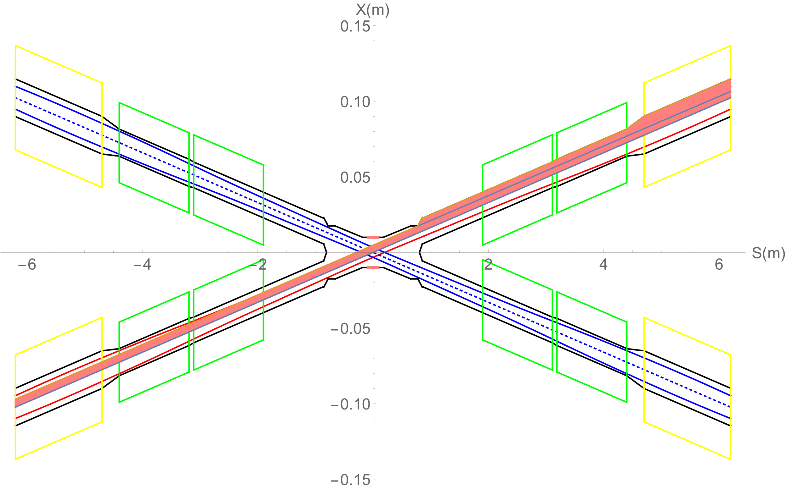
SR on IR beam pipe from last bend upstream and
Final Doublet
There is no SR photons hitting the central beam pipe in normal conditions.
Single layer beam pipe with water cooling, SR heat load is not a problem.
QF1
Region | SR heat load | SR average power density
0~780mm | 0 | 0
780mm~805mm | 23.04W | 256W/cm²
805mm~855mm | 53.39W | 296.6W/cm²
855mm~1.9m(QDa entrance） | 4.32W | 1.15W/cm²
QDa | 3.28W | 0.75W/cm²
QDa~QDb | 22.92W | 79.58W/cm²
QDb | 3.96W | 0.91W/cm²
QDb~QF1 | 71.04W | 65.8W/cm²
QF1 | 7.26W | 1.34W/cm²
QDb
QDa

Slide 6
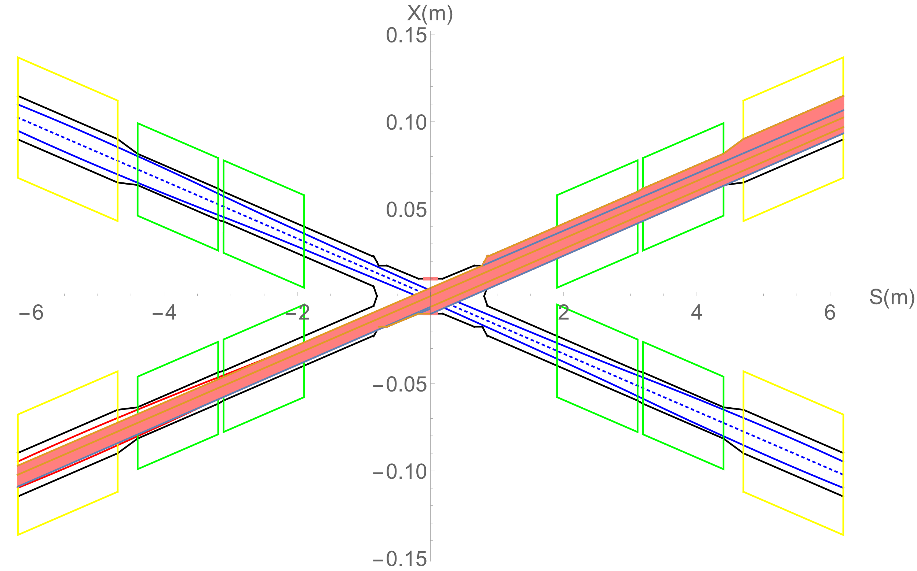
SR from last bending magnet upstream of IP
Abnormal condition
SR photons hitting the bellows (no cooling) and berrylium pipe under the extreme beam conditions , since it is a transient effect, heat load is not a problem.
Extreme condition, eg, if a magnet power is lost, a large distortion will appear immediately for the whole ring orbit. The beam will be lost when exceeded.
In extreme cases ~ at least 10 times per day. The beam will be stopped within 0.5ms when abnormal.
The background of the detector and radiation dose should be considered under abnormal conditions.
It is not necessary to care about whether the beam orbit deviation will affect detector operation, since the high background part will be removed when data analysis is carried out.

Slide 7
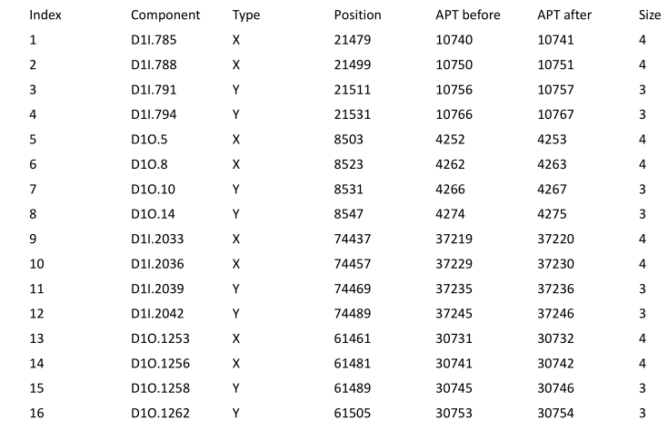
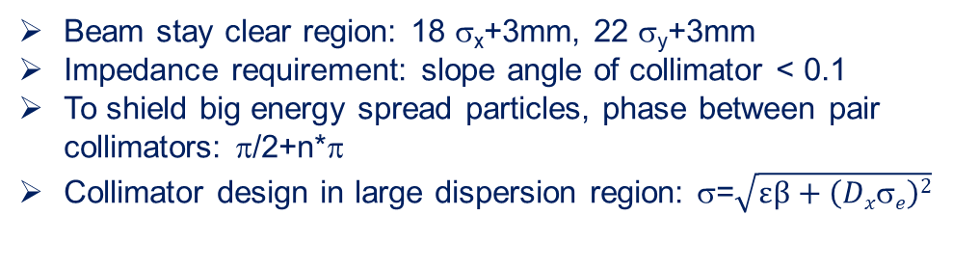
Initial Collimator design
Beam stay clear region: 18 σ_{x}+3mm, 22 σ_{y}+3mm
Impedance requirement: slope angle of collimator < 0.1
To shield big energy spread particles, phase between pair collimators: π/2+n*π
Collimator design in large dispersion region: σ=$\sqrt{εβ+\left(Dxσe\right)2}$
Set the aperture before and after to same narrow size
name | Position | Distance to IP/m | Beta function/m | Horizontal Dispersion/m | Phase | BSC/2/m | Range of half width allowed/mm
APTX1 | D1I.785 | 44611 | 20.7 | 0.12 | 164.00 | 0.006 | 1~6
APTX2 | D1I.788 | 44680 | 20.7 | 0.12 | 164.25 | 0.006 | 1~6
APTY1 | D1I.791 | 44745 | 105.37 | 0.12 | 165.18 | 0.0036 | 0.156~3.6
APTY2 | D1I.794 | 44817 | 113.83 | 0.12 | 165.43 | 0.0036 | 0.156~3.6
APTX3 | D1O.5 | 1729.66 | 20.7 | 0.06 | 6.85 | 0.00182 | 1~6
APTX4 | D1O.8 | 1798.24 | 20.7 | 0.12 | 7.10 | 0.00182 | 1~6
APTY3 | D1O.10 | 1832.52 | 20.7 | 0.25 | 7.22 | 0.00182 | 0.069~3.3
APTY4 | D1O.14 | 1901.1 | 20.7 | 0.25 | 7.47 | 0.00182 | 0.069~3.3
horizontal collimator half width 4mm(13σ_{x}), Vertical collimator half width 3mm (22σ_{y})
The collimators will not have effect on the beam quantum lifetime.

Slide 8
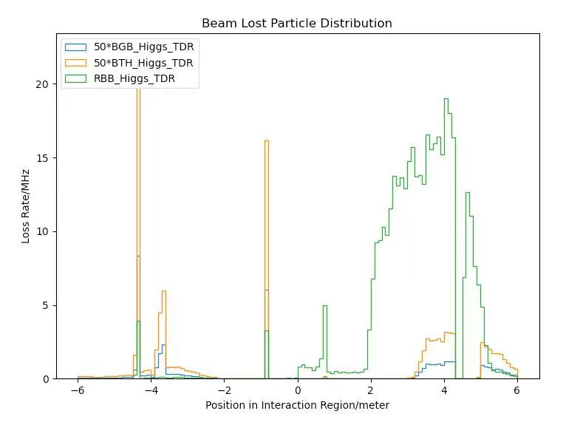
Radiation background
Including Radiative Bhabha, Beam-Gas, Beam Thermal Photon.
Normalized to loss power in mW(one beam).
Higgs mode in TDR.
The detector simulation with a safety factor of 10 for TID/NIEL.
Scale according to Luminosity(1e34/cm2/s): CDR→TDR
 | CDR | TDR(30MW) | TDR(50MW)
Higgs (3T) | 2.93 | 5.00 | 8.00
Z (2T) | 32.1 | 115.0 | 184.0

Slide 9

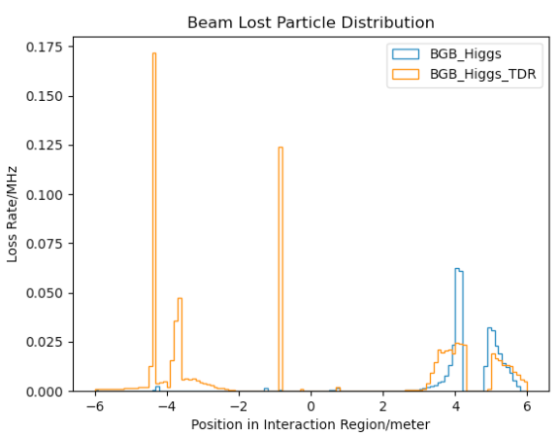
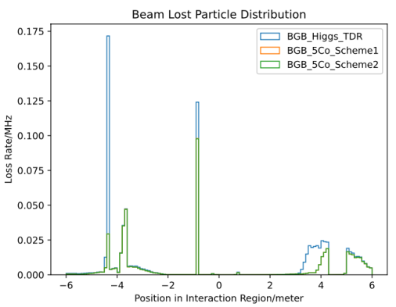
BGB simulation results and more collimator attempt
Try new h-collimators after last bending magnet
Try a farthest position and a nearest position
With the new collimator, BGB reduced significantly

Slide 10
Summary
The new IR beam pipe with narrow IP chamber is designed.
Heat load from High Order Mode is calculated in CEPC 30MW parameters, and can be accepted. It could be extended to 50MW.
Heat load from Synchrotron radiation is calculated. Single layer beam pipe with water cooling, SR heat load is not a problem.
SR photons hitting the bellows (no cooling) and berrylium pipe under the extreme beam conditions , since it is a transient effect, heat load is not a problem.
The background of the detector and radiation dose should be considered under abnormal conditions.
Radiation background including Radiative Bhabha, Beam-Gas, Beam Thermal Photon is under study. And collimators are designed.
New Collimator(s) after the last bending magnet is(are) needed.

