Slide 1
Methods and special concerns for CEPC normal conducting magnets measurements
Jianxin Zhou、Wen Kang、Mei Yang
2022.03.25

Slide 2
Outline
  Information of CEPC magnets
  Introduction of magnetic field measurement system
  Challenges and Solutions
  Target

Slide 3
1. Information of CEPC booster magnet
Dipole
Magnet name | BST-63B-Arc | BST-63B-Arc-SF | BST-63B-Arc-SD | BST-74B-IR
Quantity | 10192 | 2017 | 2017 | 640
Aperture(mm) | 63 | 63 | 63 | 63
Dipole Field(Gs)@180Gev | 564 | 564 | 564 | 549
Dipole Field(Gs)@120Gev | 376 | 376 | 376 | 366
Dipole Field(Gs)@10Gev | 63 | 63 | 63 | 61
Sextupole Field(T/m²)@180Gev | 0 | 16.0388 | 19.1423 | 0
Sextupole Field(T/m²)@120Gev | 0 | 10.6925 | 12.7615 | 0
Sextupole Field(T/m²)@10Gev | 0 | 1.7821 | 2.1269 | 0
Effective Magnetic Length (mm) | 4700 | 4700 | 4700 | 2350
Good Field Region(radius)(mm) | 55 | 55 | 55 | 55
Harmonic Errors | 0.1% | 0.1% | 0.1% | 0.1%
Characteristic: combined magnetic field(B、S), weak field（61or63Gs@10Gev ）

Slide 4
1. Information of CEPC booster magnet
Quadrupole
Magnet name | QDM-63 | QFM-63 | QM-RF-63 | QFM-ARC-63 | QFM-ARC-63 | QF-DIS-63 | QD-DIS-63
Quantity | 64 | 48 | 264 | 1152 | 2272 | 16 | 32
Aperture(mm) | 63 | 63 | 63 | 63 | 63 | 63 | 63
Quatrupole Field(T/m)@180Gev | 12.8811 | 16.3553 | 6.3624 | 12.0313 | 8.6146 | 18.0522 | 15.8575
Quatrupole Field(T/m)@120Gev | 8.5874 | 10.9036 | 4.2416 | 8.0209 | 5.6109 | 12.0348 | 10.5717
Quatrupole Field(T/m)@10Gev | 1.4312 | 1.8173 | 0.7069 | 1.3368 | 0.9352 | 2.0058 | 1.7619
Effective Magnetic Length (mm) | 2000 | 2000 | 2000 | 2000 | 1000 | 2000 | 1000
Good Field Region(radius)(mm) | 27.5 | 27.5 | 27.5 | 27.5 | 27.5 | 27.5 | 27.5
Harmonic Errors | 0.1% | 0.1% | 0.1% | 0.1% | 0.1% | 0.1% | 0.1%
Characteristic: small aperture and large good field region.

Slide 5
1. Information of CEPC Collider Ring magnet
Magnet name |  | Quantity | Gap /Ape（mm） | Leff (mm)
Dipoles | B0、B1、BMV01IRD、BMVIRD、BMHIRD、BGM1、BGM2、BMV01IRU、BMVIRU、 BMHIRU、 BRF0 | 2464 | 66 | 4833~5745
Quadrupole | Q、QSTR、 QAI、 QA0、QSTR、QDI、QINJI、QFI、QD0、QINJ0、QF0 | 2582 | 76 | 2000
 | QH、QSEP、QSTRH、QHAI、QHA0、QSTRH、QHAI、QHA0、QSTRH、QSEP、QSTRHI、QFSTRH0 | 36 | 76 | 1000
 | QDVHIRD、QFVIRD、QFHHIRD、QDHIRD、QDCIRD、QFCIRD、QMIRD、QDGMH、QFGM、QFVIRU、QDVHIRU、QDHIRU、QFHHIRU、QDCIRU、QFCIRU、QMIRU、QSEP、QFSTRH | 224 | 66 | 1250
 | QCMIRD、QMIRD、QCMIRU、QMIRU、QRF、QFSTR | 192 | 66 | 3000
 | Q3IRD、Q4IRD、Q5IRD、Q3IRUJ2、Q4IRUJ2 | 10 | 37 | 1000
Sextupole | SFI、SF0 | 448 | 80 | 700
 | SDI、SD0 | 448 | 80 | 1400
 | VSCIRD、HSCIRD、VSCIRU、HSCIRU、SC0IRD、SC0IRU | 36 | 66 | 1000
Correctors | CH | 1452 | 66 | 875
 | CV | 1452 | 85 | 875
Characteristic: many kinds and quantities；

Slide 6
2. Introduction of magnetic field measurement system
2.1、Content of magnetic field measurement；
2.2、Comparison of magnetic measurement systems；
2.3、Introduction of hall probe measurement system；
2.4、Introduction of rotating coil measurement system；
2.5、Arrangement of batch magnet measurement.

Slide 7
2.1、 Content of magnetic field measurement
1. Dipole、Corrector
    1.1. Central field B(x=0,y=0,z=0) and its uniform distribution B(x,y=0,z=0)
    1.2. Integral field B(x,y=0,z) and its uniform distribution B(x,y=0,z)
    1.3. Effective length (Leff)
    1.4. Excitation curve
2. Quadrupole（the same to sextupole）
    2.1. Gradient integral field (G*L) and excitation curve
    2.2. Central gradient field G0 and Effective length (Leff)
    2.3.Harmonics (Bn/B2)
    2.4. Magnetic center offset（dx，dy）

Slide 8
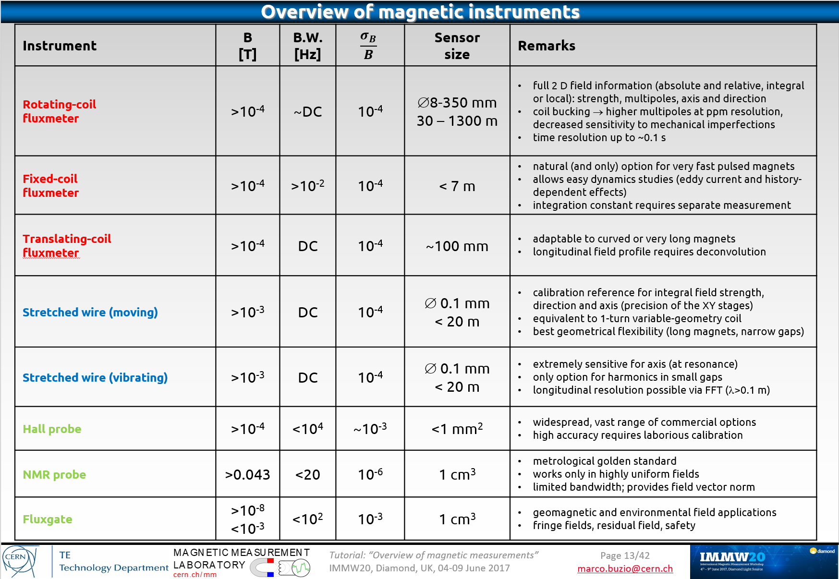
2. 2、Comparison of magnetic measurement systems
Sensor size: coil、stretched wire can be very long; Hall can be very small;

Slide 9
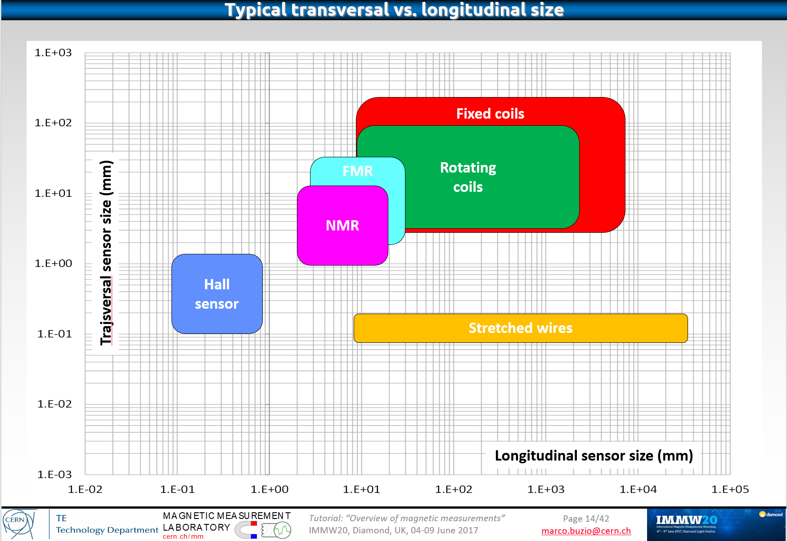
2. 2、Comparison of magnetic measurement systems

Slide 10
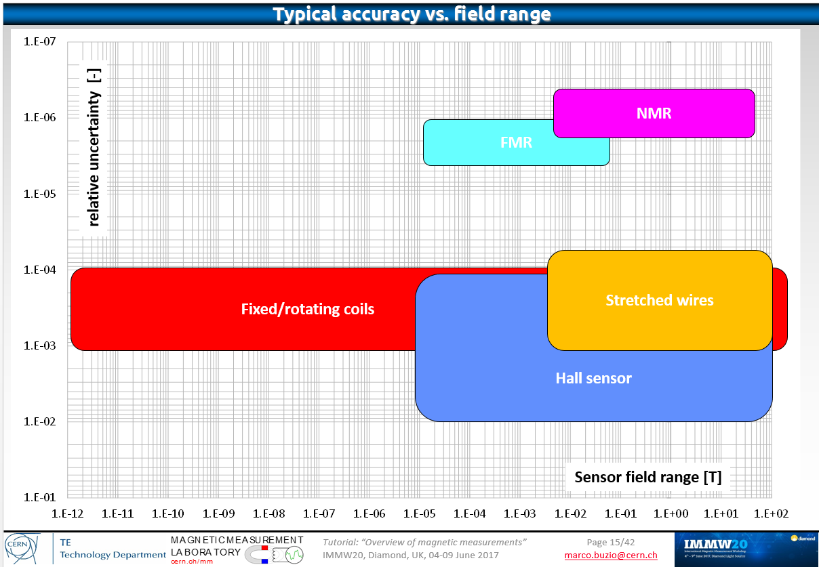
2. 2、Comparison of magnetic measurement systems
According to the range, accuracy, size, efficiency and other aspects, rotating coil and hall are the best choices.

Slide 11
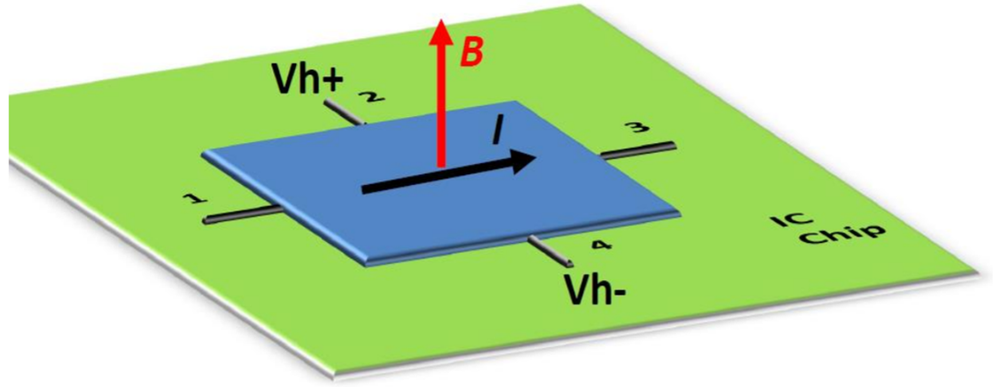
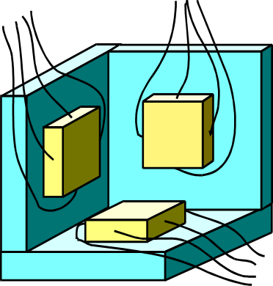
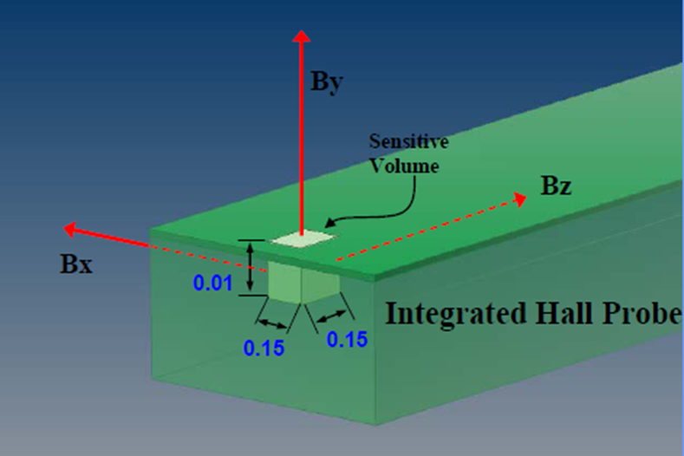
2. 3、Introduction of hall probe measurement system
Principle of hall probe
1. In a Hall effect sensor, a thin strip of metal has a current applied along it. In the presence of a magnetic field, the electrons in the metal strip are deflected toward one edge, producing a voltage gradient across the short side of the strip .
2. Multidimensional measurement is feasible. Mutual orthogonality: 0.1°.
3. It can be very small. 3D spatial resolution: 150 µm.

Slide 12
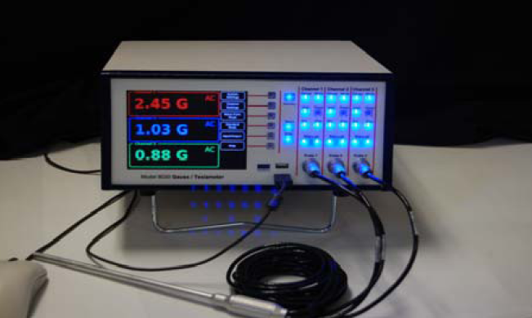
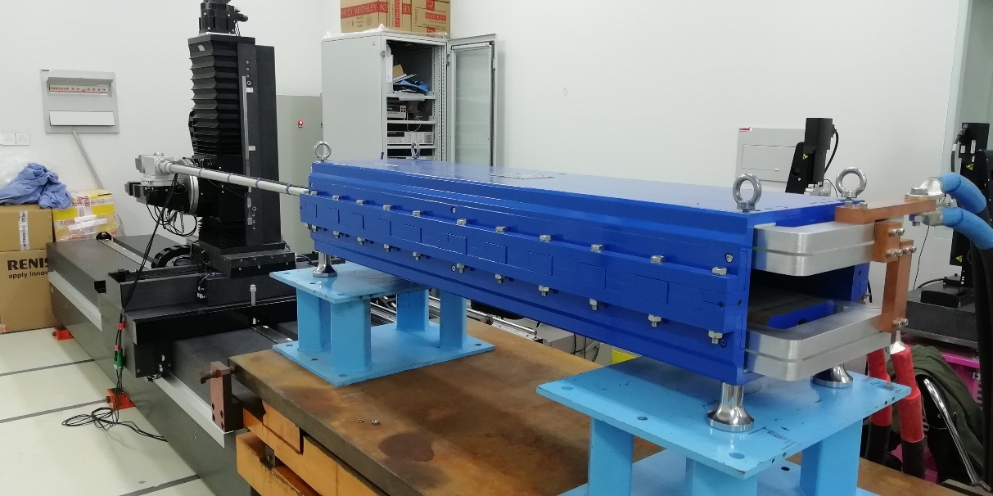
2. 3、Introduction of hall probe measurement system
The composition of the Hall measurement system
1. Six dimensional mechanical platform.
2. Hall probe and gauss meter.
3. Computer.
Advantage:
Local magnetic field information can be measured in detail.
Disadvantages：
1. Low measurement efficiency.
2. Affected by temperature change.

Slide 13


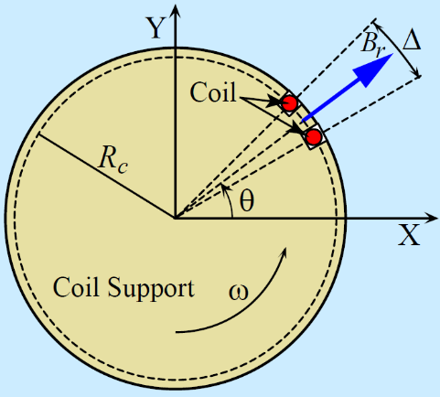
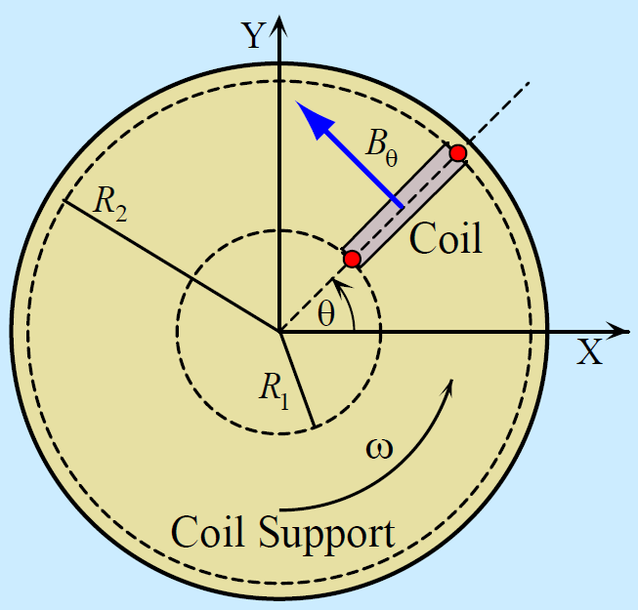
2.4、 Introduction of rotating coil measurement system
Rotating coil
The radial and azimuthal components of a two dimensional field in a current free region can be written as:
Coil rotating
Flux change
Induced voltage
Signal acquisition
Voltage integration
Data processing and storage
Completed

Slide 14
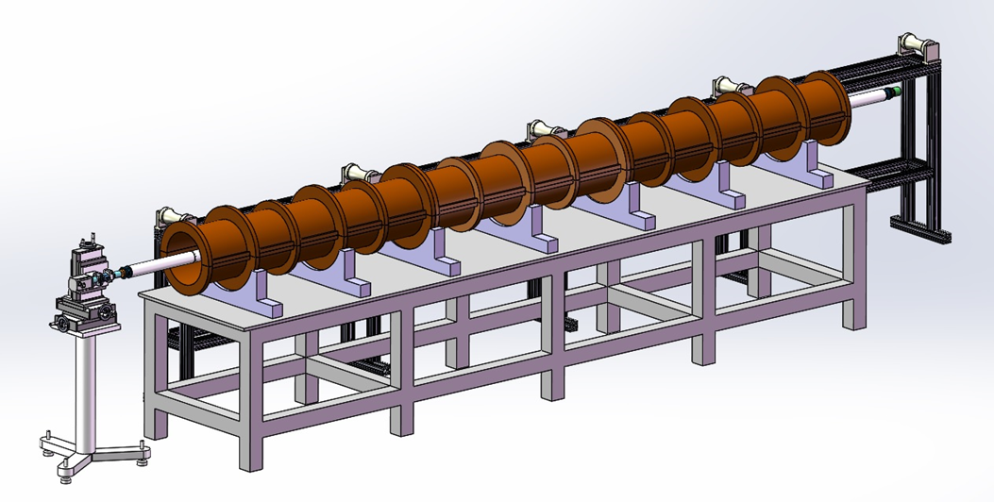
2. 4、Introduction of rotating coil measurement system
System composition
1. Rotating coil；2. Mechanical platform；3. Signal acquisition device; 4. Motion control devices.
Advantage:
1. High efficiency.
2. long sensor size.
3. Good accuracy at low field range.
Disadvantages：
1. The coil needs to be calibrated.
2. Difficult to measure the local field.

Slide 15
2. 5、Arrangement of batch magnet measurement
Hall probe
Prototype
Rotating coil
CEPC magnets
Batch productions
Rotating coil
1. Rotating coil and hall probe measurement can complement each other, and they can can meet the requirement of accelerator operation.
2. This is the most efficient combination and they are used in many accelerator construction.

Slide 16
3. Challenges and Solutions
1、Small aperture, Long mechanical length;
2、Weak field;
Challenges
3、Movement and collimation;
4、Huge quantity;

Slide 17
3. Challenges and Solutions-----What we are doing now?
1、Small aperture
  Booster dipole 63mm,
  Collider dipole 70mm,
Long mechanical length
  Booster dipole 4.7m,
  Collider dipole 5.75m,
2、Weak field
  Minimum magnetic field 61Gs;
  The requirement of measurement accuracy is 0.05%(error＜0.03Gs), far below the geomagnetic level of 0.5Gs ;
What we are doing now?
1、The longest rotating coil measurement system and hall probe measurement system in China are under development;
2、Develop special equipment for magnetic field measurement with higher accuracy.

Slide 18
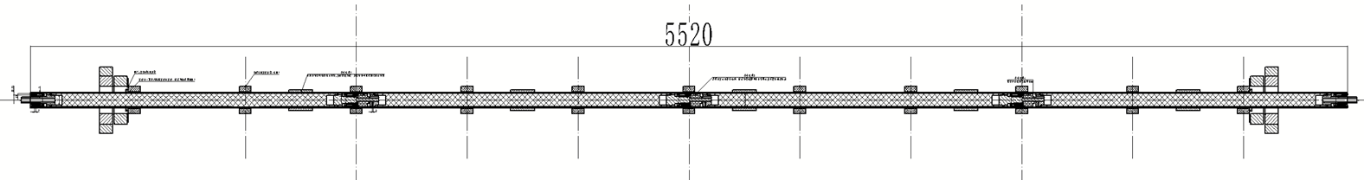
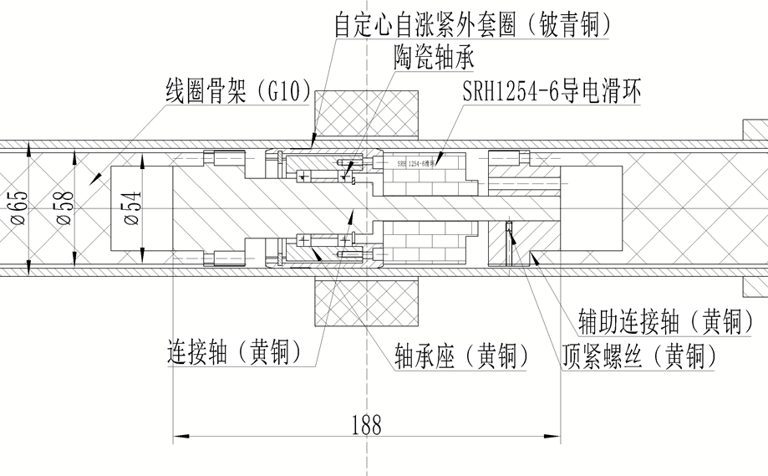
3.1 Solution of long mechanical length-----rotating coil
Scheme: multi section coil assembly
The coil frame has four sections, and the length of single section is 1218mm;
The self centering and self tightening structure is adopted between the framework and the outer tube;
The two skeletons are connected through the connecting shaft and the auxiliary connecting shaft hole shaft to ensure the coaxiality;

Slide 19
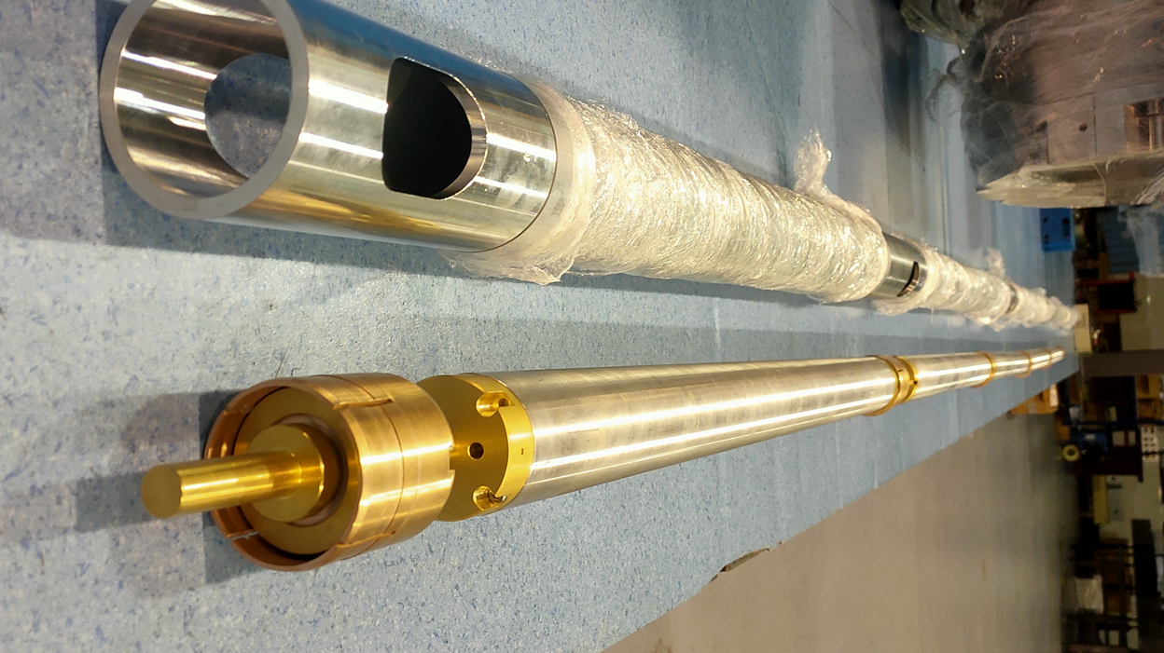
3.1 Solution of long mechanical length-----Rotating coil
Progress: skeleton fabrication has been completed and coil winding is being wound

Slide 20
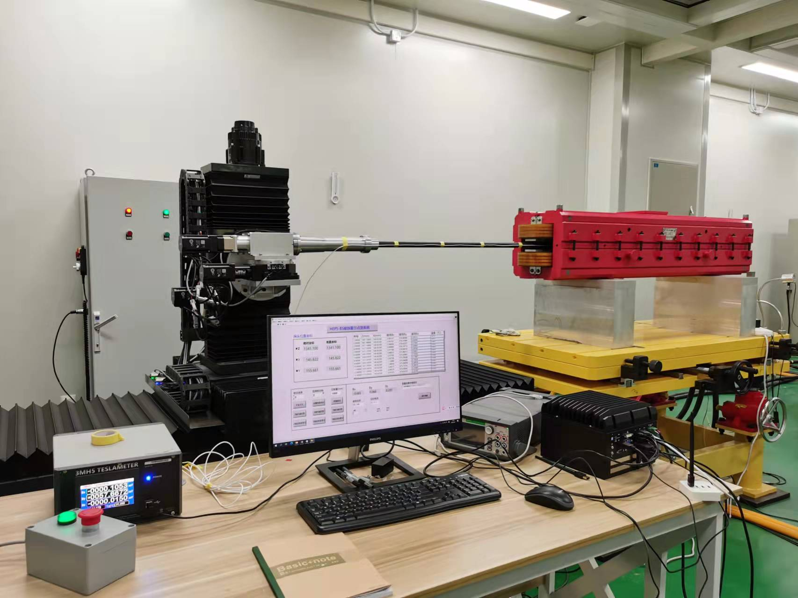
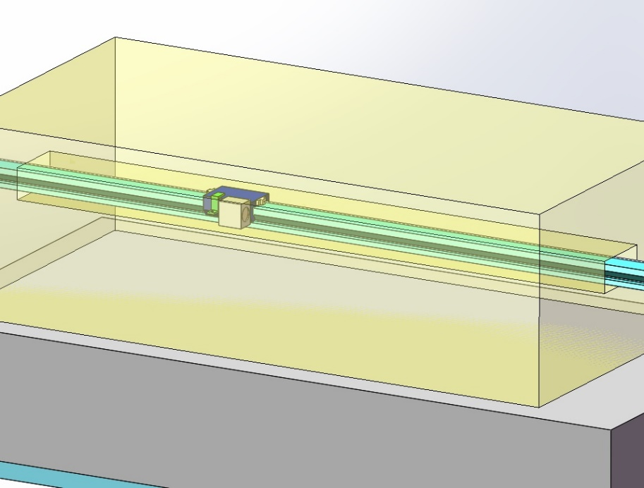
3.1 Solution of long mechanical length-----hall probe
Complete change of mechanical structure!
Six dimensional mechanical platform.
The guide rail is directly placed on the pole of the magnet.

Slide 21
3.2、Solution of weak field ------Rotating coil design
Increase the voltage induced by the coil!
Aperture
Coil radius
Magnet
Coil turns
Mechanical strength
Coil Length
Coil parameters | Value
R1(mm) | 26
R2(mm) | 18.417
R3(mm) | 19.5
R4(mm) | 11.917
外层匝数(Turns) | 240
内层匝数(Turns) | 360
The induced voltage is 0.124V, Barely enough!

Slide 22
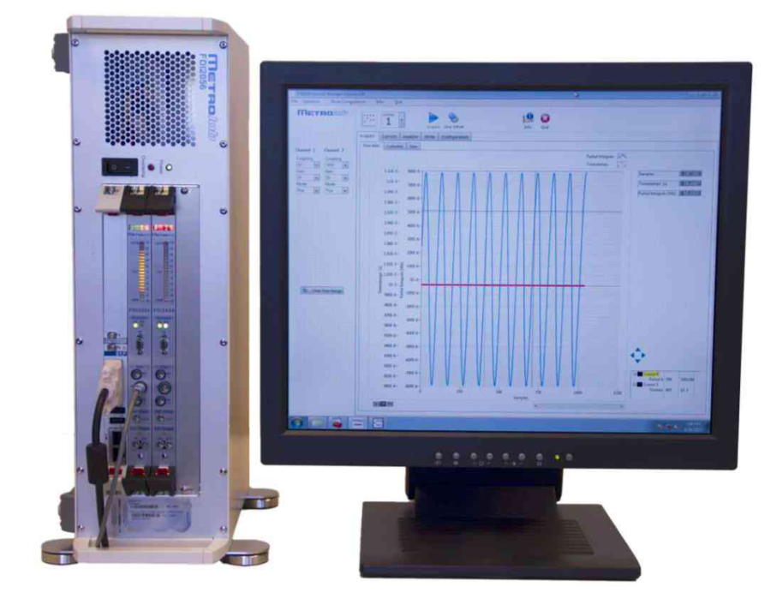
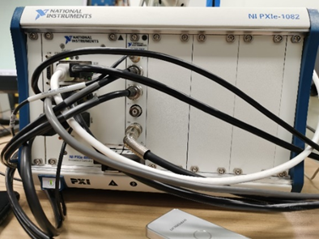
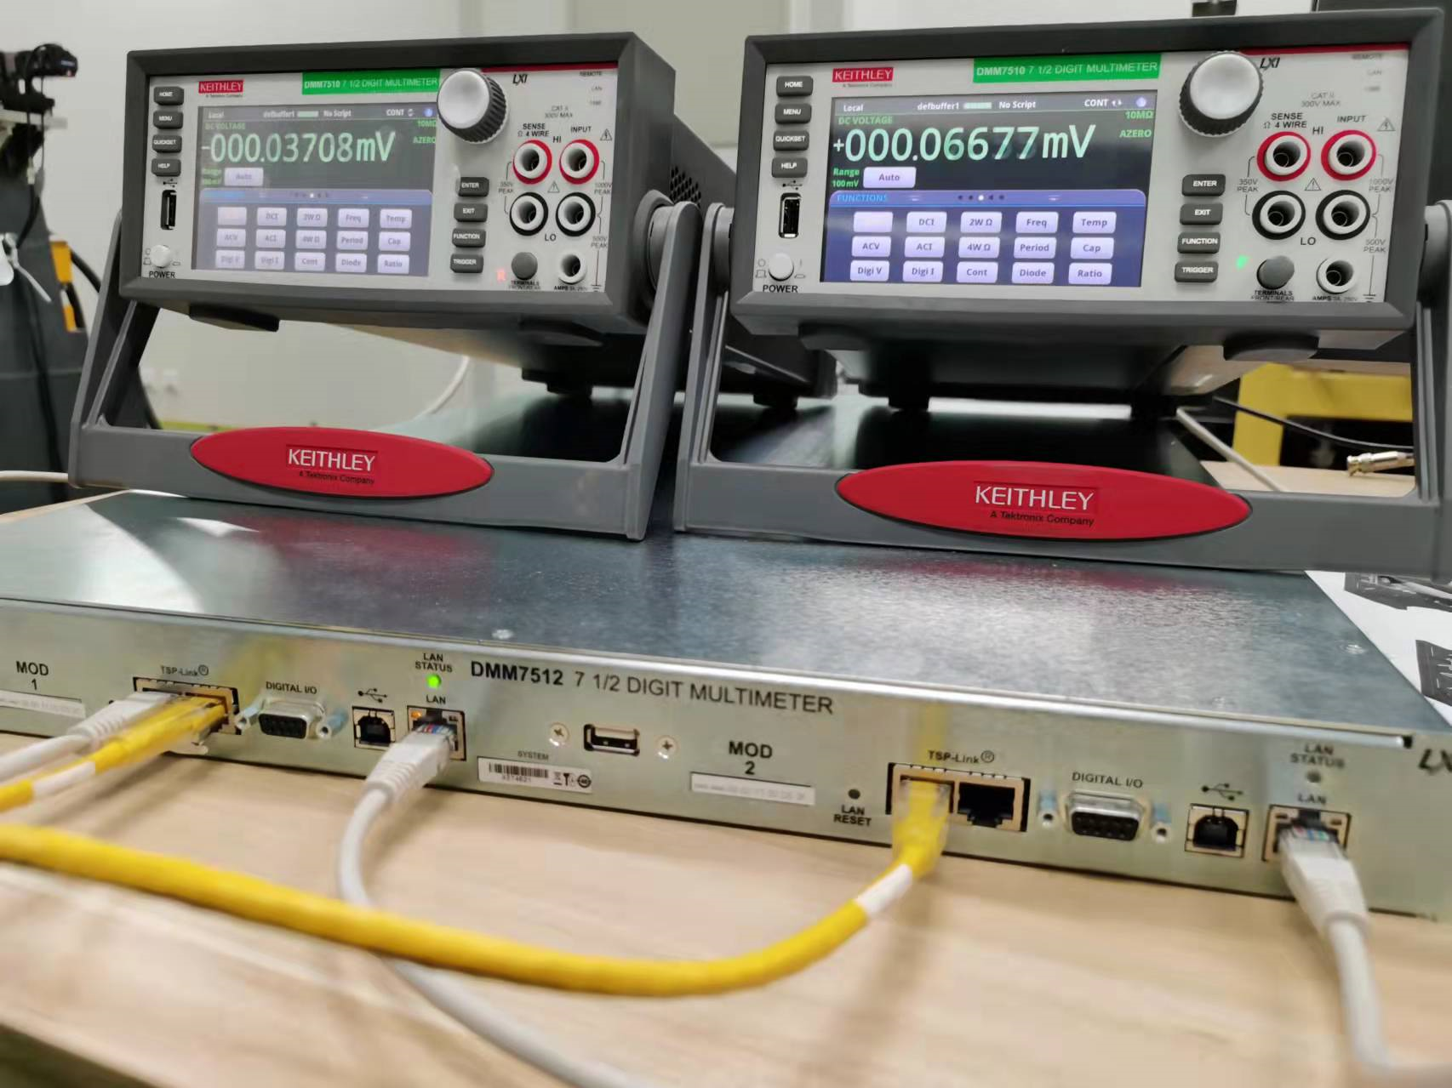
3.2、Solution of weak field ------Develop equipment
Develop professional equipment!
Integrator based on NI device
The integrator is developed by ourselves based on NI voltage acquisition equipment.
Application:CSNS、HEPS booster
Integrator based on Keithley
The second generation integrator under development has higher accuracy
Metrolab FDI2056
FDI2056 is a high precision, high-speed voltage integrator, developed at the European Organization for Nuclear Research (CERN).

Slide 23

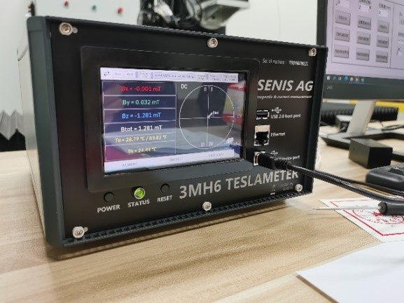
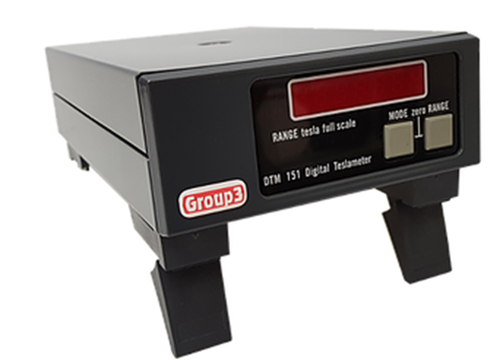
3.2、Solution of weak field-------Hall probe
Track and investigate the Hall probe equipment with the highest accuracy in the world!
Fw bell
Senis
Group 3
When undertaking other projects, purchase the latest and most accurate equipment and test the performance!

Slide 24
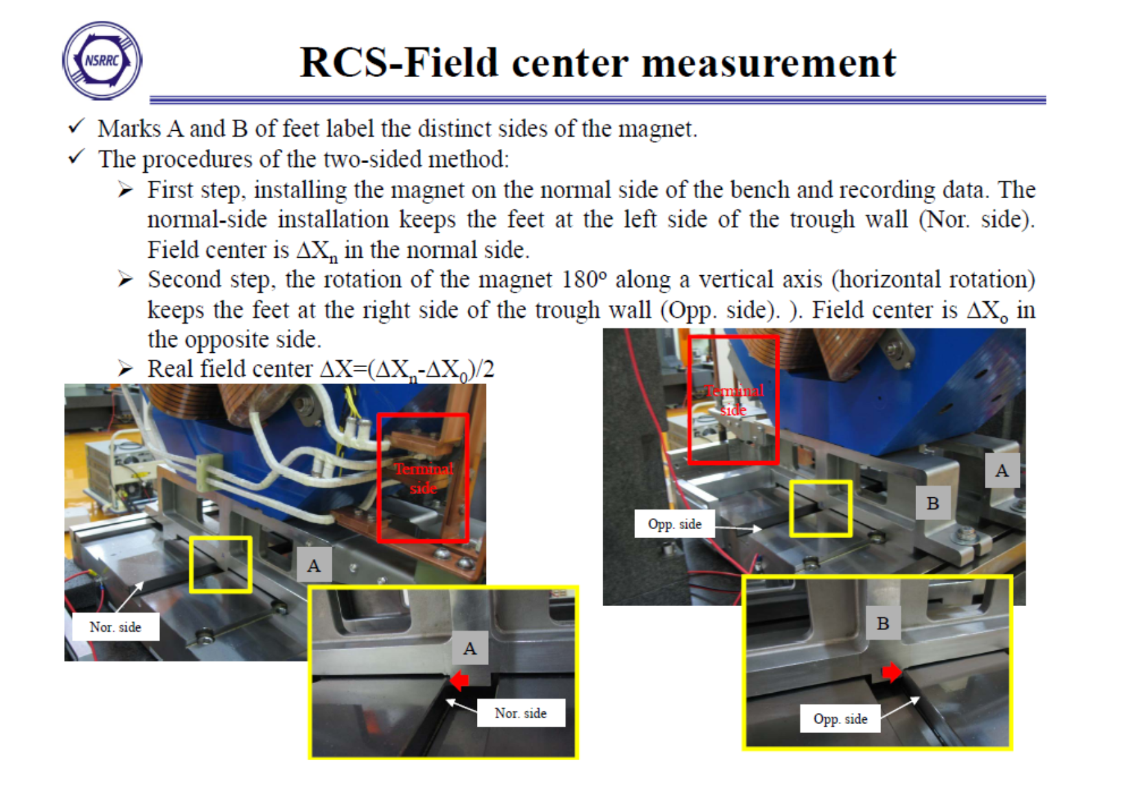
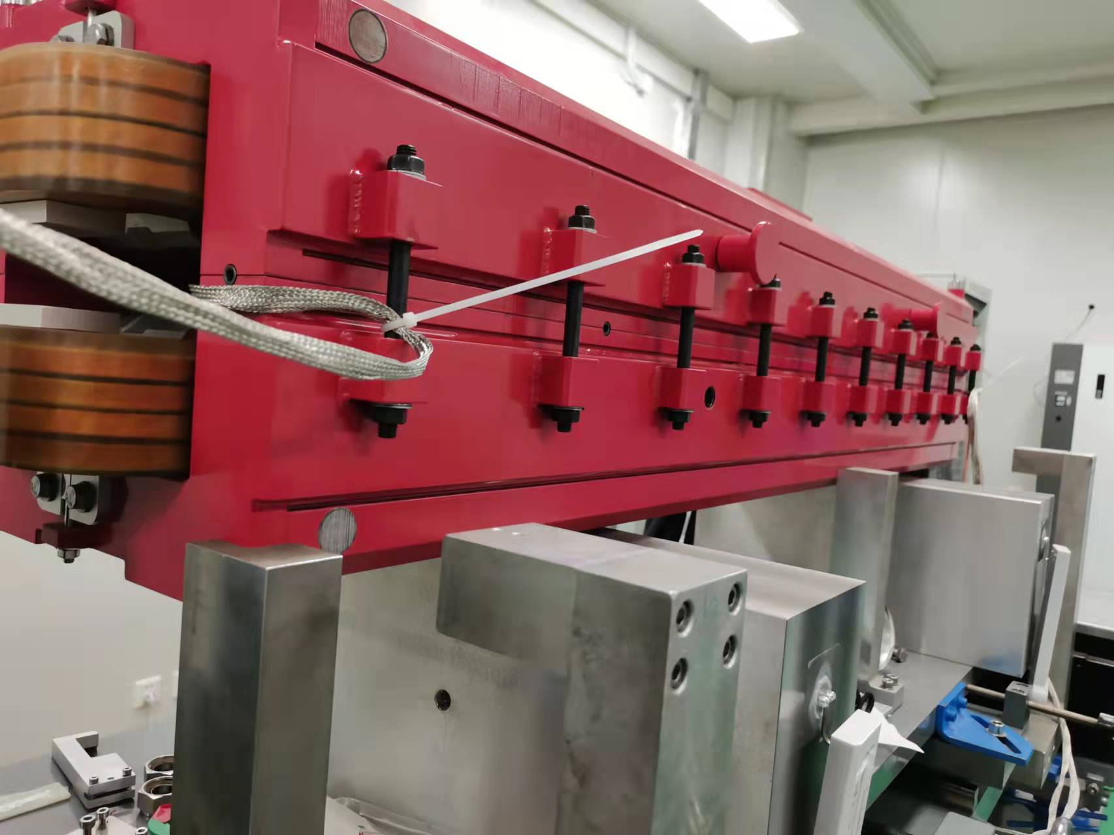
3.3、Solution of collimation
Research special tooling for various types of magnets, and the alignment is completed when the magnets are placed in place.
Collimation of quadrupole before measurement(NSRRC).
Collimation of HEPS Booster dipole before measurement.

Slide 25
3.4、Solution of huge quantity-------common requirements
1、Test site ：1000 square meters；
2、Magnet power supply：22 sets；
3、Deionized cooling water；
4、Collimating equipment ：2 sets；
5、Rotating Coil system：19 sets；
6、Hall probe system：2 sets.
Booster magnets
1、Test site ：2000 square meters；
2、Magnet power supply：39 sets;
3、Deionized cooling water;
4、Collimating equipment：6 sets;
5、Rotating Coil system：37 sets;
6、Hall probe system：2 sets.
Collider Ring

Slide 26
3.4、Solution of huge quantity-------Dispersion&Centralized
1、Before leaving the factory, magnetic field measurement is a part of magnet quality inspection；
2、Remote monitoring of the state of the factory’s measurement system;
3、Generate key parameter requirements. Only these parameters are qualified can they leave the factory.
Dispersion measurement
1、Study the prototype magnet in detail；
2、Sampling measurement of magnets completed by factory .
Centralized sampling

Slide 27

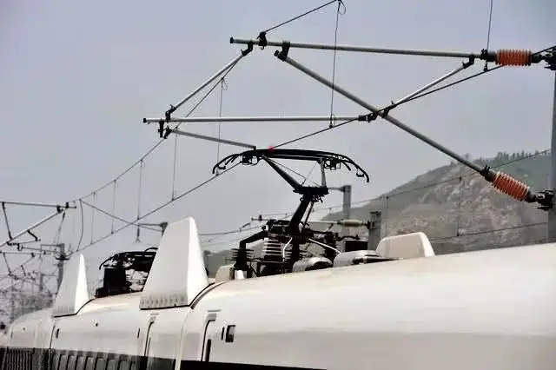
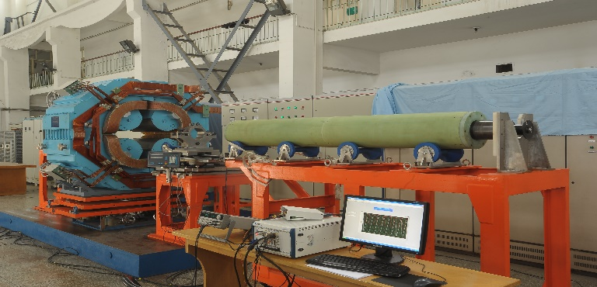
3.4、Solution of huge quantity-------Automatic measurement
1、The automatic guided transport vehicle transports the magnet to the position of the magnetic measurement system;
2、Similar to train pantograph, the water and cable of the magnet are automatically connected;
Power on
Current rise
Automatic
Power off
Measurement
3、After the magnet is in place, the measuring coil is installed automatically;
4、The magnetic field measurement is carried out automatically.

Slide 28
3.4、Solution of huge quantity-------New methods
Power supply
1、Select a magnet as the reference magnet;
2、Five magnets are connected in series with the reference magnet；
3、Six magnets are powered by AC current;
4、Each coil consists of PCB matrix winding；
5、The signal acquisition device collects the magnetic field signals of six magnets at the same time.
Reference Magnet
Signal acquisition device
Magnet 1
AC Current
Magnet 2
Magnet 3
Magnet 4
Magnet 5

Slide 29
4. Target
Prototype:
The prototype magnet can be studied completely and in detail.
Batch productions:
All magnets are accurately and efficiently measured within three years!

Slide 30
Thanks！

