Slide 1
Transport line design and injection & extraction update
CEPC DAY (April 22, 2022)
Cui Xiaohao
(Accelerator Physics Group)
2022/04/22

Slide 2
Contents:
1. From Linac to Damping ring;
2. From Linac to Booster;
3. Extraction from Booster;
4. From Booster to Collider;
5. From Collider to Beam Dump.
6. Summary

Slide 3
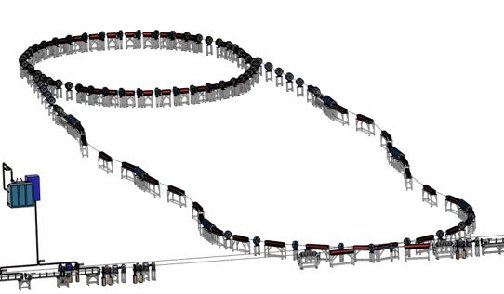
1. From Linac to Damping ring
Energy: 1.1 GeV
Beam: positron
Linac repetition: 100Hz
Double bunch mode needed for Z
Before damping ring, Energy spread of the beam should be reduced in order to match the RF acceptance of the damping ring.
After damping ring, Bunch of the beam should be reduced to control the energy spread after acceleration.
Damping ring circumference | 150 m
Store time of the bunches: | 20 ms
Bunch number: | 4 (maybe 8)

Slide 4
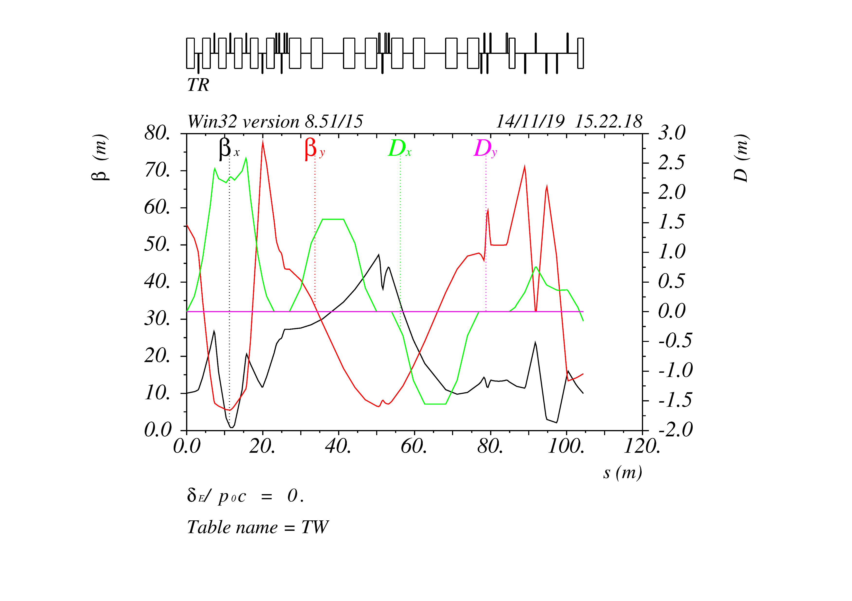
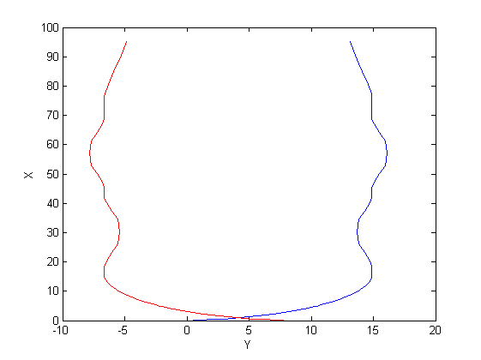
1. From Linac to Damping ring
Chicanes for Bunch length control;
Arcs for geometry matching;
Matching for injection twiss matching;
Arcs
Chicane
Matching

Slide 5
1. From Linac to Damping ring
0.5m
Lambertson
Kicker
Top View:
25mm
1.25m
1.25m
0.847m
1m
0.5m
Side View:

Slide 6
1. From Linac to Damping ring
T=0
T=10 ms
The bunches are injected into the damping ring with 100 Hz;
Double bunch mode is needed for Z mode;
Each bunch which cooled for 20 ms will be extracted and re-injected into the linac.
With small changes, the cooling time of the bunches can be increased by holding more bunches in the damping ring.
T=20ms-250ns
T=20ms
T=30ms-250ns

Slide 7
1. From Linac to Damping ring
Update: Changed some design parameters, According to the change of damping ring design;
To Do: Beta function optimization to increase the transfer efficiency.

Slide 8
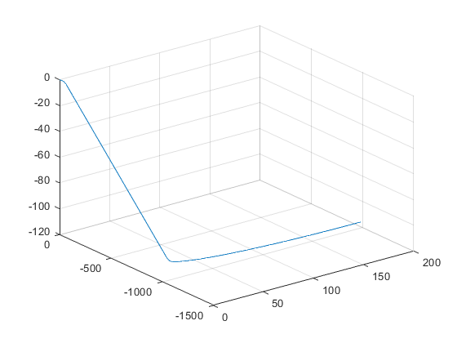
2. From Linac to Booster
Energy: 20 GeV
Beam: positron & electron
Linac repetition: 100Hz
Different bunch pattern in the booster for Higgs, W , Z and tt.
horizontal bending section and one vertical bending section
Vertical bending section matches the 100m height

Slide 9
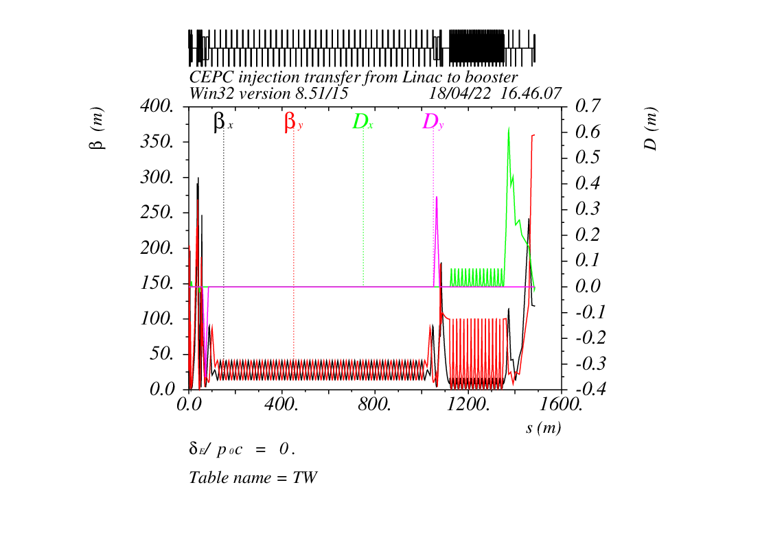
2. From Linac to Booster
Twiss parameters for the transport line, and a top-view of the geometry

Slide 10
2. From Linac to Booster
Injection into the booster is also a standard on-axis injection

Slide 11
2. From Linac to Booster
 | W
Energy（GeV） | 20
Bunch number | 1230
Bunch seperation（us） | 0.2677
Injection scheme | bunch by bunch
Kicker frequency(Hz) | 100
Kicker pules duration (us) | <0.535
Kicker rise up/ fall down (us) | <0.2677
Timing delay(us) | 0.2677
Injection duration (s) | 12.3
T_{Linac}=N*Turns+T_{booster}
Changing T_{Linac} slightly, we can fill the booster with any pattern we needed.
 | Z
Energy（GeV） | 20
Bunch number/train | 80
Bunch separation（ns） | 23.076
Number of trains | 48
Train separation (us) | 5.11
Kicker frequency(Hz) | 200 or 100 (double bunch)
Injection scheme | bunch by bunch or two by two
Kicker rise up/ fall down (ns) | <23.076
Flat top (ns) | 23.1 for double bunch mode
Injection duration (s) | 19.2
 | tt | H
Energy（GeV） | 20 | 20
Bunch number | 37 | 240
Bunch seperation（us） | 4.2 | 0.647
Injection scheme | bunch by bunch | bunch by bunch
Kicker frequency(Hz) | 100 | 100
Kicker pules duration (us) | <8.4 | <1.29
Kicker rise up/ fall down (us) | <4.2 | <0.647
Timing delay(us) | 4.2 | 0.647
Injection duration (s) | 0.37 | 2.4

Slide 12
2. From Linac to Booster
Update: Some optimization for Transfer line optics design; calculation and considerations for the injection pattern for different operation Energy.
To Do: More considerations on the injection flexibility.

Slide 13
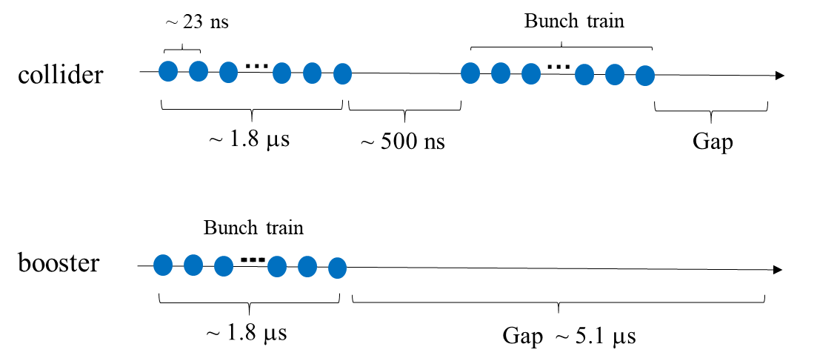
3. Extraction from booster
Energy: 45 GeV, 80 GeV, 120 GeV, 180 GeV
Beam: positron & electron
Extraction for different bunch patterns.
For Z energy, it becomes more complicated due to the large bunch number needed in the collider.
the separation between bunches are only 20~30 ns. Considering the rise time of the kickers, bunches are arranged train by train in the collider for Z energy.

Slide 14
4. From Booster to Collider
Energy: 45 GeV, 80 GeV, 120 GeV, 180 GeV
Beam: positron & electron
Extraction for different bunch patterns.
For tt, Higgs and W energy, injection into the collider is bunch by bunch; and for Z energy, injection is train by train.
Considering the robustness of the design, the baseline injection of the main collider ring is conventional off-axis injection & an on-axis injection for Higgs.
Booster
Transport line
2.4 m
Collider

Slide 15
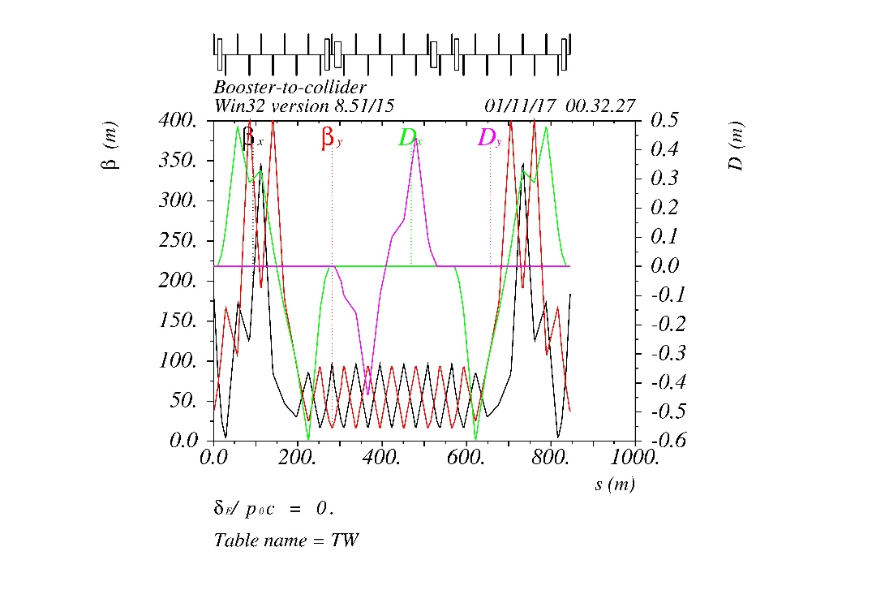
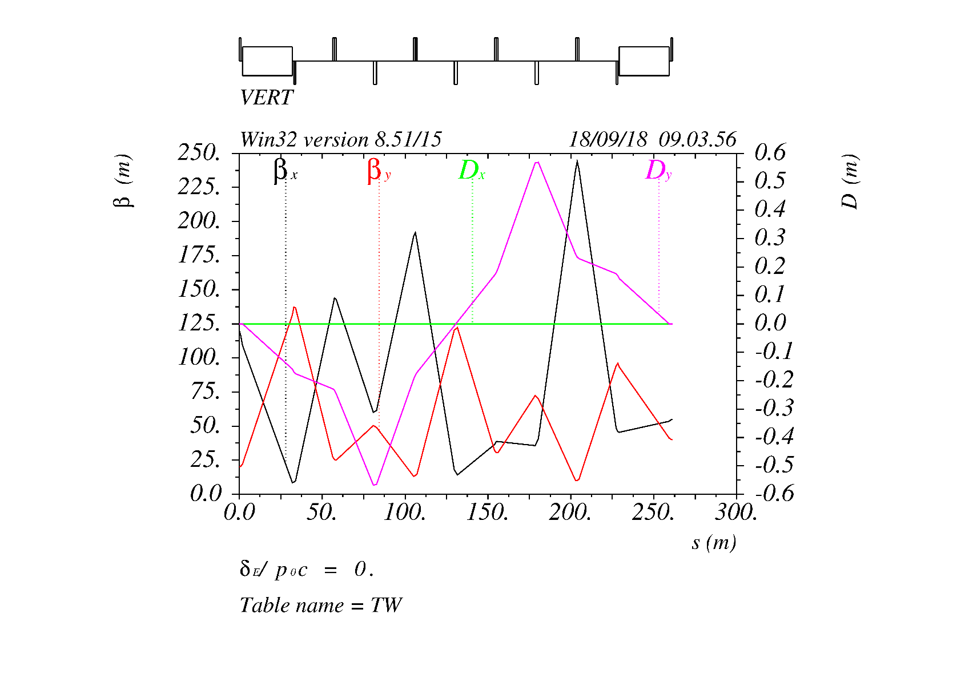
4. From Booster to Collider
Transport line optics for off-axis and on-axis injection

Slide 16
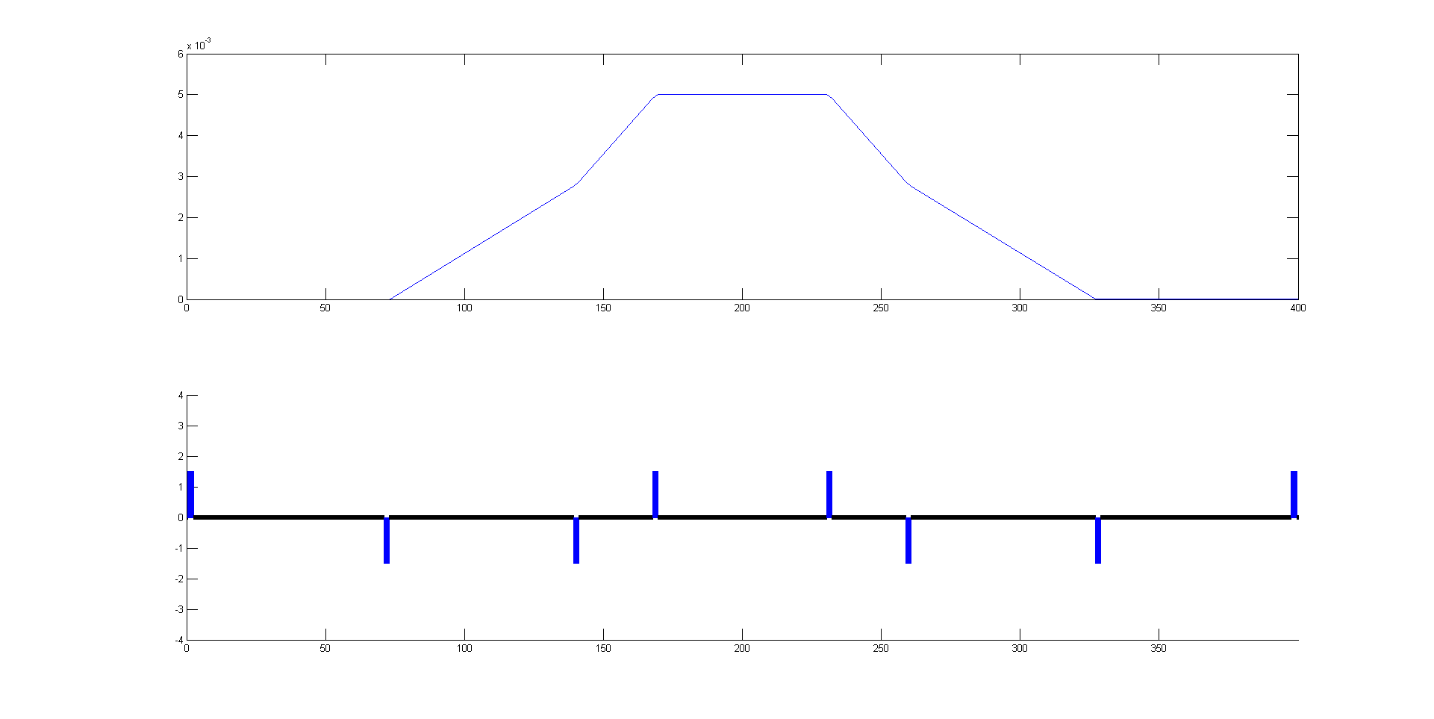
4. From Booster to Collider
60m
26m
66m
68m

Slide 17
4. From Booster to Collider
Update: Calculation and considerations for the injection pattern;
To Do: More optimization on optics design;

Slide 18
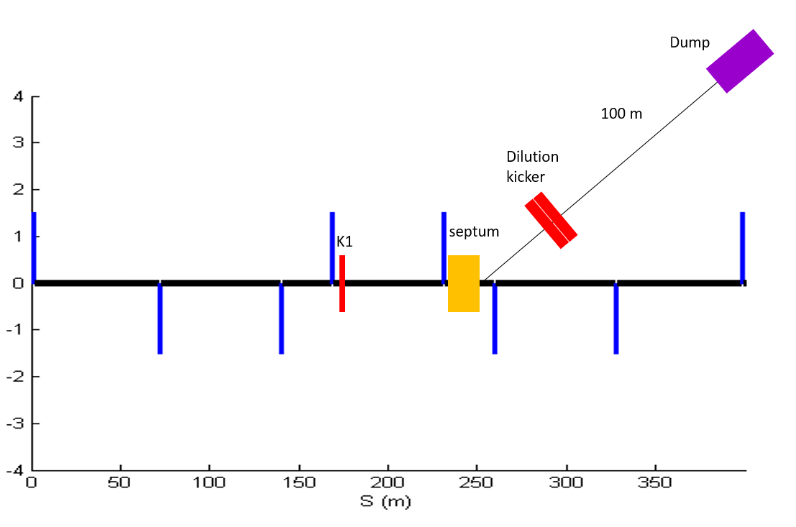
5. From Collider to the Beam dump
For machine and detector protection;
Use one kicker and one septum to get the beams into the dump line, so all bunches can be dumped in one turn;
Horizontal and vertical dilution kickers are used to change the position of different bunches at the dump, in order to reduce the beam damage to the dump.

Slide 19
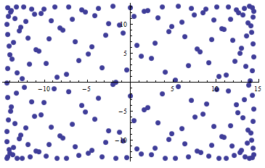
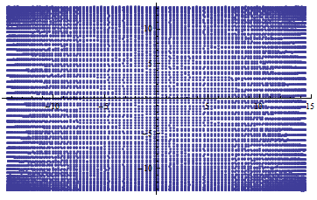
5. From Collider to the Beam dump
Update: Due to the increase in the number of bunches, some changes have been made to the kicker parameters;
To Do: More discussions on the machine protection system.
Distribution of bunches at the Dump for different bunch pattern

Slide 20
6. Summary
1. Some changes and optimization on the transfer optics design;
2. More considerations on the bunch pattern for different energy;
3. Some considerations of the injection system as a whole.

Slide 21
Thank You!

