Slide 1
Beam energy & center-of-mass energy
12 April 2022

Slide 2
Outline
The relationship between center-of-mass energy and beam energy
The sources of c.m. energy
How to precise measure the c.m. energy

Slide 3
Relationship between beam energy and center-of-mass energy
For a linear collider
In a linear collider with $p_{1}={−p}_{2}$, the c.m. energy is
$$E_{cm}=\sqrt{{(E_{1}+E_{2})}^{2}}$$
Note that, due to “beamstrahlung” and “crossing angle”, generally the center of mass energy is lower…
$$E_{cm}<2E$$
Thus, the collision is not a “clean monochromatic” process but there are spurious effects that lower the collision energy and introduce an energy spread.
Ref: Mauro Pivi(SLAC), Beam-Beam Effects in particle colliders, 2011 in Hampton,Virginia

Slide 4
Relationship between beam energy and center-of-mass energy
For a circular collider
the c.m. energy depends on the individual beam energy on the crossing angle $α$
$${<\sqrt{s}>}_{x^{′},y^{′}}=2\sqrt{E_{+}E_{−}}cos\frac{α}{2}(1−\frac{1}{4}σ_{x^{′}}^{2}−\frac{1}{4}σ_{y^{′}}^{2}\left[1−\tan^{2}\frac{α}{2}\right]+…)$$
$${angular spread: σ}_{x^{′}}^{2}={ε_{x}}/{β_{x}^{∗}}, { σ}_{y^{′}}^{2}={ε_{y}}/{β_{y}^{∗}}$$
For the typical FCC-ee beam emittances and betatron functions at the IPs, both ${ σ}_{x^{′}}^{2}$ and ${ σ}_{y^{′}}^{2}$ are at the level less than ${10}^{−9}$ and can be neglected.
$$<\sqrt{s}>=2\sqrt{E_{+}E_{−}}cos\frac{α}{2}$$
Ref: Alain Blondel (Geneva U. and CERN and Paris U., VI-VII), Patrick Janot (CERN), Jörg Wenninger (CERN), Ralf Aßmann (DESY), Sandra Aumon (CERN) et al.

Slide 5
Potential corrections of c.m. energy
Ref: [1] Assmann R, LEP Energy Working Group. Calibration of centre-of-mass energies at LEP 2 for a precise measurement of the W boson mass[J]. arXiv preprint hep-ex/0410026, 2004.
the correlated effects of dispersion
collision offsets
Difference between the electron and positron beams
Beam energy uncertainties from surroundings
Tidal effect → collider orbit circumference
Railway → magnetic field
Ref: [2] Müller, Anke-Susanne. "Measurements of beam energy." (2009).
[3] Alain Blondel (Geneva U. and CERN and Paris U., VI-VII), Patrick Janot (CERN), Jörg Wenninger (CERN), Ralf Aßmann (DESY), Sandra Aumon (CERN) et al.

Slide 6
Evaluation of $E_{CM}$ at the Interaction Points at LEP
The estimate of the collision energy at each experimental interaction point (IP), $E_{CM}^{MOD}$,is given by:
$$E_{CM}^{MOD}=2×E_{b}^{MOD}+\sum{∆E_{CM}}$$
The sum of several possible corrections(in IP)
local beam energy at each IP differs from the average energy around the ring, because of the combined effects of synchrotron radiation and the RF system.
Dispersion effects and the possibility of an energy difference between the $e^{−}$ and $e^{−}$ beams must also be considered.

Slide 7
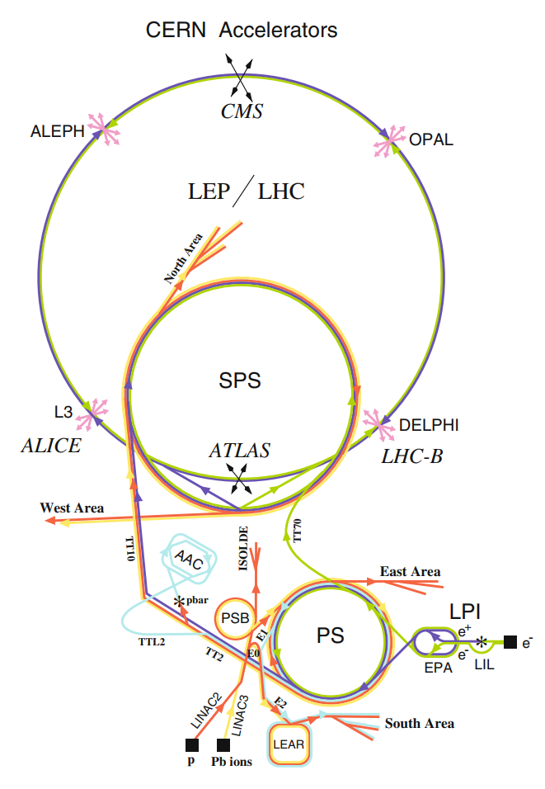
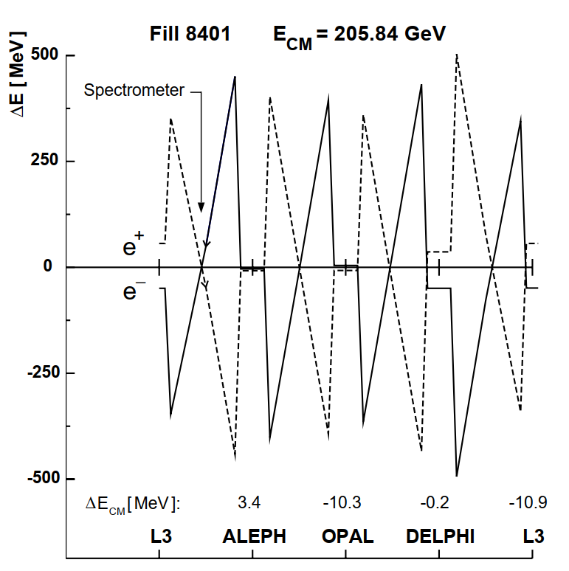
Corrections of $E_{CM}$from the RF System
Sawtooth distribution
The continuous loss from the synchrotron radiation and the localised boosts from the RF stations lead to a characteristic sawtooth distribution in both the energy loss and in the horizontal displacement between the two beams.

Slide 8
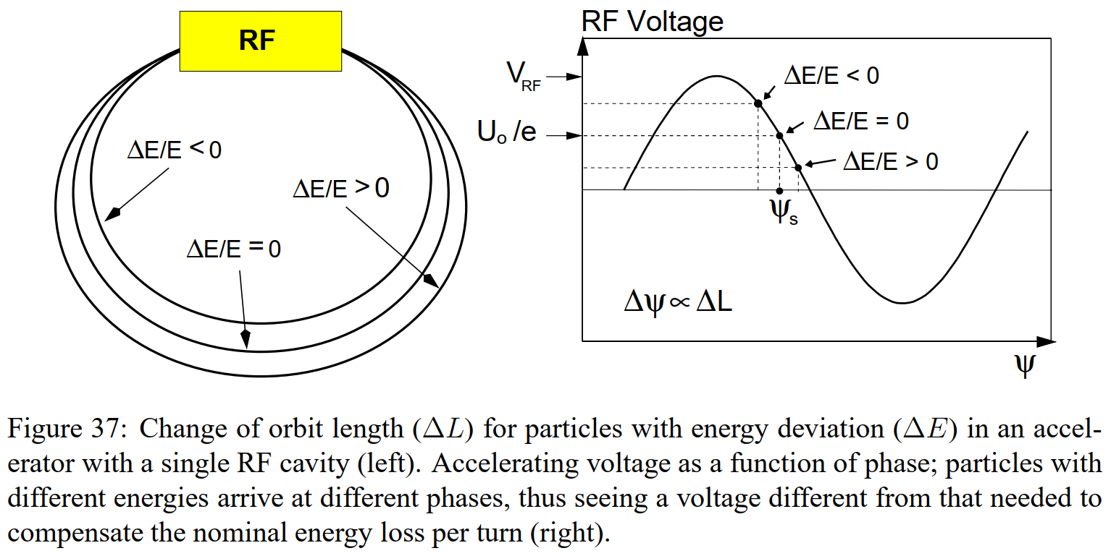
Corrections of $E_{CM}$from the RF System
Modelling the sawtooth
Particles with lower-than-nominal energy follow a shorter path length and, arrive at an earlier time in the RF cycle, therefore experiencing a larger energy boost than particles at $Ψ_{S}$ .
Particles with lower-than-nominal energy is converse.
The voltage provided by the cavity to the arriving beam is: ${V\left(Ψ\right)=V}_{RF}sin⁡(Ψ)$
$V_{RF}$ is the peak voltage $Ψ$ is the phase $Ψ_{S}$ is the stable phase, of particles with the nominal energy: $U_{0}=eV_{RF}sinΨ_{S}$ ($U_{0}$ is the energy loss per turn)
BMAD→ The total error on $E_{CM}^{MOD}$from the RF correction is estimated to be 8 MeV for the 183 GeV, 189 GeV and 192 GeV energy points, and 10 MeV for all other running.

Slide 9
Corrections of $E_{CM}$from the dispersion effects
A shift in the c.m. energy occurs if there is a difference in the vertical dispersion, $∆D_{y}^{∗}$, between the electron and positron beams, and a vertical offset,$δy$, between the beam centres at collision.
$$∆E_{CM}=−\frac{1}{2}\frac{δy}{σ_{y}^{2}}\frac{σ_{E_{b}}^{2}}{E_{b}}∆D_{y}^{∗}$$
$σ_{y}$ is the vertical beam size $σ_{E_{b}}$ is the energy spread
Results:
The calculated value of $∆D_{y}^{∗}$is typically < 1 mm at all IPs.
the instantaneous shifts are generally below 6 MeV

Slide 10
Corrections of $E_{b}$from the Tidal effects(潮汐效应)
The beam revolution frequency and the length of the orbit are defined by the frequency of RF system.
The beam energy for ultra-relativistic particles in a ring is given by
$$E_{0}=\frac{ec}{2π}\oint{ds B(s)}$$
this means an additional contribution to the integrated bending field as the field of the quadrupole magnets increases with the position offset.
A change in circumference ∆C causes the beam to move on average off-center of the accelerator axis.
$$\frac{∆p}{p_{0}}≈\frac{∆E}{E}=−\frac{1}{α_{c}}\frac{∆C}{C}=−\frac{1}{α_{c}}\frac{f_{RF}−f_{RF}^{c}}{f_{RF}^{c}}$$
$α_{c}$ is the momentum compaction factor $f_{RF}$ the actual frequency of the RF system $f_{RF}^{c}$ is the “central frequency” corresponding to an orbit passing on average through the center of the quadrupoles.

Slide 11
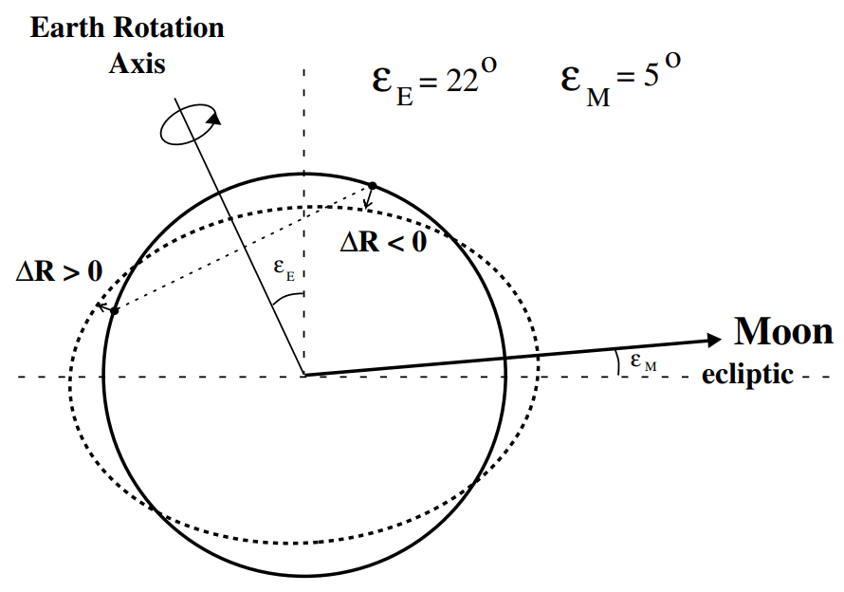
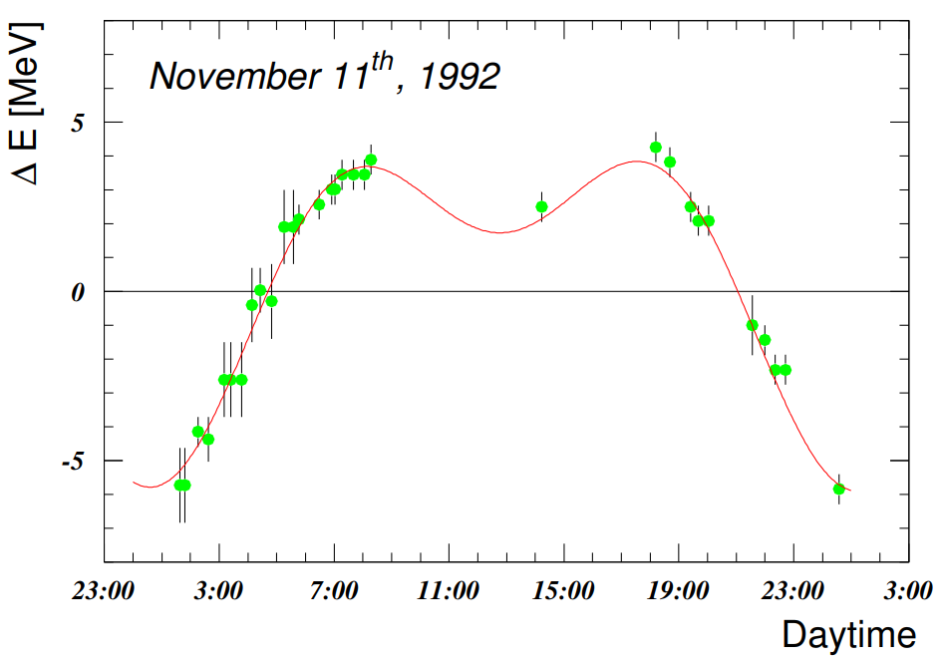
Corrections of $E_{b}$from the Tidal effects(潮汐效应)
Tidal effects due to the combined gravitational attraction of the Sun and the Moon cause deformations of the local Earth radius and therefore also have an influence on the accelerator circumference.
The change in the local Earth radius ∆R is related to the mass M at a distance d with a zenith angle θ
$$∆R∝\frac{M}{d^{3}}(3\cos^{2}θ−1)$$
In the Geneva area, the vertical motion can be as large as 25 cm peak-to-peak. This distortion changed the circumference of LEP by about ±0.5 mm.
Energy shift in LEP due to tidal effects measured with resonant depolarization during a full moon tide. The curve is a prediction from a geological model.
Tidal deformation of the Earth’s crust due to the presence of the Moon.

Slide 12
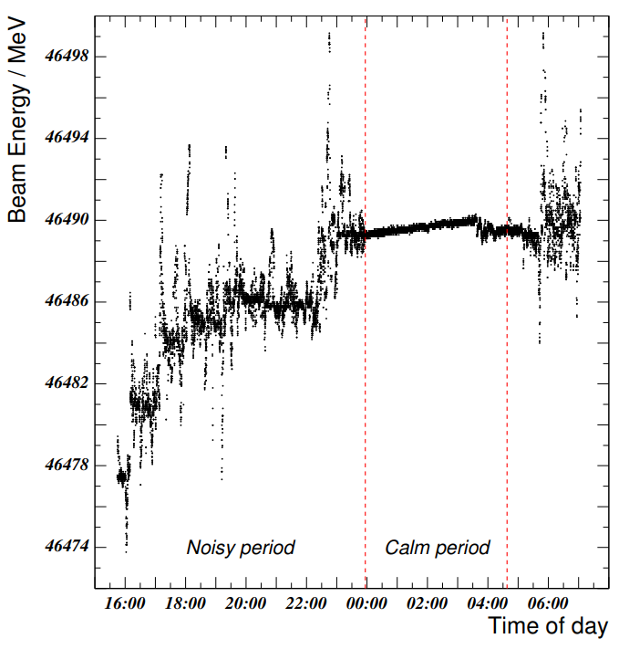
Corrections of $E_{b}$from the railways
All perturbations lead to an effective rise of the dipole field with time.
The observed typical integrated field rise is of the order of ∆B/B ≈${10}^{−5}$. The effect on the average beam energy is of the order of 4 MeV and needs to be taken into account in the LEP energy model.
Beam energy in LEP as derived from field measurements of a single NMR probe as a function of day time.

Slide 13
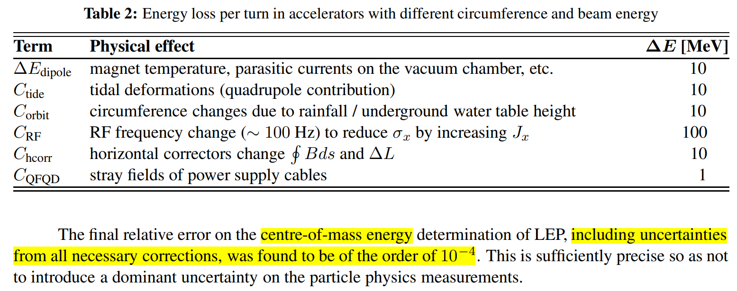

Slide 14
How to precise measure the c.m. energy?
Two potentially very precise methods have been identified to measure and control these uncertainties:
The measurement of the scattered electron and positron energy end-point in their respective polarimeter
The direct measurement of the centre-of-mass energy using muon pairs.

Slide 15
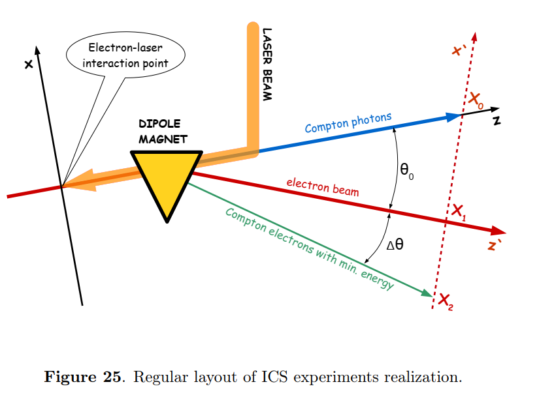
FCC-ee polarimeter-spectrometer (P-S)
Ref: N. Muchnoi, Fcc-ee polarimeter, arXiv preprint 521 arXiv:1803.09595
The statistical power amounts to a precision of 4 MeV every 10 seconds
This provides an independent relative test by resonant depolarization (RD)
The complement of instrumentation that is needed to ensure the stability of the device remains to be evaluated and designed – temperature and magnetic probes, possibly in-situ geometric monitoring, come to mind.

Slide 16
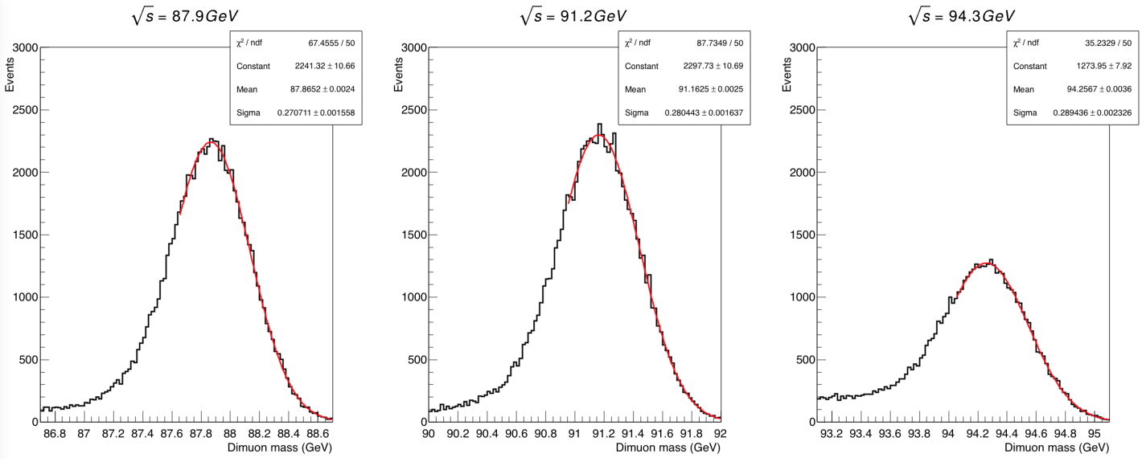
Ref. Polarization and Centre-of-mass Energy Calibration at FCC-ee
Using muon pairs
$$e^{+}e^{−}→X{(μ}^{+}μ^{−})$$
The c.m. energy is equal to the invariant mass of the final states X: $\sqrt{s}=M(X)$
The observed invariant mass is expected to increase as the energy spread getting larger.
$$∆E=M\left(X\right)−\sqrt{s}$$
The effect of QED initial- and final-state radiation is in a shift of the fitted invariant mass with respect to the input centre-of-mass energy
Invariant mass distribution of ${10}^{5}$ muon pairs in the CLD detector, at centre-of-mass energies of (left-to-right) 87.9, 91.2 and 94.3 GeV respectively;
the width of the distribution is dominated by the muon momentum measurement uncertainty.

Slide 18
backup
16

