Slide 1
Synchrotron Sidebands Resonances ChenTao

Slide 2
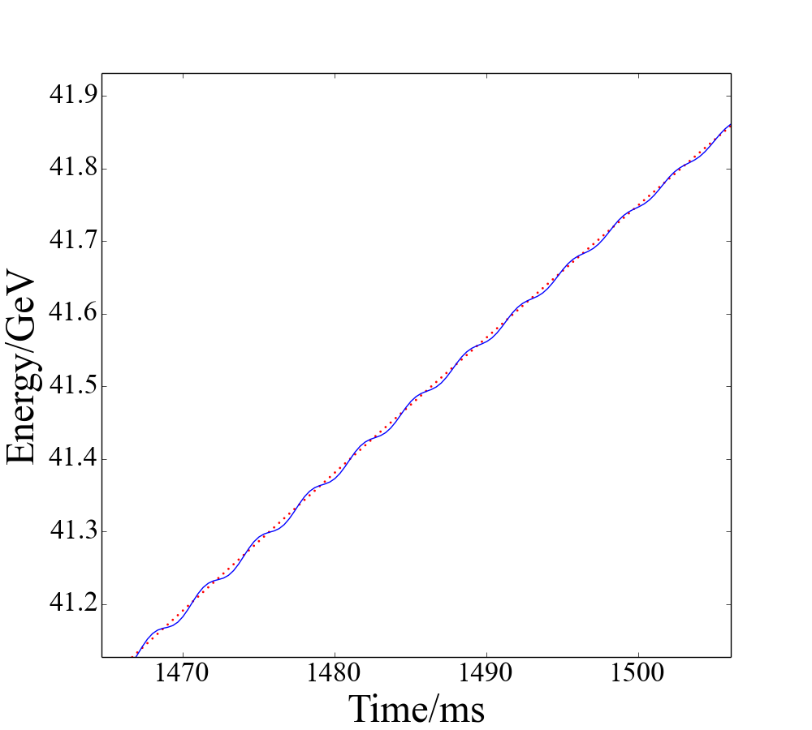
In an accelerator without Siberian snakes, the spin tune
$$ν_{s}=Gγ$$
In synchrotrons, the energy of each particle is modulated due to synchrotron oscillations：
$$γ=γ_{0}+∆γ\cos{(ν_{syn}θ)}$$
$∆γ$is an amplitude of the energy modulation, $ν_{syn}$ is the synchrotron tune and
$θ=2πt/τ$, is time in units ofthe revolution period $τ$ of the ring.
Assuming a localized horizontal spin kick of strength $ε_{0}$at a frequency $ν_{r}$, the resonance strength can be computed as the spin perturbation averaged over many turns
Particle Accelerators, Vol. 59, pp. 169-174

Slide 3
Assuming a localized horizontal spin kick of strength $ε_{0}$at a frequency $ν_{r}$, the resonance strength can be computed as the spin perturbation averaged over many turns:
Without energy modulation, the sum in The equation would be equal to N whenever $G_{γ}$ r is equal to an integer. The energy modulation term in the exponent can be expanded in series using:
where Jm is the mth Bessel function of the first kind. The resonance strength equation then becomes:

Slide 4
Thus, along with the main resonance at $Gγ=K+ν_{r}$the spin tune modulation creates synchrotron sideband resonances at$Gγ=K+ν_{r}+mν_{syn}$, where k and m are integers. The strength of each synchrotron sideband resonance is
In a ring with a single Siberian snake, the spin tune $ν_{s}$can be expressed in terms of $Gγ$ and the snake strength s:
Low energy snakes are usually solenoids. The snake strength of a solenoid is given by:

Slide 5
The spin tune modulation amplitude ${∆ν}_{s}$can be written as:
Substituting the energy dependence of the snake strength, the amplitude of the spin tune modulation becomes:
Note that with no snake (s = 0), the spin tune modulation amplitude reduces to $ν_{s}=G∆γ$, and for a full solenoidal snake (s = 1):
which is nonzero except when $Gγ$ is a half-integer. The depolarizing resonances that occur even in the presence of a Siberian snake (so called "snake resonances"s). ; Their maximum strength is $2Gγβ^{2}$times smaller than the strength of the synchrotron sidebands without a snake

Slide 6
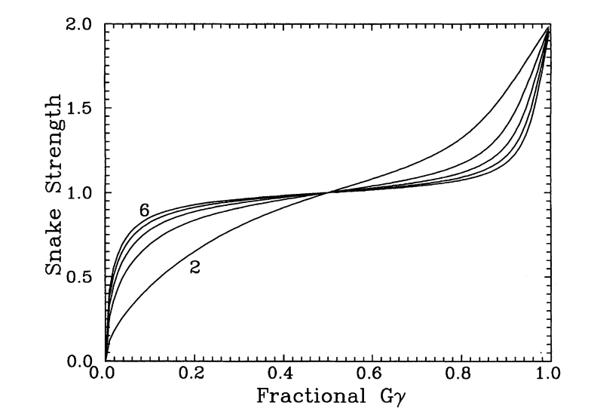
This equation can be used to predict the snake strength required for zero spin tune modulation at a given energy

