Slide 1
R&D and production of CMS-GEM GE21 Electronics boards
Zhe Li, on behalf of Peking University group

Slide 2
Outline
Outline
Overview
Development of new GEB test device
Production and test of GEM GE2/1 GEB at Sinofast Shenzhen
Acceptance test at CERN
Summary

Slide 3
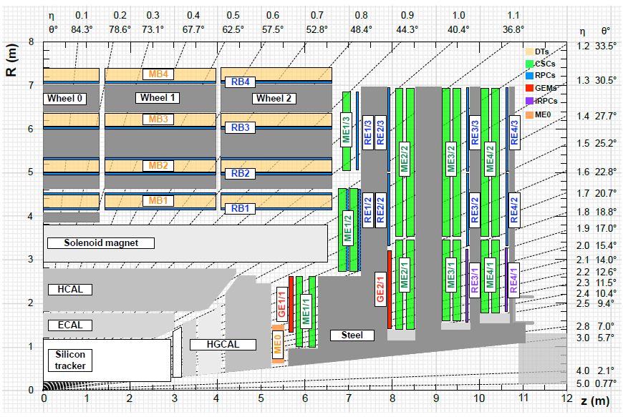
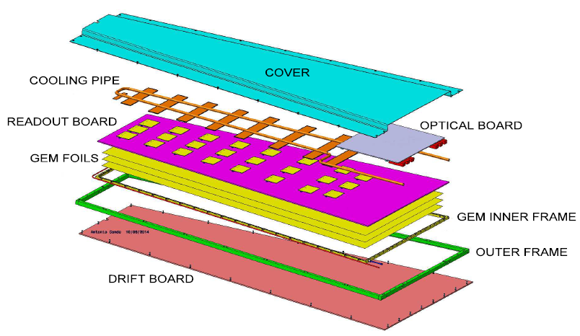
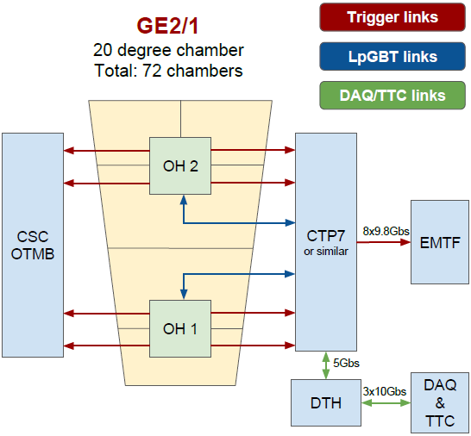
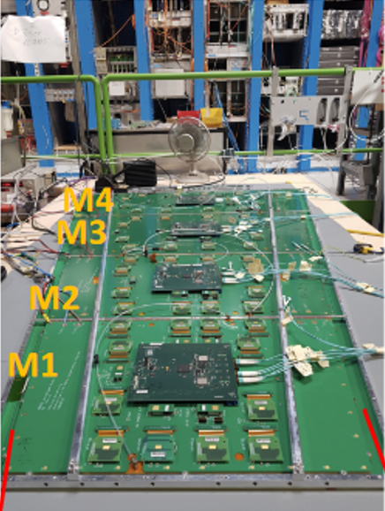
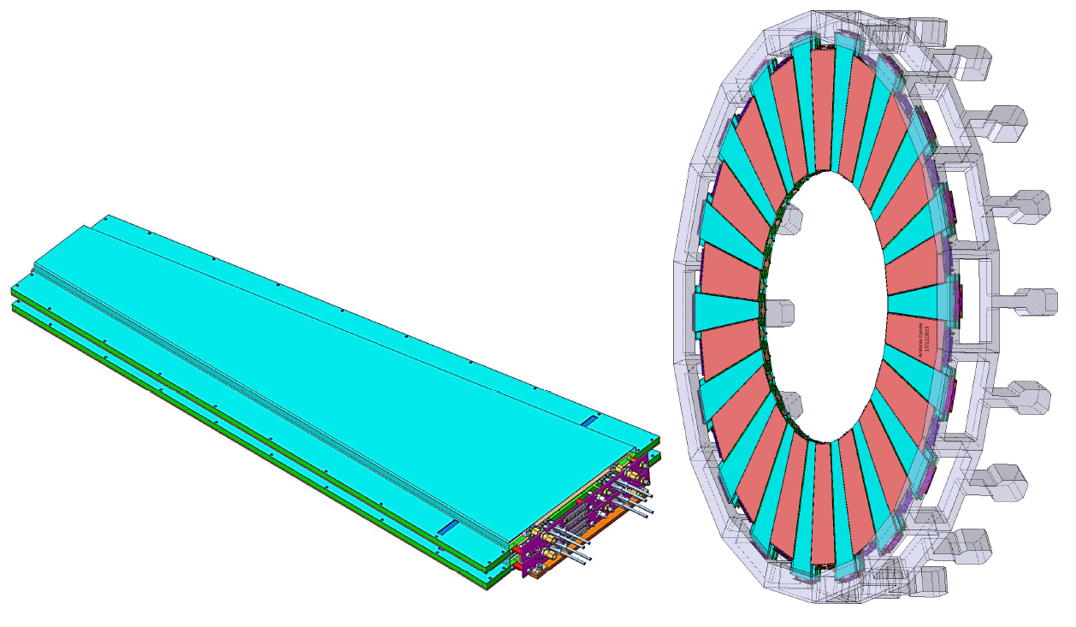
Overview: GE2/1 GEM electronics system
GE2/1 GEM at CERN
GE2/1 electronics readout system
GE2/1 (inner ring on 2nd endcap station) GEM system:
72 super-module GEM detectors (36 on each endcap), consists of 288 GEM modules,
  Signals on each GEM module are read out by 12 VFAT chips, mounted on GEB (GEM Electronics Board)
Total GE2/1 electronics components： GEBs (288), OH (288), fibers to OTMB (288), fibers to ATCA trigger signal(288), fibers to ATCA GBTx links (288)
VFAT

Slide 4
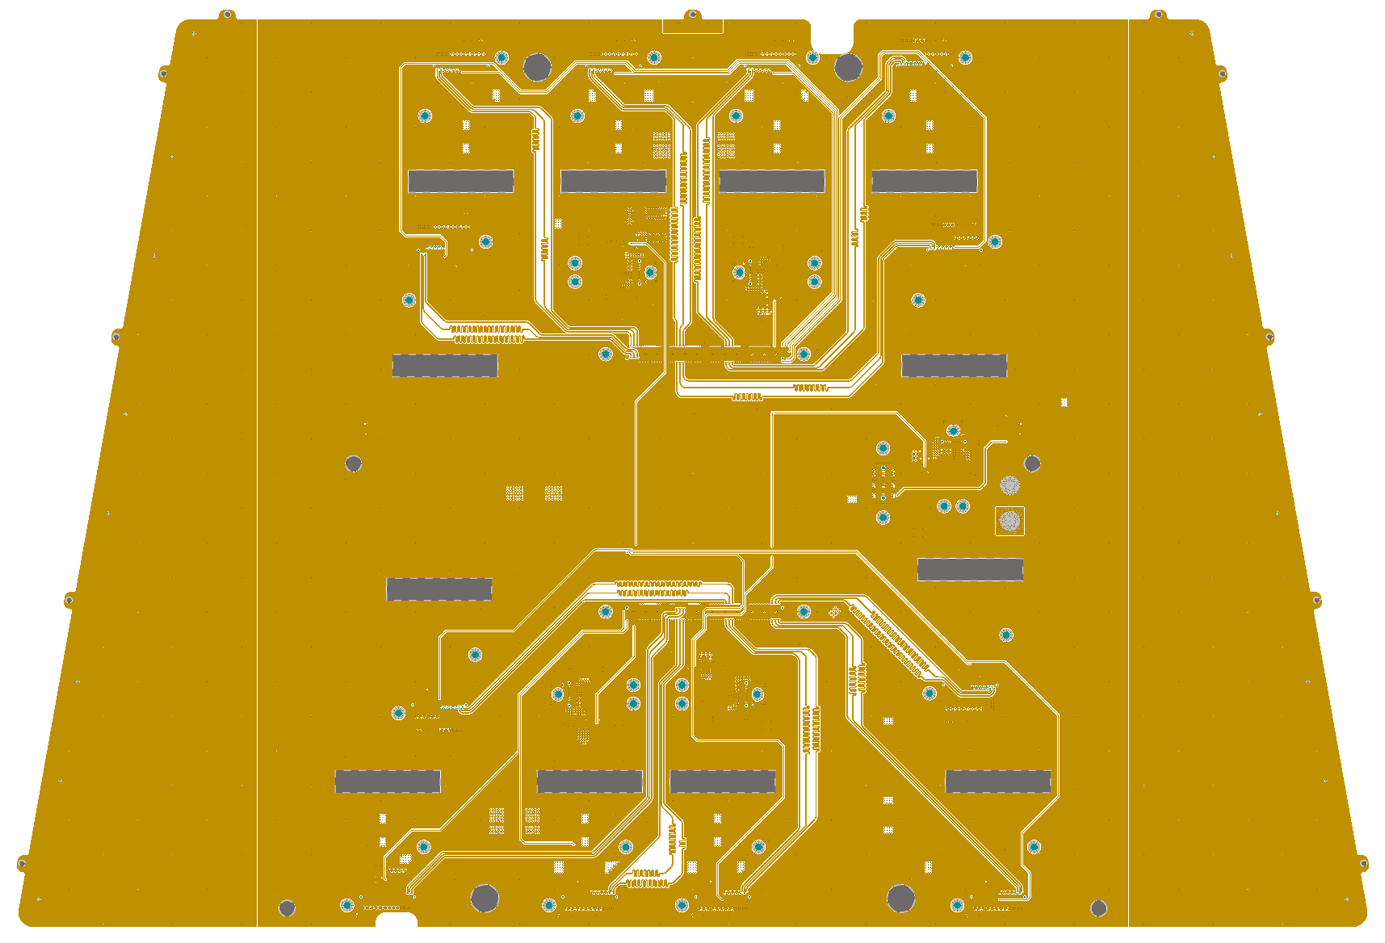
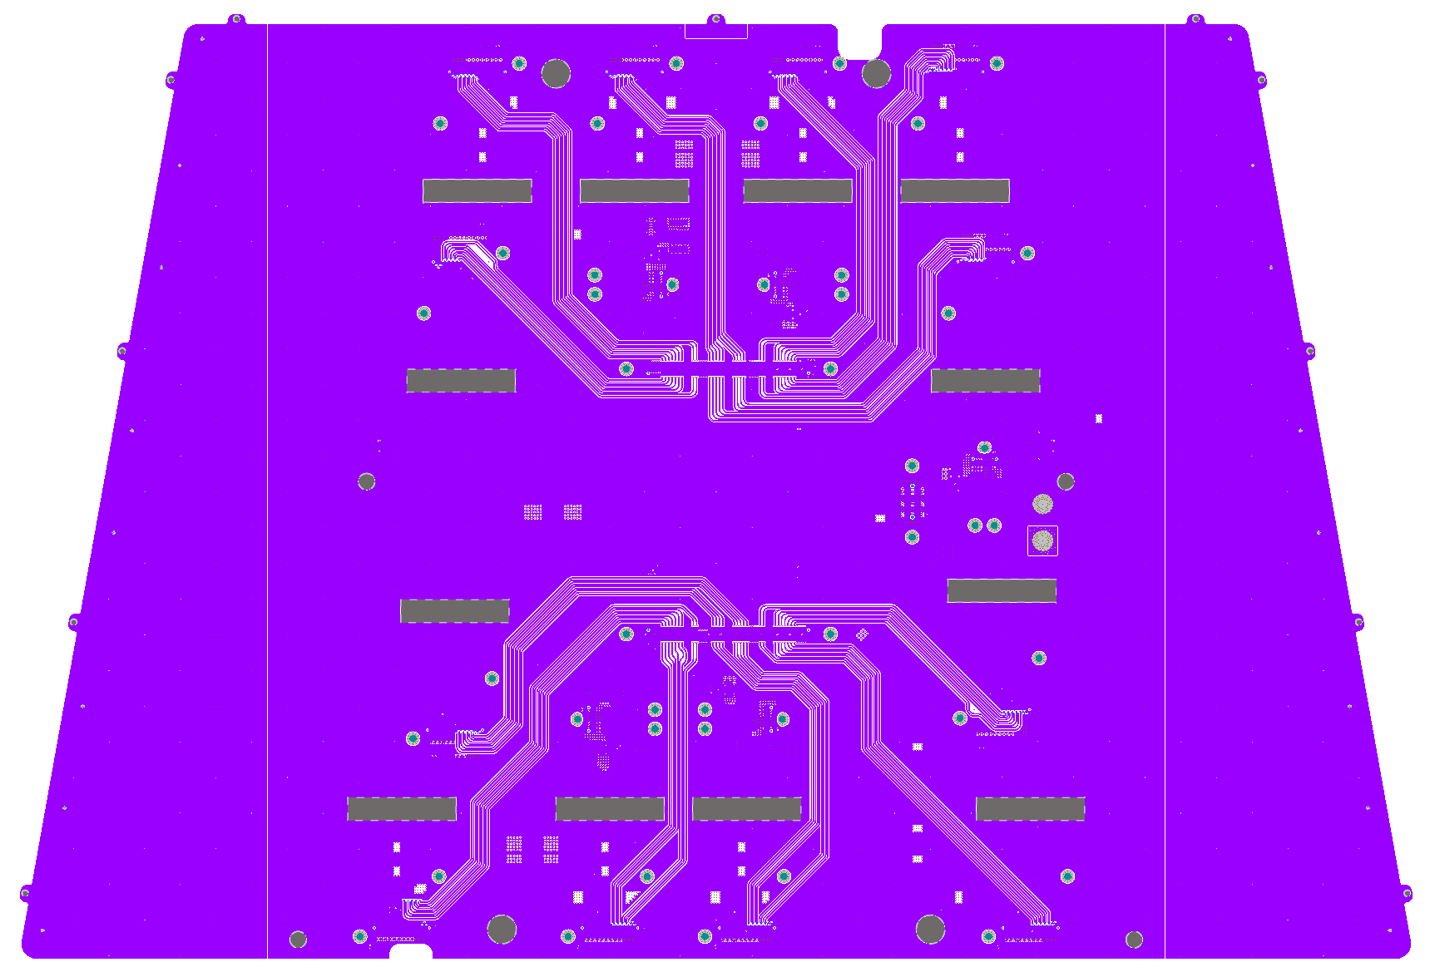
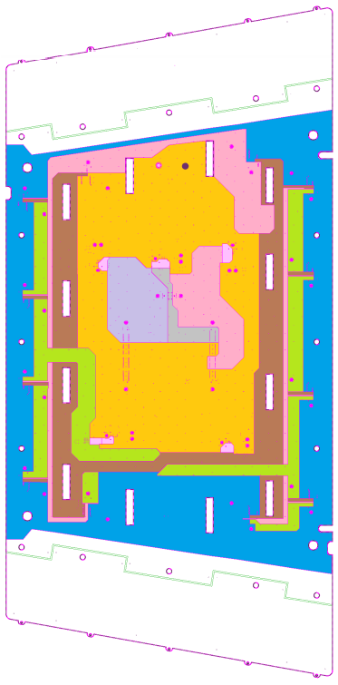
Overview: GEB（GEM Electronics Board）
GEB functions:
  Transmission of signals between front-end VFAT and OH board.
  Power drive and distribution.
  Providing electrical shielding to signal of GEB
  GEB requirements:
  Signal transmission system:
    Links on GEB: The characteristic impedance is 100 Ohm for differential line, and small fluctuations in characteristic impedance to reduce signal reflections
    Time resolution: Time delay of the signal lines are the same to meet isochronism requirement
    Low BER (Bit Error Rate) and noise
  Power distribution system:
    5 FEASTs: Provide voltage to VFAT and OH board
    Power layer: Effective power distribution systems
  Mechanical properties:
    Total board thickness is less than 1.1mm, limited by installation space.
    Lower than the IPC standard curvature 0.75%.
    Torque strength of standoff can stand 0.5N·m
Transmission line in signal layer of GEB
Power distribution system of GEB
GE2/1 GEM GEBs :
  → Design, prototyping, mass production and test by China Group (Peking U., Tsinghua U., Sun Yet Sen U. )

Slide 5
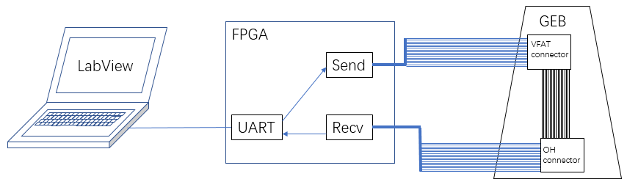
New Test device for GEB mass production
GEB test tool used in previous mass production: FPGA+LED light，manual operation；
New automatic test device developed by PKU group: FPGA + computer+ LabView. Goals:
Connectivity Test: Automatic test the connectivity of GEB internal transmission line on FPGA and graphical display on the computer.
BER Test: Perform high-speed differential signal test on GEB.
Differential Lines on GEBs
Design diagram of new GEB test device

Slide 6
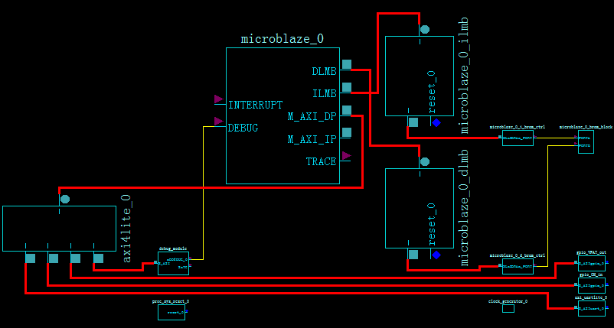
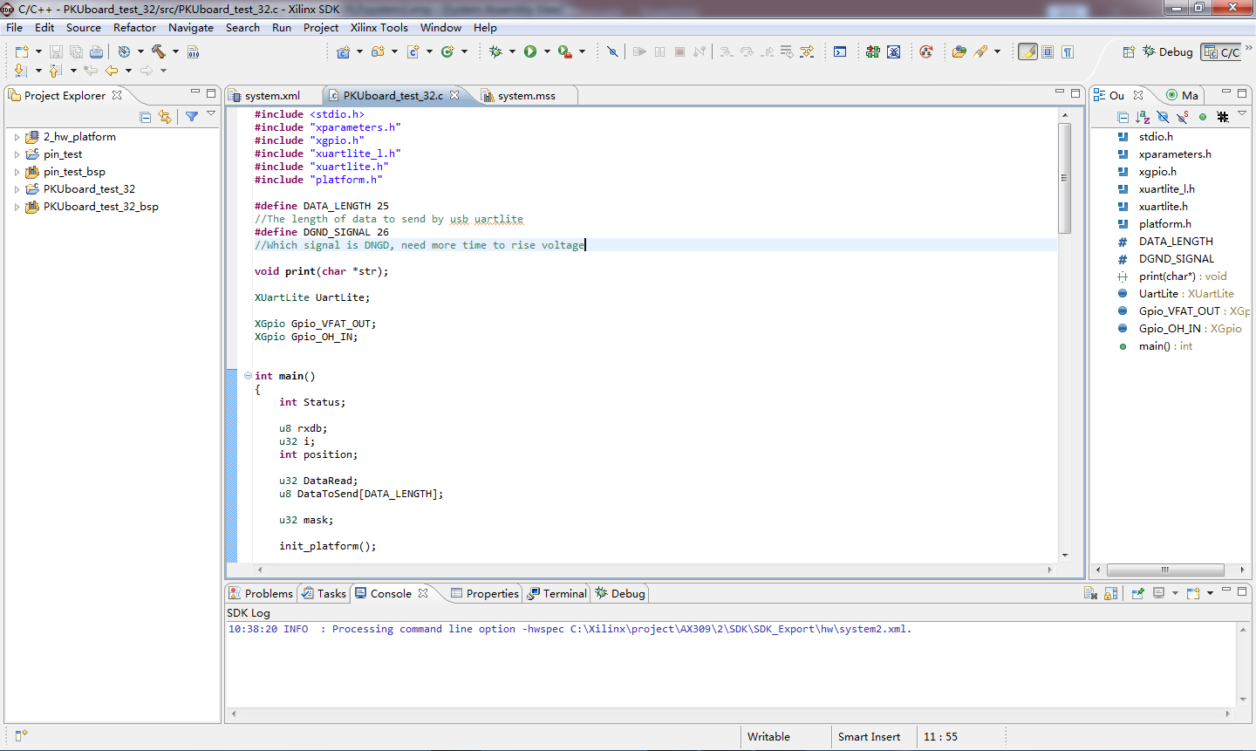
Development of new GEB test device
Connectivity Tool (Programming):
1.Use Microblaze in XPS to build soft cores and add required IP modules.
(Main modules: UART and GPIO)
2.Program the soft cores in SDK.
Establish serial communication between FPGA and laptop.
The structure of soft cores
Programming of FPGA

Slide 7
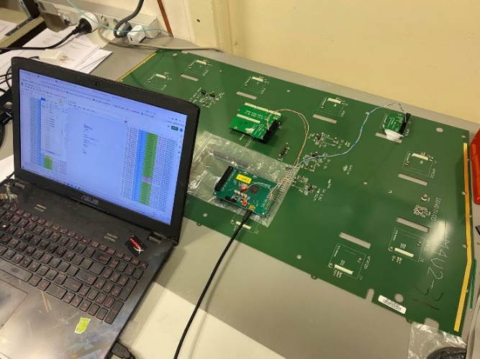
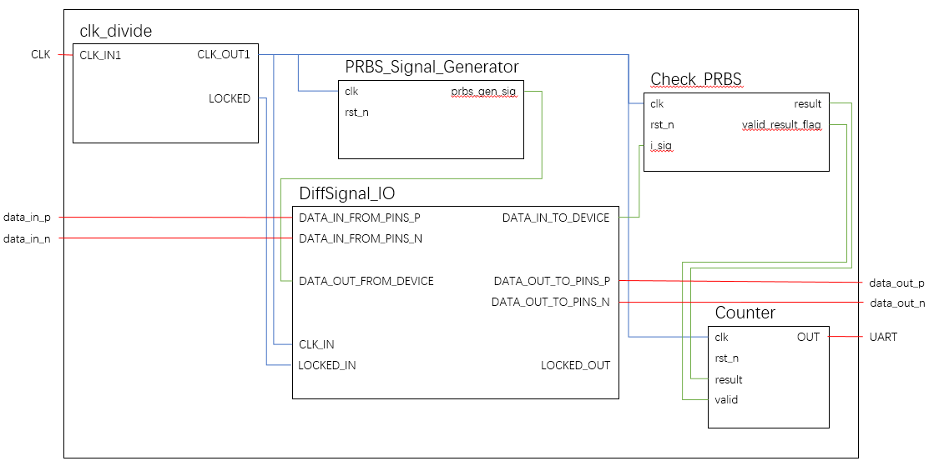
Development of new GEB test device
BER Tool (Program FPGA directly with Verilog):
Module:
1.Clock conversion module
2.Differential Signal Communication Module
3.Pseudo-random sequence generation module
BER automatic tester
4.Pseudo-random sequence check module
The new test device was successfully used in GEB production test in Shenzhen and CERN
5. Counting and Communication Module
FPGA Programming module

Slide 8
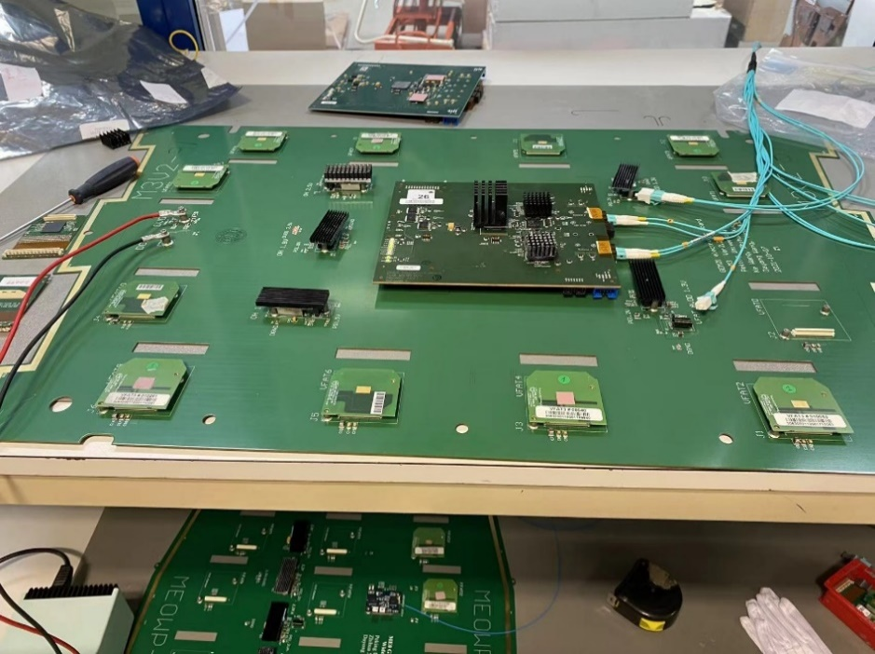
Mass production and test of GE2/1 GEB
GE2/1 GEBs are produced in Sinofast LtD in ShenZhen;
GEBs are tested in Sinofast after production, qualified GEBs will be sent to CERN;
GEBs will be tested again at CERN (acceptance test).
Status of GE2/1 GEB production and test:
8 GE2/1 M1 halogen-free GEBs were produced and sent to CERN in June 2021
160 GE2/1 M1-M4 GEBs were produced and tested by Jan. 2022 and sent to CERN, acceptance test completed in June 2022.
168 GE2/1 M5-M8 GEBs were produced and tested by June. 2022 and sent to CERN, acceptance test completed in Sept. 2022.
Content of GEB test:
Manual and visual inspection, PCB bending degree checks
Connectivity test (by PKU tester)
HDLC-address check, Power Check
Standoff check and torque test
Pre-Order QC7 test (at CERN)
Pre-order QC7 test

Slide 9
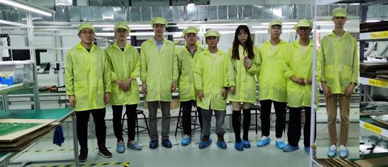
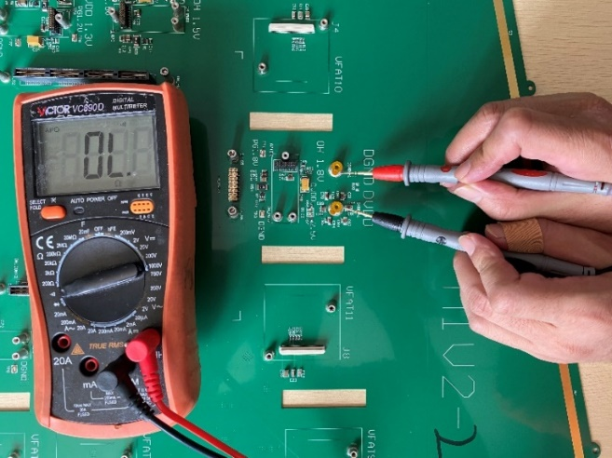
GEB Test at Shenzhen by PKY, SYU and THU groups
1. Manual and visual inspection:
Find out omission and damage of components.
Find out orientation and misalignment of components
Find out obvious short circuit and open circuit
2. Power check:
No short circuit to each other in power distribution system
Open circuit between AGND, DGND and SHIELD_NET
Voltage measurement
Power current measurement
The short circuit check of M1V2-1

Slide 10
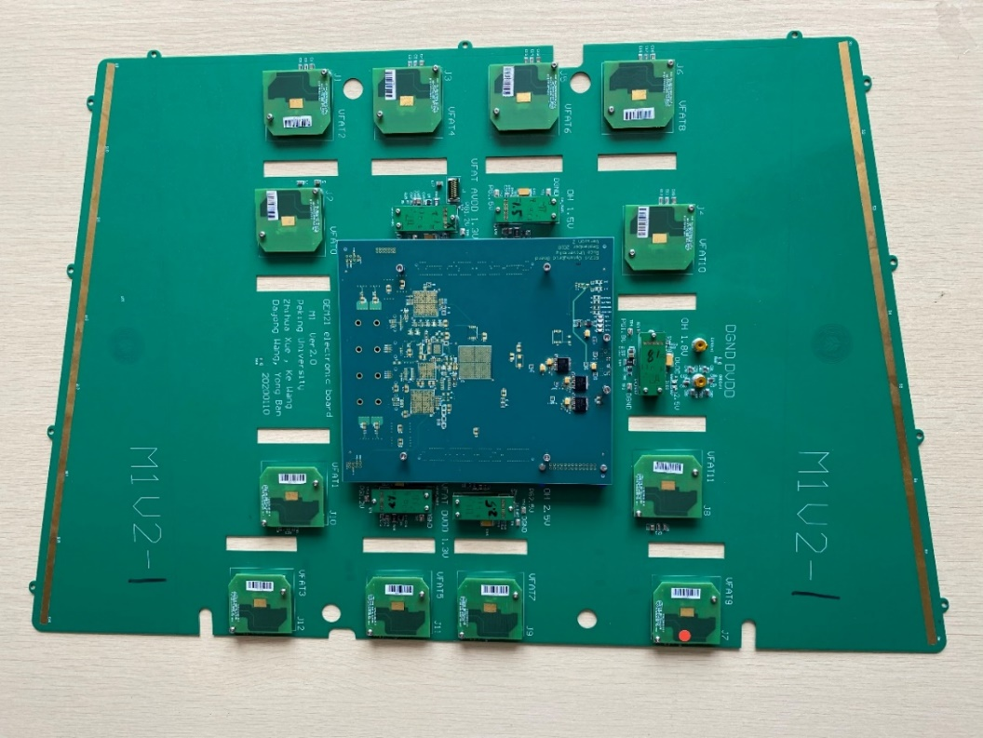
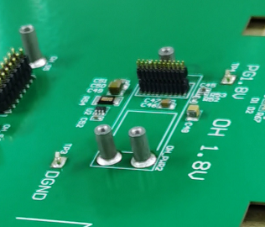
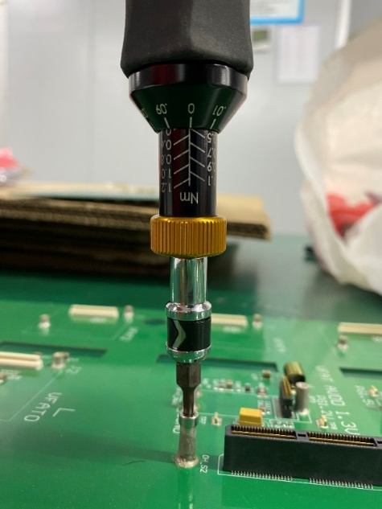
GEB Test at Shenzhen
3. Standoff check and torque test of standoff:
Check positions and orientation of standoffs;
Torque test of opto-hybrid standoff (The strength of standoff)
Standoff for fixing components
4. Connectivity test:
Torque test
Position check of standoff
Check the connectivity of the Differential signals and Reset signal of VFAT and OH;
Using PKU tester developed by PKU HEP group

Slide 11
GE2/1 GEB Test Results
Summary of 328 GEBs test in ShenZhen (Jan. and Jun. 2022):
Type | Power short |  | Monitor chips* |  | Standoff position |  | Standoff torque |  | VFAT address |  | Connectivity |  | Repaired |  | Total
M1V2 | 0/34 | 0/34 | 13/170 | 0/170 | 15/1530 | 0/1530 | 0/204 | 0/204 | 0/408 | 0/408 | 1/408 | 0/408 | 18/34 | 1/34 | 34
M2V2 | 1/42 | 0/42 | 27/210 | 0/210 | 20/1890 | 0/1890 | 0/252 | 0/252 | 0/504 | 0/504 | 3/504 | 0/504 | 31/42 | 1/42 | 42
M3V2 | 1/42 | 0/42 | 19/210 | 0/210 | 19/1890 | 0/1890 | 3/252 | 0/252 | 0/504 | 0/504 | 6/504 | 0/504 | 30/42 | 1/42 | 42
M4V2 | 5/42 | 2/42 | 23/210 | 0/210 | 12/1890 | 0/1890 | 8/252 | 0/252 | 0/504 | 0/504 | 2/504 | 0/504 | 29/42 | 3/42 | 42
M5V2 | 2/42 | 3/42 | 18/210 | 0/210 | 4/1890 | 0/1890 | 15/252 | 0/252 | 0/504 | 0/504 | 2/504 | 0/504 | 12/42 | 4/42 | 42
M6V2 | 1/42 | 0/42 | 24/210 | 0/210 | 9/1890 | 0/1890 | 179/252 | 0/252 | 0/504 | 0/504 | 1/504 | 0/504 | 39/42 | 0/42 | 42
M7V2 | 2/42 | 0/42 | 25/210 | 0/210 | 8/1890 | 0/1890 | 87/252 | 0/252 | 0/504 | 0/504 | 3/504 | 0/504 | 35/42 | 7/42 | 42
M8V2 | 1/42 | 0/42 | 27/210 | 0/210 | 1/1890 | 0/1890 | 9/252 | 0/252 | 0/504 | 0/504 | 4/504 | 0/504 | 10/42 | 5/42 | 42
Total | 13/160 | 5/328 | 176/1640 | 0/1640 | 88/14760 | 0/14760 | 301/1968 | 0/1968 | 0/3936 | 0/3936 | 22/1920 | 0/3936 | 165/328 | 22/328 | 328
Acceptance test of 328 GEBs at CERN (Jun and Sept. 2022):
5 GEBs found minor problems (probably due to transportation), in reparation.

Slide 12
Summary
CMS GE2/1 GEB design, production and test are completed. All 336 GEBs were shipped to CERN by Aug. 2022, passed acceptance test (~1.5% need reparation).
The new automatic GEB test tool developed by PKU group were successfully used in production and acceptance test, increased the test efficiency and reliability.
The design and prototyping of ME0 GEB is at the final stage, the Engineering Design Review is scheduled in Jan. 2023, mass production of ~420 GEBs will start a few months later.
Thanks!

