Slide 1
Clustering for crystal bar ECAL
Weizheng Song
2022.4.20

Slide 2
Outline
Motivation
Clustering for crystal bar ECAL
Clustering results
Summary

Slide 3
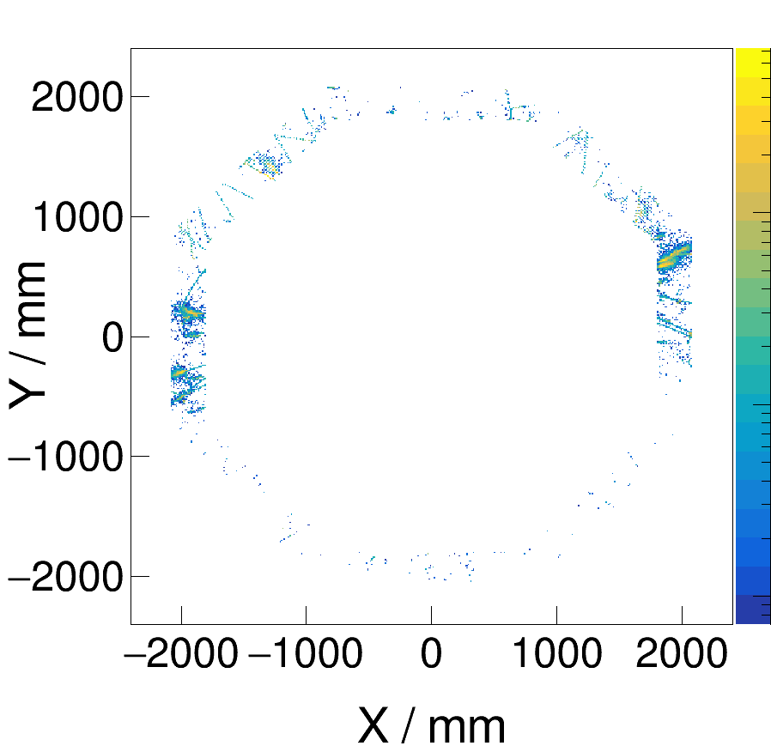
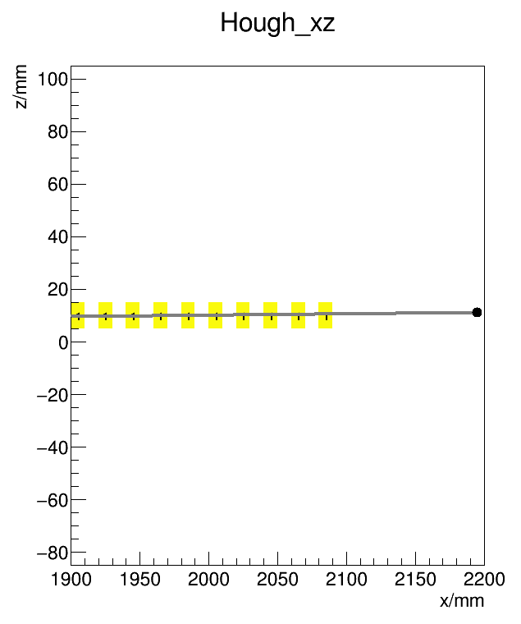
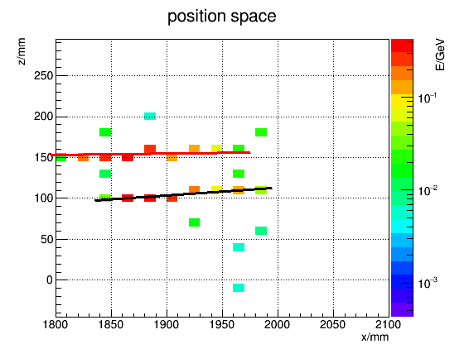
Clustering for crystal bar ECAL
Avoid double counting of energy from same particle
Separate energy deposits from different particles
Clustering: collect hits into clusters
Seed finding: recognize how many particles
Energy spilitting: associate energy with particles

Slide 4
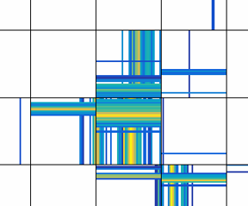
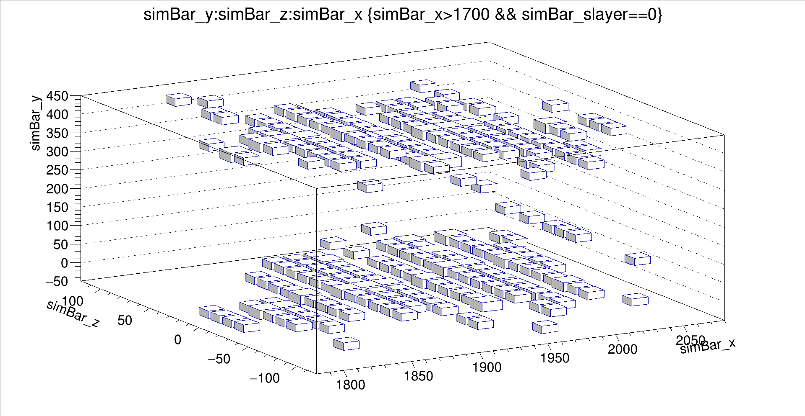
How to define and collect a cluster
Hits 1D clusters 2D clusters 3D clusters
2D cluster
hit
1D cluster
3D cluster

Slide 5
Physics results after clustering (3D clusters)
Single gamma events:
200, 10GeV, $φ$=0°,$θ$= 90° as an example
Homogeneous crystal bar barrel ECAL
Physics results after clustering
number of clusters
sum of energy
transverse and longitudinal development
1

Slide 6
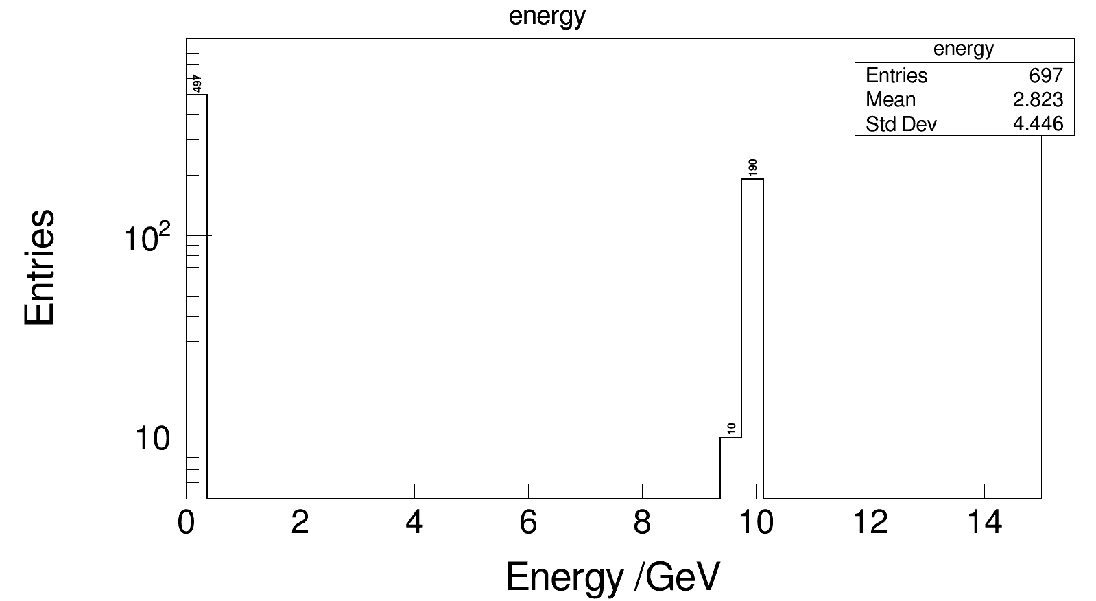
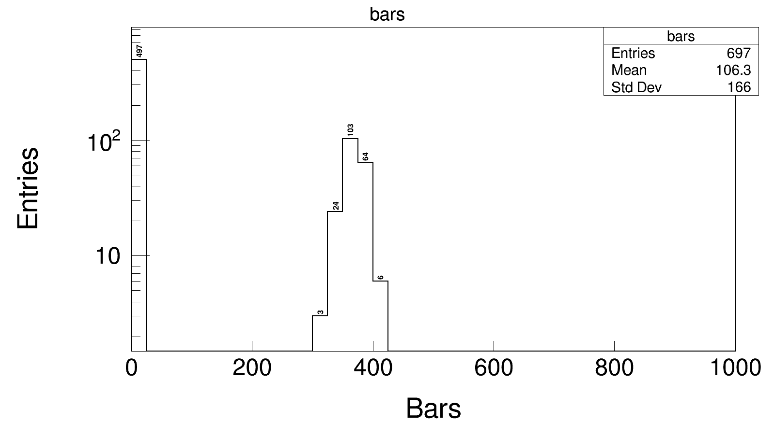
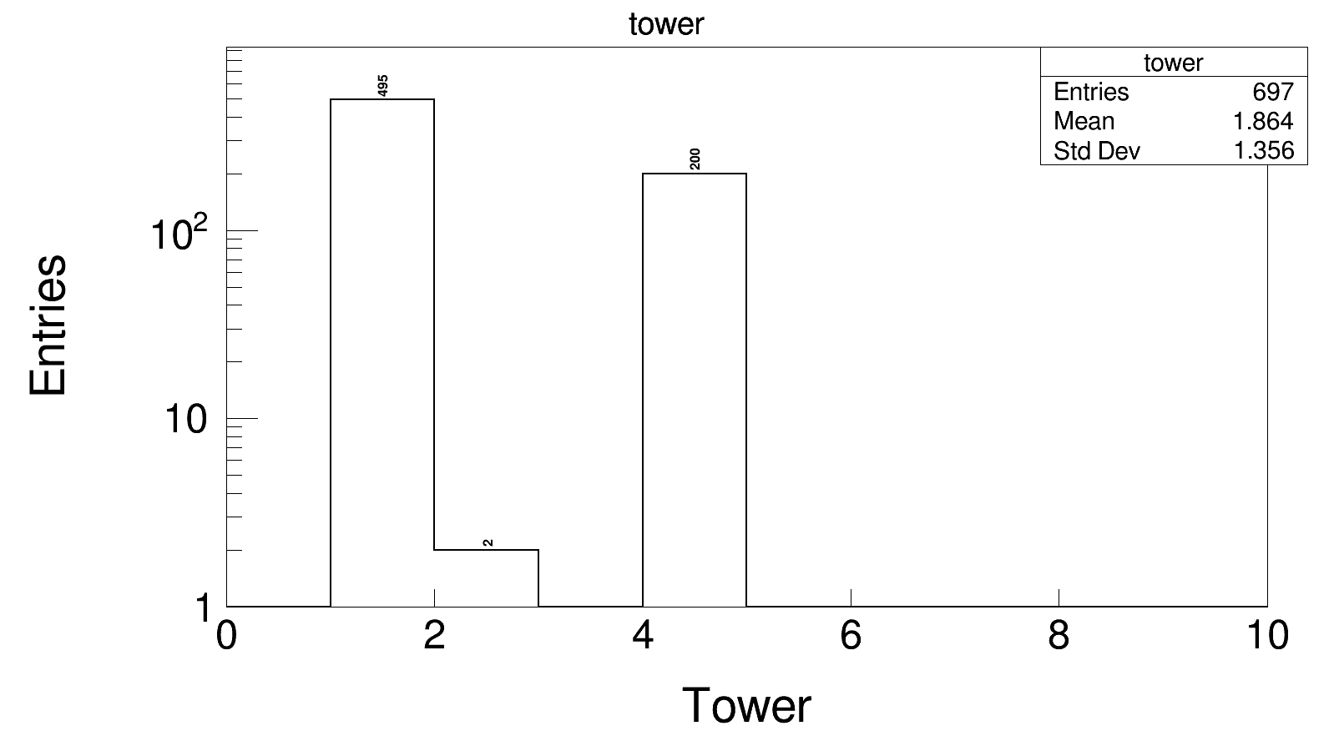
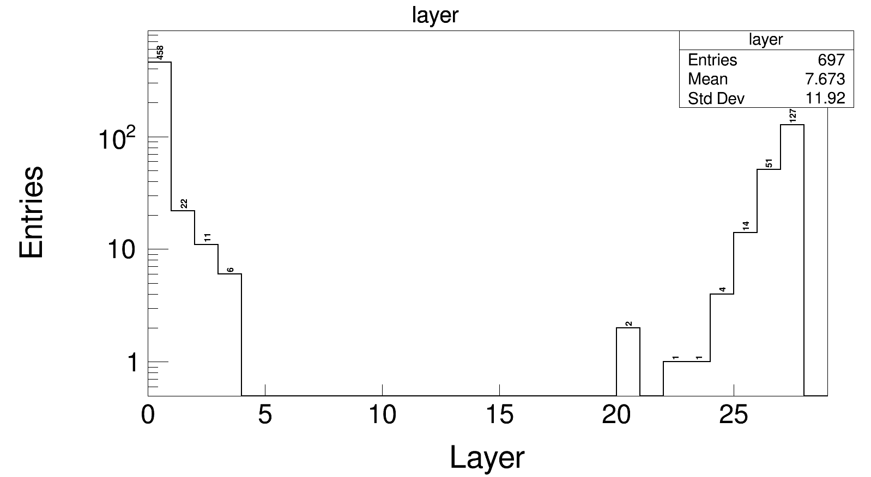
Number of clusters
Energy and cone angle (bars, tower, layer)
v

Slide 7
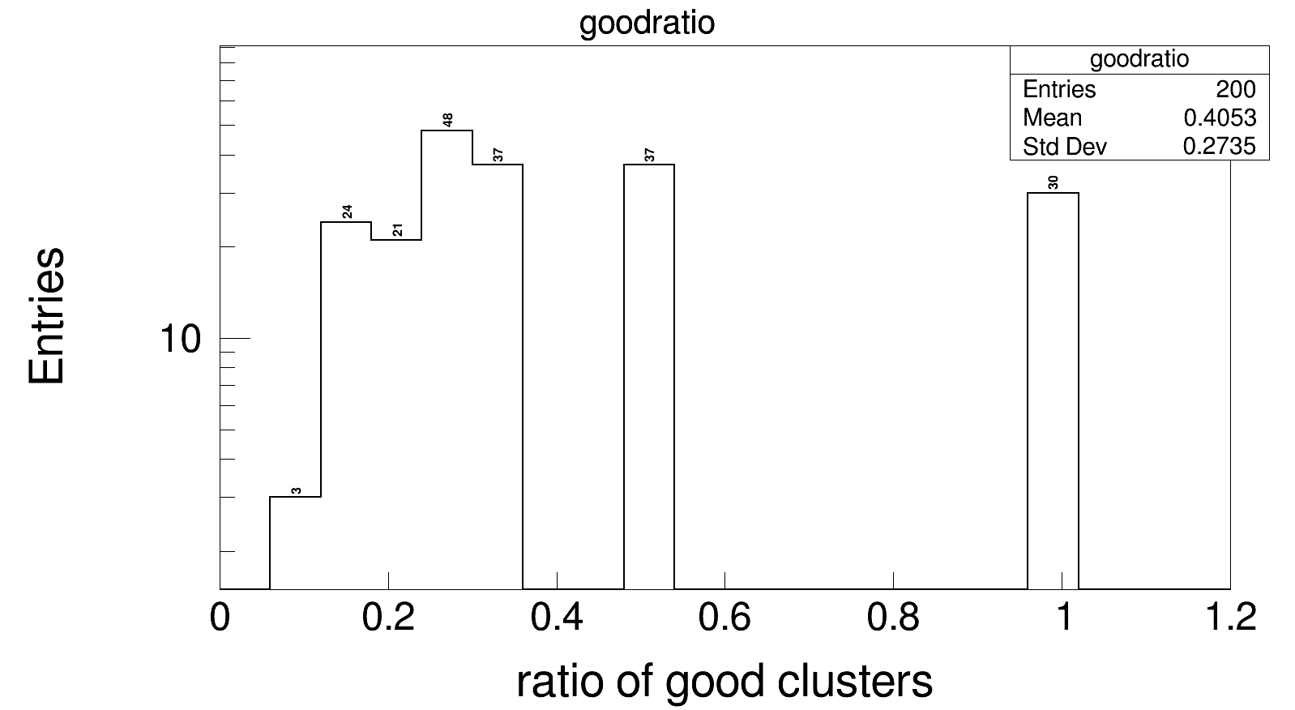
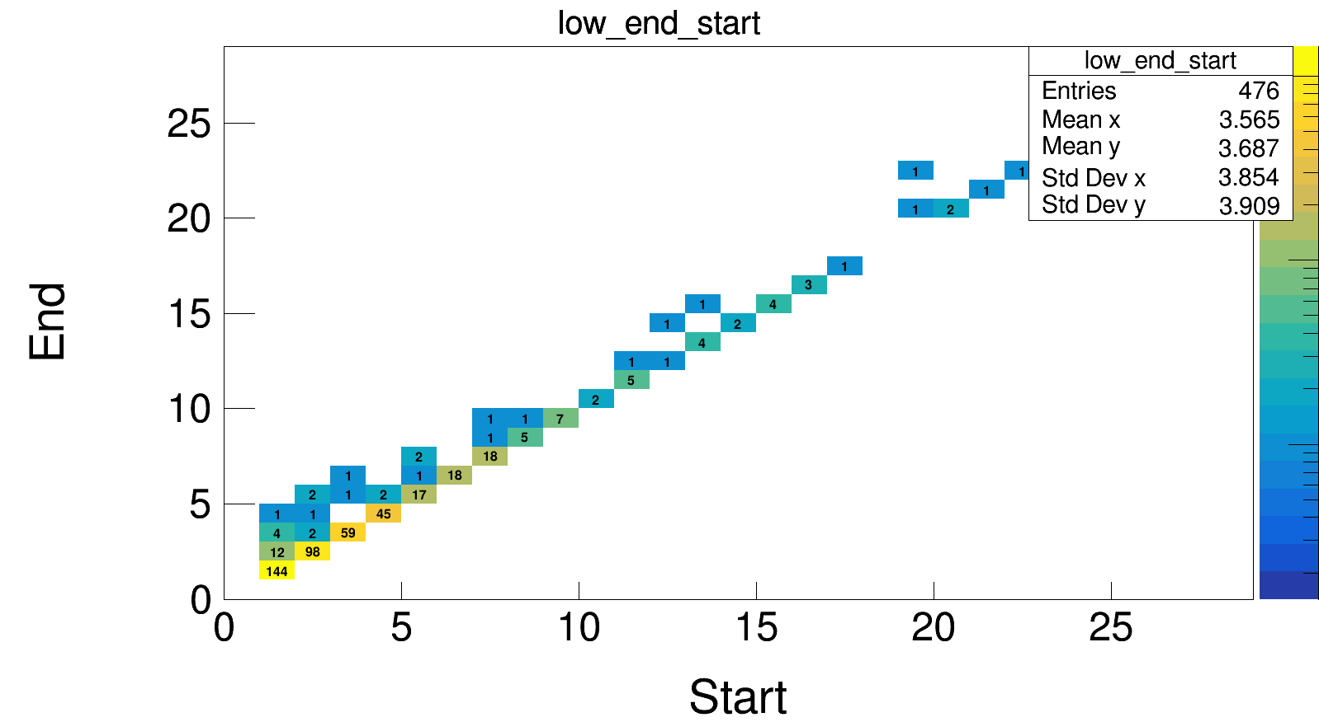
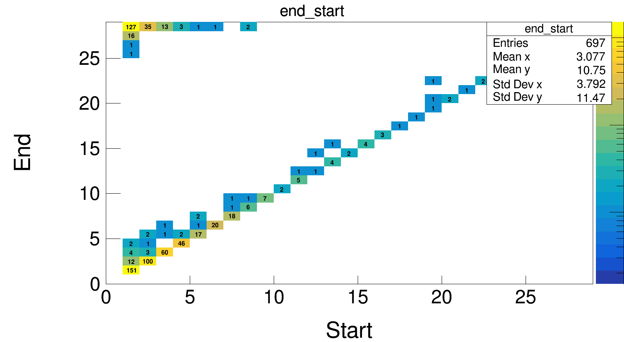
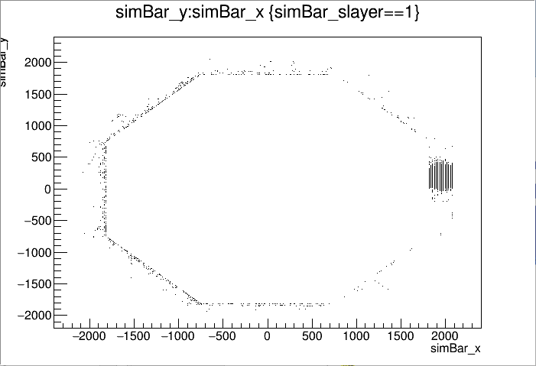
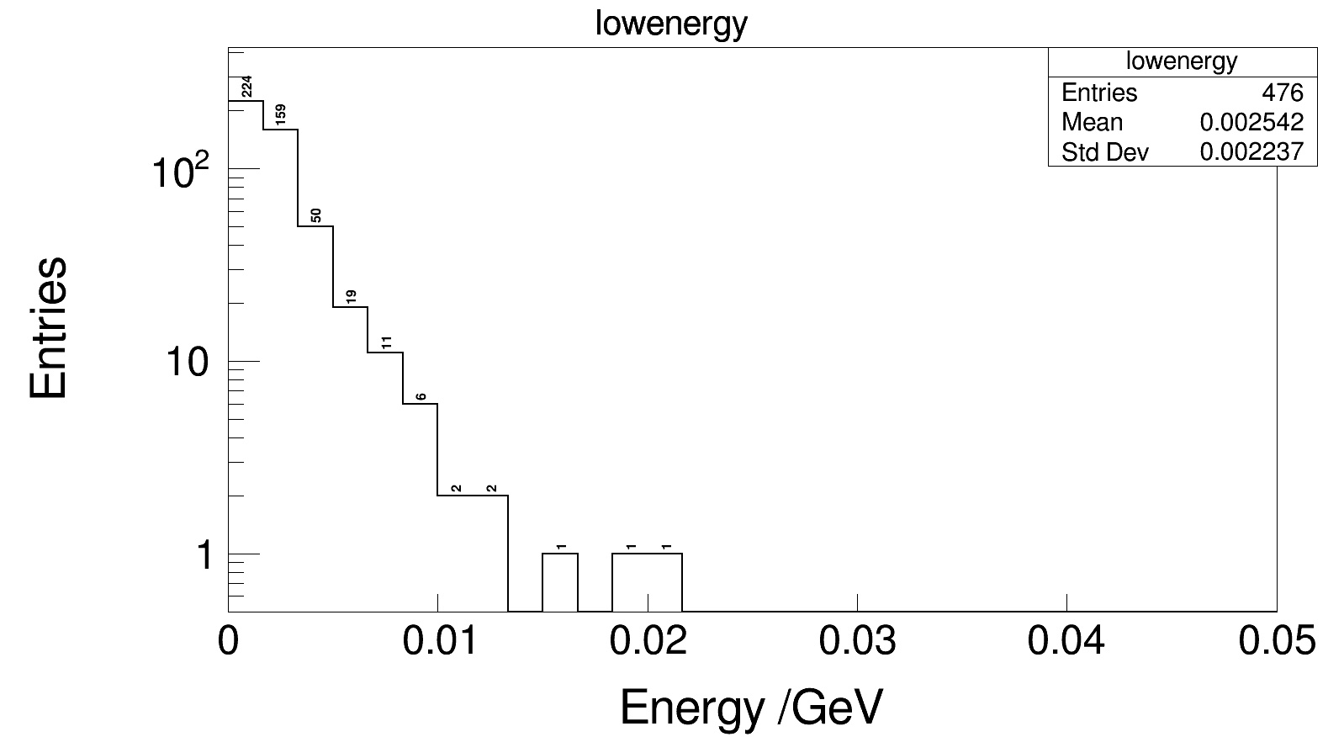
Number of clusters: ratio of “good 3D clusters”

Slide 8
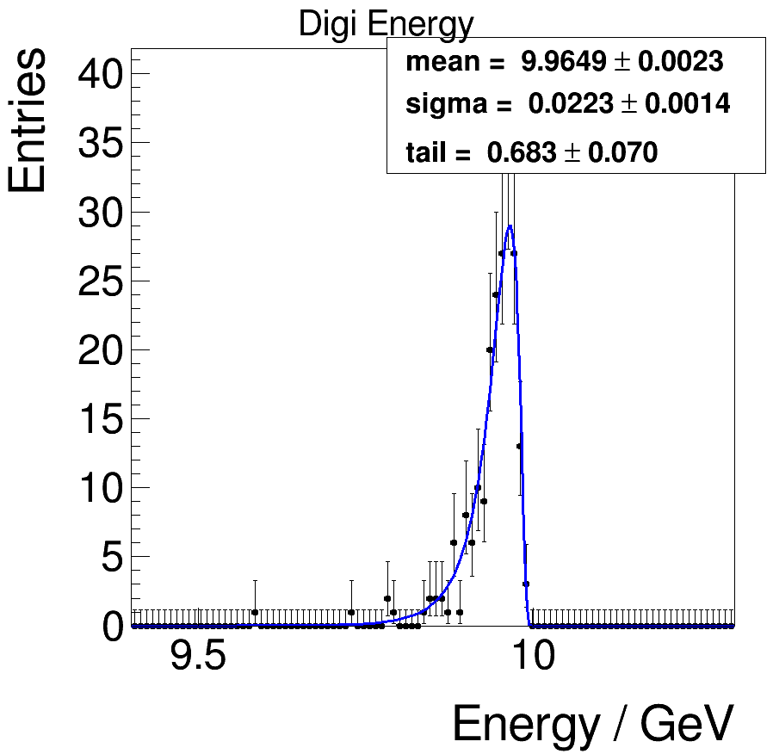
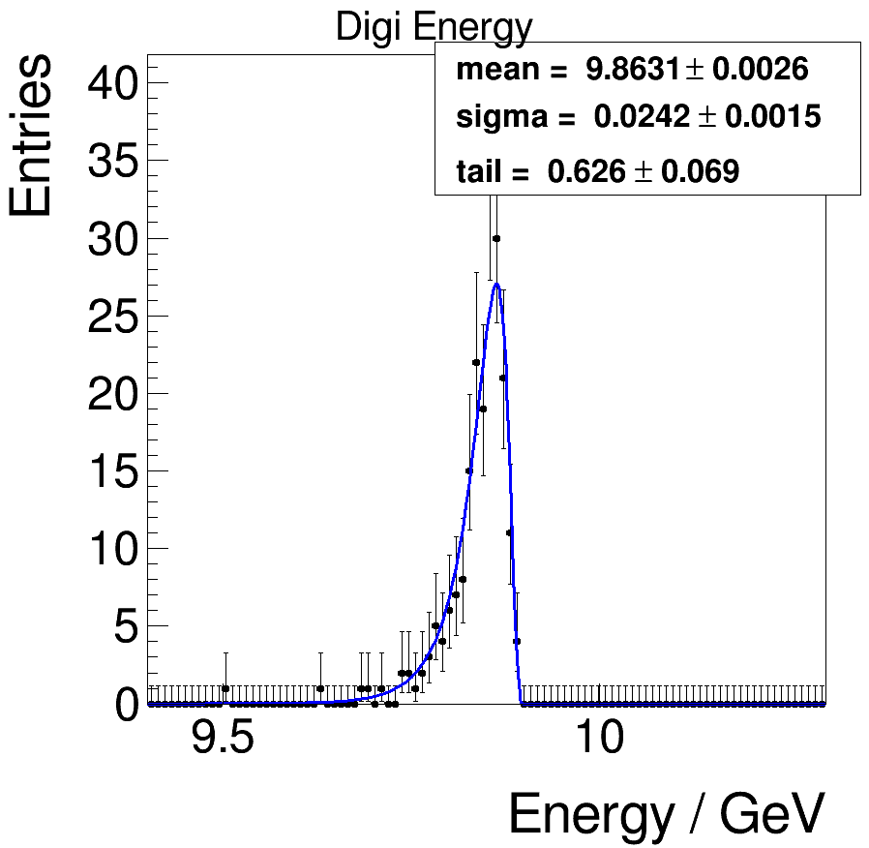
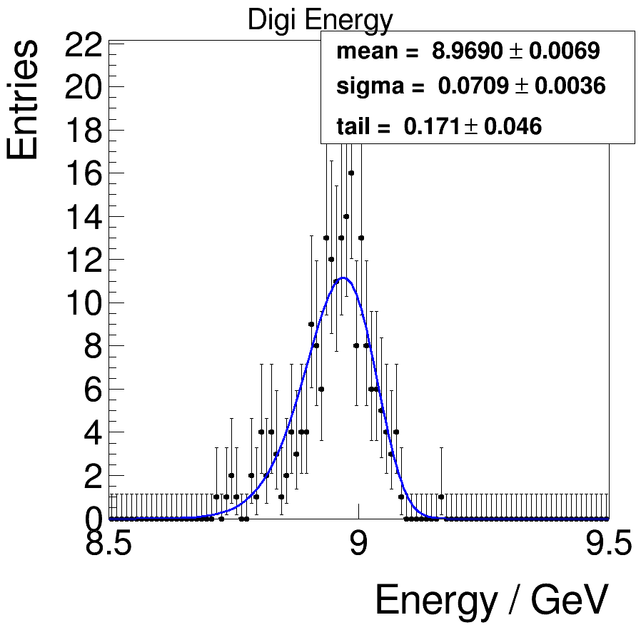
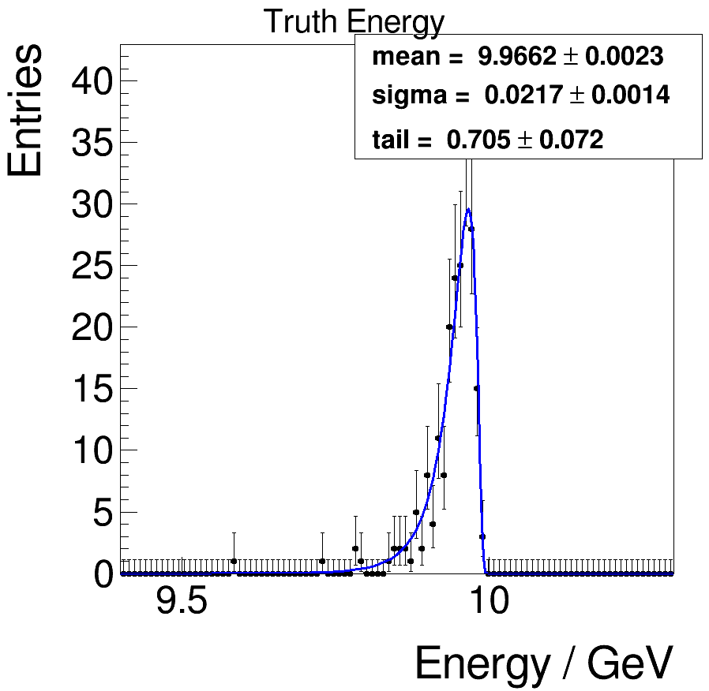
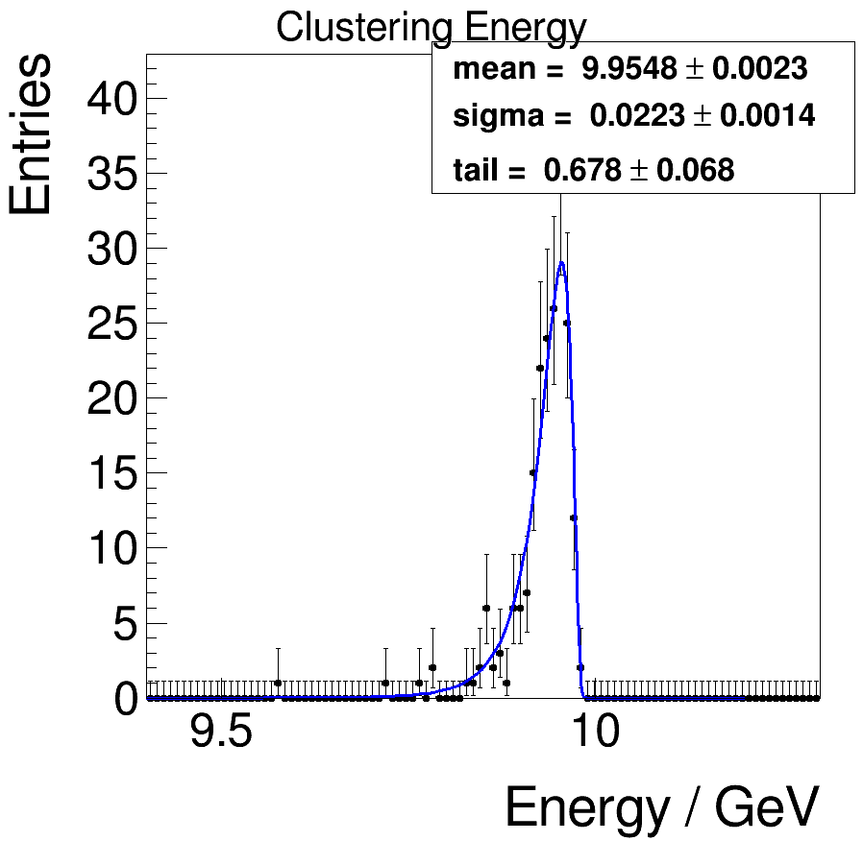
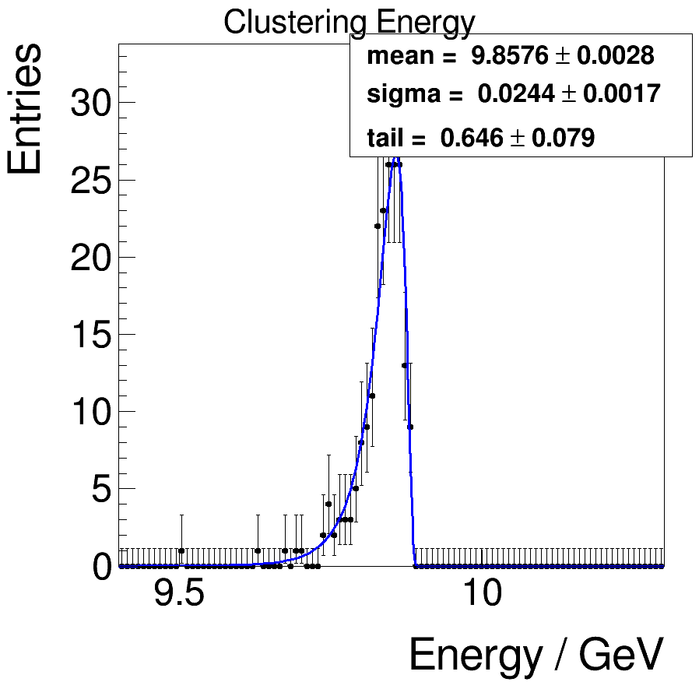
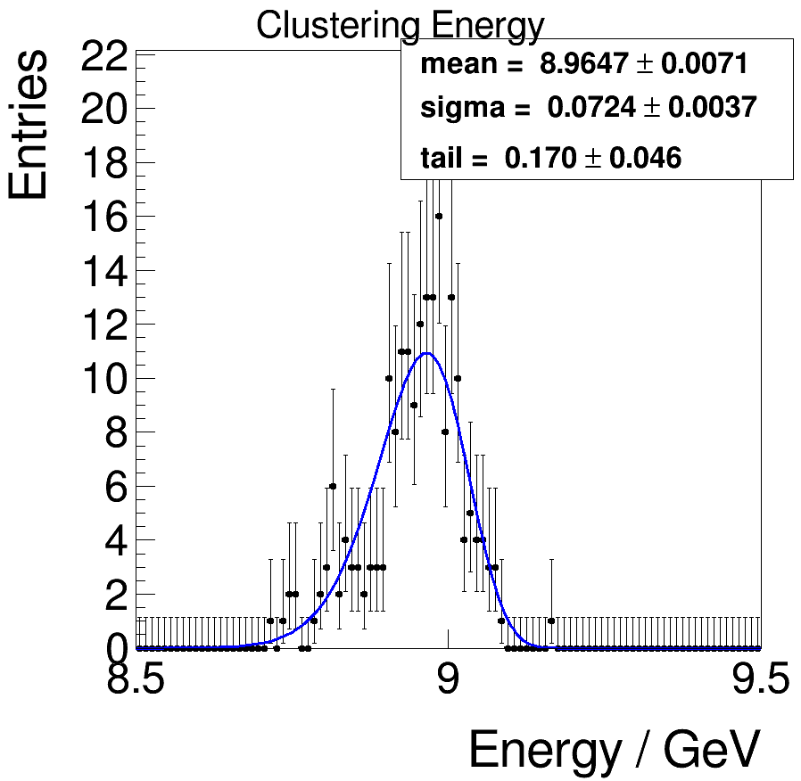
Sum of energy: truth → digitization → clustering
Fit with novosibirsk function
0.1MeV
1MeV
10MeV
mean = 9.9649 ± 0.0023
sigma = 0.0223 ±0.0014
mean = 9.8631 ± 0.0026
sigma = 0.0242 ±0.0015
mean = 8.9690 ± 0.0069
sigma = 0.0709 ±0.0036
mean = 9.9548 ± 0.0023
sigma = 0.0223 ±0.0014
mean = 9.8576 ± 0.0028
sigma = 0.0244 ±0.0017
mean = 8. 9647± 0.0071
sigma = 0.0724 ±0.0037

Slide 9
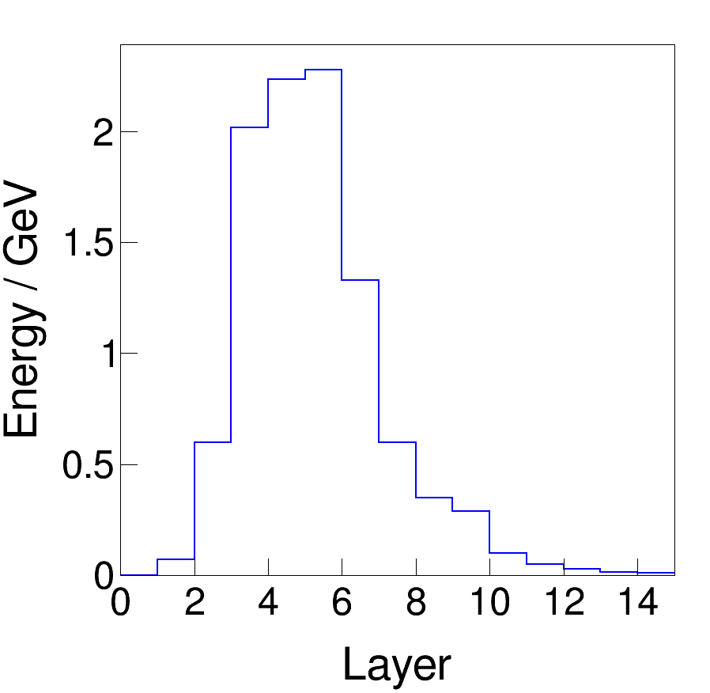
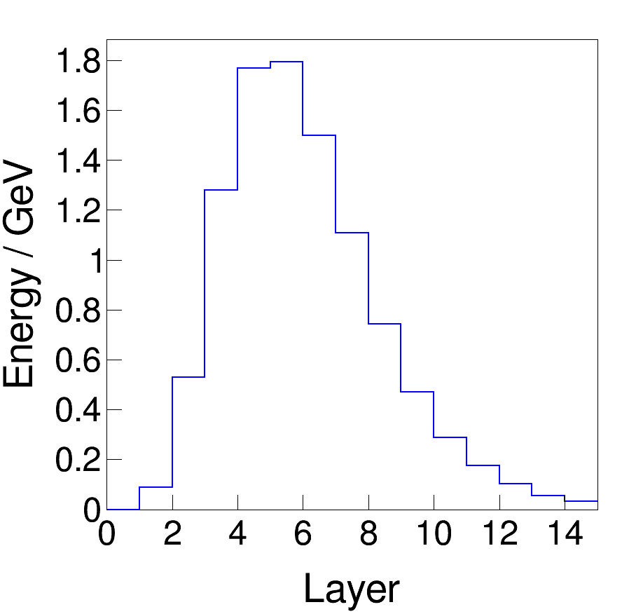
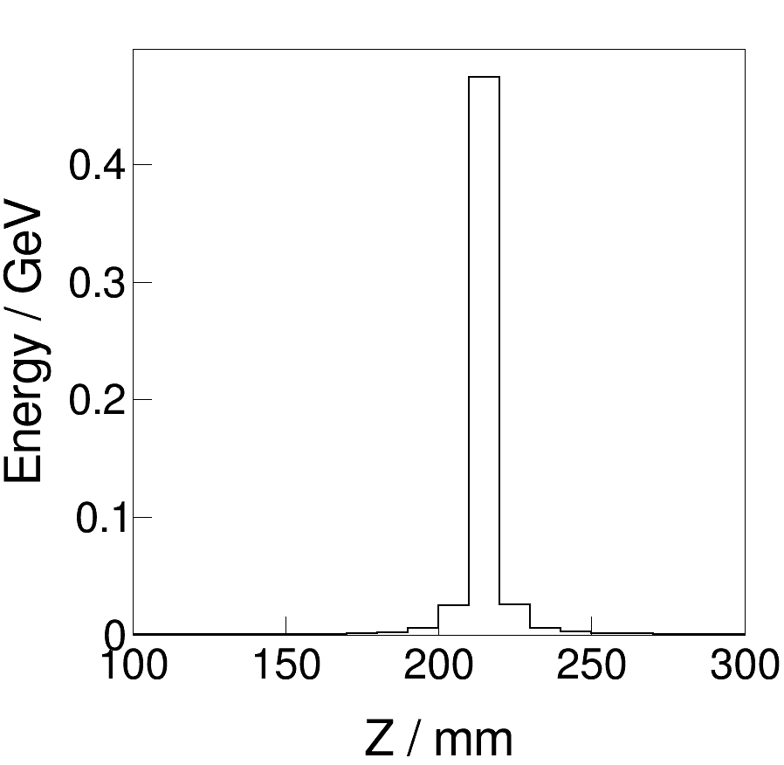
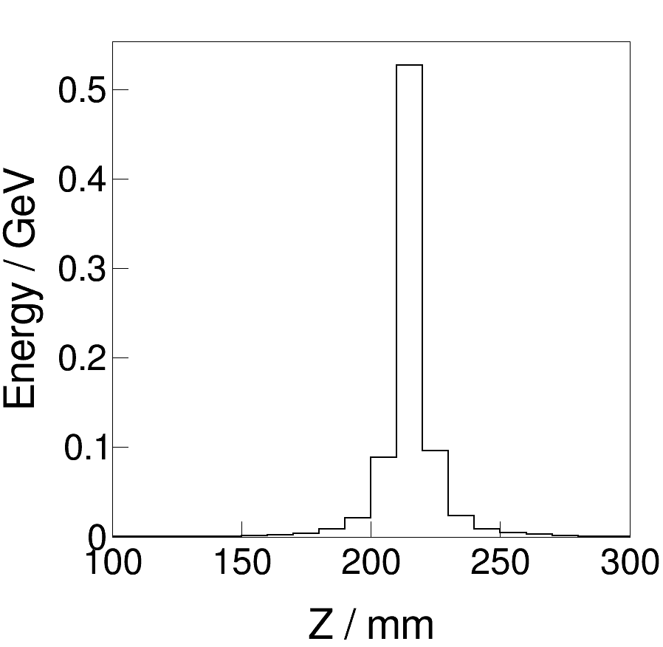
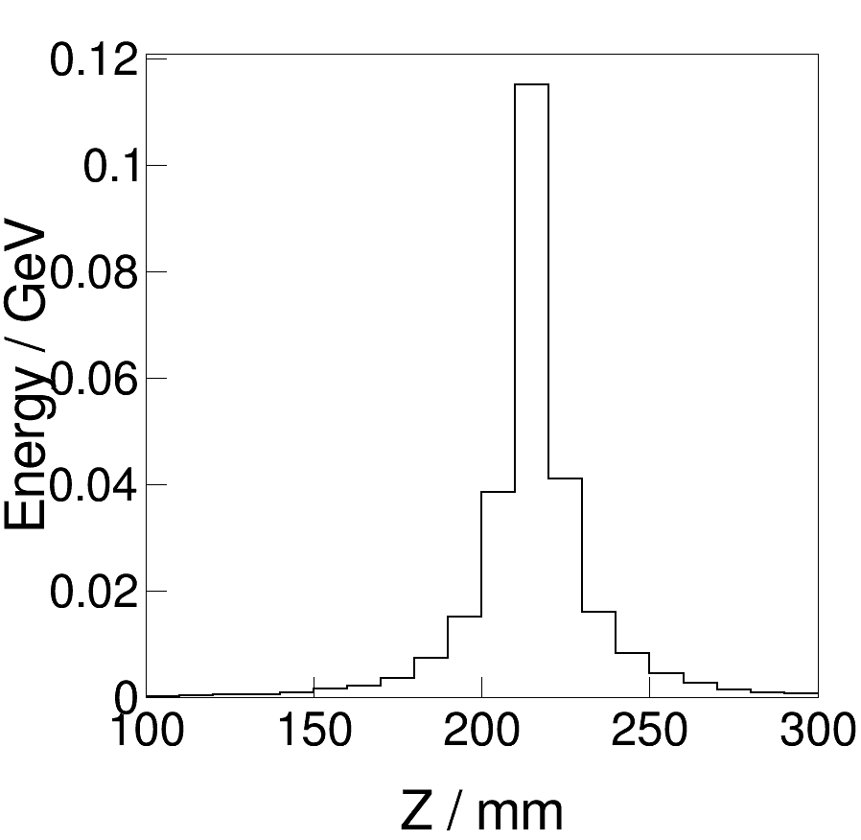
Transverse and longitudinal development
single gamma
200 single gamma
3 layer
6 layer
9 layer

Slide 10
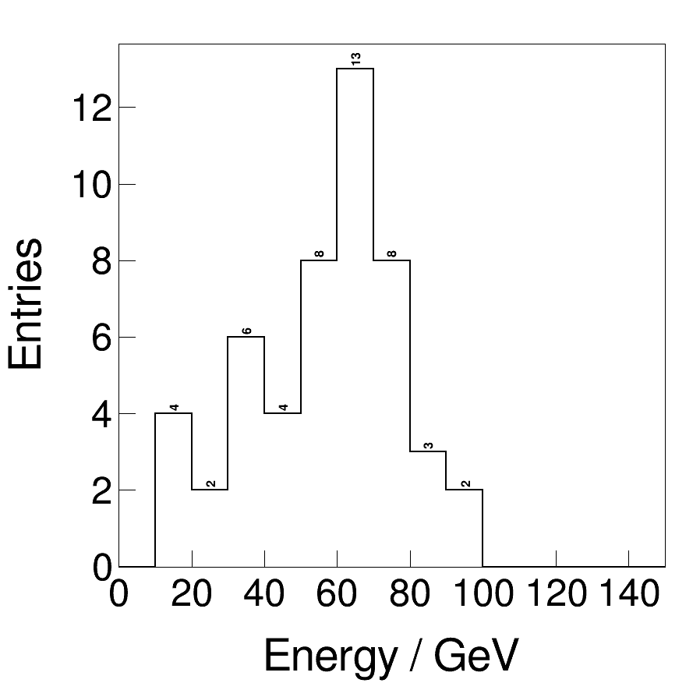
Physics results after clustering
Two-jet events:
240GeV, $e^{+}e^{−}−>ZH−>υυgg$ as an example
Homogeneous crystal bar barrel ECAL
Physics results after clustering
number of hits
number of clusters
energy and position information
transverse and longitudinal development of two-jet events
mean = 56.39 GeV

Slide 11
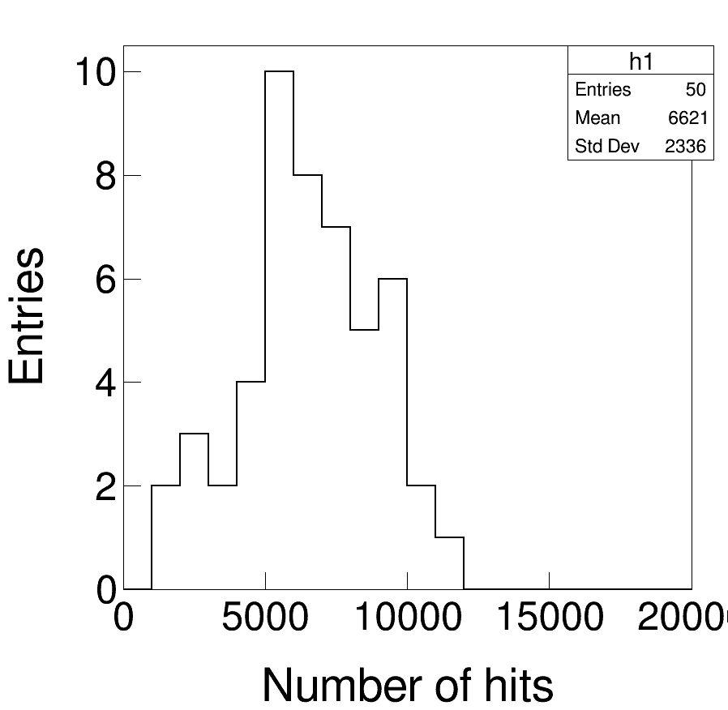
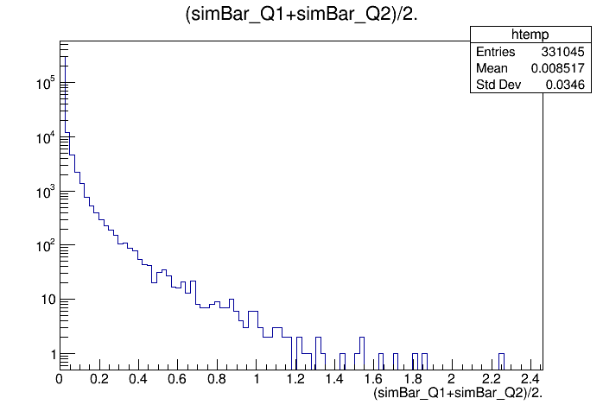
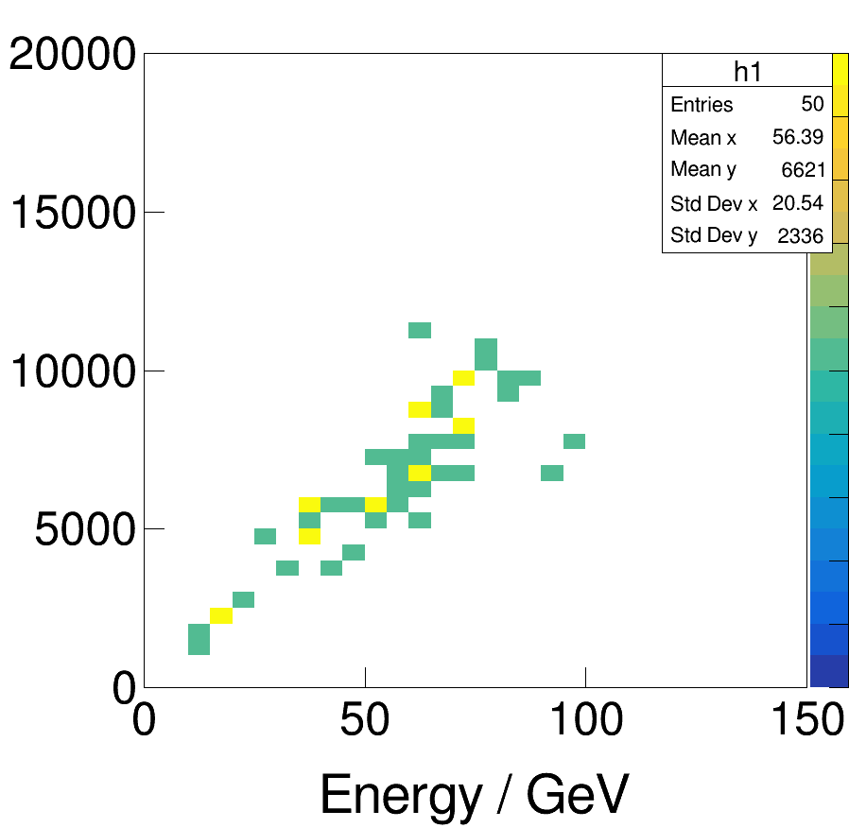
Number of hits
Barrel ECAL: ~400k crystals
Mean: 6621, ~1.7%
mean = 8.5MeV
maxima = 2.25GeV

Slide 12
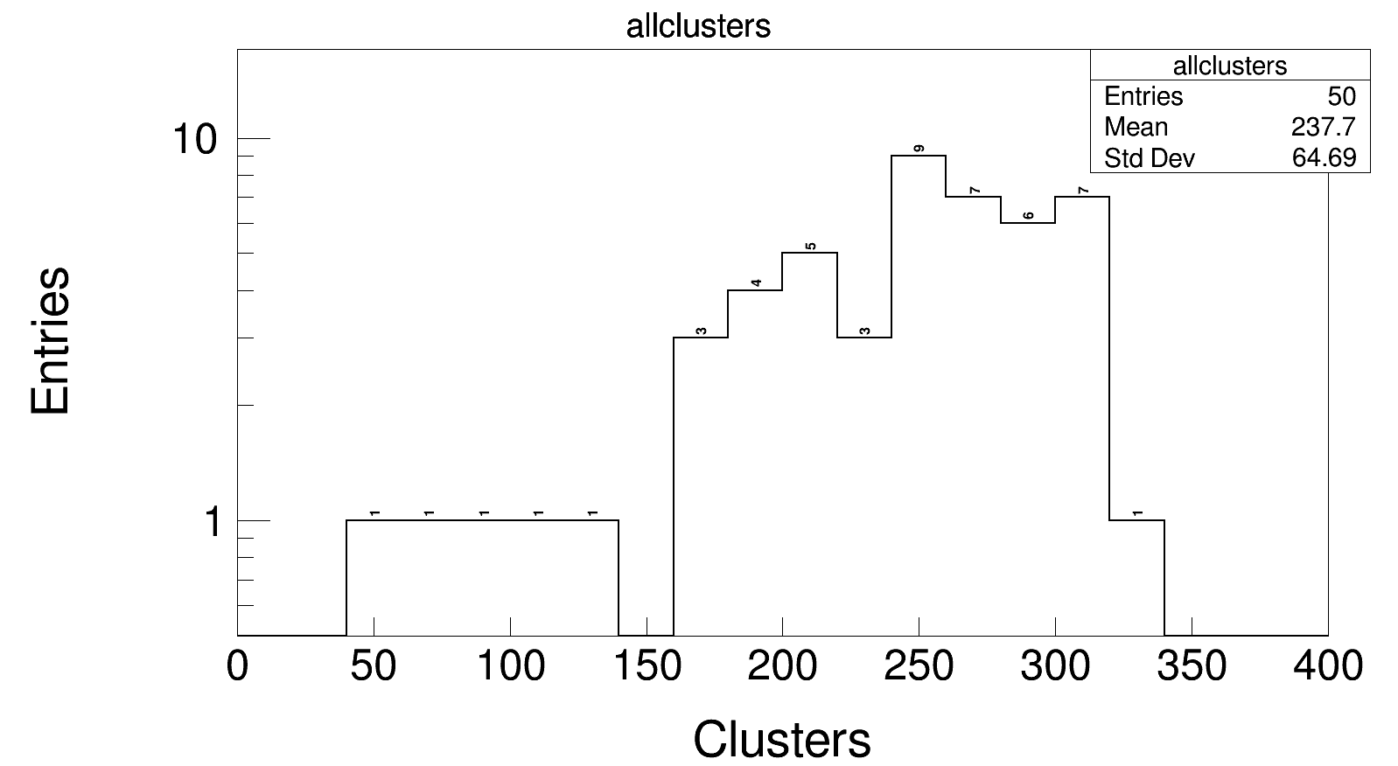
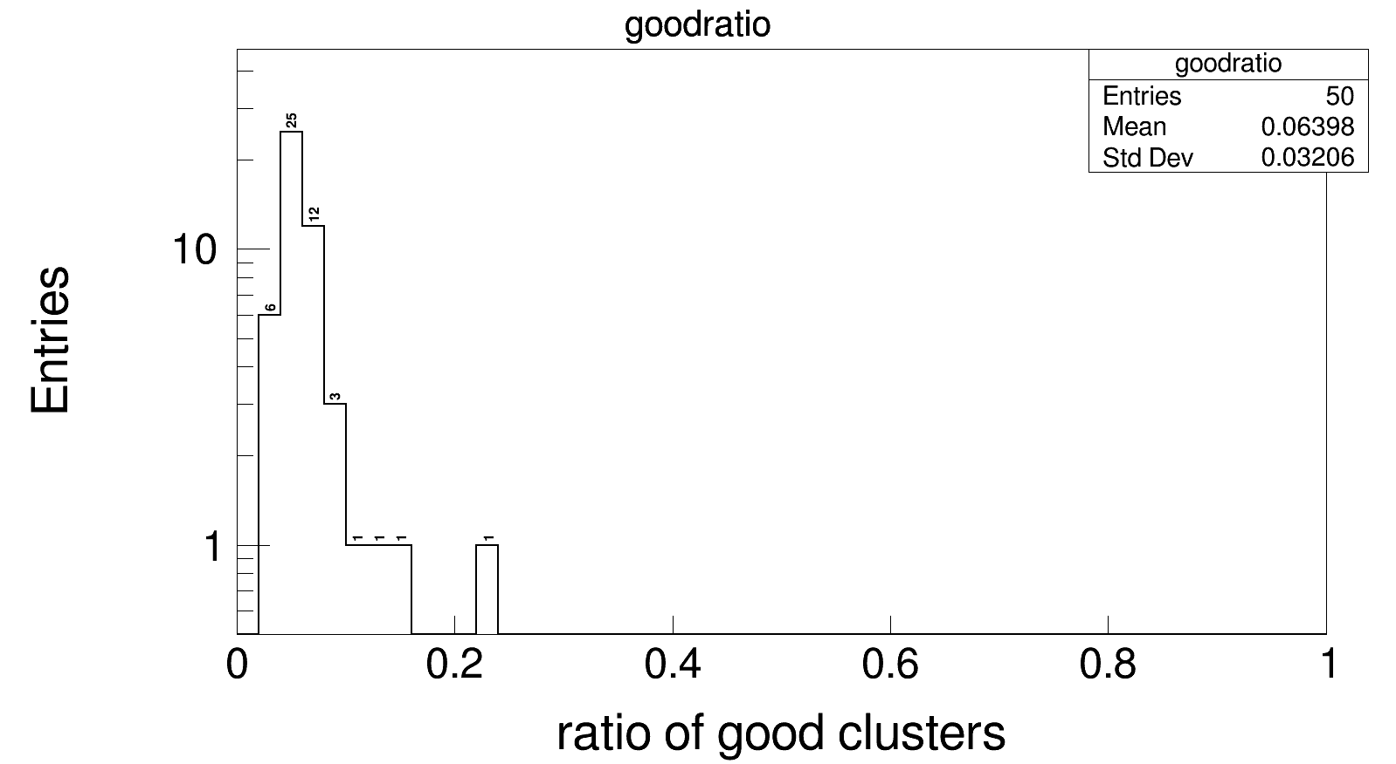
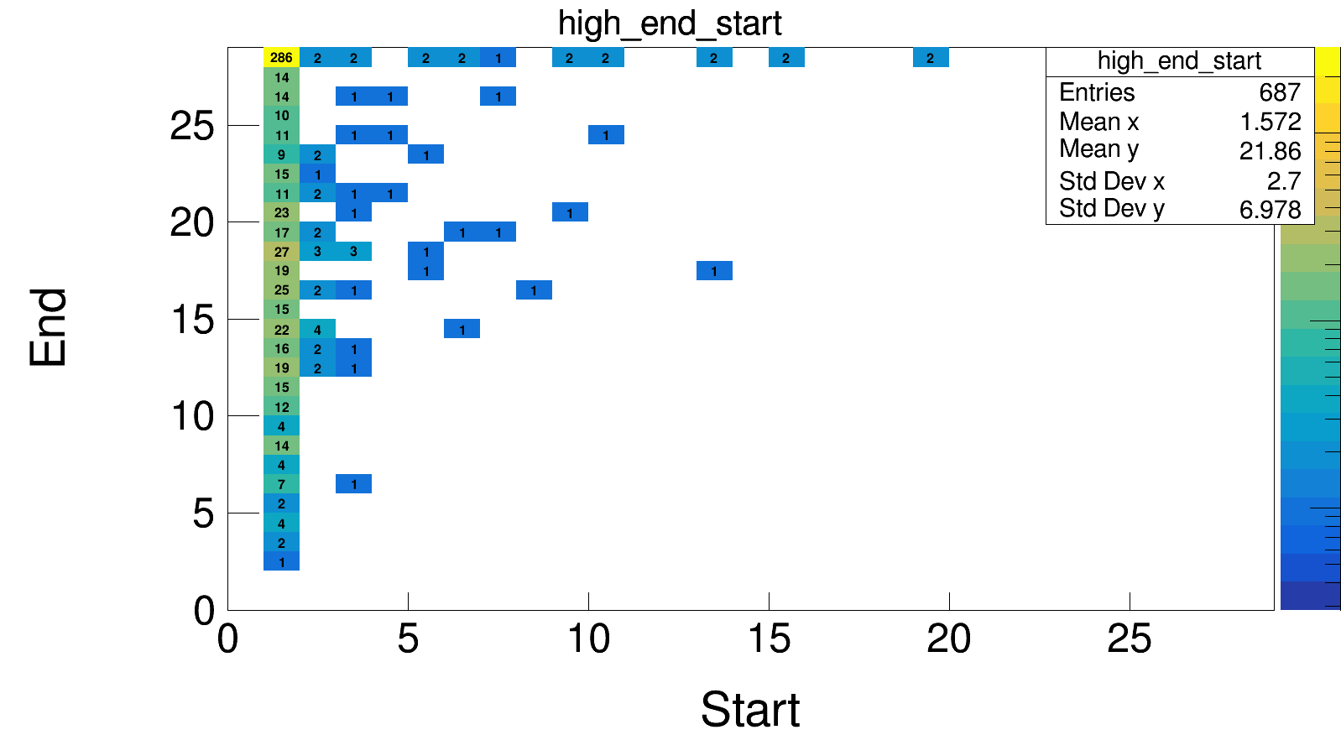
Number of clusters
energy >= 0.14 GeV

Slide 13
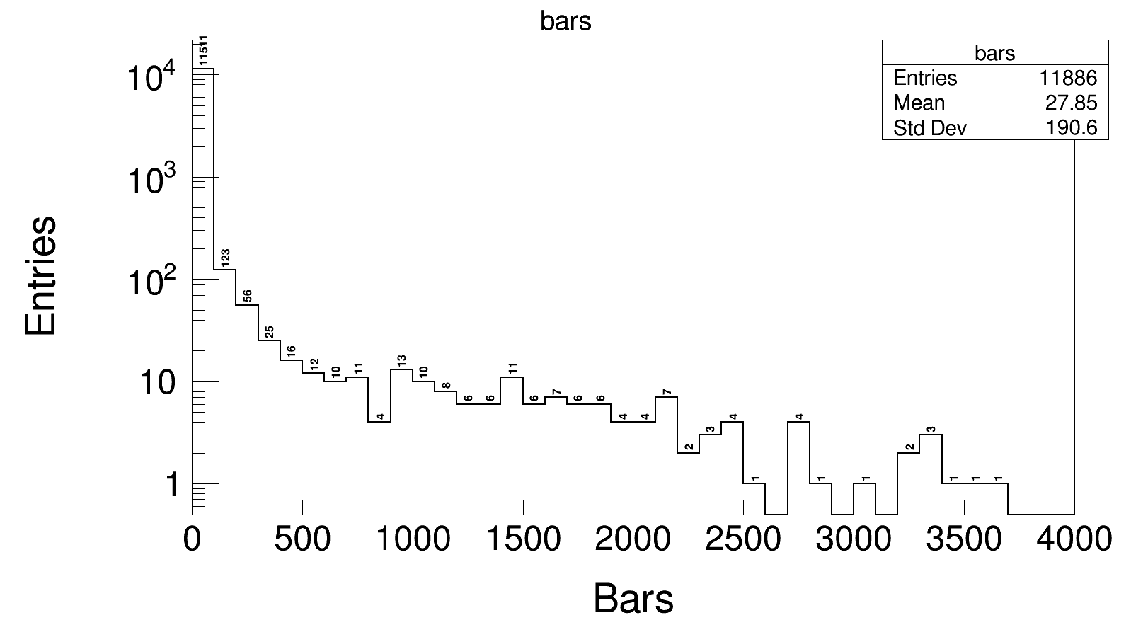
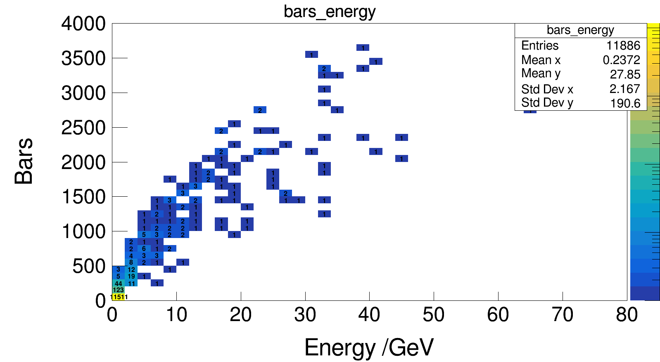
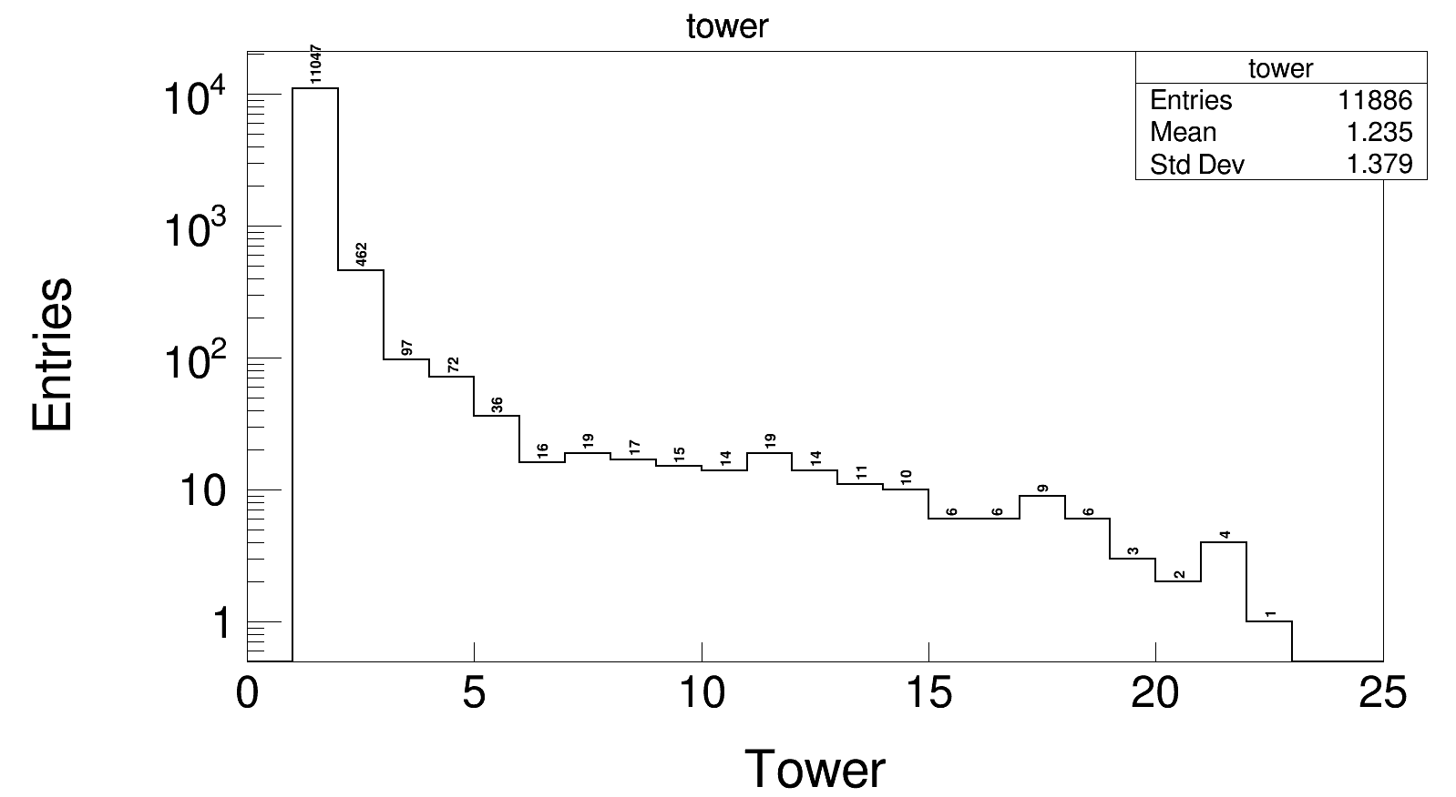
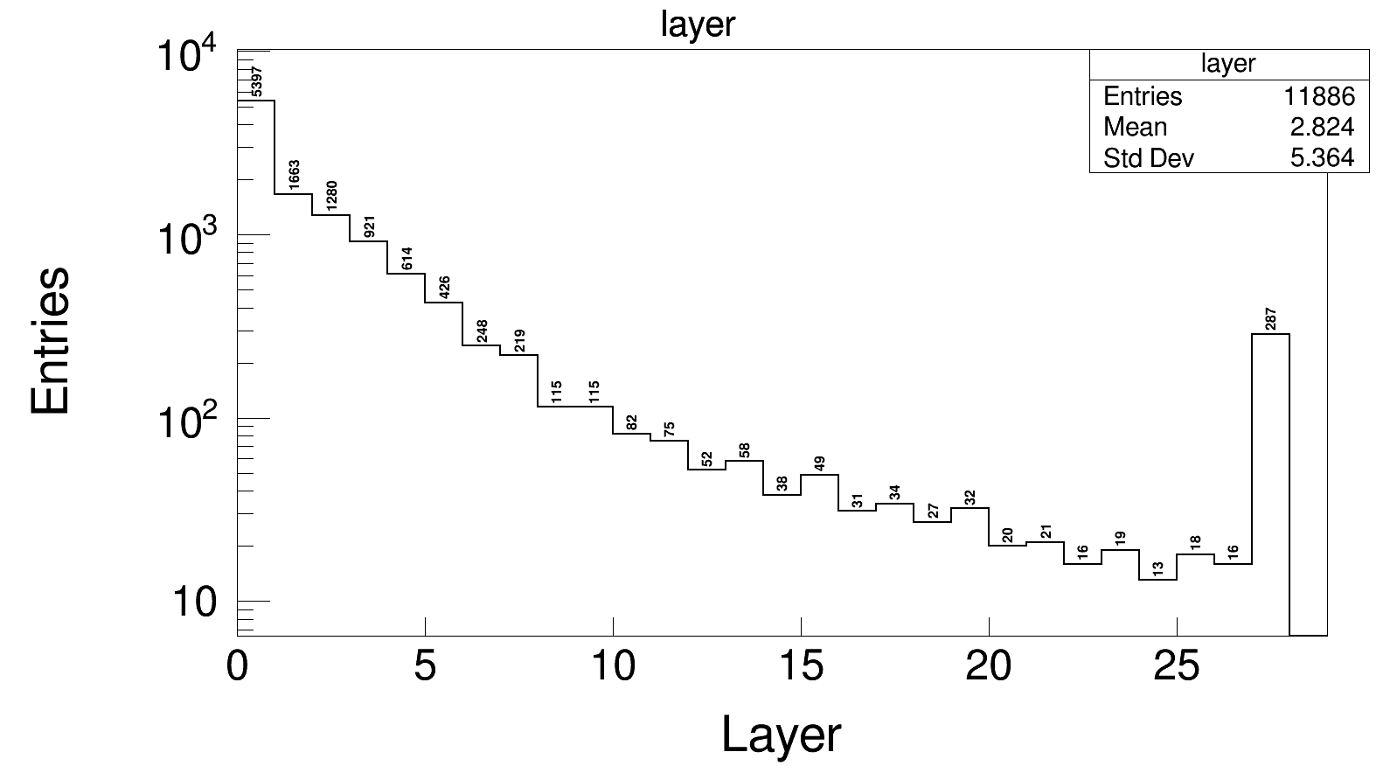
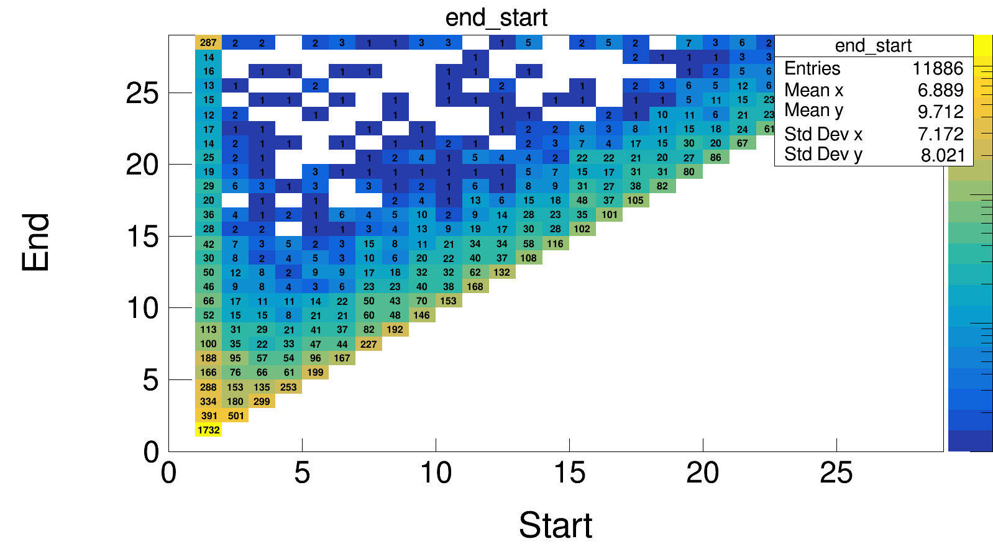
Energy and position information

Slide 14
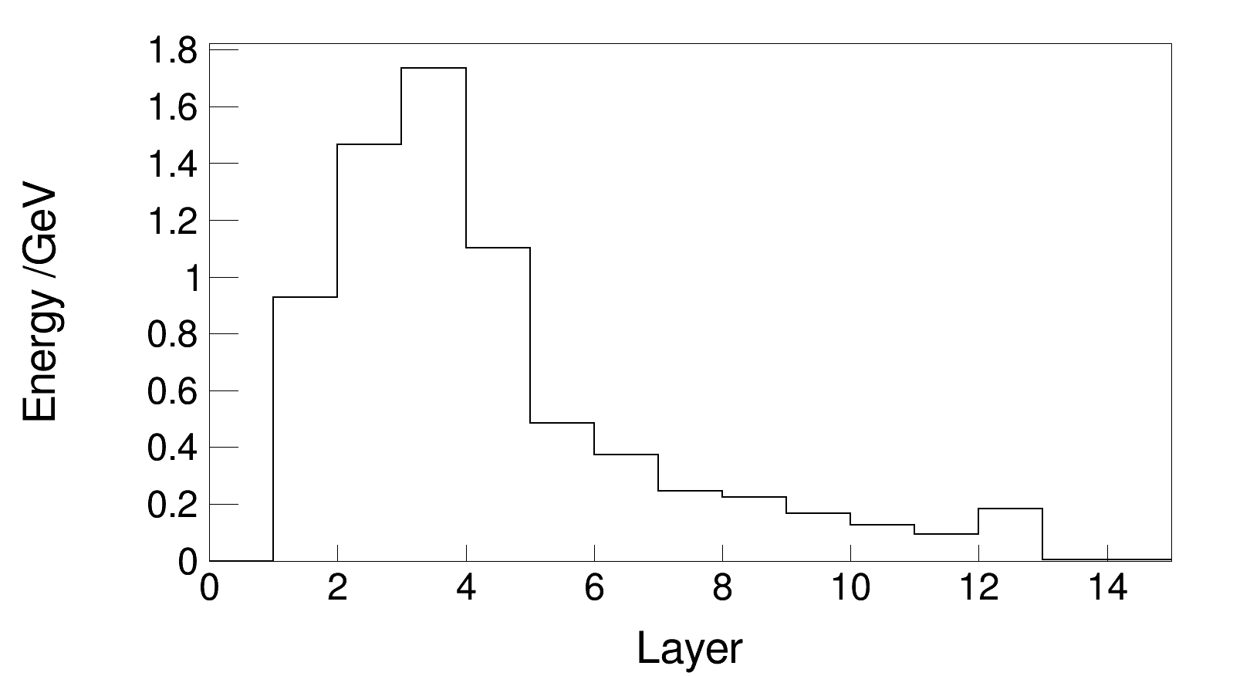
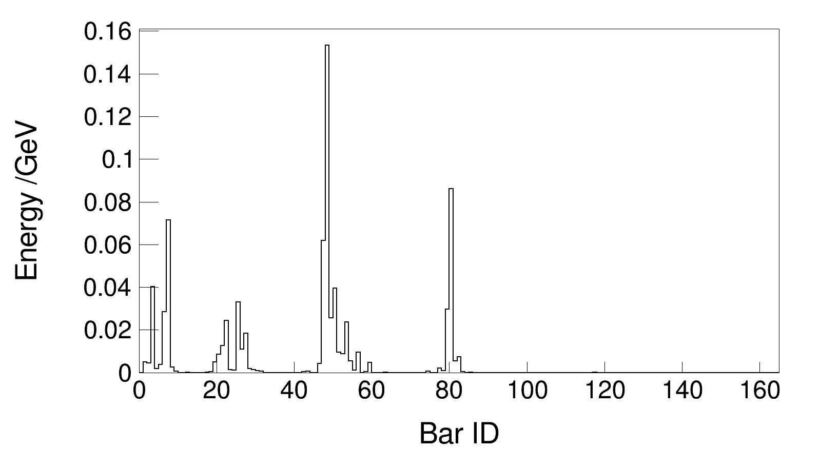
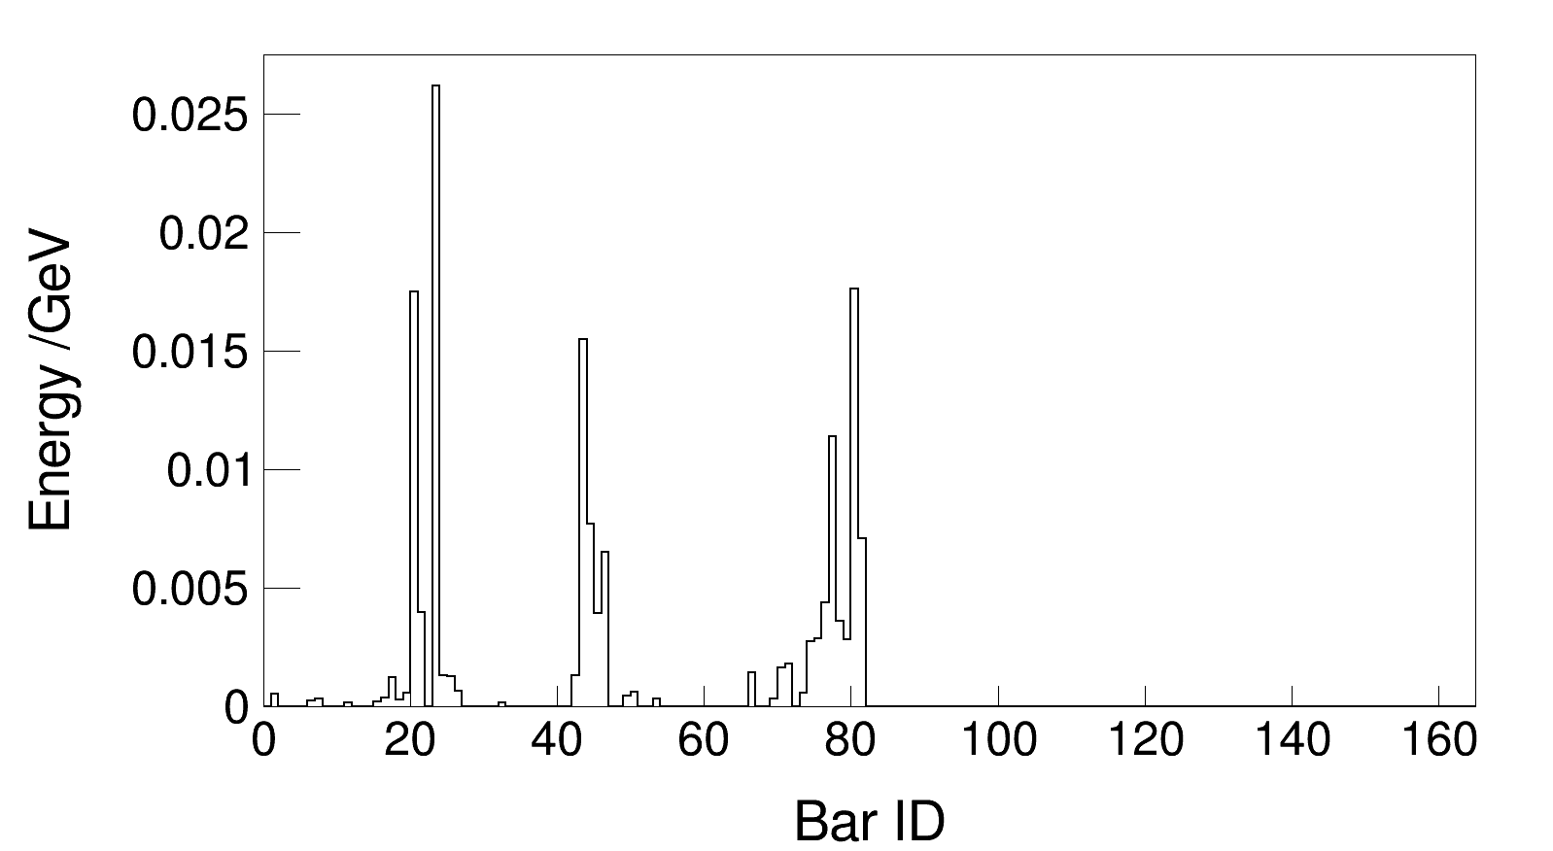
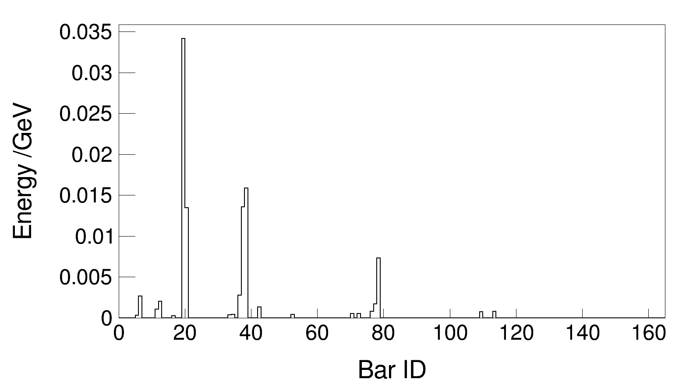
Transverse and longitudinal energy distribution
cluster 258
layer 3
layer 6
layer 9

Slide 15
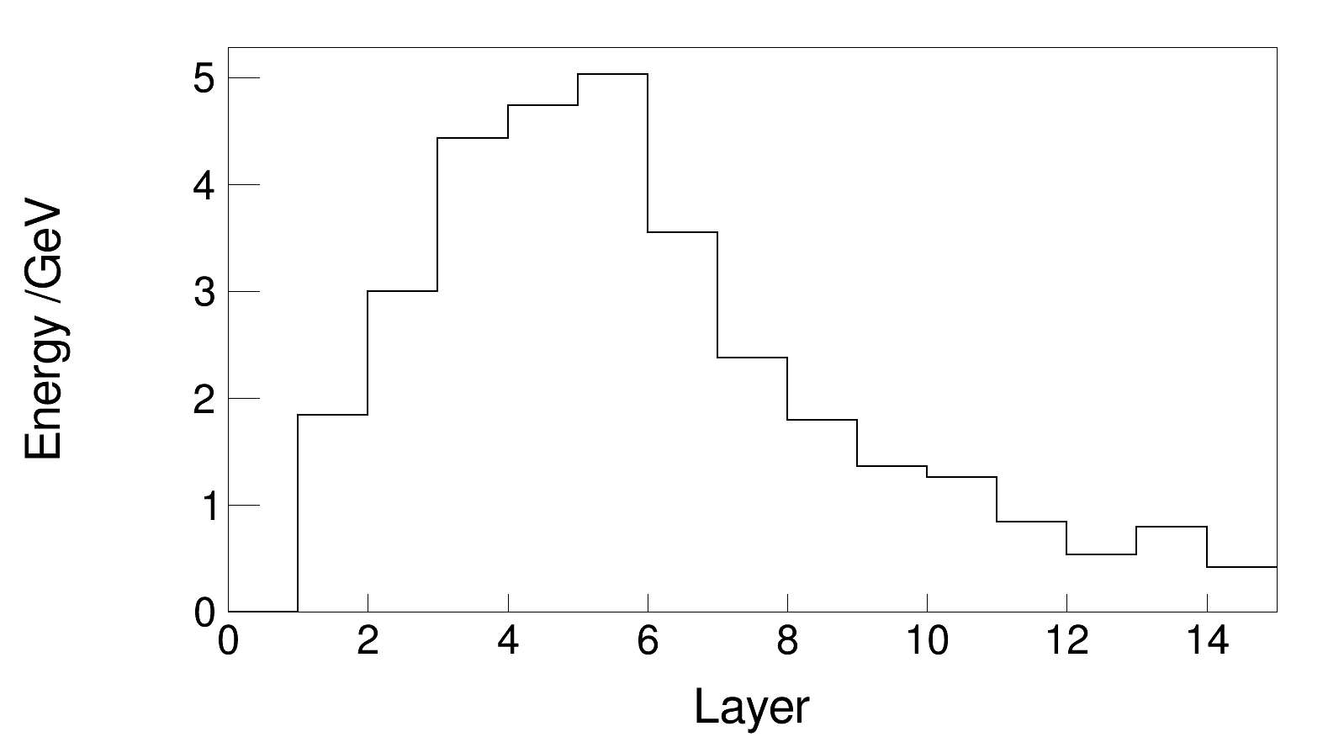
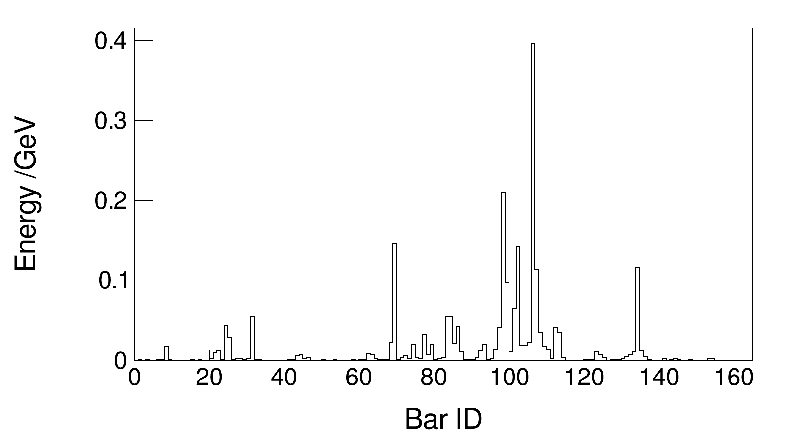
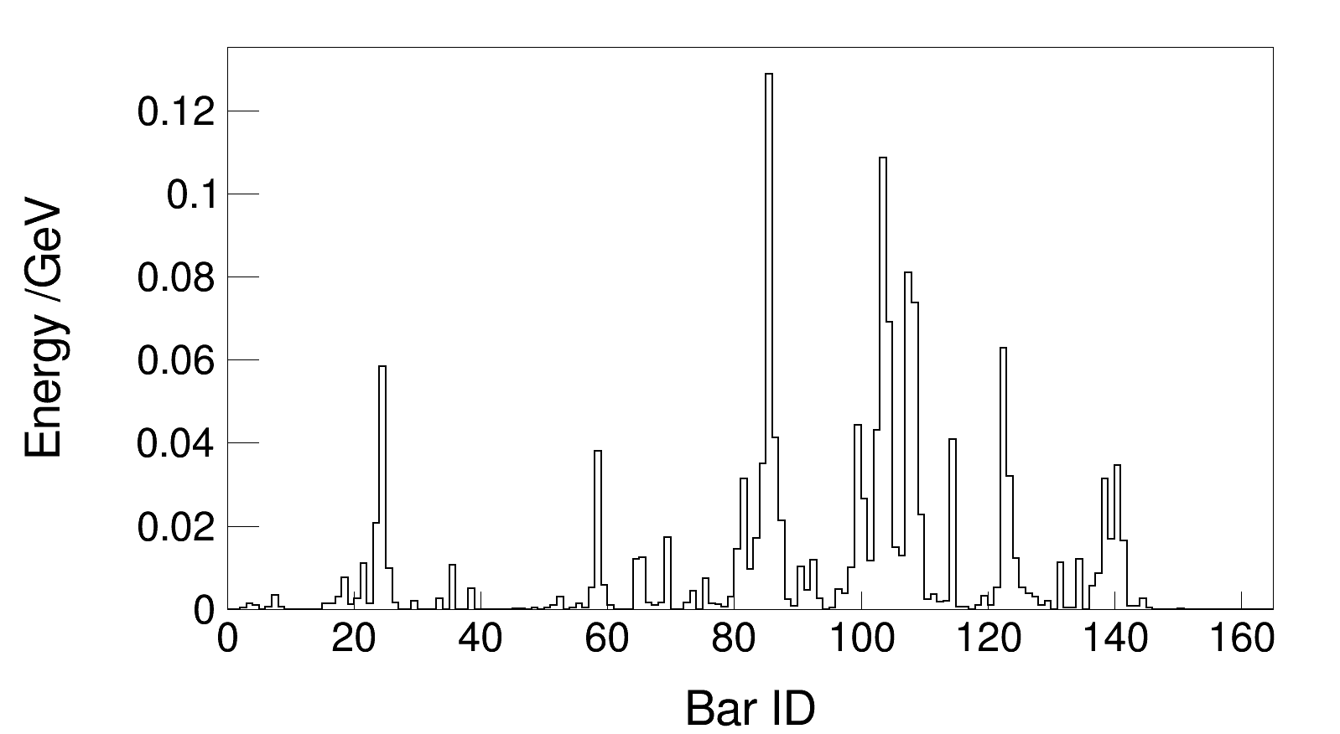
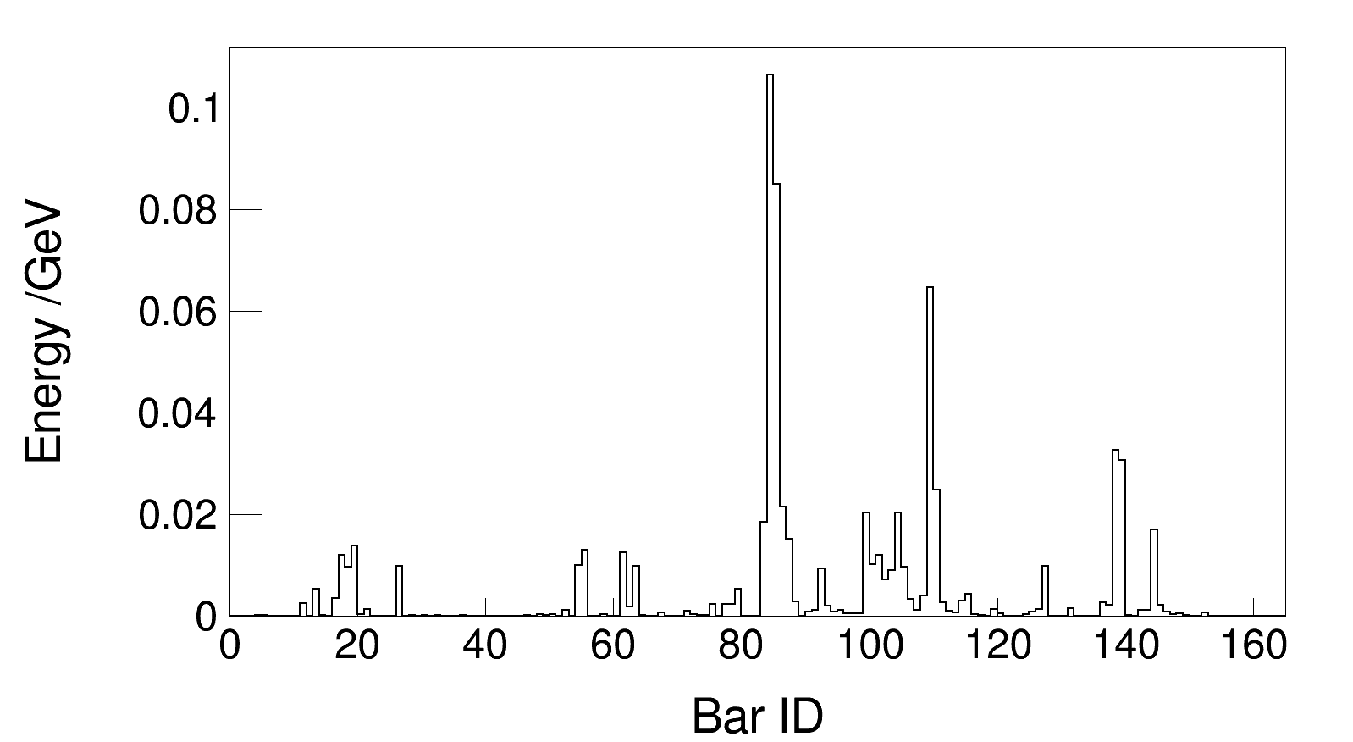
Transverse and longitudinal energy distribution
cluster 260
layer 3
layer 6
layer 9

Slide 16
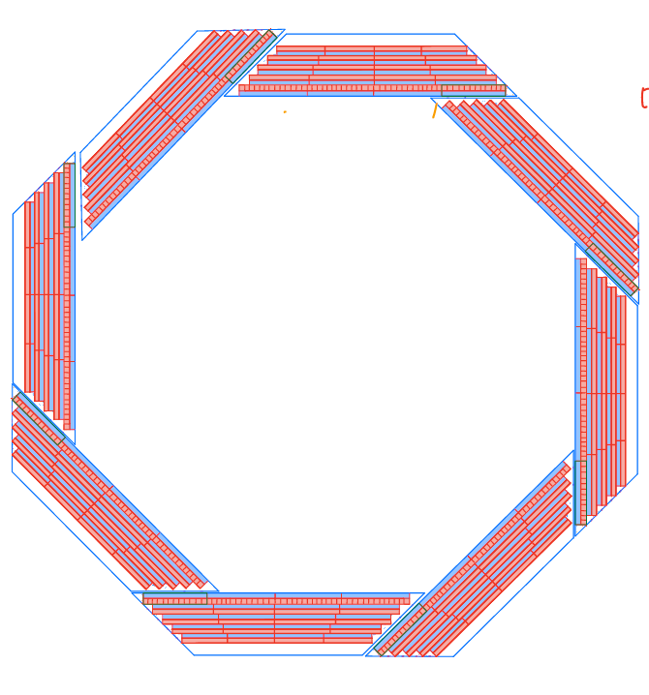
Summary
Design and implementation of clustering for crystal bar ECAL
Physics results of single gamma and two-jet events after clustering
Implementation of clustering for particles between two modules
Thanks!

