Slide 1
CPEC Vertex Detector Prototype Electronics & DAQ design status
JunHu, Hongyu Zhang, Jia Zhou
2022/4/13

Slide 2
Readout structure
interposer
Flex
FPGA
interposer
Flex
Sockets
FPGA
Flex board：Assembled with 10 TAICHU chips, Dual sides readout.
Interposer board：FMC mezzanine rigid and flex board
FPGA board：FMC carrier board

Slide 3
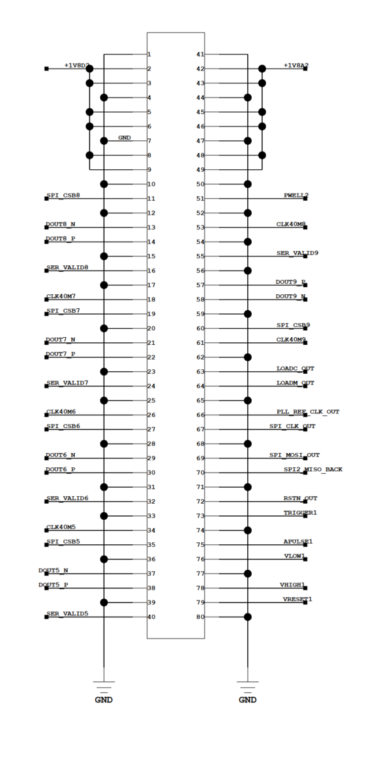
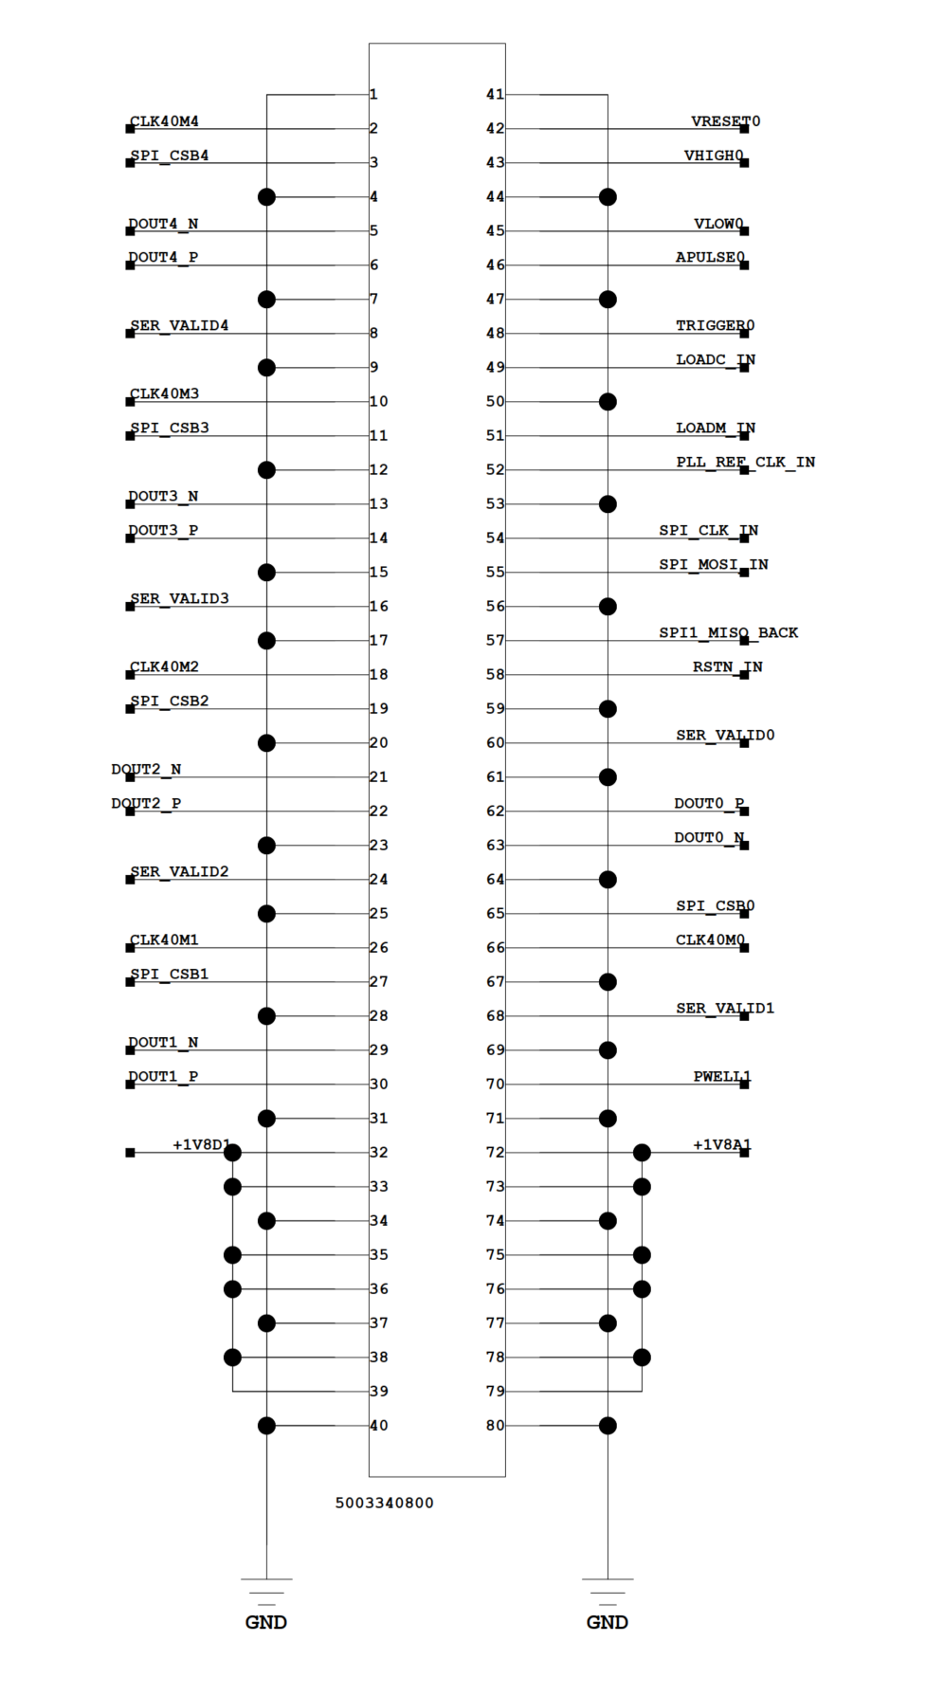
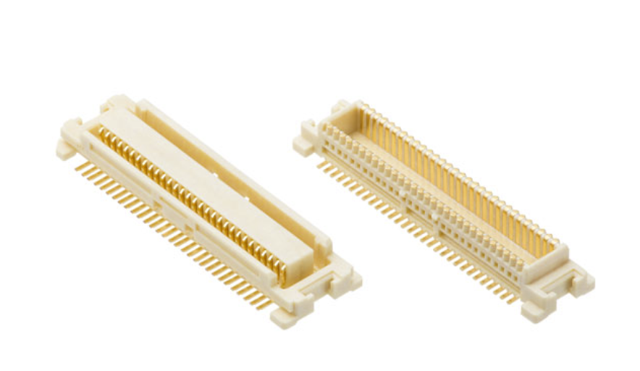
Flex board
External flex
(147.7 X 17.23)
Sensor area(257.6 X 17.23)
External flex
(147.7 X 17.23)
socket
socket
553mm length in total
Socket signal definition
500334-0800
54102-0804
Left
Right

Slide 4
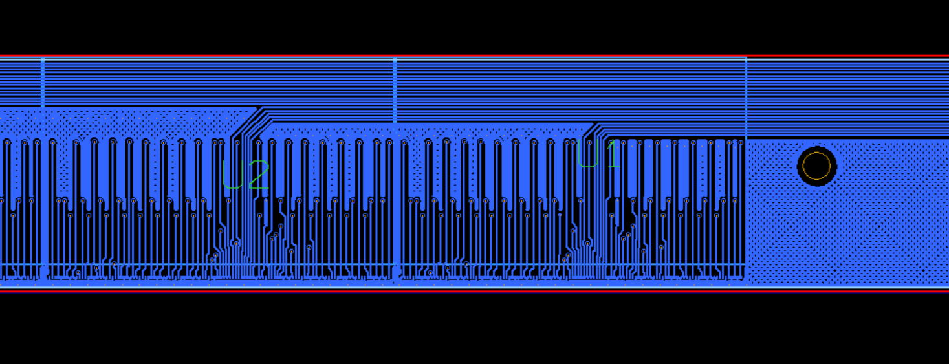
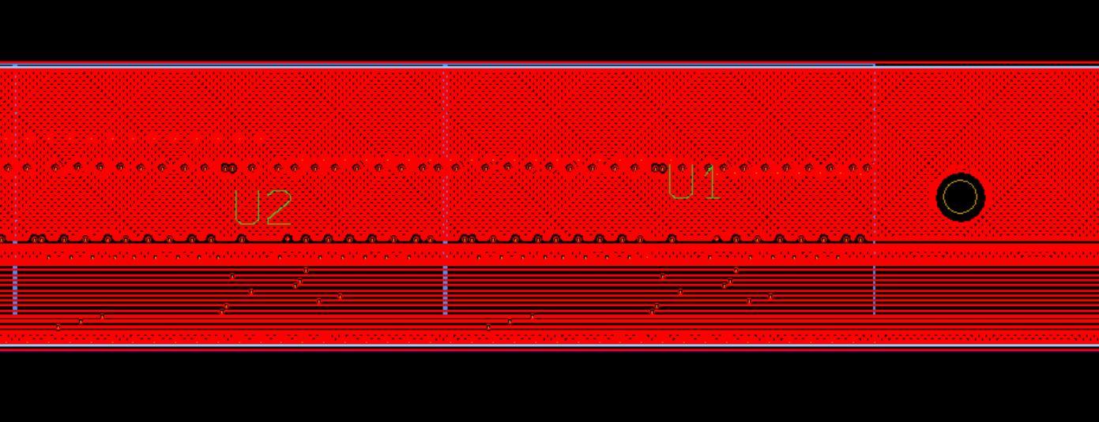
Layout topological
Independent signals（Bonding side）:
CLK40M, SPI_CSB, DOUT_P, DOUT_N, SER_VALID
Shared signals（Bottom side）:
APULSE, TRIGGER, VRESET, VHIGH, VLOW, 7 SPI signals
Power supply
VDDD, VDDA, PWELL, GND
Bonding side
VDDD
VDDA
Bottom side

Slide 5
2 options
Option1
2 layers + stiffener
Inter-conn signal used
worse signal integrity
Noise
Ground bounce
Thickness: ~0.2mm
Option2
4 layers flex + stiffener
Dedicated GND and power plane
better signal integrity
Thickness: 0.38+/-0.08mm
Vdrop: 0.03Ω = (1mmX25.6mmX0.5oz)
VDDD 6mm width, 0.21A * 0.03 / 6 *12.5 = 13mV
VDDA 4mm width，0.21A * 0.03 / 4 * 12.5 = 20mV
GND 2mm width， 0.42A * 0.03 / 2 *12.5 = 79mV

Slide 6
Interposer board
10cm max
F
M
C
LINEAR REGULATOR
Top view
Socket
100X17.23
7cm
Flex
DAC
REF
Voltage Regulator
Sockets
1.6cm
Side view
power supply and filter are placed on rigid area

Slide 7
Power supply
ADP7158ARDZ-1.8(2A)
1.8VD
Requirement:
1.8VDDA ≈ 0.21A
1.8VDDD ≈ 0.21A
PWELL (-6V – 0)
VRESET, VHIGH, VLOW from DAC
LMZ12003
(3A)
+12V
+2.3V
ADP7158ARDZ-1.8(2A)
1.8VA
+12V
LT1054ISW
(100mA)
PWELL
+3V3
DAC80004
VRESET, VHIGH, VLOW,

Slide 8
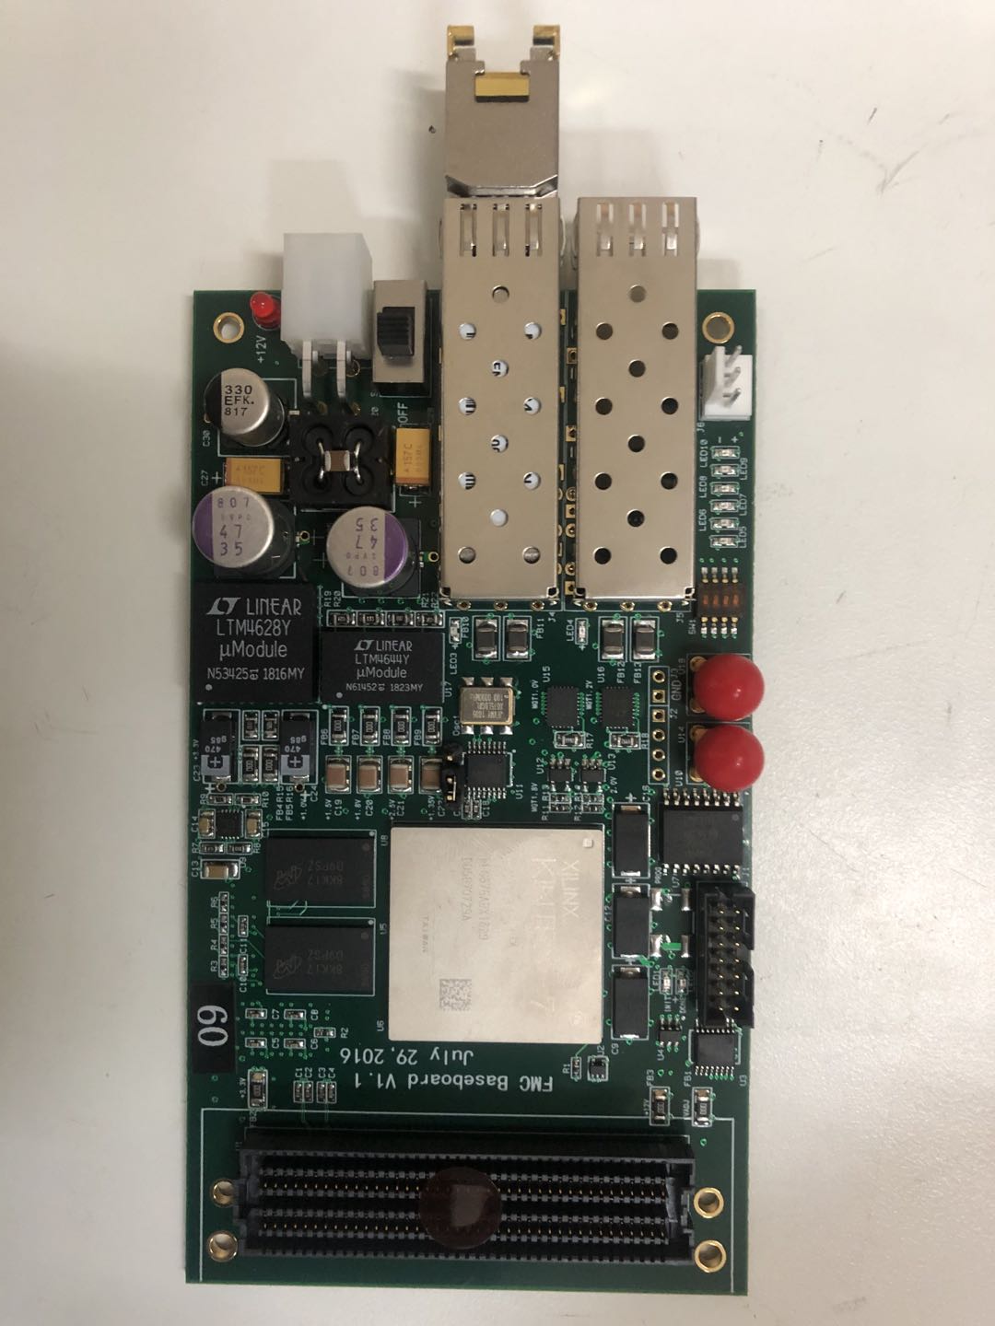
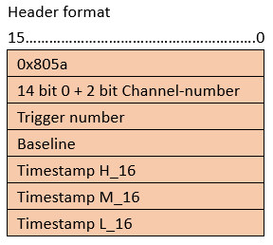
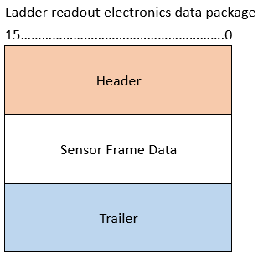
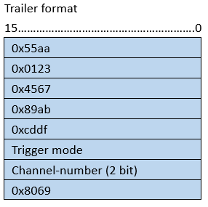
FPGA board
FMC standard
ASP-134606-01: 8.5mm height
1Gbps Ethernet to PC
Data Readout：TCP/IP
Configuration：UDP
FPGA board
To be defined
Data Format

Slide 9
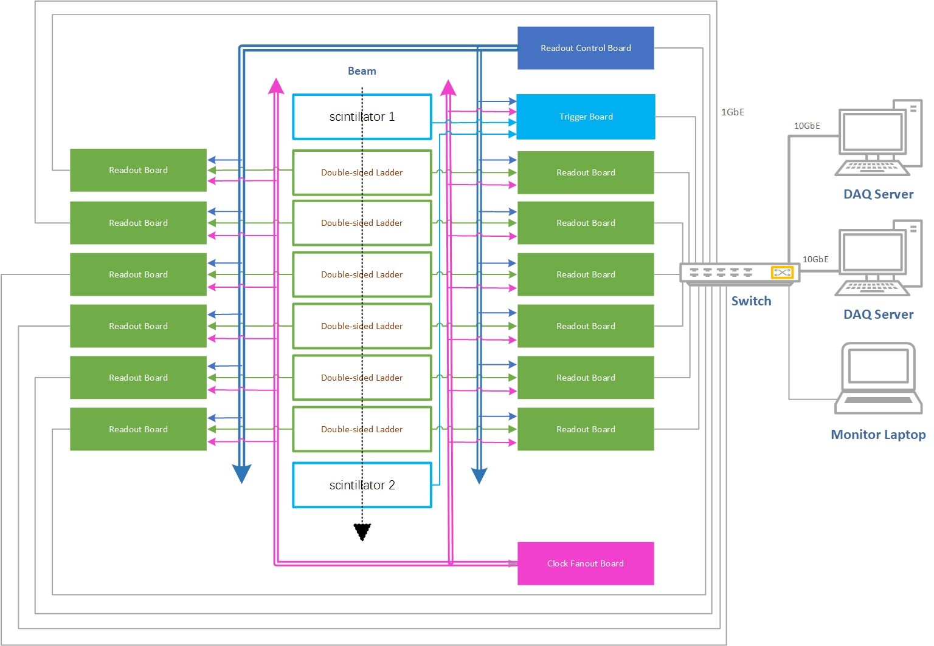
Architecture of CEPC Vertex Detector Prototype
Front End Electronics:
Readout Board: x12
Readout Ladder electronics data
Clock Fan-out Board: x1
Fan-out common clock signal to each readout board
Readout Control Board: x1
Fan-out common reset / common start / common stop signals to each readout board
Synchronize global timestamps of each readout board
Trigger Board: x1
Provide timestamp of Scintillator trigger signal

Slide 10
Schedule
Flex boards:
Finished design
In production ~ 2-3 weeks
Interposer board:
Under design ~ 2 weeks
FPGA board and fanout board:
18 FPGA boards and 2 fanout board are ready.

