Slide 1
SYNTHESIS, STRUCTURE AND CONDUCTIVITY OF NOVEL ANTIPEROVSKITE Na₃(H)(SO₄) AND Na₃(NH₂)(SO₄) AS SOLID ELECTROLYTES IN BATTERIES
KOEDTRUAD Anucha

Slide 2
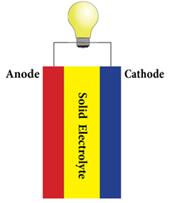
All-solid state batteries
A solid electrolyte is considered a key factor for efficient all-solid stae batteries
Required properties for solid electrolytes
Cathode
Solid Electrolyte
Anode
High bulk ionic conductivity
(> 10⁻⁴ S/cm)
Compatibility with a positive electrode and negative electrode
Stability against ambient atmosphere and high voltage
Low electronic conductivity
Cathode
Anode
Ref: Wu, B.; Wang, S.; Xiao, J. J. Mater. Chem. A, 2016, 4, 15266 - 15280.
2

Slide 3
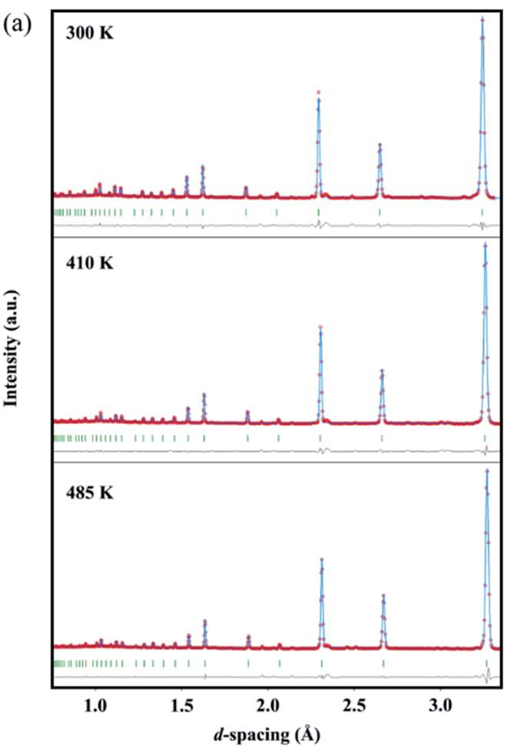
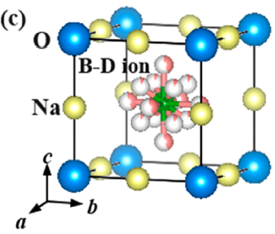
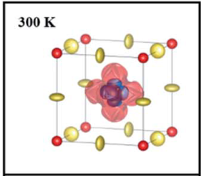
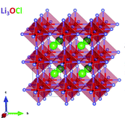
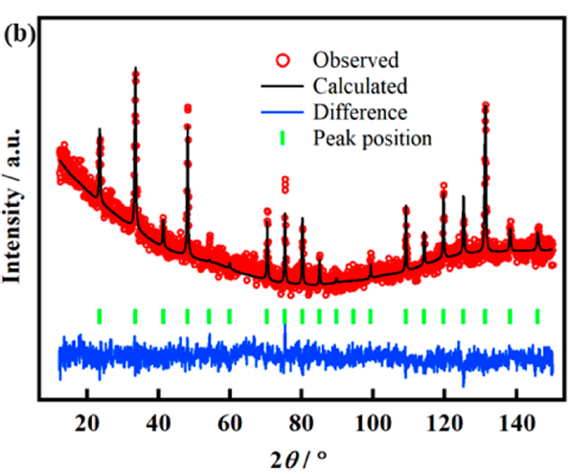
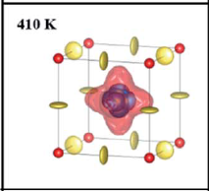
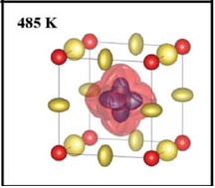
Solid Electrolytes
Rotational dynamics of cluster anions facilitate ionic mobility
Na₃OX
(X = Cl, Br, BH₄, NO₂, SO₄)
Na₃OBH₄
Na₃ONO₂
Ref: J. Am. Chem. Soc. 2019, 141, 5640−5644
The reported results are limited with oxide-based antiperovskites.
Ref: J. Mater. Chem. A, 2020, 8, 21265–21272
3

Slide 4
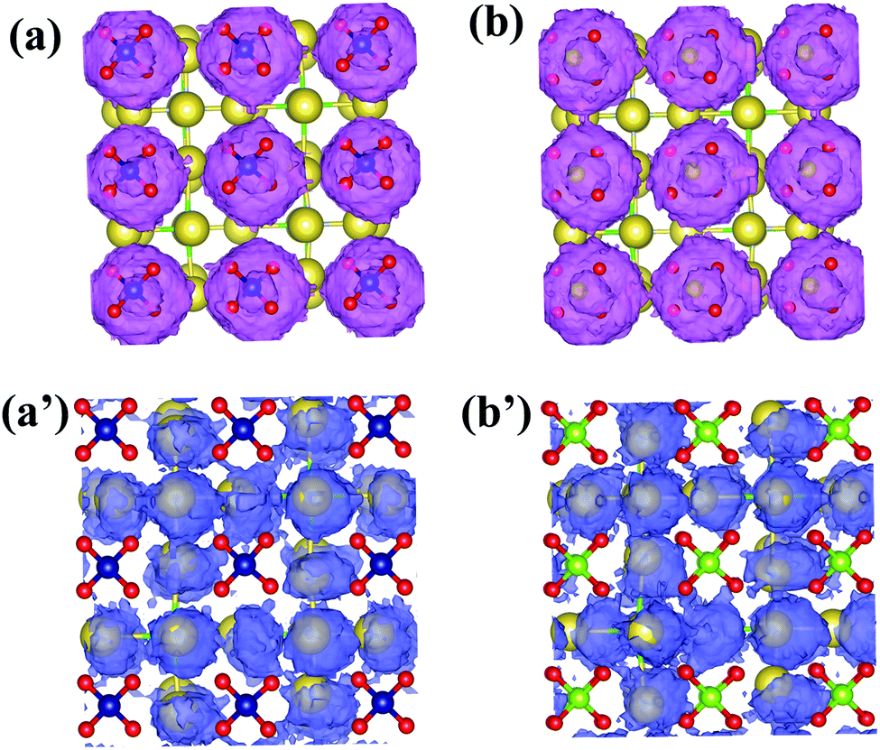
Solid Electrolytes
Na₃(F/Cl)(SO4)
Calculated E_{a} and conductivity of Na₃(F/Cl)(SO₄)
 | E_{a} (eV) | σ (mS/cm) at 300 K
Na₃(F_{0.5}Cl_{0.5})(SO₄) | 0.21 | 1.086
Na₃(Cl)(SO₄) | 0.2 | 2.328
[1] J. Mater. Chem. A, 2019, 7, 21985
[2] Energy Storage Materials, 2020, 31, 87-94
Stable structure and good Na-conductivity
- Ionic size
- Weak ionic H-Na bond
- Local dynamics of H
This work
Novel Na₃(H)SO₄ and Na₃(NH₂)(SO₄) antiperovskites
4

Slide 5
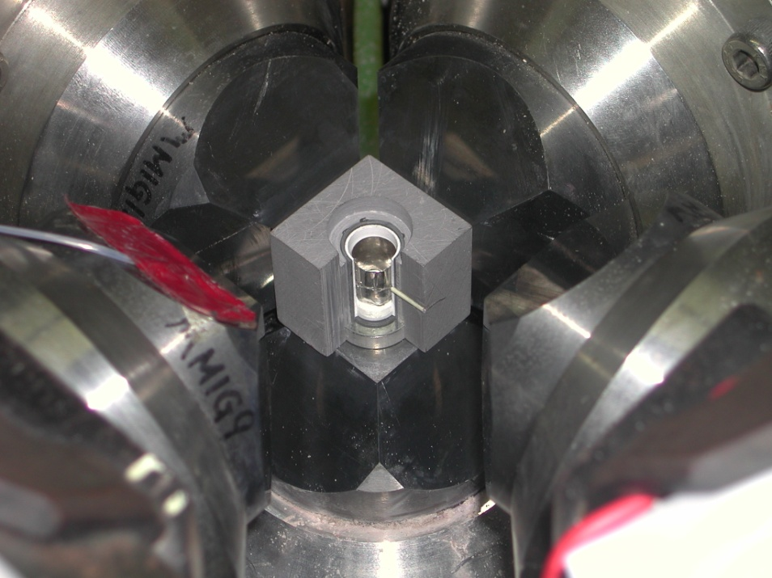
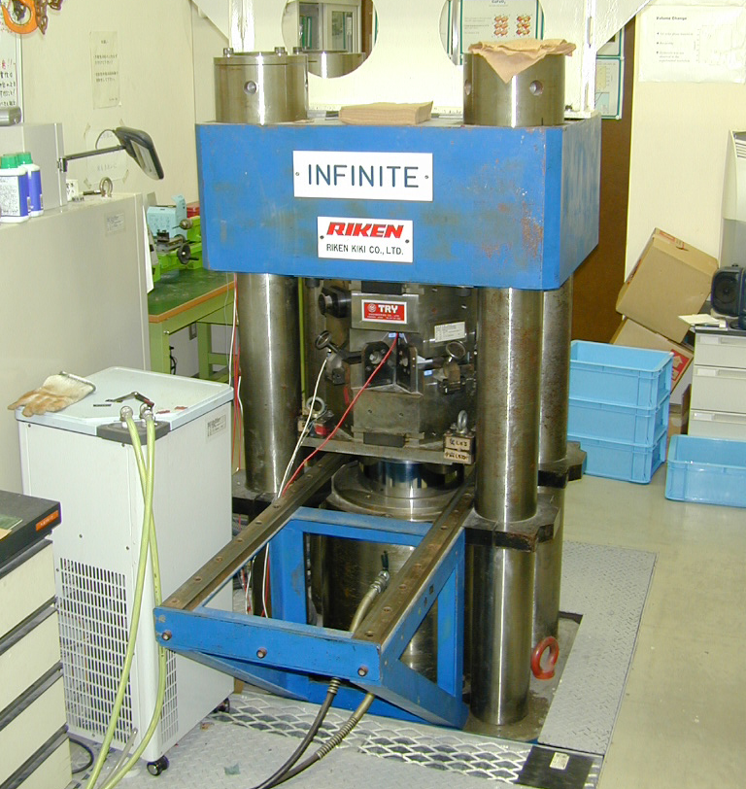
Materials Synthesis and Characterization
Synthesis
High Pressure High Temperature Technique
1 GPa
200 – 400 C
NaNH₂/NaH
Na₂SO₄
Characterization
-Phase identification by laboratory XRD,
-Detailed structure analysis by synchrotron XRD and neutron diffractometry
-Conductivity by impedance spectroscopy
5

Slide 6
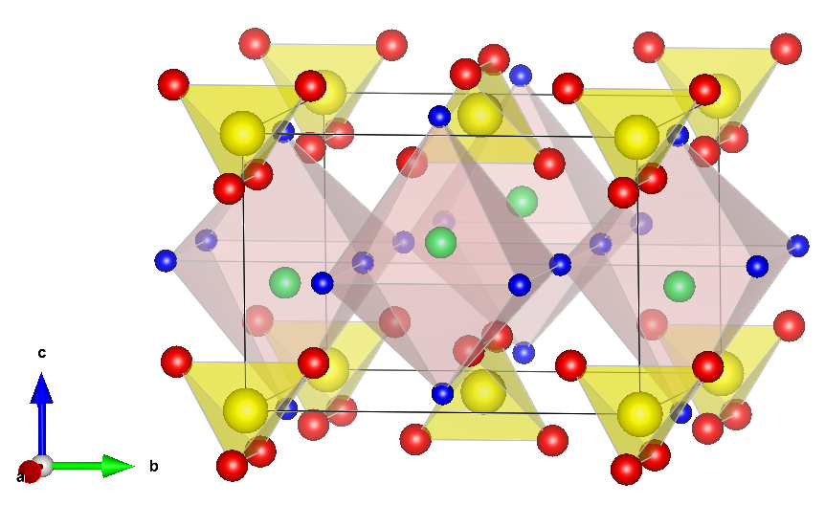
Structure analysis with synchrotron XRD data
Proposal No. | 2021B1437
Proposal Title | Study of the structure behavior of Na-ion conducting Na₃(H)(SO₄) and Na₃(NH₂)(SO₄) antiperovskites
Beamline | BL02B2 at SPring-8, Japan
Na
SO₄
Na₃(H)(SO₄)
Tetragonal, P4/nmm
H/NH₂
Na₃(NH₂)(SO₄), Tetragonal, P4/nmm
R_{wp} = 11.67
Na₃(H)(SO₄) = 88% wt
Na₂SO₄ = 12%wt
R_{wp} = 13.69
Na₃(NH₂)(SO₄) = 96% wt
Na₂SO₄ = 4%wt
Typical RT SXRD patterns of Na₃(H)(SO₄) and Na₃(NH₂)(SO₄), and their refinement results
6

Slide 7
Structure analysis with synchrotron XRD data
Both compounds are thermally stable: Na₃(H)(SO₄) ~ 207 C, Na₃(NH₂)(SO₄) ~147 C
Na₃(H)(SO₄)
Na₃(H)(SO₄)
207 ºC
187 ºC
167 ºC
147 ºC
127 ºC
107 ºC
Na₃(NH2)(SO₄)
87 ºC
67 ºC
47 ºC
27 ºC
Typical temperature-variable SXRD
Temperature-dependent lattice parameters of the compounds
7

Slide 8
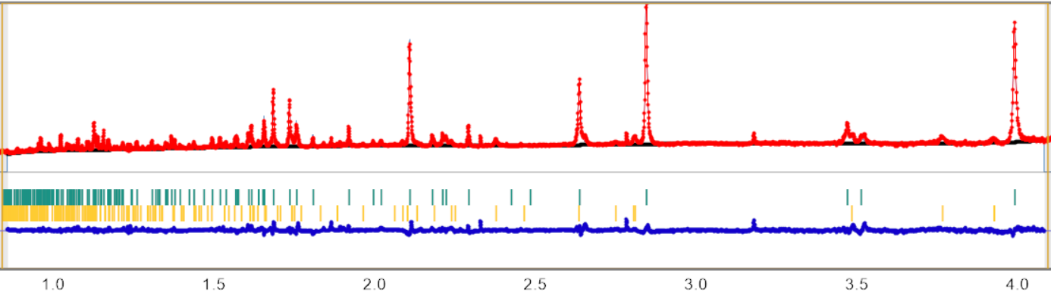
Structure analysis with neutron diffraction data
Proposal No. | 2022A0055
Proposal Title | Study of the H and NH₂ dynamics in Na₃(H)(SO₄) and Na₃(NH₂)(SO₄) antiperovskites as solid electrolytes for Na-ion batteries
Beamline | BL-09 SPICA at J-PARC
Na₃(H)(SO₄): RT and 200 C
Na₃(H)(SO₄): RT and 150 C
R_{wp} = 3.75
Na₃(H)(SO₄), RT
Tetragonal, P4/nmm
Na₃(H)(SO₄) = 91% wt
Na₂SO₄ = 9%wt
Na
SO₄
d
H
MEM analysis will be implemented to get visualization of Na, H and NH₂ dynamics
Correlation between H/NH₂ dynamics and Na-mobility will be discussed with NPD
8

Slide 9
Summary
Novel Na₃(H)(SO₄) and Na₃(NH₂)(SO₄) have been studied for solid electrolytes in batteries
The compounds were successfully prepared by a high pressure high temperature technique
Their phases and detailed antiperovskite structure were confirmed with SXRD and NPD techniques
The compounds show good thermal stability
The ionic conductivity will be next measured, and the conduction pathway/mechanism and structure-property relationship will be discussed with SXRD and NPD data
9

