Slide 1
Performance study of cross-crystal Fan Ecal for CEPC & Silicon module assembly for HGCAL upgrade
Xiao Zhao (Institute of High Energy Physics, CAS)
Supervisor：Huaqiao Zhang, Yong Liu
30/06/2022

Slide 2
Outline
Performance study of cross-crystal Fan (CCF) Ecal
  Basic concept
    Performance with CCF ECAL
    Section summary
HGCal silicon module assembly and QA/QC
    Introduction
        Module assembly and QA/QC at IHEP lab
        Sensor testing
    Section summary
Summary

Slide 3
Performance study of cross-crystal Fan(CCF)Ecal
  Basic concept
    Performance with CCF ECAL
      Energy resolution
      Separation power of close-by particles
        separation method
            γ/γ separation
            γ/π⁻ separation
    Boson mass resolution
    Ghost Hit in CCF design
    Section summary

Slide 4
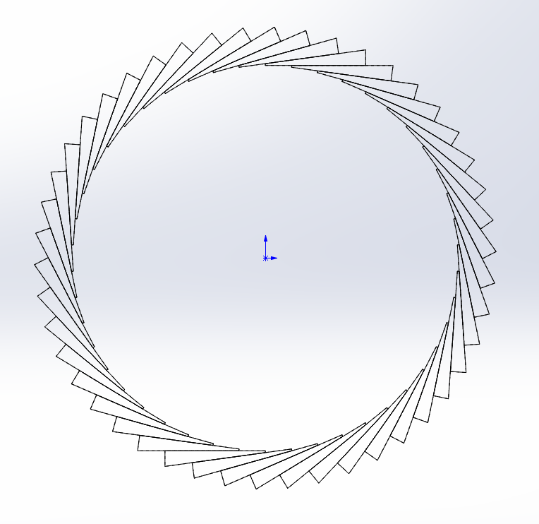
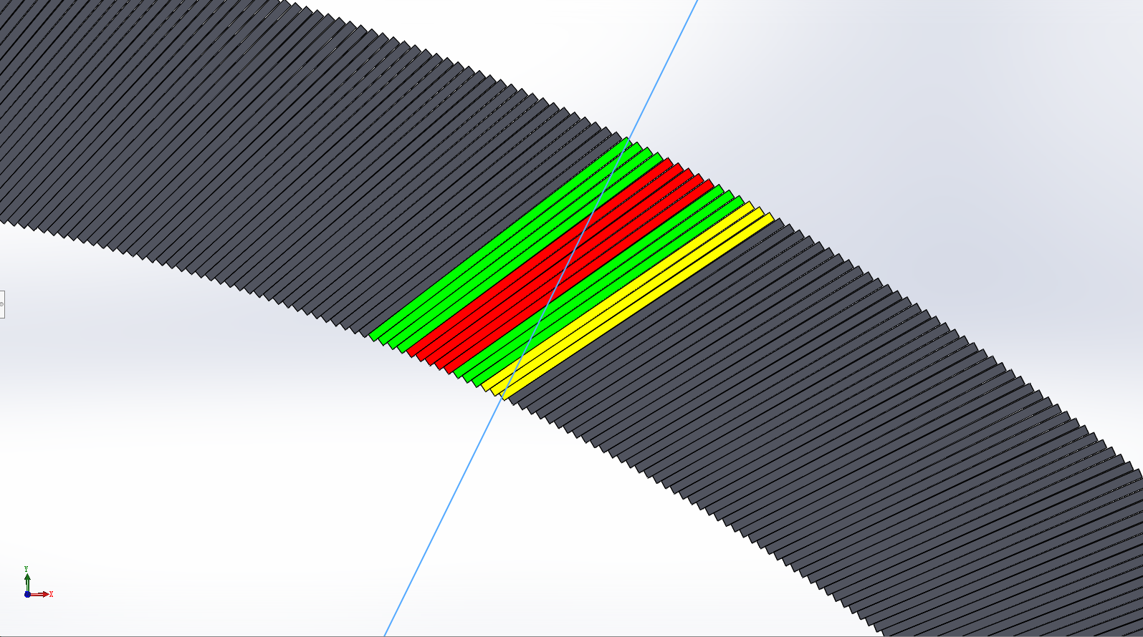
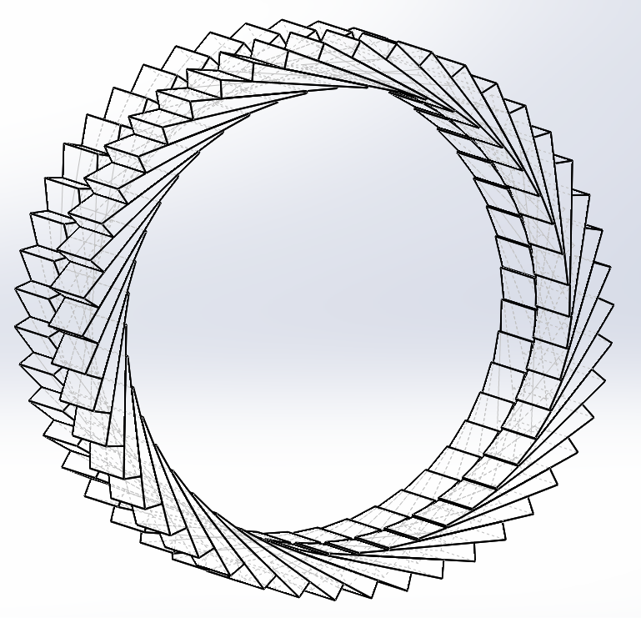
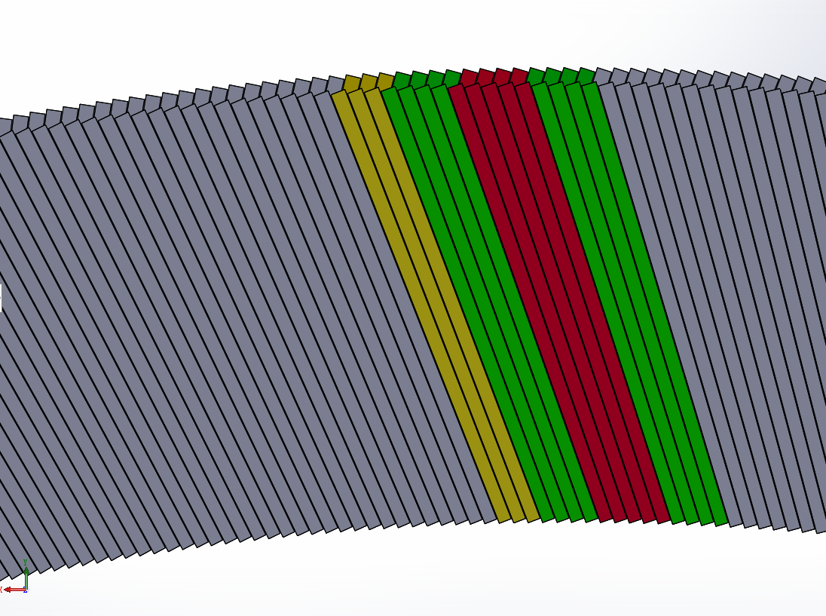
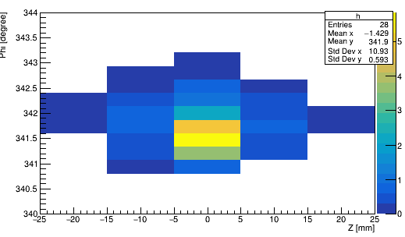
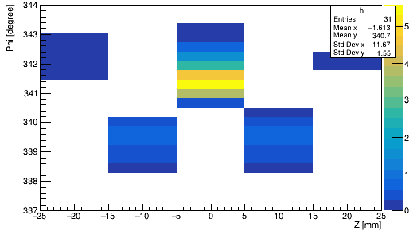
Basic concept
alpha
Alpha = 30 °
14 layers
Alpha = 20 °
10 layers
D
r1
φ
r2
cross-crystal Fan
crystal Fan
Crystal not pointing back to IP (Z axis)
  Angle with inner det. radius is alpha
  alpha <= 90°
  Transverse Segmentation
    Different number of layers
  Uniform along Z
  Fine segmentation of Z, Phi, r
  2D readout in Z, Phi plane, reduced readout electronics channels
  r2 = 1.9 m, r1 = 2.2 m
To improve the phi resolution accuracy:
  Crossing even and odd modules
  Odd layer： alpha’= -alpha
  Simulation and reconstruction done using CEPCSW
    Geometry implemented by Chengdong FU
    Simulation readout using carloStep info (no digitization)
    Reconstruction code initially provided by Fangyi Guo
    Development and reconfiguration by Huaqiao Zhang and X. Zhao
Cited : Huaqiao Zhang, New idea of Crystal fan(晶扇) Ecal for CEPC
Huaqiao Zhang, Energy/position resolution of Crystal Fan Ecal for CEPC
Notes:
The basic unit is a wedge-shaped crystal

Slide 5
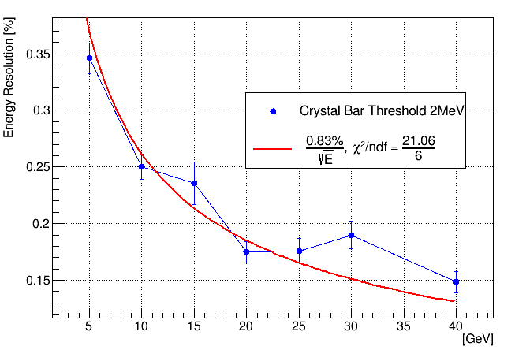
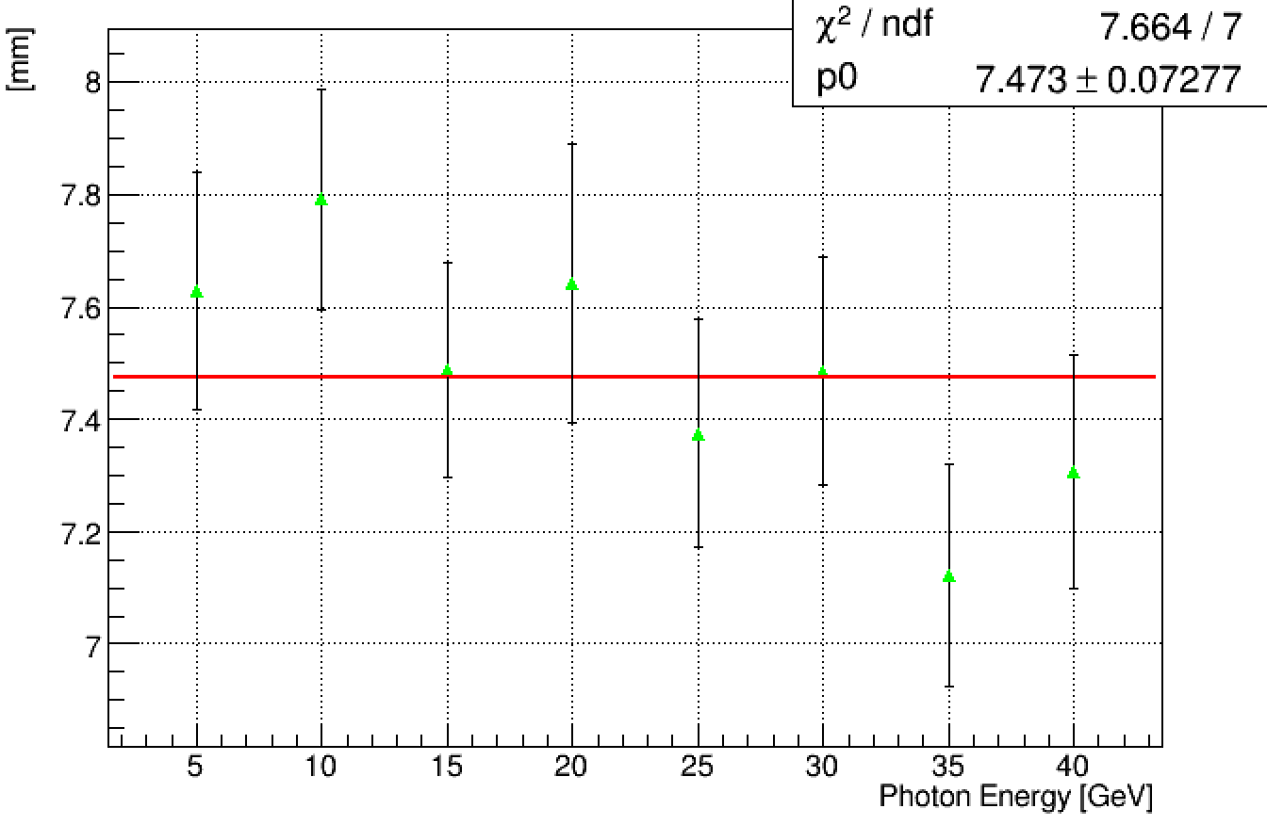
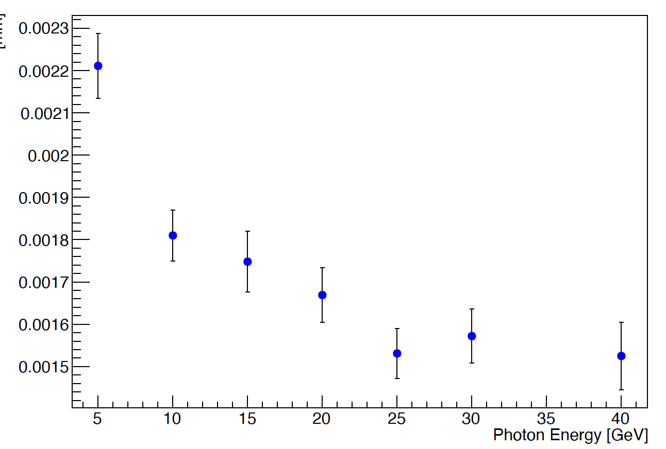
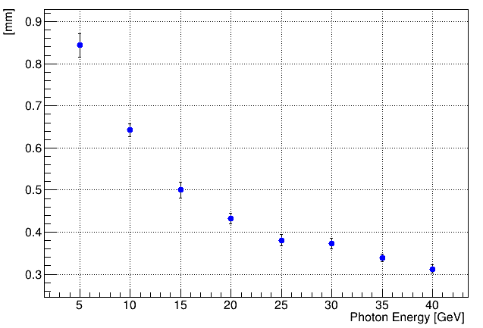
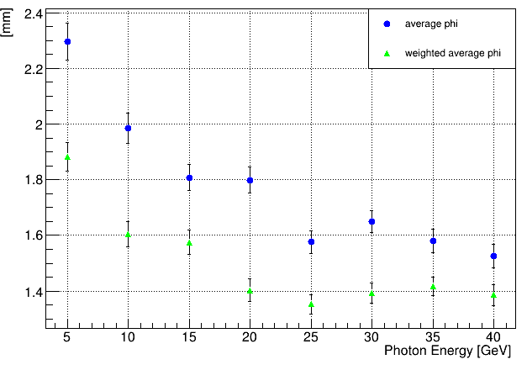
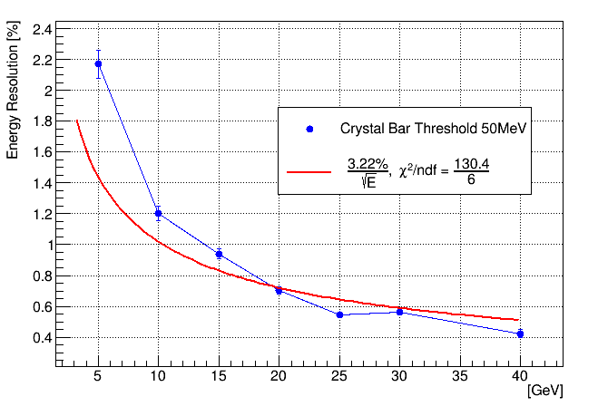
Energy resolution
Good performance: 5GeV gamma, phi: 10~350°, theta: 90°
  Z resolution ~ 0.84 mm
  Phi resolution ~ 1.9 mm
  R resolution ~ 7.6 mm
  related to crystal bar threshold
The following plots are done with event generated using
cross-crystal fan Ecal with 10 layers
E resolution
E resolution with gaus. fit
R resolution
Threshold：0.1MeV
Z resolution
Phi resolution
E resolution

Slide 6
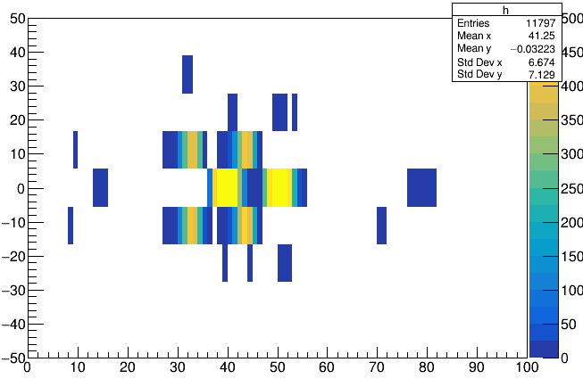
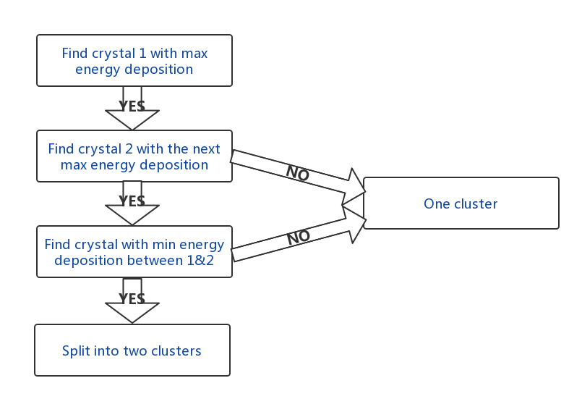
Separation method
For each module (along Z):Find two locations with maximum energy deposition and separate them by the minimum value between them
Merge individual modules
Z
two 5GeV γ
Phi

Slide 7
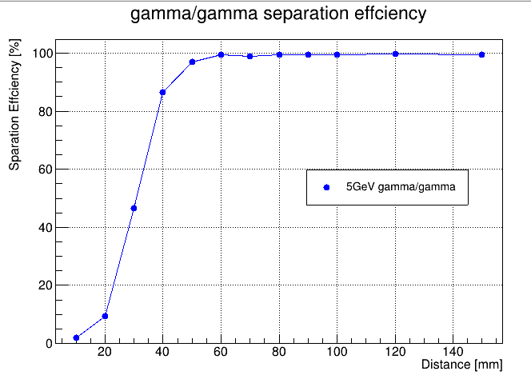
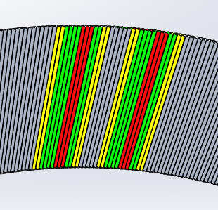
γ/γ separation
Two 5 GeV gammas, vary distance in between
Success reconstruction: 2 neutral particles, 3.3GeV<E_{gamma}<6.6GeV for each gamma
Threshold: 2MeV
two γ from IP

Slide 8
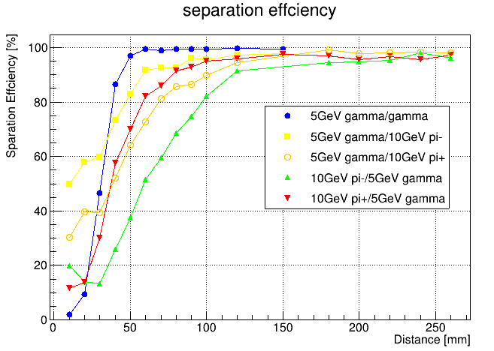
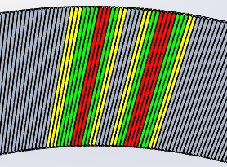
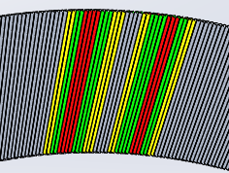
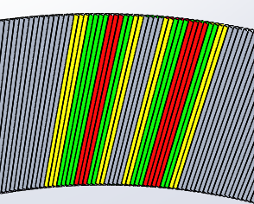
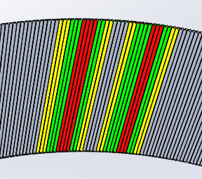
γ/π separation
5 GeV γ/10GeV π, vary distance in between
Success reconstruction: 3.3GeV<E_{gamma}<6.6GeV
Different π/γ separation power: geometry/ magnetic field
Optimize reconstruction method
γ
π+
π+
γ
Threshold: 2MeV
γ
π-
π-
γ

Slide 9
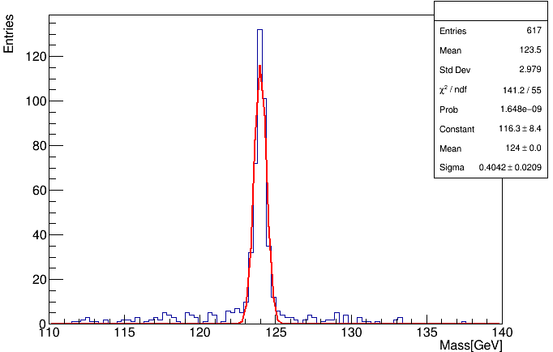
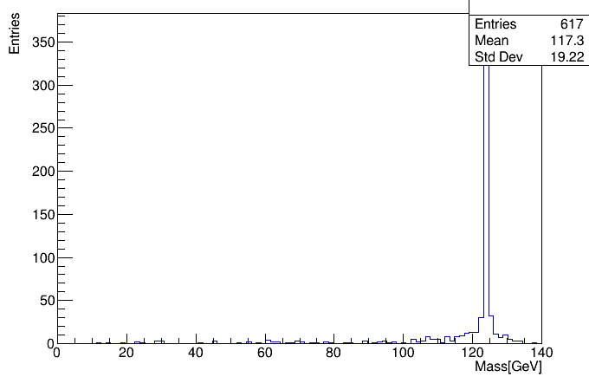
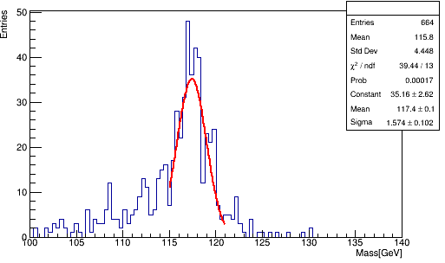
Boson mass resolution
ZH->gamma/gamma + 2 neutrinos at 240 GeV
Success reconstruction:
  Crystal bar energy threshold: 2 MeV/50MeV
    10° < Phi <350° to avoid affect of geometry
  Two particles
BMR = 0.33%
Threshold: 2MeV
BMR = 1.3%
Threshold: 2MeV
Threshold: 50MeV

Slide 10
Ghost Hit in cross-crystal Fan design
R
Confusion of red hit with yellow ones
Happens only in small phi/R range
  R-range: 0-30CM
  Phi-range: ~ - 4.5 cm - +4.5 cm (10 layer)
Large probability have hits in middle shower depth, small chance to have hits in small or large shower depth
Big energy deposited in middle shower depth hit, small in small or large shower depth
If ghost hits happens
  largest change of phi: ~4.5 cm,
  largest change of R: ~15cm
Huaqiao Zhang
Phi
Phi range
Not yet estimated, but should be very small chance to have ghost hit have big impact

Slide 11
Section summary
Present the resolution of single photon shower
  Z resolution ~ 0.84 mm
  Phi resolution ~ 1.9 mm
  R resolution ~ 7.6 mm
  related to crystal bar threshold
  Quantify γ/γ and γ/π separation based on cross-crystal Fan Ecal
  Good separation effciency of γ/γ
  Optimize γ/π⁻ separation effciency
Boson Mass Resolution
  Related to the reconstruction method and threshold
Next step：
  Optimize reconstruction method
  Preparations for beam tests：Detector module design
  Event Display
  Many technical support needed.....

Slide 12
Silicon module assembly and QA/QC for HGCAL
    Introduction
    Module assembly at IHEP lab
    QA/QC
    Sensor testing
    Section summary

Slide 13
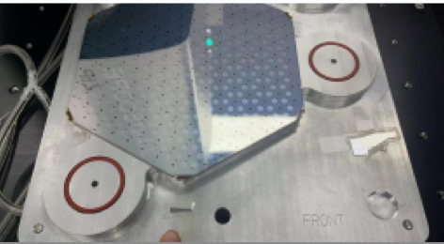
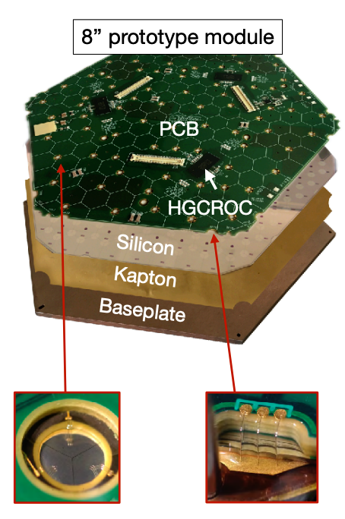
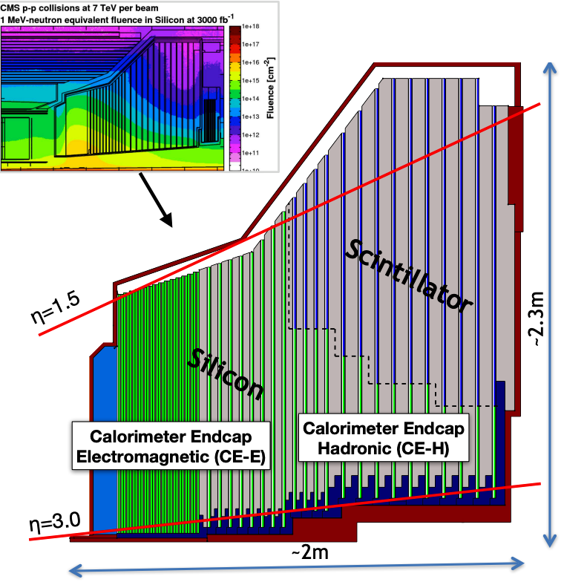
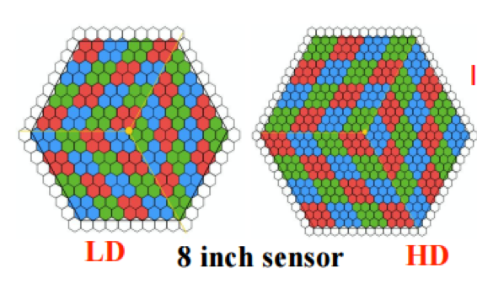
Introduction
In order to meet the requirements of the HL-LHC particle flow calorimeters require high granularity
The High Granularity Calorimeter (HGCAL) is to replacing existing CMS endcap calorimeter
  3D imaging calorimeter with timing capabilities
  ~ 620m² of 8’’ silicon sensors: Radiation hard and fast signals
IHEP campus: one of six silicon module MACs in world
  ~ 5000 silicon modules in total
8’’HPK Silicon

Slide 14
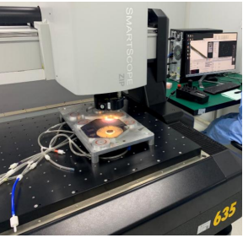
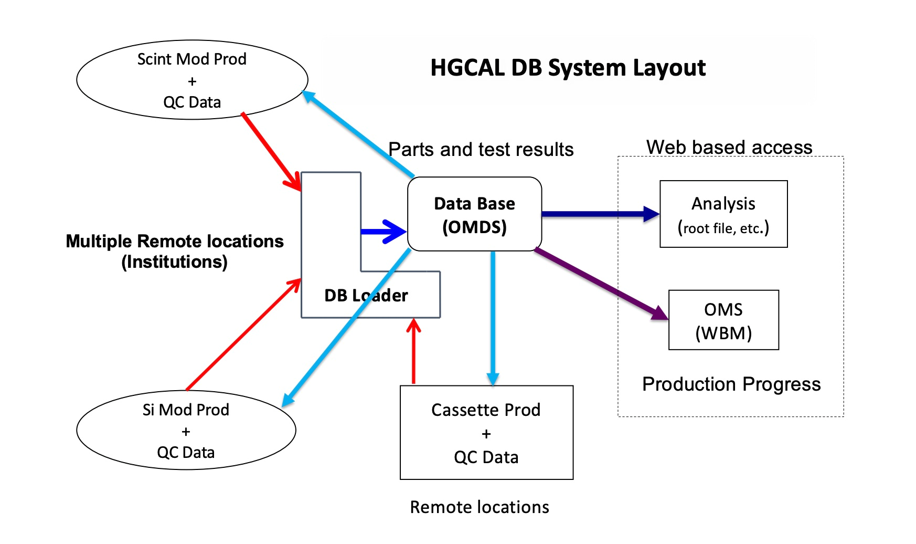

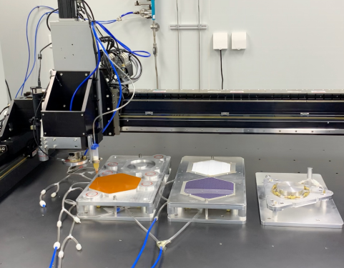
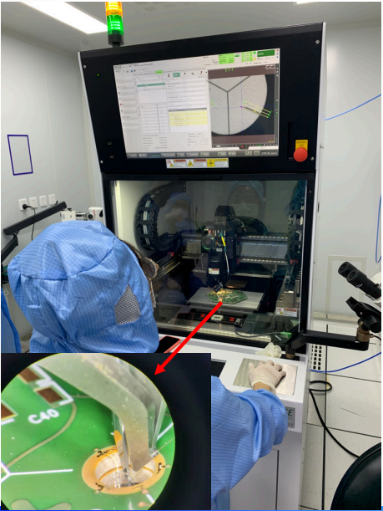
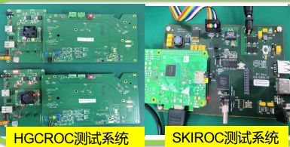
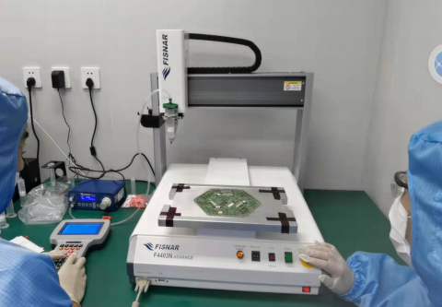
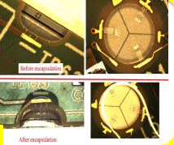
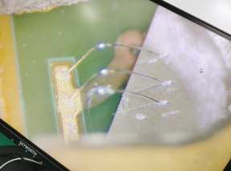
Module assembly at IHEP lab
  QA/QC
  Database
  (in progess)
  Module assembly on gantry
  Wire bonding
  Encapsulation
  Module testing

Slide 15
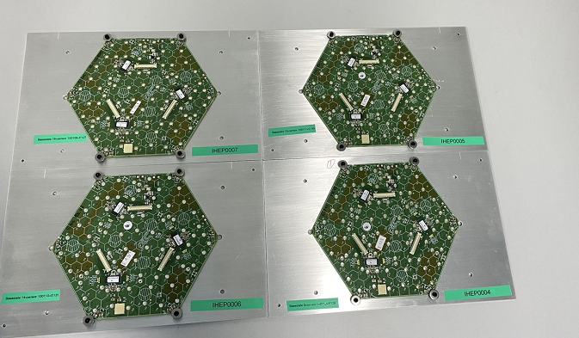
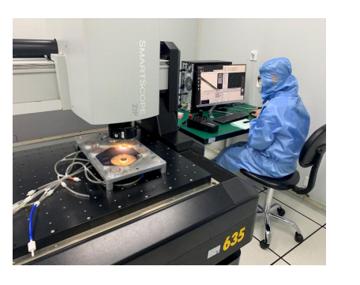
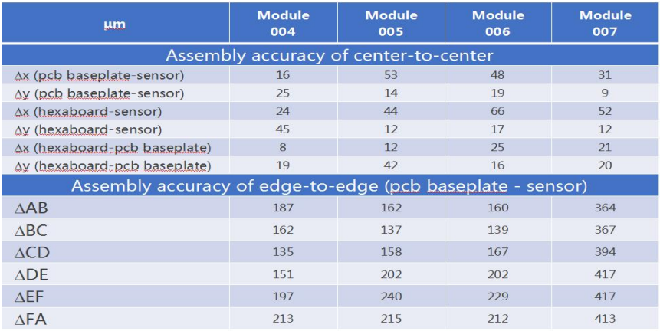
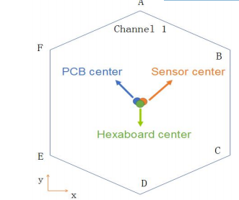
QA/QC
Perform QA/ QC test to Hexaboard/Sensor/baseplate on OGP
before Module Assembly
  Flatness, thickness and width of hexaborads/baseplates/sensors
  Make sure no scratches on sensors
In Module Assembly
  Flatness, thickness and width of sensors on baseplate, photo taking
After Module Assembly
  Flatness, thickness and width of module
  Photos of module
Requirement for all modules
  Center-to-center & edge-to-edge accuracy are measured
  Each edge of sensor is inside PCB baseplate
  Standard tolerance: No bigger than 50 um
  center-to-center tolerance around 50 um
Good quality control

Slide 16
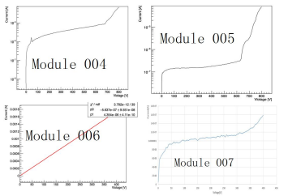
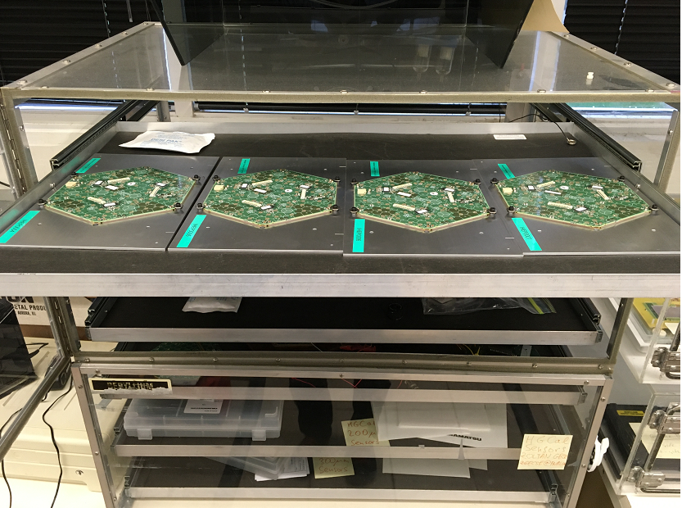
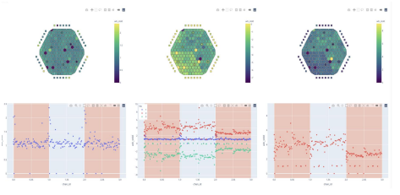
“small Mass” pre-production
4 Modules for Fermilab
@March-April 2022

Slide 17
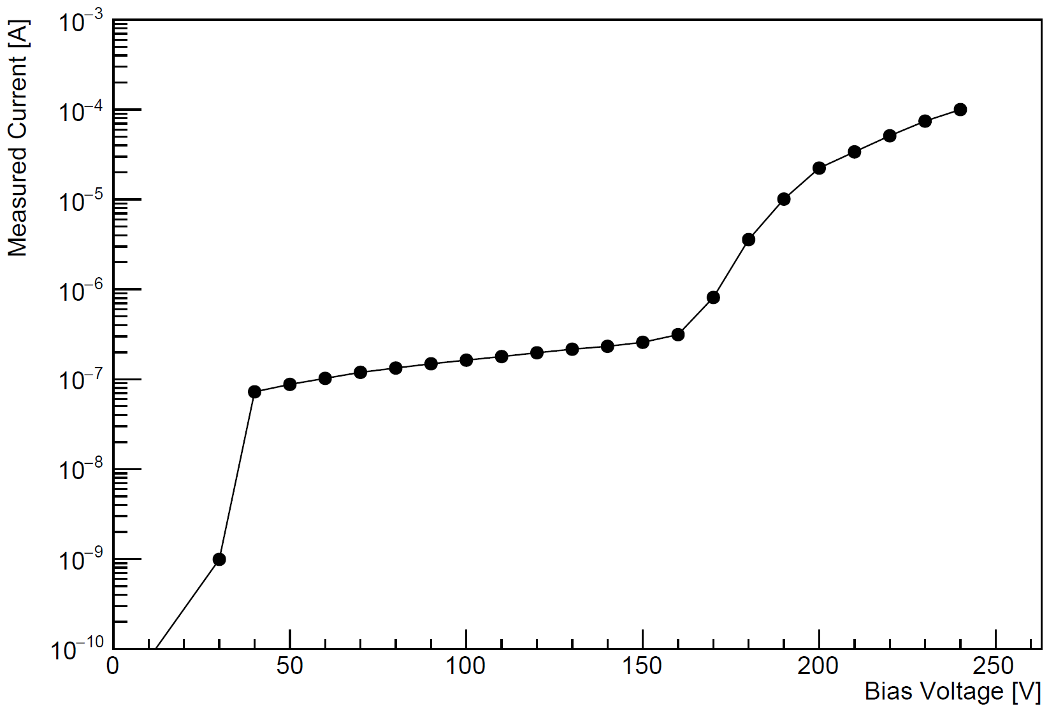
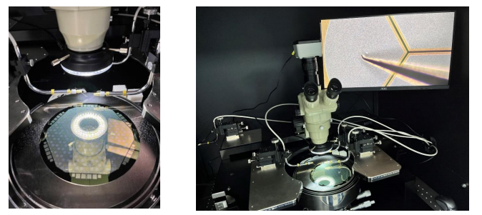
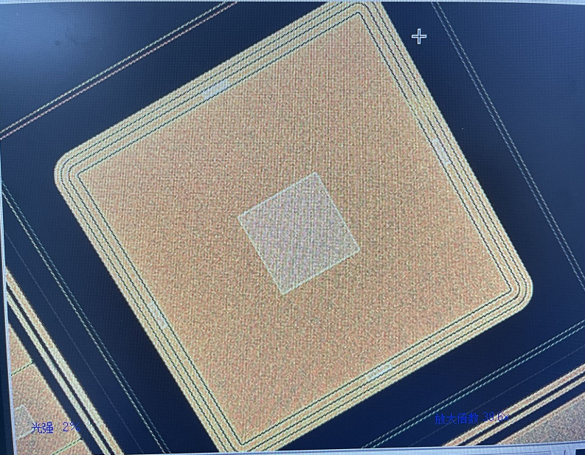
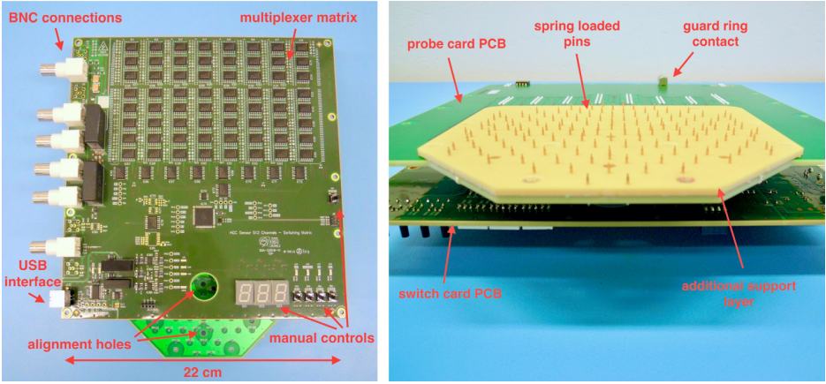
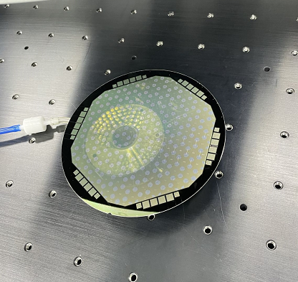
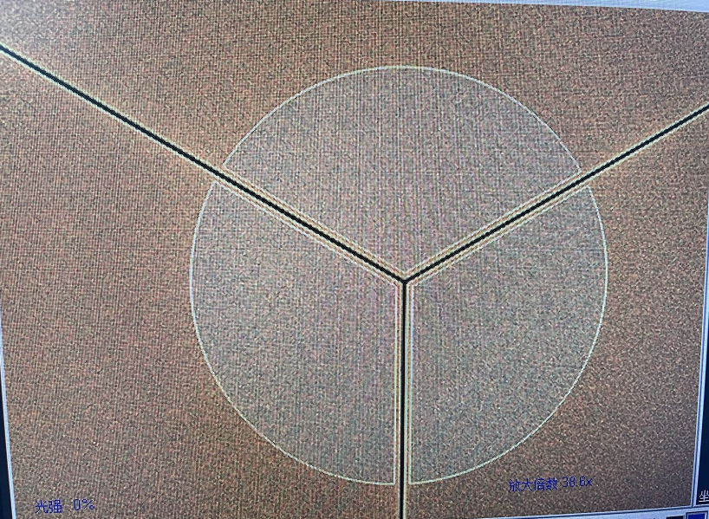
Silicon sensor testing (6-inch)
6-inch Silicon sensor produced in China
  Manual probe station(MPI-TS200)
  Sensor Pin/ test sturcture(Square pad)
    IV-curve scans
  Preparing for testing with the probe card
test sturcture
6 inch sensor
sensor pin
multi channel testing for Si sensor

Slide 18
Section summary
  HGCal module assembly and QA/QC processes are settled
4 modules are successfully produced ▪
  All modules passed QA/QC test ▪
  ➢
Next step：▪ ▪
  Improving QA/QC process
  Prepare for formal module production (productivity goal: 24 modules per day)
  Setup silicon sensor test platform using probe card

Slide 19
Summary
▪
CCF Ecal performance study▪
  Good resolution（5GeV gamma）
    Z resolution ~ 0.84 mm
    Phi resolution ~ 1.9 mm
    R resolution ~ 7.6 mm▪
  Quantify γ/γ and γ/π separation based on CCF Ecal
  Boson Mass Resolution study
  Working on reconstruction method optimize
  Preparations for beam tests
  Summarise results and prepare papers
Silicon module assembly for HGCAL upgrade ▪
  4 modules are successfully produced in 2022 and all modules passed QA/ QC test
  Prepare for formal module production
  Platform being prepared for testing silicon sensors▪
Thank you！

