Slide 1
Kagome体系电荷密度波、超导及拓扑性质的理论研究
博士后学术交流
报 告 人： 司建国
合作导师： 王保田
散裂中子源科学中心
2022 年 6 月 30 日
中国科学院高能物理研究所东莞研究部

Slide 2
Outline
Background of kagome materials
Origins of CDW and HP-controlled SC in CsV₃Sb₅
Prediction of SC & topological in CsM₃Te₅ (M=Ti, Zr, Hf)
Summary
Acknowledgements

Slide 3
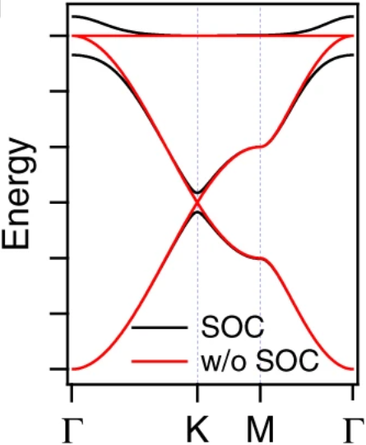
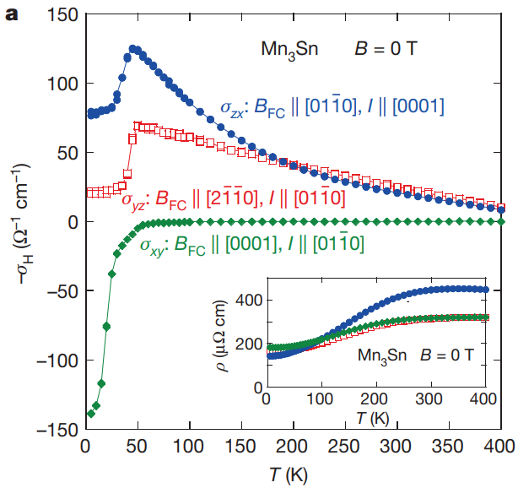
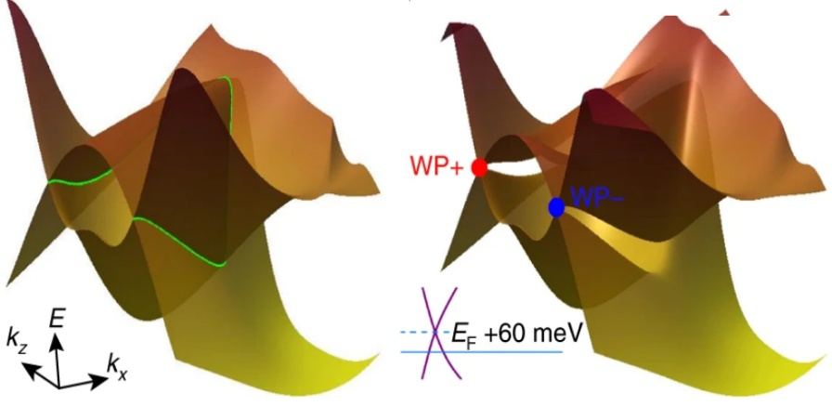
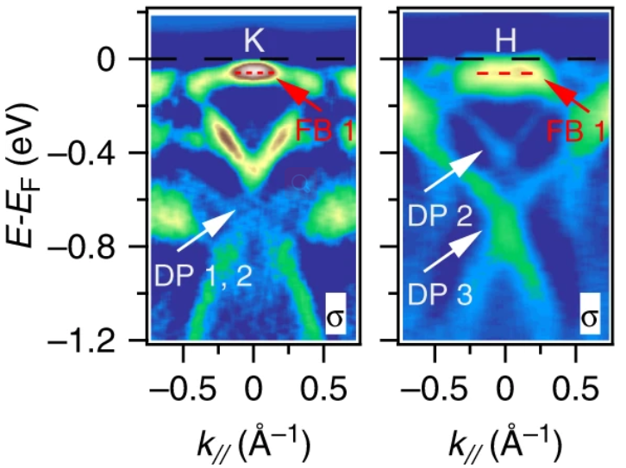
Background of kagome materials
Schematic of band structure:
Flat band over the Brillouin zone;
Dirac crossing at K point;
Van Hove singularity (saddle point) at M point.
Japanese woven bamboo pattern & kagome lattice
magnetism
Materials | Properties | Magnetism | Reference
Mn₃Sn | Large AHE | antiferromagnet | Nature 527, 212(2015)
Co₃Sn₂S₂ | Magnetic WSM | ferromagnetic | Nat. phys. 14,1125(2018)
FeSn | Dirac fermion, flat band | antiferromagnetic | Nat. Mater. 19, 163(2020)
TbMn₆Sn₆ | Chern magnet | ferromagnetic | Nature 583, 533(2020)
Nature 527, 212 (2015)
Nat. Phys. 14,1125 (2018)
Nat. Mater. 19, 163 (2020)
Notes:
日本竹编织篮
magnetic WSM may serve as a platform for realizing phenomena such as chiral magnetic effects

Slide 4
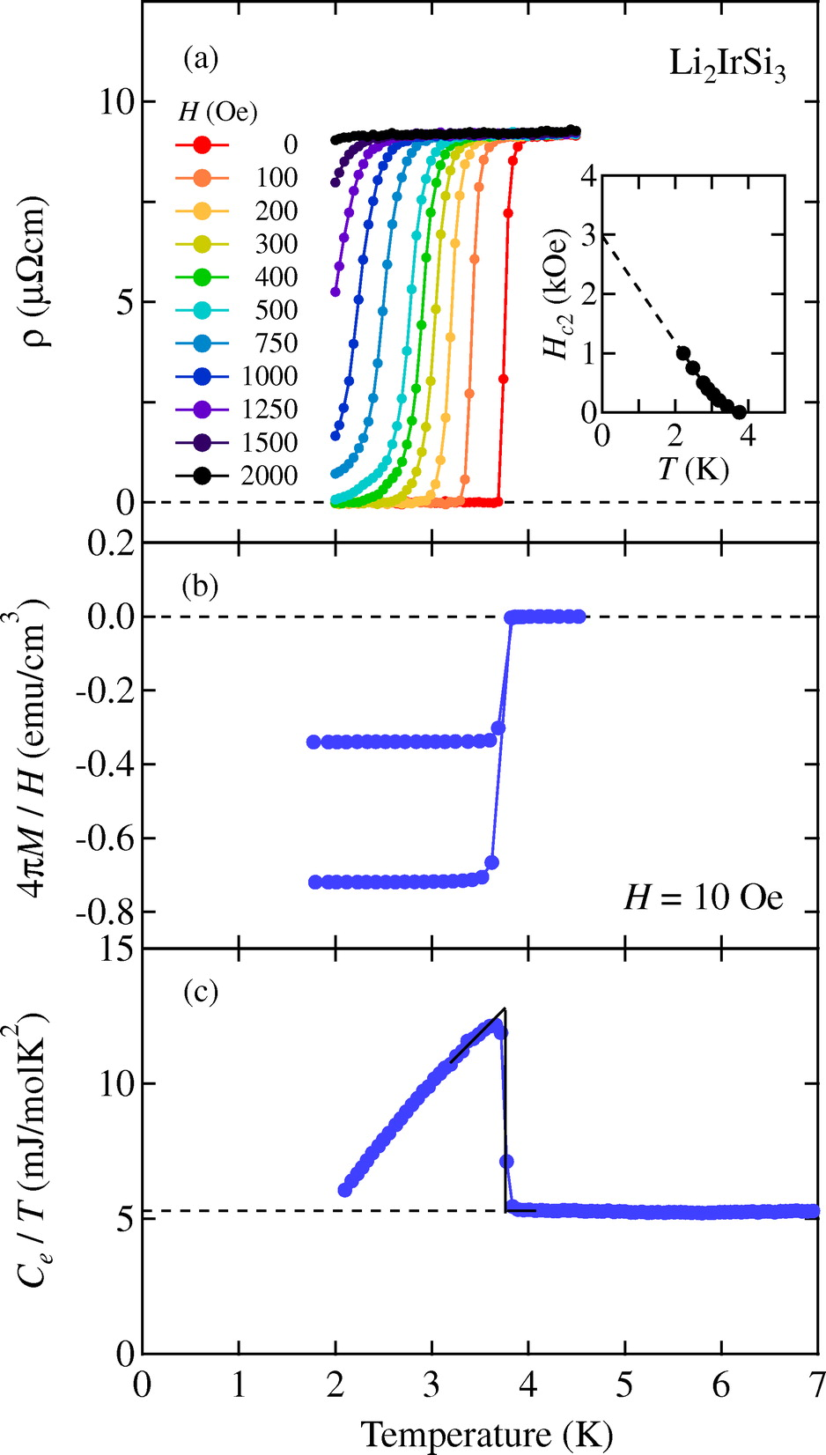
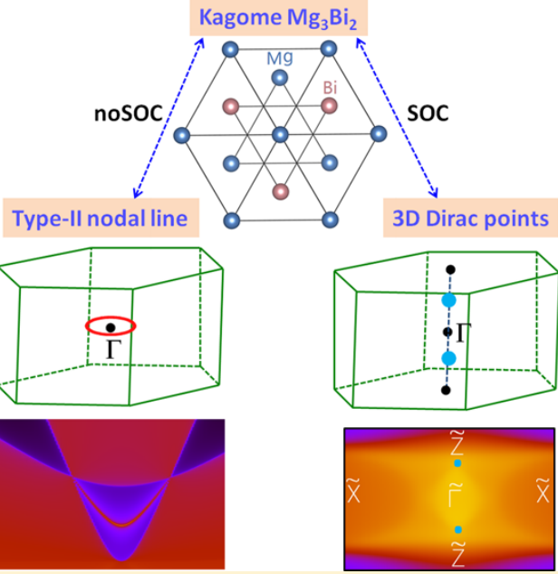
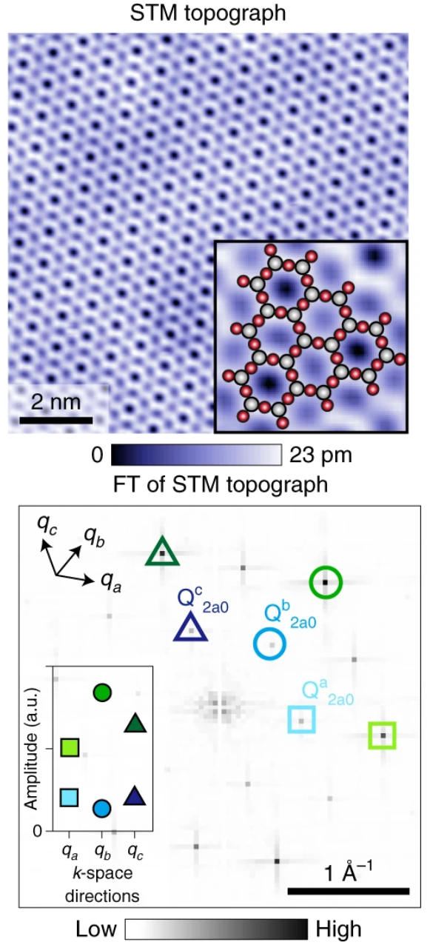
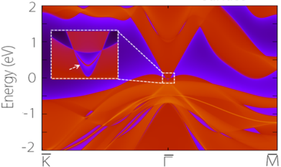
Background of kagome materials
absence of magnetism
Superconductivity
Topological
Charge density wave
J. Phys. Soc. Jpn. 83, 093706 (2014)
J. Phys. Chem. Lett. 8, 4814 (2017)
Nat. Phys. 18, 265 (2022)

Slide 5
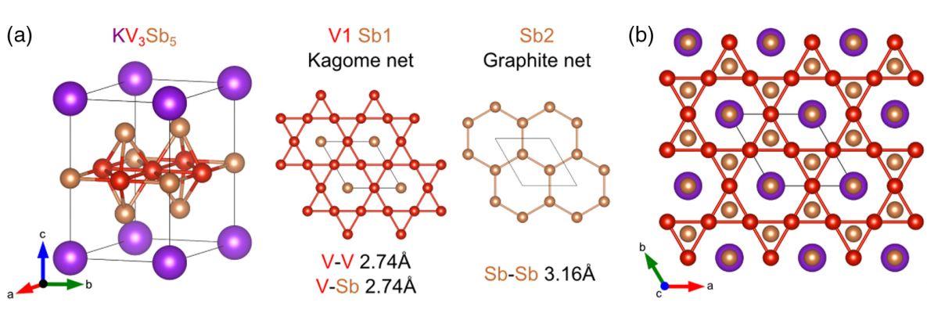
Origins of CDW and HP-controlled SC in CsV₃Sb₅
Crystal structure:
Phys. Rev. Mater. 3, 094407 (2019)
Space group : P6/mmm (No. 191)
V atoms formed a Kagome structure.
K, Cs, Rb inserted between V₃Sb₅ layers.

Slide 6
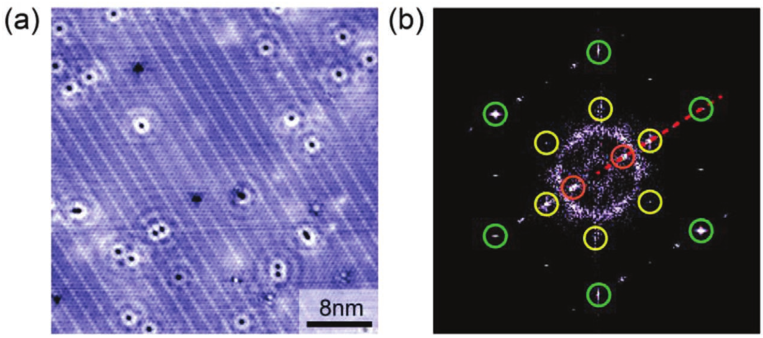
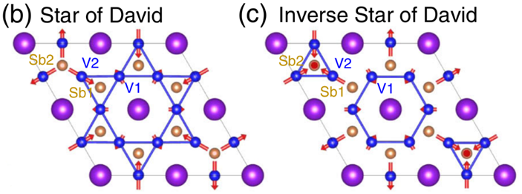
Origins of CDW and HP-controlled SC in CsV₃Sb₅
Motivation: Origin of the formation of CDW order in CsV₃Sb₅?
Ortiz et al., Phys. Rev. Lett. 125, 247002(2020)
Wang et al., Adv. Mater. 33, 02813 (2021)
Tan et al., Phys. Rev. Lett. 127, 046401(2021)
Magnetization, electrical resistivity, and heat capacity exhibits anomaly at 94 K.
CDW order confirmed by STM, ARPES and theoretical calculations.

Slide 7
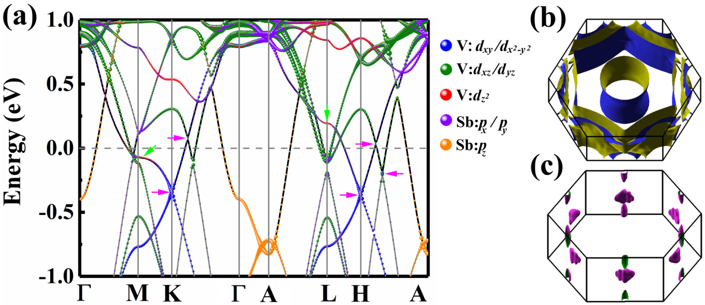
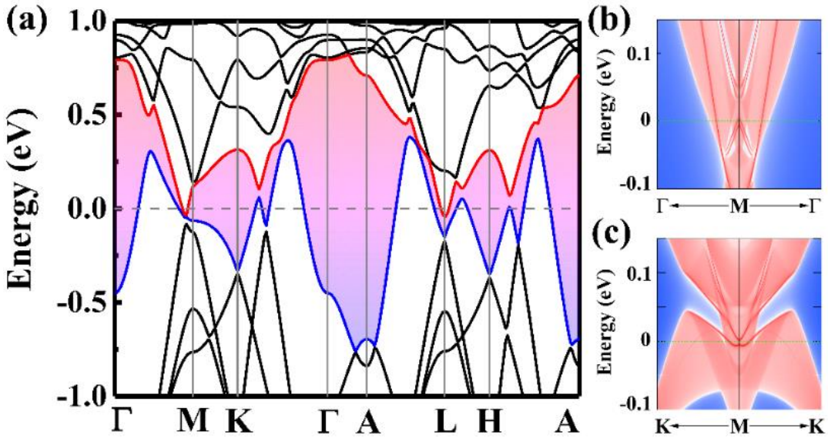
Origins of CDW and HP-controlled SC in CsV₃Sb₅
Without SOC:
multiple Dirac points near Fermi level;
van Hove singularities at M/L points.
With SOC:
continuous direct gap;
nontrivial topological index;
clear surface states.
Traditional CDW mechanism:
Fermi surface nesting;
Electron-phonon coupling;
Exciton condensation.

Slide 8
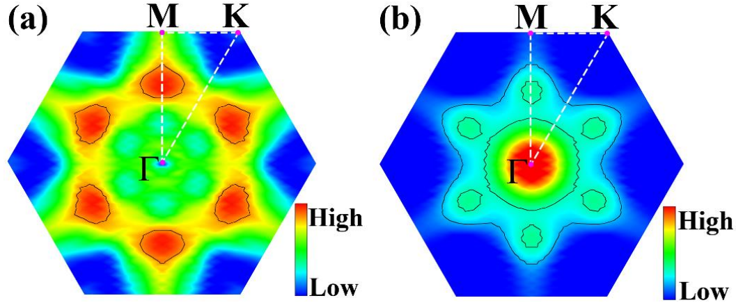
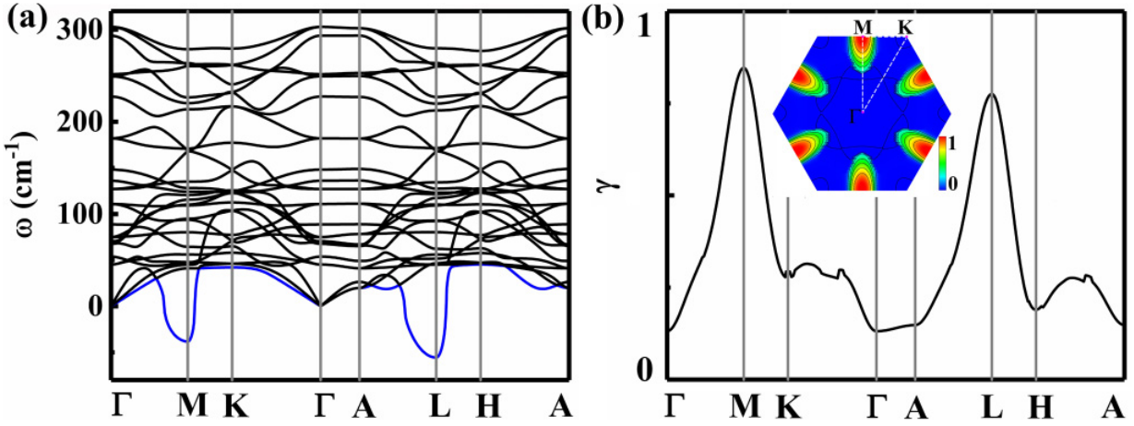
Origins of CDW and HP-controlled SC in CsV₃Sb₅
Fermi surface nesting (electron susceptibility ):
Maximum deviate from the Q_{CDW}
Electron-phonon coupling:
Maximum at the Q_{CDW}

Slide 9
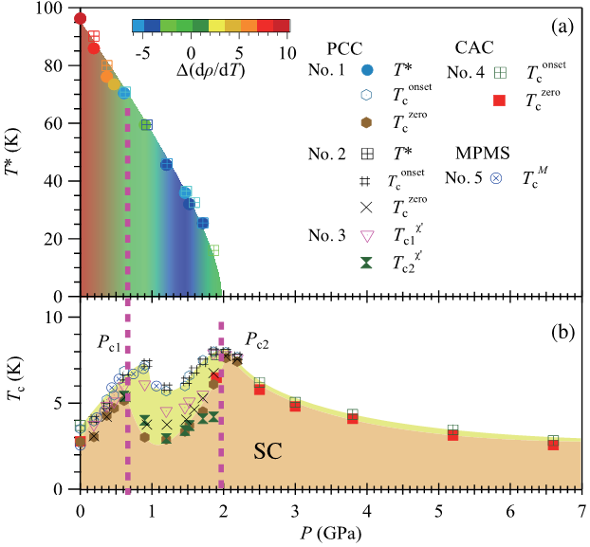
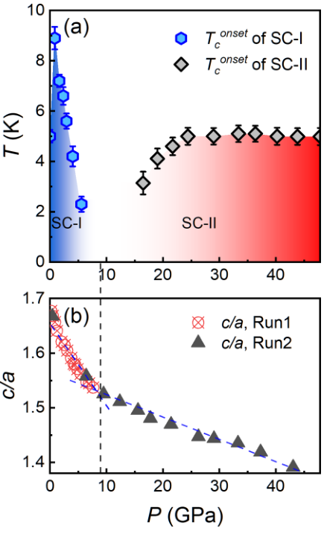
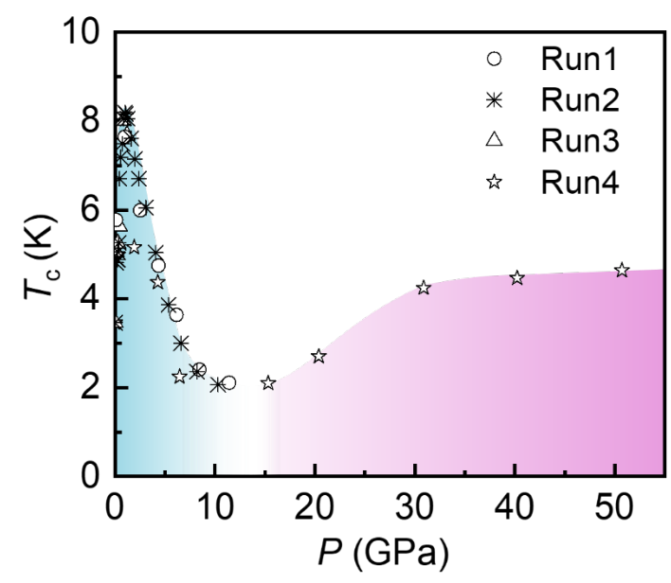
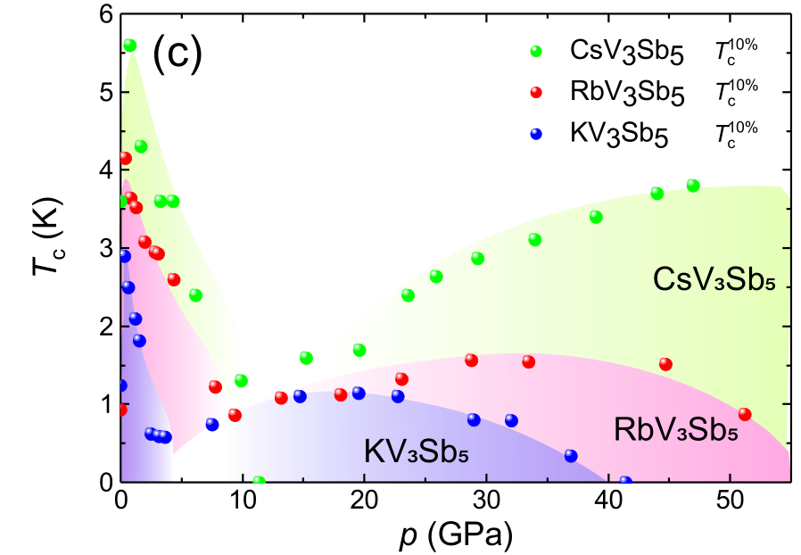
Origins of CDW and HP-controlled SC in CsV₃Sb₅
Adv. Mater. 33, 02813 (2021)
Motivation: Analyze superconductivity under high pressure theoretically.
Phys. Rev. Lett. 126, 247001 (2021)
Phys. Rev. B 103, 224513 (2021)
arXiv:2104.14487
CDW transition is monotonically suppressed by pressure, and fully suppressed at ~2 GPa.
Superconducting transition temperature exhibits a double-peak character (low pressure).
Superconducting transition temperature exhibits a double-dome character (high pressure).

Slide 10
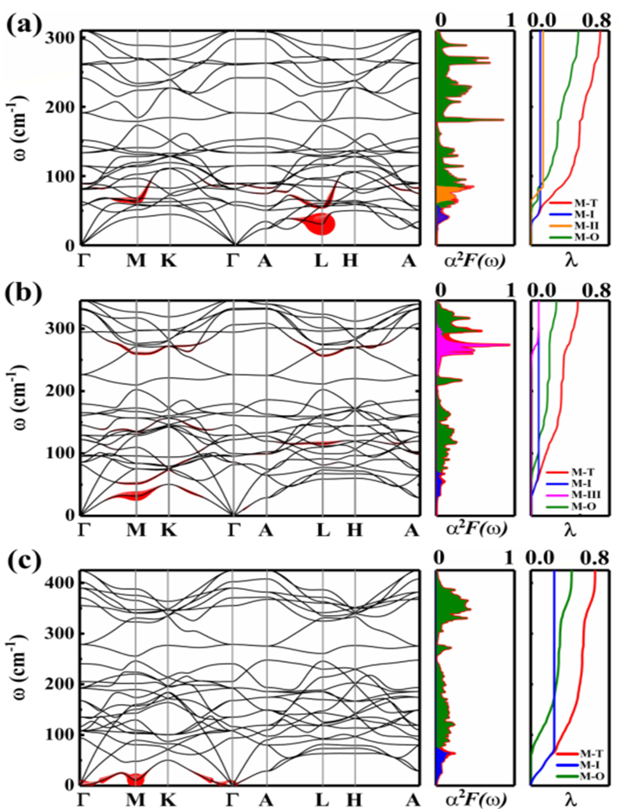
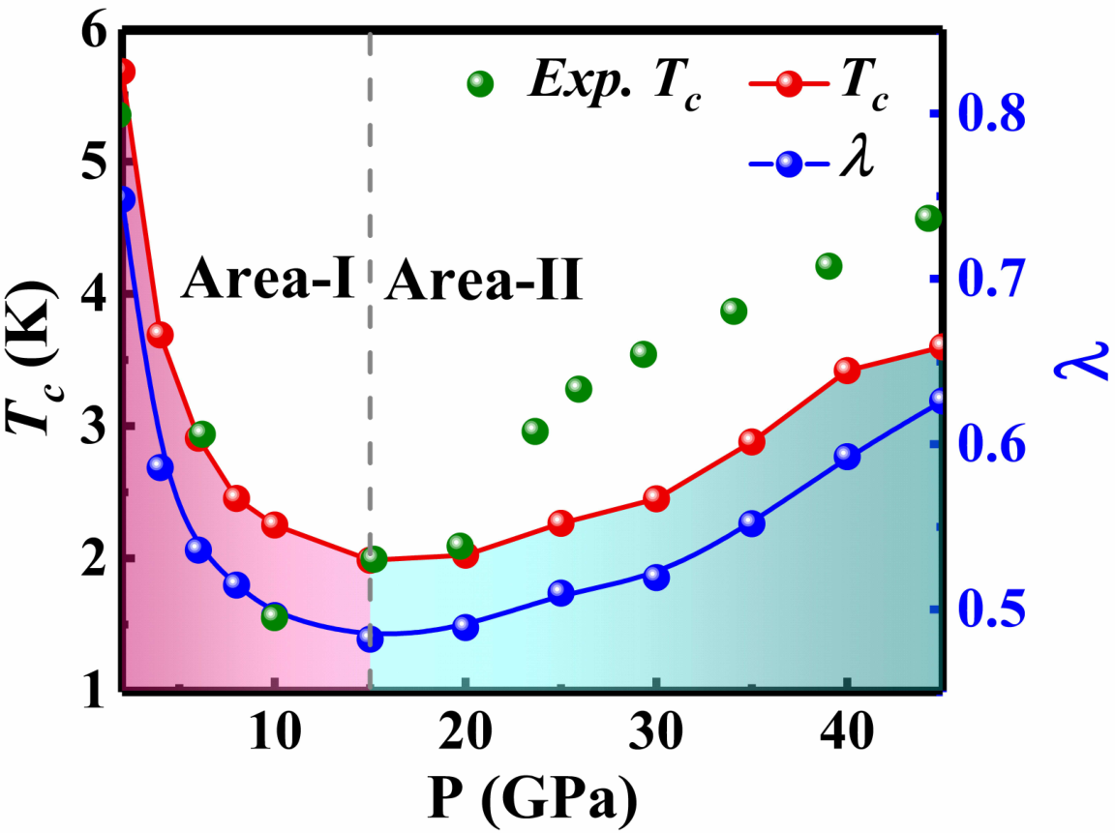
Origins of CDW and HP-controlled SC in CsV₃Sb₅
Allen-Dynes-modified McMillan formula：
Consistent with the experimental results，following the BCS theory.
Superconductivity mainly contributed by the soft modes.

Slide 11
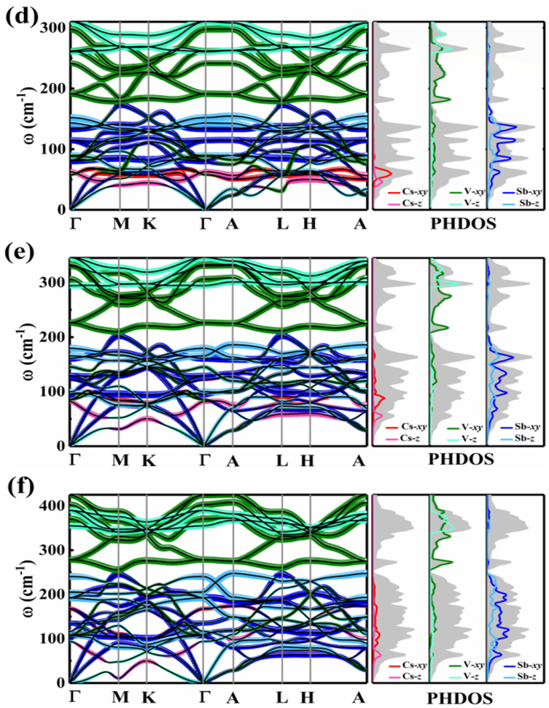
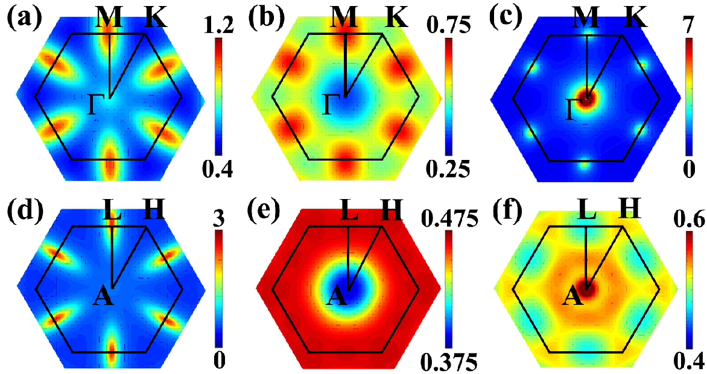
Origins of CDW and HP-controlled SC in CsV₃Sb₅
With increasing pressure:
Soften mode at q_{z}=0.5 is disappeared and recreated at the plane of q_{z}=0;
Contribution to superconductivity change from in-plane modes to out-of-plane modes;
The EPC is redistributed.

Slide 12
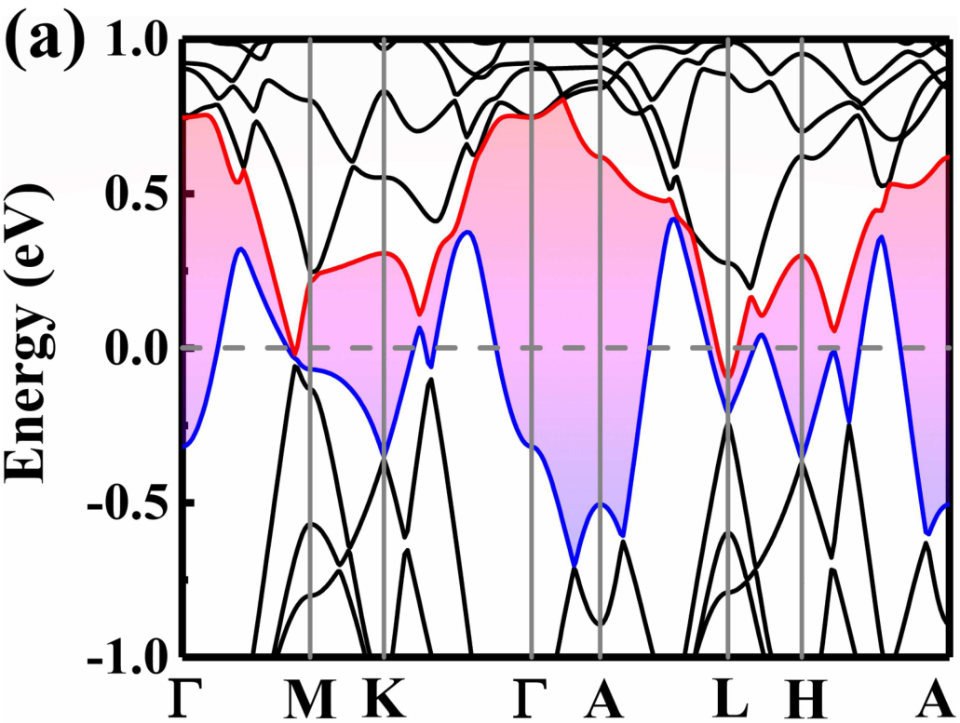
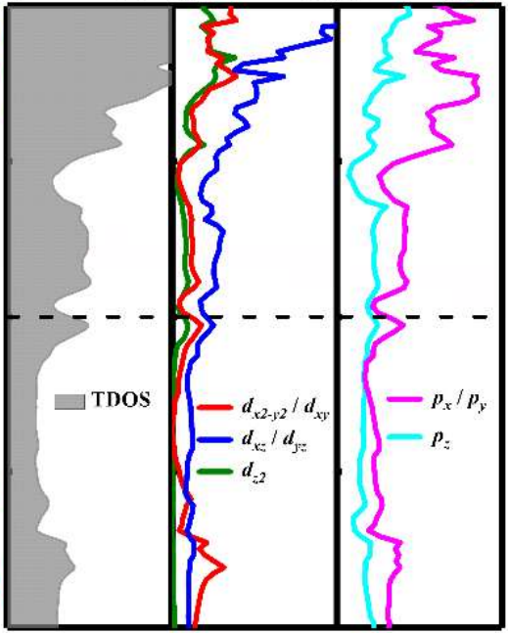
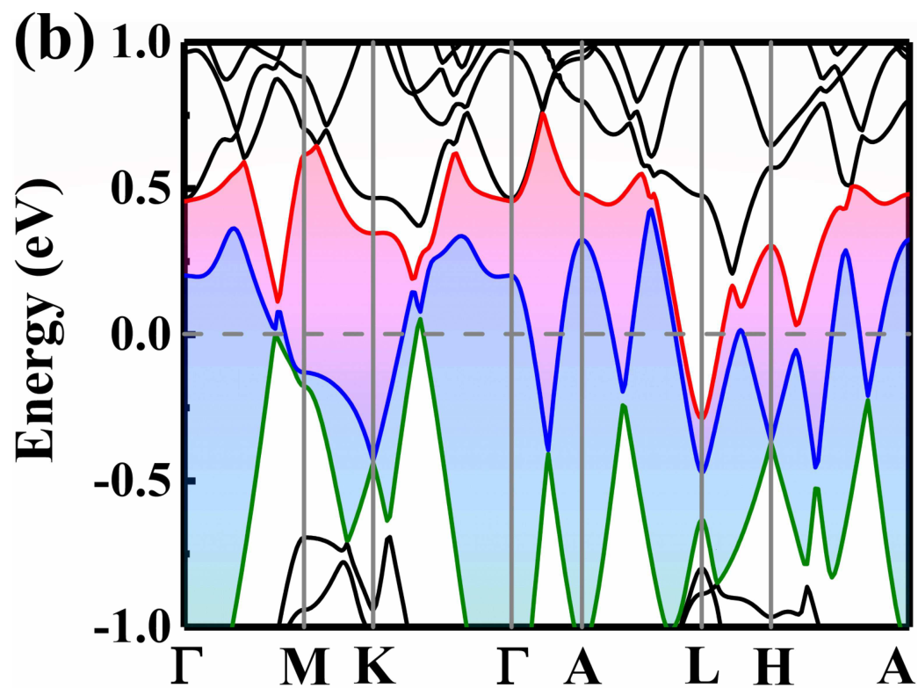
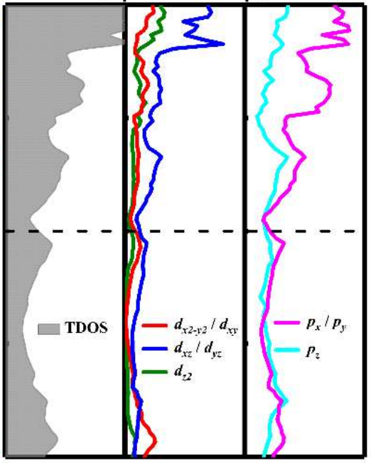
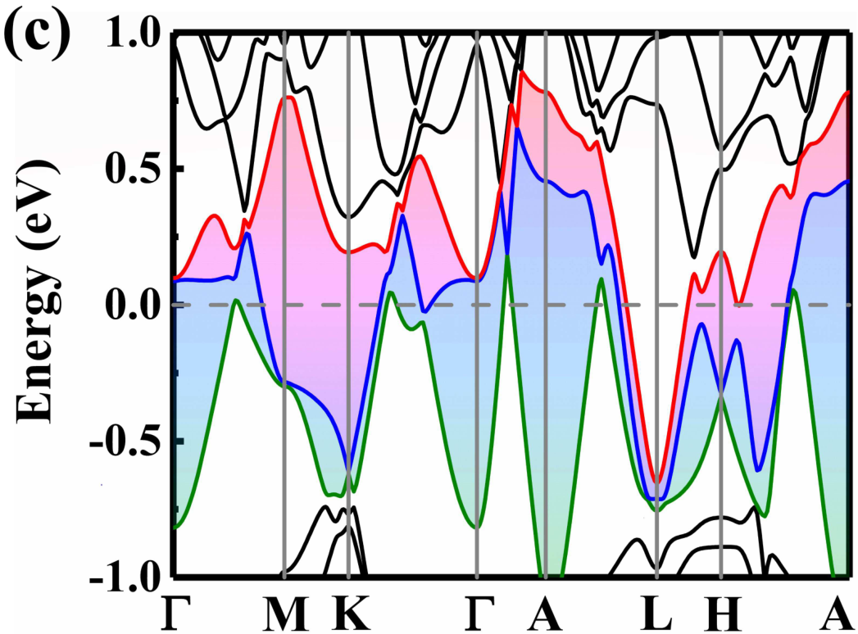
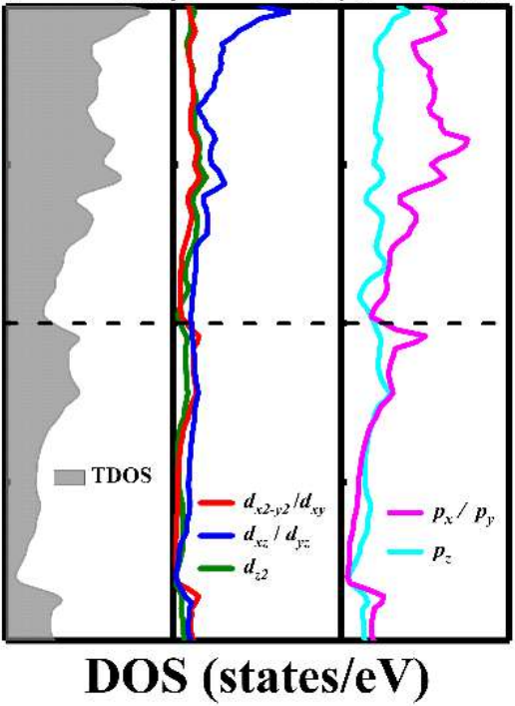
Origins of CDW and HP-controlled SC in CsV₃Sb₅
Electronic structure：
Lifshitz transition under 15 GPa, which corresponds to the minimum of the superconducting transition.
N(E_{F})：
2 GPa: 5.50 states/eV
15 GPa: 4.22 states/eV
45 GPa: 4.32 states/eV
The nontrivial topological nature is robust under high pressure.

Slide 13
Origins of CDW and HP-controlled SC in CsV₃Sb₅
Conclusion:
The origin of the formation of CDW order in CsV₃Sb₅ is momentum-dependent electron-phonon coupling.
The kagome metal CsV₃Sb₅ is still within the frame work of BCS theory, the double-dome liked superconductivity can be attributed to the change of λ and N(E_{F}).
The nontrivial topological nature is robust under high pressure (P< 45 GPa).
Charge density wave and pressure-dependent superconductivity in the kagome metal CsV₃Sb₅: A first-principles study
Phys. Rev. B 105, 024517 (2022)

Slide 14
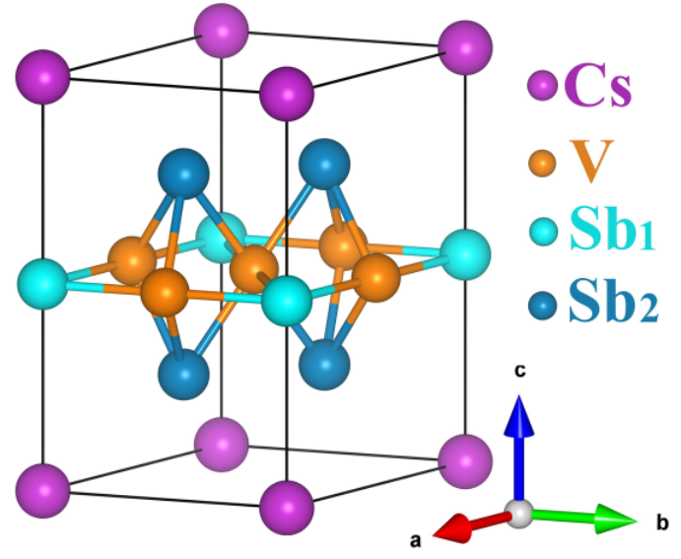
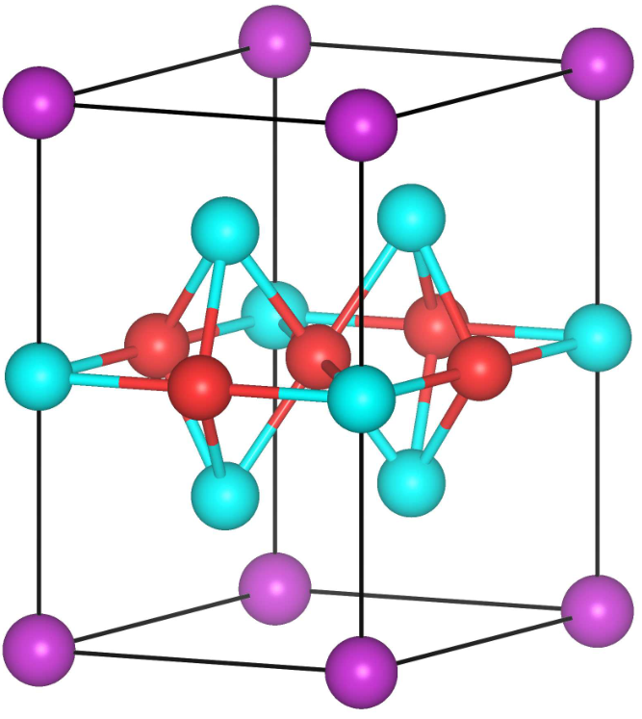
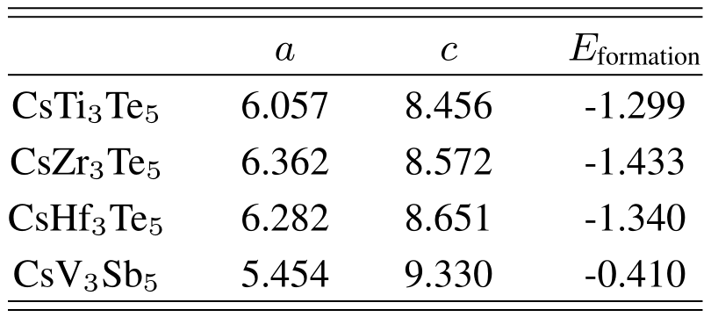
Prediction of SC & topological in CsM₃Te₅ (M=Ti, Zr, Hf)
The CsM₃Te₅ family materials are thermodynamically stable.

Slide 15
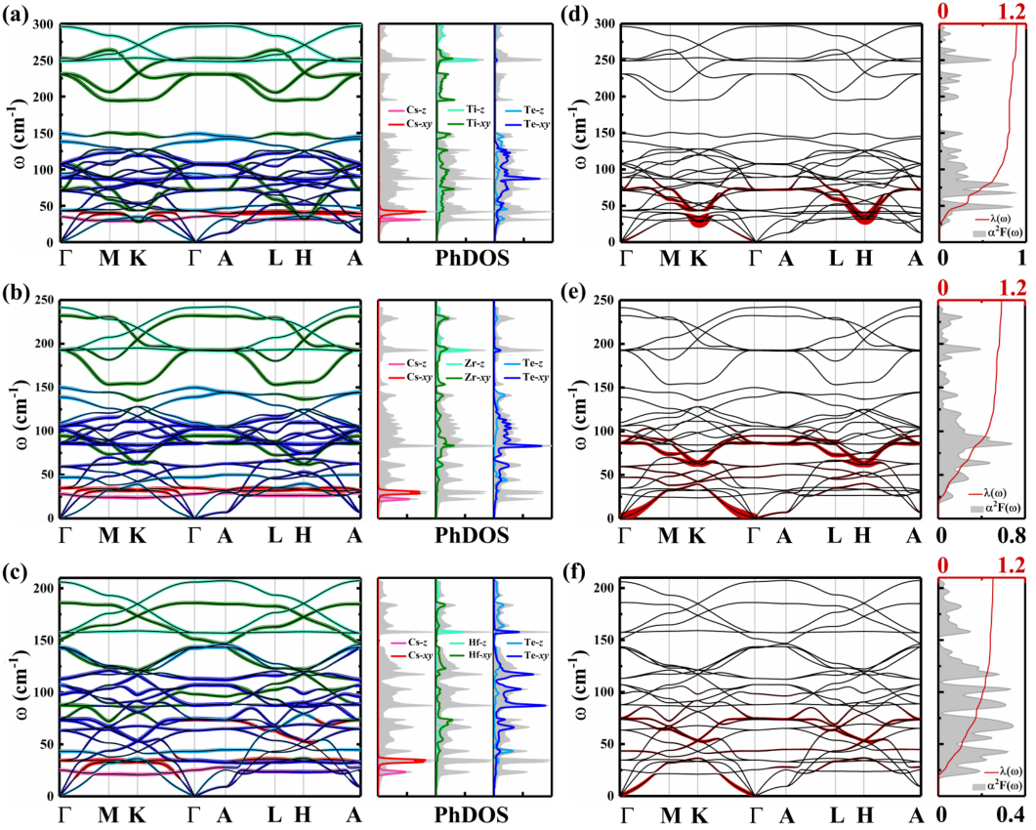
Prediction of SC & topological in CsM₃Te₅ (M=Ti, Zr, Hf)
Dynamically stable, without CDW order transition.
T_{C} (K):
CsTi₃Te₅: 8.02
CsZr₃Te₅: 5.47
CsHf₃Te₅: 3.51
Superconductivity is mainly contributed by in-plane atomic vibrational mode.

Slide 16
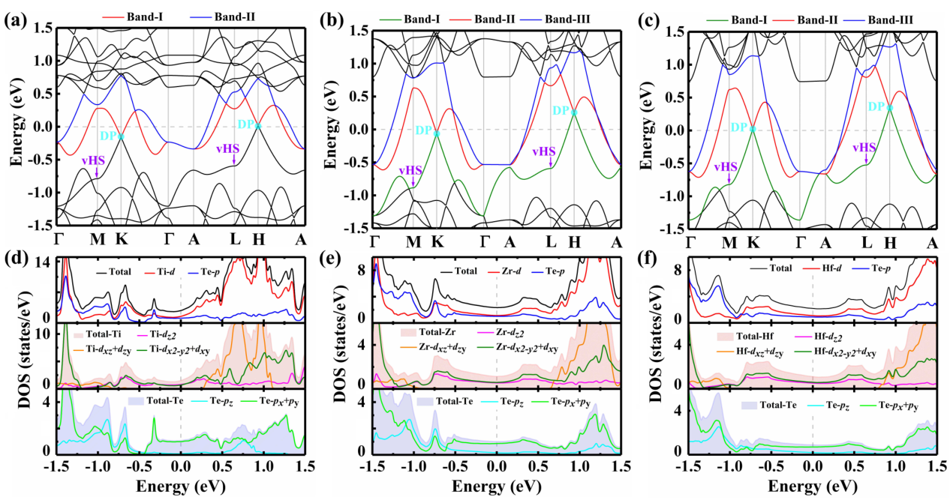
Prediction of SC & topological in CsM₃Te₅ (M=Ti, Zr, Hf)
Without SOC:
Dirac points at K&H points; van Hove singularities at M&L points;
DOS at Fermi level: M-d_{x2-y2}/d_{xy} Te-p_{x}/p_{y}

Slide 17
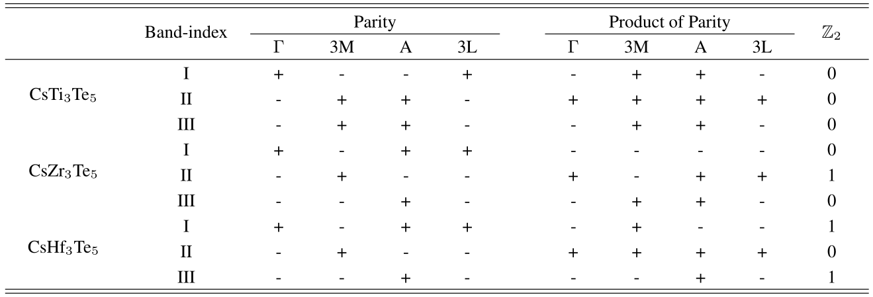
Prediction of SC & topological in CsM₃Te₅ (M=Ti, Zr, Hf)
Similar to the CsV₃Sb₅, the CsZr₃Te₅ and CsHf₃Te₅ could also be classified as Z₂ topological metal.

Slide 18
Prediction of SC & topological in CsM₃Te₅ (M=Ti, Zr, Hf)
Conclusion:
The CsM₃Te₅ (M=Ti, Zr, Hf) are stable both in sides of thermodynamics and dynamics.
The superconductivity are evaluated Allen-Dynes modified McMillan formula, and the T_{C} is higher than the AV₃Sb₅ family materials.
CsZr₃Te₅ and CsHf₃Te₅ exhibit nontrivial band structures and could be classified as Z₂ topological metal.
Superconductivity and topological properties in kagome metals CsM₃Te₅ (M=Ti, Zr, Hf):A first-principles investigation
(Phys. Rev. B under 2st review)

Slide 19
Summary
The origin of the formation of CDW order and the high-pressure controlled superconductivity in CsV₃Sb₅ are explained.
[Charge density wave and pressure-dependent superconductivity in the kagome metal CsV₃Sb₅: A first-principles study Phys. Rev. B 105, 024517 (2022)]
The stability, superconductivity and nontrivial topological properties of CsM₃Te₅ (M=Ti, Zr, Hf) family materials are predicted.
[Superconductivity and topological properties in kagome metals CsM₃Te₅ (M=Ti, Zr, Hf):A first-principles investigation Phys. Rev. B under 2st review ]

Slide 20
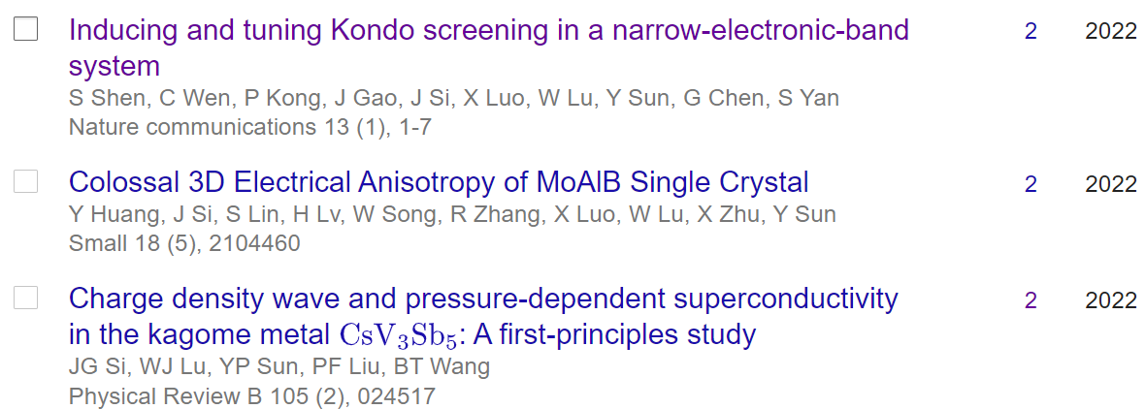
Summary
Publications results:
Total Number: 18
(First & Co-First: 9)
Total cite: 235 (101)
2022 submitted paper:
Superconductivity and topological properties in kagome metals CsM₃Te₅ (M=Ti, Zr, Hf): A first-principles investigation (First) Phys. Rev. B Reviesd
Superconductivity and topological states in hexagonal TaC and NbC
(co-Correspondence) PCCP under 2nd review
Magnetoresistance and quantum oscillations in In₃Rh single crystals
(co-First) Phys. Rev. B under 2nd review
In situ electrochemical defect engineering on VS₂ cathode and magnetic-field induced uniform zinc deposition for high-performance aqueous zinc-ion batteries
(co-Correspondence) Nat. Commun. submitted

Slide 21
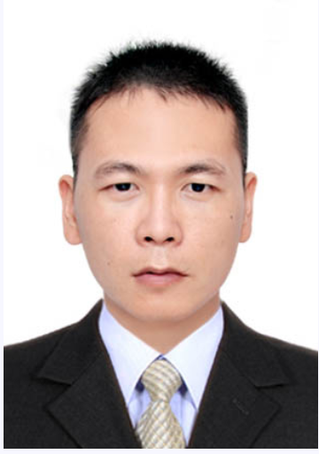
Acknowledgements
Prof. B. –T. Wang
Prof. W. –J. Lu
Dr. P. –F. Liu
Dr. L. –T. Shi
Thanks for your attention !
中国科学院高能物理研究所东莞研究部

Slide 22
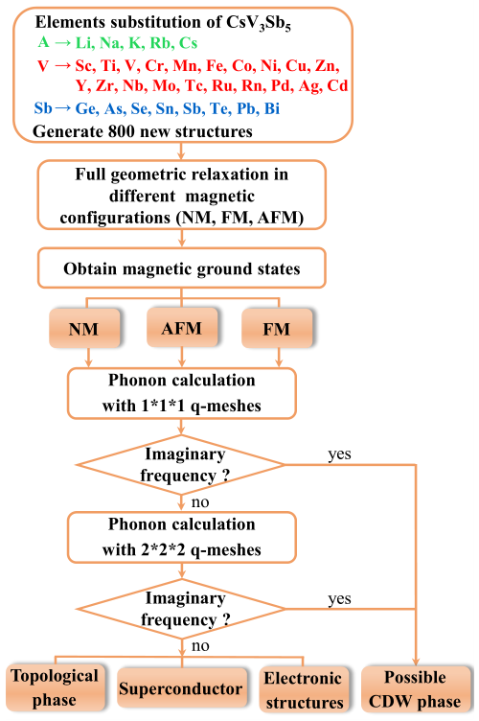
Prediction of SC & topological in CsM₃Te₅ (M=Ti, Zr, Hf)
BACKUP
Chin. Phys. Lett. 39, 047402 (2022)
arXiv:2202.05588
800 structures➔ 24 dynamic stability
1 FM, 1 AFM and 22 NM structures
➔14 superconductors
1386 structures➔ 28 thermodynamic stability

