Slide 1
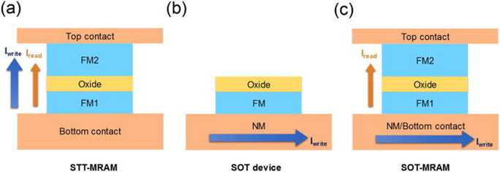
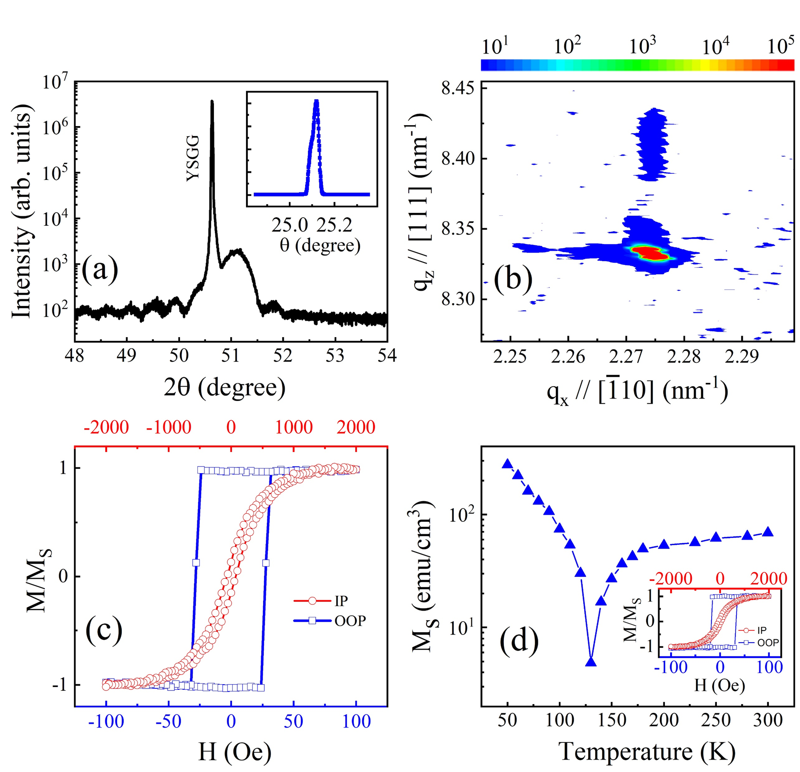
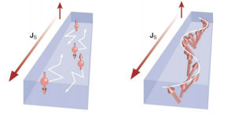
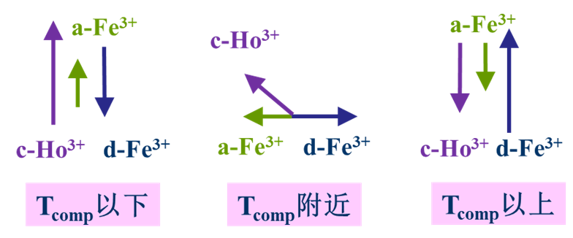
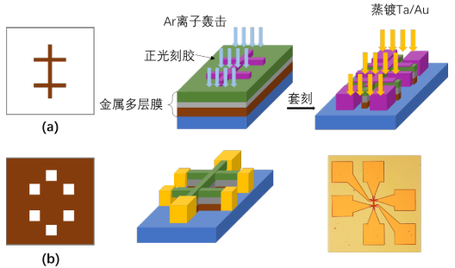
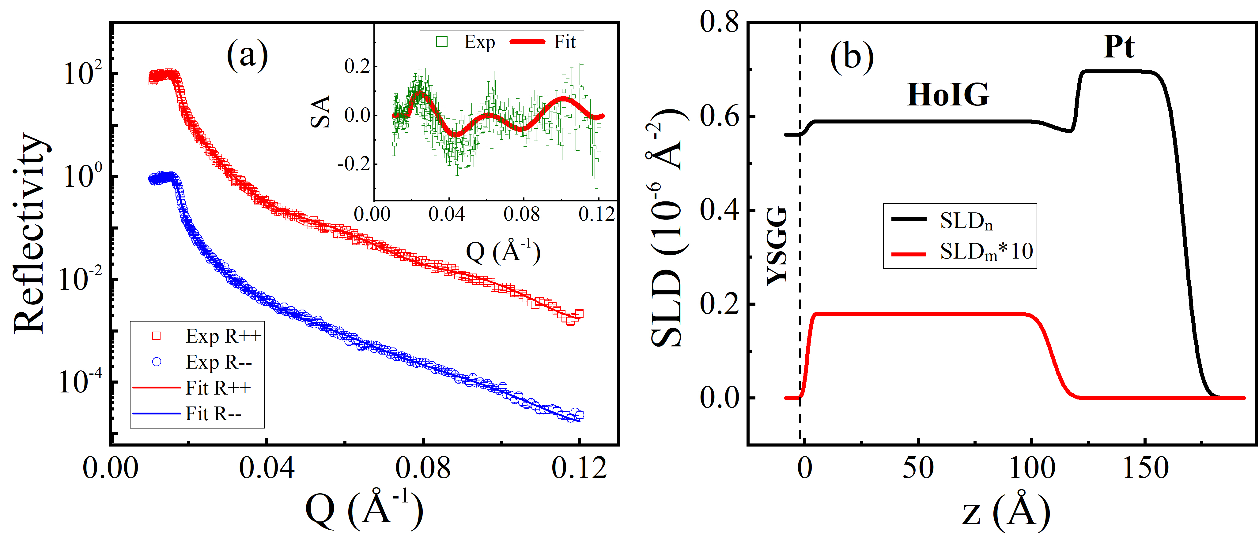
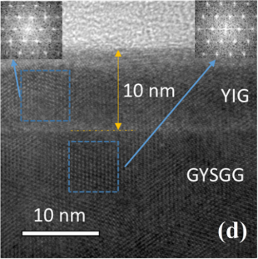
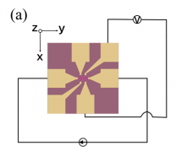
Characterization of perpendicular magnetized Ho₃Fe₅O₁₂ films with efficient spin-orbit torque induced switching
CSNS
He Bai^{1,2}, Z. Z. Zhu², Tao Zhu^{2,1} and J. W. Cai²
¹Institute of High Energy Physics, Chinese Academy of Sciences
²Institute of Physics, Chinese Academy of Sciences
Rare-earth iron garnet films with perpendicular magnetic anisotropy (PMA) are important to develop magnon-based spintronic devices. In this study, high quality epitaxial Ho₃Fe₅O₁₂ (HoIG) films with PMA are fabricated on (111) Y₃(Sc₂Ga₃)O₁₂ substrates by sputtering. The magnetization compensation temperature of HoIG films is determined to be 130 K, highly consistent with its bulk value. The magnetic dead layer at the interface is quantified as thin as about 0.6 nm through polarized neutron reflectivity. Furthermore, spin–orbit torque switching in HoIG/Pt films is realized with the threshold current density of 1.4×10¹¹ A/m² and assisting field as small as 10 Oe. These results provide one more alternative for spintronic materials using compensated ferrimagnetic insulators.
Introduction
Crystal Structure
The advantages of SOT compared with STT:
Lowering the critical switching charge current
Reducing the Joule heating caused by high current
Realizing the separation of “Reading” and “Writing”
XRD 2θ/ω scan for the HoIG film on the (111) YSGG substrate. Inset: the rocking curve of the HoIG (444) peak.
The RSM of high-resolution XRD around (486) diffraction.
Compensation Temperature
The advantages of magnon waves :
PMA realized in the FMI originates from bulk
The current shunting is prevented
The magnetic damping in the FMI is usually lower
The total magnetic moments of the three sublattices cancel each other at the compensation temperature of 137 K, where the net spontaneous magnetization of HoIG vanishes.
Experimental Details
Polarized Neutron Reflectivity
光刻Hall bar过程：涂胶—前烘—曝光—显影—定影—刻蚀
Room temperature PNR results for the YSGG/HoIG(10 nm)/Pt(3) sample at H =1.2 T
HRTEM Image
SOT-induced Switching
Experimental configuration of Current-induced switching in the HoIG(10 nm)/Pt(3 nm) sample.
Switching behavior as a function of the current density for a given field of H_{x} = ±10 Oe
High-resolution transmission electron microscopy image
主要论文
[1] Appl. Phys. Lett. 119, 212406 (2021)
Contact: baih@ihep.ac.cn tzhu@iphy.ac.cn jwcai@iphy.ac.cn

