Slide 1

Nonleptonic two-body decays of ${ Λ}_{b}$ baryon in the perturbative QCD approach
Based on arXiv:2202.09181
周锐
华北理工大学
@河南师范大学 4.23.2022

Slide 2
Outline
Motivation
Baryons in Quark Model
pqcd CALCULATIONS
Results
Summary

Slide 3
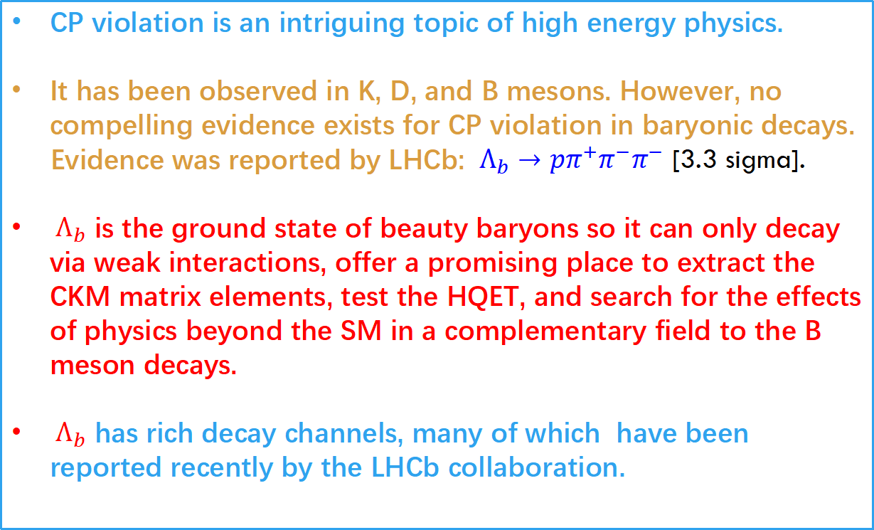
Motivation
CP violation is an intriguing topic of high energy physics.
It has been observed in K, D, and B mesons. However, no compelling evidence exists for CP violation in baryonic decays.
Evidence was reported by LHCb: ${ Λ}_{b}→pπ^{+}π^{−}π^{−}$ [3.3 sigma].
${ Λ}_{b}$ is the ground state of beauty baryons so it can only decay via weak interactions, offer a promising place to extract the CKM matrix elements, test the HQET, and search for the effects of physics beyond the SM in a complementary field to the B meson decays.
${ Λ}_{b}$ has rich decay channels, many of which have been reported recently by the LHCb collaboration.

Slide 4
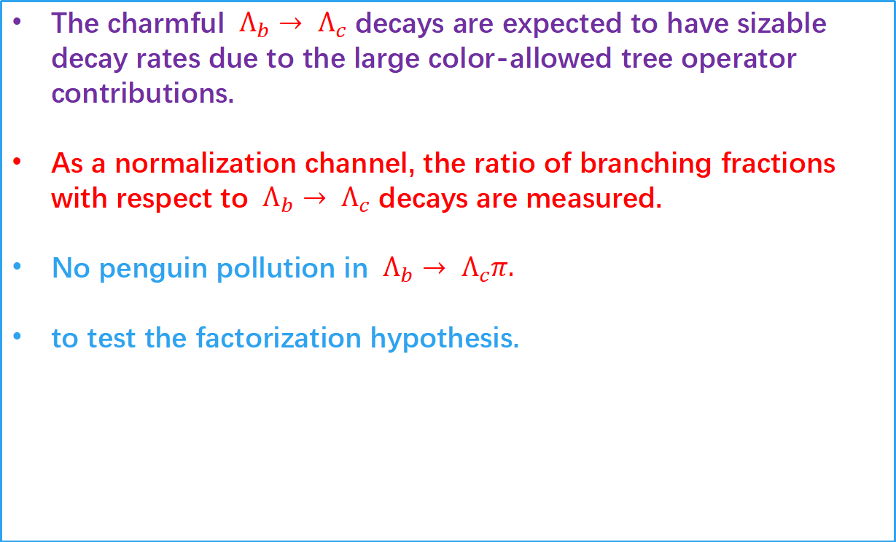
Motivation
The charmful ${ Λ}_{b}→{ Λ}_{c}$ decays are expected to have sizable decay rates due to the large color-allowed tree operator contributions.
As a normalization channel, the ratio of branching fractions with respect to ${ Λ}_{b}→{ Λ}_{c}$ decays are measured.
No penguin pollution in ${ Λ}_{b}→{ Λ}_{c}π.$
to test the factorization hypothesis.

Slide 5
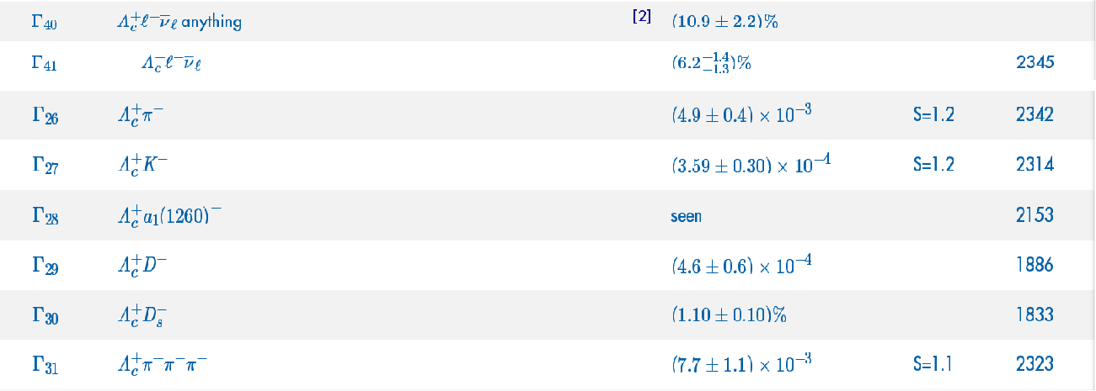
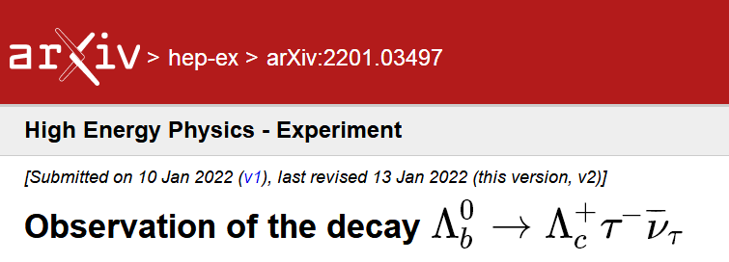

Several semileptonic and nonleptonic decays of ${ Λ}_{b}→{ Λ}_{c}$ were measured.
Very recently, the first observation of the semitauonic ${ Λ}_{b}$ decay is reported with a significance of 6.1σ by LHCb

Slide 6
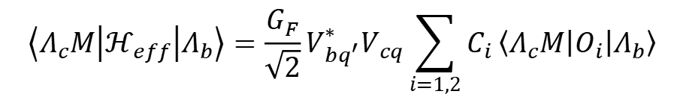
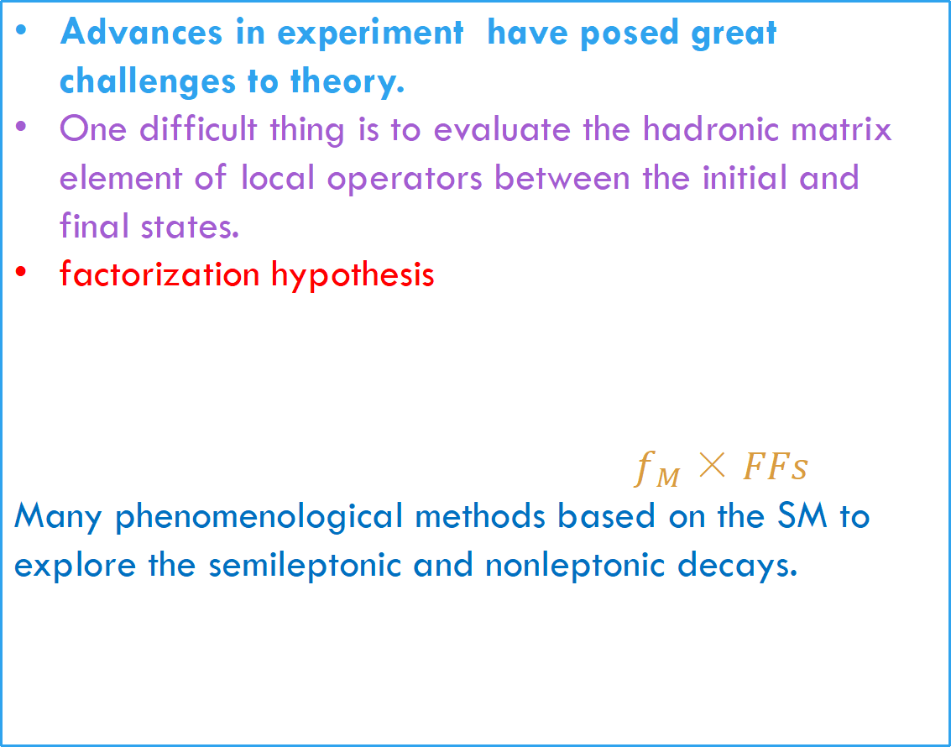
Advances in experiment have posed great challenges to theory.
One difficult thing is to evaluate the hadronic matrix element of local operators between the initial and final states.
factorization hypothesis
$f_{M}×FFs$
Many phenomenological methods based on the SM to explore the semileptonic and nonleptonic decays.
$$\left\langle Λ_{c}M | ℋ_{eff} | Λ_{b}\right\rangle =\frac{G_{F}}{\sqrt{2}}V_{bq^{′}}^{∗}V_{cq}\sum_{i=1,2}{C_{i}}\left\langle Λ_{c}M | O_{i} | Λ_{b}\right\rangle$$
SCET,LFQM,CCQM,BSM,NRQM,QCDF......

Slide 7
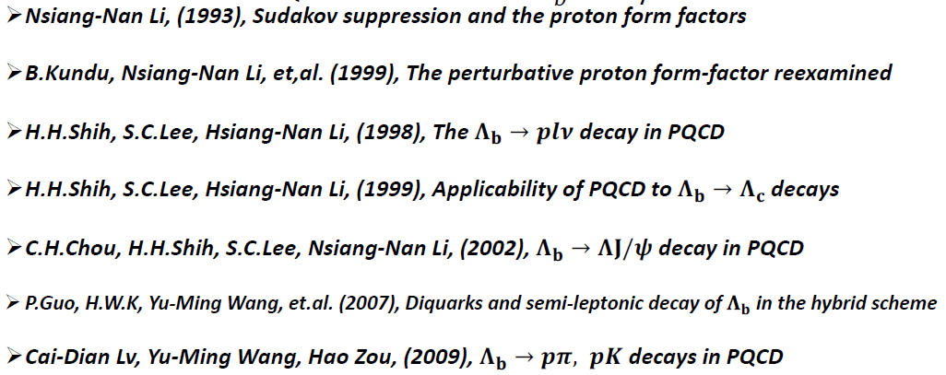
IN PQCD
The basic ingredient is the decay amplitudes are factorized into the convolution of hard scattering kernels with the universal hadronic wave functions.
Keeping the parton transverse momenta to avoid the endpoint singularity.
Large logarithmic corrections are organized to all orders by Sudakov resummation.
The PQCD factorization theorem have been applied to deal with the exclusive heavy baryon decays.

Slide 8
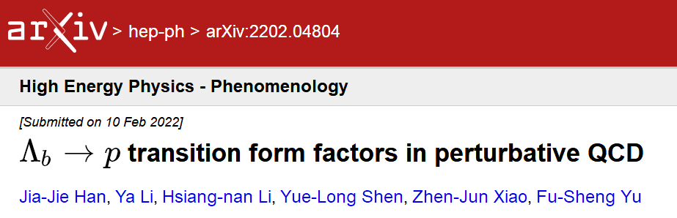
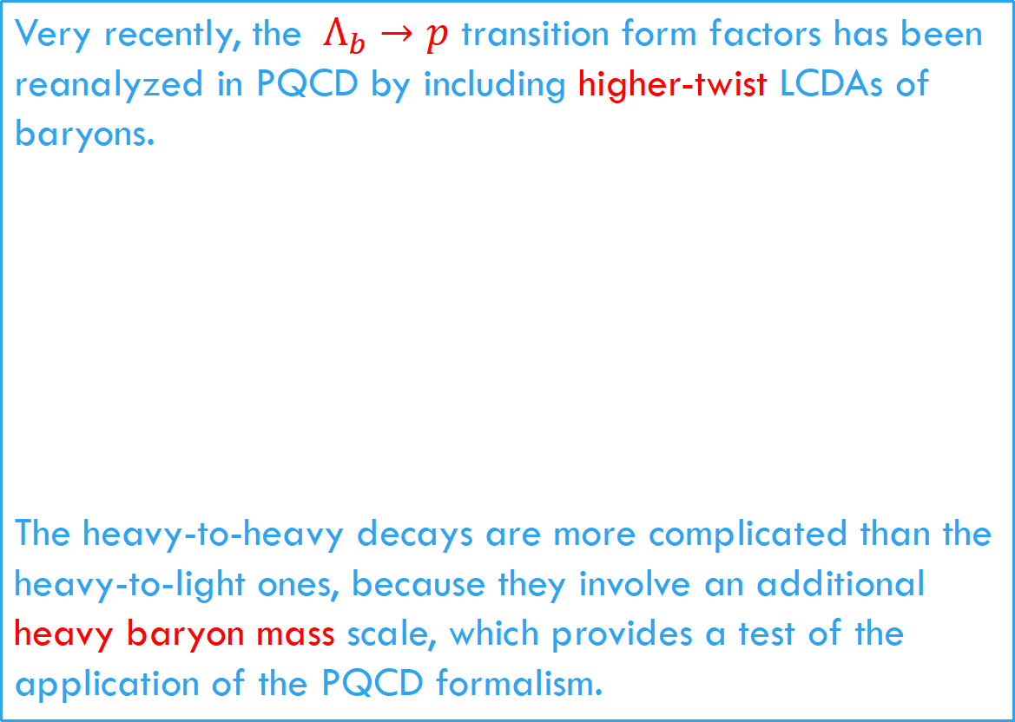
Very recently, the ${ Λ}_{b}→p$ transition form factors has been reanalyzed in PQCD by including higher-twist LCDAs of baryons.
The heavy-to-heavy decays are more complicated than the heavy-to-light ones, because they involve an additional
heavy baryon mass scale, which provides a test of the application of the PQCD formalism.

Slide 9



Baryons in Quark Model [see the review of PDG]
Baryons are fermions with baryon number 1.
Baryons are 3-quark (qqq) configurations.
Fermi statistics require the state function must be antisymmetric under interchange of any two equal-mass quarks.
Light baryons (q=u,d,s)
Single charmed and bottom baryons (Qqq’)
The light quarks needs to be symmetry under permutation.

Slide 10
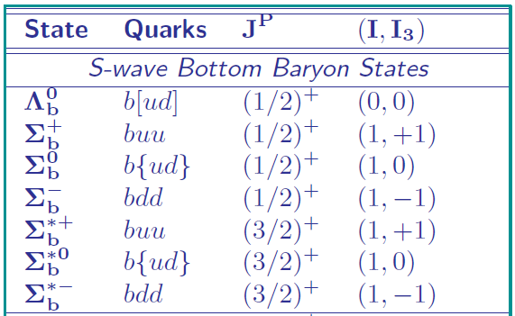
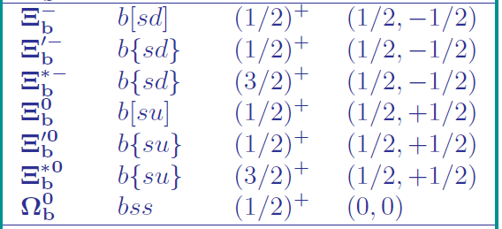
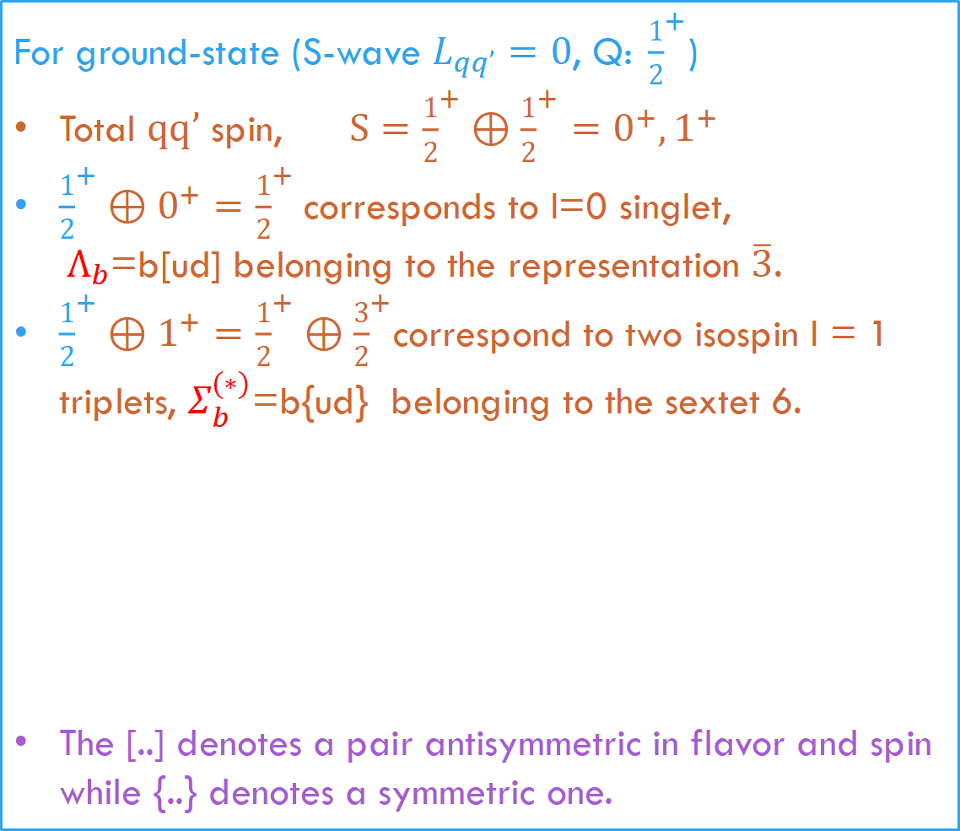
For ground-state (S-wave $L_{qq’}=0$, Q:${ \frac{1}{2}}^{+}$)
Total $qq’$ spin, $S={\frac{1}{2}}^{+}⊕{\frac{1}{2}}^{+}=0^{+},1^{+}$
${\frac{1}{2}}^{+}⊕0^{+}={\frac{1}{2}}^{+}$corresponds to I=0 singlet,
${ Λ}_{b}$=b[ud] belonging to the representation $\overline{3}$.
${\frac{1}{2}}^{+}⊕1^{+}={\frac{1}{2}}^{+}⊕{\frac{3}{2}}^{+}$correspond to two isospin I = 1 triplets, $Σ_{b}^{(∗)}$=b{ud} belonging to the sextet 6.
The [..] denotes a pair antisymmetric in flavor and spin while {..} denotes a symmetric one.

Slide 11
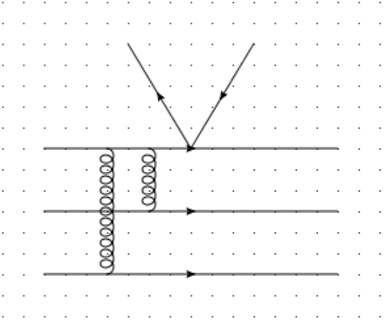


PQCD calculations
The decay amplitudes are factorized into the convolution of hard scattering kernels with the universal hadronic wave functions.
The hard kernels start at $α_{s}^{2}$ in the PQCD approach.
$$M∝ψ_{Λ_{b}}⊗H⊗ψ_{Λ_{c}}⊗ψ_{P}$$

Slide 12
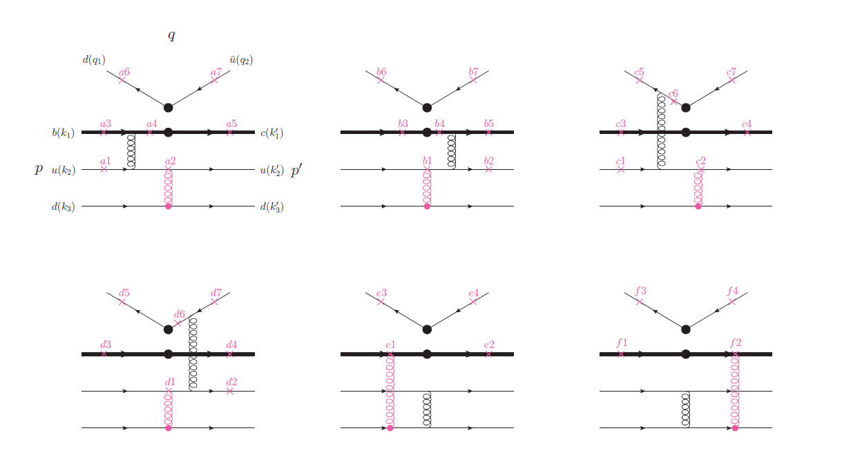

$$Λ_{b}→Λ_{c}π$$
The hard amplitude involves eight external on shell quarks, four of which correspond to the four-fermion operators and four of which are the spectator quarks in the initial and final states.
External W-emission (T ) diagrams at the leading order
The factorizable diagrams: a1-a5, b1-b5, e1, e2, f1, and f2.
Exchanging two identical d quarks, one get 36 C-type diagrams.
Six quarks interaction

Slide 13
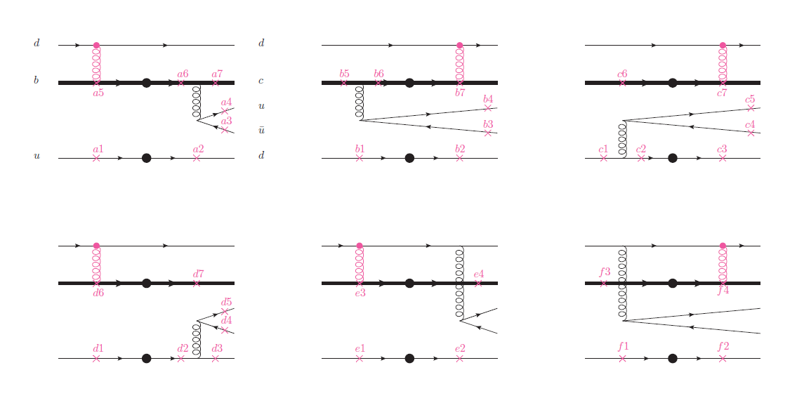
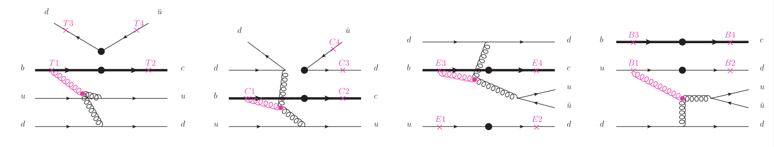
W-exchange (E) diagrams
Three-gluons vertex (G) diagrams
36 × 4 + 16 = 160

Slide 14
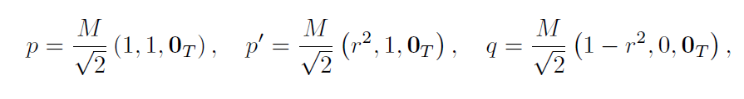

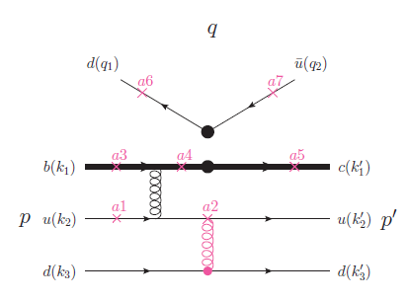
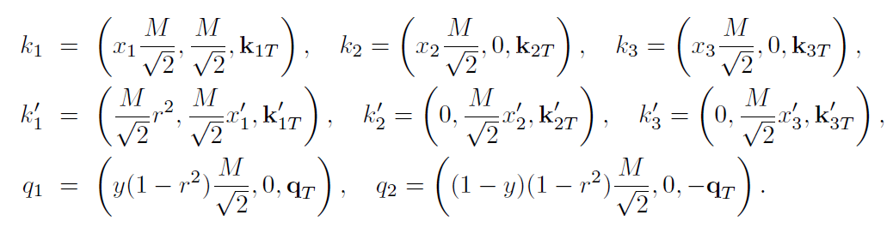

Kinematics:
$$Λ_{b}(p)→Λ_{c}(p’)π(q)$$
In the rest frame of $Λ_{b}$ in the light-cone coordinates
The b and c quarks are considered to be massive, while the masses of all light quarks and meson are neglected.
The conservation laws

Slide 15
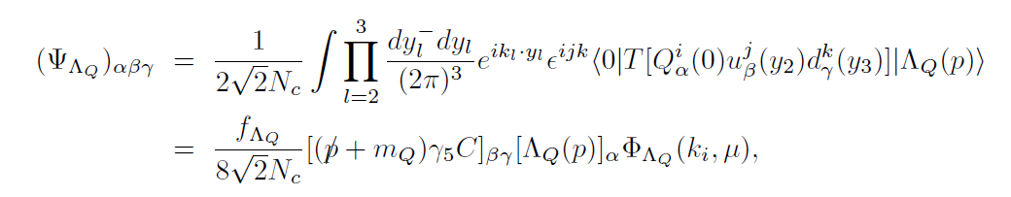
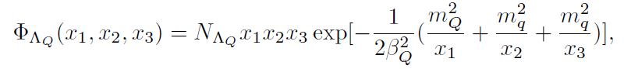


The leading-twist heavy baryon LCDAs
In the heavy quark limit, the heavy quark can factorize from
the light degrees of freedom.
A simple model [F.Schlumpf (1992)]
Normalization condition
The $Λ_{b}$ baryon LCDAs up to twist-4 has been available currently.
P.Ball, V.M.Braun, E.Gardi (2008)
G.Bell, T.Feldmann, Yu-Ming Wang, M.W.Y.Yip (2013)
Yu-Ming Wang, Yue-Long Shen (2016)
[PRD61,114002]

Slide 16
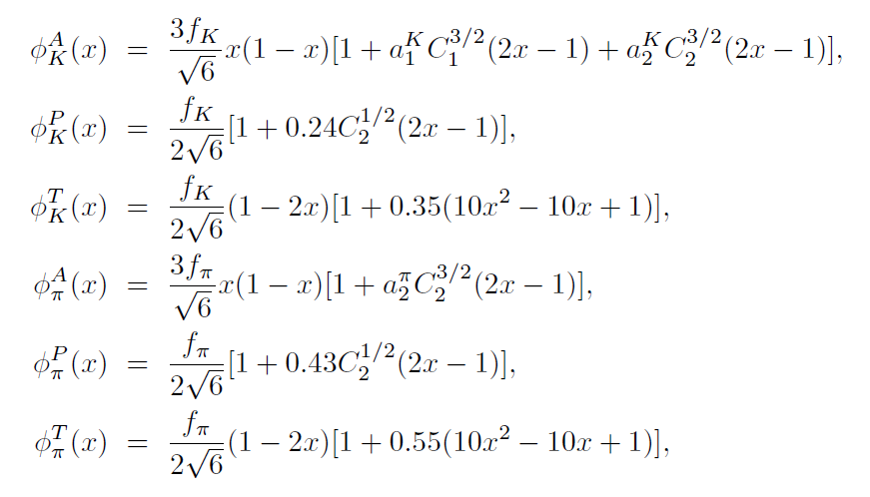

The LCDAs for the pseudoscalar mesons
The kaon and pion meson distribution amplitudes up to twist-3 are determined using the light-cone QCD sum rules.
[P. Ball, 1999,P. Ball, V.M. Braun, and A. Lenz,2006]

Slide 17
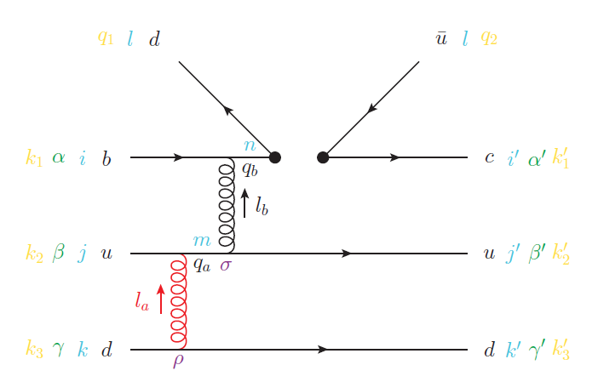




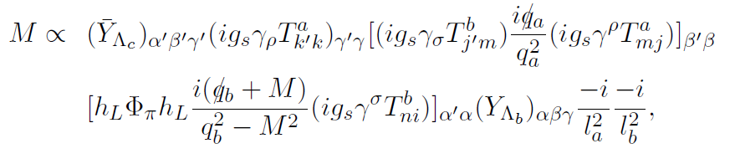
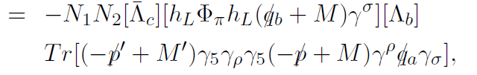
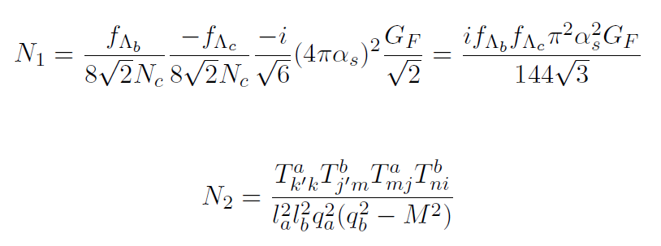
One example
The momenta of the four internal particles
The hard amplitude

Slide 18
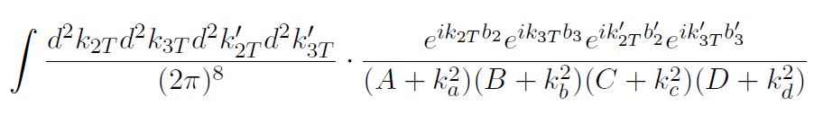
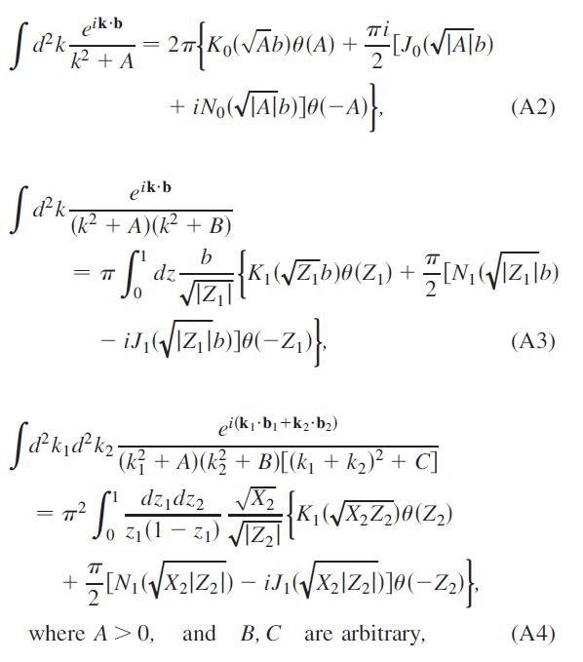

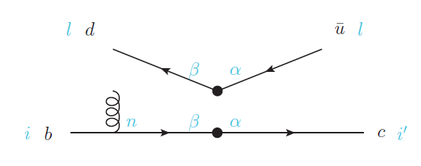




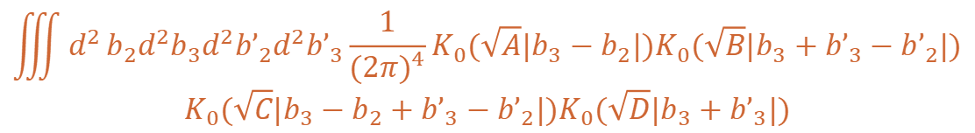

Performing the Fourier transformation
$$\iiint{d^{2}}b_{2}{d^{2}b}_{3}{d^{2}b’}_{2}{d^{2}b’}_{3}\frac{1}{{(2π)}^{4}}K_{0}(\sqrt{A}|b_{3}−b_{2}|)K_{0}(\sqrt{B}|b_{3}+{b’}_{3}−{b’}_{2}|)$$
$$K_{0}(\sqrt{C}|b_{3}−b_{2}+{b’}_{3}−{b’}_{2}|)K_{0}(\sqrt{D}|b_{3}+{b’}_{3}|)$$
$${d^{2}b}_{i}=b_{i}db_{i}dθ$$
Inserting the operator to get the color factor.
$$θ_{3}$$
$$θ_{2}$$
$$T_{k’k}^{a}T_{j’m}^{b}T_{mj}^{a}T_{ni}^{a}=\frac{8}{3}$$
$$θ_{1}$$

Slide 19
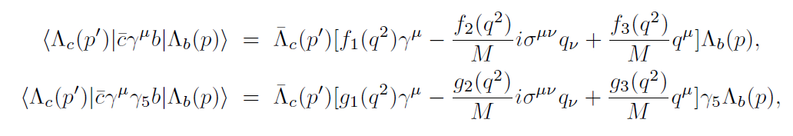
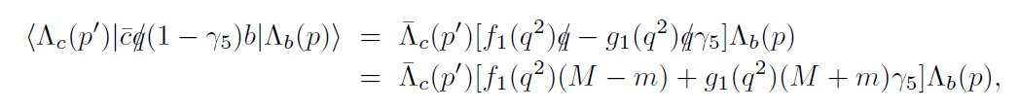

Numerical results and discussions
1. baryonic transition form factors
The ${ Λ}_{b}→{ Λ}_{c}$ transition matrix elements induced by the vector and axial-vector currents can each be decomposed into three dimensionless invariant form factors.
Contracting with q_{\mu} and considering the massless limit, one have
We shall concentrate on f_1 and g_1 at the zero momentum transfer.

Slide 20
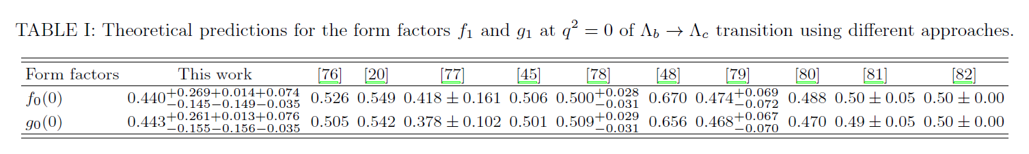
The main uncertainties in our calculations come from the baryon LCDAs.
The higher-twists contributions of the baryon LCDAs are neglected, which may give significant uncertainties.
Our results are comparable with other predictions ranging from 0.4 to 0.7.
The two form factors are nearly equal as expected in the heavy quark limit.
Our results were twice than the previous PQCD predictions [PRD61,114002]
The transverse momentum of the internal quark propagators were neglected.
The different treatment of the charm quark and charmed baryon masses.

Slide 21

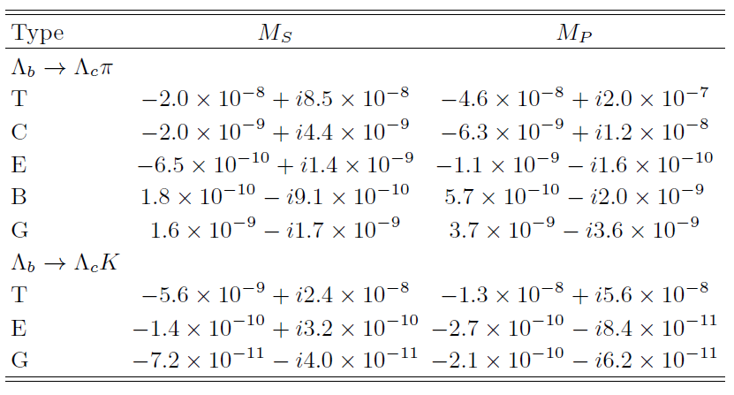
2. The Invariant amplitudes
Their generic factorization formula can be written as
T -type diagrams
dominant (>90%)
hierarchy pattern:
T>C>G>E>B

Slide 22
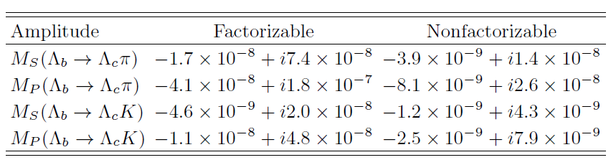

The factorizable contributions dominate over the nonfactorizable ones.
The T_b4 and T_b5 play the most significant role.
$$q_{a}^{2}∼1+r_{c}^{2}−r^{2}−x_{1}, m−m_{c}\sim 1 GeV$$
On shell in the large transverse momentum region.

Slide 23


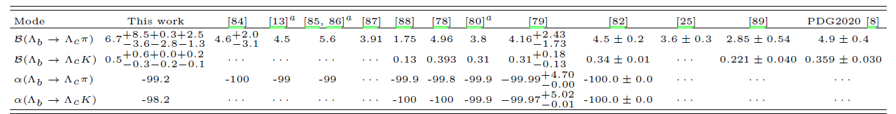






Our results are generally larger than other theoretical predictions due to the involved important nonfactorizable effects.
Without the NF, our results will be reduced to and
The nonfactorizable contributions can enhance the branching ratios by about 30%.
All the predicted asymmetry parameters are nearly -1.
The ratio =0.071 is compatible with the LHCb
measurement

Slide 24
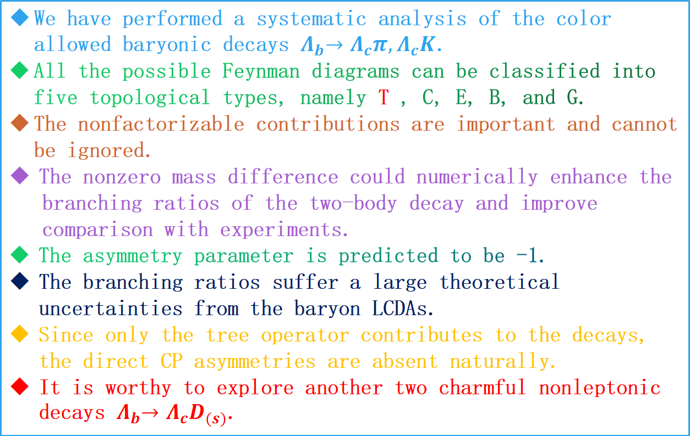
Summary
We have performed a systematic analysis of the color allowed baryonic decays $Λ_{b}{→Λ}_{c}π{,Λ}_{c}K$.
All the possible Feynman diagrams can be classified into five topological types, namely T , C, E, B, and G.
The nonfactorizable contributions are important and cannot be ignored.
The nonzero mass difference could numerically enhance the
branching ratios of the two-body decay and improve
comparison with experiments.
The asymmetry parameter is predicted to be -1.
The branching ratios suffer a large theoretical uncertainties from the baryon LCDAs.
Since only the tree operator contributes to the decays, the direct CP asymmetries are absent naturally.
It is worthy to explore another two charmful nonleptonic decays $Λ_{b}{→Λ}_{c}D_{(s)}$.

Slide 25
Thank you for attention!

Slide 26
Spare slides

Slide 27
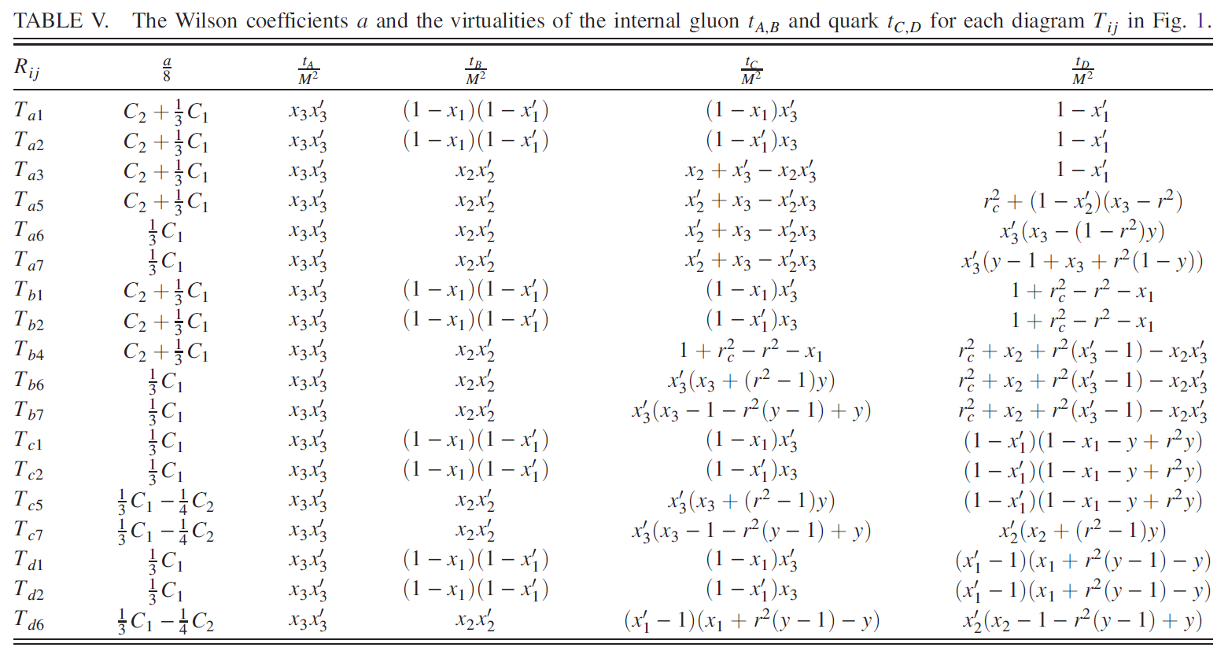

Slide 28
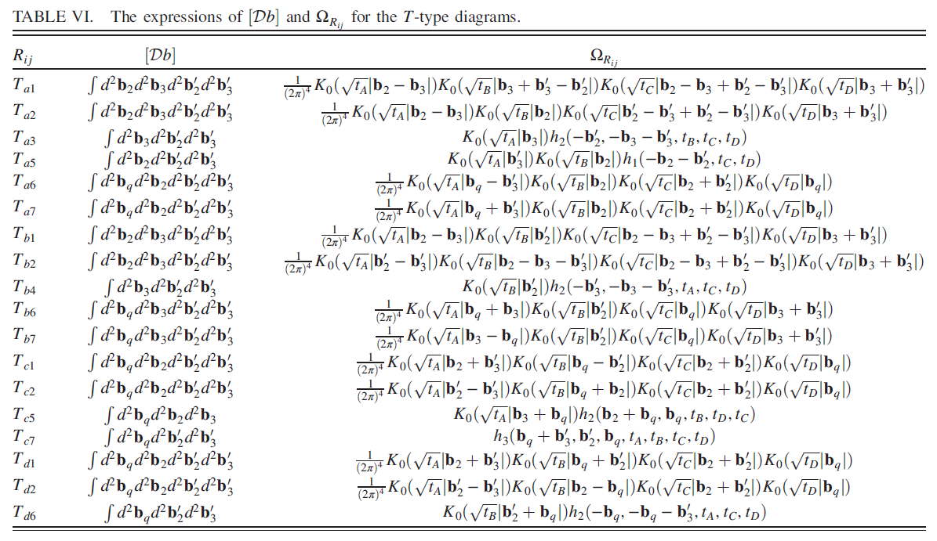

Slide 29
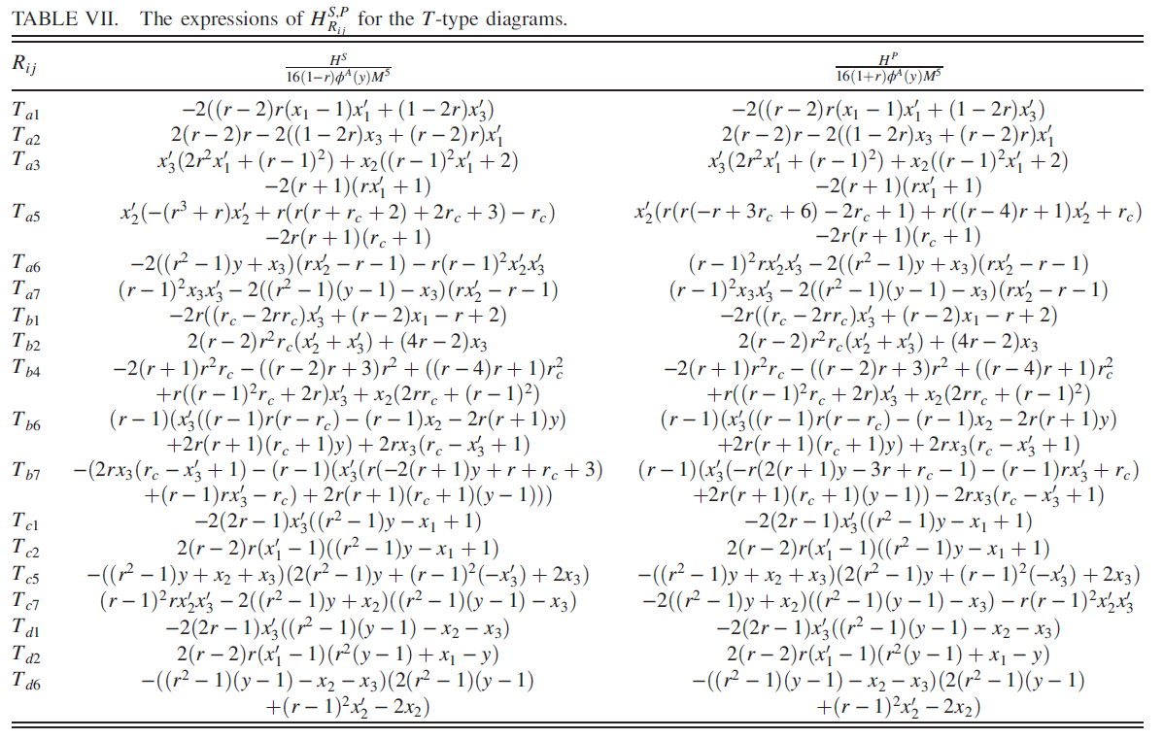

Slide 30
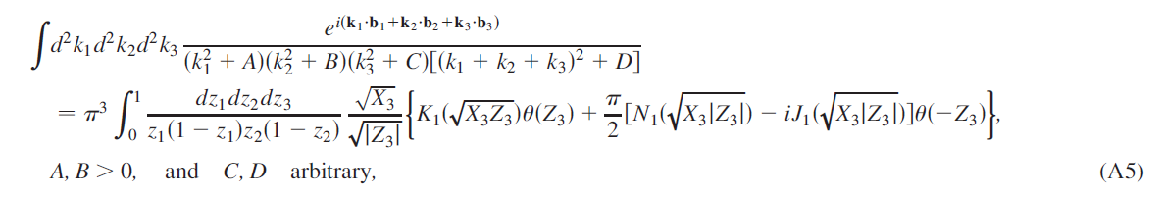

Slide 31
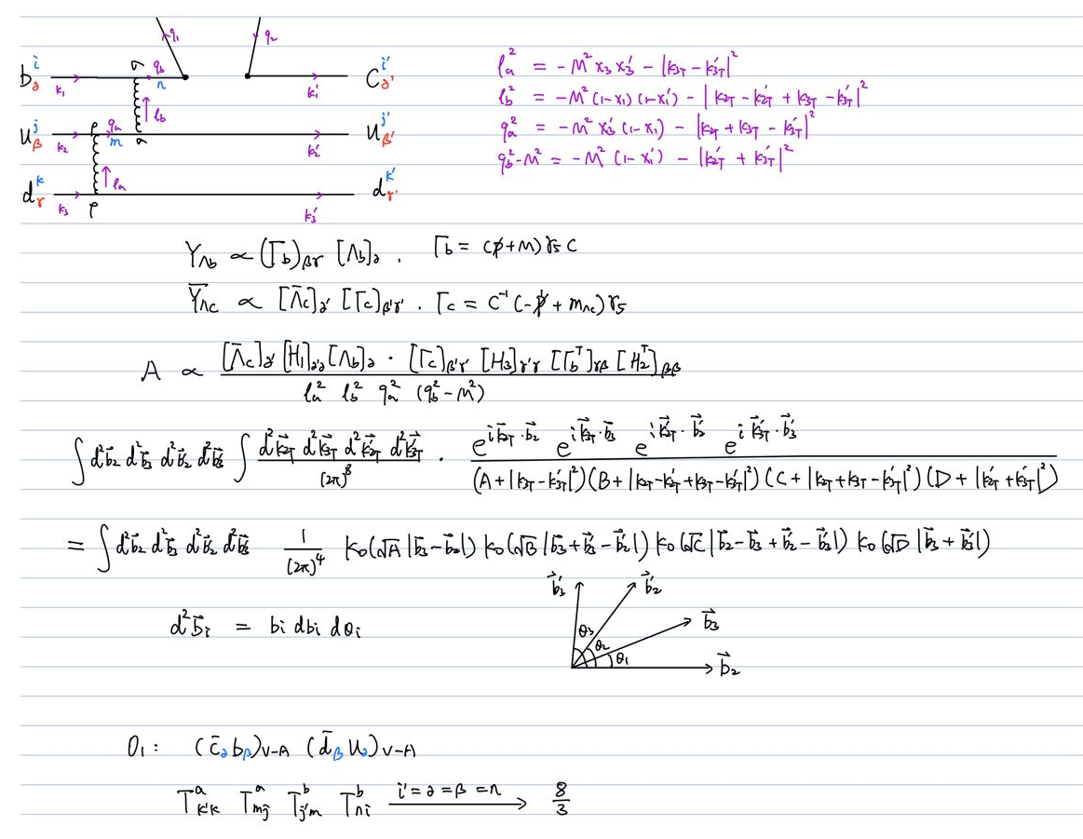
One example

