Slide 1
Status of Silicon Tracking
FU Chengdong

Slide 2
Status and Issues
Full silicon tracking chains migrated from cepcsoft/ILCSoft work
Test on non-uniform magnetic field
momentum shift
correction is considering
Study on tracking efficiency
low efficiency for tracks far away from IP
fixed through optimizing parameters, but…
Shift of track parameters (observed on D0)

Slide 3
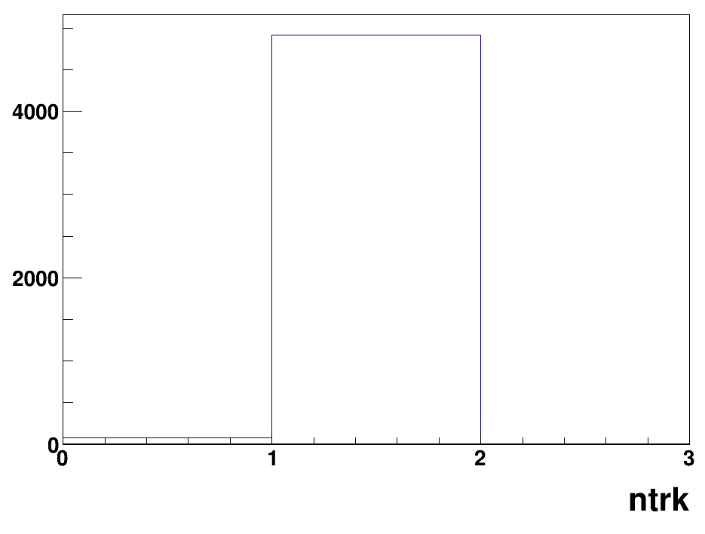
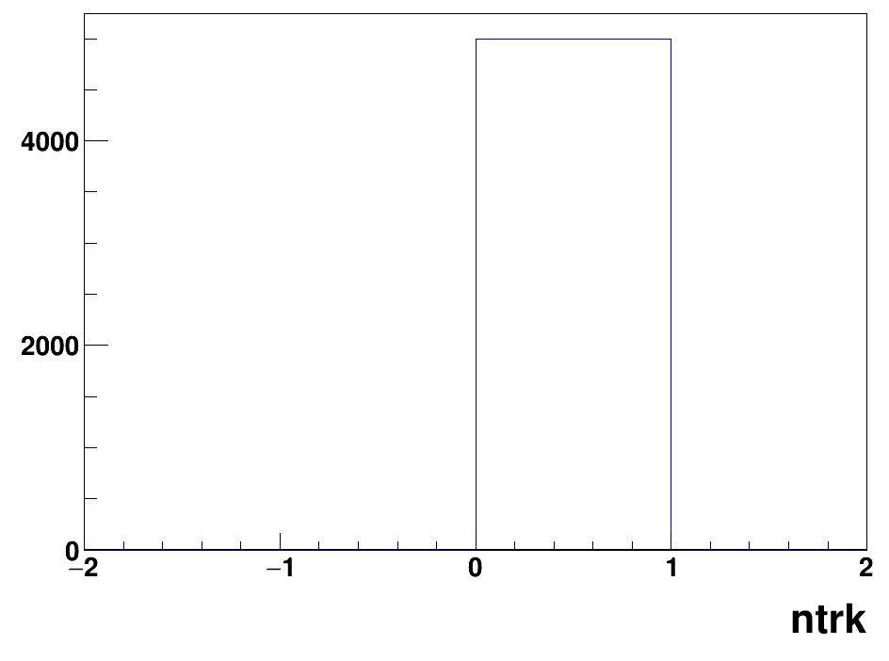
New Migration: ConformalTracking
status
works for 4th conceptual detector
comparison
single muon from vertex (1mm,1mm,-50mm) with θ=45°
ConformalTracking
SiliconTracking chain

Slide 4
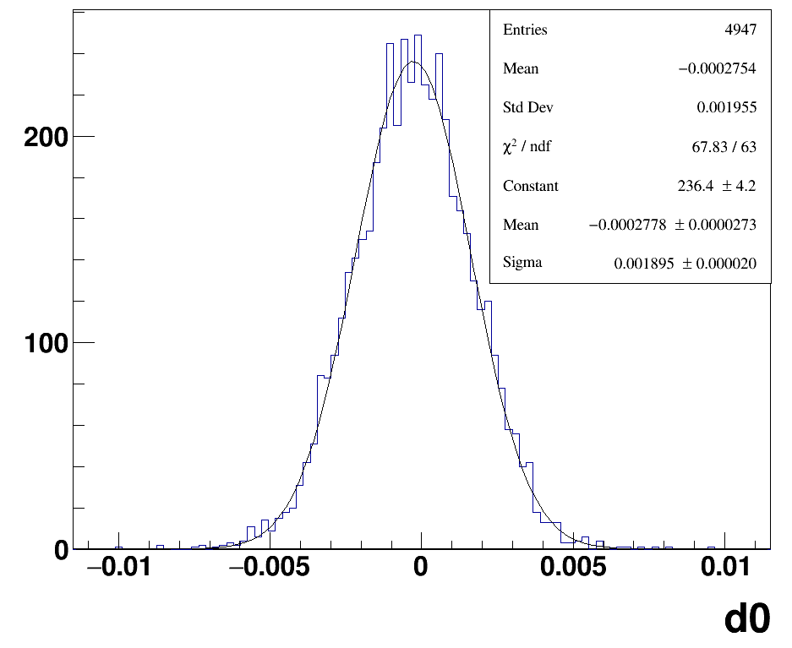
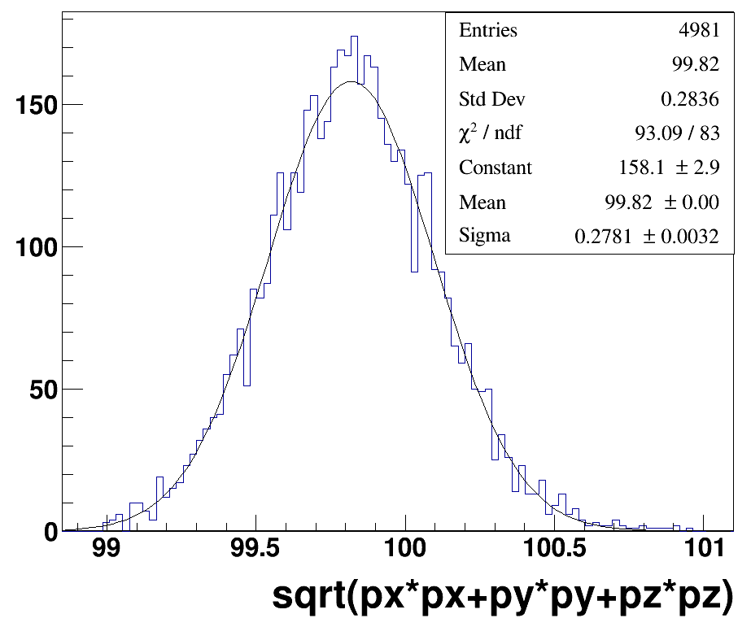
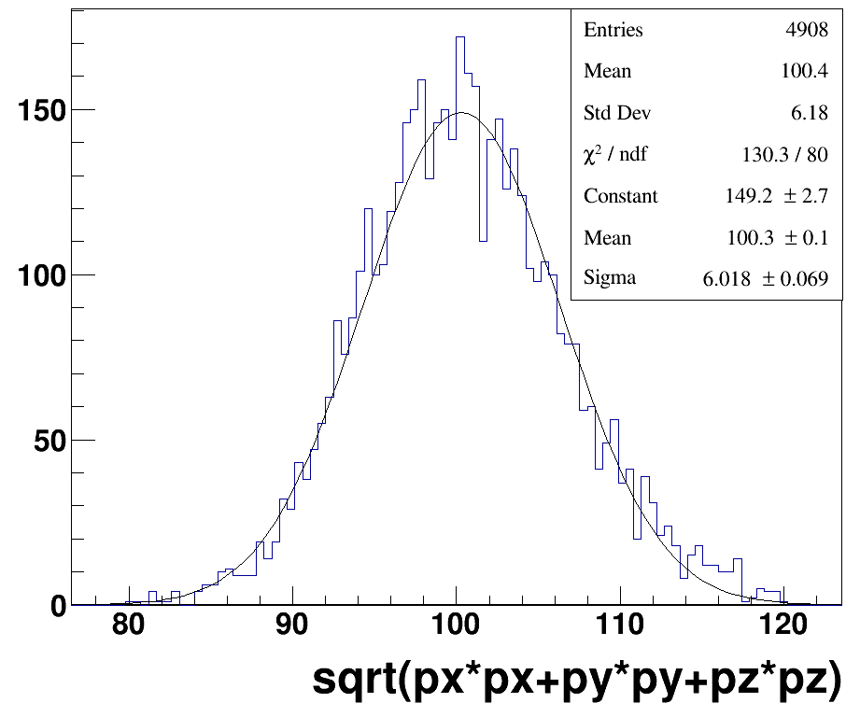
History: Resolution in CDR with cepcsoft
small d0 shift
observed momentum shift by silicon+TPC fitting, not obvious by silicon fitting only
silicon+TPC
silicon only

Slide 5
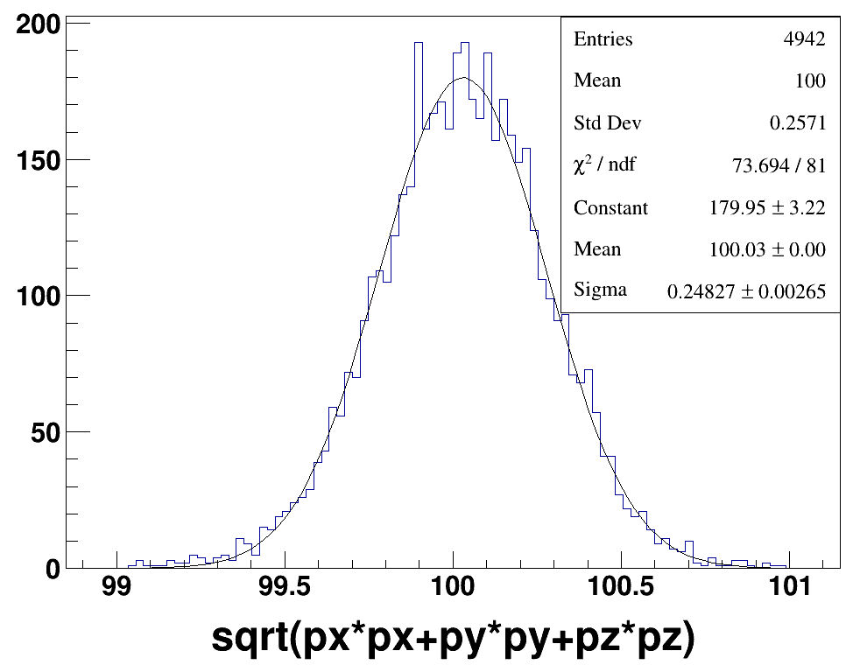
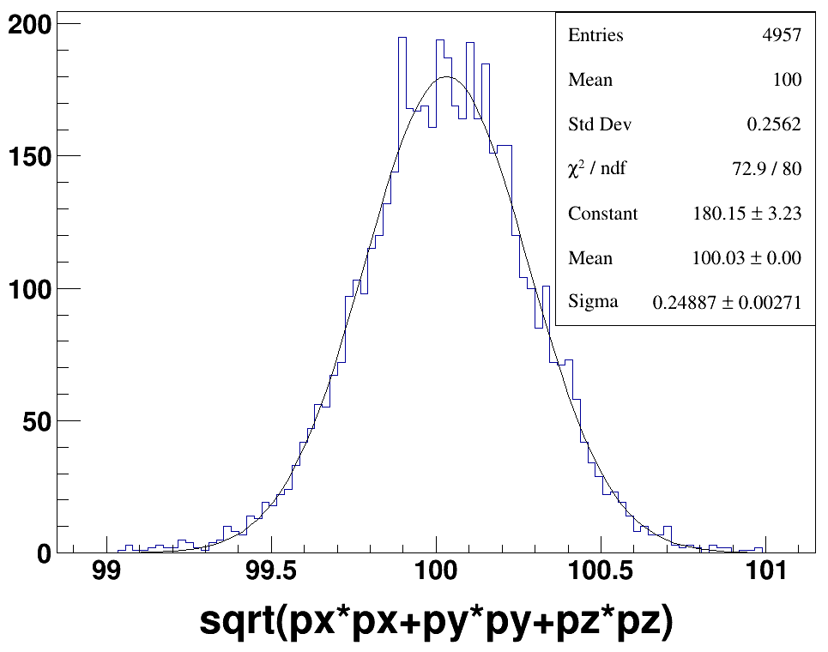
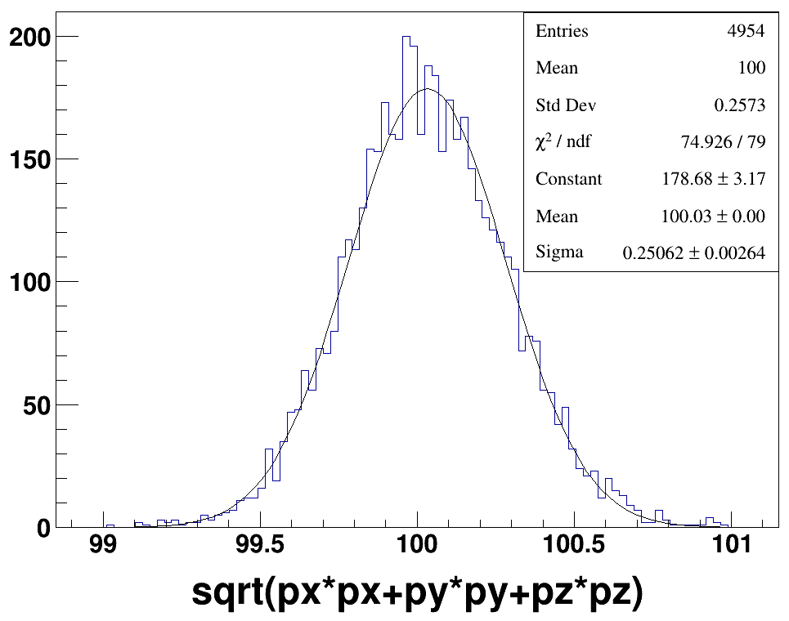
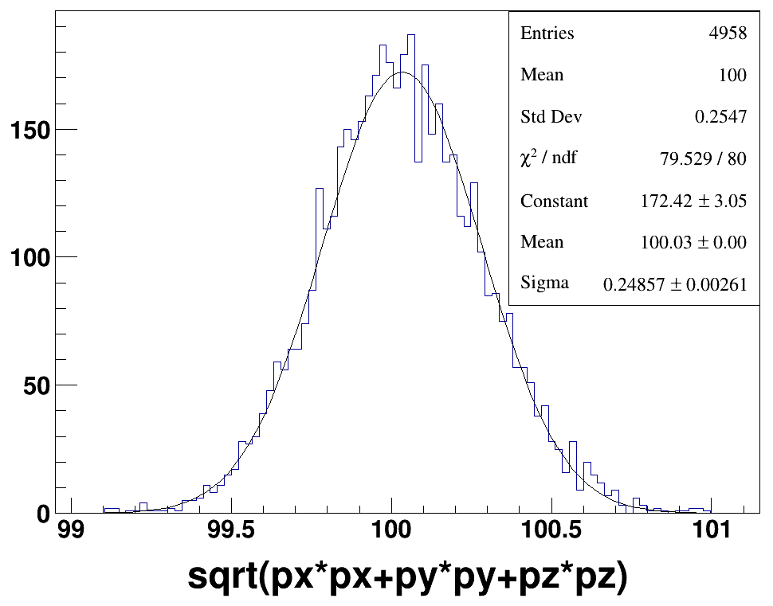
non-combine VS combine
ConformalTracking
SiliconTracking chain
ConformalTracking & Combined
SiliconTracking chain & Combined

Slide 6
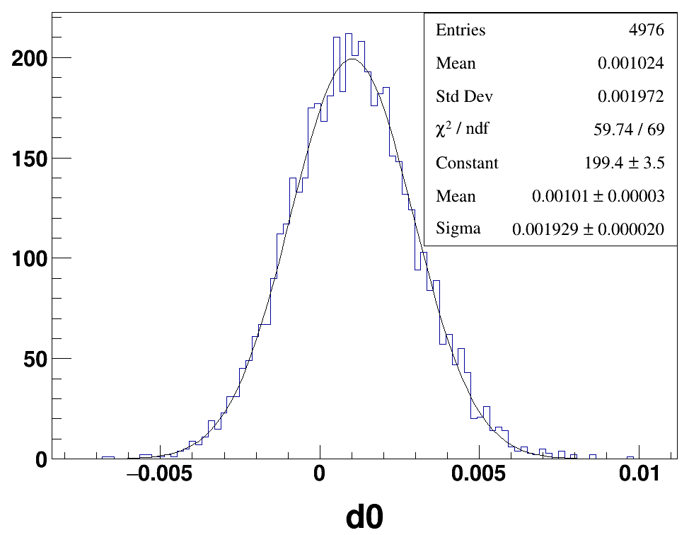
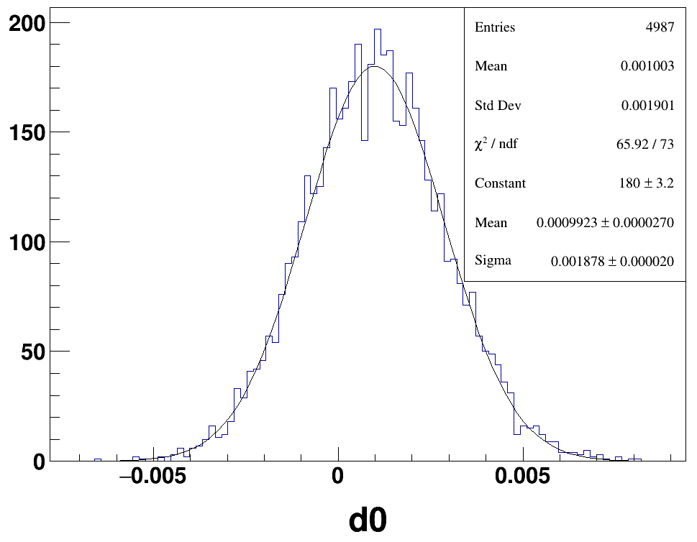
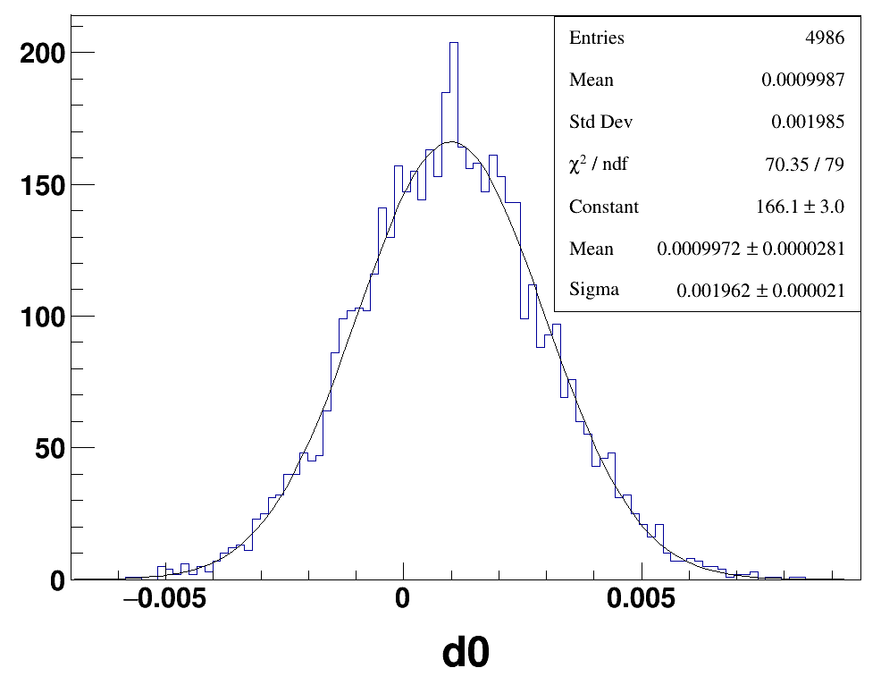
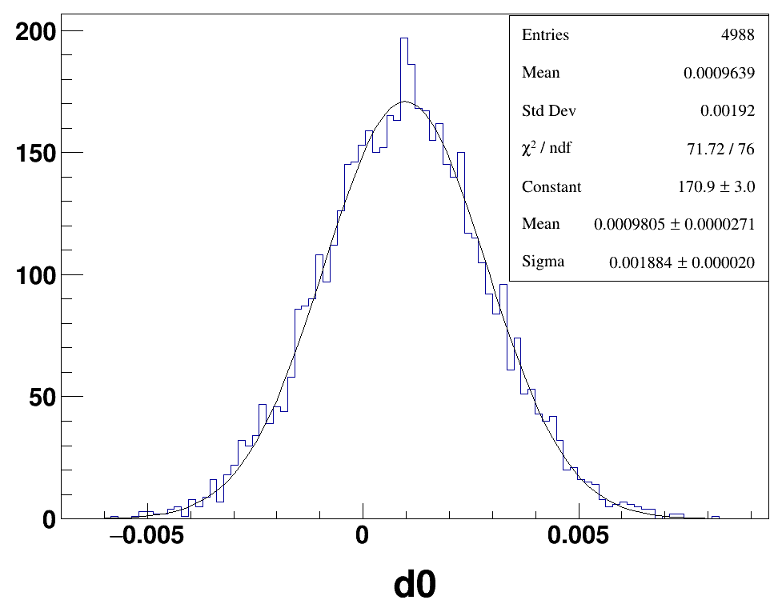
ConformalTracking
SiliconTracking chain
ConformalTracking & Combined
SiliconTracking chain & Combined

Slide 7
Conclusion and Plan
small affect on tracker hits simulation
small momentum shift for only silicon fitting
D0 shift larger than CDR, compare difference between 4th conceptual detector with CDR (such as beam pipe), and try to fix
Compare efficiency and CPU time between ConformalTracking and SiliconTracking
Optimize fitting for non-uniform field

