Slide 1
Overcoming Depolarizing Resonance ChenTao 2022-4-26

Slide 2
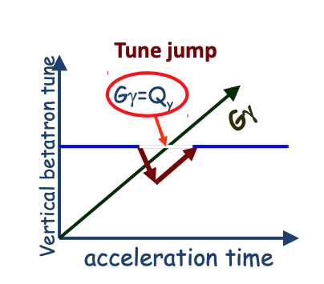
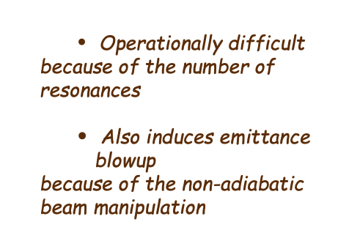
Overcoming Depolarizing Resonance
Harmonic orbit correction
to minimize the closed orbit distortion at all imperfection resonances
Operationally difficult for high energy accelerators
Tune Jump
Example：ZGS、AGS

Slide 3
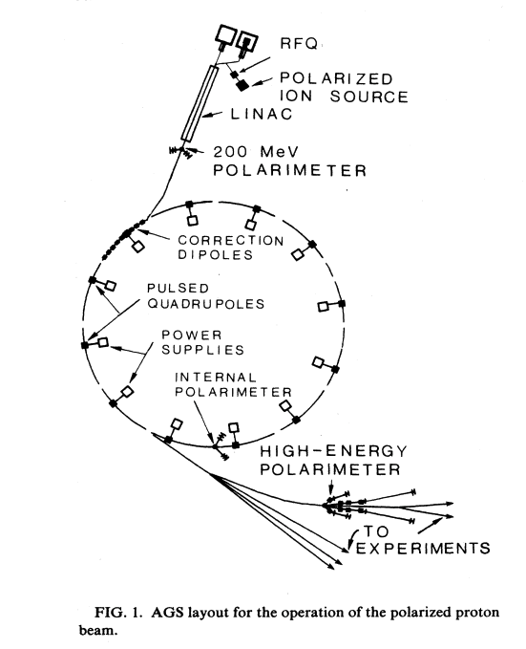
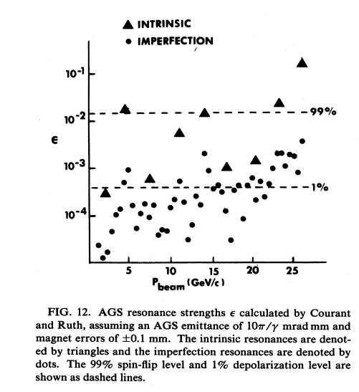
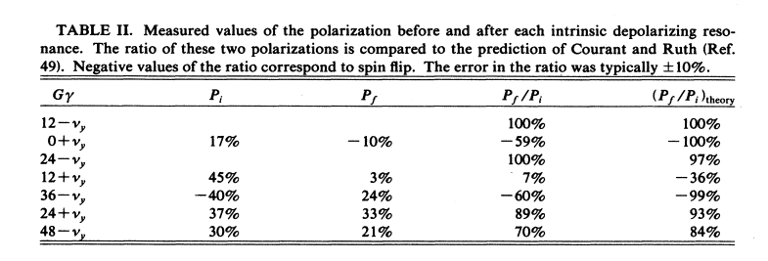
Acceleration of polarized proton in AGS
Accelerating polarized protons to 16 GeV
45 depolarizing resonances
The periodicity P is 12, and $ν_{y}$=8.75.
Intrinsic resonance at $Gγ=kP±ν_{y}$
Ref : F.Z. Khiari et al, PRD 39 (1989) 45

Slide 4
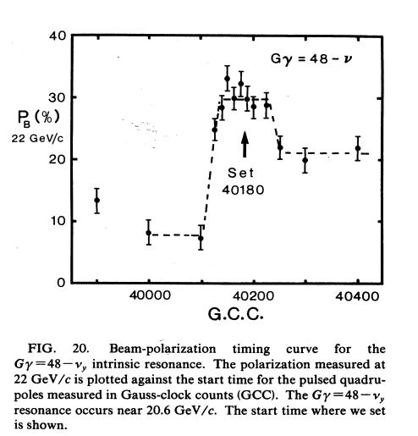
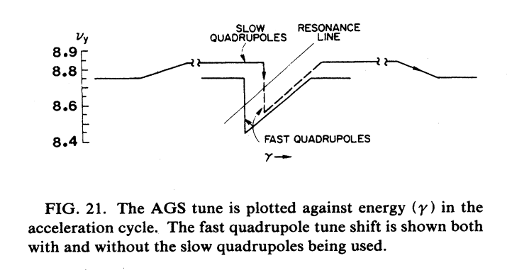
Acceleration of polarized proton in AGS
A large tune shift by these pulsed quadrupoles could cause a beam blow-up resonance if $ν$ crossed an integer or half-integer value
Slow quadrupoles moves $Gγ=36±ν_{y}$ far from $Gγ=27$
The $γ$ trigger pulse was determined by the AGS Gauss clock whose calibration against the true AGS ring magnetic field occasionally shifted by up to 1%
each fast quadrupole had a 1.6 $μs$ risetime and then decayed back to zero in about 3 $ms$
‘Understanding and somehow separating these two overlapping resonances was perhaps the most unexpected and diScult problem in the entire polarized beam project’

Slide 5
Overcome Intrinsic Resonance w. RF Dipole
intrinsic spin resonances at $Gγ=0+ν_{y},12+ν_{y},36±ν_{y}$,
partial Siberian snake for overcoming the imperfection spin resonances
50% polarization at the RHIC injection energy of 25 GeV.
Ref:M.Bai, PhD thesis, 1998

Slide 6
Partial Siberian Snake

Slide 7
Dual partial snake configuration
Ref： H. Huang, L .et al . PHYSICAL REVIEW SPECIAL TOPICS - ACCELERATORS AND BEAMS 17, 081001 (2014)

Slide 8
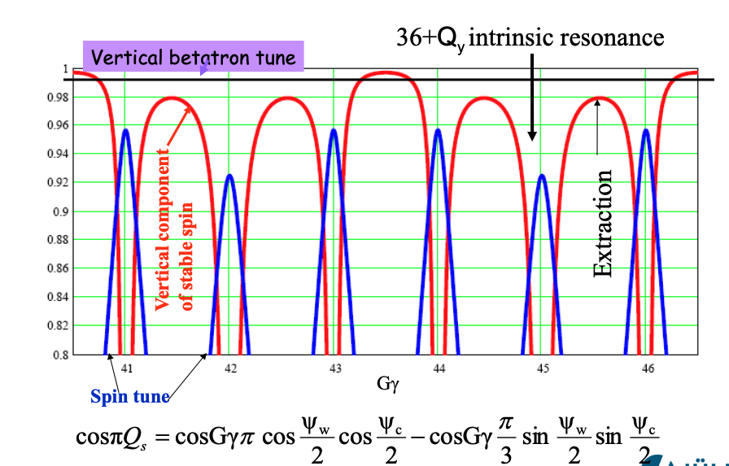
Spin tune with two partial snakes
IN AGS: The two partial snakes are separated by 1=3 of ring circumference

Slide 9
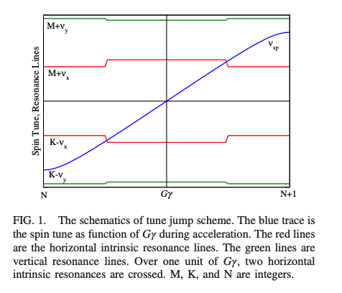
Horizontal intrinsic Resonance
horizontal tune jump
V. Schoefer et al, INCREASINGTHEAGSBEAMPOLARIZATIONWITH80TUNEJUMPS, Proceedings of IPAC2012, New Orleans, Louisiana, USA

