Slide 1
A General Amplitude Analysis Tool TF-PWA and its application
Yi Jiang (蒋艺)
University of Chinese Academy of Sciences (中国科学院大学)
Collaborators: Hao Cai¹, Chen Chen², Shuangshi Fang⁵, Hangjie Jing, Pei-Rong Li⁴, Beijiang Liu⁵, Yinrui Liu³, Xiao-Rui Lyu³, Runqiu Ma, Rong-Gang Ping⁵, Wenbin Qian³, Rongsheng Shi, Mengzhen Wang², Zi-Yi Wang³, Jiajun Wu³, Liming Zhang²,Yang-Heng Zheng³
¹WHU, ²THU, ³UCAS, ⁴LZU, ⁵IHEP
Friday, 09 December 2022

Slide 2
Outline
Introduction
TF-PWA
Framework (aim for general propose amplitude analysis)
Decay process
Helicity amplitude
Special technology (to make it fast and easy to use)
Automatic differentiation
Batch method
Factor system
Practical applications in physics analyses
Summary

Slide 3
Introduction
Partial wave analysis (PWA) is a powerful method to study multi-body decay processes, e.g.
to search for (exotic) resonances
and measure their properties
to understand CP violation
over phase space
Most of previous fitters are designed for special processes
or are time-consuming
A general PWA framework using modern acceleration technology (such as GPU, AD, …) is eagerly needed.
We have developed a new framework using TensorFlow
B : $p_{B}^{μ}$
A: $p_{A}^{μ}$
?
C : $p_{C}^{μ}$
$$∼P(p_{B}^{μ},p_{C}^{μ},p_{D}^{μ};θ)$$
…
D : $p_{D}^{μ}$

Slide 4
TF-PWA: Partial Wave Analysis with TensorFlow
Fast
General
Easy to use
GPU based
Vectorized calculation
Automatic differentiation
Quasi-Newton Method: scipy.optimize
Custom model available
Simple configuration file (example provided)
Most of the processing is automatic
All necessary functions implemented (details later)
Open access and well supported
https://github.com/jiangyi15/tf-pwa

Slide 5
The Framework
Automatic generations of different kinds of fitting outputs
General Decay Description.
Decay, Particle
General Helicity Angle Process
Results
data
MC sample
4-momenta
DecayChain
structure
plots
config.yml
angle
Configuration file
DecayGroup
fit fractions
alignment
Helicity Amplitude Rule
error matrices
users only need to take care of the input files
fit parameters
partial wave
distributions
amplitude model
fit
toy mc
Likelihood model,
Expression transformation
Fast Evaluation
…
Can be a black box for beginners

Slide 6
Configuration File
YAML (YAML Ain't Markup Language) format https://yaml.org
config.yml
Full example
Widely used in other packages
Easy to read and write
Easy to rewrite in scripts
Basic Parameters
Decay:
in state, out states
model (helicity amplitude
as default)
model parameters.
Particle:
spin parity ($J^{P}$),
mass ($m_{0})$
width ($Γ_{0}$),
model (Breit-Wigner),
model parameters.
decay:
B0:
- [DK , Dst, model: default, p_break: True]
- [DstK , D, p_break: True]
- [DstD , K, p_break: True]
DstD: [Dst, D]
DstK: [Dst, K]
DK: [D, K]
Dst: [D0, pi]
$B^{0}→D^{∗−}D^{0}K^{+}$, $D^{∗−}→D^{0}π^{−}$
config.yml
particle:
$top:
B0: {J: 0, P: -1, mass: 5.2}
$finals:
D: {J: 0, P: -1, mass: 1.86}
K: {J: 0, P: -1, mass: 0.5 }
D0: {J: 0, P: -1, mass: 1.86}
pi: {J: 0, P: -1, mass: 0.14}
DstD: [Zc(3900)]
DK: [Ds1(2700), Ds2(2573)]
DstK: []
Dst: {J: 1, P: -1, mass: 2.01, model: one}
$include: Resonances.yml
Resonances.yml
Zc(3900): {J: 1, P: +1, mass: 3.8817, width: 0.0266, model: default}
Ds1(2700): {J: 1, P: -1, mass: 2.7083, width: 0.120}
Ds2(2573): {J: 2, P: +1, mass: 2.5691, width: 0.0169}
The only places users need to modify for different decay processes

Slide 7
Topology based algorithm
$B^{0}→D^{∗−}D^{0}K^{+}$, $D^{∗−}→D^{0}π^{−}$
$$B^{0}$$
$$B^{0}$$
Initial particles
replace $D^{∗}D with Z_{c}\left(3900\right)$
Real decay chain:
$B^{0}→Z_{c}\left(3900\right)K^{+}$
$Z_{c}\left(3900\right)→D^{∗−}D^{0}$
$D^{∗−}→D^{0}π^{−}$
Decay1:
Decay1:
$$K$$
$$D^{∗}D$$
$$Z_{c}(3900)$$
$$K$$
Decay
Chain
Decay2
Decay2
$$D$$
$$D^{∗}$$
$$D^{∗}$$
$$D$$
Decay3
Decay3
final particles
$$D^{0}$$
$$π$$
$$D^{0}$$
$$π$$
Topological structure
Real Decay chain

Slide 8
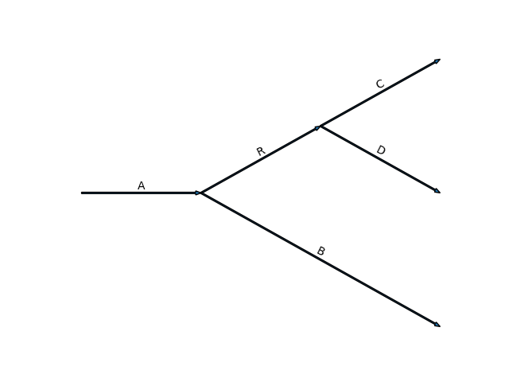
Helicity formalism
Feynman rules
User defined
$$C$$
$$R$$
$$D$$
Decay
$$H_{λ_{1},λ_{2}}D_{λ_{0},λ_{1}−λ_{2}}^{j_{0}⋆}(φ,θ,0)$$
$$A$$
Wigner-D matrix
$$B$$
$$R\left(M\right)=\frac{1}{m_{0}^{2}−M^{2}−im_{0}Γ},⋯$$
Particle
$$1$$
$$A_{λ_{A},λ_{B}^{′},λ_{C}^{′},λ_{D}^{′}}^{R}$$
=
$$D_{λ_{1},λ_{1}′}^{j_{1}⋆}(α,β,γ)$$
$$\sum_{λ}{{H_{λ_{R}λ_{B}}D}_{λ_{A},λ_{R}−λ_{B}}^{j_{A}⋆}\left(φ_{1},θ_{1},0\right)R\left(M\right)H_{λ_{C},λ_{D}}D_{λ_{R},λ_{C}−λ_{D}}^{j_{R}⋆}\left(φ_{2},θ_{2},0\right)}$$
$$D_{λ_{B},λ_{B}′}^{j_{B}⋆}\left(α_{B},β_{B},γ_{B}\right)D_{λ_{C},λ_{C}′}^{j_{C }⋆}\left(α_{C},β_{C},γ_{C}\right)D_{λ_{D},λ_{D}′}^{j_{D}⋆}(α_{D},β_{D},γ_{D})$$
alignment
probability: $|𝒜|^2$
Decay Group: $𝒜={\tilde{A}}_{1}+{\tilde{A}}_{2}+⋯$
Decay Chain: $\tilde{A}=A_{1}RA_{2}⋯$
Decay: Wigner D-matrix, $A=FD^{∗J} (φ,θ,0)$
Particle: Breit-Wigner: $R(m)$, user defined
$$\frac{dσ}{dΦ}∝\sum_{λ_{A}}{\sum_{λ_{B},λ_{C},λ_{D}}{{\left|\sum_{R}{A_{λ_{A},λ_{B},λ_{C},λ_{D}}^{R}}\right|}^{2}}}$$
Automatically calculated from decay structure

Slide 9
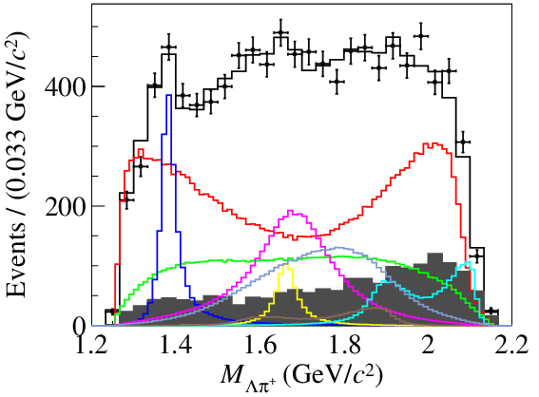
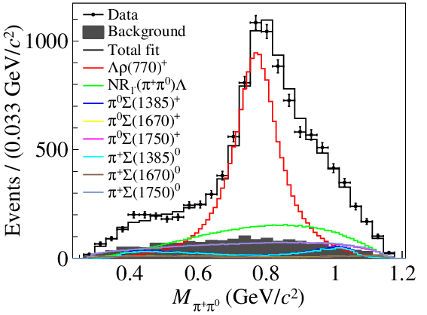
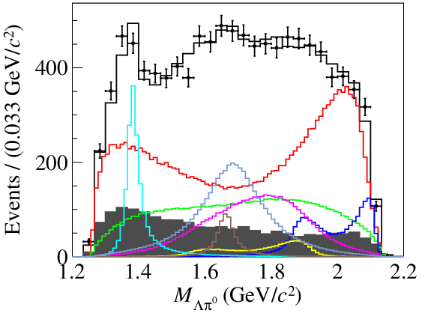
Application in BESIII analysis
[arxiv:2209.08464]
$Λ_{c}^{+}→Λ\left(→pπ^{−}\right)π^{+}π^{0}$
Simultaneous fit
7 energy points
Total 10k events, 854k MC
38 free parameters

Slide 10
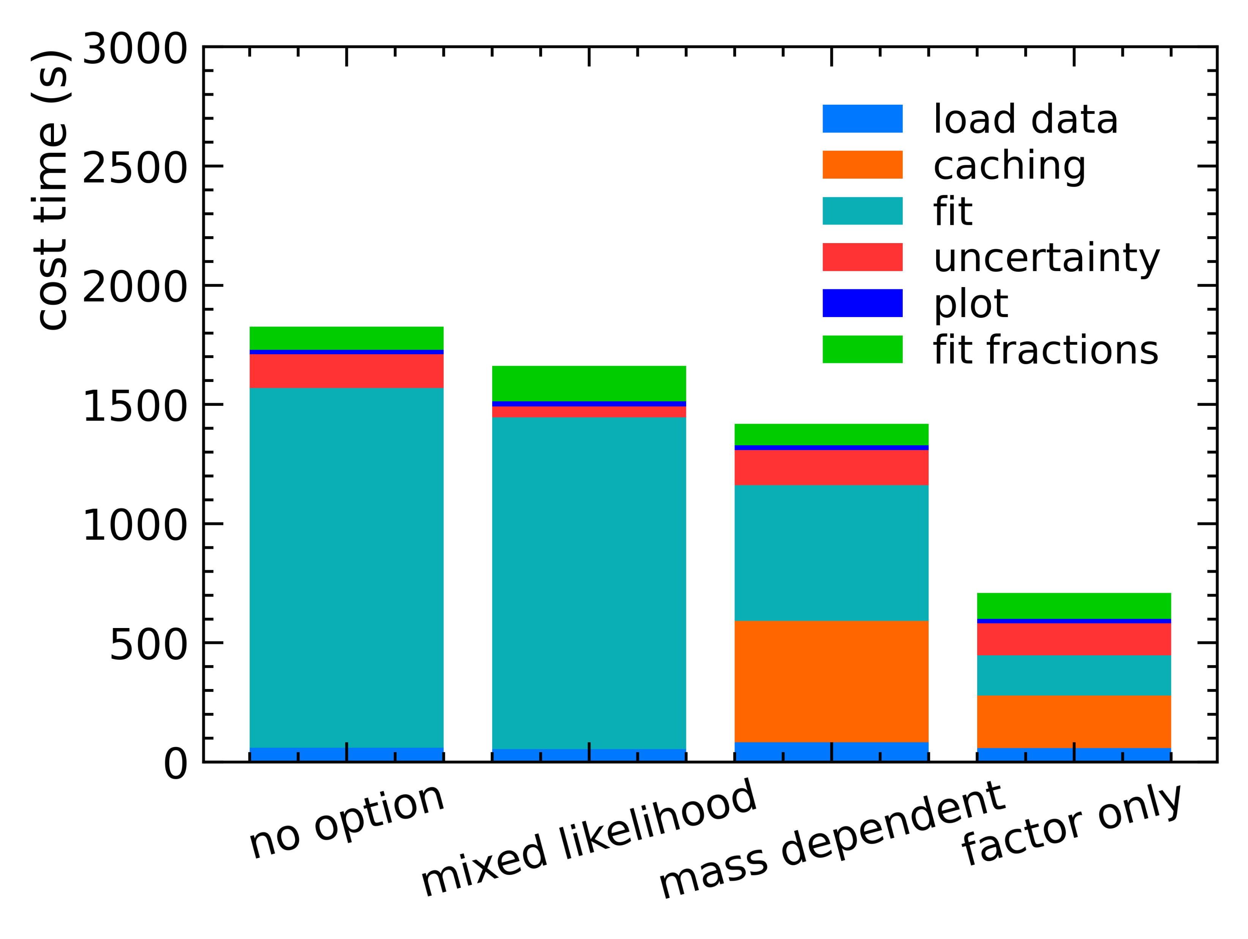
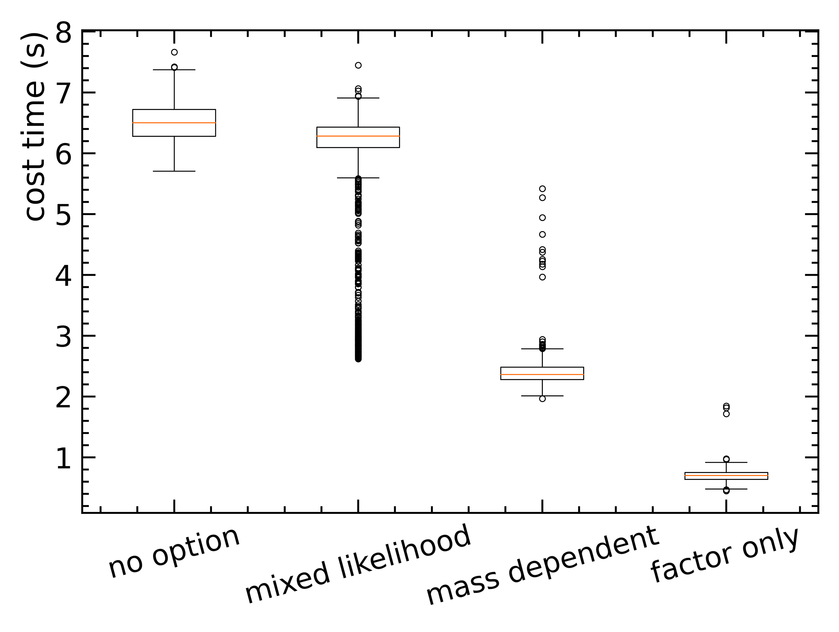
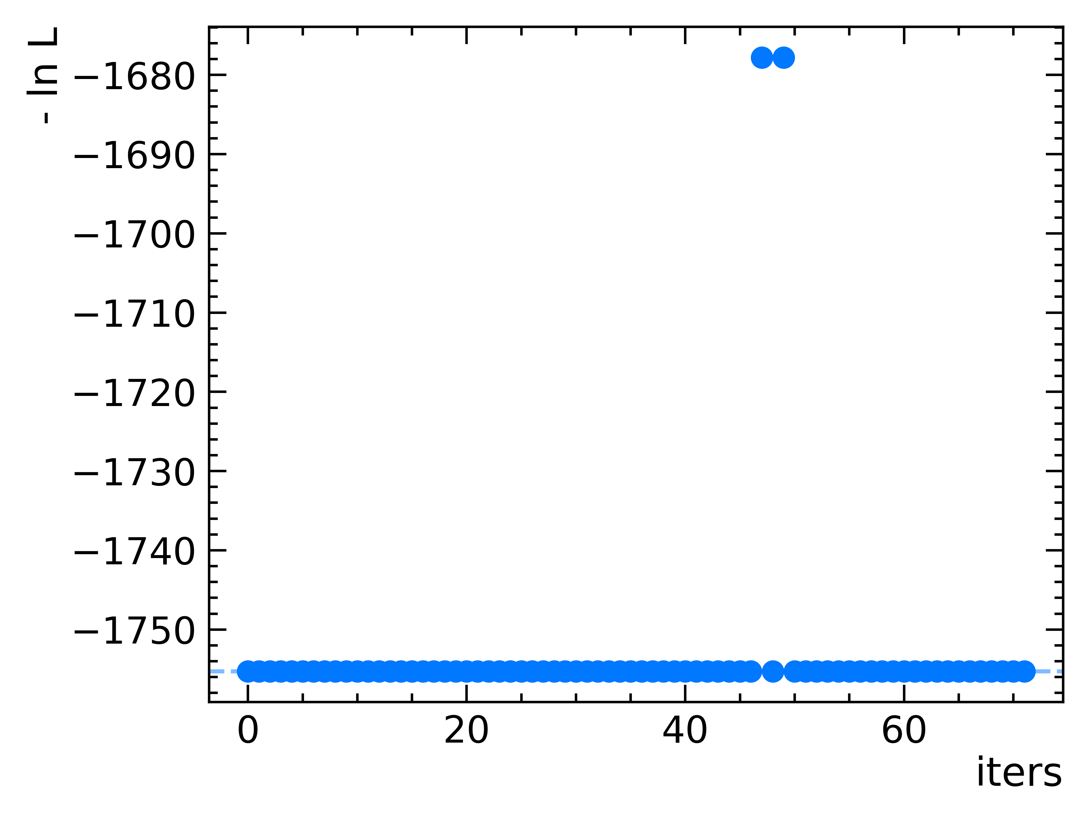
Real analysis performance
Environment:
NVIDIA RTX 3080
TensorFlow 2.2
CUDA 10.1
Optimized method in Factor System page
Caching method
Large time for caching
required more memory
Limited in special cases
Fit stability looks well in random initial parameters
Total fit time
~20 mins
Time in each iterations
Fit stability test
Fit time scale to
N iterations = 230

Slide 11
Application in LHCb Analysis
 | Time / numbers
Caching | ~99 s
Fit each iteration | 0.51+/-0.04 s
N iterations | ~ 160
Total time | ~5 min
[arxiv:2212.02716]
[arxiv:2212.02717]
$B^{+}→D^{−}D_{s}^{+}π^{+}+B^{0}→D^{0}D_{s}^{+}π^{−}$
6 datasets, two decay Simultaneous fit
4k + 4k events, 600k MC
8 points Spline function for $Dπ$ S-wave
34 parameters
First double charged tetraquark candidate
Mass: $2908 ± 11 ± 20$ MeV
Width: $136 ± 23 ± 11$ MeV

Slide 12
Functions implemented
Toy studies
Plotting
Fit fractions, interference fractions
Simultaneous fit between different datasets
Parity conversation
Gaussian constraints on parameters
2D chi2 test
CP violation fit
Final states with identical particles
Amplitude factorization
Resolution
Simple symbolic formula
Model independent fit
Error propagation
Data transform (helicity angle -> $p_{i}^{μ}$)
Particle lineshape function
Lazy loader for data
…
see https://tf-pwa.readthedocs.io/en/latest/auto_examples/index.html for some examples
See https://github.com/jiangyi15/tf-pwa/blob/dev/CHANGELOG.md change log

Slide 13
Summary
TF-PWA
A general framework is developed for PWA based on TensorFlow
Fast, easy to use and still in active development
TF-PWA cross-checked with other fitters used in BESIII and LHCb collaborations
Have been used for a large variety of amplitude analyses
Well supported , welcome to use and provide feedback.
Thank you for your attentions!

Slide 14
Back Up

Slide 15
Next to do
Fast
Better performance for large datasets
graph mode / JIT compile / …
multiple GPU
General
Amplitude formula: covariant tensor
General constrains of variable
Symmetry
Data input format
Likelihood formula and fit method
Easy to Use
more functions
visualization

Slide 16
Data process: Automatic angle calculation
Total data
{
"particle": {
A:{
"p":...,
"m":...
}
...
},
"decay": {
[A-> (C, D) +B,
(C, D)->C+D]:
{
A-> (C, D) +B: {
(C, D) : {
"ang": {
"alpha":[...],
"beta": [...],
"gamma": [...]
},
…
},
B : {...}
},
…
}, ...
}
}
$$p_{0}→p_{1}+p_{2}+p_{3}: p_{0}→p_{1}+p_{R}, p_{R}→p_{2}+p_{3}$$
final states 4-momentum
boost
$$p_{1}^{μ}, p_{2}^{μ},p_{3}^{μ}$$
$$p_{0}^{μ}=\left(E_{cm},0,0,0\right),p_{1}^{μ},p_{2}^{μ},p_{3}^{μ}$$
infer momentum
$$z_{0}=\left(0,0,1\right),$$
$$x_{0}=(1,0,0)$$
$$z_{R}=\vec{p_{R}},$$
$$y_{R}=z_{0}×z_{R}, x_{R}=y_{R}×z_{R}$$
$$p_{R}^{μ}=p_{2}^{μ}+p_{3}^{μ}$$
$$θ_{1}=z_{0}→z_{R},φ_{1}=x_{0}→x_{R}$$
$$M_{R}^{2}=p^{μ}p_{μ}$$
all angles
invariant mass
loop for decay and decay chain,
so that all angles are calculated automatically

Slide 17
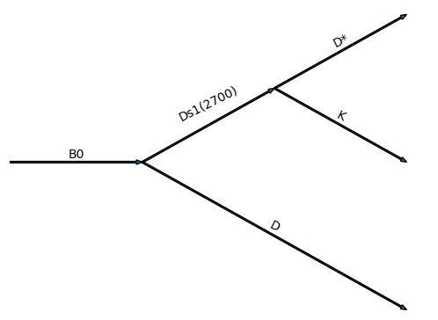
Topology based algorithm
Automatically built from config.yml
…
Particles
Decays
$$B^{0}→D_{s1}^{∗}{\left(2700\right)}^{+}D^{∗−}$$
initial state ($B^{0}$),
final states ($D^{∗−},D^{0},K^{+}$)
propagator ($D_{s1}^{∗}(2700)$)
One decay chain
$$D_{s1}^{∗}{\left(2700\right)}^{+}→D^{0}K^{+}$$
$$B^{0}→D_{s1}^{∗}{\left(2700\right)}^{+}(→D^{0}K^{+}) D^{∗−}$$
etc.
Ds1 = Particle(“Ds1(2700)”,J=1, P=-1)
Dst = Particle(“Dst”, J=1, P=-1)
B = Particle(“B”, J=0, P=-1)
…
generated by TFPWA
…
d1 = Decay(B, [Ds1, D])
$B^{0}→D^{∗−}D^{0}K^{+}$: decay group
dec1 = DecayChain([d1, d2, d3])
dg = DecayGroup([dec1, dec2, dec3])

Slide 18
Alignment angle
$$Boost: B_{z}\left(ω\right),Rotation: R_{z}\left(φ\right),R_{y}(θ)$$
For final state $\left|out\right\rangle =\left|p_{1}\right\rangle ⨂\left|p_{2}\right\rangle ⨂\left|p_{3}\right\rangle$ ,choose a single particle state $|p_{1}⟩$.
The final state define in $0→R,2;R→1, 3$:
$${\left|p_{1}\right\rangle }_{R}=B_{z}\left(ω_{1}\right)R_{z}\left(0\right)R_{y}\left(θ_{1}\right)R_{z}\left(φ_{1}\right)\left|p_{1}\right\rangle =L_{1}\left|p_{1}\right\rangle$$
$${\left|p_{1}\right\rangle }_{1}=B_{z}\left(ω_{2}\right)R_{z}\left(0\right)R_{y}\left(θ_{2}\right)R_{z}\left(φ_{2}\right)\left|p_{1}\right\rangle =L_{2}{\left|p_{1}\right\rangle }_{R}$$
On the other decay chain $0→R^{′},3;R^{′}→1, 2$:
$${\left|p_{1}\right\rangle }_{R^{′}}=B_{z}\left(ω_{1}^{′}\right)R_{z}\left(0\right)R_{y}\left(θ_{1}^{′}\right)R_{z}\left(φ_{1}^{′}\right)\left|p_{1}\right\rangle =L_{1}^{′}\left|p_{1}\right\rangle$$
$${\left|p_{1}\right\rangle }_{2}=B_{z}\left(ω_{2}^{′}\right)R_{z}\left(0\right)R_{y}\left(θ_{2}^{′}\right)R_{z}\left(φ_{2}^{′}\right)\left|p_{1}\right\rangle =L_{2}^{′}{\left|p_{1}\right\rangle }_{R^{′}}$$
The alignment angle is the rotation
$${\left|p_{1}\right\rangle }_{2}=L_{r}{\left|p_{1}\right\rangle }_{1}=B_{z}\left(ω\right)R_{z}\left(γ\right)R_{y}\left(β\right)R_{z}\left(α\right){\left|p_{1}\right\rangle }_{1}$$
So
$$L_{r}=B_{z}\left(ω\right)R_{z}\left(γ\right)R_{y}\left(β\right)R_{z}\left(α\right)=L_{2}^{′}L_{1}^{′}L_{1}^{−1}L_{2}^{−1}$$
In general
$$L_{r}=L_{a}L_{b}^{−1}=\left(\prod_{i}{L_{n−i}^{′}}\right)\left(\prod_{j}{L_{j}^{−1}}\right)$$
$$\vec{p_{2}}$$
$$\vec{p_{0}}$$
$$y_{1}$$
$$x_{2}$$
$$x_{1}$$
$$z_{2}$$
$$θ$$
$$φ$$
$$z_{1}$$
$$\vec{p_{1}}$$
$$y_{2}$$
$$\vec{p_{3}}$$
$$\vec{p_{4}}$$

Slide 19
choose SU(2) representation as
$$B_{z}\left(ω\right)=\left(\begin{matrix}e^{−\frac{ω}{2}} & 0 \\ 0 & e^{\frac{ω}{2}}\end{matrix}\right),R_{z}\left(φ\right)=\left(\begin{matrix}e^{−\frac{iφ}{2}} & 0 \\ 0 & e^{\frac{iφ}{2}}\end{matrix}\right),R_{y}\left(θ\right)=\left(\begin{matrix}\cos{\frac{β}{2}} & −sin{\frac{β}{2}} \\ \sin{\frac{β}{2}} & \cos{\frac{β}{2}}\end{matrix}\right)$$
$$ω=\operatorname{arccosh}{\frac{1}{\sqrt{1−\frac{v^{2}}{c^{2}}}}}$$
$${L_{ab}=B}_{z}\left(ω\right)R_{z}\left(γ\right)R_{y}\left(β\right)R_{z}\left(α\right)=\left(\begin{matrix}e^{−\frac{ω}{2}}\cos{\frac{β}{2}}e^{−\frac{i\left(α+γ\right)}{2}} & −e^{−\frac{ω}{2}}\sin{\frac{β}{2}}e^{\frac{i\left(α−γ\right)}{2}} \\ e^{\frac{ω}{2}}\sin{\frac{β}{2}}e^{−\frac{i\left(α−γ\right)}{2}} & e^{\frac{ω}{2}}\cos{\frac{β}{2}}e^{\frac{i\left(α+γ\right)}{2}}\end{matrix}\right)$$
$$\cos{β}=\cos^{2}{\frac{β}{2}}−\sin^{2}{\frac{β}{2}}=L_{11}L_{22}+L_{12}L_{21},β∈[0,π]$$
$$ω=\ln{|\frac{L_{22}}{L_{11}}|}$$
$α+γ=−2\operatorname{ang}{L_{11}}=2\operatorname{ang}{L_{22}}$, $α−γ=−2\operatorname{ang}{L_{12}}=−2\operatorname{ang}{L_{21}}$
$$L_{ab}^{−1}=\left(\begin{matrix}L_{22} & −L_{12} \\ −L_{21} & L_{11}\end{matrix}\right)$$
$$\left|L_{ab}\right|=1$$

Slide 20
Custom Model
$$F_{\left[λ_{R}λ_{B}\right]}\left(x;θ\right)D_{{[λ}_{A},λ_{R}−λ_{B}]}^{j_{A}⋆}\left(x\right)R (x;θ)F_{\left[λ_{C},λ_{D}\right]}(x;θ)D_{\left[λ_{R},λ_{C}−λ_{D}\right]}^{j_{R}⋆}(x)$$
$$D_{{[λ}_{B},λ_{B}^{′}]}^{j_{B}⋆}\left(x\right)D_{\left[λ_{C},λ_{C}^{′}\right]}^{j_{C }⋆}\left(x\right)D_{\left[λ_{D},λ_{D}^{′}\right]}^{j_{D}⋆}\left(x\right)→A_{\left[λ_{A},λ_{B}^{′},λ_{C}^{′},λ_{D}^{′}\right]}(x;θ)$$
Line: $R\left(M;a\right)=M+a$
from tf_pwa.amp import register_particle
from tf_pwa.amp import Particle
@register_particle("Line")
class LineModel(Particle):
def init_params(self): # define parameters
self.a = self.add_var("a")
def get_amp(self, *args, **kwargs):
""" model as m + a """
m = args[0]["m"]
zeros = tf.zeros_like(m)
return tf.complex(m + self.a(), zeros)
$$λ_{\left[RB\right]\left[ARB\right]\left[ \right]\left[CD\right]\left[RCD\right]\left[BB^{′}\right]\left[CC^{′}\right]\left[DD^{′}\right]→\left[AB^{′}C^{′}D^{′}\right]}$$
The shape is (number of events, ), type is complex128
$x$: all data, (*args, **kwargs)
$θ$: all parameters (self.a , …)
$$R(x;θ)$$
here the data, (*args, **kwargs) is passed from DecayChain.
For convenience, different data will be divided into different parts to pass to get_amp(self, *args, **kwargs)
The parameters are directly defined in the class, and the values are obtained from VarsManager.
Use register_particle to register it,
then it can be used in config.yml

Slide 21
Resonant models and LS coupling
Default Model:
$R\left(M\right):$ Breit-Wigner with running width
LS coupling: from helicity base to LS base
$F_{λ_{1},λ_{2}}: J^{P}(λ_{0})→j_{1}^{η_{1}}(λ_{1})+j_{2}^{η_{2}}(λ_{2})$
$$R\left(M\right)=\frac{1}{M^{2}−m_{0}^{2}+m_{0}Γ(M)},$$
$$Γ\left(M\right)=Γ_{0}{\left(\frac{q}{q_{0}}\right)}^{2l_{0}+1}\frac{m_{0}}{m}{B_{l_{0}}^{′}}^{2}(q,q_{0},d)$$
Blatt-Weisskopf factor
$$F_{λ_{1},λ_{2}}=\sum_{ls}{g_{ls}}\sqrt{\frac{2l+1}{2J+1}}\left\langle j_{1}λ_{1}; {j_{2}−λ}_{2} | sδ\right\rangle \left\langle l0;sδ | J δ\right\rangle q^{l}B_{l}^{′}\left(q,q_{0},d\right), δ=λ_{1}−λ_{2}$$
fit parameters
CG coefficients
LS coupling: $\left|j_{1}−j_{2}\right|<s<j_{1}+j_{2},\left|l−s\right|≤J≤l+s$
Parity conversation: $P=η_{1}η_{2}{\left(−1\right)}^{l}$

Slide 22
CP conservation
CP symmetry
Charge conjugate process has the same amplitude after parity transform
$A^{C}\left(p_{i}^{μ}\right)=A(−p_{i}^{μ})$
Using $−p_{i}^{μ}$ as input if charge is different
Parity symmetry in helicity formula
$A=F_{λ_{1},λ_{2}}D_{λ_{0},λ_{1}−λ_{2}}^{J∗}\left(φ,θ,0\right)$
Keep the relation in parameters
$F_{−λ_{1},−λ_{2}}={{\left(−1\right)}^{J_{0}−J_{1}−J_{2}}P}_{0}P_{1}P_{2}F_{λ_{1},λ_{2}}$
CP violate
use other decay model replace default.
use charge information in data to use different parameters
The normal way is using $−φ$ in LHCb,
It is the same by
the automatic angle calculation.

Slide 23
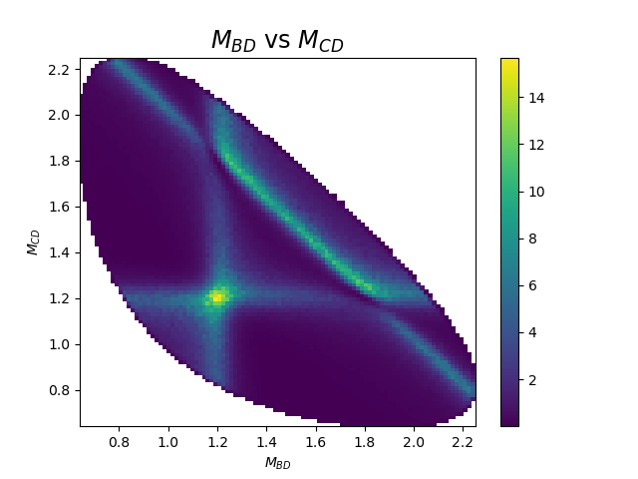
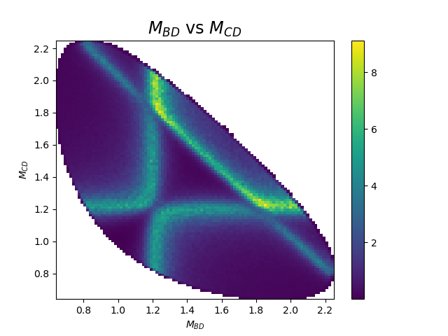
Identical particles
$$A→BCD$$
$$A→\left(BC\right)D,A→\left(BD\right)C$$
B，C are identical particles
$Amp\left(p_{B}, p_{C},p_{D}\right)⇒$ $Amp\left(p_{B}, p_{C},p_{D}\right)±Amp(p_{C},p_{B}, p_{D})$
boson :
Interference is enhanced
fermion:
Interference is eliminated
No identical particles

Slide 24
Fit process: maximum likelihood
$$P\left(x_{i};θ\right)=\frac{1}{σ_{tot}}\frac{dσ}{dΦ}\left(x_{i};θ\right), σ_{tot}=\sum_{x_{i}∈MC}{ω_{i}\frac{dσ}{dΦ}\left(x_{i};θ \right)}, ω_{i}=\frac{1}{N_{MC}}$$
Negative Log-Likelihood (NLL):
$$−\ln{L}=−α\sum_{x_{i}∈data}{w_{i}\ln{P\left(x_{i};θ\right)}}, α=\frac{∑w_{i}}{{∑w}_{i}^{2}}$$
Can either subtract background using weights or directly include background in the fit
BFGS:
$$θ_{i+1}=θ_{i}+kp_{i}$$
$$p_{i}=−B_{i}g_{i}$$
$$B_{i+1}=B_{i}+\frac{y_{i}y_{i}^{T}}{y_{i}^{T}s_{i}}−\frac{B_{i}s_{i}s_{i}^{T}B_{i}}{s_{i}^{T}B_{i}s_{i}}$$
$$s_{i}=θ_{i+1}−θ_{i}, y_{k}=g_{i+1}−g_{i}$$
Automatic differentiation:
Reduce the number of calculation of $−\ln{L}$, speed up the fit.
More accurate gradient, improve the fit result
$$\hat{θ}=argmin (−\ln{L})$$
$$g_{i}=−\frac{∂ln⁡L}{∂θ}$$
error matrix: $V_{ij}^{−1}=−\frac{∂\ln{L}}{∂θ_{i}∂θ_{j}}{\left.​\right|}_{θ=\hat{θ}}$
also calculated by automatic differentiation
$$V≈B$$

Slide 25
Automatic Differentiation (AD)
f
f=sin(z)
AD provides a powerful way to
calculate gradient automatically
Chain Rules
$×: \frac{∂f(g\left(x\right))}{∂x_{i}}=\frac{df}{dg}×\frac{∂g}{∂x_{i}}$
$+: \frac{∂f\left(h\left(x\right), g(x)\right)}{∂x_{i}}=\frac{∂f}{∂h}\frac{∂h}{∂x_{i}}+\frac{∂f}{∂g}\frac{∂g}{∂x_{i}}$
z=g(a, b)
a=x
b=x
x
Only basic operator need for differentiation.
Similar as amplitude rules
$$f=\sin\left(x^{x}\right)=\sin\left(z\right),z=x^{x}$$
$$g\left(a,b\right)=a^{b}$$
$$\frac{df}{dz}=\cos{z },\frac{∂g(a,b)}{∂a}=ba^{b−1},\frac{∂g(a,b)}{∂b}=a^{b}\ln{a}$$
Symbolic method:
$$\frac{df}{dx}=\frac{df}{dz}\frac{dg\left(x,x\right)}{dx}=\cos{z}\left[\left(ba^{b−1}\right){\left.​\right|}_{a,b=x}+\left(a^{b}\ln{a}\right){\left.​\right|}_{a,b=x}\right]$$
$$=\cos{x^{x}}[xx^{x−1}+x^{x}\ln{x}]=x^{x}\cos{x^{x}}\left(\ln{x}+1\right)$$
$$\text{Automatic} \text{Differentiation} \text{(}\text{numerically}\text{)}:$$
$$\frac{df}{dx}(1)=\frac{df}{dz}(1^{1})[\frac{∂g}{∂a}\left(1, 1\right)+\frac{∂g}{∂b}\left(1, 1\right)]=0.5403$$
forward
backward

Slide 26
Reduce Memory Usage
y
AD time and space complexity
Complexity | time | memory
forward | O(mns) | O(mn)
backward | O(ms) | O(ms)
y=f(x)
$$\frac{∂y}{∂θ_{i}}$$
$$θ_{1}$$
…
$$θ_{n}$$
n: number of parameters
m: number of data
s: model complexity
memory is dependent on number of data for each differentiation calculation
split MC into batches $MC→\left\{MC_{0},MC_{2},⋯\right\}⇒memory↓$
$$−\frac{∂\ln{L}}{∂θ}=−α\frac{∂\left[\sum{w_{i}\ln{\frac{dσ}{dΦ}\left(x_{i}\right)}}\right]}{∂θ}+\frac{α∑w_{i}}{\sum_{j}{I_{j}}}\left(\sum_{j}{\frac{∂I_{j}}{∂θ}} \right), I_{j}=\sum_{i∈MC_{j}}{ω_{i}\frac{dσ}{dΦ}(x_{i};θ)}$$

Slide 27
Benchmarks
number of parameters: $N=8$
reference time: $t=0.39$
factor of GPU/CPU: $k_{1}=2$
factor of ‘mass dependent’: $k_{1}=0.5$
bias of ‘mass dependent’: $a_{1}=18$
factor of ‘factor only’: $k_{2}=0.1$
bias of ‘factor only’: $a_{1}=9.4$
a simple toy in
https://github.com/jiangyi15/tf-pwa-example
Cost time (s) | Cached (a) | each iteration | Total fit
without gradient | 0 | 9 * 0.14 | 40
Normal CPU fit | 0 | 0.56 | 25
Normal GPU fit | 0 | 0.39 | 18
mass dependent | 18 | 0.17 | 31
factor only | 9.4 | 0.046 | 21
without gradient: $(N+1) t/2$
Normal CPU fit: $k_{G} t$
Normal GPU fit: $t$
Faster
mass dependent : $k_{1}t+a_{1}$
factor only: $k_{2}t+a_{2}$
when model become more complex,
the effect would become more significant
the number of iterations is 23

Slide 28
Benchmarks
CPU: i7-9750H@2.6 Hz with 12 cores
GPU: Nvidia 1660 Ti, a cheap GPU
Test based on simple MC (200000) sample of a simple amplitude model of
$e^{+}e^{−}→R_{1}\left(1^{+}\right)π,R_{1}→D^{∗}D^{∗}$
Both based on TF-PWA
process | CPU (ms) | GPU (ms) | Ratio
$$N=∫{\left|A\right|}^{2}dΦ$$ | 573 | 53 | ~11 X 12 = 132
$N$ with $\frac{∂N}{∂θ}$ | 1122 | 117 | ~9.5 X 12 = 114
Almost a factor of 100 times faster for GPU than single CPU core.
Automatic differentiation cost the same time as normal evaluation.

Slide 29
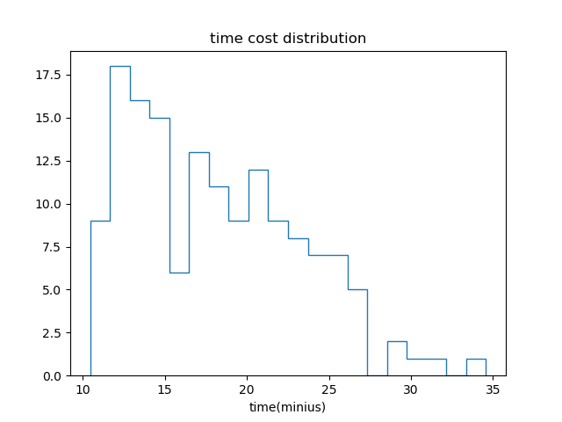
Performance in a real fit
number of function evalutions ~ 500
number of gradient evalutions ~ 500
average ~ 10 – 30 minutes
Randomizing of initial parameters, better searching for global minimum
Toy studies
Uncertainty studies etc.

Slide 30
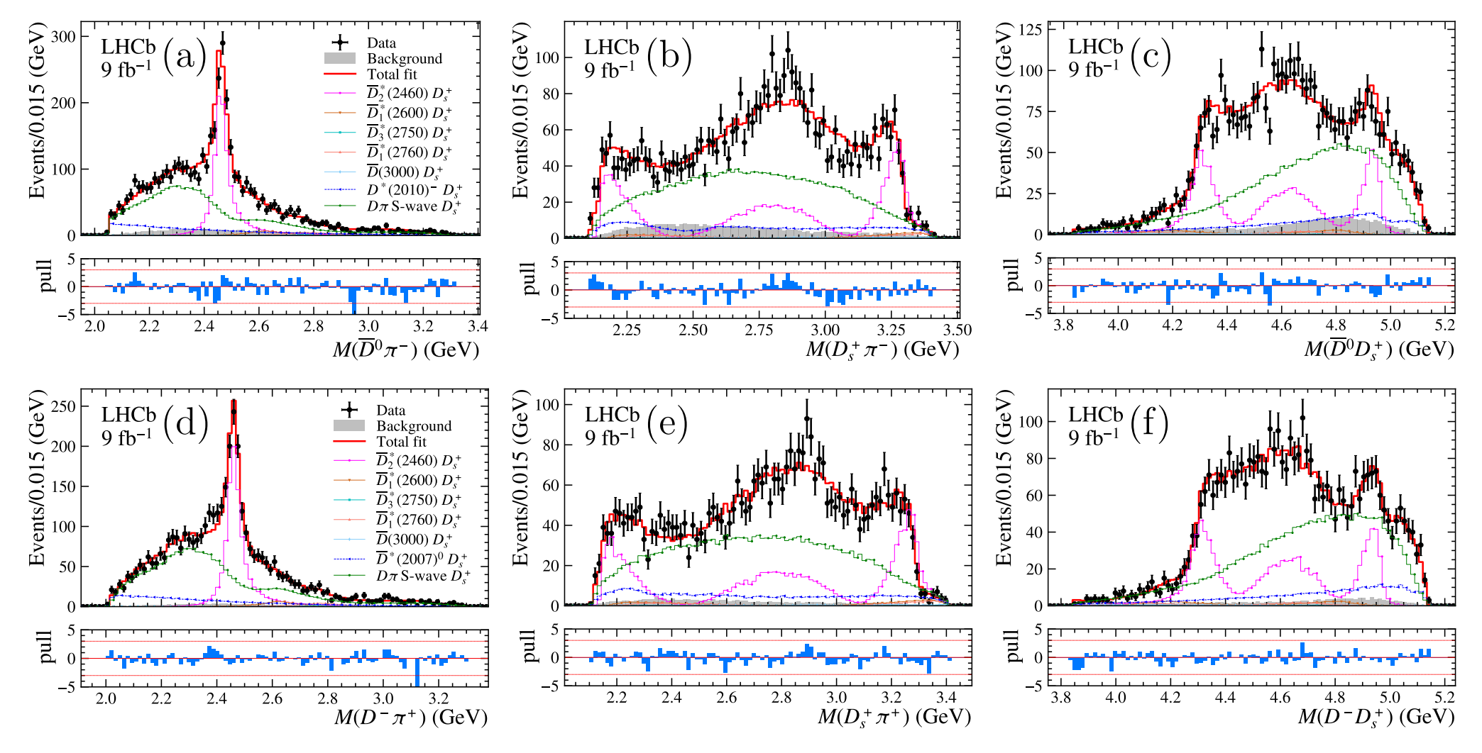
Amplitude analysis without new states
Only $D^{∗}$ states and $Dπ$ S-wave, can not describe it well
$$\text{LHCb}\text{−}\text{PAPER}\text{−2022−026}$$

Slide 31
Automatic angle calculation
$$z_{0}$$
$$z_{1}$$
$$p_{1}$$
$$y_{1}$$
input
momentum of final states
$p_{1}^{μ},$ $p_{2}^{μ},$ $p_{3}^{μ},⋯$
initial coordinate system $(x_{0},y_{0},z_{0})$
decay chains
output
helicity angle
Euler Angle $\left(x_{0},y_{0},z_{0}\right)→(x_{1},y_{1},z_{1})$
$z_{1}=\vec{p_{1}}, y_{R}=z_{0}×z_{1},$
$φ_{1}=roation angle y_{0} →y_{R}$
$\cos{θ_{1}}=\frac{z_{0} ⋅z_{1}}{\left|z_{0}\right|\left|z_{1}\right|}$
alignment angle
$$θ$$
$$x_{1}$$
$$y_{0}$$
$$φ$$
$$x_{0}$$
$$\vec{p_{2}}$$
$$\vec{p_{0}}$$
$$y_{1}$$
$$x_{2}$$
$$x_{1}$$
$$z_{2}$$
$$θ$$
$$φ$$
$$z_{1}$$
$$\vec{p_{1}}$$
$$\vec{p_{4}}$$
$$y_{2}$$
Traverse though decay chain, then the process is automatic.
$$\vec{p_{3}}$$

Slide 32
Plot of Angle
${\vec{p}}_{B}^{A}$ means momentum of B in the rest frame of A
$φ$ means the rotation is anticlockwise, $−φ$ means the rotation is clockwise
The sign Is dependent on data
$$θ_{D^{∗}}^{D^{∗}D}$$
$${\vec{p}}_{D^{0}}^{{D^{∗}(D}^{∗}D)}$$
$$D^{∗}→D^{0}π$$
$$χ=φ_{D^{0}}^{D^{∗}}+φ_{D}^{DK}$$
$$θ_{D^{0}}^{D^{∗}(D^{∗}K)}$$
$$D^{∗}→D^{0}π$$
$${\vec{p}}_{π}^{{D^{∗}(D}^{∗}D)}$$
$$θ_{D^{0}}^{D^{∗}}$$
$$θ_{D^{∗}}^{D^{∗}D}$$
$${\vec{p}}_{D^{∗}}^{D^{∗}D}$$
$$D^{∗}→D^{0}π$$
$${\vec{p}}_{D^{0}}^{D^{∗}(D^{∗}K)}$$
$$φ_{D^{0}}^{D^{∗}(D^{∗}D)}$$
$${\vec{p}}_{π}^{D^{∗}(D^{∗}K)}$$
$${\vec{p}}_{D^{0}}^{D^{∗}}$$
$${\vec{p}}_{π}^{D^{∗}}$$
$$−φ_{D^{0}}^{D^{∗}(D^{∗}K)}$$
$$θ_{D^{∗}}^{ D^{∗}K}$$
$$\left(D^{∗}D\right)→D^{∗}K$$
$$−φ_{D^{∗}}^{D^{∗}D}$$
$$θ_{(D^{∗}K)}^{B}$$
$${\vec{p}}_{D^{∗}}^{D^{∗}K}$$
$$θ_{\left(D∗D\right)}^{B}$$
$${\vec{p}}_{K}^{D^{∗}D}$$
$$θ_{\left(DK\right)}^{B}$$
$$φ_{D^{0}}^{D^{∗}}$$
$$(D^{∗}K)→D^{∗}K$$
$${\vec{p}}_{D^{∗}D}^{B}$$
$$B→\left(DK\right)D^{∗}$$
$$−φ_{D}^{DK}$$
$${\vec{p}}_{D^{∗}K}^{B}$$
$${\vec{p}}_{K}^{D^{∗}K}$$
$$φ_{\left(D∗D\right)}^{B}$$
$$φ_{D^{∗}}^{ D^{∗}K}$$
$${\vec{p}}_{K}^{B}$$
$${\vec{p}}_{D}^{DK}$$
$${\vec{p}}_{D}^{B}$$
$$B→\left(D^{∗}D\right)K$$
$${\vec{p}}_{DK}^{B}$$
$$θ_{D}^{DK}$$
$$B→\left(D^{∗}K\right)D$$
$$−φ_{(D^{∗}K)}^{B}$$
$${\vec{p}}_{K}^{DK}$$
$$\left(DK\right)→DK$$

Slide 33
Automatic Differentiation (AD)
AD provides a powerful way to calculate gradient automatically
Time for calculating gradient
$N$ is the number of parameters
$t$ is the time of function evaluation
Fast Fit
can reduce time for many gradient based method
$f\left(x\right)≈f\left(x_{0}\right)+\frac{∂f}{∂x}\left(x−x_{0}\right)$
$+\frac{∂^{2}f}{∂x_{i}∂x_{j}}{\left(x−x_{0}\right)}_{i}{\left(x−x_{0}\right)}_{j}⋯$
$x_{out}=argmin f\left(x\right)⇒x_{out}≈{\left(\frac{∂^{2}f}{∂x_{i}∂x_{j}}\right)}^{−1}\frac{∂f}{∂x}$
Error propagation
$σ_{y}=\sqrt{\frac{∂y}{∂x_{i}}V_{ij}\frac{∂y}{∂x_{j}}}$
Calculate uncertainties of physical observables , (such as fit fractions)
Easy to use in TFPWA
AD | [$f\left(x+δ\right)−f(x)]/δ$
$$\sim t$$ | $$\sim N t$$
Example AD in likelihood
$$−\ln{L}=\sum{\ln{{\left|\sum_{λ}{g_{λ}A_{λ}\left(φ,θ,0\right)}\right|}^{2}}}$$
Automatic calculated by TensorFlow
$$\frac{∂\ln{L}}{∂g_{λ}}=\sum{\left[\frac{1}{{\left|\sum_{λ}{g_{λ}A_{λ}\left(φ,θ,0\right)}\right|}^{2}}× \sum_{λ^{′}}{g_{λ^{′}}^{∗}A_{λ^{′}}^{∗}}×A_{λ}\right]}$$
Most terms are already calculated in $−\ln{L}$

Slide 34
Batch method
AD required the intermediate result
Complex model have more intermediate result
Large size of data required large memory
Limited GPU memory
Divide total data into small size of data
Rewrite some parts which can not be divided
$$−\ln{L\left(θ\right)}=−∑\ln\left[\frac{P_{1}\left(x;θ\right)}{∫P_{1}\left(x;θ\right)dx}+\frac{P_{2}\left(x;θ\right)}{∫P_{2}\left(x;θ\right)dx}\right]$$
$$I_{1}=∫P_{1}\left(x\right)dx, I_{2}=∫P_{2}\left(x\right)dx$$
MC integration can not be divided
Detach $I_{1},I_{2}$
$$\frac{∂\ln{L\left(θ\right)}}{∂θ}=\frac{∂\ln{L^{′}\left(θ,I_{1},I_{2}\right)}}{∂θ}+\frac{∂\ln{L^{′}\left(θ,I_{1},I_{2}\right)}}{∂I_{1}}\frac{∂I_{1}}{∂θ}+\frac{∂\ln{L^{′}\left(θ,I_{1},I_{2}\right)}}{∂I_{2}}\frac{∂I_{2}}{∂θ}$$
All parts is simple sum

Slide 35
Factor system: automatic factorization of amplitude
Amplitude can be written as the combination of summation and production.
$$A=\left(∑g_{i}A_{i}\right)\left(∑g_{j}^{′}A_{j}^{′}\right)⋯⇒A=\sum_{ij}{(g_{i}g_{j}^{′})(A_{i}A_{j}^{′})}$$
$$G_{(i,j)}=g_{i}g_{j}^{′}=\left\{\begin{aligned}1 i,j=(a,b) \\ 0 i,j≠(a,b)\end{aligned}\right.⇒A=B_{(i,j)}=A_{i}A_{j}^{′}$$
Some special treatment is implemented as option
Amplitude caching method
mass dependent:
$A\left(p_{i}^{μ} \right)=∑g_{i}R\left(m\right)A_{i}(p_{i}^{μ})⇒A\left(m\right)=∑g_{i}R\left(m\right)B_{i}$
factor only: (only for MC integration)
$∑{\left|A\right|}^{2}→G_{i}G_{j}^{∗}(∑C_{ij})$
Required all shape parameters fixed
simultaneous fit
Mixed likelihood, avoid small size data
fit parameters related
calculate only once
$$−\ln{L_{1}}−\ln{L_{1}}=−\sum_{data1+data2}{\ln{{\left|A\right|}^{2}}}+N_{1}\ln{\sum_{mc1}{{\left|A\right|}^{2}}}+N_{2}\ln{\sum_{mc2}{{\left|A\right|}^{2}}}$$

