Slide 1
CP violation induced by T-odd correlations and its baryonic applications
Jian-Peng Wang (汪建鹏)
2022.12.10
@第十九届重味物理前与CP破坏研讨会
Based on arXiv:2211.07332v1
In collaboration with Qin-Qin and Fu-Sheng Yu

Slide 2
Outline
Motivation
T-odd correlation and CP violation
Complementary dependence of strong phase
Baryonic applications
Summary

Slide 3
Motivation
Sakharov three requirements
Baryon number violation; C and CP violation; Out of thermal equilibrium
In Standard Model, CP violation was only confirmed in K, B, D meson, but not yet in baryon sector!
Principal question: how to find baryon CPV?
First baryonic CPV evidence: 3.3$σ$ CPV in $a_{CP}^{triple product}\left(Λ_{b}→pπ^{+}π^{−}π^{−}\right)$
[Sakharov ,1967]
[LHCb, 2017]
$$A_{CP}\left(Λ_{b}→pπ^{−}\right)=\left(−3.5±1.7±2.0\right)\%,$$
$$A_{CP}\left(Λ_{b}→pK^{−}\right)=\left(−2.0±1.3±1.0\right)\%$$
$$A_{CP}^{α}\left(Λ→pπ^{−}\right)=\text{−}\text{0.006 ± 0.012 ± 0.007}$$
$A_{CP}^{α}\left(Λ→pπ^{−}\right)=\text{+0.013±0.007±0.011}$
[LHCb, 2018],[BESIII, 2019],[BelleII,2022]
From Prof. Yan-Xi Zhang’s Slide

Slide 4
Motivation
In theory
Theoretical calculation
[Geng,Liu 2021,2022], [Hong-Wei Ke,2019], [Lu, Wang, Zou, Ali, Kramer, 2009], [Xiao-Gang He,2015]……
Phenomenological discussion [Z.H.Zhang 2021,2022], [JPWang, FS-Yu,2022]……
Lack of theoretical research……
New perspective
New type of CP observation may be helpful to search for CPV in baryon sector
Partial wave CPV from prof. Zhen-Hua Zhang [Z.H.Zhang 2021,2022]
T-odd correlations induced CPV provide a complementary perspectives: Phase dependence and scheme of measurement
Key point
CPVs with different strong phase dependence $sinδ_{s} vs cosδ_{s}$
BESIII measure the CPV induced by Lee-Yang parameters
[BESIII, Nature 2022]
$$cosδ_{s}$$
(i) Small strong phase and Large CPV
(ii) Strong phase is far beyond control
$$sinδ_{s}$$

Slide 5
T-odd correlation and CP violation
T-odd correlation $Q_{−}$
An non-vanishing T-odd correlation does not imply T-violation, or CPV
A CPV observation is defined
A general decay or scattering
When some conditions are satisfied, T-odd correlation CPV is always
${(\vec{S}}_{1}×{\vec{S}}_{2})∙\vec{p}, {(\vec{p}}_{1}×{\vec{p}}_{2})∙{\vec{p}}_{3}$……
$$TQ_{−}=−Q_{−}T$$
This is general a regional CPV in phase space
$$\frac{dΓ}{dΩ}=f({\vec{p}}_{1},{\vec{p}}_{2}…{\vec{S}}_{1},{\vec{S}}_{2}…)$$
$$a_{CP}^{T−odd}∝cosδ sinφ$$
$δ$ is strong phase

Slide 6
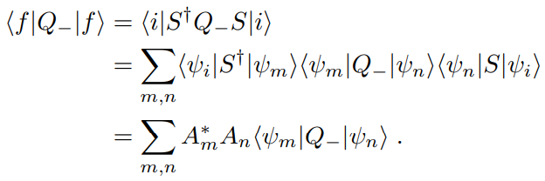
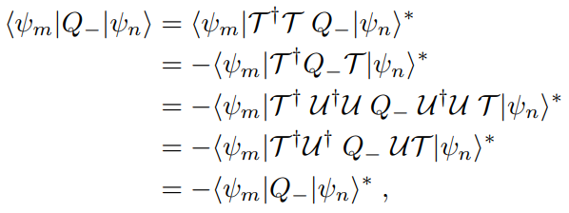
Complementary dependence of strong phase
Two conditions
In the Hilbert space of the final states of a physical process that we are interested, with a properly chosen basis : $UTψ_{n}=e^{iα}ψ_{n}$
$Q_{−}$ is invariant under unitary transformation $U$: $UQ_{−}=Q_{−}U$
CP violation $a_{CP}^{T−odd}$
$a_{CP}^{T−odd}$ $∝\sum_{m,n}{iIm\left(A_{m}^{∗}A_{n}−\overline{A_{m}^{∗}} \overline{A_{n}}\right)\left\langle ψ_{m} | Q_{−} | ψ_{n}\right\rangle }∝cosδ sinφ$
$a_{CP}^{dir}$ $∝\sum_{m,n}{Re\left(A_{m,t}^{∗}A_{n,p}−\overline{A_{m,t}^{∗}} \overline{A_{n,p}}\right)}∝sinδ sinφ$
Conclusion
This complementarity generally exist
They can be found systematically
different strong phase dependences

Slide 7
Complementary dependence of strong phase
Some examples
$$B→V_{1}V_{2}$$
$${(\vec{ε}}_{1}×{\vec{ε}}_{2})∙\vec{p}$$
Relative transverse polarization
$$Λ→pπ^{−}$$
$${(\vec{S}}_{1}×{\vec{S}}_{2})∙\vec{p}$$
Proton transverse polarization
Helicity amplitudes representation
$$R\left(0,π,0\right)Tψ_{j,m,λ_{1},λ_{2}}={{(−1)}^{j+m}(−1)}^{j−m}ψ_{j,m,λ_{1},λ_{2}}$$
The expectation value
[Geng,Liu 2021]
It is found that there is a T-even correlation complementary to
$$P_{1}={\vec{ε}}_{1}∙{\vec{ε}}_{2}−({\vec{ε}}_{1}∙\vec{p} )({\vec{ε}}_{2}∙\vec{p} )$$
$$\left\langle P_{1}\right\rangle =2Re(H_{00}^{∗}H_{+1,+1}+H_{+1,+1}^{∗}H_{0,0})$$

Slide 8
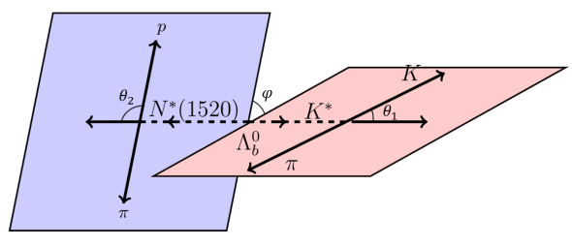
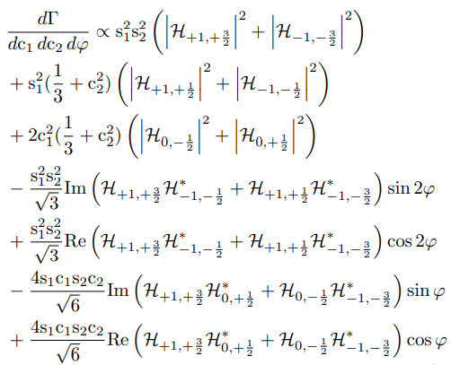
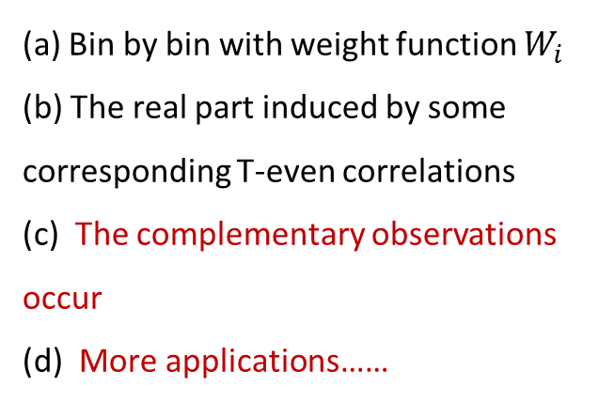
Baryonic applications
Angular distribution
Multi-body decay provides a platform to measure T-odd correlations
(a) Bin by bin with weight function $W_{i}$
(b) The real part induced by some corresponding T-even correlations
(c) The complementary observations occur
(d) More applications……

Slide 9
Summary
General property of T-odd correlation CPV is considered
A simple application in baryon case is discussed
More systemic investigation is preparing
[J. P. Wang, Q. Qin and F. S. Yu, in preparation]
Thank you

