Slide 1
Confinement phase transition: from Polyakov Loop Models to quasi-particle model
Jiang Zhu
Based on: JHEP09(2021)060 and Our new Works
Jiang Zhu, Zhaofeng Kang, Shinya Matsuzaki, Jun Guo
The III Workshop on Frontiers of Particle Physics
at Sun Yat-sen University
07/23/2022
Huazhong university of science and technology

Slide 2
Outline
Introduction
Road to a Proper Polyakov Loop Model
Phase Transition and Gravitational Wave
From PLM to Quasi-Particle Model
Conclusion & Outlook

Slide 3
Introduction
1
Motivation
Pure Yang-Mills (PYM) sector surviving at low energy is of particular interest in the new physics domain, in the context of dark sector of the universe, including dark matter and also in the string theory.
Dark PYM Sector
Coupled?
Visible Sector
If not, how to detect?
Method: Confinement Phase Transition
Confinement Phase Transition for PYM is normally First Order Phase Transition (FOPT) and it can produce background gravitational wave signal which may meet the GW detectors in the sky.
Gravitational Wave from PT can extract information of PYM
The Question is: How to describe it?

Slide 4
Introduction
2
Method to describe Confinement Phase Transition
Because the SU(N) theory is a strong interaction theory. It is hard to discuss it from the First principle
phenomenological models: Ginzburg-Landau Theory
Order parameter: Fundamental Polyakov Loop^{[1]}
The theory is unchanged under transformation^{[1]}
A constant field shift
The corresponding transformation for Polyakov Loop is
Symmetry for effective theory
This is so-called center symmetry $Z_{n}∈SU(N)$
[1] K. Fukushima and V. Skokov, Prog. Part. Nucl. Phys. 96, 154-199 (2017) [arXiv:1705.00718 [hep-ph]].

Slide 5
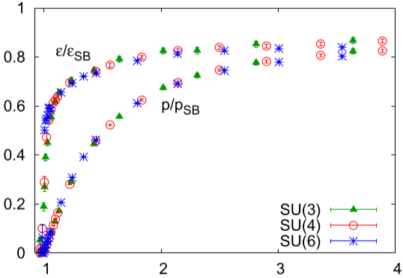
Introduction
3
Method to describe Confinement Phase Transition
The input information: lattice data
Center idea for effective model: One can find a obvious $N^{2}−1$ scaling behavior from the lattice data^{[1-2]}
$p\left(T\right)={−F/V=−V}_{eff}$
$ε\left(T\right)=T\frac{dp}{dT}−p=V_{eff}−\frac{dV_{eff}}{dT}$
If we have the form of $V_{eff}$ then we can fit all the parameter form the lattice data
Another critical information from lattice data: The latent heat^{[2]}
Also process a $N^{2}−1$ scaling behavior for large $N$ situation
A good effective model should satisfy all above lattice behavior
[1] M. Panero, Phys. Rev. Lett. 103, 232001 (2009) [arXiv:0907.3719 [hep-lat]]
[2] S. Datta and S. Gupta, Phys. Rev. D 82, 114505 (2010) [arXiv:1006.0938 [hep-lat]].

Slide 6
Road to a Proper Polyakov Loop Model
4
Effective Potential for Confinement Phase Transition
The first try is based one the SU(3) theory, the $Z_{3}$ center symmetry allow a cubic term to trigger the phase transition, so C. Ratti, M.A. Thaler^{[1]}, W. Weise propose as model to describe this phase transition.
In different directions, K. Fukushima^{[2]} found in SU(3) theory the phase transition near the critical temperature can be described by
Reduce free parameter
Problem: can not describe $T>{1.5T}_{c}$
Haar-measure of SU(3)
In order to build a PLMs with all above consideration and S. Roessner, C. Ratti and W. Weise^{[3]} propose a model
Can describe all temperature area for $T>T_{c}$
[1] C. Ratti, M. A. Thaler, and W. Weise, Phys. Rev. D73 (2006) 014019, [arXiv:0506234 [hep-ph]]
[2] K. Fukushima, Phys. Lett. B591, 277 (2004), [arXiv: 0310121 [hep-ph]]
[3] S. Roessner, C. Ratti, and W. Weise, Phys. Rev. D75 (2007) 034007, [arXiv:0609281 [hep-ph]].

Slide 7
Road to a Proper Polyakov Loop Model
5
The Haar-type PLMs for general SU(N) theory
Extend above potential in general SU(N) theory. Replace SU(3) Haar-measure
by general SU(N) measure $H_{N}[L]$, one can get
With Phase transition condition
Those phase transition condition make sure there must exist a phase transition, with a careful computation
The last equation is naturally Guaranteed by formation of
Haar-measure term

Slide 8
Road to a Proper Polyakov Loop Model
6
No Go of The Haar-type PLMs
However there is another condition which one mast into consideration
Latent heat behavior from Lattice data:
Latent heat present the strength of Phase transition and directly affect GWs spectrum
For Haar-type PYMs
Numerical computing tell us $l_{c}∼0.5$ and $a_{0}∼\frac{2π^{2}}{45}(N^{2}−1)$(the SB limit)
If this condition is added, then scaling rules tell us all the parameter should proportional to $N^{2}−1$! However $b_{3}$ can never satisfy that condition
$$∼const$$
But：
So, Haar-type PLMs can not be used to discuss GWs

Slide 9
Road to a Proper Polyakov Loop Model
7
A Proper Model: Polynomial Potential
One must propose a better model to discuss PT.
Polyakov Loop is Order parameter
Landau PT theory
Polynomial Potential
But what kind of Polynomial Potential?
We propose that:
$$V\left(l,T\right)=T^{4}𝒰(l,T)=T^{4}\left[−\frac{a\left(T\right)}{2}{\left|l\right|}^{2}+b{\left|l\right|}^{4}+c{\left|l\right|}^{n}\right]$$
Where $n=6 or 8.$ This potential can be naturally constructed by consider a general renormalizable PLMs with fundamental PL $l$ and charge-two PL $l_{2}$^{[1]}
The most general potential which satisfy $Z_{n}$ symmetry is given by
Assume $m_{2}≫m$, then integral the $l_{2}$ field one can get
So, it is natural to construct above potential
[1] R. D. Pisarski, Nucl. Phys. A 702, 151-158 (2002) [arXiv:0112037 [hep-ph]].

Slide 10
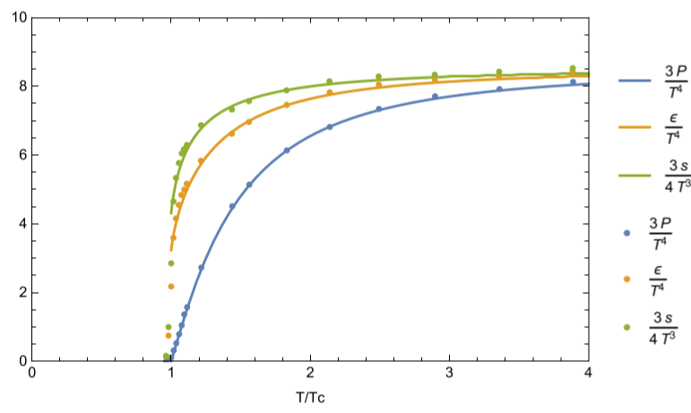
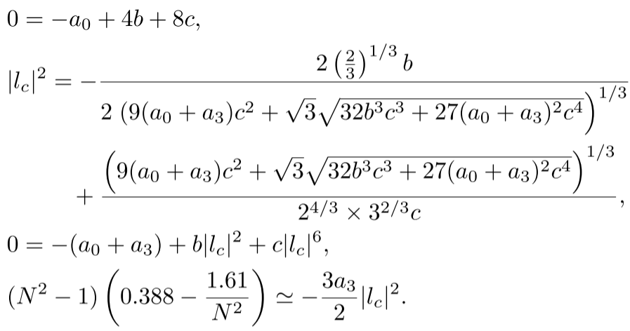
Road to a Proper Polyakov Loop Model
8
Following previous discuss base on Haar-type PLMs, one can wrirte down the Phase transition condition and the Latent heat condition for our model is given by
The remaining free parameters can be obtained by fitting with lattice data
For 4-8 PLMs:
The fitting parameter table
For large enough $N$(or $N$>6)

Slide 11
Phase Transition and Gravitational Wave
9
Phase Transition
The phase transition can be computed by normal vacuum phase transition
With 3 dimensional action
One have to notice in the case of confinement phase transition the order parameter $l$ is dimensionless
$$l→φ=Λl$$
SM is also exist
And there are three critical phase transition parameter
Approximate PT ending condition for radiation dominant period
The strength of phase transition: $α$
The time scale of phase transition:$\tilde{β}$
The temperature of phase transition: $T_{n}$

Slide 12
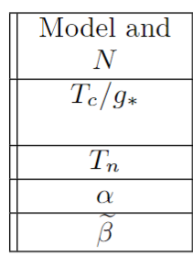
Phase Transition and Gravitational Wave
10
Numerical result
SM: $𝒯$ and SU(N): $T$
Set $𝒯=ζT$
Only discuss $ζ$=0, $ζ$=1 represent SU(N) dominate and equal temperature situation
The numerical result for $ζ=1$
GWs for different SU(N) for different critical temperature

Slide 13
From PLM to Quasi-Particle Model
11
We find a model to describe the confinement phase transition, and it can also tell us about the GW signal from confinement in early universe but it contain serval question:
Problem
1. The bubble velocity in our model is a parameter, how to find that value for the real case?
2. This model can describe confinement PT and the phenomenological for $N≥3$, but How about $N=2$?
3. The 4-6 PLM and 4-8 PLM which are the real case? Is there a model can come from First principle?
To solve this Problem we have to consider Bubble dynamics. The experience from EW phase transition tell us we have to reintroduce particle(interact with bubble).
This two question seem more complicated. Fortunately, we can find hint from Haar type model: Haar type model are come from first principle and phase transition for $SU(2)$ theory are naturally crossover phase transition.

Slide 14
From PLM to Quasi-Particle Model
12
From Polyakov Loop Model(PLM) to Quasi-Particle Model
We have to introduce particle and we should find a way to build model from First principle
The pervious discussion
However $SU(N)$ theory is strong-interaction theory
Extremely hard to find a model directly from Lagrangian
So, we have to find a way to avoid directly compute the non-perturbation effect
This information lead us into Quasi-Particle model
First developed at 1990s^{[1-2]}
Effective mass by HTL method^{[3]}
Recently regain attention^{[4-6]}
[1] A. Peshier, B. Kampfer, O. P. Pavlenko and G. Soff, Phys. Rev. D 54, 2399 (1996)
[2] P. Levai and U. W. Heinz, Phys. Rev. C 57, 1879 (1998)
[3] O. Andersen, L. E. Leganger, M. Strickland and N. Su, Phys. Lett. B 696, 468-472 (2011)
[4] U. Reinosa, J. Serreau, M. Tissier and N. Wschebor, Phys. Lett. B 742, 61-68 (2015)
[5] P. M. Lo, K. Redlich and C. Sasaki, Phys. Rev. D 103, no.7, 074026 (2021)
[6] D. M. van Egmond, U. Reinosa, J. Serreau and M. Tissier, SciPost Phys. 12, no.3, 087 (2022)
Notes:
Quasi-particle model is first developed at 1990s to discuss the thermal dynamics around critical temperature and confinement^{[1-2]}, and the thermal mass can be computed by HTL method at high temperature region^{[3]}. recently this method regain attention because the effective potential in this method can be find by first principle lagrangian^{[4-6]}

Slide 15
From PLM to Quasi-Particle Model
13
The Unified Frameworks from the First Principle with Quasi-Particle method
Quasi-particle method: Change the dispersion relation for particles for phenomenological reason
We will add a thermal mass for gluon and this should contain all the non-perturbation effect
Starting from the Lagrangian:
With ghost and BRST term
We will discuss in Landau-DeWitt gauge
Split the field:
Background field
Fluctuation field

Slide 16
From PLM to Quasi-Particle Model
14
The Unified Frameworks from the First Principle with Quasi-Particle method
According to quasi-particle method, we only keep quadratic term and adding a quasi-particle mass for fluctuation field and integrate this Lagrangian by path integral. to find the effective potential is form as:
The effective energy:
$s$ is the parameter of adjoint representation of Polaykov Loop
We have used the average eigenvalue assumption that $q_{i}−q_{j}=\frac{i−j}{N}s$

Slide 17
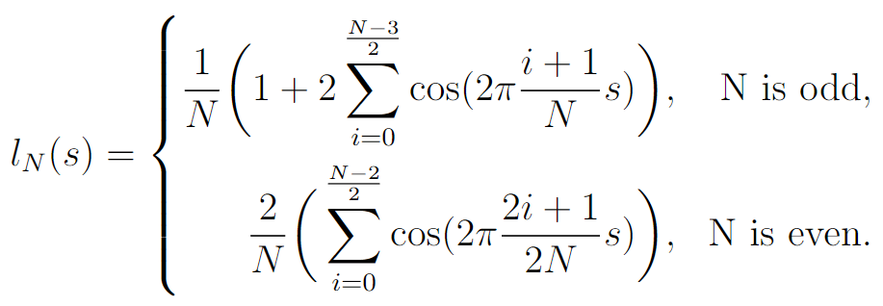
From PLM to Quasi-Particle Model
15
The Unified Frameworks from the First Principle with Quasi-Particle method
This potential is very complicated, but we can simplified it by some hit
Asymptotic Freedom
For $T≫T_{c}$
$𝒱$ must became $V_{weiss}$
$V_{weiss}$ is the potential for free gluon
Theory became perturbation at high energy
When will our model return to $V_{weiss}$?
$$M_{g}≪T$$
So, $M_{g}≪T$ is the case for perturbation phase, one may guess $M_{g}>T_{c}$ at non-perturbation region. We can expand this potential by $M_{g}/T$ around $T_{c}$ and find
$$s=1, l=0$$
$$s=0,l=1$$
Where $l_{N}$ is the order parameter-the trace of Polyakov Loop

Slide 18
From PLM to Quasi-Particle Model
16
Numerical result for Phase Transition
Treat $M_{g}(T_{c})/T_{c}$ and $dM_{g}(T_{c})/dT_{c}$ as parameters and it can be determinate by PT condition and Latent heat
PT for $SU(2)$ is indeed a crossover in our frameworks

Slide 19
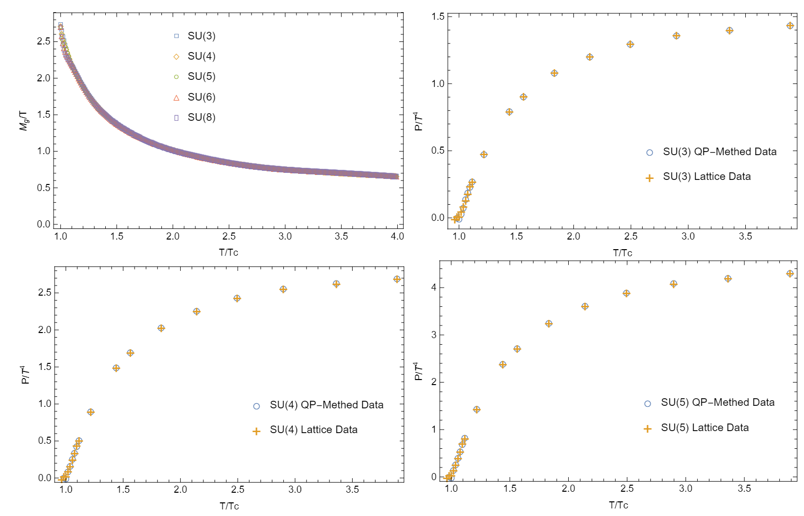
From PLM to Quasi-Particle Model
17
Numerical result for thermal mass and pressure
$M_{g}$ have a unified behavior

Slide 20
Conclusion & Outlook
18
Conclusion
1. We find that Haar type PLMs possesses incompatibility between the latent
heat and thermodynamic quantities
2. We proposed a proper model: Polynomial Potential which can balance
latent heat and thermodynamic quantity and it can predict gravitational
wave which can be observed by BBO and DECIGO.
3. We build a model from first principle with the quasi-particle model which
can describe the confinement phase transition in a unified framework and
this model can make up for the deficiency of the previous model.
Outlook
This new model is base on fluctuation field. So, we can easily use this model to compute the EoMs of particle to discuss the bubble dynamics just like EW phase transition. We are studying this part right now and the new result showed the wall velocity is around $v_{w}\sim 0.01$. This will change the result of
GW signal.

Slide 21
Appendix：A
Gravitational Wave signal
There are three source of the gravitational wave signal
Bubble collision
Turbulence in plasma
Sound Speed wave in plasma
The total Gravitational Wave:
But the dominant part of confinement PT are given by sound speed wave and turbulence
We choose $v_{w}=1$
Sound wave:
Turbulence:
Question: Is $v_{w}=1$ is a physical situation? Is the EWPT-types evolution still hold for confinement? If not, what is bubble evolution picture of confinement phase transition?

Slide 22
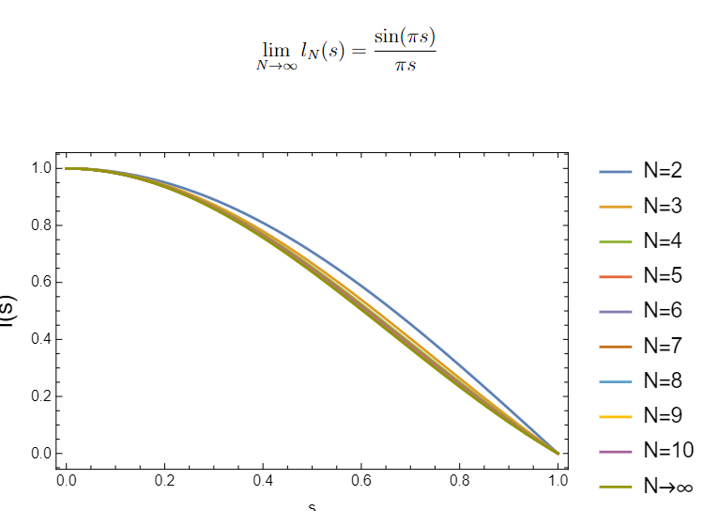
Appendix：B
Polyakov Loop and $s$ Parameter

Slide 23
Appendix：C
Wall velocity

