Slide 1
Astrophysical background and dark matter implication based on latest AMS-02 data
Hong-Bo Jin
Collaborators: Yu-Feng Zhou, Yue-Liang Wu
July 24, 2022
APJ,901, 1(2020) ArXiv: 1410.0171, 1504.04604
第三届粒子物理前沿研讨会
(The III Workshop on Frontiers of Particle Physics) (21-July 26, 2022)

Slide 2
Outline
Motivation
Over-predicted background of cosmic ray positrons.
Under-predicted background of cosmic ray antiprotons.
Methods
Hadronic interaction model: choose QGSJET-II-4
Propagation model: use convection and re-acceleration model(DCR) instead of the re-acceleration diffusion model(DR)
conclusion
the excess of CR antiprotons in the low energy are not justified.

Slide 3
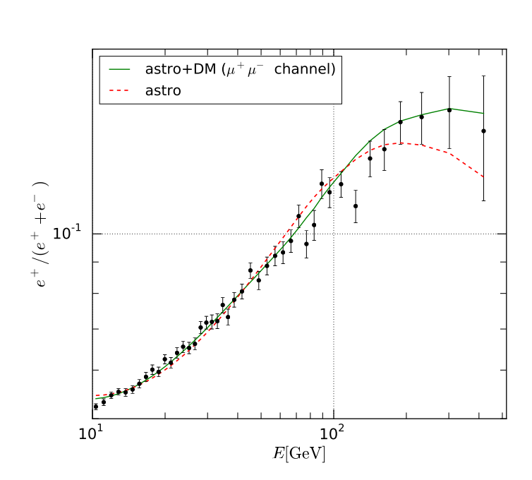
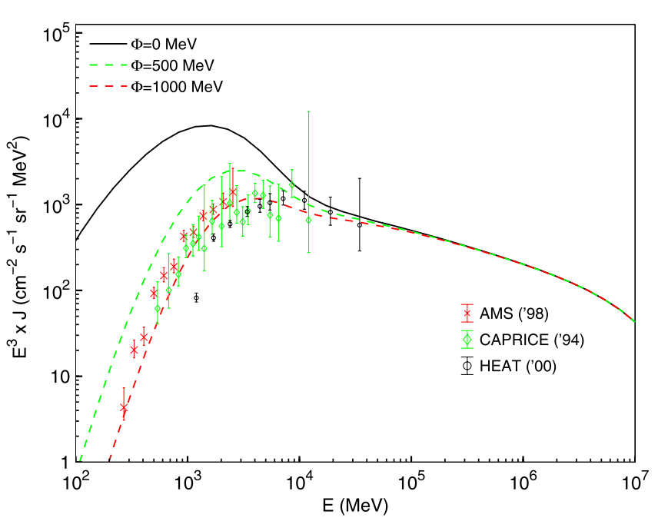
Cosmic ray Positrons: Over-predicted flux below 10GeV
﻿arxiv: 1507.07001
﻿arxiv: 1011.0037
CR Positrons is only from Collision product between the primary particles and interstellar medium, which is strongly constrained by the over-predicted flux of CR positron and exclude the primary positrons.

Slide 4
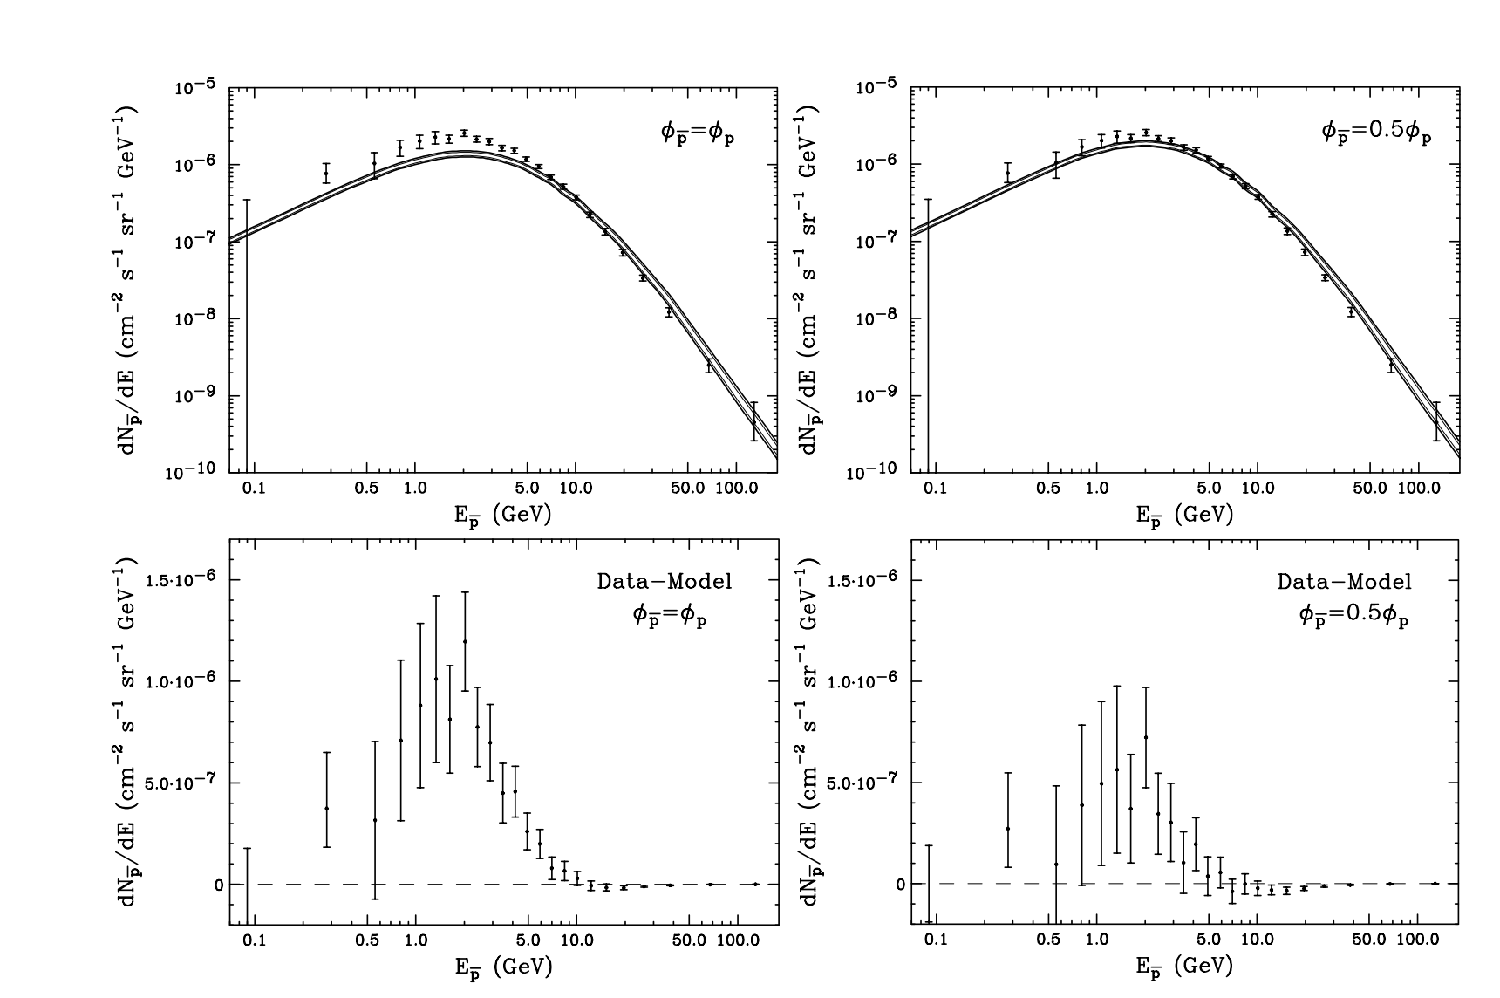
Antiproton excess below 10GeV: the difference between the measured data and model. If let the solar modulations of antiproton and proton are different, that difference is weaken but exist. If dark matter contributes to it, the contour between the cross-section and mass of dark matter can be predicted in the confidence levels.
﻿arxiv: 1410.1527

Slide 5
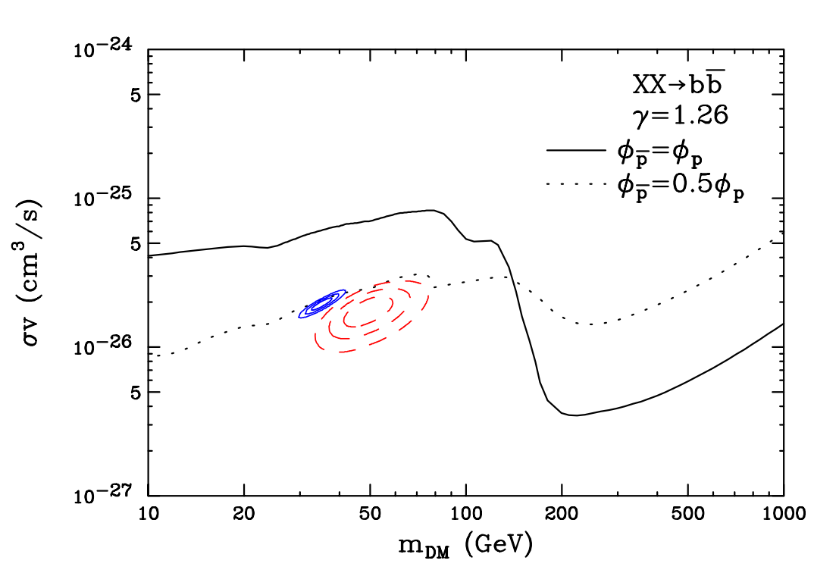
Antiproton excess below 10GeV: the difference between the measured data and model. If let the solar modulations of antiproton and proton are different, that difference is weaken but exist. If dark matter contributes to it, the contour between the cross-section and mass of dark matter can be predicted in the confidence levels.
﻿arxiv: 1410.1527

Slide 6
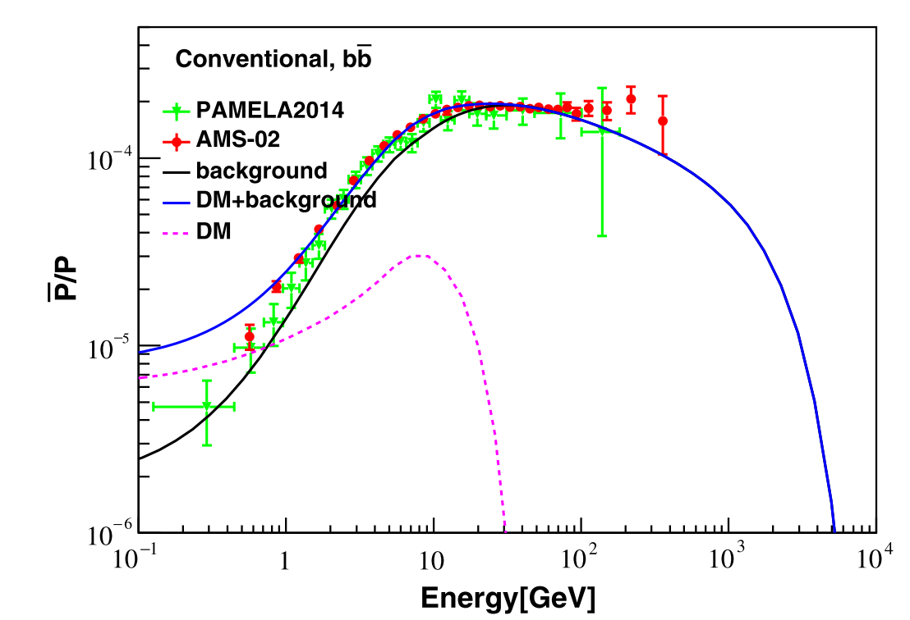
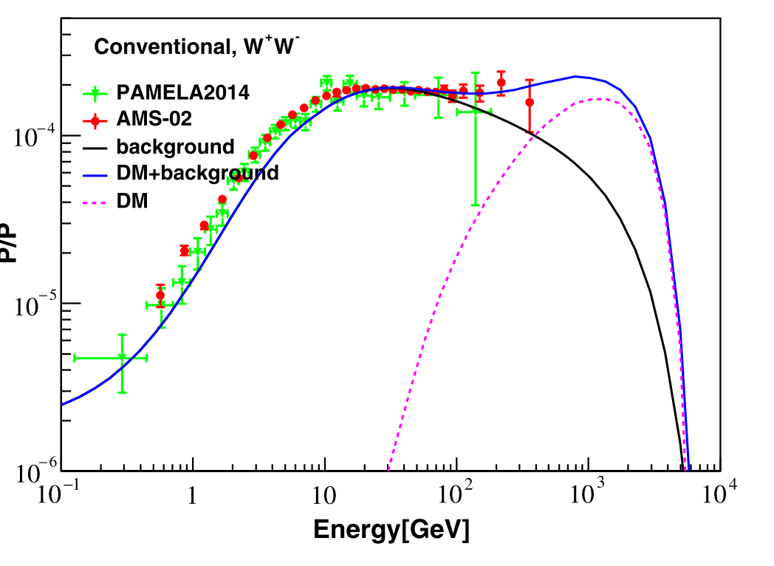
Antiproton excess above 100GeV:
same as the low energy excess, the background flux is greater than AMS-02 data. If dark matter contribute to it, the mass of dark matter up to TeV
arxiv: Hong-Bo Jin etc., 1504.04604

Slide 7
Astrophysical background nee be re-predicted from the latest AMS-02 data
Below 10 GeV, over-predicted flux of CR positrons are not natural.
Some methods are used:
1, the difference solar modulation between the cosmic rays. But for force-field approximation model of the solar modulation does not favored
2, adding the normalization factor to CR positron flux works, but that is unreasonable.
Below 10 GeV, under-predicted flux of CR antiprotons is not perhaps also natural.

Slide 8
Origin of the spectral structure alteration of the secondary particles
Since, CR positrons and antiprotons are only from collision product between the primary particles and interstellar medium, the origin of the alteration structure of their spectra should be considered to reduce the inconsistences.
A simple power law with the breaks
The spectra of the primary particles
Conventional model
(﻿parameterizations by Tan & Ng (1983))
QGSJET-II-4
EPOS-LHC
FLUKA
Hadronic interaction model
Propagation model
Diffusion
Energy loss(IC, synchrotron radiation etc.)
Re-acceleration
convection

Slide 9
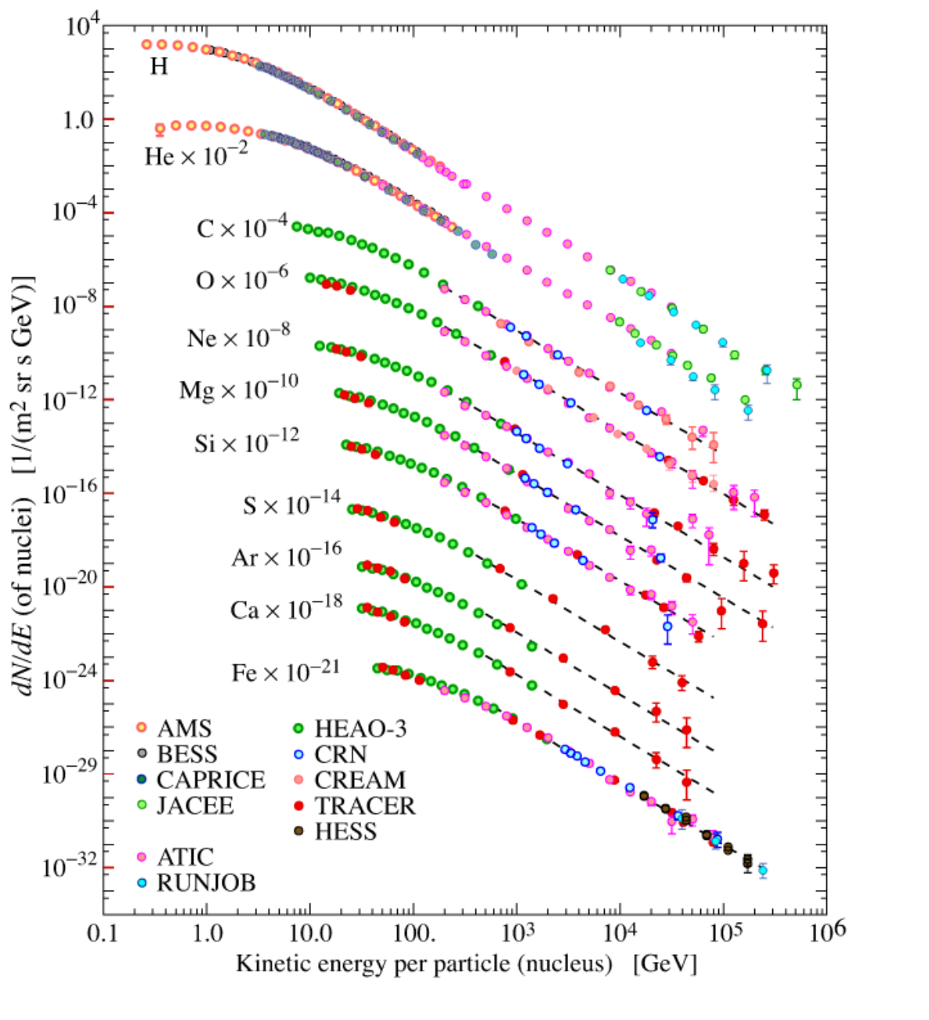
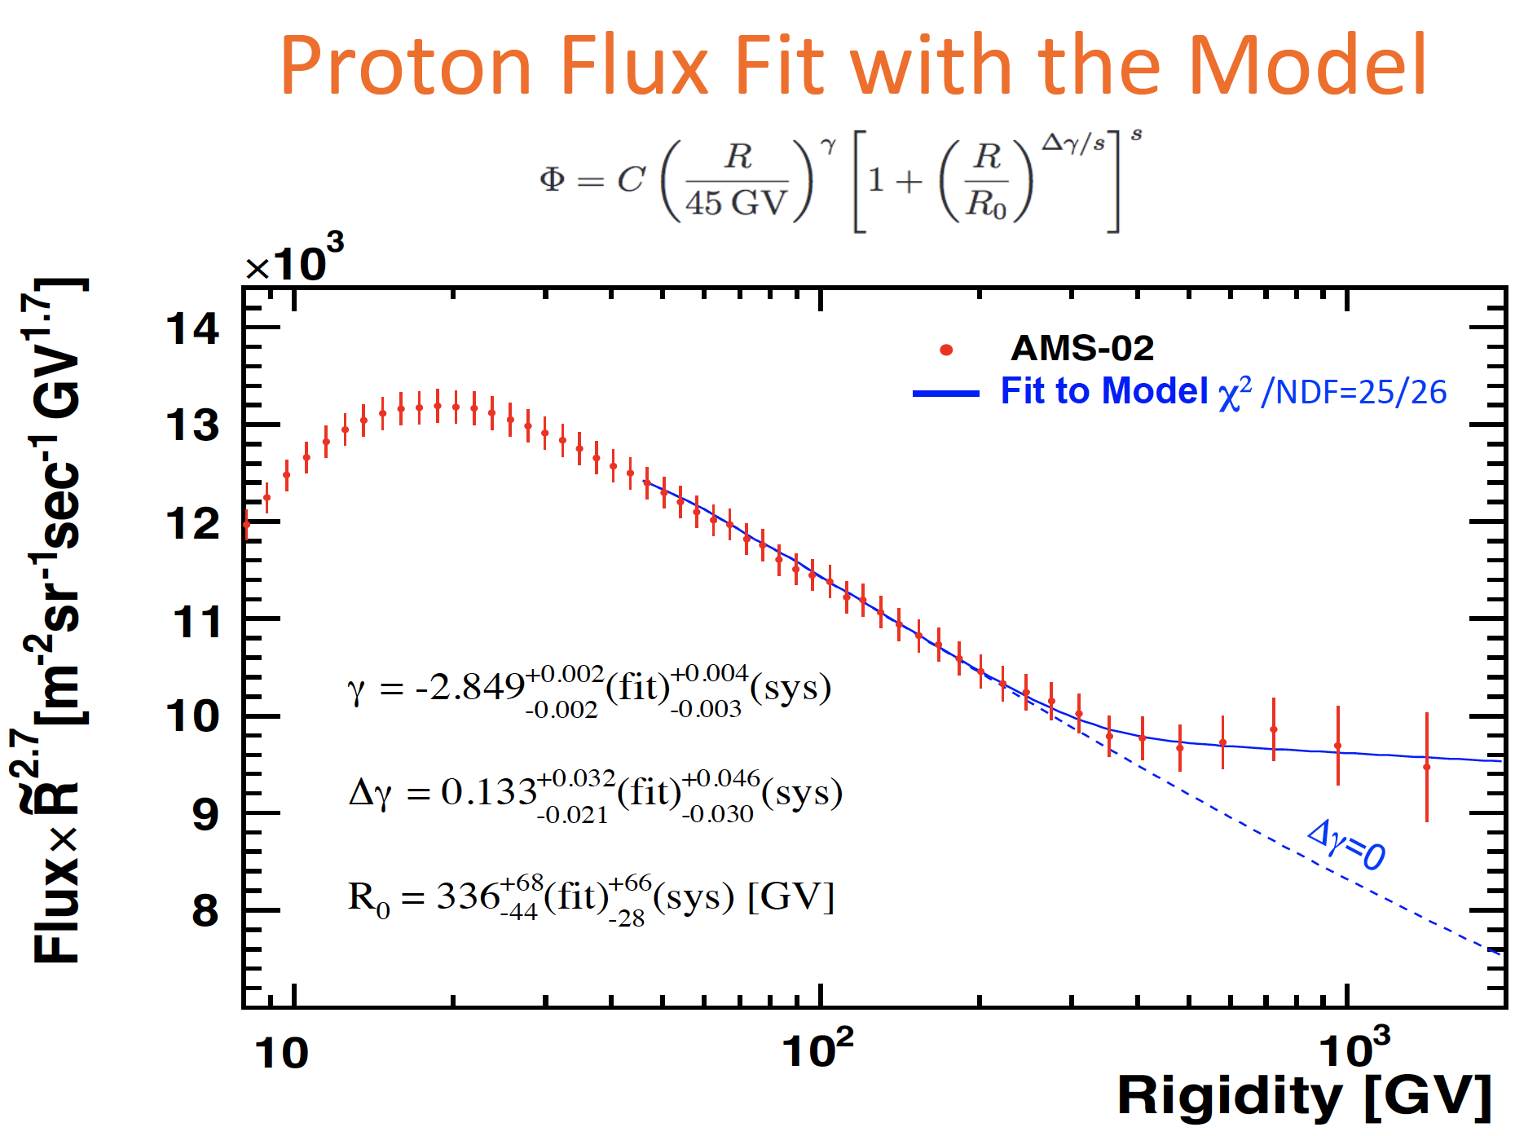
Spectra of CR Protons
The secondary product is dominated by CR protons, but the two breaks are not sensitive to the feature of secondary antiprotons and positrons
From V.Choutko AMS Days CERN
From ﻿Daniel Kerszberg

Slide 10
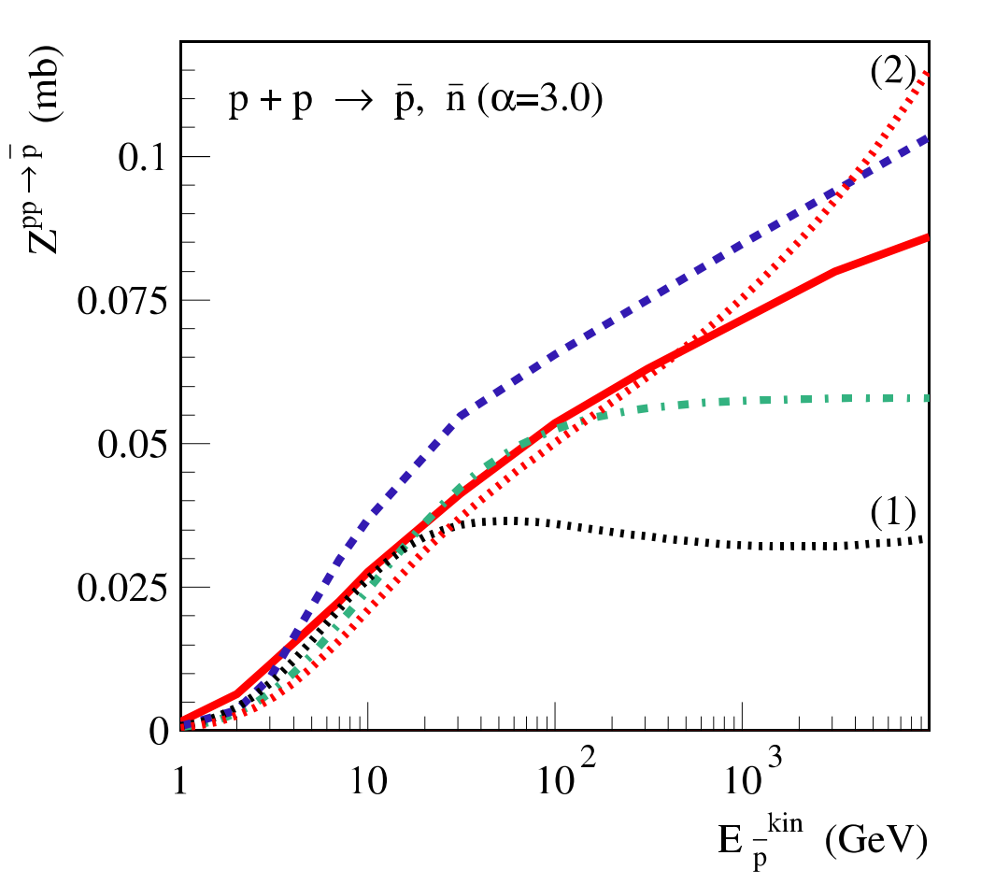
Hadronic interaction model
In the Conventional model, the antiproton yield is less than the others below 10 GeV. And in the ranges from 10 GeV to 100 GeV, EPOS-LHC model has more contribution to the antiproton yields than the Conventional and QGSJET-II-04 model. QGSJET-II-04 is moderate model to describe the hadronic interaction
﻿QGSJET-II-4 (solid, red)
﻿EPOS-LHC (dashed, blue)
﻿(dotted–dashed, green)
(﻿parameterizations by Tan & Ng (1983))
﻿arxiv: 1502.04158

Slide 11
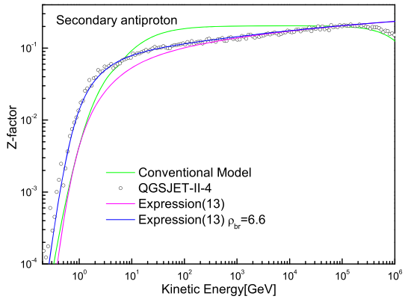
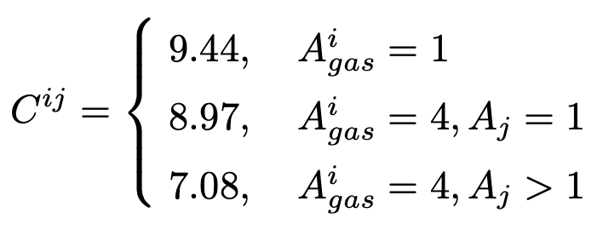
anti-particle product with Z-factor expression

Slide 12
comparison of Z-factor between this paper and Kachelriess et all(2015)

Slide 13
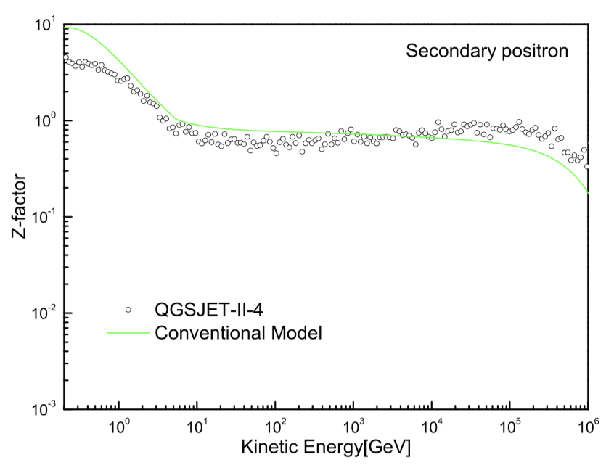
Hadronic interaction model
As in the paper of arxiv:﻿1502.04158, CR positron is not included to analyze the product of them.
In our work, we re-calculate the cross-section relevant to CR positrons in QGSJET-II-04.
In the Conventional model, the positron yield is greater than the QGSJET-II-04 model. QGSJET-II-04 is just used to decrease the product of CR positrons.
But the the positron yield is not enough in the QGSJET-II-04 model. Need the propagation model to depress it.

Slide 14
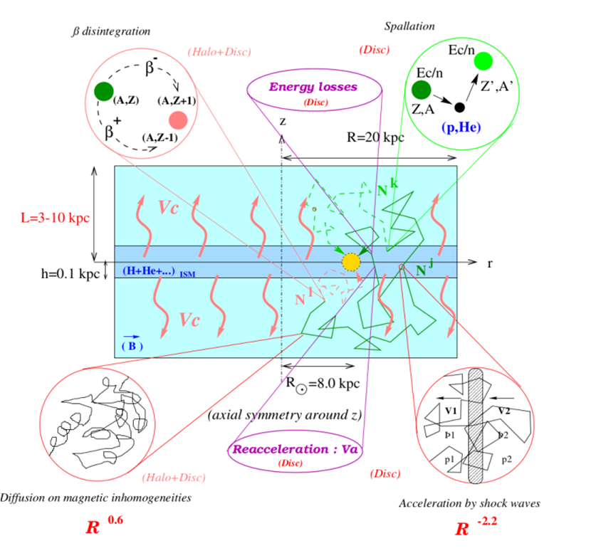
Propagation model: two-zone diffusion
re-acceleration:
CRs accelerated via the interaction with the turbulent interstellar magnetic field
convection:
the Galactic winds are blowing outwards from the Galactic disc.
Maurin, etal, arxiv: astro-ph/0212111

Slide 15
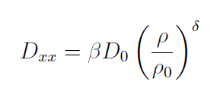
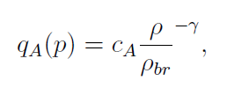
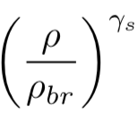
Propagation equation of CRs
the CR propagation equation is solved by GALPROP v54 package, which is based on a Crank-Nicholson implicit second-order scheme
Re-acceleration
Diffusion coefficient
Primary source
Secondary source
A.W. Strong et al, APJ 509:212
In this work
is modified as
α determines the smoothness of the spectral change in the left and right sides of the referred rigidity, when α is 0, as a broken power law

Slide 16
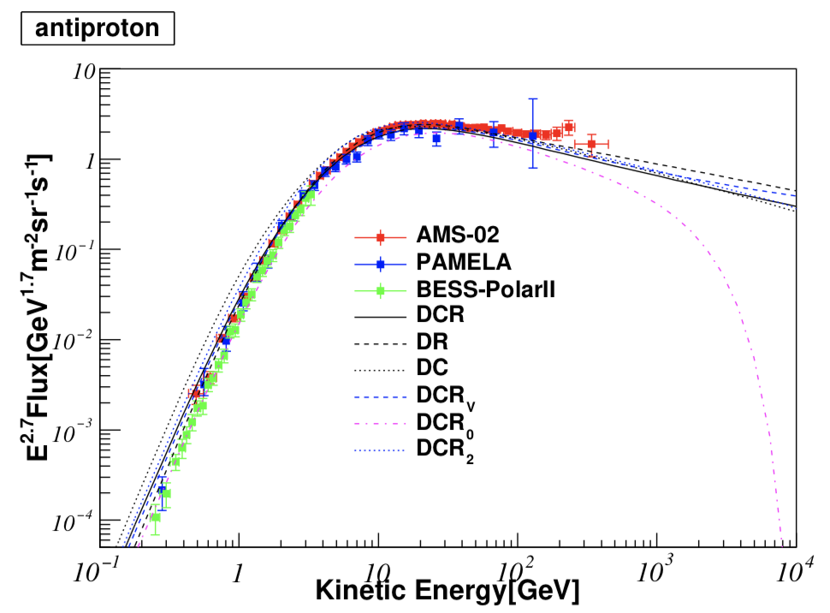
The Consistence appears when QGSJET-II-4 and convection model are included
In the re-acceleration diffusion (DR) model the under-predicted flux of CR antiprotons has been intensified to be consistent with the AMS-02 data.The more product of antiprotons from QGSJET-II-04 model enhances the flux of CR antiprotons. Above 100 GeV, antiproton excess keeps.

Slide 17
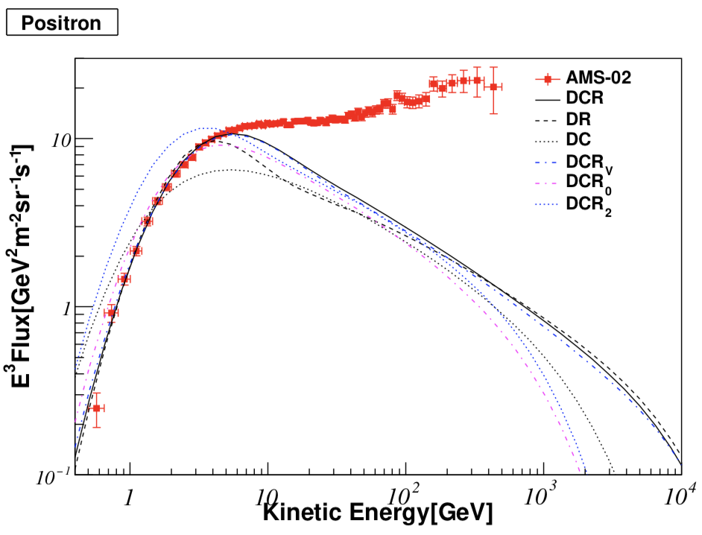
The Consistence appears when QGSJET-II-4 and convection model are included
While the predicted flux of CR positrons below 10 GeV keeps weak inconsistence with the AMS-02 data in DR model.
When convection is included, the better consistence appears.
That is called DCR model.
Above 10 GeV, the positron excess keeps apparently.

Slide 18
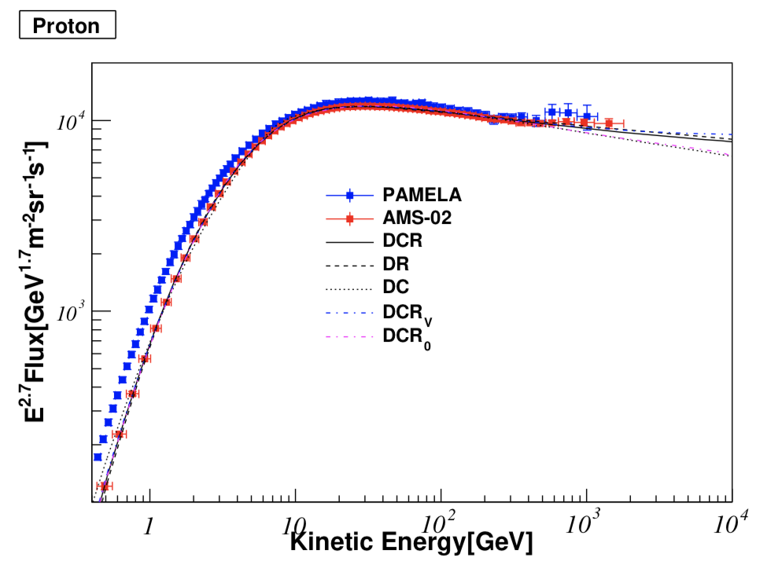
Un-expectable result for CR protons
In DCR model, the predicted flux of CR protons is consistent with AMS-02 data whose hardening feature above 330 GeV is also matched. Χ²/N is 22.2/72 and very small in DCR model. DR model is relevant to 47/72

Slide 19
Un-expectable result for CR protons
In DCR model, the predicted flux of CR protons is consistent with AMS-02 data whose hardening feature above 330 GeV is also matched. Χ²/N is 22.2/72 and very small in DCR model. DR model is relevant to 47/72

Slide 20
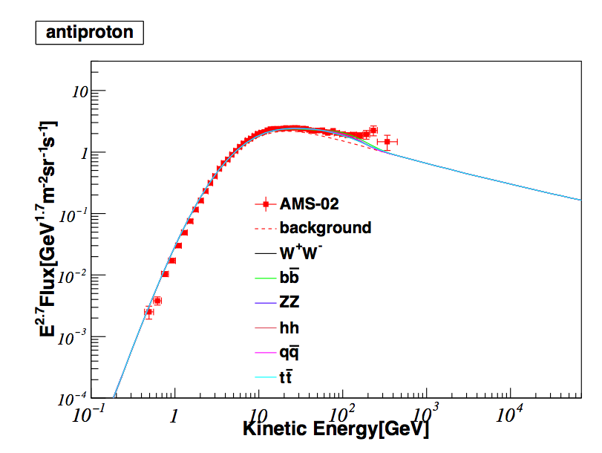
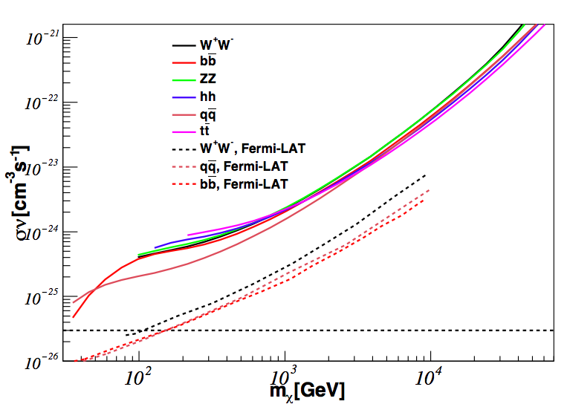
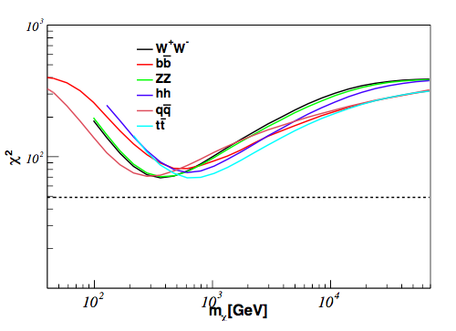
Interpretation of antiproton excess from dark matter
The best-fit masses of dark matter are found near 600 GeV. In the different channels of dark matter annihilation the predicted best-fit mass only is from 300 GeV to 700 GeV. Dark matter interpretation of CR antiproton excess has the weak effect to discriminate the dark matter annihilation channels.

Slide 21
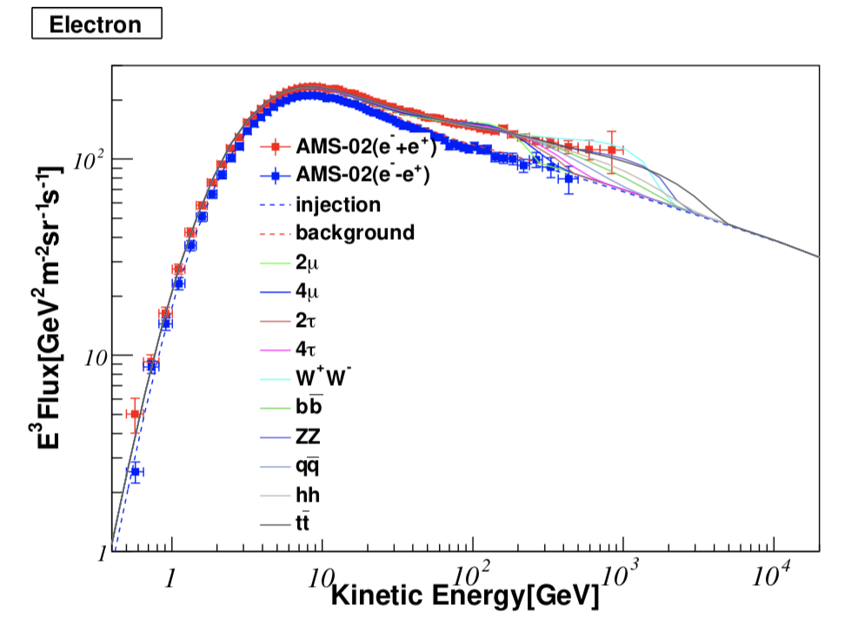
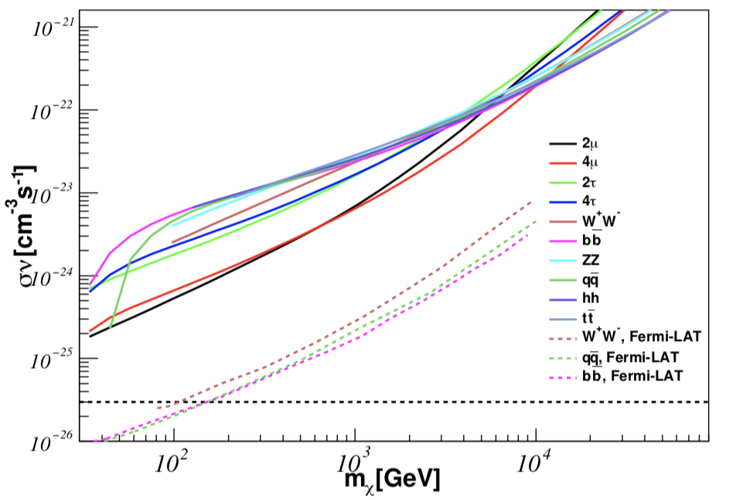
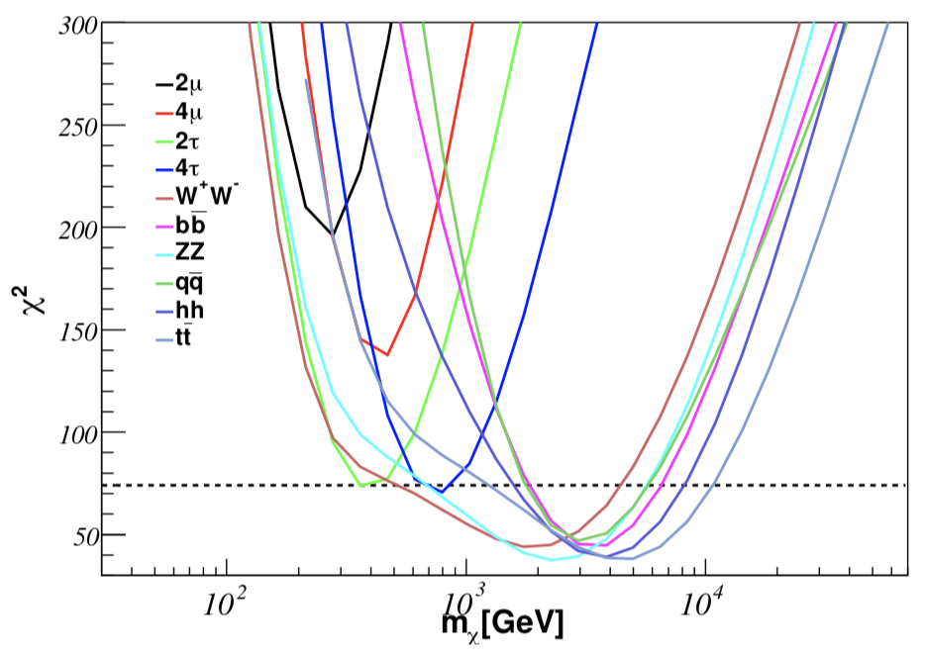
Interpretation of positron excess from dark matter
The issues of the large annihilation cross-sections still exist.
Except for 2μ and 4μ final states, in the other channels, the best-fit masses of dark matter are from 400 GeV to 4 TeV.
The annihilation of heaviest dark matter is through the t\bar{t} final state and the lightest one is via the 2τ channel. The best flux fitting to AMS-02 data is relevant to the ZZ final state.

Slide 22
conclusion
In low energies the predicted fluxes of CR antiprotons and positrons are consistent with AMS-02 data in the diffusion model combining the re-acceleration and convection terms.
the excess of CR antiprotons in the low energy are not justified.
The predicted flux of CR protons is consistent completely with AMS-02 data whose hardening feature above 330 GeV is also matched.
The predicted best-fit masses of dark matter are from 400 GeV to 4 TeV. The DCR model does not give the unusual interpretation of the positron excess.

Slide 23
Thank you! 谢谢!

