Slide 1
国家重点研发计划
高能环形正负电子对撞机关键技术研发和验证
课题2：硅径迹探测器关键技术验证
报告人： 梁志均
项目负责人： João Guimarães da Costa
项目承担单位：中国科学院 高能物理研究所

Slide 2
国家重点研发计划
R&D and Verification of Key Technologies for a High Energy Circular Electron-Positron Collider
课题2：硅径迹探测器关键技术验证
报告人： 梁志均
项目负责人： João Guimarães da Costa
项目承担单位：中国科学院 高能物理研究所

Slide 3
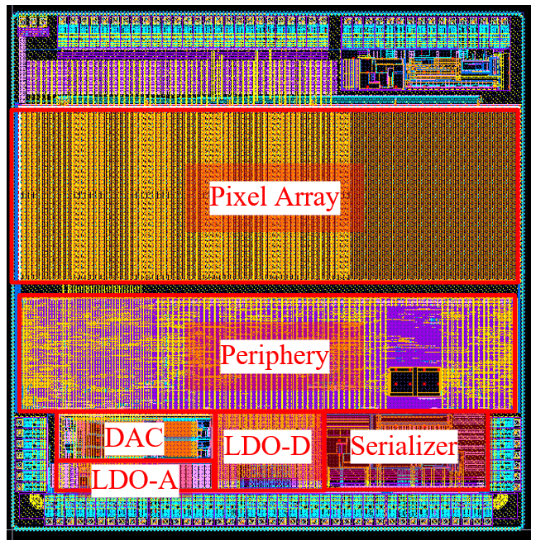
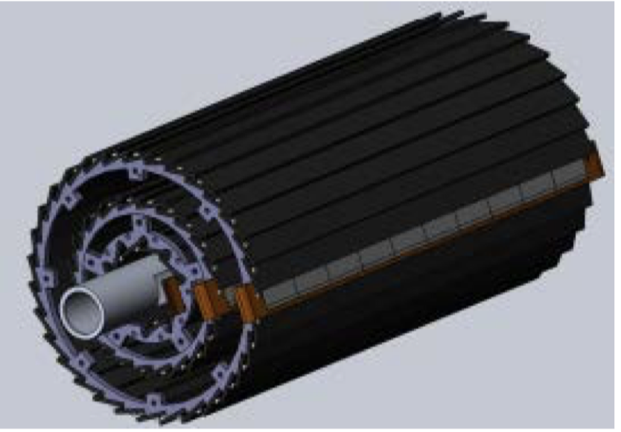
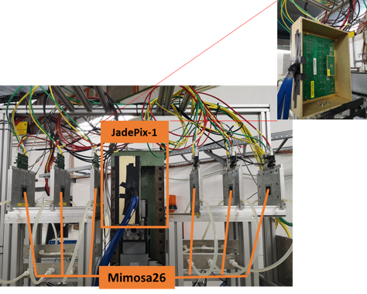
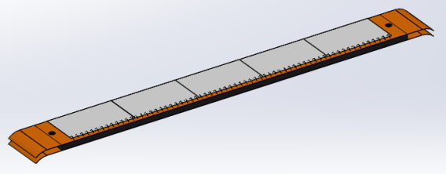
Overview of task2： vertex detector R & D
Can break down into sub-tasks:
CMOS imaging sensor chip R & D
Detector layout optimization, Ladder and vertex detector support structure R & D
Detector assembly
Data acquisition system R & D
CMOS imaging
sensor prototyping
Detector module (ladder)
Prototyping
Full size vertex detector Prototype
Beam test to
verify its spatial resolution
Notes:
Full size vertex detector

Slide 4
Timeline
Ladders Mechanics:
Now: Carbon support samples available
May: Pre-production carbon support ladders available
August: Production of final carbon support ladders (if needed)
Ladders Assembly:
May: Flex cable available
May: Test of wire bonding and gluing on carbon support
July: ASICs arrive to IHEP
August: Wafer level test of ASICs
September: Single chip and module testing
September: Assembly of ladders with chips

Slide 5
Time line
Barrel Prototype:
June: Production of installation tooling
June: Installation mock-up
July: Barrel support parts fabricated
End September: Assembly first barrels
October: Assembly of multiple ladders and readout tests
Earlier November: Finish assembly of prototype
November: Cosmic ray testing or BEPC beam test
End November/December: DESY test beam

