Slide 1
$$B_{s}→D_{s}K$$
Federica Cuna

Slide 2
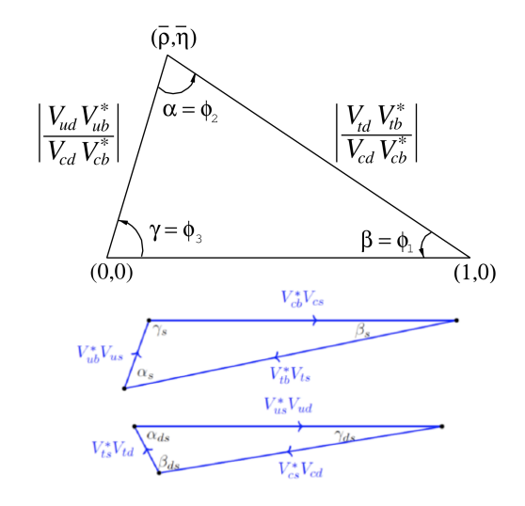
Motivation
Study of CP violation
A lot of studies have been focused on the “so called” Unitarity Triangle, one of whose angles is obtained from the “golden” channel B₀($\overline{B_{0}}$) → J/ψKs.
It is interesting to measure the “non common” triangle directly and independently at FCC.
By directly we mean the measurement of an angle without making use of its relations to other angles in the SM.
$$β_{s}$$
From the Bs in J/ψφ or J/ψη
$$α_{s}$$
From the Bs in DsK or Dφ
$$γ_{s}$$
From the B± in DK

Slide 3
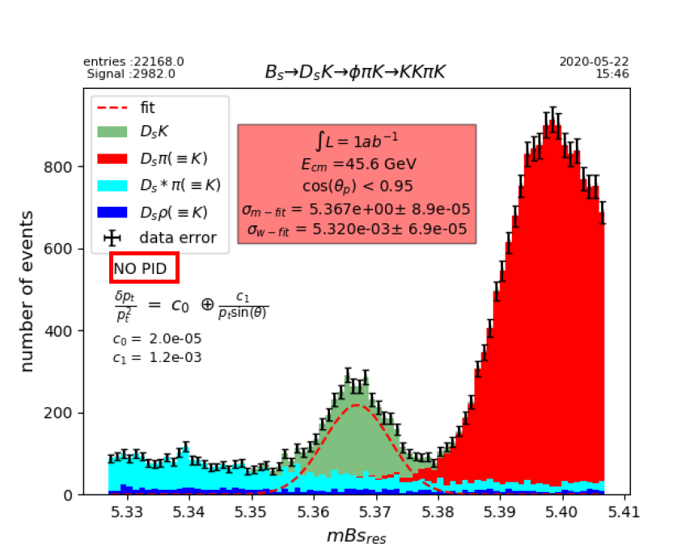
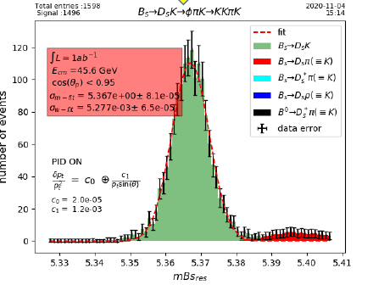
Some preliminary results
Without particle identification, great contribution from pion and kaon misidentification.
With a modest PID: ToF + dE/dx
σ(dE/dx)=5%
σ(ToF)=20ps
ToF Detector location : 2m from IP
Our goal
Use the cluster counting technique to improve the particle identification capabilities.
Prof. R.Aleksan talk

Slide 4
First plan
Write an analysis macro to study the Bs decay evaluating the performances improvement achievable with the dN/dx technique.
But…
The simulation does not have all the necessary ingredients:
dE/dx in Delphes
dN/dx in EDM4HEP (just done by Clements)
dN/dx in key4SimDelphes
About first item, we have:
A function which gives the energy loss by a track at different βγ.
A method to evaluate the energy loss cell per cell.
A method to evaluate the truncated mean for the particle identification.
We should be sure that all the new ingredients inserted in Delphes work properly, then we can move to the other item (3.) and simulate a bunch of event to start the analysis.

Slide 5
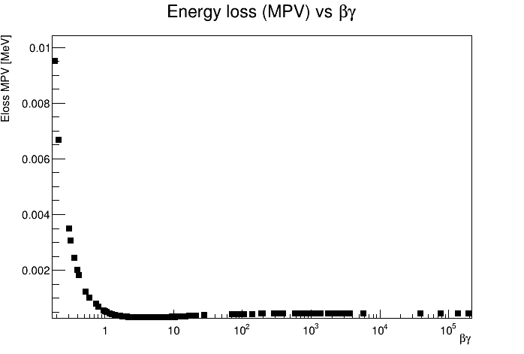
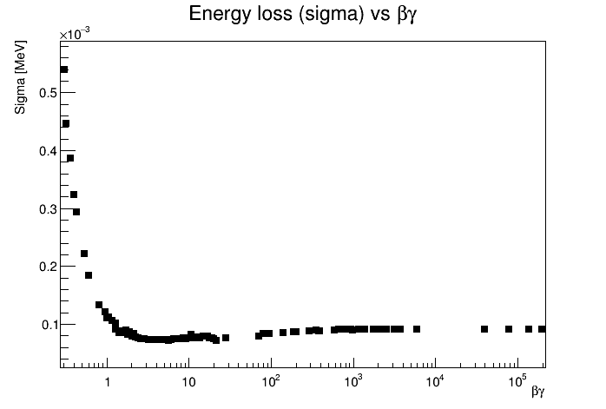
Status of the dE/dx in Delphes
Goal: simulate the energy loss by a track in each cell of the tracker.
The starting point is the simulation results from Garfield++:
5 charged particles passing through 1 cm of Helium-Isobutane have been simulated.
The distribution of the energy loss for the 5 particles at different βγ has been obtained.
To insert these information in Delphes, an interpolation has been performed so that a simple function gives the energy loss (MPV, sigma) for a charged particle at a fixed βγ.
This value is smearing according to a Landau distribution and multiplicated by the path length of the track in each cell.
A function which evaluates the truncated mean has been inserted.

Slide 6
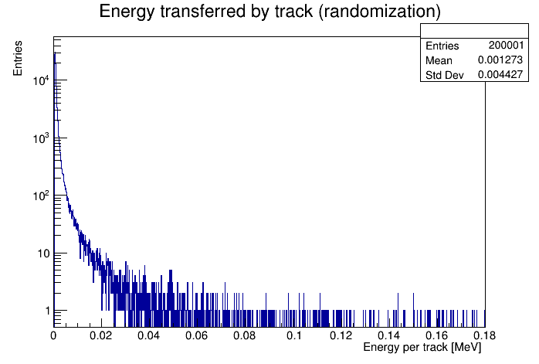
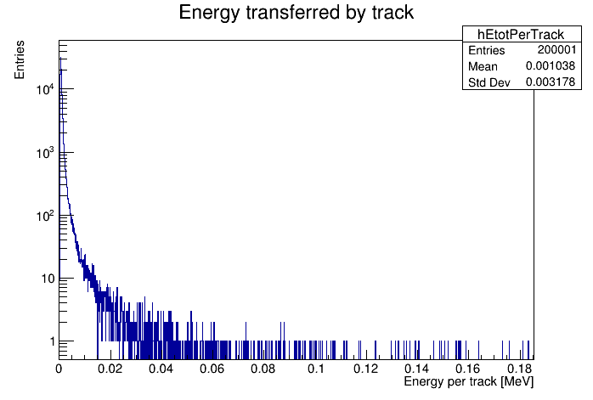
An example
A comparison between the Garfield++ energy loss distribution and the same distribution obtained by implementing our function, for a kaon with momentum of 500 MeV, passing through 1 cm of He-Isobutane.
Randomization
Kaon
500 MeV
1cm
Garfield

Slide 7
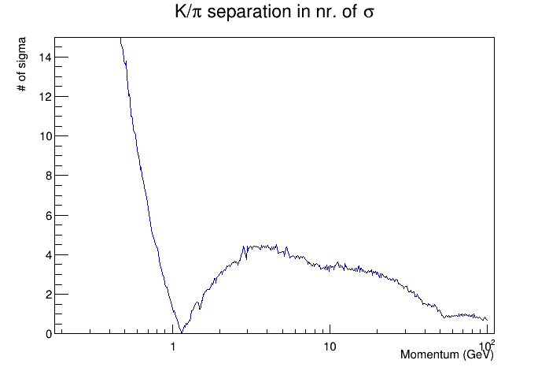
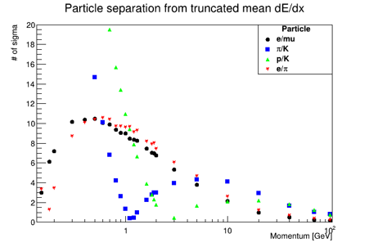
First preliminary results of particle identification in Delphes
We test our procedure with a simple example in Delphes, trying to evaluate the particle separation power between kaon and pion.
Delphes
Garfield++

Slide 8
To do
Optimization of the interpolation function.
Generation of a bunch of events to start the particle identification analysis in DELPHES & EDM4HEP.

Slide 9
Thank you

Slide 10
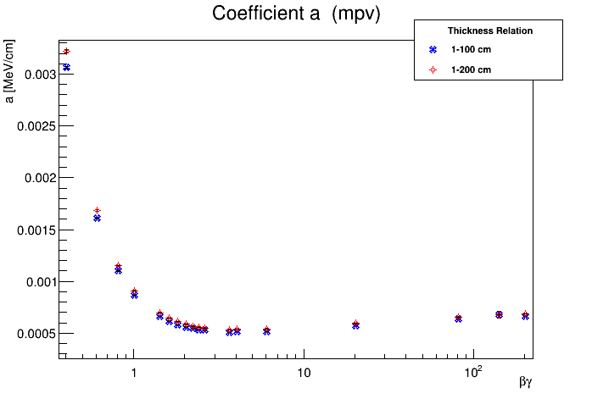
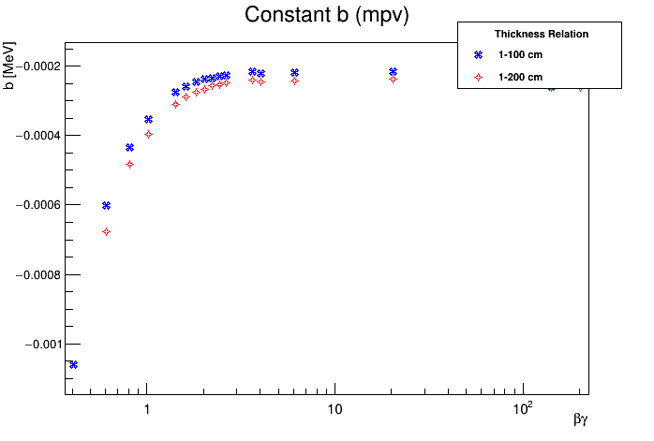
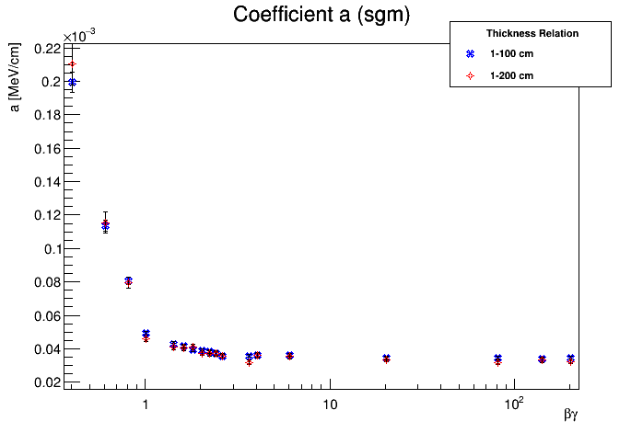
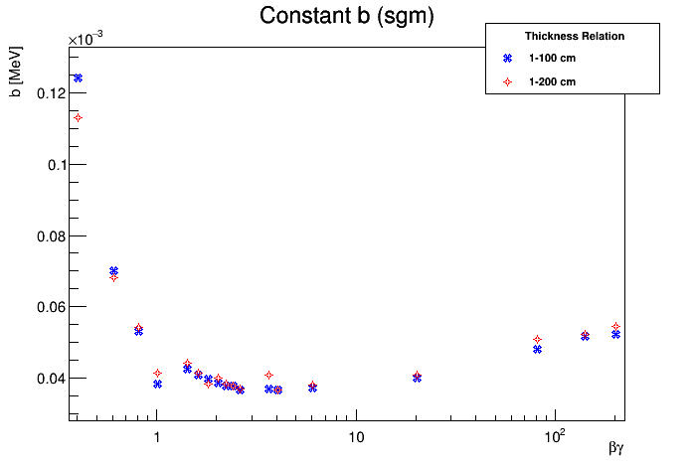

Slide 11
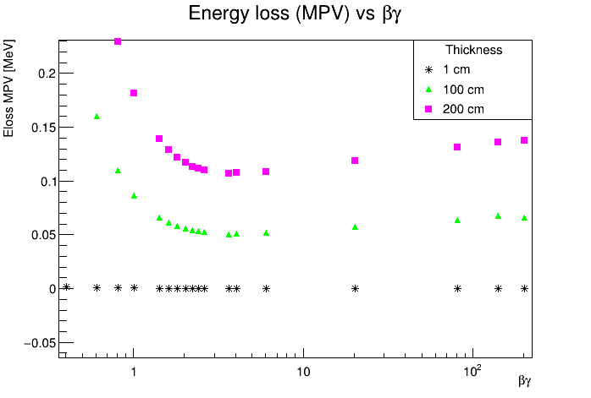
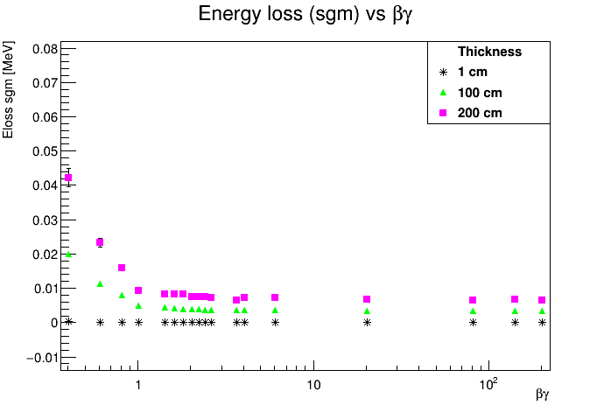
Energy loss distribution simulated by Garfield++ for different thickness

Slide 12
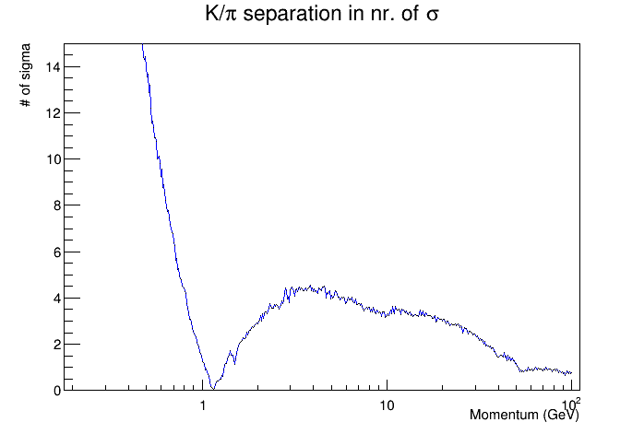
Garfield++

