Slide 1
  Status of CEPC Electro-magnetic
  Separator and Magnet Power supply
  Bin Chen
  CEPC Day (May 19) 2022

Slide 2
Contents
  Design and progress for electrostatic-magnetic deflector
  Design and progress for power supply
  Summary

Slide 3
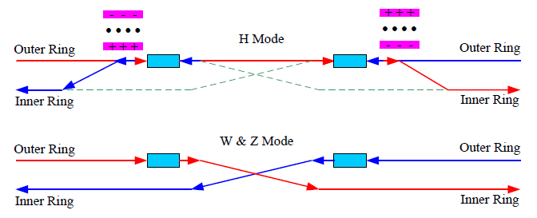
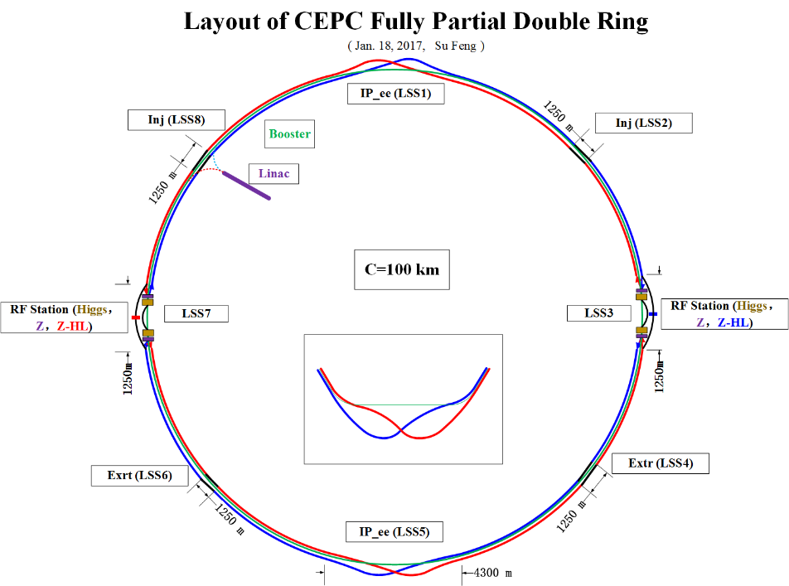
Design and progress for electro-magnetic separator
  In the RF region, A set of electrostatic separators combined with dipole magnet (Electro-Magnetic Separator ) are installed downstream of the RF cavities.
  They are used to avoid bending of incoming beam and deflect the outgoing beam in H mode. After the Separators, the positive and negative electron beams of the outer ring passing through the RF cavities are deflected to their respective inner rings.
Introduction
Layout of RF region
  Optics of the RF region for Higgs (left), W and Z (right) modes

Slide 4
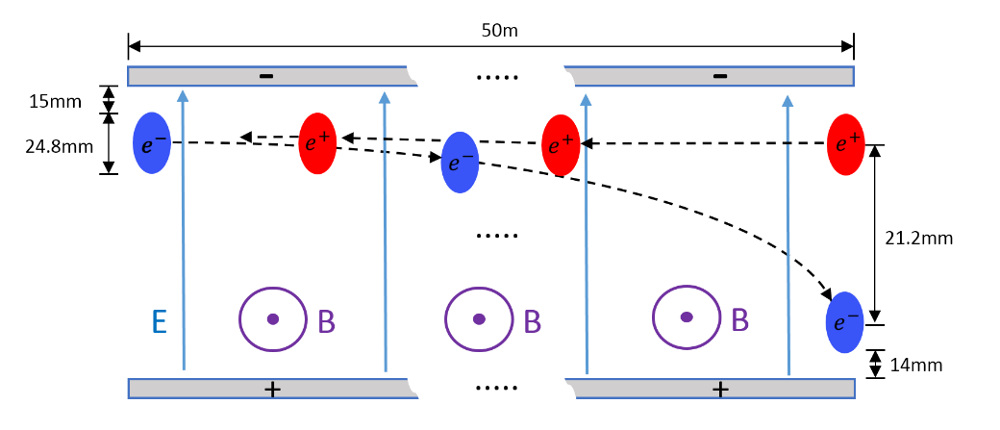
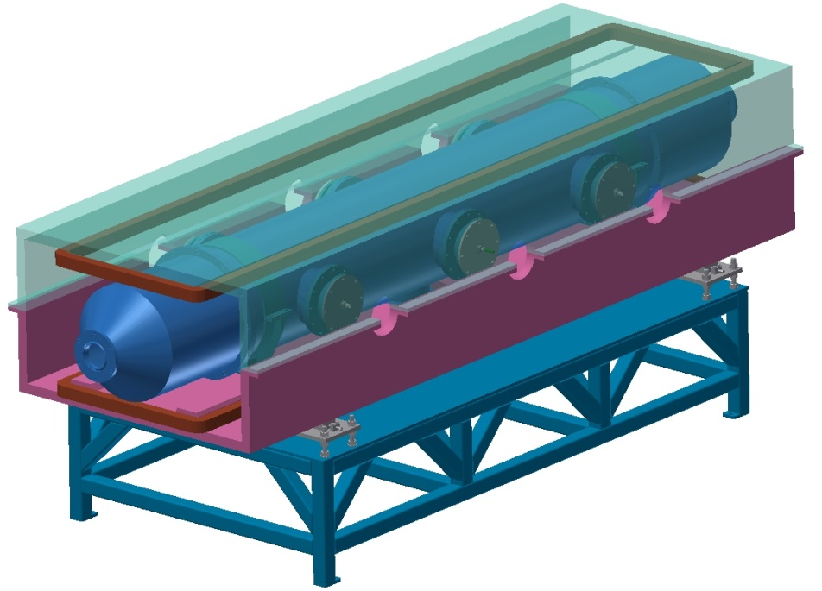
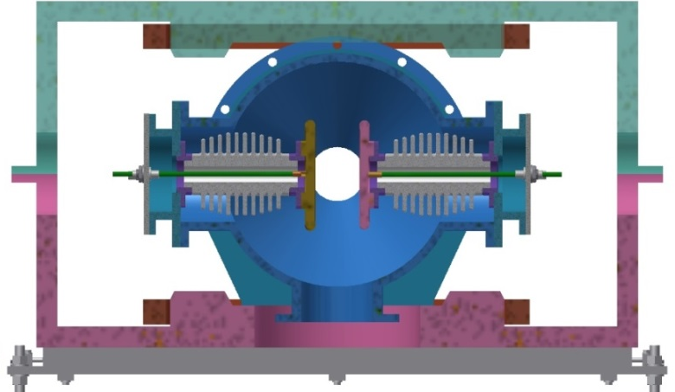
Design and progress for electro-magnetic separator
  The Electro-Magnetic Separator is a device consisting of perpendicular electric and magnetic fields.
  One set of Electro-Magnetic Separators including 8 units, total 32 units will be need for CEPC.
 | Filed | Effective Length | Good field region | Stability
Electrostatic separator | 2.0MV/m | 4m | 46mm ⅹ11mm | 5ⅹ10⁻⁴
Dipole | 66.7Gauss | 4m | 46mm ⅹ11mm | 5ⅹ10⁻⁴
Schematic of Electrostatic-Magnetic Deflector
metal-ceramic support
high voltage feedthrough
UHV tank
Magnet
Support
  structure drawing of Electro-Magnetic Separator
coil
electrode

Slide 5
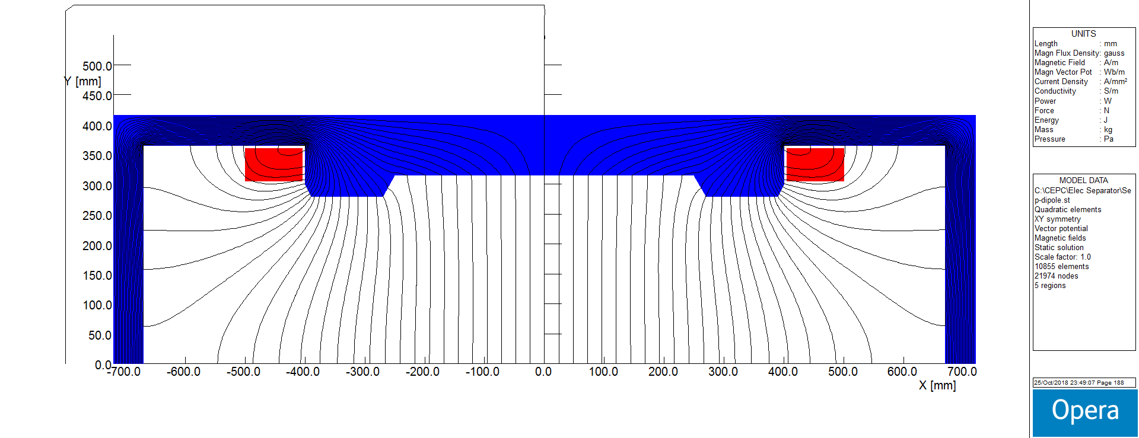
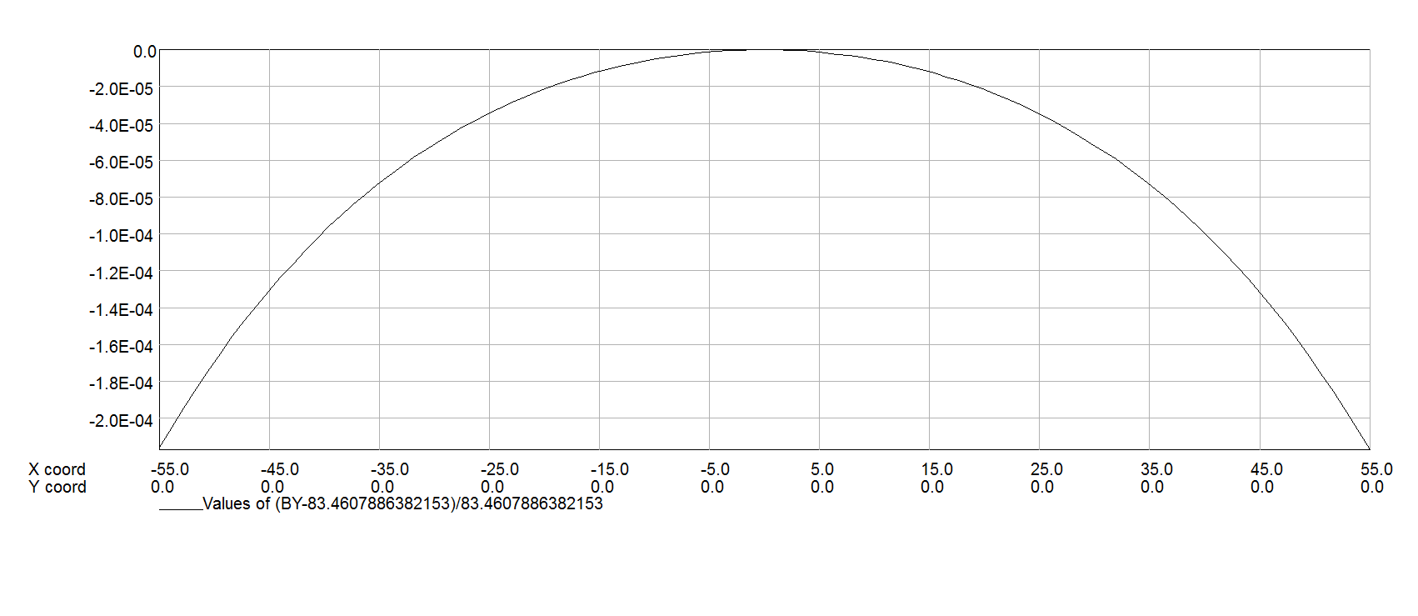
Design of dipole magnet
  The magnet yoke is H-type, because of the higher field integrals uniformity and installation consideration of the electro-static system.
  According to the Lorentz force equation, the center magnetic field needs to reach 66.7Gauss.
  The magnet aperture arrives at 600 mm due to the inner electro-static system size.
  Within the patch of 6cm*11cm, the uniformity of the field integrals reaches ±2E-04.
Field Distribution
Field homogeneity

Slide 6
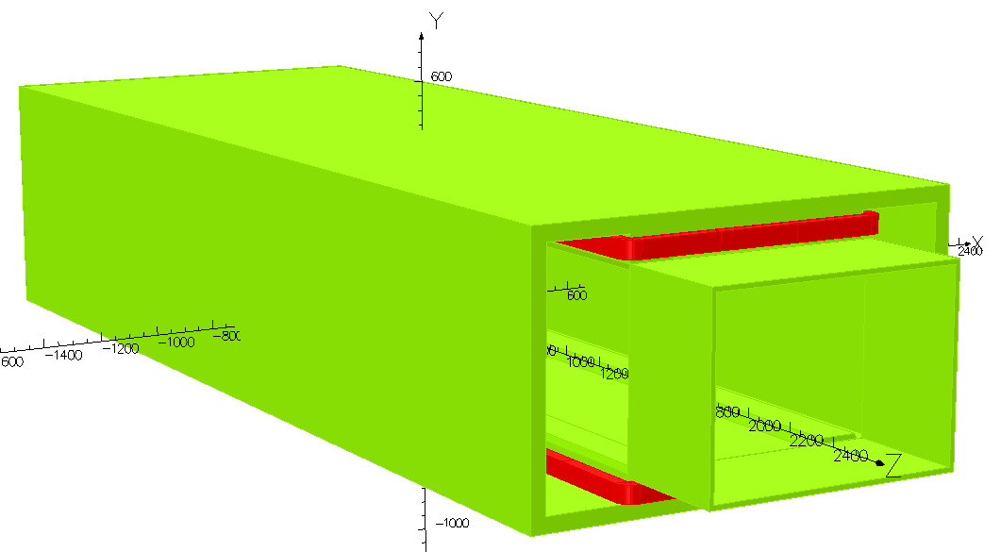
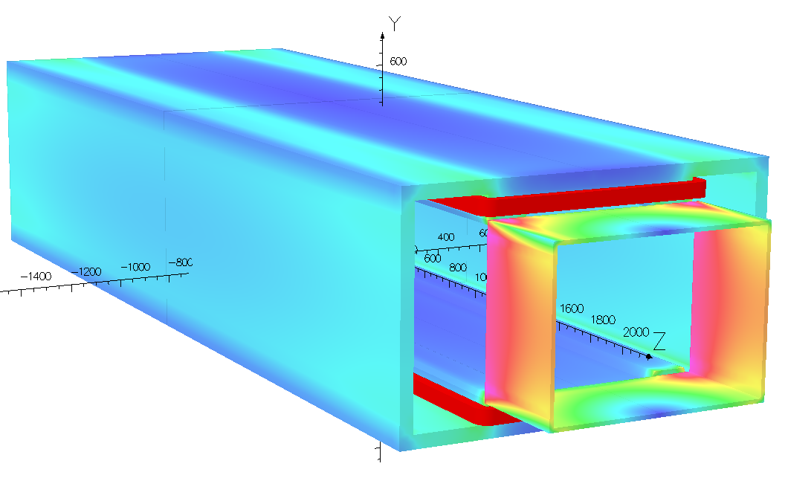
Design of dipole magnet
Magnet Name | ESM
Center field [Guass] | 75.5
Magnet Length [m] | 4.4
Current [A/turn] | 10.8
Turns [H×V] | 12×17
Field Clamp Size [H×V, mm] | 830×610
Field Clamp Wall Thickness [mm] | 10
Field Clamp Number | 2
Coil Number | 2
Conductor Size [H×V, mm] | 3×3
Current Density [A/mm^2] | 1.2
Magnet Resistance [Ω] | 7.82
Magnet Voltage [V] | 84.4
Magnet Power [W] | 660
Magnet Inductance [H] | 2.42
Cooling Method | Air
Yoke Weight [Ton] | 11
Coil Weight [Ton] | 0.328
Magnet Weight [Ton] | 11.328
3D Model
Parameters of the magnet

Slide 7
  Design of Electrostatic Separator
  An electrostatic separator comprise a pair of electrodes, UHV tank, metal-ceramic supports, high voltage feedthrough, High voltage circuit and vacuum system, etc.
  Parameters of electrostatic separator
Separator length | 4.5m
Inner diameter of separator tank | 380mm
Electrode length | 4.0m
Electrode width | 180mm
Nominal gap | 75mm
Maximum operating field strength | 2MV/m
Maximum operating voltage | ±75kV
Good field region (0.5‰ limit) | 46mm ⅹ11mm
Nominal vacuum pressure | 2.7e-8 Pa

Slide 8
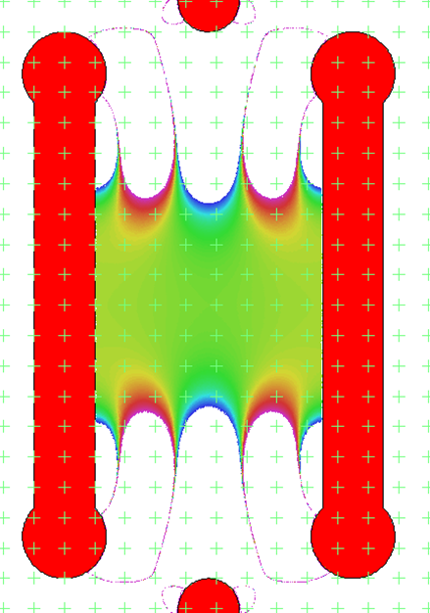
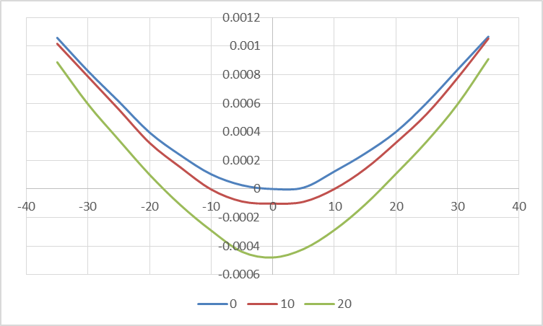


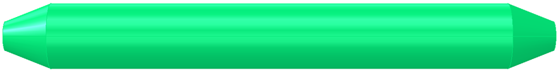
  Design of Electrostatic Separator
Electrode (a pair of metal flat plate)
Dimension : 4m long and 180mm wide
Material : Pure Titanium
  Field strength : 2MV/m
UHV tank
4.5m long and 38cm inner diameter
Material : stainless-steel 316L
Field homogeneity：7.5cm*5cm 0.5‰
Calculated electrical field integrals uniformity ：4.6cm*3cm 0.5‰
18cm
Length：400cm
With：18cm
Thickness：2cm
Radius：1.5cm
Density：4.54g/cm³
Weight：≈65kg
400cm
ID：9.5cm
ED：7.5cm
thickness：1cm
25cm
400cm

Slide 9

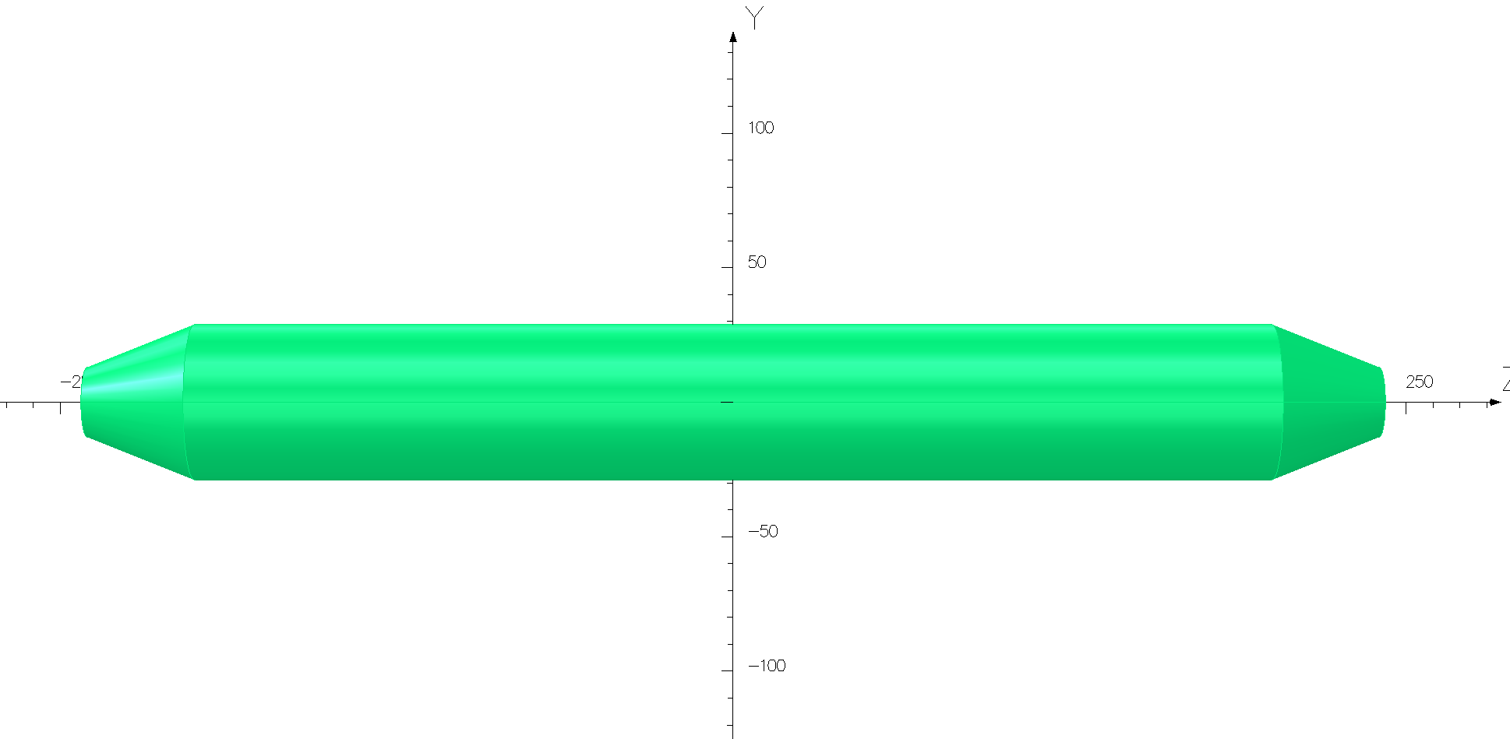
Methods to reduce the Parasitic mode losses
  The electrostatic separators are large contributors to the overall impedance. There are two methods implemented in the design of the separator which reduce the loss factor:
  ground electrodes
  tapered ends
  These two methods are merged in one unusual surface which smoothly guides the field energy from a normal vacuum chamber geometry to the multiple electrode geometry and then back to the normal vacuum chamber.
tapered ends
Ground electrodes

Slide 10
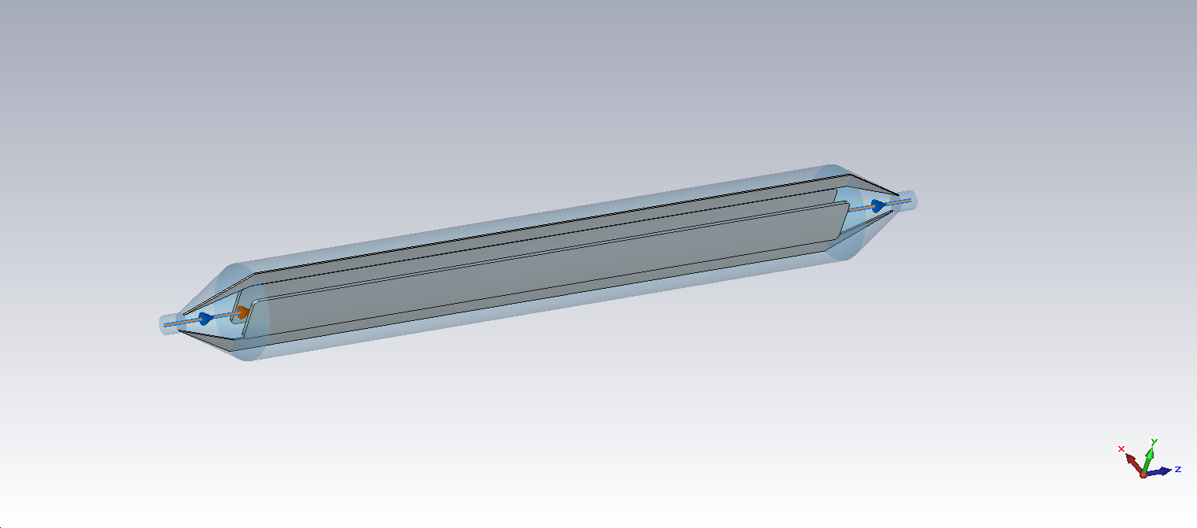
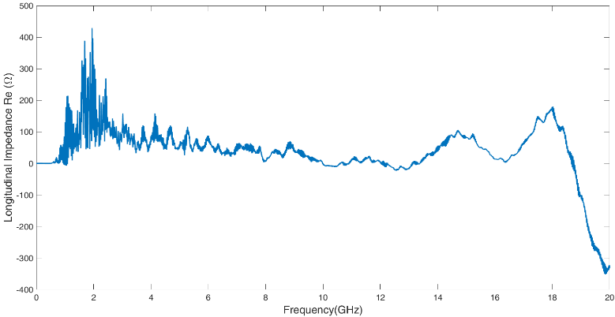
Methods to reduce the Parasitic mode losses
Separator tank length | 4000mm
Inner diameter of separator tank | 380mm
Electrode height | 180mm
Electrode gap | 75mm
Electrode thickness | 15mm
Taper length | 231mm
Taper end diameter | 98mm
Ground plate length | 4462mm
Ground plate height | 100mm
Ground plate thickness | 20mm
σ_{z}=5mm: Loss factor @k_trap: 0.032v/pc
 | Higgs(w) | W (w) | Z(w) | ttbar（w）
HOM power(30MW) | 385w | 1.87kw | 18.6w | 107w
HOM power(50MW) | 643 | 3.13 | 31.0 | 178

Slide 11
  Methods to maintain E/B ration in fringe field region
  Another challenge in designing deflector is the spatial difference in electric and magnetic fringe ﬁelds. Because of the large gap, the magnetic fringe ﬁeld extends over a larger distance than the electric fringe ﬁeld.
  In this fringe ﬁeld region, the ratio of E/B differs from that inside the deflector, and this can result in a synchrotron radiation from the Separation Region, which will affect the down stream RF cavities.
  For the coming-in beam, the radiation power of 3.4 W is significant if it point to one cavity.
Critical energy of photons
Radiation power
Upper figures for out-going beam Lower figures for coming-in beam

Slide 12
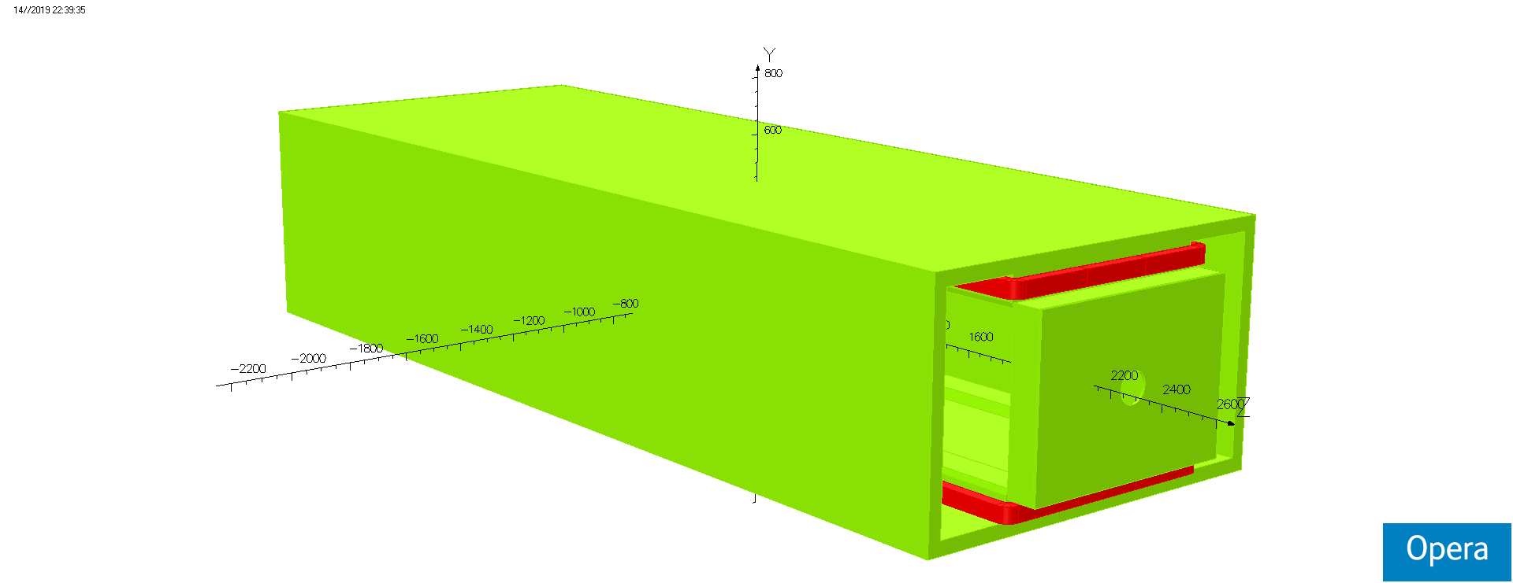
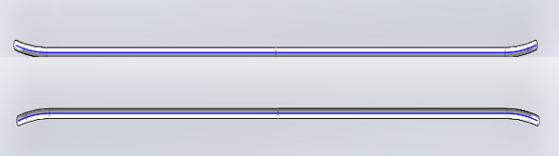
  Methods to maintain E/B ration in fringe field region
  Several Methods have been incorporated into the design of the deflector in an effort to minimize the distortions in the fringe ﬁeld region.
  Magnet: addition of ﬁeld clamps, along with the mirror plates.
  Separator: ﬂaring open the electrode ends progressively
mirror plate
ﬁeld clamp
Initial design
optimization design

Slide 13
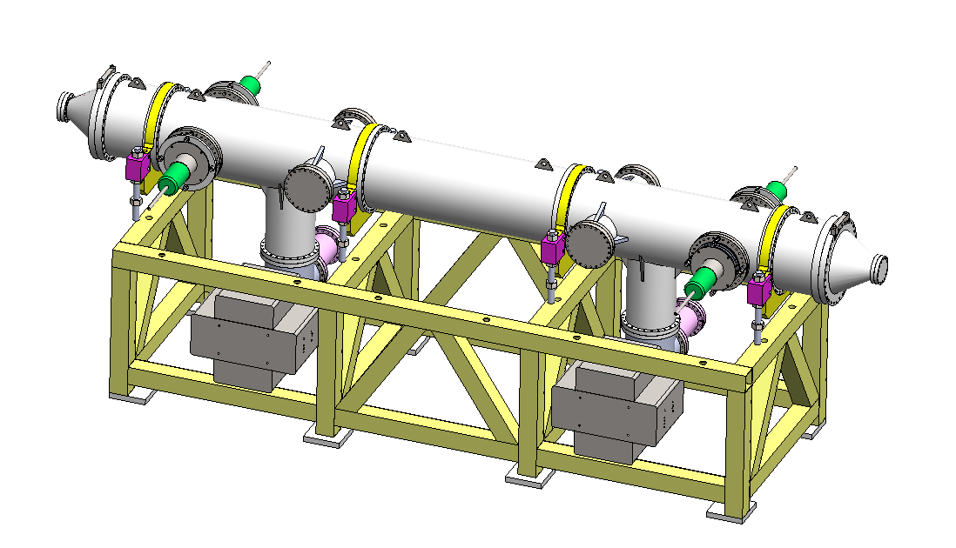
Prototype development of electrostatic separator
  A separator unit including: 1. Vacuum chamber (5 straight through chambers, 2 cone tubes and 2 pump chambers); 2. a pair of electrodes; 3. 2 ground electrodes; 4. 4 groups of insulation metal-ceramic support; 5. 4 groups of high voltage feedthrough; 6. 2 sets of vacuum system (including ion pump, sublimation pump and gauge); 7. support platform.
  structure drawing of Electrostatic Separator

Slide 14
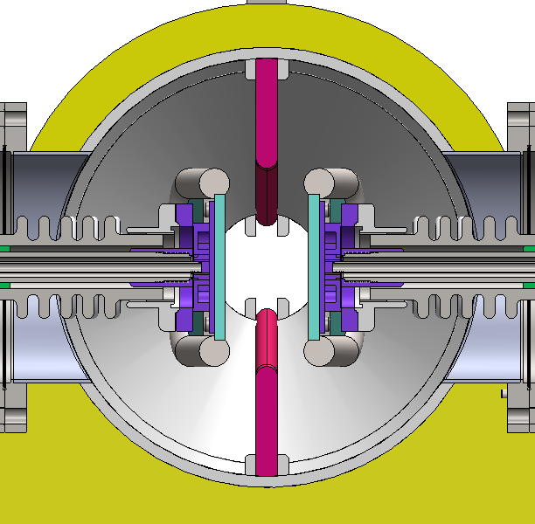
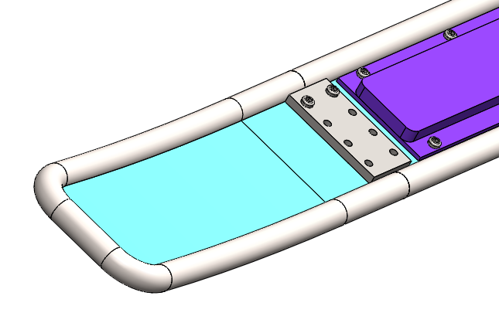
  Mechanical design
Electrode
Due to the large size, titanium welding deformation is large and difficult to correct, so as to minimize the range of welding.
Electrode plate and cooling plate are separated and bolted together.
The cold plate material is stainless-steel 316L.
The electrode plate is divided into three sections: the middle straight plate, the arc plate on both sides, and bolted connection. In this way, the dimensional accuracy of the middle part and the curved part on both sides is easy to be realized.

Slide 15
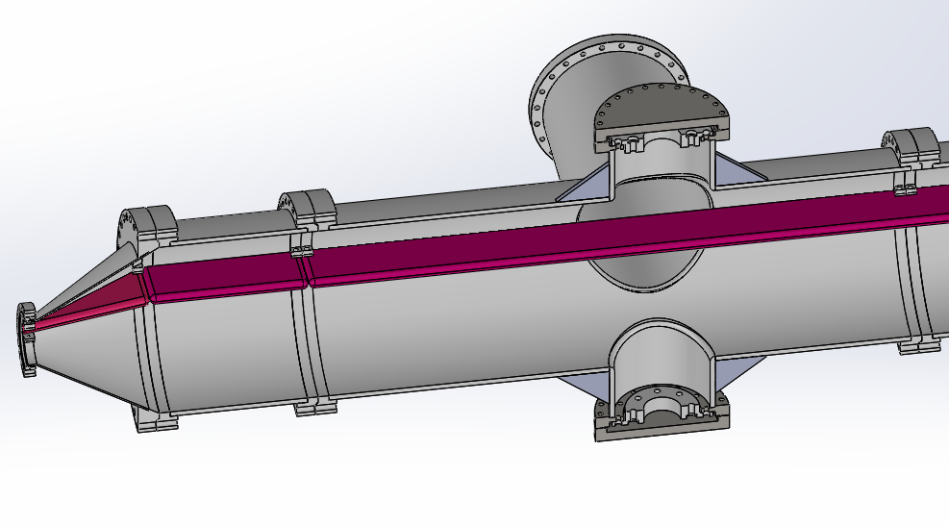
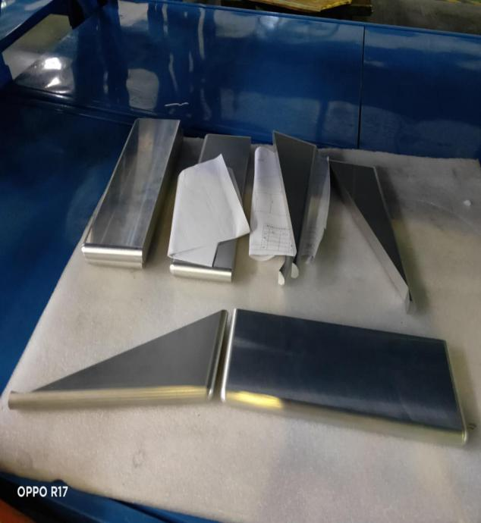
  Mechanical design
Ground Electrode
The ground electrode material is aluminum 6061 T6.
The ground electrode is divided into 5 sections: 2 sections of triangle, 2 sections of short rectangle and 1 section of long rectangle. The purpose of segmentation is to facilitate machining and installation
The ground electrode is fixed with a fixed clamp welded on the vacuum chamber.

Slide 16
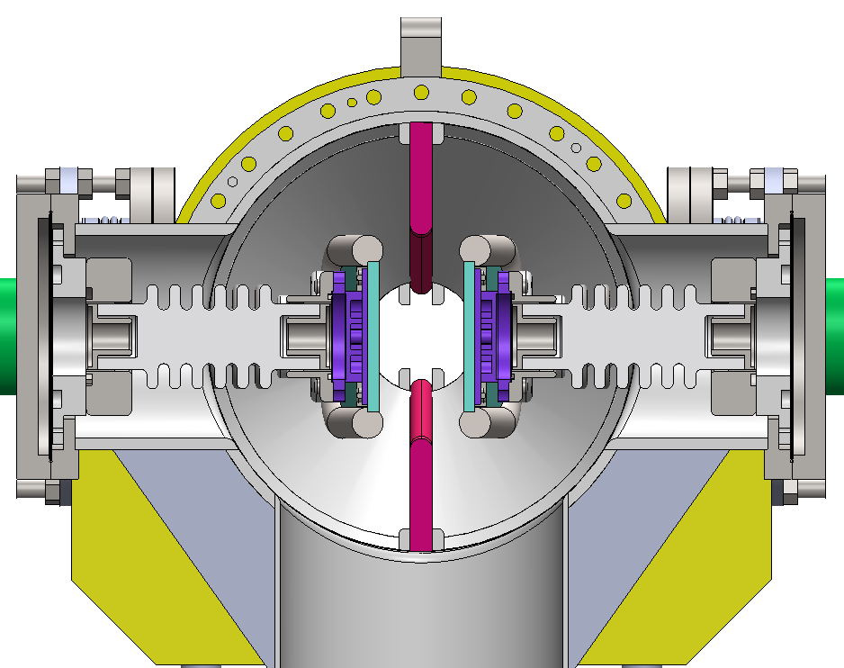
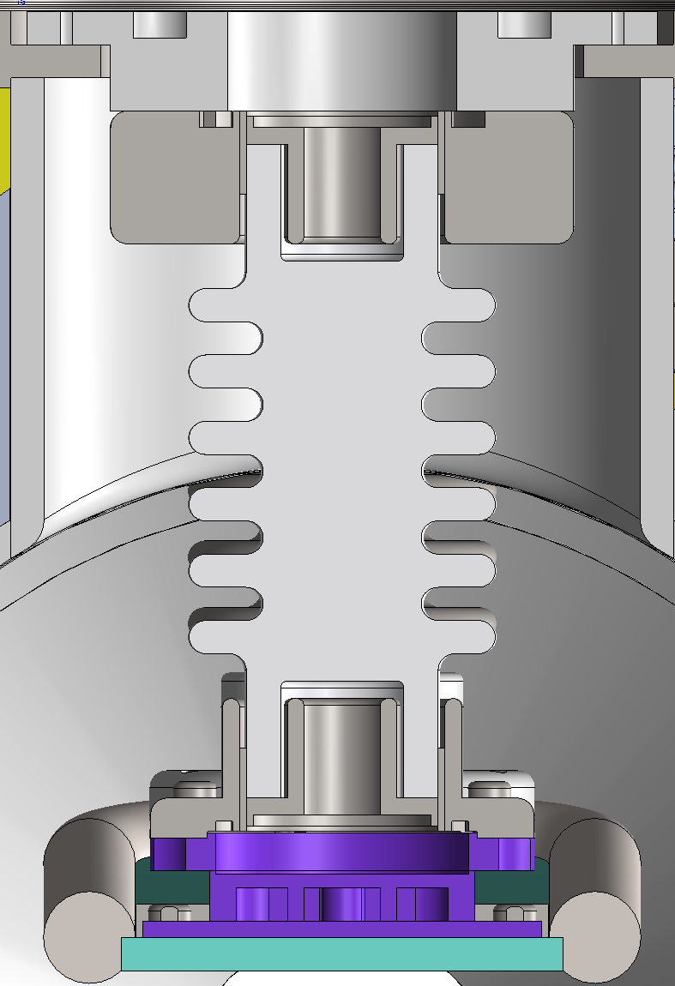
  Mechanical design
HV metal-ceramic support
The ceramic parts are made of 95% alumina ceramics.
The ceramic ends are metallized , and the metal flanges are welded for fixation, which has the advantage of high mechanical strength.
The electrode have two supports, one is fixed, the other can be fine-tuned, to ensure the installation accuracy requirement and avoid the deformation of electrode.

Slide 17
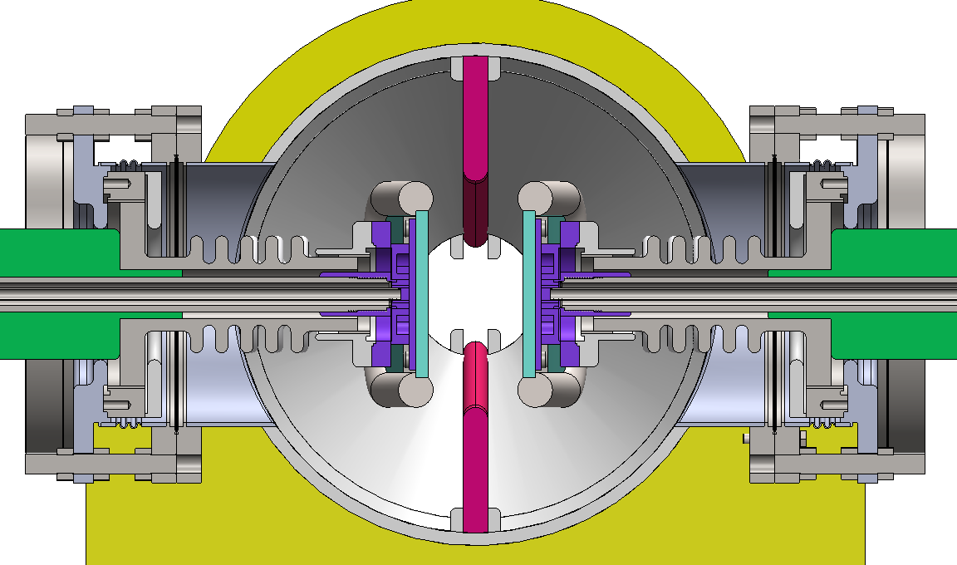
  Mechanical design
High voltage feedthrough
The inside of the ceramic tube is atmosphere, with feedthrough cable and liquid pipe, and the outside is vacuum.
Bellows are soft connections for easy installation and position adjustment.
Each electrode plate has only one feedthrough device, both feed HV and cooling liquid.

Slide 18
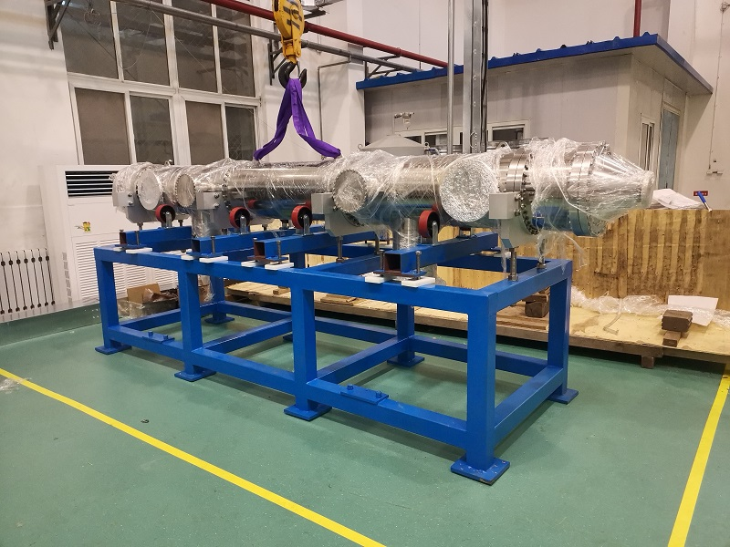
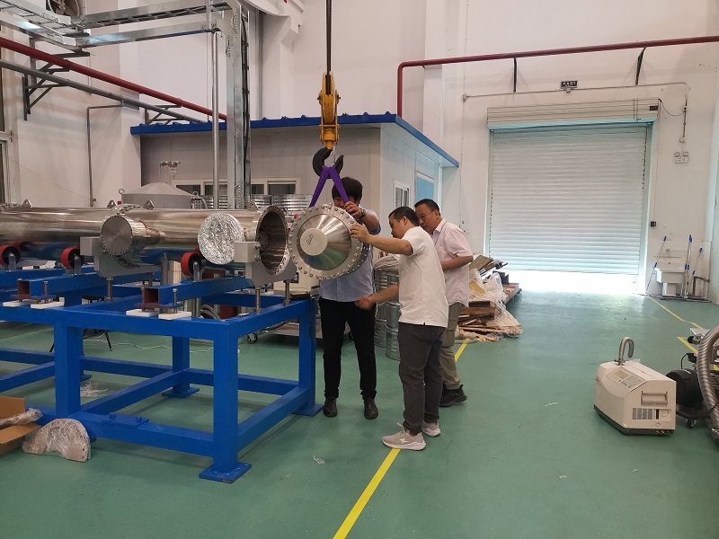
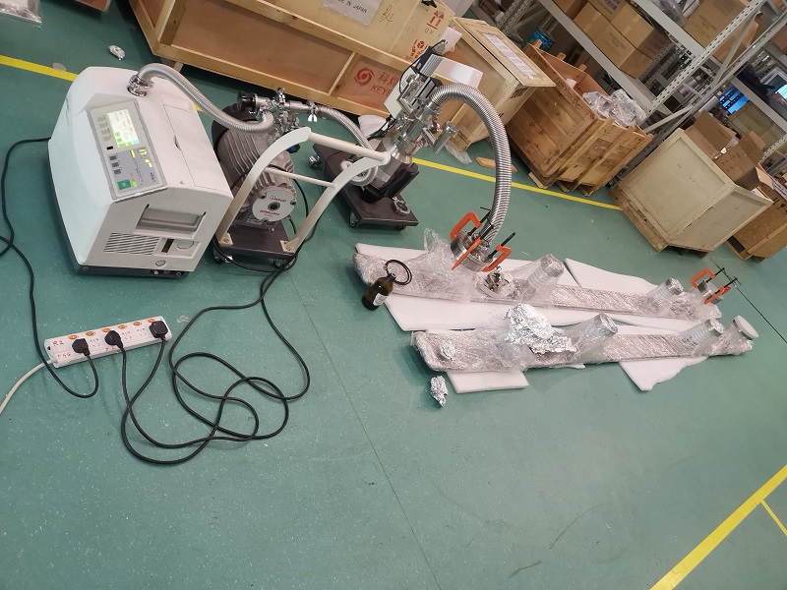
  Prototype development of electrostatic separator
  Install vacuum chamber and electrode plate vacuum leak detection.

Slide 19
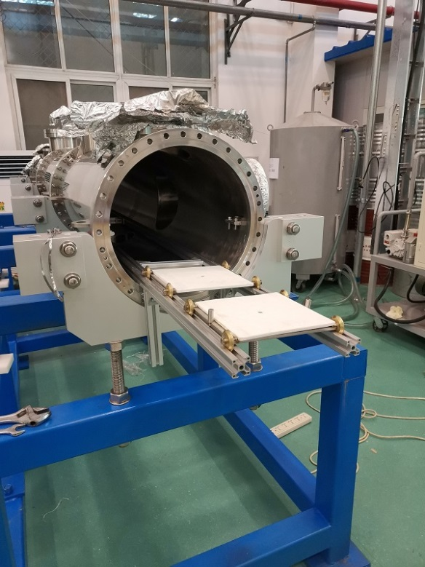
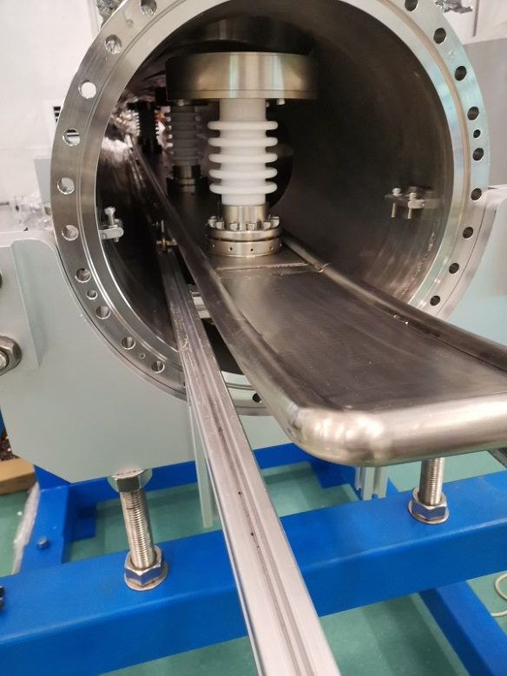
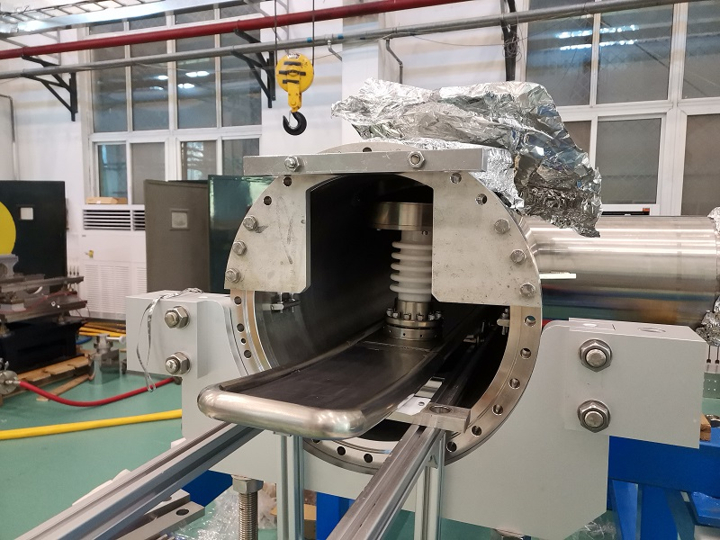
  Prototype development of electrostatic separator
  Installation of electrostatic separator.

Slide 20
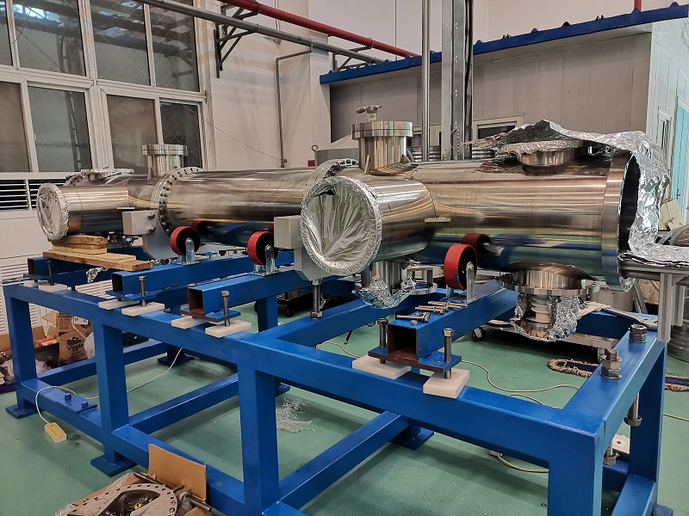
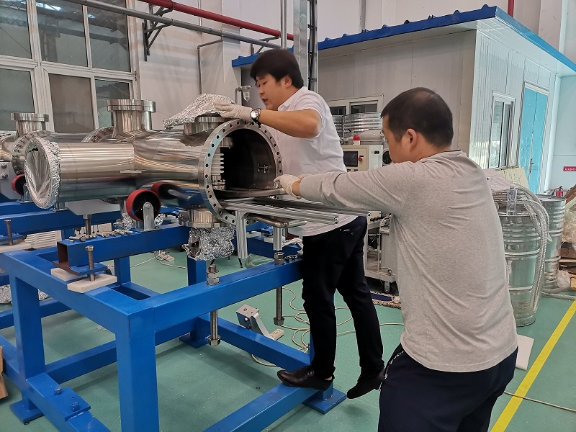
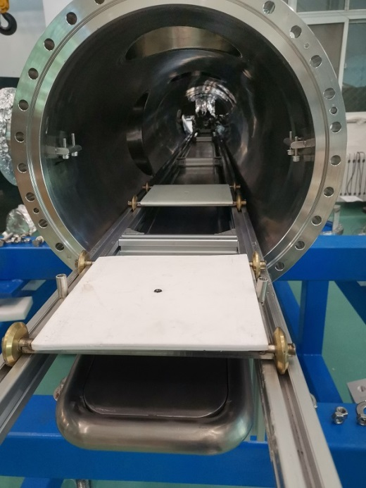
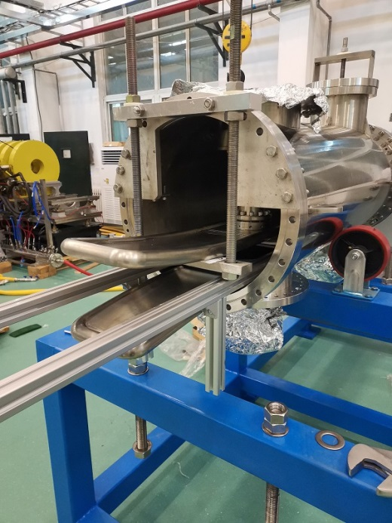
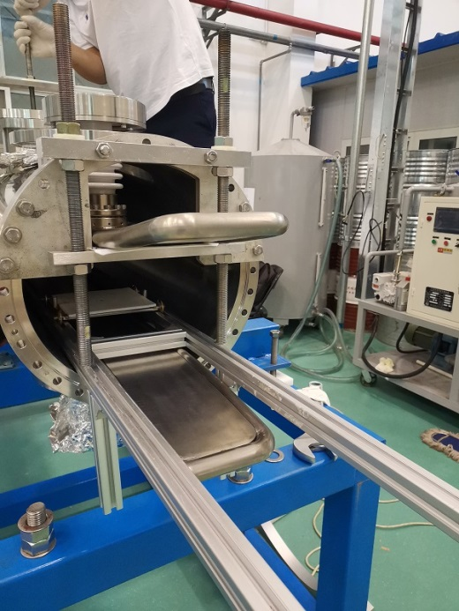
  Prototype development of electrostatic separator
  Installation of electrostatic separator.

Slide 21
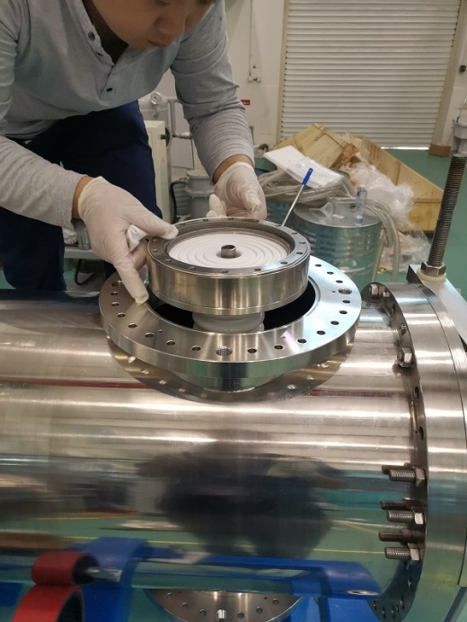
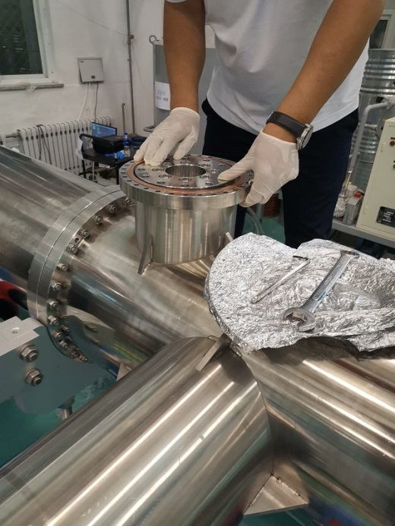
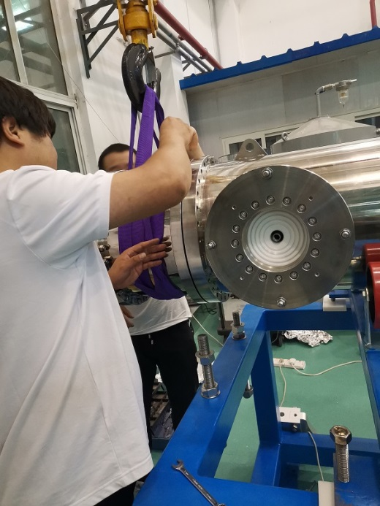
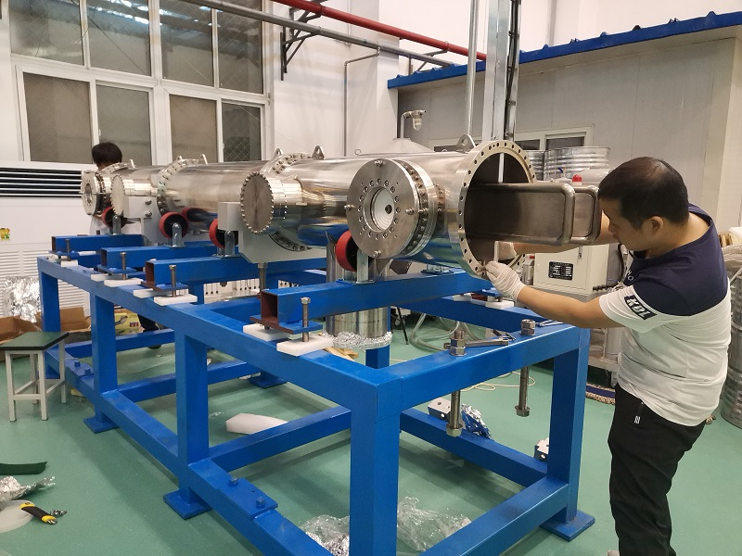
  Prototype development of electrostatic separator
  Installation of electrostatic separator.

Slide 22
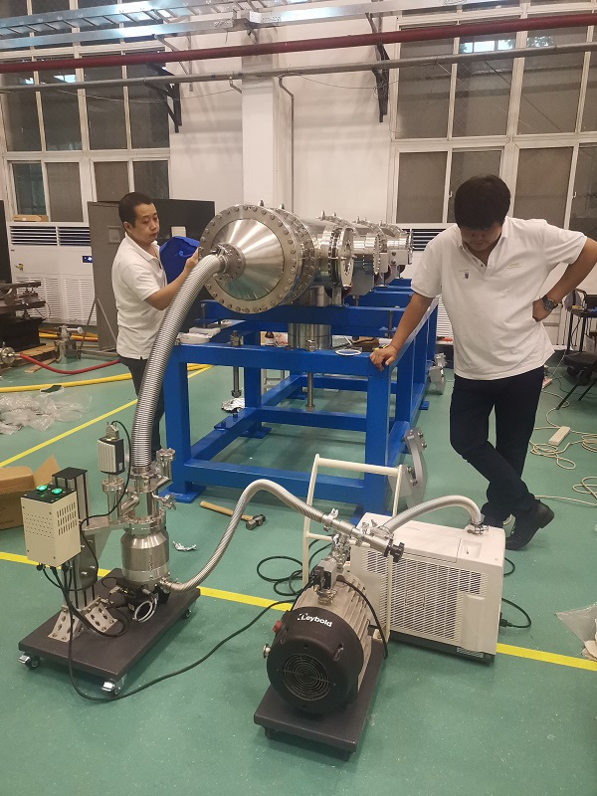
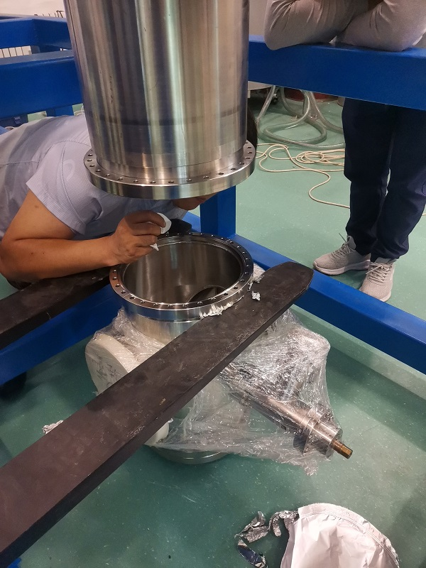
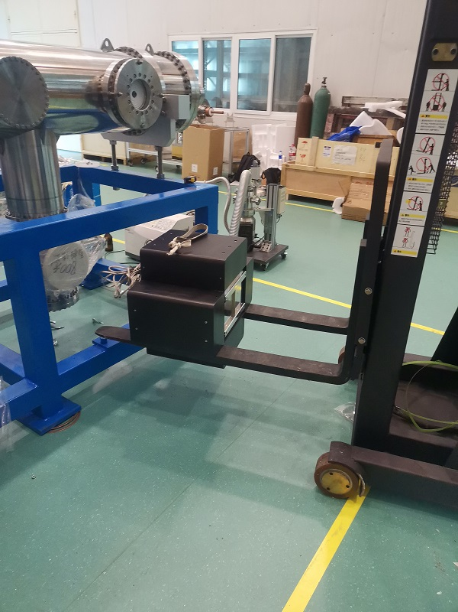
  Prototype development of electrostatic separator
  Installation of electrostatic separator.

Slide 23
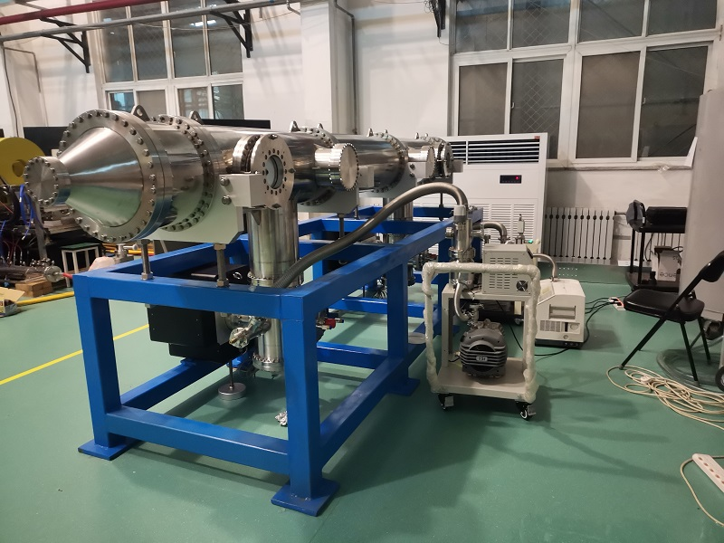
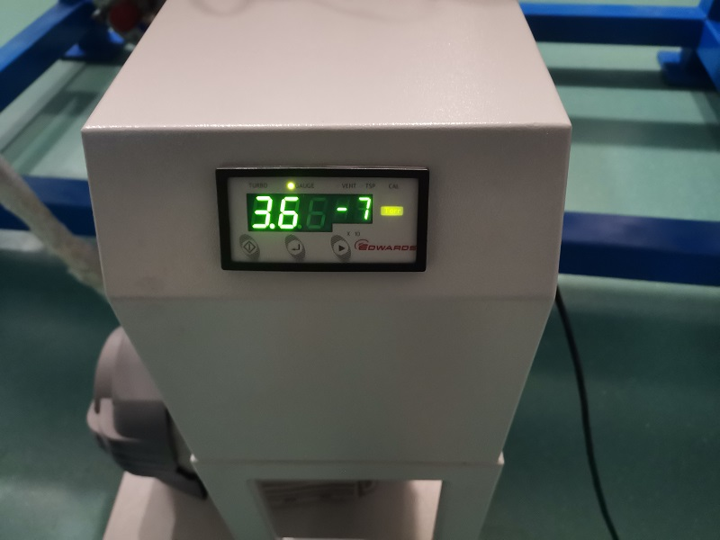
  Prototype development of electrostatic separator
  Molecular pump unit for crude pumping.

Slide 24
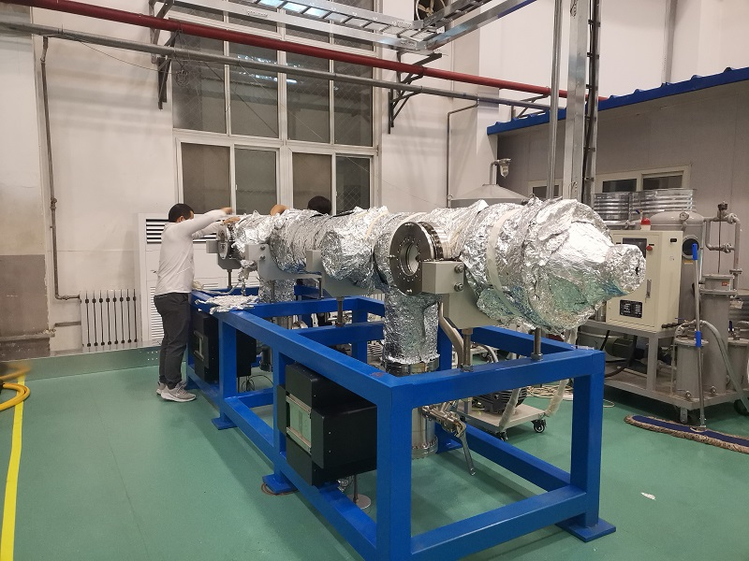
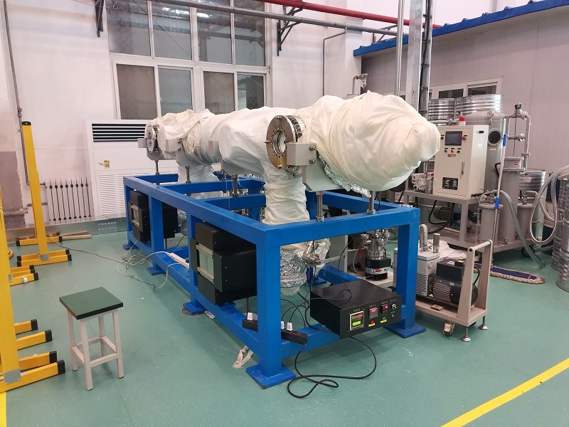
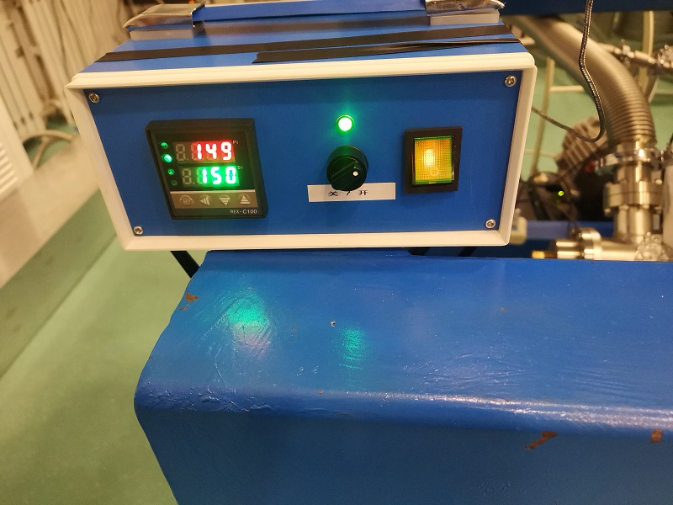
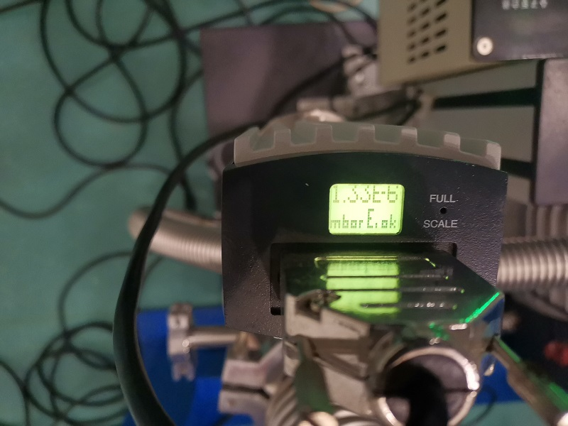
  Prototype development of electrostatic separator
  Vacuum baking.

Slide 25
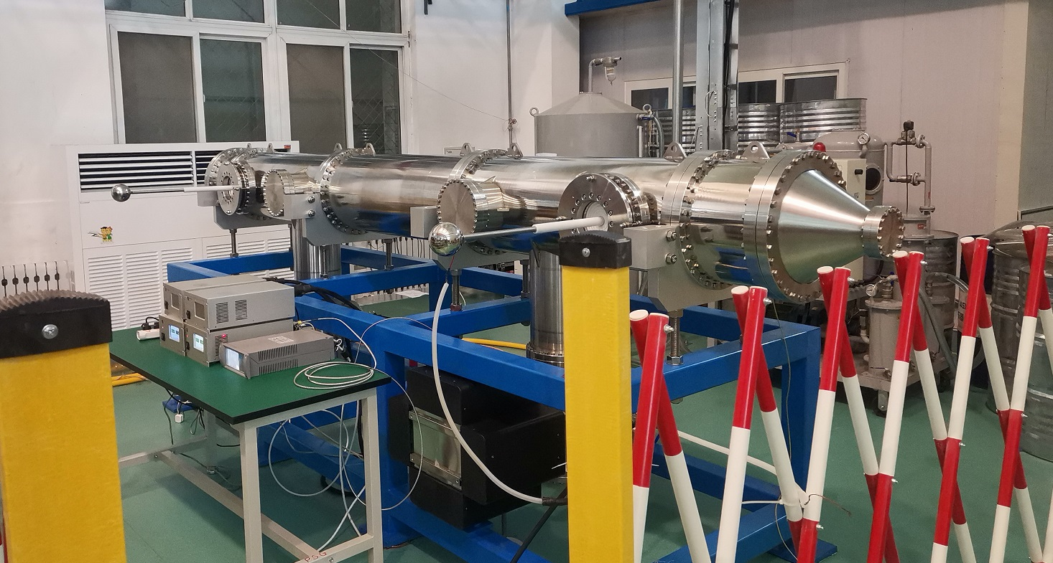
Prototype development of electrostatic separator
  Test platform
  The test mainly includes: vacuum test, high voltage test, etc.

Slide 26



Prototype development of electrostatic separator
  System vacuum leak detection
vacuum leakage rate ≤2×10⁻¹³Pa.m3/s

Slide 27


Prototype development of electrostatic separator
  The system was vacuumed after baking
vacuum pressure: 1.3×10⁻⁸Pa (1.0×10⁻¹⁰Torr)

Slide 28

Prototype development of electrostatic separator
  High voltage test

Slide 29





Prototype development of electrostatic separator
  High voltage test
  Due to the arc occurred at the air side of feedthrough during the factory test, Some methods implemented in the HV feedthrough : 1. carve annular groove on the outer surface of ceramic parts to increase the creepage distance; 2. Electrode probe is coated with insulation bushing and sealed to block the creepage path on the air side of the HV feedthrough.

Slide 30



Prototype development of electrostatic separator
  High voltage test
  Arc occurs at ±90kV.
  The operating voltage of the electrostatic separator in Higgs Mode (120GeV) is ±75kV, and the high voltage of prototype test can reach ±90kV, which basically meets the requirements of Higgs Mode operation. In order to improve the redundancy, we need to continue the high voltage conditioning to reach ±135kV.

Slide 31




  Prototype development of dipole magnet
  Completed the mechanical design of the magnet

Slide 32



  Prototype development of dipole magnet
  The magnet was being manufactured in the factory

Slide 33

  Prototype development of dipole magnet
  The prototype of the magnet has been developed.
  Due to the large size of the prototype, there is no suitable platform for measuring it. The new hall probe measurement system is under construction and is scheduled to be completed in July. Then a weak field measurement of the prototype will be made.

Slide 34
Design and progress for power supply
  Basic design principles for the power supplies
    Modular design for power supplies
    Switching mode as the main topology.
    digital design for all power supplies.
Focusing on key issues for PS system
    Booster Power Supply
    Corrector PS (Multi-unit combination structure)

Slide 35
Design and progress for power supply
  the digital control power supplies are split in three independent parts
    A power part acting as a voltage source or a current source, which is suitable for industrial design and production
    Current transducers （Commercial Product or Self-design)
    Self-designed digital electronics control module, which performs the current regulation, diagnostics, monitoring and local/remote service . It’s standardized for all types of power supply.

Slide 36


Booster power supply
  Design principles of the booster power supplies：
  Based on the current waveform requirement of the dipoles, quadrupoles and sextupoles (as shown below); the rating voltage considering the inductive value caused by the magnet inductance.
  Duration of ramp-up and ramp-down are 5s .
  Repetitive frequency 0.08Hz, trapezoidal .
  Power supply performance: tracking error less than 0.2% .
The magnetic field cycle waveform for CEPC booster

Slide 37
booster power supply
  Topology:
    Mature Multi – module series technology is adopted for high voltage output.
    AC-DC-AC structure
    Front stage rectifier circuit: diode rectifier + Booster.
    Output stage is the two-quadrant chopper,
    A power control circuit is used to reduce the fluctuation of input power

Slide 38



booster power supply
  Simulation:
red curve: output current ; blue curve: output voltage
output current and tracking error waveform

Slide 39




Prototype: test
the stability meets the requirements.
Prototype for HEPS magnet Measuring
Current tracking waveform

Slide 40


Corrector PS Design
  For large number of corrector PS:
  1) each one stand-along, but multi power supplies share one chassis;
  2) power supplies in one chassis share one digital controller
  pros:
  each power supply can be maintained independently;
  cost effective with respect of chassis and digital controller, and space savings.

Slide 41




Corrector PS Design
  Topology of single module:
    AC-DC source + Full Bridge (Zero Voltage Switch-Phase Shifting)
  Embedded self-designed DPSCM

Slide 42


Prototypes: test
  Stability: (Imax – I min)/IN during 8h, 19.1ppm , meets the requirements.
High frequency ripple is 9.04mV, caused by PWM switching frequency (24 kHz)
Power frequency voltage ripple is 332uV (50Hz)

Slide 43
Summary
  The Electro-magnetic separator including two part: Electrostatic Separator and Dipole Magnet
  The magnet yoke is H-type. The prototype of the magnet has been developed.
  A separator unit consists of a pair of pure Titanium electrodes — each 4 m long and 180 mm wide —mounted in an UHV tank of about 380 mm inner diameter.
  There are two methods implemented in the design of the separator to reduce the loss parameter: ground electrodes & tapered ends.
  we use the field clamps, along with the mirror plates and ﬂaring open the electrode ends progressively to minimize the distortions in the fringe ﬁeld region.
  The prototype of the separator was fabricated in factory and the test had been done.
  During the voltage test, the arc occurred at the air side of feedthrough. So feedthrough needs further improvement.
Prototypes for Booster power supply and Correctors with Multi-unit combination structure has been fabricated and finished the test.

Slide 44
Thank You!

