Slide 1
Boost Lattice and Error Study
Daheng Ji
CEPC DAY (May 19, 2022)

Slide 2
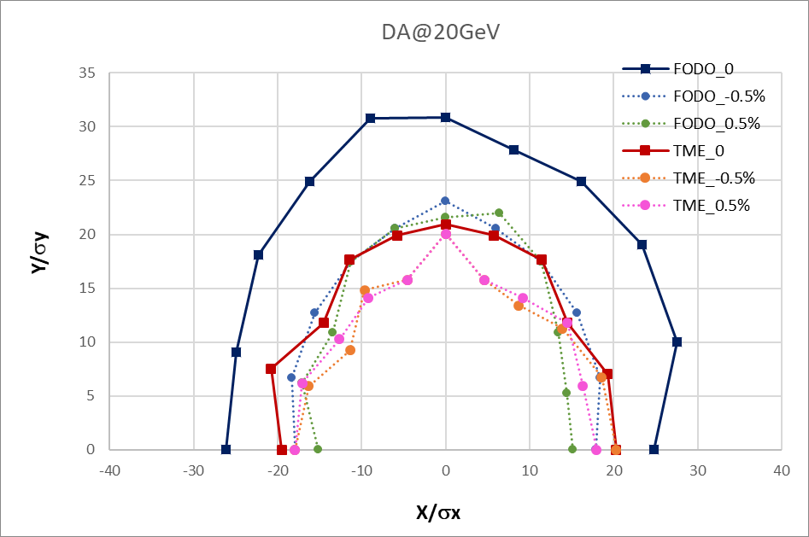
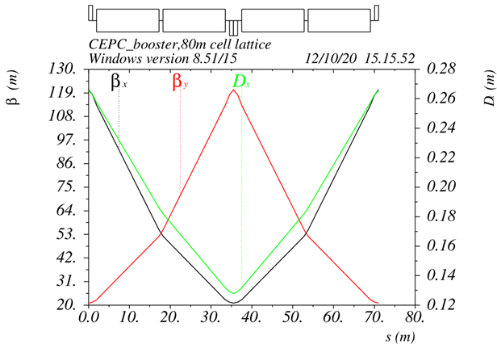
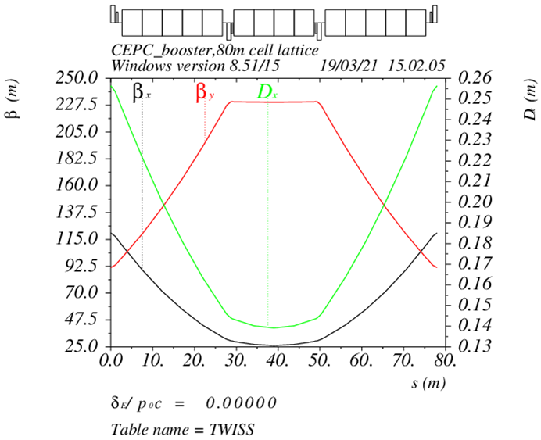
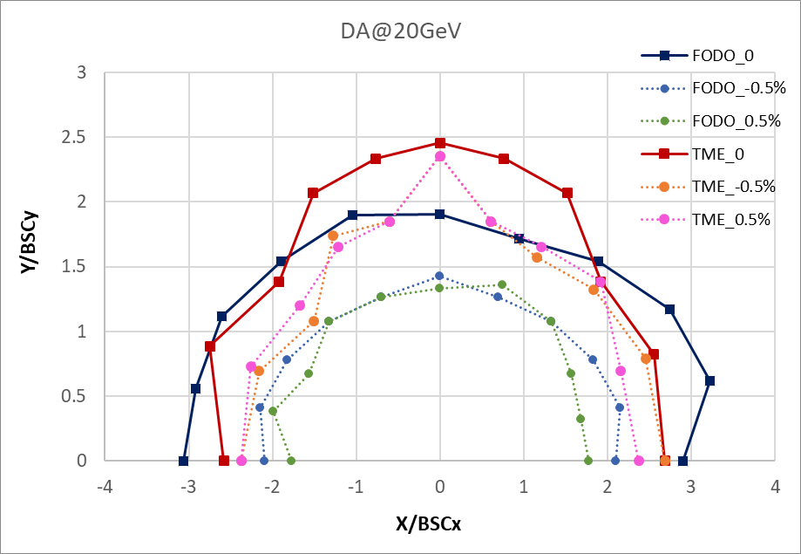
Booster TDR optics
D. Wang, C. H. Yu, Y. M. Peng…
FODO structure (cell length=70m)
90°/90° phase advance
Non-interleave sextupole scheme
Similar structure as CDR
TME like structure (cell length=80m)
Overall idea: uniform distribution for the Q
Combined magnet (B+S) scheme possible
Interleave sextupole scheme
FODO
TME
ε=1.29nm
ε=1.26nm
Booster energy: 20GeV~180GeV
Inj. emittance from Linac:10nm
Energy spread from Linac: 0.16%
20GeV: BSCxy=4σxy+5mm

Slide 3
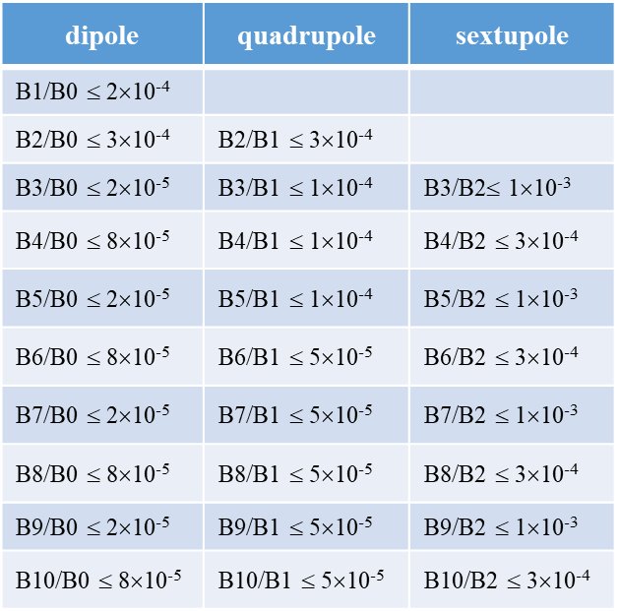
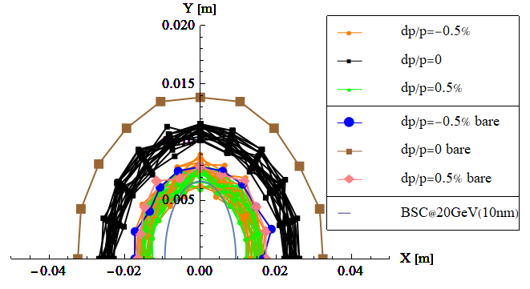
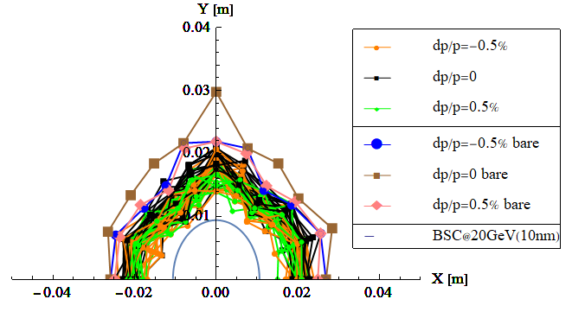
Multipole errors @ 20GeV
Multipole errors only
Multipole errors can not be corrected
FODO
TME

Slide 4
Optics parameter comparison
TME is chosen as the baseline for TDR.
D. H. Ji, W. Kang
Lattice | FODO 0 （CDR） | FODO | TME (combine magnets)
Emittance X (nm) @120GeV | 3.57 | 1.29 | 1.26
Momentum compaction (×10⁻⁵) | 2.44 | 1.18 | 1.12
Tunes | [263.201/261.219] | [353.180/353.280] | [321.271/117.193]
Quad amount | 2110 | 2816 | 3458
Quad Strength (K1L rms） | 0.0383 | 0.0407 | 0.0259
Sext amount | 512 | 896 | 0
Sexts Strength (K2L rms) | 0.179 | 0.4091 | 0.0492
H Corrector | 1053 | 1408 | 1218
V Corrector | 1054 | 1408 | 2240
BPM | 2108 | 2816 | 3458
Magnets’ cost of TME is lower than FODO
TME is less sensitive to error effects
No independent sextupole for TME
Quadrupole strength of TME is lower
Weaker quadrupole strength
Weaker sextupole strength

Slide 5
Booster TDR parameters
Injection energy: 10GeV → 20GeV
Max energy: 120GeV → 180GeV
Lower emittance ─ new lattice (TME)
Extraction
Injection
*Diameter of beam pipe is 55mm for re-injection with high single bunch current @120GeV.

Slide 6
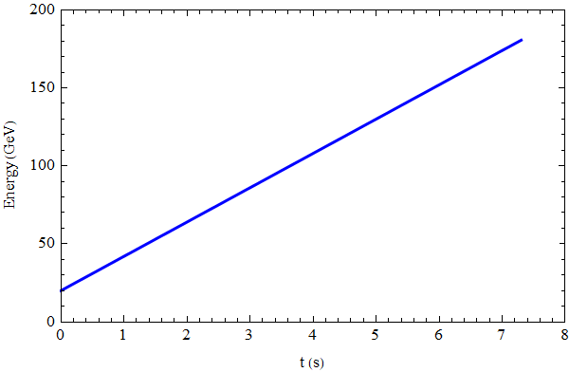
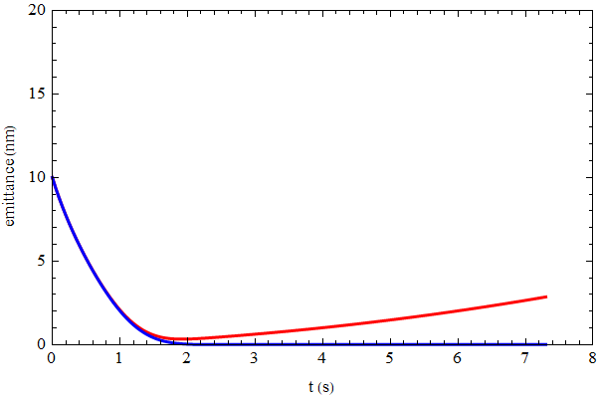
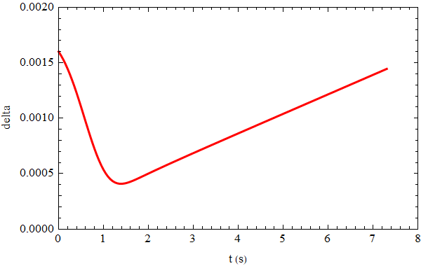
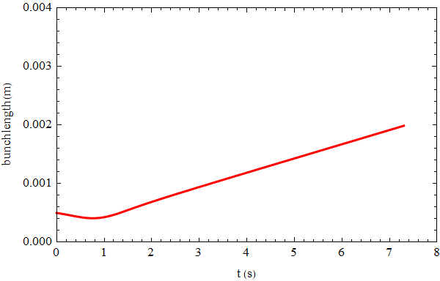
Beam parameter evolution
Injection emittance: 10nm @20GeV
Beam parameters reach balance after 60GeV.
emittance
energy
emit_x
emit_y
energy spread
bunch length

Slide 7
Error Effect & Correction Simulation
 | Dipole | Quadrupole | Sextupole
Transverse shift X/Y (μm) | 100 | 100 | 100
Longitudinal shift Z (μm) | 100 | 150 | 100
Tilt about X/Y (mrad) | 0.2 | 0.2 | 0.2
Tilt about Z (mrad) | 0.1 | 0.2 | 0.2
Nominal field | 5e-4 | 2e-4 | 3e-4
 | Accuracy (m) | Tilt (mrad) | Gain | Offset w/ BBA(mm)
BPM(10Hz) | 1e-7 | 10 | 5% | 30e-3
dipole | quadrupole | sextupole
B1/B0 ≤ 2×10⁻⁴
B2/B0 ≤ 3×10⁻⁴ | B2/B1 ≤ 3×10⁻⁴
B3/B0 ≤ 2×10⁻⁵ | B3/B1 ≤ 2×10⁻⁴ | B3/B2≤ 1×10⁻³
B4/B0 ≤ 8×10⁻⁵ | B4/B1 ≤ 1×10⁻⁴ | B4/B2 ≤ 3×10⁻⁴
B5/B0 ≤ 2×10⁻⁵ | B5/B1 ≤ 1×10⁻⁴ | B5/B2 ≤ 1×10⁻³
B6/B0 ≤ 8×10⁻⁵ | B6/B1 ≤ 5×10⁻⁵ | B6/B2 ≤ 3×10⁻⁴
B7/B0 ≤ 2×10⁻⁵ | B7/B1 ≤ 5×10⁻⁵ | B7/B2 ≤ 1×10⁻³
B8/B0 ≤ 8×10⁻⁵ | B8/B1 ≤ 5×10⁻⁵ | B8/B2 ≤ 3×10⁻⁴
B9/B0 ≤ 2×10⁻⁵ | B9/B1 ≤ 5×10⁻⁵ | B9/B2 ≤ 1×10⁻³
B10/B0 ≤ 8×10⁻⁵ | B10/B1 ≤ 5×10⁻⁵ | B10/B2 ≤ 3×10⁻⁴
Simulation based on Accelerator Toolbox(AT).
Orbit Correction + Horizontal dispersion
  RM + SVD
  1218H+1220V Corrector
  Iteration from small singular value (max 80%)
  Corrector strength limited
Optics correction
  RM + LOCO
  All quadrupole independent
More computing cores and memory
  All quadrupole magnets are now included in the calibration procedure independently, which was only 1/7 in the past
  It makes the correction simulation including multipole field possible
  More seeds are generated and included in the statistics, ~50/week
DA Tracking based on SAD
  Error Lattice is converted from AT to SAD element by element
RMS | TME
Orbit (mm) | 0.062/0.071
Beta Beating(%) | 0.16/0.1
Δ Dispersion(mm) | 1.2/3.3

Slide 8
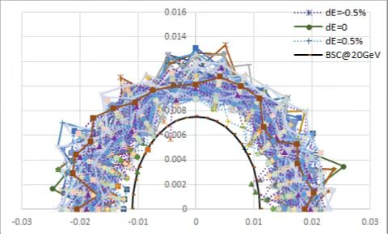
DA@20GeV
On axis injection from Linac to booster
Tracking by SAD (2500 turns)
include errors
Include SR sawtooth orbit (without taper)
Include SR damping & fluctuation
BSC definition (ε_{inj}=10nm):
Energy acceptance: 3*δ_{inj} =0.48%

Slide 9
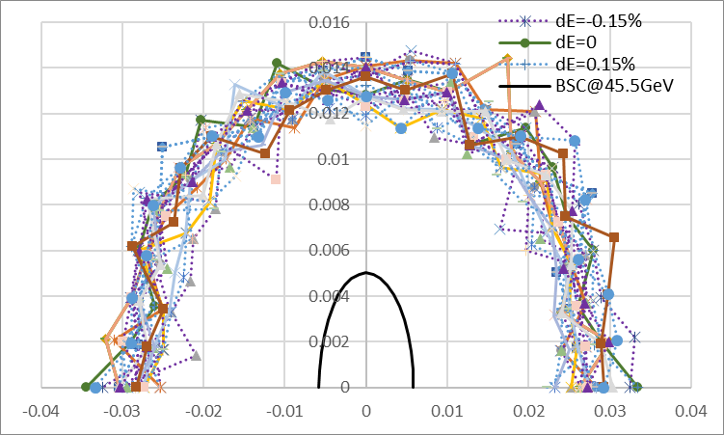
DA@45GeV
Tracking by SAD (1200 turns)
include errors
Include SR sawtooth orbit (without taper)
Include SR damping & fluctuation
Off axis injection from booster to collider
BSC definition (ε_{x}=0.18nm, ε_{y}=ε_{x} *1%):
Energy acceptance: 4*δ =0.15%

Slide 10
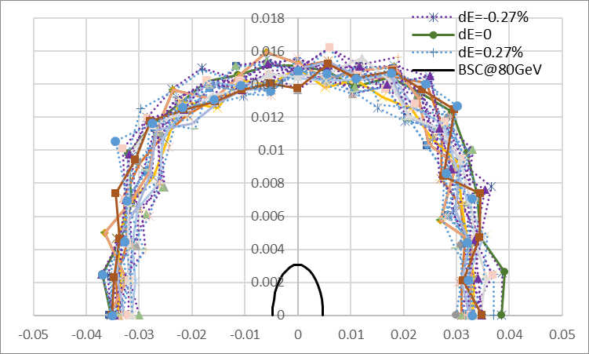
DA@80GeV
Tracking by SAD (500 turns)
include errors
Include SR sawtooth orbit (without taper)
Include SR damping & fluctuation
Off axis injection from booster to collider
BSC definition (ε_{x}=0.56nm, ε_{y}=ε_{x} *1%):
Energy acceptance: 4*δ =0.27%

Slide 11
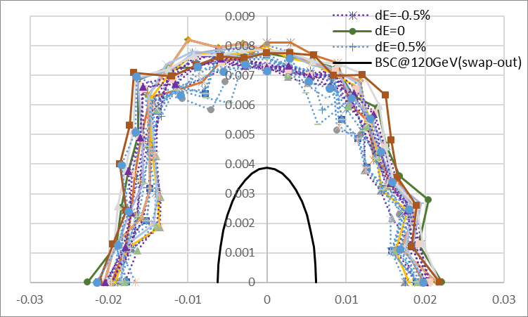
DA@120GeV
Tracking by SAD (250 turns)
include errors
Include SR sawtooth orbit (without taper)
Include SR damping & fluctuation
On axis injection from booster to collider
BSC definition (ε_{x}=1.26nm, ε_{y}=ε_{x} *1%):
Energy acceptance: 5*δ =0.5%

Slide 12
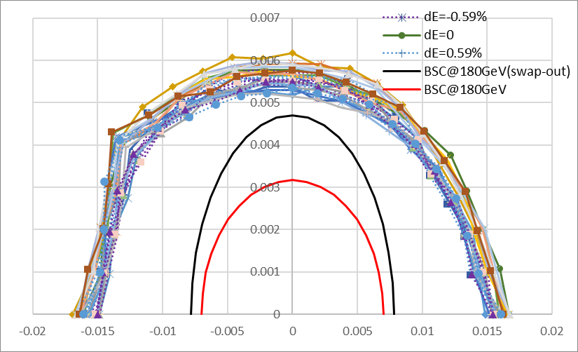
DA@180GeV
Tracking by SAD (150 turns)
include errors
Include SR sawtooth orbit (with taper)
Include SR damping & fluctuation
Keep possibility for on axis injection to collider
BSC definition (ε_{x}=2.84nm, ε_{y}=ε_{x} *1%):
--
--
Energy acceptance: 4*δ =0.59%

Slide 13
Summary
Compared with the FODO structure (CDR), the TME structure (TDR) has the following characteristics
  The dynamic aperture of bare lattice is abundant
  The combine structure of the diople-sextupole magnet reduces the total number of magnets
  The strength of the quadrupole and sextupole magnet is reduced
  Evaluate the error sensitivity in the early stage of lattice design to improve the redundancy of lattice robustness
  Error sensitivity is greatly optimized
Error effect and correction simulation
  The error requirements for the hardware system are basically determined
  Error and correction simulation process is clear
  Computing resources to meet large-scale computing needs
  The error and correction simulation show that the linear parameters and DA of TME design can meet the requirements, which is basically completed at this stage
  Error simulations can be completed quickly if updated iterations are performed on lattice designs

Slide 14
Thank You for Your Attention

Slide 15
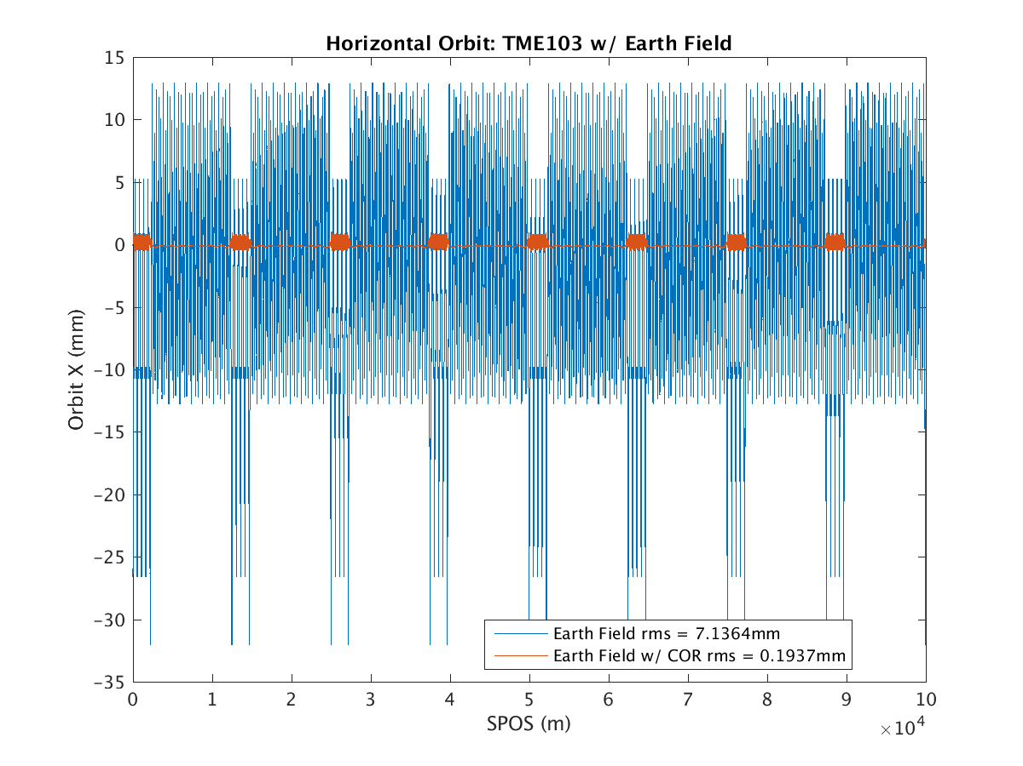
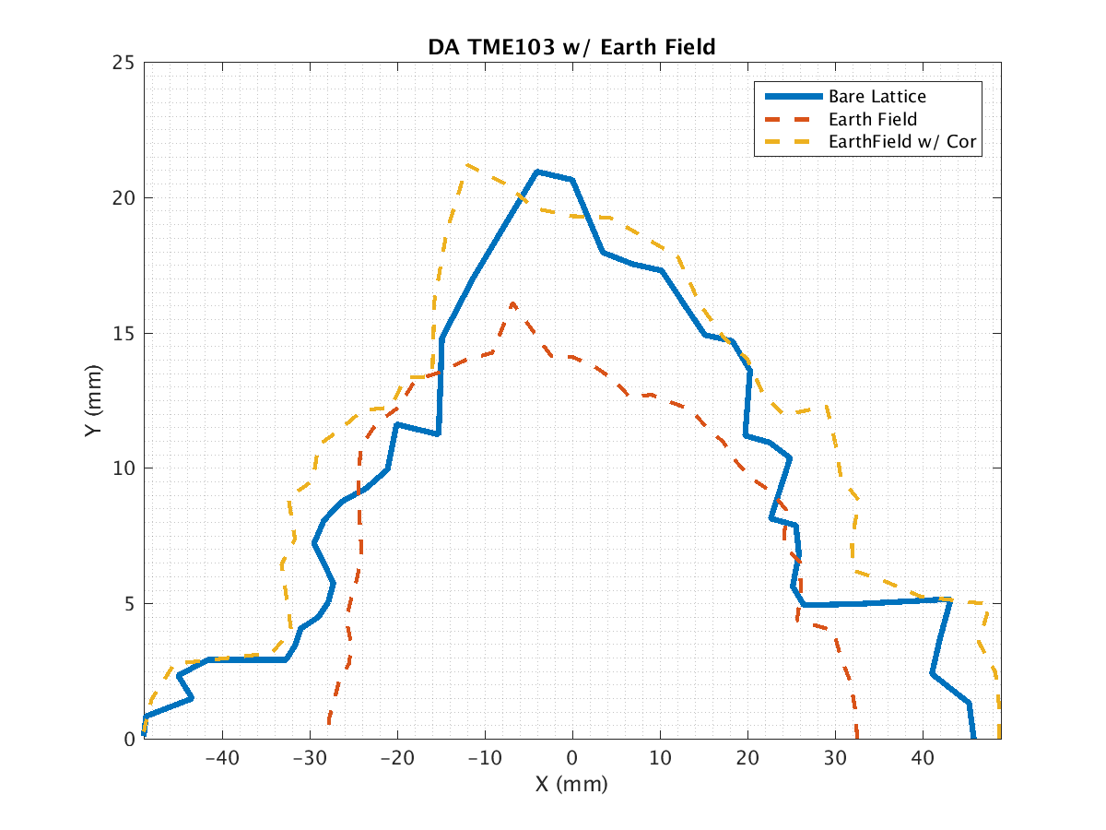
Effect of earthfield @20GeV
D. H. Ji, D. Wang
~20% vacuum pipe (drift) is exposed in earthfield directly.
treat drifts as week dipole to simulate the effect of earthfield
Assume earthfield: 0.6 gauss (simple model: perpendicular component only )
Working point can be corrected by weaken the dipoles systematically (-0.07%)
Earthfield problem can be solved by global orbit correction.
first turn trajectory

Slide 16
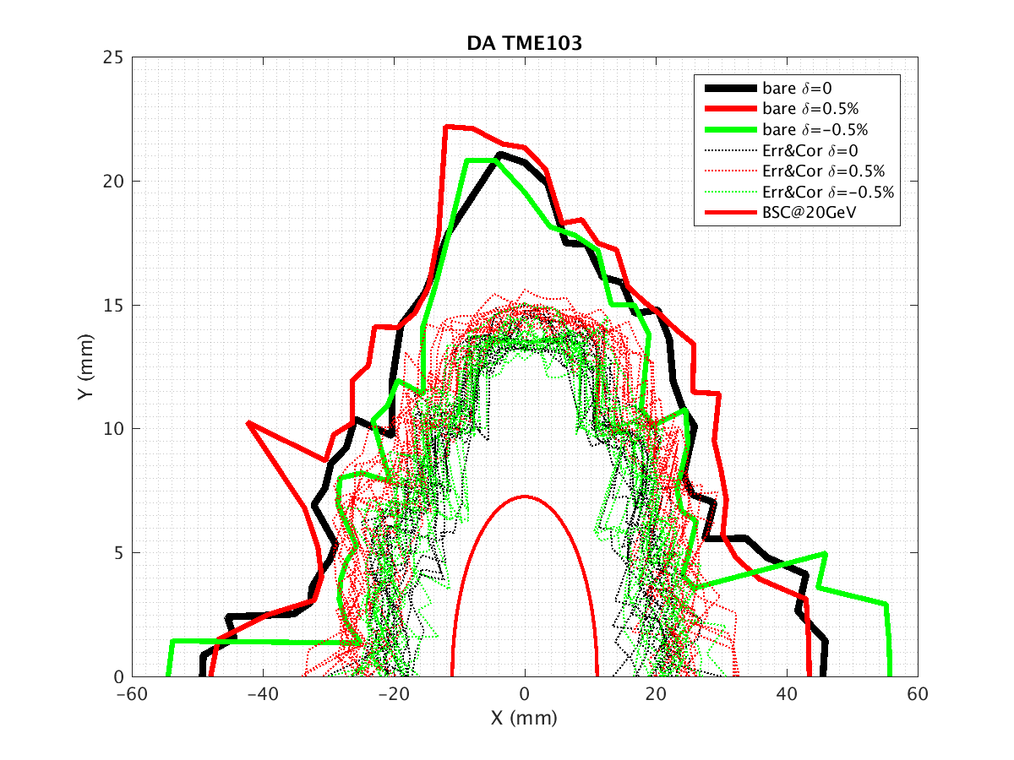
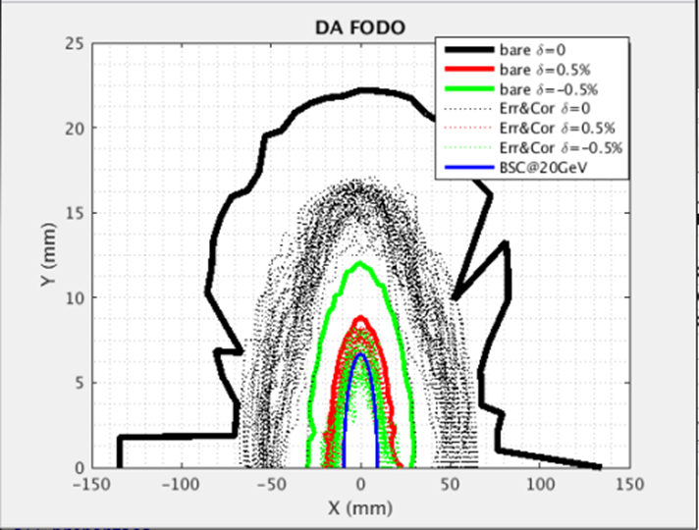
DA results with errors and correction
D. H. Ji
 | Dipole | Quadrupole | Sextupole
Transverse shift X/Y (μm) | 100 | 100 | 100
Longitudinal shift Z (μm) | 100 | 150 | 100
Tilt about X/Y (mrad) | 0.2 | 0.2 | 0.2
Tilt about Z (mrad) | 0.1 | 0.2 | 0.2
Nominal field | 1e-3 | 2e-4 | 3e-4
 | Accuracy (m) | Tilt (mrad) | Gain | Offset w/ BBA(mm)
BPM(10Hz) | 1e-7 | 10 | 5% | 30e-3
error correction (w/o SR effect)
Obit correction
Optics correction
TME
FODO

