Slide 1
Instrumentation and Beam Diagnostics
Yanfeng Sui
On behalf Beam Instrumentation Team,
Accelerator Center, IHEP

Slide 2
Outline
Update of CEPC beam instrumentation system design
Progress of beam instrumentation R&D
  BPM electronics
Summary

Slide 3
The beam instrumentation in CEPC Linac
 | Item | Method | Parameter | Amounts
Linac | Beam position | Stripline BPM | Resolution ：30um | 140
 | Beam current | ICT | 2.5%@1nC-10nC | 42
 | Beam profile | YAG/OTR | Resolution: 30um | 80
 | Beam emittance | Q+PR | 10% | 3
 | Beam energy & spread | AM+PR | 0.1% | 3
Damping ring | Average current | DCCT | Resolution :50uA@0.1mA-30mA | 1
 | Beam position | Button BPM | Resolution : 20um @ 5mA TBT | 40
 | Tune measurement | Frequency sweeping | Resolution:0.001 | 1

Slide 4
The beam instrumentation in CEPC booster
 | Item |  | Method | Parameter | Amounts
Booster | Beam position monitor | Turn by turn | Button electrode BPM | Measurement area (x × y)：±20mm×±10mm Resolution：<0.02mm Measurement time of COD：< 4 s | 1808
 |  | Bunch by bunch | Button electrode BPM | Measurement area (x × y)：±40mm×±20mm Resolution：0.1mm
 | Bunch current |  | BCM | Measurement range：10mA / per bunch Relatively precision：1/4095 | 2
 | Average current |  | DCCT | Dynamic measurement range：0.0~1.5A Resolution:50uA@0.6-8mA Linearity：0.1 % Zero drift: <0.05mA | 2
 | Beam size |  | Double slit interferometer x ray pin hole | Resolution:0.2 µm | 2
 | Bunch length |  | Streak camera Two photon intensity interferometer | Resolution:1 ps | 2
 | Tune measurement |  | Frequency sweeping method | Resolution:0.001 | 2
 |  |  | DDD | Resolution:0.001
 | Beam loss monitor |  | optical fiber | Space resolution:0.6m | 400
 | Feedback system |  | TFB | Damping time<=3ms | 2
 | Feedback system |  | LFB | Damping time<=35ms（50ms） | 2

Slide 5
The beam instrumentation in CEPC ring
 | Item |  | Method | Parameter | Amounts
Storage ring | Beam position monitor | Closed orbit | Button electrode BPM | Measurement area (x × y)：±20mm×±10mm Resolution：<0.6um Measurement time of COD：< 4 s | 2900
 |  | Bunch by bunch | Button electrode BPM | Measurement area (x × y)：±40mm×±20mm Resolution：0.1mm
 | Bunch current |  | BCM | Measurement range：10mA / per bunch Relatively precision：1/4095 | 2
 | Average current |  | DCCT | Dynamic measurement range：0.0~1.5A Linearity：0.1 % Zero drift: <0.05mA | 2
 | Beam size |  | Double slit interferometer x ray pin hole | Resolution:0.2 µm | 4
 | Bunch length |  | Streak camera Two photon intensity interferometer | Resolution:1ps@10ps | 2
 | Tune measurement |  | Frequency sweeping method | Resolution:0.001 | 2
 |  |  | DDD | Resolution:0.001
 | Beam loss monitor |  | PIN-diode | Dynamic range:120 dB Maximum counting rates≥10 MHz | 5800
 | Feedback system |  | TFB | Damping time<=1ms | 2
 |  |  | LFB | Damping time<=12ms | 2

Slide 6
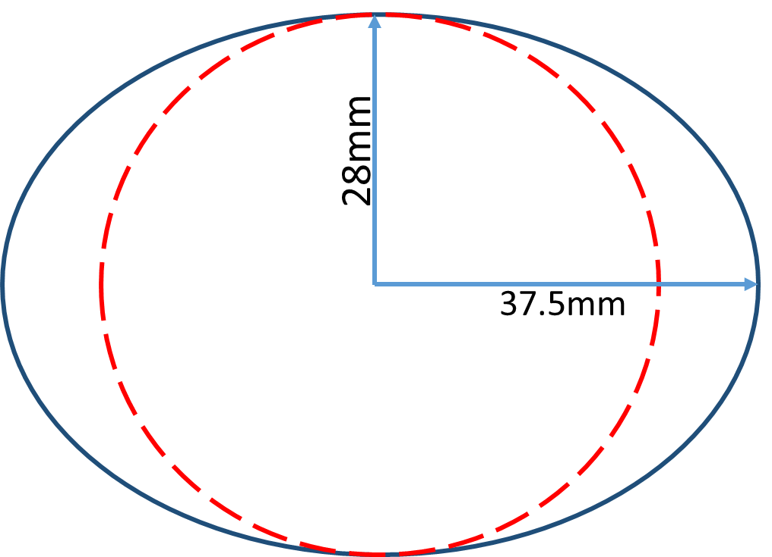
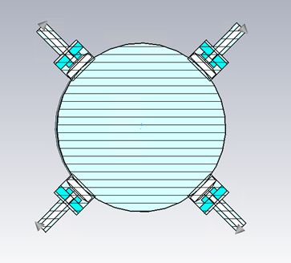
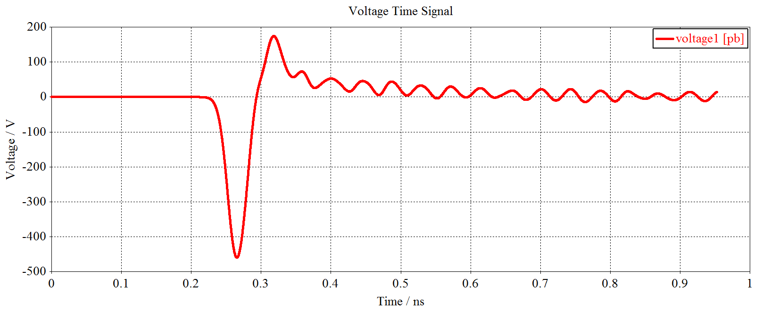
Update of BPM pick-ups
Due to modification of vacuum chamber in storage ring, the BPM pick-ups have been redesigned.
Considering the suggestions of the IARC, the diameter of the button are reduced to 5mm.
 | ttbar |  | Higgs |  | W |  | Z
 | Real | CST | Real | CST | Real | CST | Real | CST
Charge | 20e10 | 32 nC | 14e10 | 22.4 nC | 13.5e10 | 21.6 nC | 14e10 | 22.4 nC
Bunch length | 2.2/2.9 | 3 mm | 2.3/3.9 | 4 mm | 2.5/4.9 | 5 mm | 2.5/8.7 | 8.7 mm
Vpp | 635V |  | 359V |  | 295V |  | 179V
Z_500M | 0.22Ω |  | 0.22Ω |  | 0.22Ω |  | 0.22Ω
P_500M | -7.3dBm/320mA |  | -12.8dBm/170mA |  | -10.6dBm/216mA |  | -10.4dBm/224mA
Kx=Ky | 19.9mm |  | 19.9mm |  | 19.9mm |  | 19.9mm

Slide 7
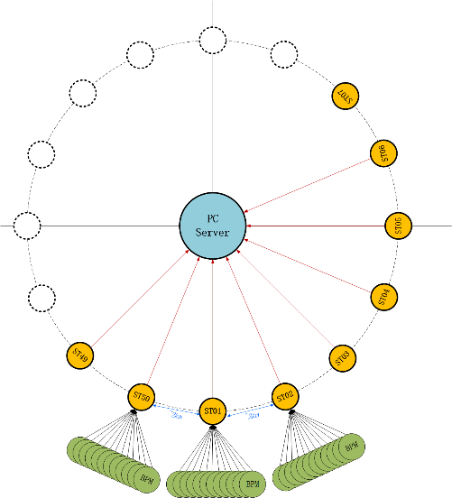
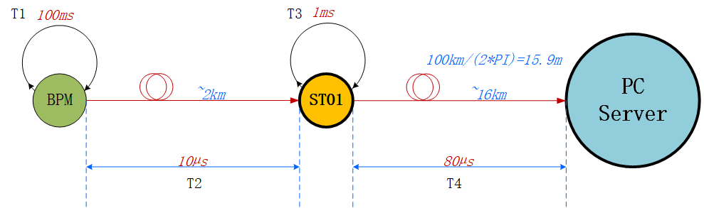
Time cost calculation of the COD measurement
50 stations along the storage ring and connecting with PC sever station with the star topology fiber optic network.
Consider the delay of whole system, the BPM COD measurement takes about 1s .

Slide 8
Update of beam feedback system

Slide 9
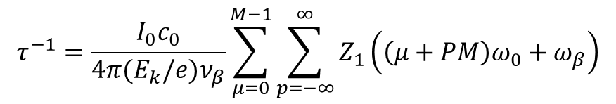
Transverse resistive wall instability - wang na
$$τ^{−1}=\frac{I_{0}c_{0}}{4π(E_{k}/e)ν_{β}}\sum_{μ=0}^{M−1}{\sum_{p=−∞}^{∞}{Z_{1}\left(\left(μ+PM\right)ω_{0}+ω_{β}\right)}}$$
The worst case lowest energy and highest current, so Z mode is the most dangerous.
 | 30 MW
Instability growth time [ms] | 1.9 (~6 turns)
Radiation damping [ms] | 850
Bunch by bunch feedback [ms] | 1.0 (~3 turns)
Growth of the most dangerous mode vs. damping factors

Slide 10
The power of transverse feedback
TFB CEPC ring（CDR）
Parameter | Value
E | 4.55E+10
R | 1.55E+05
Beta-k | 2.25E+02
Beta-m | 2.25E+02
A | 2.00E-04
T | 3.30E-04
tao | 1.60E-03
P | 8.98E+02
TFB CEPC Ring （30MW）
Parameter | Value
E | 4.55E+10
R | 1.55E+05
Beta-k | 2.25E+02
Beta-m | 2.25E+02
A | 2.00E-04
T | 3.30E-04
tao | 1.00E-03
P | 2.30E+03

Slide 11
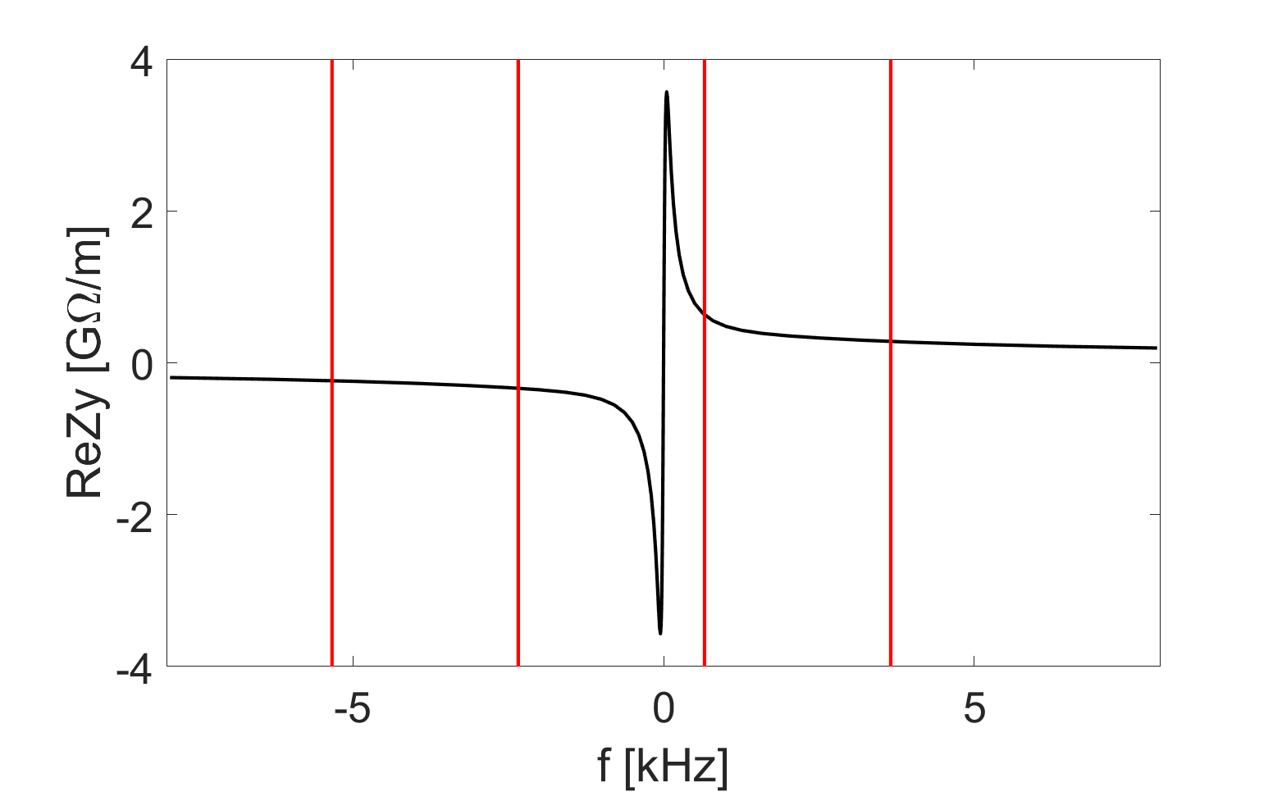
The update of TFB feedback system
Narrow-band feedback + bunch by bunch feedback
Consider narrow-band feedback, in addition to bunch-by-bunch ones, for specific instabilities such as resistive wall coupled bunch. Mode No. 19650 & 19651
Mode frequency [kHz] | Mode number | Growth time [ms]
-2.338 | 19650 | 1.1 (3 turns)
-5.335 | 19651 | 1.6 (5 turns)
-8.332 | 19650 | 2.0 (6 turns)
-11.330 | 19649 | 2.3 (7 turns)
n=11252
n=11253
n=11251
n=11254

Slide 12
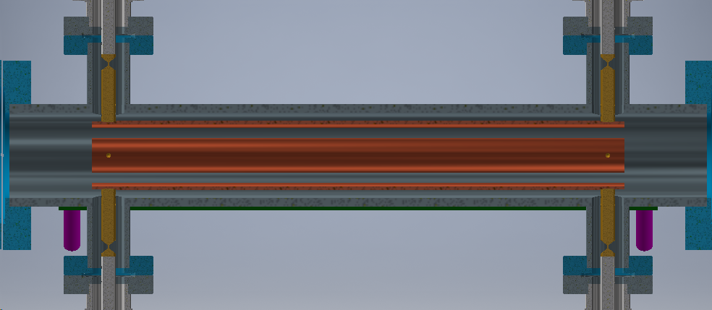
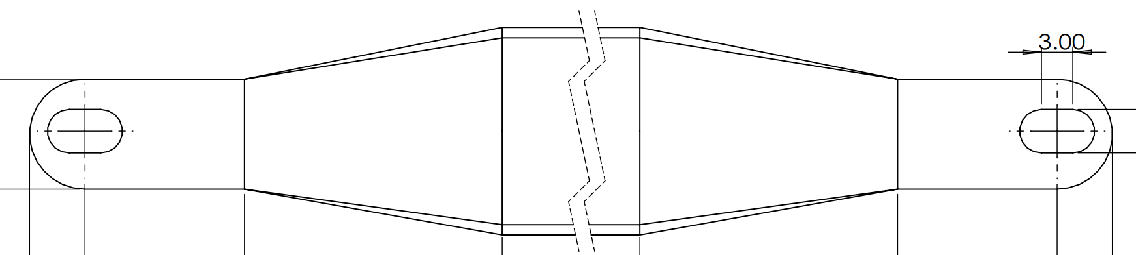
The update of TFB kicker
Variable diameter of pins to overcome the thermal deformation in electrodes
The electrode with slotted holes connecting with feed through
To reduce deformation, the electrodes will be made of copper plated aluminum to reduce own weight.
For the thermal deformation of kicker, slotted holes on electrode are adopted to allow relative movement between the electrodes and the feed through along the beam direction; second, the pin of the feed through will use variable diameter to allow the deformation.

Slide 13
The power of longitudinal feedback
CEPC LFB（CDR）
Parameters | Value
f | 6.50E+08
alpha | 1.11E-05
mus | 2.80E-02
deltaphi | 1.70E-03
Tao(s) | 2.00E-01
E | 4.55E+10
Rk(Ω) | 2600
V(V) | 3.00E+03
P(W) | 1.73E+03
CEPC LFB（30MW-12ms）
Parameters | Value
f | 6.50E+08
alpha | 1.48E-05
mus | 3.50E-02
deltaphi | 1.70E-03
Tao(s) | 1.20E-02
E | 4.55E+10
Rk(Ω) | 2600
V(V) | 4.69E+04
P(W) | 4.23E+05

Slide 14
CEPC TDR Collider Ring Cavity HOM CBI –Zhai Jiyuan
30 MW SR per beam. Consider only SR damping for HOM Q_{L} requirement. Cavity HOM spread not included. | ttbar |  | Higgs | W | Z
 | new 5-cell common cavity | old 2-cell common cavity | common cavity | separate cavity | by-pass separate cavity
Cell number / cavity | 5 | 2 | 2 | 2 | 1
Beam energy [GeV] | 180.0 | 180.0 | 120.0 | 80.0 | 45.5
Beam current per beam [mA] | 3.4 | 3.4 | 16.7 | 84.0 | 802.6
Revolution time [μs] | 333.6 | 333.6 | 333.6 | 333.6 | 333.6
Momentum compaction | 7.1E-06 | 7.1E-06 | 7.1E-06 | 1.4E-05 | 1.4E-05
Synchrotron tune | 0.08 | 0.08 | 0.05 | 0.06 | 0.04
Synchrotron oscillation period [ms] | 4.4 | 4.4 | 6.6 | 5.5 | 9.5
Longitudinal damping time [ms] | 6.6 | 6.6 | 22.2 | 74.7 | 410.2
Cavity number on line per beam | 240 | 240 | 240 | 120 | 30
Average beta-x/y in RF region [m] | 30 | 30 | 30 | 30 | 30
Longitudinal impedance threshold per cavity [ohm*MHz] | 3.58E+11 | 3.58E+11 | 9.62E+09 | 9.05E+08 | 2.27E+07
Transverse impedance threshold per cavity [ohm/m] | 1.88E+08 | 1.88E+08 | 7.48E+06 | 1.18E+06 | 5.12E+04
Cavity higher order mode | Required Q_{L}
TM011 | 7.2E+06 | 9.4E+06 | 2.5E+05 | 2.4E+04 | 1.5E+03
TM020 | 9.3E+06 | 4.0E+08 | 1.1E+07 | 1.0E+06 | 4.2E+04
TE111 | 4.5E+05 | 1.3E+06 | 5.3E+04 | 8.4E+03 | 6.5E+02
TM110 | 5.5E+05 | 9.0E+05 | 3.6E+04 | 5.6E+03 | 3.5E+02
2-cell | f (GHz) | R/Q (Ω)
TM011 | 1.17 | 65.20
TM020 | 1.38 | 1.29
TE111 | 0.84 | 279.82
TM110 | 0.91 | 420.05
5-cell | f (GHz) | R/Q (Ω)
TM011 | 1.17 | 84.80
TM020 | 1.43 | 54.15
TE111 | 0.82 | 832.23
TM110 | 0.93 | 681.15
1-cell | f (GHz) | R/Q (Ω)
TM011 | 1.09 | 28.17
TM020 | 1.32 | 0.82
TE111 | 0.79 | 157.00
TM110 | 0.90 | 291.07
No beam feedback is needed even for 50 MW.
Designed 650 MHz 2-cell cavity HOM coupler Q_{L} can meet Higgs and W damping requirement.
1-cell cavity similar to BEPCII can meet 30/50 MW Z HOM damping requirement. No beam feedback is needed even for 50 MW.
Low lumi Z with 2-cell cavities may need beam feedback depending on the operation beam current.

Slide 15
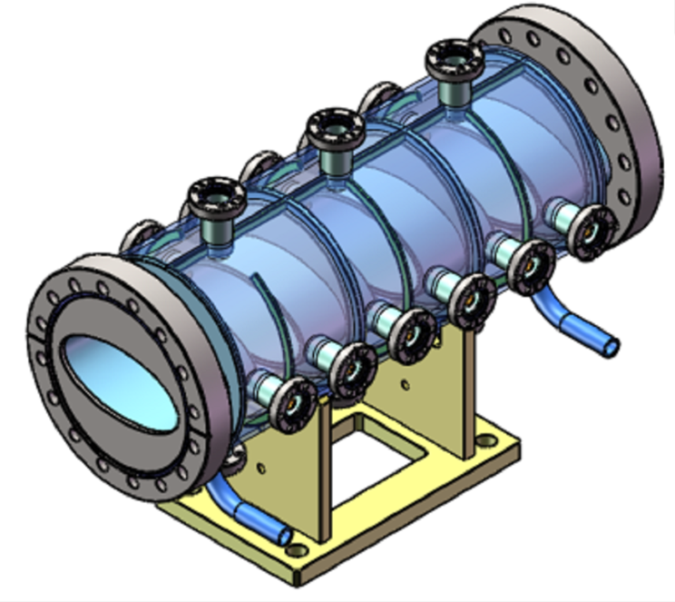
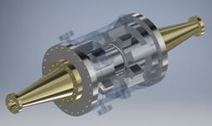
Study of LFB kicker
Resonant strip-line type longitudinal kicker
Pillbox cavity with ridged waveguides type kicker

Slide 16
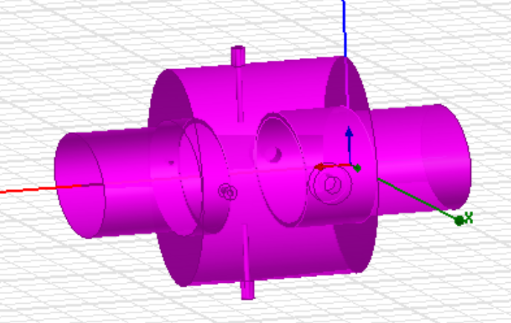
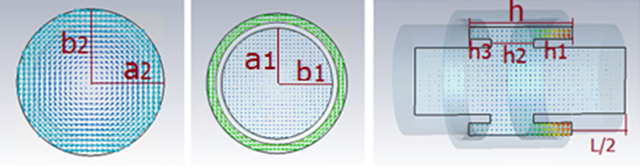
Study of longitudinal feedback kicker
The procedure for designing the was based on initially rescaling Spring-8 design to our vacuum chamber diameter and desired center frequency.
The CST Microwave Studio and HFSS code has been used for the electromagnetic simulations.
Multiple parameter sweeps were performed to set the longitudinal shunt impedance curve, with maximum amplitude (Rs).

Slide 17
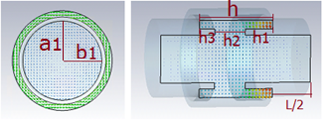
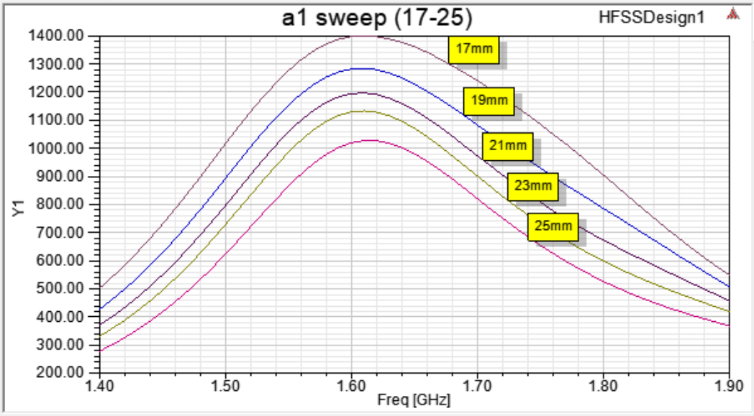
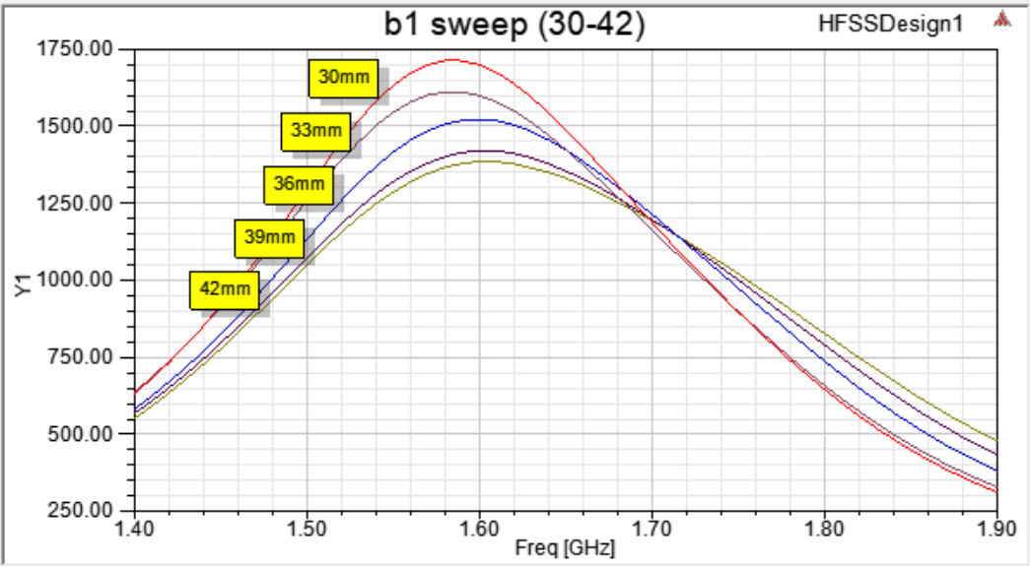
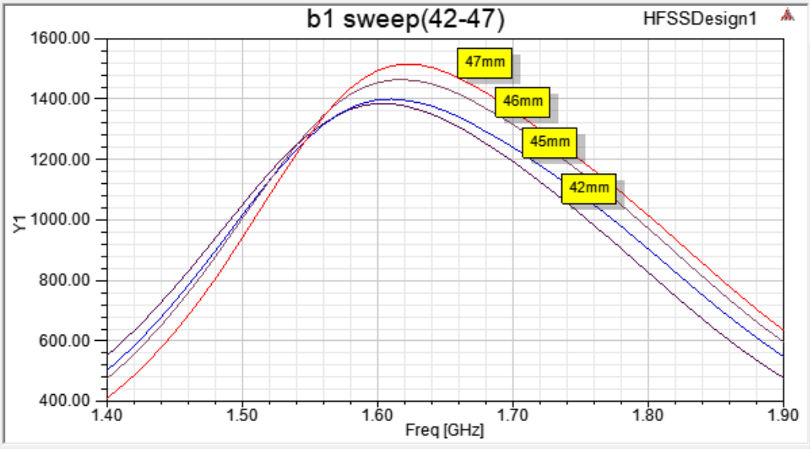
Sweep the geometric parameters to maximum RS
Rs VS a1
17mm->25mm
Rs VS b1
30mm->42mm
42mm->47mm

Slide 18

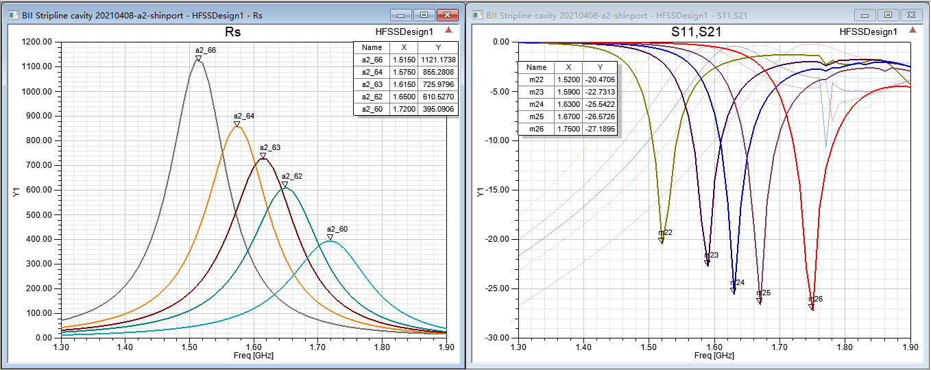
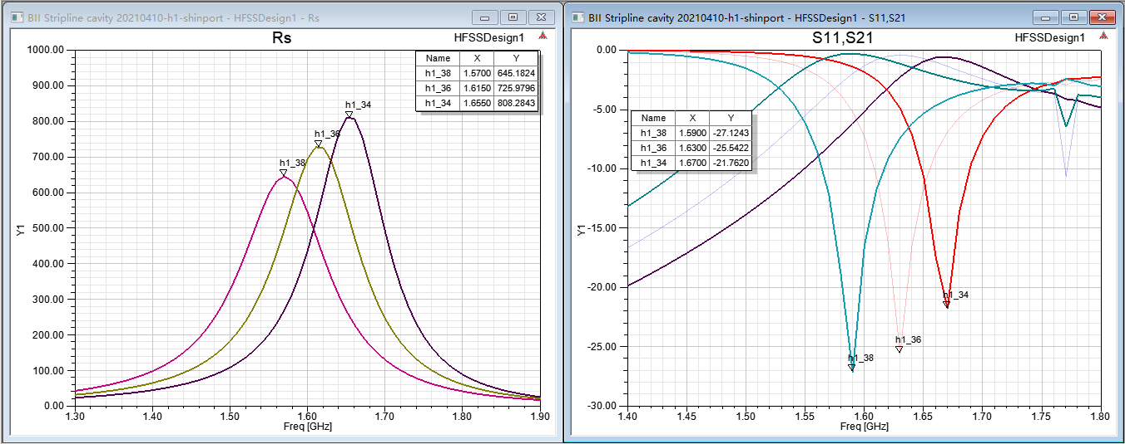
1、条带谐振腔式kicker设计
Sweep the geometric parameters to maximum RS
Rs VS a2
60mm->66mm
Rs VS h1
34mm->38mm

Slide 19
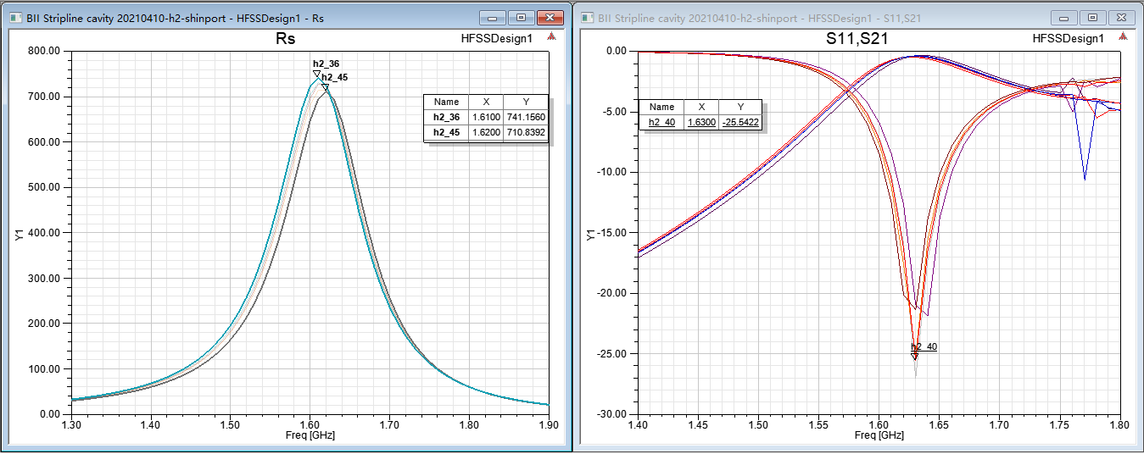
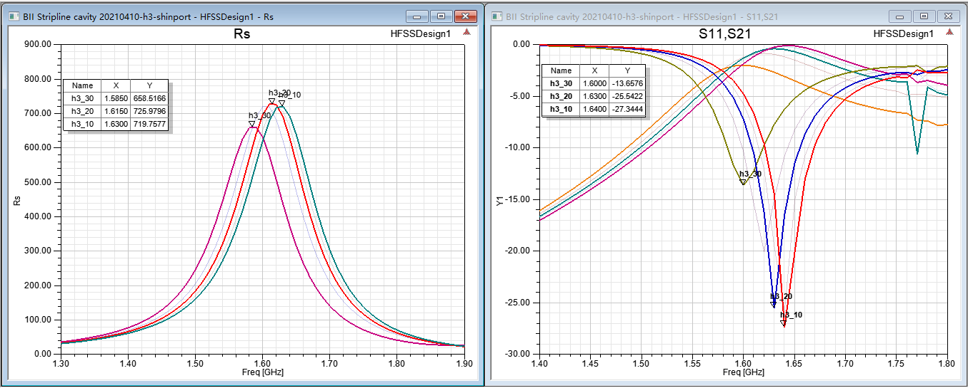
1、条带谐振腔式kicker设计
Sweep the geometric parameters to maximum RS
Rs VS h2
36mm->45mm
Rs VS h3
10mm->30mm

Slide 20
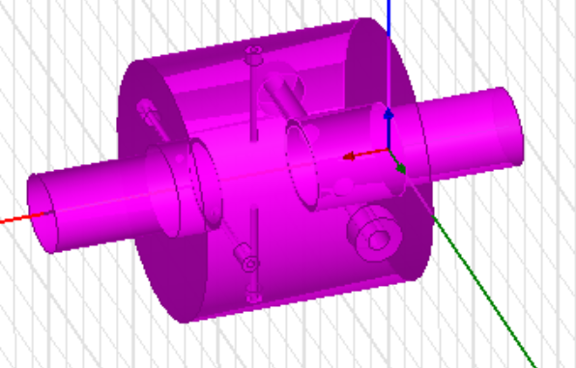
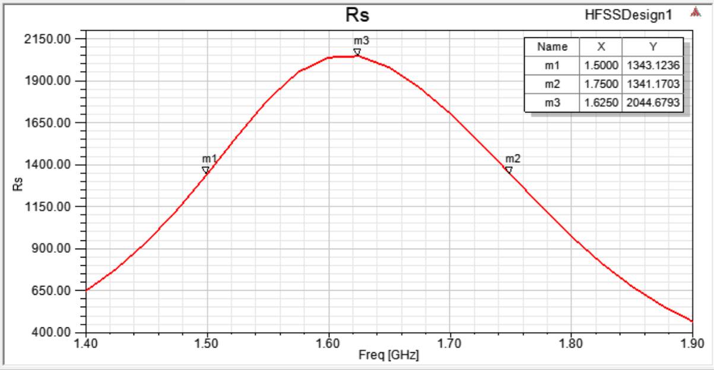
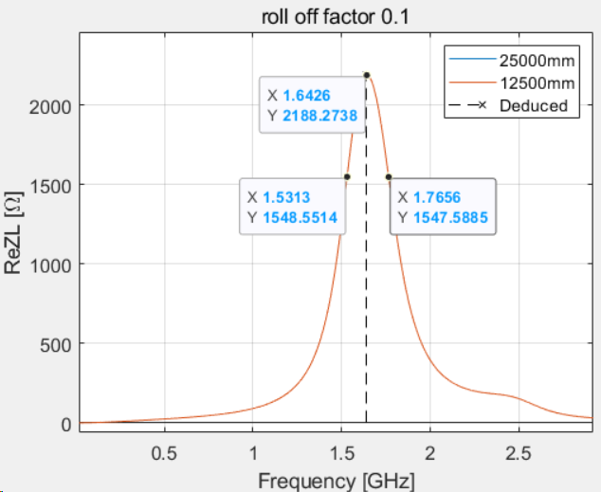
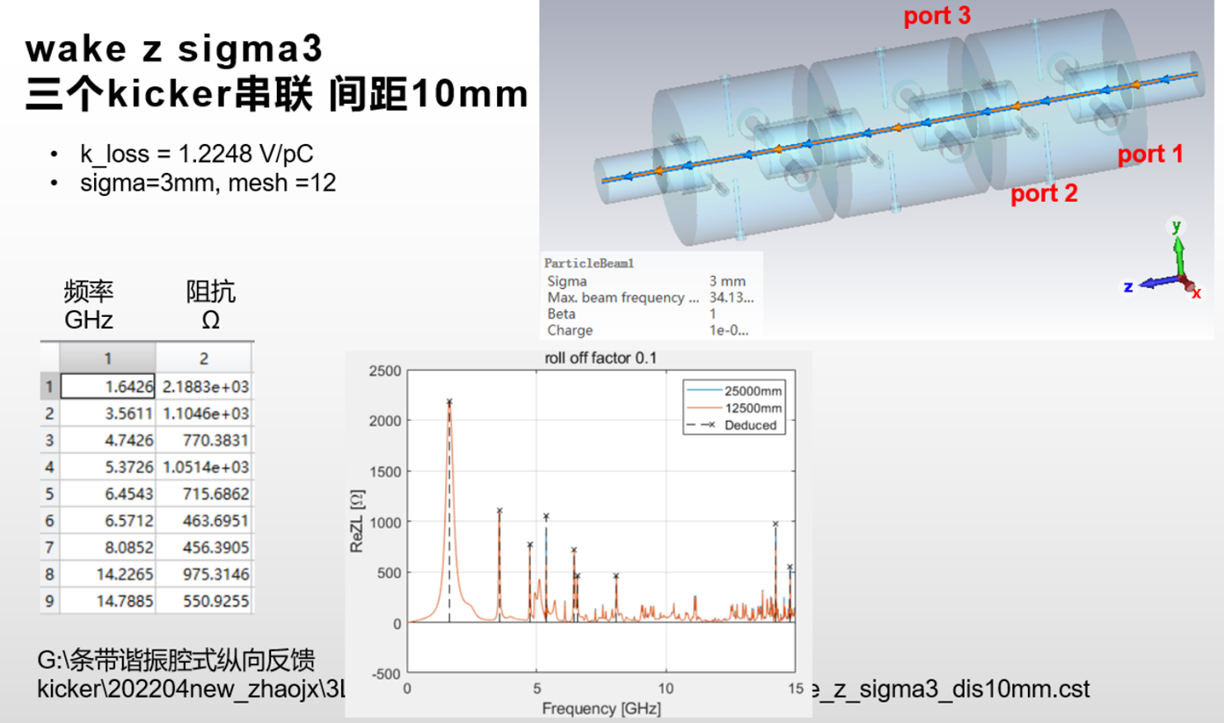
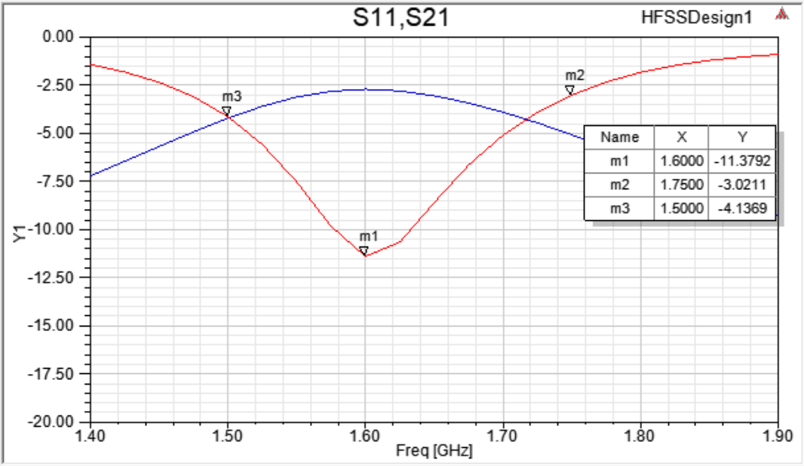
1、条带谐振腔式kicker设计
Study of LFB kicker
Effective length:94mm
Rs max=2044Ω；
Rs @1.5GHz=1343Ω
Rs @1.75GHz=1341Ω

Slide 21
R&D Motivation
To reduce the budget of BI system, due to a large number of monitors and the high price of commercial products.
To grasp key technologies of beam diagnostics.
To make the whole system easy to maintain and upgrade

Slide 22
Overview of the BPM electronics R&D
The R&D of BPM electronics founded by seed money of IHEP and other funding（HEPS-TF etc.）
Kicked off in the start of 2015
The first version(V1.0) of the electronics was finished in 2018.
The second version(V2.0) was finished in middle of 2019. modification was done to improve the performance of the electronics. 8 versions have been tested in the past six years.
In 2019, self-developed electronics were put into use in the BEPCII.

Slide 23
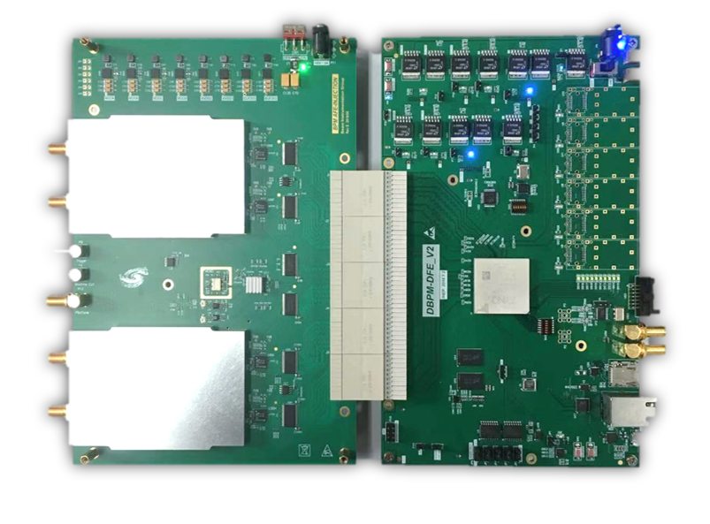
Overview of the BPM Electronics
ADF
ADF
Since of ADF interface is not suitable for RF signal transmission,
so we developed new hardware, ADC&CLK in AFE board.
AFE board：RF Processing+ ADCs + Clock + Pilot tone;
DFE board：FPGA(ZYNQ) + DDR3 memory + SFPs + Ethernets;
EPICS IOC：In ZYNQ FPGA, Increase the convenience of the BPM system;

Slide 24
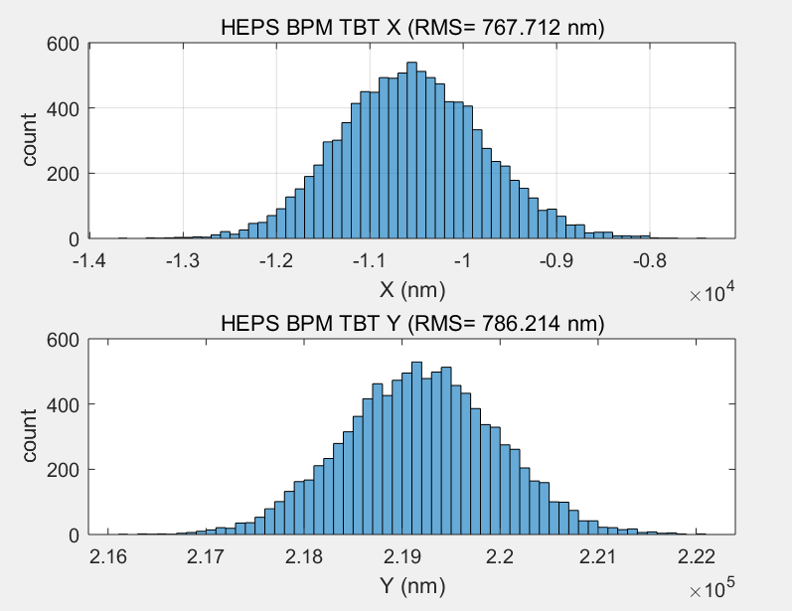
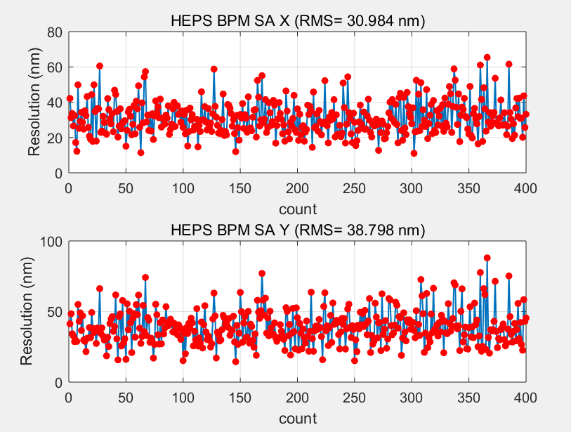
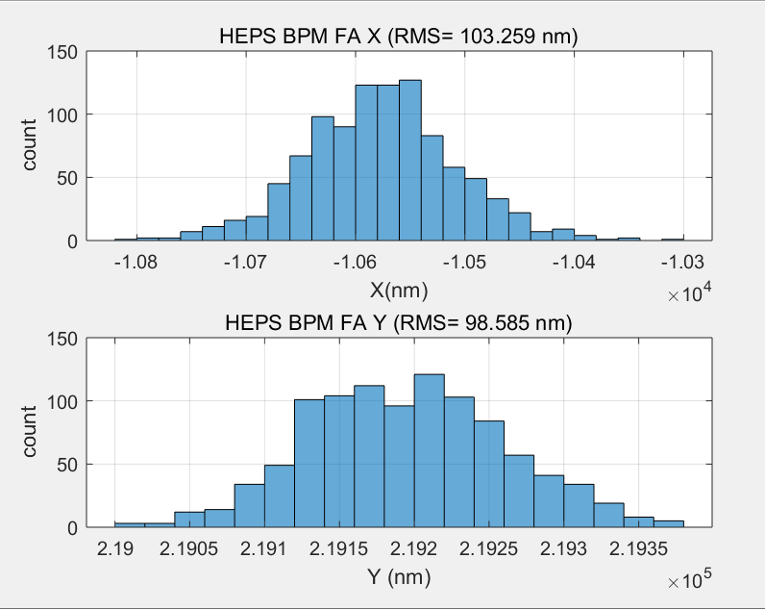
BPM TbT/FA/SA Resolution Test in Lab
TBT RMS (X=767nm,y=786nm)
SA RMS(X=30nm,Y=38nm) 10points STD
We test the performance of DBPM in house
RF frequency is 499.8MHz(-15dBm) from R&S SMA100
TBT data rms xpos ≈767nm, ypos ≈786nm;
FA data rms xpos ≈103nm, ypos ≈98nm;
SA data rms xpos ≈30nm, ypos ≈38nm;
Kx=Ky=8.26mm;
FA RMS (X=103nm,y=98nm)

Slide 25
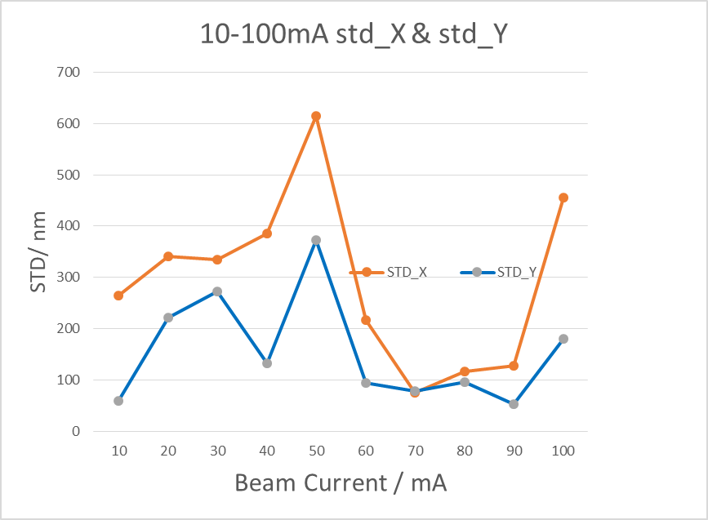
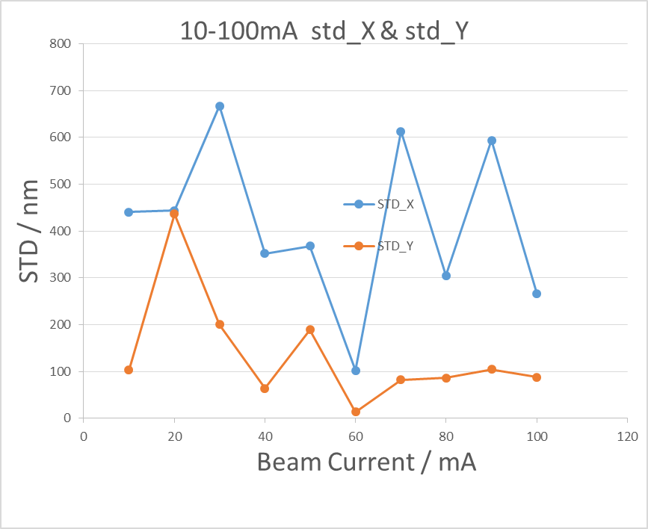
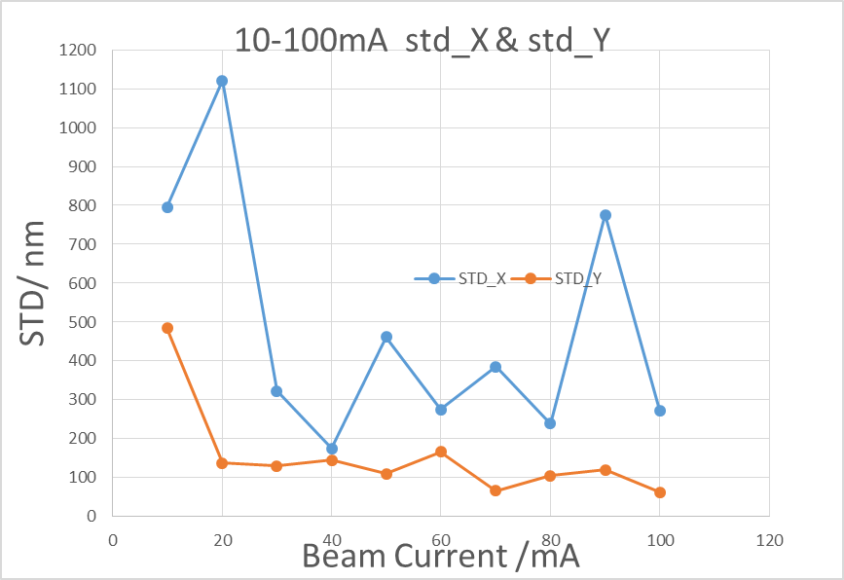
Beam test in BEPCI
Resolution of BPM electronics （110 bunches, 1/3）
BPM3
BPM4
BPM5
BPM electronics NO. | Beam current（10-20mA） |  | Beam current（20-818mA）
 | ΔX(um) | ΔY(um) | ΔX(um) | ΔY(um)
Commercial product | - | - | 6 | 7
BPM1 | - | - | 10 | 17
BPM3 | 22 | 11 | 29 | 11
BPM4 | 71 | 61 | 11 | 36
BPM5 | 5 | 17 | 4 | 31
Beam current dependence of BPM electronics

Slide 26
Home made products VS commercial products
BPM pick up
Cable
Comparative test of self-developed product and commercial product
Libera brilliance+ VS Home-made BPM
Both are the same pick-up signal from button-> splitter

Slide 27
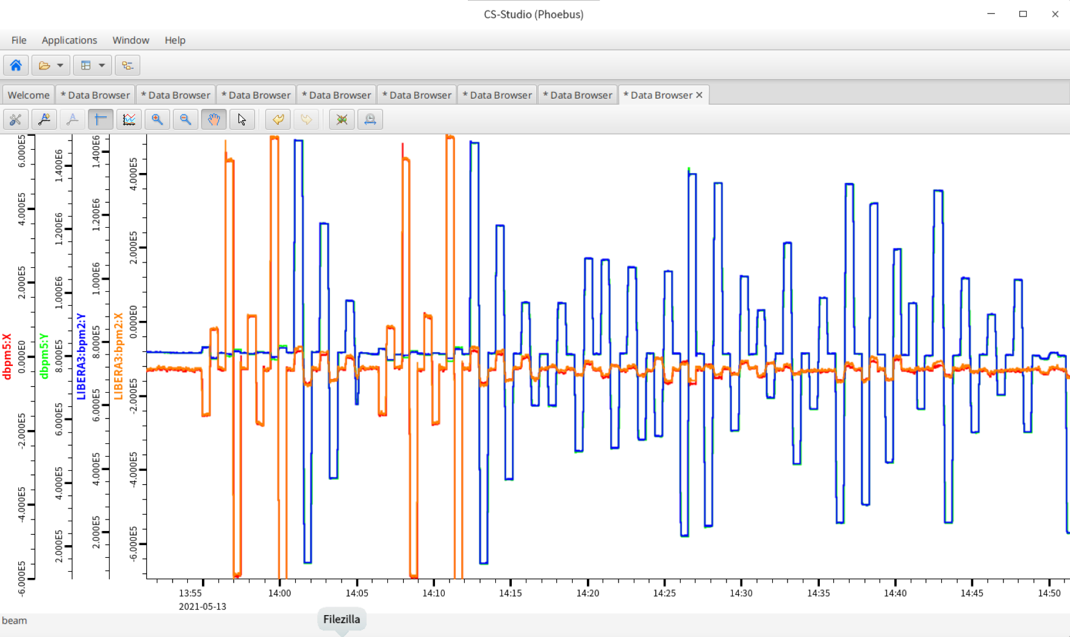
Long time stability（1 hour）

Slide 28
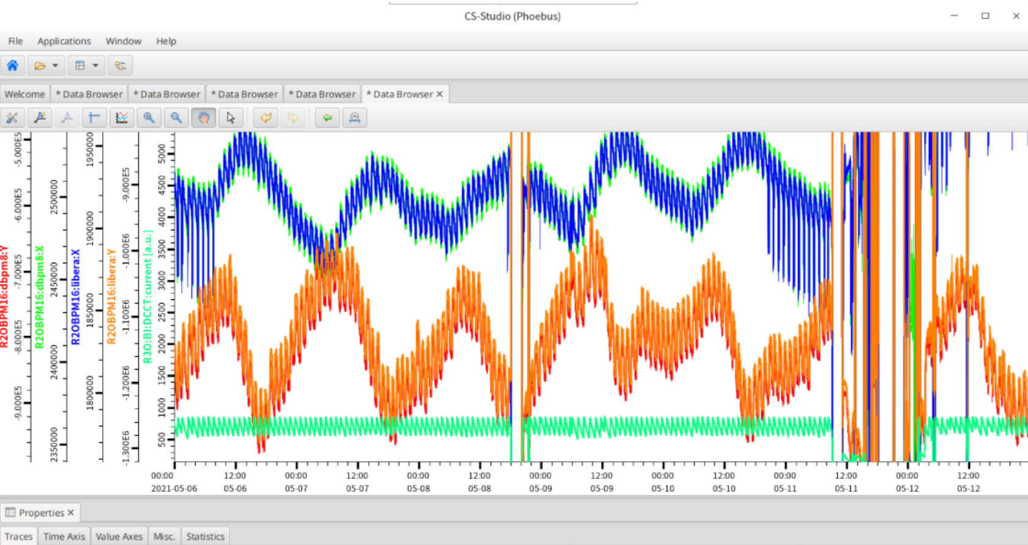
Long time stability（7 days）

Slide 29
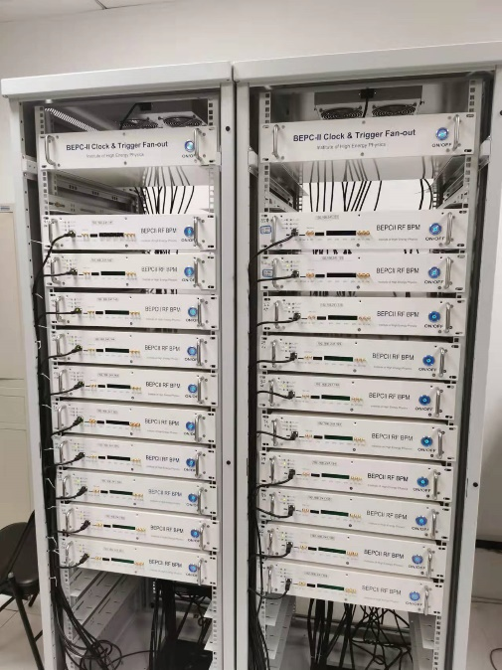
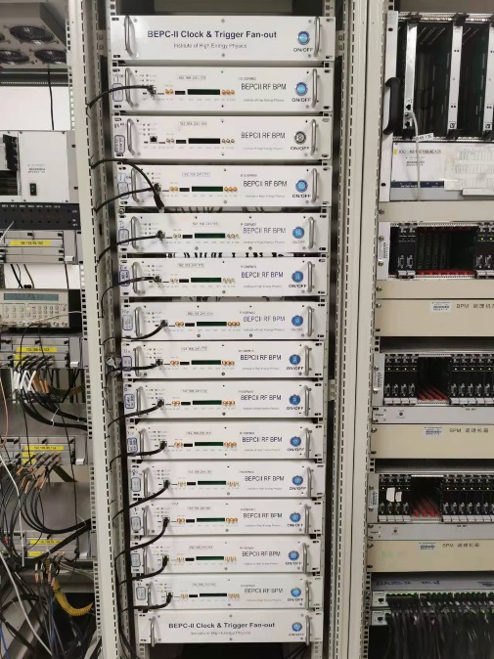
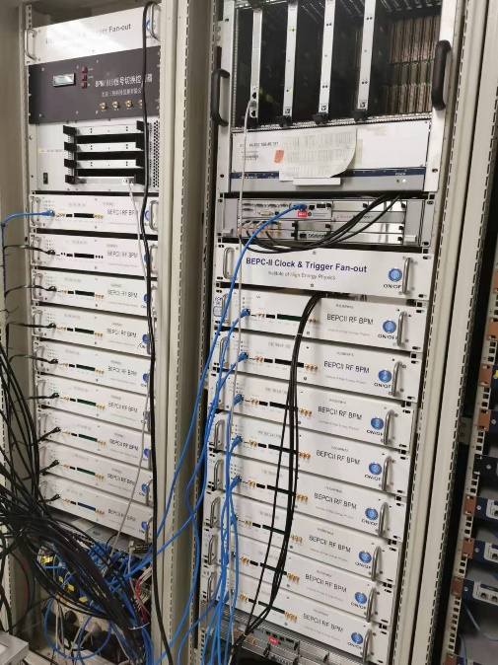
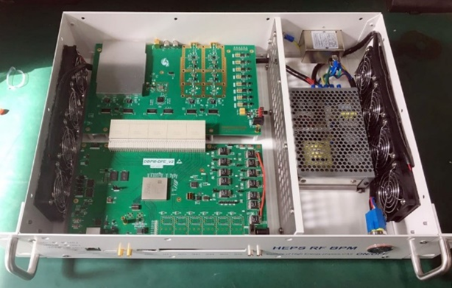
Application of home-made BPM electronics
There are 20 singal-pass BPM electronics were installed and operating in BEPCII Linac in 2019.
All Bergoz type BPM electronics had been upgraded to home-made electronics by the end of last year. Totally ,90 sets of electronics running online now.
There will be 700+ sets electronics in the new project -HEPS

Slide 30
Summary
The BPM pick-ups and the feedback systems are refined based on latest parameters and suggestion of IARC.
110 sets of home-made electronics running online in BEPCII and more units will be used on both injector and storage ring of HEPS.
The application of electronics is conducive to improving the performance of electronics and accumulating experience , which is helpful for the CEPC BPM electronics R&D.

Slide 31
Thanks for your attention !

