Slide 1
Improved Asymptotic Formulae with an application to the Di-Higgs resonance search
Ligang Xia
Nanjing University
SYSU-PKU Collider Physics Forum for Young Scientists 5th, June 8th, 2022

Slide 2
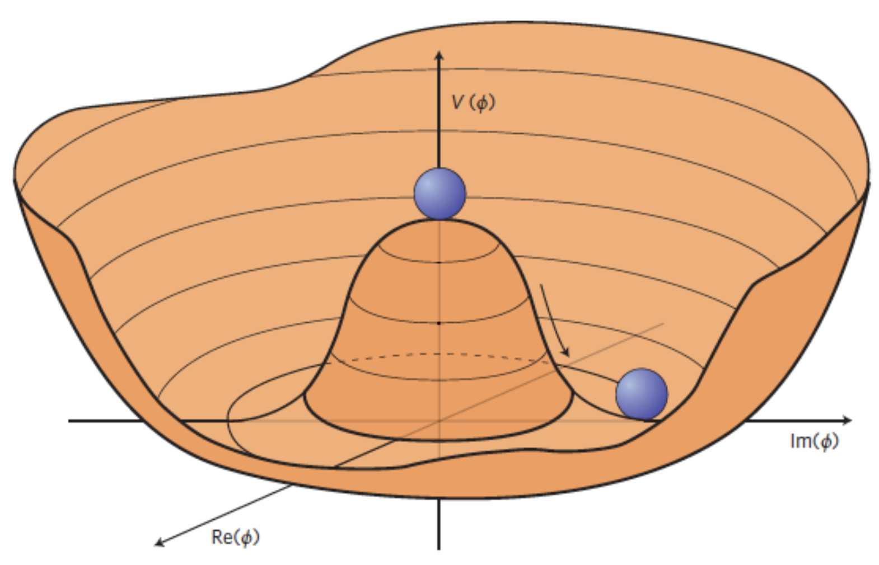
Di-Higgs production
Non-resonant production of double higgs events → triple-higgs coupling strength, …
$$λ_{HHH}$$
Resonant production of double higgs events → search for high-mass resonance, graviton, …

Slide 3
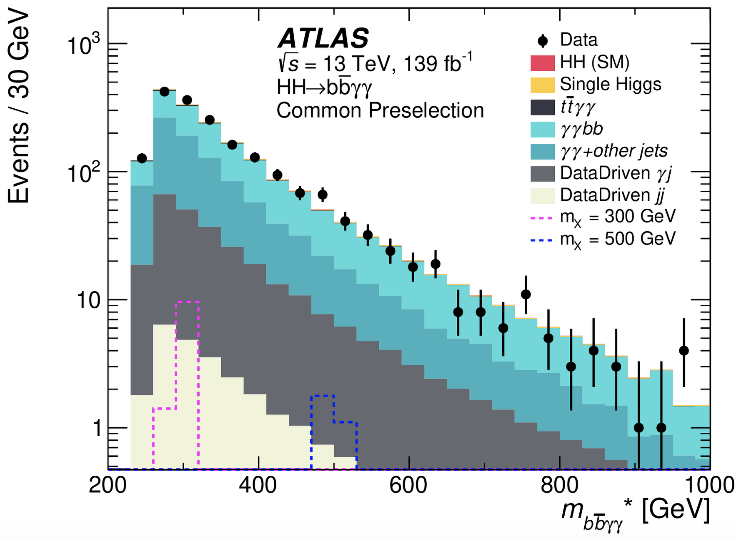
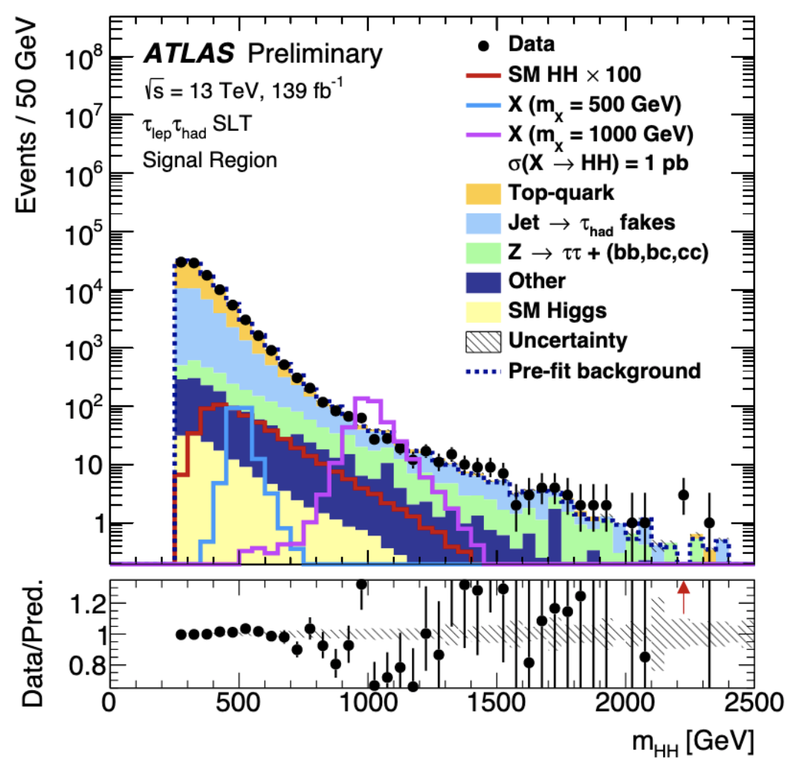
Di-Higgs resonance search in ATLAS
The search has been performed in several final states.
(H→bb)(H→𝛾𝛾): low BR, clean, sensitive to low-mass resonances (< 1 TeV)
(H→bb)(H→𝜏𝜏): sensitive to median-mass resonances
(H→bb)(H→bb): high BR, dirty, sensitive to high-mass resonances (>1 TeV)

Slide 4
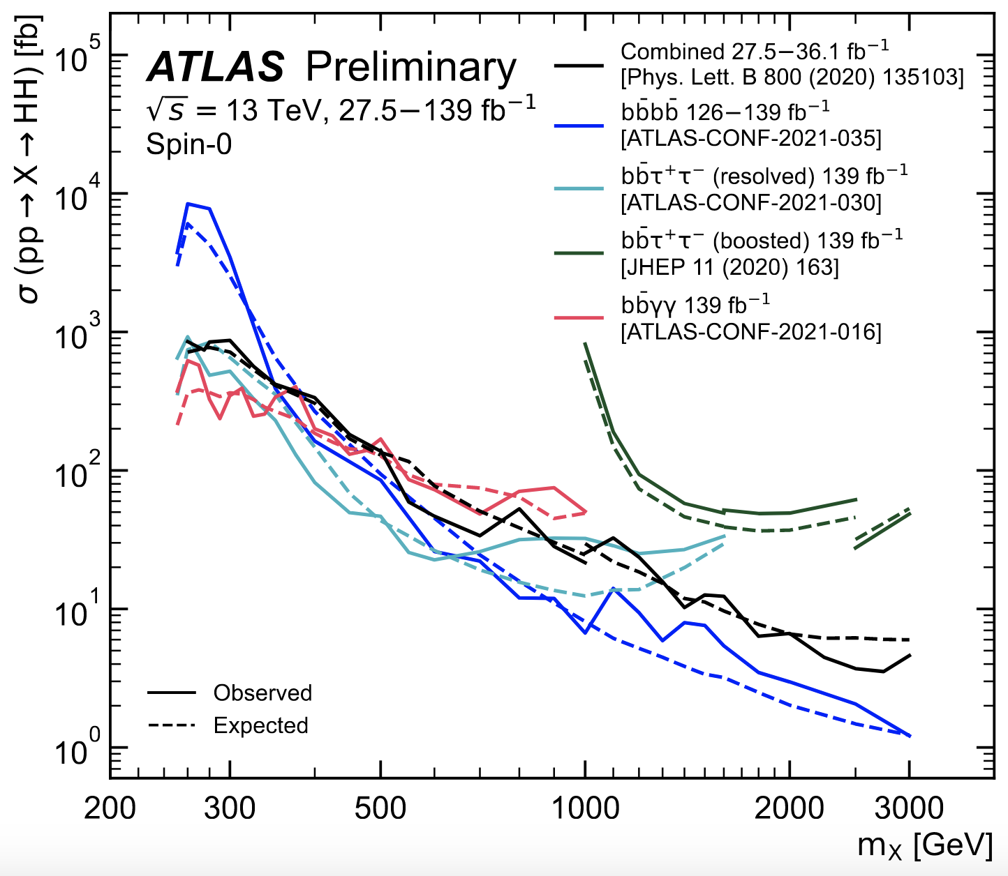
Di-Higgs resonance search in ATLAS
The search has been performed in several final states.
(H→bb)(H→𝛾𝛾): sensitive to low-mass resonances (< 1 TeV)
(H→bb)(H→𝜏𝜏): sensitive to median-mass resonances
(H→bb)(H→bb): sensitive to high-mass resonances (>1 TeV)
Current status:
Using full run2 dataset, no significant evidence for an HH resonance up to 3 TeV
Upper limits on production cross section are provided.

Slide 5
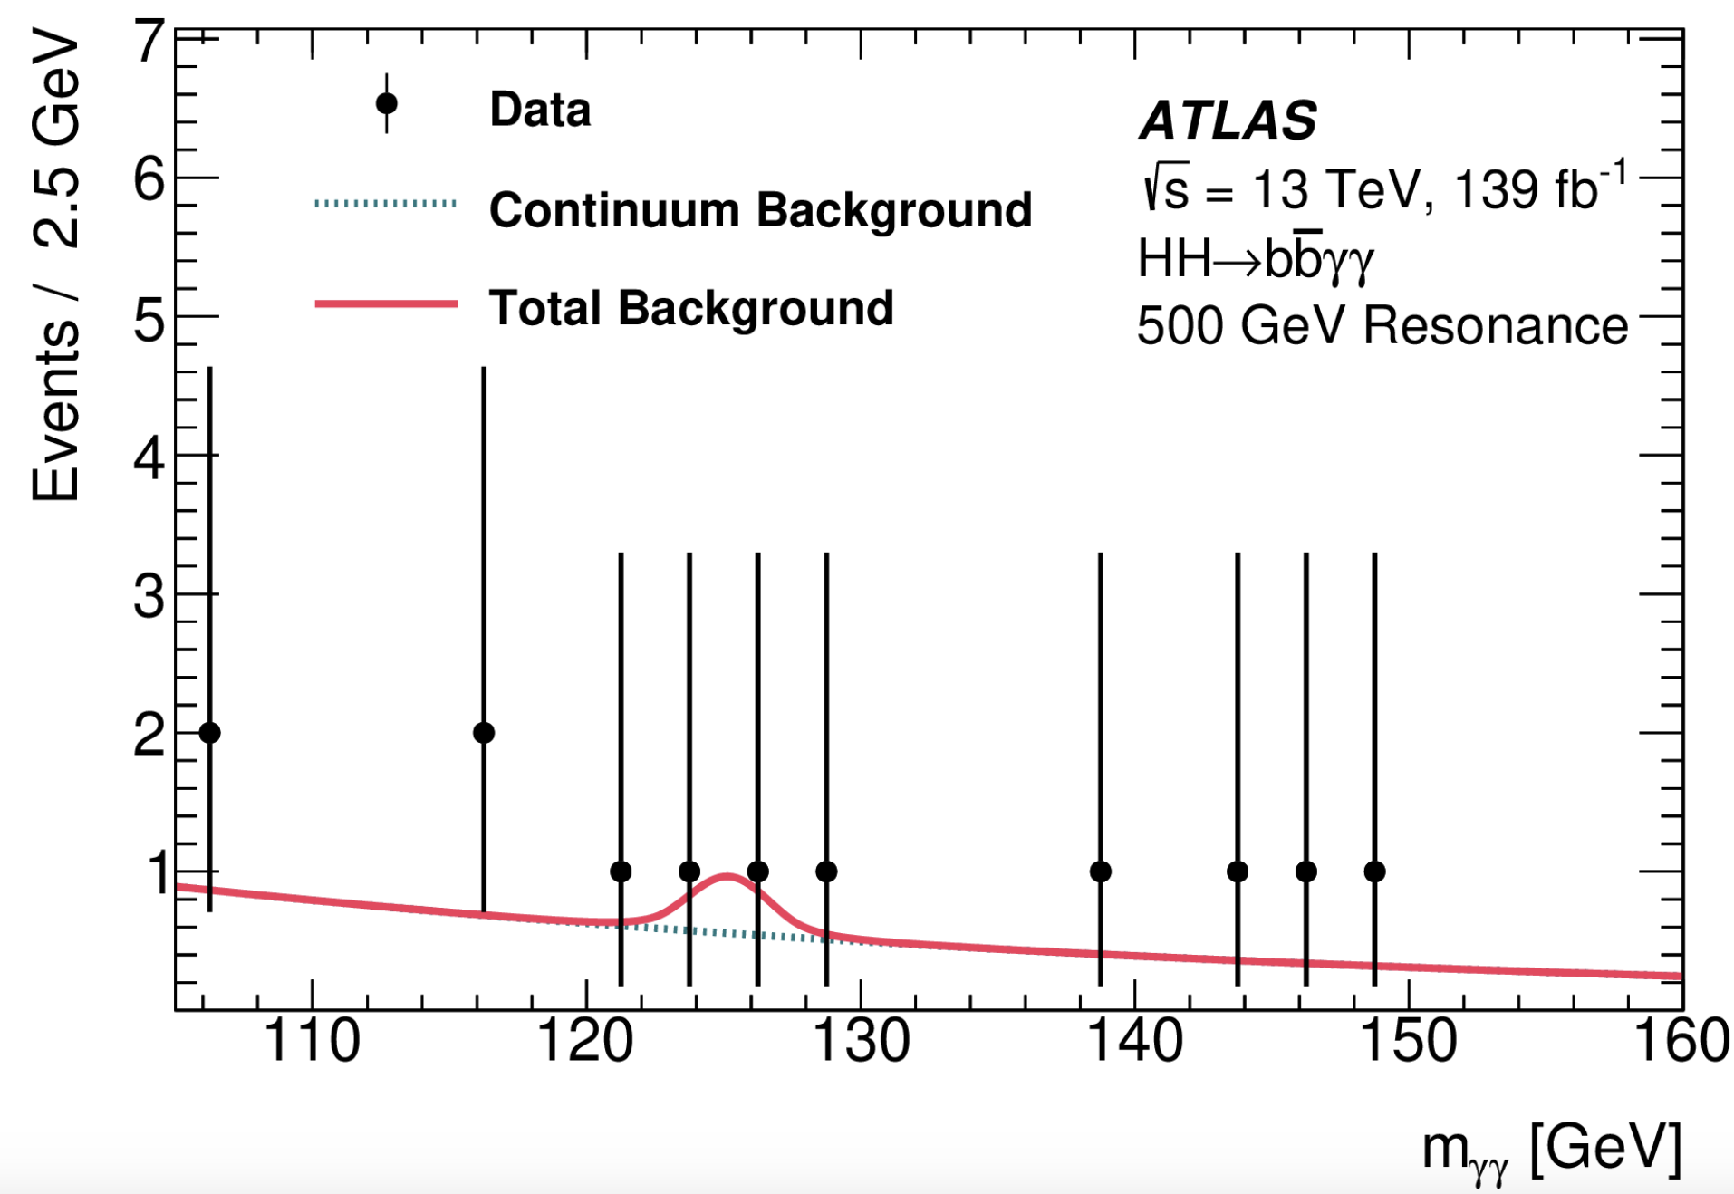
Di-Higgs resonance search using bb𝛾𝛾
Search for HH resonance using (H → bb, H→𝛾𝛾) in ATLAS
Multi-Variant-Analysis-based event selection:
training on many observables including m(bb𝛾𝛾), m(bb)
Cut on Boosted-Decision-Tree score and look at m(𝛾𝛾)
X=500 GeV

Slide 6
Statistical Interpretation
Event selection
Statistical Interpretation
Hypothesis
SM vs BSM
PDF of test statistics
Observables
mass, BDT score
Test statistics
N.O.E., L.H.R.
best-estimation
uncertainty
significance
upper limits
Only if significant!!!

Slide 7
Statistical Interpretation
Event selection
Statistical Interpretation
Hypothesis
SM vs BSM
Asymptotic Formulae
vs Toy Monte-Carlo
PDF of test statistics
Observables
mass, BDT score
Test statistics
N.O.E., L.H.R.
best-estimation
uncertainty
significance
upper limits
Only if significant!!!

Slide 8
Summary of 6 Test statistics
Test statistic | Note
t₀ | To establish the discovery of a signal
q₀ | To establish the discovery of a positive signal
t_{𝛍} | To set an interval at a given confidence level
$${\tilde{t}}_{μ}$$ | To set an interval for a positive signal at a given confidence level
_{q𝛍} | To set an upper limit of a signal at a given confidence level
$${\tilde{q}}_{μ}$$ | To set an upper limit of a positive signal at a given confidence level

Slide 9
Classical Asymptotic Formulae
arXiv:1007.1727

Slide 10
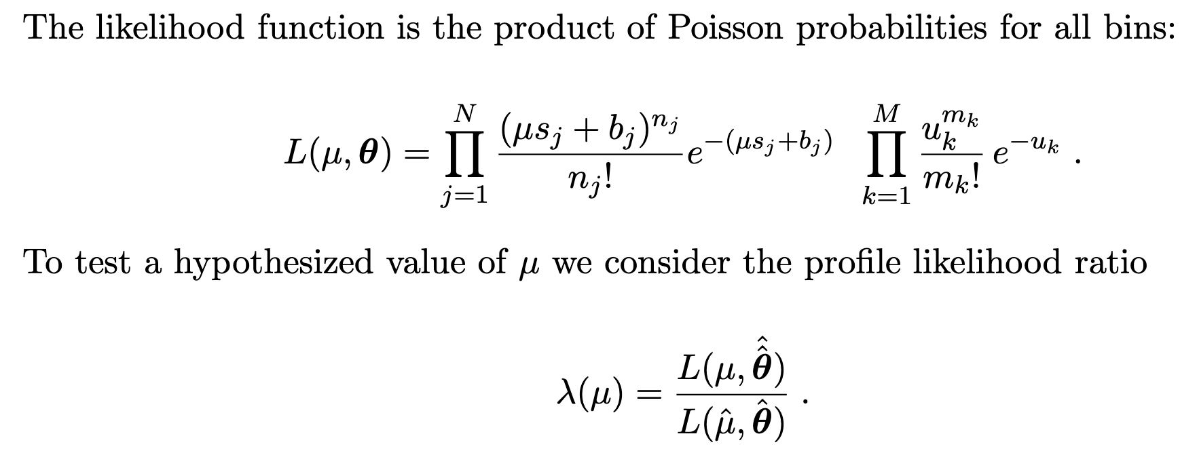
Likelihood ratio in a measurement
Signal region:
sensitive to Parameter Of Interest (𝛍)
Control region:
sensitive to Nuisance Parameters (𝜃)
Most powerful test (Neyman-Pearson theorem)
The 𝛍 value we want to test
Optimal estimate of 𝛍

Slide 11
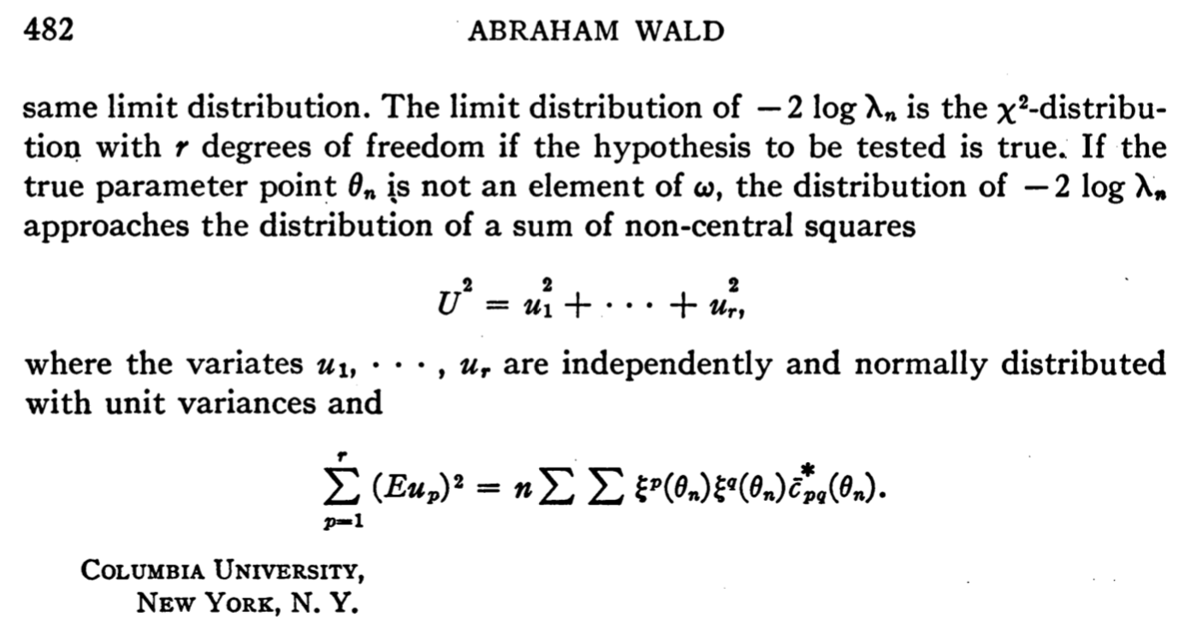
Wald’s theorem
Can we go one small step further?

Slide 12
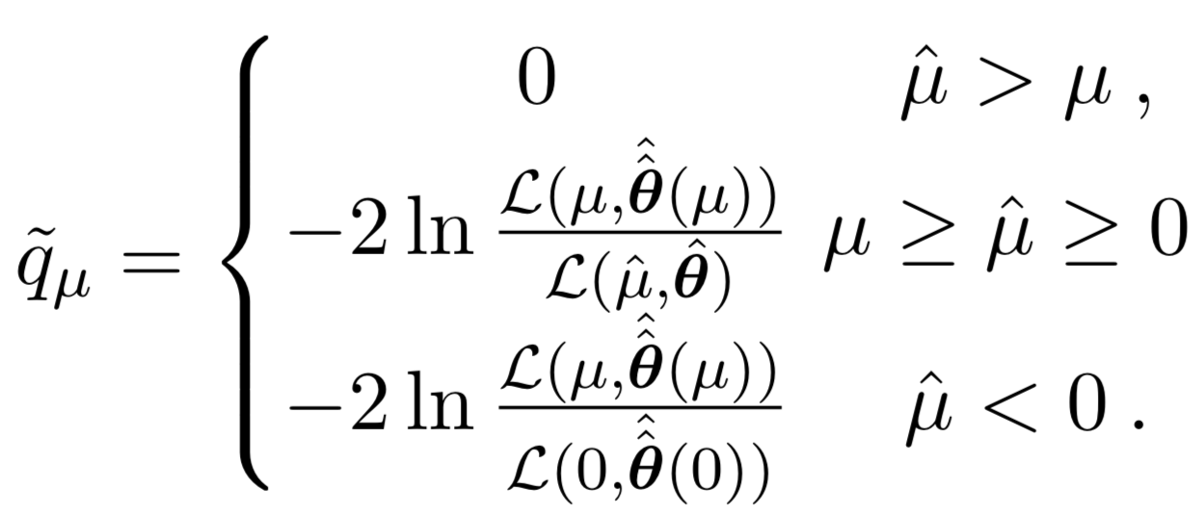
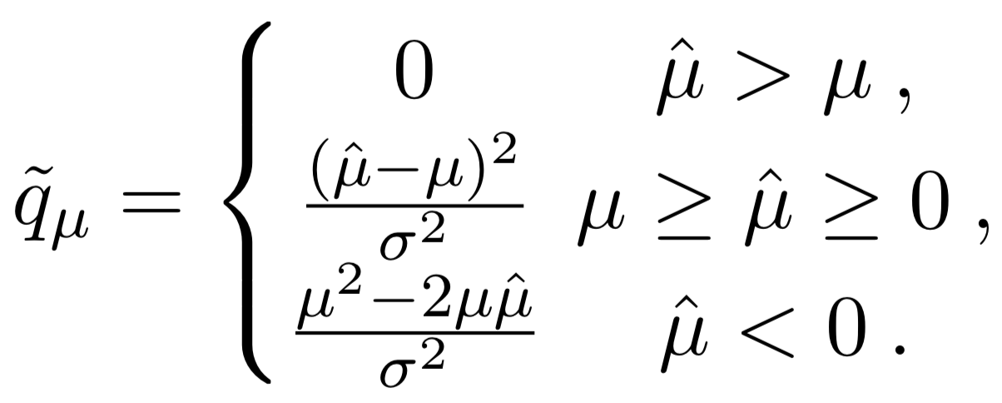
Example: $\tilde{q_{μ}}$
$\hat{μ}>μ$: not inconsistent with upper limit mu
$\hat{μ}<0$: assume non-negative signal strength and we compare with 0
Classic asymptotic formulae

Slide 13
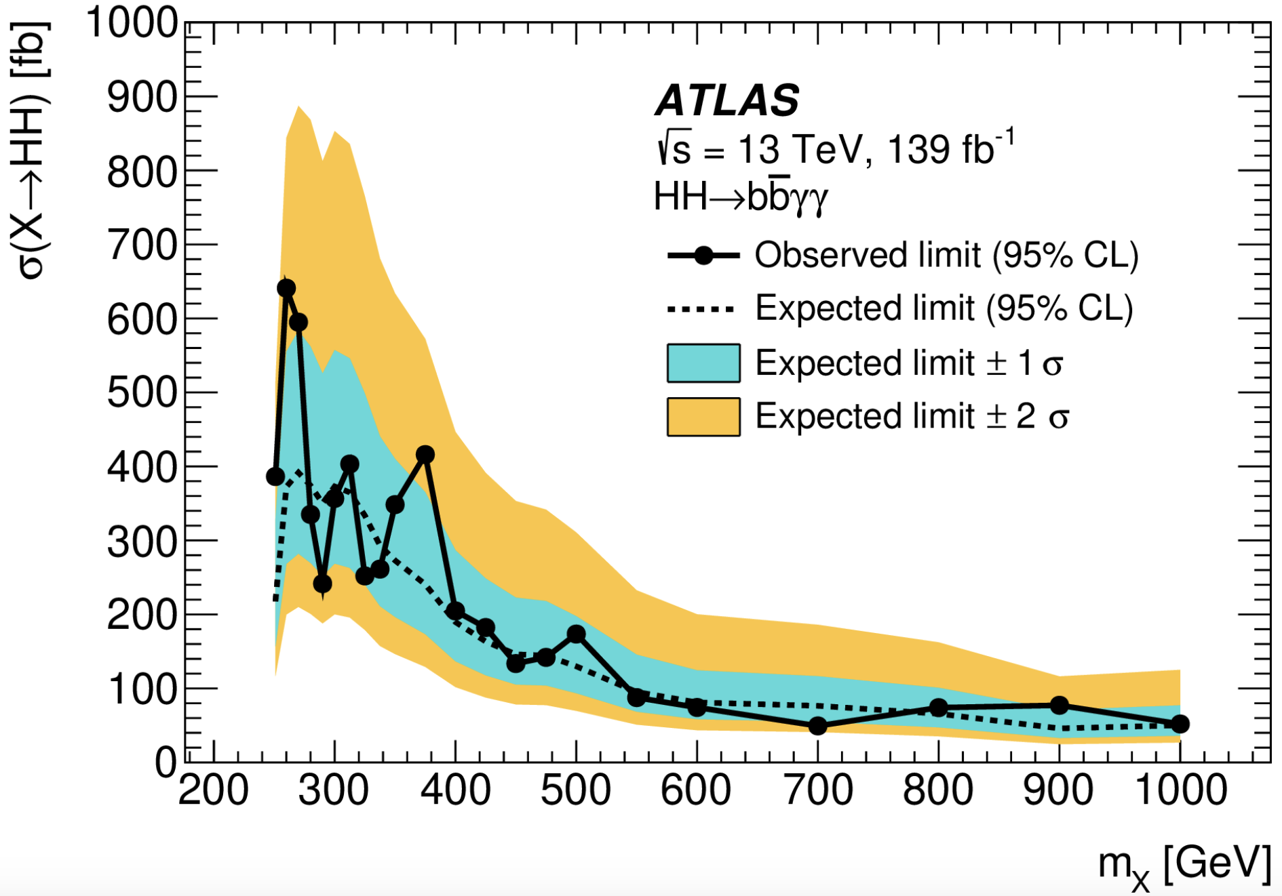
Example: X(900GeV)→HH𝛾𝛾→bb
Signal like
Background like

Slide 14
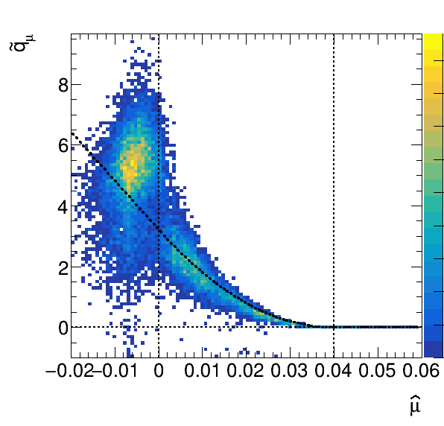
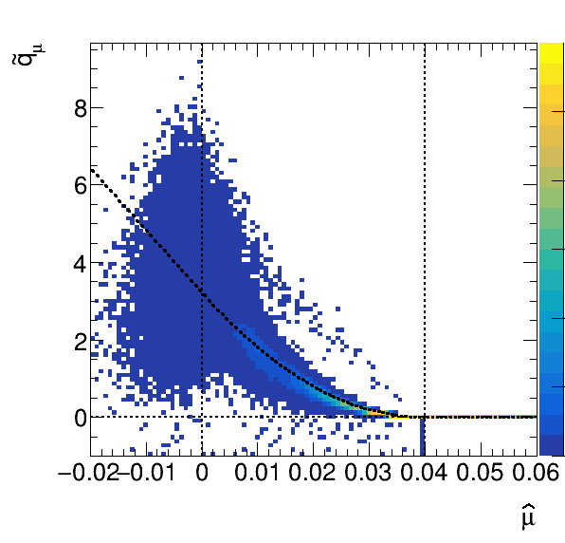
Why “bumps” in PDF of $\tilde{q_{μ}}$?
bkg. +sig.
𝜇_{H}>0
bkg. only
𝜇_{H}=0

Slide 15
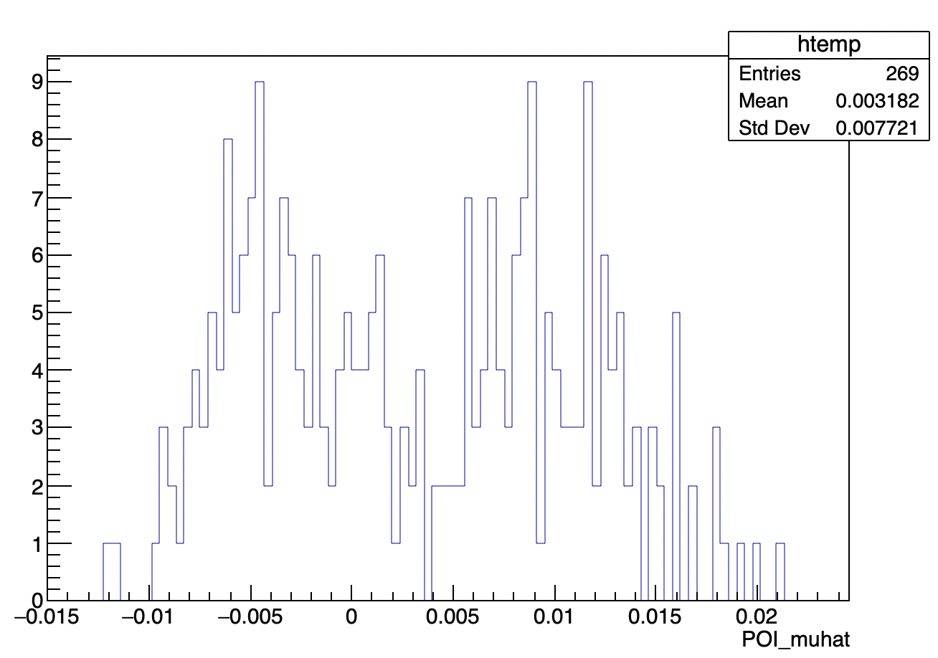
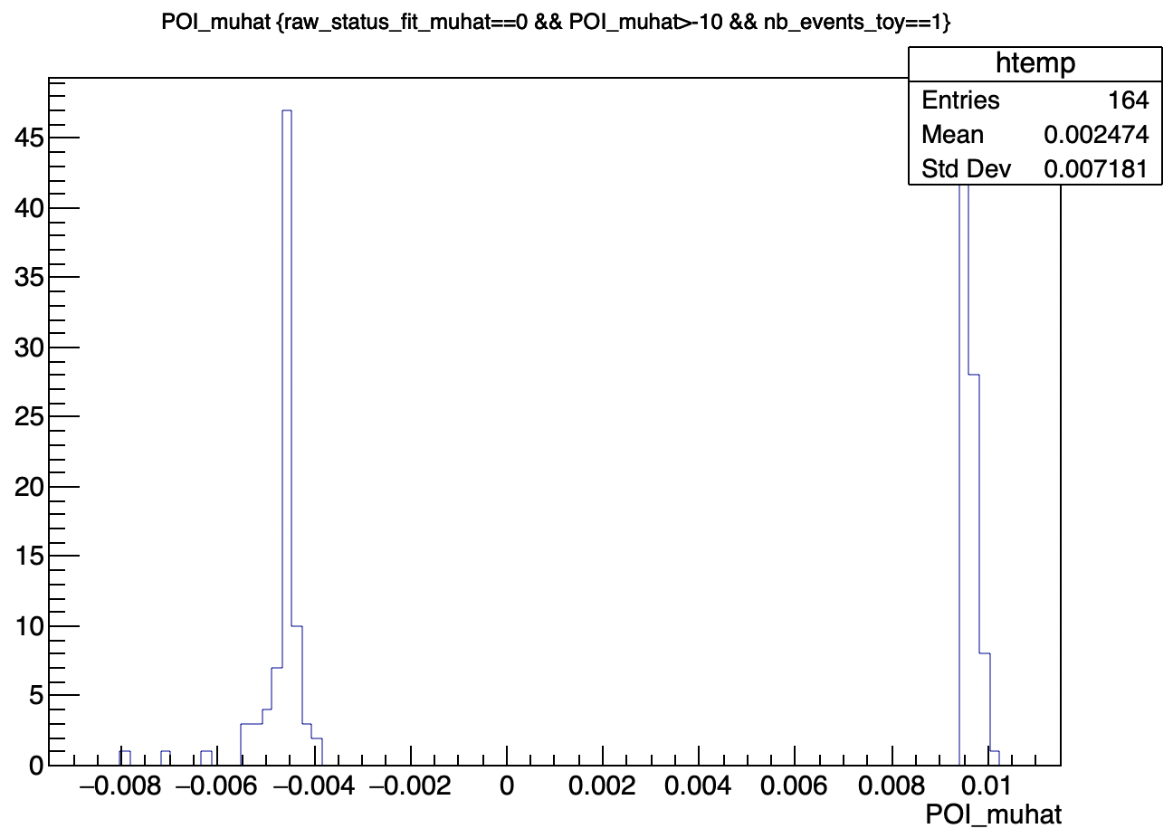
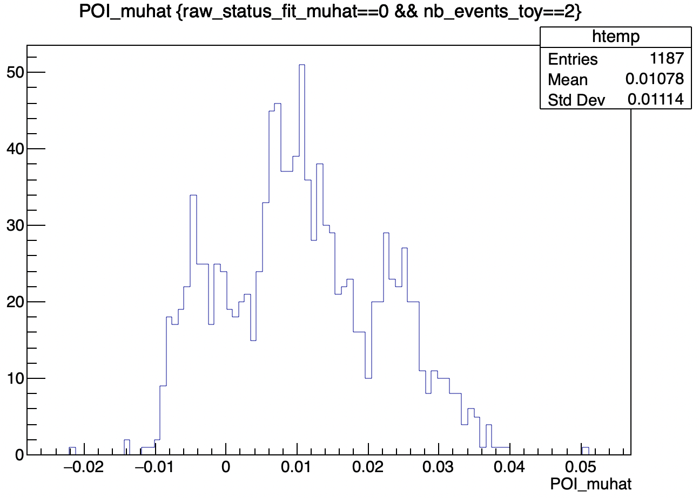
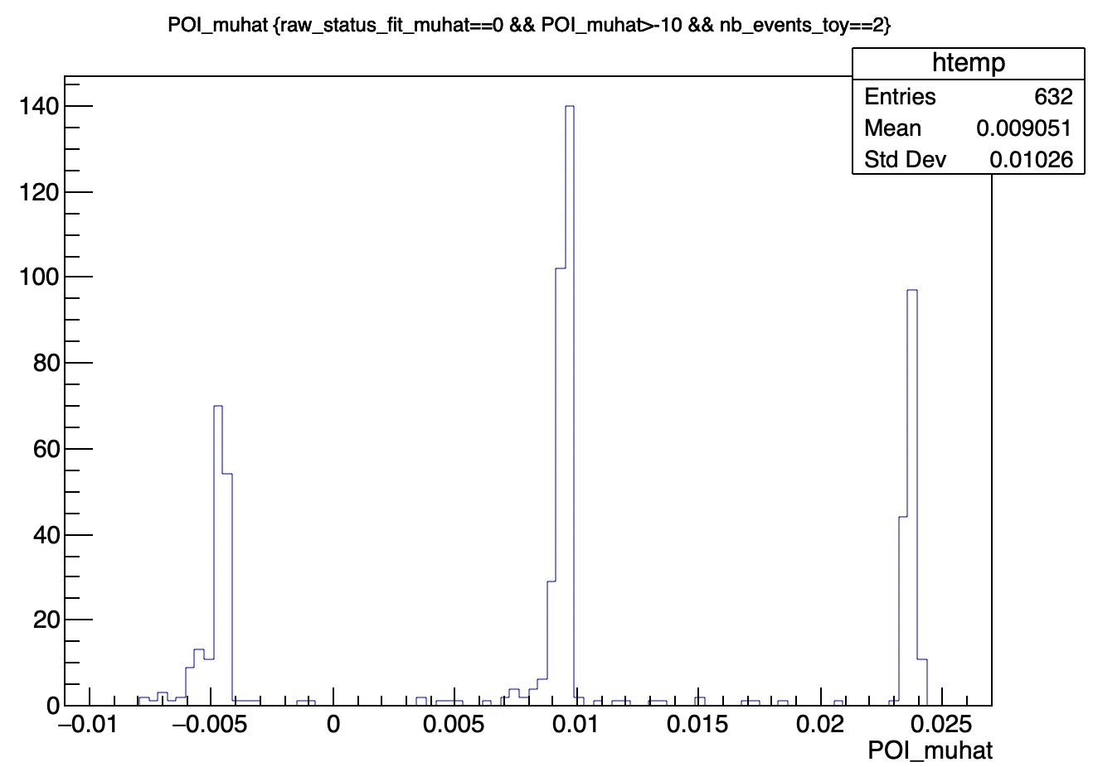
Why “bumps” in PDF of $\tilde{q_{μ}}$?
switch off systematics
n=1
Things are clear if looking at the $\hat{μ}$ distribution in toys for the number of events = 1, 2, …
n=2

Slide 16
Why “bumps” in PDF of $\tilde{q_{μ}}$?
switch off systematics
s0
n=1
s1
b1
b0
supposing a 2-bin observable distribution
n=2

Slide 17
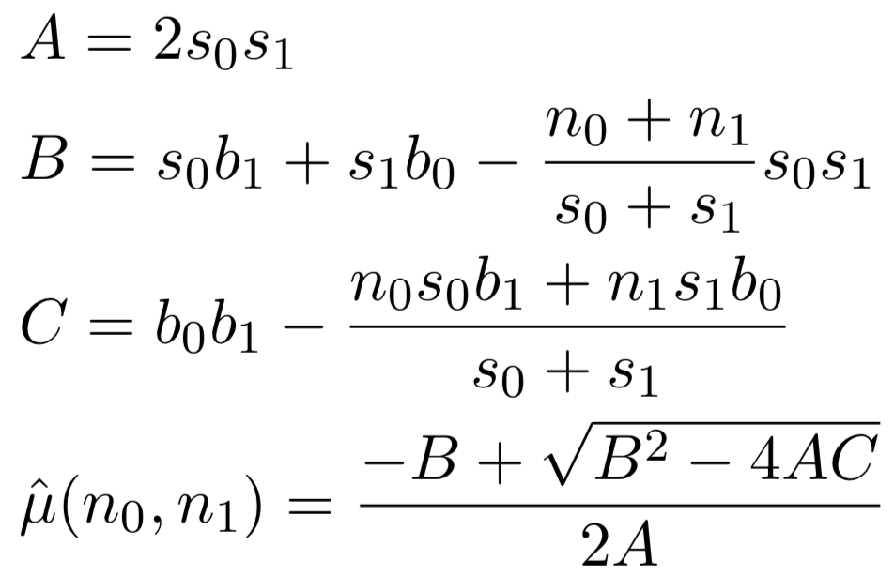
Why “bumps” in PDF of $\tilde{q_{μ}}$?
s0
s1
b1
b0
Probability= 1 : 2 : 1
supposing a 2-bin observable distribution
n=2

Slide 18
New Asymptotic Formulae
n_{small}: threshold between large statistics and small statistics
s0
s1
b1
b0
Small-Statistics part:
discrete
analytical/numerical calculation
Large-Statistics part:
continual
classical asymptotic formulae
supposing a 6-bin observable distribution
Supposing n_{small}=5

Slide 19
New Asymptotic Formulae
n_{small}: threshold between large statistics and small statistics
Small-Statistics part:
discrete
analytical/numerical calculation
Large-Statistics part:
continual
classical asymptotic formulae

Slide 20
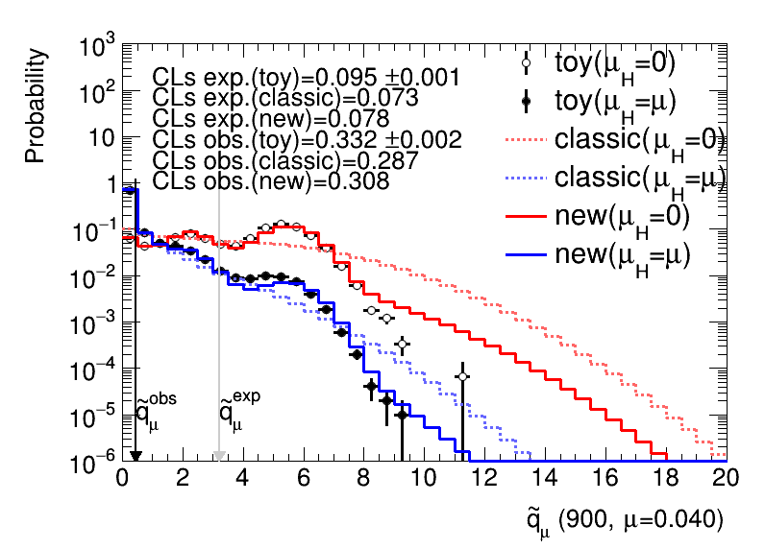
New Asymptotic Formulae
n_{small}: threshold between large statistics and small statistics
A conservative choice of n_{small}
An aggressive choice of n_{small}

Slide 21
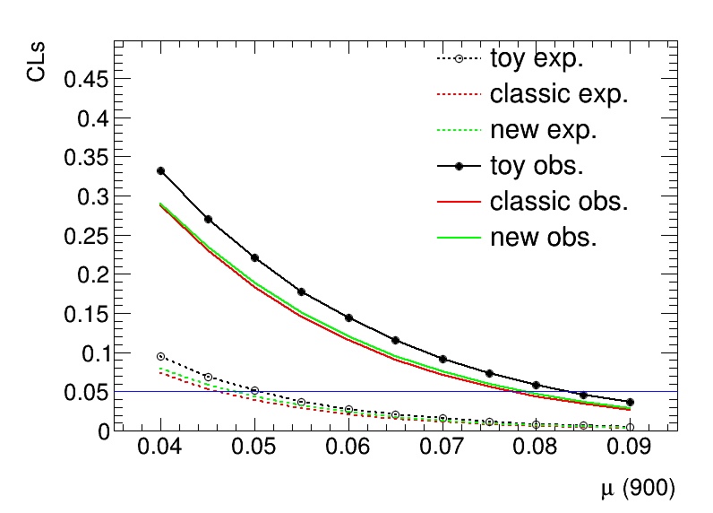
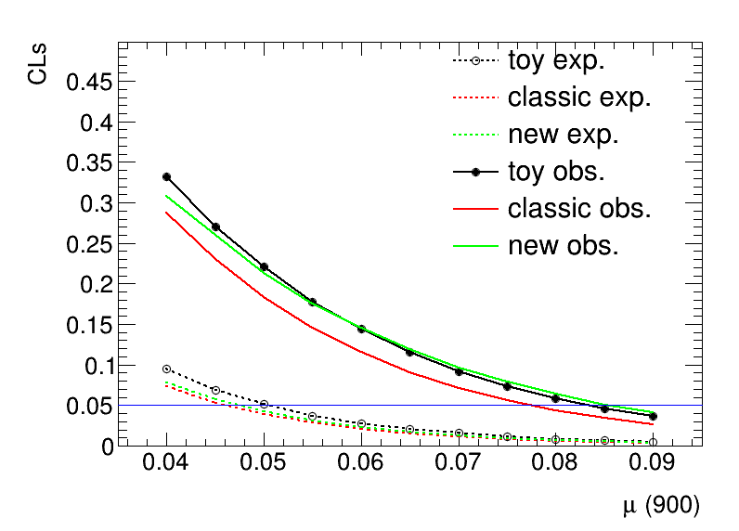
New Asymptotic Formulae
n_{small}: threshold between large statistics and small statistics
A conservative choice of n_{small}
An aggressive choice of n_{small}

Slide 22
Comments on New Asymptotic Formulae
Still more of education value due to
How to choose n_{small}?
How many bins in the Small-Statistics part?
How to correct the Large-Statistics part if we want to be aggressive

Slide 23
Summary
New asymptotic formulae proposed (work in progress)
Large-statistics part: described by classical asymptotic formulae
Small-statistics part: described by analytic/numerical calculation
Application to a real case: di-higgs resonance search X→HH→bbyy
Look promising
Still some issues to be fixed
More of education value for the moment
Thank you for your attention!

