Slide 1

Machine protection, beam dumps and other safety issues
Guangyi Tang, Haoyu Shi and Zhongjian Ma
IARC meeting, 2022

Slide 2
outline
Introduction
Collider ring dump design
Synchrotron radiation shielding
Radionuclide productions
Linac hot spots and beam losses
Summary and outlook
Using FLUKA, Flair.

Slide 3
Radiological impact
Main consideration aspects
Impact factors | Characteristics
Synchrotron radiation | Radiation damage to magnet coil; Over heat load to ventilation system; Formation of ozone and nitrogen oxides in the air; Slightly activation to the material around;
Random beam loss | Cause secondary radiation inside the tunnel; Determine the bulk shielding thickness;
Hot spots | MDI, Collimation locations, collider/linac dumps, injection/extraction points;
Radiological impact on environment | Dose from stray radiation emitted during machine running Radionuclides in the cooling water, underground water, tunnel air, soil. Radioactivity analysis for the solid components and waste
Machine protection | Active/passive protection

Slide 4
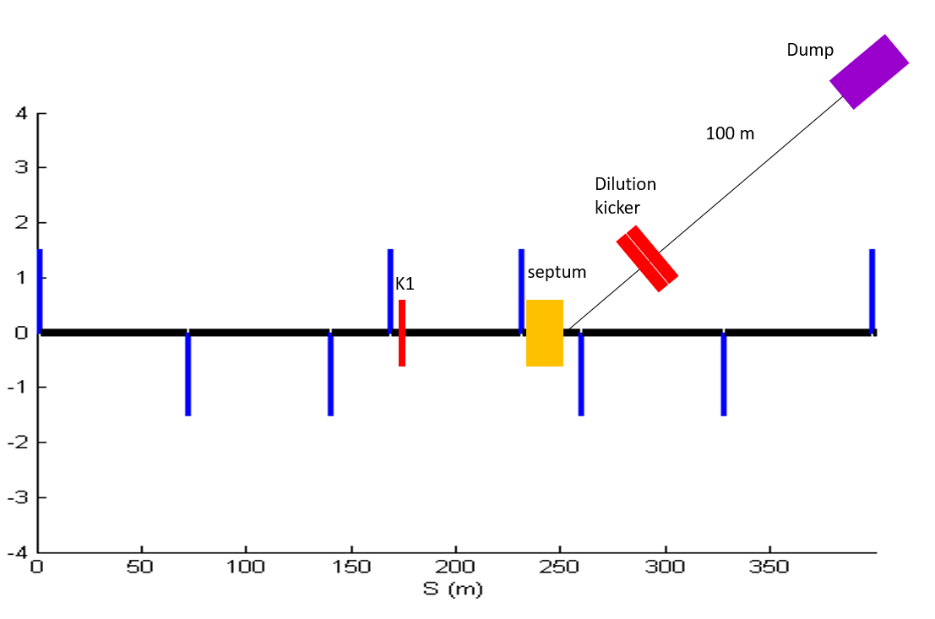
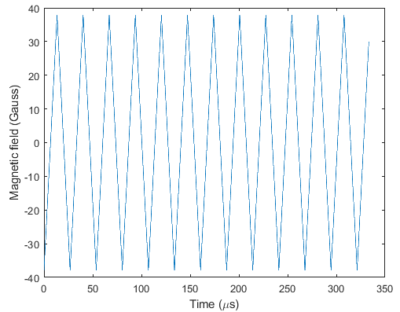
Collider dump
 |  | Extraction kicker | Septum | Dilution kickers
Length (m) |  | 2 | 20 | 10
Magnetic flux density (Gauss) | Z | 280 | 2600 | 40
 | WW | 493 | 4700
 | Higgs | 740 | 7000
 | ttbar | 1110 | 10500
A set of kicker magnets is used to dilute the beam horizontally and vertically.
The length of transfer tunnel is about 100m; the diameter is about 2m, considering the vacuum equipment, pipe installation.
The area of bunch distribution at dump entrance is optimized to be 6cm x 6cm for graphite core.
Dilution kicker requirement:
Vertical kicker should periodic oscillate 12.5 times in 300 us
From Xiaohao Cui

Slide 5
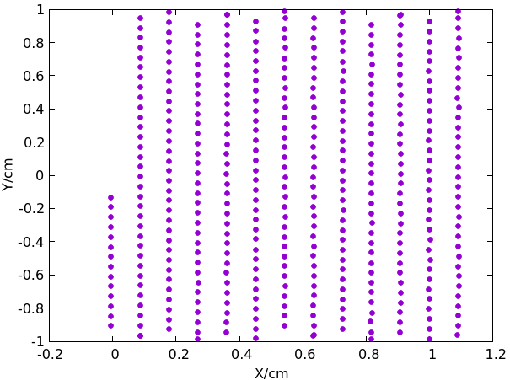
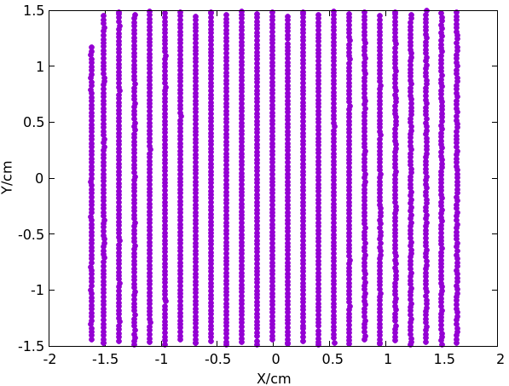
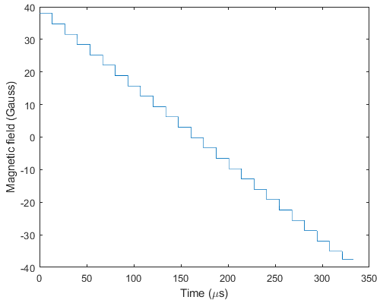
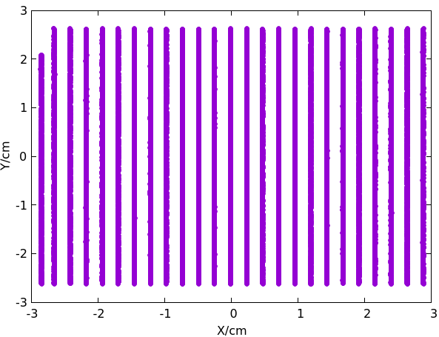
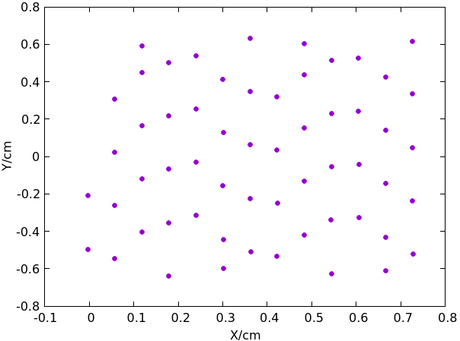

Bunch distribution: 50MW
The bunch distributions at the dump entrance is simulated.
  Bunch size: $σ_{x}>7mm;σ_{y}>40μm;$
From Xiaohao Cui
Simulate energy deposition in dump core.
Find the maximum energy deposition. And calculate maximum temperature rise.
Optimize dump dimensions
WW
Higgs
Higgs
Z pole
ttbar
Dilution kicker requirement:
2. Horizontal kicker should reduce step by step from max. to min. in 300 us

Slide 6
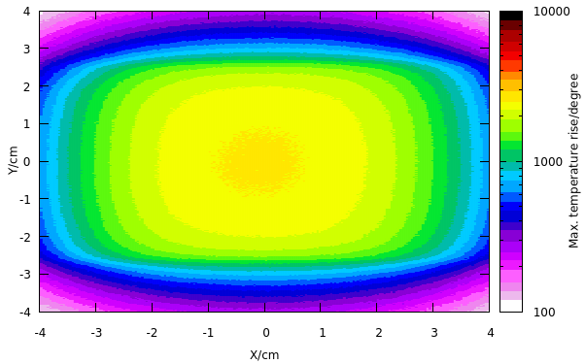
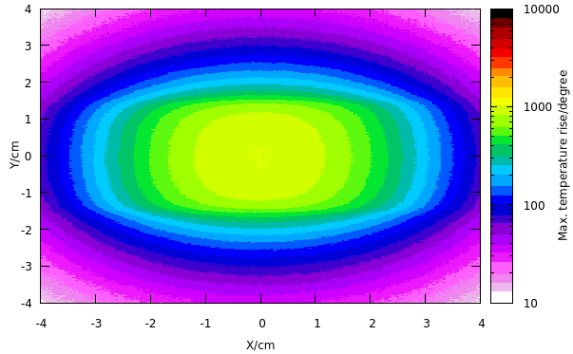
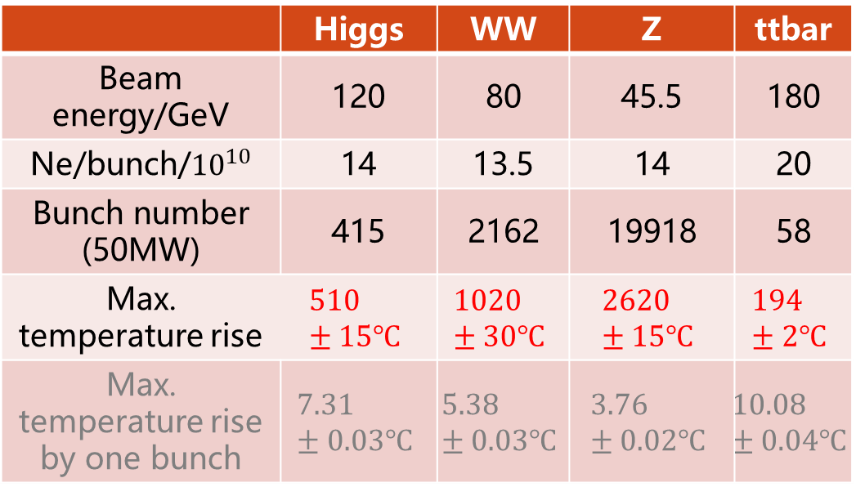
Max. temperature rise: 50MW
Example: graphite core
Max. temperature rise is smaller than graphite melting point.
Dimension (graphite + Iron): R~2.3m, L~8m; constrained by the condition that dose-eq is smaller than 5.5mSv.
Temperature rise @Z mode
Temperature rise @WW mode
 | Higgs | WW | Z | ttbar
Beam energy/GeV | 120 | 80 | 45.5 | 180
Ne/bunch/${10}^{10}$ | 14 | 13.5 | 14 | 20
Bunch number (50MW) | 415 | 2162 | 19918 | 58
Max. temperature rise | $$510±15℃$$ | $$1020±30℃$$ | $$2620±15℃$$ | $$194±2℃$$
Max. temperature rise by one bunch | $$7.31±0.03℃$$ | $$5.38±0.03℃$$ | $$3.76±0.02℃$$ | $$10.08±0.04℃$$

Slide 7
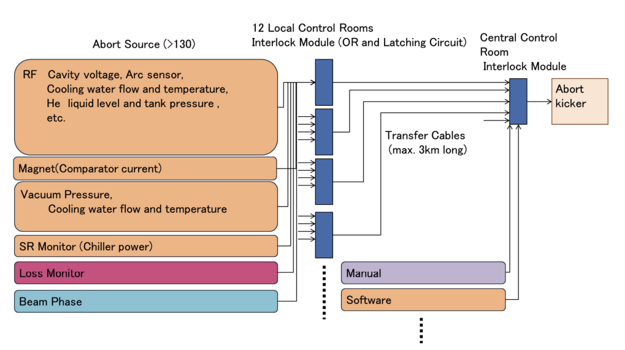
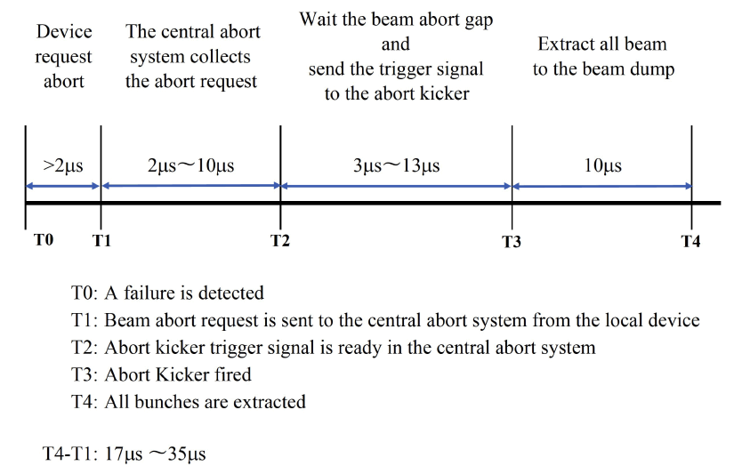



Abort trigger
SuperKEKB Design Report
Abort request:
  Beam loss monitors
  Synchrotron oscillation phase
  monitor
  Hardware components
  Manual abort
Time interval
  Device request -> local control
  Local control -> central control
  Central control -> dump system
  Extract all beam.
Collider dump response
time ~ 1ms.
$$300μs$$
$$300μs$$
$$300μs$$

Slide 8
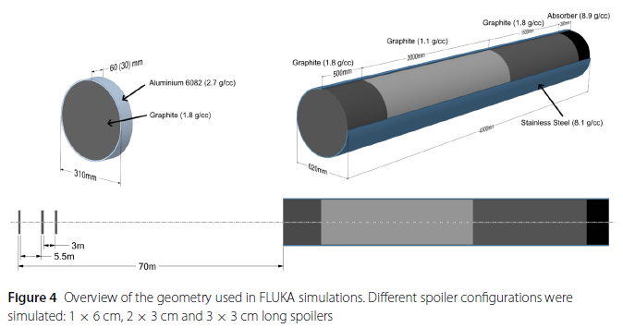
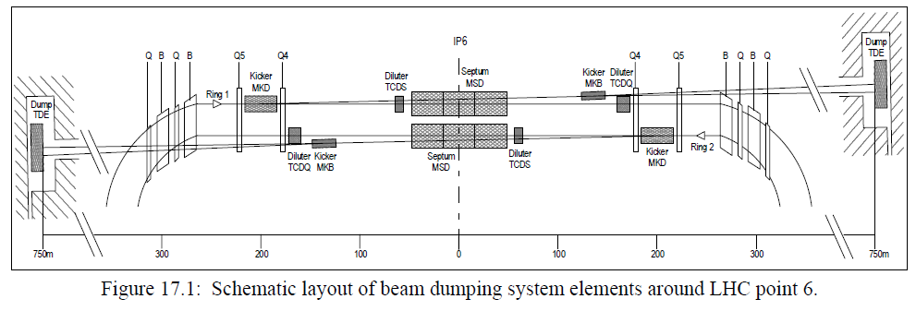
More issues
Abort beam in booster and collider
  For normal operations and machine tunning
Study feasibility to build extraction line from
booster to dump.
Can be built around 4 straight sections.
Number of dumps depends on machine
requirement and reliability.
Need absorber to protect machine elements
from incorrect extraction.
Will study reliability (or alternative design).
Response time ~ 1ms.
Need collimators to deal with
beam losses faster than 1ms.
  fault cases.
Straight sections
Krainer, A. et.al., EPJ Techn Instrum 9, 3 (2022)
LHC design report Ch.17

Slide 9
outline
Introduction
Collider ring dump system
Synchrotron radiation shielding
Radionuclide productions
Linac hot spots and beam losses
Summary and outlook

Slide 10
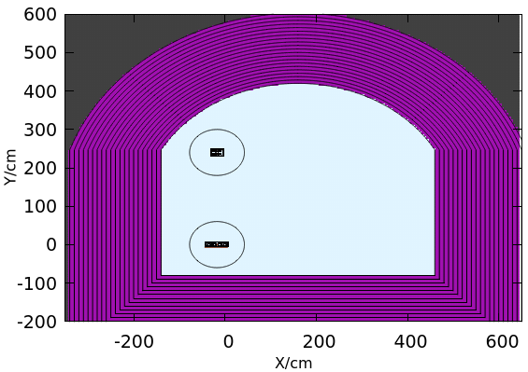
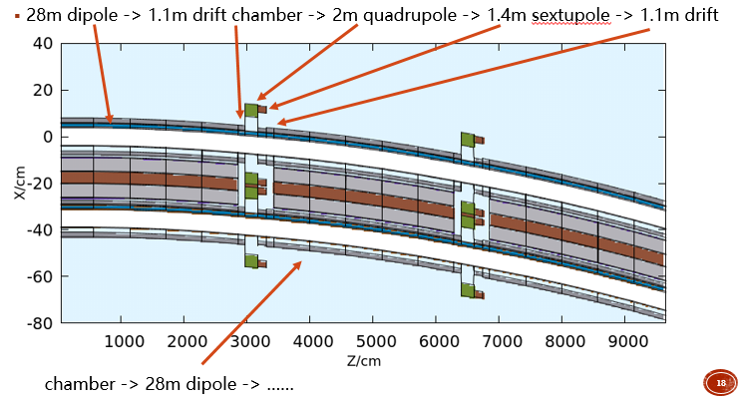
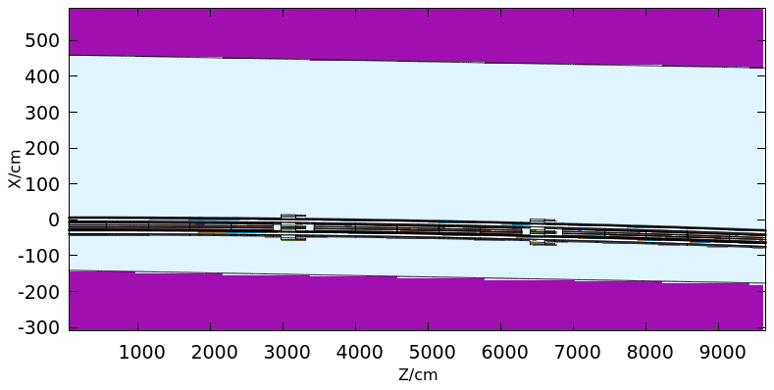
Simulation setup
Tunnel geometry
Length: 100m;
  3 dipoles;
  2 quadrupoles;
  2 sextupoles;

Slide 11
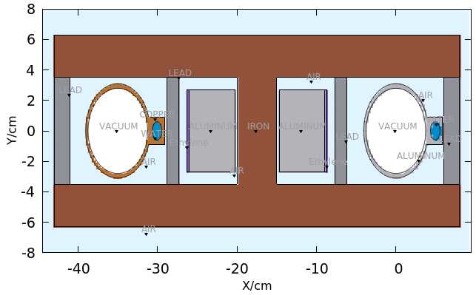
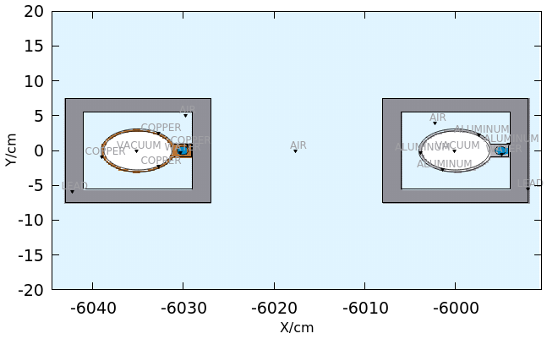


Simulation setup
Dipole
insulator, coils, lead
Insulator is added in the model.
In cross-section, area of lead: $56cm^{2}$
Drift chamber
area of lead: $216cm^{2}$

Slide 12
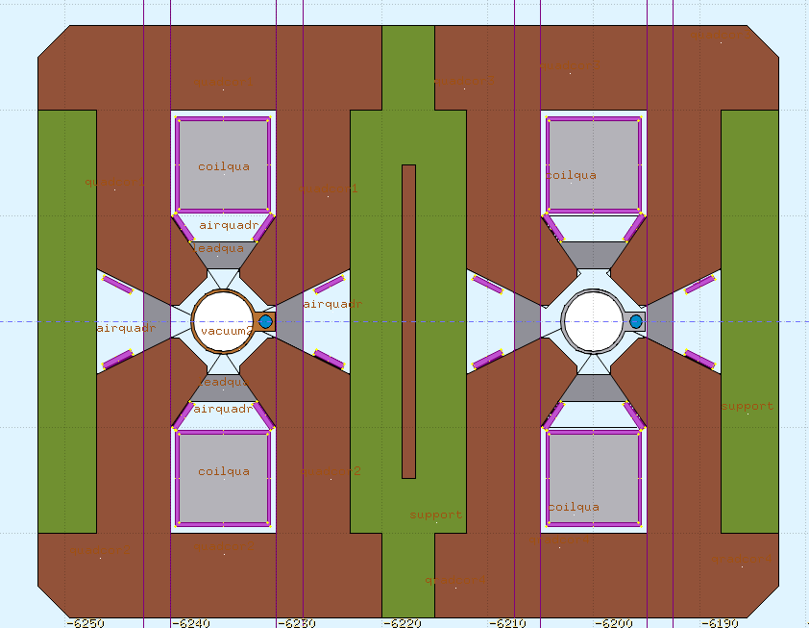
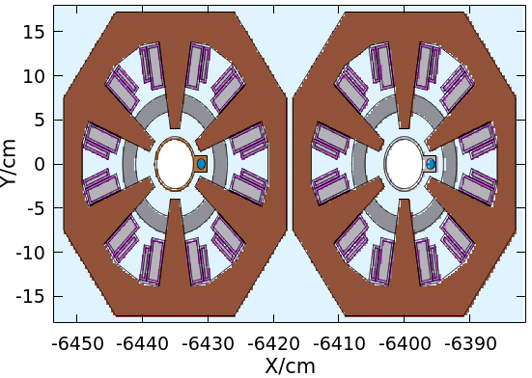

Simulation setup
Quadrupole
insulator, coils, lead
Trim coils is added in the model.
area of lead : $96cm^{2}$
Sextupole
area of lead : $100cm^{2}$

Slide 13
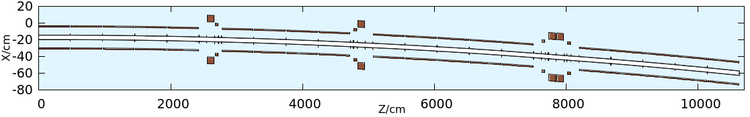
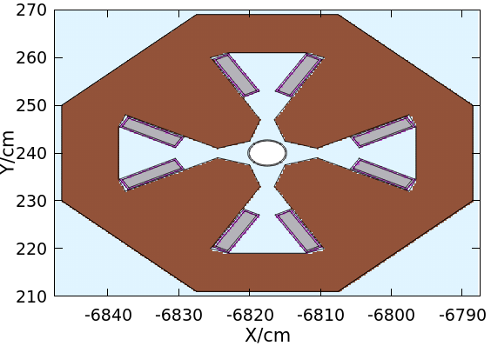
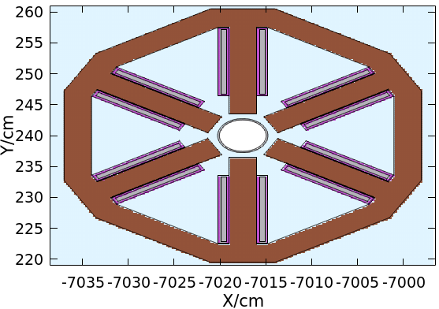
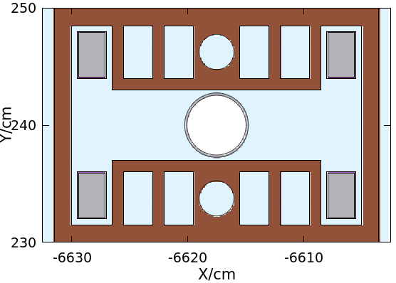
booster
dipole ->drift chamber ->quadrupole -> sextupole ->drift chamber ->dipole …
Magnets

Slide 14
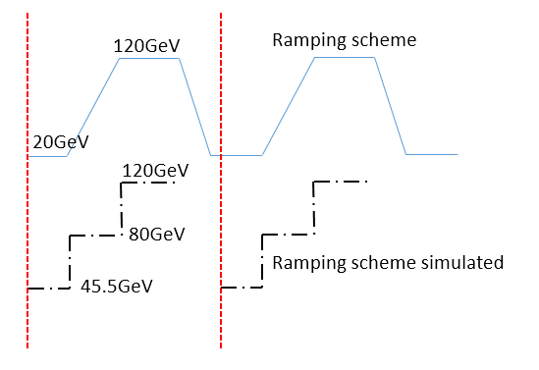
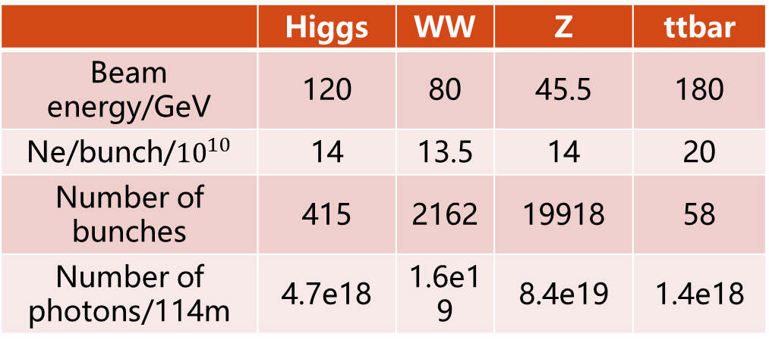
Parameters: 50MW
Collider
The ramping simulation is more critical than reality.
  Overestimate dose in booster
Booster
Ramping simulation: example @higgs
 | Higgs | WW | Z | ttbar
Beam energy/GeV | 120 | 80 | 45.5 | 180
Ne/bunch/${10}^{10}$ | 14 | 13.5 | 14 | 20
Number of bunches | 415 | 2162 | 19918 | 58
Number of photons/114m | 4.7e18 | 1.6e19 | 8.4e19 | 1.4e18
 | Higgs On | WW | Z | ttbar
Current(mA) | 1 | 2.69 | 14.4 | 0.12
Injection duration(s) | 32.8 | 39.3 | 134.7 | 30
Injection interval(s) | 38 | 155 | 153.5 | 65

Slide 15
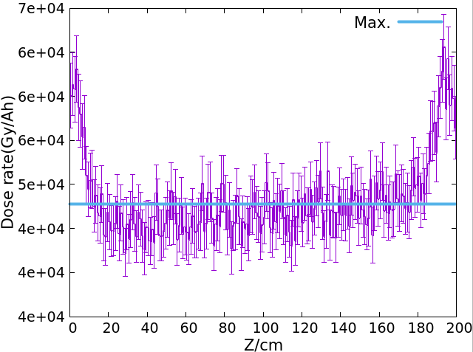
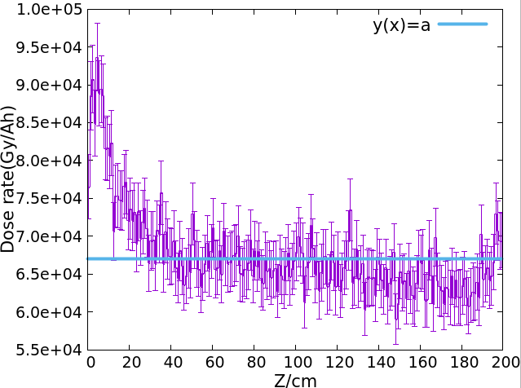
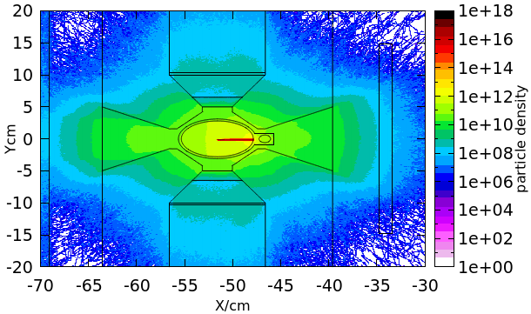
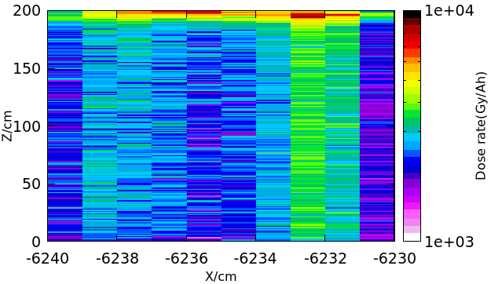
Dose in insulation
Dose value is equal in middle of magnet,
not in both sides of magnet.
“Hot spots” in insulation because:
  The shielding between magnets are not matched
  very well.
  SR hits the iron close to beam pipe and bypasses lead.
Hot spots shielding will be considered in next stage.
Dose in uniform regions are summarized in the following
pages.

Slide 16
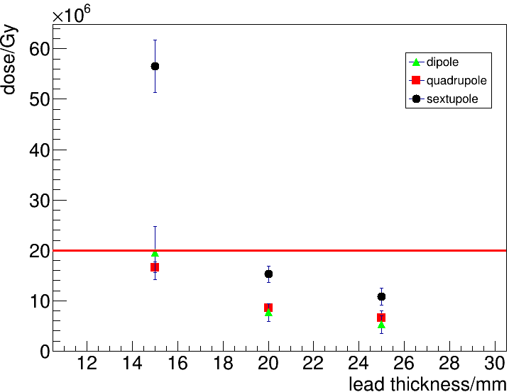
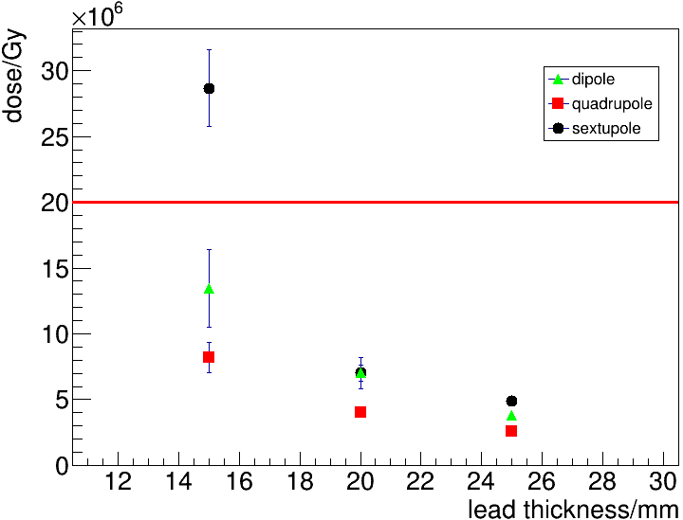
Dose vs lead thickness: 50MW
While running @Higgs/Z/WW (10 years),
  possible to reduce 2.5cm lead if no
  ttbar run;
Lead thickness is constrained by the operation plan.
While running @ttbar for 1 year,
  May run another 5 years for dipole and quadrupole, 2years for sextupole

Slide 17
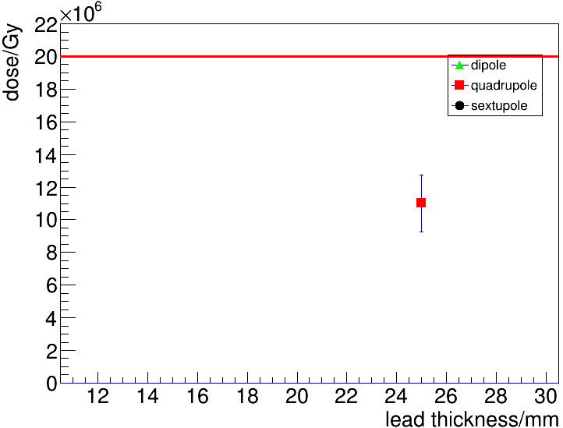
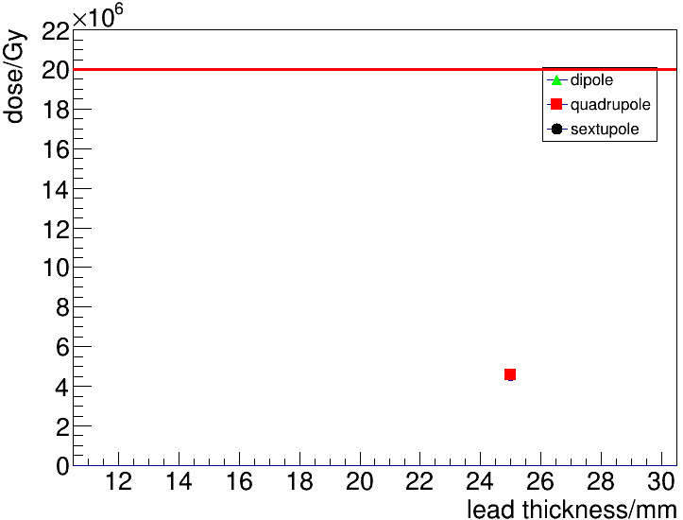
Dose in trim insulation: 50MW
While running Higgs/Z/WW (10 years),
Lead thickness is constrained by the operation plan.
While running @ttbar for 1 year,
  May run another 2 years for quadrupole trim coil

Slide 18
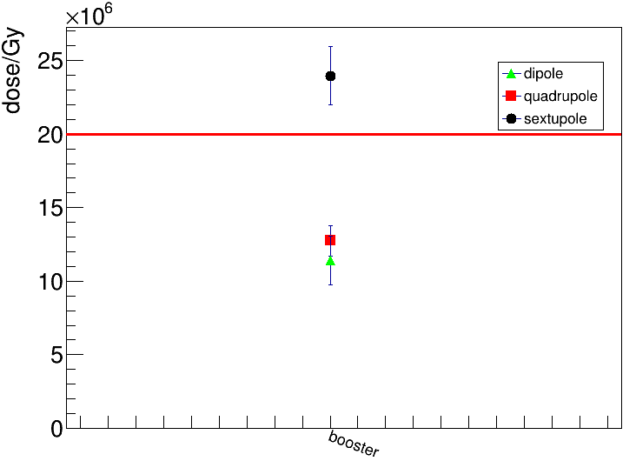
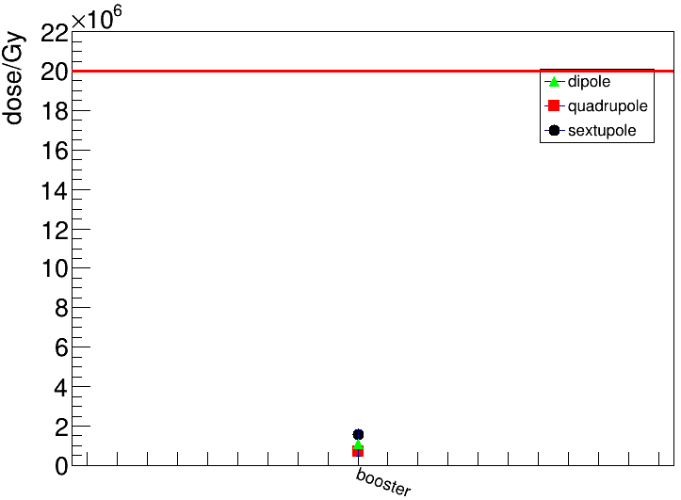
dose in booster insulation: 50MW
While running Higgs/Z/WW (10 years),
  Carefully assesse dose in sextupole
Pay attention to sextupole. Simulate more precisely.
While running @ttbar for 1 year,
  May run another 5 years for booster dipole and quadrupole

Slide 19
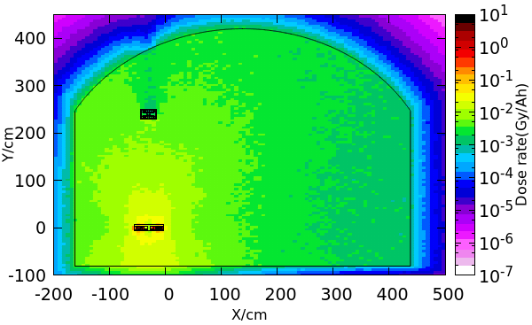
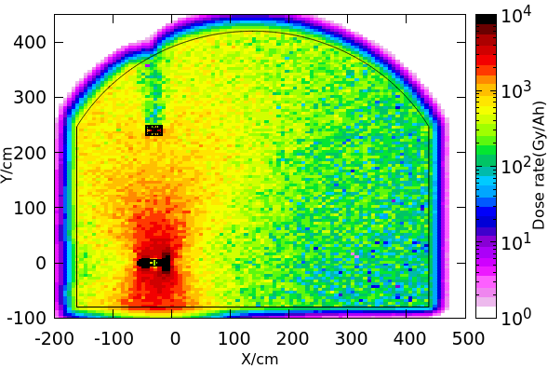
dose in the tunnel
In the arc section of the ring, the most important two radiation sources are from synchrotron radiation and random beam losses.
Radiation caused by synchrotron is more serious than beam losses
Secondary radiation components from random beam losses is harder and more liable to produce radioactivity in the material surrounded, Should be assessed.
Prompt radiation dose caused by random beam loss
Prompt radiation dose caused by synchrotron radiation

Slide 20
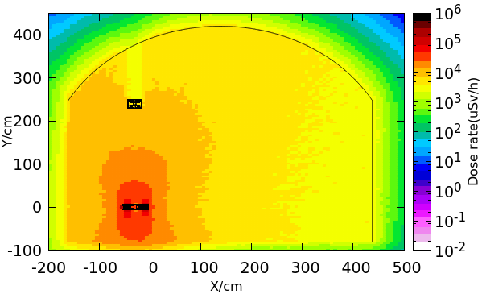
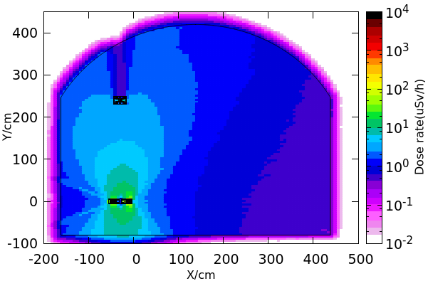
Dose-EQ in the tunnel
In the arc section of the ring, the most important two radiation sources are from synchrotron radiation and random beam losses.
Radiation caused by synchrotron is more serious than beam losses
Secondary radiation components from random beam losses is harder and more liable to produce radioactivity in the material surrounded, Should be assessed.
Prompt radiation dose-eq caused by random beam loss
Prompt radiation dose-eq caused by synchrotron radiation

Slide 21
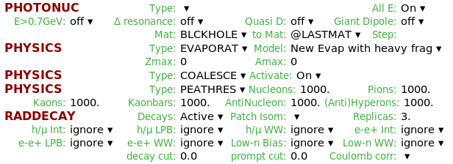
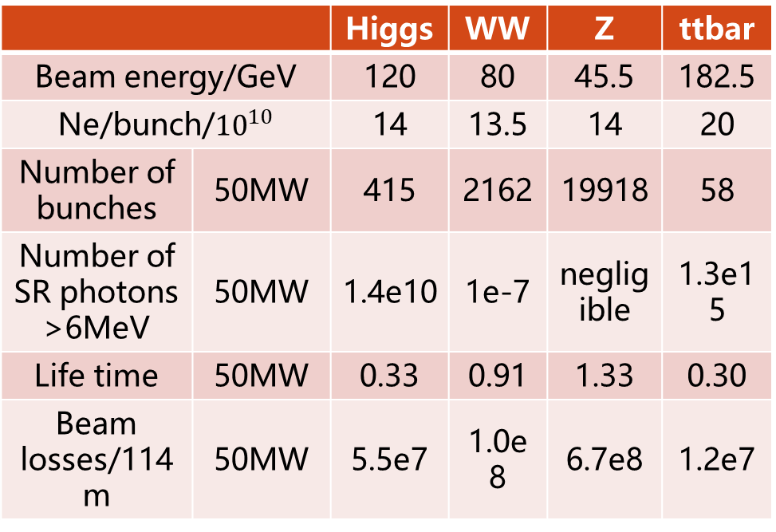
radionuclides simulation
Beam losses & SR photon of energy >6MeV
FLUKA options
Wall material:
  Case1: water as wall
  Case2: rock as wall
 |  | Higgs | WW | Z | ttbar
Beam energy/GeV |  | 120 | 80 | 45.5 | 182.5
Ne/bunch/${10}^{10}$ |  | 14 | 13.5 | 14 | 20
Number of bunches | 50MW | 415 | 2162 | 19918 | 58
Number of SR photons >6MeV | 50MW | 1.4e10 | 1e-7 | negligible | 1.3e15
Life time | 50MW | 0.33 | 0.91 | 1.33 | 0.30
Beam losses/114m | 50MW | 5.5e7 | 1.0e8 | 6.7e8 | 1.2e7

Slide 22
Soil/rock
 |  | Soil | average components of different rocks
density |  | 1.6g/cm^3 | 1.2~3.3g/cm^3
Major element (wt%) | C | 1.0 | ---
 | N | 0.12 | ---
 | O | 34 | 30~70
 | Na | 0.50 | 0.1~2.9
 | Mg | 0.52 | 0.4~3.7
 | Al | 8.0 | 3.5~9.7
 | Si | 40 | 26~39
 | P | --- | 0.02~0.16
 | K | 2.36 | 1.8~3.7
 | Ca | 2.26 | 0.2~4.8
 | Ti | 1.0 | 0.09~0.8
 | Mn | 0.24 | 0.02~0.12
 | Fe | 9.6 | 0.8~6.3
In previous study, use soil as tunnel wall.
Now use average components of different kinds of rock.
Simulate productions of residual nuclei after 1 year running in:
  Cooling water
  Air in tunnel
  Water outside tunnel
  Rock (leachable isotopes)

Slide 23
Radionuclides production
Densities of Long half-life isotopes are lower than mandatory standard, GB18871.
 |  | Half-life | Air in tunnel
 |  |  | Specific activity/GB18871 | Stat. error (%)
Beam losses @Z-pole | O15 | 122s | 2.7e-4 | 52
 | C14 | 5700a | 7.7e-7 | 1
 | Be7 | 53d | 1.1e-5 | 57
 | H3 | 12a | 3.5e-9 | 32
 | P32 | 14d | --- | ---
 | P33 | 25d | 1.9e-8 | 100
 | Cl36 | 3e5a | --- | ---
 | Cl38 | 37m | --- | ---
 | Ar37 | 35d | 6.1e-9 | 59
 | Ar41 | 2h | 1.4e-3 | 12
SR @ttbar | C14 | 5700a | 6.5e-6 | 2
 | Ar41 | 2h | 1.5e-2 | 20
 |  | Half-life | Cooling water
 |  |  | Specific activity/GB18871 | Stat. error (%)
Beam losses @Z-pole | O15 | 122s | 2.44 | 10
 | C14 | 5700a | 3.5e-7 | 23
 | Be7 | 53d | 1.3e-2 | 34
 | H3 | 12a | 2.3e-6 | 22
SR @ttbar | None

Slide 24
Radionuclides production
Only leachable isotopes are listed:
  ³H, ²²Na, ⁴⁵Ca, ⁵⁴Mn
Densities of Long half-life isotopes are
lower than mandatory standard.
Should investigate if radionuclides would transport to drinking water.
 |  | Half-life | Water wall
 |  |  | Specific activity/GB18871 | Stat. error (%)
Beam losses @Z-pole | O15 | 122s | 2e-3 | 2
 | C14 | 5700a | 5e-10 | 4
 | Be7 | 53d | 3e-5 | 5
 | H3 | 12a | 6e-9 | 3
 | F18 | 2h | 5e-6 | 52
SR @ttbar | C14 | 5700a | 2e-12 | 99
 | H3 | 12a | 1e-10 | 71
 |  | Half-life | Rock wall
 |  |  | Specific activity/GB18871 | Stat. error (%)
Beam losses @Z-pole | Mn54 | 312d | 6.94E-04 | 1.8
 | Ca45 | 163d | 5.49E-06 | 0.3
 | Na22 | 2.6y | 7.20E-04 | 1.4
 | H3 | 12a | 5.90E-09 | 0.9
SR @ttbar | H3 | 12a | 1e-10 | 71

Slide 25
outline
Introduction
Collider ring dump system
Synchrotron radiation shielding
Radionuclide productions
Linac hot spots and beam losses
Summary and outlook

Slide 26
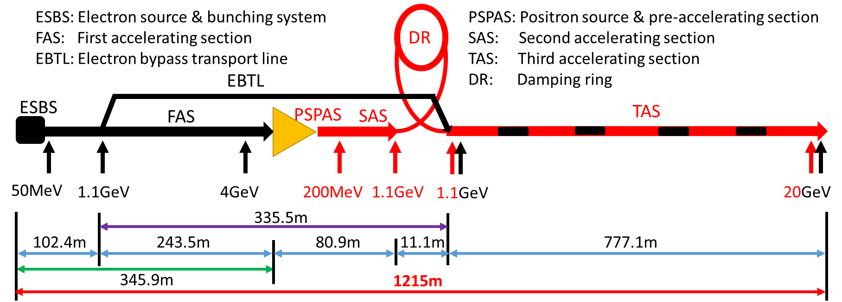
CEPC linac
Length: 1215m; 7 dumps and 1 collimator;
Dump1
Dump2
Dump3 + Collimator
Dump4
Dump5
Dump6 + dump7

Slide 27
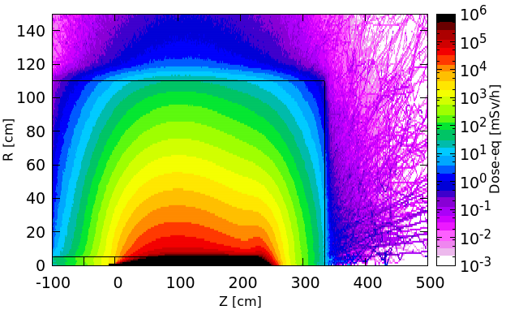
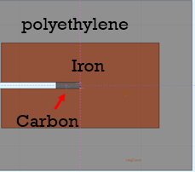
Local shield design for hot spots
Carbon and iron is selected as the absorber material, surrounded by the polyethylene as local shielding.
5.5mSv/h is set as upper limit to decide the thickness of local shielding.
The thickness of shielding will be optimized combined with Linac tunnel geometry in the next stage.
Beam energy | R/m | Length/m
60MeV | 0.7 | 1
4GeV | 1.2 | 2.6
250MeV | 0.55 | 1
1.1GeV | 0.85 | 1.7
6GeV | 1 | 2.5
20GeV | 1.2 | 3.8
Absorber geometry and local shielding:
Size for carbon and iron for different beam energy, adopt from other projects, is suitable but haven't been optimized.
Local size selection (20GeV dump as example):
2D map of dose distribution is obtained using FLUKA, the dose rate alone Z or R axis was averaged by 1x1cm^2 area, the shielding size can be selected by setting dose rate limit.
Preliminary design results for different beam energy analysis station:
Radiation level nearby each energy analysis station was figured out, also specify a roughly space for the future local shielding.

Slide 28

Linac beam losses assumptions
Angle of incidence 10mrad
Not consider EBTL & DR beam losses.
Position | Length | Beam energy | Number of bunches [s⁻¹] | Beam loss/bunch [nC] | Number of particles [$10^{10}$/s]
FAS | 100m | 300MeV | 200 | 0.5 | 62.5
Positron target | 15mm | 4GeV |  | 10 | 1250
PSPAS | 15m | 5~200MeV |  | 10 | 1250
SAS | 3m | 300MeV |  | 2 | 250
 | 30m | 600MeV |  | 0.2 | 25
TAS | 700m | 1.1~20GeV |  | 0.1 | 12.5

Slide 29




Simulation setup
Beam pipes and concrete wall
Top/side view
Dose-eq distribution
example: TAS
Thickness of Shielding wall according to upper limit 5.5mSv(left/right/bottom) /2.5uSv(top).
Wall thickness | FAS | SAS | TAS
Left | 0.3m | 1.9m | 0.3m
Right | 0.2m | 1.9m | 0.3m
Bottom | 0.3m | 2.1m | 0.3m
Top | 1.3m | 4.1m | 2m

Slide 30
Summary & outlook
Preliminary dump design for collider is done.
Lead shielding seems well. Further optimize SR shielding design
  Unequal dose distribution in the insulation.
  Precise simulation for booster.
Radionuclides productions are studied. If necessary, all operation mode can be simulated.
  Precise beam losses model is need.
The dimensions for Linac hot spots and walls are designed.
Go on:
  Reliability study for dump.
  Activation transport assessment.
  Shielding around experiment hall (around MDI).
  Machine protection: fault cases.
Thank you

Slide 31
backup

Slide 32


Max. temperature rise
Example: aluminum core
Max. temperature rise @Z mode can decrease by increasing the bunch distance on the dump surface.
Max. temperature rise @Z mode
 | Higgs | WW | Z | ttbar
Beam energy/GeV | 120 | 80 | 45.5 | 182.5
Ne/bunch/${10}^{10}$ | 14 | 13.5 | 14 | 20
Bunch number (50MW) | 415 | 2162 | 19918 | 58
Min. size (um^2) | 9261x56 | 9219x50 | 8538x49 | 9774x51
Max. temperature rise (50x28cm^2) |  | $$104±1℃$$ | $$314±2℃$$
Max. temperature rise by one bunch | $$9.68±0.03℃$$ | $$6.69±0.03℃$$ | $$4.62±0.02℃$$ | $$13.53±0.03℃$$

Slide 33


Max. temperature rise
Example: graphite core
Max. temperature rise @Z mode can decrease by increasing the bunch distance on the dump surface.
Max. temperature rise @Z mode
 |  | Higgs | WW | Z | ttbar
Beam energy/GeV |  | 120 | 80 | 45.5 | 182.5
Ne/bunch/${10}^{10}$ |  | 14 | 13.5 | 14 | 20
Bunch number (50MW) |  | 415 | 2162 | 19918 | 58
Min. size of bunch (um^2) |  | 9261x56 | 9219x50 | 8538x49 | 9774x51
Max. temperature rise | 50x28cm^2 |  |  | $$260±2℃$$
 | 6x6cm^2 |  |  | $$2620±15℃$$
Maximum temperature rise by one bunch |  | $$7.31±0.03℃$$ | $$5.38±0.03℃$$ | $$3.76±0.02℃$$ | $$10.08±0.04℃$$

Slide 34

Parameter
Collider
Booster
Ramping simulation
 |  | Higgs | WW | Z | ttbar
Beam energy/GeV |  | 120 | 80 | 45.5 | 182.5
Ne/bunch/${10}^{10}$ |  | 14 | 13.5 | 14 | 20
Number of bunches | 30MW | 249 | 1297 | 11951 | 35
 | 50MW | 415 | 2162 | 19918 | 58
Number of photons/114m | 30MW | 2.8e18 | 9.2e18 | 5.0e19 | 8.4e17
 | 50MW | 4.6e18 | 1.5e19 | 8.4e19 | 1.4e18
Life time | 30MW | 0.33 | 0.91 | 1.33 | 0.30
 | 50MW
Beam losses/114m | 30MW
 | 50MW | 5.5e7 | 1.0e8 | 6.7e8 | 1.2e7
 | Higgs On | WW | Z | ttbar
Current(mA) | 1 | 2.69 | 14.4 | 0.12
Injection duration(s) | 32.8 | 39.3 | 134.7 | 30
Injection interval(s) | 38 | 155 | 153.5 | 65

Slide 35

hot spots inside Linac
Radiation hot spots, such as beam energy analysis stations, collimators, positron targets, dumps, should be shielded in order to protect equipment and people and minimize the thickness of the wall of Linac tunnel.
  Two kinds of prompt radiation inside Linac tunnel: radiation from hot spots and from beam loss
  Many hot spots inside Linac are used for beam energy analysis in different locations.
For 20GeV linac, there are more hot spots and will be updated soon.
No. | Purpose of dumps | Beam energy | Bunch size/mm | Frequency/Hz | Charge/nC | Bunch populartion/$10^{10}$
1 | Beam Energy Analysis | 60MeV | 2/1 | 1 | 10 | 6.3
2 | Beam Energy Analysis | 1.2GeV | 0.5/0.5 | 1 | 10 | 6.3
3 | Beam Energy Analysis | 250MeV | 1.5/1.5 | 1 | 5 | 3.2
4 | Positron target position | 4GeV | - | - | - | 6.0
5 | Dump for Linac beam | 11GeV | 0.5/0.5 | 1 | 3 | 1.9

Slide 36



Local shield design for hot spots
Carbon and iron is selected as the absorber material, surrounded by the concrete as local shielding.
5.5mSv/h dose-equivalent is set as upper limit to decide the thickness of local shielding .
The thickness of shielding will be optimized so that the dose-eq out of dumps is in the same order of dose-eq by beam loss.
Beam energy | Trans. Area /$m^{2}$ | Length/m
60MeV | 0.75*0.75 | 1.36
1.2GeV | 1.56*1.56 | 3.05
250MeV | 0.98*0.98 | 1.56
11GeV | 2.10*2.10 | 3.36
Absorber geometry and local shielding:
Size for carbon and iron for different beam energy, adopt from other projects, is suitable but haven't been optimized.
Local size selection (11GeV dump as example):
2D map of dose distribution was simulated by FLUKA, the dose rate alone Z or X axis was averaged by 10*10cm^2 area, the shielding size can be selected by the setting dose rate limit.
Preliminary design results for different beam energy analysis station:
Radiation level nearby each energy analysis station was figured out, also specify a roughly space for the future local shielding.

Slide 37

 | No. | Purpose of dumps | Beam energy | Bunch size/mm | Frequency/Hz | Charge/nC | Bunch populartion/$10^{10}$
10GeV | 1 | Beam Energy Analysis | 60MeV | 2/1 | 1 | 10 | 6.3
 | 2 | Beam Energy Analysis | 1.2GeV | 0.5/0.5 | 1 | 10 | 6.3
 | 3 | Beam Energy Analysis | 250MeV | 1.5/1.5 | 1 | 5 | 3.2
 | 4 | Positron target position | 200MeV | 1.5/1.5 | 100 | - | 6.0
 | 5 | Beam Energy Analysis | 1.2GeV | 0.5/0.5 | 1 | 3
 | 6 | Beam Energy Analysis | 11GeV | 0.5/0.5 | 1 | 3
 | 7 | Dump for Linac beam | 11GeV | 0.5/0.5 | 1 | 3 | 1.9
20GeV | 1 |  | 60MeV | 2/1 | 1 | 10 | 6.3
 | 2 |  | 4GeV | 0.5/0.5 | 1 | 10 | 6.3
 | 3 |  | 250MeV | 1.5/1.5 | 1 | 5 | 3.2
 | 4 |  | 1.1 | 0.5/0.5 | 1 | 5
 | 5 |  | 6 | 0.5/0.3 | 1 | 3
 | 6 |  | 20GeV | 0.3/0.3 | 1 | 3
 | 7 |  | 20GeV | 0.3/0.3 | 1 | 3 | 1.9
 | 8 |  | 250MeV | 1.5/1.5 | 100 | 5

Slide 38


 | No. | Purpose of dumps | Beam energy | Bunch size/mm | Frequency/Hz | bunch charge/nC | Number of particles [$10^{10}$/s] | Total energy[W] | CSDA range[g/cm^2]
TDR 20GeV | 1 |  | 60MeV | 2/1 | 2 | 10 | 12.5 | 1.2 | 26
 | 2 |  | 4GeV | 0.5/0.5 | 2 | 10 | 12.5 | 80 | 214
 | 3 |  | 250MeV | 1.5/1.5 | 2 | 5 | 6.3 | 2.5 | 64.7
 | 4 |  | 1.1GeV | 0.5/0.5 | 2 | 5 | 6.3 | 11 | 128
 | 5 |  | 6GeV | 0.5/0.3 | 2 | 3 | 3.7 | 36 | 248
 | 6 |  | 20GeV | 0.3/0.3 | 2 | 3 | 3.7 | 120 | 383
 | 7 |  | 20GeV | 0.3/0.3 | 2 | 3 | 3.7 | 120 | 383
 | 8 |  | 250MeV | 1.5/1.5 | 200 | 5（暂定） | 624 | 250 | 64.7
 | Beam energy | R/m | Length/m
1 | 60MeV | 0.7 | 1
2 | 4GeV | 1.2 | 2.6
3 | 250MeV | 0.55 | 1
4 | 1.1GeV | 0.85 | 1.7
5 | 6GeV | 1 | 2.5
6/7 | 20GeV | 1.2 | 3.8
8 | 250MeV | 1.3 | 1.8

Slide 39
直线dump和线损屏蔽
Dump 尺寸估计
线损屏蔽墙厚度估计

Slide 40

dump点损参数
 | No. | Purpose of dumps | Beam energy | Bunch size/mm | Frequency/Hz | bunch charge/nC | Number of particles [$10^{10}$/s] | Total energy[W]
TDR 20GeV | 1 |  | 60MeV | 2/1 | 2 | 10 | 12.5 | 1.2
 | 2 |  | 4GeV | 0.5/0.5 | 2 | 10 | 12.5 | 80
 | 3 |  | 250MeV | 1.5/1.5 | 2 | 5 | 6.3 | 2.5
 | 4 |  | 1.1GeV | 0.5/0.5 | 2 | 5 | 6.3 | 11
 | 5 |  | 6GeV | 0.5/0.3 | 2 | 3 | 3.7 | 36
 | 6 |  | 20GeV | 0.3/0.3 | 2 | 3 | 3.7 | 120
 | 7 |  | 20GeV | 0.3/0.3 | 2 | 3 | 3.7 | 120
 | 8 |  | 250MeV | 1.5/1.5 | 200 | 5（暂定） | 624 | 250

Slide 41

直线dump结构
参考HEPS直线dump，采用三层圆柱（筒）结构
  中心圆柱：碳（石墨）；半径5cm，长度15cm~225cm。
  中层圆桶：铁；内径5cm，外径60cm~1.1m，长度80cm~3.7m。
  外层圆桶：聚乙烯；厚10cm~20cm。
为了抑制背散射剂量，铁圆桶和聚乙烯圆桶左端面相比碳靶左端面，向左侧超出若干距离，此距离未优化。
即图中碳圆柱左端面Z坐标为0，铁和聚乙烯左端面坐标为负值。
各dump半径和长度；长度从碳靶左端面（左图坐标原点，Z=0处）算起。
 | Beam energy | R/m | Length/m
1 | 60MeV | 0.7 | 1
2 | 4GeV | 1.2 | 2.6
3 | 250MeV | 0.55 | 1
4 | 1.1GeV | 0.85 | 1.7
5 | 6GeV | 1 | 2.5
6/7 | 20GeV | 1.2 | 3.8
8 | 250MeV | 1.3 | 1.8

Slide 42
CEPC linac
Length: 1215m; 6 dumps and 1 collimator;
Dump1
Dump2
Dump3 + Collimator
Dump4
Dump5
Dump6

Slide 43
Linac beam losses assumptions
Angle of incidence 10mrad
Not consider EBTL & DR beam losses.
Position | Length | Beam energy | Number of bunches [s⁻¹] | Beam loss/bunch [nC] | Number of particles [$10^{10}$/s]
FAS | 100m | 300MeV | 200 | 0.5 | 62.5
Positron target | 15mm | 4GeV |  | 10 | 1250
PSPAS | 15m | 5~200MeV |  | 10 | 1250
SAS | 3m | 300MeV |  | 2 | 250
 | 30m | 600MeV |  | 0.2 | 25
TAS | 700m | 1.1~20GeV |  | 0.1 | 12.5

Slide 44

Simulation setup
有、无bypass部分的右视图
俯视图
  隧道内只有束流管和部分bypass束流管
  混凝土墙
  长度参照前页直线示意图

Slide 45


Dose-eq: FAS
束流管所在水平面内剂量当量约1~100Sv/h
以5.5mSv限值（土壤中）估计，左/右/下侧混凝土墙厚度约30cm/20cm/30cm。
以2.5uSv限值（空气中）估计，顶部混凝土厚度1.3m。

Slide 46
Dose-eq: PSPAS ~ SAS
束流管所在水平面内剂量当量约10~1000Sv/h
以5.5mSv限值（土壤中）估计，左/右/下侧混凝土墙厚度约1.9m/1.9m/2.1m。
以2.5uSv限值（空气中）估计，顶部混凝土厚度4.1m。

Slide 47


Dose-eq: tAS
束流管所在水平面内剂量当量约2~100Sv/h
以5.5mSv限值（土壤中）估计，左/右/下侧混凝土墙厚度约30cm/30cm/30cm。
以2.5uSv限值（空气中）估计，顶部混凝土厚度2m。

Slide 48





Dose-eq in Linac tunnel
Dose-eq inside Linac tunnel is important to determine the local shielding thickness.
Assume that leptons will be lost alone the beam-pipe. About 10% leptons with energy 10GeV is lost alone the beamline.
Dose-eq: total, gamma, neutron
Linac parameters
Linac simulation setup

Slide 49



vacuum chamber: FCC-ee, two schemes
Absorbers (ABS)
Continuous shielding
CuCrZr alloy
Length: 30cm
5-6m distance
Angled surfaces for even power
Water cooled
25 ABS in each beam (MBs, MQs)
    (Design and initial placement by R. Kersevan)
Barbara Humann, FCC week 2021 talk
Equivalent to LEP layout
Continuous shielding around VC in MBs
  Due to space restrictions from yoke and coils respectively, no shielding in MQs and MSs.
Intermet180 (Tungsten alloy)
Shielding thickness:
  Top/bottom: 1cm
  Sides: 1.3cm

Slide 50
deposited Energy
The energy deposited in air and wall is less than 5%.
Energy deposited in dipole and beam-pipe is quite large.
2cm-lead shielding
 | Z | WW | Higgs | ttbar
Beam pipe (Al) | 50.0% | 45.9% | 38.5% | 36.0%
Beam pipe (Cu) | 46.7% | 27.4% | 23.0% | 26.8%
Lead | 1.1% | 9.6% | 14.9% | 14.5%
Iron of dipole | 1.9% | 14.5% | 18.7% | 16.4%
Iron of quadrupole | 0.1% | 0.9% | 1.4% | 1.4%
Iron of sextupole | 0.1% | 0.6% | 0.9% | 0.8%
Air | 0.0005% | 0.01% | 0.03% | 0.04%
Wall | 0.0004% | 0.03% | 1.8% | 3.1%

Slide 51

CEPC parameters
 | Higgs | WW | Z | Z (high lum.) | ttbar
Beam energy (GeV) | 120 | 80 | 45.5 |  | 182.5
SR loss/turn (GeV) | 1.73 | 0.34 | 0.036 |  | 9.15
Particles/bunch (${10}^{10}$) | 15 | 12 | 8 | 15 | 20
Bunch number | 242 | 1524 | 12000 | 15000 | 35
Beam current (mA) | 17.4 | 87.9 | 461.0 | 1081.4 | 3.36
SR power/beam (MW) | 30 | 30 | 16.5 | 38 | 30
Bending radius (km) | 10.72
Critical energy(keV) | 358 | 106 | 19 |  | 1258
Ave. energy/photon (keV) | 110.1 | 32.6 | 6.0 |  | 387.3
Photons/57.2m dipole | $$1.44×{10}^{18}$$ | $$4.83×{10}^{18}$$ | $$1.44×{10}^{19}$$ | $$3.38×{10}^{19}$$ | $$4.2×{10}^{17}$$

Slide 52


Hot points (2cm lead)
Quadrupole XY plane
Quadrupole : YZ plane
Dose hot points caused by particles bypassing
lead shielding.
2D dose distribution on the surface of insulator

Slide 53




Hot points (2cm lead)
Sextupole XY plane
Sextupole : YZ plane
Dose hot points caused by particles bypassing
lead shielding.
2D dose distribution on the surface of insulator

Slide 54







Slide 55


Dose around insulators
Lead thickness: 1.5cm
Dipole:
Quadrupole:
 | Dose(Gy/Ah)
 | Z | WW | Higgs | ttbar
Al | $$0±0$$ | $$257±4$$ | $$10673±46$$ | $$\left(2.23±0.01\right)×{10}^{5}$$
Cu | $$0.42±0.32$$ | $$201±4$$ | $$10151±47$$ | $$\left(2.30±0.01\right)×{10}^{5}$$
 | Dose(Gy/Ah)
 | Z | WW | Higgs | ttbar
Top right | $$0±0$$ | $$221±4$$ | $$9367±99$$ | $$\left(1.41±0.02\right)×{10}^{5}$$
Bottom right | $$0±0$$ | $$216±4$$ | $$9249±97$$ | $$\left(1.31±0.02\right)×{10}^{5}$$
Top left | $$0±0$$ | $$121±2$$ | $$6070±58$$ | $$\left(9.94±0.10\right)×{10}^{4}$$
Bottom left | $$0.11±0.04$$ | $$117±2$$ | $$5924±54$$ | $$\left(9.56±0.09\right)×{10}^{4}$$

Slide 56



Dose around insulators
Lead thickness: 1.5cm
Sextupole:
Running
schedule
Dose:
  10y H/Z/WW
  One year
  running ttbar
 | Dose(Gy/Ah)
 | Z | WW | Higgs | ttbar
Left | $$0±0$$ | $$651±17$$ | $$\left(3.19±0.05\right)×{10}^{4}$$ | $$\left(4.93±0.08\right)×{10}^{5}$$
right | $$0±0$$ | $$325±8$$ | $$\left(1.80±0.03\right)×{10}^{4}$$ | $$\left(2.95±0.05\right)×{10}^{5}$$
 | Higgs | Z | WW
Running time (yr) | 7 | 2 | 1
 | Dipole | Quadrupole | Sextupole
Dose(${10}^{6}$Gy) | $$11.33±0.05$$ | $$9.94±0.11$$ | $$33.76±0.6$$
 | Dipole | Quadrupole | Sextupole
Dose(${10}^{6}$Gy) | $$8.06±0.04$$ | $$4.94±0.07$$ | $$17.3±0.3$$

Slide 57


Dose around insulators
Lead thickness: 2.5cm
Dipole:
Quadrupole:
 | Dose(Gy/Ah)
 | Z | WW | Higgs | ttbar
Al | $$0±0$$ | $$12±1$$ | $$3421±23$$ | $$\left(9.26±0.06\right)×{10}^{4}$$
Cu | $$5±2$$ | $$0±0$$ | $$2914±22$$ | $$\left(8.36±0.06\right)×{10}^{4}$$
 | Dose(Gy/Ah)
 | Z | WW | Higgs | ttbar
Top right | $$0±0$$ | $$99±2$$ | $$4806±48$$ | $$\left(6.66±0.08\right)×{10}^{4}$$
Bottom right | $$0±0$$ | $$126±2$$ | $$5166±55$$ | $$\left(6.64±0.08\right)×{10}^{4}$$
Top left | $$0±0$$ | $$50±1$$ | $$2795±27$$ | $$\left(4.48±0.04\right)×{10}^{4}$$
Bottom left | $$0.29±0.07$$ | $$67±1$$ | $$3029±30$$ | $$\left(4.67±0.04\right)×{10}^{4}$$

Slide 58



Dose around insulators
Lead thickness: 2.5cm
Sextupole:
Running
schedule
Dose:
  10y H/Z/WW
  One year
  running ttbar
 | Dose(Gy/Ah)
 | Z | WW | Higgs | ttbar
Left | $$0±0$$ | $$243±9$$ | $$\left(1.13±0.02\right)×{10}^{4}$$ | $$\left(1.69±0.03\right)×{10}^{5}$$
right | $$0±0$$ | $$114±6$$ | $$\left(6.65±0.11\right)×{10}^{3}$$ | $$\left(1.09±0.02\right)×{10}^{5}$$
 | Higgs | Z | WW
Running time (yr) | 7 | 2 | 1
 | Dipole | Quadrupole | Sextupole
Dose(${10}^{6}$Gy) | $$3.62±0.03$$ | $$5.49±0.06$$ | $$12.0±0.2$$
 | Dipole | Quadrupole | Sextupole
Dose(${10}^{6}$Gy) | $$3.24±0.02$$ | $$2.33±0.03$$ | $$5.9±0.1$$

Slide 59

Temperature rise
Simulate only one bunch whose width is minimum
 |  | ttbar | Higgs | WW | Z(2T high lumi.)
Beam energy/GeV |  | 175 | 120 | 80 | 45.5
Ne/(bunch$∙{10}^{10}$) |  | 24 | 17 | 12 | 15
Bunch number |  | 34 | 218 | 1569 | 15000
Total energy/MJ |  | 0.2 | 0.7 | 2.4 | 16.4
Maximum temperature rise | Fluka | $$229±3℃$$ | $$138±4℃$$ | $$103±1℃$$ | $$714±12℃$$
 | One bunch | $$227.7±0.5℃$$ | $$140.8±0.3℃$$ | $$78.5±0.3℃$$ | $$88±29℃$$

Slide 60


dose Around insulators
In the arc section of the ring, the most important two radiation sources are from synchrotron radiation and random beam loss.
Around coils, dose caused by SR is more serious than by beam loss.
Prompt radiation dose caused by random beam loss
Prompt radiation dose caused by synchrotron radiation

Slide 61

Number of Beam losses & SR
Beam losses & SR photon of energy >6MeV
FLUKA options
Wall material:
  Case1: water as wall
  Case2: rock as wall
 |  | Higgs | WW | Z | ttbar
Beam energy/GeV |  | 120 | 80 | 45.5 | 182.5
Ne/bunch/${10}^{10}$ |  | 14 | 13.5 | 14 | 20
Number of bunches | 30MW | 249 | 1297 | 11951 | 35
 | 50MW | 415 | 2162 | 19918 | 58
Number of SR photons >6MeV | 30MW | 8e9 | 6e-8 | negligible | 8e14
 | 50MW | 1.4e10 | 1e-7 |  | 1.3e15
Life time | 30MW | 0.33 | 0.91 | 1.33 | 0.30
 | 50MW
Beam losses/114m | 30MW
 | 50MW | 5.5e7 | 1.0e8 | 6.7e8 | 1.2e7

Slide 62
Soil/rock
 |  | Soil 1 | Soil 2 | average components of 花岗岩、片麻岩、黄土、砂岩 | 长沙黑麋峰
density |  | 1.6g/cm^3 | 2.2g/cm^3 | 1.2~3.3g/cm^3 | ~2.9g/cm^3
Major element (wt%) | C | 1.0 | 5.1 | --- | ---
 | N | 0.12 | --- | --- | ---
 | O | 34 | 64 | 30~70 | 48.3
 | Na | 0.50 | 0.34 | 0.1~2.9 | 2.4
 | Mg | 0.52 | 3.8 | 0.4~3.7 | 0.2
 | Al | 8.0 | 2.4 | 3.5~9.7 | 7.8
 | Si | 40 | 14.5 | 26~39 | 34
 | P | --- | --- | 0.02~0.16 | 0.06
 | K | 2.36 | 0.81 | 1.8~3.7 | 4.2
 | Ca | 2.26 | 7.0 | 0.2~4.8 | 1.0
 | Ti | 1.0 | --- | 0.09~0.8 | 0.11
 | Mn | 0.24 | --- | 0.02~0.12 | 0.02
 | Fe | 9.6 | 1.1 | 0.8~6.3 | 1.1

Slide 63

Number of Beam losses & SR
Beam losses & SR photon of energy >6MeV
FLUKA options
Wall material:
  Case1: water as wall
  Case2: rock as wall
One year running
 |  | Higgs | WW | Z | ttbar
Beam energy/GeV |  | 120 | 80 | 45.5 | 182.5
Ne/bunch/${10}^{10}$ |  | 14 | 13.5 | 14 | 20
Number of bunches | 50MW | 415 | 2162 | 19918 | 58
Number of SR photons >6MeV | 50MW | 1.4e10 | 1e-7 | negligible | 1.3e15
Life time | 30MW | 0.33 | 0.91 | 1.33 | 0.30
 | 50MW
Beam losses/114m | 50MW | 5.5e7 | 1.0e8 | 6.7e8 | 1.2e7

Slide 64
Soil/rock
 |  | Soil | average components of 花岗岩、片麻岩、黄土、砂岩 | 长沙黑麋峰
density |  | 1.6g/cm^3 | 1.2~3.3g/cm^3 | ~2.9g/cm^3
Major element (wt%) | C | 1.0 | --- | ---
 | N | 0.12 | --- | ---
 | O | 34 | 30~70 | 48.3
 | Na | 0.50 | 0.1~2.9 | 2.4
 | Mg | 0.52 | 0.4~3.7 | 0.2
 | Al | 8.0 | 3.5~9.7 | 7.8
 | Si | 40 | 26~39 | 34
 | P | --- | 0.02~0.16 | 0.06
 | K | 2.36 | 1.8~3.7 | 4.2
 | Ca | 2.26 | 0.2~4.8 | 1.0
 | Ti | 1.0 | 0.09~0.8 | 0.11
 | Mn | 0.24 | 0.02~0.12 | 0.02
 | Fe | 9.6 | 0.8~6.3 | 1.1
In previous study, use soil as tunnel wall.
Now use average components of different kinds of rock.
Simulate residual nuclei in:
  Cooling water
  Air in tunnel
  Water outside tunnel
  Rock

Slide 65
Cooling water
 |  | Half-life | Case 1 |  |  | Case 2
 |  |  | Specific activity/GB18871 | Activity/GB18871 | Stat. error (%) | Specific activity/GB18871 | Activity/GB18871 | Stat. error (%)
Beam losses @Z-pole | O15 | 122s | 2.44 | 2.76 | 10 | 2.37 | 2.67 | 3
 | C14 | 5700a | 3.5e-7 | 3.9e-3 | 23 | 3.4e-7 | 3.9e-3 | 9
 | Be7 | 53d | 1.3e-2 | 15.2 | 34 | 1.3e-2 | 14.4 | 12
 | H3 | 12a | 2.3e-6 | 2.6e-2 | 22 | 2.8e-6 | 3.2e-2 | 7
SR @ttbar | None

Slide 66
Air in tunnel
 |  | Half-life | Case 1 |  |  | Case 2
 |  |  | Specific activity/GB18871 | Activity/GB18871 | Stat. error (%) | Specific activity/GB18871 | Activity/GB18871 | Stat. error (%)
Beam losses @Z-pole | O15 | 122s | 2.7e-4 | 0.13 | 52 | 3.2e-4 | 0.15 | 17
 | C14 | 5700a | 7.7e-7 | 3.6 | 1 | 3.2e-7 | 1.5 | 0.5
 | Be7 | 53d | 1.1e-5 | 5.4 | 57 | 1.0e-5 | 4.8 | 27
 | H3 | 12a | 3.5e-9 | 1.7e-2 | 32 | 3.9e-9 | 1.8e-2 | 10
 | P32 | 14d | --- | --- | --- | 1.9e-7 | 9.0 | 100
 | P33 | 25d | 1.9e-8 | 9.0e-2 | 100 | 3.8e-9 | 1.8e-2 | 100
 | Cl36 | 3e5a | --- | --- | --- | 1.6e-14 | 7.7e-7 | 100
 | Cl38 | 37m | --- | --- | --- | 7.e-5 | 3.6 | 61
 | Ar37 | 35d | 6.1e-9 | 0.29 | 59 | 1.4e-9 | 6.5e-2 | 38
 | Ar41 | 2h | 1.4e-3 | 0.65 | 12 | 5.4e-4 | 0.26 | 6
SR @ttbar | C14 | 5700a | 6.5e-6 | 31 | 2 | 2.5e-6 | 11.7 | 3
 | Ar41 | 2h | 1.5e-2 | 7.2 | 20 | 3.3e-3 | 1.6 | 29
Activation by beam losses

Slide 67
Water outside tunnel
 |  | Half-life | Water in wall
 |  |  | Specific activity/GB18871 | Activity/GB18871 | Stat. error (%)
Beam losses @Z-pole | O15 | 122s | 2e-3 | 39 | 2
 | C14 | 5700a | 5e-10 | 8e-3 | 4
 | Be7 | 53d | 3e-5 | 477 | 5
 | H3 | 12a | 6e-9 | 1 | 3
 | F18 | 2h | 5e-6 | 9 | 52
SR @ttbar | C14 | 5700a | 2e-12 | 3e-4 | 99
 | H3 | 12a | 1e-10 | 2e-2 | 71

Slide 68
rock around tunnel
 |  | Half-life | Rock
 |  |  | Specific activity/GB18871 | Activity/GB18871 | Stat. error (%)
Beam losses @Z-pole | Co60 | 5.3a | 8.92E-12 | 1.71E-04 | 99
 | Fe59 | 44d | 1.62E-03 | 3.11E+03 | 0.586
 | Ni59 | 7.6e4a | 2.08E-17 | 3.99E-10 | 72.617
 | Co58 | 71d | 7.13E-07 | 1.37E+00 | 70.563
 | Co57 | 272d | 1.09E-07 | 2.09E+00 | 47.979
 | Mn56 | 2.6h | 1.03E-01 | 1.98E+06 | 0.184
 | Co56 | 77d | 8.54E-06 | 1.64E+02 | 22.207
 | Fe55 | 3a | 1.24E-05 | 2.37E+04 | 0.166
 | Co55 | 18h | 1.70E-06 | 3.25E+00 | 50.501
 | Mn54 | 312d | 6.94E-04 | 1.33E+03 | 1.793
 | Mn53 | 3.8e6a | 1.98E-13 | 3.79E-07 | 2.116
 | Mn52 | 5.6d | 2.02E-04 | 3.87E+03 | 4.816
 | Fe52 | 8.3h | 7.45E-06 | 1.43E+01 | 23.642

Slide 69
rock around tunnel
 |  | Half-life | Case 1
 |  |  | Specific activity/GB18871 | Activity/GB18871 | Stat. error (%)
Beam losses @Z-pole | Cr51 | 28d | 3.58E-06 | 6.86E+01 | 3.519
 | Mn51 | 46.2m | 3.46E-05 | 6.63E+02 | 11.289
 | Sc48 | 1.8d | 3.07E-05 | 5.88E+02 | 11.042
 | V48 | 16d | 8.87E-05 | 1.70E+03 | 7.25
 | Ca47 | 4.5d | 1.95E-05 | 3.74E+01 | 10.514
 | Sc47 | 3.3d | 1.41E-05 | 2.70E+02 | 5.303
 | Sc46 | 84d | 1.67E-04 | 3.20E+02 | 5.993
 | Ca45 | 163d | 5.49E-06 | 1.05E+03 | 0.279
 | K43 | 22h | 1.66E-05 | 3.18E+01 | 16.576
 | K42 | 12h | 4.55E-03 | 8.71E+04 | 0.201
 | Ar41 | 1.8h | 2.26E-06 | 4.33E-02 | 10.589
 | K40 | 1.2d9a | 4.66E-11 | 8.94E-04 | 0.108
 | Cl38 | 37m | 3.64E-05 | 6.97E+01 | 12.14

Slide 70
rock around tunnel
 |  | Half-life | Case 1
 |  |  | Specific activity/GB18871 | Activity/GB18871 | Stat. error (%)
Beam losses @Z-pole | Ar37 | 35d | 4.45E-08 | 8.52E+01 | 0.697
 | Cl36 | 3e5a | 1.45E-11 | 2.77E-02 | 0.563
 | S35 | 87d | 9.35E-09 | 1.79E+00 | 6.826
 | P33 | 25d | 5.57E-09 | 1.07E+00 | 8.923
 | P32 | 14d | 1.44E-06 | 2.76E+03 | 5.557
 | Si31 | 2.6h | 6.82E-04 | 1.31E+05 | 0.123
 | Na24 | 15h | 3.26E-01 | 6.24E+06 | 0.113
 | Na22 | 2.6y | 7.20E-04 | 1.38E+03 | 1.322
 | F18 | 1.8h | 7.62E-04 | 1.46E+03 | 2.468
 | O15 | 122s | 1.34E-03 | 2.58E+01 | 0.694
 | C14 | 5700y | 3.47E-10 | 6.65E-02 | 1.337
 | Be7 | 53d | 2.09E-05 | 4.00E+02 | 1.632
 | H3 | 12a | 5.90E-09 | 1.13E+00 | 0.884

Slide 71
rock around tunnel
 |  | Half-life | Case 1
 |  |  | Specific activity/GB18871 | Activity/GB18871 | Stat. error (%)
SR @ttbar | C14 | 5700a | 1.5e-12 | 2.9e-4 | 99
 | H3 | 12a | 9.5e-11 | 1.8e-2 | 71

Slide 72
Leachable radionuclides
H3, Na22, Ca45, Mn54, Cs134

Slide 73
Production of toxic gases
Deposited energy by photons
Saturated concentrations of ozone and oxides of nitrogen. [Hoefert, 1986]
  smaller than limit values
 | Case 1 | Case 2
Beam losses | 2.1e13eV | 6.0e12eV
SR | 6.4e15eV | 1.6e15eV
 |  | O3 | NOx | HNO3
Number | Case 1 | 3.3e17 | 1.6e17 | 5.0e16
 | Case 2 | 9.3e16 | 4.5e16 | 1.4e16
Density (g/m^3) | Case 1 | 1.8e-10 | 8.6e-11 | 2.7e-11
 | Case 2 | 5.1e-11 | 2.4e-11 | 8.6e-12

