Slide 1

Collective instability and countermeasures to collider, booster and damping ring
Na Wang, Yudong Liu, Yuan Zhang, Haisheng Xu, ChunTao Lin, Saike Tian
IARC meeting, June 8th, 2022, IHEP

Slide 2
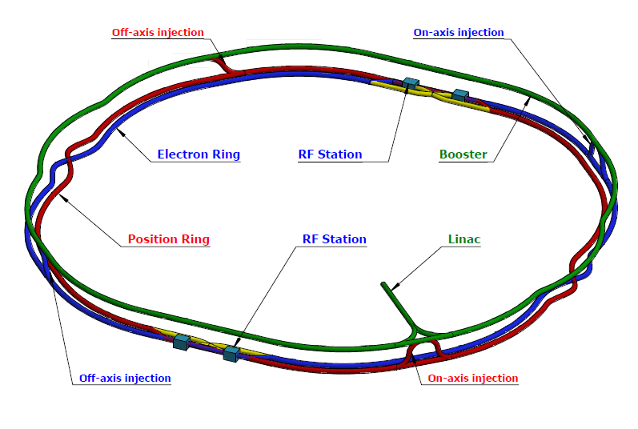
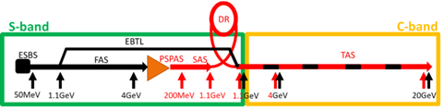
CEPC Layout
Booster
Circ: 100km
E_{k}: 20 → 180GeV
I₀: 16 → 0.1mA
N_{p}: 4.8 → 7.1×10⁹
Collider rings
Circ: 100km
E_{k}: 45 → 180GeV
I₀: 1339 → 5.5mA
N_{p}: 13 → 20×10¹⁰
Damping ring
Circ: 147m
E_{k}: 1.1GeV
I₀: 12.4 mA
N_{p}: 0.95×10¹⁰

Slide 3
Outline
Collider
  Influence of longitudinal impedance on luminosity degradation
  Simulations performed with both longitudinal and transverse impedance
  Cross-talk between impedance and beam-beam
  Coupled bunch instabilities
Booster
  Geometrical impedance and CSR impedance are included
  Instabilities updated considering different operation modes
Damping ring
  Geometrical impedance is included
  Single bunch instabilities updated

Slide 4
Collective instability in the collider

Slide 5
Main beam parameters
Parameter [unit] | Higgs | W | Z | tt-bar
Beam energy [GeV] | 120 | 80 | 45.5 | 180
L_{max}/IP (10³⁴cm⁻²s⁻¹) | 5 | 16 | 115 | 0.5
Emittance (H/V) [nm] | 0.64/0.0013 | 0.87/0.0017 | 0.27/0.0014 | 1.4/0.0047
Beam current [mA] | 16.7 | 84.1 | 803.5 | 3.3
Bunch number | 249 | 1297 | 11934 | 35
Bunch Population [10¹⁰] | 13 | 13.5 | 14 | 20
Momentum compaction [10⁻⁵] | 0.71 | 1.43 | 1.43 | 0.71
Natural bunch length σ_{z} (mm) | 2.3 | 2.5 | 2.5 | 2.2
Natural energy spread [10⁻⁴] | 10 | 7 | 4 | 15
Betatron tune ν_{x}/ν_{y} | 445.10/445.22 | 317.10/317.22 | 317.10/317.22 | 445.10/445.22
Synchrotron tune | 0.049 | 0.062 | 0.035 | 0.078
Radiation damping [ms] | 44/44/22 | 156/156/78 | 850/850/425 | 14/14/7

Slide 6
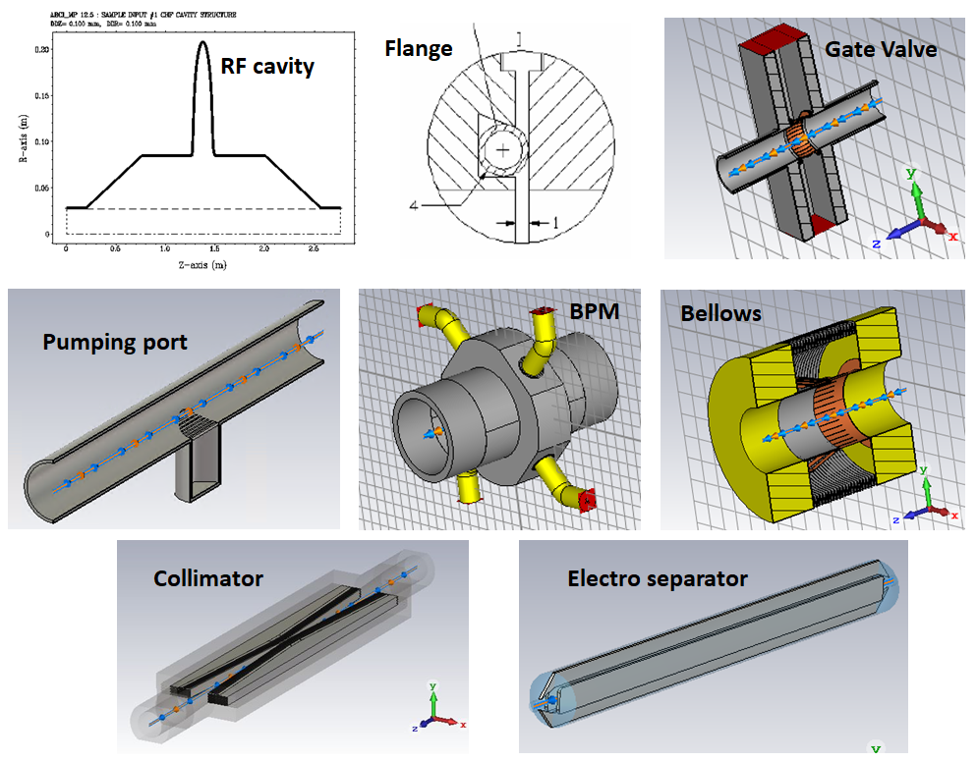
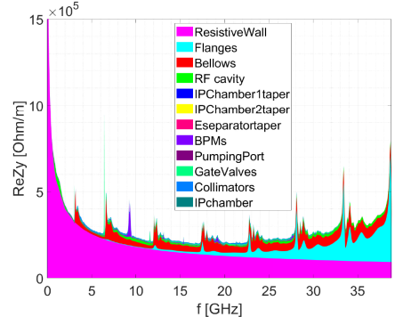
Impedance model
Impedance model is developed considering both RW and GEO impedances
Inj./ext. elements, feedback kickers, absorbers, masks and collimators outside the IR region are not included yet.

Slide 7
Impedance budget @σ_{z}=3mm
Components | Number | Z||/n, mΩ | k_{loss}, V/pC | k_{y}, kV/pC/m
Resistive wall | - | 6.2 | 363.7 | 11.3
RF cavities | 60 | 0.5 | 101.2 | 0.5
Flanges | 37714 | 5.2 | 37.3 | 5.2
BPMs | 1808 | 0.04 | 9.5 | 0.2
Bellows | 15949 | 2.9 | 87.4 | 3.9
Gate Valves | 500 | 0.2 | 14.5 | 0.4
Pumping ports | 5316 | 0.3 | 2.3 | 0.2
Collimators | 16 | 0.04 | 23.4 | 0.6
IP chambers | 2 | 0.004 | 0.3 | 0.05
Electro-separators | 20 | -0.1 | 34.5 | 0.1
Taper transitions | 48 | 0.04 | 2.5 | 0.09
Total |  | 15.3 | 676.6 | 22.5
CDR Total |  | 11.4 | 786.8 | 20.2
Longitudinal and transverse broadband impedances are dominated by the RW, flanges and bellows.
The loss factor is mainly contributed by the resistive wall, RF cavities and bellows.
Compare to the CDR budget, we have larger Z/n and k_{y}, but smaller k_{loss}.

Slide 8
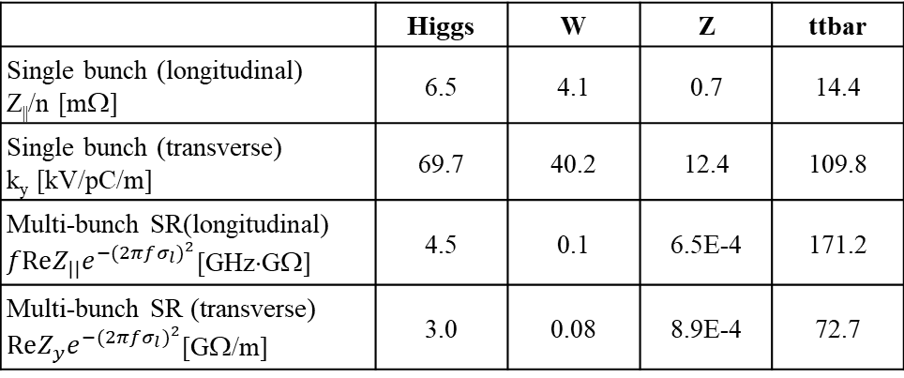
Rough instability estimations
Preliminary estimation of the instability threshold based on analytical criterions.
 | Higgs | W | Z | ttbar
Single bunch (longitudinal) Z||/n [mΩ] | 6.5 | 4.1 | 0.7 | 14.4
Single bunch (transverse) k_{y} [kV/pC/m] | 69.7 | 40.2 | 12.4 | 109.8
Multi-bunch SR(longitudinal) $fReZ_{||}e^{−{(2πfσ_{l})}^{2}}$[GHz⋅GΩ] | 4.5 | 0.1 | 6.5E-4 | 171.2
Multi-bunch SR (transverse) $ReZ_{y}e^{−{(2πfσ_{l})}^{2}}$[GΩ/m] | 3.0 | 0.08 | 8.9E-4 | 72.7
Impedance budget
Z||/n, mΩ | 15.3
k_{y}, kV/pC/m | 22.5

Slide 9
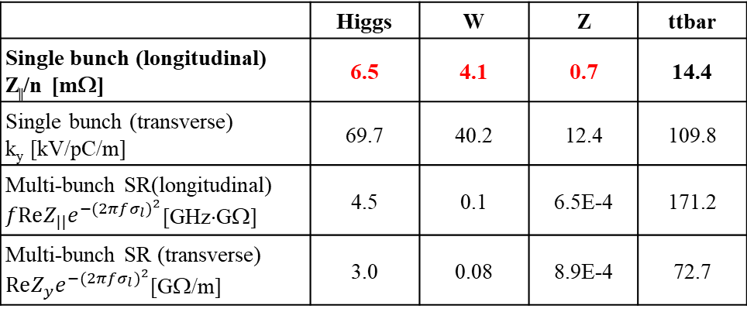
Rough instability estimations
Preliminary estimation of the instability threshold based on analytical criterions.
 | Higgs | W | Z | ttbar
Single bunch (longitudinal) Z||/n [mΩ] | 6.5 | 4.1 | 0.7 | 14.4
Single bunch (transverse) k_{y} [kV/pC/m] | 69.7 | 40.2 | 12.4 | 109.8
Multi-bunch SR(longitudinal) $fReZ_{||}e^{−{(2πfσ_{l})}^{2}}$[GHz⋅GΩ] | 4.5 | 0.1 | 6.5E-4 | 171.2
Multi-bunch SR (transverse) $ReZ_{y}e^{−{(2πfσ_{l})}^{2}}$[GΩ/m] | 3.0 | 0.08 | 8.9E-4 | 72.7
Impedance budget
Z||/n, mΩ | 15.3
k_{y}, kV/pC/m | 22.5
The longitudinal impedance above the threshold of Higgs, W, Z ⇒ bunch lengthening & energy spread increase ⇒ luminosity degradation
  The criterion usually underestimates the instability threshold in lepton machines.

Slide 10
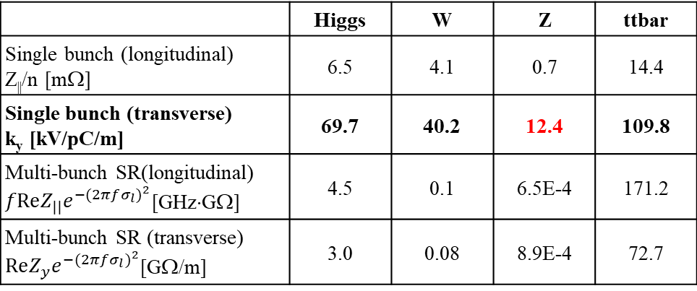
Rough instability estimations
Preliminary estimation of the instability threshold based on analytical criterions.
 | Higgs | W | Z | ttbar
Single bunch (longitudinal) Z||/n [mΩ] | 6.5 | 4.1 | 0.7 | 14.4
Single bunch (transverse) k_{y} [kV/pC/m] | 69.7 | 40.2 | 12.4 | 109.8
Multi-bunch SR(longitudinal) $fReZ_{||}e^{−{(2πfσ_{l})}^{2}}$[GHz⋅GΩ] | 4.5 | 0.1 | 6.5E-4 | 171.2
Multi-bunch SR (transverse) $ReZ_{y}e^{−{(2πfσ_{l})}^{2}}$[GΩ/m] | 3.0 | 0.08 | 8.9E-4 | 72.7
Impedance budget
Z||/n, mΩ | 15.3
k_{y}, kV/pC/m | 22.5
The transverse impedance above the threshold of Z ⇒ TMCI unstable

Slide 11
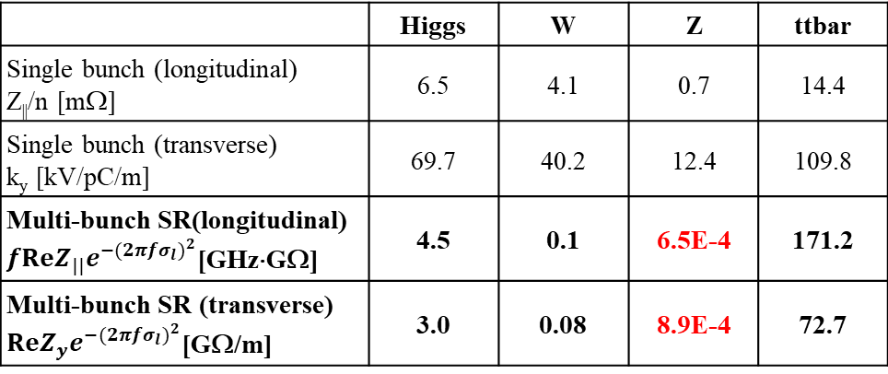
Rough instability estimations
Preliminary estimation of the instability threshold based on analytical criterions.
 | Higgs | W | Z | ttbar
Single bunch (longitudinal) Z||/n [mΩ] | 6.5 | 4.1 | 0.7 | 14.4
Single bunch (transverse) k_{y} [kV/pC/m] | 69.7 | 40.2 | 12.4 | 109.8
Multi-bunch SR(longitudinal) $fReZ_{||}e^{−{(2πfσ_{l})}^{2}}$[GHz⋅GΩ] | 4.5 | 0.1 | 6.5E-4 | 171.2
Multi-bunch SR (transverse) $ReZ_{y}e^{−{(2πfσ_{l})}^{2}}$[GΩ/m] | 3.0 | 0.08 | 8.9E-4 | 72.7
Impedance budget
Z||/n, mΩ | 15.3
k_{y}, kV/pC/m | 22.5
Tight narrowband impedance requirements for Z (at least ~two orders higher for the other energies) ⇒ HOMs needs to be well controlled to meet the requirements from Z

Slide 12
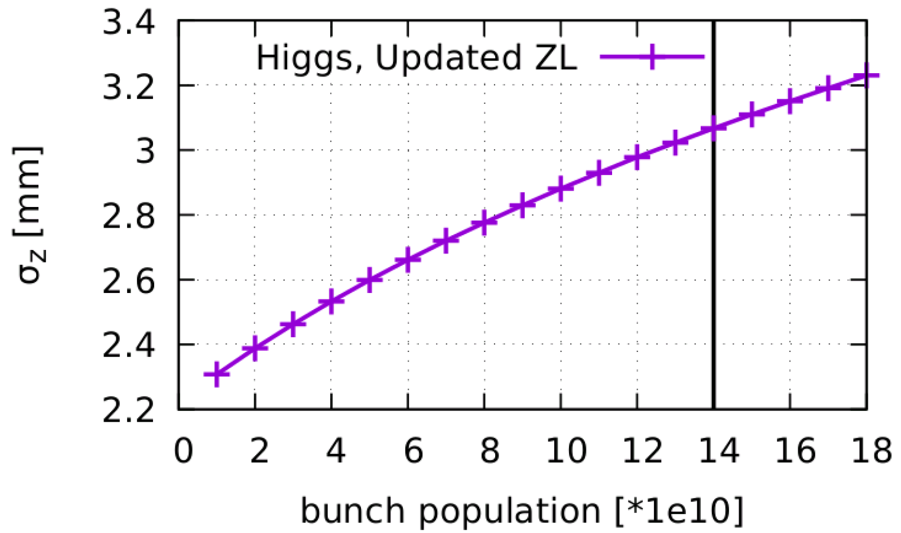
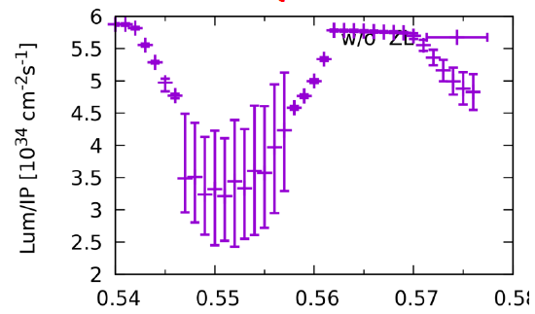
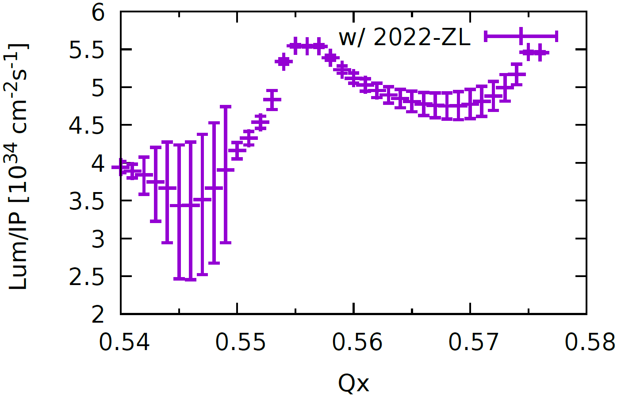
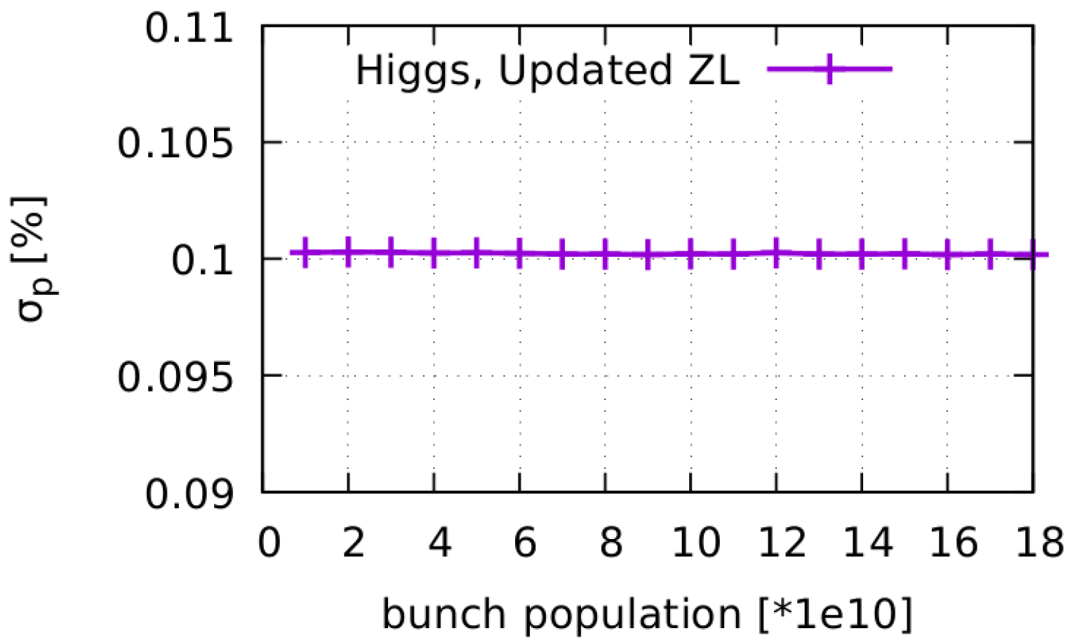
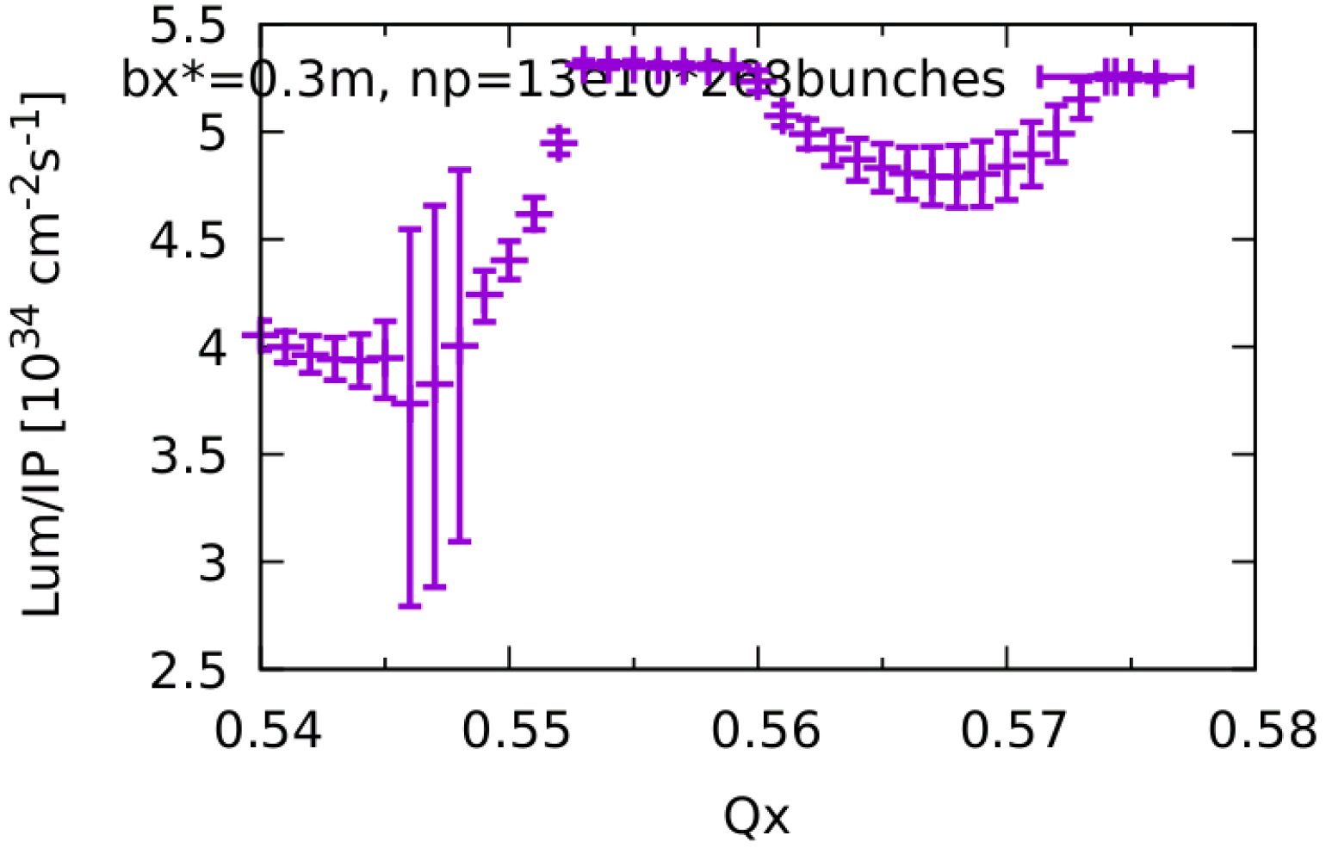
Instability issues for Higgs
Yuan Zhang’s talk for details
No microwave instability with collision off
Stable beam-beam tune area is limited due to the impedance
w/o ZL
w/ ZL
Optimizations
  Lower bunch population
    14 ×10¹⁰ →13×10¹⁰
  Squeeze β_{x}*
    0.33m→0.30m
w/ ZL

Slide 13
Instability issues for Z
Transverse mode coupling instability (TMCI)
Cross talk between ZT and beam-beam
Coupled bunch instabilities

Slide 14
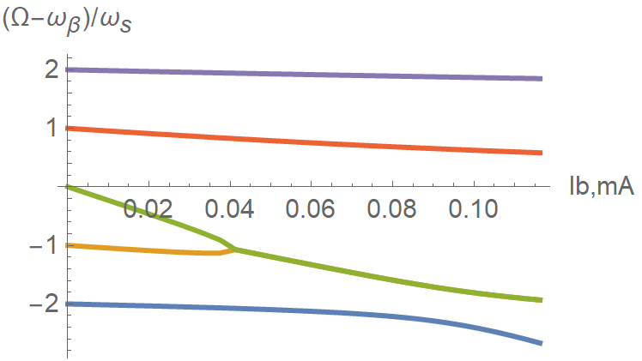
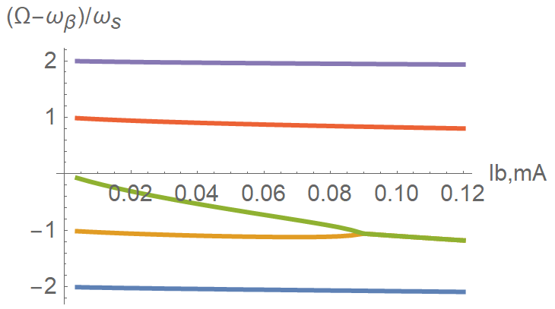
Transverse mode coupling instability
Analytical estimations show that the design current is below the TMCI threshold if considering bunch lengthening from longitudinal impedance.
The instability is supposed to get weaker when considering further bunch lengthening due to the beamstrahlung. However ….
W/O ZL bunch lengthening
W/ ZL bunch lengthening
Design
67μA (14E10)
Design
67μA (14E10)

Slide 15
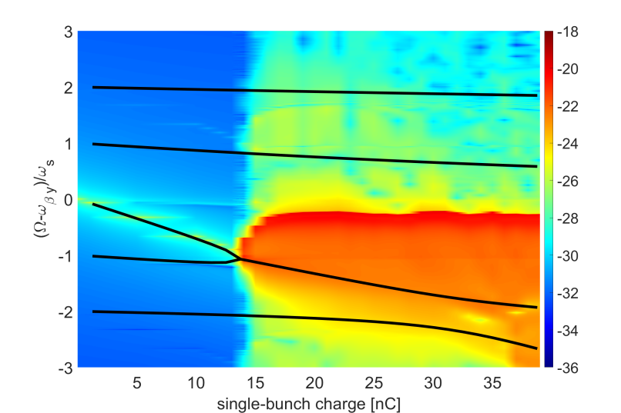
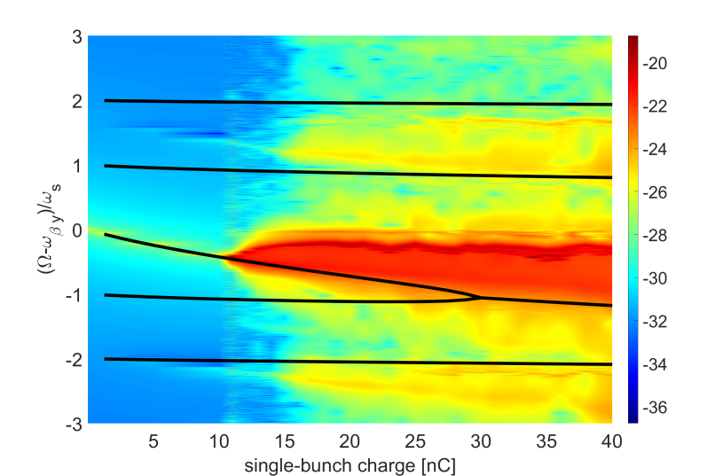
Transverse mode coupling instability
Particle tracking simulations performed with Elegant shows that the TMCI get more unstable when including longitudinal impedance.
  Without ZL: TMCI threshold→14nC (consistent between simulation and theory)
  With ZL: TMCI threshold →10nC (much lower than theoretical estimation: 30nC)
W/O ZL
W/ ZL

Slide 16
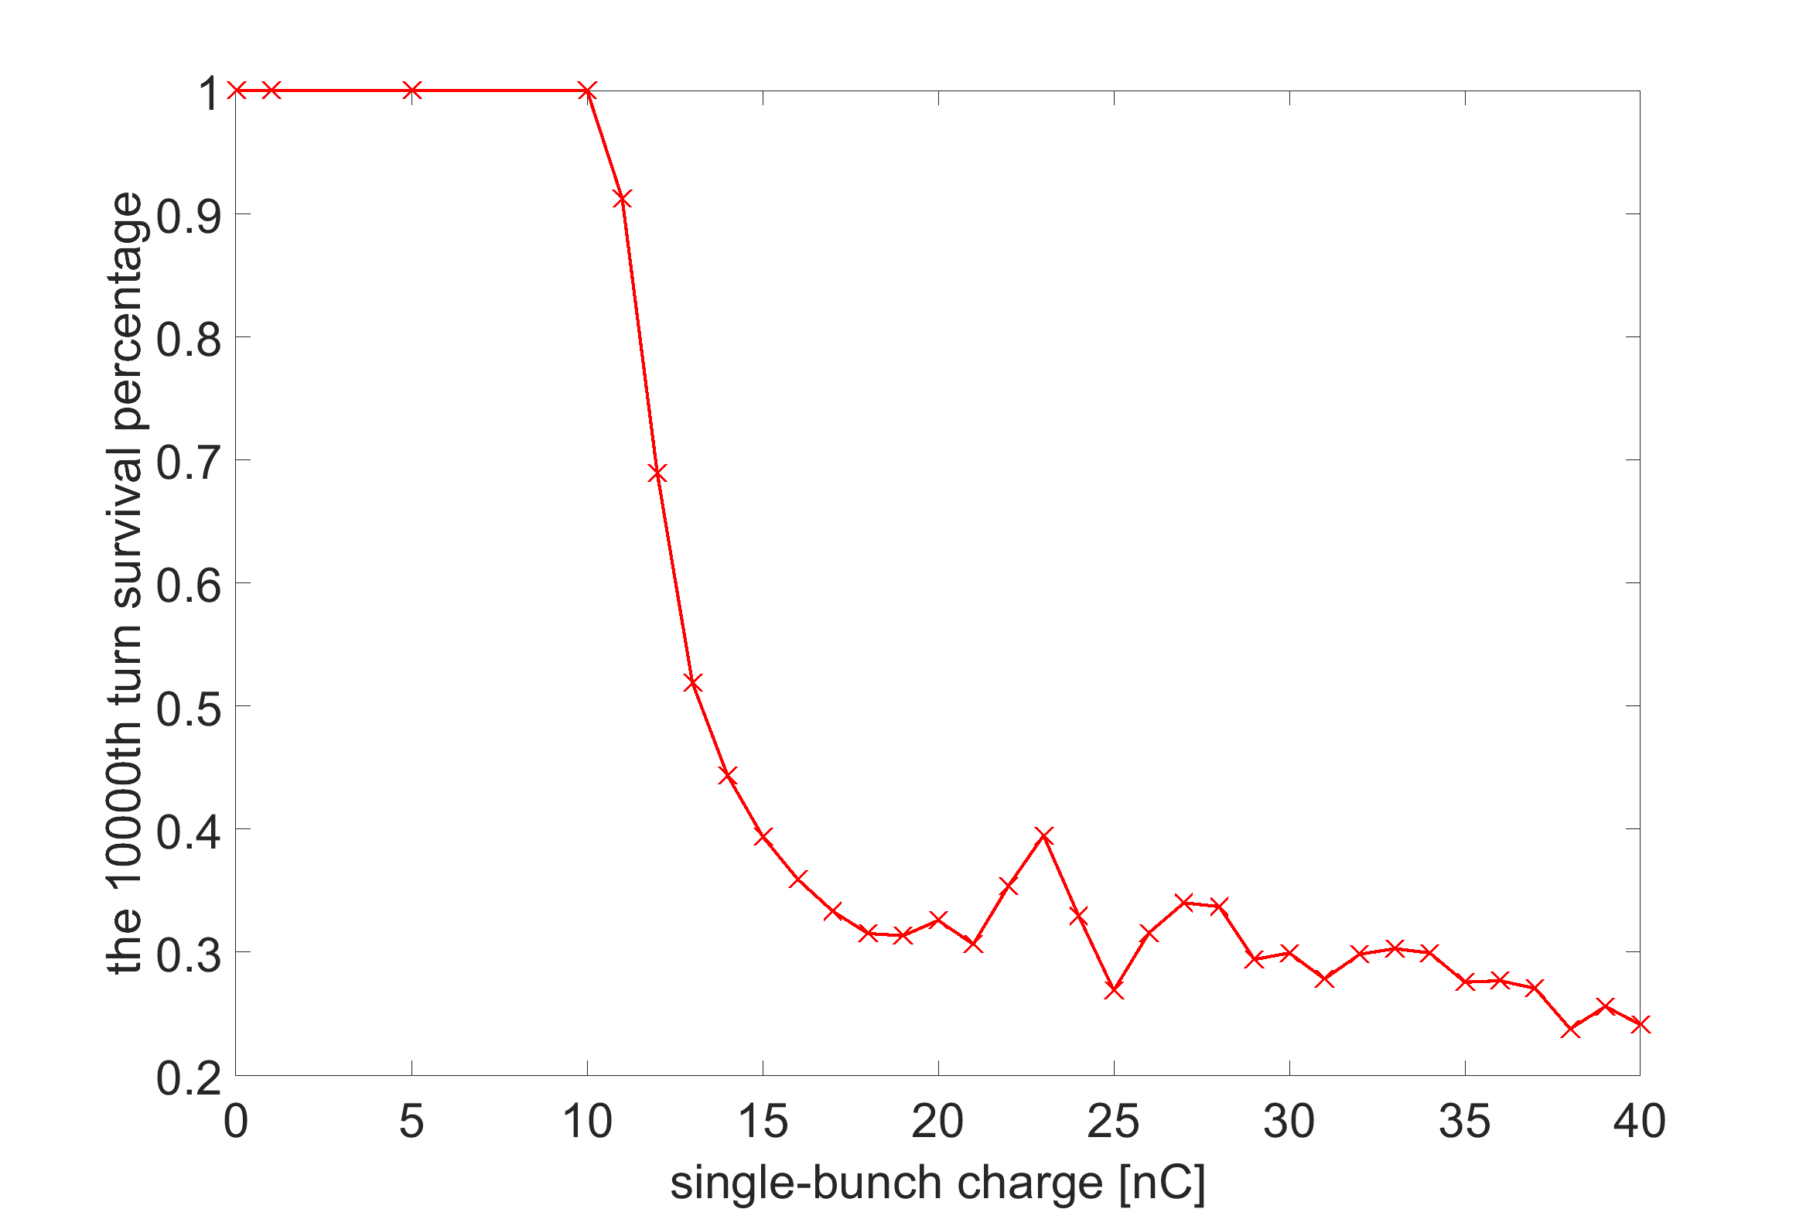
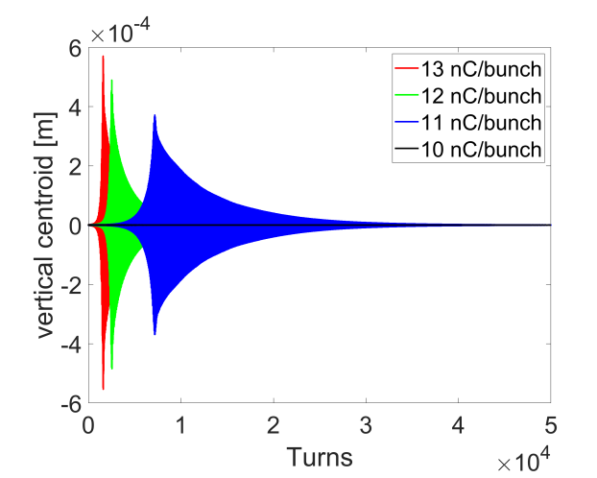
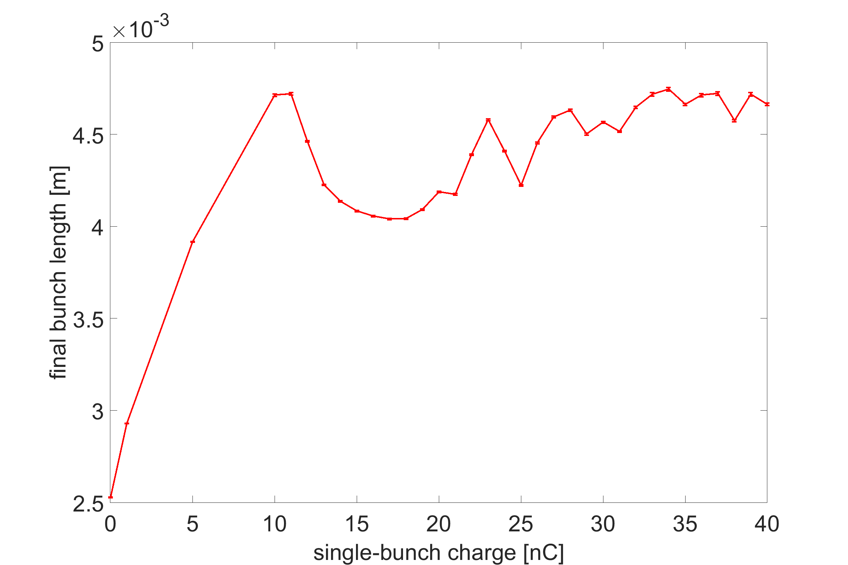
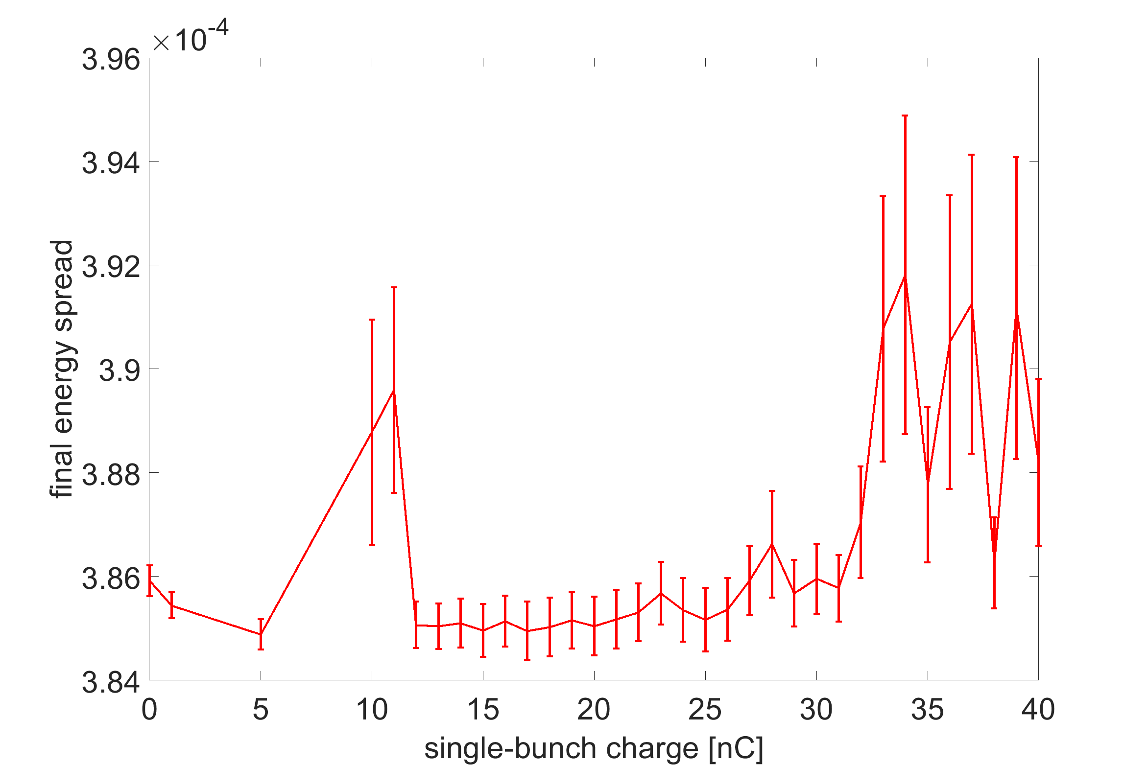
Transverse mode coupling instability
Apparent beam losses are observed above 10nC (6.2E10) with ZL.
  Transverse centroid oscillations are observed above threshold
  Bunch length and beam energy spread are crashed due to the sudden beam loss
  The instability is suspected to be induced by the enhanced mode coupling due to the synchrotron tune spread or even combined effect with MWI.

Slide 17
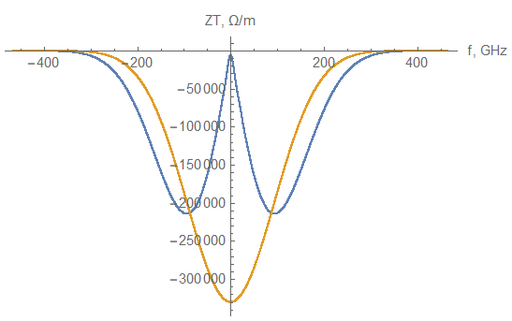
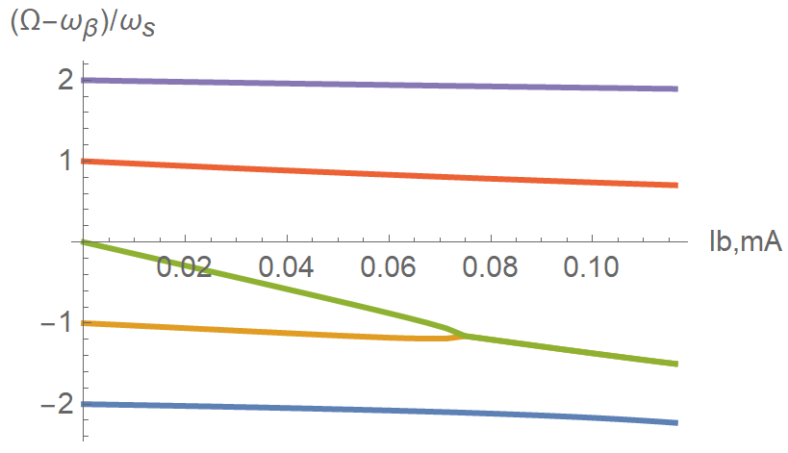

Cross talk between ZT and beam-beam
Preliminary analytical studies are performed
  Both horizontal and vertical Cross Wake force are obtained
  Beam-beam wake is included in the total ring impedance budget
  Conventional TMCI analysis is performed with BB wake included:
    Horizontal threshold reduced from 22.6E10 to 21.9E10 (↓3%)
    Vertical threshold reduced from 22.6E10 to 15.6E10 (↓30%)
Cross-Wake of Beam-Beam
with beam-beam lengthened bunch (σ_{z}=9mm)

Slide 18
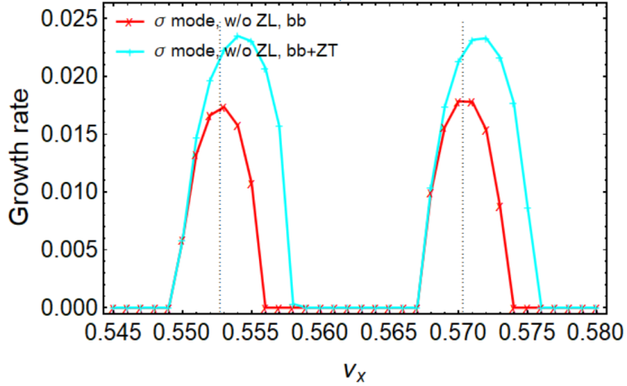
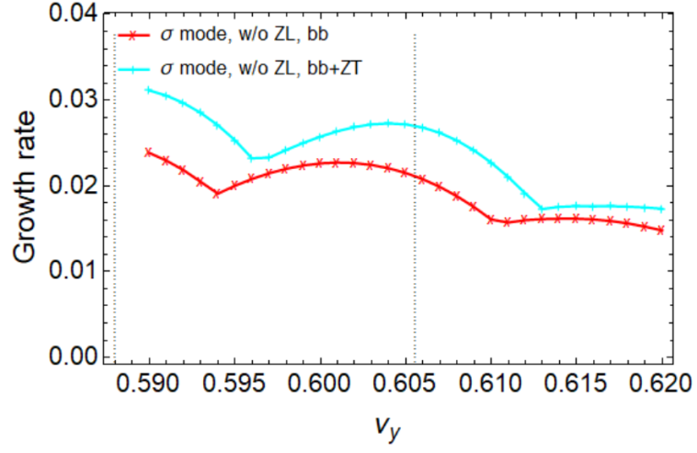
Cross talk between ZT and beam-beam
Local beam-beam model
  In horizontal direction: combined effect of X-Z instability and TMCI
    Instability growth rate gets faster + unstable tune area increases
  In vertical direction: TMCI like instability
    Pure beam-beam is unstable due to ignorance of strong nonlinearity?
    It is also found enhance of instability when considering ZY
  More detailed studies are undergoing.

Slide 19
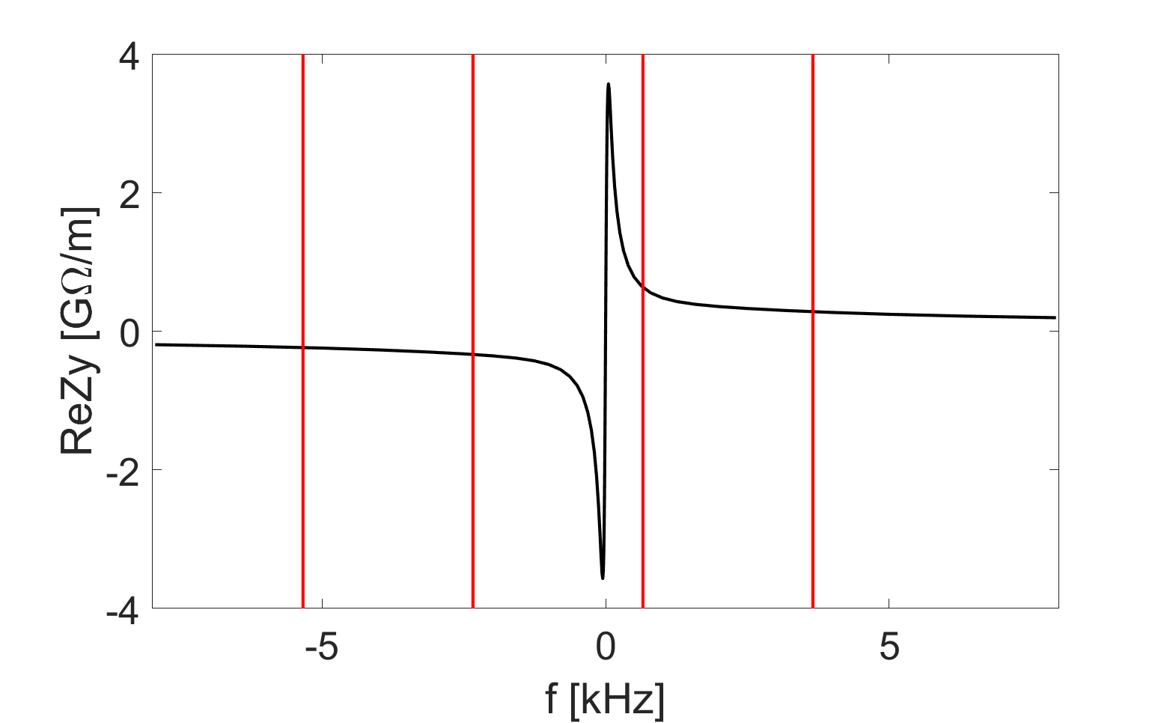
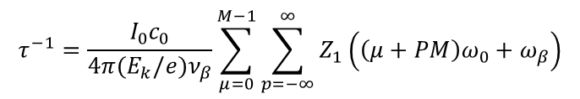
Transverse resistive wall instability
Instability growth rate is much faster than the synchrotron radiation damping (τ=850ms).
$$τ^{−1}=\frac{I_{0}c_{0}}{4π(E_{k}/e)ν_{β}}\sum_{μ=0}^{M−1}{\sum_{p=−∞}^{∞}{Z_{1}\left(\left(μ+PM\right)ω_{0}+ω_{β}\right)}}$$
n=11616
n=11617
n=11615
n=11618
f [kHz] | Mode index | Growth t [ms]
-2.338 | 11616 | 2.2 (7 turns)
-5.335 | 11615 | 3.2 (10 turns)
-8.332 | 11614 | 4.0 (12 turns)
-11.330 | 11613 | 4.6 (14 turns)
Tough requirement on feedback damping (broadband feedback + mode feedback?)

Slide 20
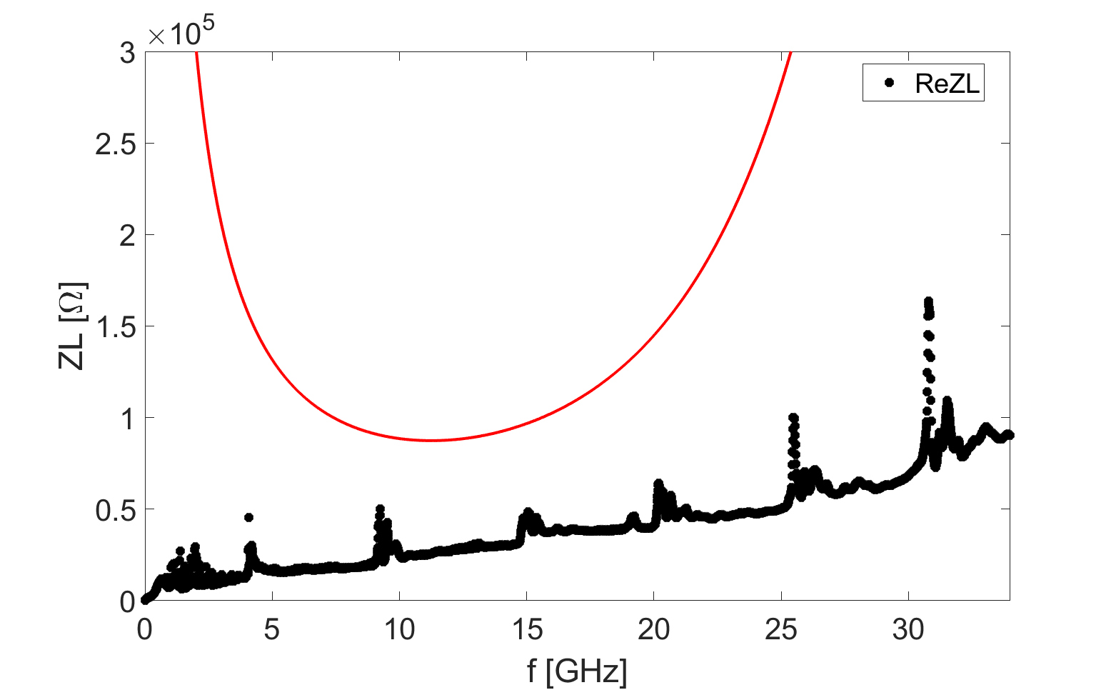
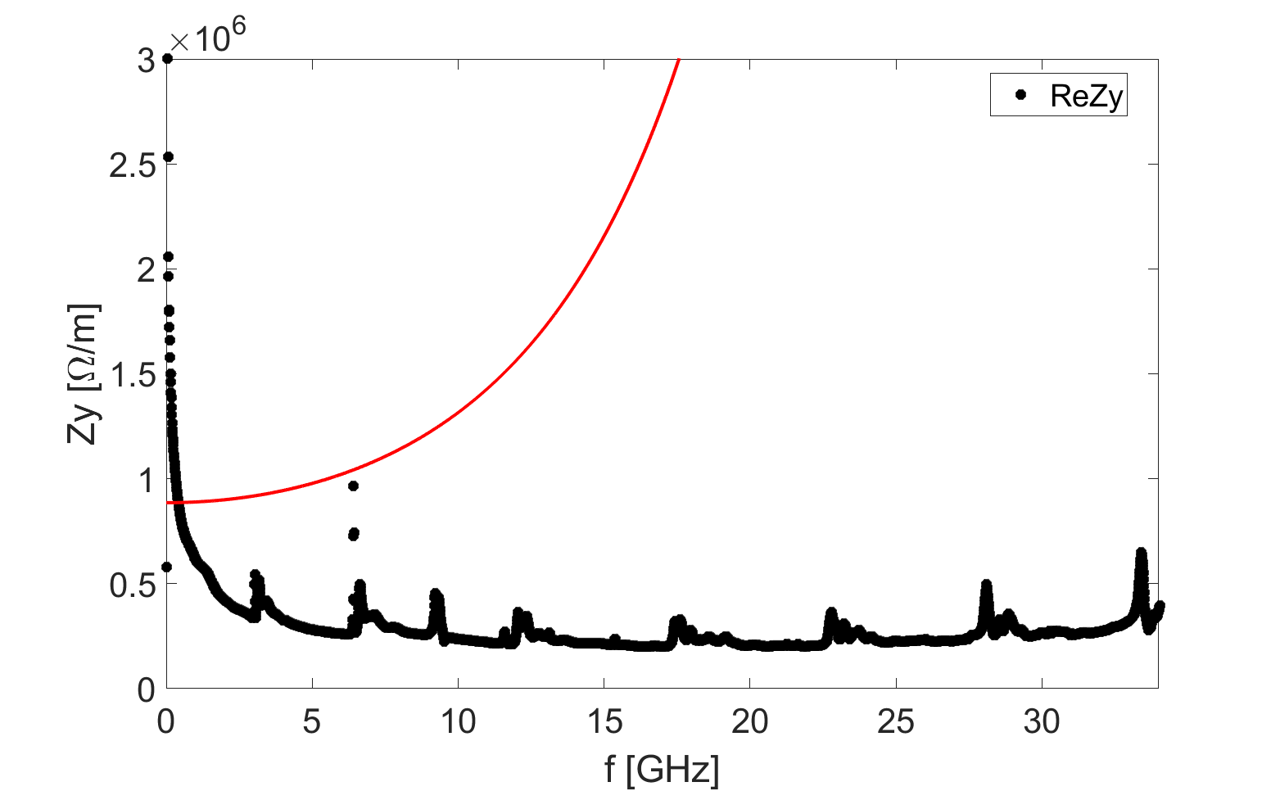
High order modes
Narrowband impedances generated from flanges, bellows, gate valves, and BPMs are all bellow the CBI instability threshold determined by synchrotron radiation damping.

Slide 21
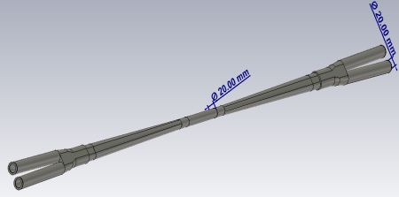
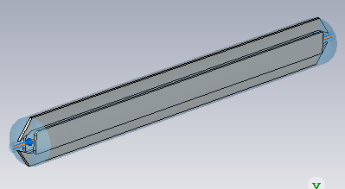
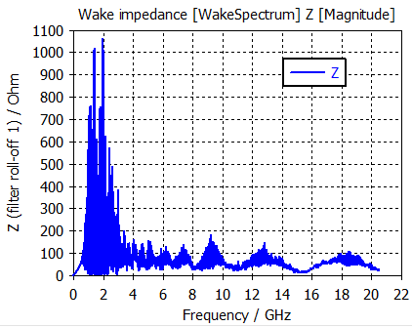
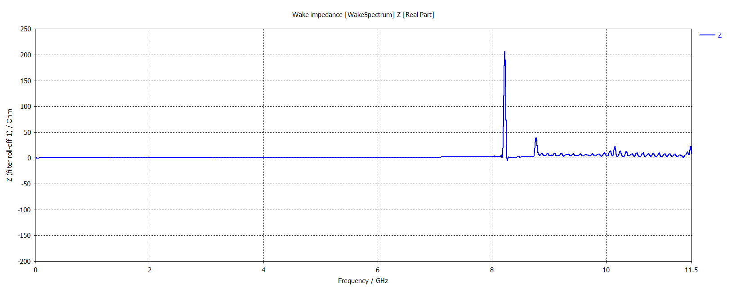
High order modes
RF cavities
  650 MHz 2-cell cavity HOM coupler Q_{L} can meet Higgs and W damping requirement.
  1-cell cavity similar to BEPCII can meet Z HOM damping requirement. No beam feedback is needed
Key elements needs to be further checked/optimized
  Electro separators, IP chambers, kickers …

Slide 22
Summary on collective instability in Collider
No showstoppers from collective effects for Higgs, W (however, influence the stable beam-beam tune area.)
Main constraints for Z include:
  TMCI threshold is bellow the design current when including both longitudinal and transverse impedance in tracking simulations, more detailed analysis on exploring the physics underline and possible mitigations are required.
  Preliminary analytical studies show crosstalk between transverse impedance and beam-beam interaction.
  Tough requirement on feedback damping is given by TRWI.
  CBI due to HOMs needs to be further checked.
  Need to get more involved with beam-beam and hardware designs.

Slide 23
Collective instability in the Booster

Slide 24
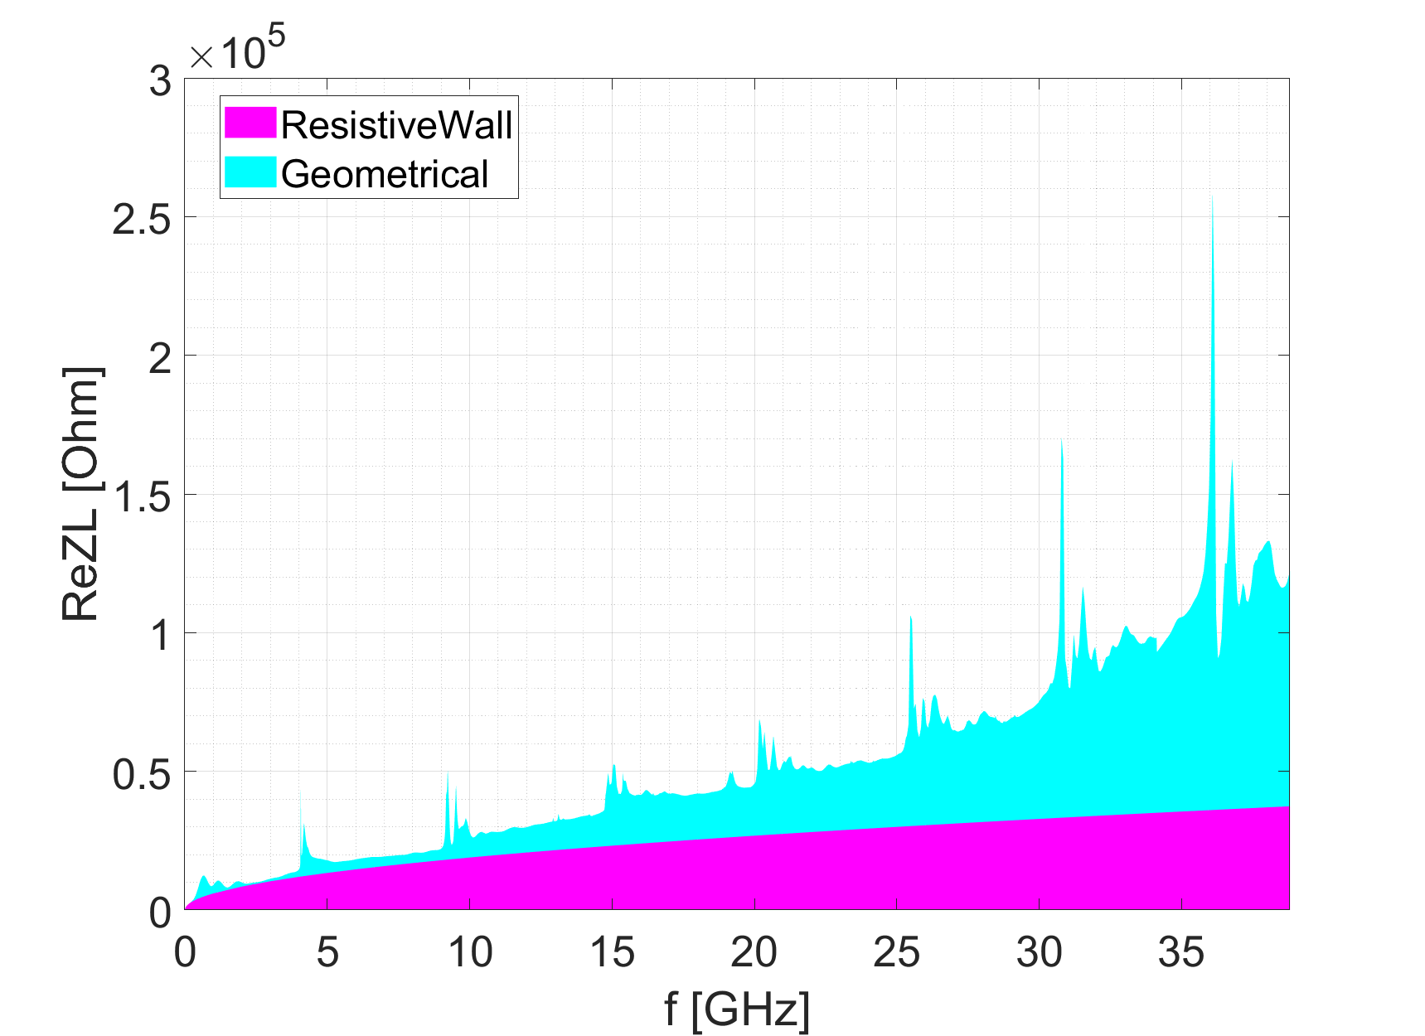
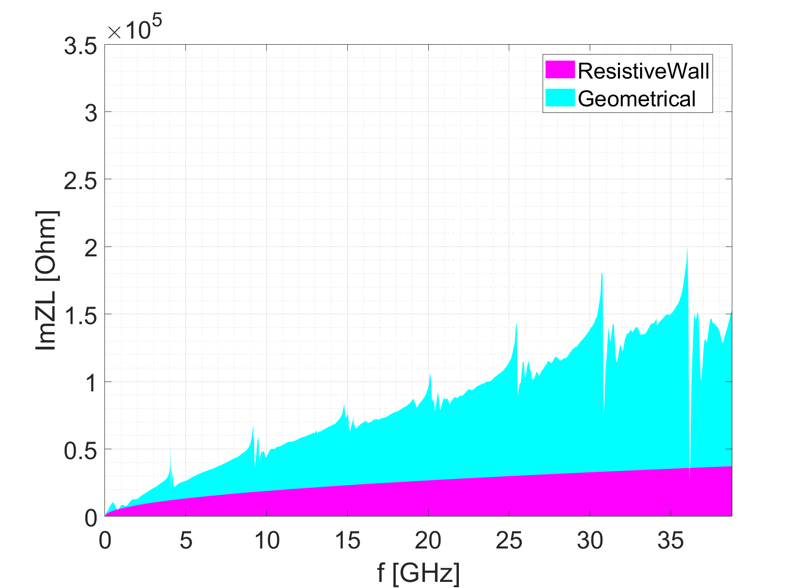
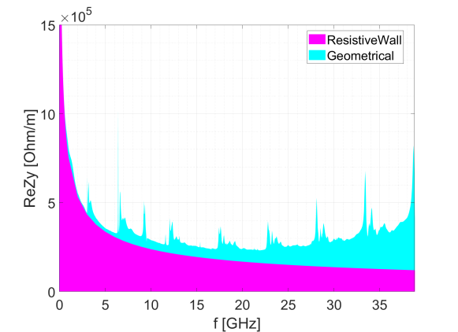
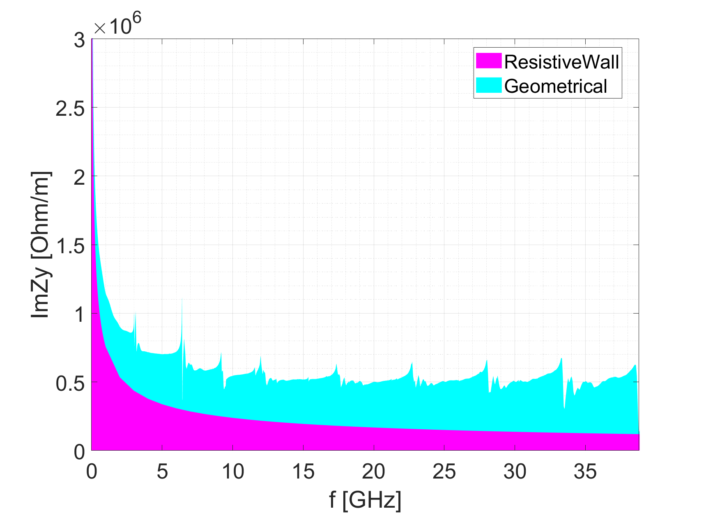
Impedance model
Resistive wall
  r=27.5mm, thick=2mm, Aluminum
Geometrical impedance
  Same as in the collider ring, excluding the components in the IR region
Longitudinal impedance
Transverse impedance

Slide 25
Single bunch effects
Impedance budget
Single bunch instabilities
  Enough safety margin reserved for TMCI
  Bunch lengthening is expected
Components | Z||/n, mΩ | k_{loss}, kV/pC | k_{y}, kV/pC/m
Resistive wall | 2.3 | 3.7 | 22.2
Geometrical | 4.1 | 1.9 | 24.8
Total | 6.4 | 5.6 | 47.0
@σ_{z}=0.75mm
Threshold value | Injection | Extraction
Single bunch (longitudinal) Z||/n [mΩ] | 0.3 | 3.4
Single bunch (transverse) k_{y} [kV/pC/m] | 130 | 320
Thresholds are given for the most critical case

Slide 26
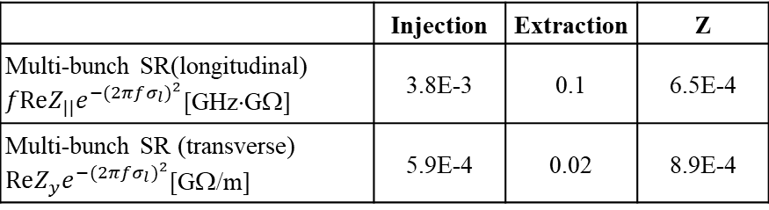
Coupled bunch instabilities
Transverse resistive wall instability
HOMs
  Much more relaxed compare to the collider ring
Instability growth time
Beam energy [GeV] | τ [ms]
20 | 14
45.5 | 35
The growth times are much shorter than the radiation damping (Inj./Ext.=10.4s/880ms)
It can be damped by the bunch by bunch feedback system
 | Injection | Extraction | Z
Multi-bunch SR(longitudinal) $fReZ_{||}e^{−{(2πfσ_{l})}^{2}}$[GHz⋅GΩ] | 3.8E-3 | 0.1 | 6.5E-4
Multi-bunch SR (transverse) $ReZ_{y}e^{−{(2πfσ_{l})}^{2}}$[GΩ/m] | 5.9E-4 | 0.02 | 8.9E-4

Slide 27
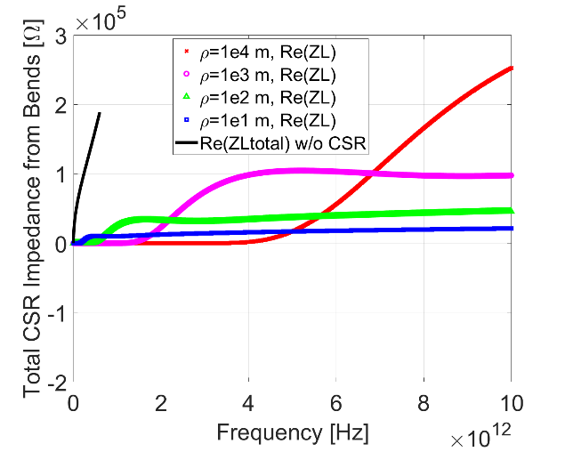
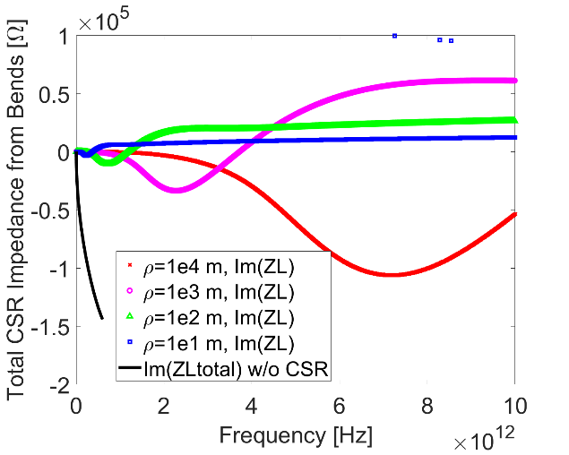
CSR effect
CSR impedance and its induced MWI threshold are calculated, considering the quite short bunch length of ~0.5mm.
CSR impedance is much lower than the resistive wall impedance
  Bunch spectrum to ~200 GHz

Slide 28


CSR effect
MWI threshold due to the CSR effect are estimated analytically
  K. Bane et al. (PR AT-AB 13, 104402 (2010))
At extraction energies, enough safety margin is reserved concerning CSR effect
At injection energies,
  With injection beam parameters → the threshold is much higher than the design current
  With equivalent beam parameters → the lowest threshold is comparable to the design current (only degrade beam quality during energy ramping + MWI is self-limiting ⇒ less critical)
strength parameter:
$$S_{CSR}=I⋅ρ^{1/3}/σ_{z0}^{4/3}$$
$${\left(S_{CSR}\right)}_{th}=0.5+0.12σ_{z0}ρ^{1/2}/h^{3/2}$$
threshold:
 | Inj. (linac beam: σ_{z0}=0.5mm, σ_{δ}=1.6E-3) | Inj. (equivalent: σ_{z0}=1mm, σ_{δ}=1.6E-4) | Extraction
Threshold value | >38I_{b, design} | >0.8I_{b, design} | >10I_{b, design}

Slide 29
Collective instability in the Damping ring

Slide 30

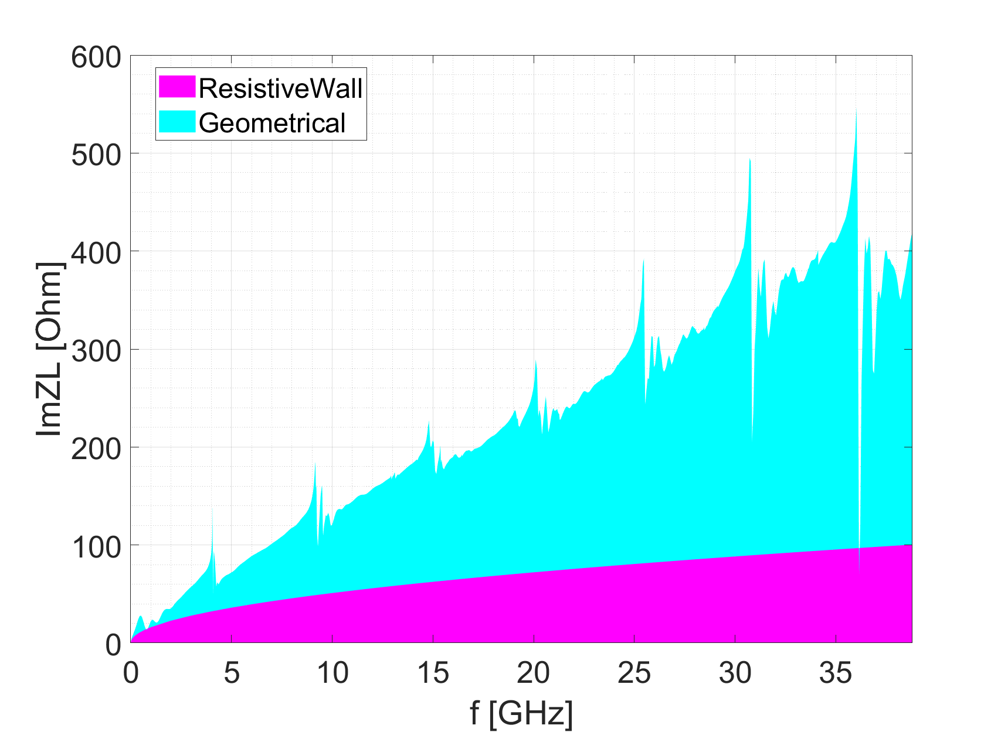
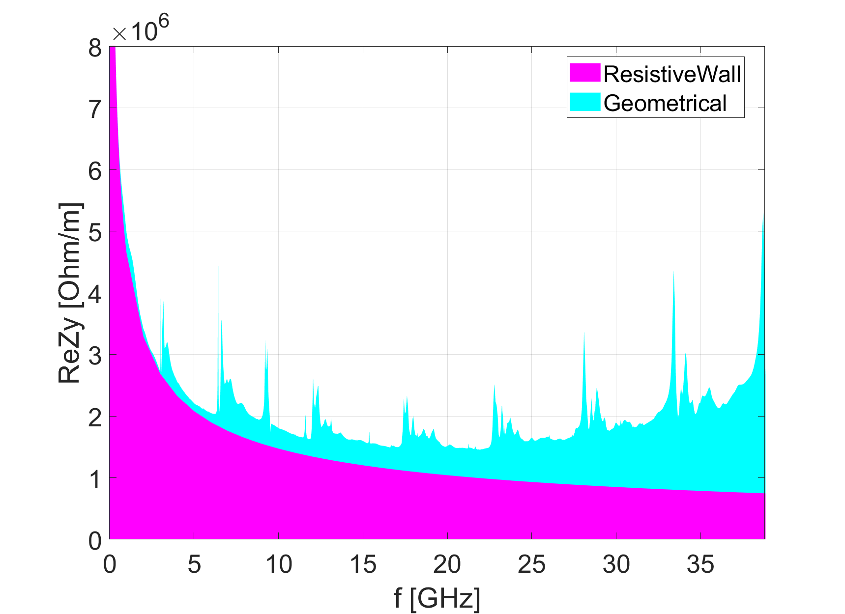
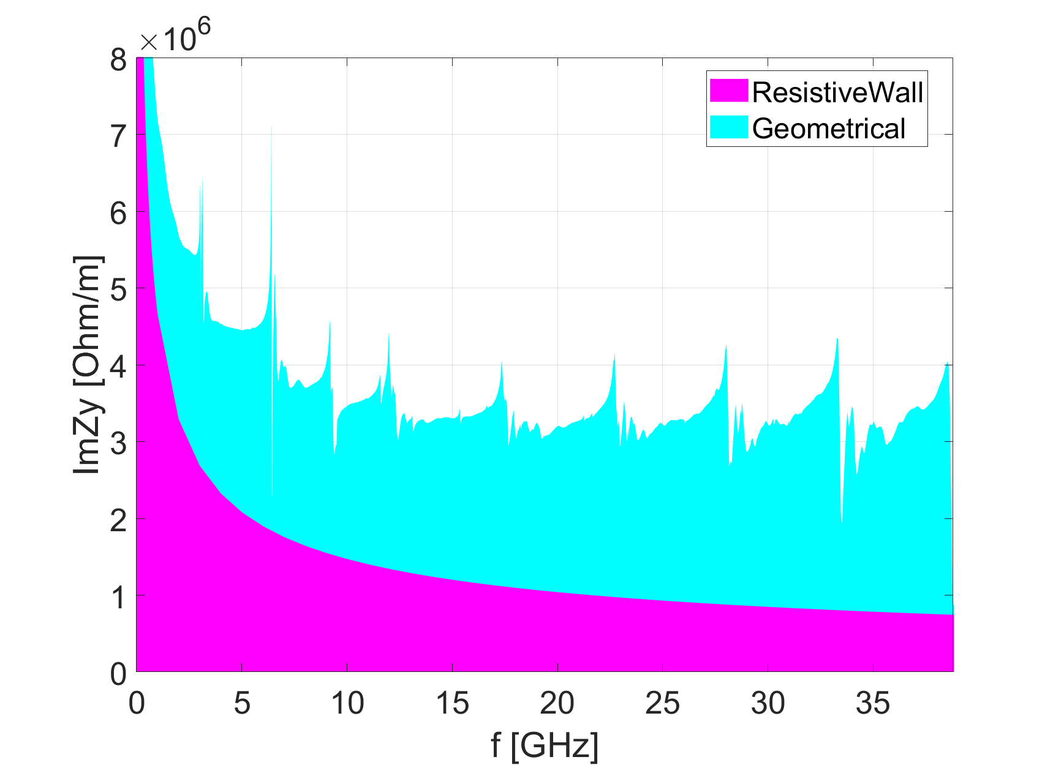
Impedance model
Resistive wall
  r=15mm, thick=2mm, Aluminum
Geometrical impedance
  Scaled from the collider ring (exclude the components in the IR region)
  ZL*(28mm/15mm)*147m/100km, ZY *(28mm/15mm)^{3*}147m/100km
Longitudinal impedance
Transverse impedance

Slide 31
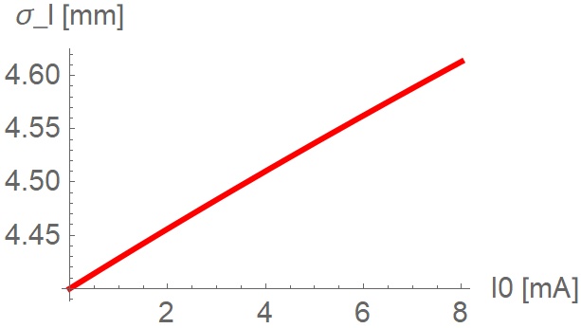
Single bunch effects
Impedance budget
Single bunch instabilities
  Enough safety margin reserved for TMCI
  Bunch lengthen is increased by 2%
Components | Z||/n, mΩ | k_{loss}, V/pC | k_{y}, kV/pC/m
Resistive wall | 10.2 | 0.7 | 0.2
Geometrical | 17.3 | 0.3 | 0.1
Total | 27.5 | 1.0 | 0.3
@σ_{z}=4.4mm
Threshold on Z||/n [Ω] | 680
Threshold on k_{y} [kV/pC/m] | 90
⇒Meet the Requirements on the beam quality
  Increase on the bunch length, beam energy spread and emittance should be less than 20%

Slide 32
Summary on Booster and damping ring
Rough geometrical impedance models are included in the instability studies.
The Booster show no apparent constraints from single bunch and CSR effect, however, bunch-by-bunch feedback is required to damp the TRWI.
No constraints observed from the Damping ring, and the impedance will lengthen the bunch by ~2%, which still meet the requirement from injections.

Slide 33
Thank you for your attention!

