Slide 1


Timing and bunch pattern for different operation energies and the relevant transporting beam line
Cui Xiaohao
For CEPC Accelerator Physics Group
The Institute of High Energy Physics, Chinese Academy of Sciences
The 2022 CEPC international accelerator review committee meeting
June 7-10, 2022, IHEP

Slide 2
Introduction
Gun
Linac
20 GeV
Booster Ring
Collider Ring
20 GeV
Damping ring
Injection and extraction from: Linac, damping ring, booster, and collider;
Energy: Higgs (120 GeV), W (80 GeV), Z (45.5 GeV), tt (180 GeV);

Slide 3
Introduction
 | Higgs | W | Z | tt
Bunch Number in collider | 268 | 1297 | 11934 | 35
Bunch Separation | 591 ns | 257 ns | 23 ns | 4524 ns
Bunch Number in booster | 268 | 1297 | 3978 | 35
Lifetime (hour) | 0.33 | 0.92 | 1.33 | 0.3
Interval for top up* (s) | 36 | 101 | 146 | 33
* Beam current in collider decays by 3%.
Z-mode is the most challenging operation in terms of charge flux delivered by the injectors.
At Z mode, the bunch number in the booster is only 1/3 of that in the collider, so the booster need to be ramped up and down 3 times to inject into every bunch in the collider.

Slide 4
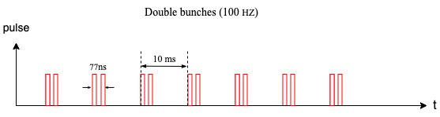
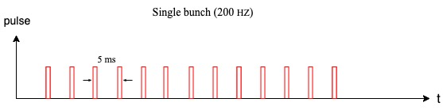
1. Linac
From the electron gun, bunches are generated in 100 Hz.
pulse
10ms
t
For Z mode, more bunches are needed
It can be upgraded to double bunch (100Hz, baseline choice) or 200 Hz.

Slide 5
2. Damping Ring
Positron bunches will be injected into a damping ring at 1.1 GeV.
Damping ring circumference | 150 m
Store time of the bunches: | 20 ms
T=0
T=10ms
The bunches are injected into the damping ring with the same frequency as bunches in the Linac;
For 200 Hz or double-bunch mode, more bunches will be stored in the damping ring;
Each bunch which cooled for 20 ms will be extracted and re-injected into the linac.
With small changes, the cooling time of the bunches can be increased by holding more bunches in the damping ring.
T=20ms-250ns
T=20 ms
T=30ms-250ns

Slide 6
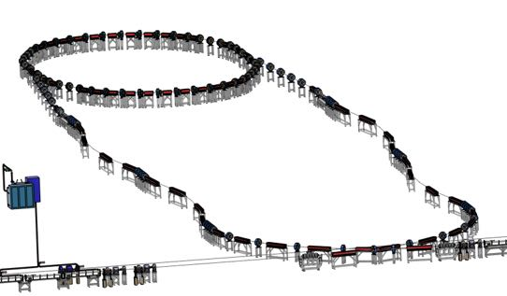
3. From Linac to Damping ring
Energy: 1.1 GeV
Beam: positron
Linac repetition: 100Hz
Double bunch mode needed for Z
Before damping ring, Energy spread of the beam should be reduced in order to match the RF acceptance of the damping ring.
After damping ring, Bunch of the beam should be reduced to control the energy spread after acceleration.
Damping ring circumference | 150 m
Store time of the bunches: | 20 ms
Bunch number: | 4 (maybe 8)

Slide 7
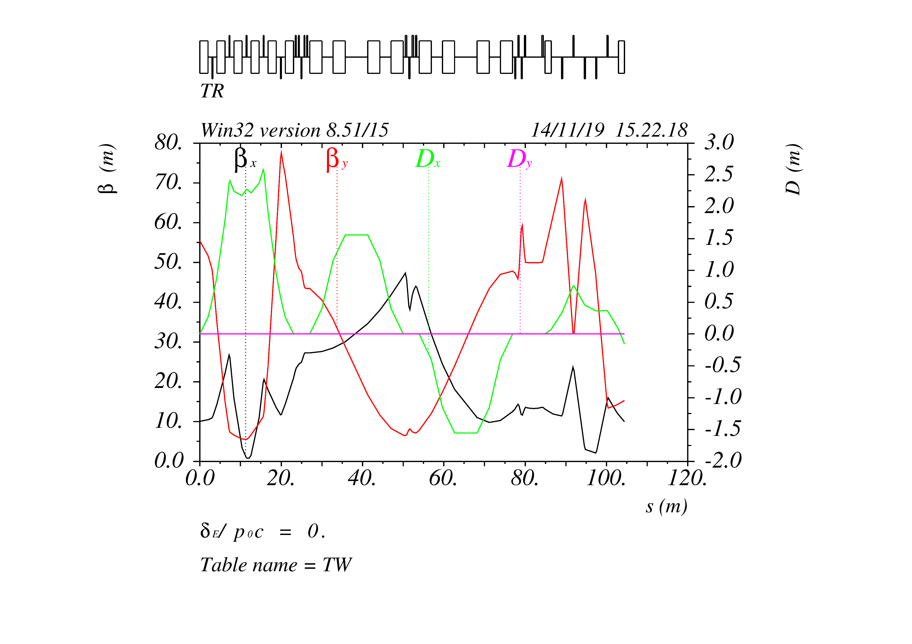
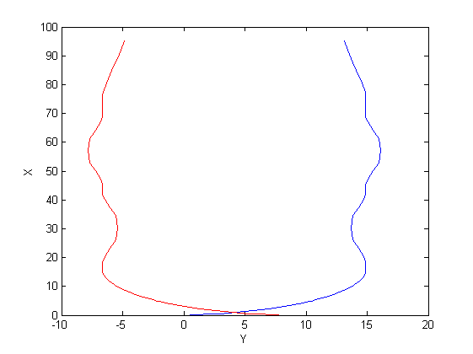
3. From Linac to Damping ring
Chicanes for Bunch length control;
Arcs for geometry design;
Matching for injection twiss matching;
Arcs
Chicane
Matching

Slide 8
3. From Linac to Damping ring
0.5m
Lambertson
Kicker
Top View:
25mm
1.25m
1.25m
0.847m
1m
0.5m
Side View:

Slide 9
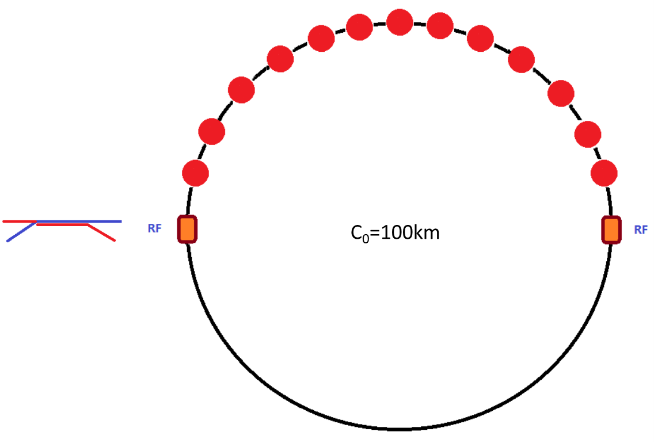
4. Injection to booster
 | tt | H
Energy（GeV） | 20 | 20
Bunch number | 35 | 268
Bunch seperation（us） | 4.52 | 0.591
Injection scheme | bunch by bunch | bunch by bunch
Kicker frequency(Hz) | 100 | 100
Kicker pules duration (us) | <8.4 | <1.29
Kicker rise up/ fall down (us) | <4.2 | <0.647
Timing delay(us) | 4.2 | 0.647
Injection duration (s) | 0.35 | 2.68
To share the RF system, for tt and Higgs energy, bunches per beam are in the half ring both for booster and collider.

Slide 10
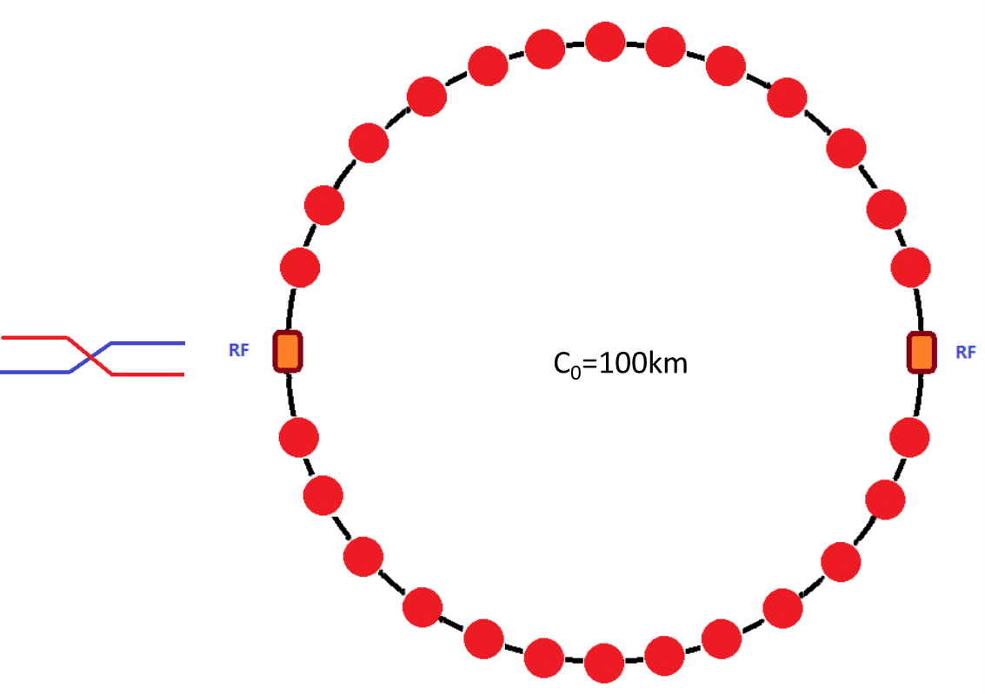
4. Injection to booster
 | W
Energy（GeV） | 20
Bunch number | 1297
Bunch seperation（us） | 0.257
Injection scheme | bunch by bunch
Kicker frequency(Hz) | 100
Kicker pules duration (us) | <0.535
Kicker rise up/ fall down (us) | <0.2677
Timing delay(us) | 0.2677
Injection duration (s) | 12.9
For W mode, bunches are uniform in the whole ring both for booster and collider.

Slide 11
4. Injection to booster
 | Z
Energy（GeV） | 20
Bunch number/train | 78
Bunch separation（ns） | 23.076
Number of trains | 51
Train separation (us) | 5.11
Kicker frequency(Hz) | 200 or 100 (double bunch)
Injection scheme | bunch by bunch or two by two
Kicker rise up/ fall down (ns) | <23 ns
Flat top (ns) | 23.1 for double bunch mode
Injection duration (s) | 19.2
bunches per beam are distributed train by train both in booster and collider. (This will be talked about in detail later)
The number of train in the booster is 1/3 of that in the collider.

Slide 12
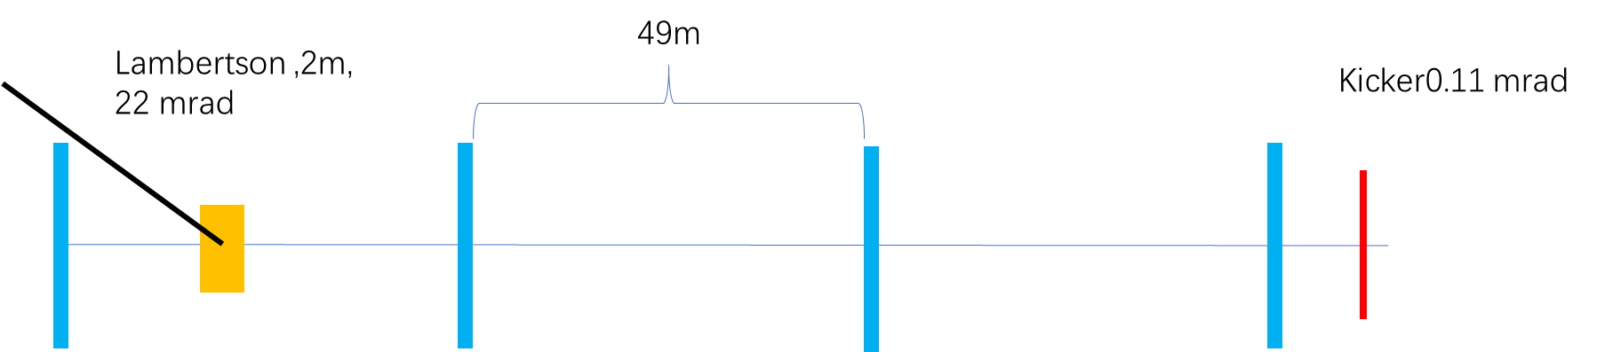
4. Injection to booster
Injection into the booster is a simple on-axis injection with 1 kicker
Bunches from the Linac will be in 100 Hz or 200 Hz
Booster Ring
T_{Linac}
T_{booster}
T_{Linac}=N*Turns+T_{booster}
Changing T_{Linac} slightly, we can fill the booster with any pattern we needed.

Slide 13
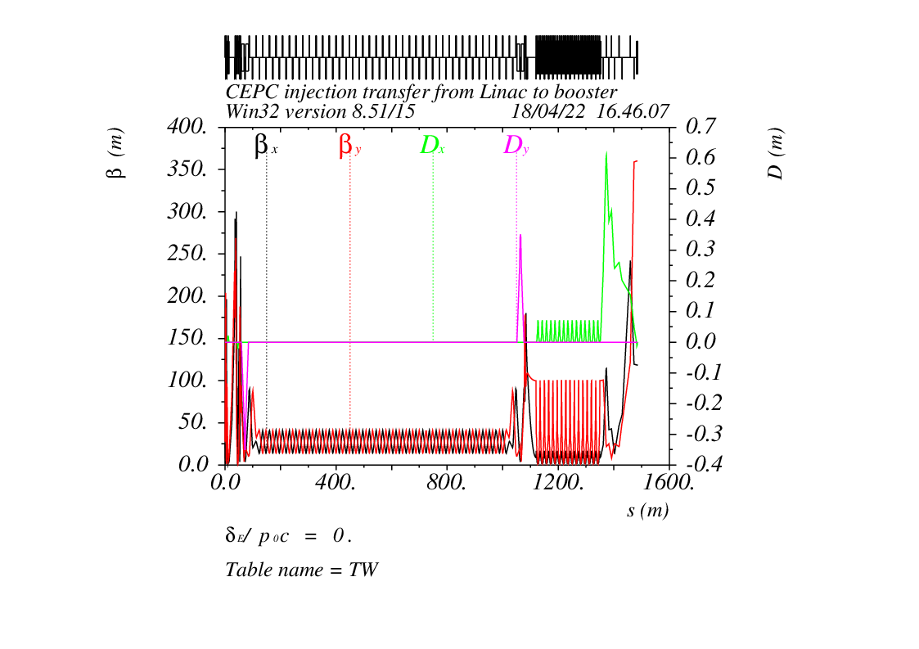
4. Injection to booster
Twiss parameters for the transport line, and a top-view of the geometry

Slide 14
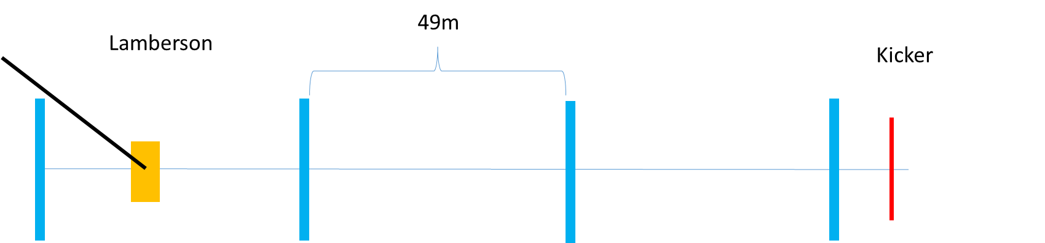
4. Injection to booster
Injection into the booster is also a standard on-axis injection

Slide 15
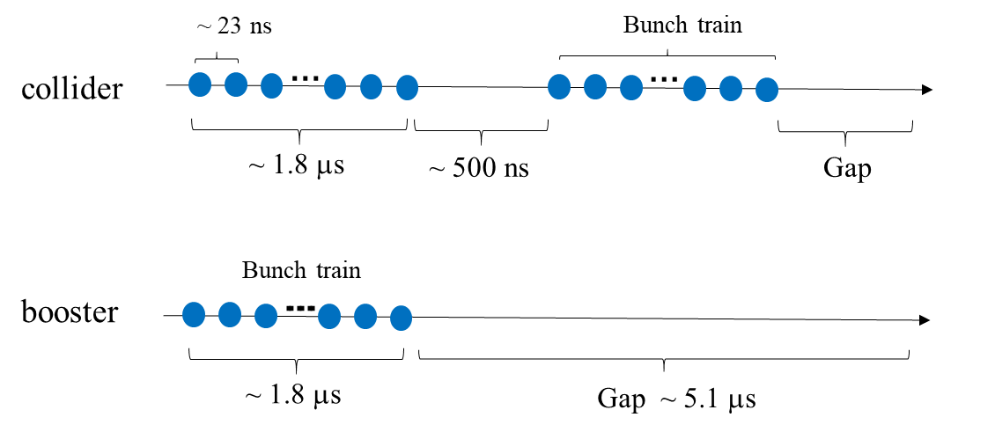
5. Extraction from booster
Energy: 45 GeV, 80 GeV, 120 GeV, 180 GeV
Beam: positron & electron
Extraction for different bunch patterns.
For Z energy, it becomes more complicated due to the large bunch number needed in the collider.
the separation between bunches are only 20~30 ns. Considering the rise time of the kickers, bunches are arranged train by train in the collider for Z energy.
For Higgs, W, tt, the bunches are extracted bunch by bunch;
For Z energy, the bunches are extracted train by train.

Slide 16
5. Extraction from booster
 | tt | Higgs | W
Energy（GeV） | 180 | 120 | 80
Bunch number | 37 | 240 | 1230
Bunch seperation（us） | 4.2 | 0.647 | 0.2677
Extraction scheme | bunch by bunch | bunch by bunch | bunch by bunch
Kicker frequency(Hz) | 1000 | 1000 | 1000
Kicker pules duration (us) | <8.4 | <1.29 | <0.535
Kicker rise up/ fall down (us) | <4.2 | <0.647 | <0.2677
Timing delay(us) | 4.2 | 0.647 | 0.2677
Extraction duration (s) | 0.037 | 0.24 | 1.23
 | Z
Energy（GeV） | 45.5
Bunch number/train | 80
Bunch separation（ns） | 23.076
Number of trains | 48
Train separation (us) | 5.11
Extraction scheme | train by train
Kicker frequency(Hz) | 1000
Flat top (us) | 1.83
Kicker pules duration (us) | <12.05
Kicker rise up/ fall down (us) | <5.11
Timing delay(us) | 6.94
Extraction duration (s) | 0.048

Slide 17
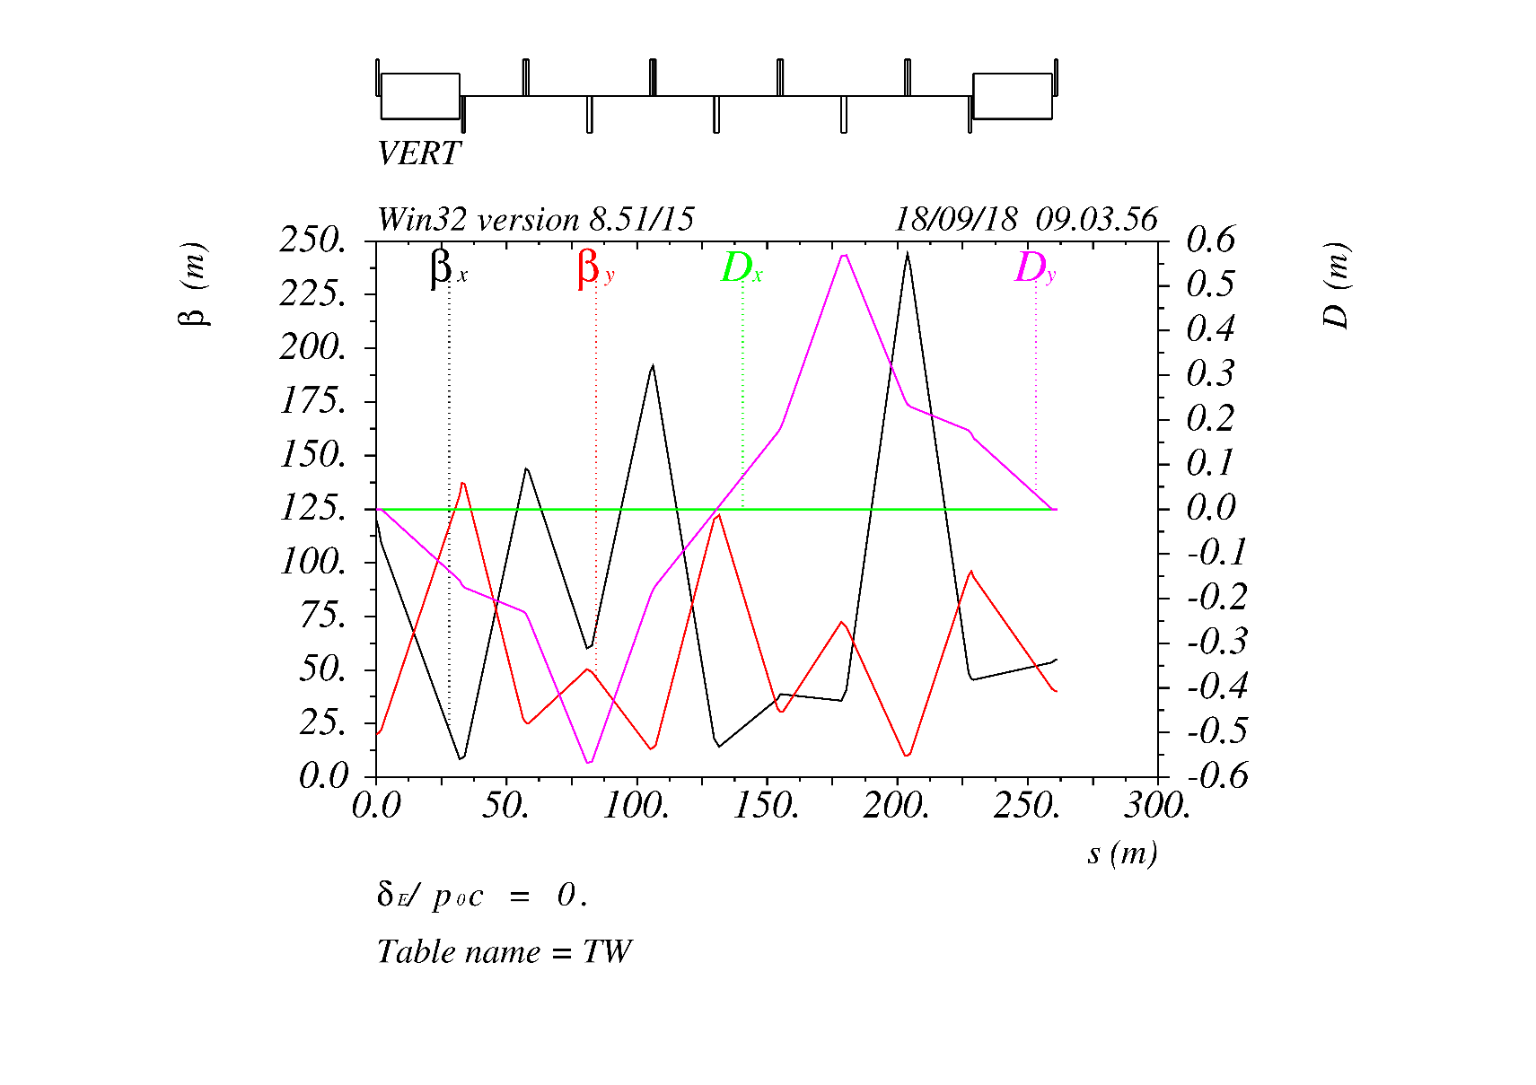
6. Injection to Collider
Energy: 45 GeV, 80 GeV, 120 GeV, 180 GeV
Beam: positron & electron
For tt, Higgs and W energy, injection into the collider is bunch by bunch; and for Z energy, injection is train by train.
Considering the robustness of the design, the baseline injection of the main collider ring is conventional off-axis injection & an on-axis injection for Higgs.

Slide 18
6. Injection to Collider
Considering the robustness of the design, the injection of the main collider ring is conventional off-axis injection. (Maybe an on-axis injection is needed for Higgs)
For tt, Higgs and W energy, injection into the collider is bunch by bunch; and for Z energy, injection is train by train.
Bunch by bunch
Train by train
Kicker:
1000 Hz
1000 Hz
The kickers rise up, inject one bunch into the collider, and fall down. This process repeated in 1000 Hz, to inject all bunches into the ring.
The kickers rise up, stay there to inject a whole train into the collider, and fall down. This process repeated in 1000 Hz, to inject all bunches into the ring.

Slide 19
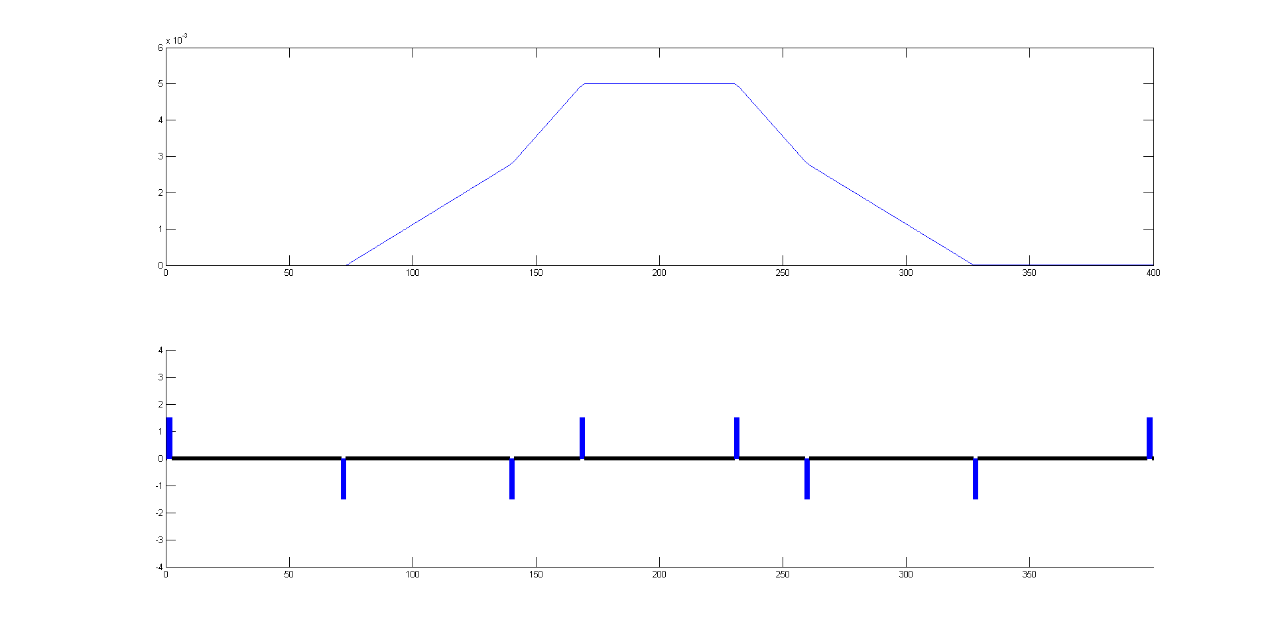
6. Injection to Collider
60m
26m
66m
68m

Slide 20
7. A diagram of the time structure
Extract from booster
0.035s
Ramp up
7.3s
Ramp down
7.3s
tt
0.35s+7.3s+0.035s+7.3s ~15s
Inject from Linac
0.35s
Extract from booster
0.268s
Ramp up
4.5s
Ramp down
4.5s
Higgs
2.68s+4.5s+0.268s+4.5s ~12s
Inject from Linac
2.68s

Slide 21
7. A diagram of the time structure
Extract from booster
1.29s
Ramp up
2.7s
Ramp down
2.7s
W
12.9s+2.7s+1.29s+2.7s ~20s
Inject from Linac
12.9s
Extract from booster
0.048s
Ramp up
1.6s
Ramp down
1.6s
Z
Inject from Linac
19.9
(19.9s+1.6s+0.048s+1.6s)*3=69.5s

Slide 22
7. A diagram of the time structure
On-axis injection 5s
Ramp up
4.5s
Ramp down
4.5s
2.4s+4.5s+5.0s+4.5s=16.4s
Higgs on-axis
Inject from Linac
2.4s
 | tt | Higgs (off-axis) | Higgs (on-axis) | W | Z
Interval for top up* (s) | 33 | 36 | 36 | 101 | 146
Injection time for both e⁺/e⁻ (s) | 30 | 24 | 32.8 | 40 | 139

Slide 23
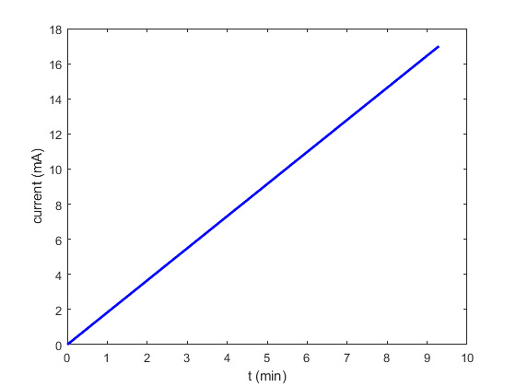
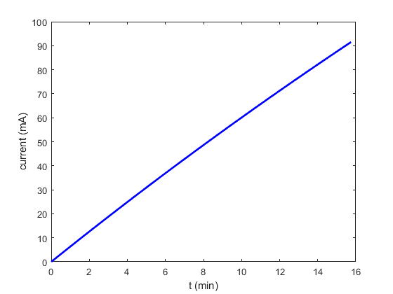
8. Injection from scratch
Yuan Zhang, Dou Wang
Injection from scratch is easy for Higgs, W and tt.
Injection from scratch takes 10min for Higgs, and 16 mins for W.

Slide 24
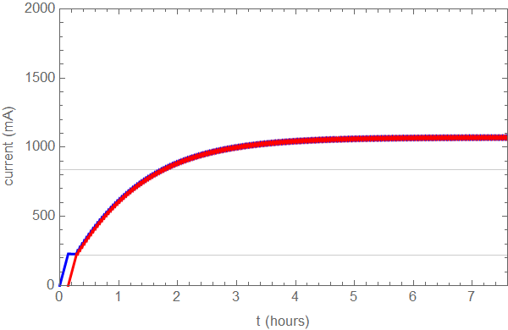
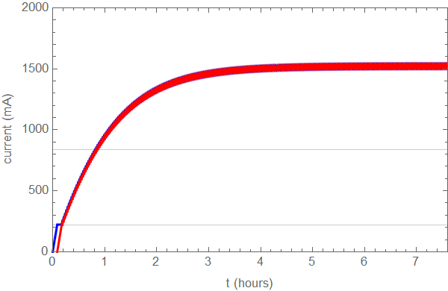
8. Injection from scratch-Z
Yuan Zhang, Dou Wang
Design current in collider is 840mA.
Total current in booster limited by RF system: < 10 mA (will be increased to 16mA)
Collider lifetime: ≥19 hours (non-collision), 1.9~1.4 hours (w. collision)*
Bootstrapping from 220mA
Full injection from empty for both beam → 2 hours (50min)
Booster threshold: 10mA
Booster threshold: 16mA
*the beam lifetime with collision is related to the current.

Slide 25
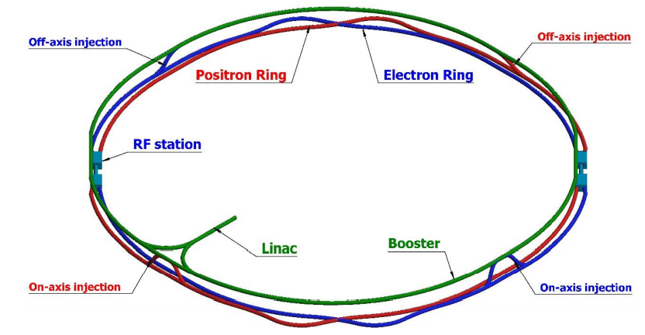
9. From Collider to the Beam dump
Beam dump put in one of the straight lines
For machine and detector protection;
Use one kicker and one septum to get the beams into the dump line, so all bunches can be dumped in one turn;
Horizontal and vertical dilution kickers are used to change the position of different bunches at the dump, in order to reduce the beam damage to the dump.

Slide 26
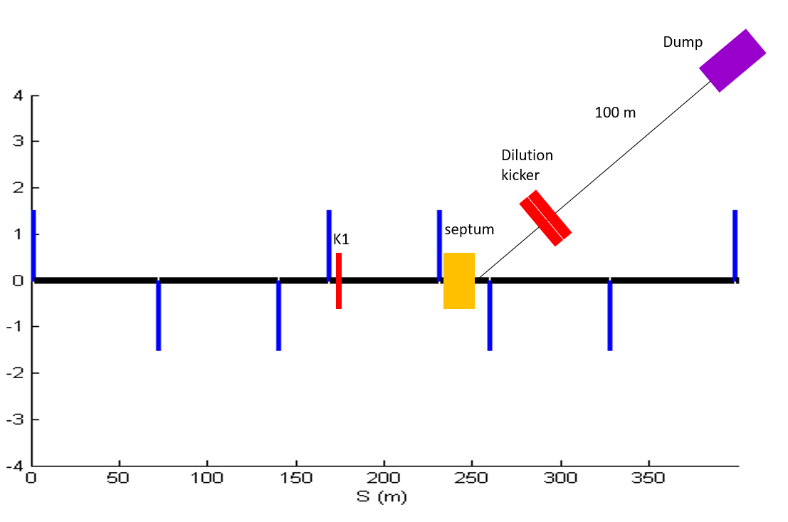
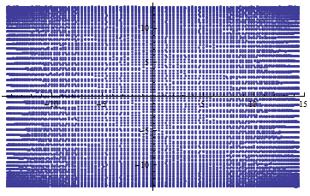
9. From Collider to the Beam dump
The Beam dump line and bunch distributions on the dump

Slide 27
Summary:
1. This talk gives a general overview of the timing of CEPC injection process and transport line design.
2. Some changes and optimization on the optics design have been made ;
3. Considerations on the bunch pattern for different energy, especially for Z energy mode;
4.Beam dump added as a part of the machine protection system.

Slide 28
Thank You!

Slide 29
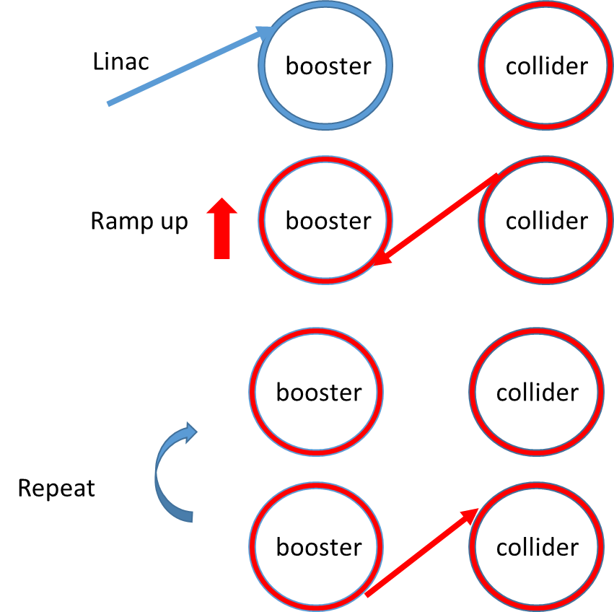
Back Up:on axis injection
1. Inject 240 small bunches into the booster.
2. Ramp the booster to high energy and inject several bunches from the collider into the booster.
3. Booster stay at 120 GeV for 4 damping time(200ms), so that the injected large bunches merge with small bunches.
4. Inject the merged large bunches back to the same empty buckets left by the last step.
5. Repeat from last step.

Slide 30
Back Up:frequency
f (MHz) | SHB1 | SHB2 | Linac | DR | booster | collider
CEPC | 143 | 572 | 2860 | 650 | 1300 | 650

