Slide 1

CEPC SRF System Design and R&D Progress
Jiyuan Zhai (IHEP)
On behalf of CEPC SRF R&D team
1st CEPC International Accelerator Review Committee Meeting in 2022
June 7, 2022

Slide 2
Outline
SRF system TDR layout and parameters
SRF technology R&D

Slide 3
CEPC Collider TDR Parameters
2 June 2022 | Higgs | Z | W | ttbar
Number of IPs | 2
Circumference [km] | 100.0
SR power per beam [MW] | 30
Half crossing angle at IP [mrad] | 16.5
Bending radius [km] | 10.7
RF frequency [MHz] | 650
Energy [GeV] | 120 | 45.5 | 80 | 180
Energy loss per turn [GeV] | 1.8 | 0.037 | 0.357 | 9.1
Piwinski angle | 5.94 | 24.68 | 6.08 | 1.21
Bunch number | 268 | 11934 | 1297 | 35
Bunch spacing [ns] | 591 (53% gap) | 23 (18% gap) | 257 | 4524 (53% gap)
Bunch population [10^10] | 13 | 14 | 13.5 | 20
Beam current [mA] | 16.7 | 803.5 | 84.1 | 3.3
Momentum compaction [10^-5] | 0.71 | 1.43 | 1.43 | 0.71
Beta functions at IP (bx/by) [m/mm] | 0.3/1 | 0.13/0.9 | 0.21/1 | 1.04/2.7
Emittance (ex/ey) [nm/pm] | 0.64/1.3 | 0.27/1.4 | 0.87/1.7 | 1.4/4.7
Beam size at IP (sigx/sigy) [um/nm] | 14/36 | 6/35 | 13/42 | 39/113
Bunch length (natural/total) [mm] | 2.3/4.1 | 2.5/8.7 | 2.5/4.9 | 2.2/2.9
Energy spread (natural/total) [%] | 0.10/0.17 | 0.04/0.13 | 0.07/0.14 | 0.15/0.20
Energy acceptance (DA/RF) [%] | 1.6/2.2 | 1.3/1.7 | 1.2/2.5 | 2.3/2.6
Beam-beam parameters (ksix/ksiy) | 0.015/0.11 | 0.004/0.127 | 0.012/0.113 | 0.071/0.1
RF voltage [GV] | 2.2 | 0.12 | 0.7 | 10
Longitudinal tune Qs | 0.049 | 0.035 | 0.062 | 0.078
Beam lifetime (bhabha/beamstrahlung)[min] | 39/40 | 80/18000 | 60/700 | 81/23
Beam lifetime [min] | 20 | 80 | 55 | 18
Hour glass Factor | 0.9 | 0.97 | 0.9 | 0.89
Luminosity per IP[1e34/cm^2/s] | 5.0 | 115 | 16 | 0.5

Slide 4
CEPC Booster TDR Parameters
Injection energy: 10 GeV → 20 GeV
Max energy: 120 GeV → 180 GeV
Lower emittance ─ new lattice (TME)
*Diameter of beam pipe is 55mm for re-injection with high single bunch current @120GeV.

Slide 5
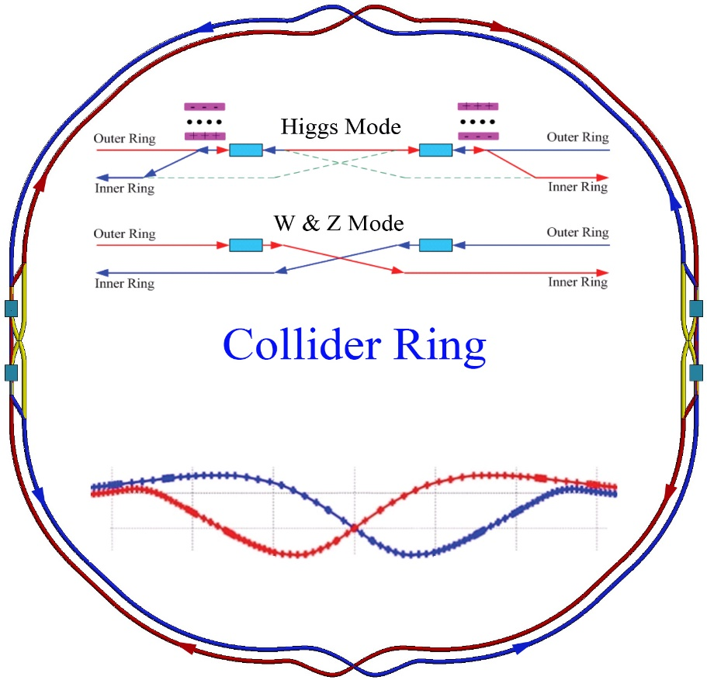
CEPC TDR RF Layout
CDR
CEPC IARC suggests RF cavity by-passes in both Collider ring and Booster ring for TDR parameters.
200 m
half H: 160 m
Z: 80 m
t: 240 m

Slide 6
CEPC TDR RF Parameters (Collider Ring)
30 MW SR power per beam for each mode. ttbar and Higgs half fill with common cavities for two rings, W and Z with separate cavities for two rings, Z upgrade use high current 1-cell cavity with RF bypass. | ttbar |  | Higgs | W | Z
 | Additional 5-cell cavities | Existing 2-cell cavities
Luminosity / IP [10³⁴ cm⁻²s⁻¹] | 0.5 |  | 5 | 16 | 115
RF voltage [GV] | 10 (7.8 + 2.2) |  | 2.2 | 0.7 | 0.12
Beam current / beam [mA] | 3.3 |  | 16.7 | 84.1 | 803.5
Bunch charge [nC] | 32 |  | 20.8 | 21.6 | 22.4
Bunch length [mm] | 2.9 |  | 4.1 | 4.9 | 8.7
650 MHz cavity number | 240 | 240 | 240 | 120/ring | 30/ring
Cell number / cavity | 5 | 2 | 2 | 2 | 1
Gradient [MV/m] | 28.5 | 20 | 20 | 12.7 | 8.7
Q₀ @ 2 K at operating gradient (long term) | 5E10 | 2E10
HOM power / cavity [kW] | 0.4 | 0.16 | 0.45 | 0.93 | 2.9
Input power / cavity [kW] | 194 | 56 | 250 | 250 | 1000
Optimal Q_{L} | 1E7 | 7E6 | 1.6E6 | 6.4E5 | 7.5E4
Optimal detuning [kHz] | 0.01 | 0.02 | 0.1 | 0.9 | 13.3
Cavity number / klystron | 4 | 12 | 2 | 2 | 1
Klystron power [kW] | 1400 | 1400 | 800 | 800 | 1400
Klystron number | 60 | 20 | 120 | 60 | 60
Cavity number / cryomodule | 4 | 6 |  |  | 1
Cryomodule number | 60 | 40 |  |  | 30
Total cavity wall loss @ 2 K [kW] | 9.5 | 4.7 |  | 1.9 | 0.45
Z lower lumi in Stage 1.
If start from Stage 2: W~1/2 Lumi, Z~1/10 Lumi.

Slide 7
CEPC TDR RF Parameters (Booster Ring)
30 MW Collider SR power per beam for each mode. 20 GeV injection. | ttbar | Higgs off/on-axis | W | Z high current
Extraction beam energy [GeV] | 180 | 120 | 80 | 45.5
Extraction average SR power [MW] | 0.087 | 0.09 | 0.01 | 0.004
Bunch charge [nC] | 0.96 | 0.7 | 0.73 | 0.83
Beam current [mA] | 0.11 | 0.56/0.98 | 2.85 | 14.4
Injection RF voltage [GV] | 0.438 | 0.197 | 0.122 | 0.122
Extraction RF voltage [GV] | 9.7 | 2.17 | 0.87 | 0.46
Extraction bunch length [mm] | 1.8 | 1.85 | 1.3 | 0.75
Cavity number (1.3 GHz 9-cell) | 336 | 96 | 64 | 32
Extraction gradient [MV/m] | 27.8 | 21.8 | 13.1 | 13.8
Q₀ @ 2 K at operating gradient (long term) | 1E10
Q_{L} | 4E7 | 1E7
Cavity bandwidth [Hz] | 33 | 130
Peak HOM power per cavity [W] | 0.4 | 1.4/2.7 | 9.8 | 108.5
Input peak power per cavity [kW] | 7.9 | 15.3/21.3 | 15 | 33
SSA peak power [kW] (one cavity per SSA) | 10 | 25 | 25 | 40
Cryomodule number (8 cavities per module) | 42 | 12 | 8 | 4
Higgs and ttbar half fill for injection timing with Collider ring. Transient beam loading tolerable.
Transient beam loading of the booster for Higgs on-axis injection tolerable.
Standard quasi-CW TESLA cryomodules for Higgs, W and ttbar.
Two high current 8x9-cell cryomodules for Z in each ring with RF bypass, as well as more SSAs (or RF power transfer and combine from Higgs SSAs?) even for 50 MW upgrade. Not the limit for booster Z beam current ramp up.
High gradient high Q 9-cell cavities for ttbar. Narrow bandwidth high gradient cavity voltage ramping through the multipacting region to be studied.
SR, RF power, HOM power, cryogenic duty factors to be calculated with the real time structures.

Slide 8
CEPC RF Staging
Assumed upgrade sequence and run time, klystron lifetime ~10 years:
H/W 30/50 MW, Z 10 MW (7+1+2 yrs?)
Collider: 240 2-cell, 250/417 kW input / 1 kW HOM per CAV, 120 1 MW KLY (2 CAVs/KLY)
Booster: 96 9-cell, 25 kW SSA (50 MW: more injections other than increasing SSA power)
Z 30/50 MW (3 yrs?)
Collider: bypass +60/100 high current and deep damping 1-cell, 1 MW input, 3/5 kW HOM per CAV, 60/100 new 1.4 MW KLY. Beam feedback not needed for cavity HOM CBI.
Booster: bypass +32 high current 1.3 GHz cavities (4 modules), 32 40/80 kW SSA
ttbar 30/50 MW (5 yrs?)
Collider: +240 high Q high gradient 5-cell, 200/330 kW input per CAV, 80 1.4 MW KLY power transfer from Z (300 m?), 4 5-cell CAVs / KLY, 14 2-cell CAVs / KLY.
Booster: 336 (+240) 9-cell, +240 10 kW SSA
H/W at ttbar stage?

Slide 9
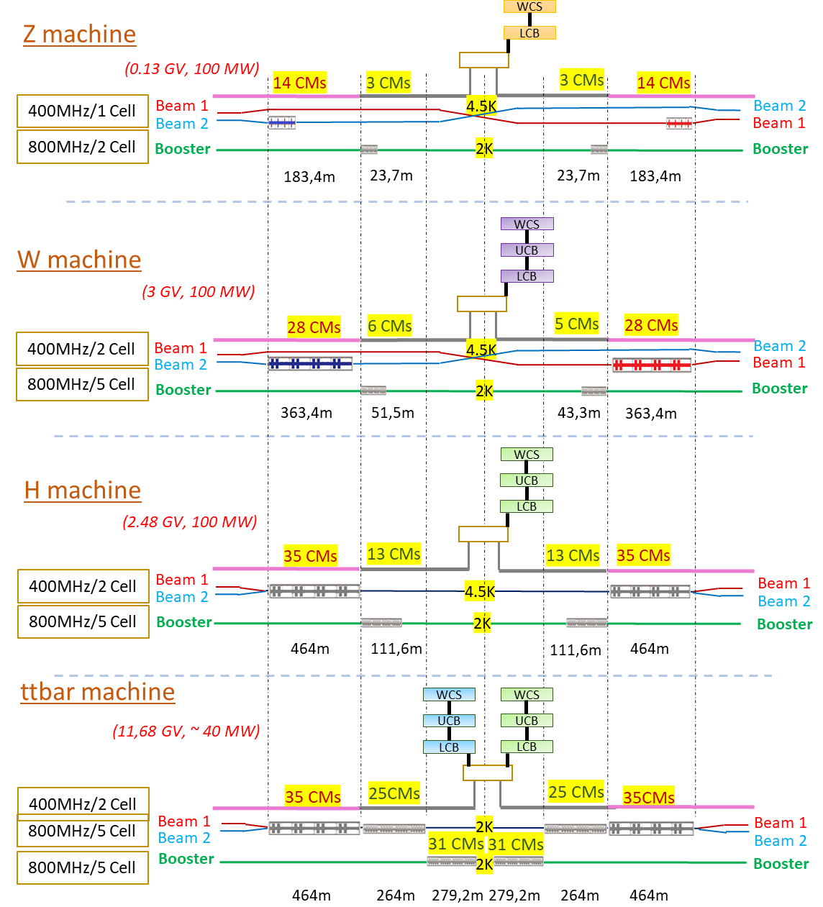
Comparison with FCC-ee RF System
Collider Ring | CEPC 650 MHz | FCC-ee 400/800 MHz
Higgs | 240 2-cell 40 CMs | 280 2-cell 70 CMs
HL-Z | 100 1-cell 100 CMs | 112 1-cell 28 CMs
W | 240 2-cell 40 CMs | 224 2-cell 56 CMs
ttbar | +240 5-cell +60 CMs | +400 5-cell (800 MHz) +100 CMs
BoosterRing | CEPC 1.3 GHz | FCC-ee 800 MHz
Higgs | 96 9-cell 12 CMs | 104 5-cell 26 CMs
HL-Z | 16 9-cell 2 CMs | 24 5-cell 6 CMs
W | 64 9-cell 8 CMs | 44 5-cell 11 CMs
ttbar | 336 9-cell 42 CMs | 496 5-cell 124 CMs
From Raubenheimer’s talk, FCC week 2022

Slide 10
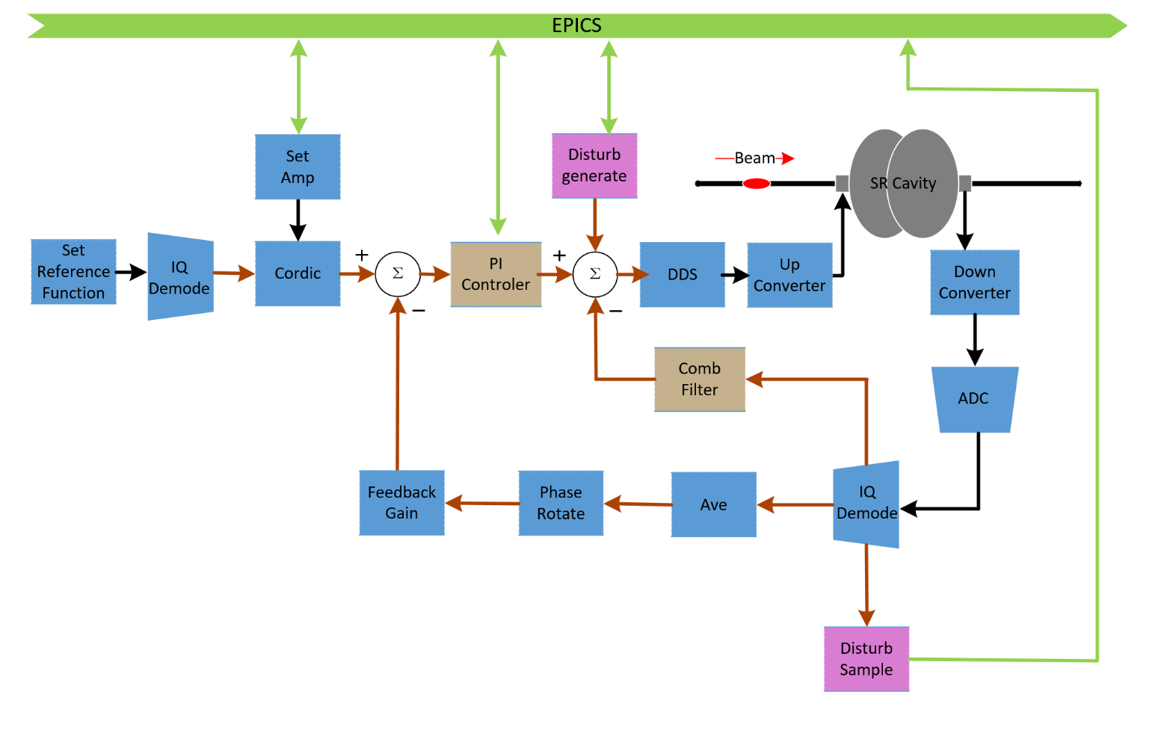
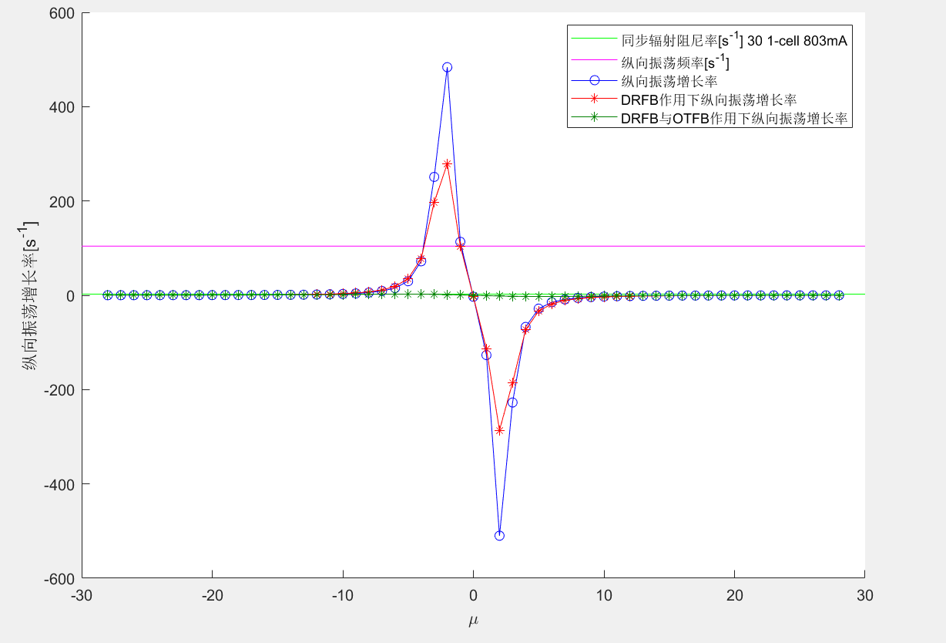
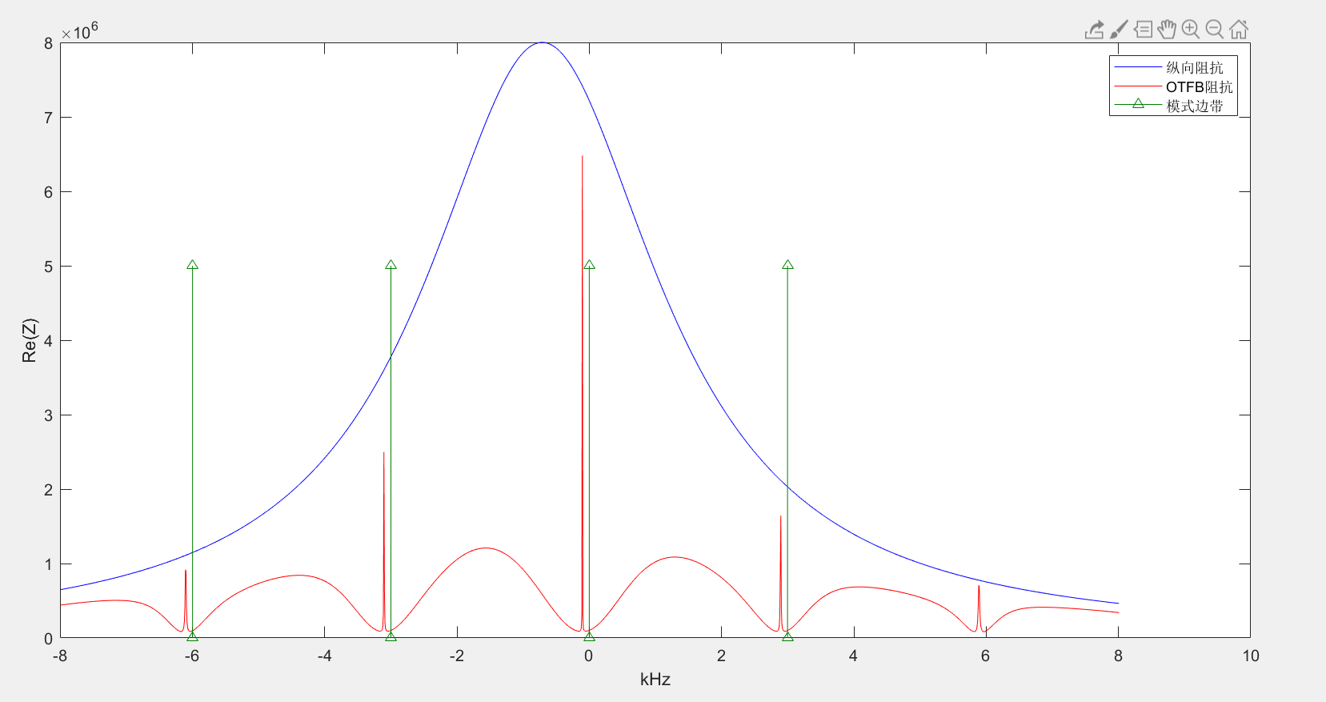
RF Feedback for Cavity FM CBI of HL-Z
Direct RF Feedback and One Turn Delay Feedback.
Stable for 30 MW and 50 MW Z.
Check feedback stability and optimize.
6.7 kHz detuning
OTFB G =100
DRFB Kp = 1.2
106 Hz (9.5 ms)
2.4 Hz (410 ms)
Mode by mode feedback for a few remained unstable modes.
Trade-off between beam (bunch by bunch) feedback and RF feedback.
Longitudinal bunch-by-bunch feedback time ~ 40 ms ?
Impedance reduction by the comb filter

Slide 11
CEPC SRF TDR and Upgrade Hardware Specifications
Suitable for 30/50 MW SR per beam | H, W, Z high gradient & high Q | HL-Z high current & power | ttbar very high gradient & high Q
Collider 650 MHz Cavity at 2 K | 2-cell VT 4E10 @ 22 MV/m HT 2E10 @ 20 MV/m OP 1.5E10 @ 20 MV/m | 1-cell 1E10 @ 8.7 MV/m | 5-cell VT 6E10 @ 32 MV/m HT 5E10 @ 32 MV/m OP 5E10 @ 28.3 MV/m
Booster 1.3 GHz 9-cell Cavity at 2 K | VT 3E10 @ 24 MV/m HT 3E10 @ 22 MV/m OP 1E10 @ 20 MV/m | 1E10@17 MV/m | VT 3E10 @ 32 MV/m HT 2E10 @ 32 MV/m OP 1E10 @ 26.7 MV/m
650 MHz Input Coupler variable | 300/500 kW variable | 1000 kW | 300 kW variable
650 MHz HOM Coupler | 1 kW | \ | 1 kW
650 MHz HOM Absorber | 5 kW | 10 kW | \

Slide 12
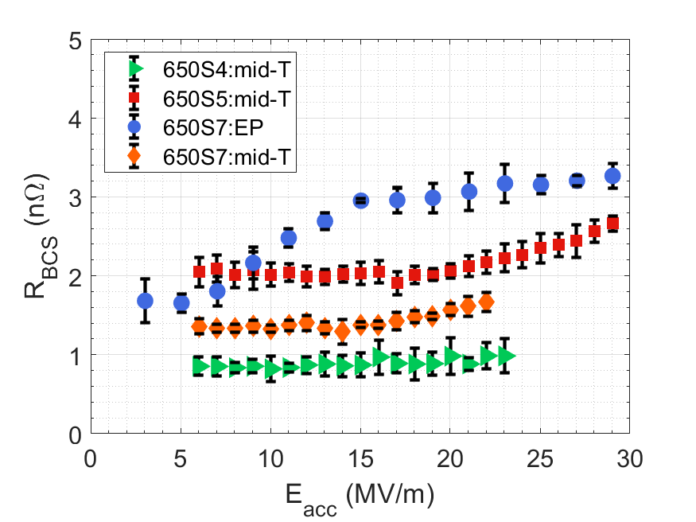
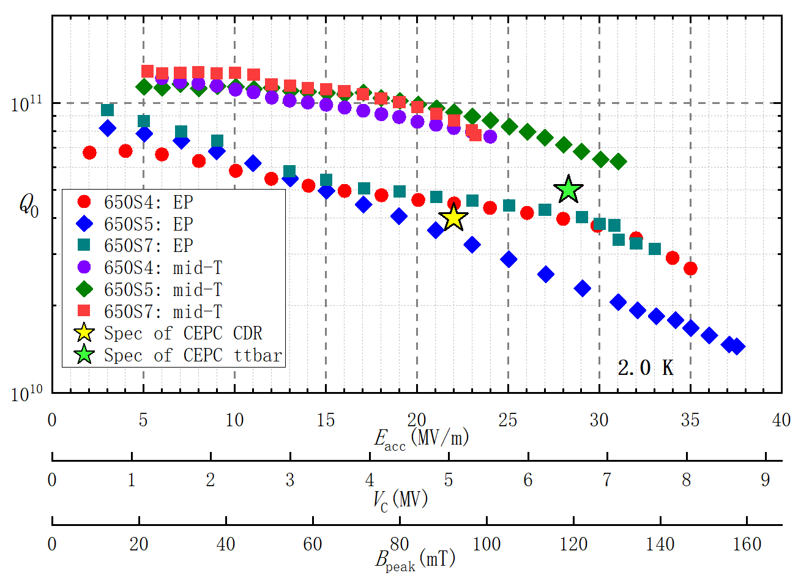
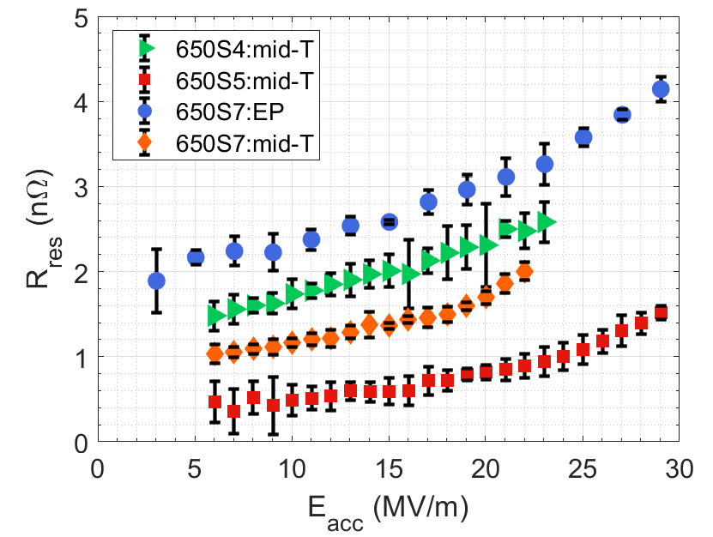
Breakthrough in High Q 650 MHz Cavity
Extremely high Q (> 1E11 up to 20 MV/m at 2 K) of several mid-T treated (900 C 3h + exposure to air + 300 C 3h + HPR) 650 MHz single cell cavities.
Best cavity reaches the world record of 6.4E10 at 31 MV/m at 2 K.
The lowest BCS resistance and residual resistance is only 1 nΩ or even less, significantly decreased relative to EP cavities. Similar ultra low resistance in FNAL’s mid-T baked (after HPR) 1.3 GHz cavities.

Slide 13
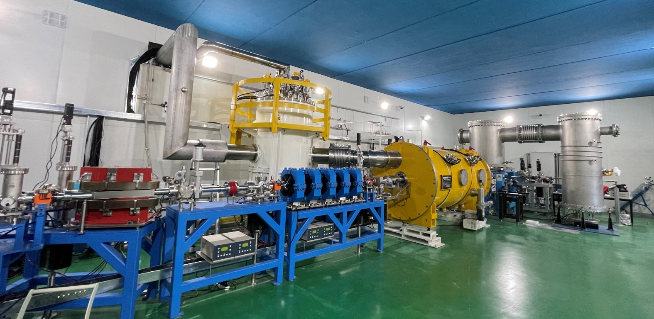
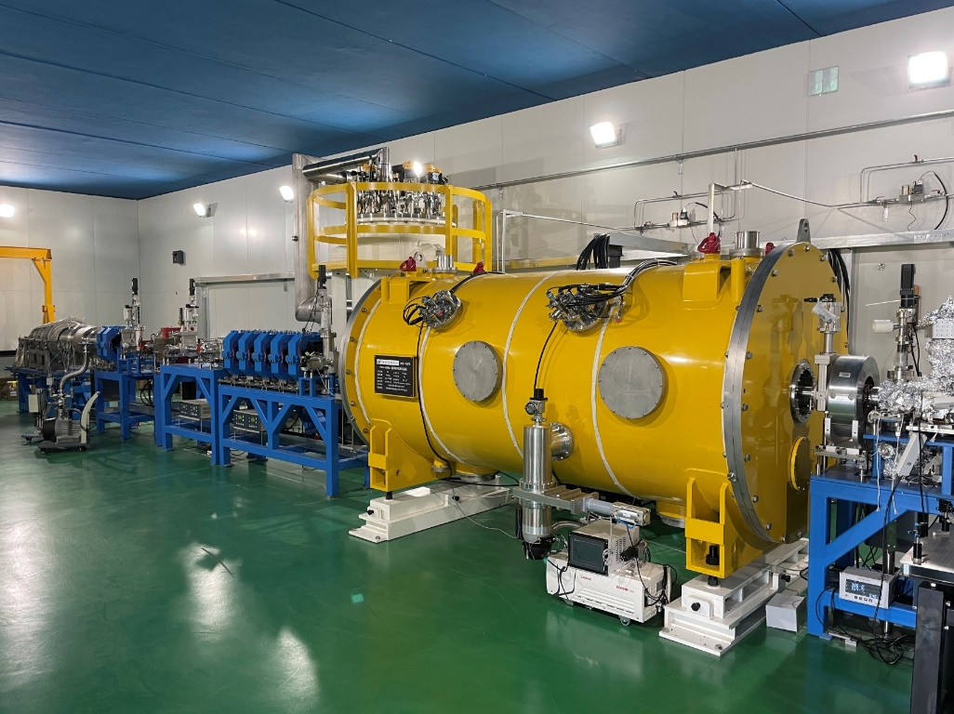
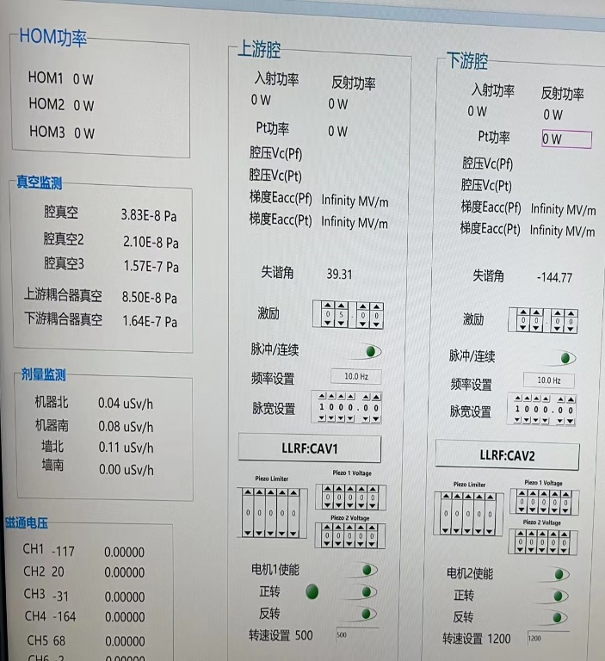
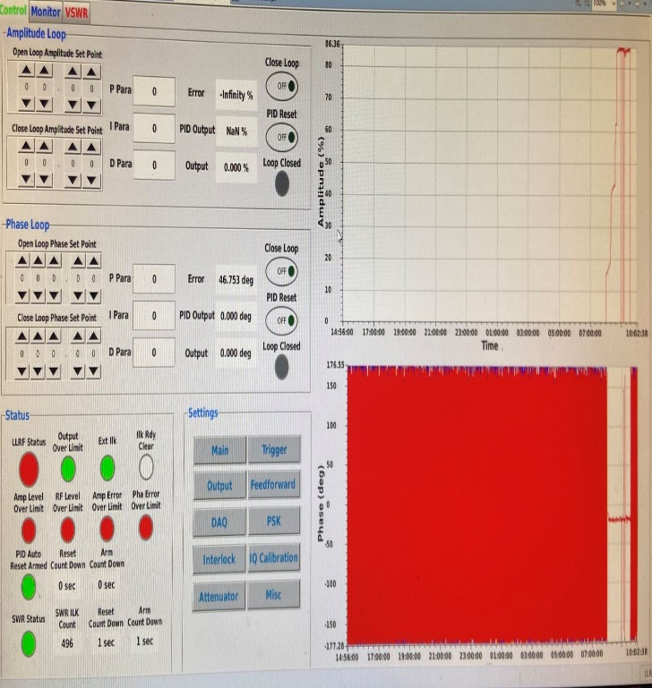
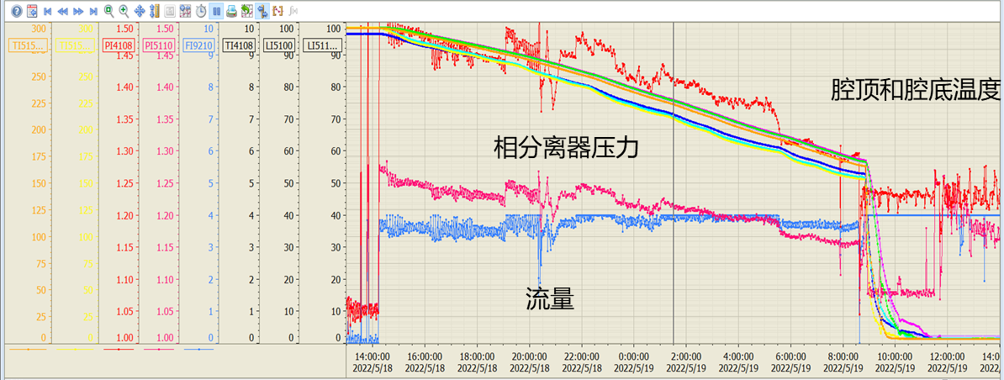
CEPC 650 MHz 2 x 2-cell Test Cryomodule
Module automatic cool-down experiment (first time in China)
  For more intelligent control of future CEPC cavity & cryogenic system
  Designed and implemented automatic cool-down/warming-up procedure for SRF cavity cryomodule with Model Predict Control (MPC) method & Artificial Neural Network (ANN)
LLRF system commissioning and high power test
  Pended in May by local prevention policy. Hope to continue in mid June
DC photo-cathode gun voltage conditioning up to 400 kV
  300 to 150 K: < 10 K/hr. Cavity top and bottom ΔT < 20 K
  150 to 4.5 K: Cavity surface > 1 K/min
  4.5 to 2 K

Slide 14
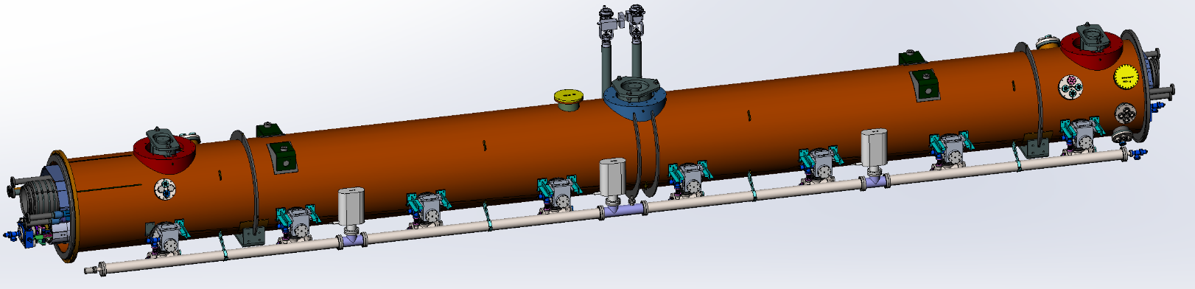
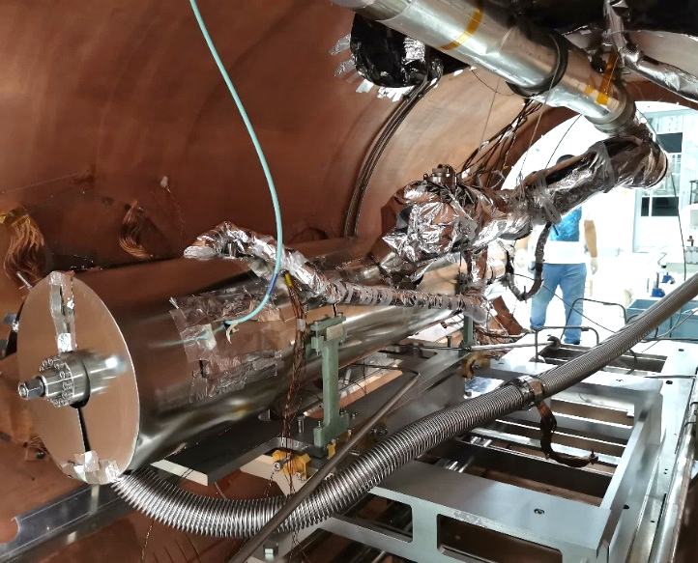
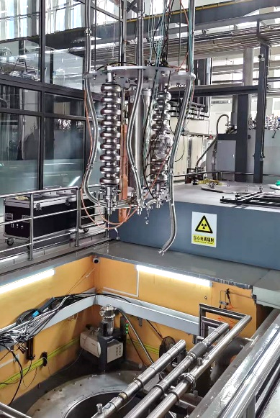
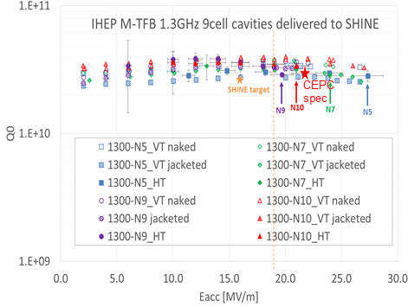
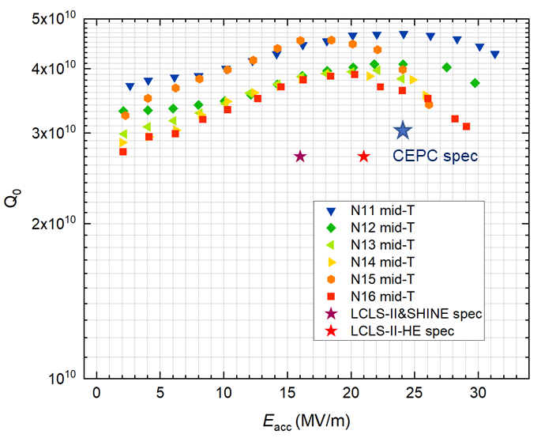
1.3 GHz High Q Cryomodule (8x9-cell)
CEPC booster 1.3 GHz SRF R&D and industrialization in synergy with CW FEL projects.
Mid-T (medium temperature furnace baked) cavities have higher gradient and Q than Nitrogen doped cavities with less EP process (1 vs 3)
Horizontal test of 4 mid-T 9-cell cavities:
avg. Q₀ 3.5E10 @ 16 MV/m, 3.1E10 @ 21 MV/m
avg. E_{acc} 24.6 MV/m, usable 22.6 MV/m (sporadic quench)
horizontal test average performance better than LCLS-II
8 NEW mid-T 9-cell cavities for the 1.3 GHz module:
VT avg. Q₀ 4.1E10 @ 16~21 MV/m, E_{acc} 27.7 MV/m
better than previous batch and LCLS-II-HE cavities.
one cavity now horizontal testing with tuner in GDR mode.
Sporadic quench is a big challenge for high Q cavities.
HT cavity quench after 1 ~ 20 min in 17 ~ 25 MV/m. 1 ~ 5 hours conditioning time needed.
Input coupler related gas absorption? XFEL no such problem.
N/O-doped surface? VT not obvious. Mid-T 300C+HPR vs EP HPR+120C
Horizontal Test (N5/7/9/10)
(self excited loop mode)
Vertical Test (N11-16)

Slide 15
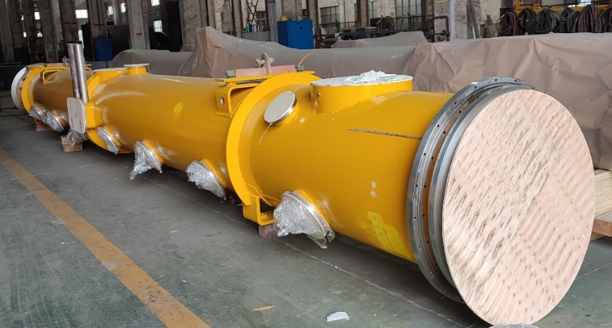
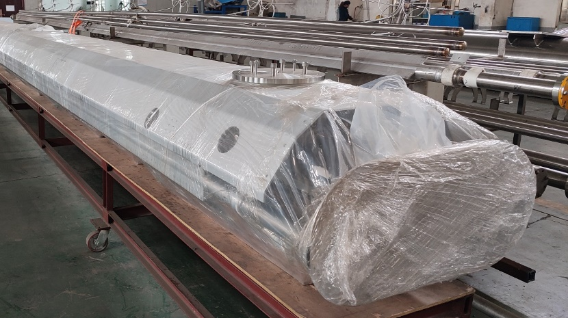
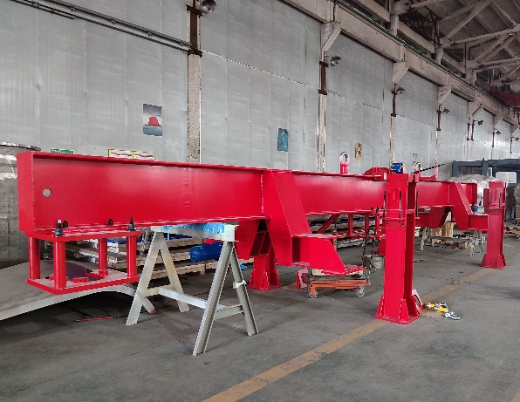
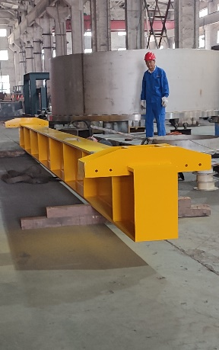
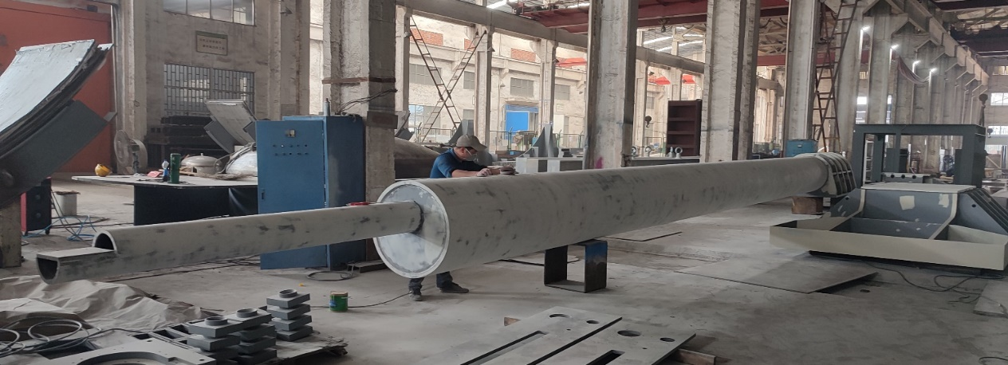
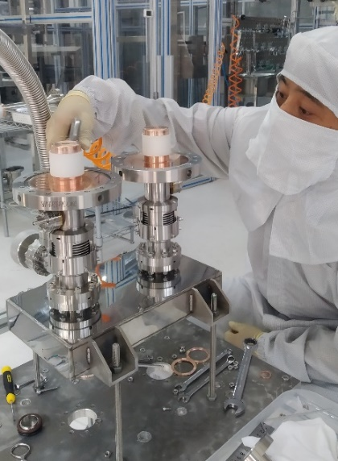
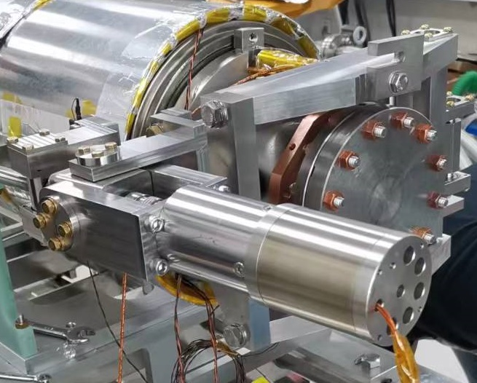
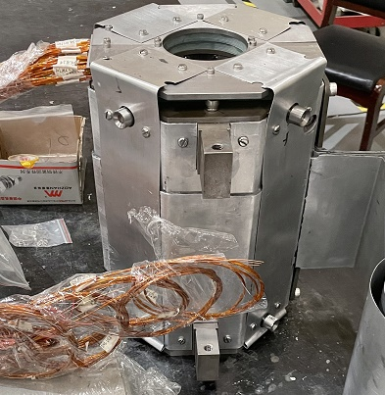
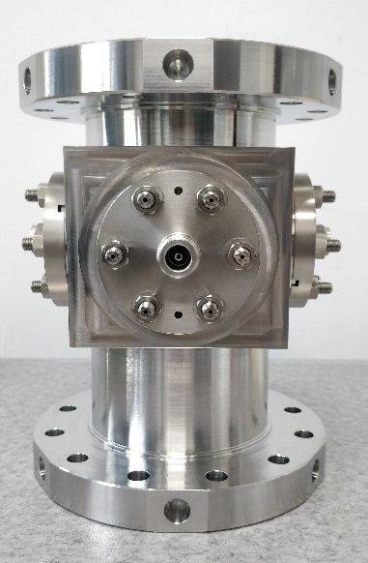
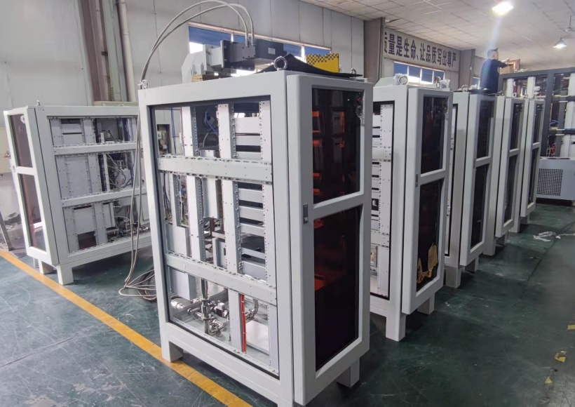
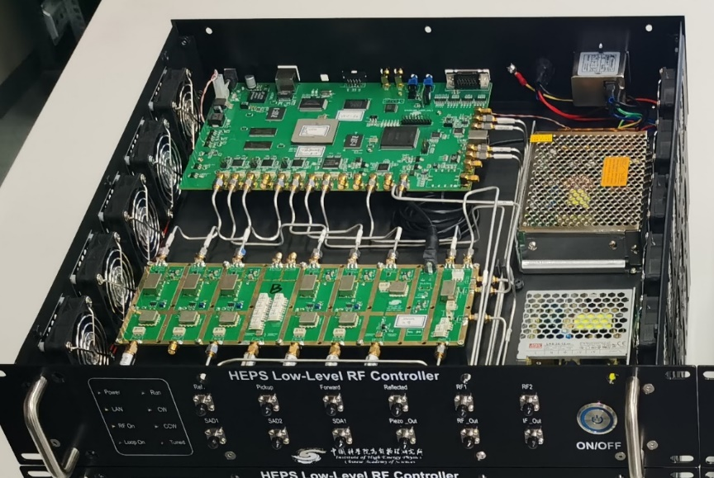
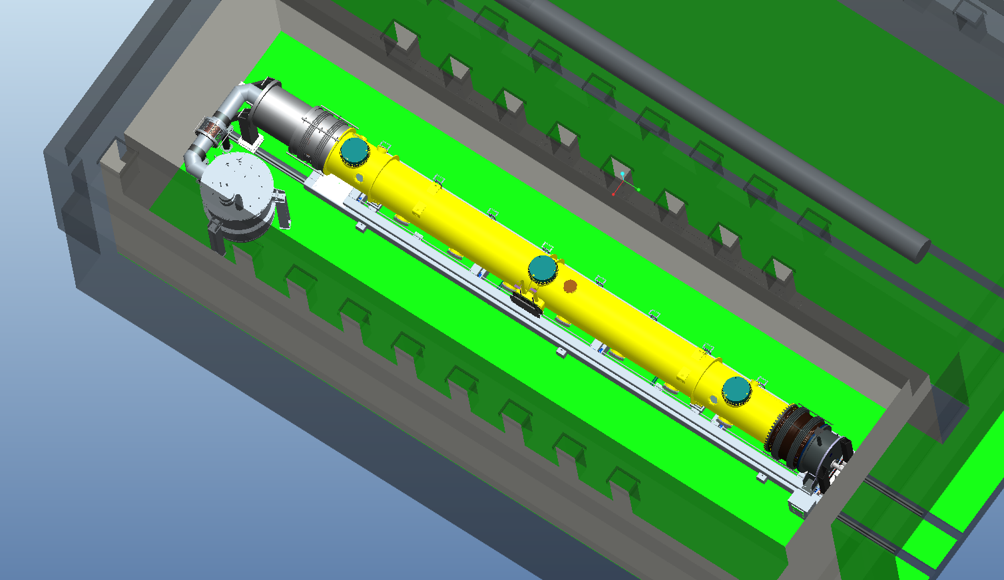
1.3 GHz High Q Cryomodule (8x9-cell)
Vacuum vessel, upper cold mass, assembly tooling, SSAs deliver to PAPS in June
8 cavities, input couplers, tuners etc finish testing at PAPS in June
Superconducting magnet test and degaussing, BPM calibration at IHEP in June
Module cart, feed-cap, end-cap, volve-box, LLRF system ... in fabrication
Cavity string and module assembly at PAPS in August-October
Horizontal test in November

Slide 16
Summary
CEPC TDR SRF layout and parameters are consistent with its own physics run scenario, different from FCC-ee, although they have more and more similar features of each other.
Both 650 MHz and 1.3 GHz high Q cavities already achieved world leading performance. High performance demonstration of the cryomodule is the next major goal.

