Slide 1







Test beam July
F. Cuna for the test beam crew

Slide 2
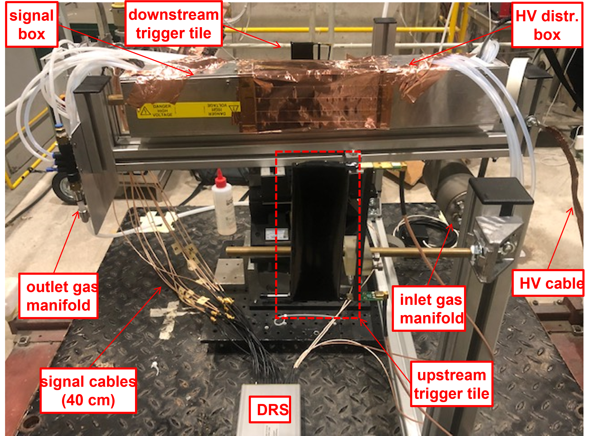
Experimental set up: the first test beam
Keep it simple!
11 drift tubes with different cell size and different material wires and diameter wires, to test different configurations.
30cm
µ beam
165 GeV
1cm
10 µm (Mo+Au)
15 µm (Mo+Au)
3cm
20 µm (W+Au)
25 µm (W+Au)
2cm
40 µm (Al+Au)
The set up consists of:
6 drift tubes 1 cm × 1 cm × 30 cm
  1 with 10 μm sense wire, 1 with 15, 2 with 20 μm, 2 with 25 μm
3 drift tubes 2 cm × 2 cm × 30 cm
  1 with 20 μm sense wire, 1 with 25 μm, 1 with 40 μm
2 drift tubes 3 cm × 3 cm × 30 cm
  1 with 20 μm sense wire, 1 with 40 μm
DRS for data acquisition
Gas mixing, control and distribution (only He and iC₄H₁₀)
2 trigger scintillators

Slide 3
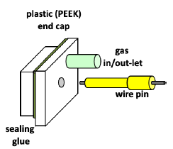
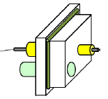
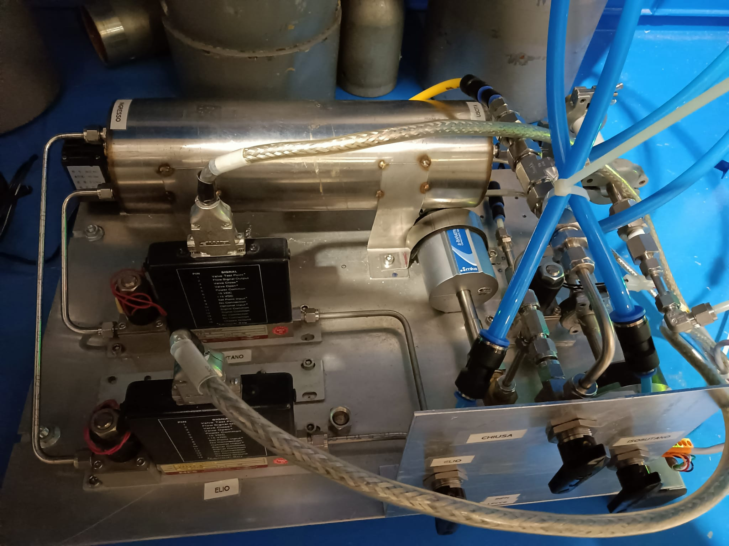
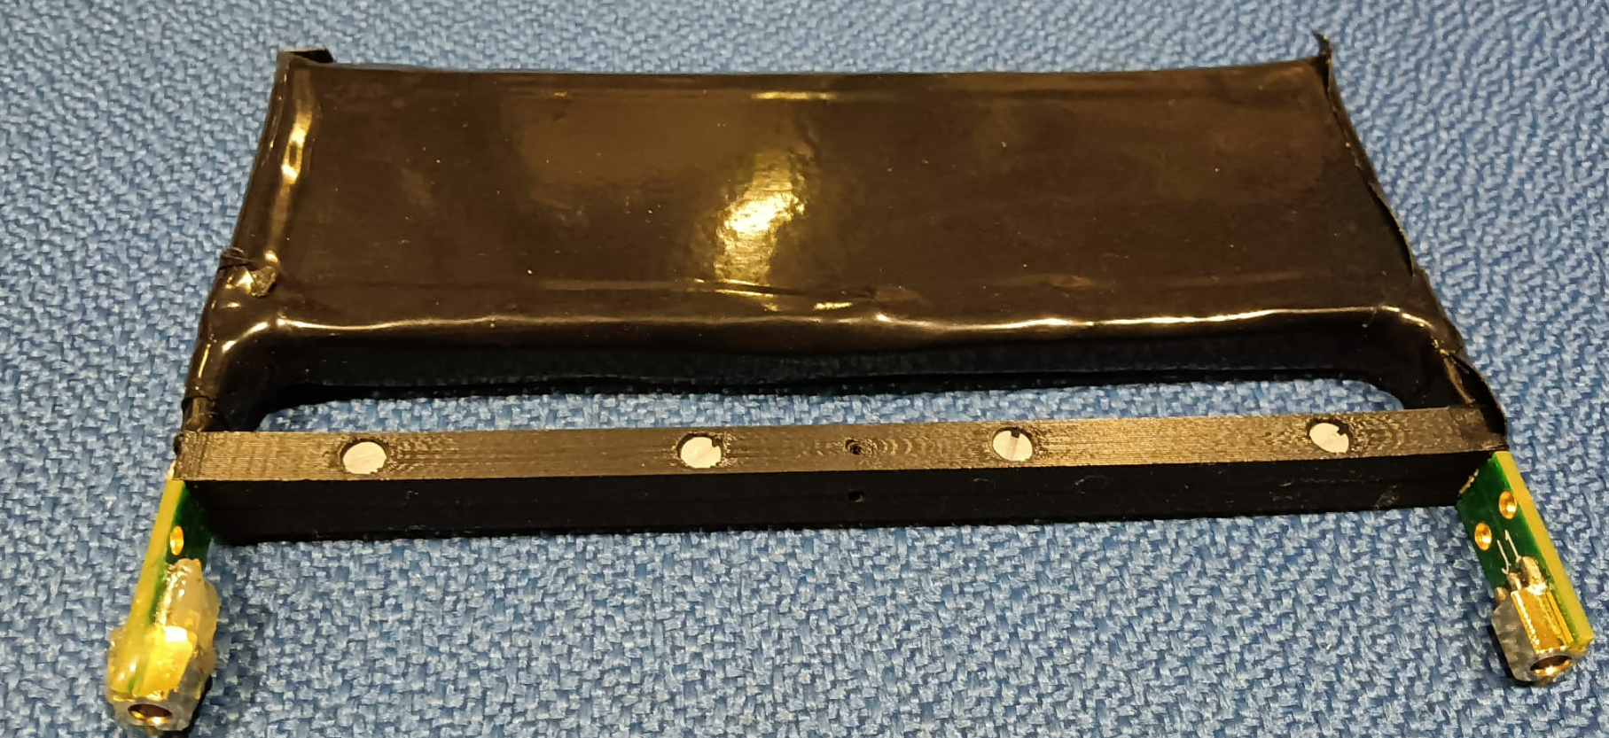
The connecting scheme
SY 1527
Mainframe
1535P
24ch
CAEN
A996
Radiall 691803004
24 leads
HV cable
HV distribution
board
connecting
pin
drift tube
end cap
connecting
pin
HV decoupling
board
Trigger scintillator
Portable gas system
The gas system :
sets the needed gas mixture
checks the gas pressure at the entrance and at the exit of the tubes
maintains constant the gas pressure inside the tubes, by using a proportional valve and a pump.
Barometer for inlet pressure
Pump
Mixer
Flow control valve
Two scintillator tiles (12 cm x 4 cm), placed upstream and downstream of the drift tubes pack, instrumented with SiPM.
Flowmeter
Barometer for outlet pressure

Slide 4
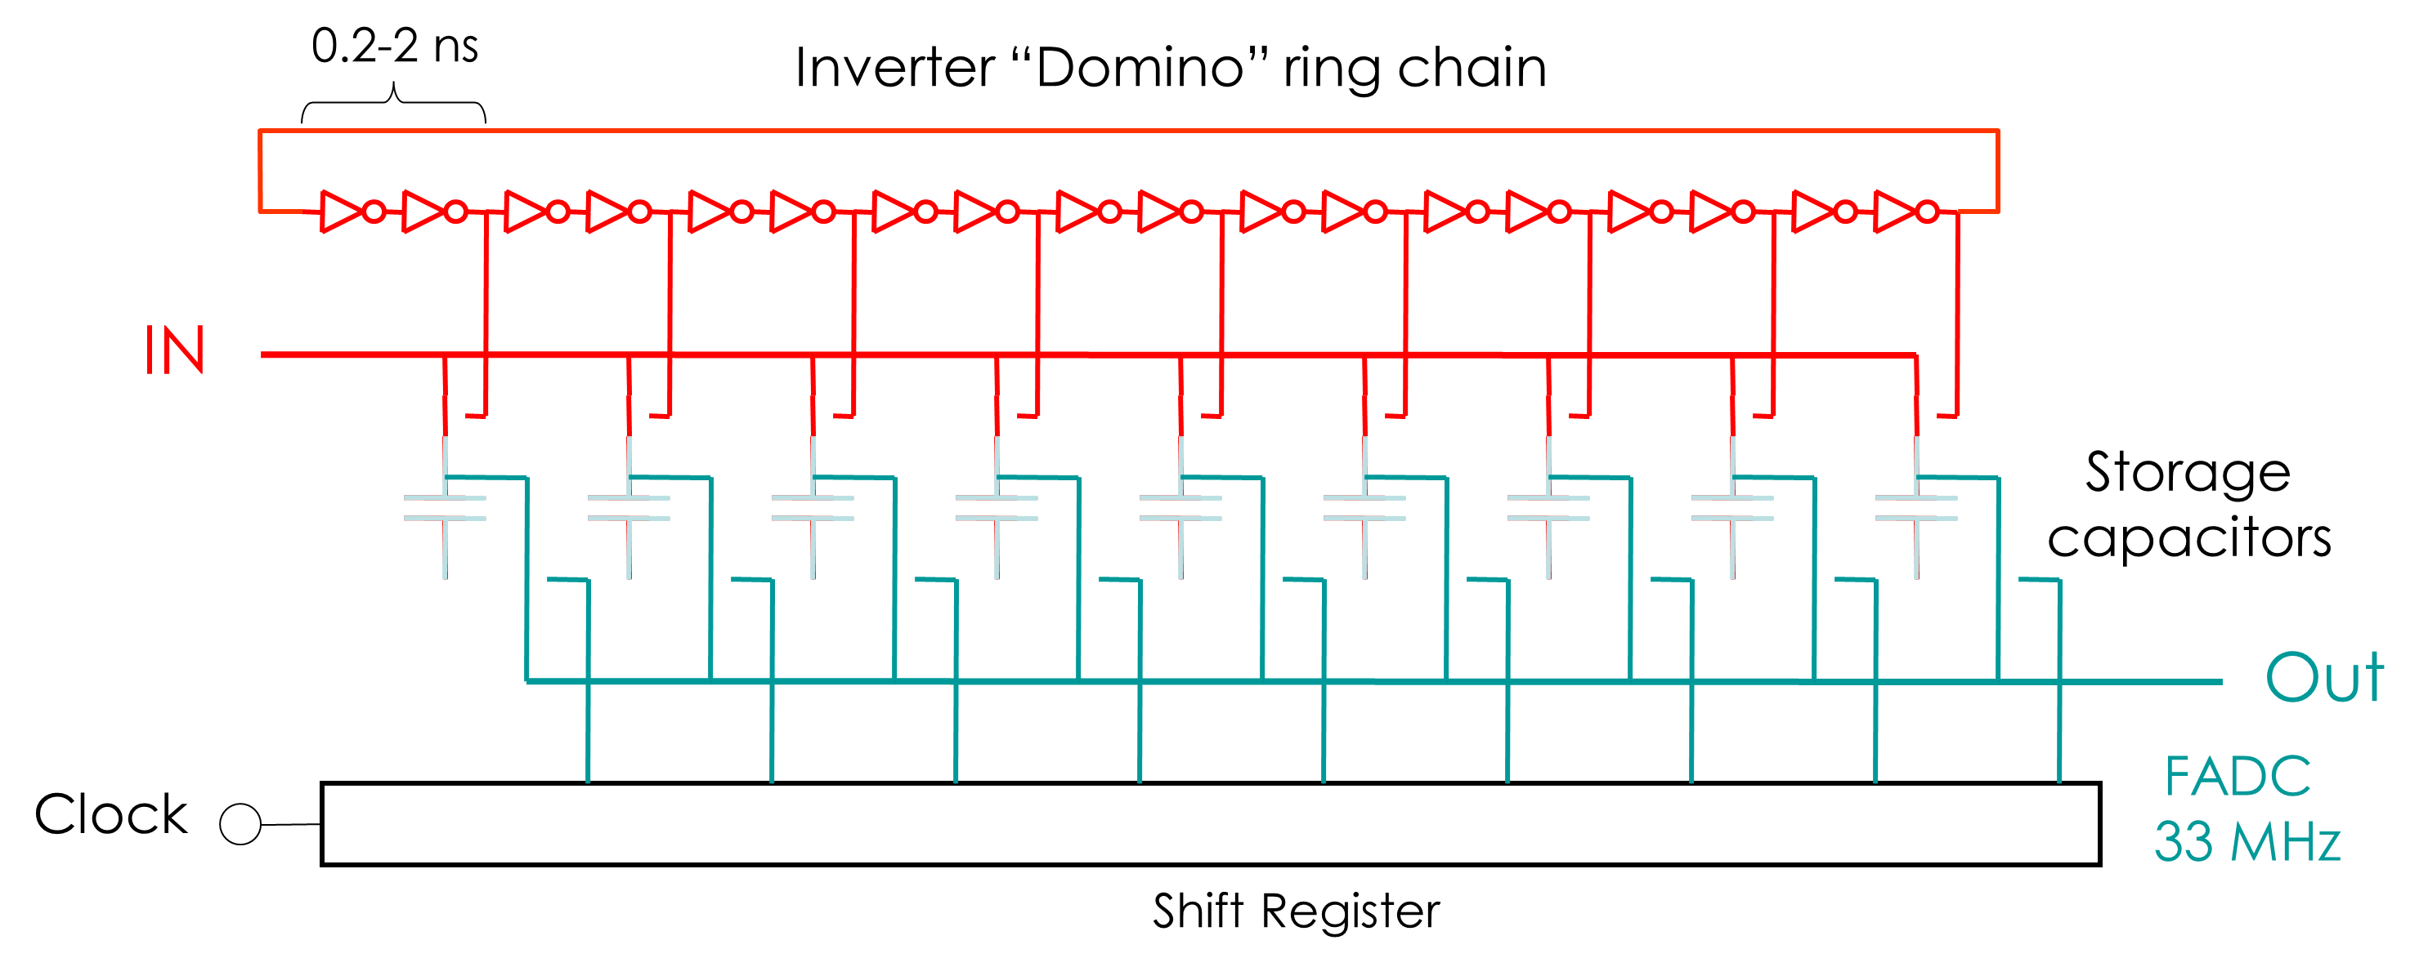
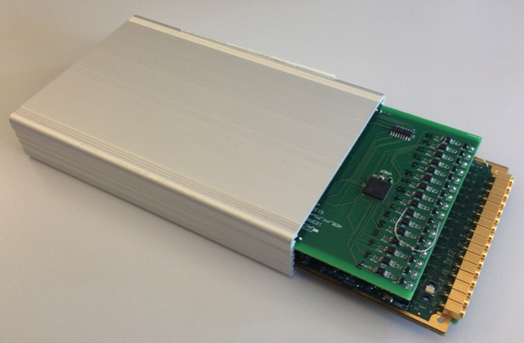
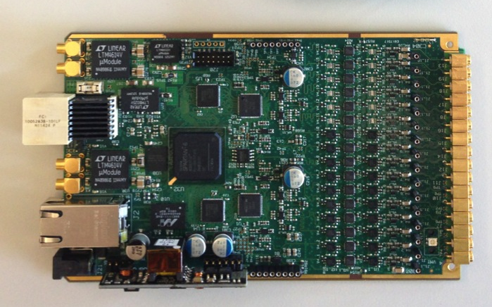
The DAQ system: WDB wave dream board 16 ch Drs4 REAdout Module
Special thanks to the MEG collaboration
16 channels data acquisition board designed and used by the MEG2 experiment at PSI (μ → e + γ)
Analog switched capacitor array: analog memory with a depth of 1024 sampling cells, perform a “sliding window” sampling.
500MSPS ↔ 5GSPS sampling speed with 11.5 bit signal-noise ratio
  8 analog channels + 1 clock-dedicated channel for sub 50ps time alignment
Pile-up rejection O(~10 ns)
Time measurement O(10 ps)
Charge measurement O(0.1%)
The data files have been converted in root format to accomplish the data analysis.
Data at different configuration have been collected:
90%He-10%iC₄H₁₀
80%He-20%iC₄H₁₀
HV nominal (+10,+20,+30,-10,-20,-30)
Angle 0° ,30 °,45 °,60 °
Details at: Application of the DRS chip for fast waveform digitizing, Stefan Ritt, Roberto Dinapoli, Ueli Hartmann, Nuclear Instruments and Methods in Physics Research A 623 (2010) 486–488

Slide 5
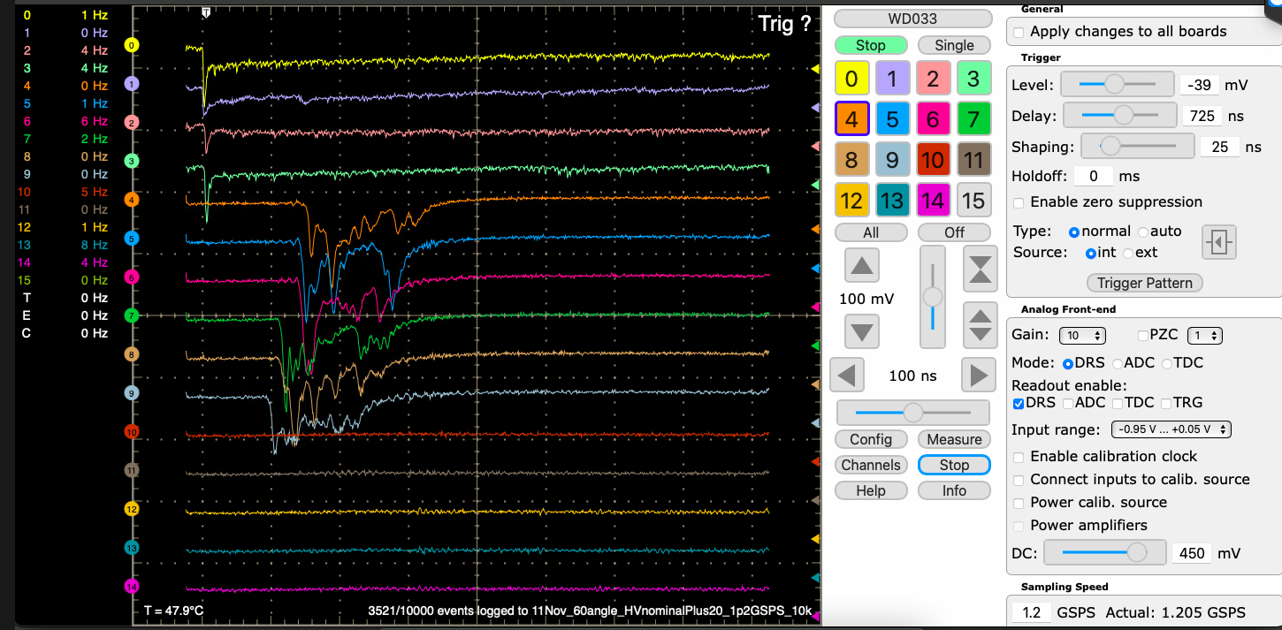
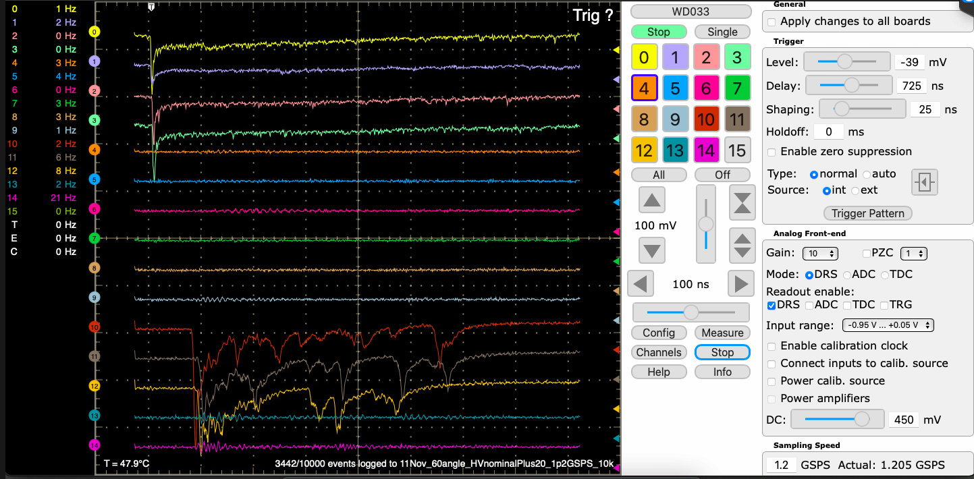
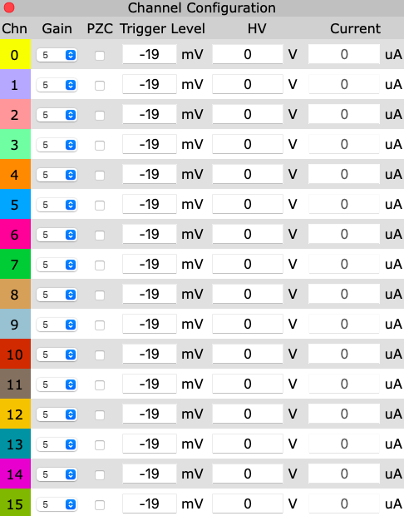
The DAQ system: an oscilloscope interface
WDB interface is similar to the interface of an oscilloscope with 16 channels
Channel selection panel
4 trigger channels
Trigger selection pattern
6 tubes 1 cm cell size with typical event
Gain selection
3 tubes 2 cm cell size
2 tubes 3 cm cell size
Channels setting
typical event

Slide 6
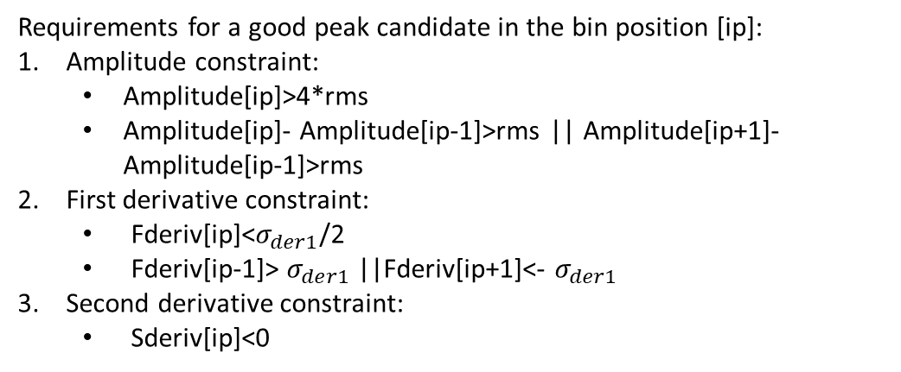
Preliminary results: an efficient algorithm to count electrons
The first and second derivative algorithm (DERIV)
0°, nominal HV+20, 90%He-10%iC₄H₁₀
Tube with 1 cm cell size and 20 µm diameter
Requirements for a good peak candidate in the bin position [ip]:
Amplitude constraint:
  Amplitude[ip]>4*rms
  Amplitude[ip]- Amplitude[ip-1]>rms || Amplitude[ip+1]- Amplitude[ip-1]>rms
First derivative constraint:
  Fderiv[ip]<$σ_{der1}$/2
  Fderiv[ip-1]> $σ_{der1}$||Fderiv[ip+1]<- $σ_{der1}$
Second derivative constraint:
  Sderiv[ip]<0
Expected number of electrons peaks:
Npeak=δcluster/cm(M.I.P.)*drift tube size[cm]*1.3(relativistic rise)*1.6 electron/cluster*1/cos(α)
δcluster/cm(M.I.P.) changes from 12 to 18 respectively for 90%He and 80%iC₄H₁₀
Drift tube size changes from 0.8 to 1.8 respectively for 1 cm and 2 cm cell size tube.
α is the angle of the muon tracks to the detector

Slide 7
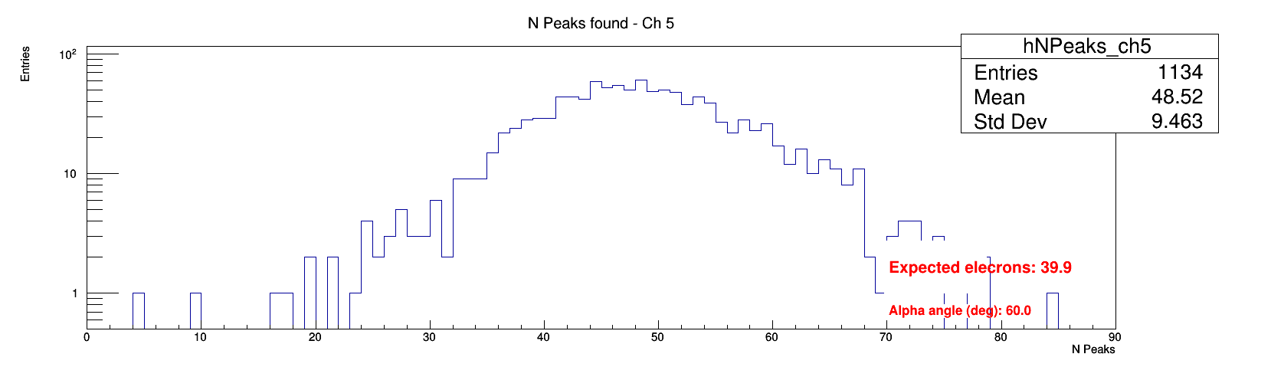
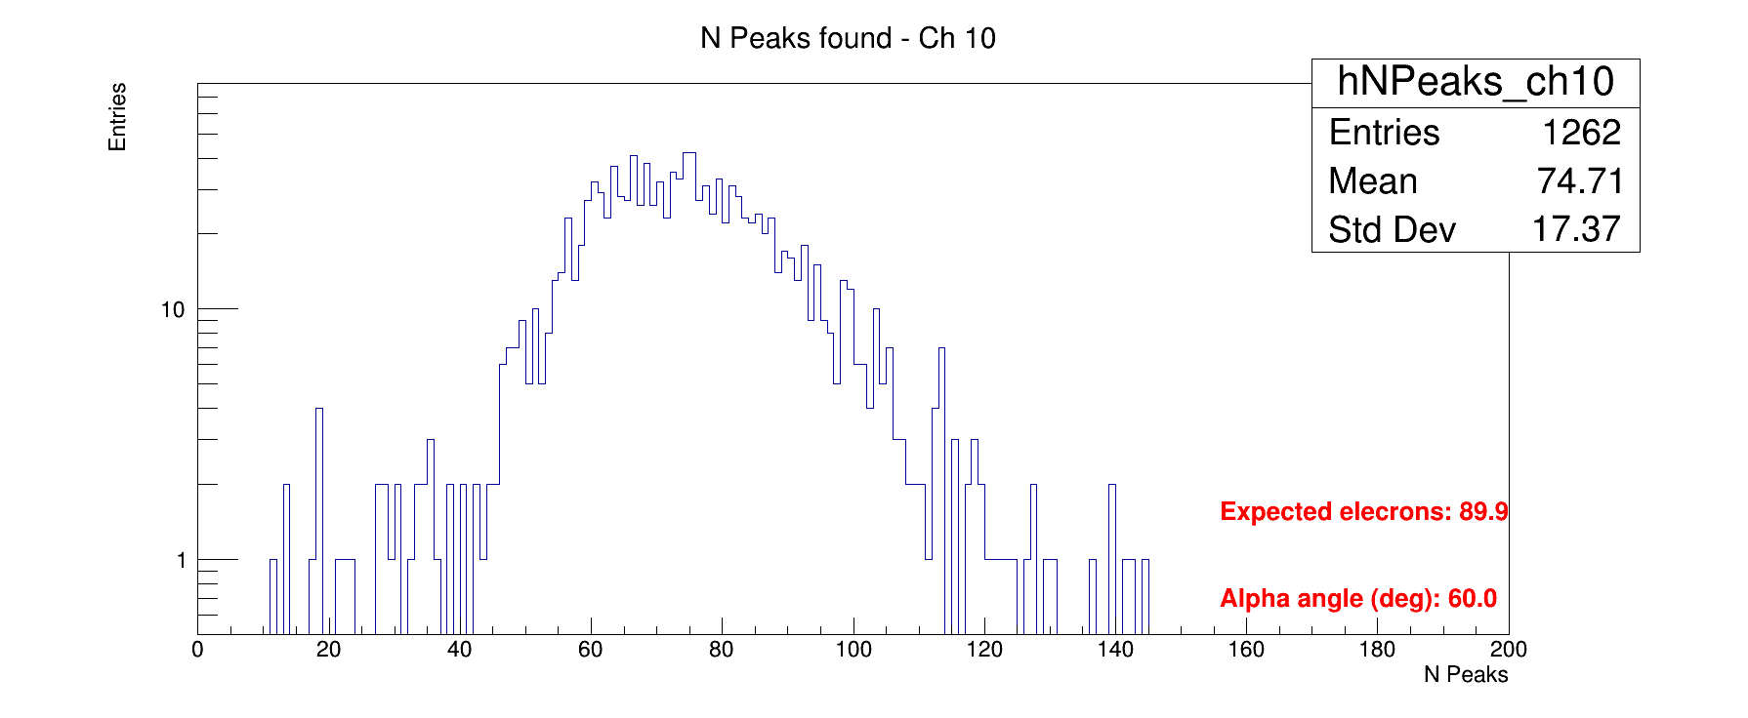
The first and second derivative algorithm: results
1 cm cell size
90%He-10%iC₄H₁₀ 60°
nominal HV+20
2 cm cell size
The mean values are compatible with the ones expected!

Slide 8
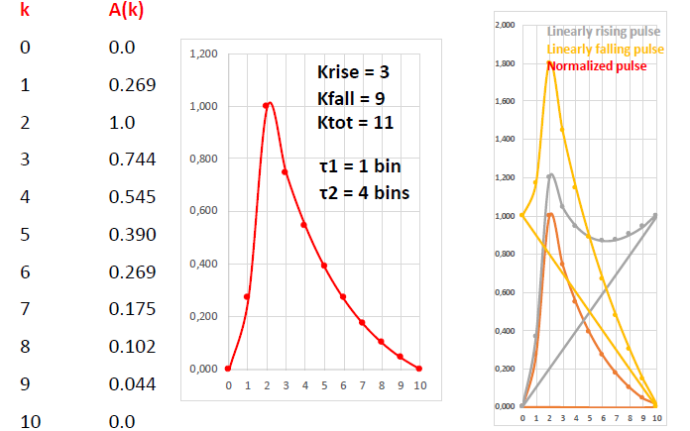
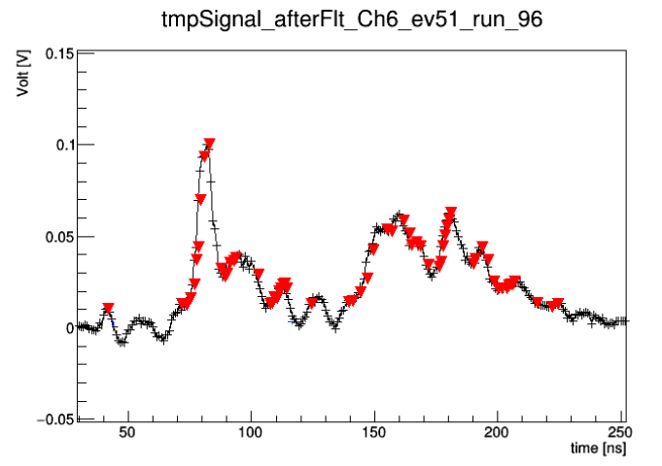
The running template algorithm (RTA)
Define an electron pulse template based on experimental data.
Raising and falling exponential over a fixed number of bins (Ktot).
Digitize it (A(k)) according to the data sampling rate.
Run over Ktot bins by comparing it to the subtracted and normalized data (build a sort of χ2).
Define a cut on χ2.
Subtract the found peak to the signal spectrum.
Iterate the search.
Stop when no new peak is found.
30°, nominal HV+20, 90%He-10%iC₄H₁₀
Tube with 1 cm cell size and 20 µm diameter

Slide 9
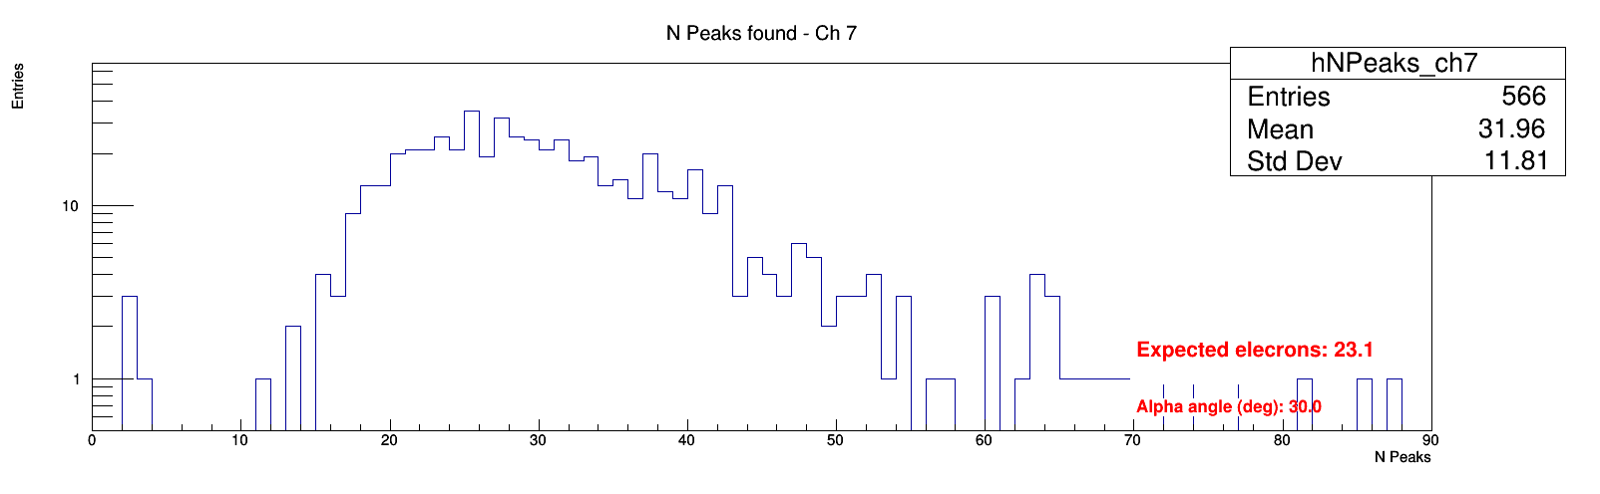
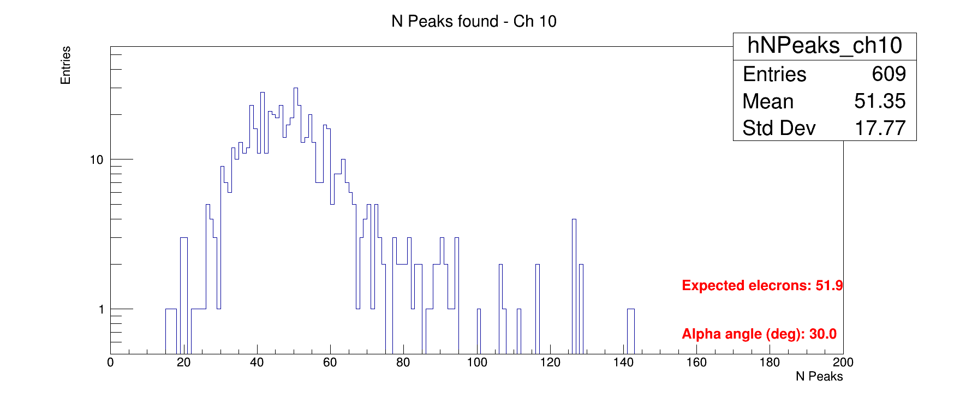
The running template algorithm (RTA): results
1 cm cell size
90%He-10%iC₄H₁₀ 30°
nominal HV+20
2 cm cell size
The mean values are compatible with the ones expected!

Slide 10
A single clusterization algorithm
Once find the electron peaks, clusterization of the electron peaks into ionization clusters has been implemented:
Association of electron peaks consisting in consecutive bins (difference in time == 1 bin) electrons to a single electron in order to eliminate fake electrons.
Contiguous electrons peaks which are compatible with the electrons diffusion time (2.5 ns or 3 bins) must be considered belonging to the same ionization cluster.
Position of the clusters is taken as the position of the last electron in the cluster.
DERIV
RTA

Slide 11
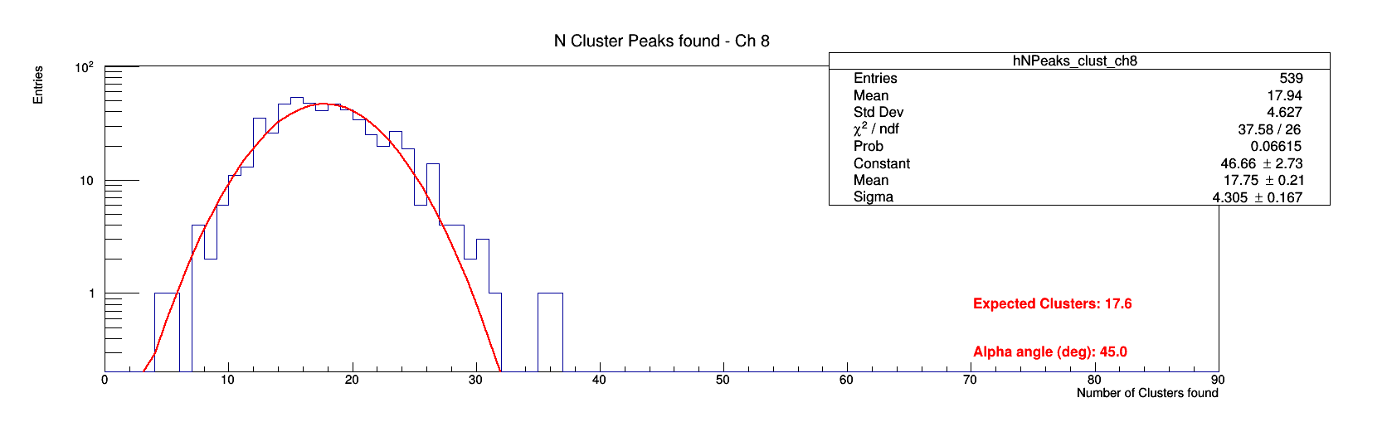
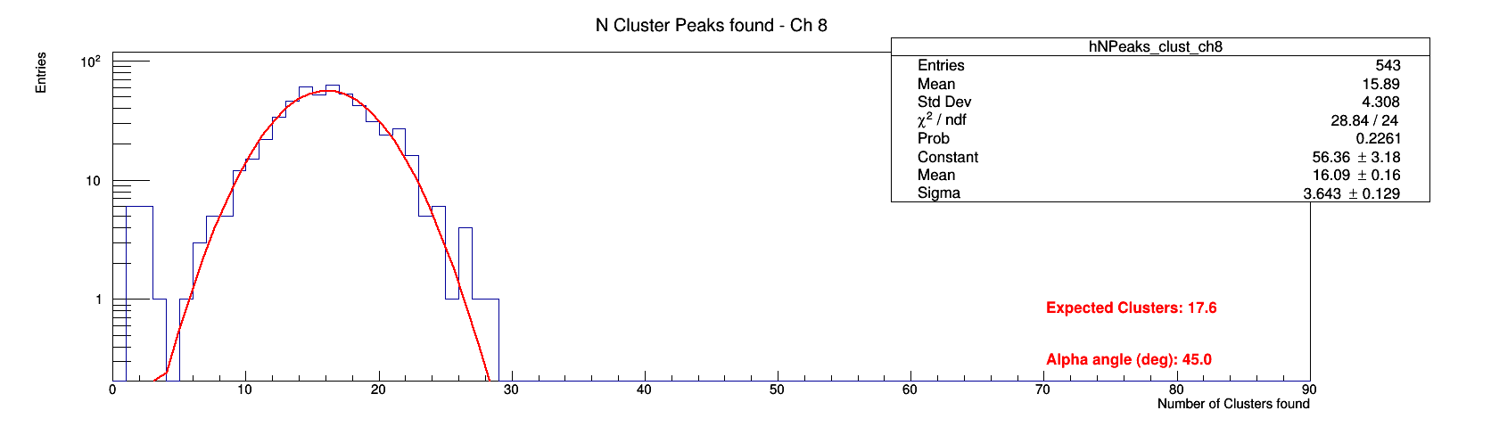
Comparison between the two algorithms
DERIV
POISSONIAN DISTRIBUTION!
RTA

Slide 12
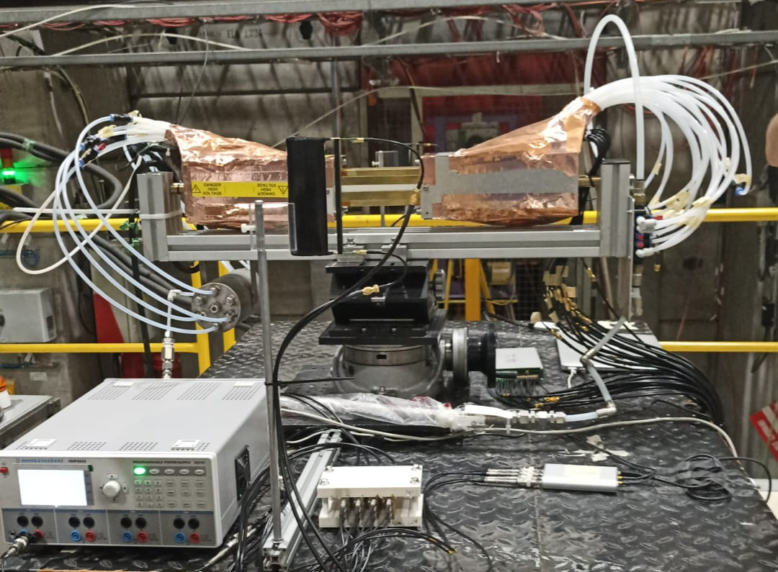
The second part of the test beam
20 tubes with different wires (different material and diameter) and different cell size.
1 16-channel DRS
3 4-channel DRS
The portable gas system
Custom PCBs for the 2 trigger scintillators.
Two external hard disk to store the data collected
1cm
15 µm (Mo+Au)
µ beam
1.5cm
20 µm (W+Au)
1.5cm
25 µm (W+Au)
1cm
NEW CONNECTION SCHEME
Connect the 2 trigger scintillators to a 4-channels DRS
Propagate the trigger signal to the 4-channel DRS and 16-channel DRS, where the tube are connected.
We plan to collect data at different percentages of helium and isobutane:
90-10
85-15
80-20
to study the relativistic rise of the dE/dx and the dN/dx.

Slide 13
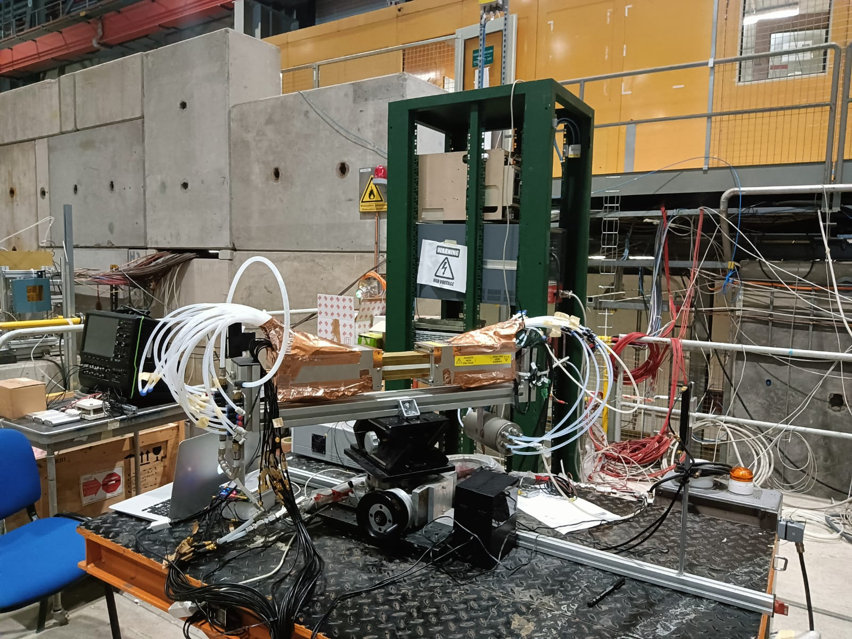
A series of unfortunate events
DRS channels | HV channels | Tubes
0 | 0 | 1.5cm-20µm
1 | 15 | 1.0cm-20µm
2 | 22 | 1.0cm-15µm
3 | 13 | 1.0cm-15µm
4 | 18 | 1.5cm-25µm
5 | 7 | 1.0cm-20µm
6 | 1 | 1.0cm-20µm
7 | 21 | 1.5cm-15µm
8 | 8 | 1.0cm-20µm
9 | 11 | 1.0cm-25µm
10 | 10 | 1.0cm-25µm
11 | 23 | 1.5cm-15µm
12 |  | Upstream scintillator up
13 |  | Upstream scintillator down
14 |  | Downstream scintillator up
15 |  | Downstream scintillator down
During the preparation of the set-up, some of the tube broke:
  1.5cm 25µm
  1.0cm 15µm
  1.5cm 20µm
  1.5cm 20µm
  1.5cm 20µm
  1.0cm 20µm
The idea to propagate the trigger signal didn’t work, so 4 channels of the 16 channels DRS have been used to host the 4 trigger scintillator signals. The association between the DRS channels and the HV channels is reported in the table.
The minimum beam energy available was 40 GeV, at an extremely low rate. So that, we collected data which will be useful to study the Fermi plateau instead of the relativistic rise, as initially planned.
Readout side
HV side
upstream trigger scintillator
16-channels DRS
Hard disks

Slide 14
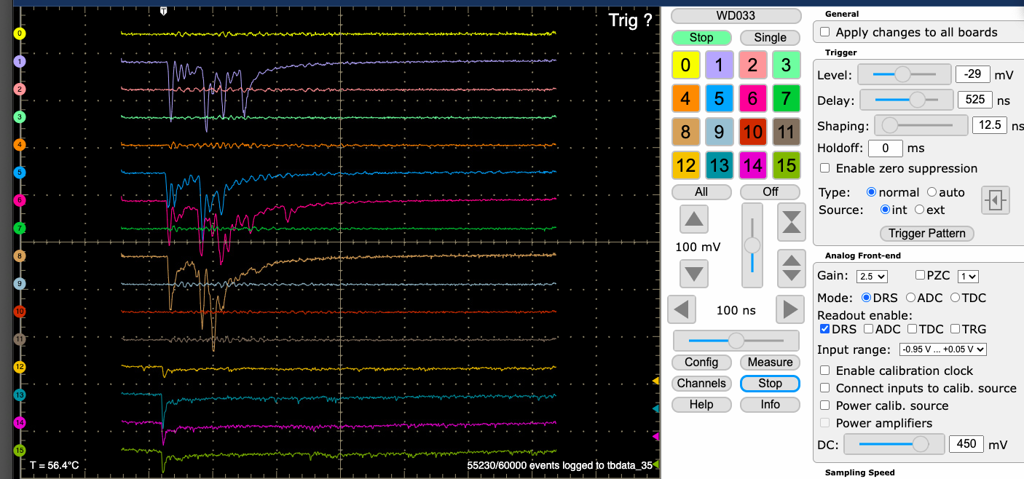
The data collected
Gas mixture (He-iC₄H₁₀) | µ beam energy | Sampling rate | Angles scan | HV scan
90/10 | 180 | 1,1.5,2 | 0,30,45,60 | Nominal,+10,+20,-10
 | 80 | 1 | 45 | Nominal
 | 40 | 1 | 0,45 | Nominal
80/20 | 180 | 1.5,2 | 0,30,45,60 | Nominal,+10,+20,-10
 | 40 | 1 | 0,45 | Nominal
85/15 | 180 | 1,2 | 0,45 | Nominal,+10,+20,-10
~700000 events!
The data have been stored in a Cern box, named TestBeam2022, where you will also find:
Run_table.xlsx with all the details about the data collected, e.g. the muon beam energy, the sampling rate, the HV configuration….
Folder “testbeam2021” with a code to convert the binary file in root file
Folder “TestBeam22 “ with the code which perform a fast data analysis, used as an online monitoring during the beam test.
Folder “converted_data”, with some data already converted in root file, by using the “testbeam2021” conversion code.
Folder “Plots” with some distributions obtained by using the online monitoring code
Ask Brunella to give you the access rights to the TestBeam2022 folder: brunella.danzi@ba.infn.it

Slide 15
THANK YOU!
The test beam crew
C. Caputo¹, G. Chiarello², A. Corvaglia³, F. Cuna^{3,4}, B. D’Anzi^{5,6}, N. De Filippis^{6,7}, F. De Santis^{3,4}, W. Elmetenawee⁶, E. Gorini³, F. Grancagnolo³, M. Greco^{3,4}, S. Gribanov, K. Johnson⁸, A. Miccoli³, M. Panareo³, A. Popov, M. Primavera³, A. Taliercio¹, G. F. Tassielli³, A. Ventura³, S. Xin⁹, Fangyi Guo⁹, Shuaiyi Liu⁹
¹Université Catholique de Louvain, Belgium
²Istituto Nazionale di Fisica Nucleare, Pisa, Italy
³Istituto Nazionale di Fisica Nucleare, Lecce, Italy
⁴Università del Salento, Italy
⁵Università degli Studi di Bari »Aldo Moro», Italy
⁶Istituto Nazionale di Fisica Nucleare, Bari, Italy
⁷Politecnico di Bari
⁸Florida State University
⁹Institute of High energy Physics

Slide 16
Back-up

Slide 17
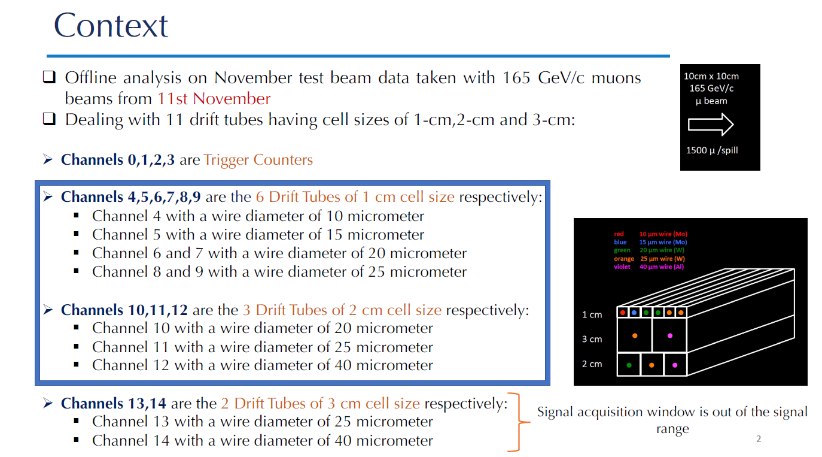

Slide 18
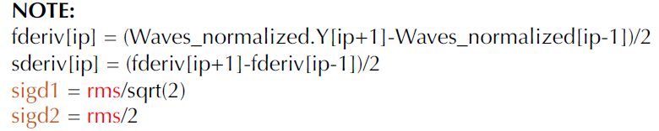

Slide 19
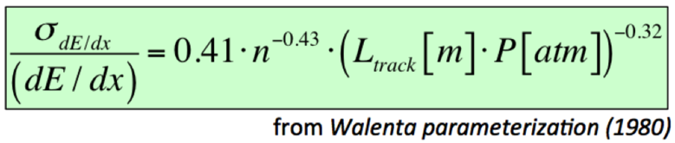
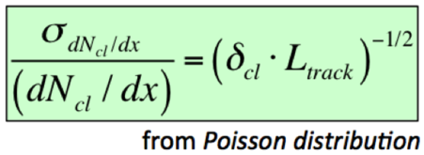
L_{track} = 0.6 m
P = 1 atm
n = 64
L_{track} = 0.6 m
δ_{cl} = 12.5/cm

Slide 20
A new Switch capacitors array(SCA), called the Domino Ring Sampler(DRS)
The recent version, DRS4, is capable of digitizing 9 differential input channels at sampling rates of up to 6 Giga-samples per second(GSPS) with an analogue bandwidth of 950MHz(3 dB).
The channel depth can be configured between 1024 and 8192 cells, and the signal-to-noise ratio allows a resolution equivalent to more than 11 bits.
The high bandwidth, low power consumption and short readout time make this chip attractive for many experiments, replacing traditional ADCs and TDCs.

Slide 21
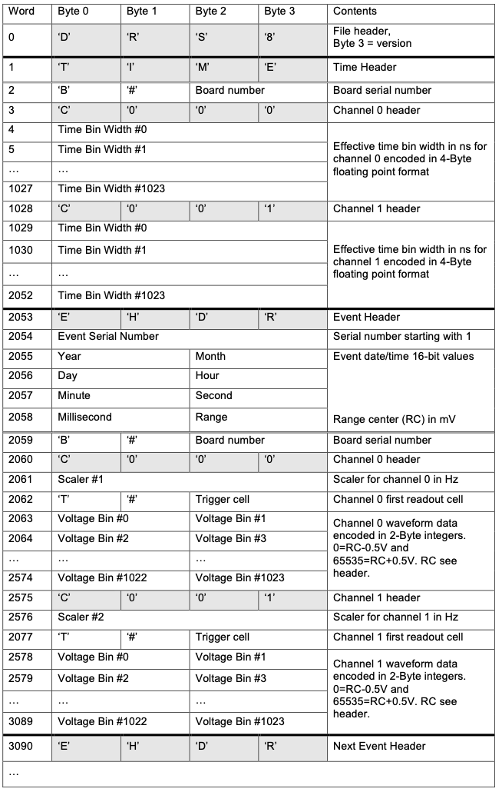
The DAQ system: binary format file
Header relating to the board consisting of the words:
  DRS8
  TIME
  B#XXX (XXX represents the card number and changes according to the WDB, in this case 033)
  Calibration information
Header EVENT
  Serial. Number
  Time information
  Channel Information
The data files have been converted in root format to accomplish the data analysis.
Data at different configuration have been collected:
90%He-10%iC₄H₁₀
80%He-20%iC₄H₁₀
HV nominal (+10,+20,+30,-10,-20,-30)
Angle 0° ,30 °,45 °,60 °

Slide 22
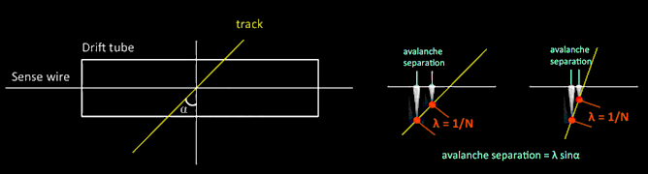
Comparison between the two algorithms
Space charge, attachment and recombination effects affect the experimental cluster counting efficiency

