Slide 1
The Optimization of SITOuter & DCInner Layers’ Position
XiaoJie Jiang
2022/5/20

Slide 2
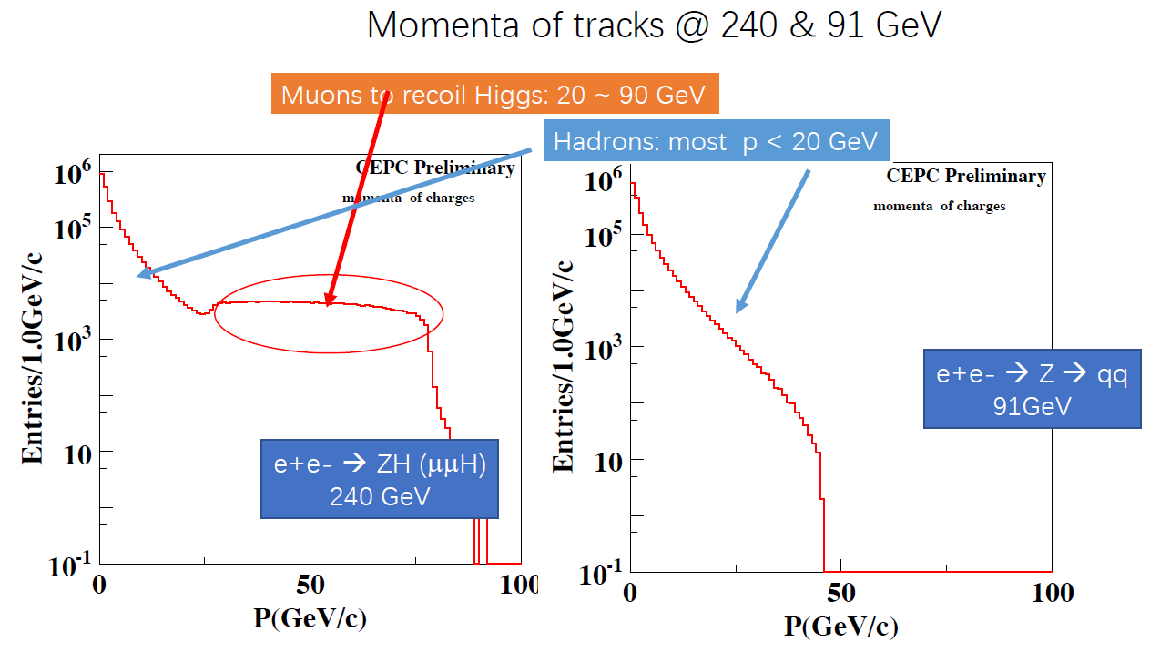
1. Introduction
The 4th CEPC conceptual Tracker
From GangLi
Particle ID with a drift chamber is a key feature for the 4th conceptual detector
Most hadrons from Higgs/Z pole data are below 20 GeV/c
The tracker should have sufficient momentum resolution for particles < 20 GeV/c

Slide 3
1.2 Introduction-CEPC Detector’s geometry

Slide 4
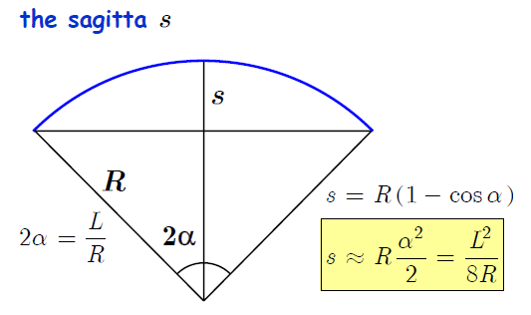
1.Introduction
In order to get a better sagitta value, we thought it’s necessary to place a sensitive enough detector at the middle of a whole Trcker

Slide 5
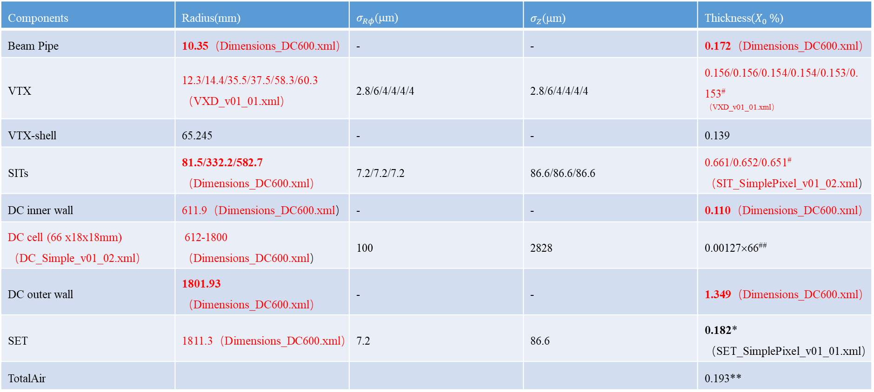
Tracker parameters （600-1800）
From ChengDong Fu
Components | Radius(mm) | $σ_{Rφ}$(μm) | $σ_{Z}$(μm) | Thickness($X_{0 }\%$)
Beam Pipe | 10.35（Dimensions_DC600.xml） | - | - | 0.172（Dimensions_DC600.xml）
VTX | 12.3/14.4/35.5/37.5/58.3/60.3（VXD_v01_01.xml） | 2.8/6/4/4/4/4 | 2.8/6/4/4/4/4 | 0.156/0.156/0.154/0.154/0.153/0.153# ^{（VXD_v01_01.xml）}
VTX-shell | 65.245 | - | - | 0.139
SITs | 81.5/332.2/582.7（Dimensions_DC600.xml） | 7.2/7.2/7.2 | 86.6/86.6/86.6 | 0.661/0.652/0.651#（SIT_SimplePixel_v01_02.xml）
DC inner wall | 611.9（Dimensions_DC600.xml） | - | - | 0.110（Dimensions_DC600.xml）
DC cell (66 x18x18mm) （DC_Simple_v01_02.xml） | 612-1800 （Dimensions_DC600.xml） | 100 | 2828 | 0.00127×66##
DC outer wall | 1801.93（Dimensions_DC600.xml） | - | - | 1.349（Dimensions_DC600.xml）
SET | 1811.3（Dimensions_DC600.xml） | 7.2 | 86.6 | 0.182*（SET_SimplePixel_v01_01.xml）
TotalAir |  |  |  | 0.193**
The red words is the parameters & the files we need to change.

Slide 6
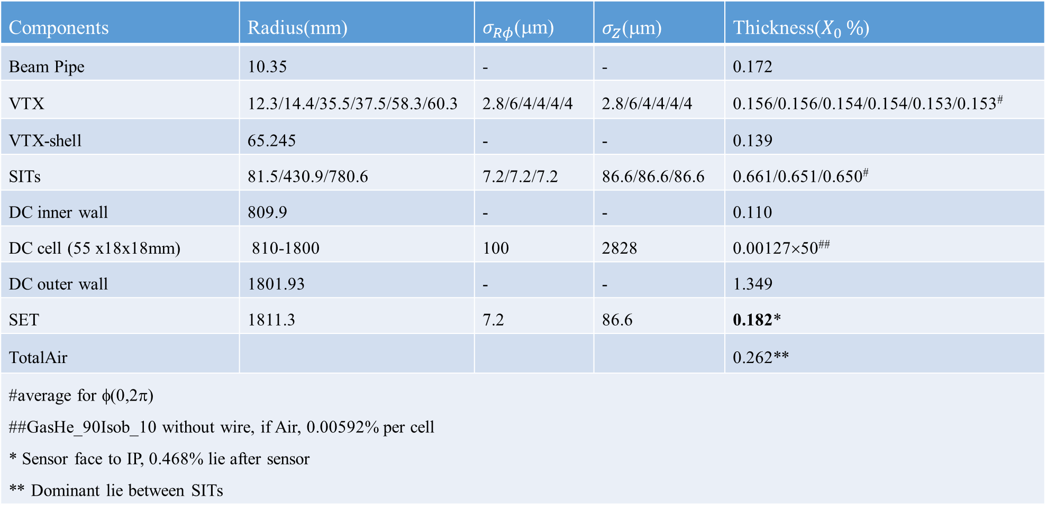
Tracker parameters （800-1800）
Components | Radius(mm) | $σ_{Rφ}$(μm) | $σ_{Z}$(μm) | Thickness($X_{0 }\%$)
Beam Pipe | 10.35 | - | - | 0.172
VTX | 12.3/14.4/35.5/37.5/58.3/60.3 | 2.8/6/4/4/4/4 | 2.8/6/4/4/4/4 | 0.156/0.156/0.154/0.154/0.153/0.153#
VTX-shell | 65.245 | - | - | 0.139
SITs | 81.5/430.9/780.6 | 7.2/7.2/7.2 | 86.6/86.6/86.6 | 0.661/0.651/0.650#
DC inner wall | 809.9 | - | - | 0.110
DC cell (55 x18x18mm) | 810-1800 | 100 | 2828 | 0.00127×50##
DC outer wall | 1801.93 | - | - | 1.349
SET | 1811.3 | 7.2 | 86.6 | 0.182*
TotalAir |  |  |  | 0.262**
#average for φ(0,2π) ##GasHe_90Isob_10 without wire, if Air, 0.00592% per cell * Sensor face to IP, 0.468% lie after sensor ** Dominant lie between SITs

Slide 7
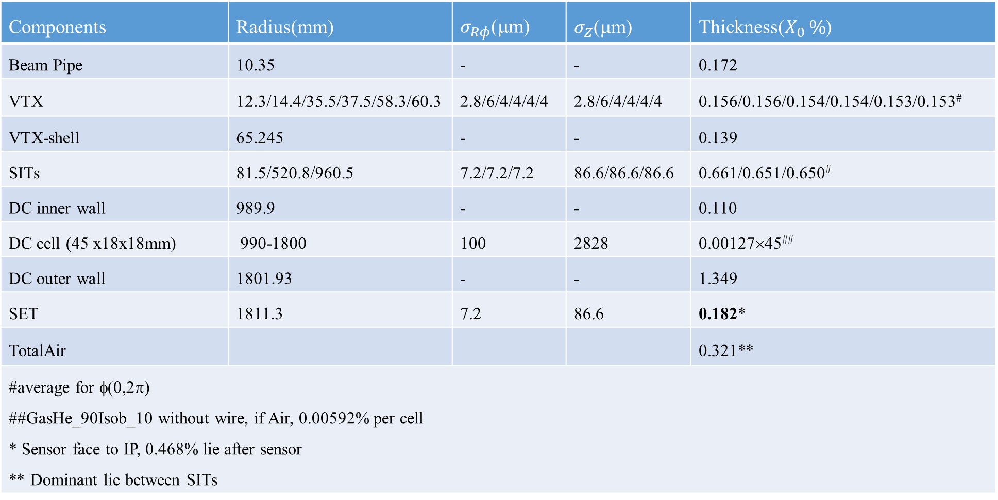
Tracker parameters （1000-1800）
Components | Radius(mm) | $σ_{Rφ}$(μm) | $σ_{Z}$(μm) | Thickness($X_{0 }\%$)
Beam Pipe | 10.35 | - | - | 0.172
VTX | 12.3/14.4/35.5/37.5/58.3/60.3 | 2.8/6/4/4/4/4 | 2.8/6/4/4/4/4 | 0.156/0.156/0.154/0.154/0.153/0.153#
VTX-shell | 65.245 | - | - | 0.139
SITs | 81.5/520.8/960.5 | 7.2/7.2/7.2 | 86.6/86.6/86.6 | 0.661/0.651/0.650#
DC inner wall | 989.9 | - | - | 0.110
DC cell (45 x18x18mm) | 990-1800 | 100 | 2828 | 0.00127×45##
DC outer wall | 1801.93 | - | - | 1.349
SET | 1811.3 | 7.2 | 86.6 | 0.182*
TotalAir |  |  |  | 0.321**
#average for φ(0,2π) ##GasHe_90Isob_10 without wire, if Air, 0.00592% per cell * Sensor face to IP, 0.468% lie after sensor ** Dominant lie between SITs

Slide 8
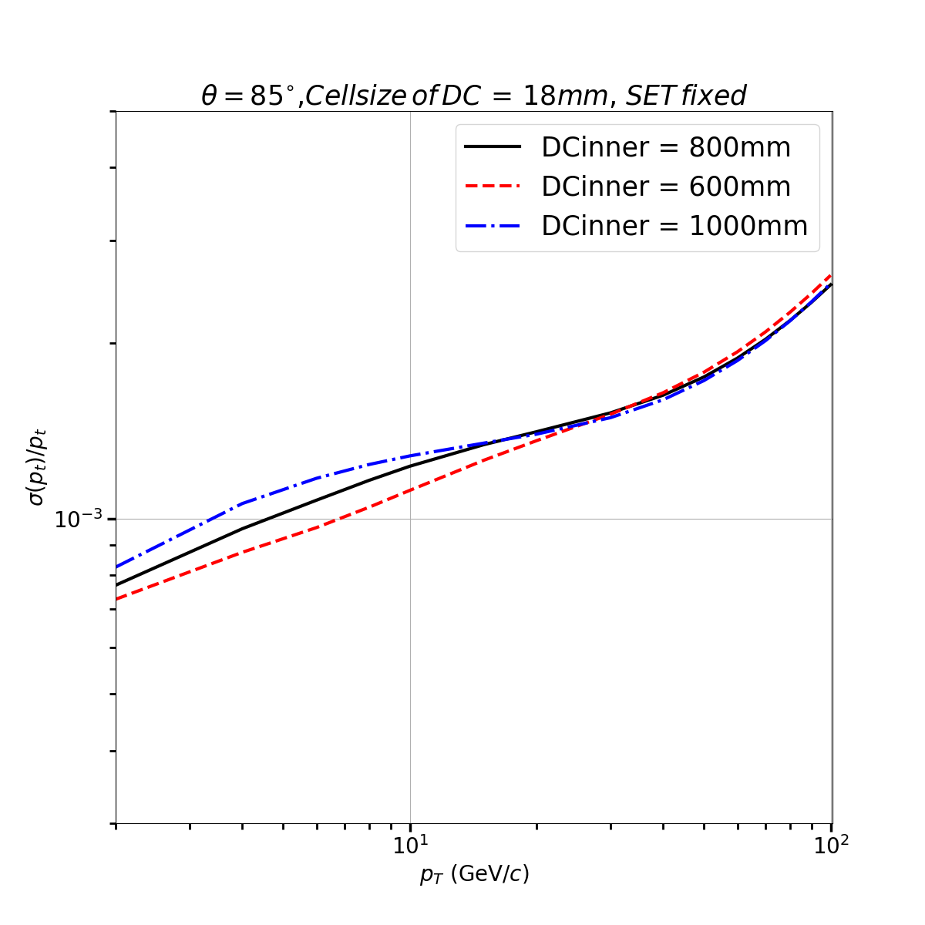
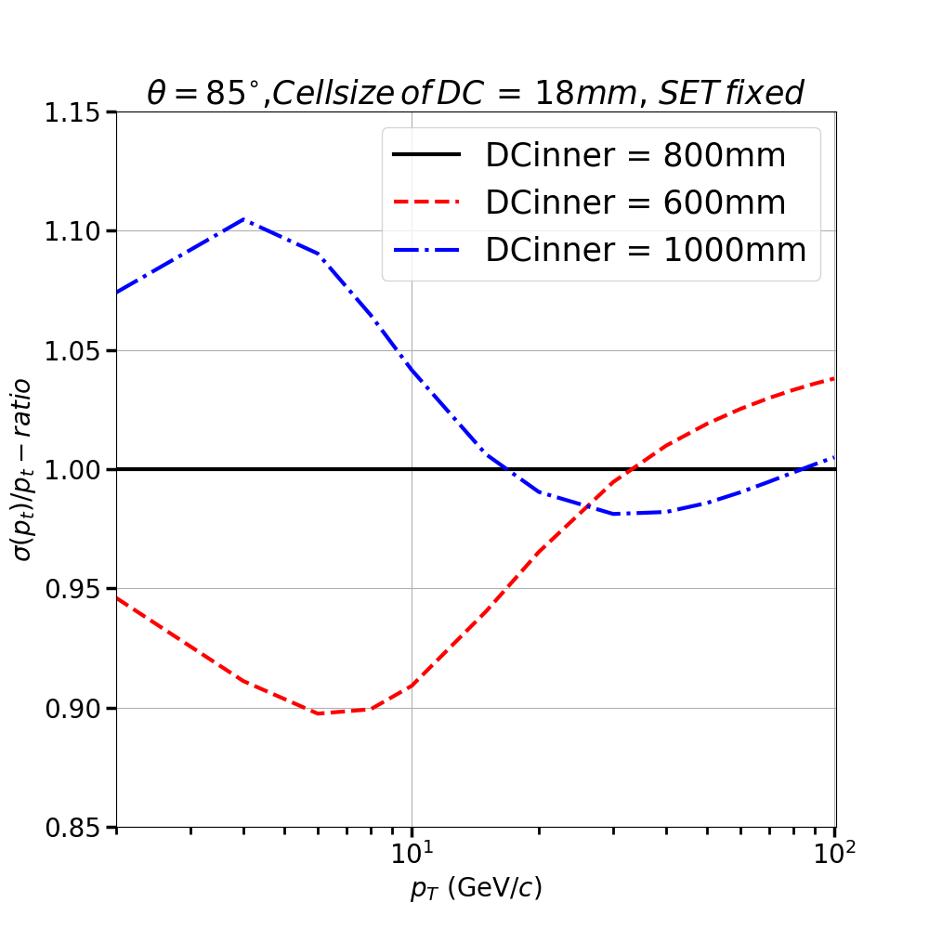
2.Fast Calculation’s result
The Dcinner = 600mm is better.

Slide 9
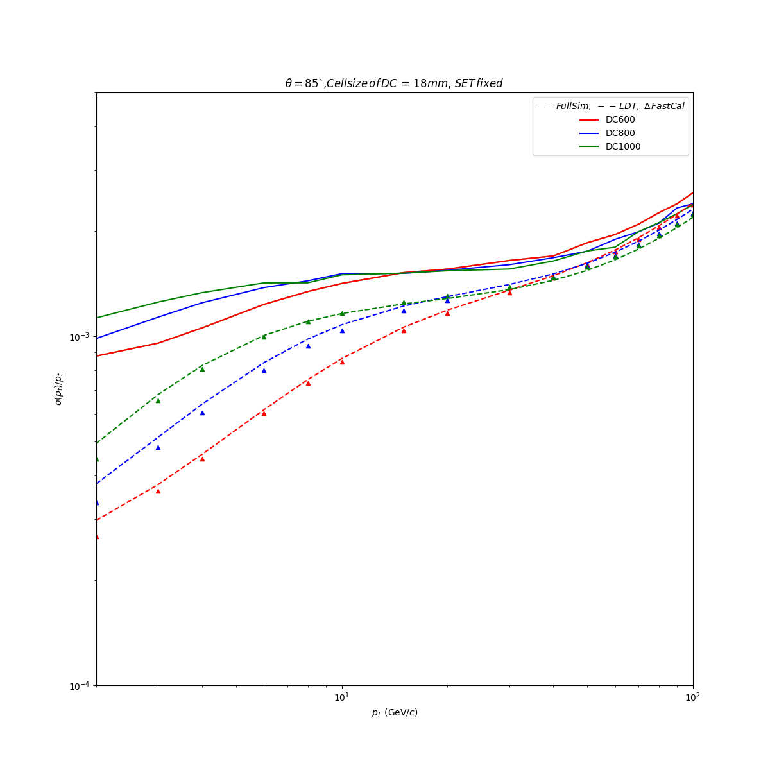
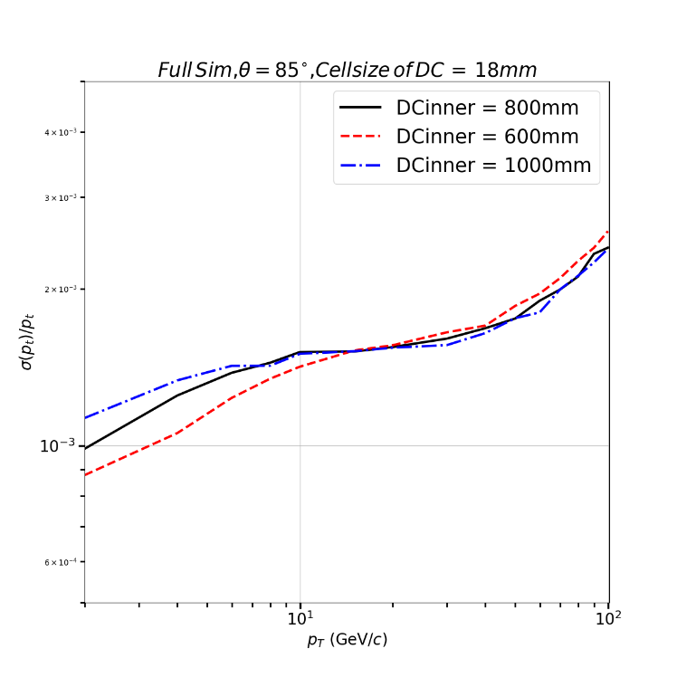
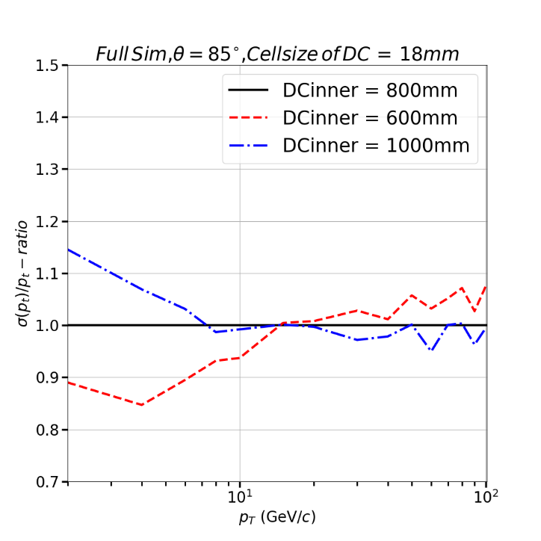
3. The verification by other tools
Compare the Full sim, LDT, Fast cal
CEPCSW’s result
The result is similar.

Slide 10
3. The verification by other tools
Compare the Full sim, LDT, Fast cal
CEPCSW’s result
The result is similar.

Slide 11
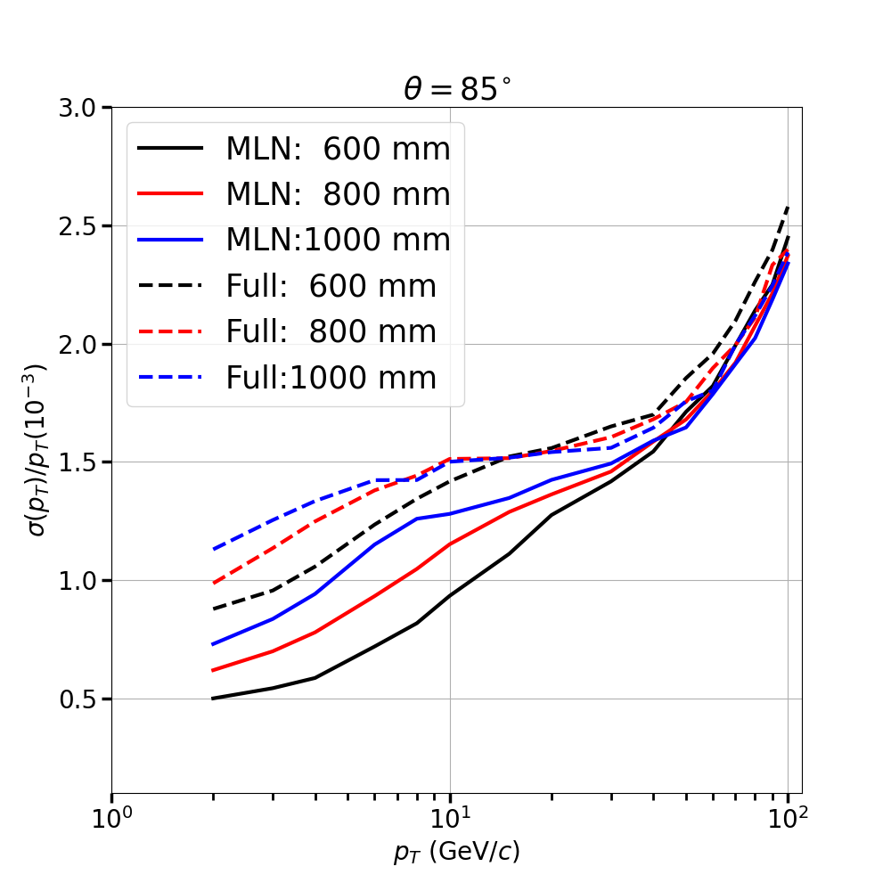
3. The difference between Marlin & CEPPCSW
Figure from GangLi, Marlin’s datas from ChengDong Fu
The trend of the curves is similar. But CEPCSW’s curve is higher overall, especially at low momentum
These two full simulation used different DC’s structure.

Slide 12
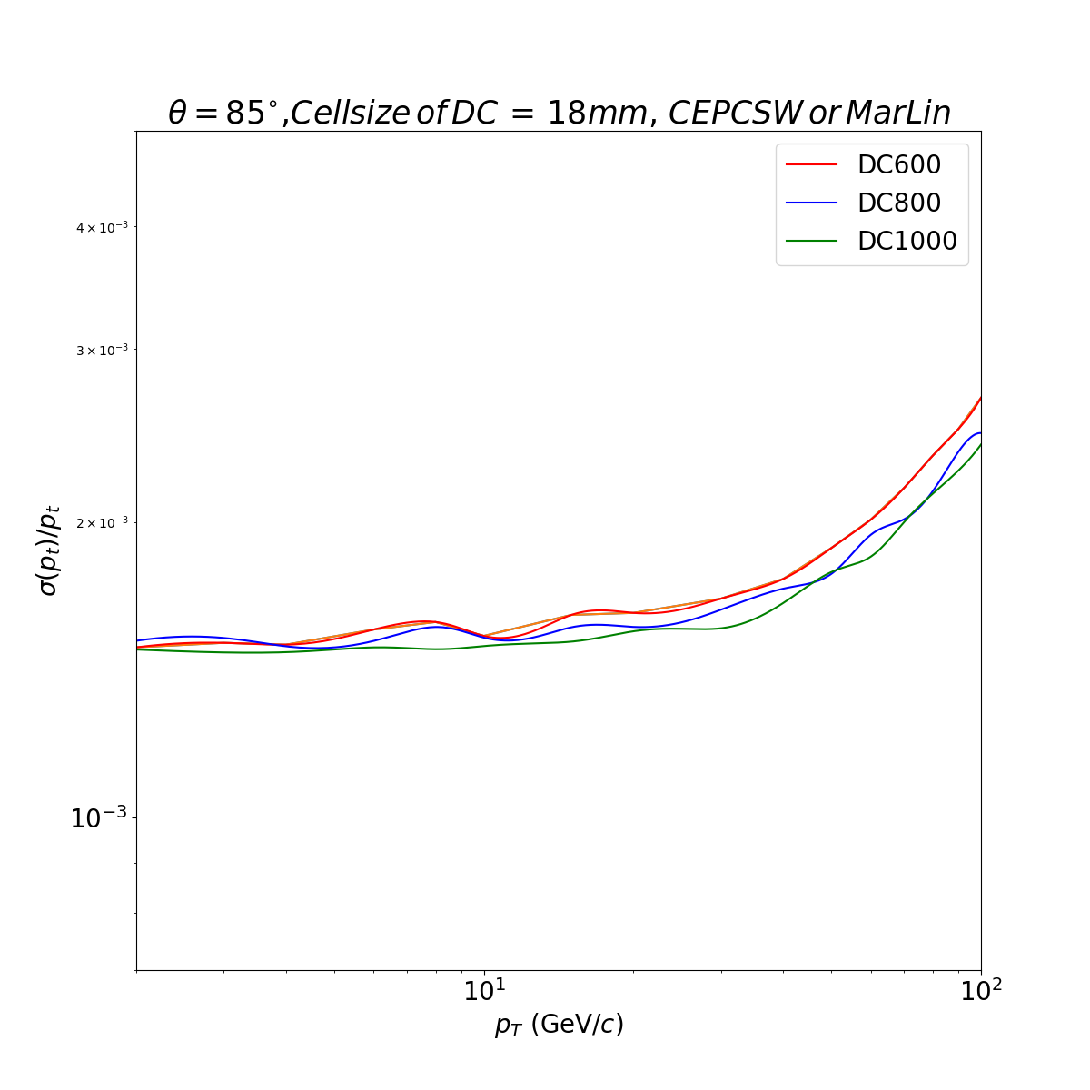
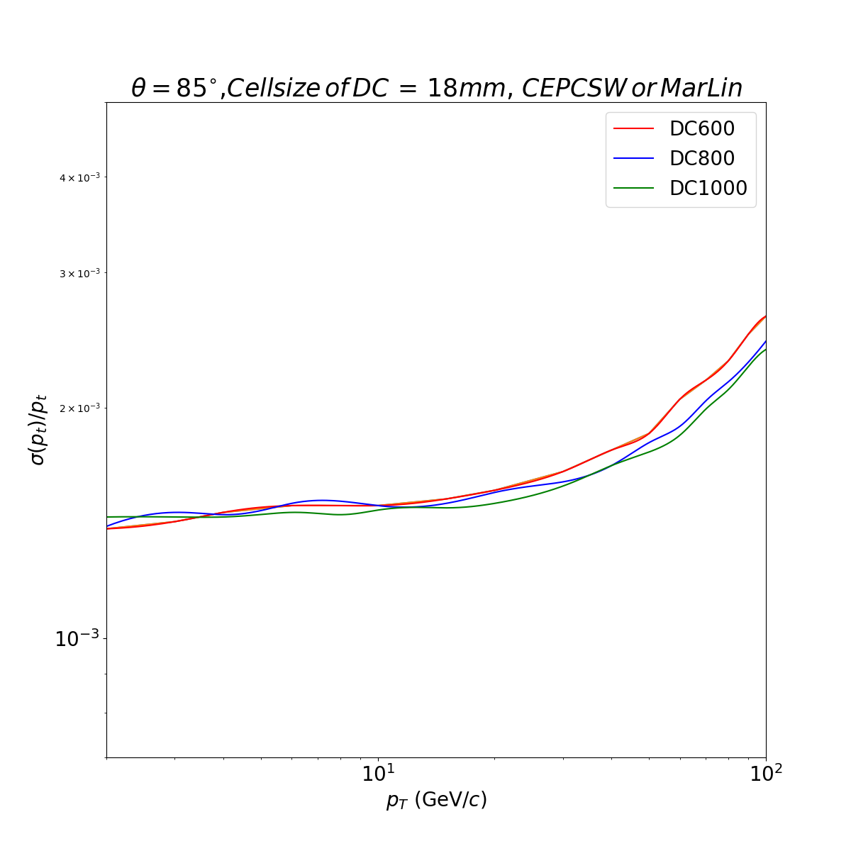
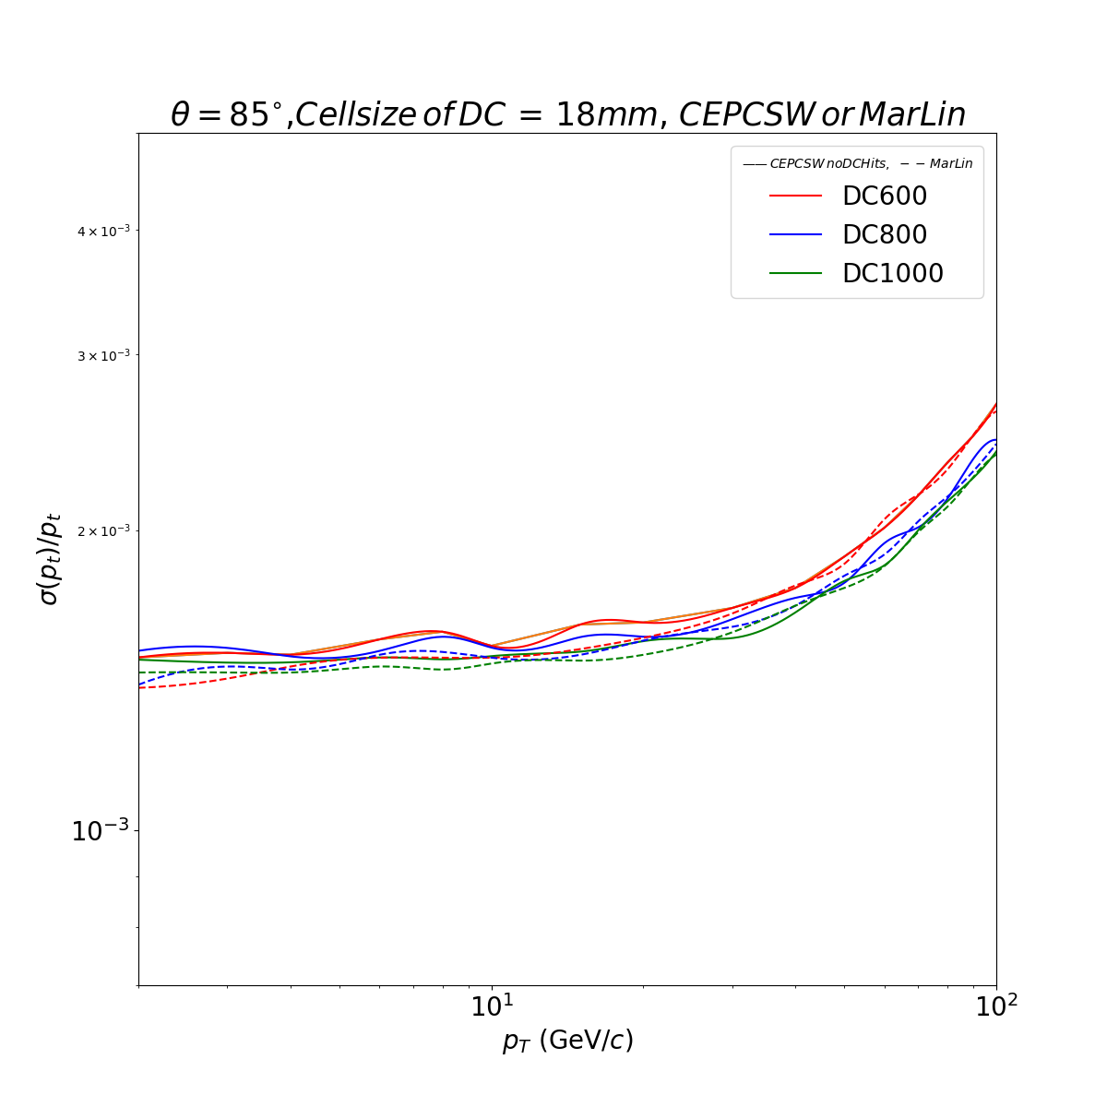
3. Not Use the DC Hits(but there are still DC’s materials)
When we don’t use the DCHits, the result is very similar of these two full simulation tools.
There are still a little difference. You can see it in the yellow circle.

Slide 13
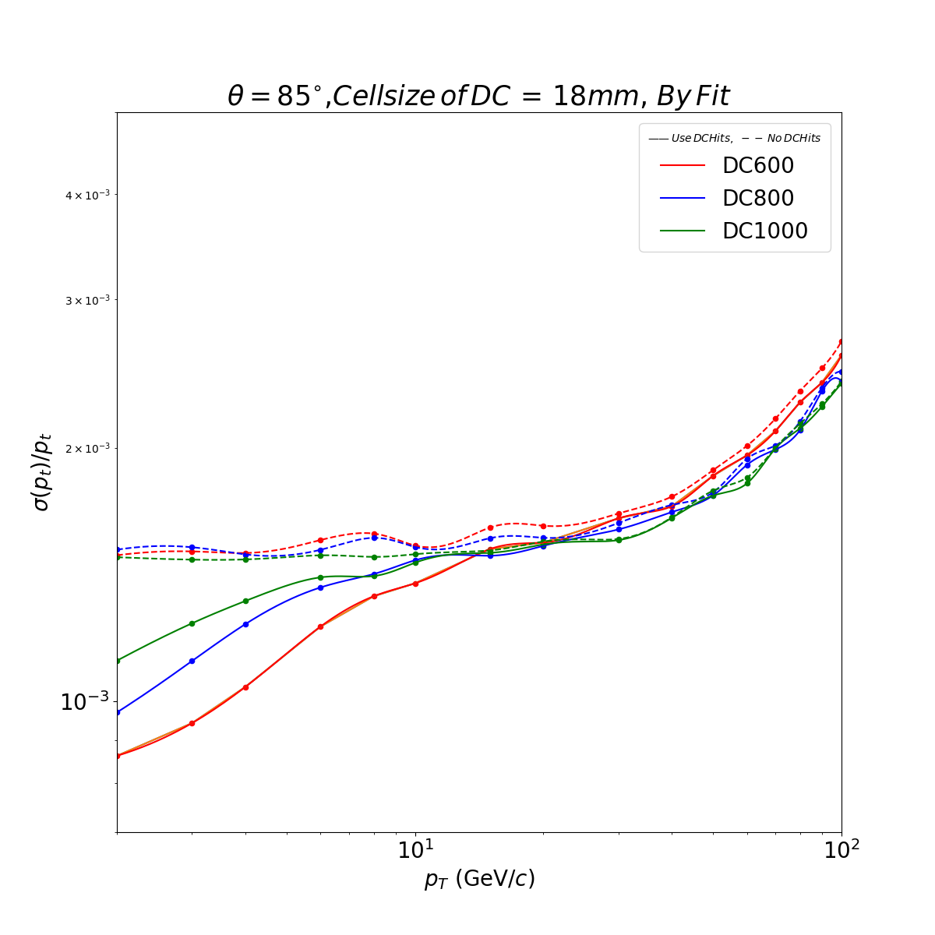
3. Smooth the Curve by interpolation method
Compare Use DCHits with not Use.
The curves are still have The big ups and downs.

Slide 14
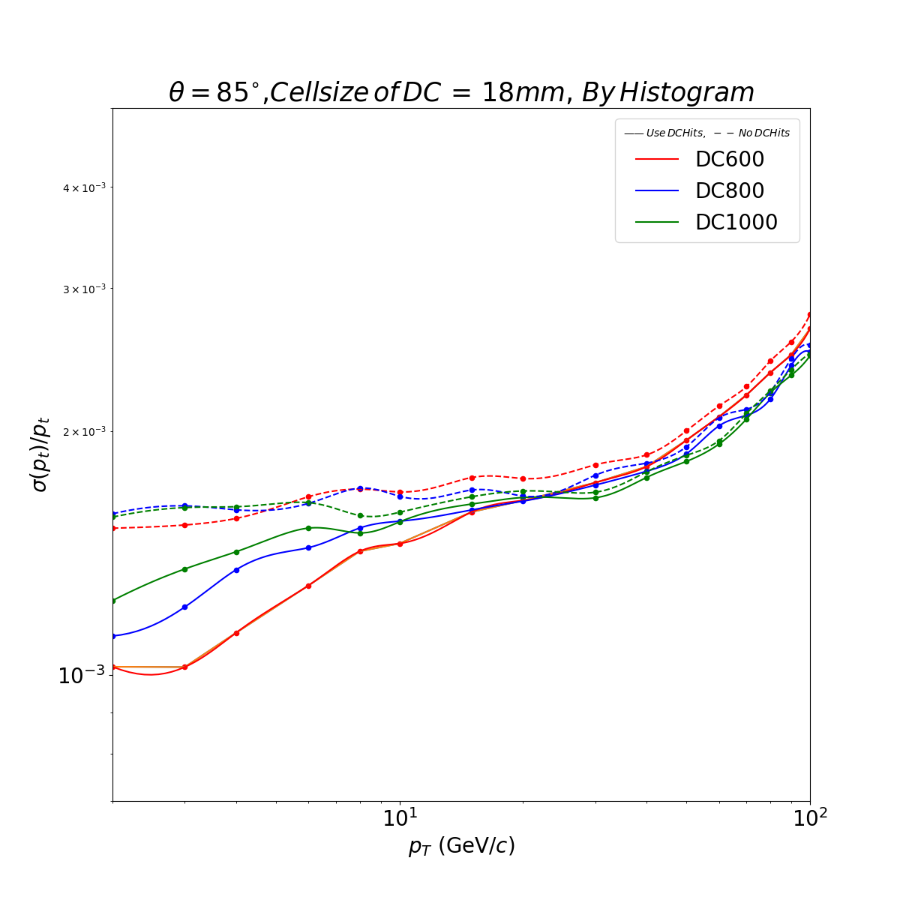
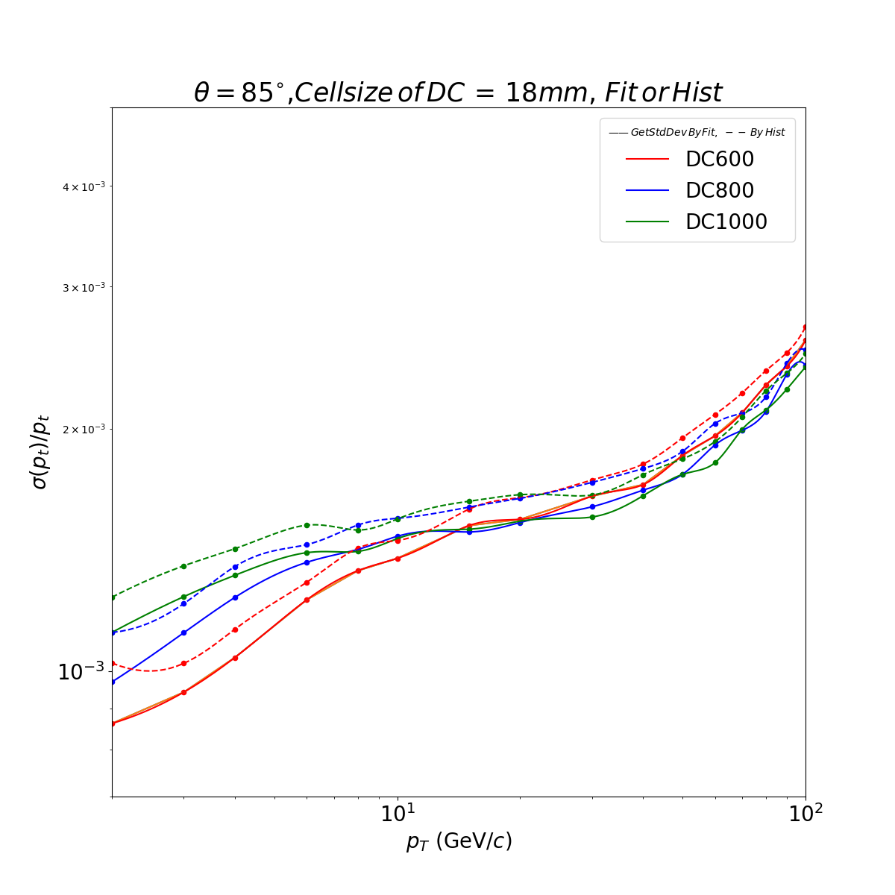
3. The StdDev values come from Histogram directly
Compare with the fitting values
The curves are still have The big ups and downs. I thought we should use larger statistics

