Slide 1
INTEROSER DESIGN UPDATES
Ziyue Yan
2022/6/2

Slide 2
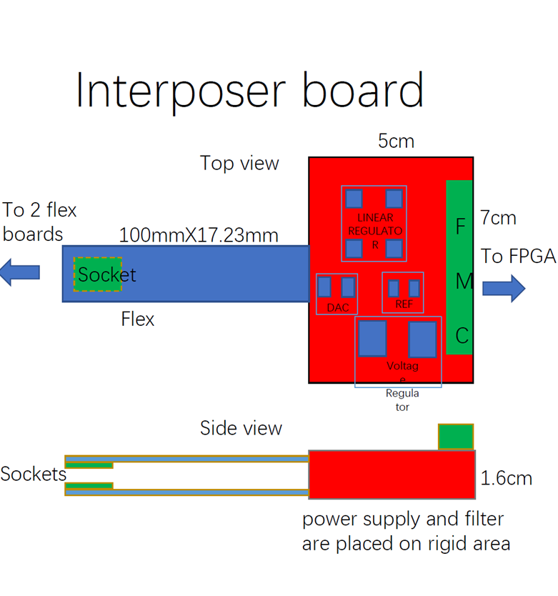
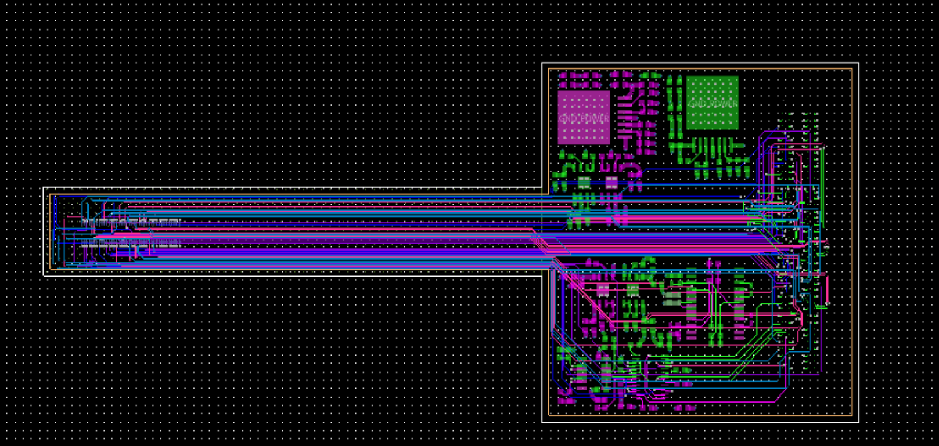
Former Design

Slide 3
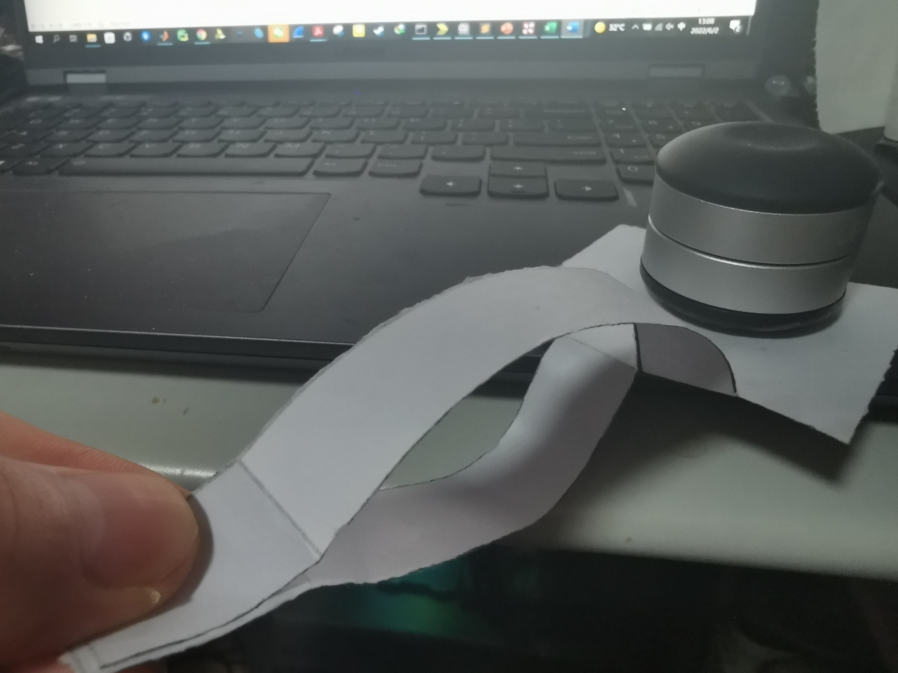
Layout Updates
The rigid part from the former design remains the same.
The flex parts’ positions from top view have been adjusted apart like shown in the layout above.
Two flex parts need to be bent to the install position similar to the right picture .

Slide 4
TOP VIEW
6.35cm
RIGID
2.7cm
10cm
1.73cm
FLEX1
7cm
FLEX2
CONNECTOR1
CONNECTOR2
FMC
SIDE VIEW
10cm
No feedback yet
6.35cm

Slide 5
Cross-section
The new rigid part shares the same cross-section with the primary part.
Flex boards would be manufactured by deep milling.

Slide 6
Rigid
Flex
Interposer
Sockets
Flex
FPGA board
Interposer
Flex
Sockets
FPGA board
Internal detector
FPGA board
Flex
Interposer
Interposer
Flex
Sockets
FPGA board
Internal detector

