Slide 1
Performance study of cross-crystal Fan Ecal for CEPC
Xiao Zhao, Huaqiao Zhang (Institute of High Energy Physics, CAS)
08/06/2022
Many thanks to Chengdong Fu, Fangyi Guo for framework support
And useful discussions with Shengsen Sun, Yong Liu, Baohua Qi, Dejing Du ....

Slide 2
Outline
cross-crystal Fan Ecal: basic concept
  Performance with cross-crystal Fan ECAL
    Energy resolution
    Separation power of close-by particles
      separation method
          γ/γ separation
          γ/π⁻ separation
  Boson mass resolution
  Ghost Hit in cross-crystal Fan design
Summary

Slide 3
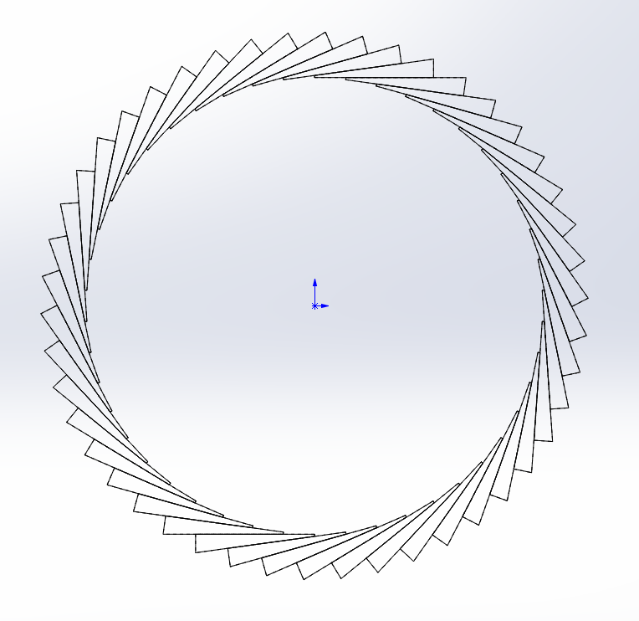
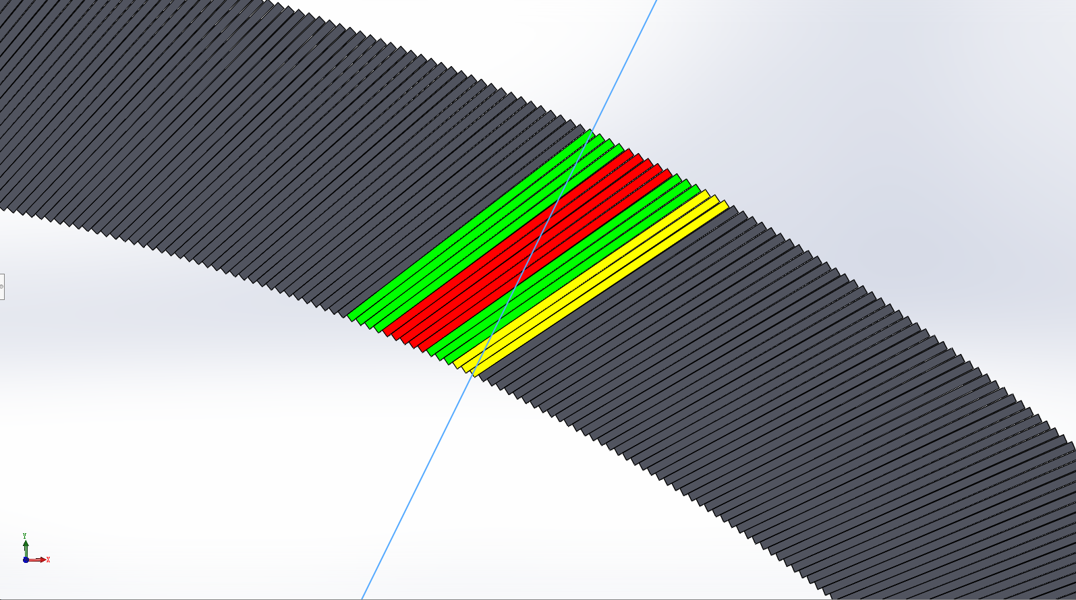
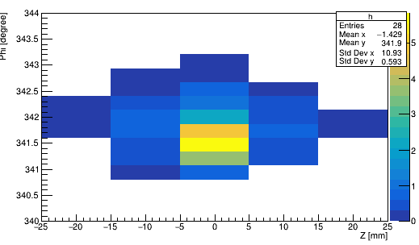
Basic concept
alpha
Alpha = 30 °
14 layers
Crystal not pointing back to IP (Z axis)
  Angle with inner det. radius is alpha
  alpha <= 90°
  Transverse Segmentation
    Different number of layers
  Uniform along Z
  Fine segmentation of Z, Phi, r
  2D readout in Z, Phi plane, reduced readout electronics channels
  r2 = 1.9 m, r1 = 2.2 m
  Simulation and reconstruction done using CEPCSW
    Geometry implemented by Chengdong FU
    Simulation readout using carloStep info (no digitization)
    Reconstruction code initially provided by Fangyi Guo
    Development and reconfiguration by Huaqiao Zhang and X. Zhao
D
r1
φ
r2
Cited : Huaqiao Zhang, New idea of Crystal fan(晶扇) Ecal for CEPC
Huaqiao Zhang, Energy/position resolution of Crystal Fan Ecal for CEPC
Notes:
The basic unit is a wedge-shaped crystal

Slide 4
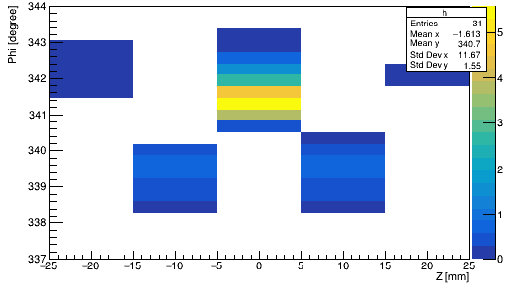
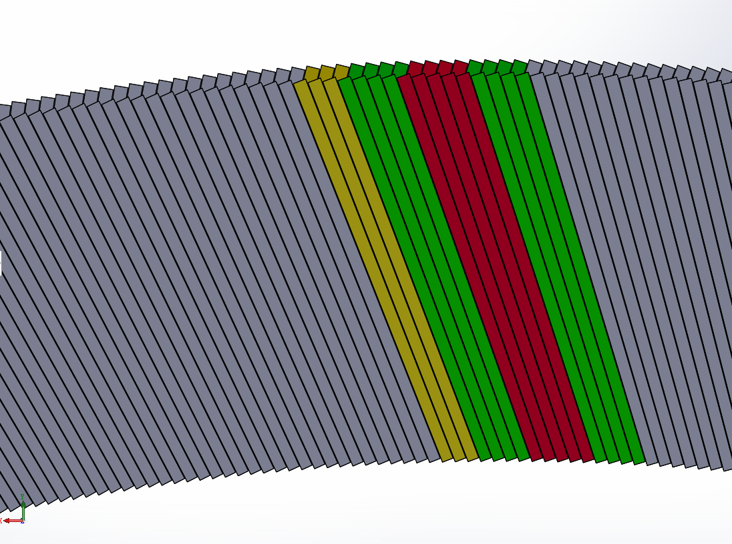
cross-crystal Fan
To improve the phi resolution accuracy:
  Crossing even and odd modules
  Odd layer： alpha’= -alpha
Good performance
  Z resolution ~ 0.886 mm
  Phi resolution ~ 1.6 mm
  R resolution ~ 6.975 mm
Crystal Fan
cross-crystal fan Ecal with 10 layers
Cross Crystal Fan

Slide 5
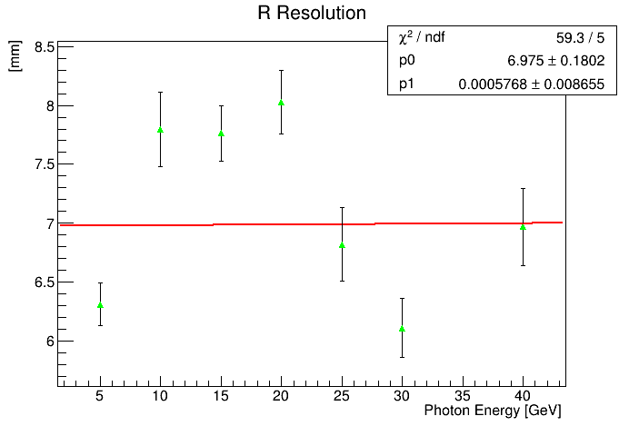
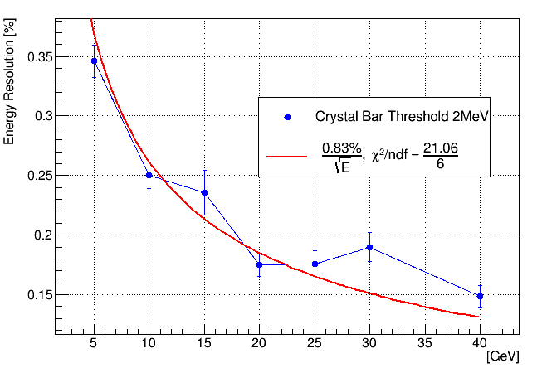
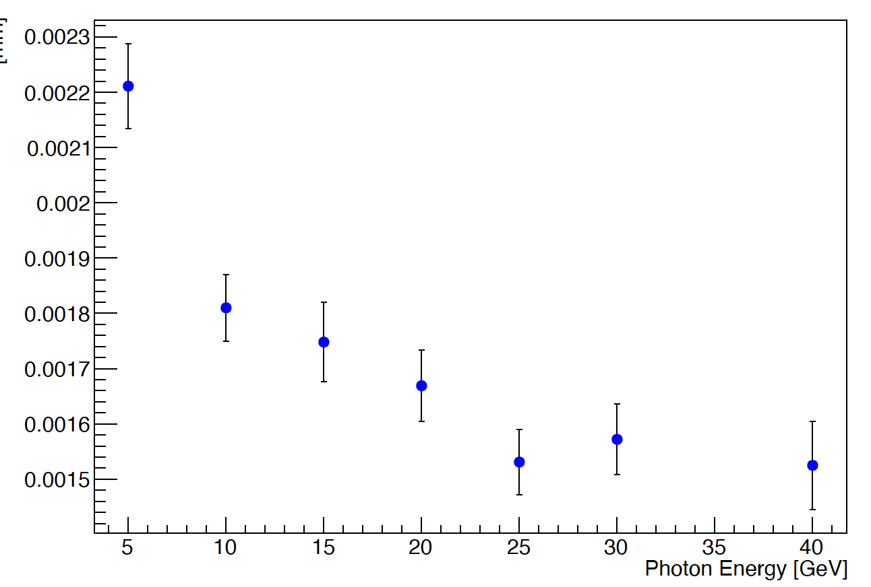
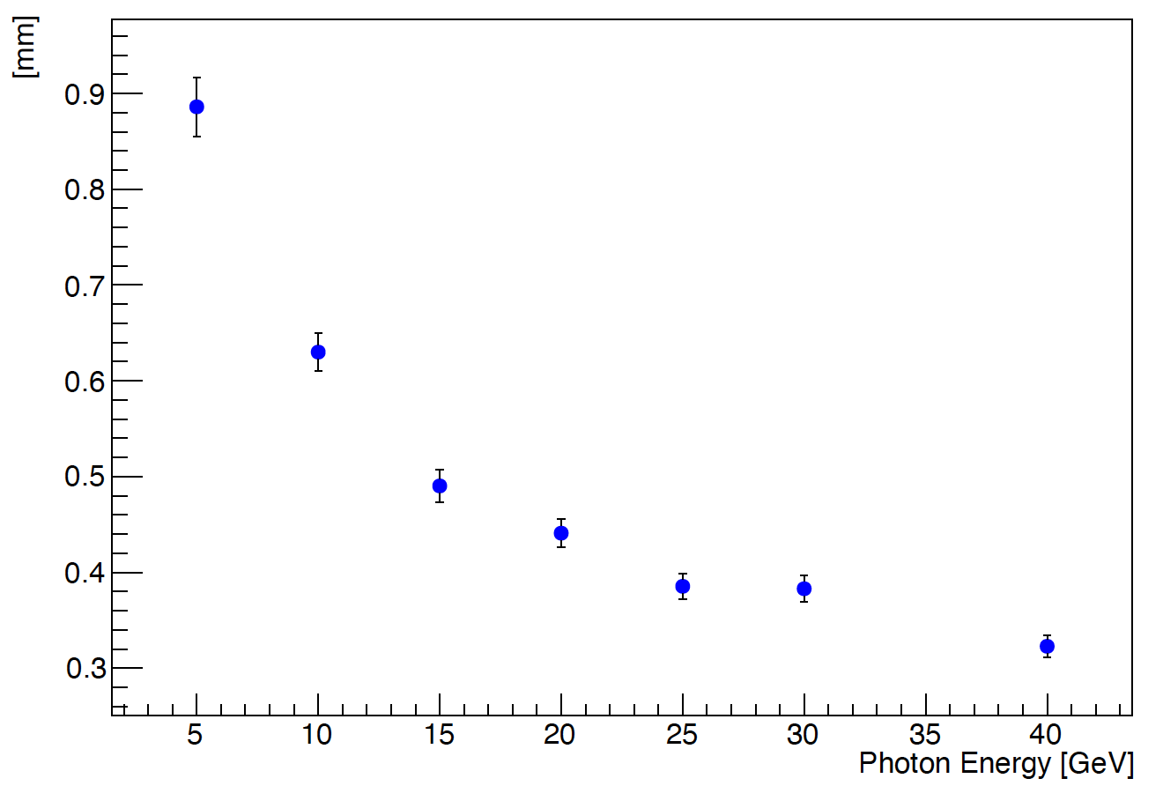
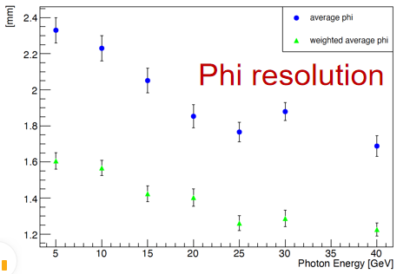
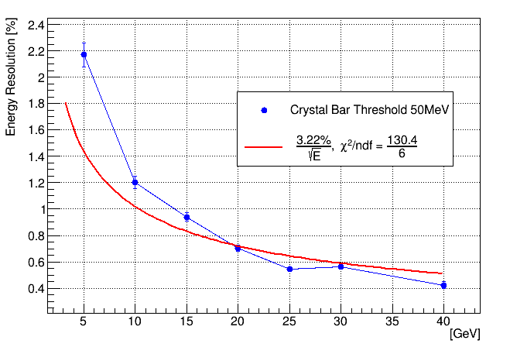
Energy resolution
The following plots are done with event generated using
cross-crystal fan Ecal with 10 layers
single gamma, phi: 10~350°, theta: 90°
R resolution
E resolution with gaus. fit
setup too optimistic?
Crystal bar threshold：0.1MeV
Z resolution
related to crystal bar threshold

Slide 6
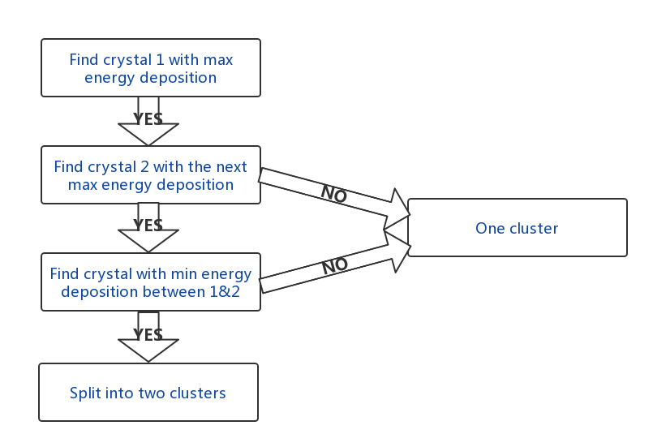
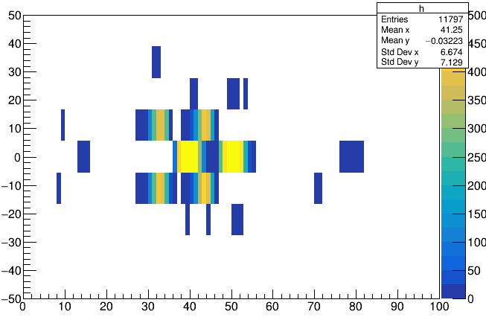
Separation method
For each module:
Z
two 5GeV γ
Phi

Slide 7
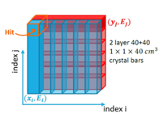
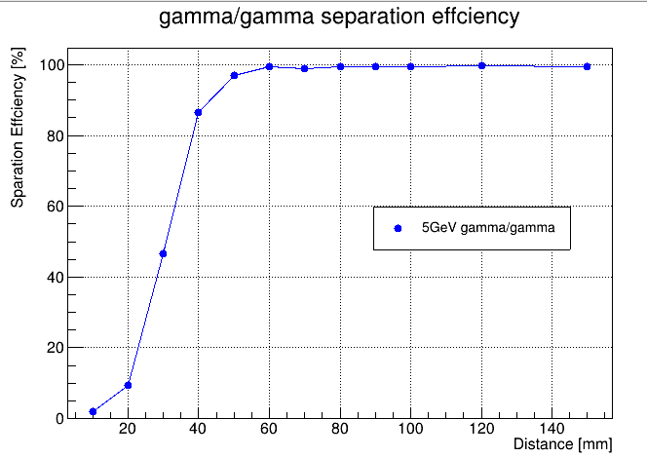
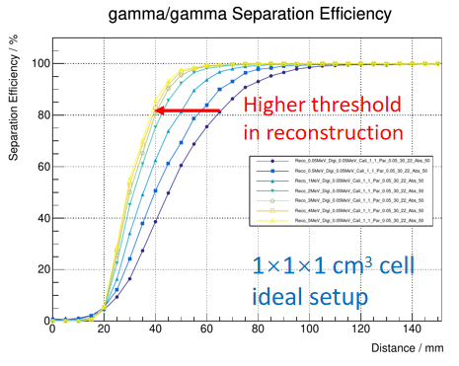
γ/γ separation
Two 5 GeV gammas, vary distance in between
Success reconstruction: 2 neutral particles, 3.3GeV<E_{gamma}<6.6GeV for each gamma
gamma
gamma
IP
Threshold: 2MeV
Baohua Qi, R&D of a Novel High Granularity Crystal ECAL

Slide 8
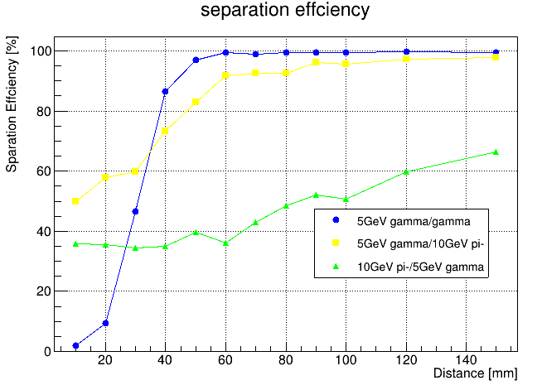
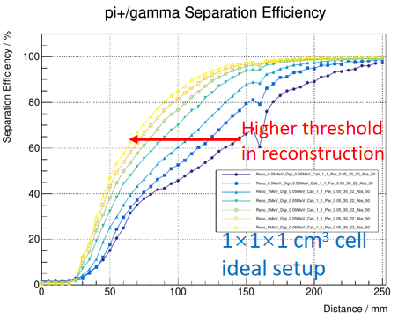
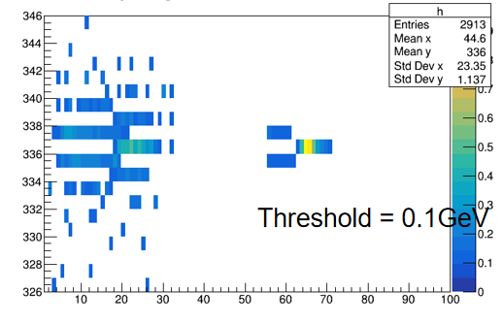
γ/π⁻ separation
5 GeV γ/10GeV π-, vary distance in between
Success reconstruction: 3.3GeV<E_{gamma}<6.6GeV
π-/γ separation should be better than γ/π- separation in our geometry: Optimize reconstruction method
pi-
gamma
pi-
IP
Threshold: 2MeV
Baohua Qi,R&D of a Novel High Granularity Crystal ECAL

Slide 9
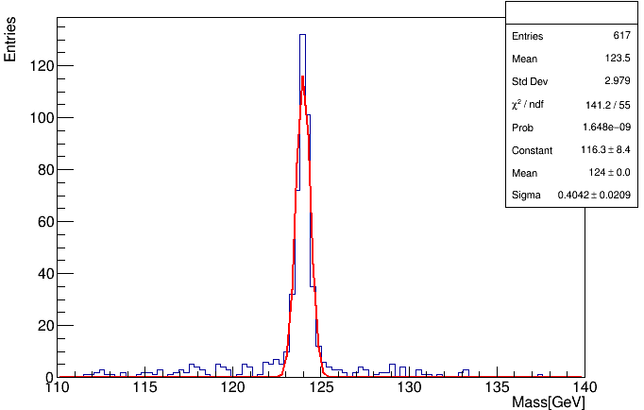
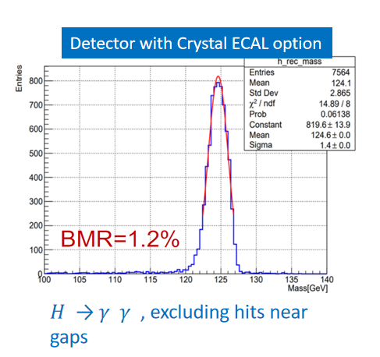
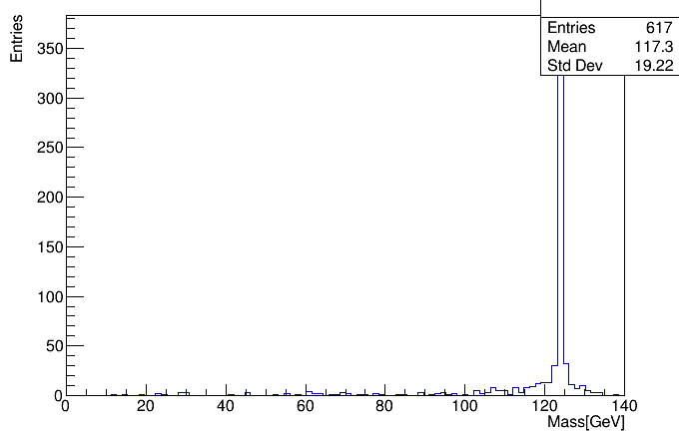
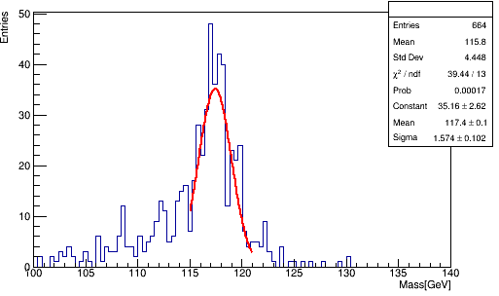
Boson mass resolution
ZH->gamma/gamma + 2 neutrinos at 240 GeV
Success reconstruction:
  Crystal bar energy threshold: 2 MeV/50MeV
    10° < Phi <350° to avoid affect of geometry
  Two particles
Zhiyu Zhao
BMR = 0.33%
Threshold: 2MeV
Threshold: 2MeV
BMR = 1.3%
Threshold: 50MeV

Slide 10
Ghost Hit in cross-crystal Fan design
R
Huaqiao Zhang
Confusion of red hit with yellow ones
Happens only in small phi/R range
  R-range: 0-30CM
  Phi-range: ~ - 4.5 cm - +4.5 cm (10 layer)
Large probability have hits in middle shower depth, small chance to have hits in small or large shower depth
Big energy deposited in middle shower depth hit, small in small or large shower depth
If ghost hits happens
  largest change of phi: ~4.5 cm,
  largest change of R: ~15cm
Phi
Phi range
Not yet estimated, but should be very small chance to have ghost hit have big impact

Slide 11
Summary
Present the energy resolution of single photon shower
  Z resolution ~ 0.886 mm
  Phi resolution ~ 1.6 mm
  R resolution ~ 6.975 mm
  Quantify γ/γ and γ/π⁻ separation based on cross-crystal Fan Ecal
  Good separation effciency of γ/γ
  Optimize γ/π⁻ separation effciency
Boson Mass Resolution
  Related to the reconstruction method and threshold
Next step：
  Optimize reconstruction method
  Many technical support needed.....

Slide 12
backup

Slide 13
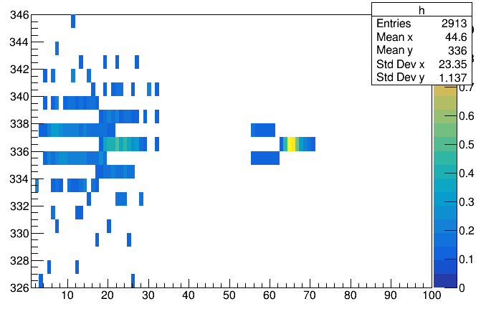
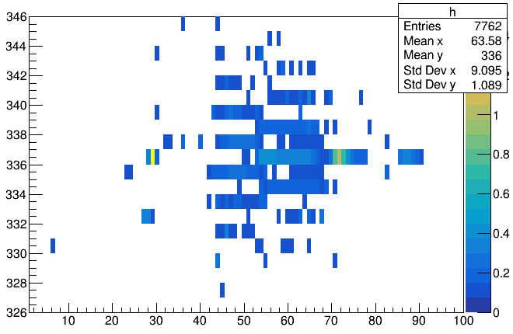
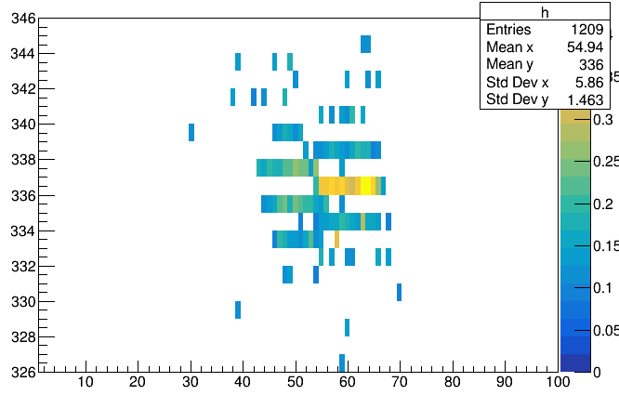
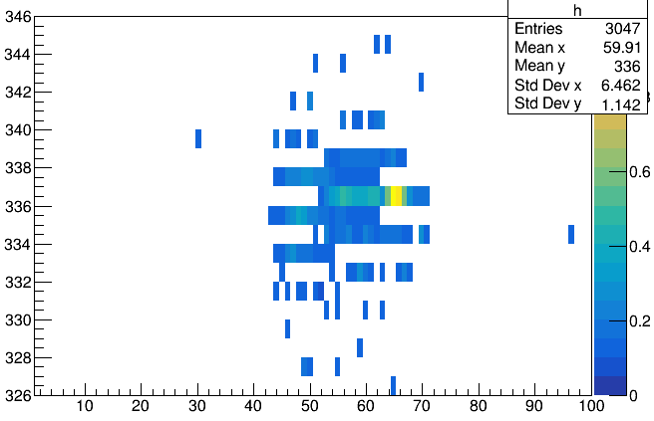
pi-/gamma, d = 150 mm delta_crystal = 16
pi+/gamma, d = 230 mm
Threshold = 0.1GeV
pi-/gamma, d = 90 mm
pi-, phi = 10

