Slide 1
Orbit correction and error analysis
Bin Wang (on the behalf of the CEPC error correction team)
Institute of High Energy Physics
10.24
2022
The 2022 international workshop on the high energy Circular Electron-Positron Collider (CEPC)

Slide 2
Content
Introduction of the high luminosity
The correction scheme
The correction results
Summary and to do list

Slide 3
Beam parameters
CEPC AP group, 2 June 2022; Y. Wang, The 2022 CEPC IARC meeting, June 7-10, 2022, IHEP
 | Higgs | Z | W | ttbar
Number of IPs | 2
Circumference [km] | 100.0
SR power per beam [MW] | 30
Half crossing angle at IP [mrad] | 16.5
Bending radius [km] | 10.7
Energy [GeV] | 120 | 45.5 | 80 | 180
Energy loss per turn [GeV] | 1.8 | 0.037 | 0.357 | 9.1
Piwinski angle | 5.94 | 24.68 | 6.08 | 1.21
Bunch number | 268 | 11934 | 1297 | 35
Bunch spacing [ns] | 591 (53% gap) | 23 (18% gap) | 257 | 4524 (53% gap)
Bunch population [10^10] | 13 | 14 | 13.5 | 20
Beam current [mA] | 16.7 | 803.5 | 84.1 | 3.3
Momentum compaction [10^-5] | 0.71 | 1.43 | 1.43 | 0.71
Beta functions at IP (bx/by) [m/mm] | 0.3/1 | 0.13/0.9 | 0.21/1 | 1.04/2.7
Emittance (ex/ey) [nm/pm] | 0.64/1.3 | 0.27/1.4 | 0.87/1.7 | 1.4/4.7
Beam size at IP (sigx/sigy) [um/nm] | 14/36 | 6/35 | 13/42 | 39/113
Bunch length (natural/total) [mm] | 2.3/4.1 | 2.5/8.7 | 2.5/4.9 | 2.2/2.9
Energy spread (natural/total) [%] | 0.10/0.17 | 0.04/0.13 | 0.07/0.14 | 0.15/0.20
Energy acceptance (DA/RF) [%] | 1.6/2.2 | 1.3/1.7 | 1.2/2.5 | 2.3/2.6
Beam-beam parameters (ksix/ksiy) | 0.015/0.11 | 0.004/0.127 | 0.012/0.113 | 0.071/0.1
RF voltage [GV] | 2.2 | 0.12 | 0.7 | 10
RF frequency [MHz] | 650 | 650 | 650 | 650
Longitudinal tune Qs | 0.049 | 0.035 | 0.062 | 0.078
Beam lifetime (bhabha/beamstrahlung)[min] | 39/40 | 80/18000 | 60/700 | 81/23
Beam lifetime [min] | 20 | 80 | 55 | 18
Hour glass Factor | 0.9 | 0.97 | 0.9 | 0.89
Luminosity per IP[1e34/cm^2/s] | 5.0 | 115 | 16 | 0.5

Slide 4
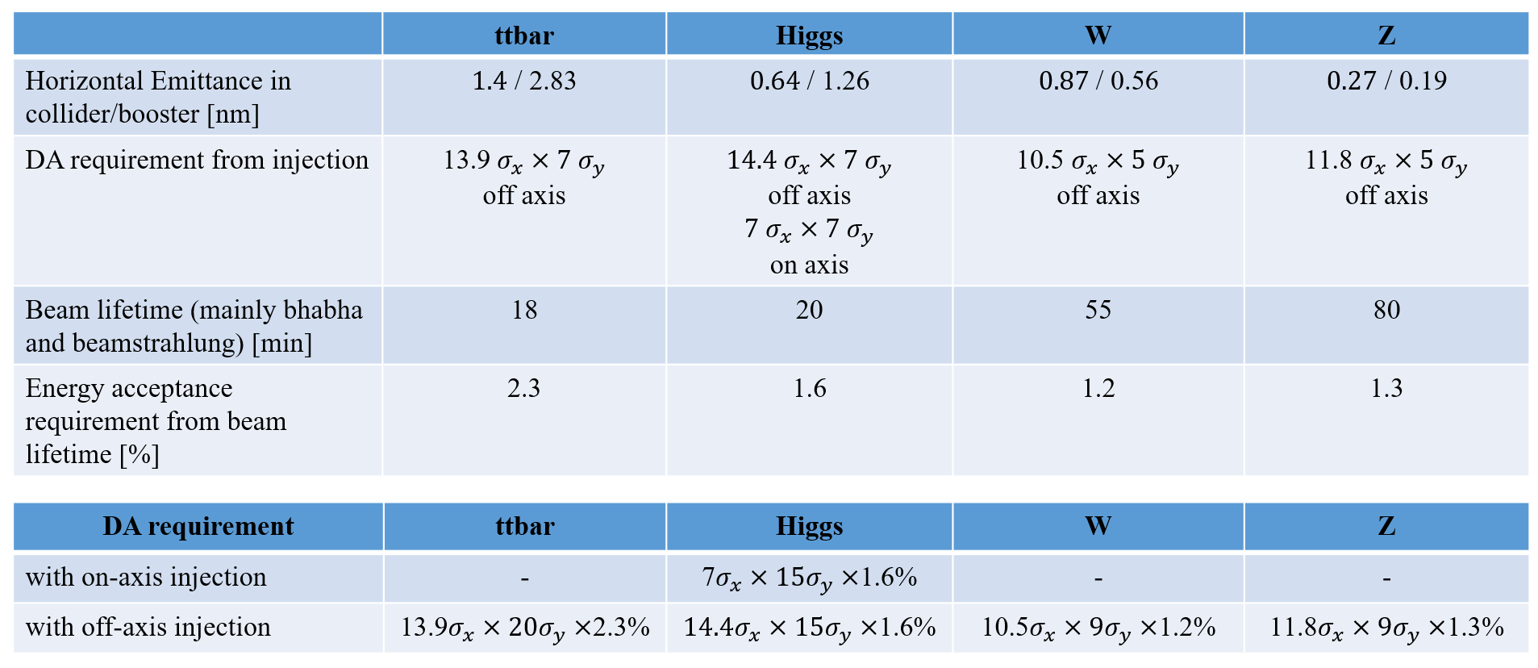
Lattice and requirements
Y. Wang, The 2022 CEPC IARC meeting, June 7-10, 2022, IHEP

Slide 5
Content
Introduction of the high luminosity
The correction scheme
The correction results
Summary and to do list

Slide 6
Errors definition and challenges
Component | Δx (mm) | Δy (mm) | Δθ_{z} (mrad) | Field error
Dipole | 0.10 | 0.10 | 0.10 | 0.01%
Arc Quadrupole | 0.10 | 0.10 | 0.10 | 0.02%
IR Quadrupole | 0.10 | 0.10 | 0.10 | 0.02%
Sextupole | 0.10 | 0.10 | 0.10
We include the field error of IR quadrupoles according the IARC 2022 comments.
1000 Higgs lattice seeds are generated for optimizing correction programme, 500 Z lattice seeds are generated for a cross check.
The correction programme are extended to the error correction of 100 W lattice seeds and 100 ttbar lattice seeds.

Slide 7
The correction scheme
Software: SAD and AT
COD correction with sextupoles off
Turn on the sextupoles and perform COD correction again.
Dispersion correction (DFS)
Beta beating correction (LOCO)
Coupling and vertical dispersion correction (Local coupling parameter correction）

Slide 8
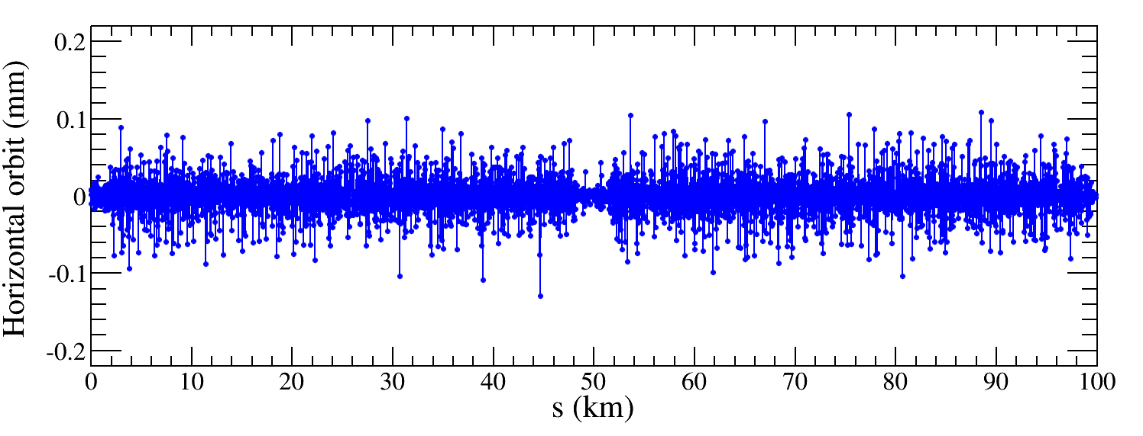
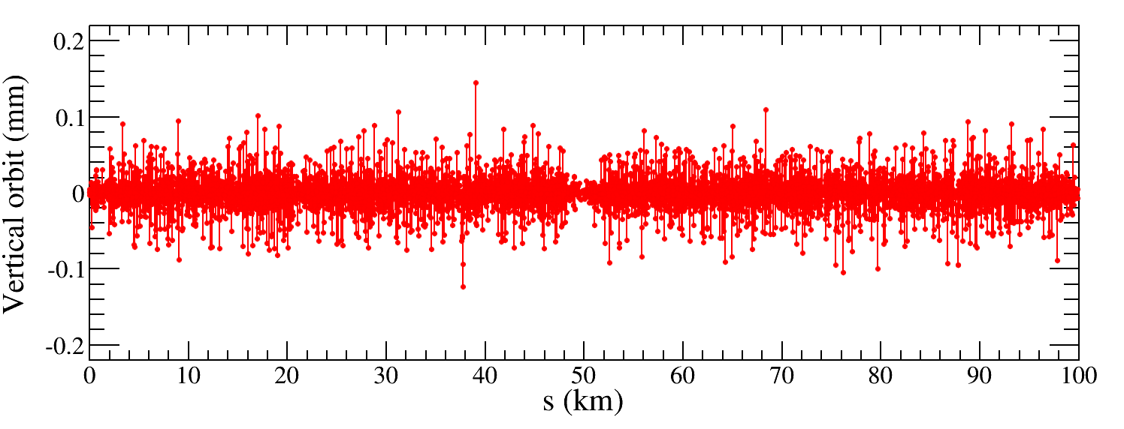
COD correction
~1850 BPMs placed at quadrupoles
~1850 Horizontal correctors placed beside focusing quadrupoles
~1850 Vertical correctors placed beside defocusing quadrupoles
There are some minor adjustments for different modes
Orbit correction is applied using orbit response matrix and SVD method
Result of a Higgs lattice seed
Both horizontal and vertical orbit are mostly lower than 50 μm.
$${RMS}_{COD}<0.03 mm$$

Slide 9
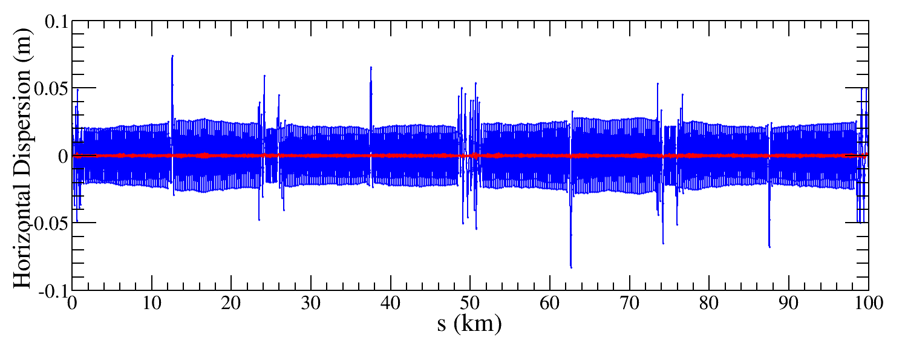
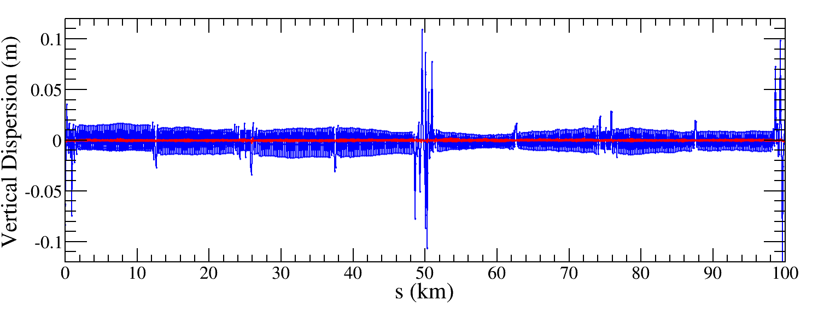
Dispersion correction
Dispersion free steering principle (DFS):$θ$_{c}
$$\vec{d}=\left(\begin{aligned}\left(1−α\right)\vec{u} \\ α\vec{D}u\end{aligned}\right)$$
M$=\left(\begin{aligned}\left(1−α\right)A \\ αB\end{aligned}\right)$
$$\vec{d}+M\vec{θ}=0$$
Result of a Higgs lattice seed
$\vec{u}$: Orbit vector
$\vec{D}u$: Dispersion vector
$\vec{θ}$: Corrector strengths vector
$α$: Weight factor
$A$: Orbit response matrix
$B$: Dispersion response matrix
The dispersion is corrected well, the RMS dispersion is about 1mm for all lattice seeds.

Slide 10
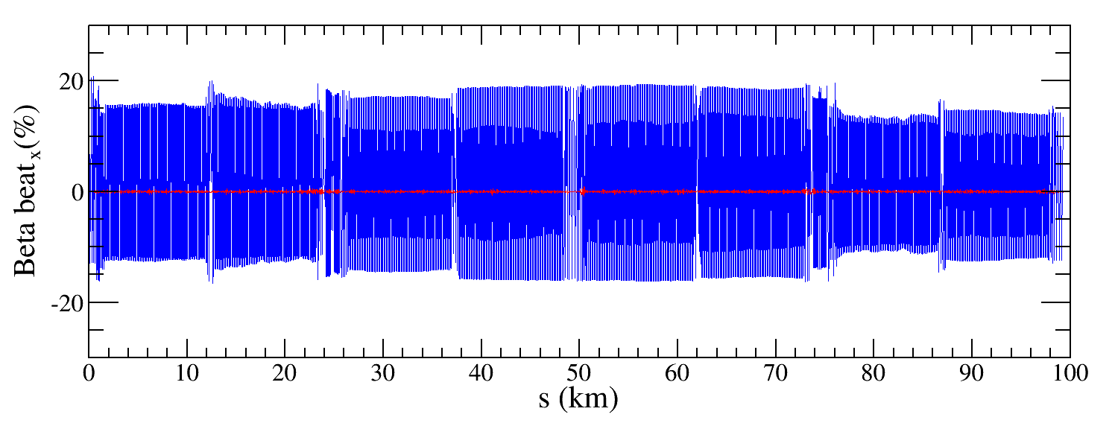
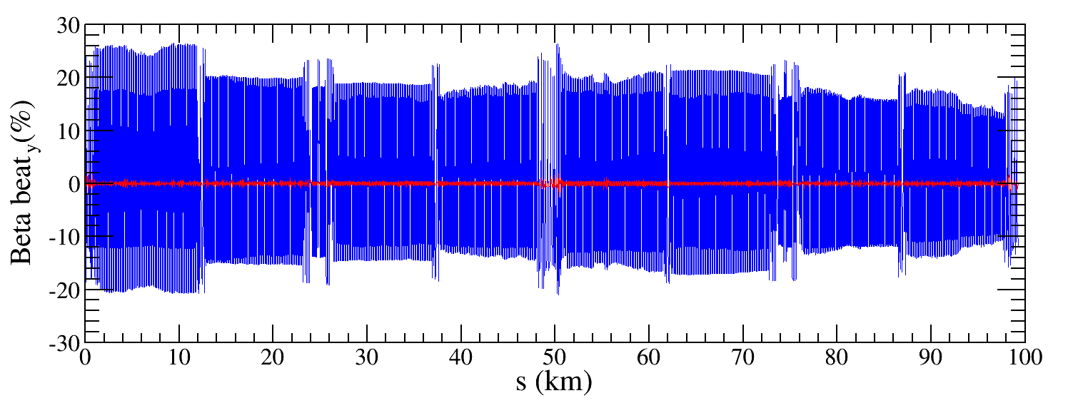
Beta-beating correction
Correct the beta functions with sextupoles on.
Based on AT LOCO: model based correction
Establish lattice model M_{mod}, multi-parameter fit to the orbit response matrix M_{meas} to obtain calibrated model:
Parameters fitted: K, KS …
Use calibrated model to perform correction and apply to machine.
Fit the dispersion at the same time.
Application to correct beta-beating, dispersion and coupled response matrix.
${∆β/β}_{rms}$ < 3%
Especially many thanks to committee and computing center group for supplying a significant amount of computing resources.

Slide 11
The correction results
Introduction of the high luminosity
The correction scheme
The correction results -- Higgs lattice
Summary and to do list

Slide 12
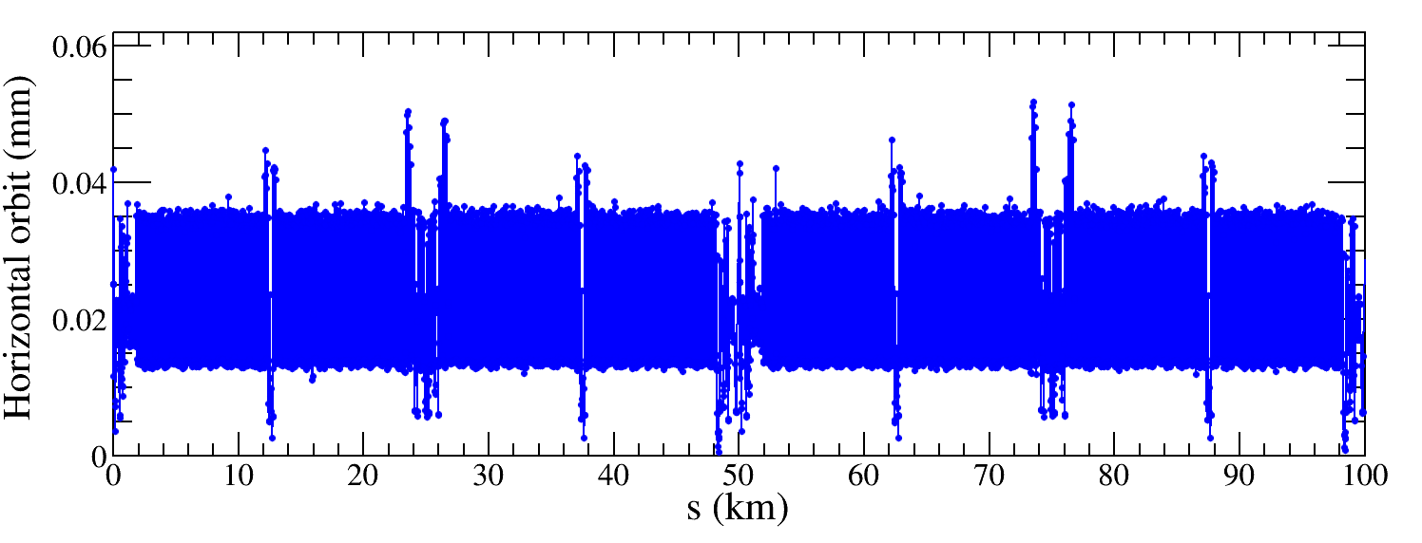
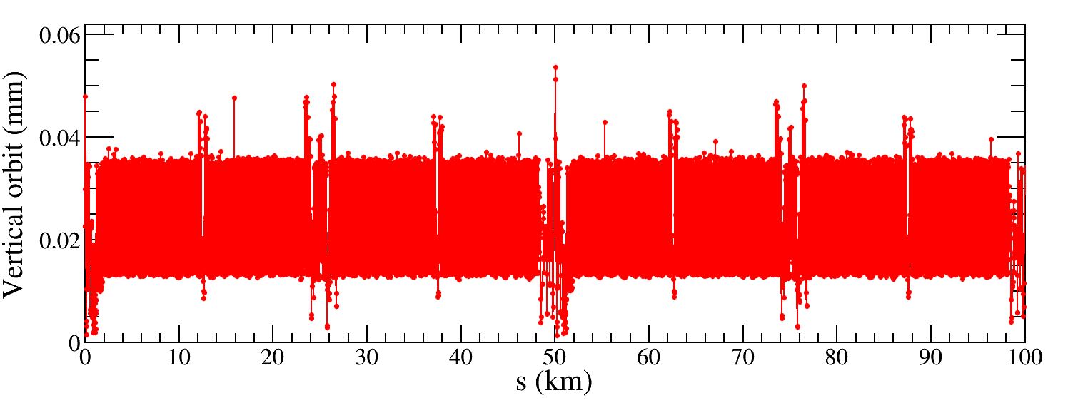
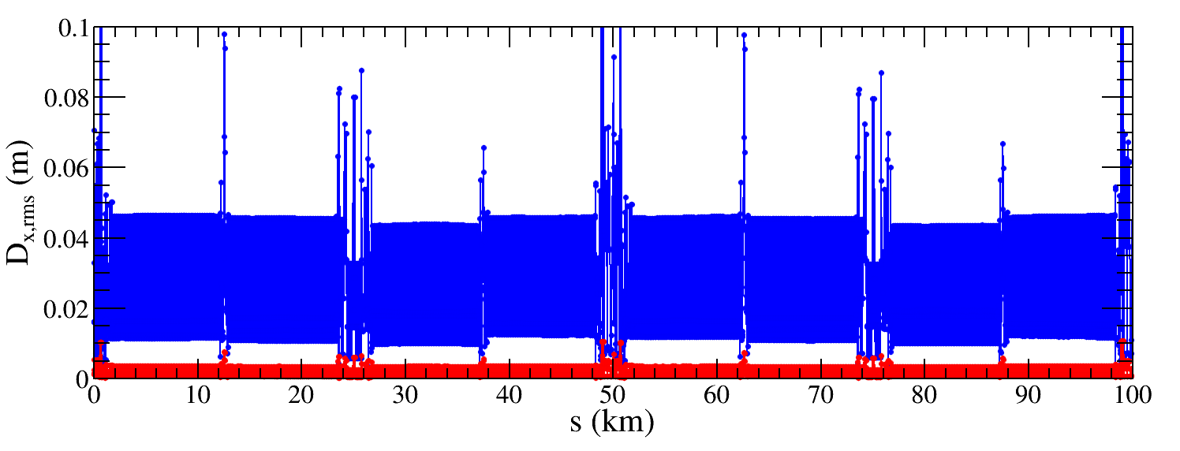
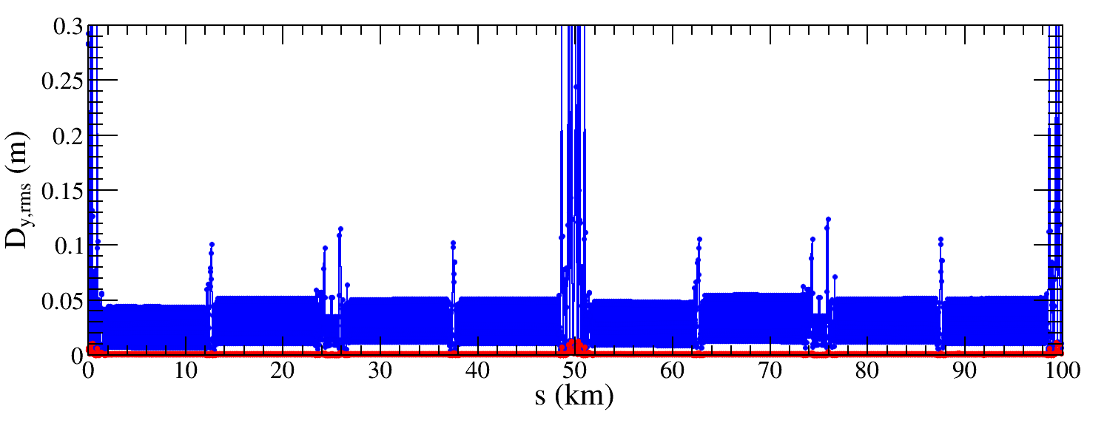
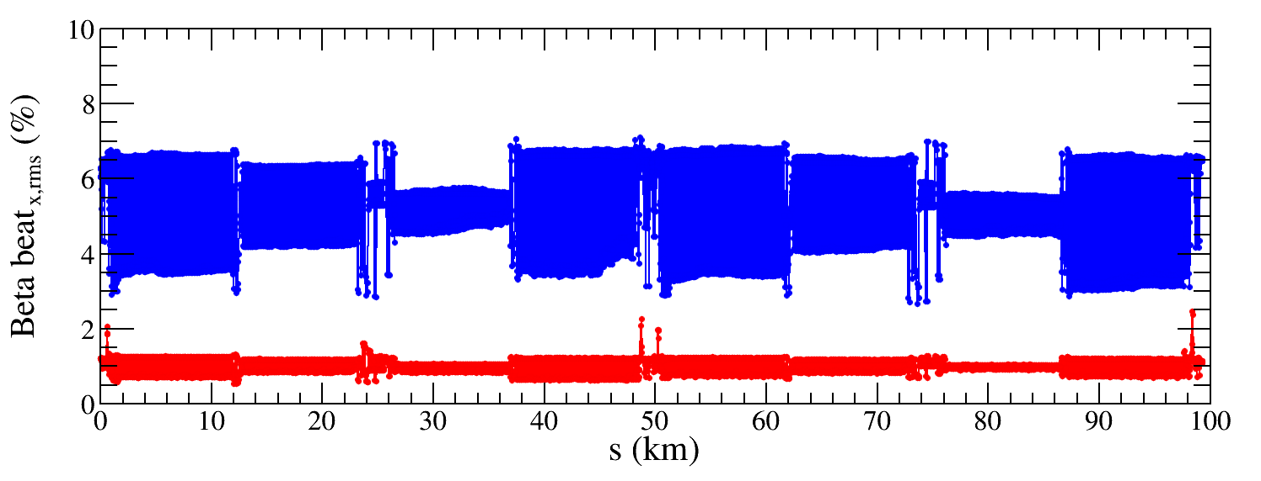
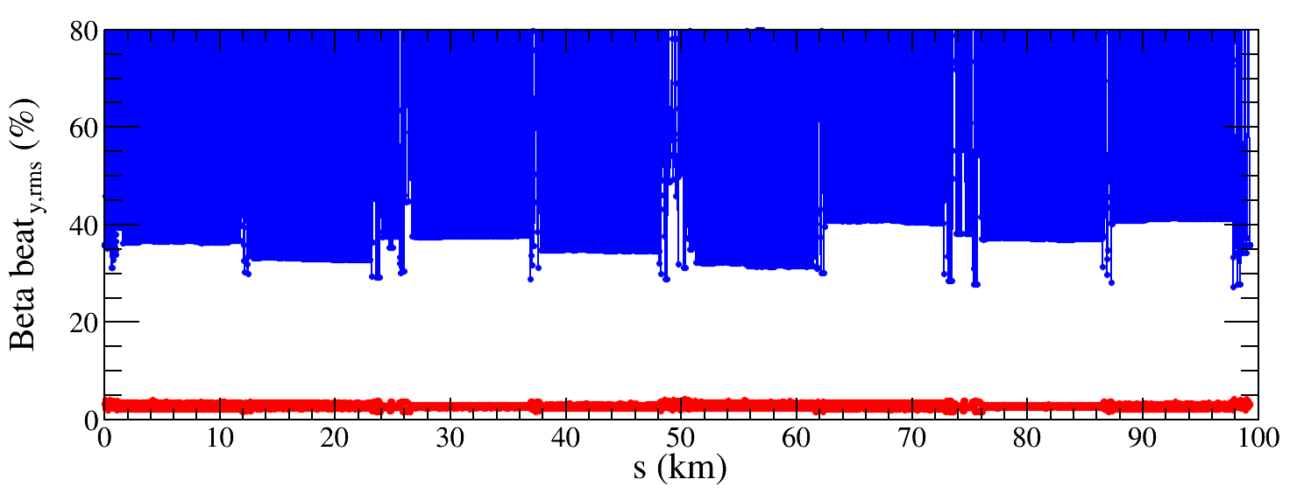
Results -- Higgs lattice
${∆D}_{x,rms}$ decreased from 23.1 mm to 1.8 mm
${∆D}_{y,rms}$ decreased from 31.9 mm to 0.9 mm
${∆β/β}_{x,rms}$ decreased from 5.2% to 1.0%
${∆β/β}_{y,rms}$ decreased from 83.2% to 2.8%

Slide 13
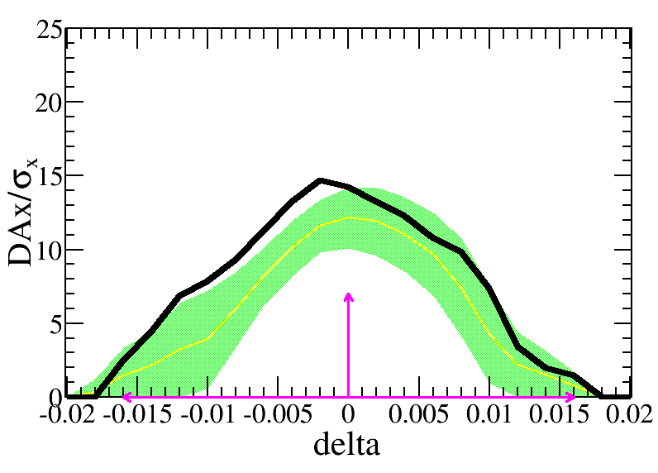
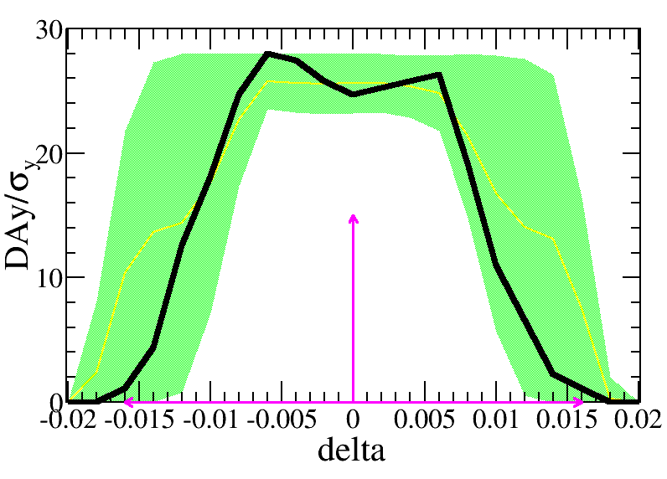
Results -- Higgs lattice
The yellow lines and green bands are the mean value and its corresponding statistics errors, the black line is the DA of bare lattice. The pink arrows are the DA requirement.
1000 Higgs lattice seeds with errors are fully corrected.
The DA with error correction are tracked and satisfy the on-axis injection requirement, 7$σ_{x}×15σ_{y} \& 0.016$.

Slide 14
The correction results
Introduction of the high luminosity
The correction scheme
The correction results -- Z lattice
Summary and to do list

Slide 15
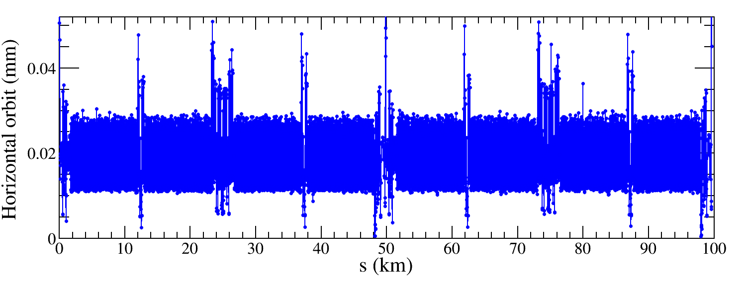
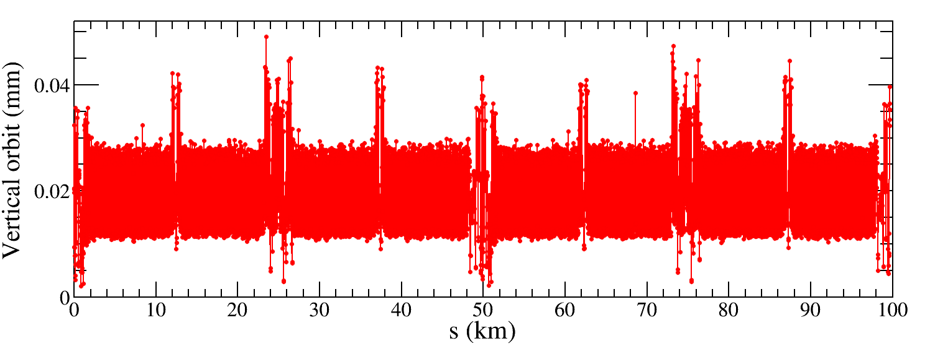
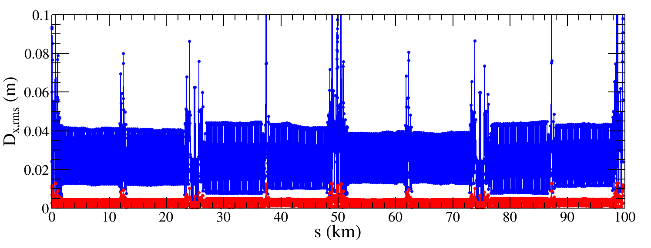
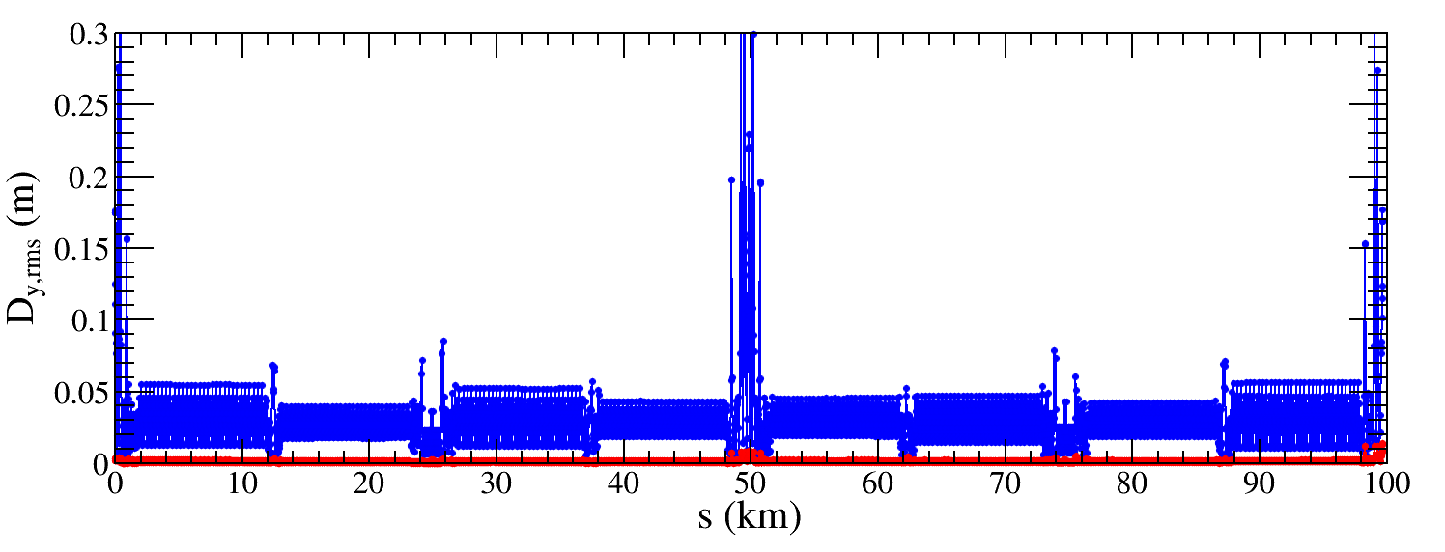
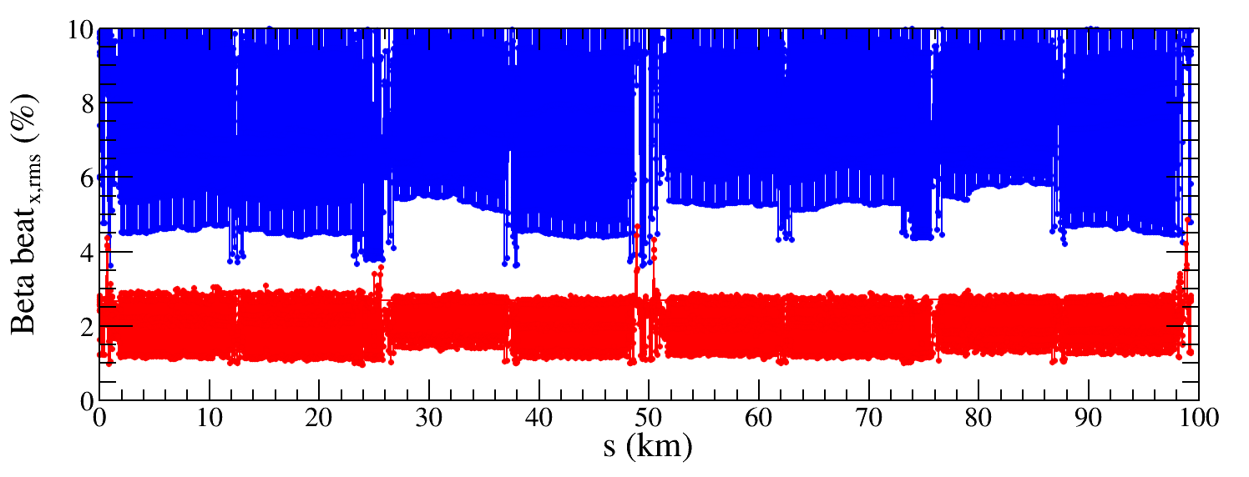
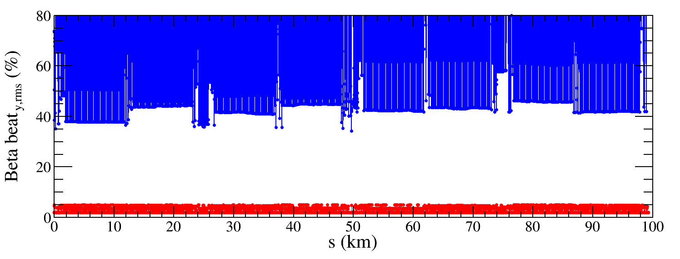
Results -- Z lattice
${∆D}_{x,rms}$ decreased from 23.1 mm to 1.8 mm
${∆D}_{y,rms}$ decreased from 31.9 mm to 0.9 mm
${∆β/β}_{x,rms}$ decreased from 7.5% to 2.0%
${∆β/β}_{y,rms}$ decreased from 148.8% to 3.0%

Slide 16
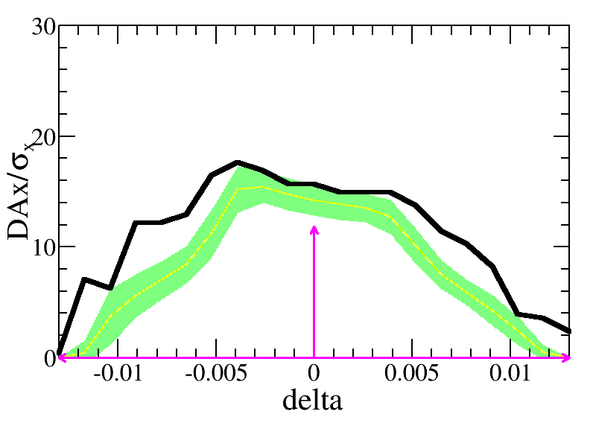
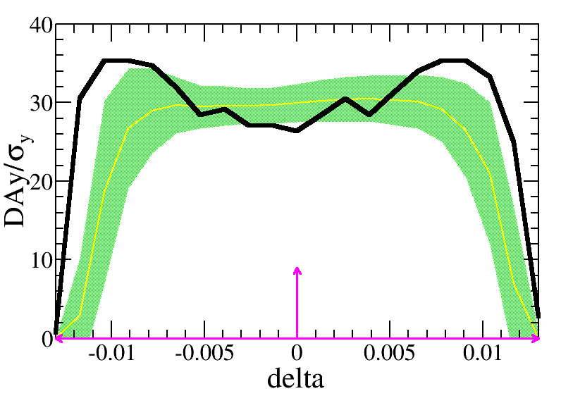
Results -- Z lattice
The yellow lines and green bands are the mean value and its corresponding statistics errors, the black line is the DA of bare lattice. The pink arrows are the DA requirement.
500 Z lattice seeds with errors are fully corrected.
The DA with error correction are tracked and satisfy the on-axis injection requirement, $11.8σ_{x}×9σ_{y} \& 0.013$.

Slide 17
The correction results
Introduction of the high luminosity
The correction scheme
The correction results -- W/ttbar lattice
Summary and to do list

Slide 18
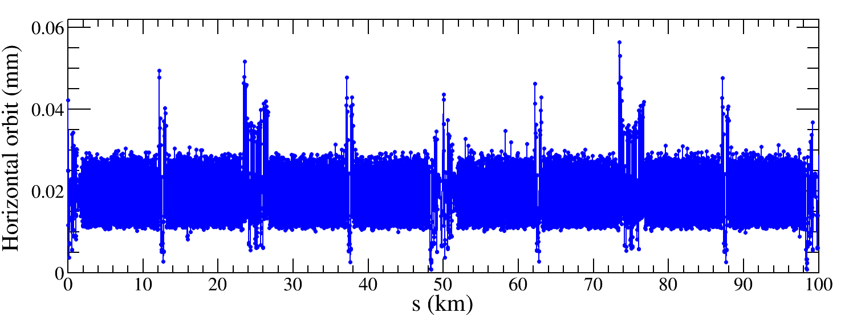
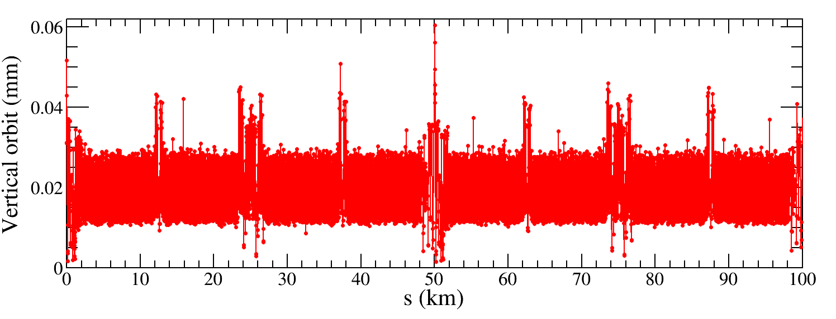
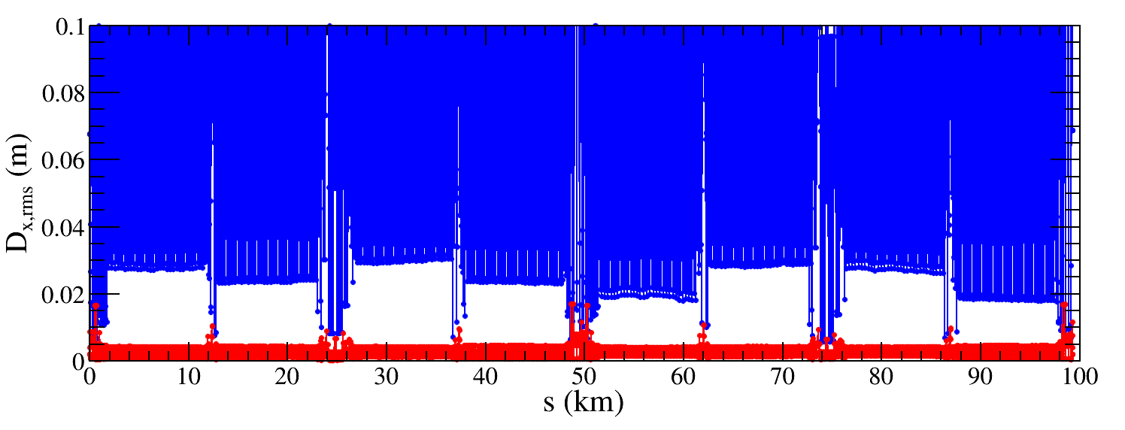
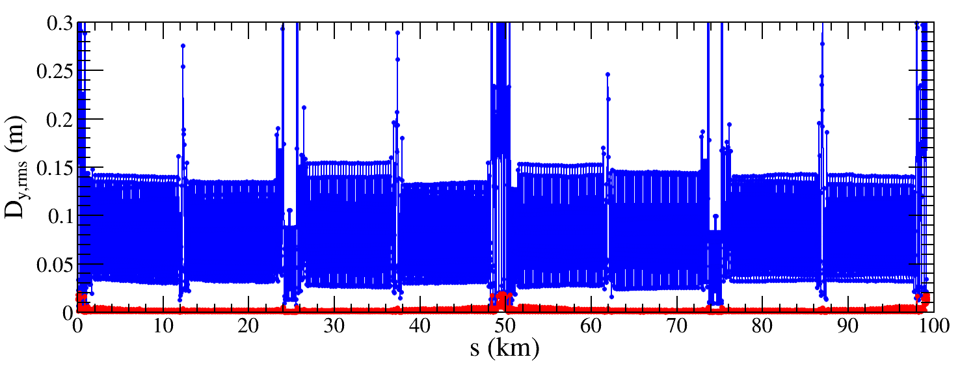
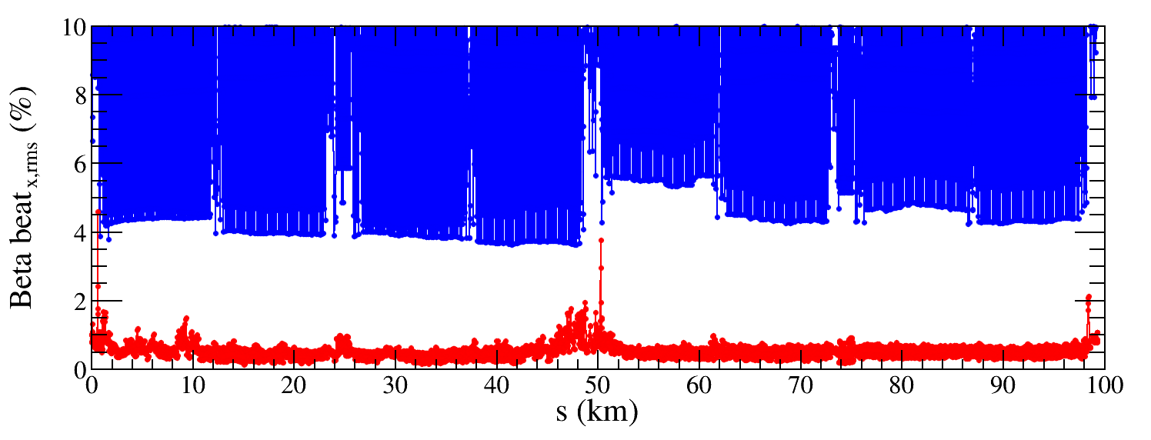
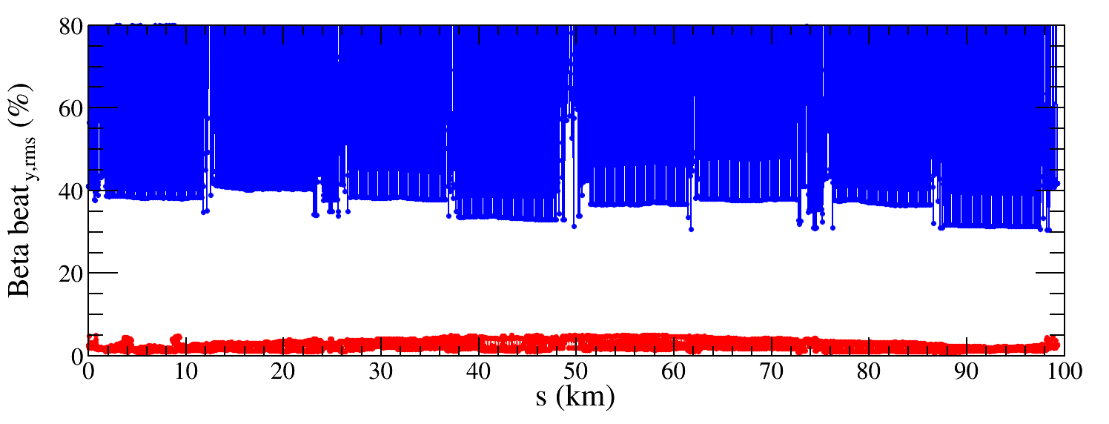
Results -- W lattice
${∆D}_{x,rms}$ decreased from 85.0 mm to 2.7 mm
${∆D}_{y,rms}$ decreased from 92.4 mm to 1.8 mm
${∆β/β}_{x,rms}$ decreased from 8.1% to 0.5%
${∆β/β}_{y,rms}$ decreased from 106.8% to 2.5%

Slide 19
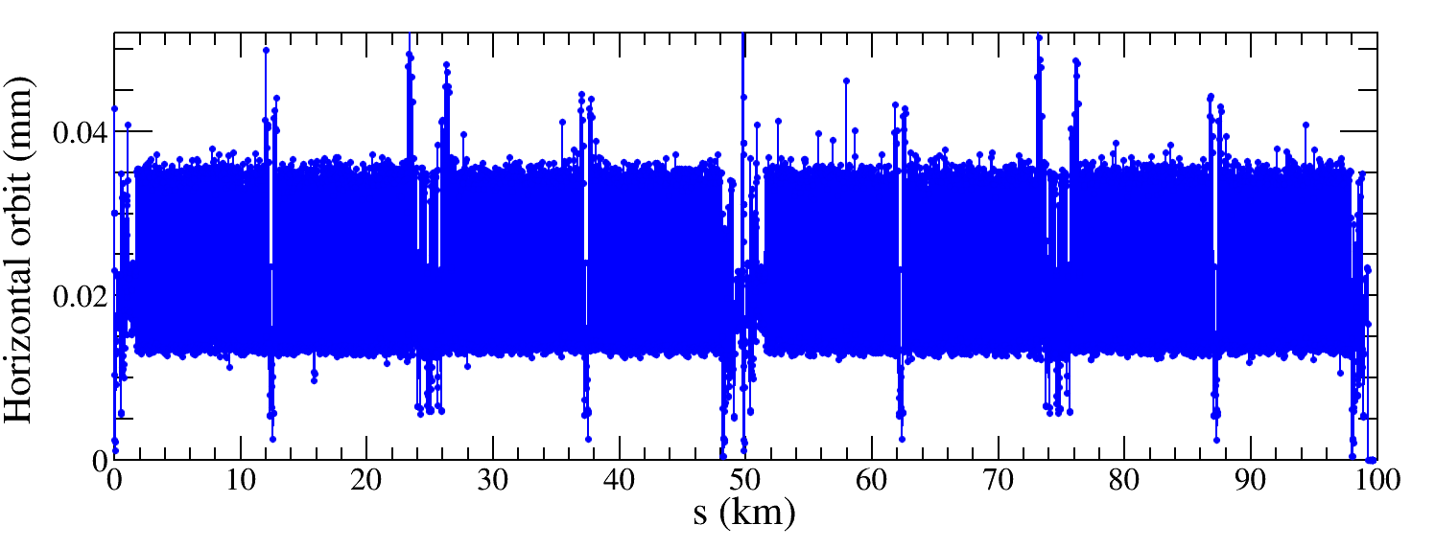
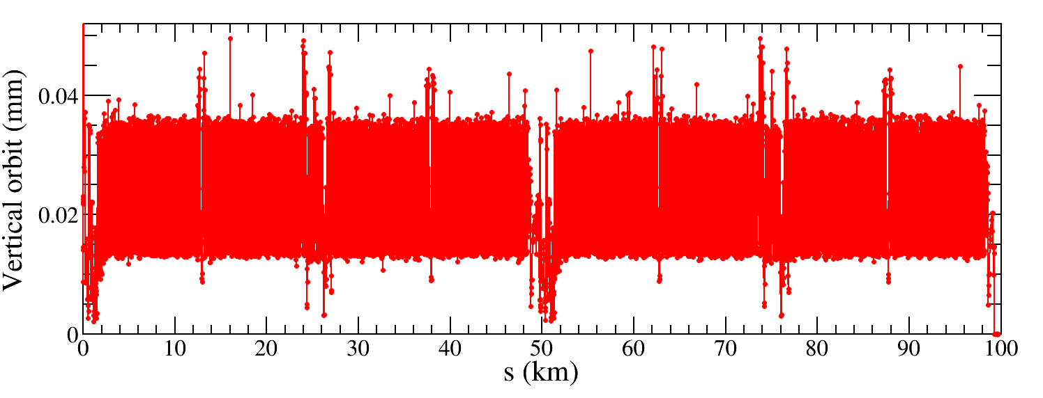
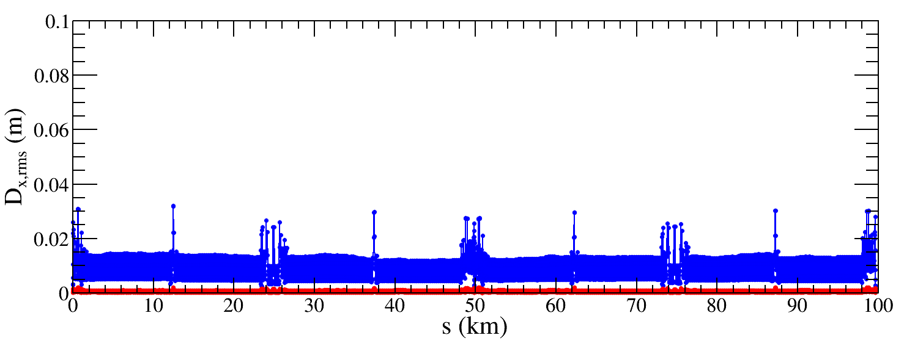
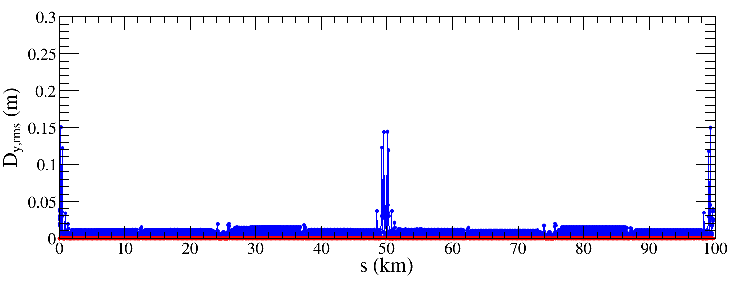
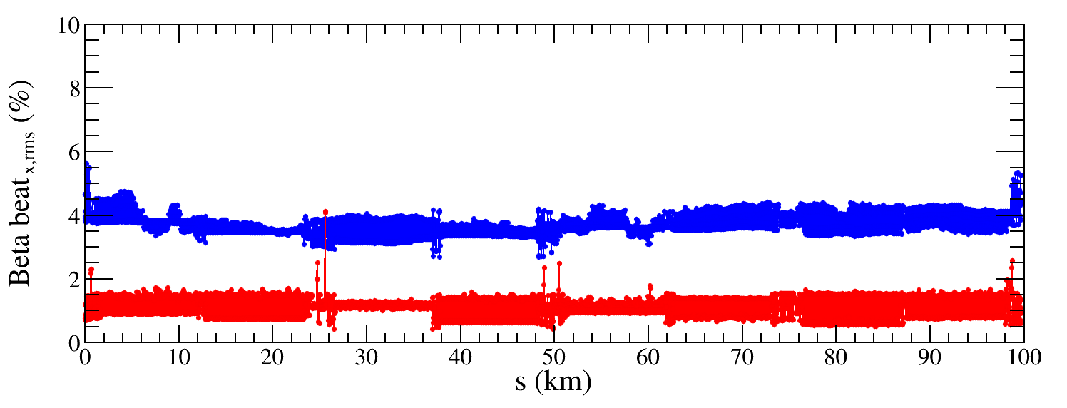
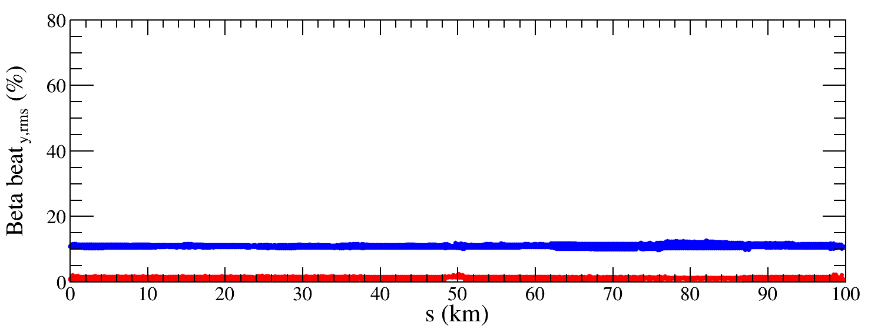
Results -- ttbar lattice
${∆D}_{x,rms}$ decreased from 8.8 mm to 0.6 mm
${∆D}_{y,rms}$ decreased from 7.7 mm to 0.3 mm
${∆β/β}_{x,rms}$ decreased from 3.7% to 1.1%
${∆β/β}_{y,rms}$ decreased from 11.1% to 1.2%

Slide 20
Summary and to do list
The imperfection correction to lattices with 4 modes (Higgs, Z, W, and ttbar) are performed.
1000 Higgs lattice seeds, 500 Z lattice seeds, 100 W lattice seeds and 100 ttbar lattice seeds with errors are corrected, where the closed orbit, dispersion and beta beating are corrected well.
The DA of Higgs lattice and Z lattice after error correction are tracked and satisfy the on-axis injection requirement.
The DA of W lattice and ttbar lattice after error correction are coming soon.
Include more types of imperfections.

Slide 21
Thank you for your attention
E-mail:
wangbin@ihep.ac.cn

