Slide 1
Beam-Beam Effects at CEPC
Yuan Zhang, Na Wang, Huiping Geng
CEPC Workshop
2022-Oct

Slide 2
Outline
Update with New Longitudinal Impedance (ZL)
Simulation with Transverse Impedance (ZT)
Mitigation Scheme of Instability
+ Lattice (Higgs)
Summary

Slide 3
Beam-Beam Related Issues
Beamstrahlung Effect (Luminosity, Lifetime)
Coherent head-tail instability (X-Z instability)
Influenced by Potential Well Distortion due to longitudinal impedance (ZL)
TMCI-like instability in vertical direction with transverse impedance (ZT)
Combined effect of Beam-Beam Interaction and realistic lattice
…

Slide 4
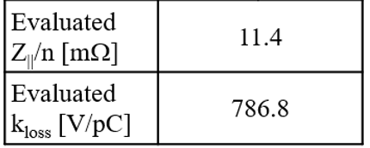
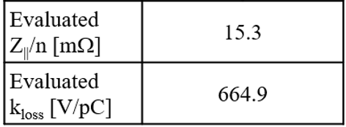
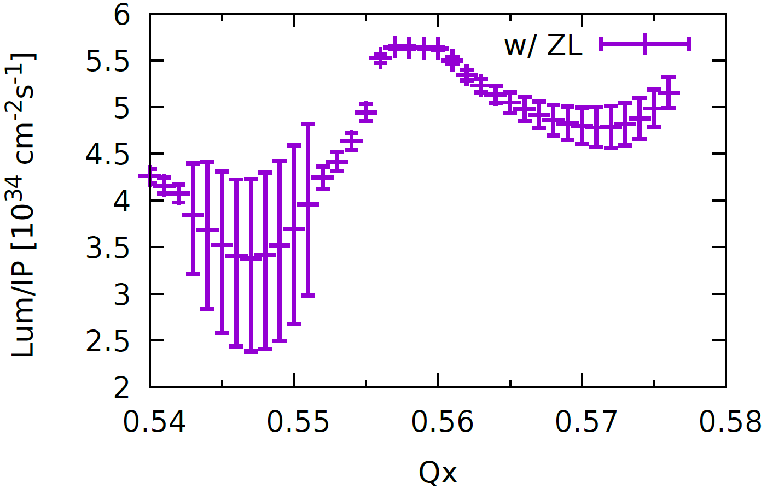
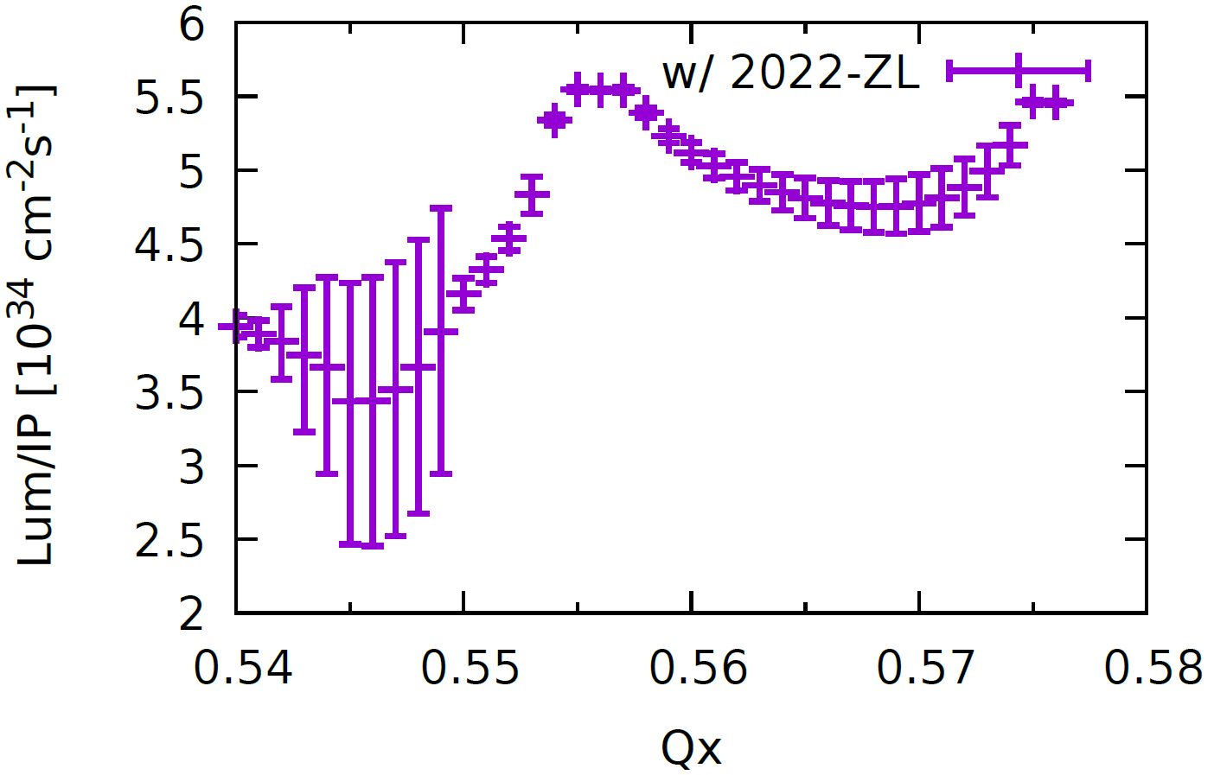
Higgs: $σ_{x} \& Lum$ versus Horizontal tune
Longitudinal impedance has been updated
$β_{x}^{∗}$ = 0.33 m, Np = 14e10
Stable tune area is too limited
Old Impedance
New Impedance
Piwinski Angle: 6

Slide 5
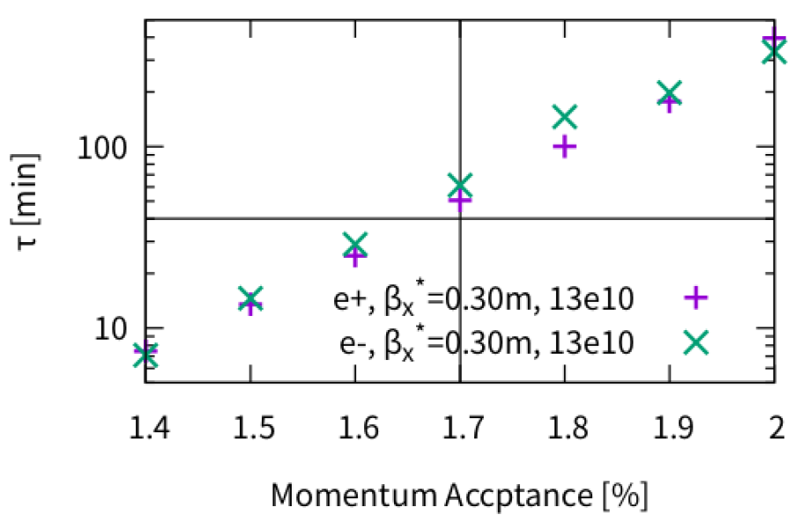
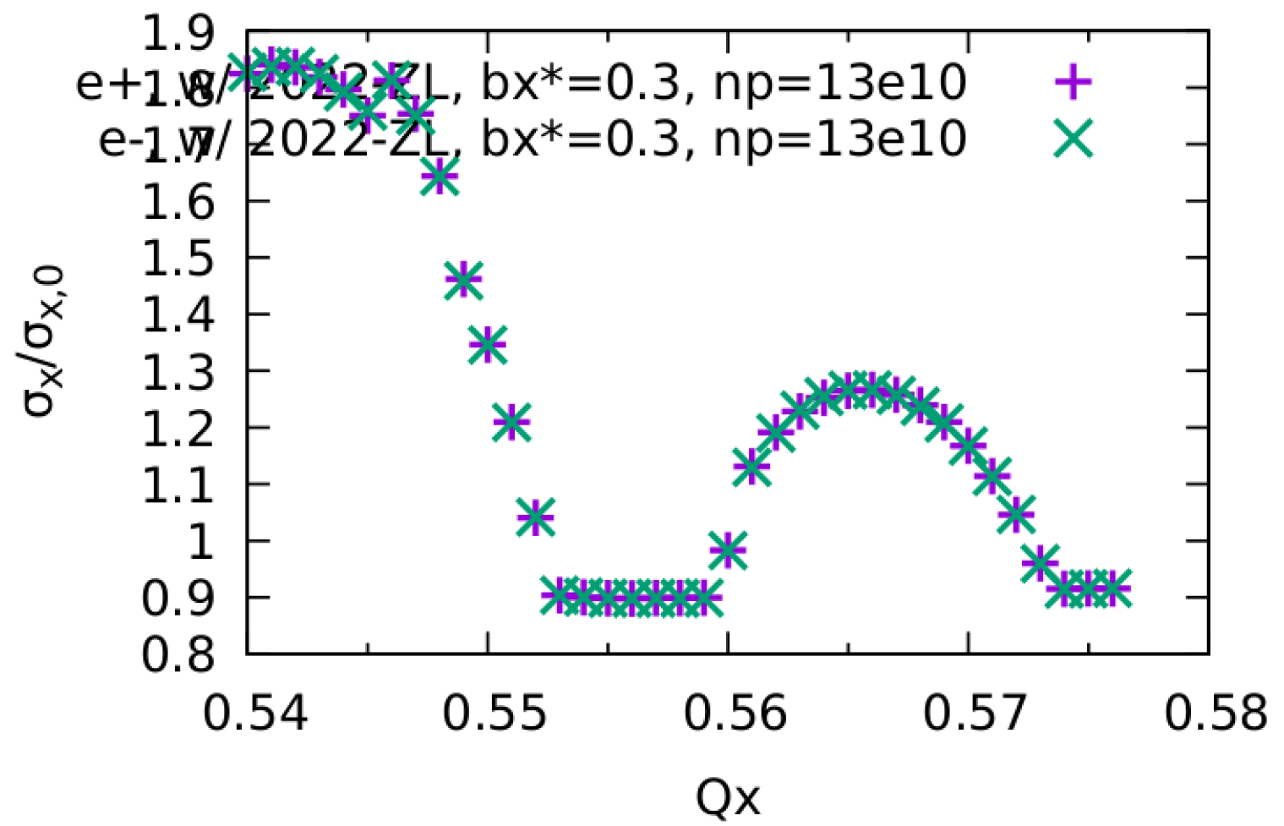
Higgs: $β_{x}^{∗}$=0.3 m, Np=13e10
Old: $β_{x}^{∗}$ = 0.33 m, Np = 14e10
Width of stable tune area: 0.006
Lum ~ 5e34
Beamstrahlung Liftime ~ 50min with MA=1.7%
Luminosity
$σ_{x}$ versus Horizontal tune

Slide 6
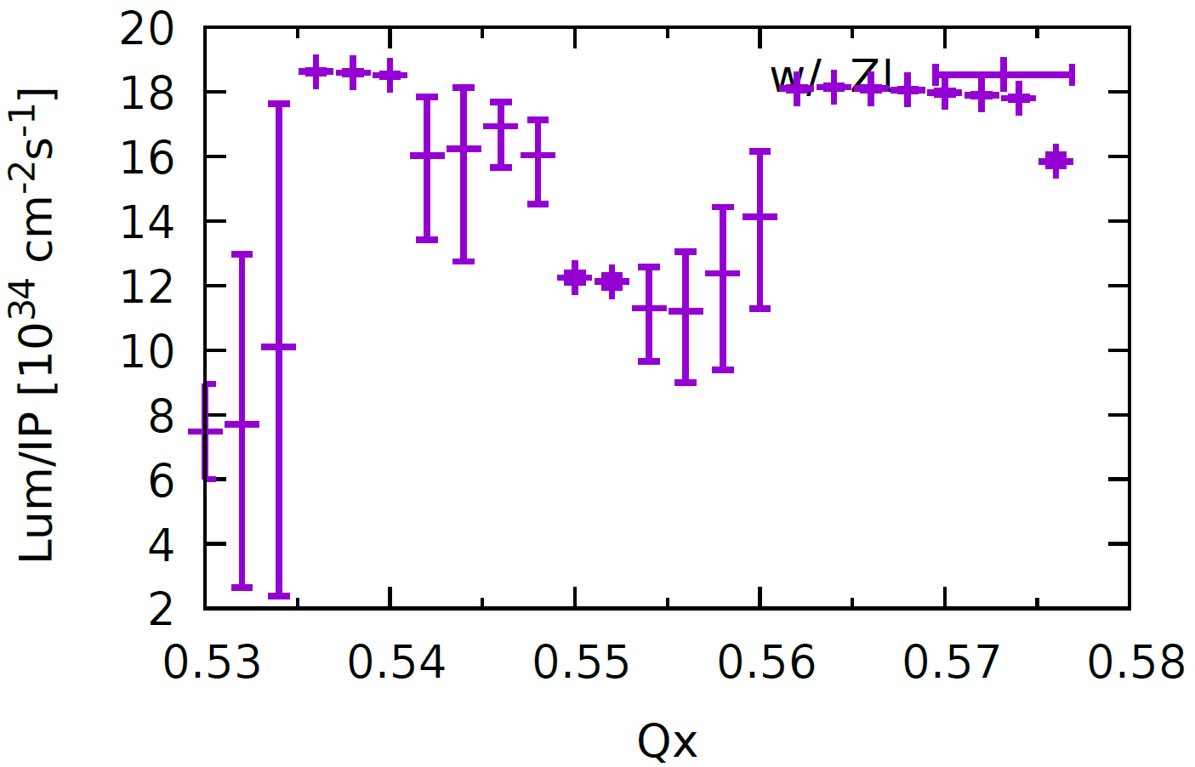
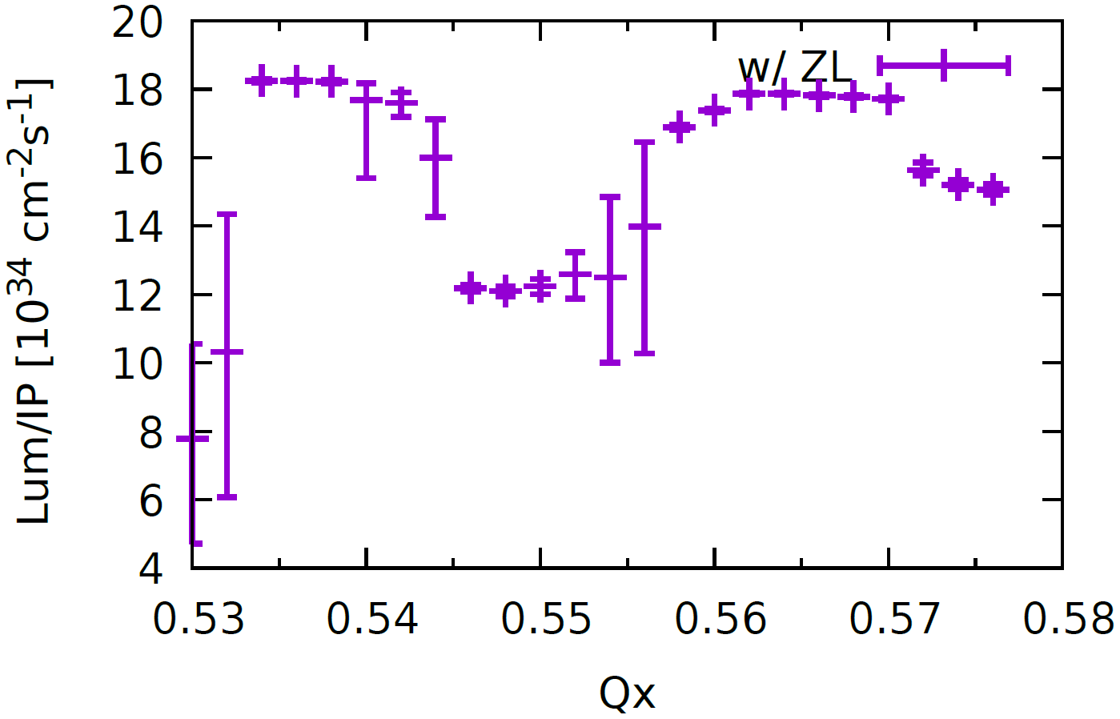
W: $σ_{x} \& Lum$ versus Horizontal tune
With stronger ZL, Stable tune area is still large enough
Old Impedance
New Impedance
Piwinski Angle: 6

Slide 7
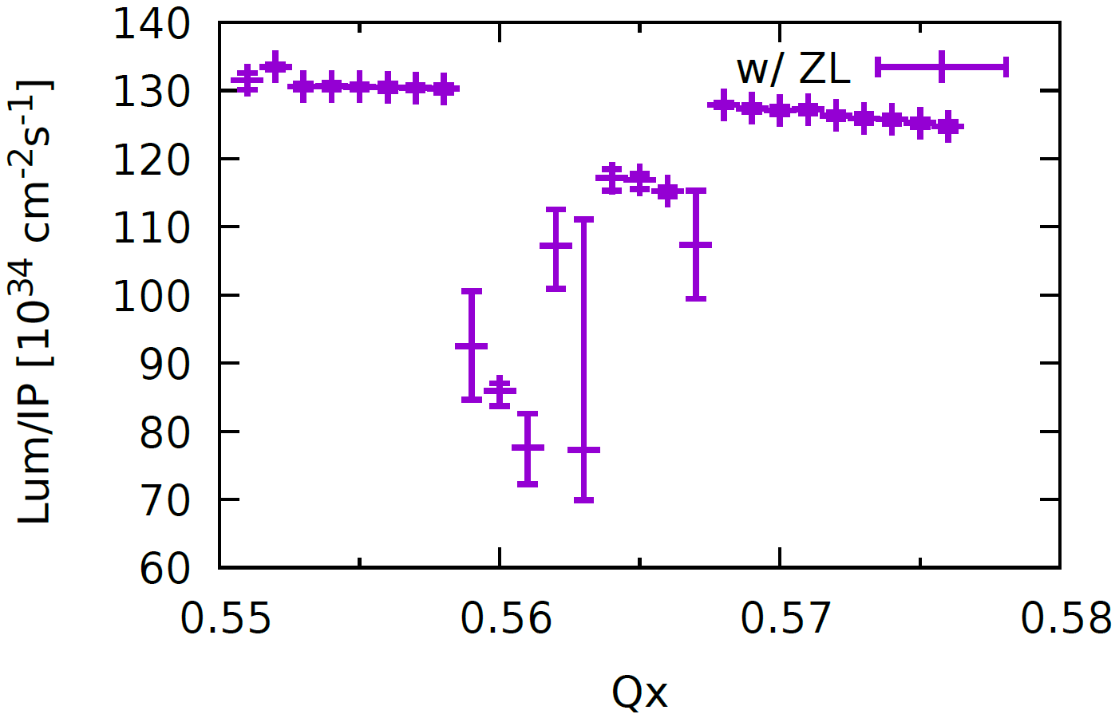
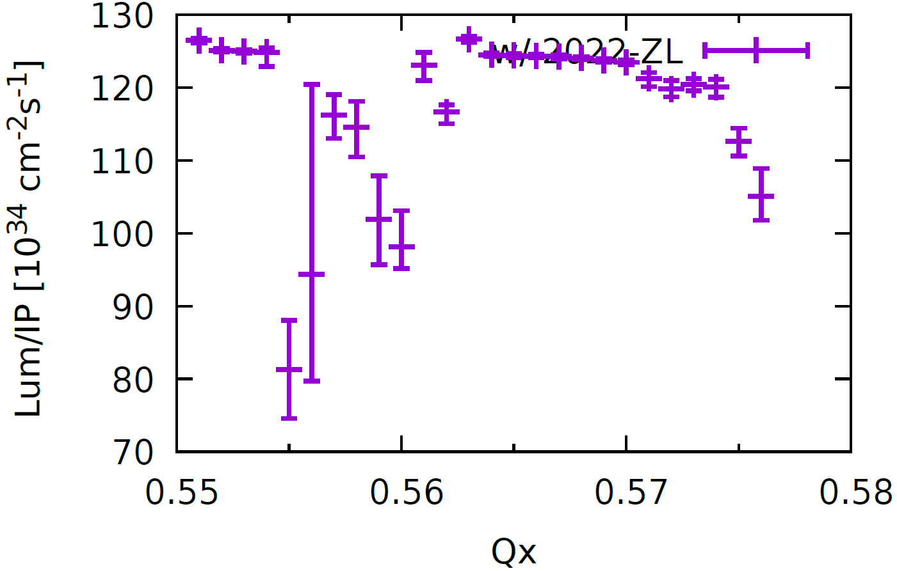
Z: $σ_{x} \& Lum$ versus Horizontal tune
Stable tune area is still large enough, even squeezed.
Piwinski Angle: 24
Old Impedance
New Impedance

Slide 8
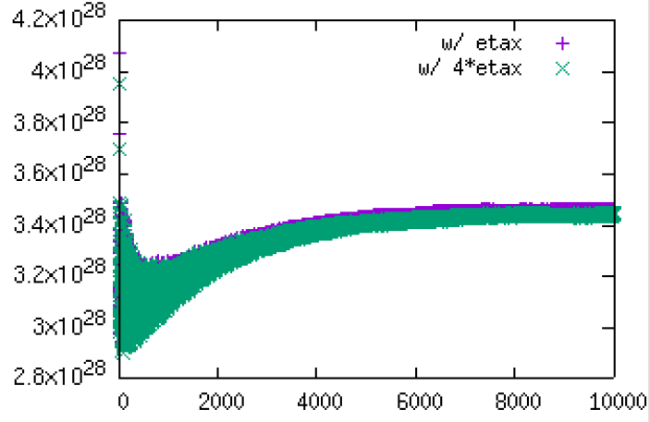
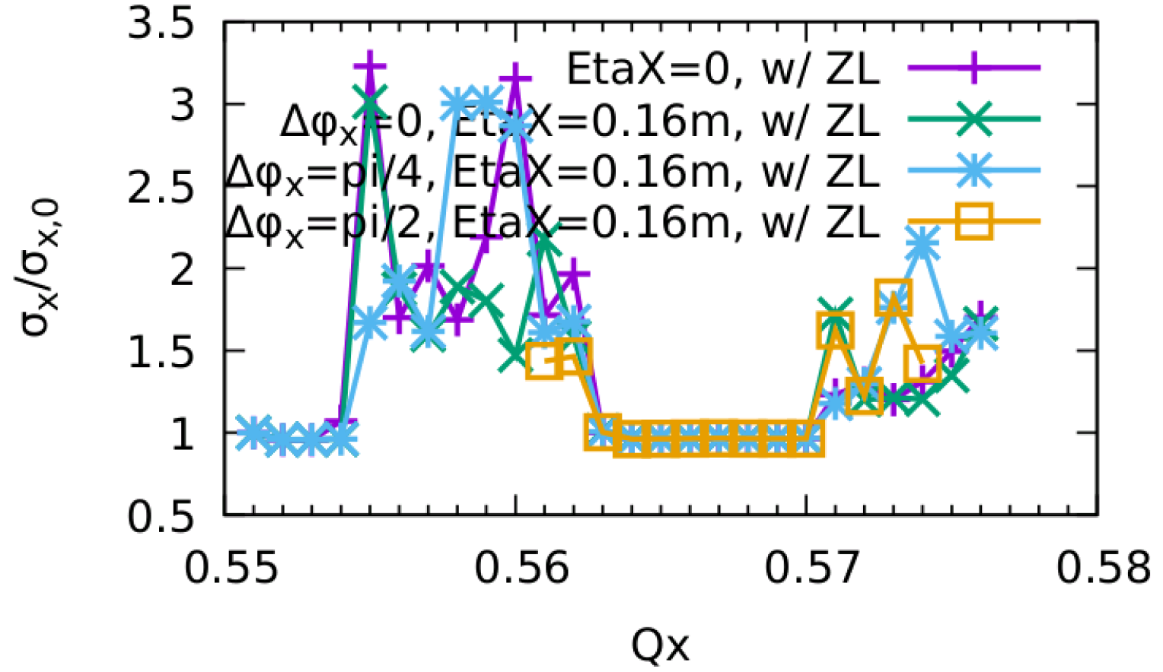
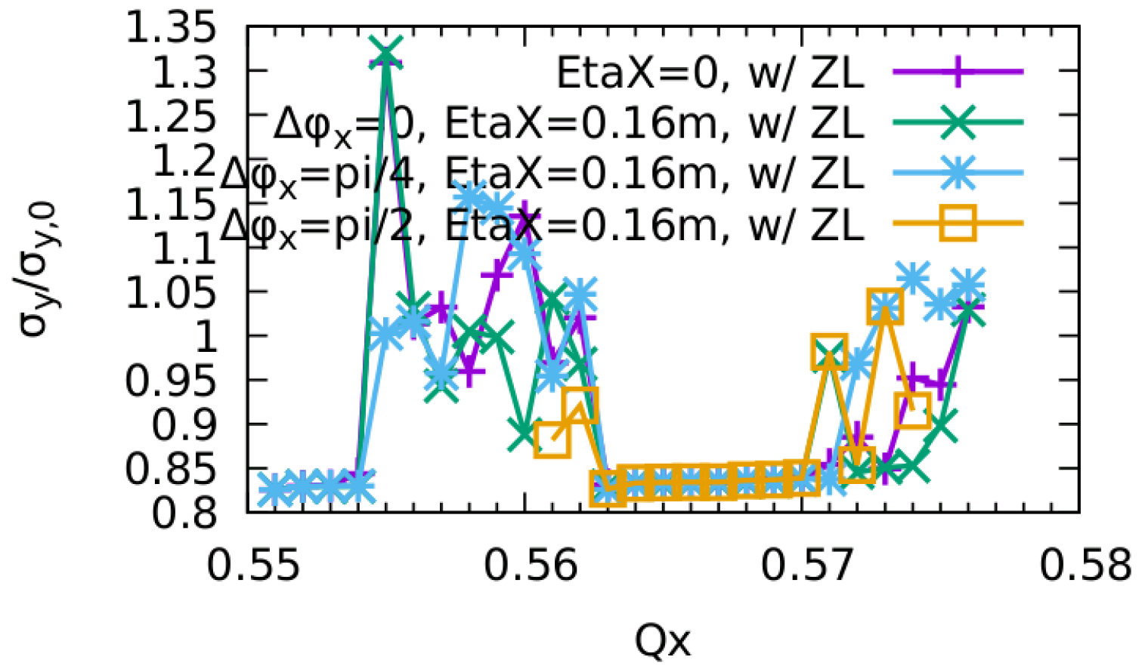
Finite dispersion @ ZL
If the finite dispersion at ZL induce more synchro-betatron coupling? By K. Oide
Lum [Arbitrary Unit]
It is not found any clear effect from finite dispersion

Slide 9
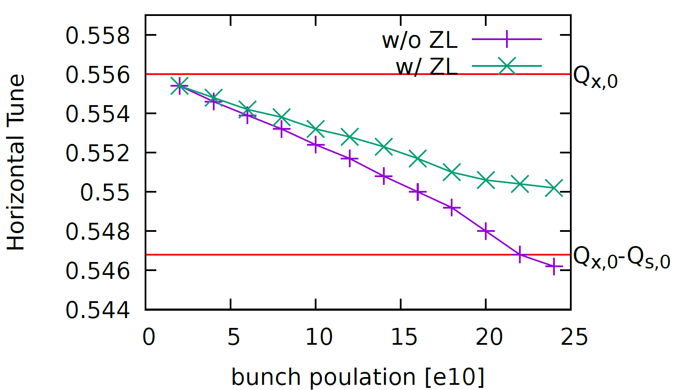
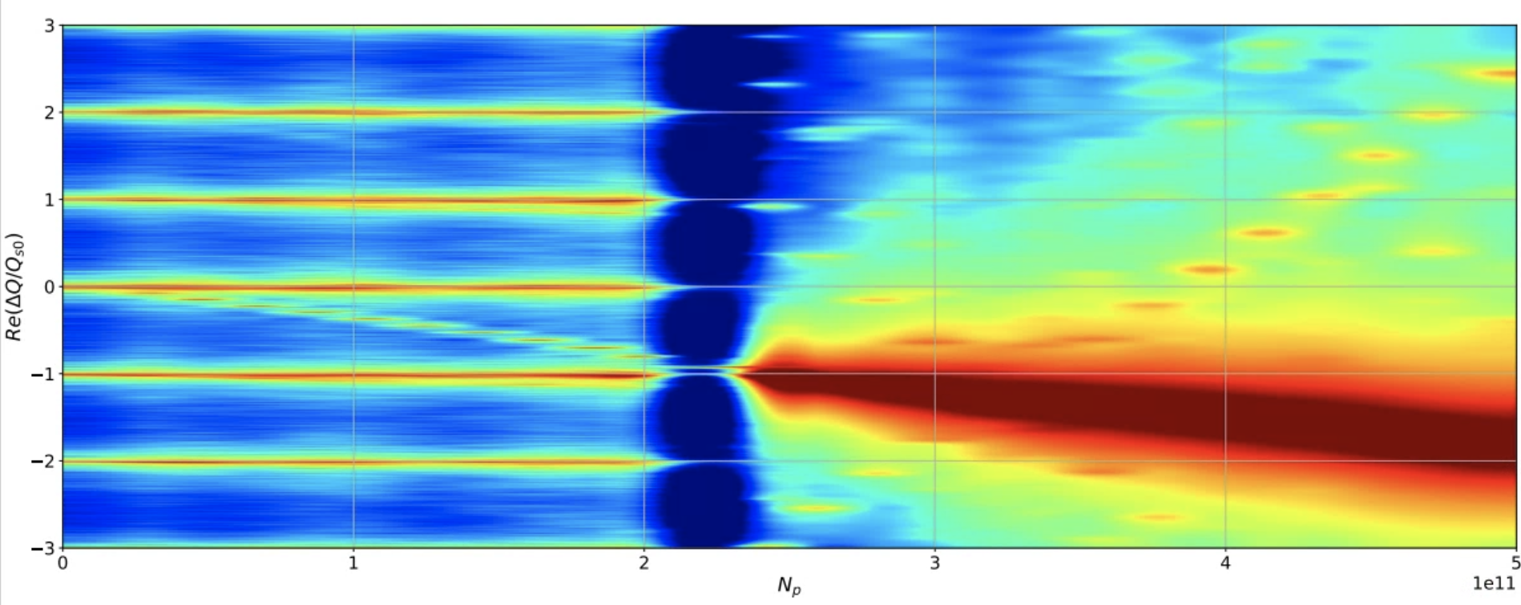
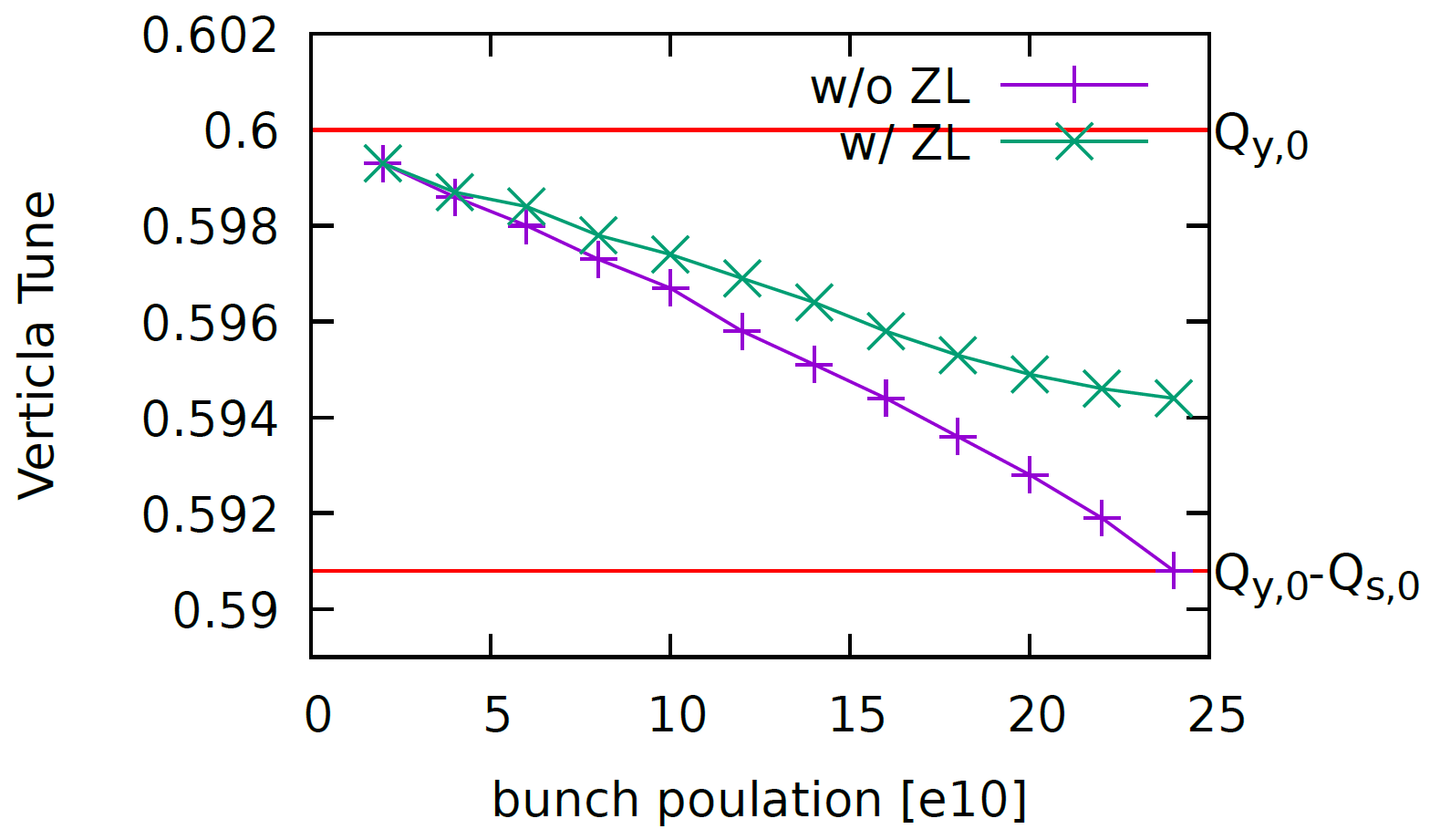
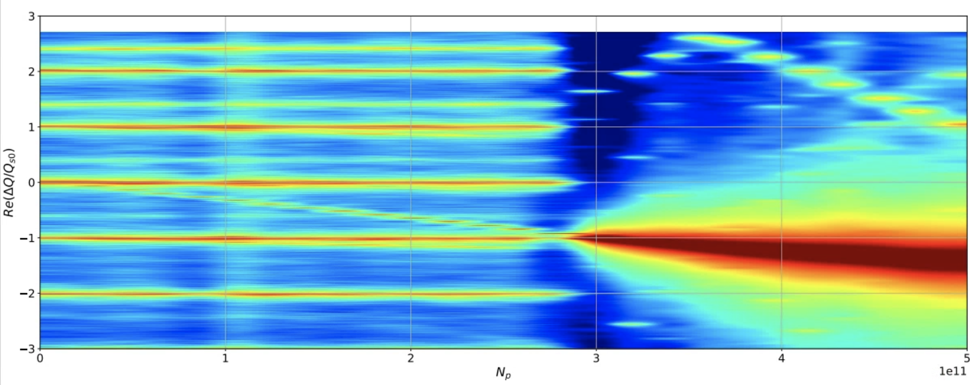
Frequency Analysis of Single Beam with Transverse Impedance (ZT)
Considering ZL,
the X threshold reduces from 22e10 to 18e10.
Courtesy of Mauro Migliorati
Considering ZL,
the X threshold reduces from 22e10 to 18e10.
IBB
PyHEADTAIL (only ZT)
Even though the tune shift reduces considering ZL, the instability threshold is lower!
PyHEADTAIL (only ZT)
Considering ZL,
the Y threshold reduces from 24e10 to 18e10.
Considering ZL,
the Y threshold reduces from 30e10 to 20e10.

Slide 10
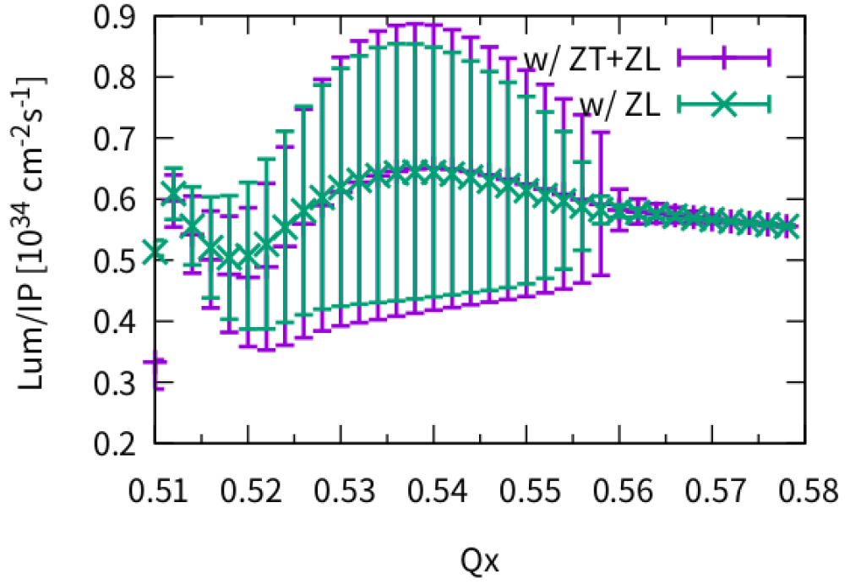
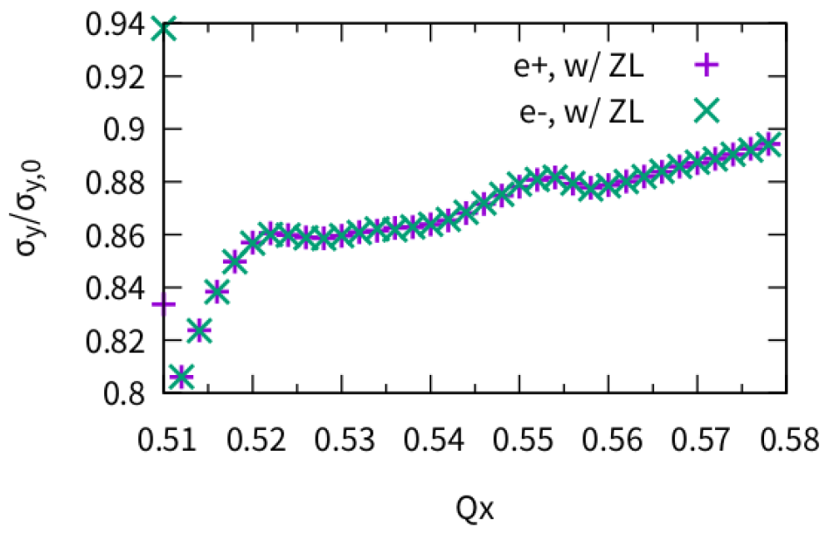
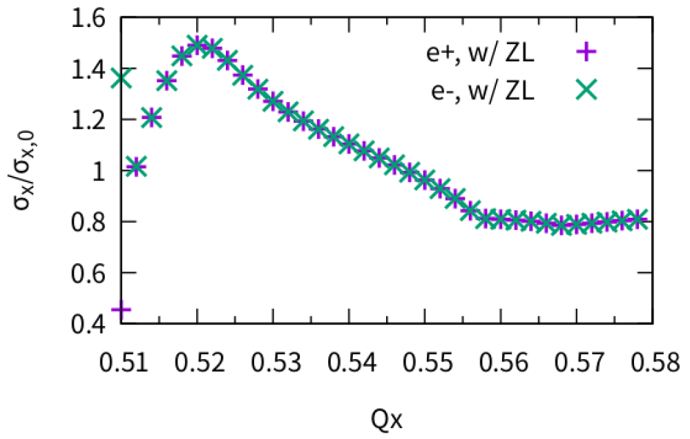
ttbar, w/ZT
Piwinski Angle: 1.2
No clear effect from transverse impedance.
Optimized Qx~0.570

Slide 11
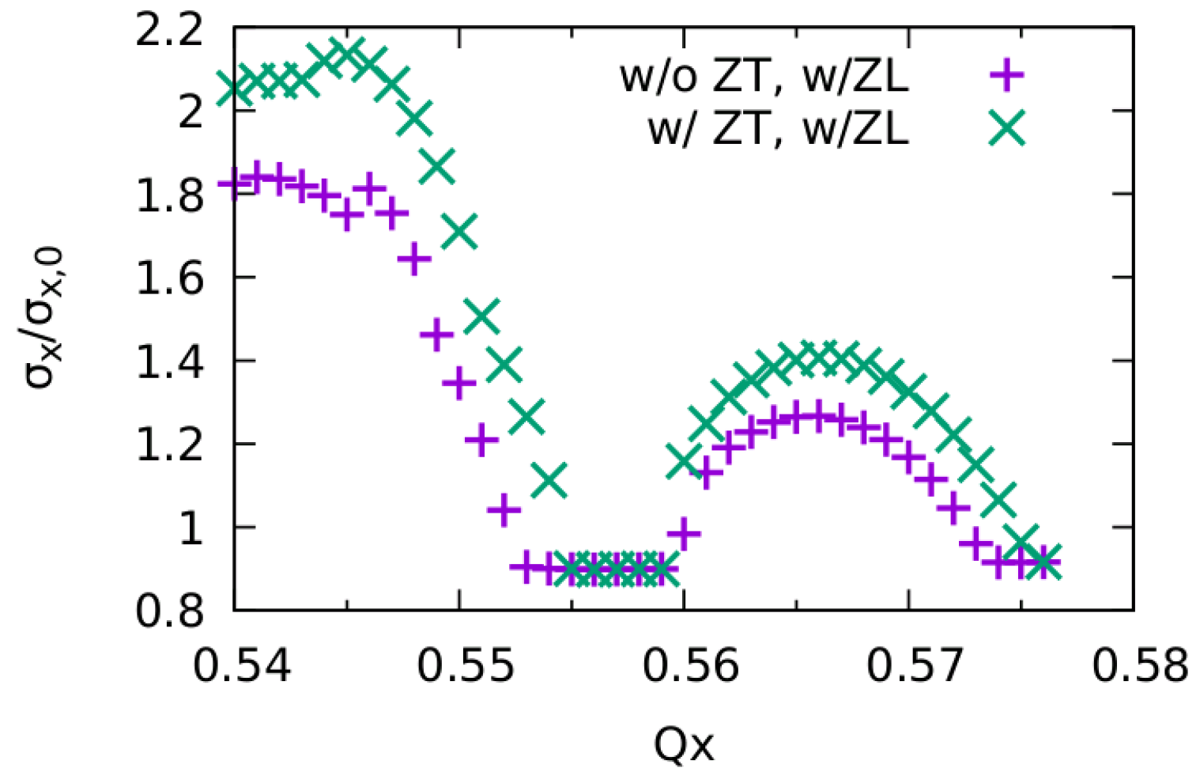
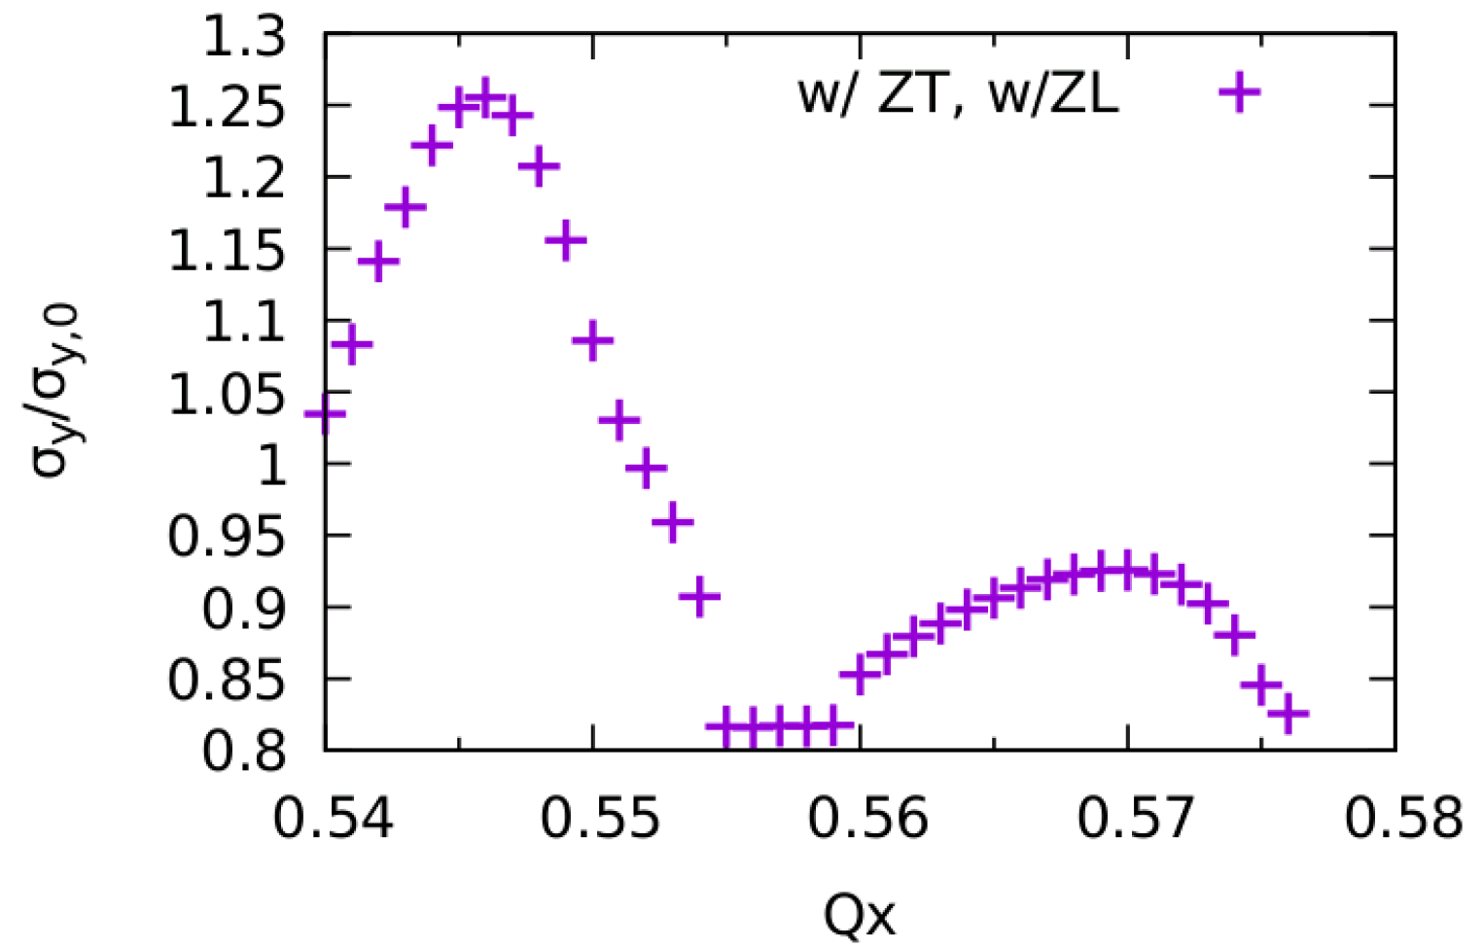
Higgs, w/ ZT
Only X-Z instability
Stable area width is reduced a little (ZT only applied 1 kick)

Slide 12
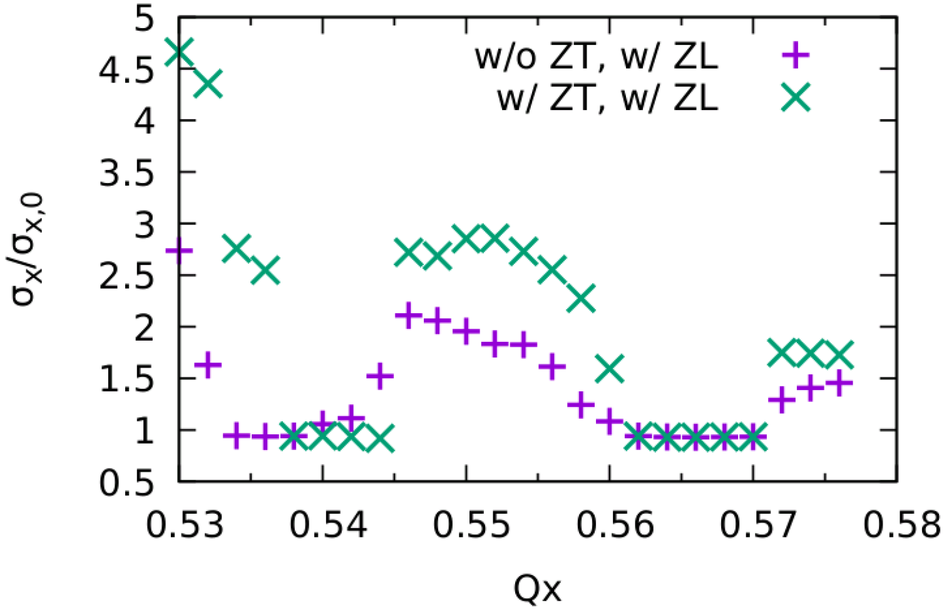
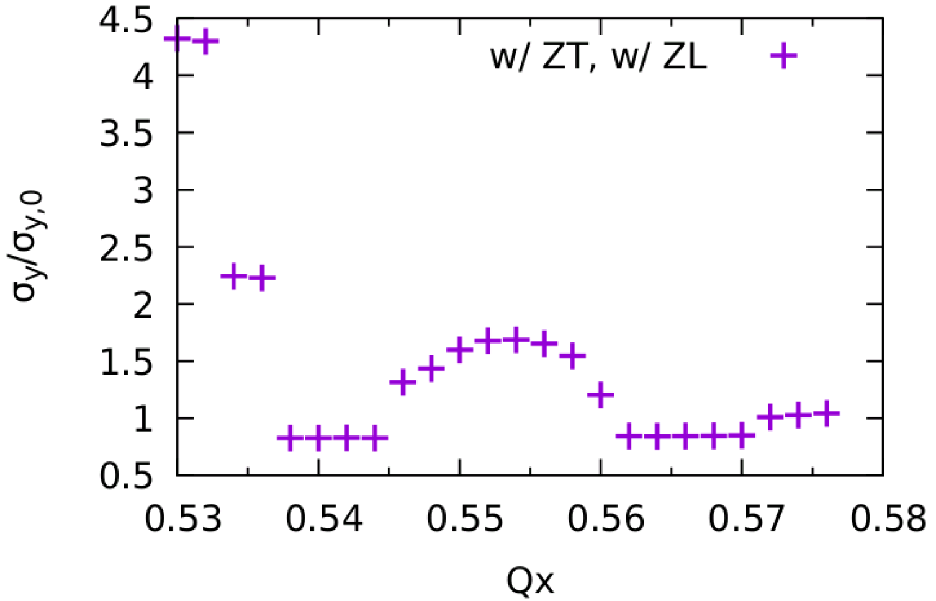
W, w/ ZT
Only X-Z instability
stable region is large enought (ZT applied 1 kick)

Slide 13
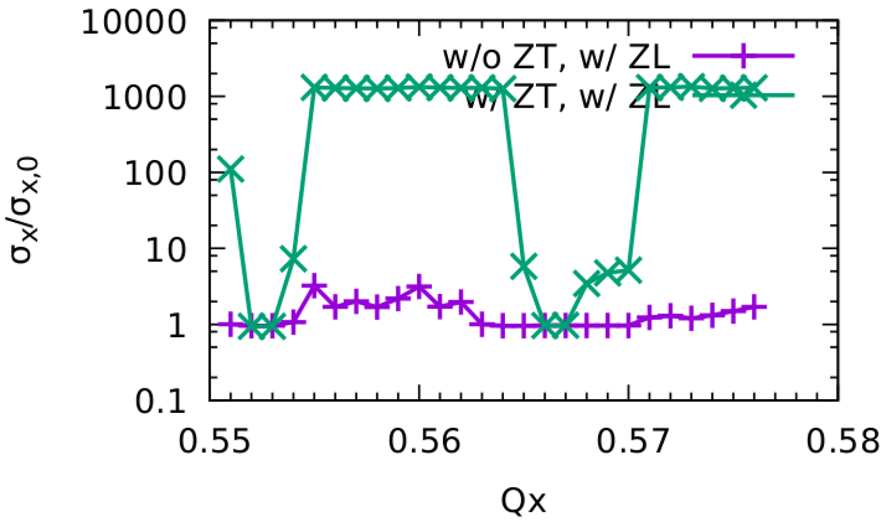
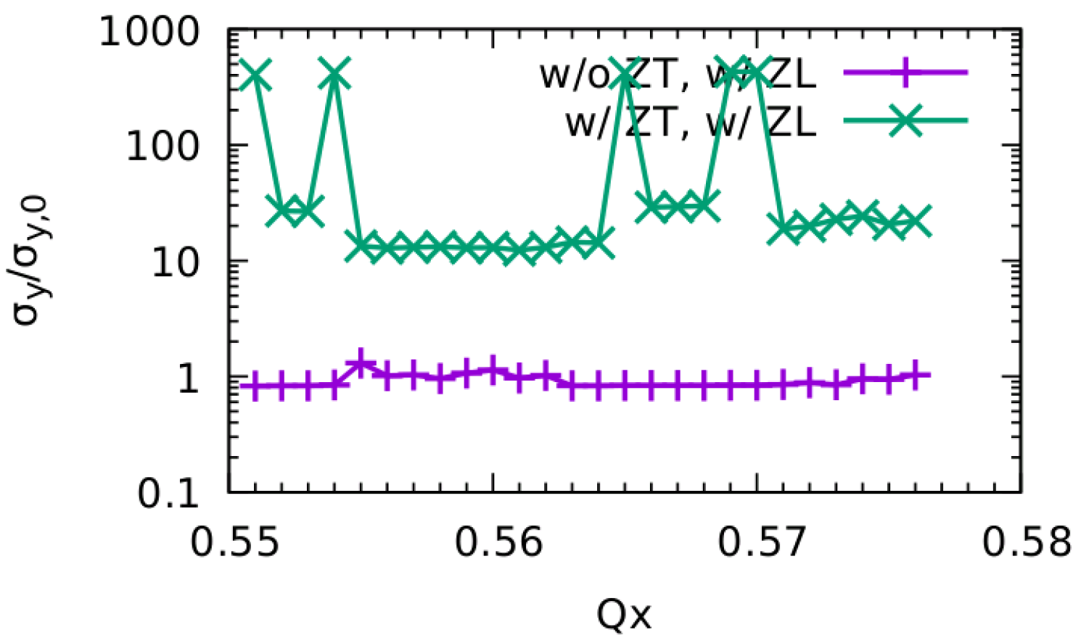
Z, w/ ZT
No stable working points
There exist very strong blowup in both X/Y direction

Slide 14
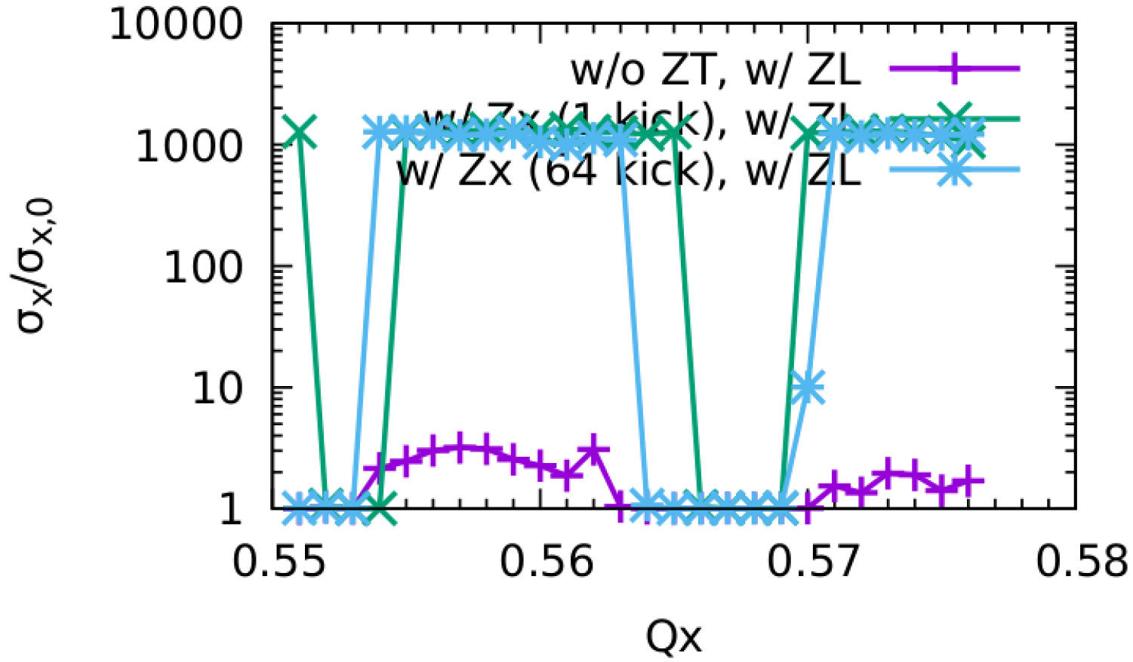
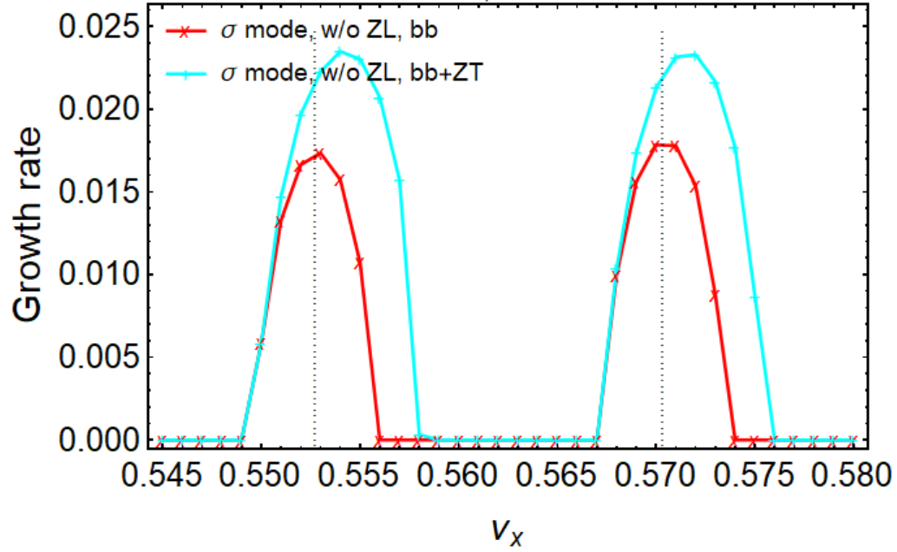
CEPC Only Zx(+ZL)
Stable tune area is large enough (w/ZT)
Simulation and analysis agrees qualitatively.
Courtesy of Chuntao Lin and Na Wang
Simulation
Analysis, ZT kick applied at IP
Kick number of wake field affect the result
In horizontal direction, smooth distributed impedance nearly does not squeeze the stable tune area serious
A very local impedance may squeeze the stable area.
In horizontal direction, considering ZX
the instability growth rate is faster,
unstable tune area increases

Slide 15
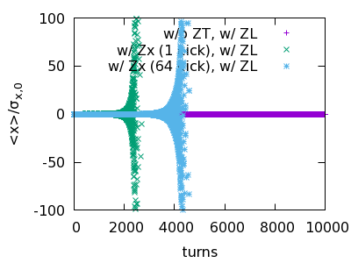
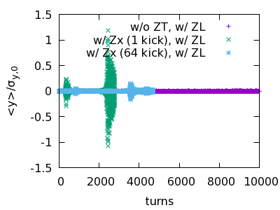
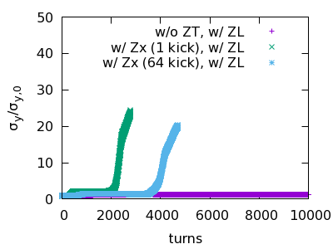
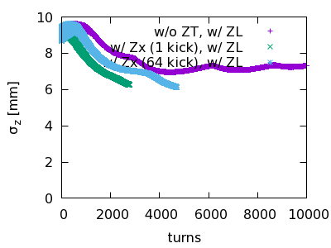
CEPC Only Zx(+ZL) @ Qx=0.562
Behavior at unstable working point
It has been simulated that w/o BS (but keep same bunch length), the TMCI-like instability would not appear.
X-Z instability is first excited
Bunch length is shorter
X-TMCI-like instability is then excited
Y is blowup due to stronger beam-beam interaction

Slide 16
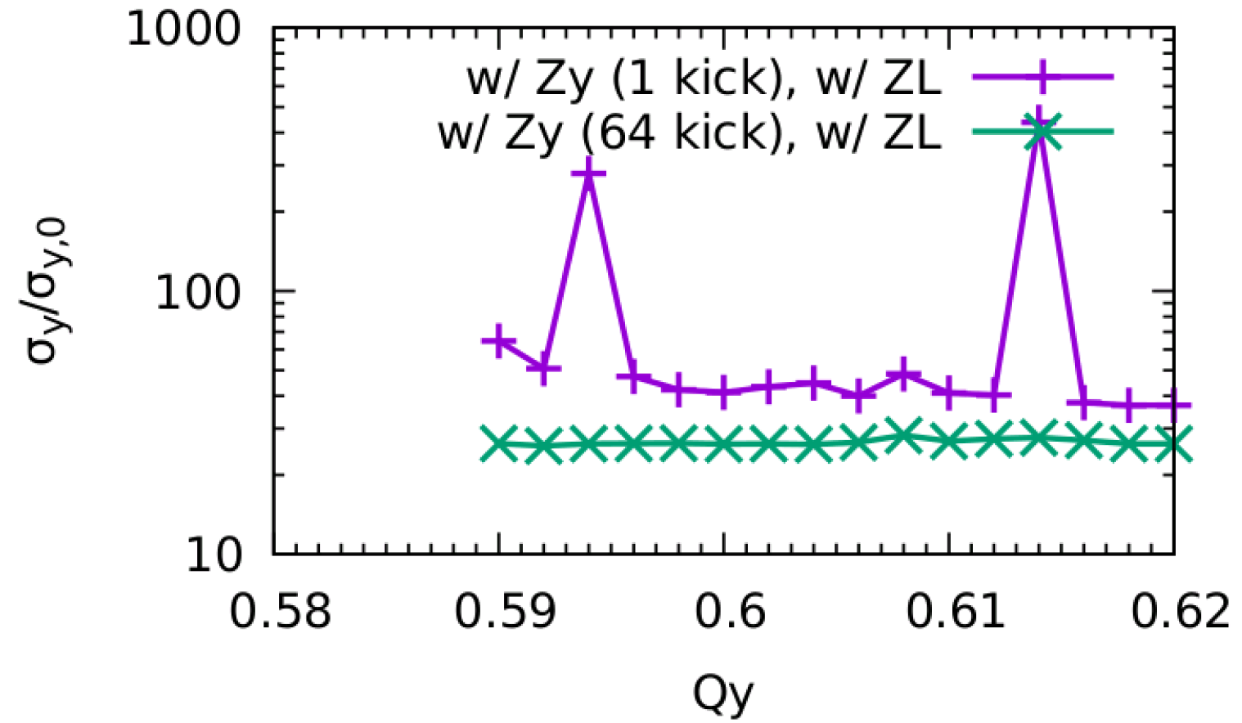
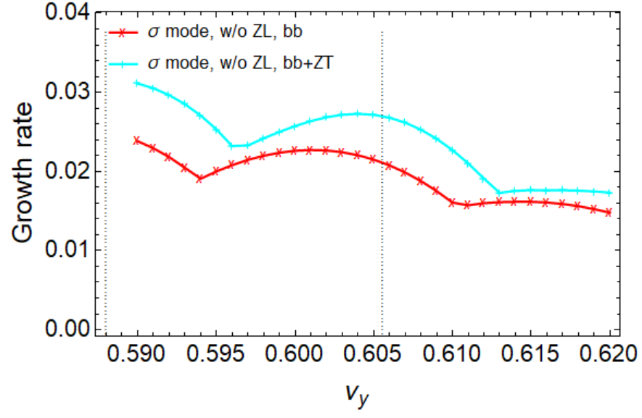
CEPC Only Zy(+ZL) Qx=0.567
No stable working point (w/ZT)
Simulation and analysis agrees qualitatively.
Courtesy of Chuntao Lin and Na Wang
Simulation
Analysis, ZT kick applied at IP
pure beam-beam is unstable due to ignorance of strong nonlinearity ?
It is also found enhance of instability when considering ZY
Kick number of wake field affect the result
No stable tune area

Slide 17
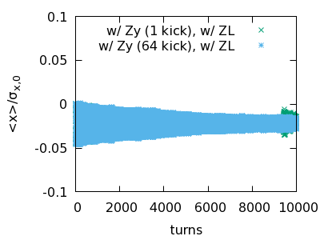
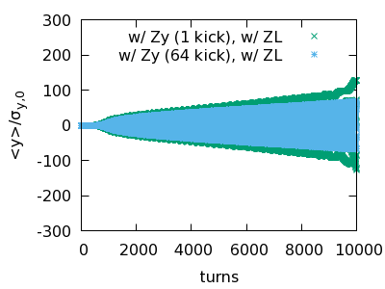
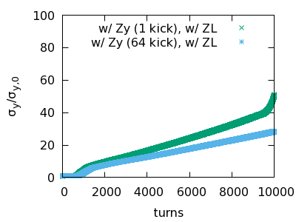
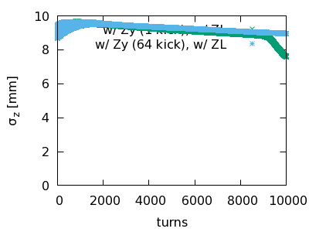
CEPC Only Zy(+ZL) Qx=0.567
Behavior at unstable working point
$σ$ mode
It has been simulated that w/o BS (but keep same bunch length), the X-Z instability would not appear.
Y-TMCI-like instability is first excited
Bunch length is shorter
X-Z instability is excited
Stronger Y blowup due to strong beam-beam

Slide 18
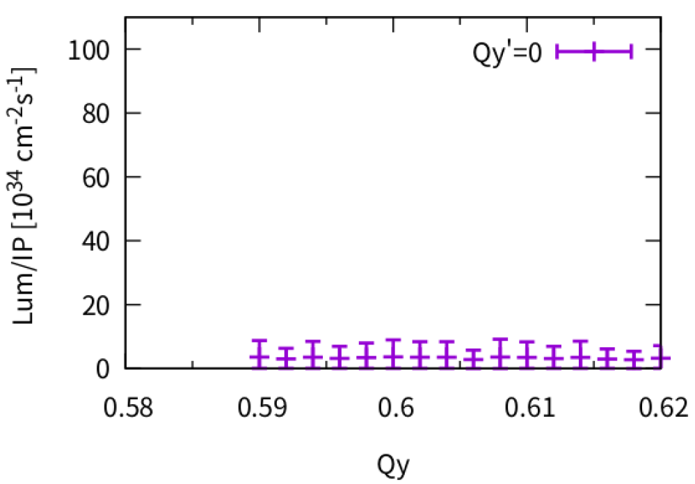
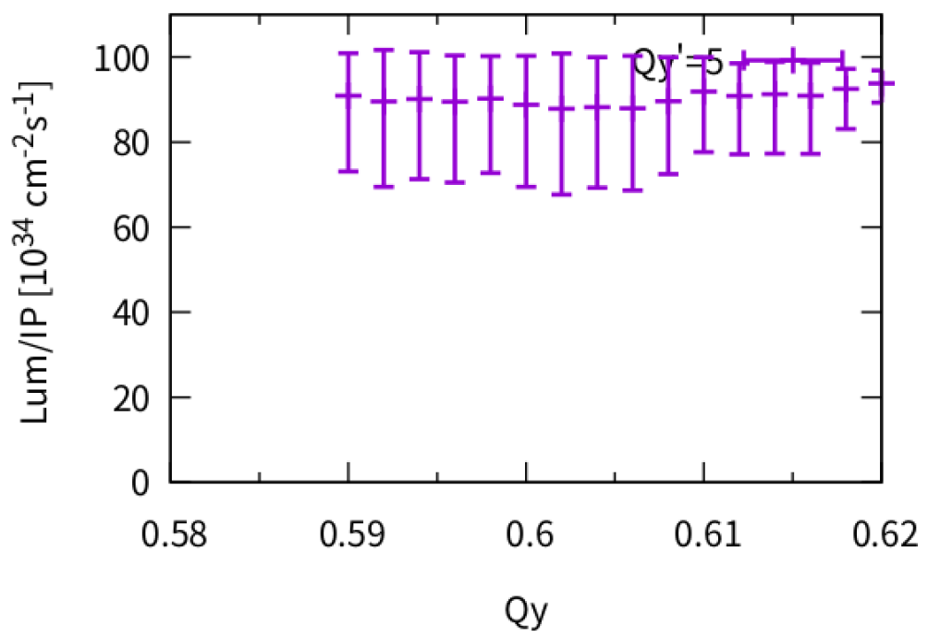
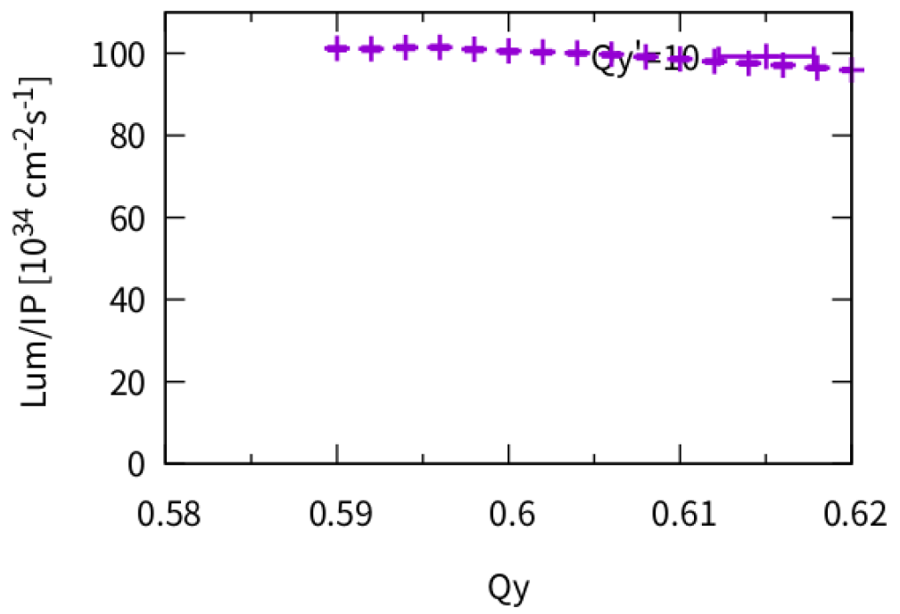
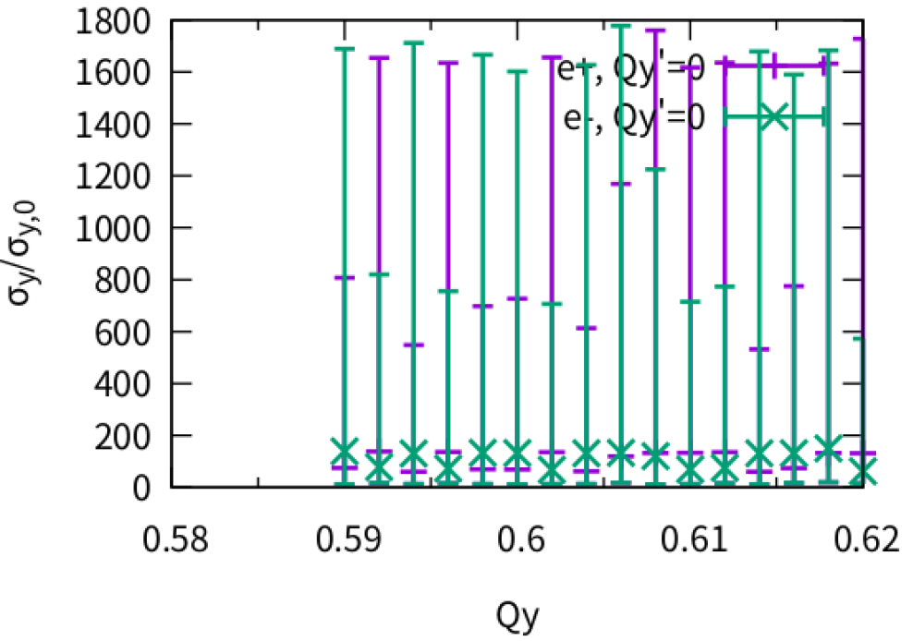
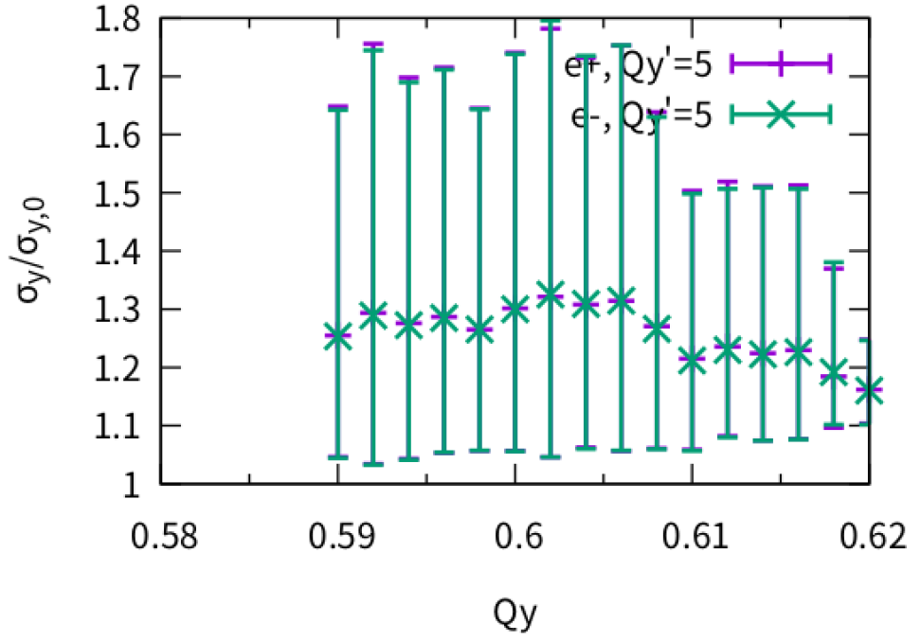
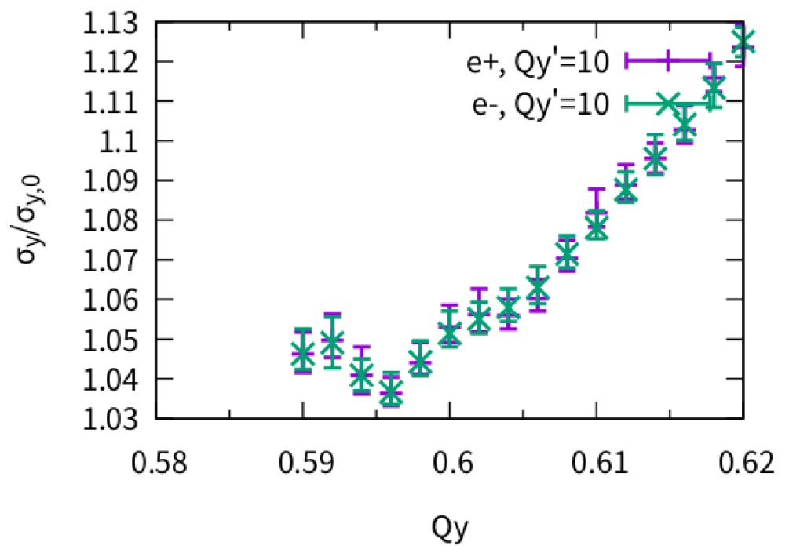
Effect of Vertical Chromaticity (Lum & $σ_{y}$)
Qy’~10 could help suppress the strong TMCI-like instability induced by BB+ZT
ZX+ZY+ZL, Qx=0.567
Qy’=0
Qy’=5
Qy’=10

Slide 19
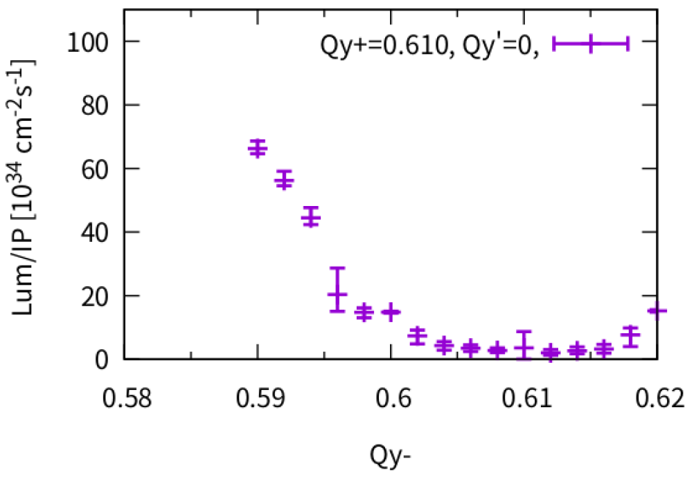
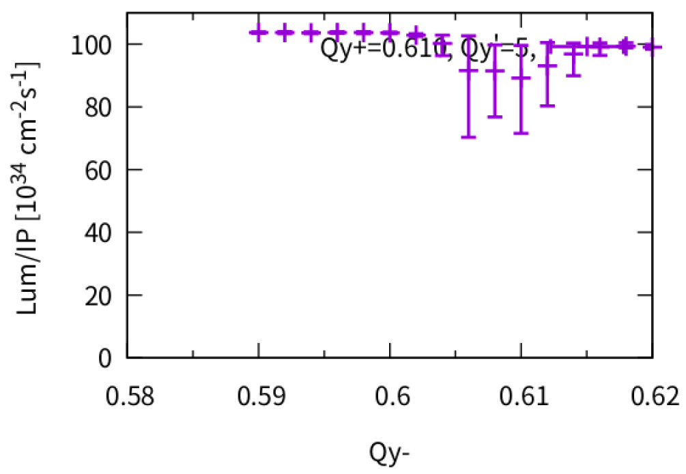
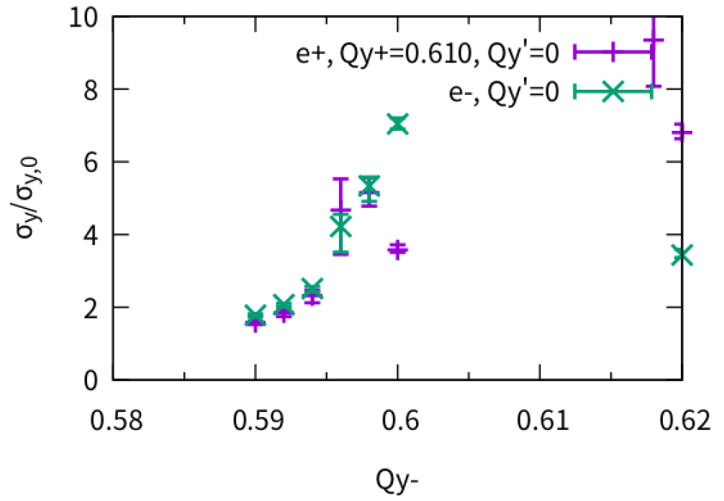
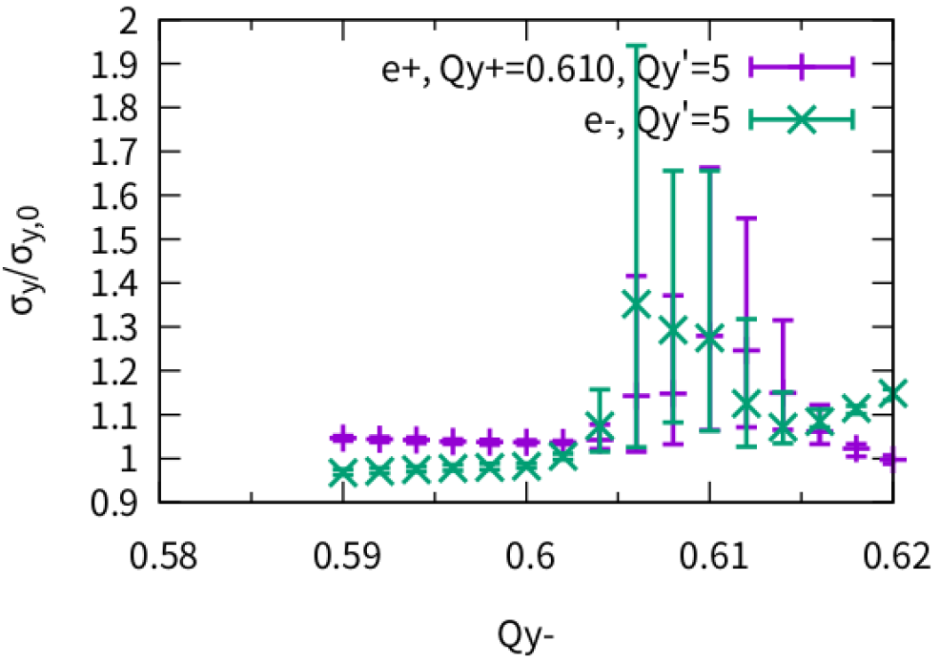
Effect of different vertical tune (Qy+=0.610)
Qy Difference > 0.01 could help suppress instability with Qy’=5
Thanks: K. Oide, K. Ohmi
Qy’=0
Qy’=5

Slide 20
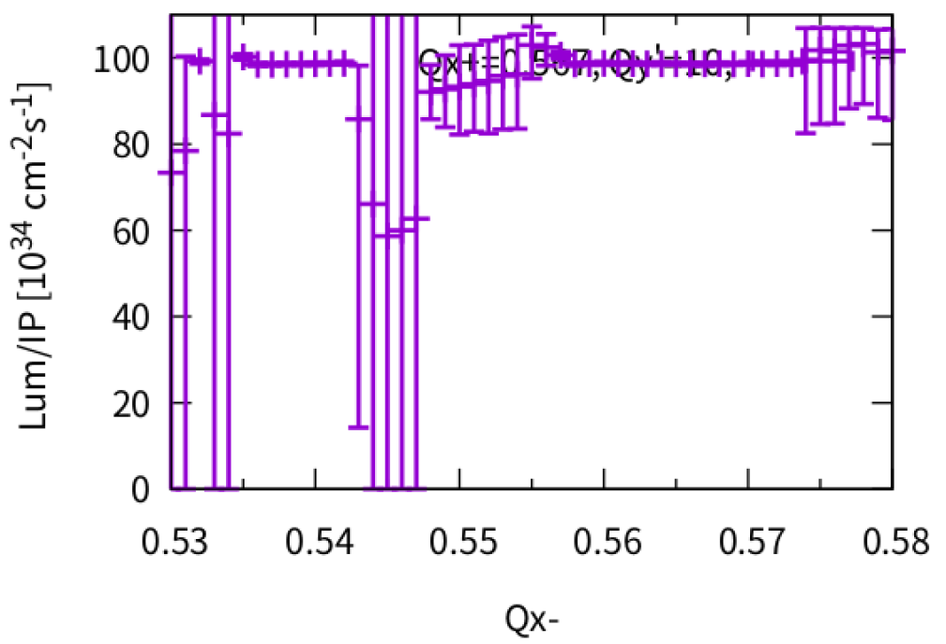
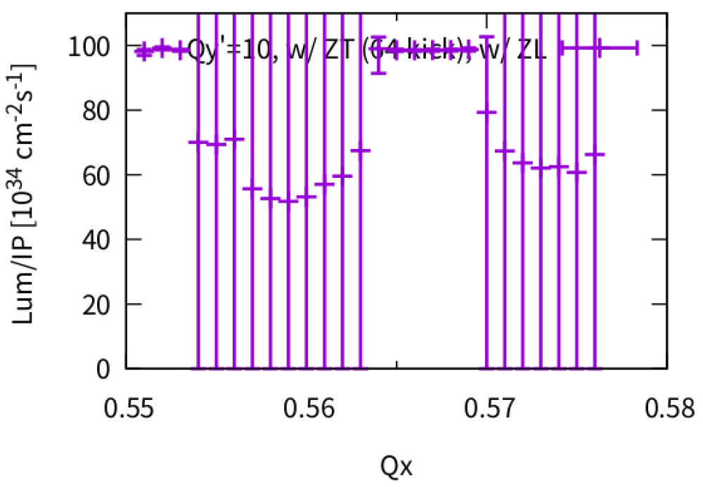
Different Horizontal tune
Asymmetric
Symmetric
Qx+=0.567

Slide 21
Higgs: Lifetime and equilibrium distribtuion
Realistic lattice w/o beam-beam
Huiping Geng and Yiwei Wang
K. Ohmi and F. Zimmermann, IPAC14
50k turns
w/o beambeam
@IP
@Injection point
@RF section

Slide 22
Higgs:Lifetime w/ and w/o beambeam
Realistic lattice w/o and w/ beam-beam
Huiping Geng and Yiwei Wang
50k turns, 1k macro-particles @injection point
w/o bb
w/ bb
Survival particles:
1000
Survival particles:
861

Slide 23
Higgs: Lifetime optimization
Realistic lattice w/ beam-beam
Huiping Geng and Yiwei Wang
NIMA 959 (2020) 163517
Diffusion Map Analysis
50k turns, 1k macro-particles @injection point
32 families of sextupoles in Arc
Survival particles:
962

Slide 24
Summary
ZL: Updated longitudinal impedance is considered, machine parameter is optimized further
Finite dispersion does not induce clear effect
The transverse impedance does not bring serious effect for ttbar/Higgs/W
Combined effect of beam-beam interaction and transverse impedance may induce strong head-tail instability in vertical direction at Z mode
In the presence of Beamstrahlung, X-Z instability may induce strong TMCI instability in horizontal direction with conventional impedance. TMCI instability in vertical direction could induce X-Z instability
The chromaticity could help mitigate the vertical TMCI instability induced by beam-beam with impedance
Asymmetric transverse tunes could help suppress the X-Z(horizontal) or TMCI (vertical) instability, since sigma-mode dominate

Slide 25
backup

Slide 26
Machine parameters of CEPC
by CEPC AP group, 2 June 2022
 | Higgs | Z | W | ttbar
Number of IPs | 2
Circumference [km] | 100.0
SR power per beam [MW] | 30
Half crossing angle at IP [mrad] | 16.5
Bending radius [km] | 10.7
Energy [GeV] | 120 | 45.5 | 80 | 180
Energy loss per turn [GeV] | 1.8 | 0.037 | 0.357 | 9.1
Piwinski angle | 5.94 | 24.68 | 6.08 | 1.21
Bunch number | 268 | 11934 | 1297 | 35
Bunch spacing [ns] | 591 (53% gap) | 23 (18% gap) | 257 | 4524 (53% gap)
Bunch population [10^10] | 13 | 14 | 13.5 | 20
Beam current [mA] | 16.7 | 803.5 | 84.1 | 3.3
Momentum compaction [10^-5] | 0.71 | 1.43 | 1.43 | 0.71
Beta functions at IP (bx/by) [m/mm] | 0.3/1 | 0.13/0.9 | 0.21/1 | 1.04/2.7
Emittance (ex/ey) [nm/pm] | 0.64/1.3 | 0.27/1.4 | 0.87/1.7 | 1.4/4.7
Beam size at IP (sigx/sigy) [um/nm] | 14/36 | 6/35 | 13/42 | 39/113
Bunch length (natural/total) [mm] | 2.3/4.1 | 2.5/8.7 | 2.5/4.9 | 2.2/2.9
Energy spread (natural/total) [%] | 0.10/0.17 | 0.04/0.13 | 0.07/0.14 | 0.15/0.20
Energy acceptance (DA/RF) [%] | 1.6/2.2 | 1.3/1.7 | 1.2/2.5 | 2.3/2.6
Beam-beam parameters (ksix/ksiy) | 0.015/0.11 | 0.004/0.127 | 0.012/0.113 | 0.071/0.1
RF voltage [GV] | 2.2 | 0.12 | 0.7 | 10
RF frequency [MHz] | 650 | 650 | 650 | 650
Longitudinal tune Qs | 0.049 | 0.035 | 0.062 | 0.078
Beam lifetime (bhabha/beamstrahlung)[min] | 39/40 | 80/18000 | 60/700 | 81/23
Beam lifetime [min] | 20 | 80 | 55 | 18
Hour glass Factor | 0.9 | 0.97 | 0.9 | 0.89
Luminosity per IP[1e34/cm^2/s] | 5.0 | 115 | 16 | 0.5

