Slide 1


CEPC booster and damping ring
Dou Wang (IHEP)
on behalf of CEPC AP group
The 2022 international workshop on the high energy Circular Electron-Positron Collider, October 24-28, 2022. IHEP & Nanjing University.

Slide 2
outline
Design status for CEPC booster
Design status for CEPC positron damping ring
Summary

Slide 3
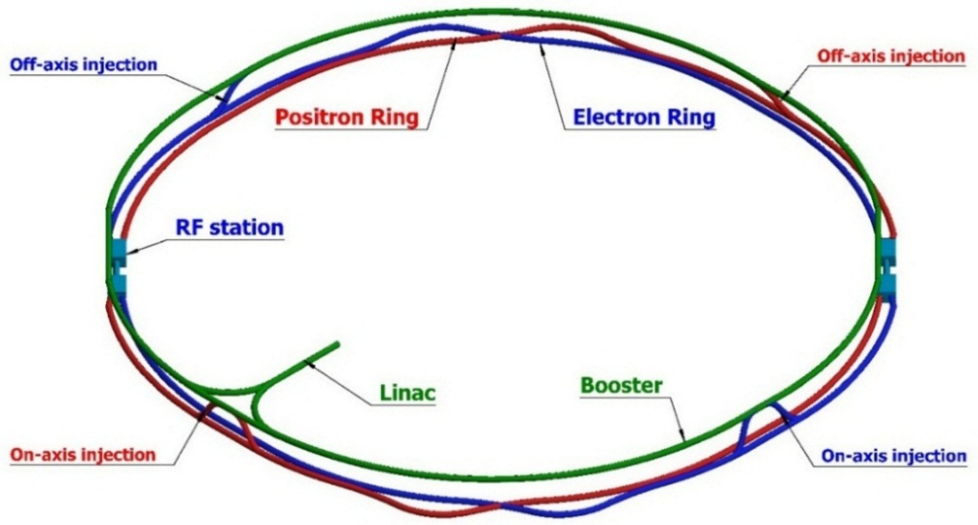
CEPC injector chain
30→180GeV
30GeV
100km
Injection energy: 30GeV
30 GeV linac provides electron and positron beams for booster.
Top up injection for collider ring ~ 3% current decay
Booster is in the same tunnel as collider ring, above the collider ring, bypass in IR.
Budget for transfer efficiency 90%: 95% for booster + 95% for transport lines.
Beam current threshold in booster is limited by RF system.
Feedback systems (Transverse & longitudinal) are need to damp the instability at low energy.

Slide 4
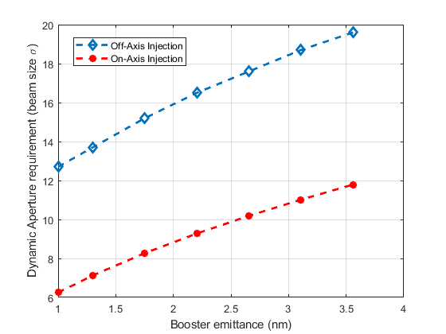
Requirement update for booster
Collider ring | Higgs (CDR) | Higgs (TDR)
Number of IPs | 2 | 2
Energy (GeV) | 120 | 120
Circumference (km) | 100 | 100
SR loss/turn (GeV) | 1.73 | 1.8
Half crossing angle (mrad) | 16.5
Piwinski angle | 3.48 | 5.94
N_{e}/bunch (10¹⁰) | 15.0 | 13.0
Bunch number | 242 | 268
Beam current (mA) | 17.4 | 16.7
SR power /beam (MW) | 30 | 30
Bending radius (km) | 10.7 | 10.2
Momentum compaction (10⁻⁶) | 11.1 | 7.1
β_{IP} x/y (m) | 0.36/0.0015 | 0.3/0.001
Emittance x/y (nm) | 1.21/0.0024 | 0.64/0.0013
Transverse σ_{IP} (um) | 20.9/0.06 | 14.0/0.036
ξ_{x}/ξ_{y}/IP | 0.018/0.109 | 0.015/0.11
V_{RF} (GV) | 2.17 | 2.20
f _{RF} (MHz) (harmonic) | 650 (216820)
Nature bunch length σ_{z} (mm) | 2.72 | 2.3
Bunch length σ_{z} (mm) | 4.4 | 4.1
Energy spread (%) (SR/BS) | 0.1/0.134 | 0.1/0.17
Energy acceptance requirement (%) | 1.35 | 1.6
Energy acceptance by RF (%) | 2.06 | 2.2
Lifetime due to beamstrahlung (min) | 80 | 40
Lifetime (min) | 25 | 20
F (hour glass) | 0.89 | 0.9
L_{max}/IP (10³⁴cm⁻²s⁻¹) | 2.93 | 5.0
Horizontal DA requirement of collider ring due to injection
X. H. Cui
Booster emittance @120 GeV <1.7nm (3.6nm in CDR)

Slide 5
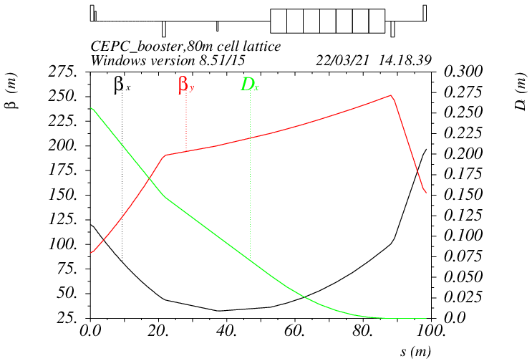
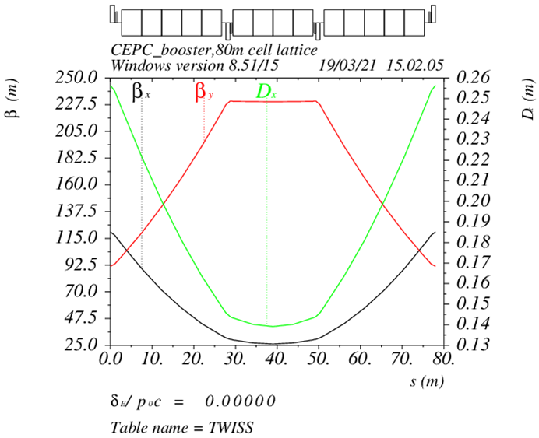
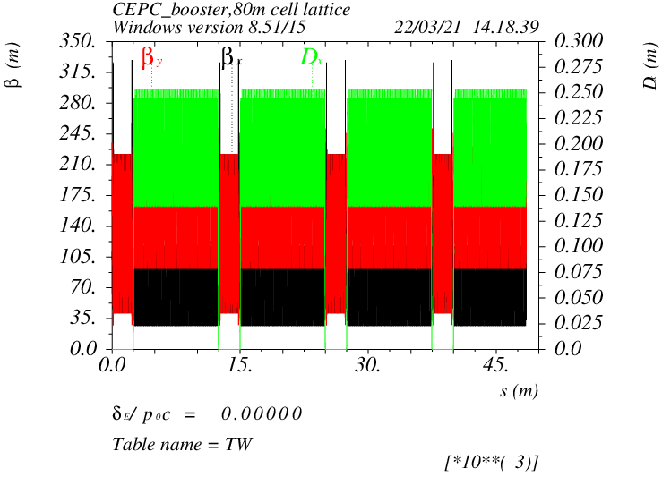
Booster TDR optics
D. Wang, C. H. Yu, Y. M. Peng…
TME like structure (cell length=78m)
Interleave sextupole scheme
Emittance@120GeV=1.26nm
Overall idea: uniform distribution for the Q
Combined magnet (B+S) scheme possible
Phase advance/cell: 100° (H) / 28° (V)
Dispersion sup.
Arc cell
Half ring

Slide 6
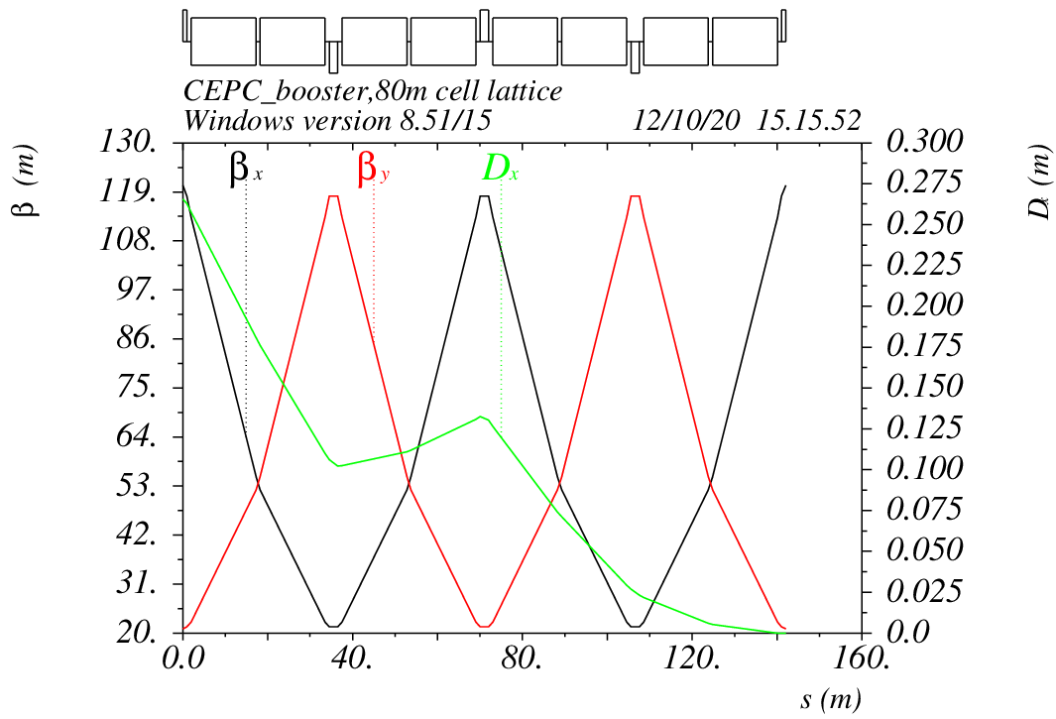
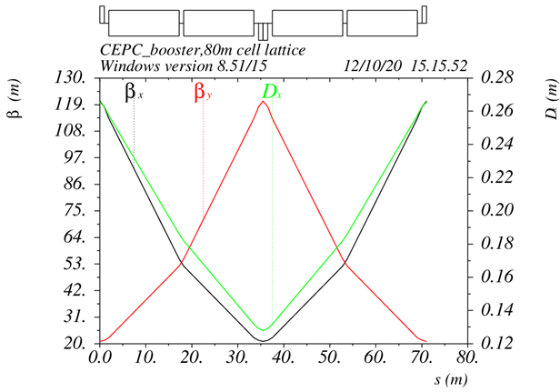
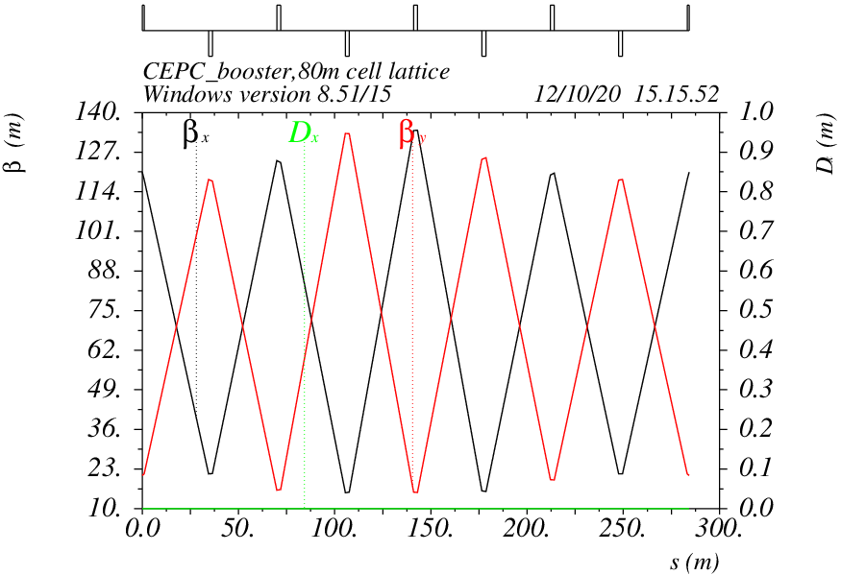
Booster alternative optics
FODO structure (cell length=70m)
90°/90° phase advance
Non-interleave sextupole scheme
Similar structure as CDR
Emittance@120GeV=1.29nm
dis. supressor
FODO
ε=1.29nm
straight section

Slide 7
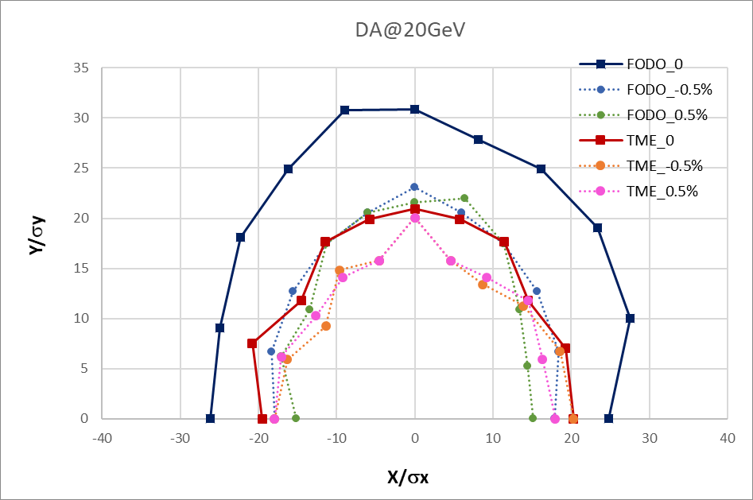
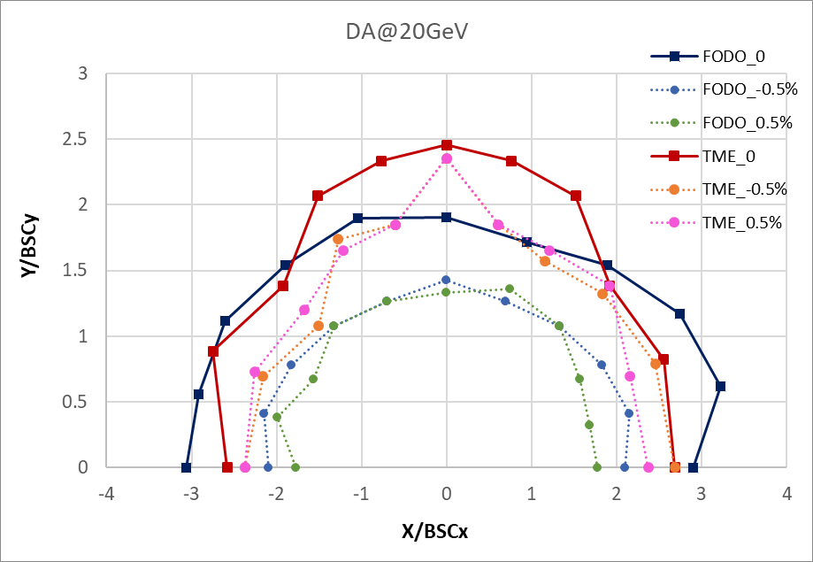
DA results @ 20GeV
Booster energy: 20GeV~180GeV
20GeV: BSC_{xy}=(4σ_{xy}+5mm)*2
Inj. emittance from Linac:10nm
Energy spread from Linac: 0.16%

Slide 8
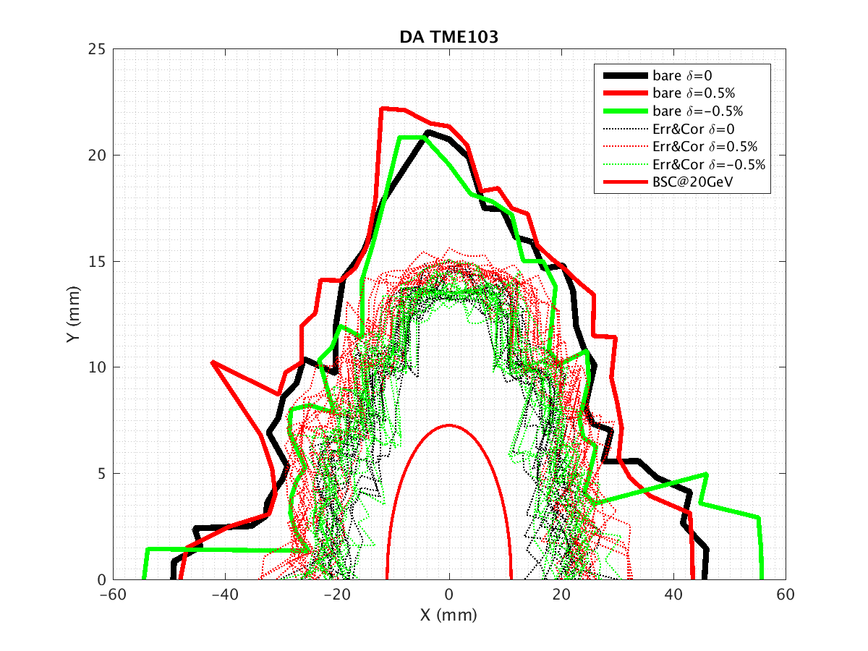
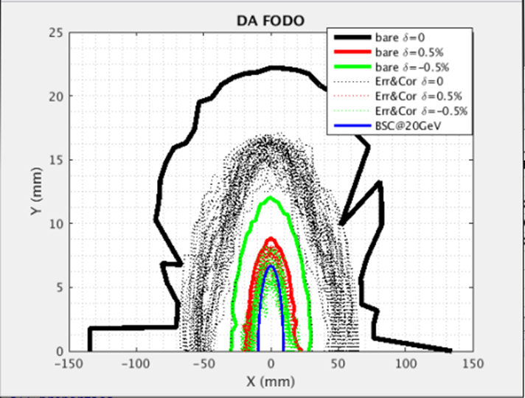
DA results with errors and correction (w/o multipoles)
D. H. Ji
 | Dipole | Quadrupole | Sextupole
Transverse shift X/Y (μm) | 100 | 100 | 100
Longitudinal shift Z (μm) | 100 | 150 | 100
Tilt about X/Y (mrad) | 0.2 | 0.2 | 0.2
Tilt about Z (mrad) | 0.1 | 0.2 | 0.2
Nominal field | 1e-3 | 2e-4 | 3e-4
 | Accuracy (m) | Tilt (mrad) | Gain | Offset w/ BBA(mm)
BPM(10Hz) | 1e-7 | 10 | 5% | 30e-3
error correction (w/o SR effect)
Orbit correction
Optics correction
TME
FODO

Slide 9
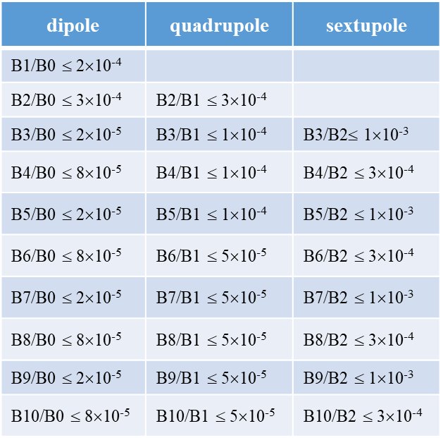
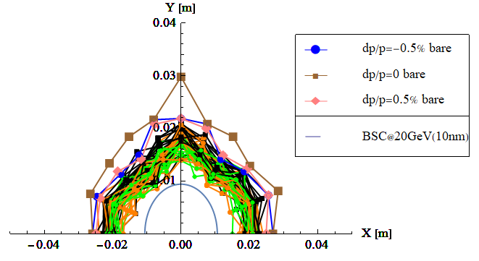
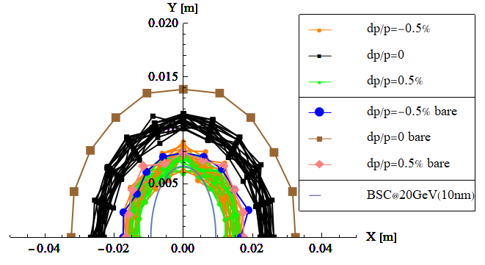
Multipole errors @ 20GeV
Multipole errors only
Multipole errors can not be corrected
TME is chosen as the baseline for TDR.
TME
FODO

Slide 10
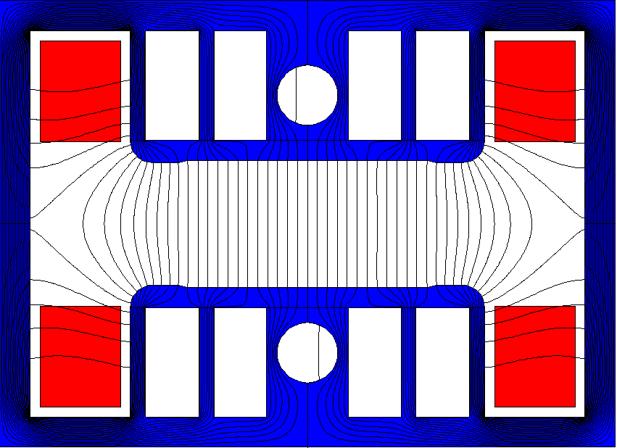
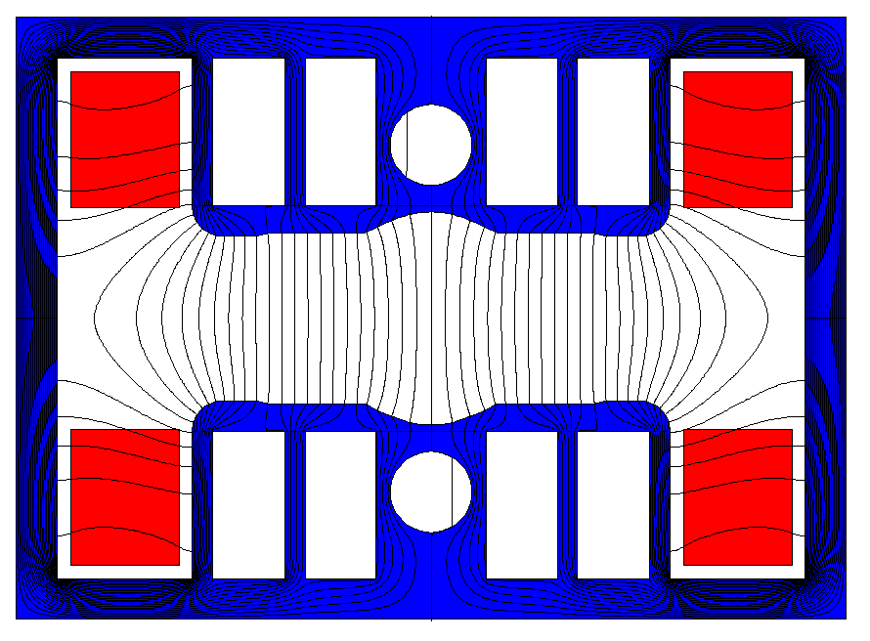
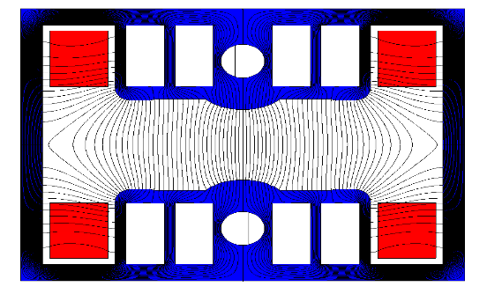
Injection energy change to 30GeV
30GeV injection is adopted for the cost saving in TDR.
The non-oriented silicon laminations for the iron dominated dipole magnet can be used at 30GeV.
Make a cost balance between Linac and booster
Linac parameters at 30GeV
- bunch length= 0.4mm, energy spread= 0.15%, emittance=6.5nm
Magnetic design: the quality of the dipole and sextupole fields meet the physical requirements.

Slide 11
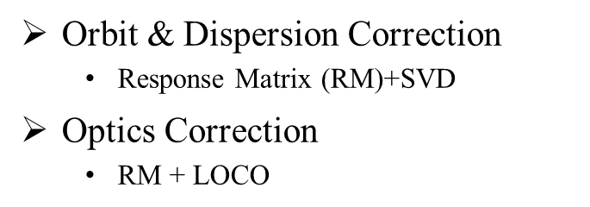
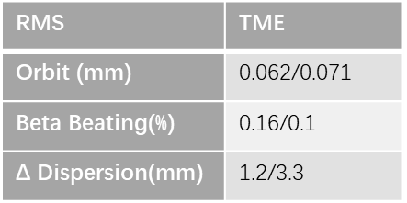
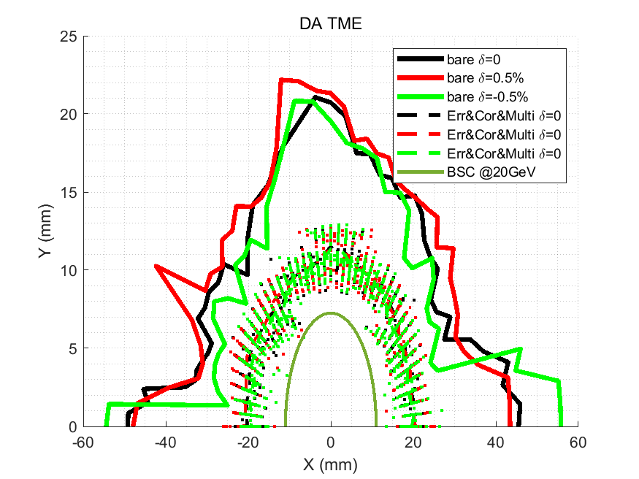
DA results with errors and correction
D. H. Ji
 | Dipole | Quadrupole | Sextupole
Transverse shift X/Y (μm) | 100 | 100 | -
Longitudinal shift Z (μm) | 100 | 150 | -
Tilt about X/Y (mrad) | 0.2 | 0.2 | -
Tilt about Z (mrad) | 0.1 | 0.2 | -
Nominal field | 1e-3 | 2e-4 | 3e-4
 | Accuracy (m) | Tilt (mrad) | Gain | Offset w/ BBA(mm)
BPM(10Hz) | 1e-7 | 10 | 5% | 30e-3
(100 seeds)
(93 seeds)
Include multipole errors
DA track in AT w/o SR
dipole | quadrupole
B1/B0 ≤ 2×10⁻⁴
B2/B0 ≤ 5×10⁻⁴ | B2/B1 ≤ 3×10⁻⁴
B3/B0 ≤ 2×10⁻⁵ | B3/B1 ≤ 2×10⁻⁴
B4/B0 ≤ 8×10⁻⁵ | B4/B1 ≤ 1×10⁻⁴
B5/B0 ≤ 2×10⁻⁵ | B5/B1 ≤ 1×10⁻⁴
B6/B0 ≤ 8×10⁻⁵ | B6/B1 ≤ 5×10⁻⁵
B7/B0 ≤ 2×10⁻⁵ | B7/B1 ≤ 5×10⁻⁵
B8/B0 ≤ 8×10⁻⁵ | B8/B1 ≤ 5×10⁻⁵
B9/B0 ≤ 2×10⁻⁵ | B9/B1 ≤ 5×10⁻⁵
B10/B0 ≤ 8×10⁻⁵ | B10/B1 ≤ 5×10⁻⁵

Slide 12
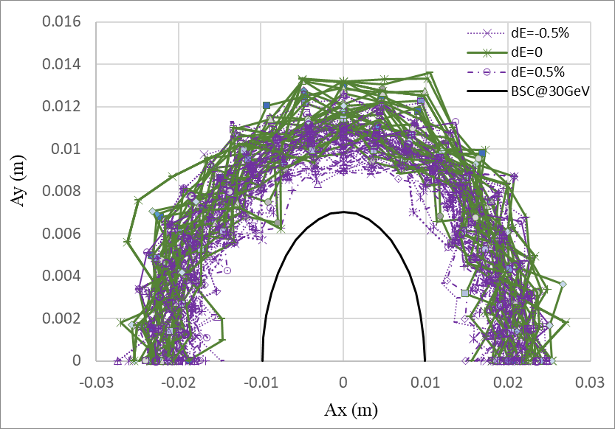
DA@30GeV
Dou Wang, Daheng Ji
On axis injection from Linac to booster
Tracking by SAD (1500 turns)
include errors (w. multipole errors)
Include SR sawtooth orbit (without taper)
Include SR damping & fluctuation
BSC definition (ε_{inj}=6.5nm):
Energy acceptance: 3*δ_{inj} =0.45%

Slide 13
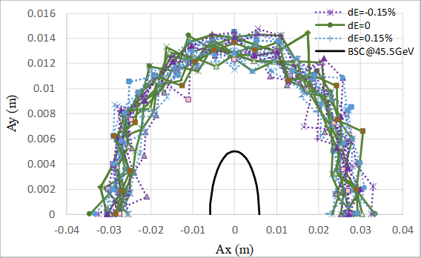
DA@45GeV
Dou Wang, Daheng Ji
Tracking by SAD (1200 turns)
include errors (w. multipole errors)
Include SR sawtooth orbit (without taper)
Include SR damping & fluctuation
Off axis injection from booster to collider
BSC definition (ε_{x}=0.18nm, ε_{y}=ε_{x} *1%):
Energy acceptance: 4*δ =0.15%

Slide 14
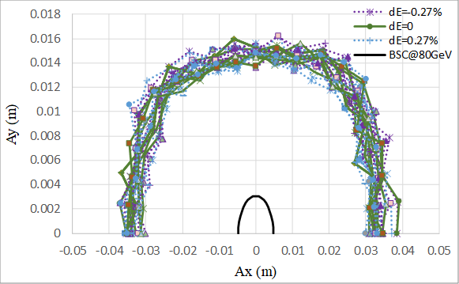
DA@80GeV
Dou Wang, Daheng Ji
Tracking by SAD (500 turns)
include errors (w. multipole errors)
Include SR sawtooth orbit (without taper)
Include SR damping & fluctuation
Off axis injection from booster to collider
BSC definition (ε_{x}=0.56nm, ε_{y}=ε_{x} *1%):
Energy acceptance: 4*δ =0.27%

Slide 15
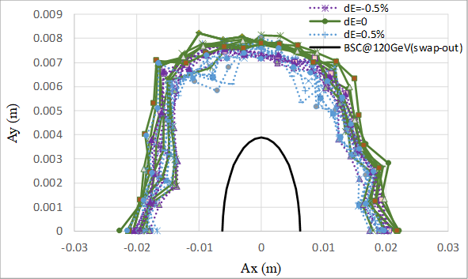
DA@120GeV
Dou Wang, Daheng Ji
Tracking by SAD (250 turns)
include errors (w. multipole errors)
Include SR sawtooth orbit (without taper)
Include SR damping & fluctuation
On axis injection from booster to collider
BSC definition (ε_{x}=1.26nm, ε_{y}=ε_{x} *1%):
Energy acceptance: 5*δ =0.5%

Slide 16
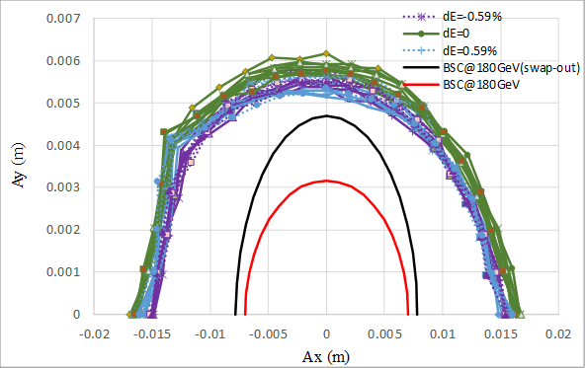
DA@180GeV
Dou Wang, Daheng Ji
Tracking by SAD (150 turns)
include errors (w. multipole errors)
Include SR sawtooth orbit (with taper)
Include SR damping & fluctuation
Keep possibility for on axis injection to collider
BSC definition (ε_{x}=2.84nm, ε_{y}=ε_{x} *1%):
--
--
Energy acceptance: 4*δ =0.59%

Slide 17

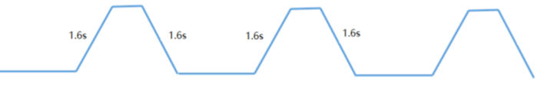
Booster ramping scheme
Dou Wang, Xiaohao Cui
0.035s
tt
7.1s
7.1s
0.35s+7.1s+0.035s+7.1s=14.6s
1 cycles/beam
0.35s
0.27s
4.7s damping
Higgs
4.3s
4.3s
4.3s
4.3s
1 cycles/beam
2.7s
off-axis
2.7s
on-axis
2.7s+4.3s+4.7s+4.3s=16.0s
1.3s
W
2.4s
2.4s
1 cycles/beam
12.97s+2.4s+1.3s+2.4s=19.1s
12.97s
0.05s
Z
1.0s
1.0s
1.0s
(19.9s+1.0s+0.05s+1.0s)*3=65.9s
1.0s
19.9s
19.9s
3 cycles/beam
19.9s

Slide 18
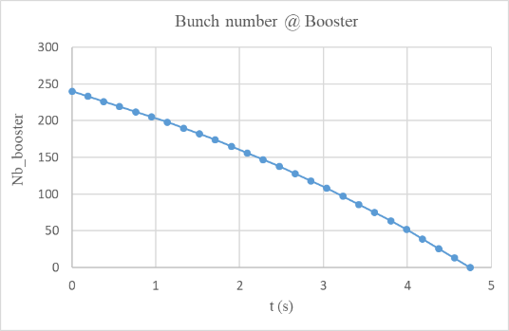
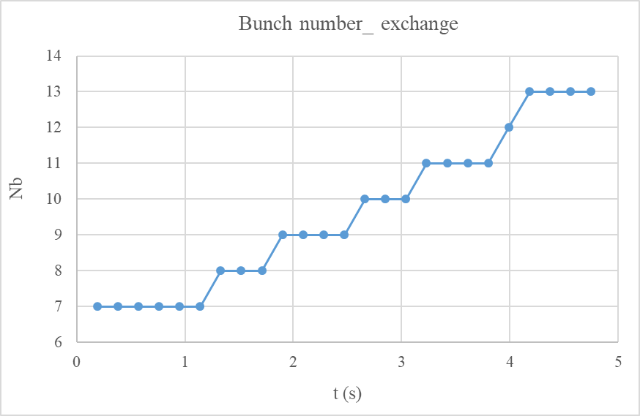
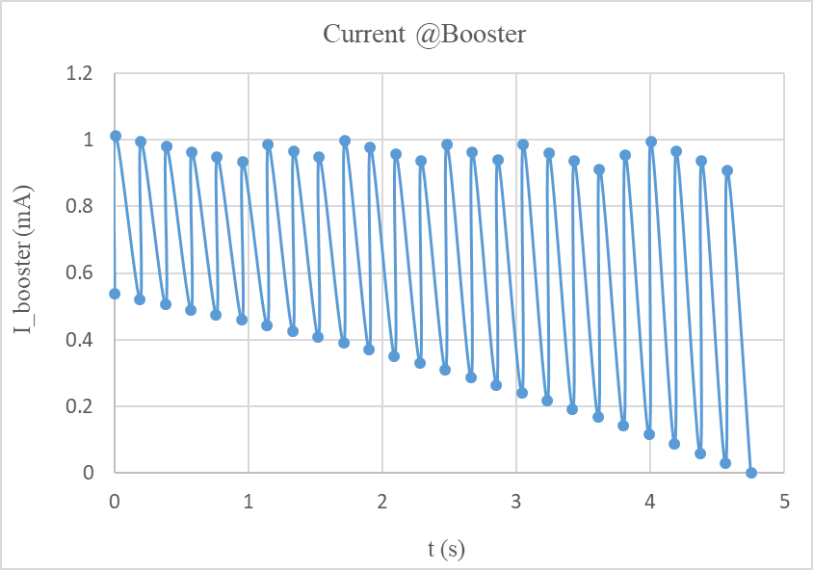
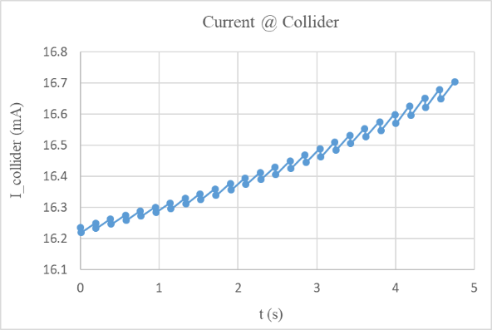
On-axis injection at Higgs energy
Swap-out injection
Current threshold in booster: 1A
Current decay for collider: 3% (top up mode)
4 damping times to merge the bunches in booster

Slide 19
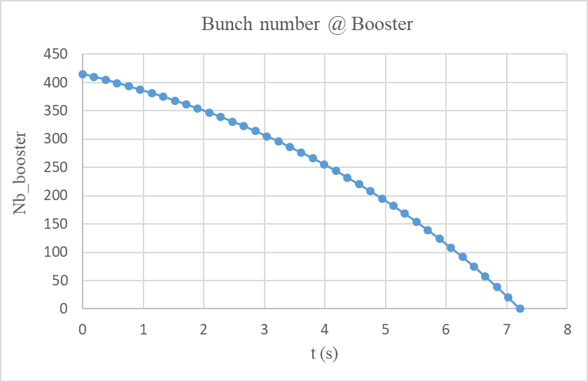
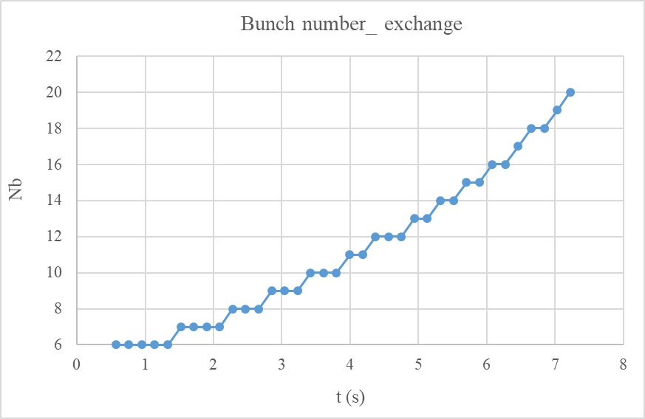
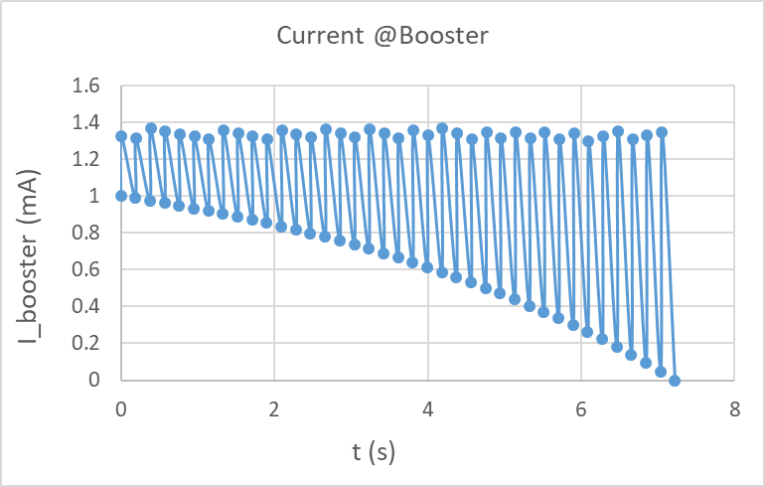
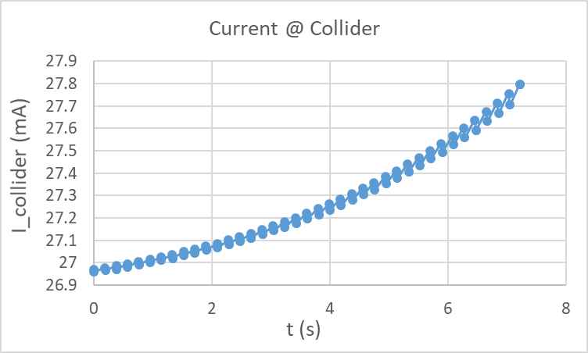
On-axis injection at Higgs energy (50MW upgrade)
Swap-out injection
Current threshold in booster: 1.4 A
Current decay for collider: 3% (top up mode)
Small upgrade for the RF power source

Slide 20
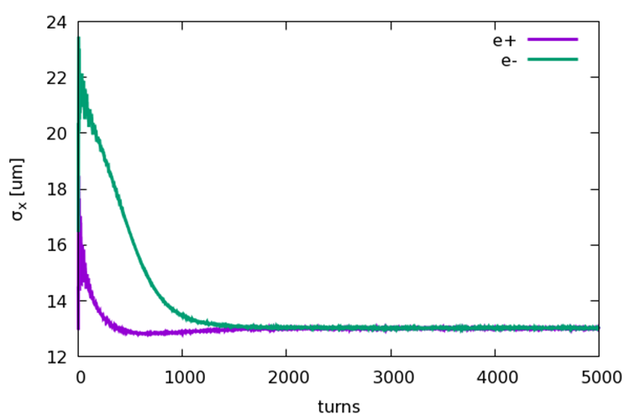
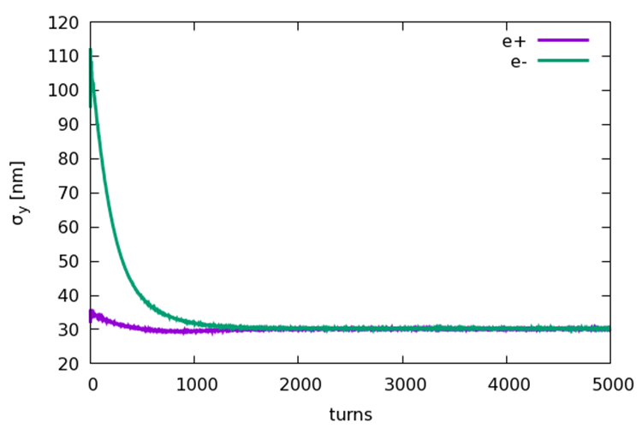
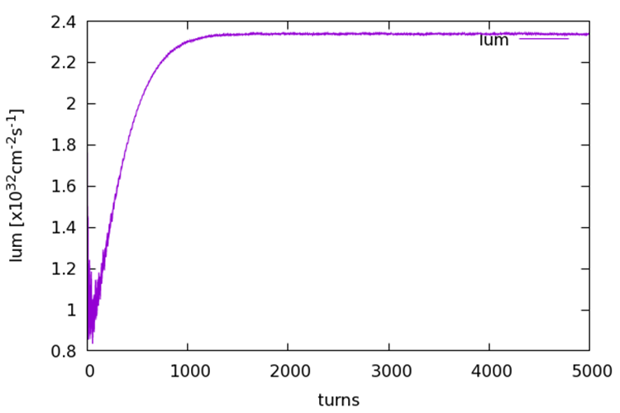
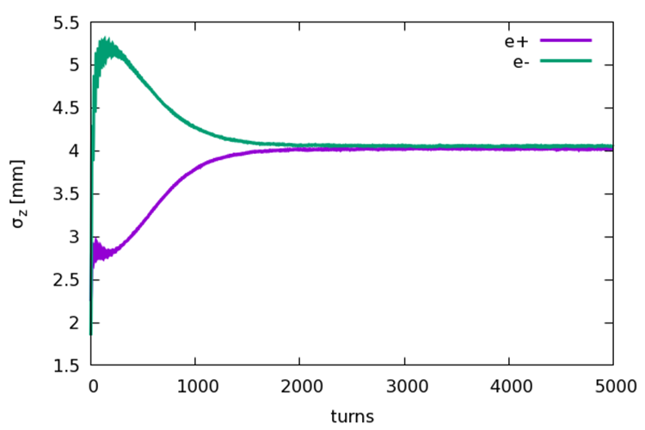
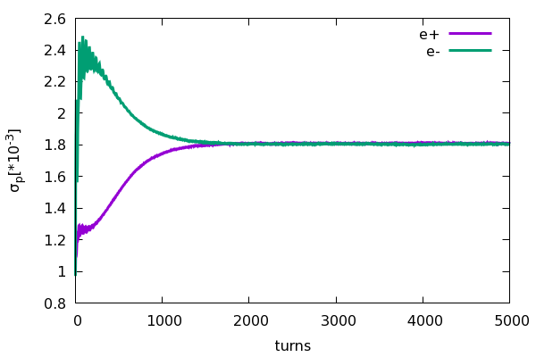
Beam beam instability for on-axis injection
Yuan Zhang
Collision stability check for on-axis injection scheme at 120GeV
e- (Ne=14×10¹⁰)
e+ (Ne=14×10¹⁰)
• Emittance X = 1.26nm
• Energy spread = 0.1%
• Bunch length=1.85mm
• Coupling=1.0%
• Emittance X = 0.64nm
• Energy spread = 0.1%
• Bunch length=2.25mm
• Coupling=0.2%

Slide 21
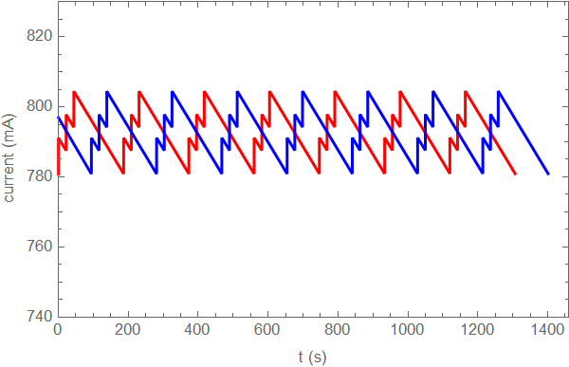
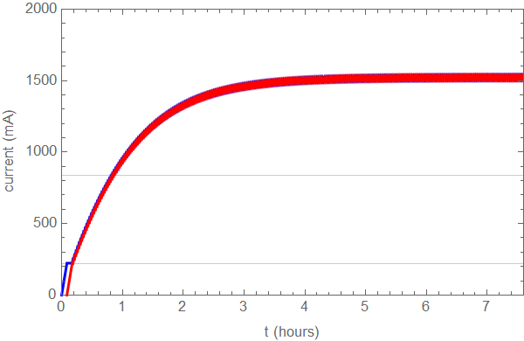
Injection scheme at Z pole
Top-up injection
Full injection
Current drop: 3.0% (804mA in collider)
Booster current = 9mA
Train num. @ booster = train num.@collider / 3
Injection speed of Linac: double bunch@100Hz
Train num. @ booster = train num.@collider / 2
Bootstrapping from 220mA
Injection speed of Linac: double bunch@100Hz
Booster threshold: 16mA
0.8h

Slide 22
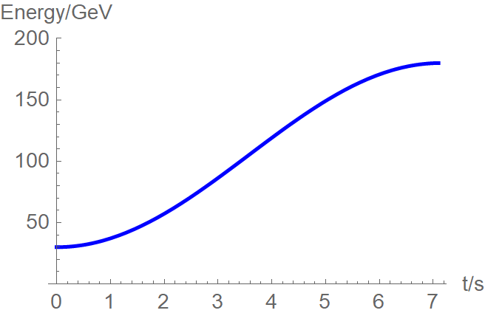
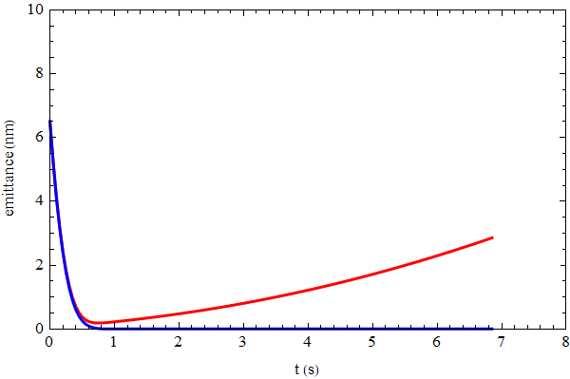
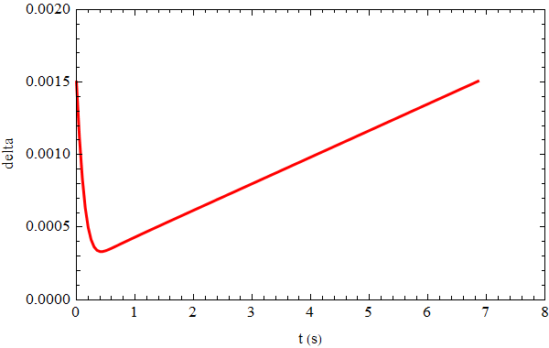
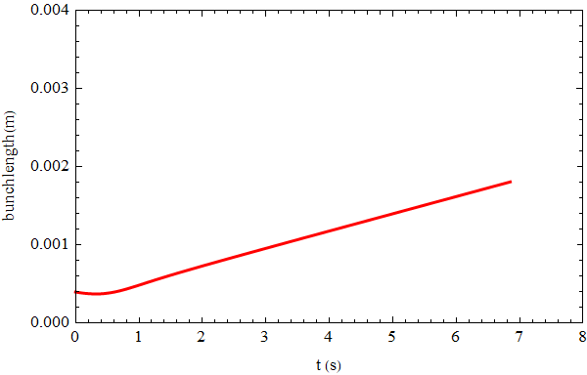
Beam parameter evolution
Injection emittance: 6.5nm @30GeV
Beam parameters reach balance after 45GeV.
emittance
energy
emit_x
emit_y
energy spread
bunch length

Slide 23
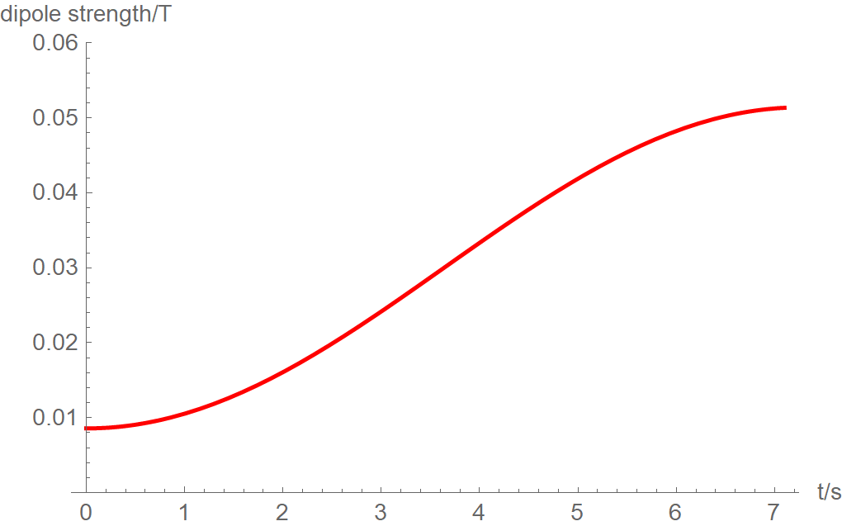
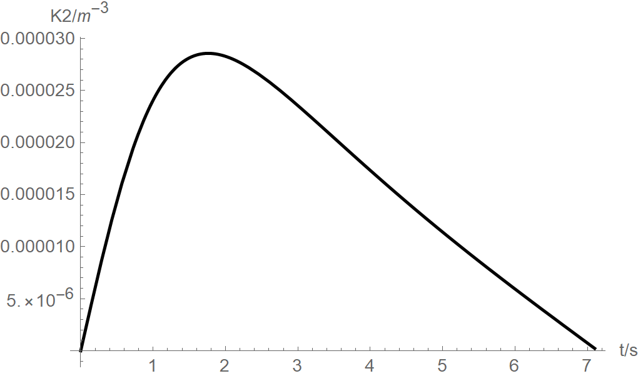
Eddy current effect
Dou Wang, Yuemei Peng, Daheng Ji
Dedicated ramping curve to control the maximum K2.
Al beam pipe (round shape)
- inner diameter: 55mm, thickness: 2mm
Dynamic chromaticity is not corrected.
- Sextupole field is attached to dipole
30 GeV injection weaken the eddy effect
Independent sext. (~100) — chromaticity adjustment
Analytical estimation for eddy effect*
K2 reaches max at 45GeV.
Max K2=0.000029 (m⁻³)
*Yuan Chen et al., Analytical expression development for eddy ﬁeld and the beam dynamics eﬀect on the CEPC booster, IJMPA, Vol. 36, No. 22 (2021) 2142010

Slide 24
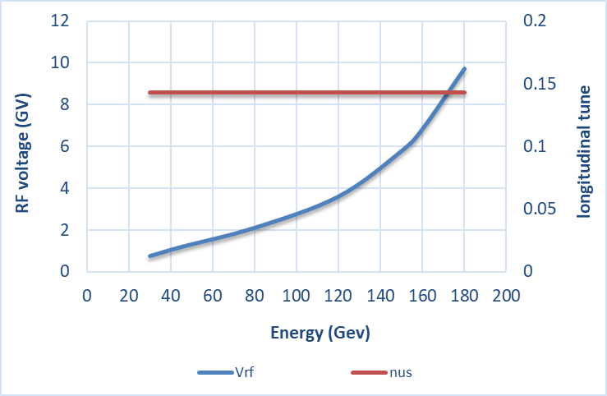
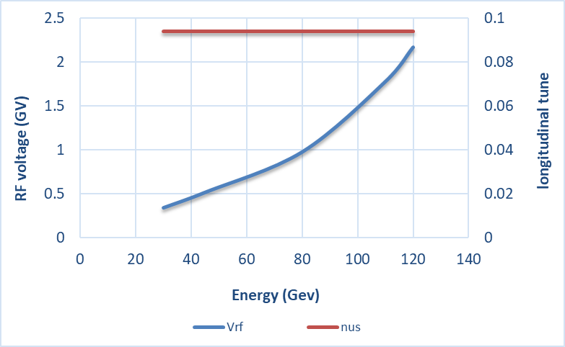

RF ramping curve
Different RF ramping curve for each energy mode (constant νs )
νs for tt: 0.14
νs for Higgs: 0.094
νs for W & Z: 0.088
tt
Max RF voltage @tt determined by longitudinal quantum lifetime & DA.
η_{RF}: ~ 12 ×δ
VRF (180GeV)=9.8GV
Higgs
W &Z

Slide 25



Longitudinal acceptance
±3 times of sigma for the longitudinal beam size
30GeV
120GeV
180GeV

Slide 26
Optics parameter comparison
D. H. Ji, W. Kang
Lattice | FODO 0 （CDR） | FODO 1 | TME (combine magnets)
Emittance X (nm) @120GeV | 3.57 | 1.29 | 1.26
Momentum compaction (×10⁻⁵) | 2.44 | 1.18 | 1.12
Tunes | [263.201/261.219] | [353.180/353.280] | [321.271/117.193]
Quad amount | 2110 | 2816 | 3458
Quad Strength (K1L rms） | 0.0383 | 0.0407 | 0.0259
Sext amount | 512 | 896 | 96
Sexts Strength (K2L rms) | 0.179 | 0.4091 | 0.0492
H Corrector | 1053 | 1408 | 1218
V Corrector | 1054 | 1408 | 2240
BPM | 2108 | 2816 | 3458
Power consumption of magnets@120GeV (MW) (max/average) | 15/6 |  | 12.1/4.8
Magnets’ cost of TME is lower than FODO 1
TME is less sensitive to error effects
Less independent sextupole for TME
Quadrupole strength of TME is lower
Weaker quad/sex strength
TME has lower magnets’ power consumption

Slide 27
Booster TDR parameters
Injection energy: 10GeV → 20GeV → 30GeV
Max energy: 120GeV → 180GeV
Lower emittance ─ new lattice (TME)
Extraction
Injection
*Diameter of beam pipe is 55mm for re-injection with high single bunch current @120GeV.

Slide 28

Damping ring layout (CDR)
Linac repetition: 100Hz
Only for positron beam
Storage time: 20 ms
Emittance (norm.): 2500→ 530 mm.mrad
e +

Slide 29
Comparison of damping ring design requirement
lower emittance collider → lower emittance booster → lower emittance linac
 | CDR | TDR | remark
Energy (GeV) | 1.1 | 1.1
Inj. Emittance (mm⋅mrad) | 2500 | 2500
Ext. emittance (mm⋅mrad) | 530 | <200 | 1) Linac lower emittance: 10nm@20GeV, 2)use C band acc. structure as early as possible
Storage time (ms) | 20 | 20
Damping time (ms) | 15 | <13 | 1) Smaller ext. emittance with same storage time
Circumference (m) | 75 | ~150 | 1) Smaller nature emittance for DR

Slide 30
DR parameters
Damping with reversed bending magnet
4 (max. 8)-bunch storage, storage time:20 (40) ms
Emittance: 2500→ 166/75 (97/3) mm.mrad
Flexibility for extr. emittance
 | DR V3.0
Energy (Gev) | 1.1
Circumference (m) | 147
Number of trains | 2 (4)
Number of bunches/trian | 2
Total current (mA) | 12.4 (24.8)
Bending radius (m) | 2.87
Dipole strength B₀ (T) | 1.28
U₀ (kev/turn) | 94.6
Damping time x/y/z (ms) | 11.4/11.4/5.7
Phase/cell (degree) | 60/60
Momentum compaction | 0.013
Storage time (ms) | 20 (40)
δ₀ (%) | 0.056
ε₀ (mm.mrad) | 94.4
injection σ_{z} (mm) | 4.4
Extract σ_{z} (mm) | 4.4
ε_{inj} (mm.mrad) | 2500
ε_{ext x/y} (mm.mrad) | 166(97)/75(3)
δ_{inj} /δ_{ext} (%) | 0.18 /0.056
Energy acceptance by RF(%) | 1.8
f_{RF} (MHz) | 650
V_{RF} (MV) | 2.5
Longitudinal tune | 0.0387

Slide 31

DR time structure
Xiaohao Cui, Cai Meng, Gang Li, Ge Lei, Jinhui Chen…
Double bunch (Inj./Ext.: two by two) ⎯ at Z pole
tt/Higgs/W: 100Hz (Inj./Ext.: bunch by bunch)

Slide 32



DR optics
Cell length: 3m
B=1.28T
θ_{r} /θ₀=0.355
Phase/cell: 60°/60°
Interleave sextupole scheme
2 sex. families
Straight
-θ_{r}
B=1.28T
θ₀
Arc

Slide 33

DR DA results
Large trans. acceptance→ inj. efficiency
DA > 5 inj. beam size (ε_{inj}=2500mm.mrad)
Energy acceptance =1.8% (RF)
Phase/cell: 60°/60°

Slide 34
Transverse Mode Coupling Instability
Yudong Liu
The threshold for the TMCI is estimated by following analytical formula
Here,ν_{s} is he synchtron tune, β_{y} is the,betraon function and κ_{y} is the transvers kicker factor which is decided by impedance and bunch length.
parameters | Phase/cell: 60°/60°
Energy | 1.1Gev
circumference | 147
Beta tune | 7.70/ 8.54
Bunch length | 4.4mm
Bunch number | 4 （2 train）
synchtron tune | 0.0387
Bunch current (mA) | 3.1
Bunch current threshold(mA) | 9.4
* Circular Al pipe with 30mm inner diameter

Slide 35

Transport lines between DR and Linac
Dou Wang, Xiaohao Cui
Linac→DR | EC
E₀ (Gev) | 1.1
δ₀ (%) | 0.5
σ_{z0} (mm) | 1.5
f_{RF} (MHz) | 2860
V_{RF} (MV) | 16.5
Length of acc. Structure (m) | 1.0
φ_{RF} (degree) | 87
R₅₆ (m) | -0.83
E_{f} (Gev) | 1.1
δ_{f} (%) | 0.18
σ_{zf} (mm) | 4.4
DR→Linac | BC
E₀ (Gev) | 1.1
δ₀ (%) | 0.056
σ_{z0} (mm) | 4.4
f_{RF} (MHz) | 2860
V_{RF} (MV) | 20.6
Length of acc. Structure (m) | 0.76
φ_{RF} (degree) | 89.7
R₅₆ (m) | -0.89
E_{f} (Gev) | 1.1
δ_{f} (%) | 0.55
σ_{zf} (mm) | 0.5

Slide 36

Optimization of the EC design
We optimized the RF voltage of EC based on the particle tracking with realistic distributions of particles from the target.
The injected energy spread at the entrance of DR is 0.185% (RMS).
RF acceptance of DR is enlarged by a higher RF voltage (1.8%).

Slide 37




Particle tracking from Linac to DR (before ECS)
Track by SAD (real distribution)
Inj emittance: ~2500mm.mrad
σ₀ :~1.5mm (RMS)
δ₀ :~0.4% (RMS)

Slide 38




Particle tracking from Linac to DR (after ECS)
Track by SAD (real distribution)
Transporting efficiency: 95%
σ_{f} :~ 4 mm (RMS)
δ_{f} :~0.18% (RMS)

Slide 39




Primary design for the polarized damping ring
Z. Duan, D. Wang
Produce polarized positron beam for the purpose of energy calibration @ Z & W*.
DR V4.0 | unpolarized e+ | polarized e+
Energy (Gev) | 1.1
Circumference (m) | 145
Number of trains | 4
Number of bunches/trian | 1(2)
Total current (mA) | 12.4
Bending radius (m) | 3.44
Dipole strength B₀ (T) | 1.07
Wiggler strength B₊ (T) | 1.8
Wiggler cell length (m) | 1.5
U₀ (kev/turn) | 88.0
Damping time x/y/z (ms) | 12.2/12.2/6.1
Momentum compaction | 0.015
Storage time | 20 ms | 10 min
δ₀ (%) | 0.05
ε₀ (mm.mrad) | 45
injection σ_{z} (mm) | 6
Extract σ_{z} (mm) | 5.7 | 5.6
ε_{inj} (mm.mrad) | 2500
ε_{ext x/y} (mm.mrad) | 106/63 | 45/2
δ_{inj} /δ_{ext} (%) | 0.18 /0.05
RF acceptance (%) | 1.8
f_{RF} (MHz) | 650
V_{RF} (MV) | 2.5
Longitudinal tune | 0.032
10 min storage → ~20% polarization
Compatible with standard top up operation
Asymmetric wigglers
B₊=1.8T=5 B₋
cell length=1.5m
Wiedemann, Particle Accelerator Physics, 4 Edition
* detail in Zhe Duan’ talk on this workshop
16 wigglers

Slide 40
Summary
Booster energy range is modified in TDR. (10GeV/120GeV → 30GeV/180GeV)
Update booster design with smaller emittance in TDR─ support for CEPC high lum. scheme
TME structure with combined magnets (B+S)
DA with error effects fulfill the requirements
Booster parameters update ─ consistent with CEPC TDR parameters at 4 energy
Damping ring update is the requirement of higher luminosity goal for TDR.
Circumference: ~150m, energy: 1.1GeV
Reversed bending, extracted emittance=97~166 mm⋅mrad (adjustable)
Damping time: 15ms (CDR) → 11ms (new)
Polarized positron damping ring is under design.

Slide 41
Thanks for your attention!

Slide 42
Back up

Slide 43
Booster power consumption @Higgs
The technical systems with changes are considered.
The power consumption of TDR is lower than CDR with much lower emittance.
Technical system | CDR [MW] |  | TDR [MW] |  | Budget increment [MW]
 | max | average | max | average | max | average
Magnet system | 15 | 6 | 12.1 | 4.8 | -2.9 | -1.2
Power supply | 10.04 | 4.02 | 6.62 | 2.65 | -3.42 | -1.37
RF system
RF power source | 3.95 | 0.15 | 4.45 | 1.44 | 0.5 | 1.29
Beam Instrumentation | 0.6 | 0.6 | 0.72 | 0.72 | 0.12 | 0.12
…
total |  | 20.97 |  | 19.81 | -5.7 | -1.16

Slide 44
Booster power consumption @Z
The technical systems with changes are considered.
The power consumption of TDR almost same as CDR with much lower emittance.
Technical system | CDR [MW] |  | TDR [MW] |  | Budget increment [MW]
 | max | average | max | average | max | average
Magnet system | 2.14 | 1.28 | 1.72 | 0.69 | -0.42 | -0.59
Power supply | 2.48 | 0.99 | 1.88 | 0.75 | -0.6 | -0.24
RF system
RF power source | 0.5 | 0.04 | 1.13 | 0.084 | 0.63 | 0.044
Beam Instrumentation | 0.6 | 0.6 | 0.72 | 0.72 | 0.12 | 0.12
…
total |  | 9.7 |  | 9.034 | -0.27 | -0.666

