Slide 1
CEPC SRF Cavities Studies Peng Sha (IHEP) The 2022 International Workshop on the High Energy Circular Electron Positron Collider

Slide 2
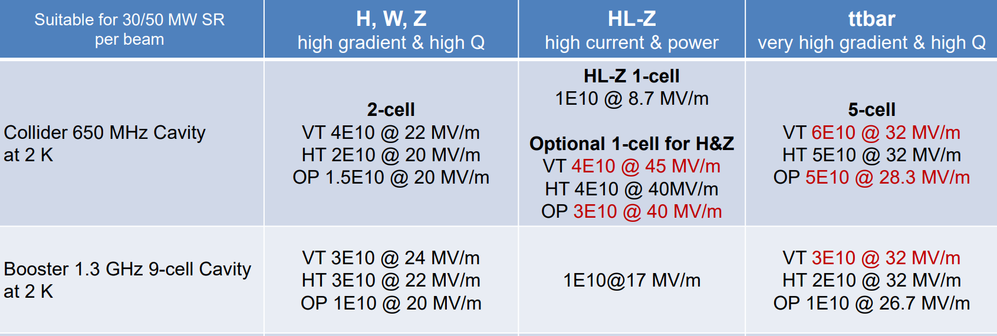
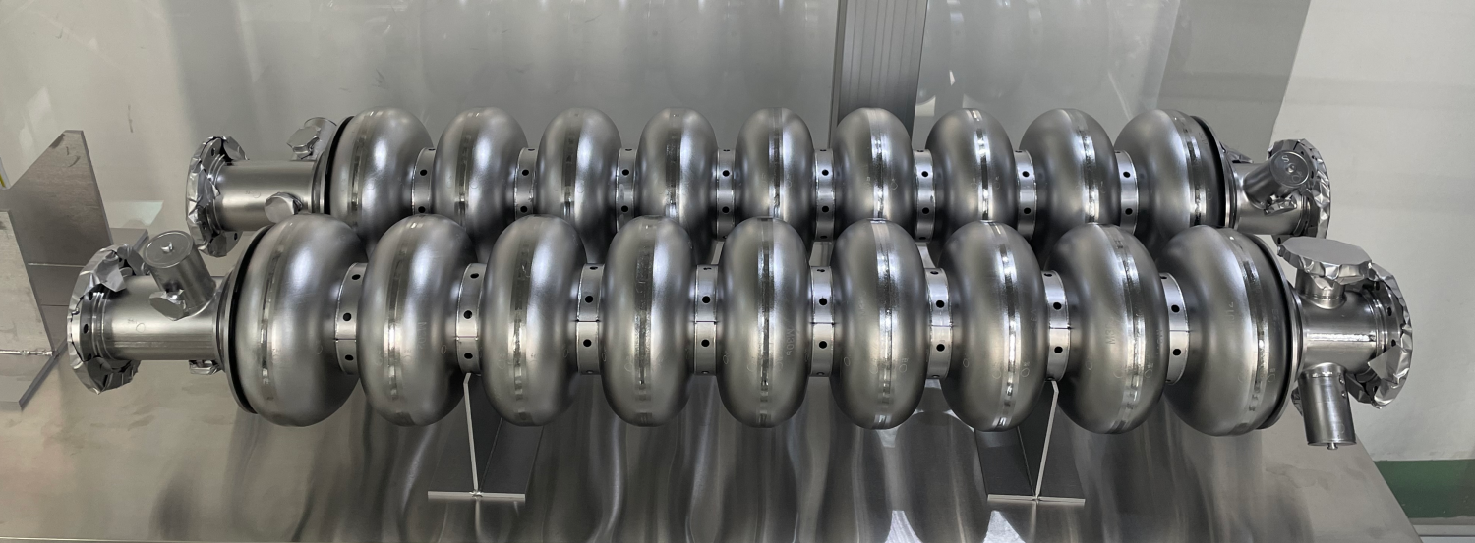
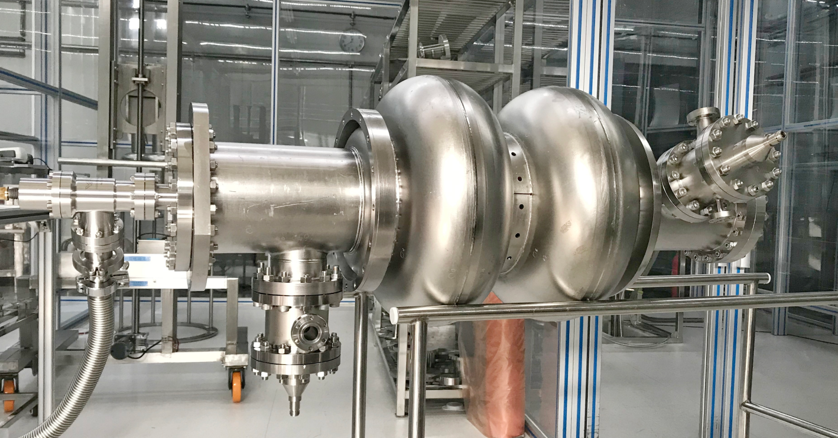
Specifications of CEPC cavities: Extremely high Q & Eacc
1.3 GHz 9-cell cavity
650 MHz 2-cell cavity

Slide 3
Outline
1.3 GHz cavity
650 MHz cavity
Nb₃Sn cavity
Conclusion

Slide 4
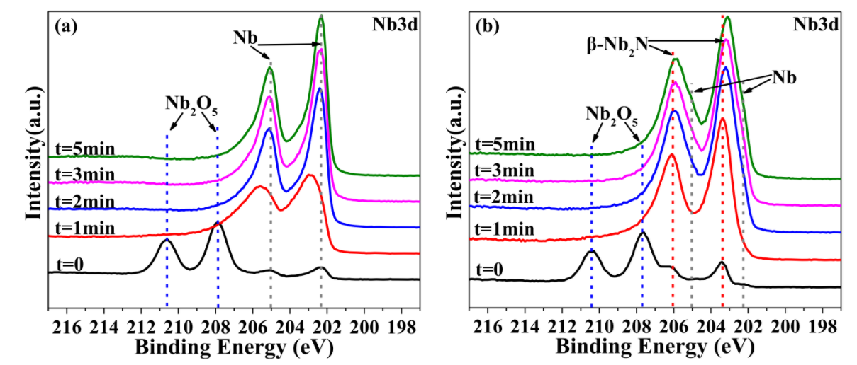
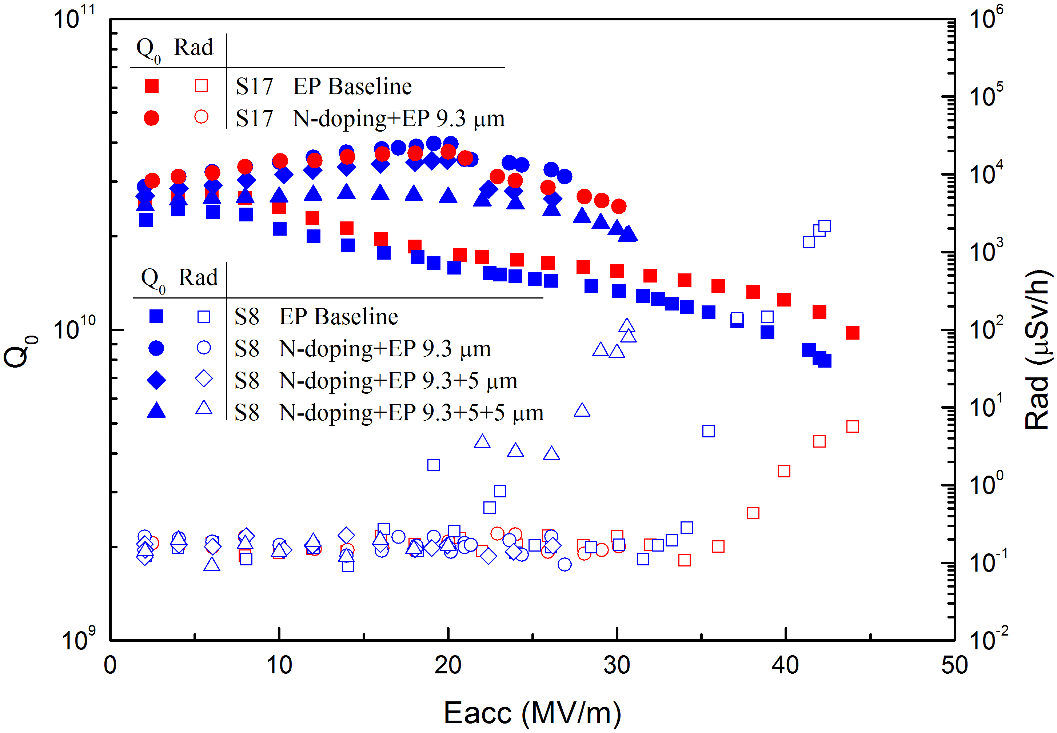
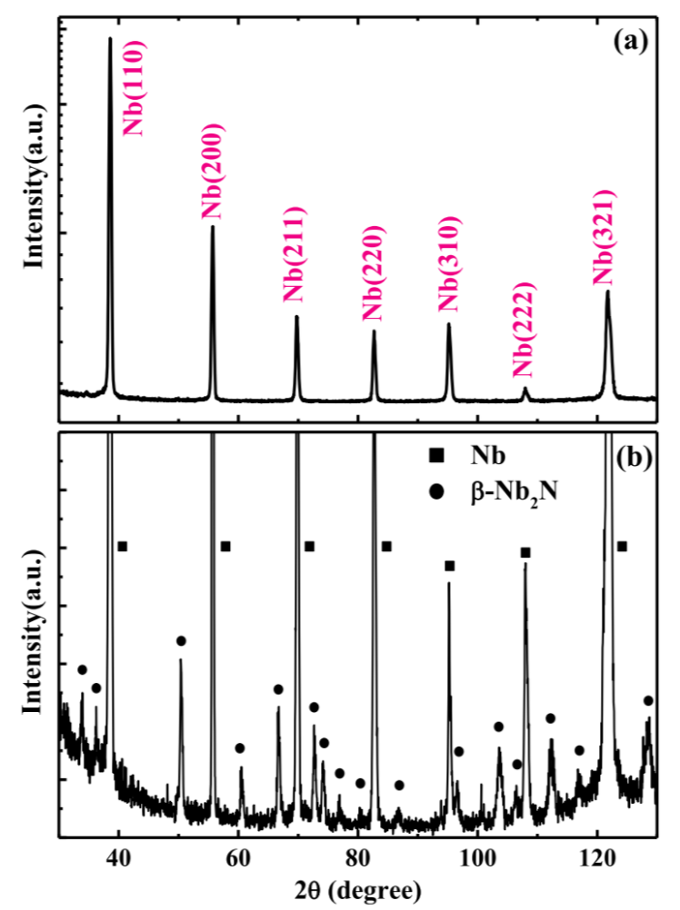
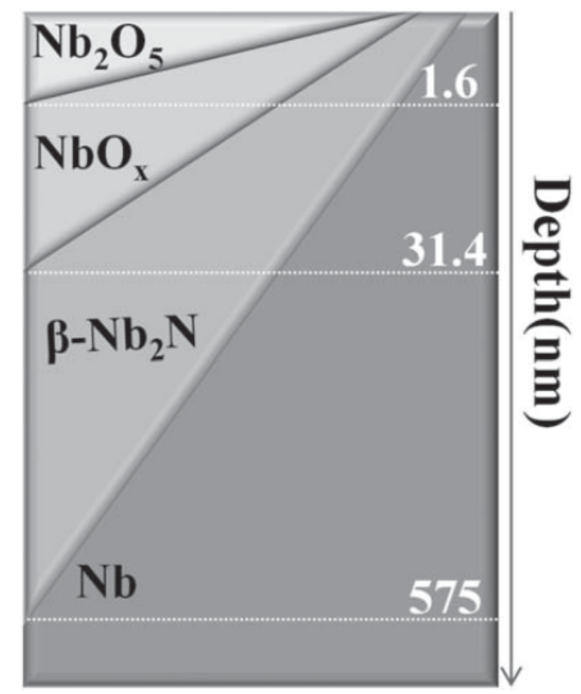
1.3 GHz 1-cell cavities nitrogen doped
“3/60” recipe is adopted for nitrogen doping. 2.6E10@30MV/m has been achieved for 1.3 GHz 1-cell.
XPS
Vertical test results of 1.3 GHz 1-cell cavities
XRD
Depth profile
NIM A 993 (2021) 165080

Slide 5
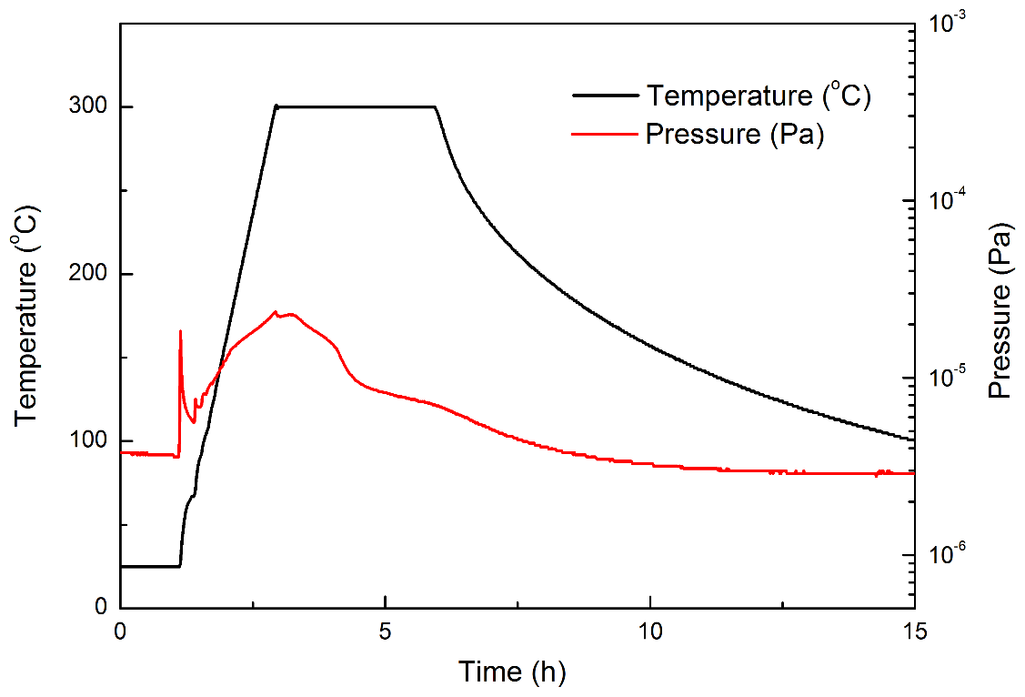
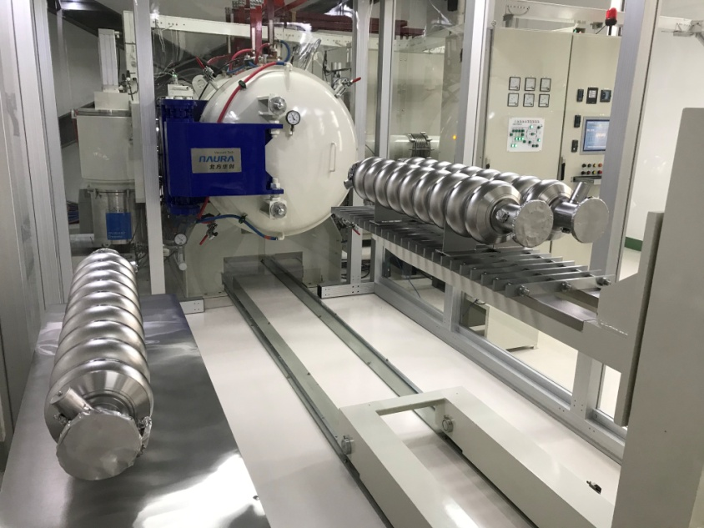
Mid-T furnace baking of 1.3 GHz 9-cell cavities
Simplification
N11 - N16: only one EP (in 2022)
N5 - N10 (in 2020)
Supercond. Sci. Technol. 34 (2021) 095005

Slide 6
Vertical test results of 1.3 GHz 9-cell cavities
2 K VT | 1st batch average | 2nd batch average
E_{acc} (MV/m) | 24 | 27.7
Q₀@16 MV/m | 3.8E10 | 4.1E10
Q₀@21 MV/m | 3.8E10 | 4.1E10
First batch (6 cavities): N5-N10
Four cavities (N5/7/9/10) delivered to SARI in early 2022 for SHINE prototype high Q cryomodule assembly
Second batch (6 cavities): N11-N16
Best Cavity (N11): 4.6E10@21 MV/m, 4.3E10@31MV/m
One of the best high Q 1.3 GHz 9-cell cavities and cavity batches in the world.
Will install to high Q cryomodule at IHEP PAPS for DALS R&D
Vertical test results of 1.3 GHz 9-cell cavities at IHEP

Slide 7
Outline
1.3 GHz cavity
650 MHz cavity
Nb₃Sn cavity
Conclusion

Slide 8
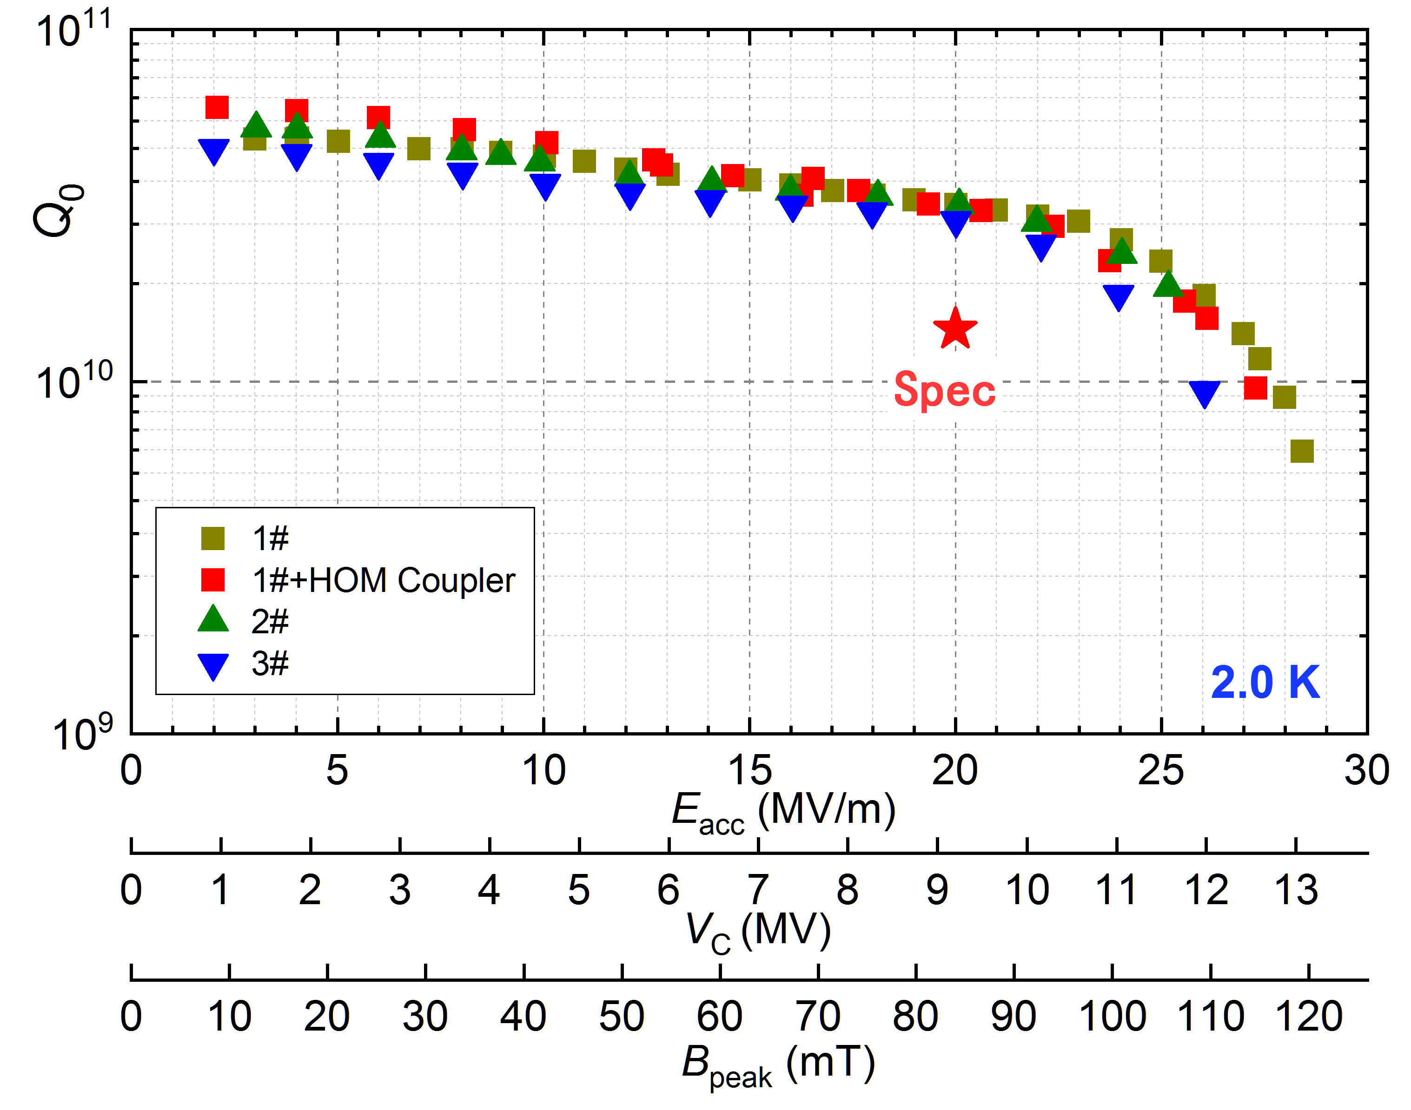
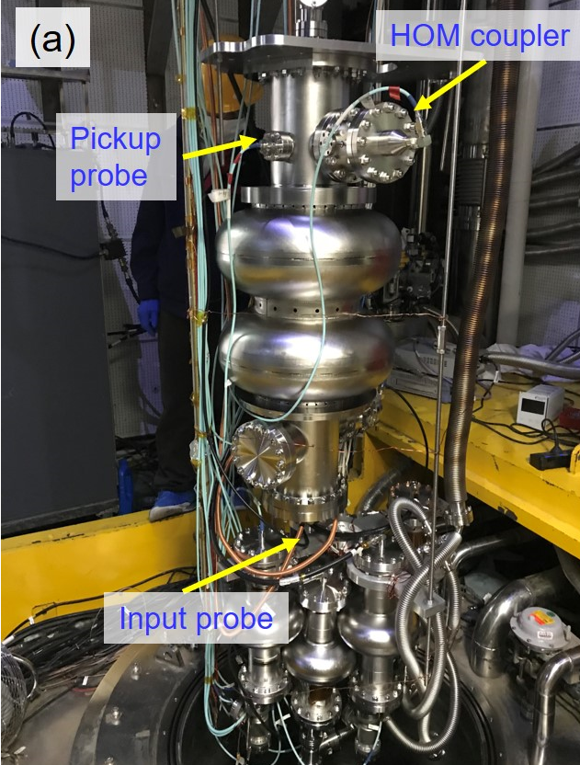
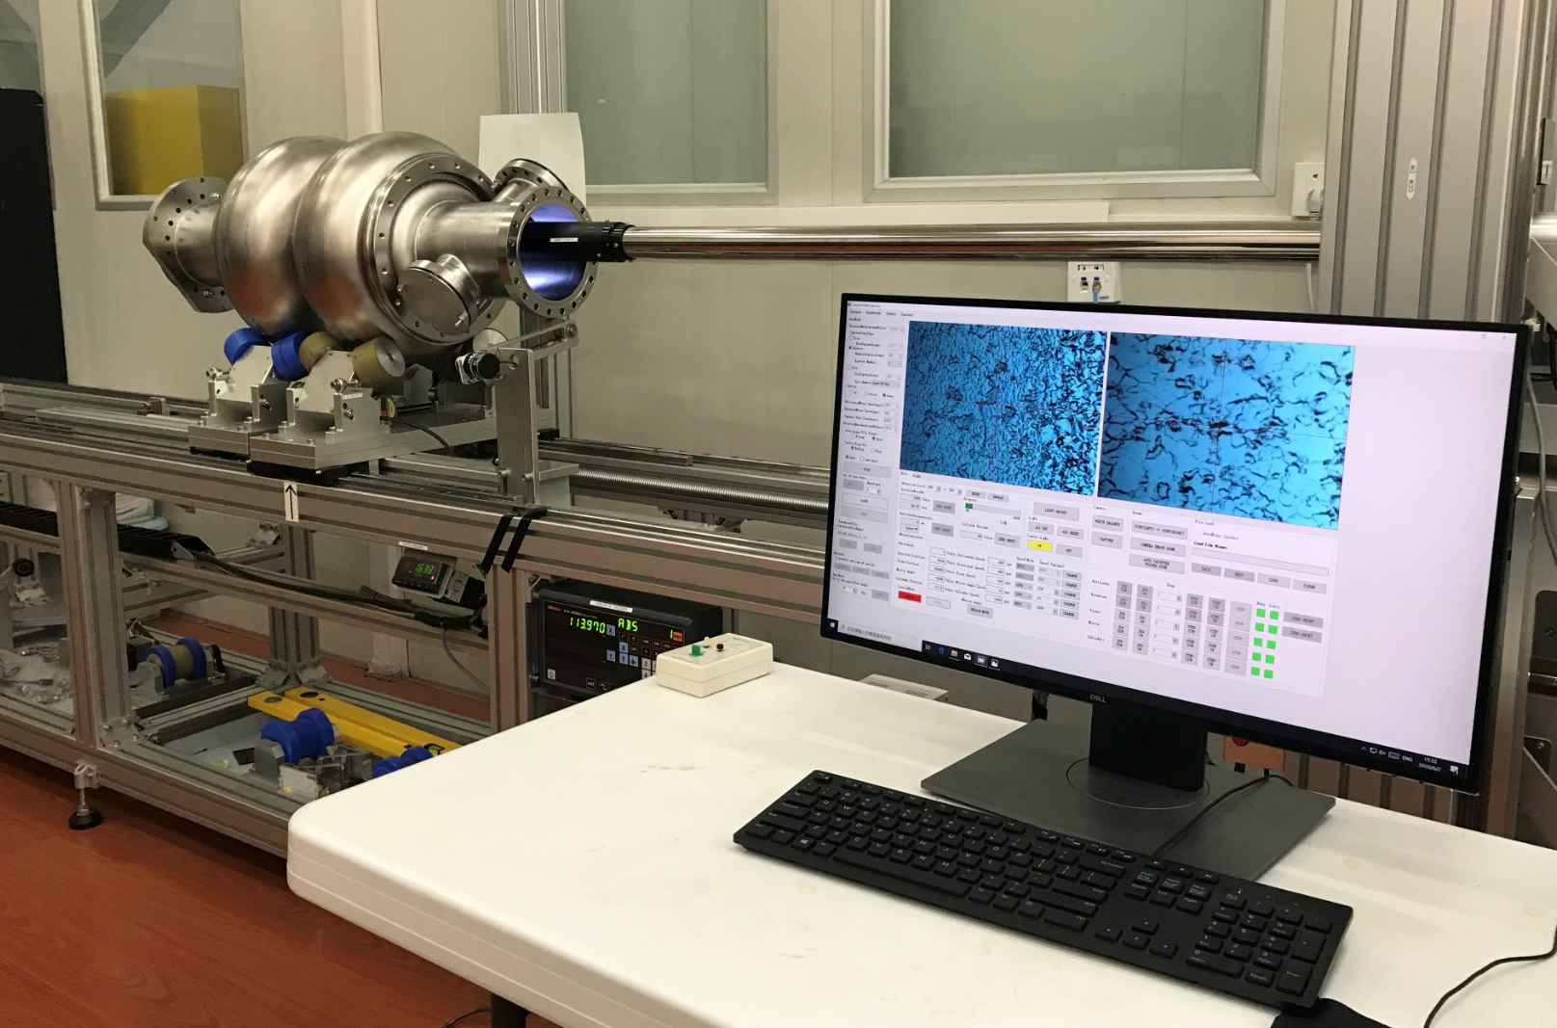
650 MHz 2-cell cavities BCP processed (1)
Three 650 MHz 2-cell cavities were fabricated, buffered chemical polished (BCP) and tested, which all exceeded 3E10@20MV/m.
BCP
Vertical test
Inspection
Vertical test results of 650 MHz 2-cell cavities

Slide 9
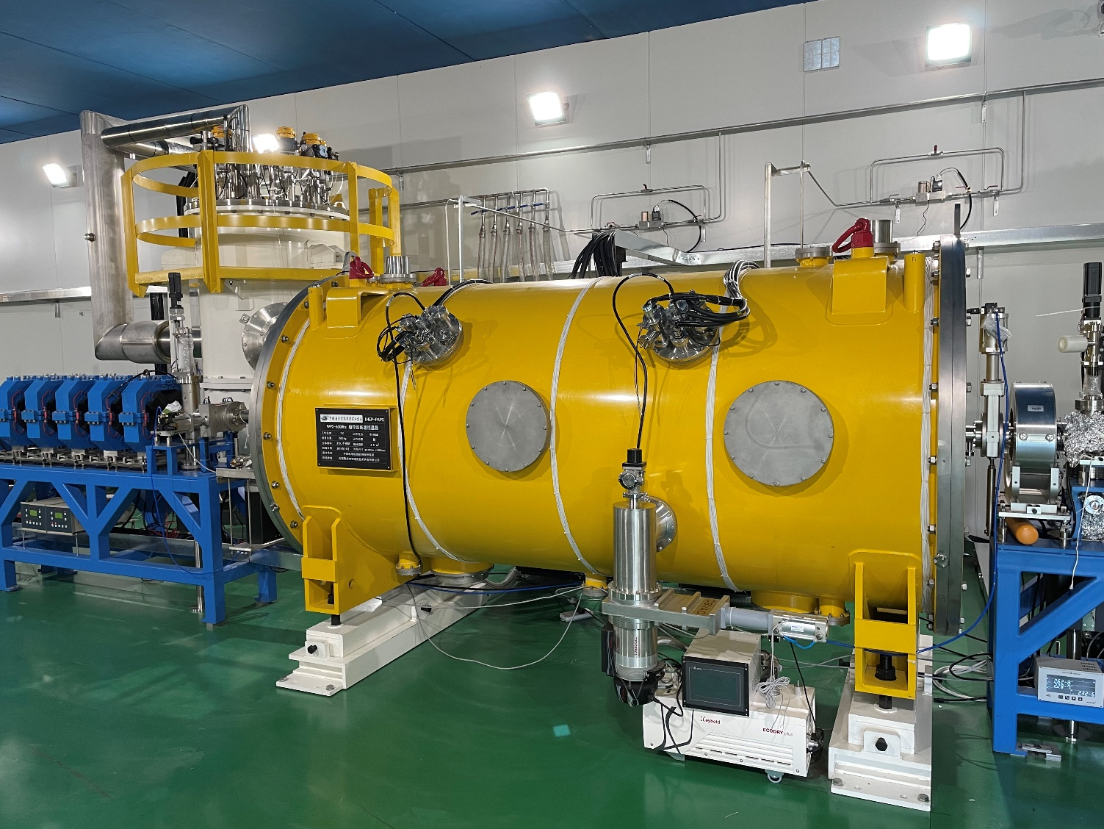
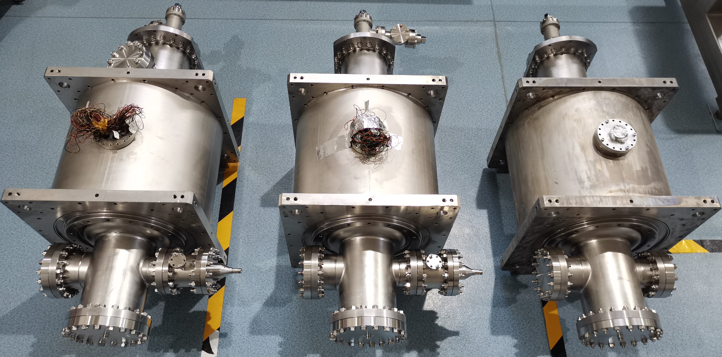
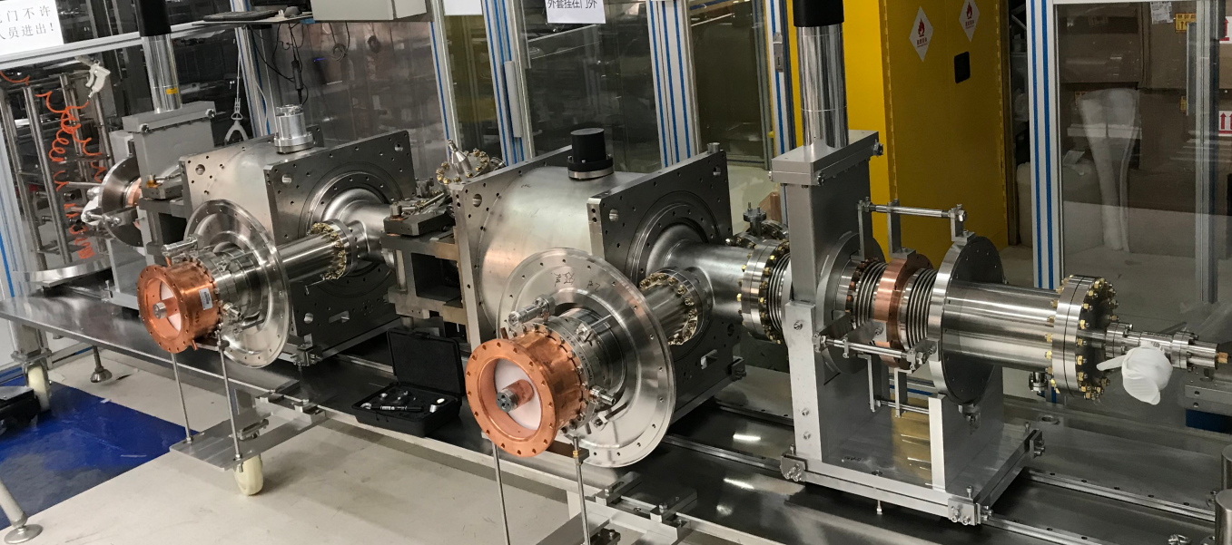
650 MHz 2-cell cavities BCP processed (2)
All the three 2-cell cavities were welded with helium vessel, two of which have been integrated into a 650 MHz test cryomodule at PAPS.
2-cell cavities jacketed
650 MHz test cryomodule for CEPC
Cavity string

Slide 10
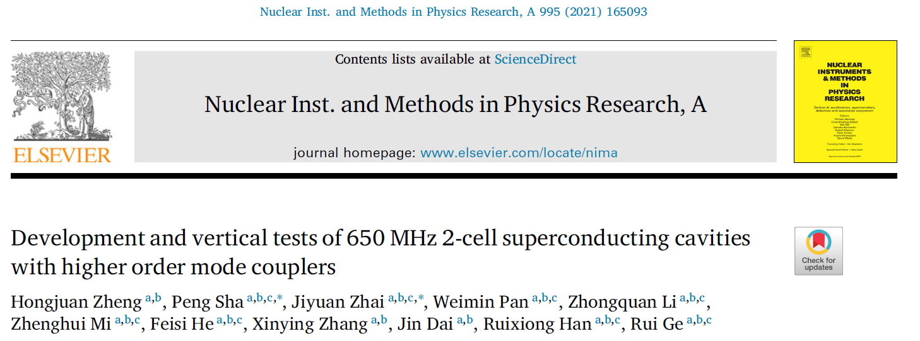
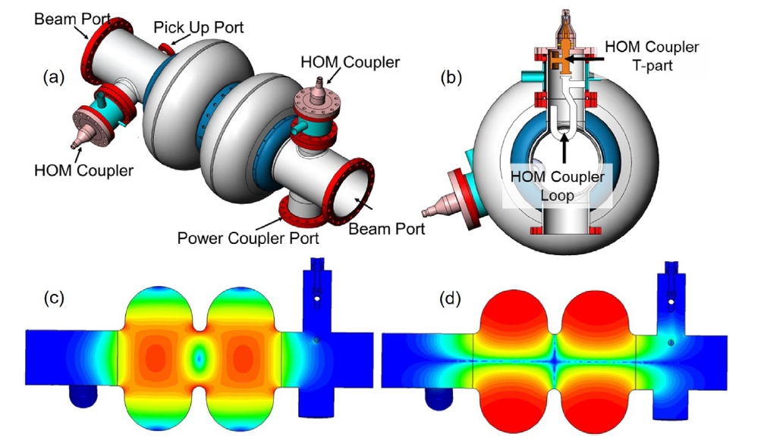
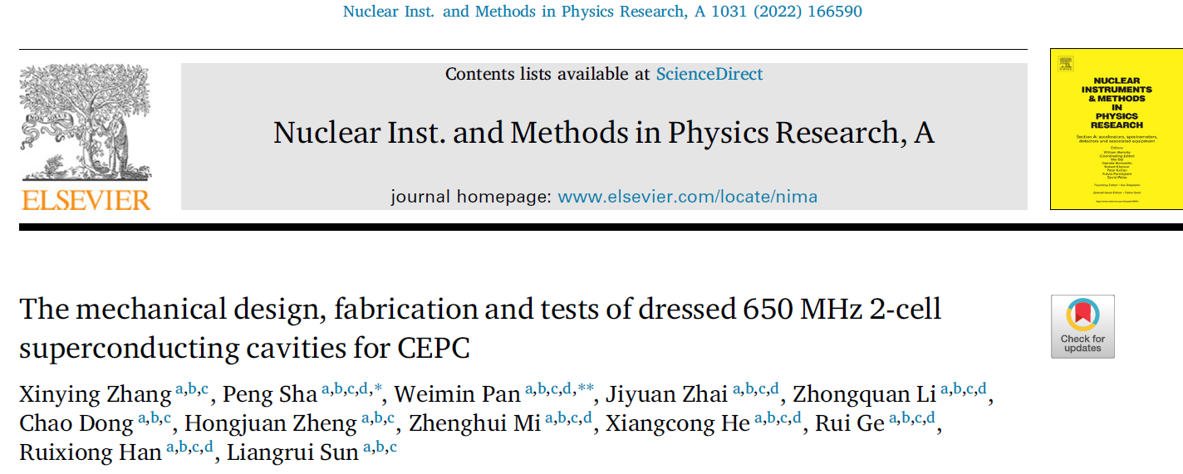
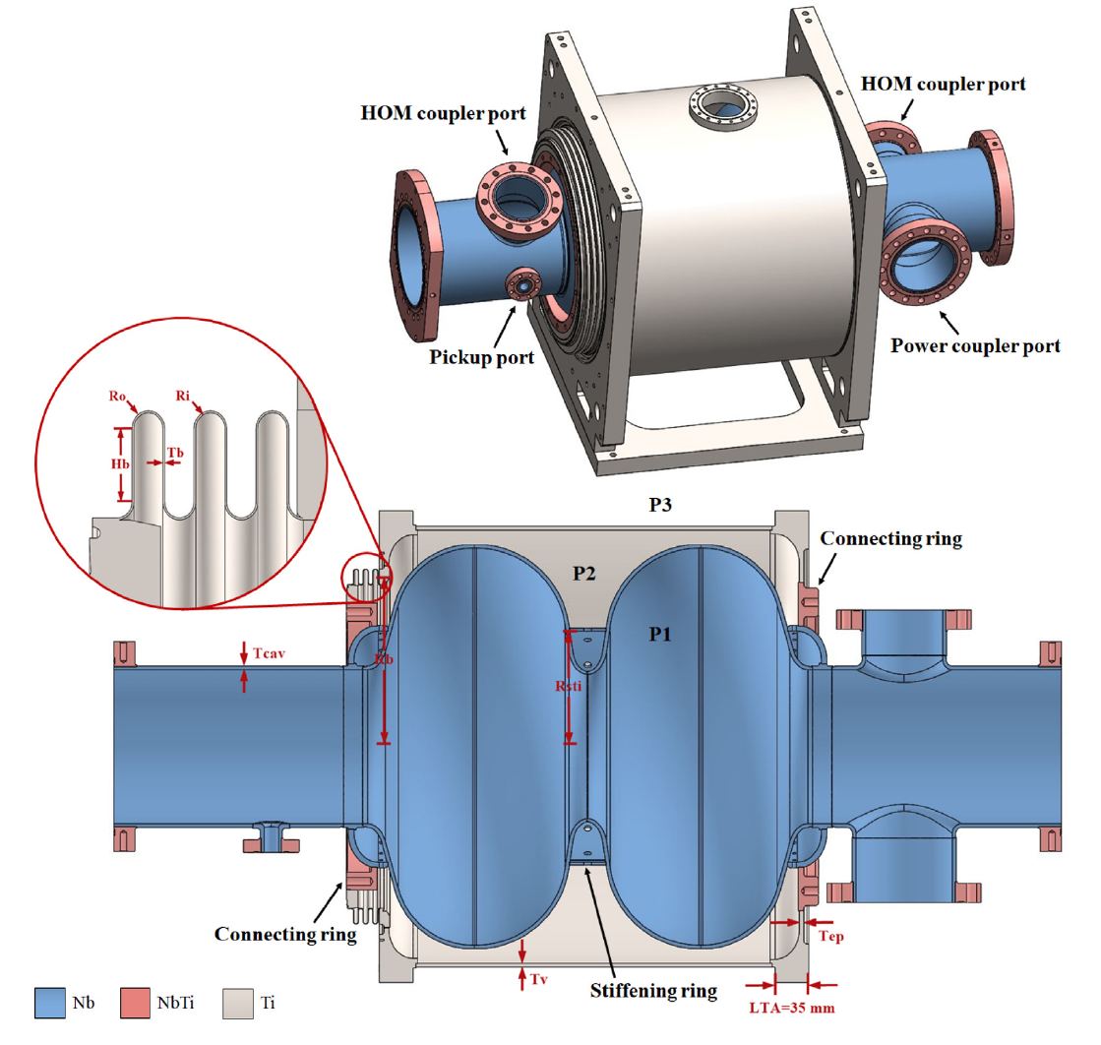
650 MHz 2-cell cavities BCP processed (3)

Slide 11
CEPC 650 MHz single-cell cavities
Cavity | Before May, 2022 |  | After May, 2022
 | Process | Result (Q₀ at max E_{acc}) | Process | Result (Q₀ at max E_{acc})
650S4 (Fine Grain) | Bulk BCP 200 um + 800C 3h + light BCP 30 um + Light EP 20 um + 950C 3h + light EP 20 um (17.5 °C) + mid-T furnace baking (300C 3h) | 7.6E10@ 24MV/m | Cold EP 30 um (12 °C) + 2-step low-T baking (75C 4h + 120C 48 h) | 1.6E10@ 42MV/m
650S5 (Fine Grain) | Bulk BCP 200 um + 800C 3 h + light BCP 30 um + EP commissioning 215 um + bulk EP 100 um (17.5 °C) + 900C 3h + mid-T furnace baking (300C 3h) | 1E11@ 20MV/m, 6.3E10@ 31MV/m | Cold EP 30 um (12 °C) + low-T baking (120C 48 h) | 2.3E10@ 42MV/m

Slide 12
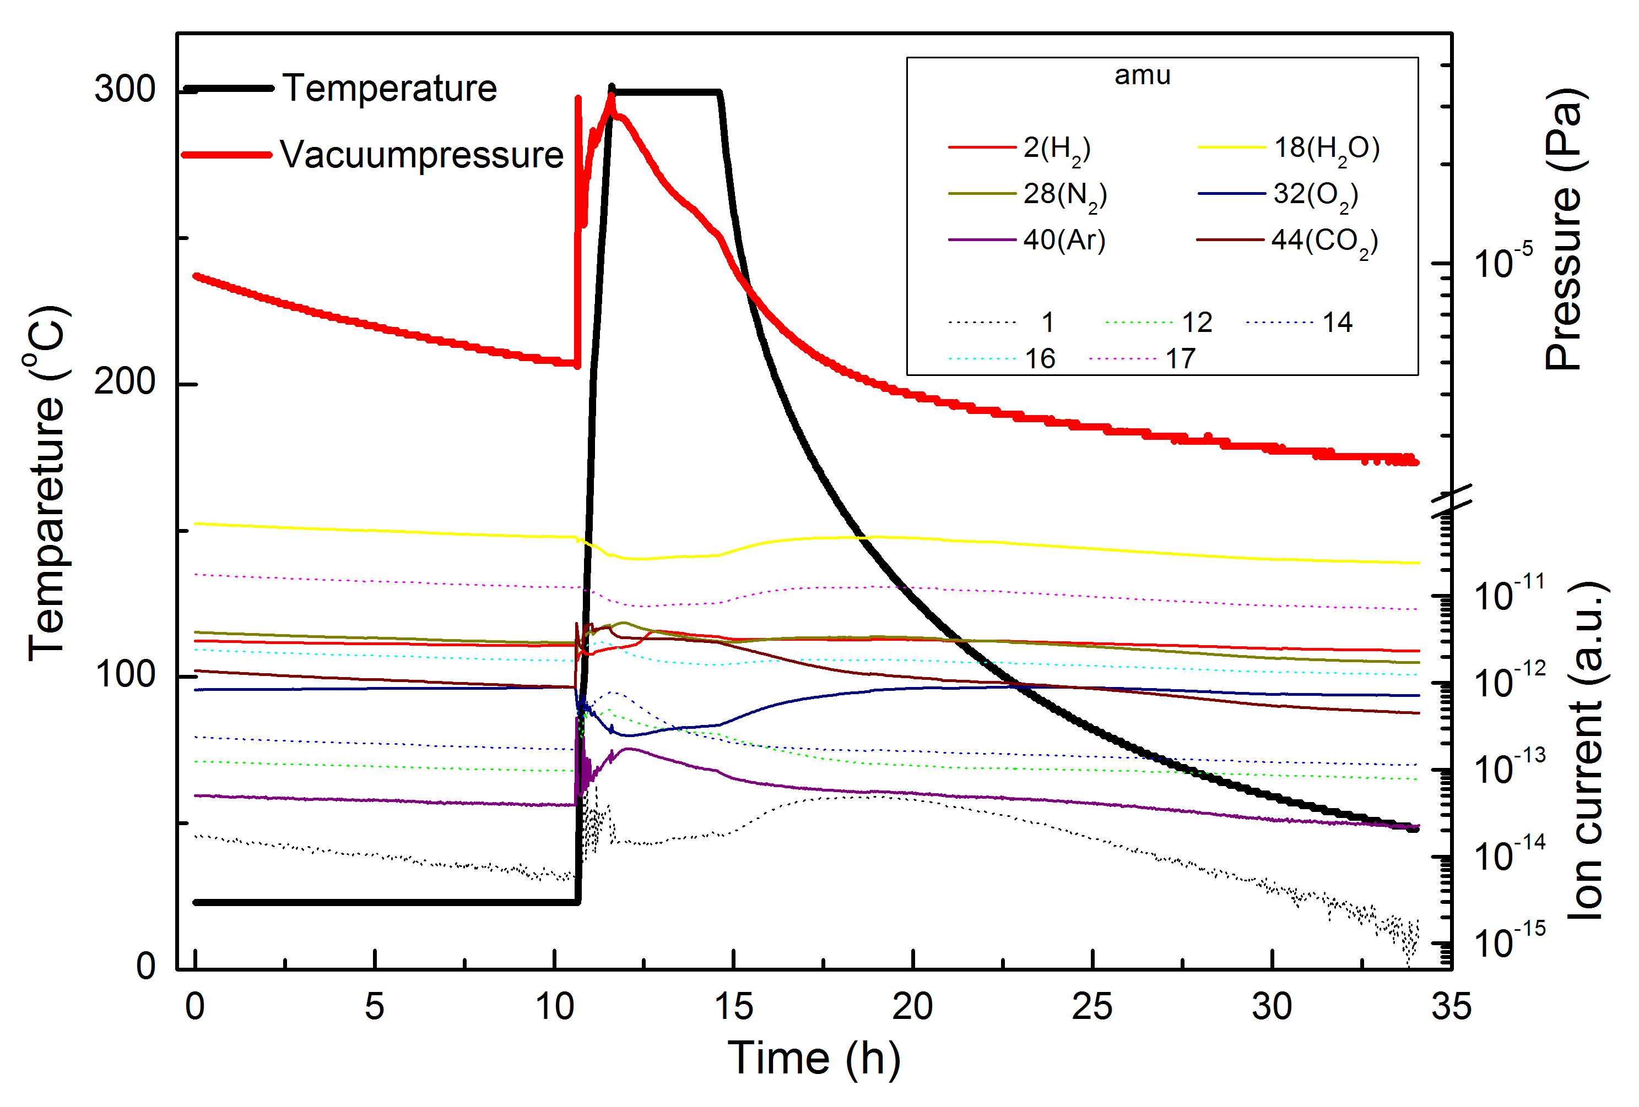
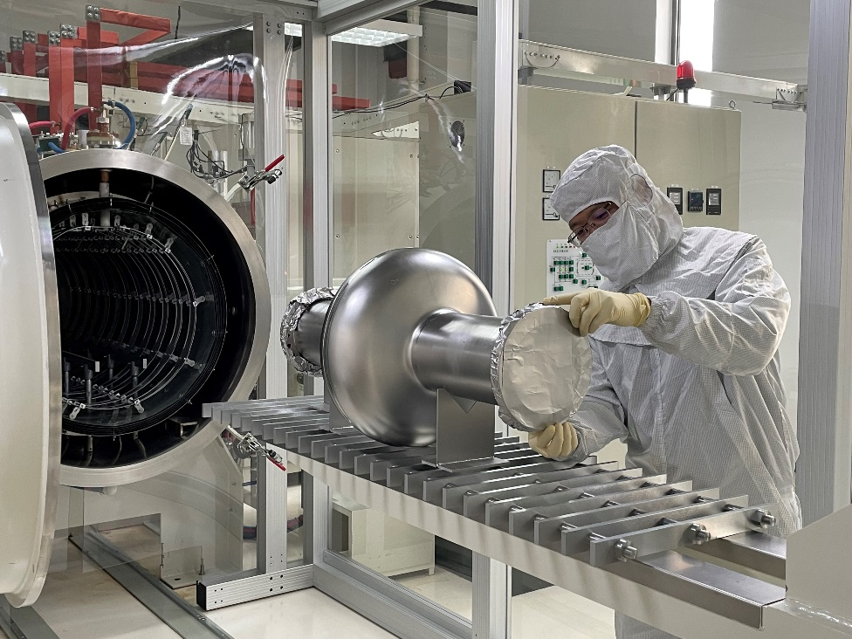
Mid-T furnace baking
Mid-T furnace baking of 650 MHz
single-cell cavity
Vacuum, temperature and RGA during mid-T furnace baking

Slide 13
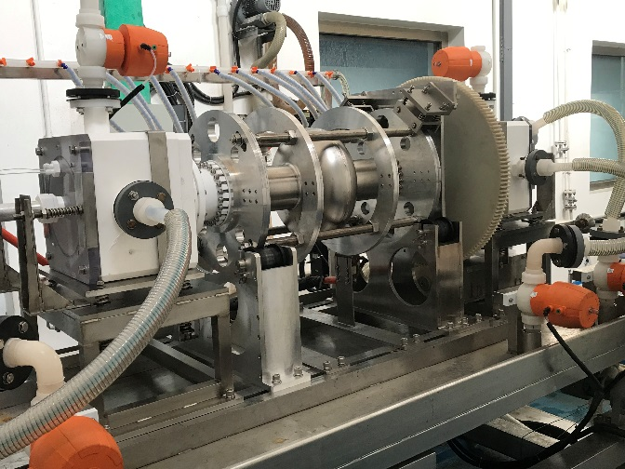
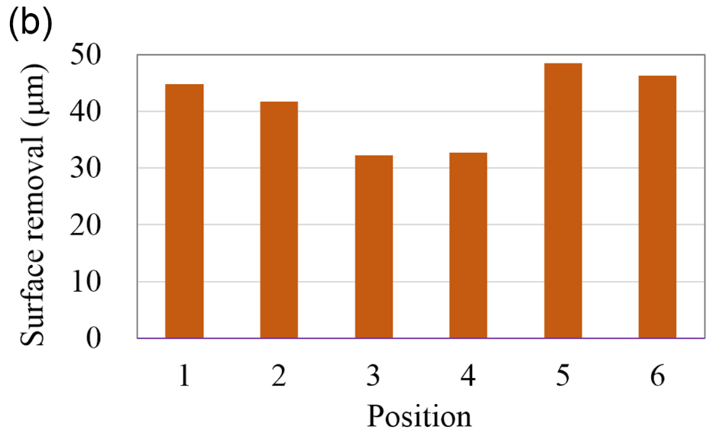
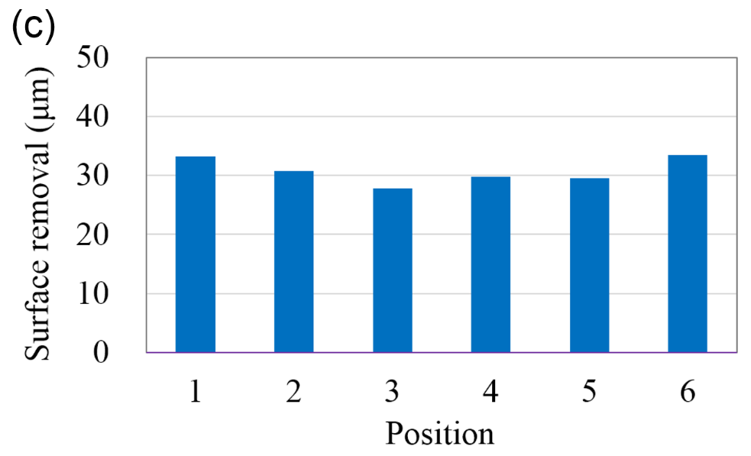
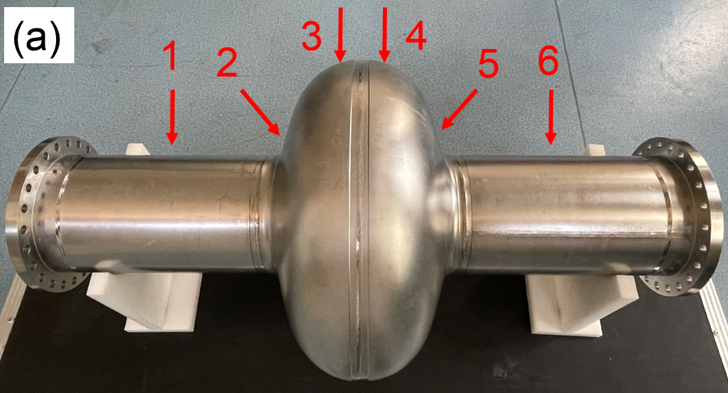
Cold EP
More uniform removal achieved by cold EP.
The average removal at the equators (3, 4) is 71% of beam pipes (1, 6) during the EP process (17.5 °C) in 2021, while 75% is perfect.
The average removal at the equators (3, 4) is 86% of beam pipes (1, 6) during the EP process (12 °C) in 2022.
EP of 650 MHz
single-cell cavity
Red arrows and numbers indicate the locations for thickness measurements
Surface removal of the EP
(17.5 °C) in 2021
Surface removal of EP
(12 °C) in 2022

Slide 14
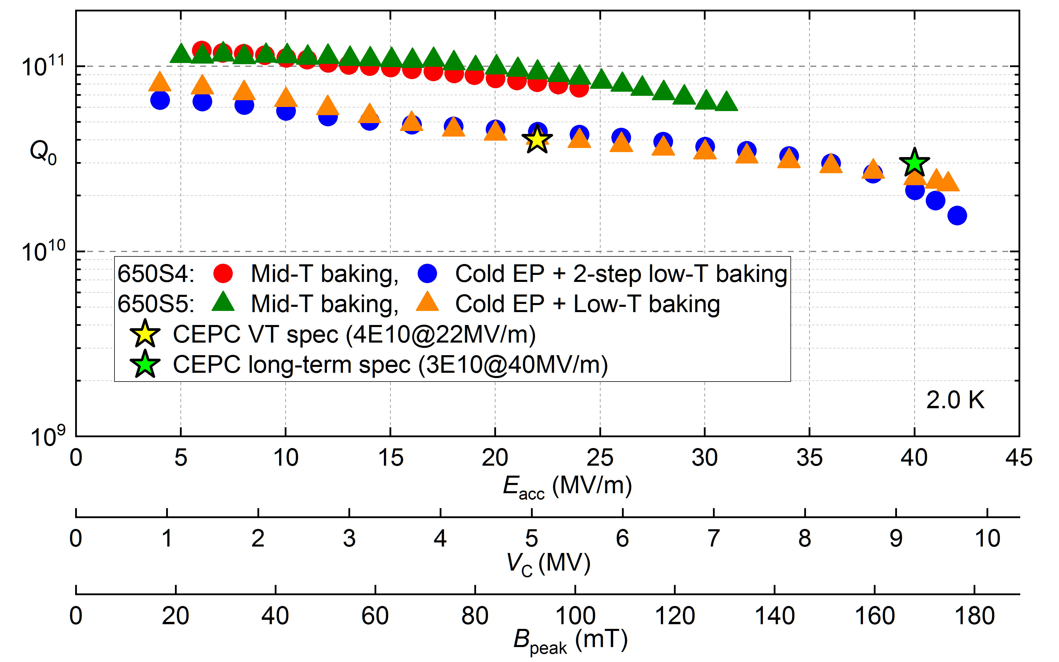
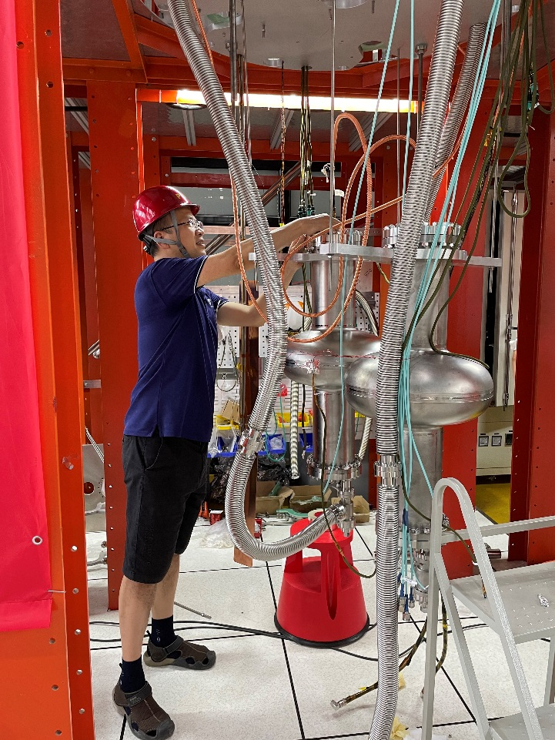
B_{peak}=176mT!
CEPC 650 MHz single-cell cavities
Vertical test results of CEPC 650 MHz single-cell cavities. The max E_{acc} was limited by quench during the tests.

Slide 15
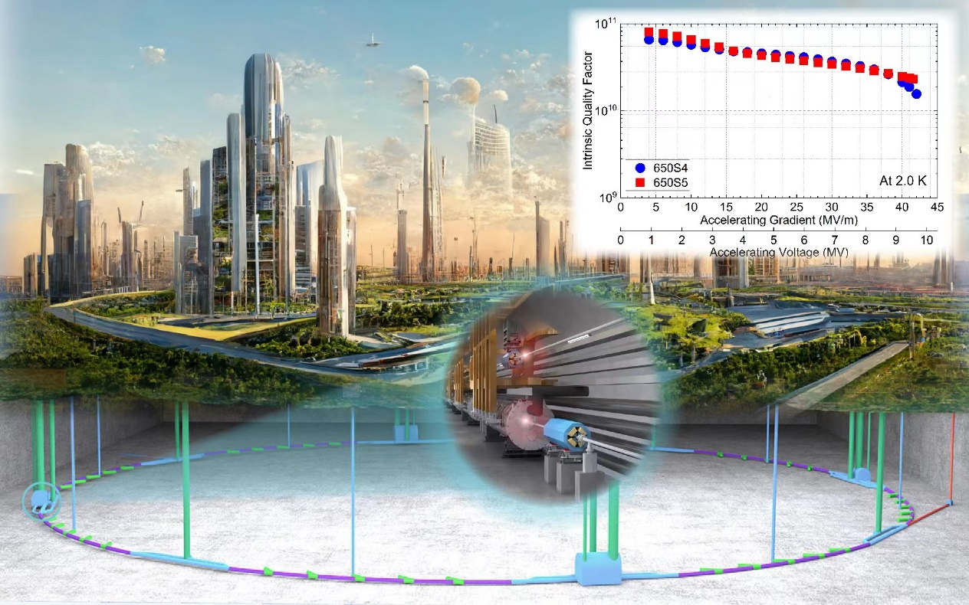
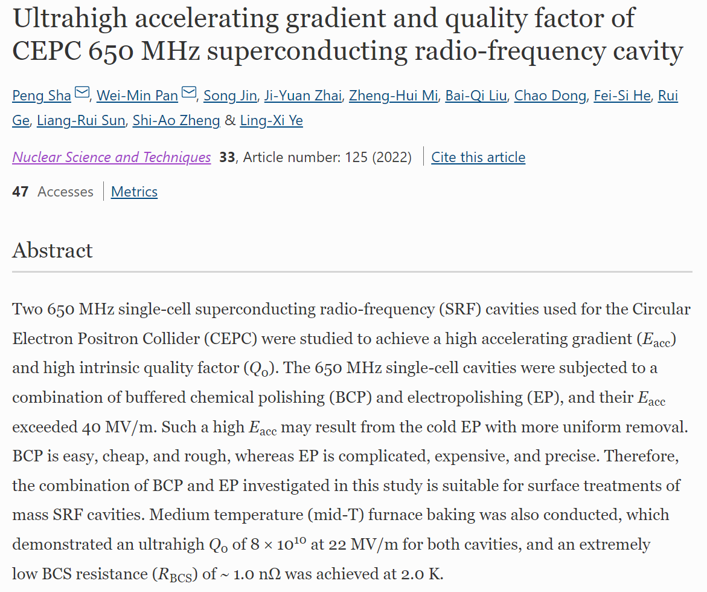
Cover Article for NST 2022 issue 10
P. Sha et al., NUCL SCI TECH 33, 125(2022)

Slide 16
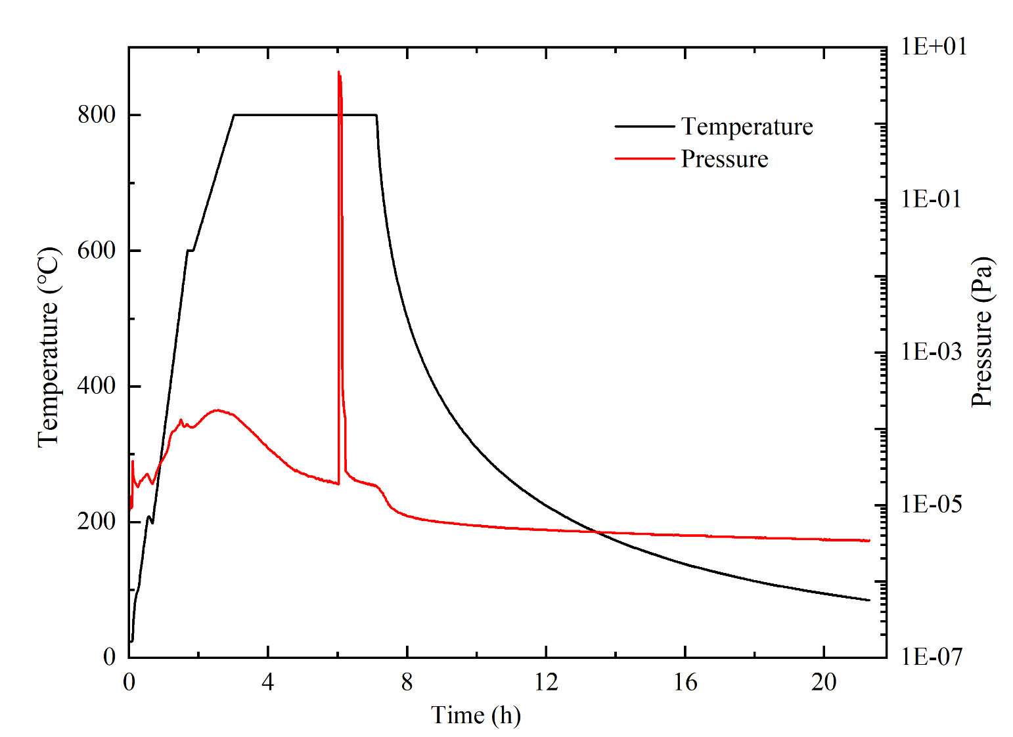
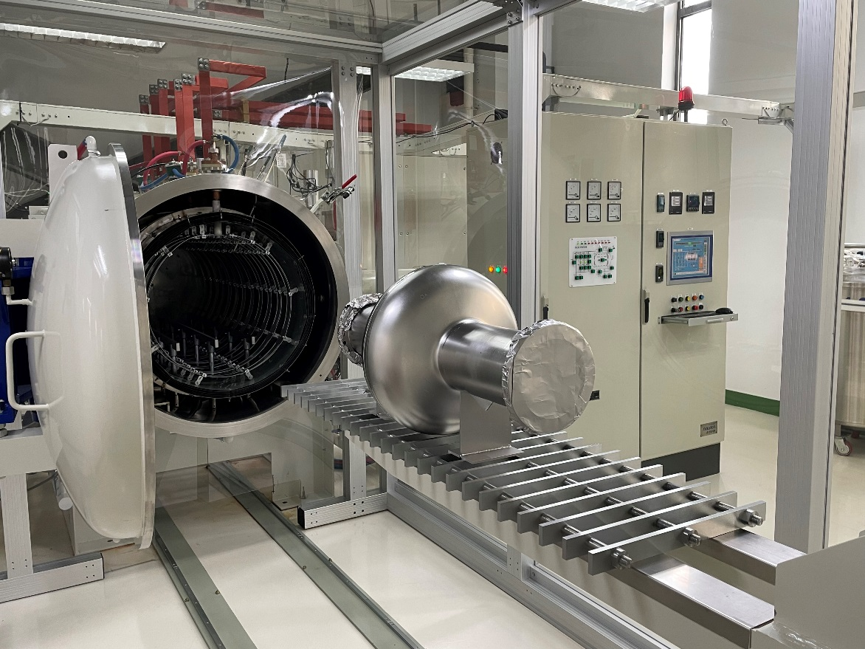
Nitrogen doping
Two 650 MHz single-cell cavities have received nitrogen doping, “3/60” recipe was adopted.
Nowadays, the cavities nitrogen doped are awaiting for the light EP, which have been delayed because of the COVID-19.
Nitrogen doping of 650 MHz single-cell at the same furnace as well as mid-T furnace baking

Slide 17
Outline
1.3 GHz 9-cell cavity
650 MHz cavity
Nb3Sn cavity
Conclusion

Slide 18
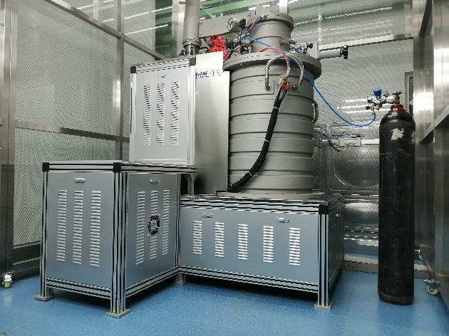
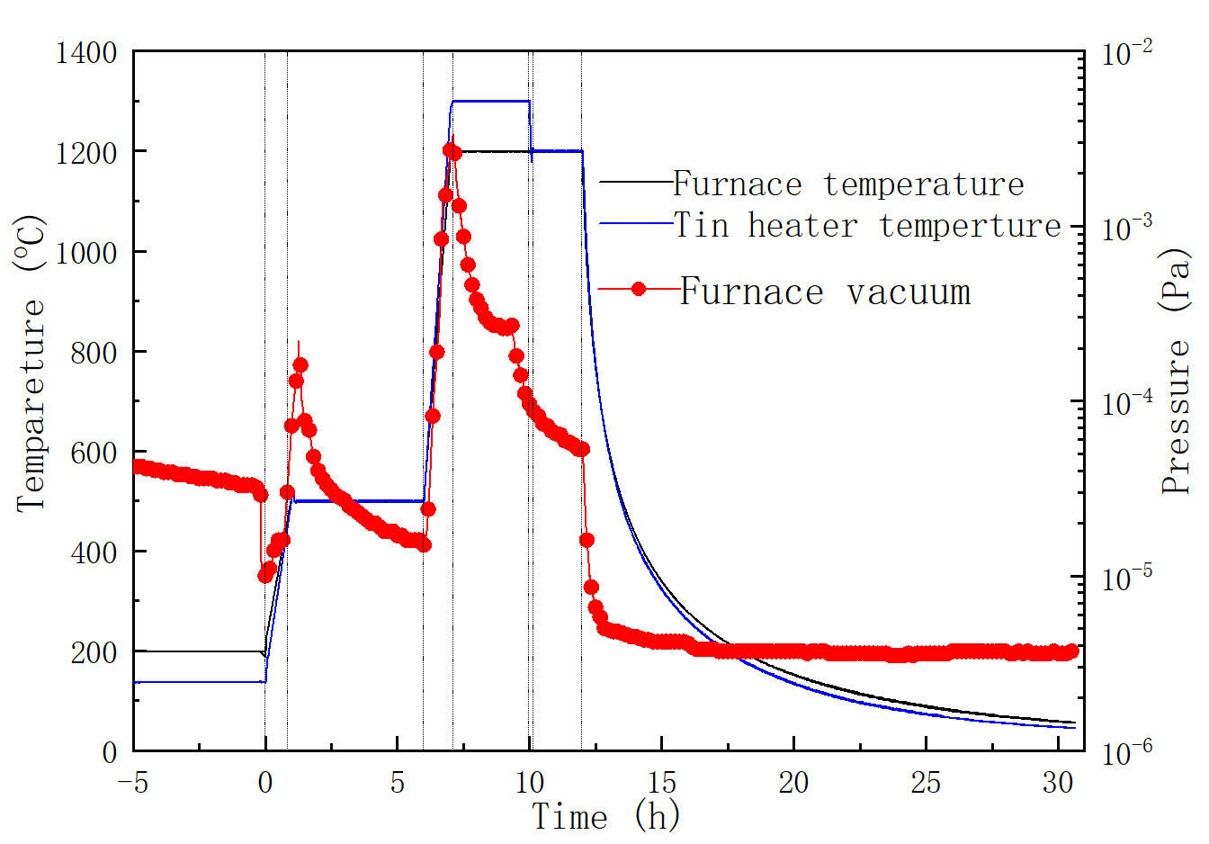
Setup
A small furnace for Nb3Sn film coating was developed at IHEP. Nb3Sn film is coated with 1.3 GHz 1-cell niobium cavity by vapor diffusion.
Furnace for Nb3Sn coating.
Curve of coating process

Slide 19
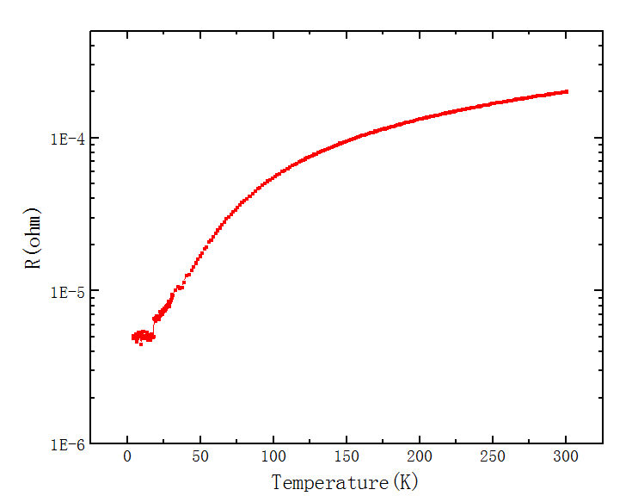
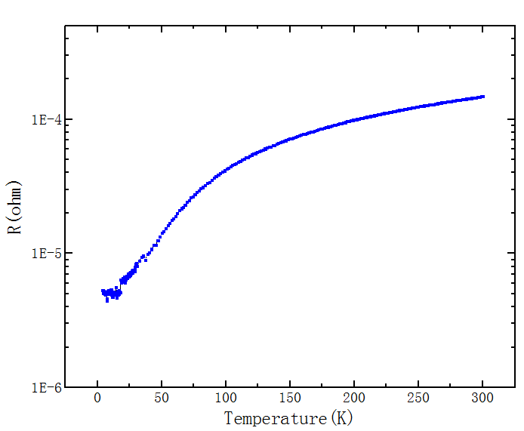
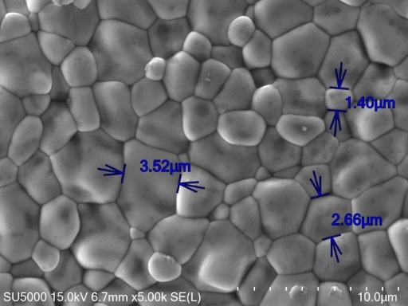
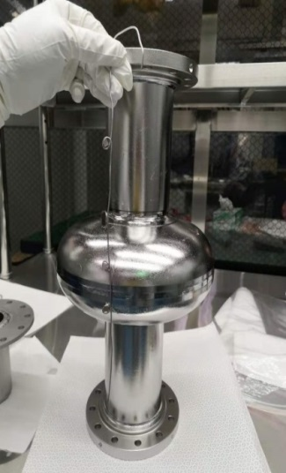
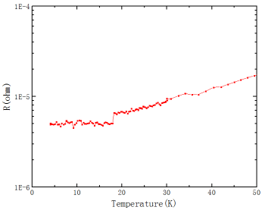
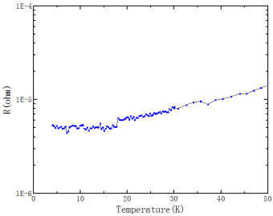
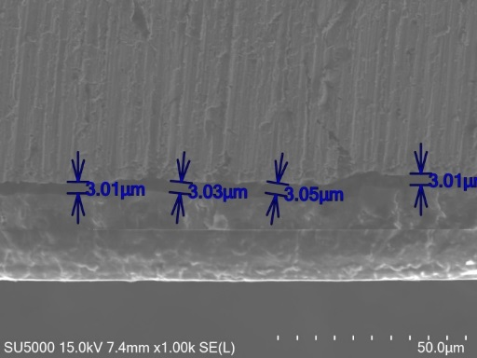
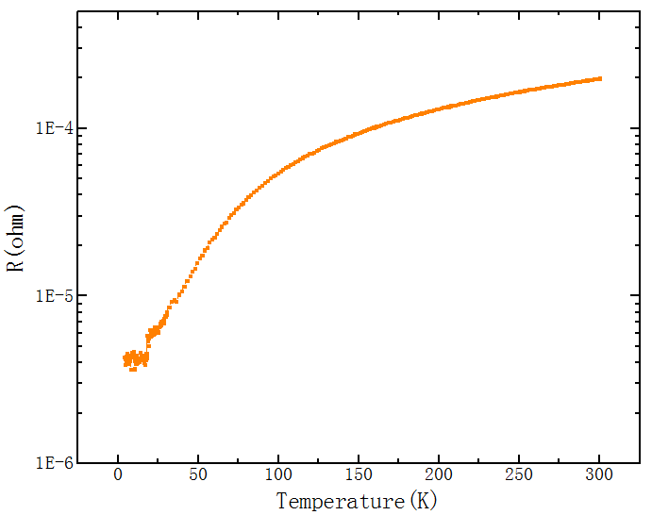
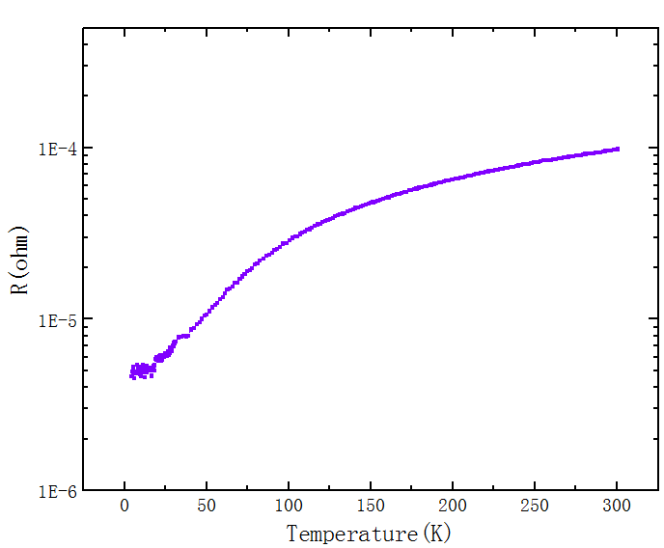
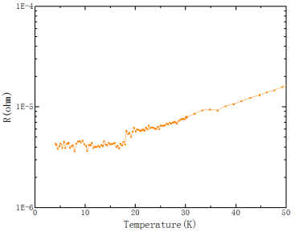
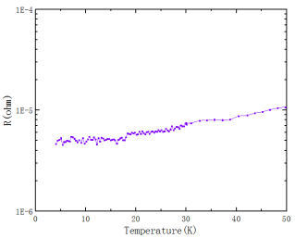
Microscopic analysis
Samples were used for microscopic analysis, which showed formation and superconducting transition of Nb3Sn.
#1: Tc0 = 18.03K
#2: Tc0 = 17.78K
2
4
1
3
#3: Tc0 = 17.96K
#4: Tc0 = 17.87K
Samples position
Nb3Sn grain (SEM)
T_{C} of Nb3Sn (R-T)

Slide 20
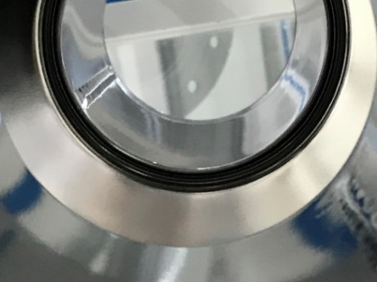
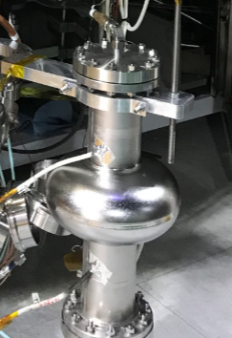
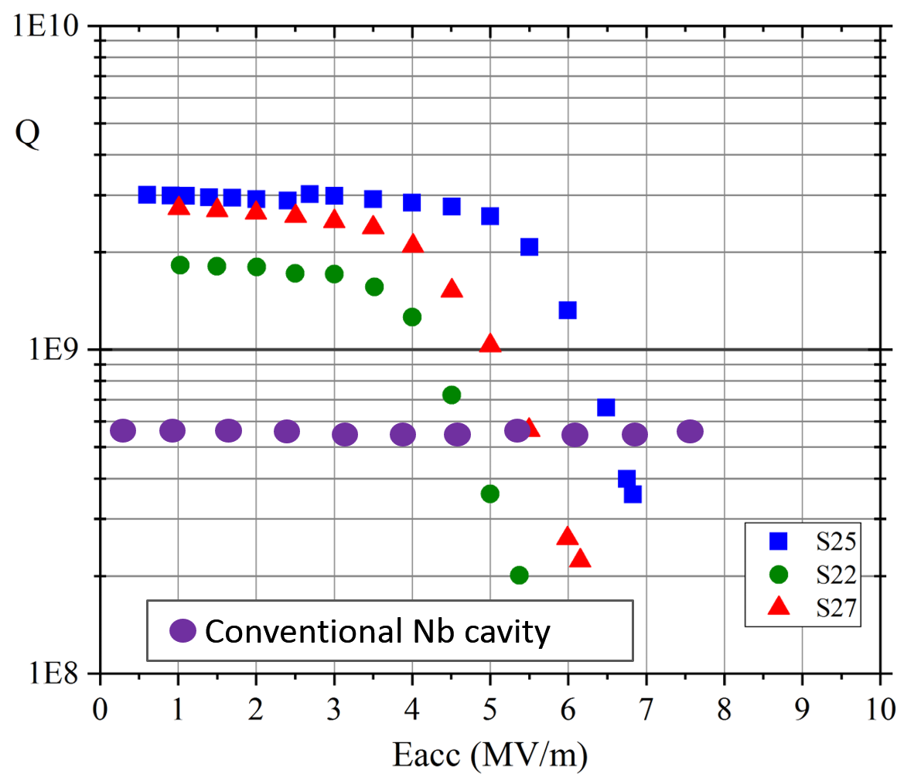
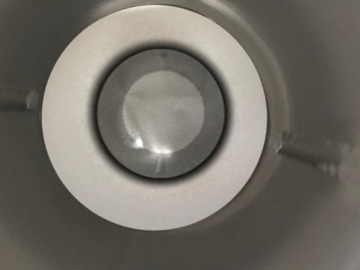
1.3 GHz 1-cell Nb3Sn cavities
Max gradient: 5~7 MV/m; Max Q: ~3E9 (@4.2K). The coating process still needs optimization.
Various cooling rates were tried, which demonstrated very different results. It verified that slow and uniform cooldown resulted in high Q and low surface resistance of Nb3Sn cavity.
Before Nb3Sn coating
4.2 K
Vertical test results of 1.3 GHz 1-cell Nb3Sn cavities
After Nb3Sn coating
Physica C: Superconductivity and its applications 600 (2022) 1354107

Slide 21
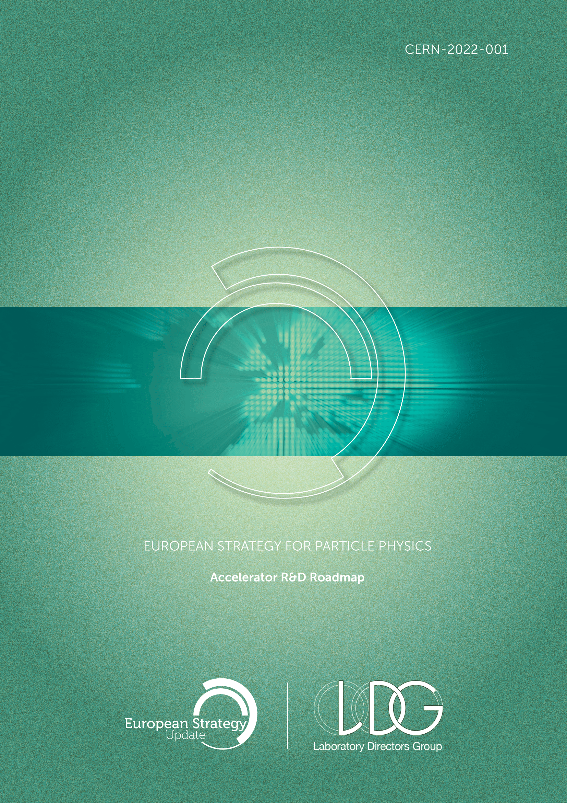
Conclusion
The CEPC superconducting cavities are keeping up with state-of-the-art SRF over the world. World-leading 650 MHz and 1.3 GHz superconducting cavities with High Q and high E_{acc} have been achieved successfully.
New and novel technology are applied: mid-T furnace baking, cold EP, large grain niobium, nitrogen doping/infusion, etc. Nb₃Sn coating has gained preliminary progress.
Sergey Belomestnykh and Hans Weise, SRF activities discussed within Snowmass and European HEP strategy process - TTC Aomori, Oct 2022

Slide 22
Thanks for your attention!

