Slide 1


CEPC Magnet Design and R&D Status
in Collider Ring
Mei Yang, Fusan Chen, Xianjing Sun
25 Oct., 2022
The 2022 International Workshop on the High Energy Circular Electron Positron Collider
October 24-28, 2022, IHEP, Beijing

Slide 2
Outline
Dipole magnet design status
Dual Aperture Quadrupole(DAQ) design
  Optimization design and prototype modification
  Field measurement results
Sextupole magnet design
Summary

Slide 3
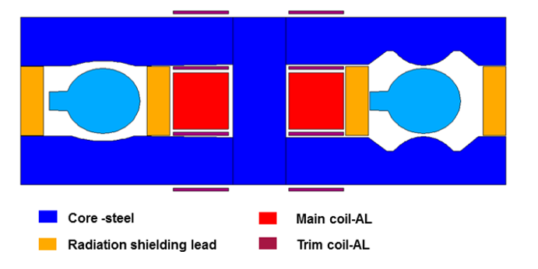
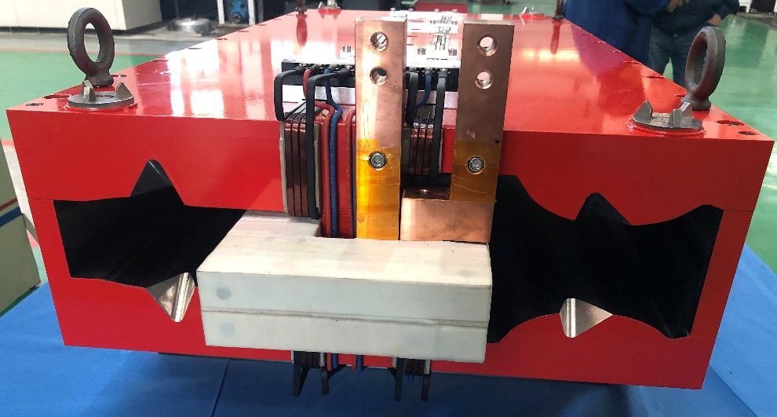
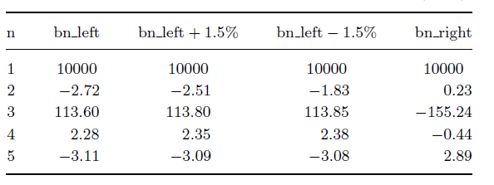
Dual aperture dipole magnet design
First short prototype of 1m
  Dual aperture dipole with sextupole component
  Simple, pure solid iron, worked at DC mode
  Same field strength in two apertures with trim coils(±1.5%)
  Low field range from 145Gs to 540Gs
  Aluminum busbar coils of 4 turns (compatible with PS)
  350mm beam separation, determined by vacuum chamber, synchrotron absorbers, lead blocks, clearance, and excited coils.

Slide 4
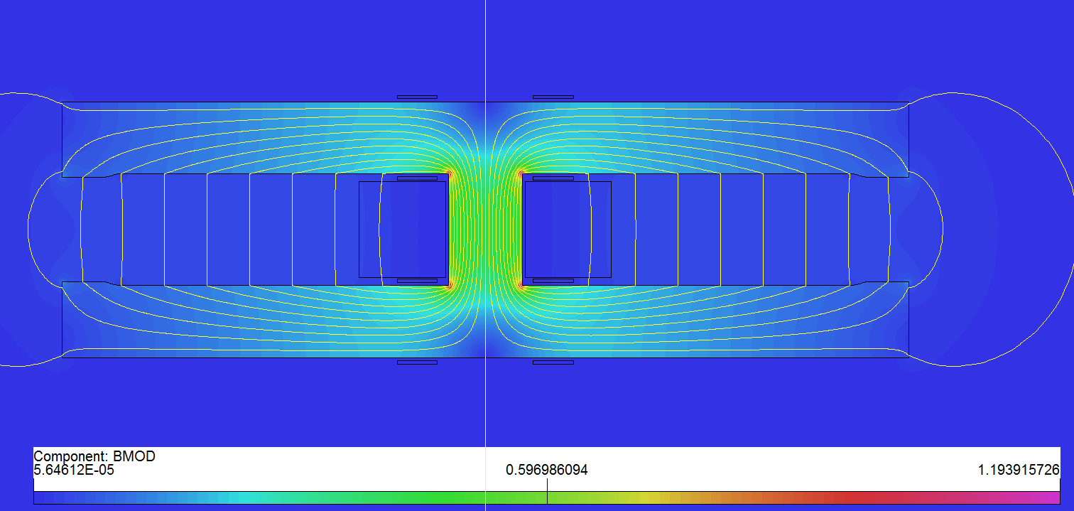
Full-scale dual aperture dipole prototype (DAD)
Long dual aperture dipole（DAD）magnet design: 5.67m
  Two turns of busbar coils made of Aluminum with a cooling hole (60*27mm)
  Solid iron with DT4, simple “I” shape yoke;
Mechanical design
  Several interleaved blocks at the open gap to keep the gap height.
  Four supporters at the bottom with a maximum deformation of 0.017mm.

Slide 5
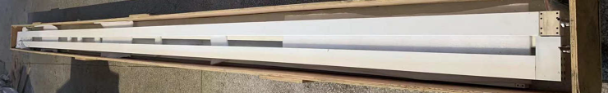
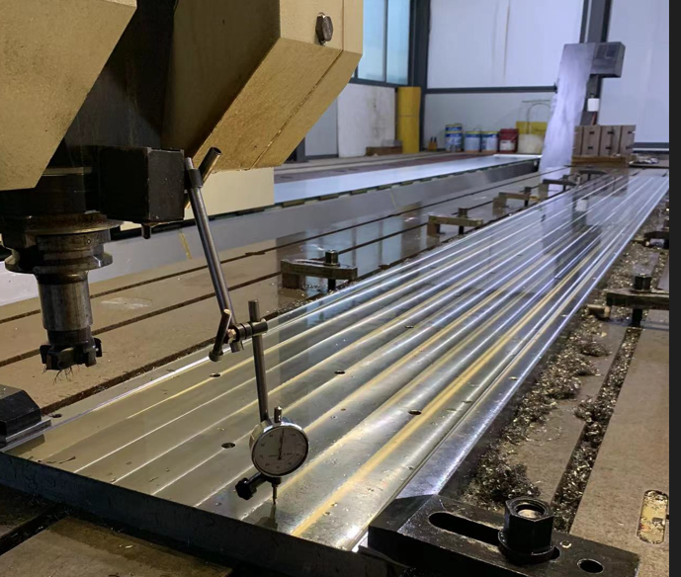
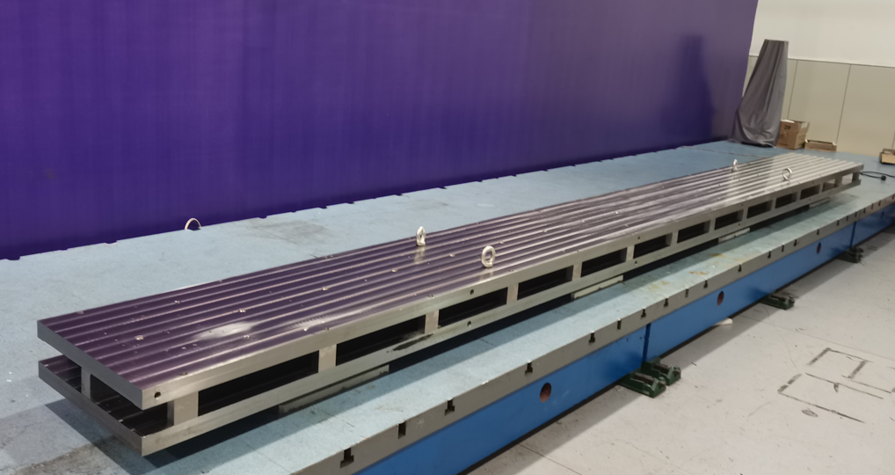
Full-scale dual aperture dipole prototype (DAD)
Development progress
  Aluminum busbar coils are finished processing, with a surface insulation of ceramic insulation coating.
  The yoke is finished on a CNC machine, and gap tolerance is within ±0.05mm.
Next steps
  Test of the coils: resistance test, turn to turn insulation test, and so on.
  Trim coils wounding.
  Final assembly.
  Field measurement.

Slide 6
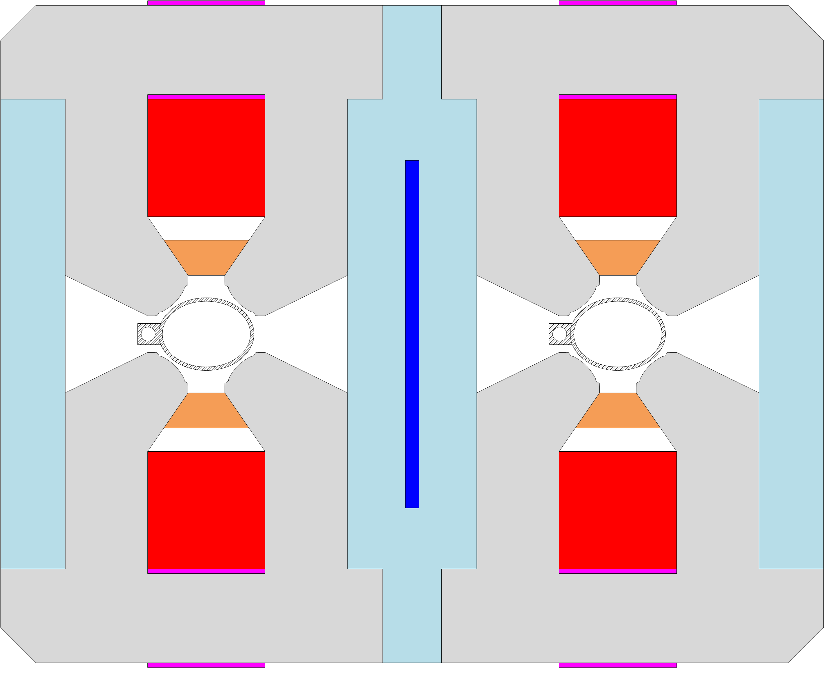
DAQ parameters and first prototype
Basic parameters of dual aperture quadrupole ( DAQ)
  Apertures：76mm
  Beam separation：350mm
  Gradient range: 3.2T/m@45.5GeV~12.8T/m@182.5GeV
  Trim coil: ±1.5% gradient tapering
  Field quality: 5×10⁻⁴@Rref=12.2mm
First F/D prototype features
  DT4 compensation sheet
  Trim coils located on the yoke, far from the midplane.
  Hollow water cooled aluminum conductor.
  Large leakage field at the outside and middle of the magnet.
  Strong dipole field at the end.
  Lead blocks for radiation shielding
First F/D design,
CDR,2018

Slide 7
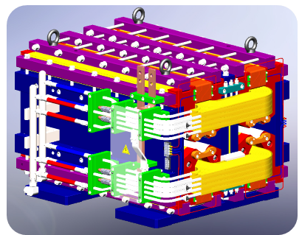
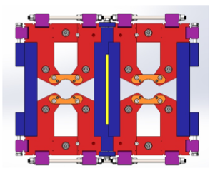
DAQ parameters and first prototype
The first prototype is a laminated one with DT4 compensate sheet in the middle.
Complex mechanical structure:
  The iron is divided into many blocks.
  The poles are slender.
  Difficult to control the mechanical tolerance.

Slide 8
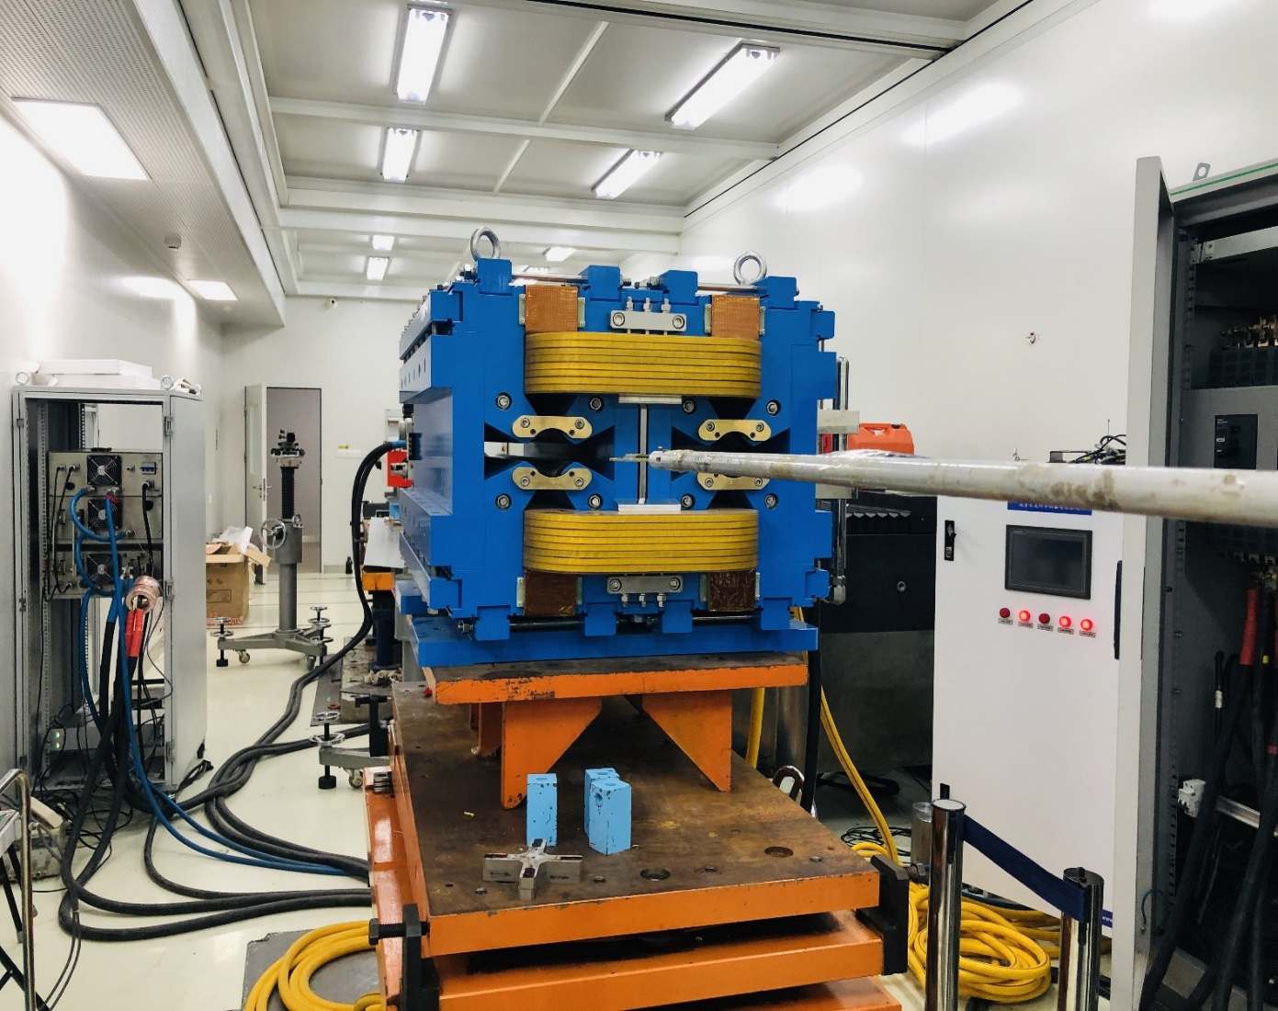
Preliminary field results of the first prototype
The first 1m long prototype was fabricated and tested by Hall probe measurement system.
  Large edge field;
  GL difference in two apertures: less than 0.5% (except 80GeV)
  X0 center shift with energy;
B
A
E(GeV） | I(A) | GL(T)-A | GL(T)-B | GL_A/GL_B-1
45 | 57.99 | -3.36 | 3.35 | 0.40%
80 | 101.99 | -5.91 | 5.88 | 0.59%
120 | 153.98 | -8.89 | 8.85 | 0.49%
148 | 189.98 | -10.93 | 10.89 | 0.40%
175 | 223.99 | -12.77 | 12.73 | 0.30%
182.5 | 233.99 | -13.27 | 13.21 | 0.40%

Slide 9
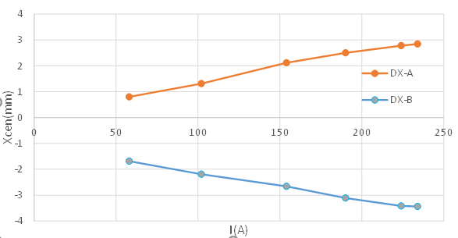
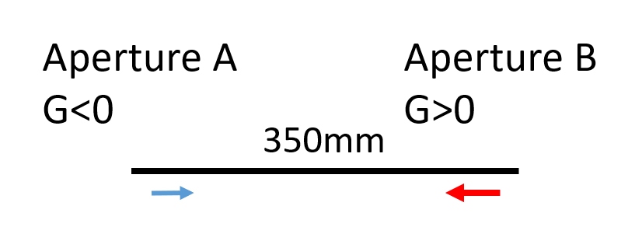
DAQ parameters and first prototype
Problems with the first design
  One DT4 sheet only can only work at one situation.
  The DAQ magnet should work at four different energy cases and with trim coils.
  The harmonics of b1 and b3 vary large at different field levels and with trim coils.
B
A
X0 shift with energy
Prototype on the hall measurement bench

Slide 10
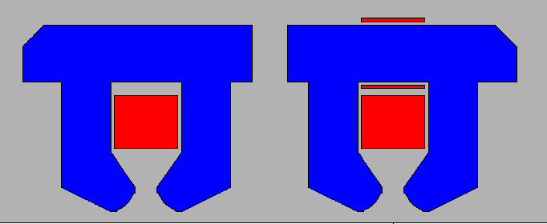
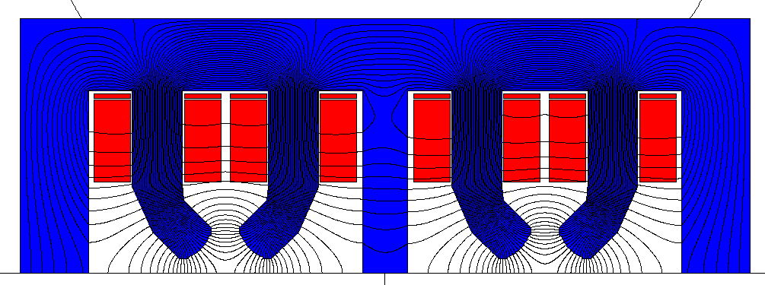
Alternative design schemes
Two separate irons with common coils
  Mechanical depart;
  No X center shift with energy shift
  Large and constant b1 and b3, and can
  compensate by iron shim;
  Trim coils on the yoke, far away from the midplane.
Parallel iron with 8 main coils
  Large power consumption.
  Nearly no cross talk effect between two apertures.
Separate irons, no DT4 compensation sheet
2020 CEPC DAY
8 main coils, F/F design
2021 IAS

Slide 11
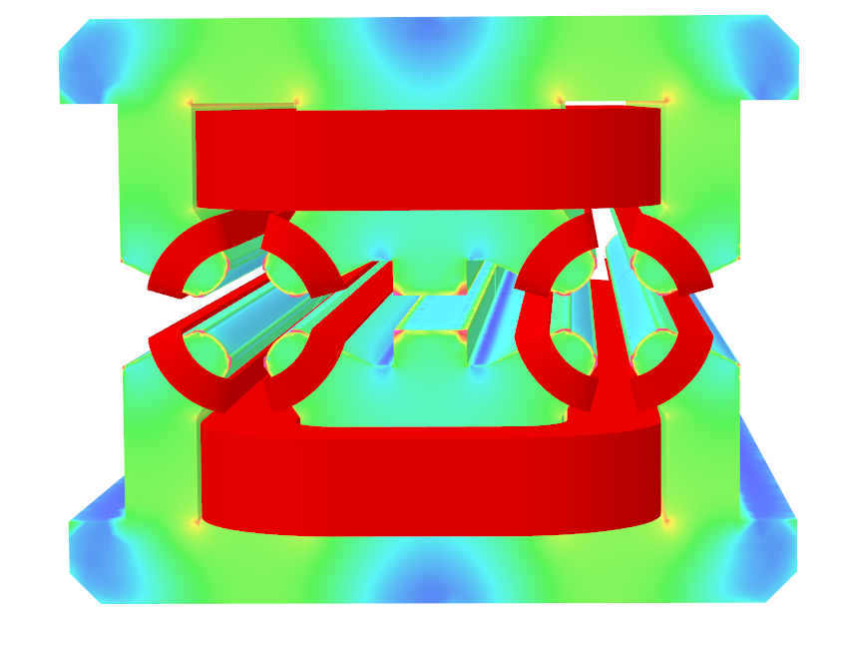
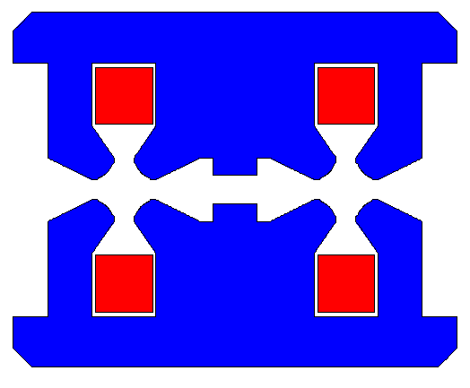
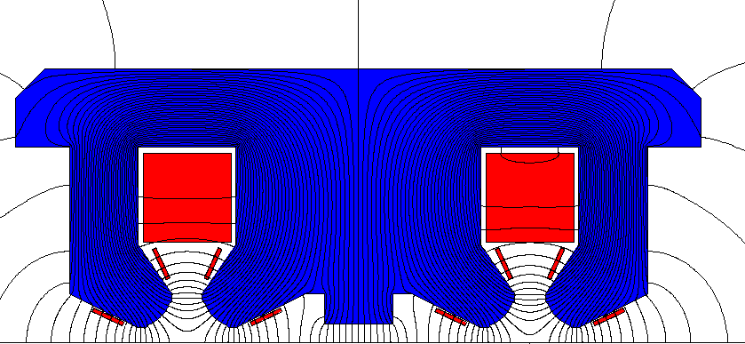
Optimization of the first prototype
Based on the prototype, with a center shim, the DAQ has a common yokes and makes the flux distribution symmetrical in a single aperture.
  @120GeV: b1 and b3 reduced a lot.
  No obvious shift at different energies.
  Trim coils on the poles.
  Strong cross talk between the two apertures.

Slide 12
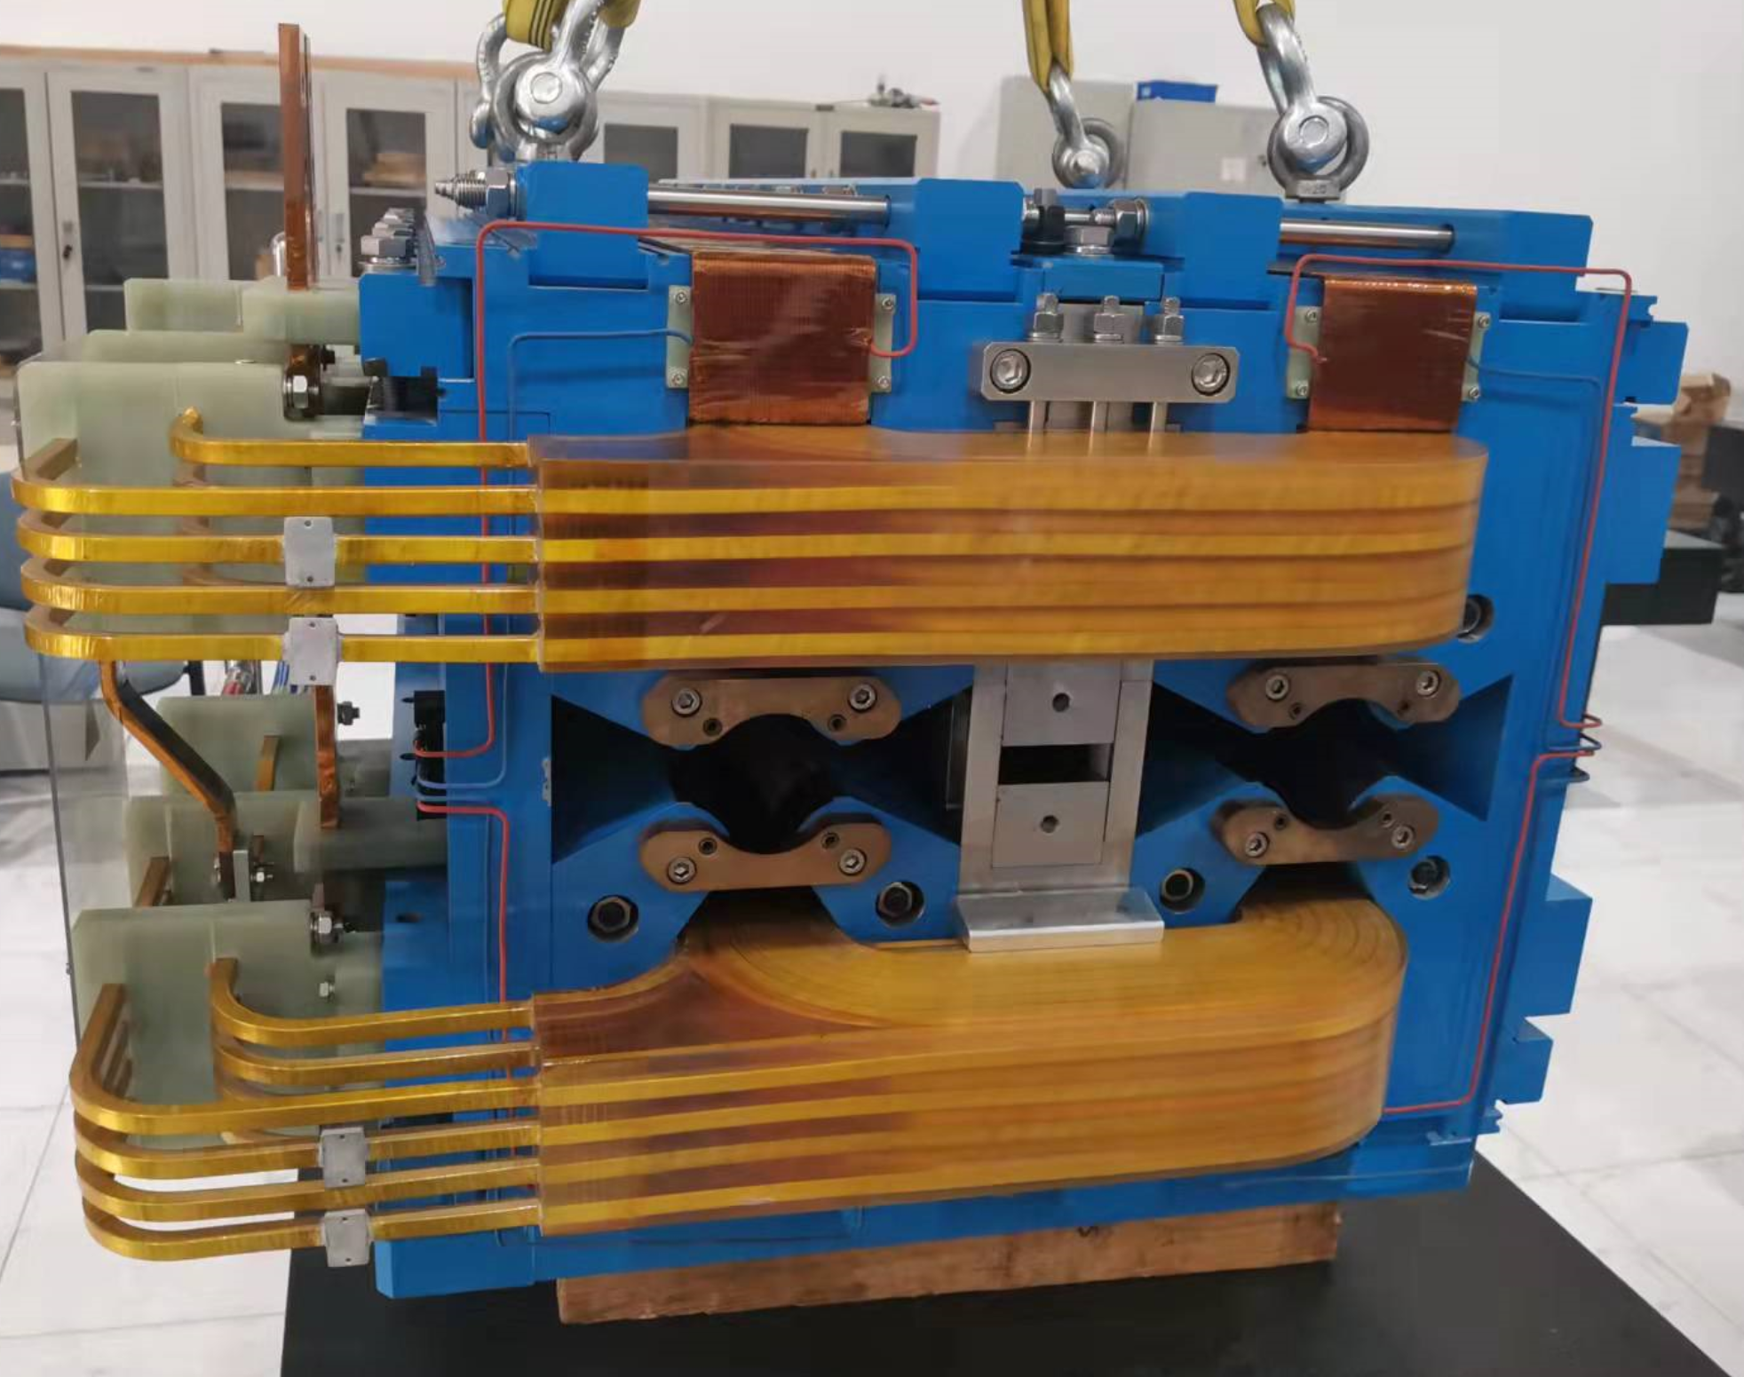
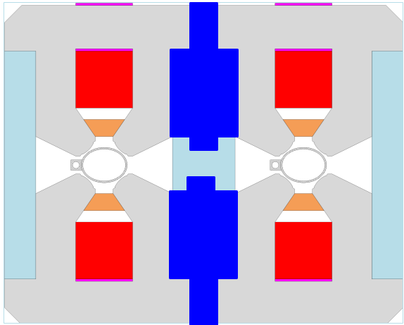
Modified DAQ prototype
1m long prototype modification
  DT4 iron blocks in the middle instead the DT4 sheet and stainless steel.

Slide 13
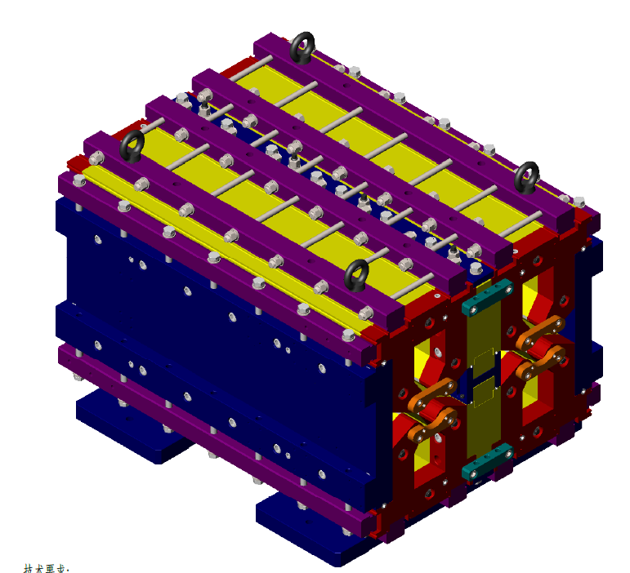
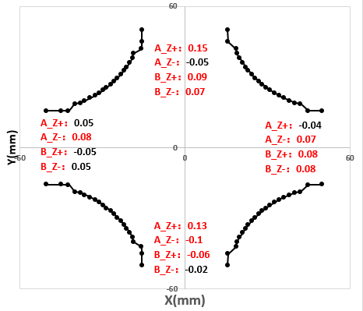
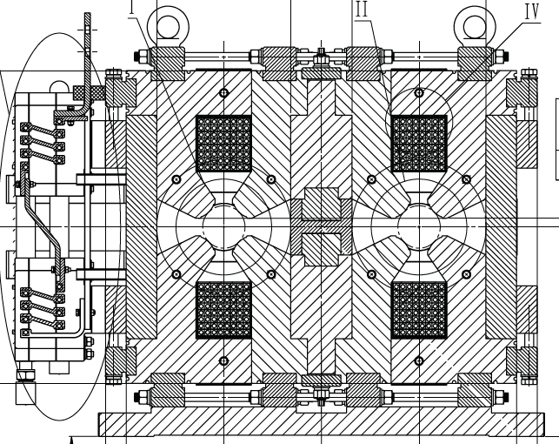
Prototype modification and field measurement results
Magnet assembly errors（tolerance:±0.05mm)
  Complex structure: laminated of two kinds, shared main coils;
  Large magnet blocks, long iron length, slender poles.
  The final assembly is out of tolerance.
Gap errors between poles
Iron model
Cross section of DAQ

Slide 14
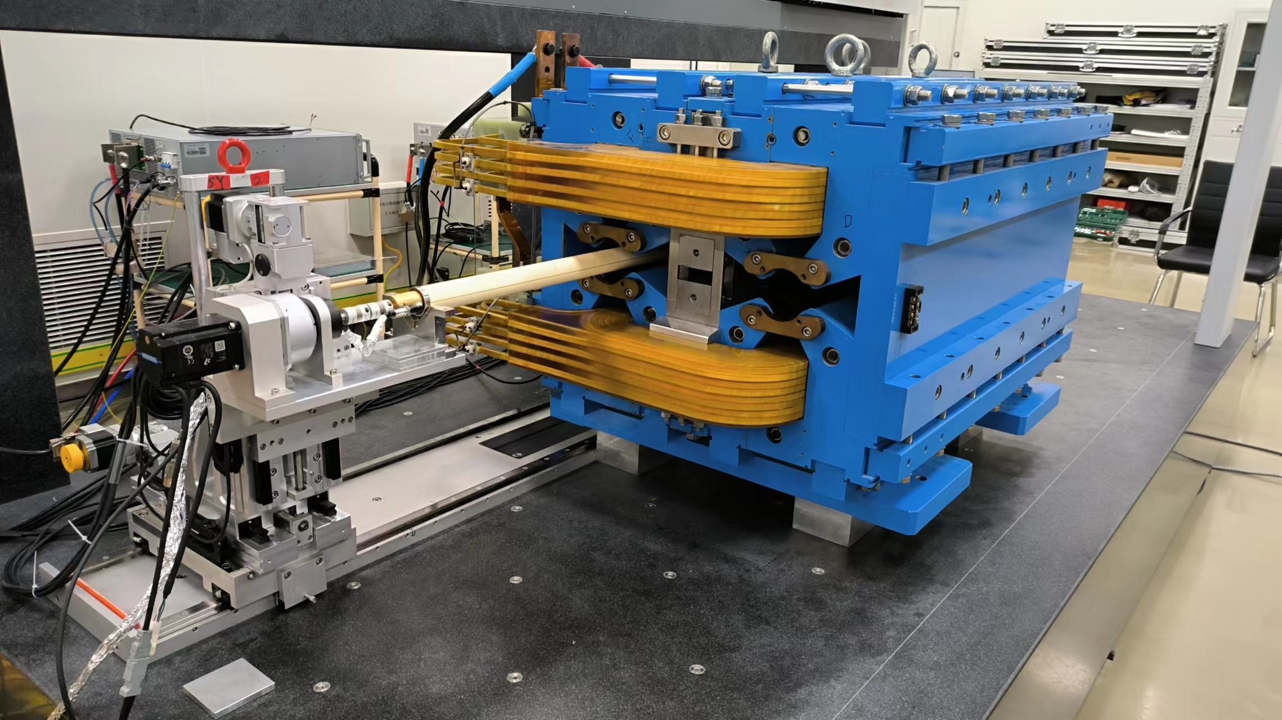
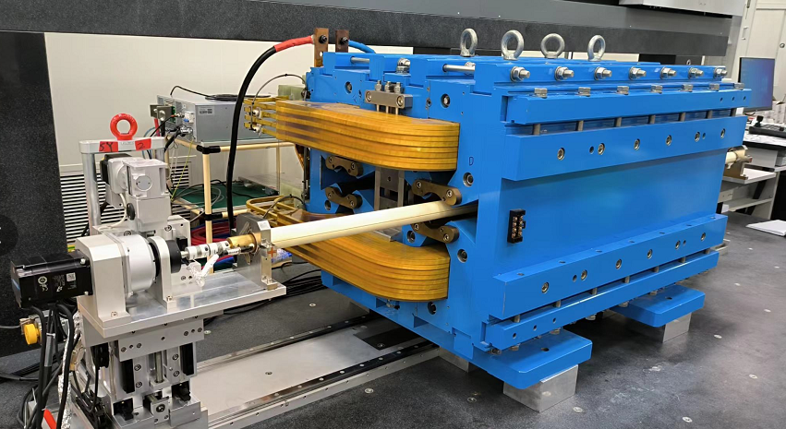
Prototype modification and field measurement results
Field measurements with rotating coil measurement system
  Aperture A: F polarity
  Aperture B: D polarity
Aperture A
Aperture B

Slide 15
Prototype modification and field measurement results
RCS results—Integral transfer function
  GL difference in two apertures ：<0.2%
  Similar transfer function in two apertures.
  The efficiency is about 97.8%, not saturated.

Slide 16
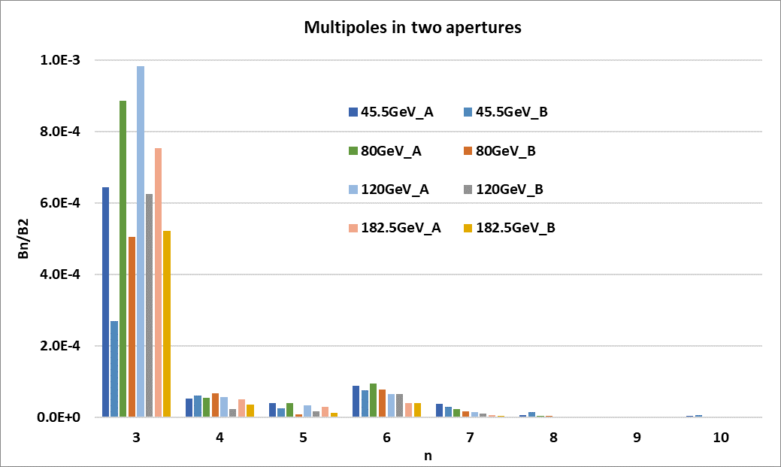
Prototype modification and field measurement results
Harmonics:
  Higher harmonics: less than 3 units, except sextupole component.
  Possible reasons:
    Large mechanical assemble errors;
    Iron deformation;
    Cross talk effect is not compensated completely.
  Possible solutions:
    Adjust the compensate blocks.
    Magic finger to adjust the field.

Slide 17
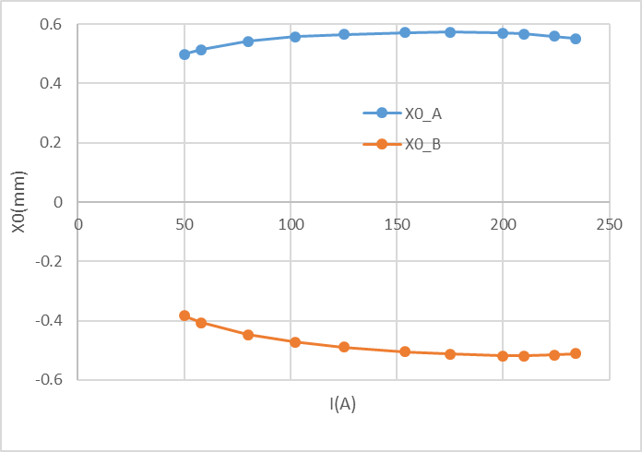
Prototype modification and field measurement results
Shift of magnetic center with energy
  X0_A varies 0.056mm，X0_B varies 0.105mm
  Possible reason: incomplete compensation;
  iron properties different.
  Y0_A varies 0.04mm
  Possible reason: Busbars’ location.
X0 shift with I
Before
dx_A=1.7mm
dx_B=2.0mm
Modified

Slide 18
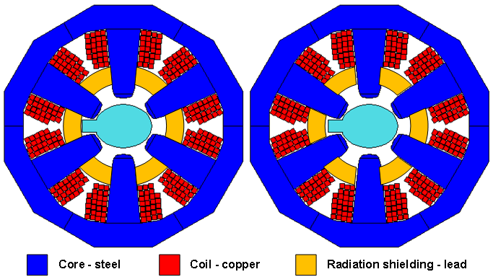
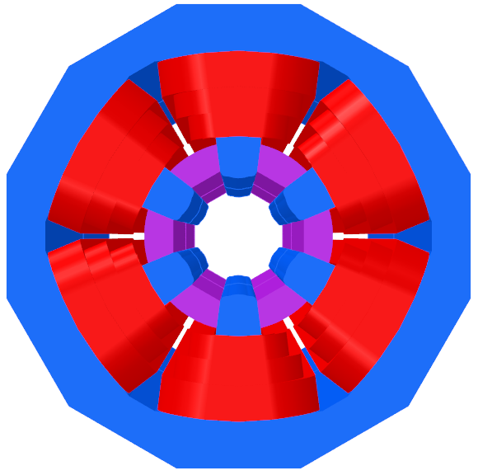
Sextupole magnet design
Two single aperture sextupoles are installed side by side.
  Core size is limited by the 350mm beam center separation.
  Use copper for coils & enlarge the cross section as much as possible.
  10mm gap between two magnets but the cross talk can be ignored.
  Field Strength: 192 T/m² @45GeV to 760 T/m² @180GeV
  Wedge-shaped magnetic poles are used to reduce magnetic pole saturation and improve excitation efficiency.
Further design will be done according to the new specifications.
  3D work ongoing
  Structural analysis
CDR

Slide 19
Summary
A full-scale DAD prototype is built. The field measurement will be done to test the magnet and mechanical design.
Optimization of the DAQ is used to address the magnetic axis shift, and has a good effect. Further optimization will be done to adjust the multipoles: adjust the gap height of the center shim, to compensate the cross talk effect; or add trim coils or use the correctors to adjust the x0 shift at different energies.
Sextupoles will be further designed and optimized.

Slide 20
Thanks for your attention!

