Slide 1
CEPC Magnet Design and R & D in Booster Ring
Wen Kang
The 2022 International Workshop on High Energy CEPC
2022-10

Slide 2
Contents
Specifications and subscale prototype magnets
R & D status of the full-scale CT coil dipole magnet
R & D status of the full-scale iron-core dipole magnet
Status of the field measurement system
Summary

Slide 3
Specifications and subscale prototype magnets
Main Specifications of CEPCB dipole magnets
 | BST-63B@CDR | BST-63B@TDR
Quantity | 16320 | 14866
Minimum field (Gs) | 28@10GeV | 63@20GeV
Maximum field (Gs) | 564@180GeV | 564@180GeV
Gap (mm) | 63 | 63
Magnetic Length (mm) | 4700 | 4700
Good field region (mm) | 55 | 45
Field uniformity | 1.0E-3 | 1.0E-3
Field reproducibility | 5.0E-4 | 5.0E-4

Slide 4
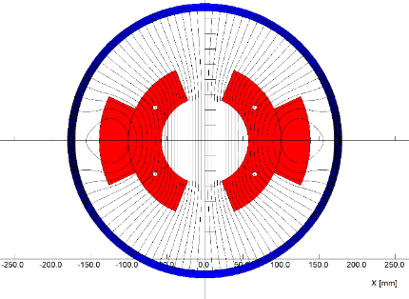
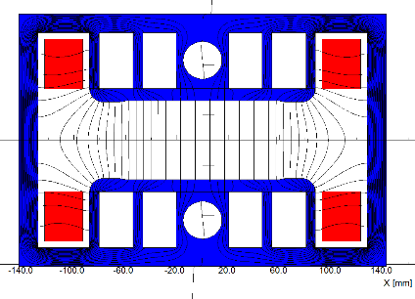
Specifications and subscale prototype magnets
Field quality of two subscale prototype dipole magnets
 | CT coil dipole | Iron-core dipole
Gap (mm) | 63 | 63
Magnetic Length (mm) | 1400 | 1400
Good field region (mm) | 55 | 55
Field uniformity @28Gs | 7.6E-4(√) | 3.6E-3(×)
Field uniformity @56Gs | 4.5E-4(√) | 5.3E-4(√)
CT coil dipole
Iron-core dipole
The test results of the subscale prototype dipole magnets showed that both the CT coil dipole magnet and iron-core dipole magnet could work well when the min. working field increases to 56 Gs.
To explore the processing technologies of the production, two full-scale prototype dipole magnets are designed and developed.

Slide 5
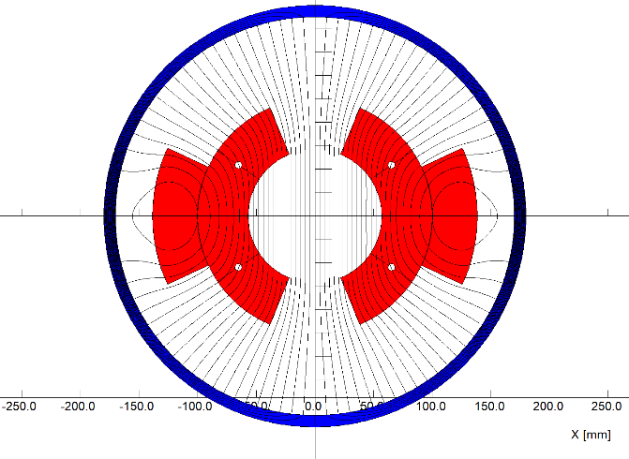
Status of the full-scale prototype CT coil dipole magnet
The total length of the magnet is 5.1m, it includes the coil and shielding tube.
The coil consists of two half coils, each half coil has two layers and three turns, which are formed by the pure aluminum conductors.
The shielding tube is made by a long steel tube. In order to install the coils, it can be split into upper and lower halves.
The water cooling tubes are inserted between two conductors in the inner layer of half coil.

Slide 6
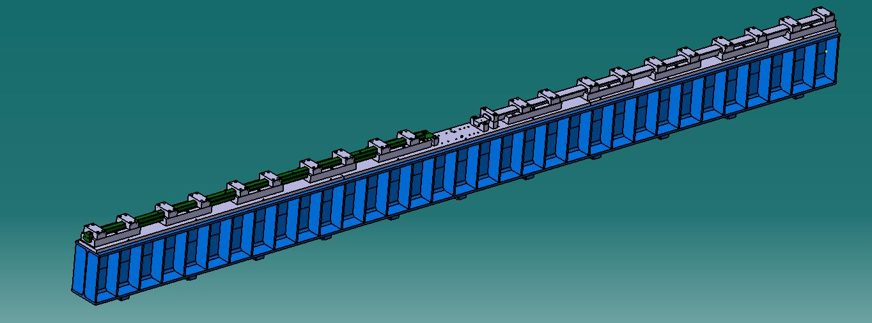
Status of the full-scale prototype CT coil dipole magnet
It is very difficult to fabricate a 5m long conductor with the size dimension tolerance less than 0.05mm, so the long conductor has to be pieced by two 2.5m short ones, of which the touch surfaces are coated with the silver film to reduce the contact resistance.

Slide 7
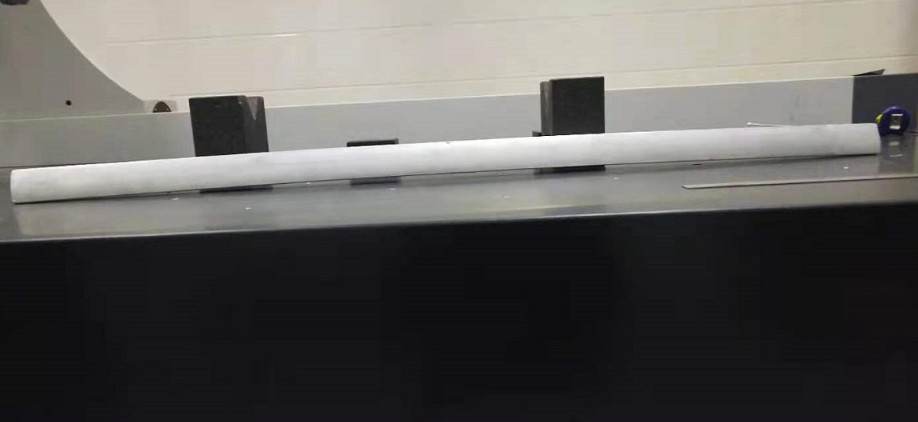
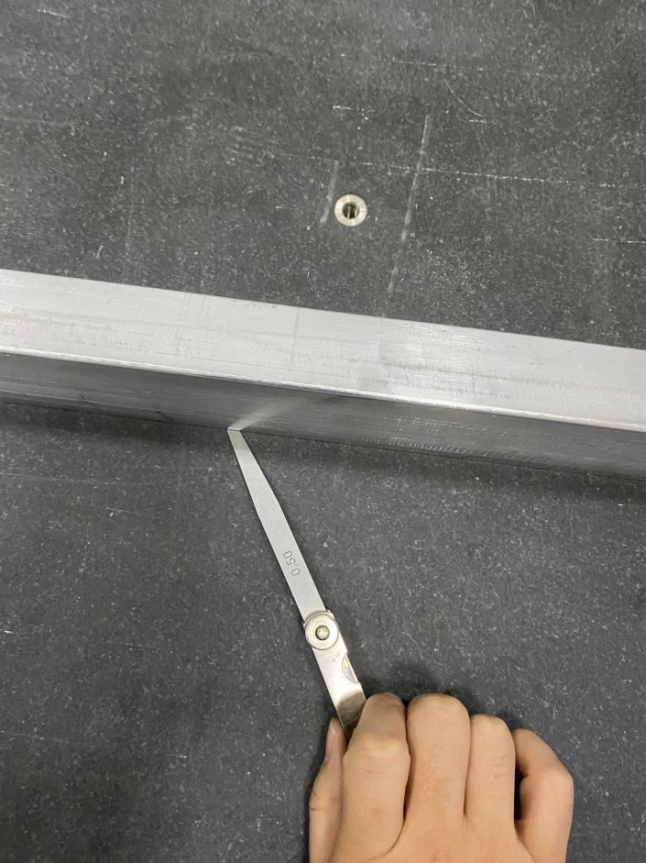
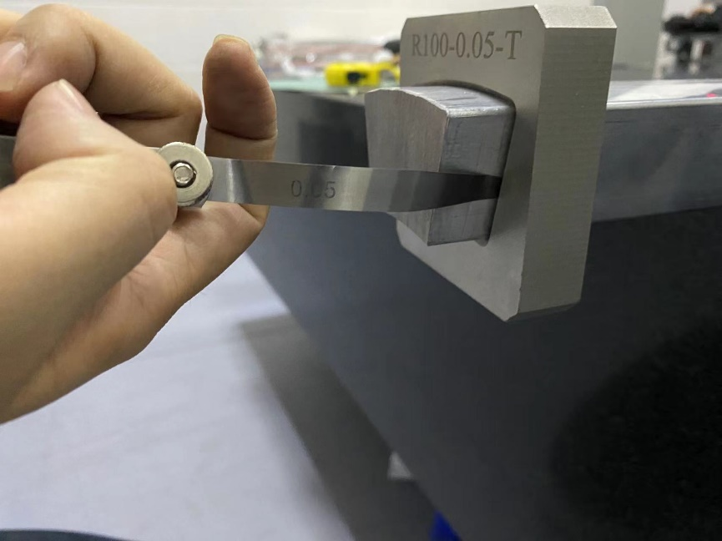
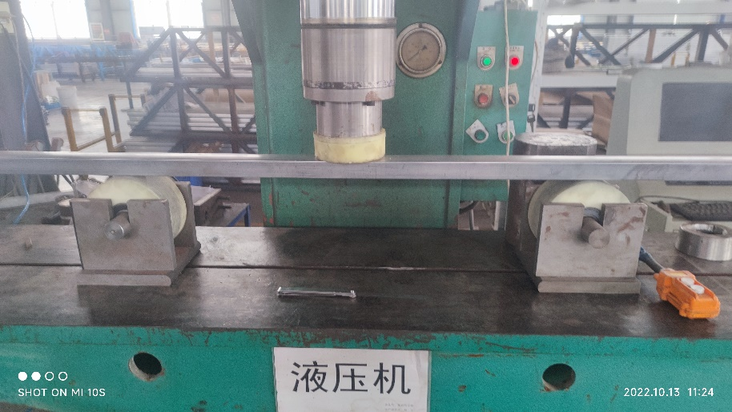
Status of the full-scale prototype CT coil dipole magnet
To reduce the production cost, the 2.5m long conductors are made by extrusion instead of by direct fabrication. But in the process of extrusion, the deformation along the conductors was found to be serious, so the conductors had to be reformed by a specially made device.
.
Before reformation
After reformation

Slide 8
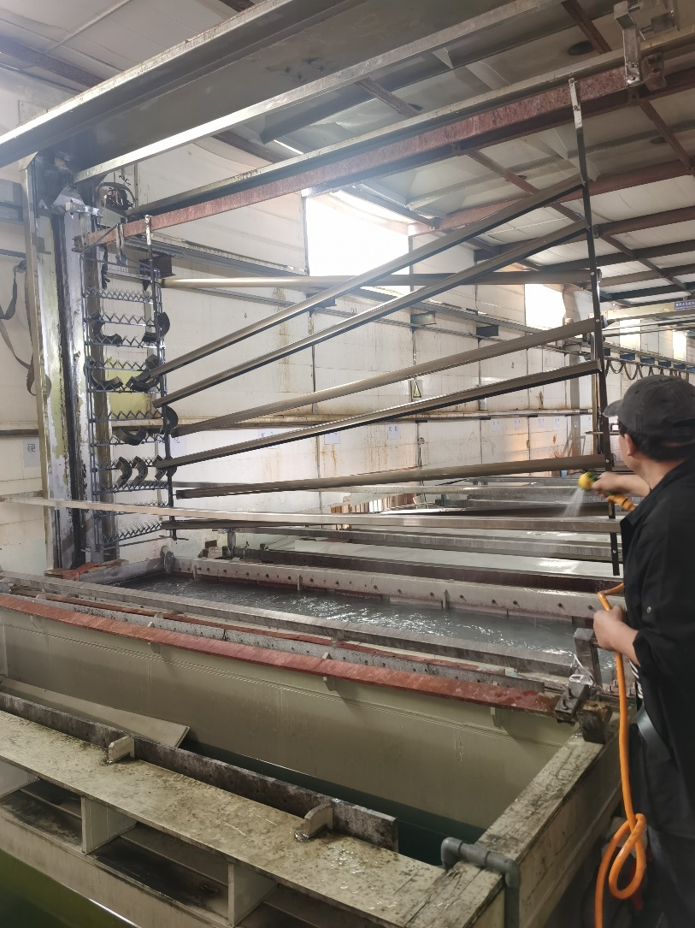
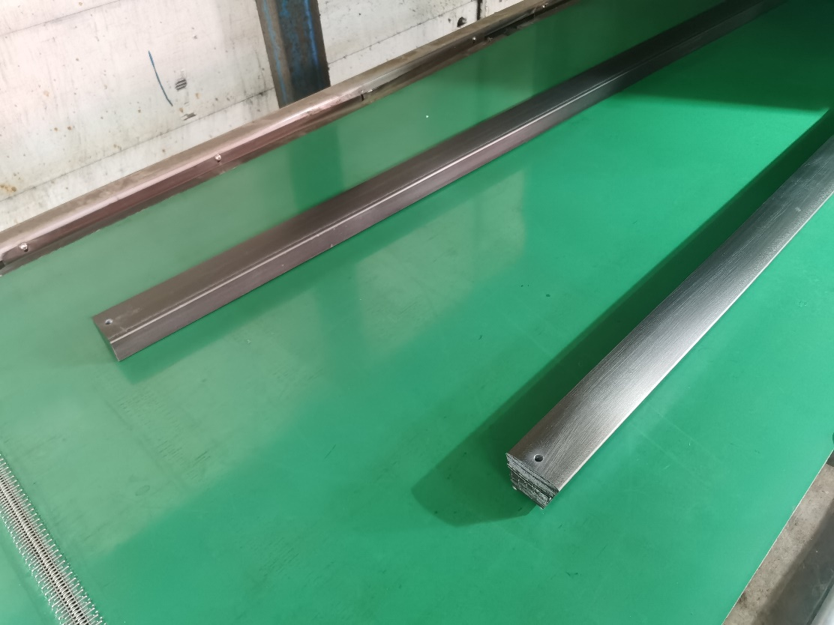
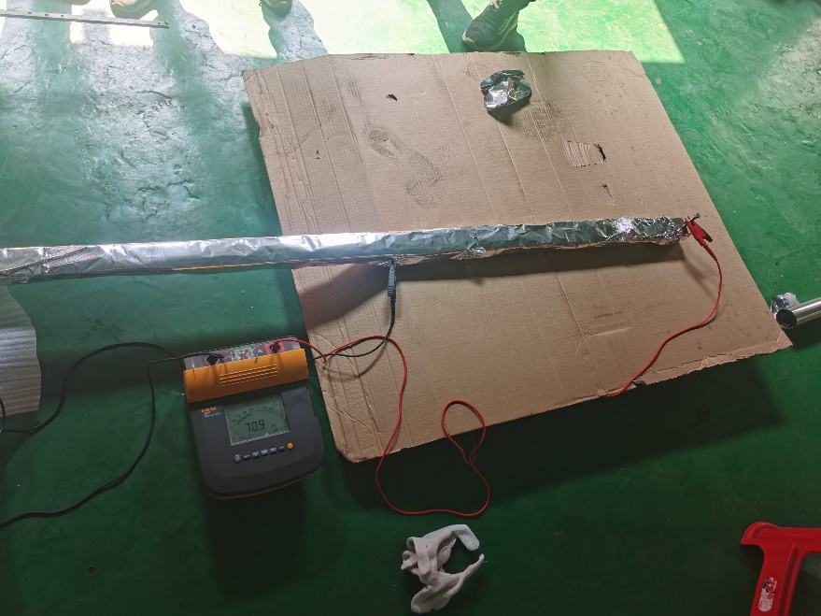
Status of the full-scale prototype CT coil dipole magnet
The insulation from turn to turn of the coils could be made by the technology of surface anodization. The insulation resistance of the anodized film is larger than 50 MΩ. The film on the touch surfaces is gotten rid of before coated with silver film.

Slide 9
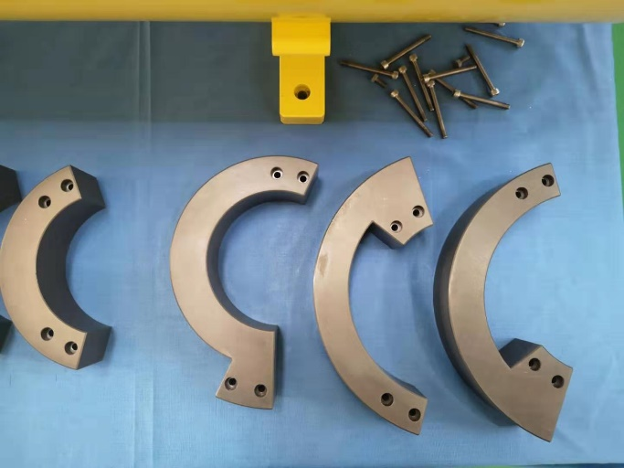
Status of the full-scale prototype CT coil dipole magnet
The conductors of the coils from turn to turn are connected by the by-pass circular conductors at the ends of the magnet. The water cooling tubes are inserted between two inner turns and led out at one end of the magnet.

Slide 10
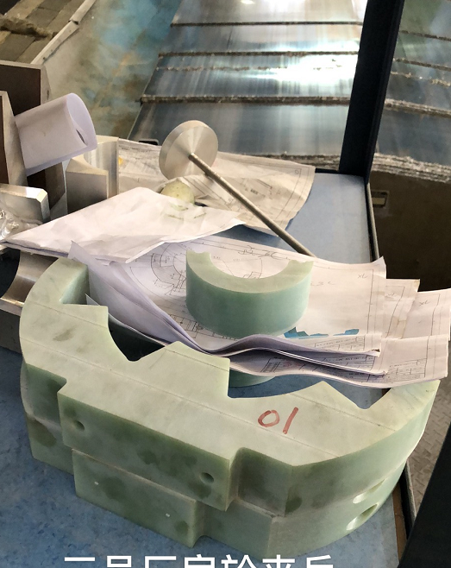
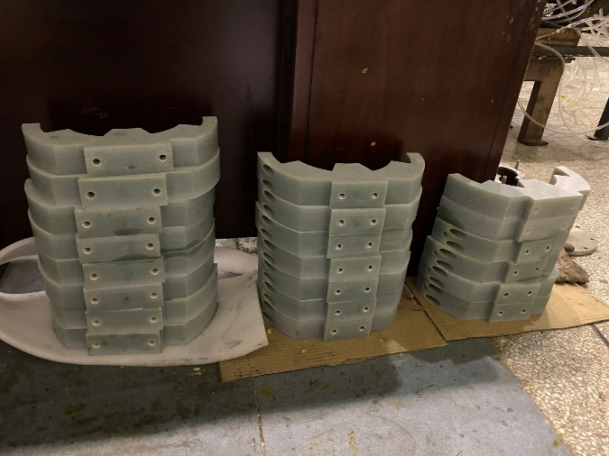
Status of the full-scale prototype CT coil dipole magnet
To insure the conductors of the coils at their right position, the supporters every 415mm in longitudinal direction are assembled. The positions of the shielding tube that support the supporters of the coils are machined carefully and precisely.

Slide 11
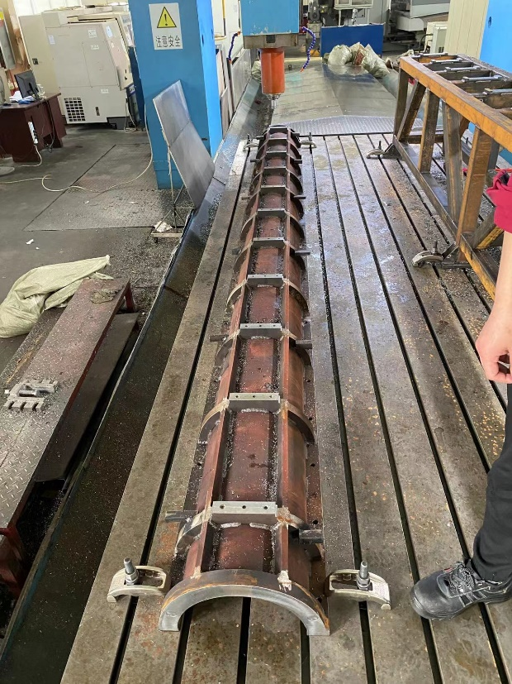
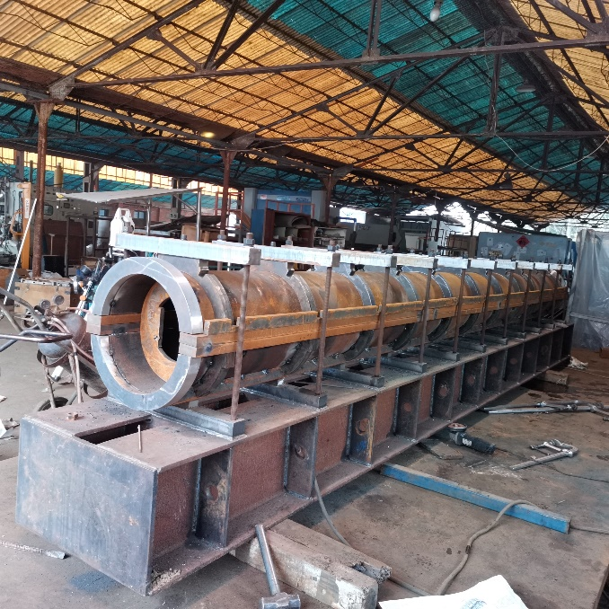
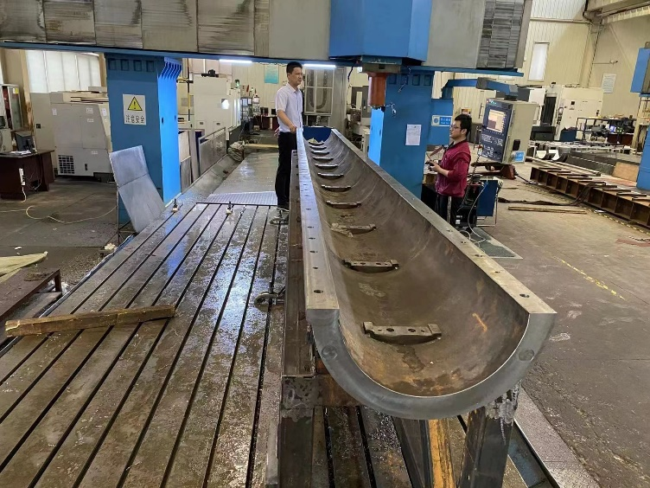
Status of the full-scale prototype CT coil dipole magnet
In the assembly process, the lower coil is directly installed in the lower shielding tube, the upper half coil should be firstly assembled in an assembling tooling and then rotated 180 degree. After it is put together with the lower coil, the upper shielding tube is assembled with the lower one by the same assembling tooling.

Slide 12
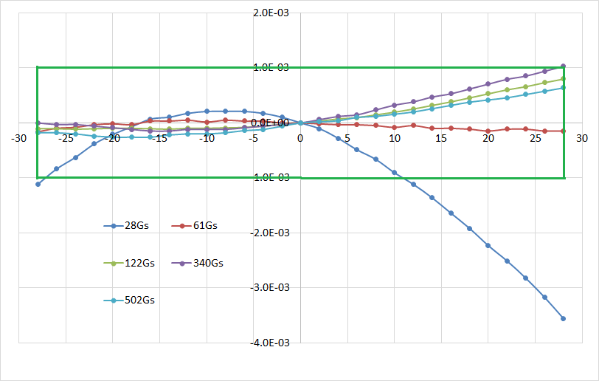
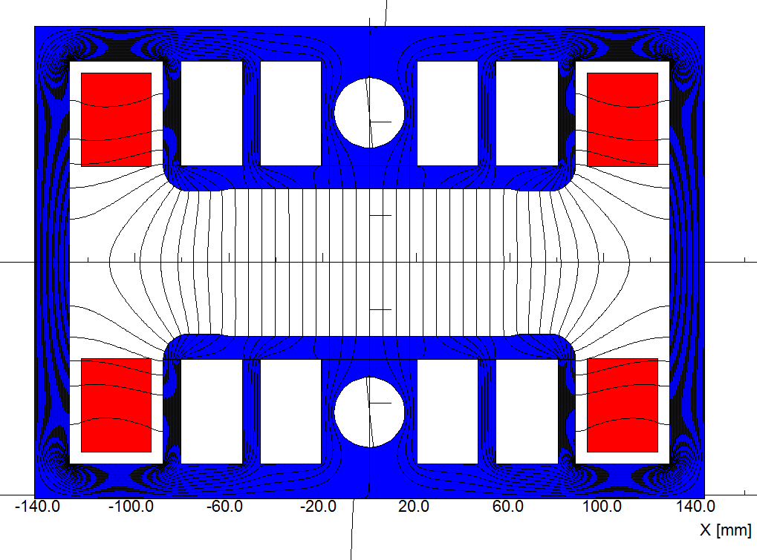
Status of the full-scale prototype iron-core dipole magnet
The key advantages of the iron-core dipole magnet are low cost and low power loss. But its field uniformity could meet the requirement only if the min. working field increases to 56Gs@20GeV.
So in the TDR stage, the injection energy of the booster was increased from 10GeV to 20GeV, the iron-core dipole magnet became the baseline design for the CEPC booster.
If the injection energy of the booster is increased to 30GeV, the non-oriented steel laminations with lower price can be used to produce the magnet cores to reduce the magnet cost further.

Slide 13
Status of the full-scale prototype iron- core dipole magnet
To reduce the influence of earth field, a closed H-type core frame is chose.
To reduce the influence of remnant field, the oriented silicon steel laminations with low remnant field have to be used to make the cores of the magnet.
Of course, if the energy of the booster is increased to 30 GeV, the non-oriented steel laminations can be used to make the cores.
To reduce the cost and weight of the magnet, the technologies of core dilution are adopted and the material of aluminum not copper is used to make the coils.

Slide 14
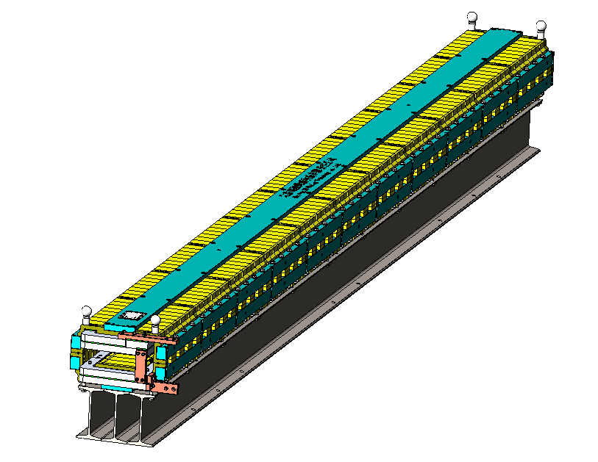
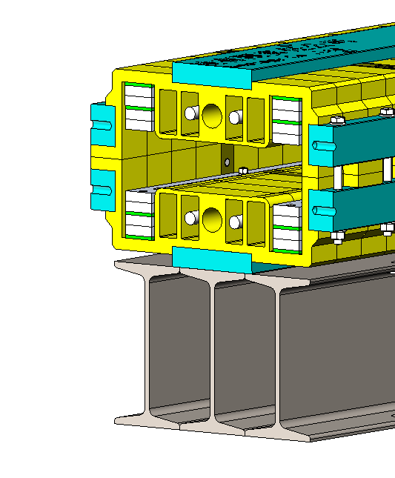
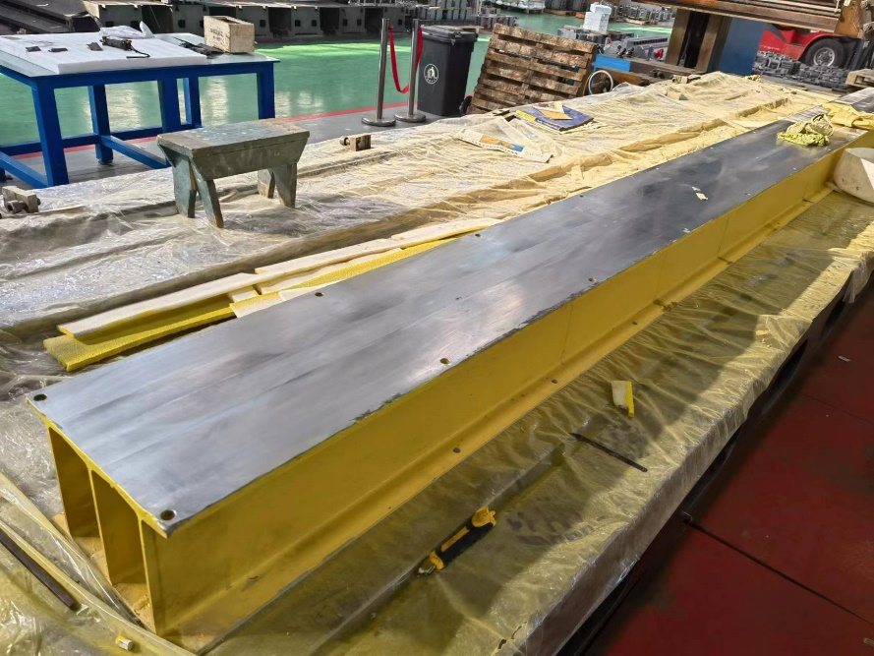
Status of the full-scale prototype iron- core dipole magnet
The length of the full-scale iron-core dipole magnet is 4.7m, which can be spit into upper and lower parts for the coil installation.
To reduce the deformation in longitudinal direction, the magnet is put on a long I-steel beam which has a precisely machined surface.

Slide 15
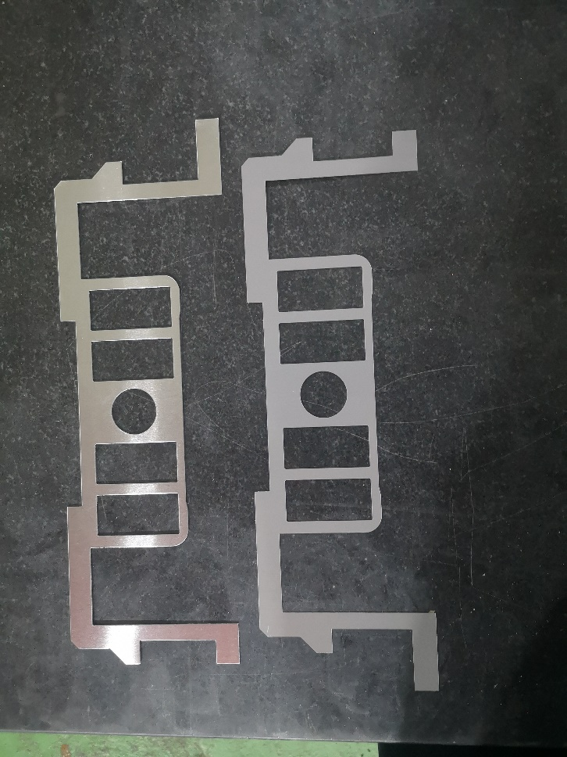
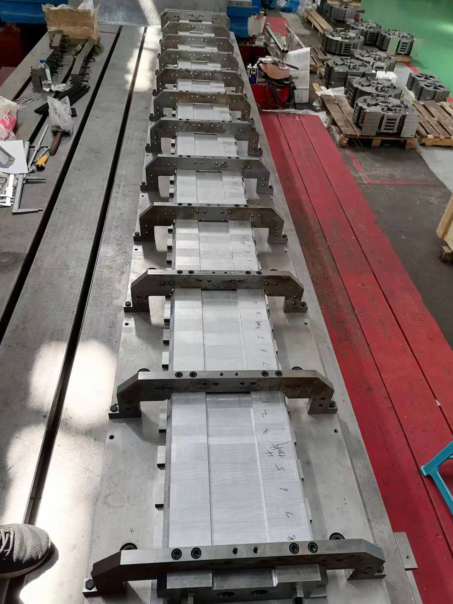
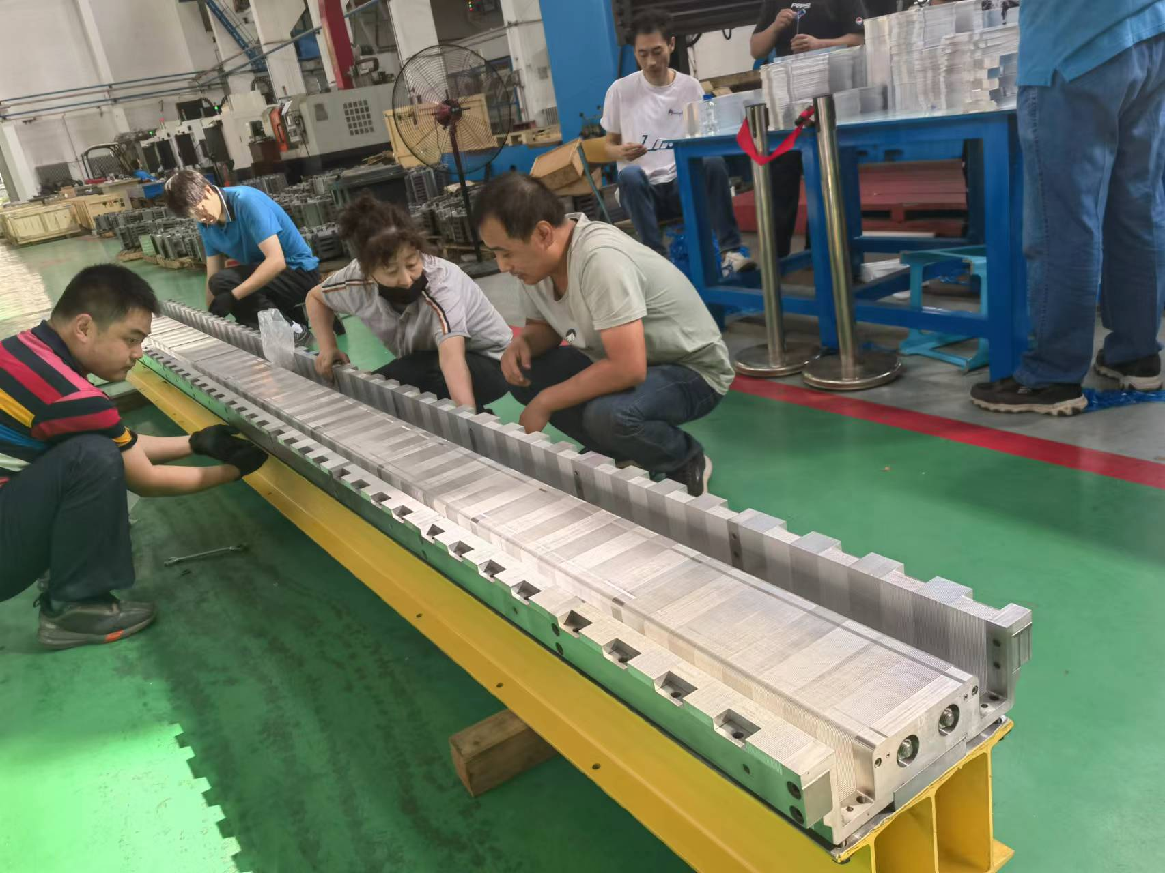
Status of the full-scale prototype iron- core dipole magnet
The half cores are stacked by the silicon steel laminations and aluminum laminations with the ratio of 1:1. The laminations are pulled together by the surrounding metal bars. After the lower half core stacked on the stacking die tooling, it is rotated 180 degree with the I-steel beam on it.

Slide 16
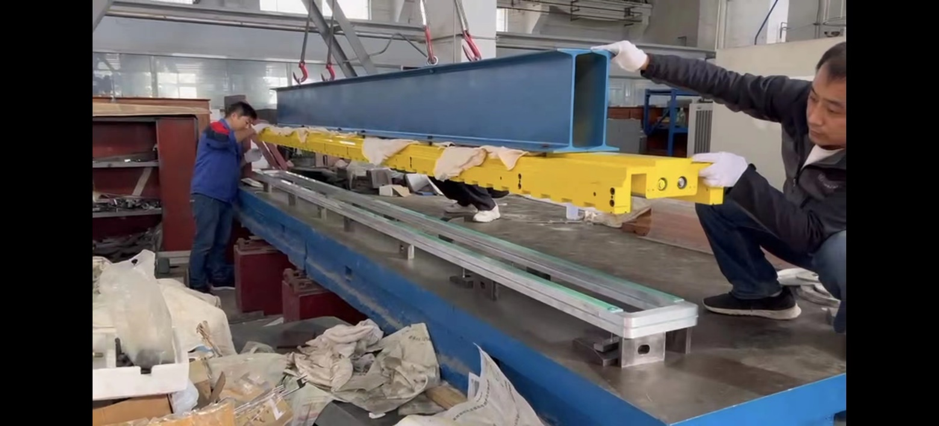
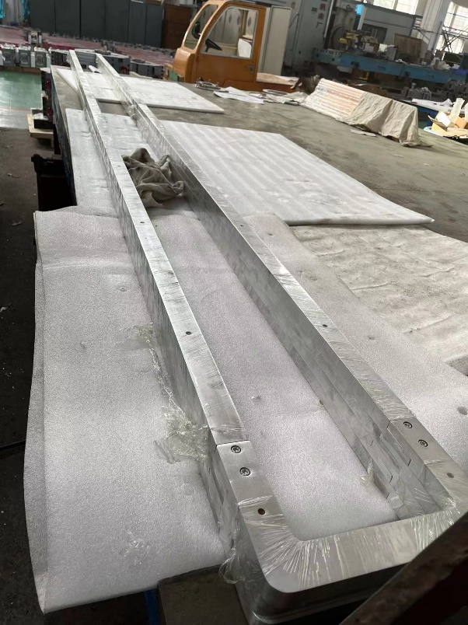
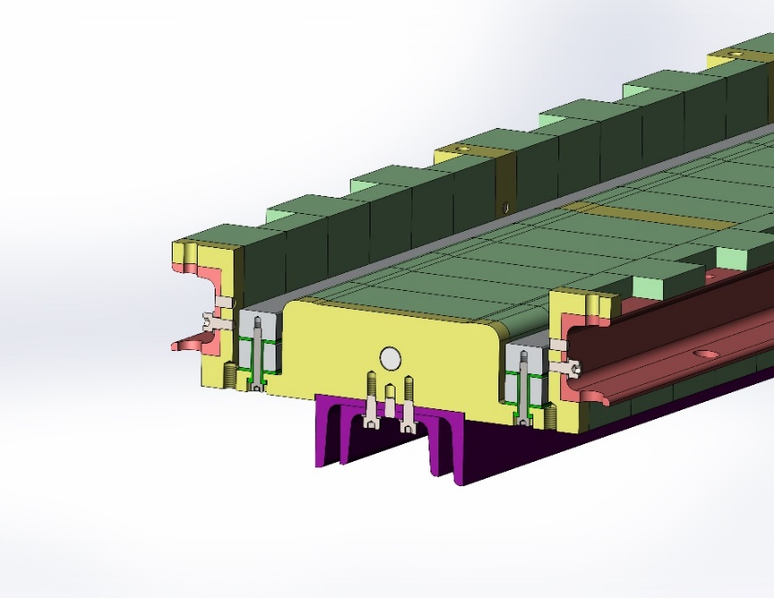
Status of the full-scale prototype iron- core dipole magnet
The magnet has two coils, each coil has two turns, which are formed with several pieces of the aluminum bars
Unlike the conventional vacuum epoxy casting, the insulation either between the turns or between coil and iron-core are simply made by G10 plates.
By using some kind of special structure, the coils can be simply fixed on the iron cores.

Slide 17
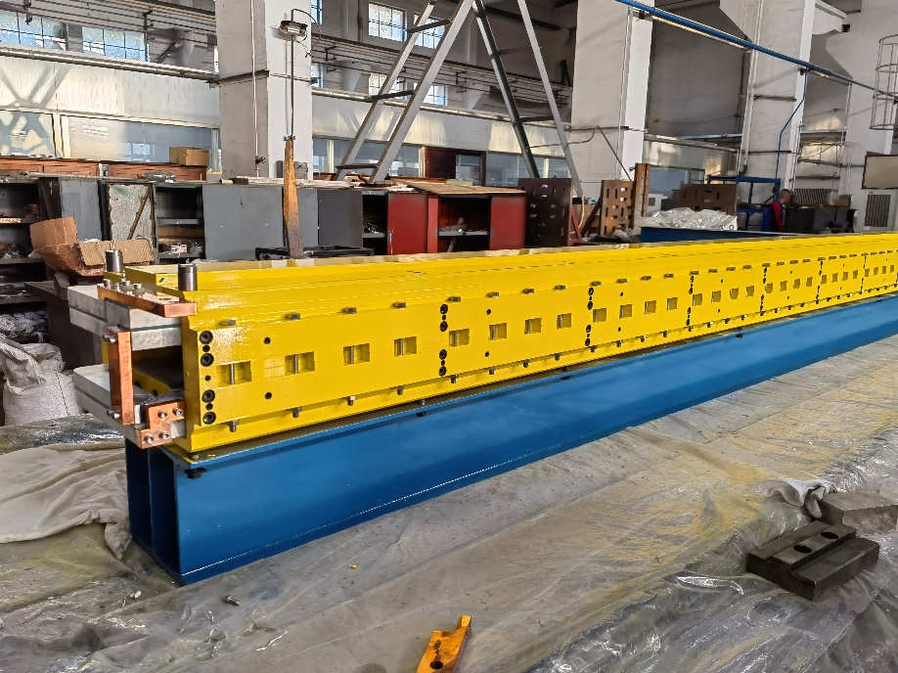
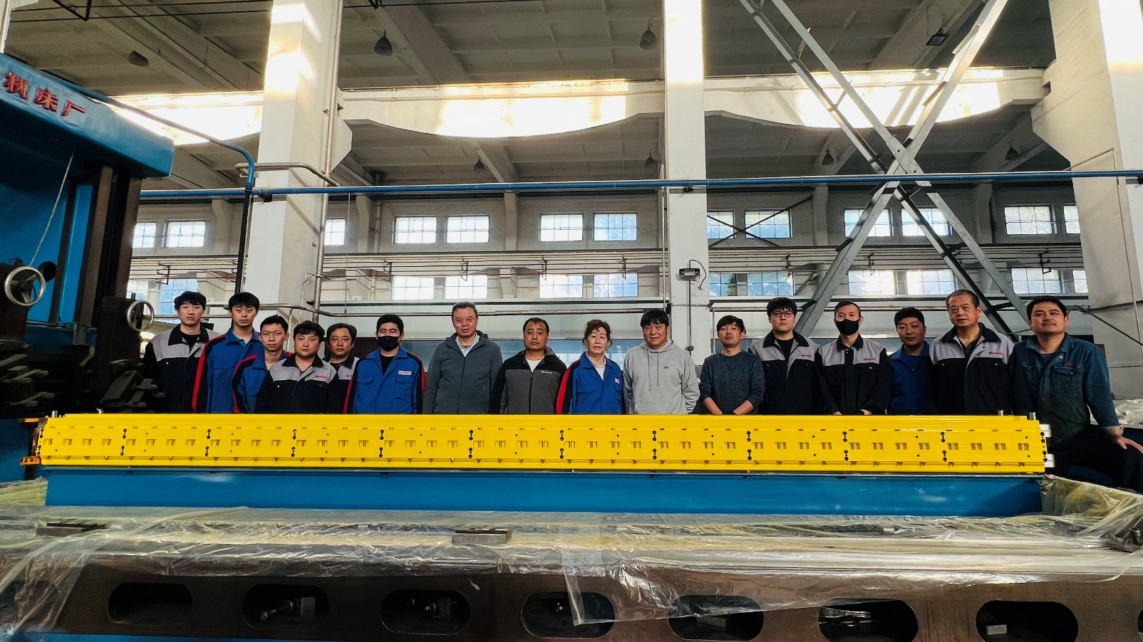
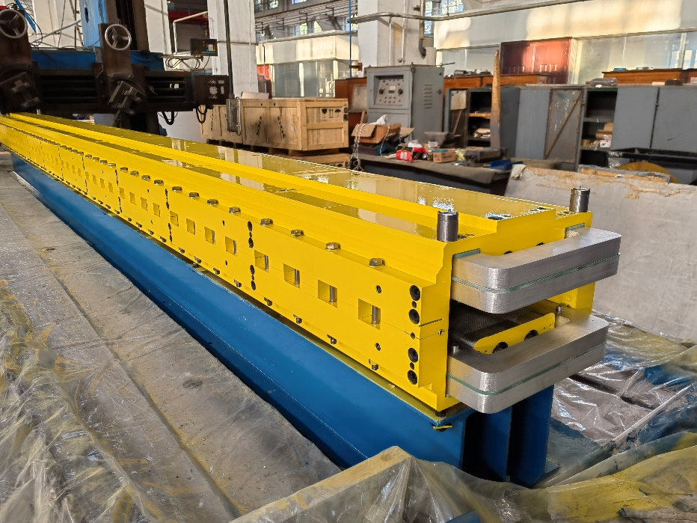
Status of the full-scale prototype iron- core dipole magnet
After two coils are installed in the two half cores, they are assembled together and then the production of the magnet is completed. The field performance of the magnet will be tested in the future months.

Slide 18
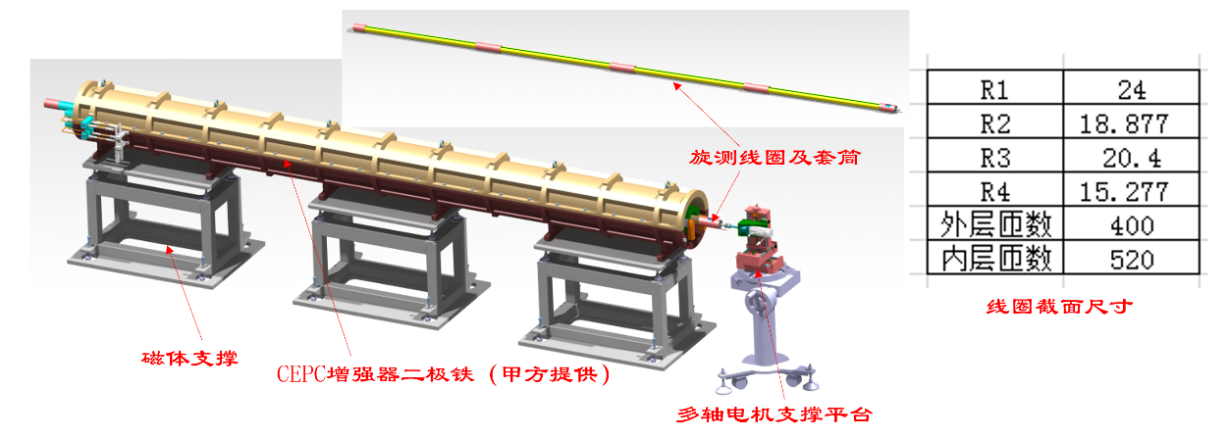
Status of the field measurement systems
To measure the field of two full-scale prototype dipole magnets, a long rotating coil field measurement system and a long hall probe field measurement system are developed.
The rotating coil system is composed of
1、Long coil
2、Motor and Driver
3、Encoder
4、Motor control
5、Signal acquisition device

Slide 19
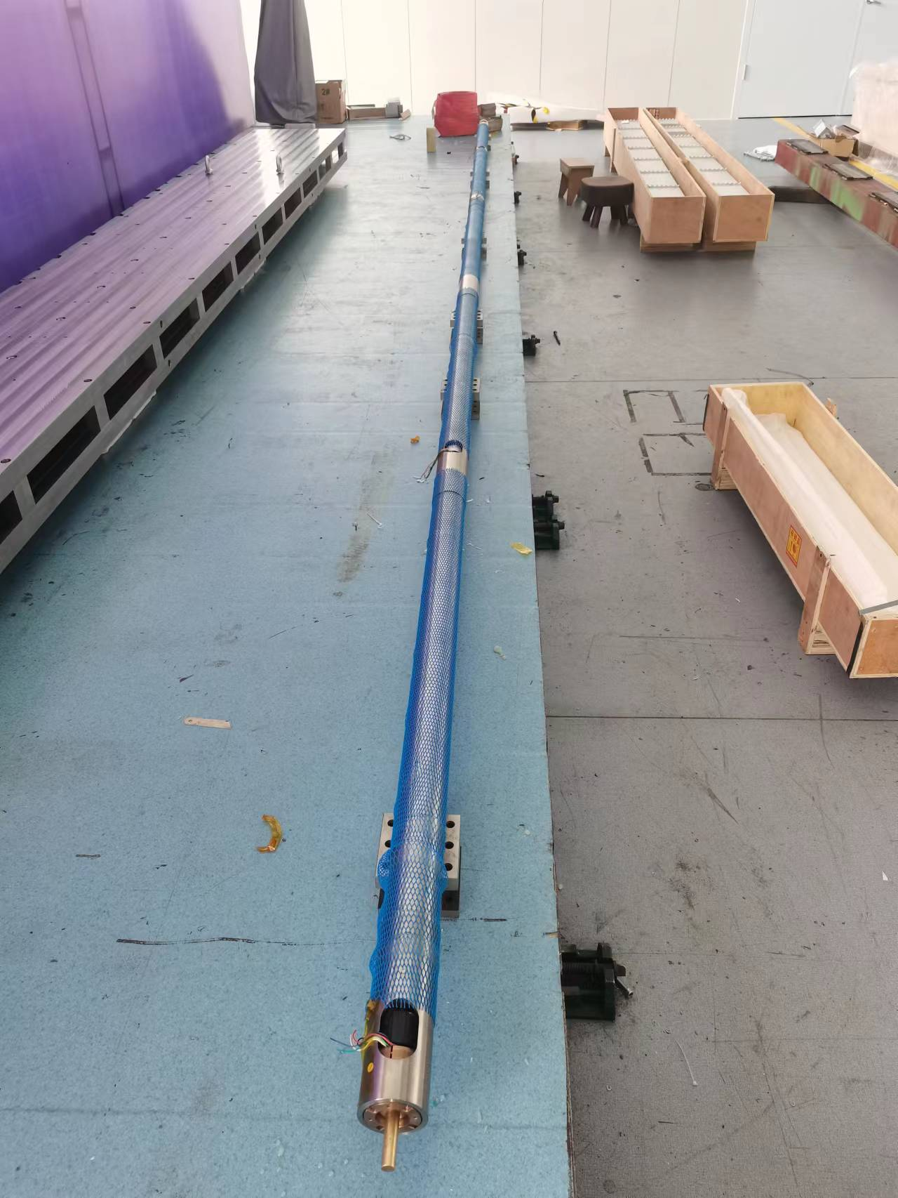
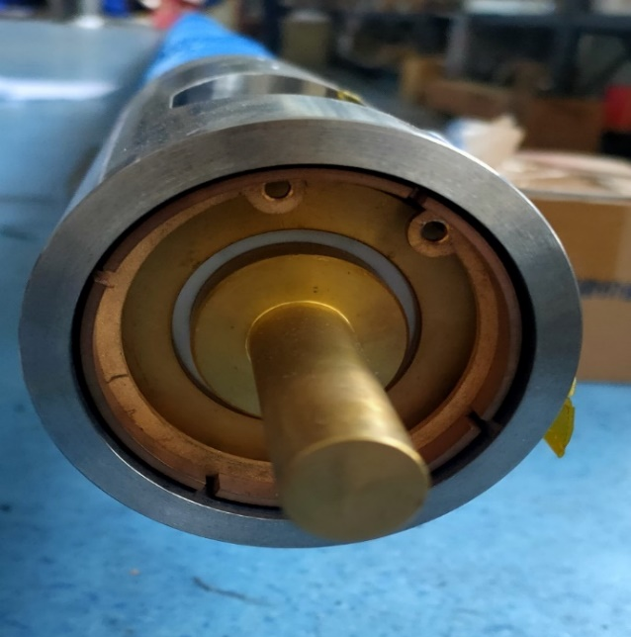
Status of the field measurement systems
The total length of the coil is 5.6m, which will be assembled with 4 sub-coils. The whole coil is installed in a supporting tube.
All the components of the measurement system are completed, they will be delivered to the lab to set up the system in future months.

Slide 20
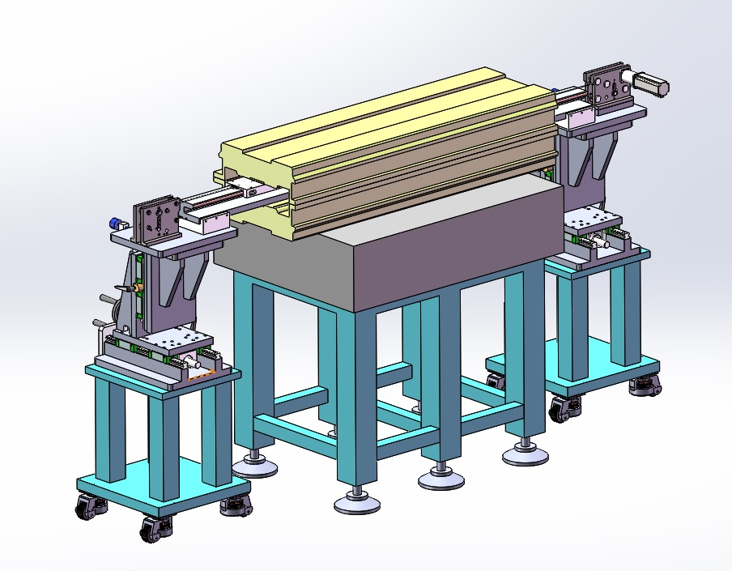
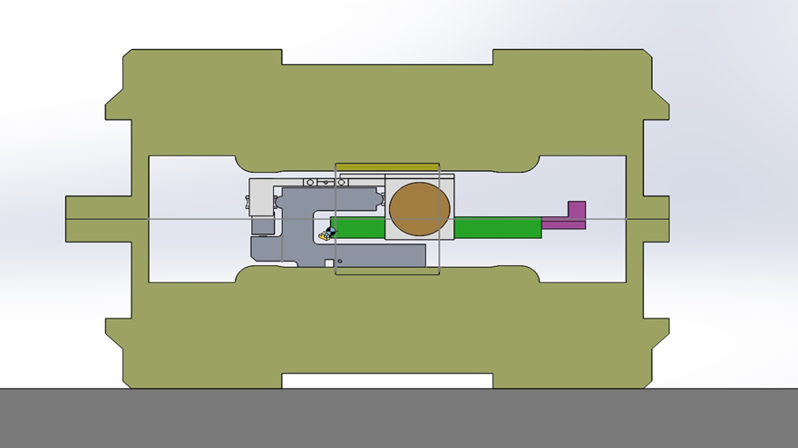
Status of the field measurement systems
The hall probe field measurement system is composed of a 6m long slide rail, a trolley, a gauss meter and a computer. The slide rail is supported on the pole surface of the magnet, the gauss meter is carried by the trolley to move along the slide rail.

Slide 21
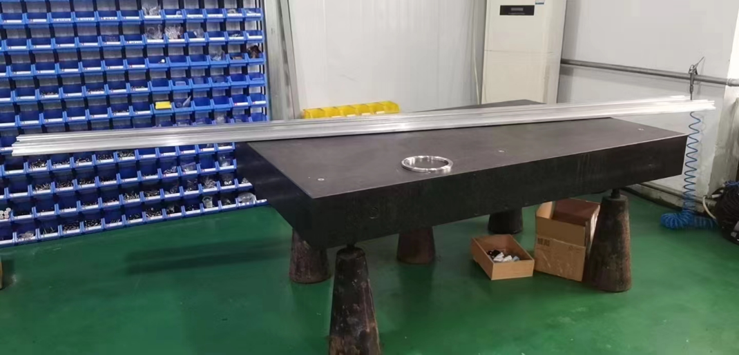
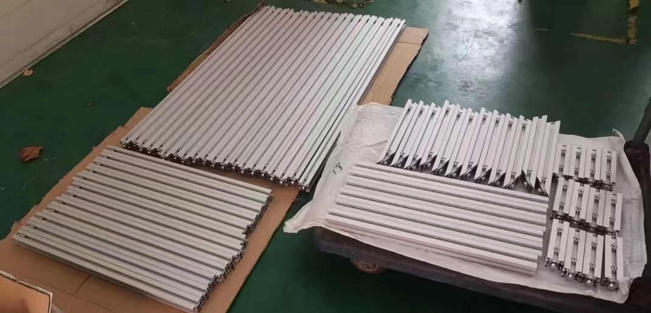
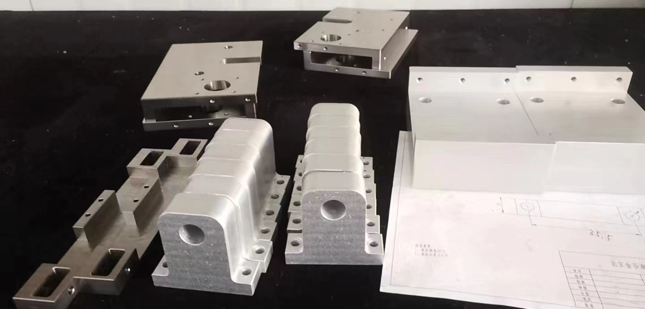
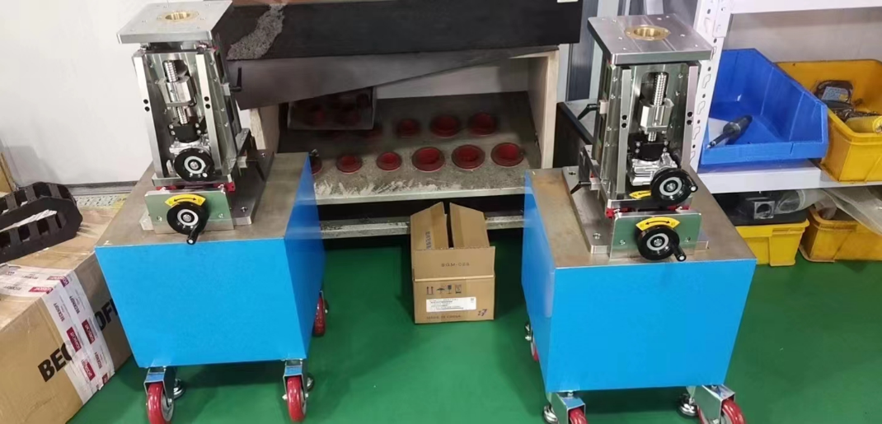
Status of the field measurement systems
Because the 6m long slide rail is too long to be produce precisely, it is pieced by three short ones.
All the components of the measurement system are completed, they will be delivered to the field measurement lab to set up the system in future months.

Slide 22
Summary
Both the CT coil dipole magnet and iron-core dipole magnet could work well when the min. working field increases to 56 Gs. To explore the processing technologies of the production, two full-scale prototype dipole magnets are designed and developed.
The most components of the full-scale CT dipole magnet are finished, it is expected that the whole magnet will be completed by the end of this year.
The production of the full-scale iron-core dipole magnet is completed, it will be delivered to the lab to check the field performance.
Two sets of the field measurement systems are developed, all the components have been produced and will be delivered to the lab to set up in future months.

Slide 23
Thank you for your attention.

