Slide 1


Superconducting quadrupoles design and R&D status for CEPC
Yingshun Zhu, Chuang Shen, Xiangchen Yang, Ran Liang
Institute of High Energy Physics, Chinese Academy of Sciences
Oct. 25, 2022
International workshop on CEPC

Slide 2
Outline
Introduction
Superconducting quadrupoles design in CEPC high
luminosity scheme
R&D status of 0.5m single aperture short model quadrupole
Summary

Slide 3
Introduction
CEPC is a Circular Electron Positron Collider with a circumference about 100 km, beam energy up to 120 GeV (Higgs) proposed by IHEP.
To greatly squeeze the beam for high luminosity, compact high gradient final focus quadrupole magnets are required on both sides of IP points.
TDR requirements of CEPC Final Focus quadrupoles are based on L* of 1.9 m, beam crossing angle of 33 mrad.
Table 1: TDR requirements of Interaction Region quadrupole magnets for Higgs
Magnet | Central field gradient (T/m) | Magnetic length (m) | Width of GFR (mm) | Outer diameter of beam pipe (mm) | Dipole field | Minimal distance between two aperture beam lines (mm)
Q1a | 142.3 | 1.21 | 14.92 | 26 or 28 | <30 Gs | 62.71
Q1b | 85.4 | 1.21 | 18.17 | 31 | <30 Gs | 105.28
Q2 | 96.7 | 1.5 | 24.48 | 40 | <30 Gs | 155.11

Slide 4
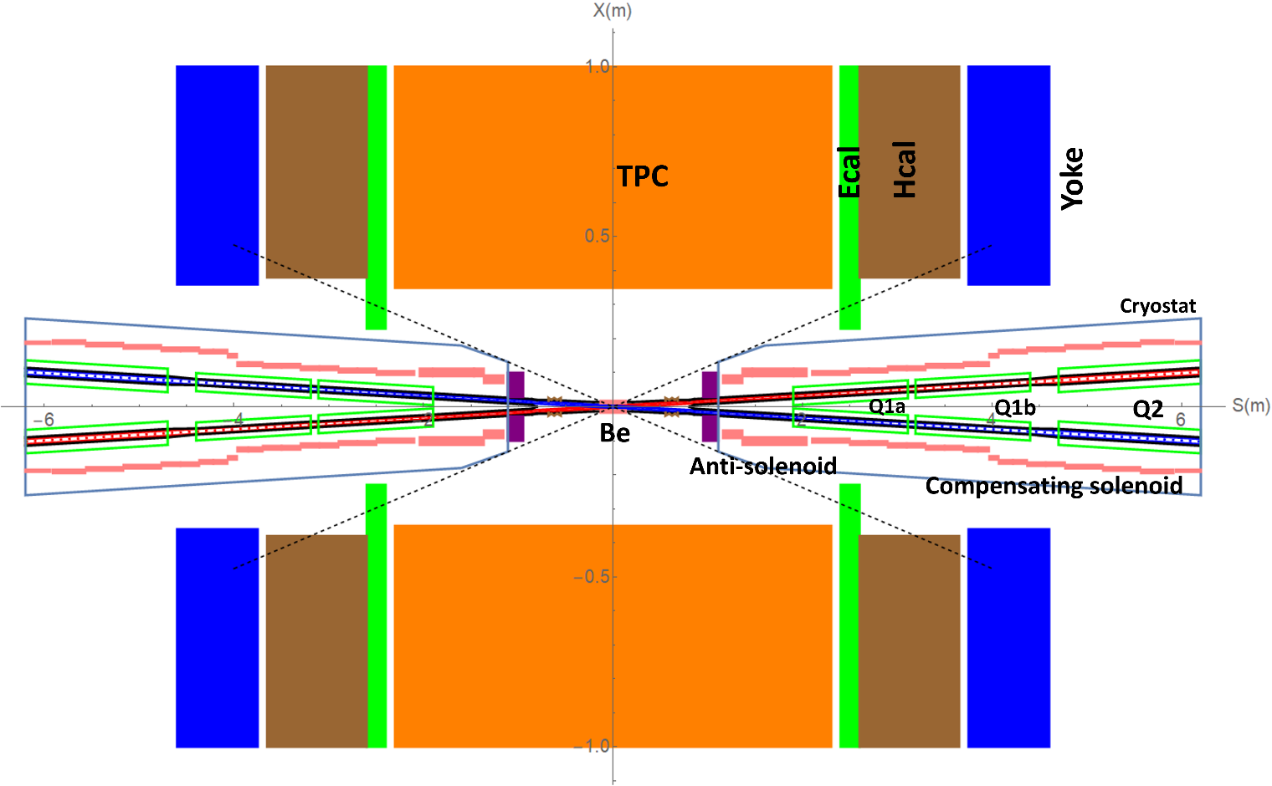
Introduction
Quadrupole magnets are operated inside the field of Detector solenoid magnet with a central field of 3.0 T.
To cancel the effect of the detector solenoid field on the beam, anti-solenoids before Quadrupole and outside Quadrupole are needed. So that total field generated by detector solenoid and accelerator anti-solenoid is zero.
Quadrupoles and anti-solenoid are in the same cryostat.
Schematic layout of IR magnets

Slide 5
Superconducting quadrupoles design in CEPC high luminosity scheme
1 Design of Q1a
Minimal distance between two aperture beam lines: 62.71 mm
Outer radius of beam pipe: 13 or 14 mm
Leaving space for helium vessel, quadrupole coil radius: 20 mm
It is challenging to meet stringent design requirement
High field gradient: 142.3 T/m
Magnetic field crosstalk between two apertures:
Dipole field <30 Gs, high order field harmonics <5×10⁻⁴
Limited radial space in the magnet middle:
R: [20mm, 31.36mm], only 11.36mm available

Slide 6
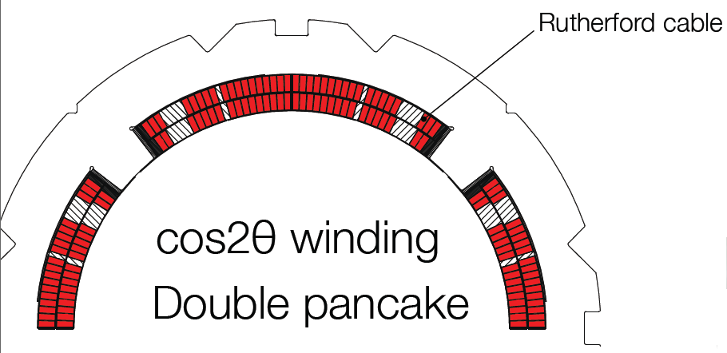
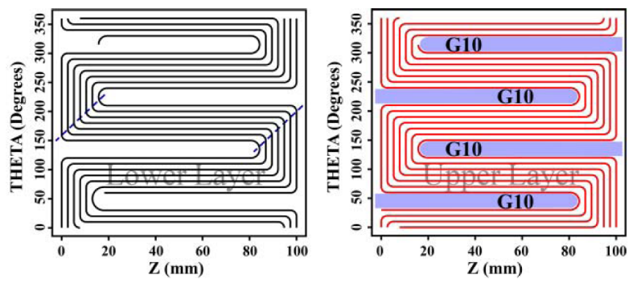
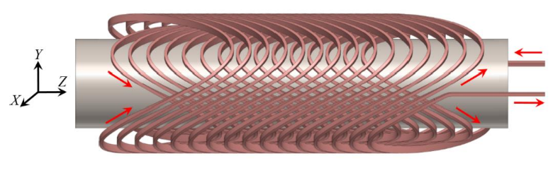
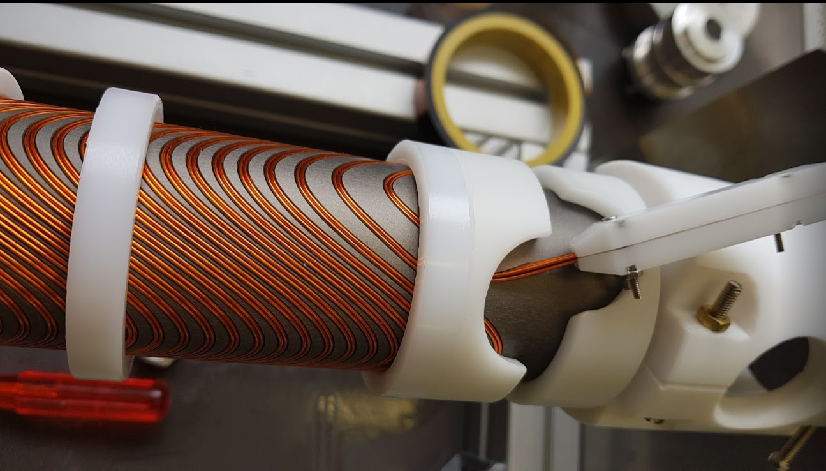
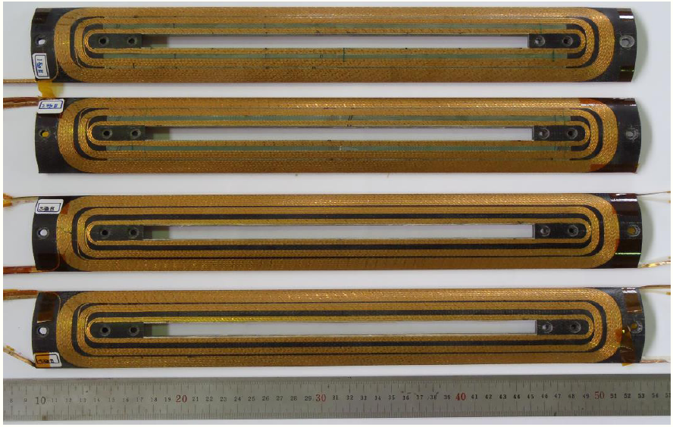
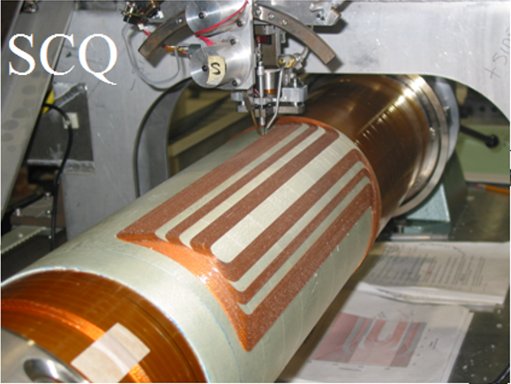
Design of Q1a
Magnetic design of Q1a with 3 kinds of quadrupole coil structures, including cos2θ coil, CCT coil, and Serpentine coil.
Cos2θ coil
(SuperKEKB)
CCT coil
(FCC-ee)
Serpentine coil
(BEPCII)

Slide 7
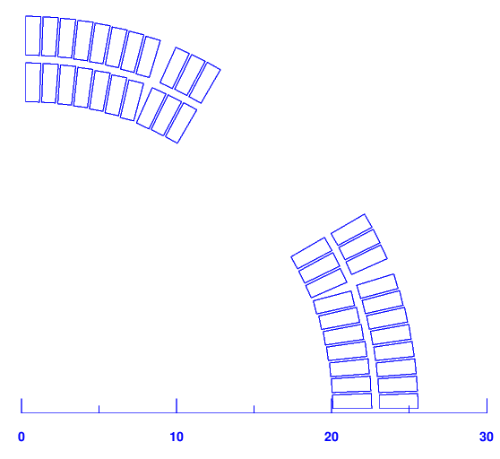
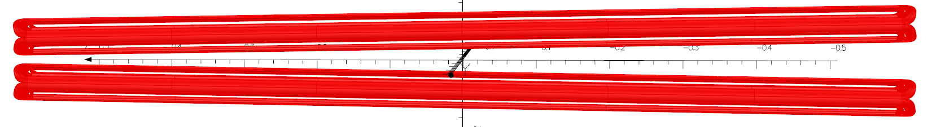
Design of Q1a
1) Cos2θ option of Q1a
Round 0.5mm strand, HTS Bi-2212 or LTS NbTi
Two layers cos2θ quadrupole coil using Rutherford, with 10 NbTi strands.
The inner diameter of the coil is 40mm.
Single aperture cross section is optimized with four coil blocks in two layers.
Width of the cable is 2.5mm, 21 turns in each pole.
Option 1: Iron free design
Field crosstalk between two apertures introduces a dipole field, >1000 Gs;
Cannot meet all design requirements: dipole and high order field harmonics
(anti-symmetric coil, add corrector coil, etc.)

Slide 8
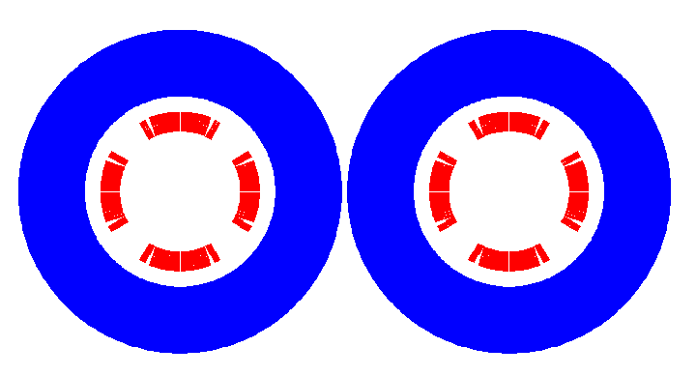
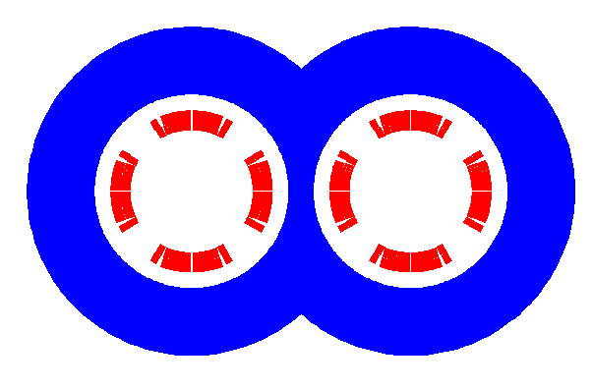
Design of Q1a
Option 2: With iron design
Iron yoke FeCoV with high saturation field is added outside the coil, to enhance the field gradient, reduce the coil excitation current, and shield the field crosstalk
Not enough space to place two single apertures side by side
Compact design: Iron core in the middle part is shared by two apertures

Slide 9
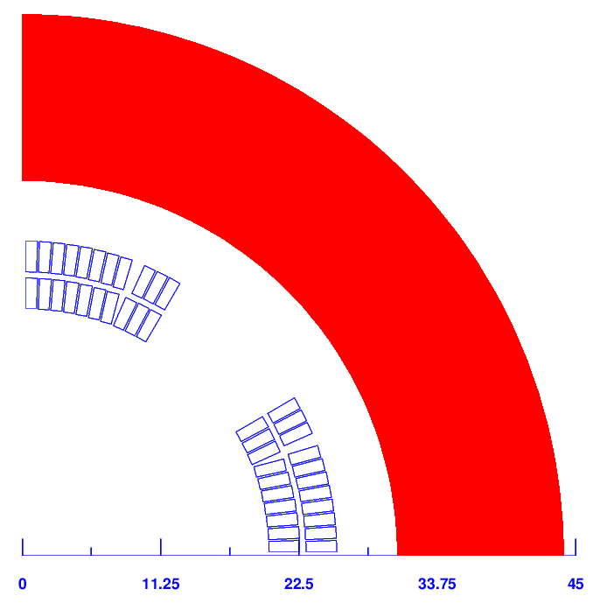
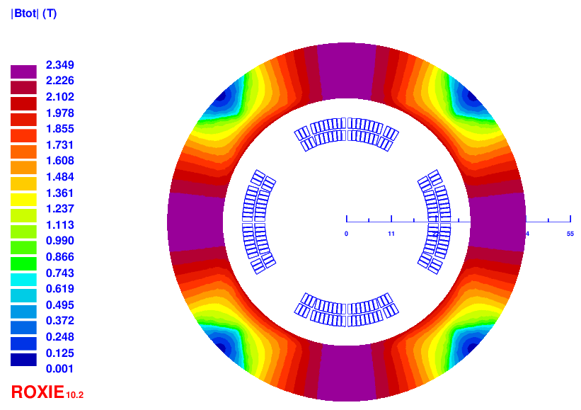
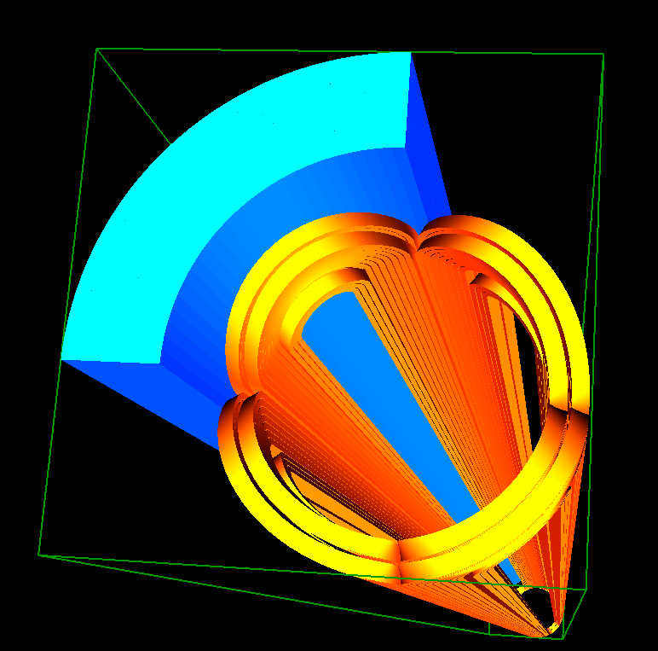
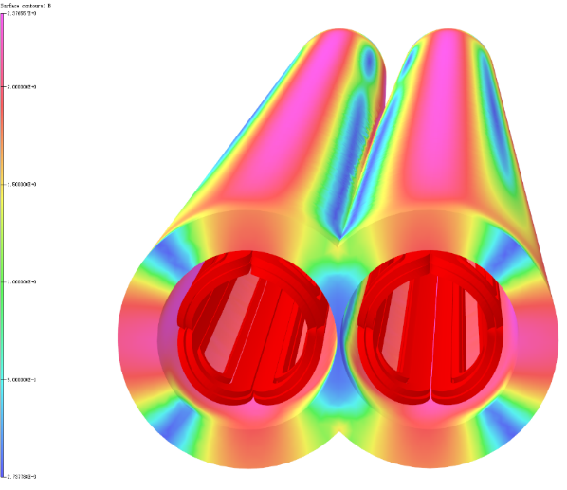
Q1a design with iron
The field harmonics as a result of field crosstalk is smaller than 1×10⁻⁴.
Dipole field at aperture center is smaller than 20 Gs. Compared with iron-free design, the excitation current is reduced to 2020A @4.2K.
Double aperture cos2θ quadrupole with iron yoke shared by two apertures, with crossing angle 33mrad. Meet all requirements.

Slide 10
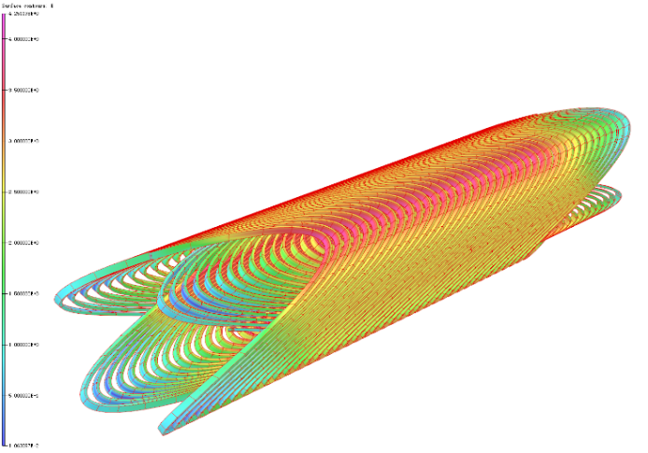
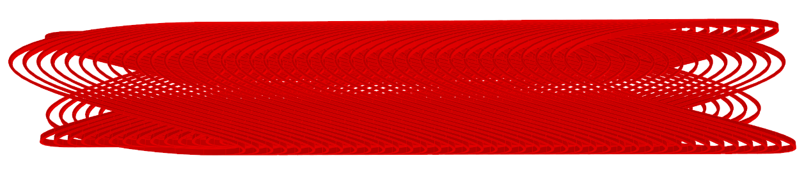
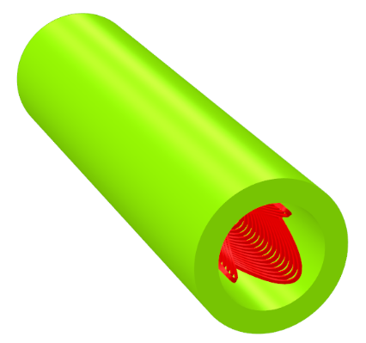
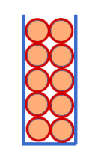
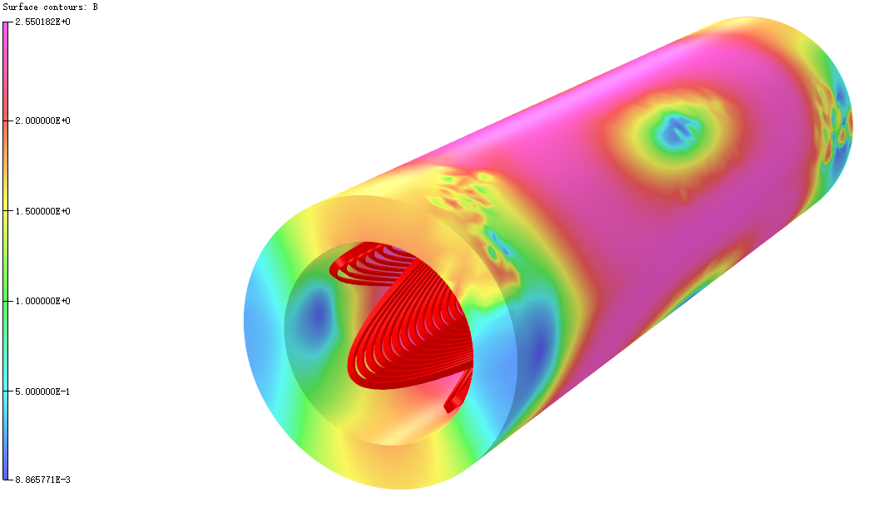
2) CCT option of Q1a
0.5mm round wire, HTS Bi-2212 or LTS NbTi.
Two layers CCT quadrupole coil. The inner radius of the spar is 20mm.
Groove on the spar: 1×2.5mm; 10 wires in a groove.
Conductor canted angle: 30 deg. Excitation current: 324A.
Field gradient is calculated using theoretical formula, and OPERA-3D.
Each integrated multipole field in single aperture is smaller than 1×10⁻⁴.

Slide 11
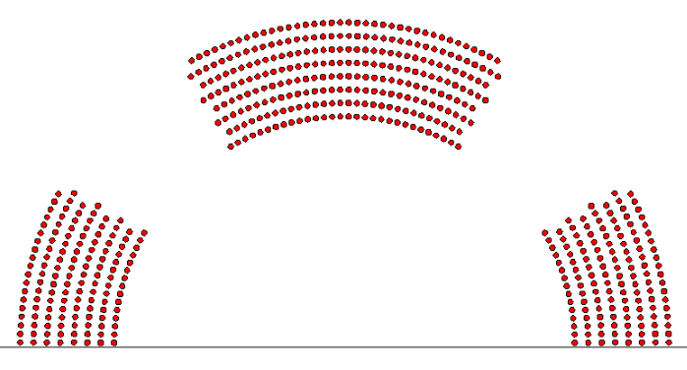
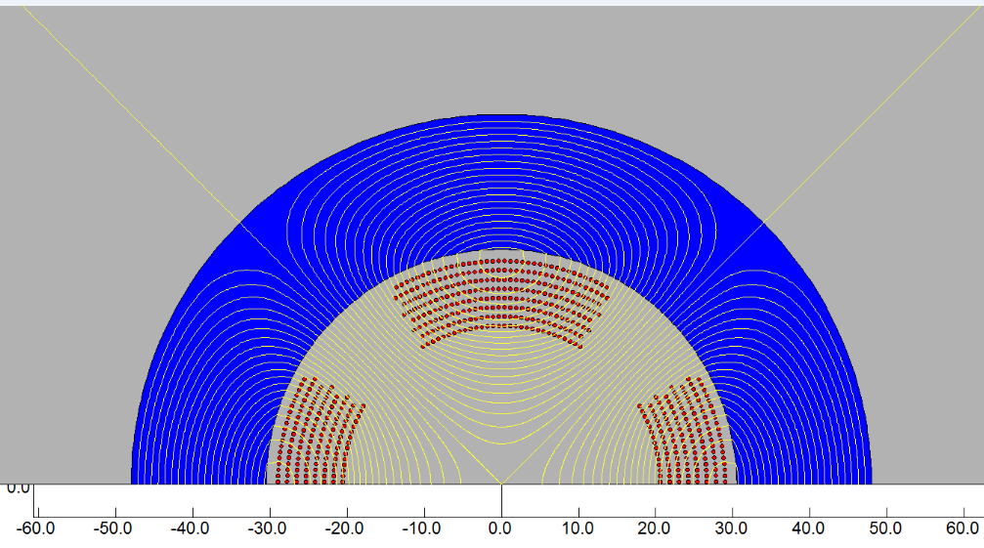
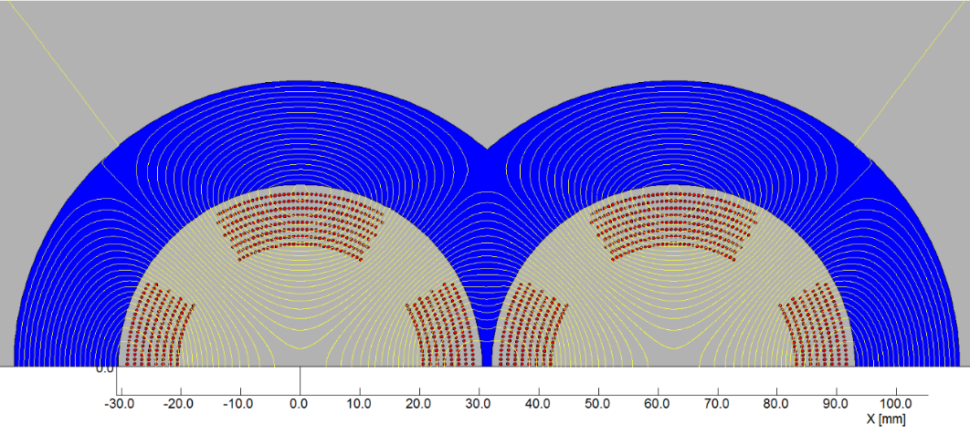
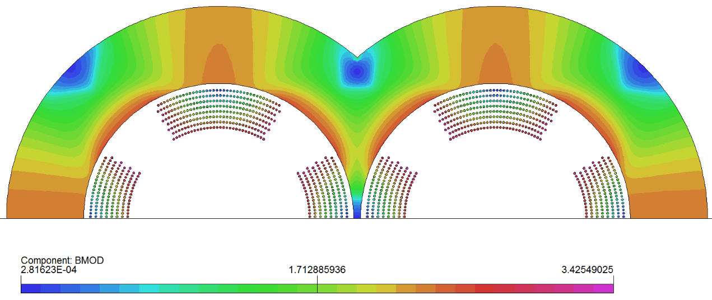
3) Serpentine option of Q1a
0.5mm round wire, HTS Bi-2212 or LTS NbTi.
8 layers Serpentine quadrupole coil. The inner radius of the coil is 20mm.
2D calculation, each multipole field in single aperture is smaller than 1×10⁻⁴.
Excitation current: 334A (with iron)

Slide 12
Comparison of three design options of Q1a
1) Comparison of three design options of Q1a (142.3T/m, no iron)
2) Comparison of three design options of Q1a (142.3T/m, with iron)
From the comparison, Cos2θ coil has lower current, lower peak field, and lower current density.
Cos2θ coil as baseline design, CCT and Serpentine coil as alternative design.
Q1a option | Cos2θ coil | CCT coil | Serpentine coil
Excitation current in strand (A) | 265 | 472.5 | 480
Current density Je on wire (A/mm²) | 1350 | 2406 | 2445
Peak field in coil (T) | 3.6 | 4.3 | 4.2
Q1a option | Cos2θ coil | CCT coil | Serpentine coil
Excitation current in strand (A) | 202 | 324 | 334
Current density Je on wire (A/mm²) | 1029 | 1650 | 1701
Peak field in coil (T) | 3.5 | 3.8 | 3.8

Slide 13
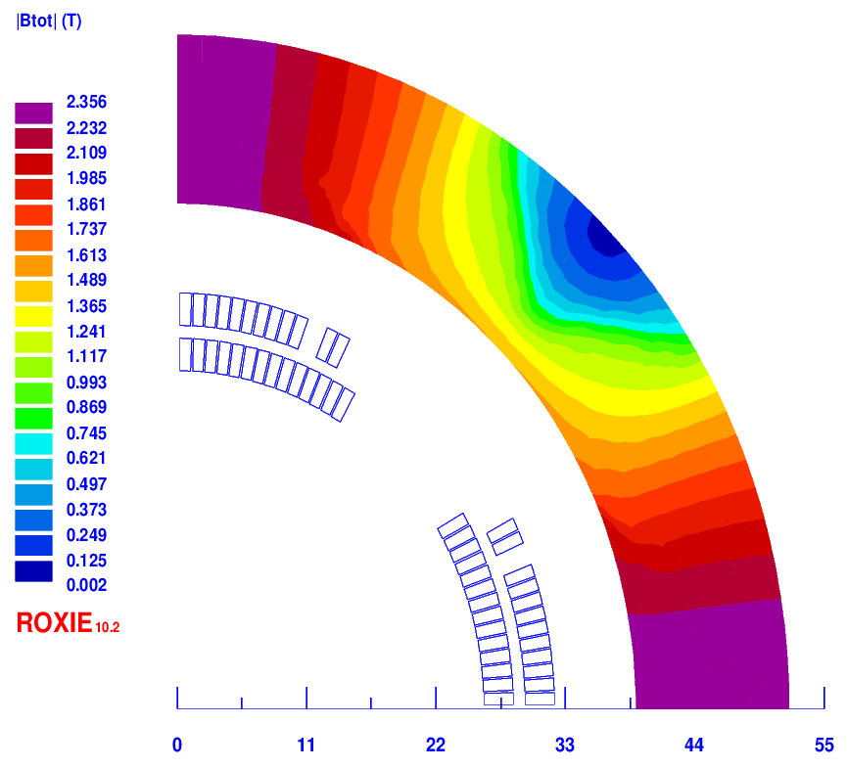
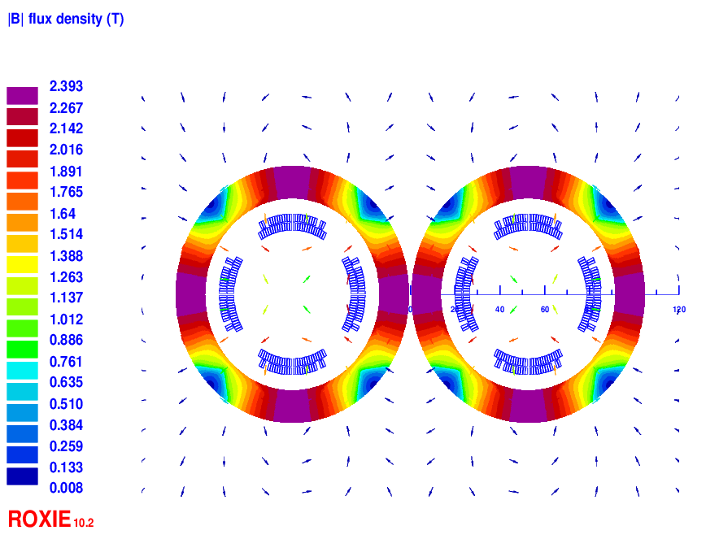
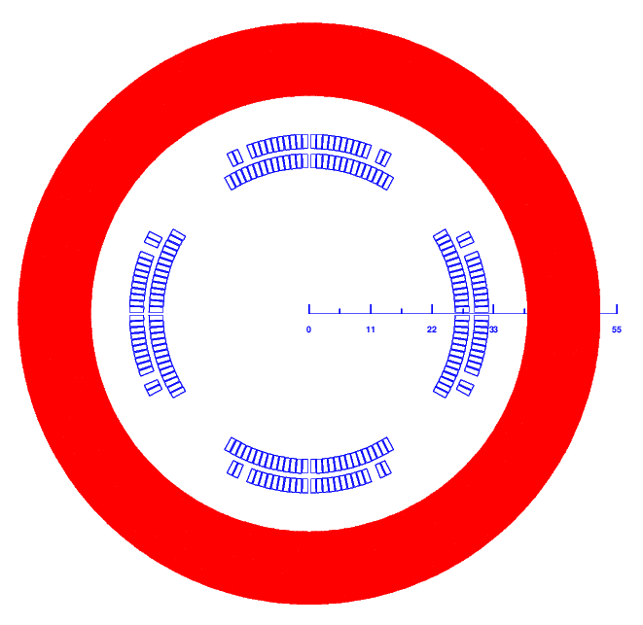
2 Design of Q1b
Baseline design: Cos2θ coil; CCT and Serpentine coil as alternative design
Round 0.5mm strand, HTS Bi-2212 or LTS NbTi
Q1b: two layers cos2θ quadrupole coil using Rutherford cable with iron yoke. The inner radius of the coil is 26 mm.
Single aperture cross section is optimized with three coil blocks in two layers.
Width of the cable is 3 mm, 26 turns in each pole.
The excitation current of Q1a is 1590A.
Two apertures do not need to share the iron yoke like Q1a.
Two layers corrector coils will be added inside quadrupole coil, using 0.33mm wire.

Slide 14
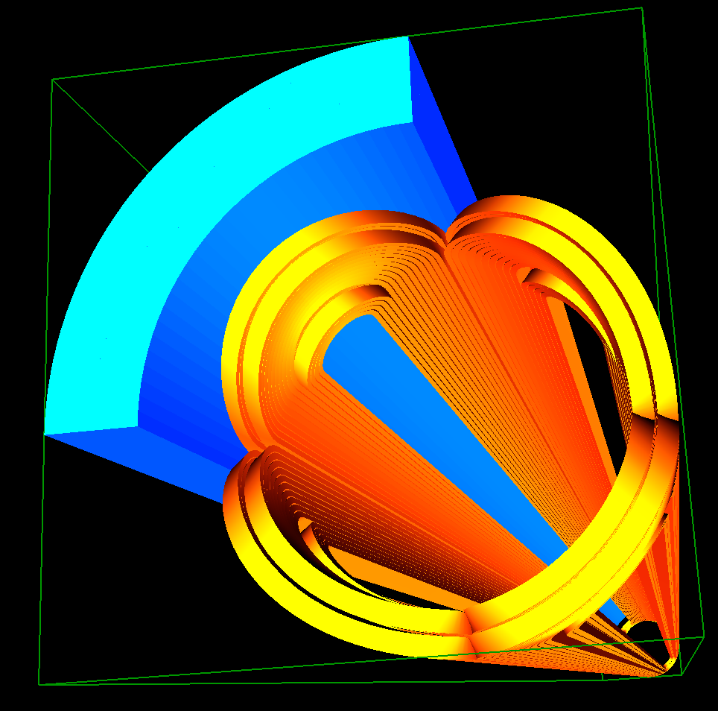
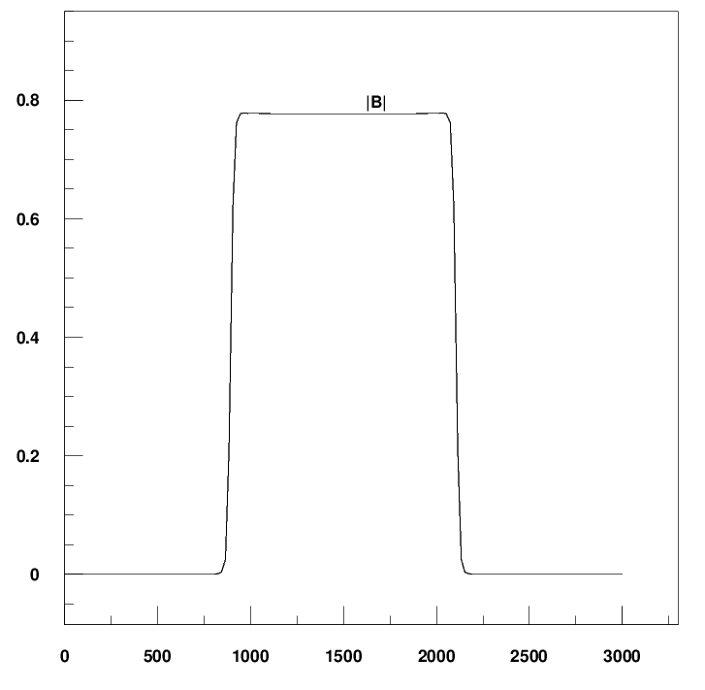
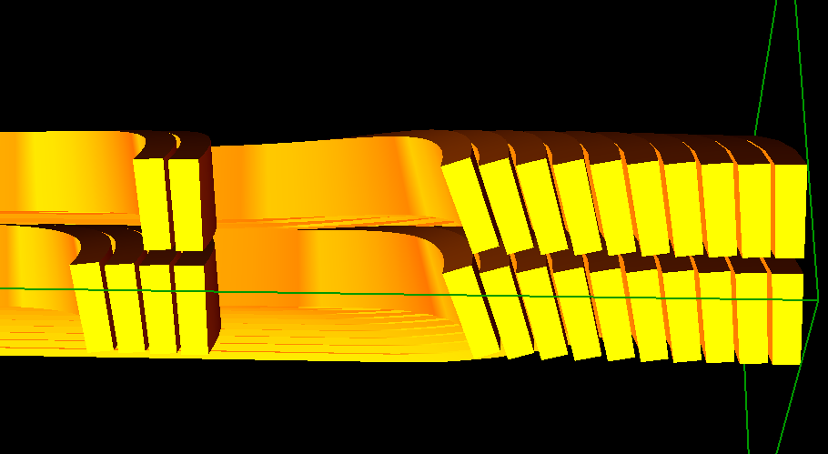
Design of Q1b
3D design of Q1b
3D magnetic field is modeled and analysed using ROXIE.
Coil end detailed shaped is optimized and determined.
Field gradient 85.4T/m, each integrated field harmonics is smaller than 1×10⁻⁴.
The 3D magnetic field performance meets requirement.
Single aperture model in 3D

Slide 15
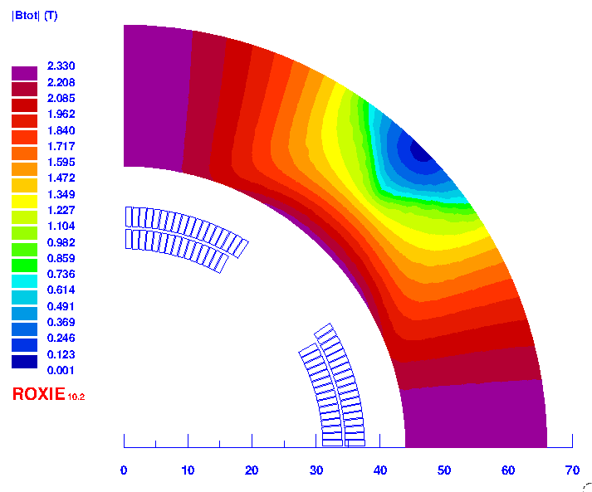
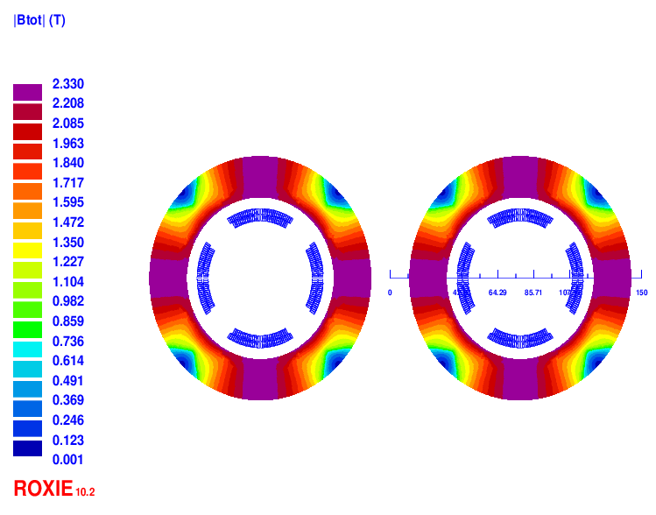
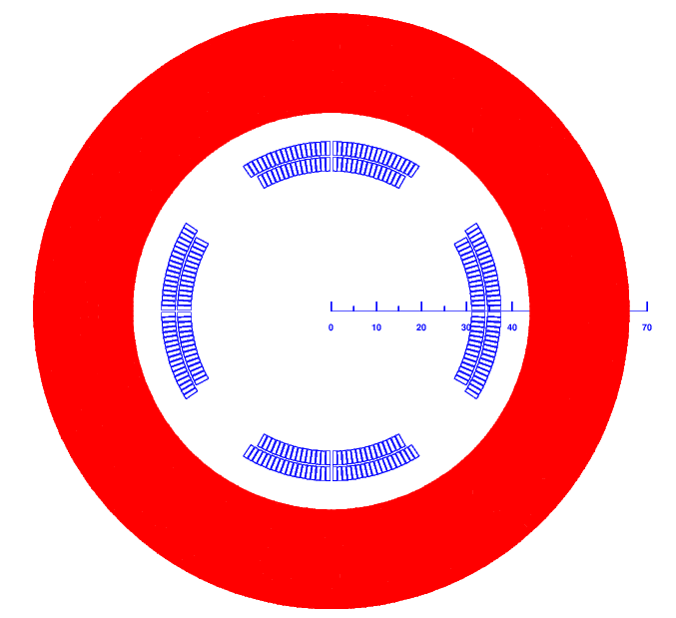
3 Design of Q2
Baseline design: Cos2θ coil; CCT and Serpentine coil as alternative design
Round 0.5mm strand, HTS Bi-2212 or LTS NbTi
Q2: two layers cos2θ quadrupole coil using Rutherford cable with iron yoke. The inner radius of the coil is 31mm.
Single aperture cross section is optimized with two coil blocks in two layers.
Width of the cable is 3mm, 33 turns in each pole.
The excitation current of Q1a is 1925A, and each multipole field in single aperture is smaller than 1×10⁻⁴ in 2D.
Two apertures do not need to share the iron yoke like Q1a.
Two layers corrector coils will be added inside quadrupole coil, using 0.33mm wire.

Slide 16
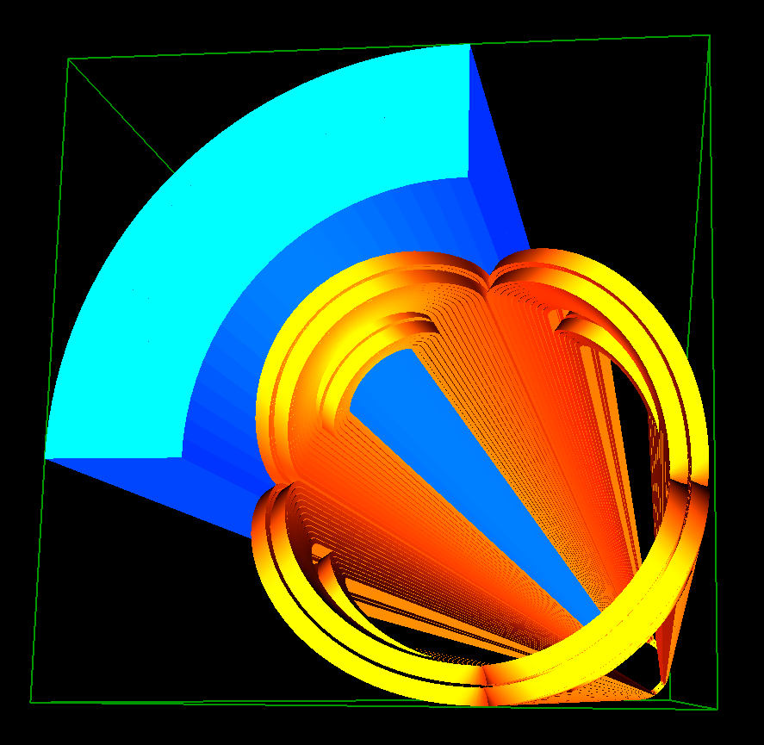
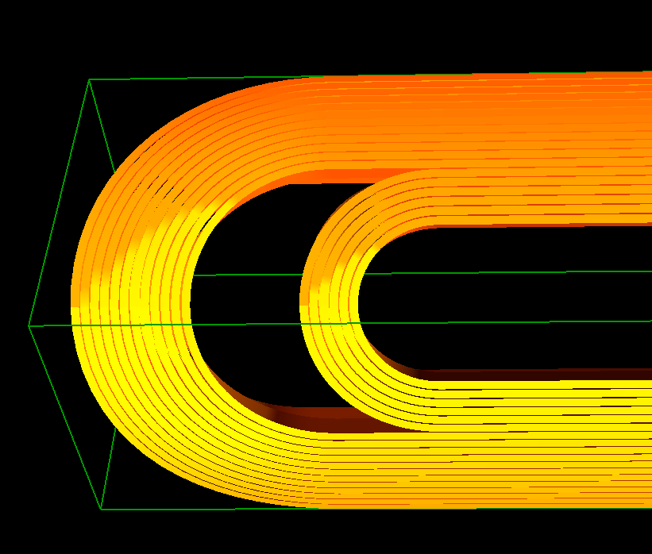
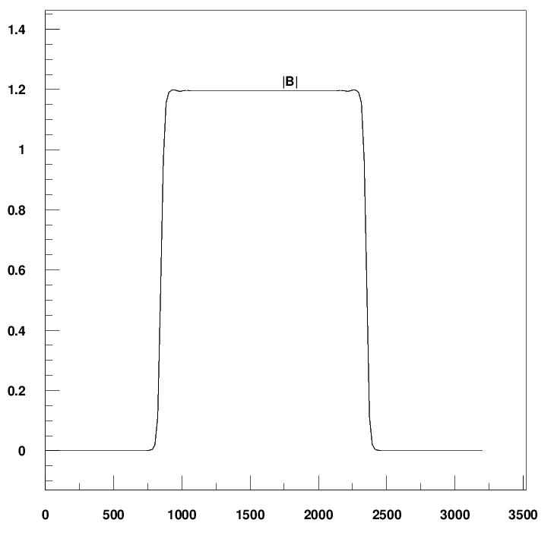
Design of Q2
3D design of Q2
3D magnetic field is modeled and analysed using ROXIE.
Coil end detailed shaped is optimized and determined.
Field gradient 85.4T/m, each integrated field harmonics is smaller than 1×10⁻⁴.
The 3D magnetic field performance meets requirement.
Single aperture model in 3D

Slide 17
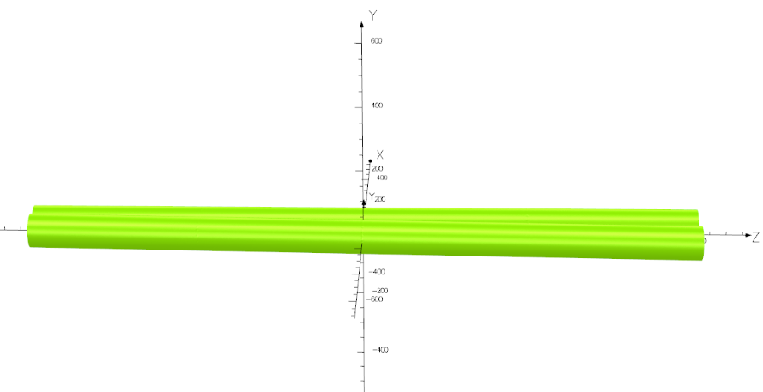
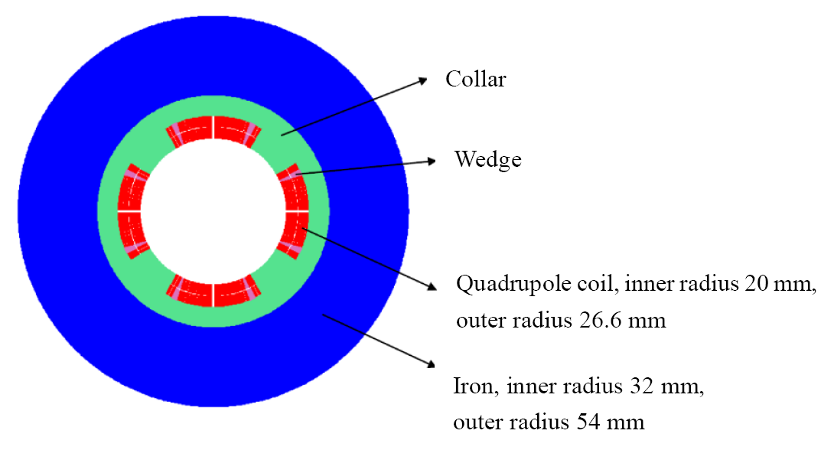
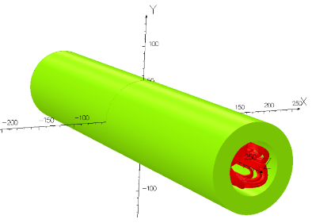
R&D status of 0.5m single aperture short model quadrupole
Baseline design of quadrupole:
Collared cos2θ quadrupole magnet, with shared iron yoke and crossing angle between two apertures.
In practice, can it be fabricated and really meet the requirement?
So far, there is no cos2θ superconducting quadrupole magnet in China.
In the R&D, the first step is to study and master main key technologies of superconducting quadrupole magnet by developing a short model magnet with 0.5m length (near IP side).

Slide 18
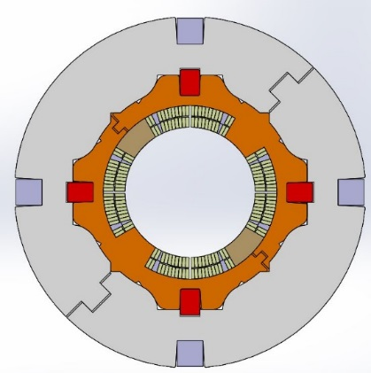
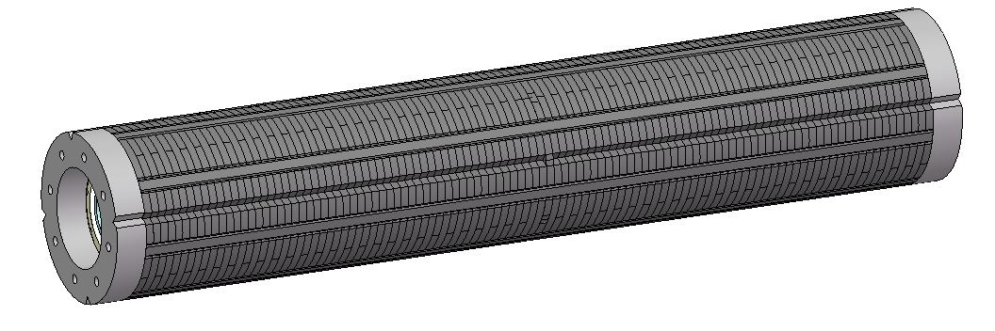
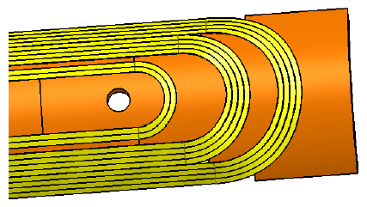

Status of 0.5m single aperture short model quadrupole
Research on main key technologies of 0.5m single aperture quadrupole model has started (NbTi, 136T/m), in collaboration with HeFei KEYE Company.
Including: quadrupole coil winding technology, fabrication of quadrupole coil with small diameter, stress control, quadrupole magnet assembly, cryogenics vertical test and field measurement technology, etc.

Slide 19
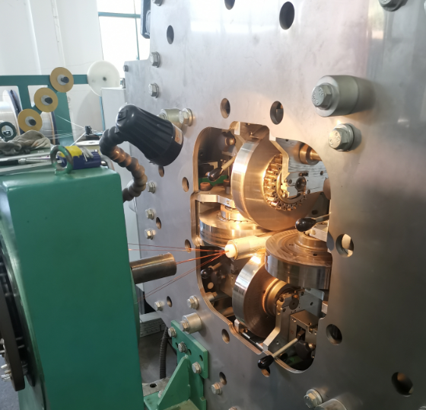
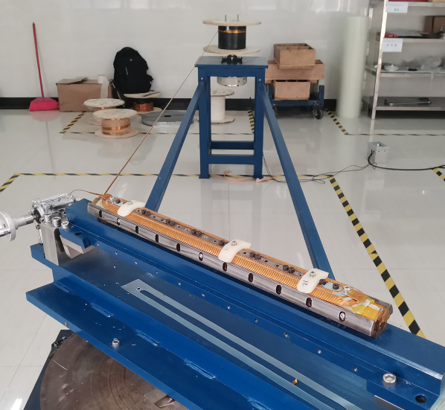
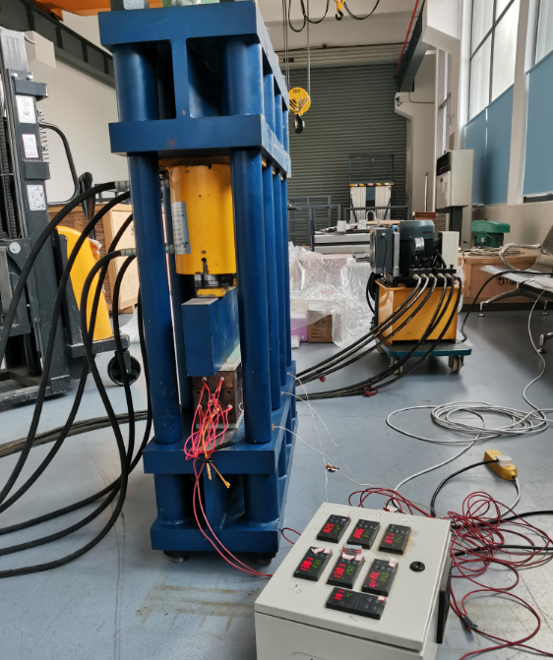
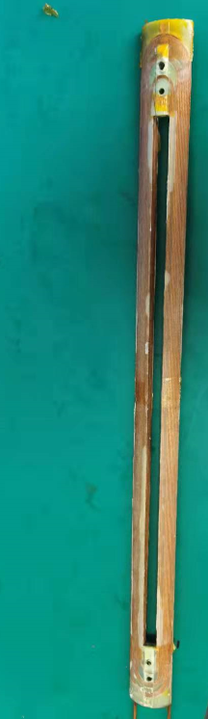
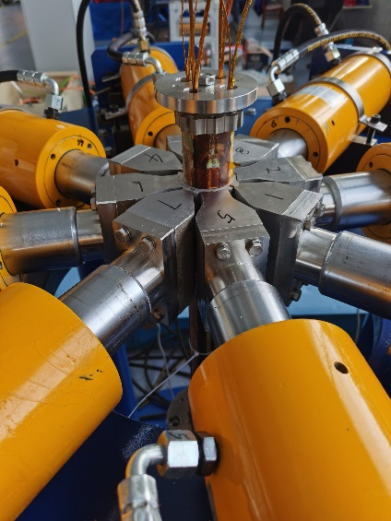
Status of 0.5m single aperture short model quadrupole
Progress: Manufacture of all hardware is completed.
NbTi Rutherford cable (12 strands)
Winding machine
Coil heating and curing system
Coils assembly system

Slide 20
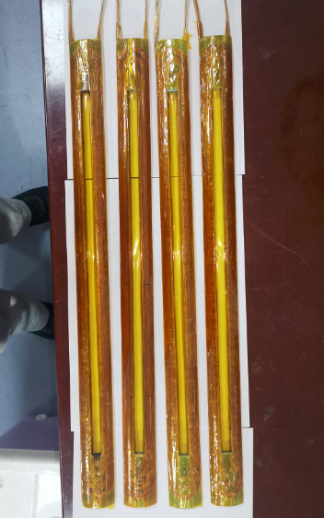
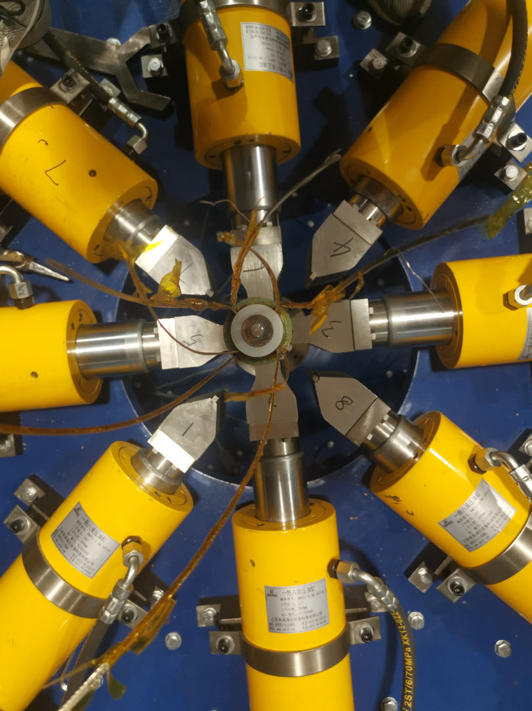
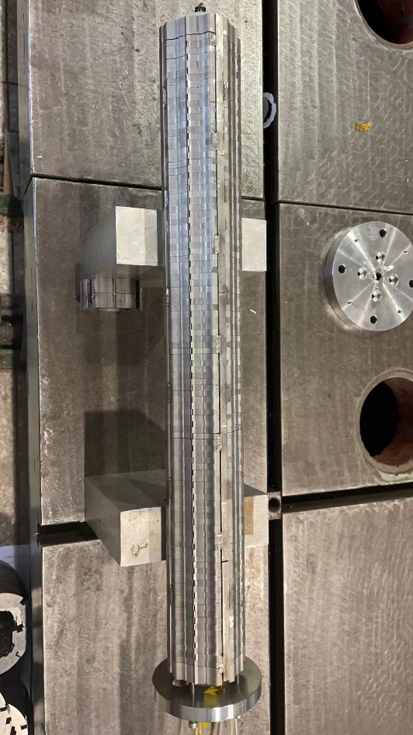
Status of 0.5m single aperture short model quadrupole
Many test on the winding and curing of quadrupole coils were performed.
Four SC quadrupole coils have been wound and cured, then they are assembled with stainless collar.
Iron yoke has been assembled with the collared-coil.
Coil resistance and ground insulation voltage test have been performed.

Slide 21


Status of 0.5m single aperture short model quadrupole
Manufacture of 0.5m single aperture short model quadrupole has been completed in HeFei KEYE in August 2022.
Then, the magnet has been transported to IHEP.
Rotating coil magnetic field measurement has been done with 4A current at room temperature.
Cryogenic excitation test at 4.2K in vertical Dewar is in preparation, to verify whether high magnetic field gradient can be achieved.

Slide 22
Summary
For CEPC superconducting quadrupole magnets, it is challenging to meet stringent design requirements, including limited space, magnetic field crosstalk between two apertures, field gradients up to 142T/m.
All the design requirements are met.
Three design options have been studied for Q1a using high luminosity parameters with L*=1.9m: Cos2θ coil, CCT coil, Serpentine coil.
Cos2θ coil has higher magnetic efficiency, lower current and low coil peak field.
Cos2θ coil as baseline design, CCT and Serpentine coil as alternative design.
Study and research on key technologies of 0.5m single aperture quadrupole model (136T/m, NbTi) is in progress; Its manufacture is completed, and cryogenic test at 4.2K in vertical Dewar is in preparation.

Slide 23
Thanks for your attention!
International workshop on CEPC

