Slide 1
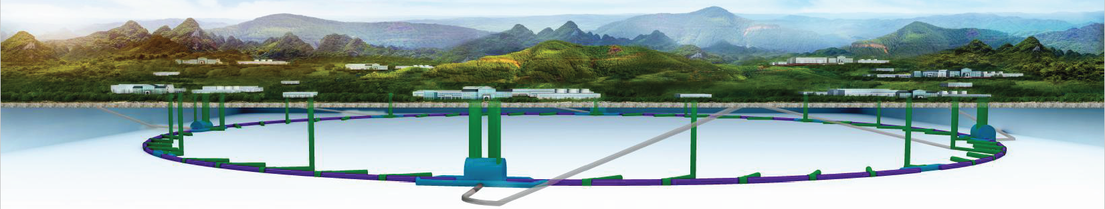
CEPC Injection/extraction system studies
The 2022 international workshop on the high energy Circular Electron-Positron Collider
Oct.24-28,2022, Online
Jinhui Chen, Guanjian Wu, Zilin Chen, Xinzhe Zhai, Guanwen Wang,
Lei Wang，Lihua Huo , Yuwen Wu, Hua Shi
Injection group
2022-10-25

Slide 2
Outline
1
Overview of CEPC Inj./Ext. systems
2
Lambertson magnets
3
Slotted-pipe kicker system
4
Ferrite core kicker magnet
5
Summary

Slide 3
Overview of the CEPC injection and extraction systems

Slide 4
CEPC injection and extraction systems
In CEPC accelerator complex, there are 9 injection and extraction sub-systems, including:
DR injection and Extraction system(e+)
Booster LE injection system (e+,e-)
Booster Extraction system1 (e+,e-)
Collider off-axis injection system (e+,e-)
Booster Extraction system2 (e+,e-)
Booster HE injection system (e+,e-)
Collider swap out injection system (e+,e-)
Collider swap out extraction system (e+,e-)
Collider beam dump system(e+,e-)
Off-axis injection
(in W and Z mode)
On-axis injection
(only in Higgs mode)
③
④
⑤
⑦
①
②
Linac
Booster
⑥
⑧
Collider
⑨
dump
1.1GeV
10~120GeV
120GeV
DR

Slide 5
Main types of inj. & ext. hardware
 | Sub-system | Kicker |  | Septa
 |  | Kicker Type | Kicker waveform | Septa Type | Stored beam pipe aperture /Thickness of septum
1 | Damping ring inj./ext. | Slotted-pipe kicker | Half-sine or trapezoid/250ns | Horizontal in air LMS | ф22/3.5mm
2 | Booster LE inj. | Strip-line kicker | Half-sine/50ns | Horizontal in air LMS | ф55/5.5mm
3 | Booster ext. for CR off-axis inj. | Delay-line dipole kicker | Trapezoid /440-2420ns | Vertical in air LMS | Ф55/6mm
4 | Collider off-axis inj. | Delay-line NLK kicker | Trapezoid /440-2420ns | Vertical in vacuum LMS | Ф75x56/2mm
5 | Booster ext. for CR on-axis inj. | Ferrite core dipole kicker | Half-sine/1360ns | Vertical in air LMS | Ф55/6mm
6 | Booster HE inj. for CR on-axis inj. | NLK or Pulsed sextupole | Half-sine/0.333ms | Vertical in air LMS | Ф55/6mm
7 | Collider swap out inj. | Ferrite core dipole kicker | Half-sine/1360ns | Vertical in air LMS | Ф75x56/6mm
8 | Collider swap out ext. | Ferrite core dipole kicker | Half-sine/1360ns | Vertical in air LMS | Ф75x56/6mm
9 | Collider beam dump | Delay-line dipole kicker | Trapezoid /440-2420ns | Vertical in air LMS | Ф75x56/6mm

Slide 6
Hardware R&D plans
One team is in charge of both HEPS and CEPC inj. & ext. system. A part of hardware R&D for 2 projects are overlapping. HEPS project started on 29th June, 2019. Some hardware prototypes are completed and some are in final assembling progress. These hardware R&D experiences should be shared for CEPC.
Hardware R&D activities:
  Lambertson septa magnets
    Outside vacuum magnet: Septum thickness ≥3.5 mm
    Half in vacuum magnet: Septum thickness =2 mm
  Kicker systems
    Strip-line kicker and super fast pulser（PW=10~50ns）
    Slotted-pipe kicker and fast pulser（PW=250~300ns）
    Ferrite core kicker （in-air with metallic coated ceramic vacuum chamber) and pusler
      Lumped parameter dipole kicker（PW=1.36us half-sine）
      Distributed parameter (delay-line) dipole kicker（ PW=440~2420ns trapezoid）
      Distributed parameter (delay-line) Nonlinear kicker（ PW=440~2420ns trapezoid）
Overlapping part

Slide 7
Lambertson magnet

Slide 8
Typical requirements for CEPC LSM
Parameters | Unit | DR-LSM | BST-LEI-LSM | CR-LSM-2
Quantity | - | 2 | 2 | 2×5
Energy | GeV | 1.1 | 10 | 120
Deflection angle | mrad | 120 | 22 | 0.35
Insertion length | m | 0.5 | 0.8 | 1.75
Magnetic field strength for injected/extracted beam | T | 0.883 | 0.9175 | 0.08
Min. Septum thickness（including septum board, wall of beam pipes, installation gap) | mm | 3.5 | 5.5 | 2
Field uniformity | - | <±0.05% | <±0.02% | <±0.05%
Leakage field | - | ≤1×10⁻³ | ≤1×10⁻³ | ≤1×10⁻³
Clearance of stored beam at lambertson（H×V） （refer to stored beam orbit） | mm | 36.4×22 | 30×50 | -
Clearance of inj.&ext. beam at lambertson（H×V）（refer to inj.&ext. beam orbit） | mm | 22×11 | 18×29 | -
Physical aperture of stored beam vacuum chamber | mm | 22×22 | 55×55 | 75x56
In-air
Half in vacuum

Slide 9
Lambertson Magnet Design Considerations
In order to decrease the septum thickness, 2 novel structures of magnet were proposed:
  half-in-vacuum (for 2mm septum)
  embedded thin-wall vacuum chamber (for 3.5mm septum)
Magnet pole
Wall of stored beam pipe
+
Wall of injected beam pipe
+
Iron septum
+
installation margins
Installation margin
Septum
thickness
Injected bunch
=
Yoke
Stored bunch
Magnet pole
Installation margin
Injected bunch
SS
Half in-vacuum
Installation margin
Yoke
Magnet pole
Stored bunch
Installation margin
Injected bunch
SS
Iron or
VP(FeCoV，1J22)
Yoke
Traditional LSM
Stored bunch
in-air

Slide 10
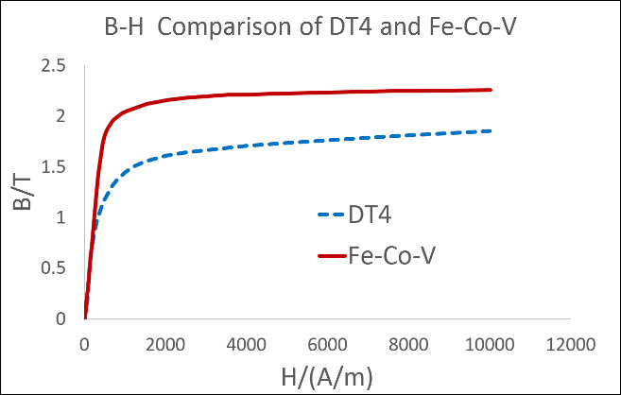
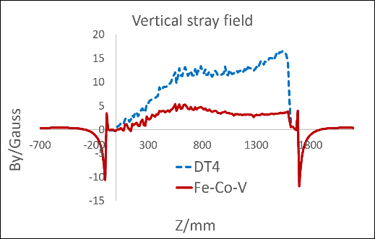
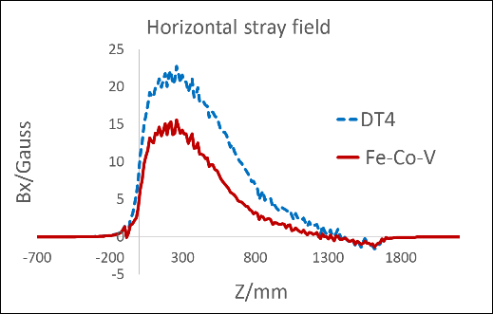
Lambertson Magnet Design Considerations
In order to decrease the absolute values of leakage field with thinner septum, Vanadium Permendur (FeCoV： iron50% cobalt 48% vanadium 2%, domestic brand 1J22 ） is adopted for septum board.
    Higher Bs (Saturation magnetic density)
    Higher μr(Relative permeability)

Slide 11
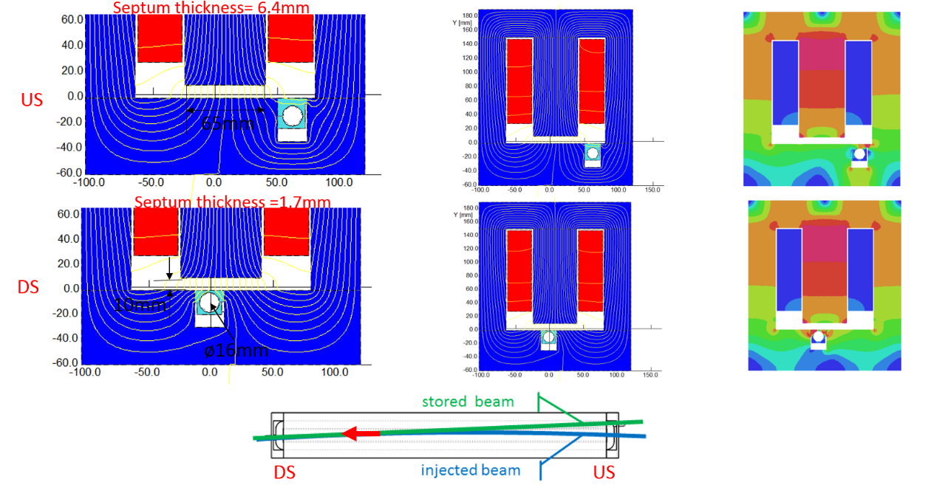
Lambertson Magnet Design Considerations
In order to decrease the integrate leakage field, the upstream end of the stored beam chamber is located under the side leg of the yoke to create a leakage field that is opposite in sign.

Slide 12
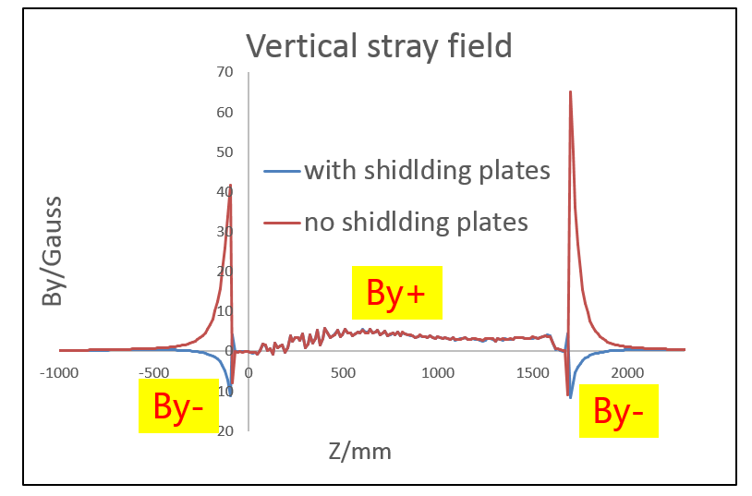
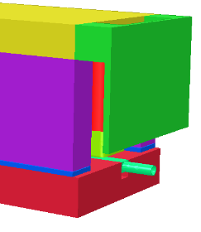
Lambertson Magnet Design Considerations
In order to further reduce the integrate leakage field, The shielding plate design at the end of Lambertson magnet also plays an important role. With the shield plate, the leakage field in the opposite direction to the main field will be generated at the end of the magnet to cancel the leakage field in the body of magnet.

Slide 13
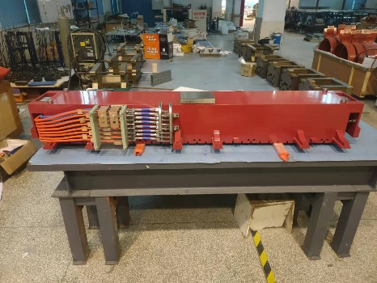
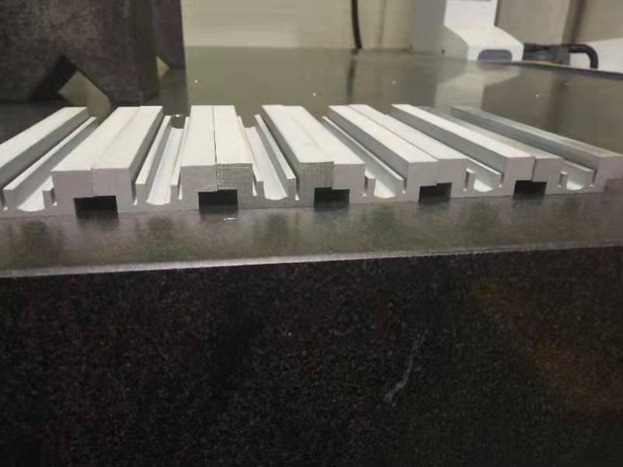
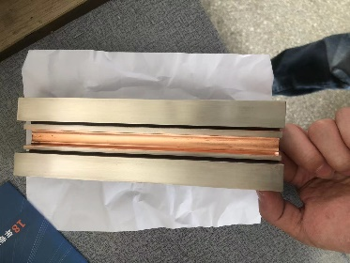
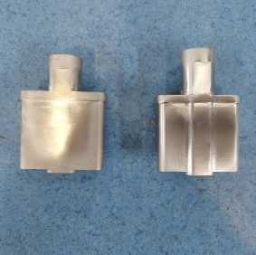
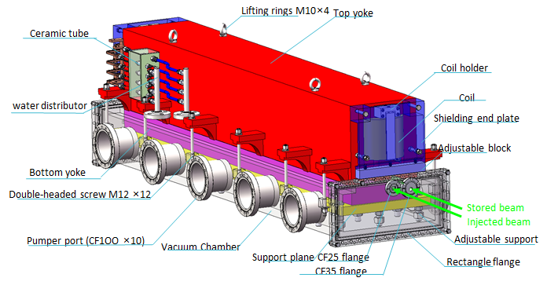
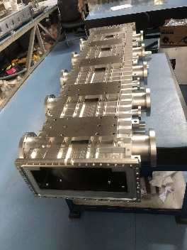
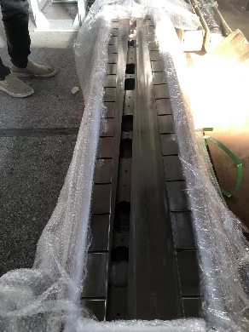
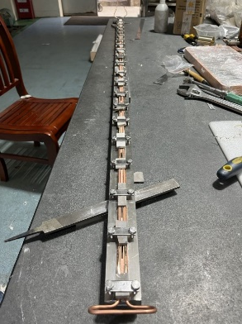
Half in-vacuum LSM R&D for HEPS SR
Full size prototype:
  Started in 2021
  All the mechanical component processing was completed
  The biggest challenge is magnetic shielding block machining because the VP is hard and brittle. Although it can be segmented processing by EDM, but annealing deformation is hard to control.
1J22 Magnetic shielding block
Upper iorn yoke
1J22: hard and brittle
Machining by EDM
But annealing deformation hard to control
DT4 with Ni coating
1J22 with cu coating
Full size prototype
Vacuum chamber
DT4 Yoke
Half cu Beam pipe

Slide 14
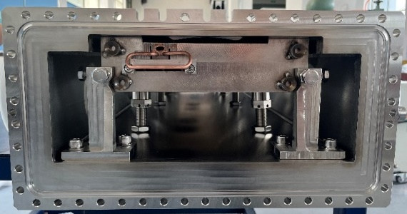
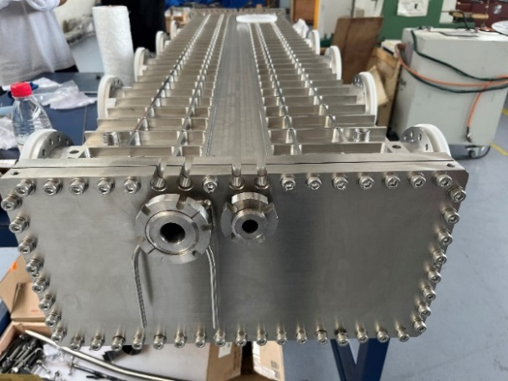
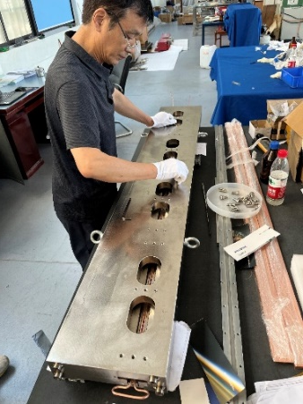
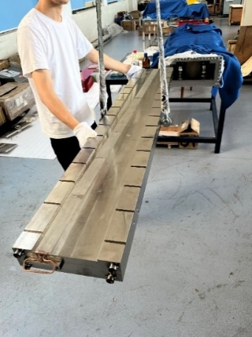
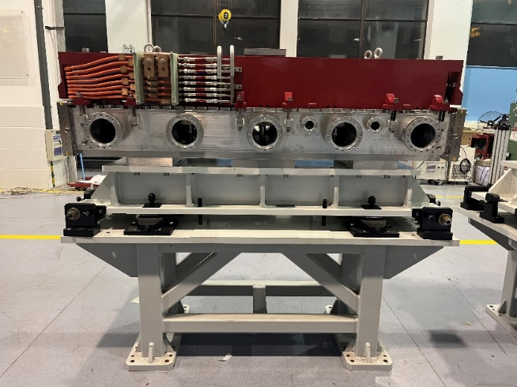
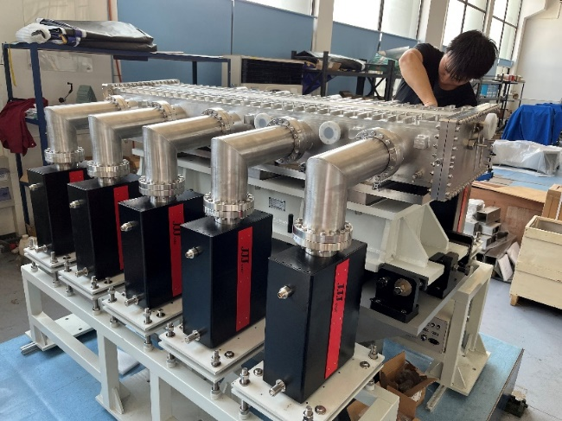
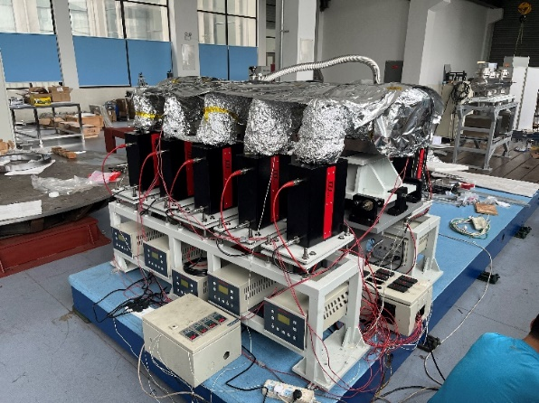
Half in-vacuum LSM prototype for HEPS
  Latest progress: Final assembling and vacuum testing was completed
  Vacuum pressure: 5.0×10-8pa（vacuum chamber）, 2.2×10-7pa（Transition section）
  Next plan: magnetic field measurement

Slide 15
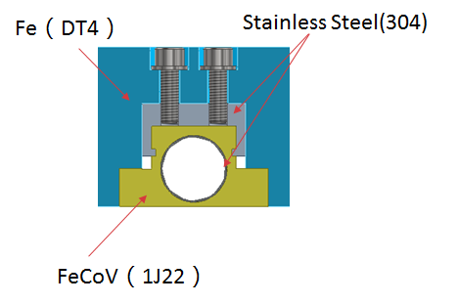
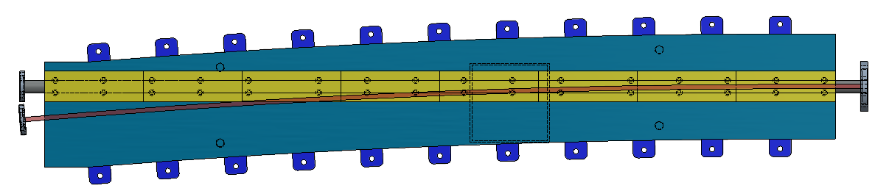
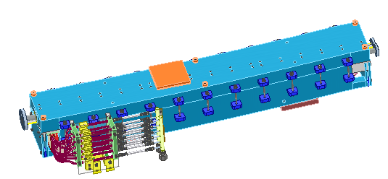
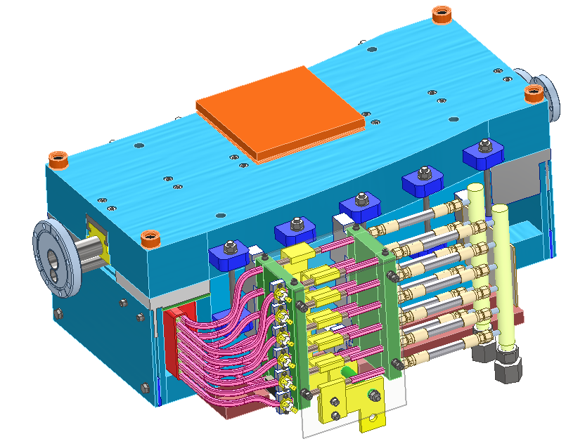
In-air LSM R&D for HEPS BST
Feature：magnet is located in the air; total septum thickness=3.5mm， Length=1.6m
Because FeCoV（1J22，Co50）is hard to machine, the magnetic shielding blocks must segmented processing by EDM . And that, the embedded thin wall SST vacuum chamber for stored beam is needed.
The gap at the joint of magnetic poles has a great influence on the leakage field and the main field distribution.

Slide 16
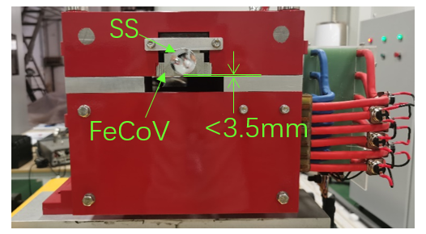
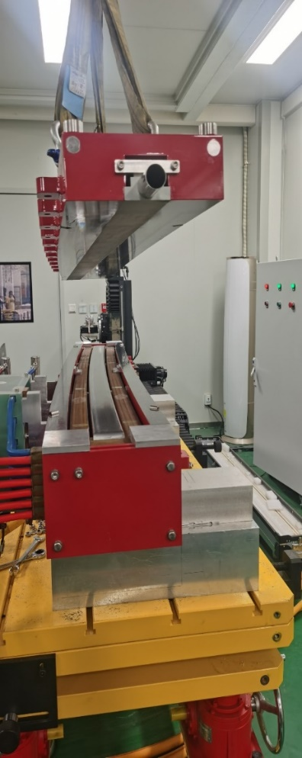
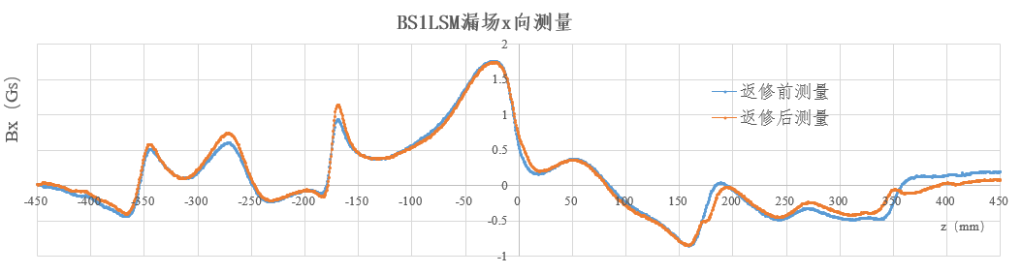
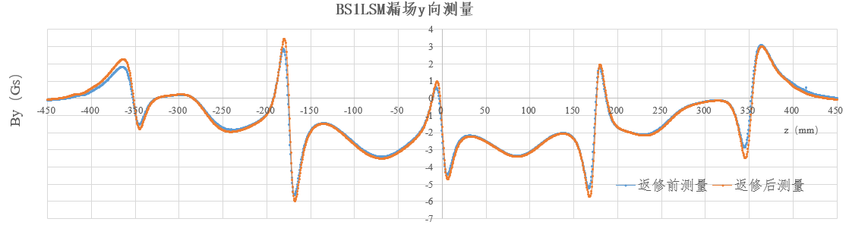
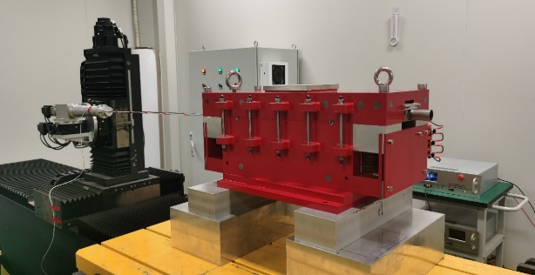
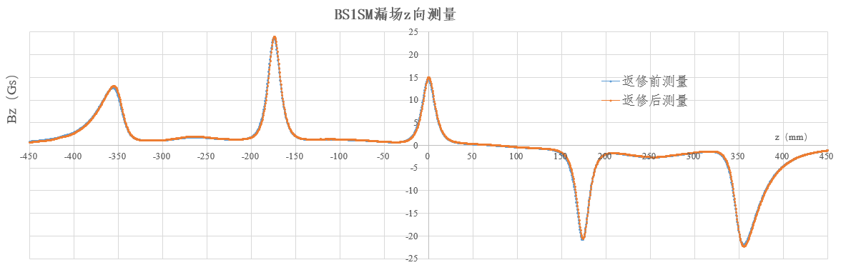
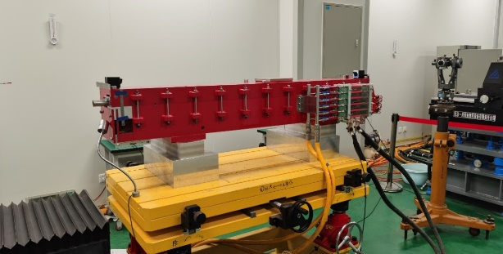
In-air LSM R&D for HEPS BST
  The latest progress: the prototypes are being in magnetic measurement
  Preliminary result：the leakage field is good enough for HEPS requirements

Slide 17
Slotted-pipe Kicker system

Slide 18
DR inj./ext. kicker design parameters
parameter | Unit | DR-kicker
Quantity | - | 2
Type | - | Slotted-pipe kicker
Deflect direction | - | Vertical
Beam Energy | GeV | 1.1
Deflect angle | mrad | 10.7
Magnetic effective length | m | 1.4
Magnetic strength | T | 0.0281
Integral magnetic strength | T·m | 0.03934
Clearance region(H×V) | mm | 32.8×26.6
Good field region(H×V) | mm | 19.8×16
Field uniformity in good field region | - | ±1.5%
Repetition rate | Hz | 100
Amplitude repeatability | - | ±0.5%
Pulse jitter | ns | ≤5
Bottom width of pulse(5%-5%) | ns | < 250

Slide 19
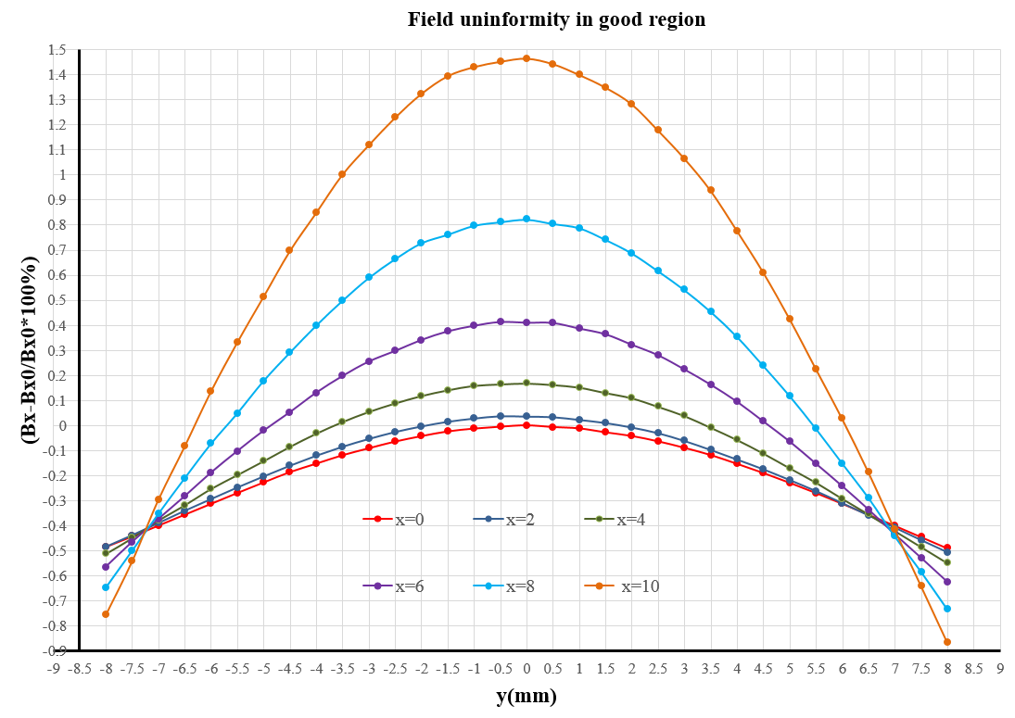
CEPC DR kicker Magnet physics design
2D simulation model
Max. voltage of coil: Umax=10622V
Max. exciting current: Imax=2400A
Magnet coil inductance=387nH
Good field region: 19.8×16mm
Field uniformity: -0.9%~1.5%
x=±10, y=±8
Un.= -0.9%~1.5%
Good field region
19.8×16mm
Contributed By Lihua Huo,Lei Wang

Slide 20
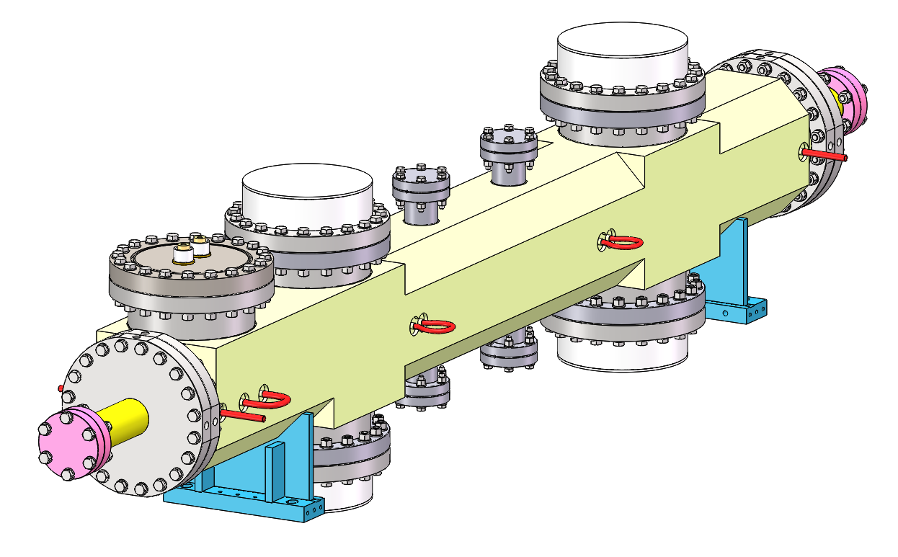
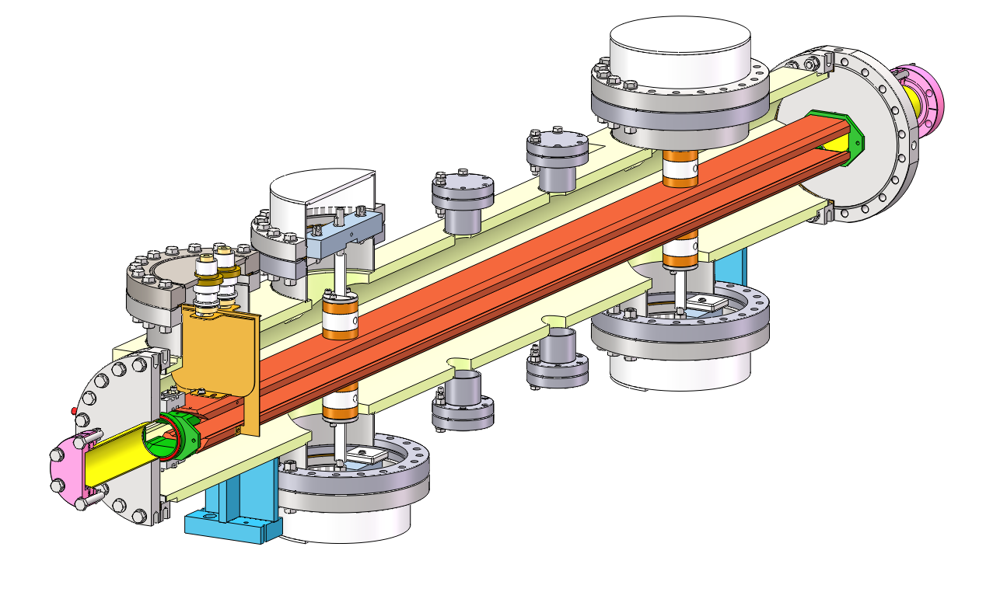
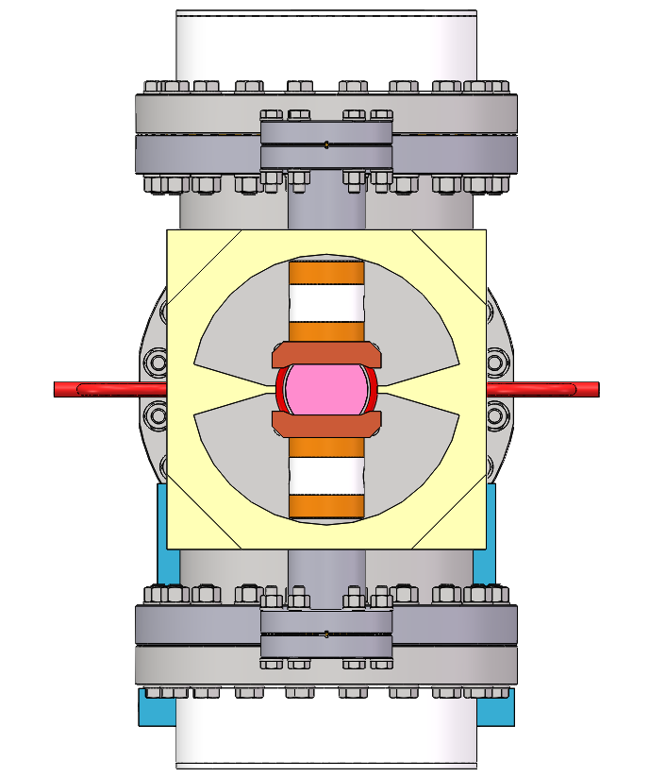
CEPC DR kicker engineer design
Outer body (316L)
Cooling water pipe
HV feedthrough
-
+
Busses (FOC)
insulation support (ceramic)
To vacuum pump
It’s the CEPC DR kicker engineer design, which is very similar to HEPS booster injection kicker.

Slide 21
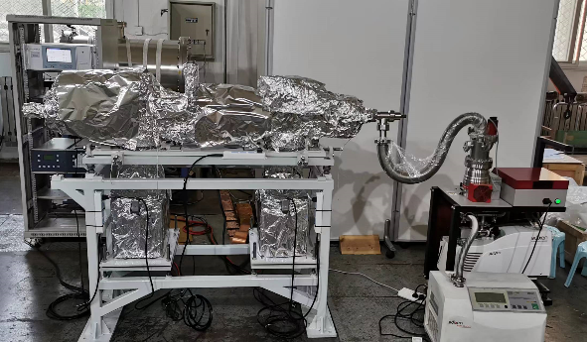
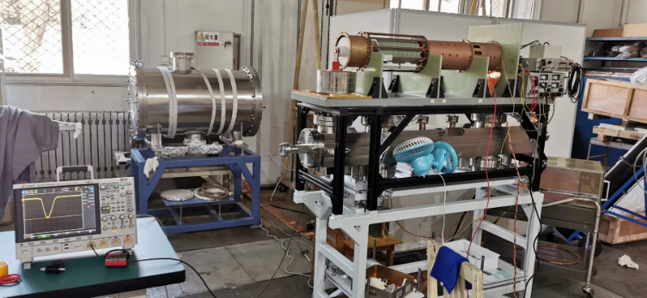
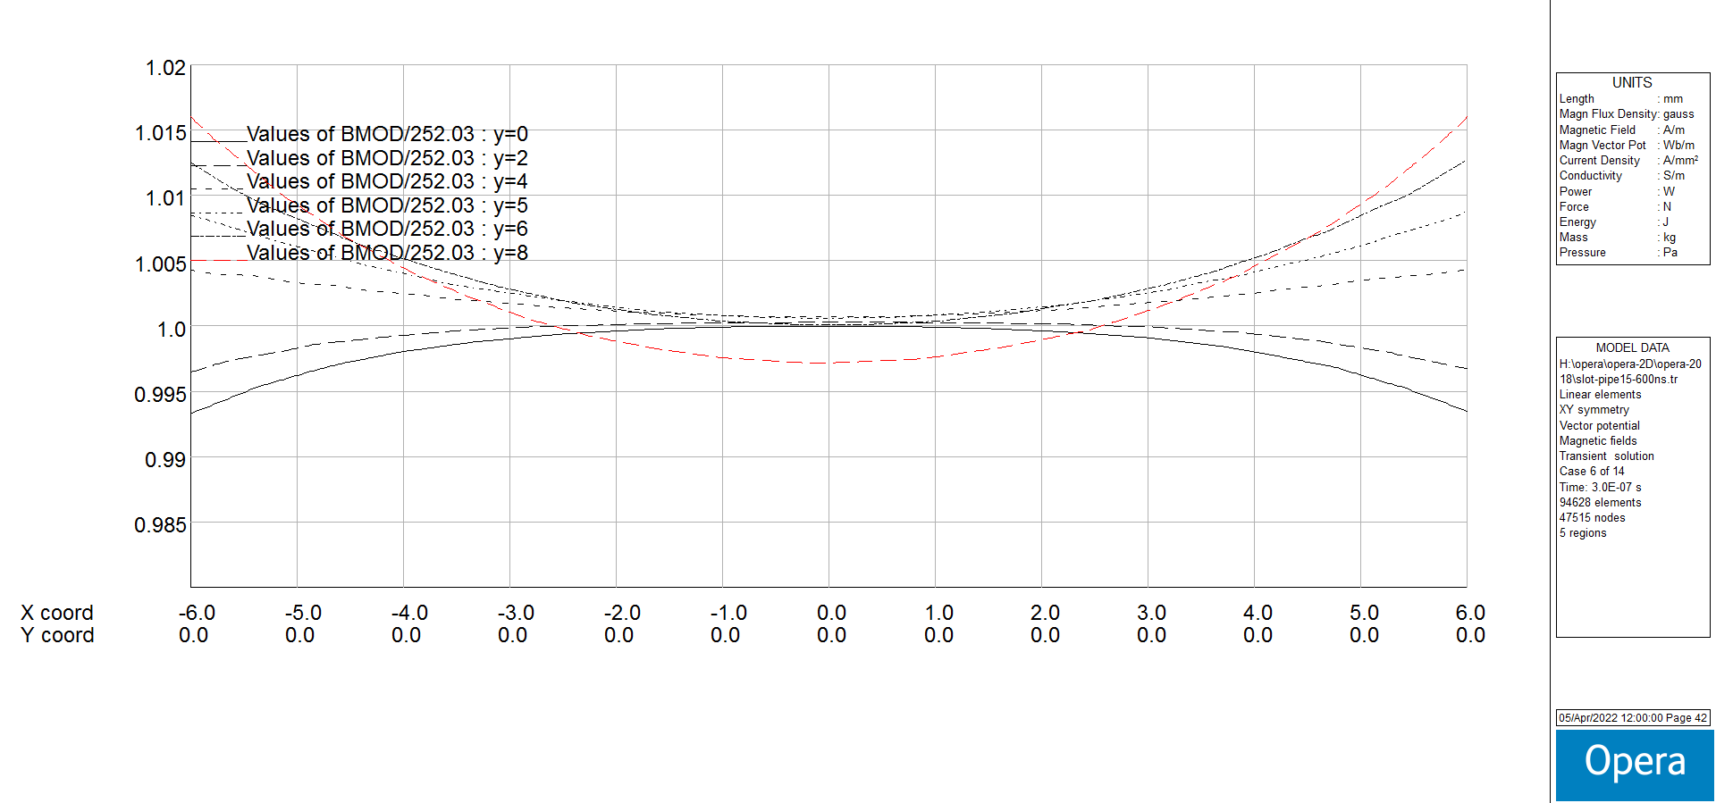
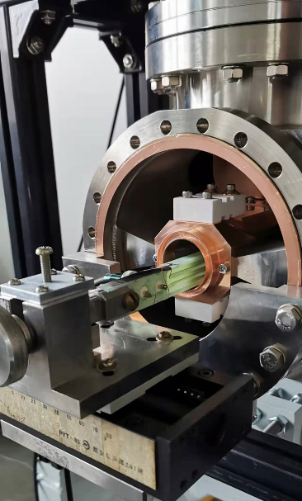
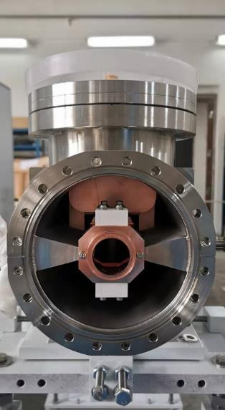
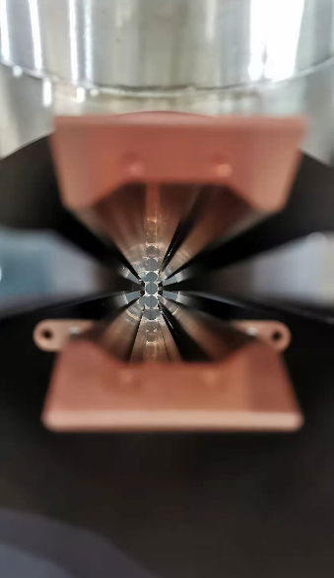
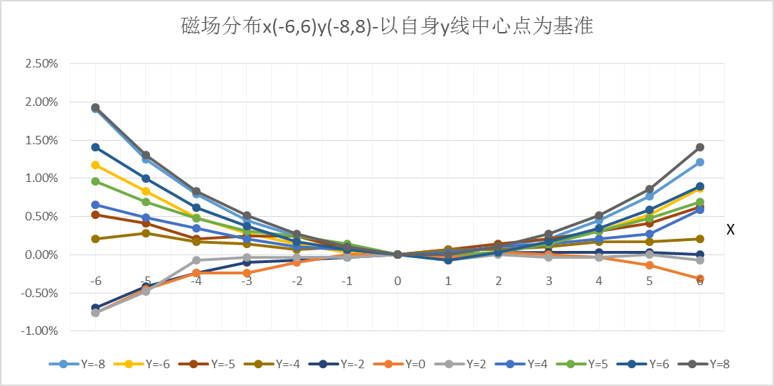
Prototype kicker for HEPS BST
  The latest progress: the kicker prototype is pass the vacuum assembling test and the magnetic field measurement have completed. The field distribute performance meet the requirements.

Slide 22
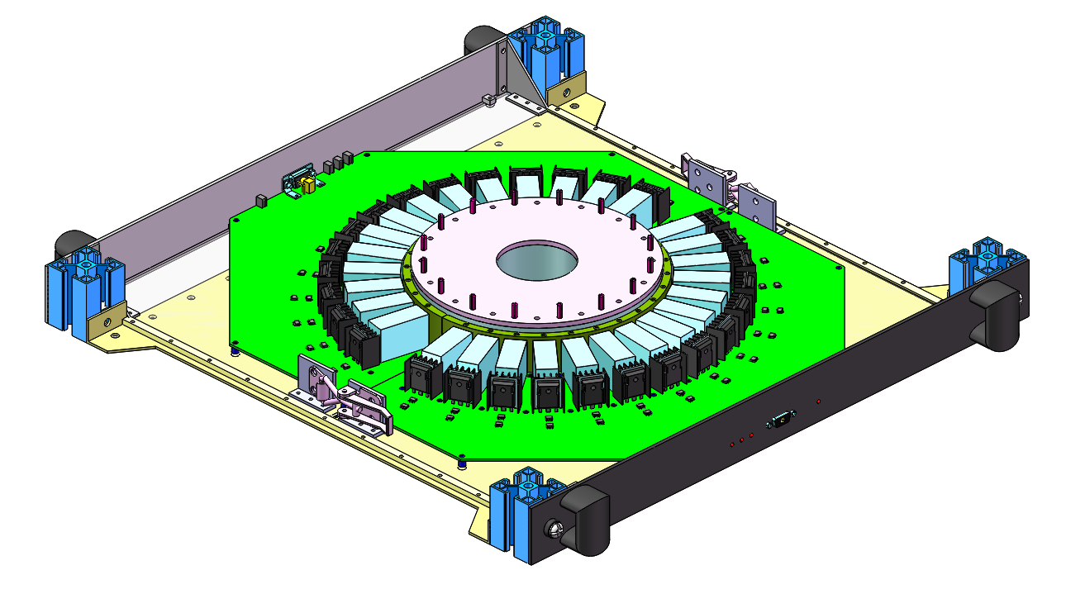
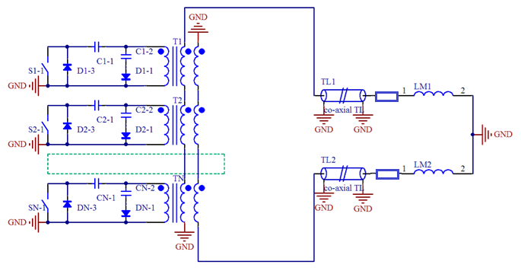
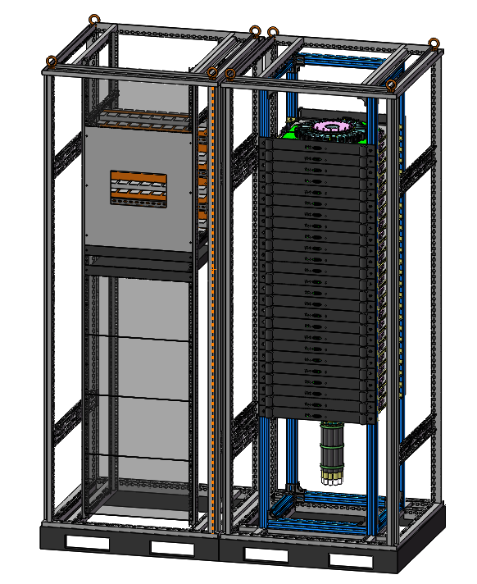
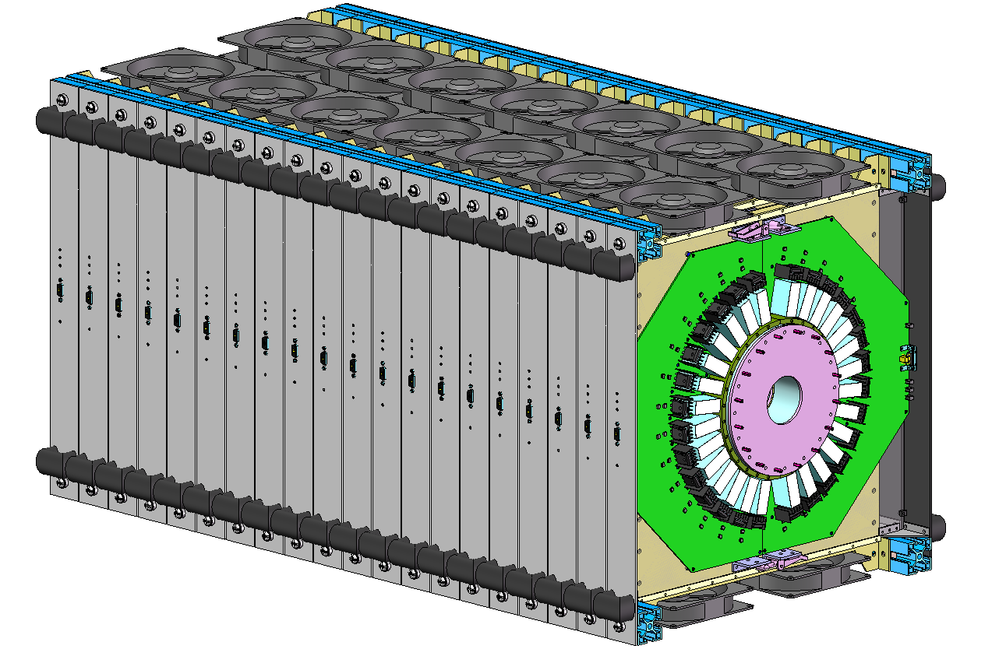
250ns-fast kicker pulser design
Scheme: 20-stage inductive adder based on SiC-MOSFETs.
The co-axial transformer is configured as bipolar output.
The pulser is located outside tunnel and 10 50 Ω cables with length more than 30m are applied to connect with kicker.
Matching terminal resistor is 10Ω.
20-stage inductive adder

Slide 23
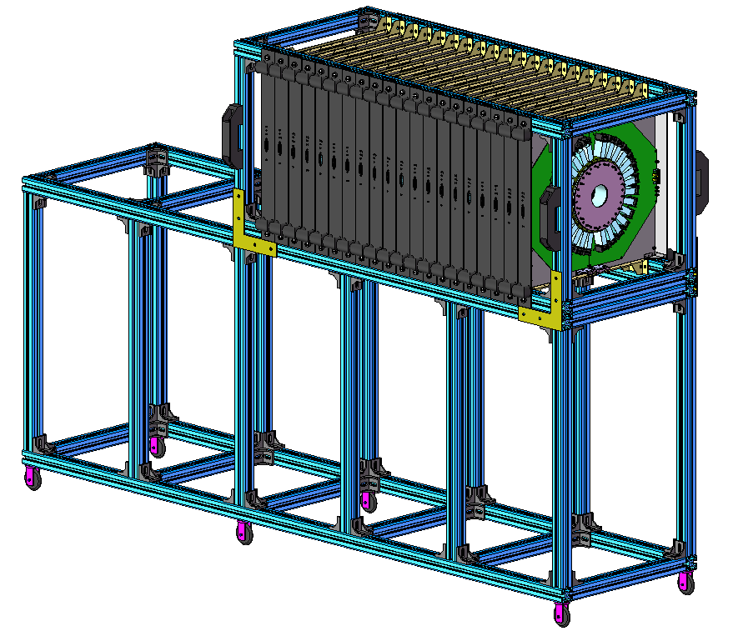
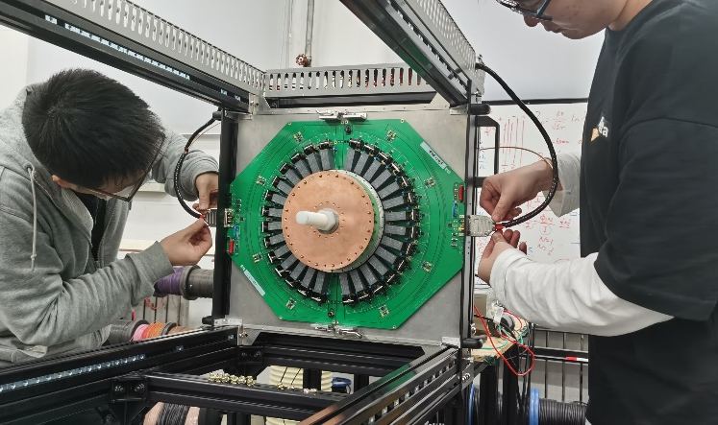






Pulser prototype for HEPS
Progress：Single stage and double stages full power test has been completed（1400V into 0.5Ω）
Mass production and test
Final version

Slide 24



Pulser prototype for HEPS
Latest Progress：18-stage inductive adder was tested（DC HV=800V, output pulse voltage is 14.2kV into 10Ω）.
Due to the existence of parasitic inductance outside the adder, a reverse voltage spike with high amplitude will be induced at the tail of the pulse when MOSFET is turned off, which must be suppressed by the reverse peak absorption circuit composed of high-speed diodes, Otherwise, MOSFET overvoltage breakdown will be caused.

Slide 25
Ferrite core kicker magnet

Slide 26
BST EXT kicker design parameters
parameter | Unit | BST-EXT-kicker1 （for CR off-axis inj.） | BST-EXT-kicker2 （for CR on-axis inj.）
Quantity | - | 2 | 2
Type | - | In-air delay-line dipole kicker | In-air lumped parameter dipole kicker
Deflect direction | - | Horizontal | Horizontal
Beam Energy | GeV | 120 | 120
Deflect angle | mrad | 0.2 | 0.1
Magnetic effective length | m | 1.4 | 0.7
Magnetic strength | T | 0.06 | 0.06
Integral magnetic strength | T·m | 0.08 | 0.04
Clearance region(H×V) | mm | 55×55 | 55×55
Good field region(H×V) | mm | ? | ?
Field uniformity in good field region | - | ±1.5%？ | ±1.5%？
Repetition rate | Hz | 1k | 1k
Amplitude repeatability | - | ±0.5% | ±0.5%
Pulse jitter | ns | ≤5 | ≤5
Bottom width of pulse(5%-5%) | ns | Trapezoid：440~2420 | Half-sine：1360
Tr/Tf(5%-95%) | ns | <200 | <680
40~2000ns
1kHz
200ns
200ns
1360ns,1kHz

Slide 27



Lumped parameter dipole kicker system
For 1.3us half-sine kicker, a Lumped parameter dipole kicker is fit.
Features:
Out-vacuum kicker with metallic coating ceramic vacuum chamber
Eddy current Shielding plate
<1360ns,1kHz
HV conductor
Ceramic vacuum chamber
Ferrite core

Slide 28



Delay-line dipole kicker system
For trapezoid kicker system, a delay-line dipole kicker is preferred, because it can helps to achieve ideal trapezoid waveform. While, its structure is complicated.
40~2000ns
1kHz
200ns
200ns
challenges
Delay-line kicker magnet
PFN
Pulser
Delay-line kicker
Lumped parameter kicker

Slide 29



Dual-C type delay-line dipole kicker R&D
Latest progress: We have finished a dual-C delay-line kicker prototype engineer design. The R&D was initiated at the end of last year.

Slide 30




Delay-line Nonlinear Kicker (NLK)
Thinking about if the nonlinear kicker injection is possible for CEPC, after all this top-up injection scheme should loose the requirement of DA.
Dipole field
Differential mode exciting
Injected bunch
Nonlinear field
stored bunch
Common mode exciting

Slide 31




Delay-line NLK preliminary design
Capacitor plate@
High potential
Capacitor plate @
Ground potential
Ceramic Vacuum chamber
HV conductor
ground potential Lead
Ferrite core
High potential Lead
Base
Eddy current Shielding plate
Ceramic support

Slide 32





Ferrite core for delay-line kicker prototype
Investigating the domestic ferrite core manufacturers
Ni-zn ferrite sample core test
L(uH)/μr | 100Hz | 1kHz | 10kHz | 100kHz
200mV | 421.7/1841 | 275.4/1202 | 279.28/1279 | 262.98/1148
400mV | 609.7/2662 | 280.85/1226 | 280.17/1223 | 260.17/1136
600mV | 871.9/3806 | 283.18/1236 | 278.73/1217 | 259.02/1131
800mV | 1139.4/4974 | 287.91/1257 | 281.26/1228 | 259/1131
1000mV | 1290.7/5635 | 295.22/1289 | 280.5/1225 | 259.92/1135

Slide 33




Ceramic vacuum chamber R&D
ceramic vacuum chamber with special pattern metallic coating is key component for outside-vacuum kicker magnet.
Latest progress: the prototype is in fabrication phase
ellipse
octagon
Race track
√
Ceramic material: 99% AL₂O₃
L=1.2m，thickness=5mm
Integrated sintering

Slide 34






Magnetron sputtering coating prepare
As for metallic coating, a set of magnetron sputtering coating platform was set up.
Solenoid coil
Inner diameter=208mm
Length =700mm
Good field region=500mm
1m
The antechamber for HEPS
(inner aperture=6mm)
Movable solenoid
Horizontal coating system have been setup. It can support 700mm long pipe coating one-time or 1400mm long pipe sectional coating.
In order to obtain uniform coating inner racing track shape vacuum chamber, a horizontal movable cathode wire target solution is proposed.
Graduated bellows is used to adjust the horizontal position of cathode wire (compression at one end and tension at the other end)
view window
Cathode wire
Moving track
Cathode pole

Slide 35








TiN coating test
And we have achieved TiN (Titanium nitride) film sample on a shorter ceramic vacuum chamber.
cathode wire discharge curve
Cathode wire discharge during coating (200mA)
TiN coating
the conductivity of TiN film is about 5.4 × 10⁴ S/m (ρ=0.0018 Ω·cm)
SEM section test diagram
EDS test results
Four probe conductivity test bench

Slide 36












Film pattern study
The film pattern study by PCB is ongoing.
ferrite
×
Mesh film
coil
Ceramic vacuum chamber
Metallic film(spiral)
Strip film
COMSOL 3D Model
the film square resistance is set to 0.2 Ω (equivalent to 86nm copper film or 1.1 μm TiN film)
Material conductivity is set to 5000S / m, and the corresponding thickness is 1mm.
Comb film
Central field deformation caused by different pattern films
Ladder film
Coil exciting current pulse
Spiral film
√
The coating pattern on PCB research by Vector network analyzer(VNA).

Slide 37
Summary
The types of all inj./ext. components are determined. The hardware designs towards TDR are being carried out. One team is in charge of both HEPS and CEPC inj. & ext. system. A part of hardware R&D for 2 projects are overlapping.
The latest progress of the Lambertson magnet prototypes for HEPS are in magnetic measurement stage.
The slotted-pipe kicker prototype for HEPS BST has completed. The pulser of 18 stage inductive adder is being test. The reverse peak absorption circuit composed of high-speed diodes has to been designed to avoid MOSFET overvoltage breakdown.
R&D of delay-line kicker including ceramic chamber with TiN coating has started this year and the prototypes will be finished in May 2023.

Slide 38
END
Thank you for attentions!!!

