Slide 1
CEPC vacuum system design and R&D status
Yongsheng Ma
Institute of High Energy Physics. CAS
Oct 25th 2022

Slide 2

Outline
Introduction
Vacuum Requirement Vs Calculation of Collider
Progress R&D
Vacuum chambers
NEG coating inside of vacuum chambers
RF shielding bellows
MDI vacuum
Summary

Slide 3
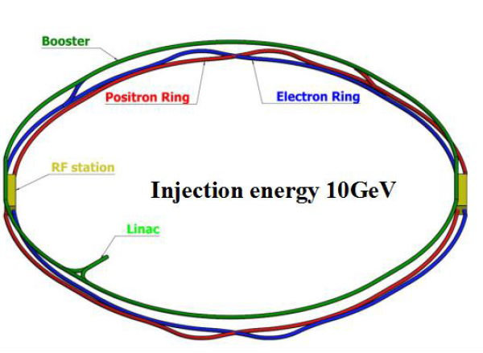
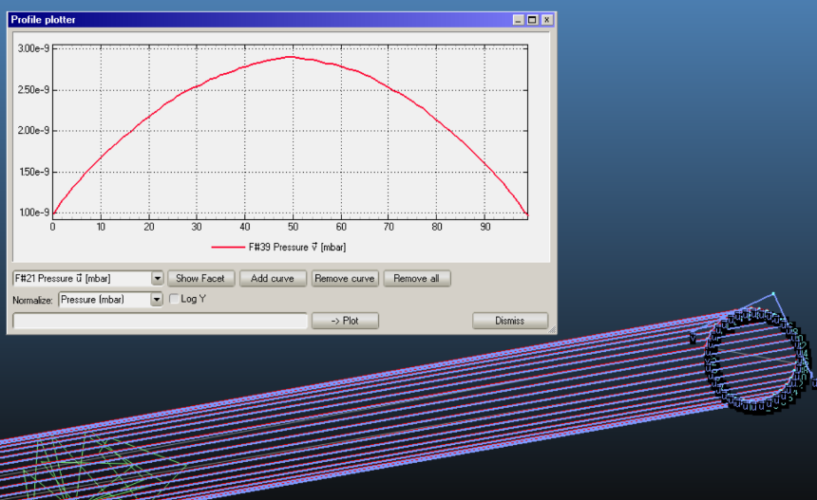
Preview of CEPC vacuum system
CDR Vacuum requirements and configuration Vs TDR
 | Material | Cross Section
Booster | Extruded aluminum 6061 | φ56
Electron Ring | Extruded copper, NEG film | 56×75 to φ56
Positron Ring | Extruded copper, NEG film | 56×75 to φ56
MDI | Copper/tungsten alloy, NEG film | φ20
Machine and Vacuum Parameters
Vacuum pressure profile of pipe
 | E | I | ρ | Vacuum
 | Gev | A | m | Torr
Higgs | 120 | 0.0167 | 10700 | 2 × 10⁻⁹
W | 80 | 0.084 | 10700 | 1.5 × 10⁻⁹
Z | 45.5 | 0.803 | 10700 | 8 × 10⁻¹⁰
tt | 180 | 0.0033 | 10700 | 1 × 10⁻⁸
CDR
TDR
Notes:
Vacuum of Booster 、storage ring, MDI are all considered and under technical design. Conventional technical such as ion pump /extruded copper pipes will be used in CEPC. There is no especial issue exceed our control, except to balance the impedance and gas absorb ability of NEG film

Slide 4
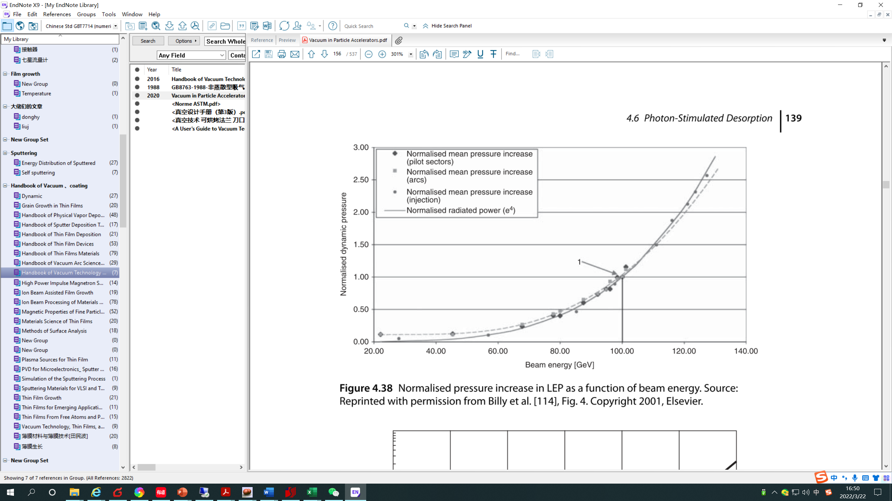
Vacuum Requirement Vs Calculation of Collider
PSD （photon-stimulated desorption）as a Function of Critical Energy of SR
 | E | PSD
 | Gev | molecules/photon
Higgs | 120 | 2.00E-05
W | 80 | 1.00E-05
Z | 45.5 | 4.00E-06
tt | 180 | 1.35E-03
CDR
η is a property of the chamber that depends on：
  Chamber material
Material fabrication and preparation
Amount of prior exposure to radiation
Photon angle of incidence
Photon energy
[4] MALYSHEV O B. Vacuum in Particle Accelerators [J]. 2020,

Slide 5
Vacuum Requirement Vs Calculation of Collider
PSD （photon-stimulated desorption）& TD （thermal desorption）
Pav-Ar, CH4-partial pressure， calculated as 1% gas load
CEPC 30MW |  |  |  |  |  |  | Pmax-Ar, CH4-partial pressure， calculated as 1% gas load
 | PSD | q_{td} | q_{lsr} | q | P_{s} | SIP Distance | Pav | Vacuum requirement
 | molecules/photon | Torr·L/s·cm² | Torr·L/s·cm² | Torr·L/s·cm² | L/s | m | Torr | Torr
Higgs | 2.00E-05 | 1E-12 | 8.21E-12 | 9.21E-12 | 10 | 22 | 1.1E-9 | 2 × 10⁻⁹
W | 1.00E-05 | 1E-12 | 2.75E-11 | 1.48E-11 | 10 | 22 | 1.5E-9 | 1.5 × 10⁻⁹
Z | 4.00E-06 | 1E-12 | 1.50E-10 | 3.09E-11 | 10 | 11 | 1.0E-09 | 8 × 10⁻¹⁰
tt | 1.35E-03 | 1E-12 | 2.43E-12 | 1.65E-10 | 10 | 11 | 4.1E-09 | 1 × 10⁻⁸
CEPC 50MW |  |  |  |  |  |  | Pmax-Ar, CH4-partial pressure， calculated as 1% gas load
Higgs | 2.00E-05 | 1E-12 | 1.43E-11 | 1.53E-11 | 10 | 22 | 1.7E-9 | 2 × 10⁻⁹
W | 1.00E-05 | 1E-12 | 4.82E-11 | 2.51E-11 | 10 | 22 | 2.1E-09 | 1.5 × 10⁻⁹
Z | 4.00E-06 | 1E-12 | 2.59E-10 | 5.28E-11 | 10 | 11 | 1. 8E-09 | 8 × 10⁻¹⁰
tt | 1.35E-03 | 1E-12 | 3.98E-12 | 2.70E-10 | 10 | 11 | 6.5E-09 | 1 × 10⁻⁸
In Z & tt mode, the number of sputtering ion pumps (SIP) needs to be doubled
Due to the high flow intensity of Z mode, the vacuum is lower than the design value, which needs to be further evaluated
[4] MALYSHEV O B. Vacuum in Particle Accelerators [J]. 2020,

Slide 6
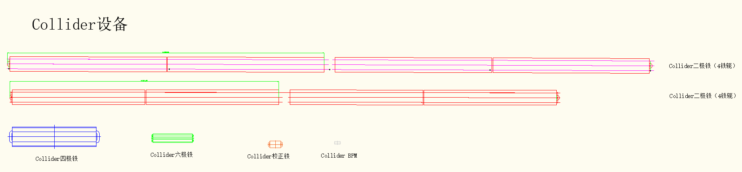
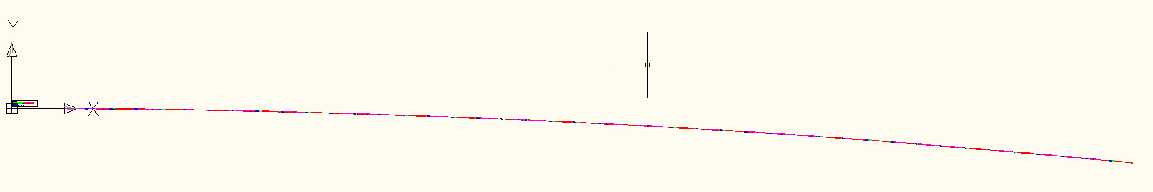
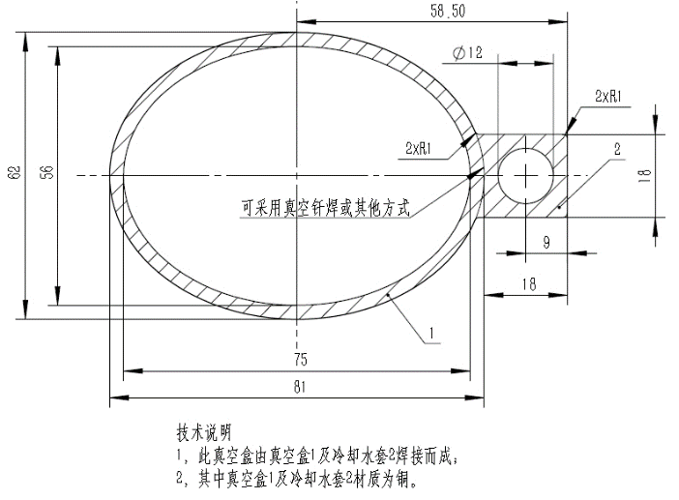
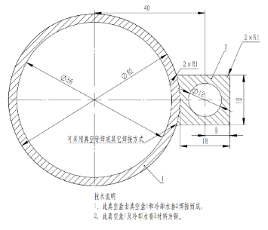
Progress R&D: Vacuum chamber
Due to the length of the magnet, the maximum length of the vacuum chamber is obout 11.3 meters, and the shortest length is about 3.8 meters.
Wang YW
LI MX
To eliminate the quadrupolar wakes, elliptical(75×56) vacuum chamber in the collider ring will be replaced by circular chambers with dimeter of 56 mm

Slide 7
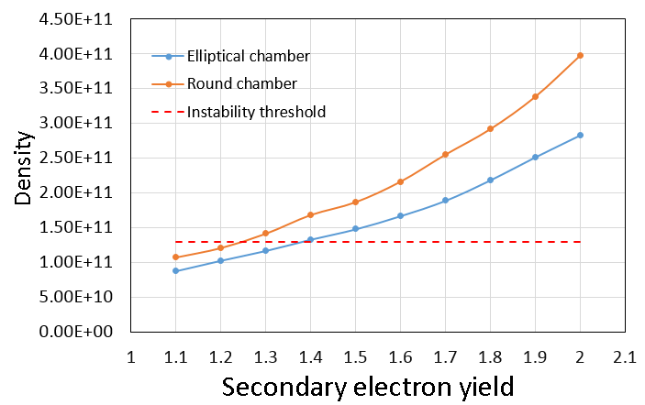
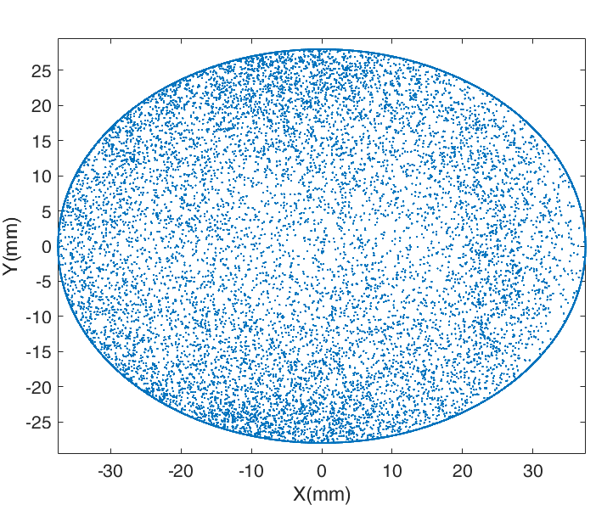
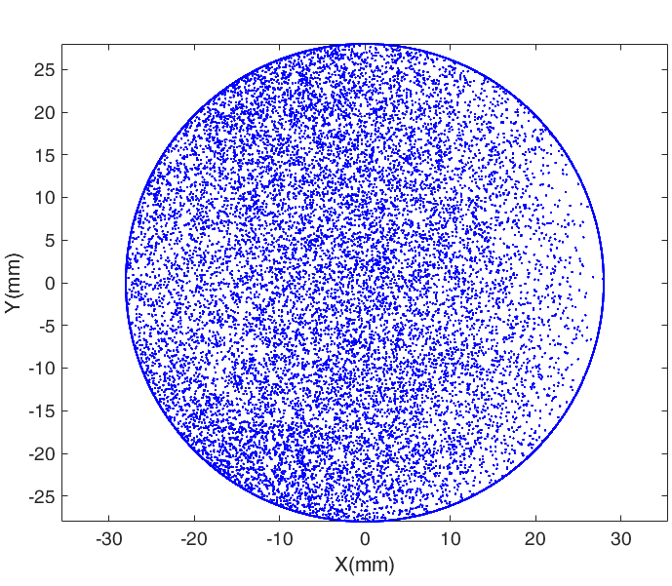
Challenge and Response : Electron Cloud & impedance
Liu Yu Dong
Electron Cloud of positron ring
Elliptical chamber: SEY<1.3
Round chamber: SEY<1.2
NEG coating : effective method on control SEY
Resistive wall impedance
  Round pipe of Copper (2mm) with NEG coating (200nm)
Strictly control on the coating thickness for impedance source to restrain the instability!
Liu Yu Dong .Modification suggestion of vacuum chamber for the collider ring. 2021/3/25

Slide 8
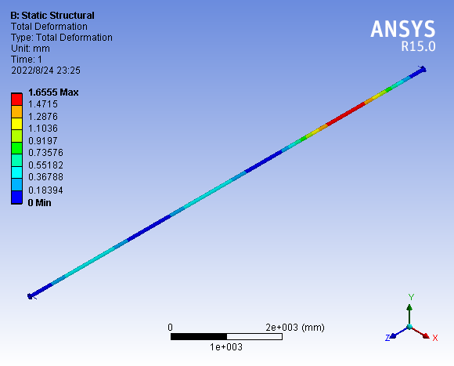
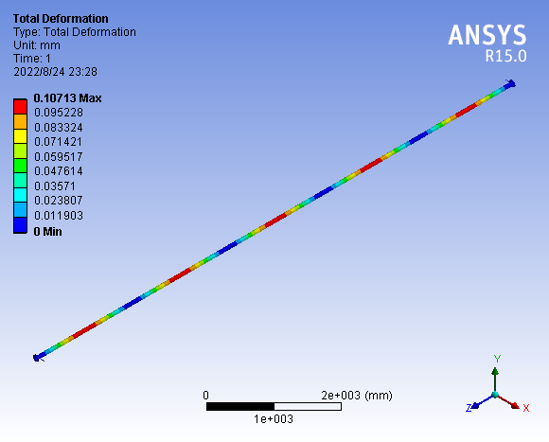
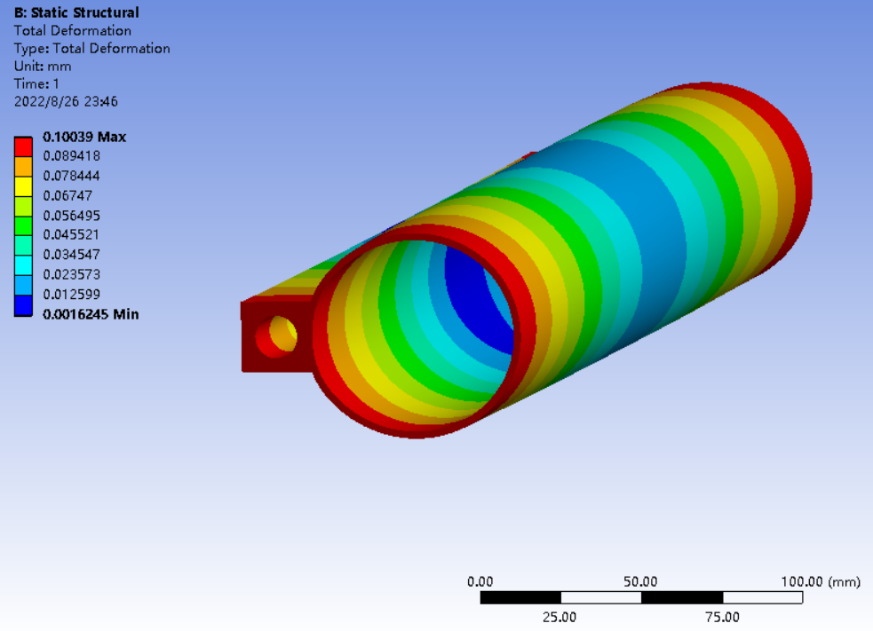
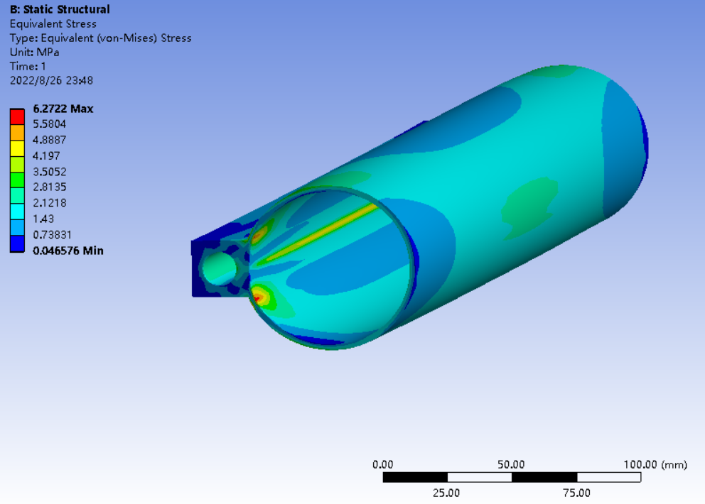
Strength calculation of 10 m vacuum chamber
Good support is an important guarantee to ensure that the 10-meter vacuum chamber does not deform
Every 3m is supported, with a maximum deformation of 1.66mm;
Every 2m is supported, with a maximum deformation of 0.1mm
The RF bellows need enough compression length

Slide 9
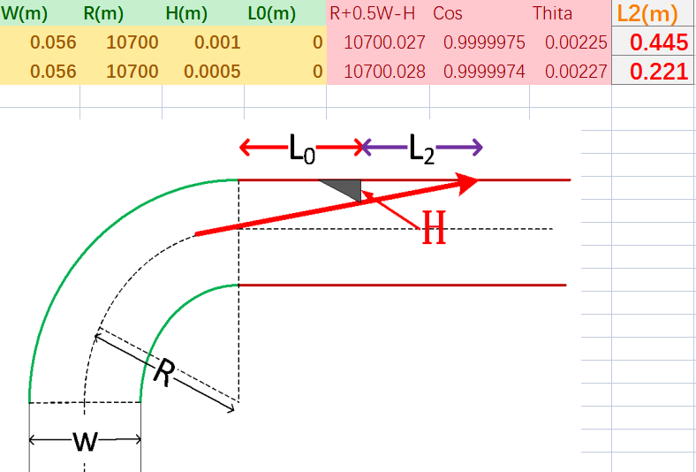
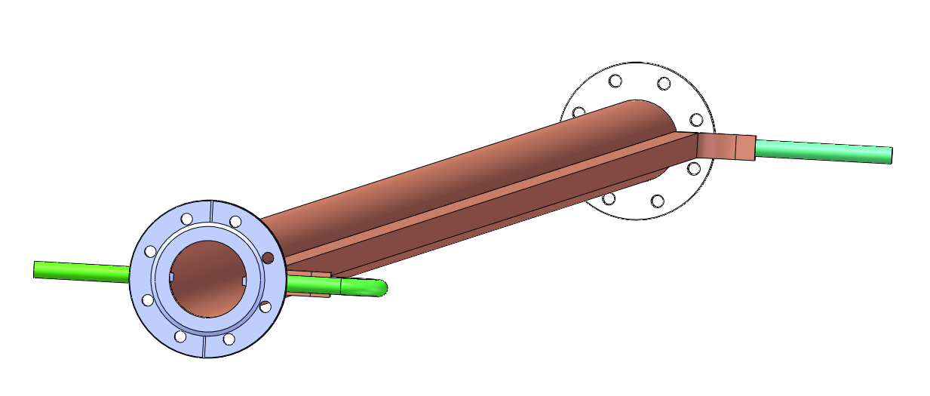
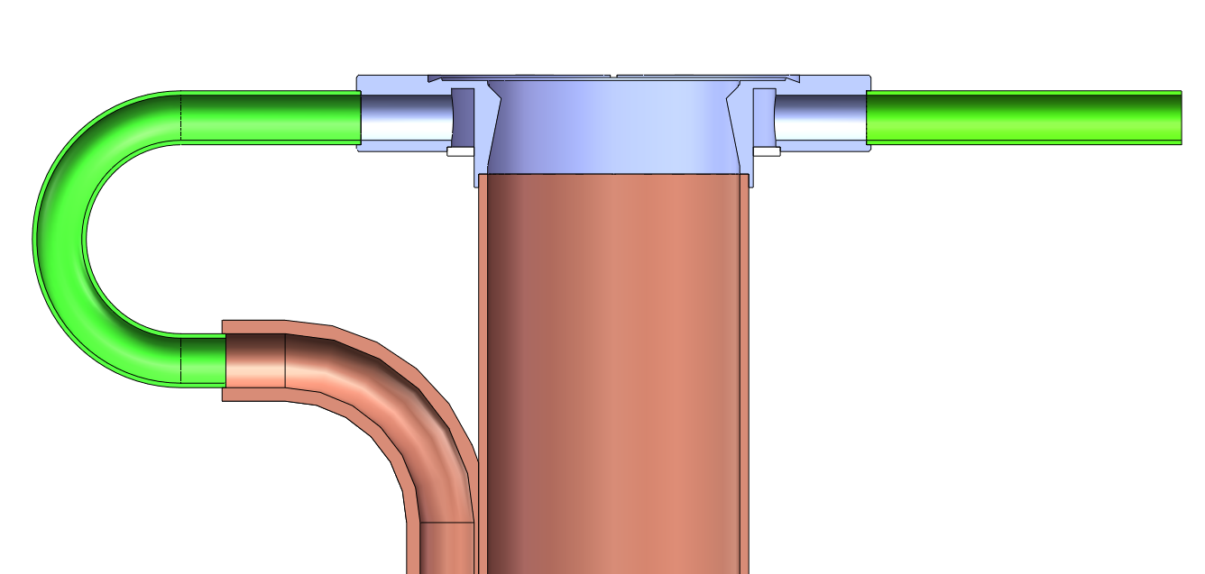
The block and water cooling design
Block is used to protect the bellows and BPM from the synchrotron radiation etc.
Due to the large bending radius, a 1mm block at the dipole iron outlet can block the synchronous light irradiation in the downstream 0.44m area, theoretically.
The installation accuracy needs to be very high.

Slide 10
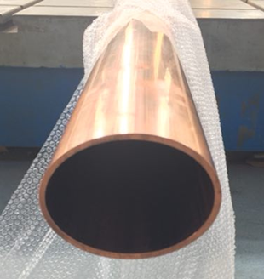
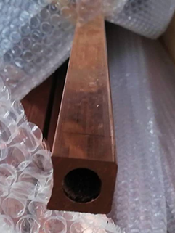
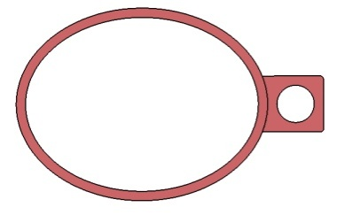
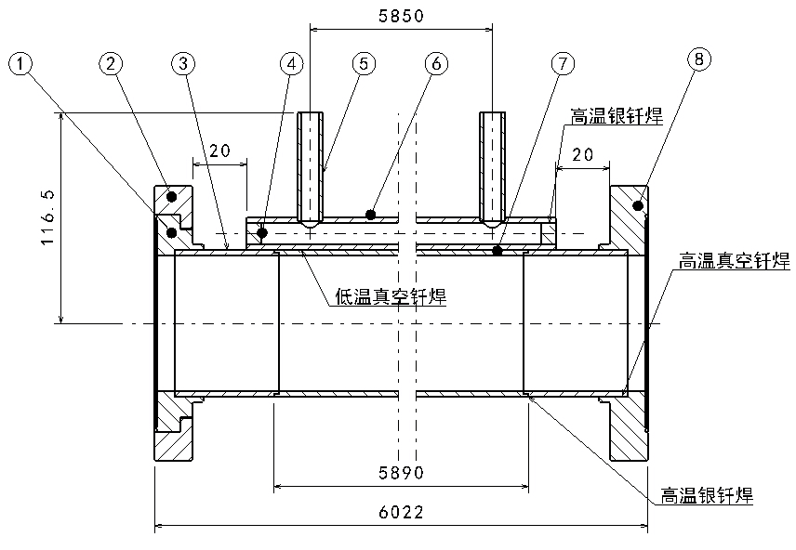
Technique process Cu vacuum chamber
Cu beam pipe and water cooling channel are extruded respectively, and brazed together.
Stainless steel material is used for flanges, and there is a rotatable flange at an end of vacuum chamber.
The flanges and beam pipe are welded by high temperature brazing solder, and low temperature brazing solder are used between the beam pipe and water cooling channel.
Vacuum chamber
Beam pipe +
Cooling channel

Slide 11
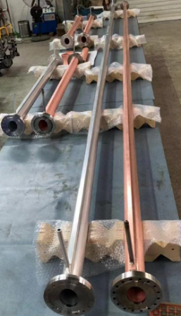
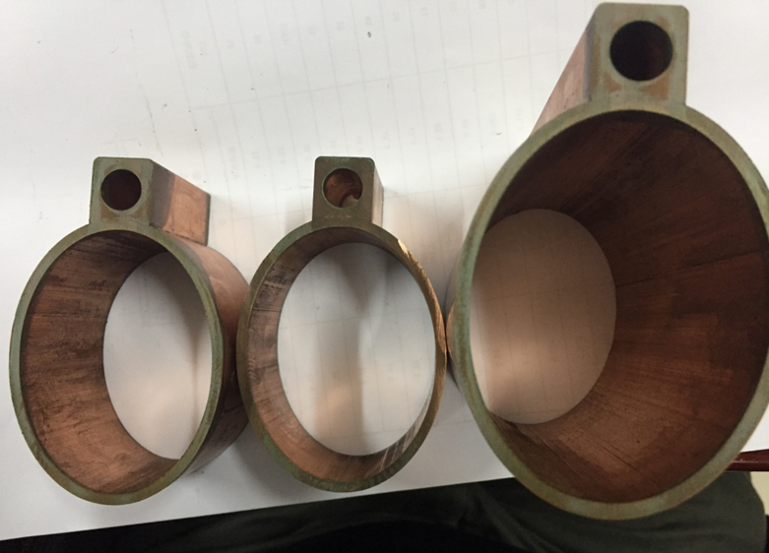
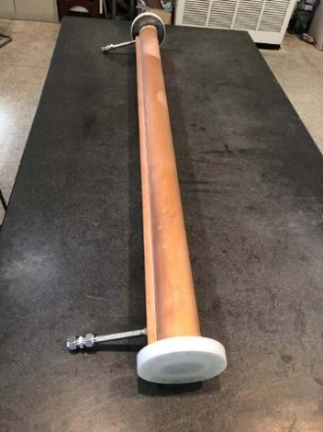
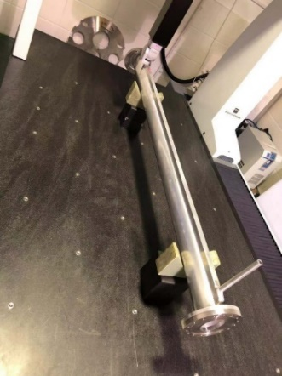
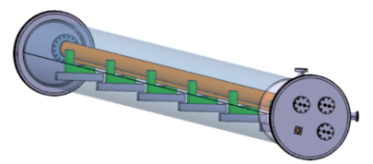
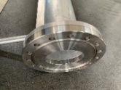
Cu and Al vacuum chamber prototypes
A 6 m long simple vacuum furnace is fabricated, which is used to weld the water cooling channels of Cu chambers through low temperature brazing solder.
The welding seams are checked by wire-electrode cutting. The welding joints are smooth and have good contacting.
The prototypes of copper & aluminum vacuum chambers with a length of 6 m have been fabricated and tested, which meet the engineering requirements.
Round chamber is easier to be fabricated.

Slide 12
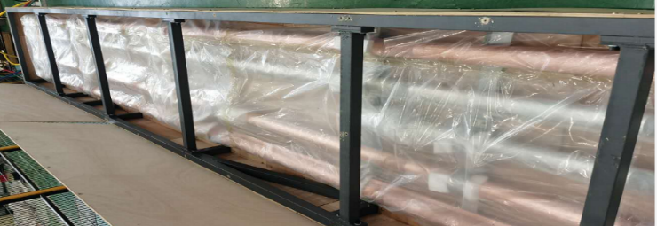
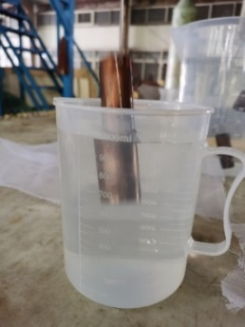
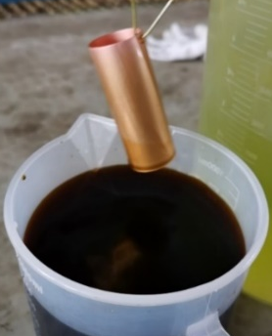
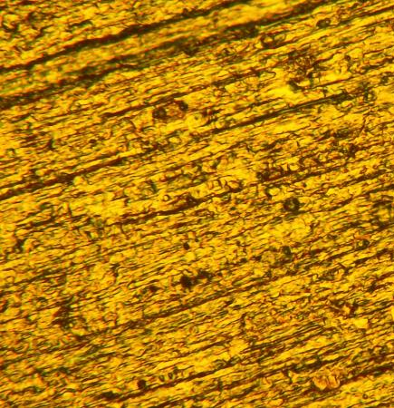
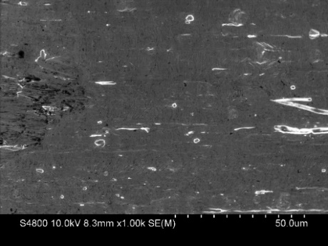
Preparation of Cu substrate for NEG coating
Vacuum pipes fabricated for NEG coating
Vacuum pipes will be degreasing
etching
passivation
5 um
The content of oxygen decreases as depth of Cu surface
Notes:
Because of NEG coating, Preparation of Cu substrate is very important, which processing contains degreasing, etching about 30min to remove the oxidized layer of Cu surface, and the passivation by chromic acid to prevent oxidized again

Slide 13
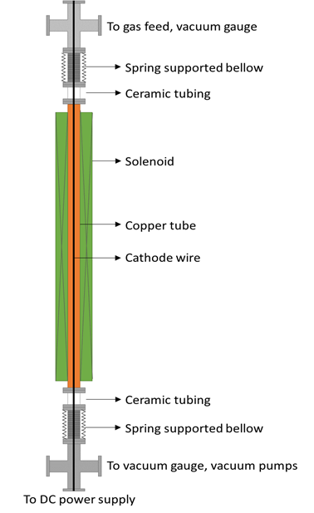
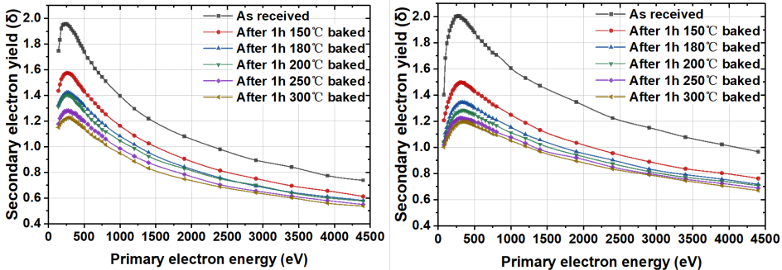
NEG coating of vacuum chamber
NEG coating suppresses electron multipacting (SEY < 1.2) and beam-induced pressure rises, as well as provides extra linear pumping.
The NEG coating is a titanium, zirconium, vanadium alloy, deposited on the inner surface of the chamber through sputtering.
The coating thickness should lower than 200nm to control impedance source to restrain the beam instability!
TiZrV
TiZrHfV
[1] LIU S, LIU Y, WANG P, et al. Experimental study on secondary electron emission characteristics of Cu [J]. Rev Sci Instrum, 2018, 89(2): 023303.

Slide 14
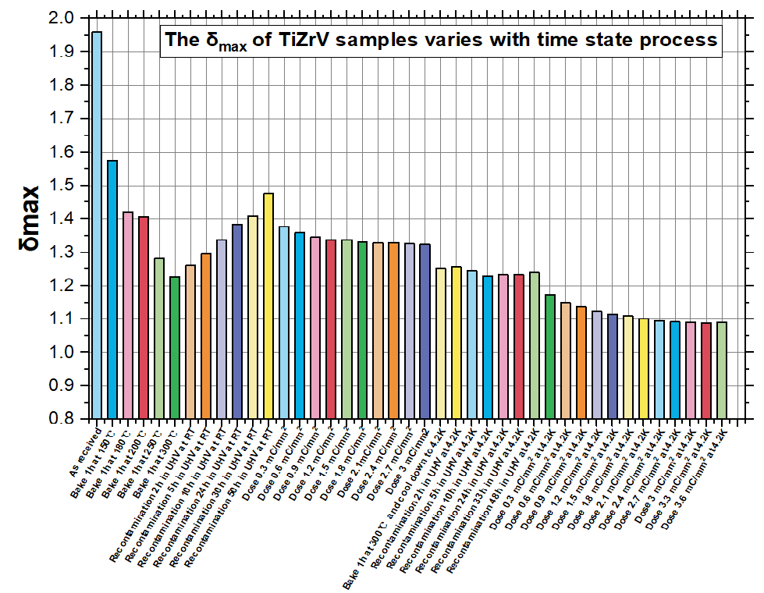
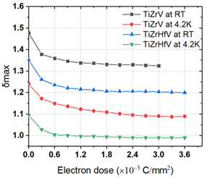
SEY of NEG coating
SEY will decrease to 1.1 after synchrotron radiation

Slide 15
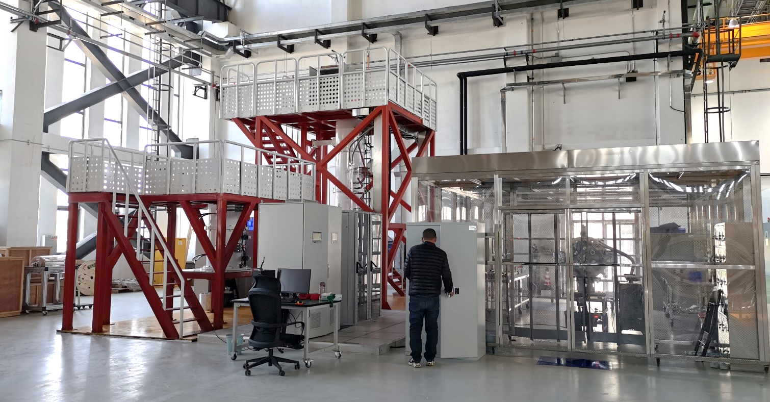
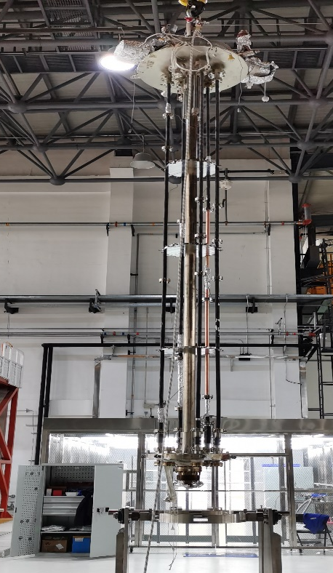
NEG coating facility synergy of HEPS
NEG coating of vacuum pipe
A setup of NEG coating which has ability to coat 4 meters long pipe has been built for vacuum pipes of HEPS at location of PAPS. And several test vacuum pipes of 4 meters long, φ22 mm of inner diameter have been coated, which shows that NEG film has good adhesion and thickness distribution. Theoretically, It is easier to be coated of CEPC vacuum pipe, because of the ratio of diameter to length is 56/6000 which is bigger then 22/4000.
A：φ22 vacuum chamber
Dust free room of NEG coating
B：Antechamber

Slide 16
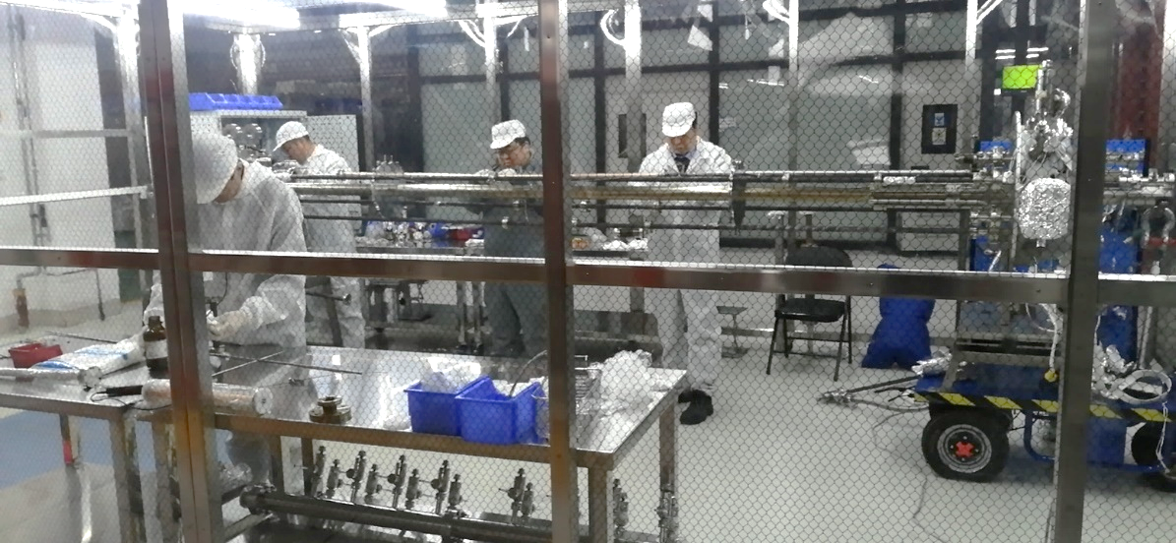
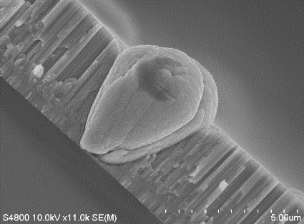
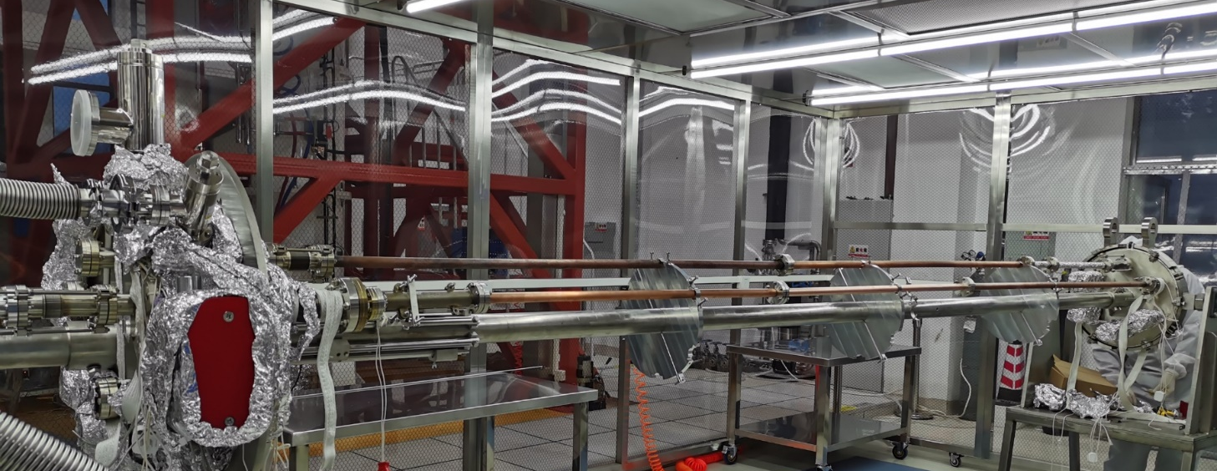
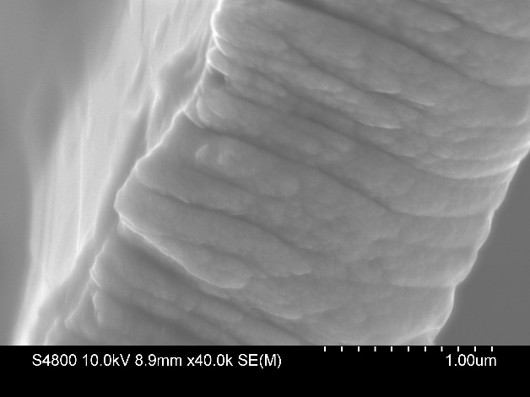
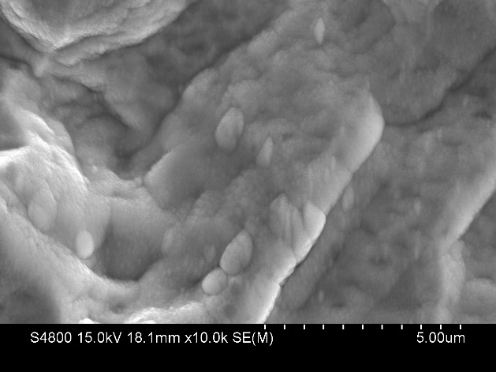
NEG coating facility synergy of HEPS
Quantity Production Control of NEG coating
Develop strict and standardized vacuum chamber assembly process to reduce pollutants and particles entering into NEG film during installation
Assembling
Air
Defect of NEG film
Parallel & Series connection
Dust free
Defect-free

Slide 17
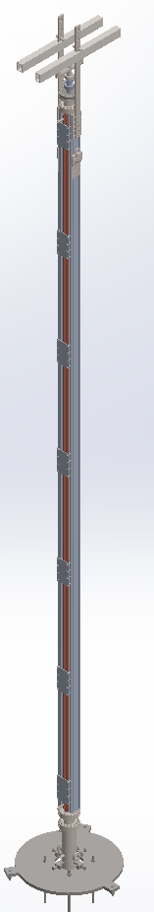
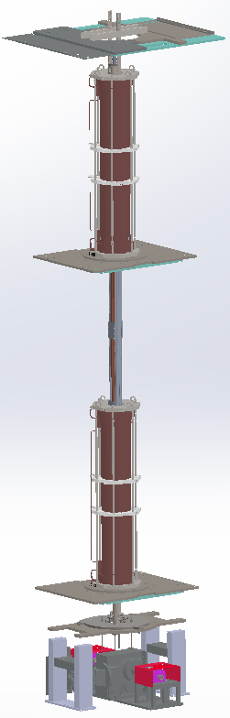
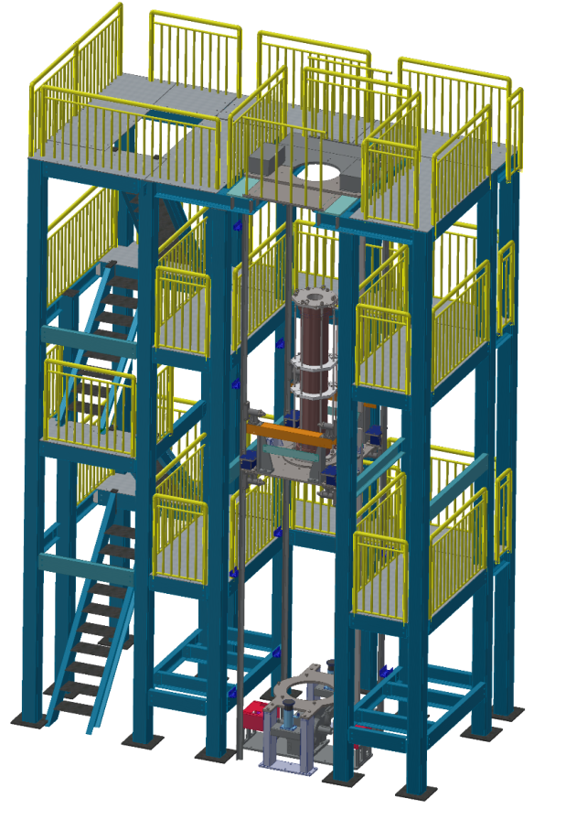
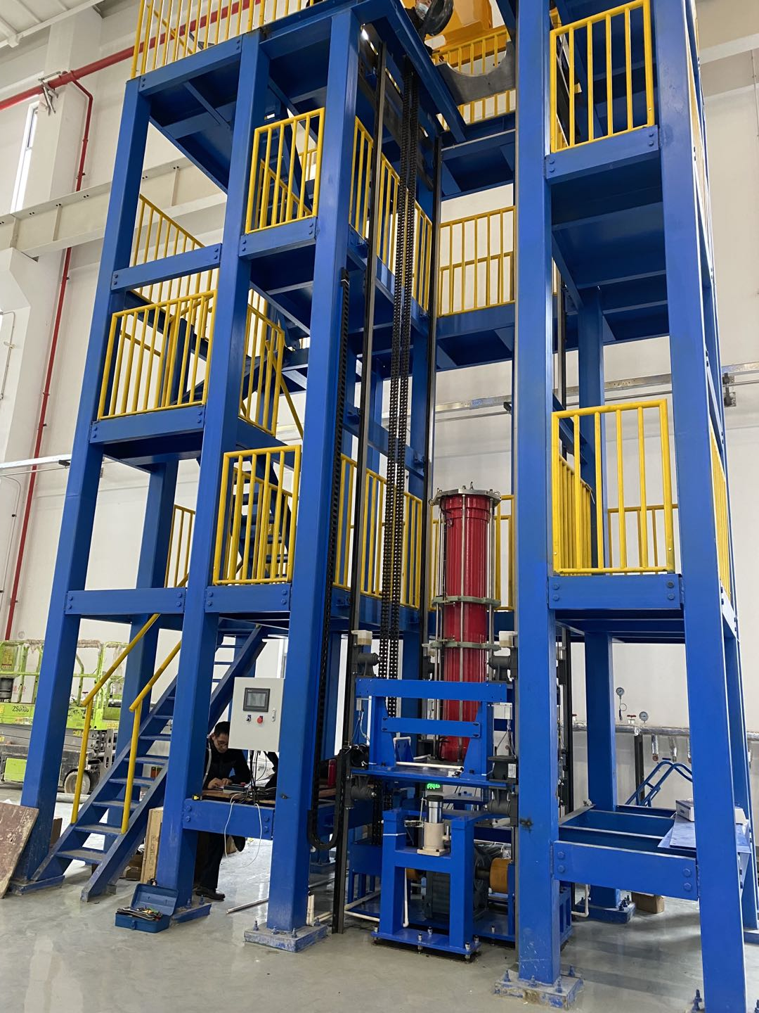
NEG coating facility @ Dongguan
A setup of NEG coating which has ability to coat 6 meters long pipe by moves solenoid is being built for vacuum pipes at location of Dongguan of Guangdong province.
6 meters

Slide 18
Progress R&D: NEG coating
Capacity and Pumping Speed of NEG
Capacity is an important parameter to characterize the life times of NEG film
Pumping speed will determine the pressure of vacuum
TiZrVHf
TiZrVHf

Slide 19
Pumping Speed as Activation/air Cycles

Slide 20
Absorbing speed of NEG coating at different activation temperature vs time
The pumping speed of NEG decreases with the increase of times of activation, but the pumping speed of NEG can be increased by prolonging the activation time and increasing the activation temperature
140h
150h
140h
130h
N063 is the number of NEG coating, (2),(3) represent the two different NEG coating pipes at the same coating process
No63（2）降温27小时后测
No63 (2) After 11 months N2 storage
No63 (3) After 7 months Ne storage
No63 (2) -18, Measure pumping speed immediately after cooling , the pressure is about 5E-9 Torr. While the others measurement
No63 (2) -18, The background of vacuum pressure is high during this NEG coating activation, due to only turbo molecular pump(TMP) worked at this occasion, while others activation both TMP and ion pump worked together . Which shows that the bad background vacuum of activation has an negative effect on the NEG pumping speed.

Slide 21
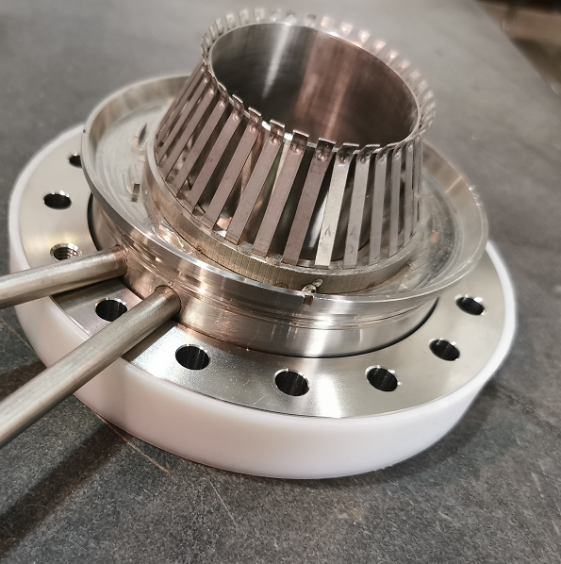
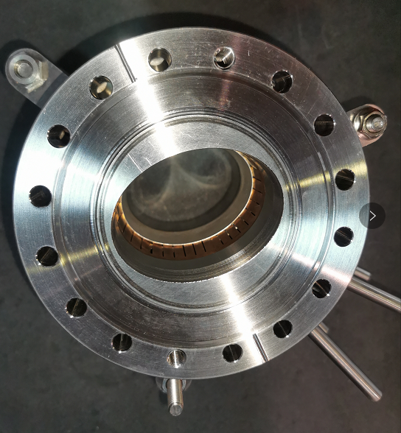
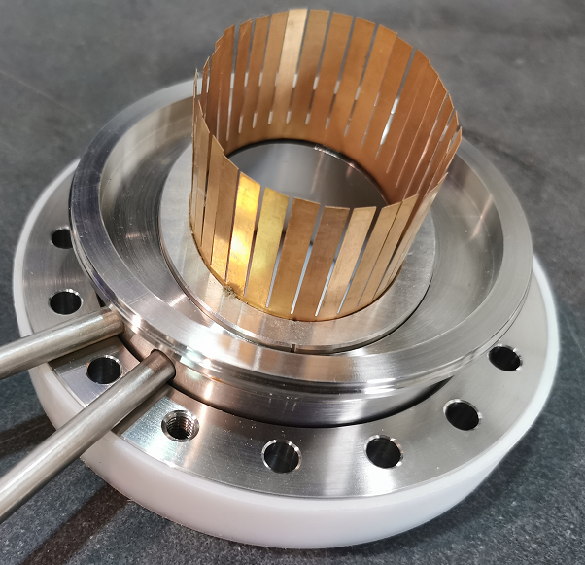
R&D of RF shielding bellows
Vacuum bellow modules are needed to compensate the mechanical misalignments of the vacuum chambers during installation and to absorb their thermal expansion during the bake-out. In order to reduce the beam impedance during operation with beams these modules are equipped with RF bridges to carry the image current.[1]
The key components experiments such as spring fingers and contact fingers have been carried out. Contact force is uniformly from different fingers and meets the target of 125±25g. The prototypes of RF shielding bellows have been fabricated in local company.

Slide 22

MDI vacuum
Conception design
OFE copper or Tungsten alloy will be used to made the fork vacuum chamber of MDI
NEG coating is suggested to the fork vacuum chambers
Water cooling pipe is designed due to the high thermal load of impedance at high light Z model.

Slide 23
Summary
Elliptical vacuum chambers in the collider ring are replaced by circular chambers with dimeter of 56 mm.
The prototypes of copper & aluminum vacuum chambers with a length of 6 m have been fabricated and tested, which meet the engineering requirements.
Similar to positron ring, NEG coating is proposed to vacuum chamber of electron storage ring to absorb extra gas load.
The prototypes of RF shielding bellows have been fabricated. Contact force is uniformly from different fingers and meets the target of 125±25g.
Tungsten alloy will be used to made the fork vacuum chamber of MDI

Slide 24
Thank you！

