Slide 1
CEPC Instrumentation development status
Yanfeng Sui
On behalf Beam Instrumentation Team,
Accelerator Center, IHEP

Slide 2
Outline
Update of CEPC beam instrumentation system design
Progress of beam instrumentation R&D
  BPM electronics
Summary

Slide 3
The beam instrumentation in CEPC Linac
 | Item | Method | Parameter | Amounts
Linac | Beam position | Stripline BPM | Resolution ：30um | 140
 | Beam current | ICT | 2.5%@1nC-10nC | 42
 | Beam profile | YAG/OTR | Resolution: 30um | 80
 | Beam emittance | Q+PR | 10% | 3
 | Beam energy & spread | AM+PR | 0.1% | 3
Damping ring | Average current | DCCT | Resolution :50uA@0.1mA-30mA | 1
 | Beam position | Button BPM | Resolution : 20um @ 5mA TBT | 40
 | Tune measurement | Frequency sweeping | Resolution:0.001 | 1

Slide 4
The beam instrumentation in CEPC booster
 | Item |  | Method | Parameter | Amounts
Booster | Beam position monitor | Turn by turn | Button electrode BPM | Measurement area (x × y)：±20mm×±10mm Resolution：<0.02mm Measurement time of COD：< 4 s | 2408
 |  | Bunch by bunch | Button electrode BPM | Measurement area (x × y)：±40mm×±20mm Resolution：0.1mm
 | Bunch current |  | BCM | Measurement range：10mA / per bunch Relatively precision：1/4095 | 2
 | Average current |  | DCCT | Dynamic measurement range：0.0~1.5A Resolution:50uA@0.6-8mA Linearity：0.1 % Zero drift: <0.05mA | 2
 | Beam size |  | Double slit interferometer x ray pin hole | Resolution:0.2 µm | 2
 | Bunch length |  | Streak camera Two photon intensity interferometer | Resolution:1 ps | 2
 | Tune measurement |  | Frequency sweeping method | Resolution:0.001 | 2
 |  |  | DDD | Resolution:0.001
 | Beam loss monitor |  | Optical fiber | Space resolution:0.6m | 400
 | Feedback system |  | TFB | Damping time<=3ms | 2
 | Feedback system |  | LFB | Damping time<=35ms（50ms） | 2

Slide 5
The beam instrumentation in CEPC ring
 | Item |  | Method | Parameter | Amounts
Storage ring | Beam position monitor | Closed orbit | Button electrode BPM | Measurement area (x × y)：±20mm×±10mm Resolution：<0.6um Measurement time of COD：< 4 s | 3544
 |  | Bunch by bunch | Button electrode BPM | Measurement area (x × y)：±40mm×±20mm Resolution：0.1mm
 | Bunch current |  | BCM | Measurement range：10mA / per bunch Relatively precision：1/4095 | 2
 | Average current |  | DCCT | Dynamic measurement range：0.0~1.5A Linearity：0.1 % Zero drift: <0.05mA | 2
 | Beam size |  | Double slit interferometer x ray pin hole | Resolution:0.2 µm | 4
 | Bunch length |  | Streak camera Two photon intensity interferometer | Resolution:1ps@10ps | 2
 | Tune measurement |  | Frequency sweeping method | Resolution:0.001 | 2
 |  |  | DDD | Resolution:0.001
 | Beam loss monitor |  | PIN-diode | Dynamic range:120 dB Maximum counting rates≥10 MHz | 5800
 | Feedback system |  | TFB | Damping time<=1ms | 2+1
 |  |  | LFB | Damping time<=12ms | 2

Slide 6
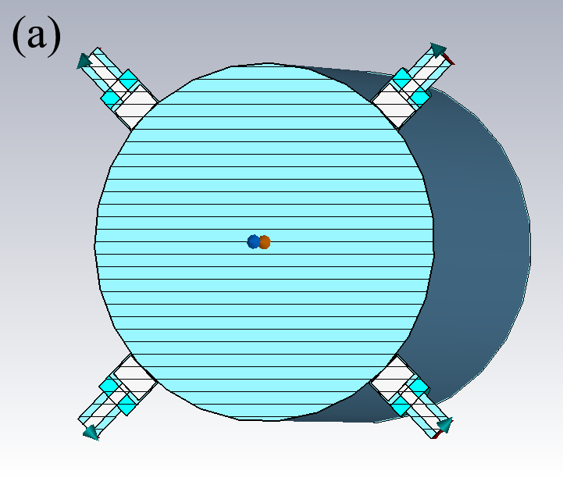
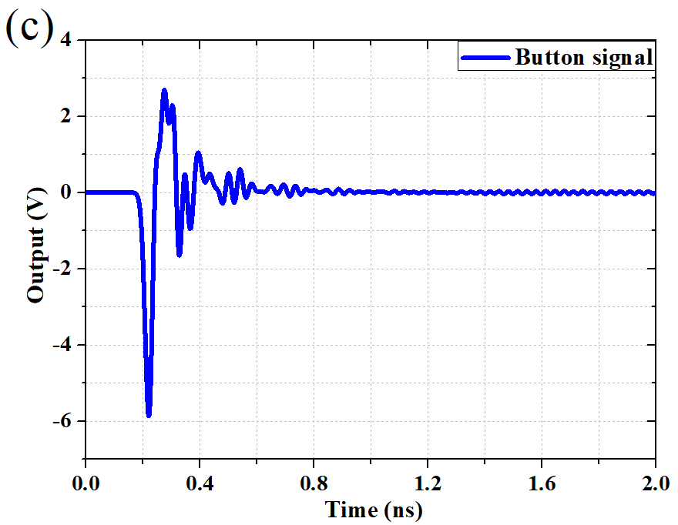
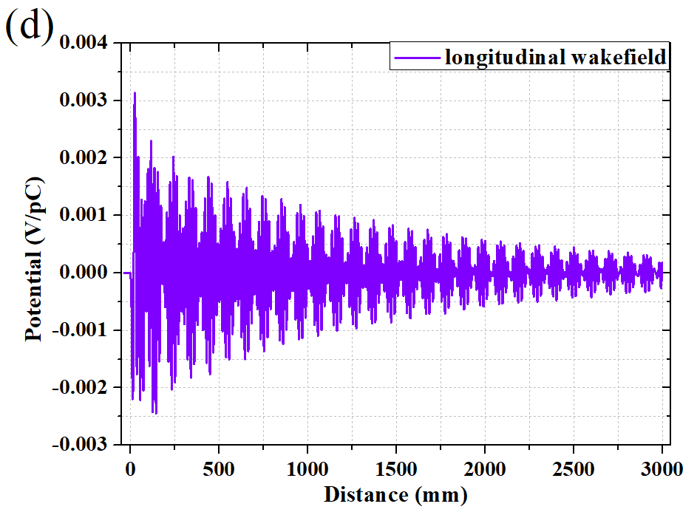
Update of BPM pick-ups
With one Beam Position Monitor (BPM) near each quadruple, there will be 3544 BPMs in storage ring and 2408 in the booster
The best solution is a capacitive monitor with a button-like electrode, as used in most other electron machines. In order to attain the required geometrical accuracy, the four buttons will be mounted on a machined block of stainless steel welded into vacuum chamber. More detail in Jun He’s report “Beam position monitors designed for the CEPC” in this workshop.
 | ttbar |  | Higgs |  | W |  | Z
 | Real | CST | Real | CST | Real | CST | Real | CST
Charge | 20e10 | 32 nC | 14e10 | 22.4 nC | 13.5e10 | 21.6 nC | 14e10 | 22.4 nC
Bunch length | 2.2/2.9 | 3 mm | 2.3/3.9 | 4 mm | 2.5/4.9 | 5 mm | 2.5/8.7 | 8.7 mm
Vpp | 635V |  | 359V |  | 295V |  | 179V
Z_500M | 0.22Ω |  | 0.22Ω |  | 0.22Ω |  | 0.22Ω
P_500M | -7.3dBm/320mA |  | -12.8dBm/170mA |  | -10.6dBm/216mA |  | -10.4dBm/224mA
Kx=Ky | 19.9mm |  | 19.9mm |  | 19.9mm |  | 19.9mm
Parameters
Bunch | Length | 4.1 mm
 | Charge | 1 nC
Mechanical | r_{b} | 3 mm
 | t_{b} | 4 mm
 | g_{b} | 0.25 mm
 | b | 28 mm

Slide 7
Update of beam feedback system

Slide 8
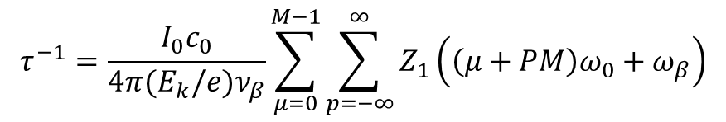
Transverse resistive wall instability - wang na
$$τ^{−1}=\frac{I_{0}c_{0}}{4π(E_{k}/e)ν_{β}}\sum_{μ=0}^{M−1}{\sum_{p=−∞}^{∞}{Z_{1}\left(\left(μ+PM\right)ω_{0}+ω_{β}\right)}}$$
The worst case lowest energy and highest current, so Z mode is the most dangerous.
 | 30 MW
Instability growth time [ms] | 1.9 (~6 turns)
Radiation damping [ms] | 850
Bunch by bunch feedback [ms] | 1.0 (~3 turns)
Growth of the most dangerous mode vs. damping factors

Slide 9
The power of transverse feedback
TFB CEPC ring（CDR）
Parameter | Value
E | 4.55E+10
R | 1.55E+05
Beta-k | 2.25E+02
Beta-m | 2.25E+02
A | 2.00E-04
T | 3.30E-04
tao | 1.60E-03
P | 8.98E+02
TFB CEPC Ring （30MW）
Parameter | Value
E | 4.55E+10
R | 1.55E+05
Beta-k | 2.25E+02
Beta-m | 2.25E+02
A | 2.00E-04
T | 3.30E-04
tao | 1.00E-03
P | 2.30E+03

Slide 10
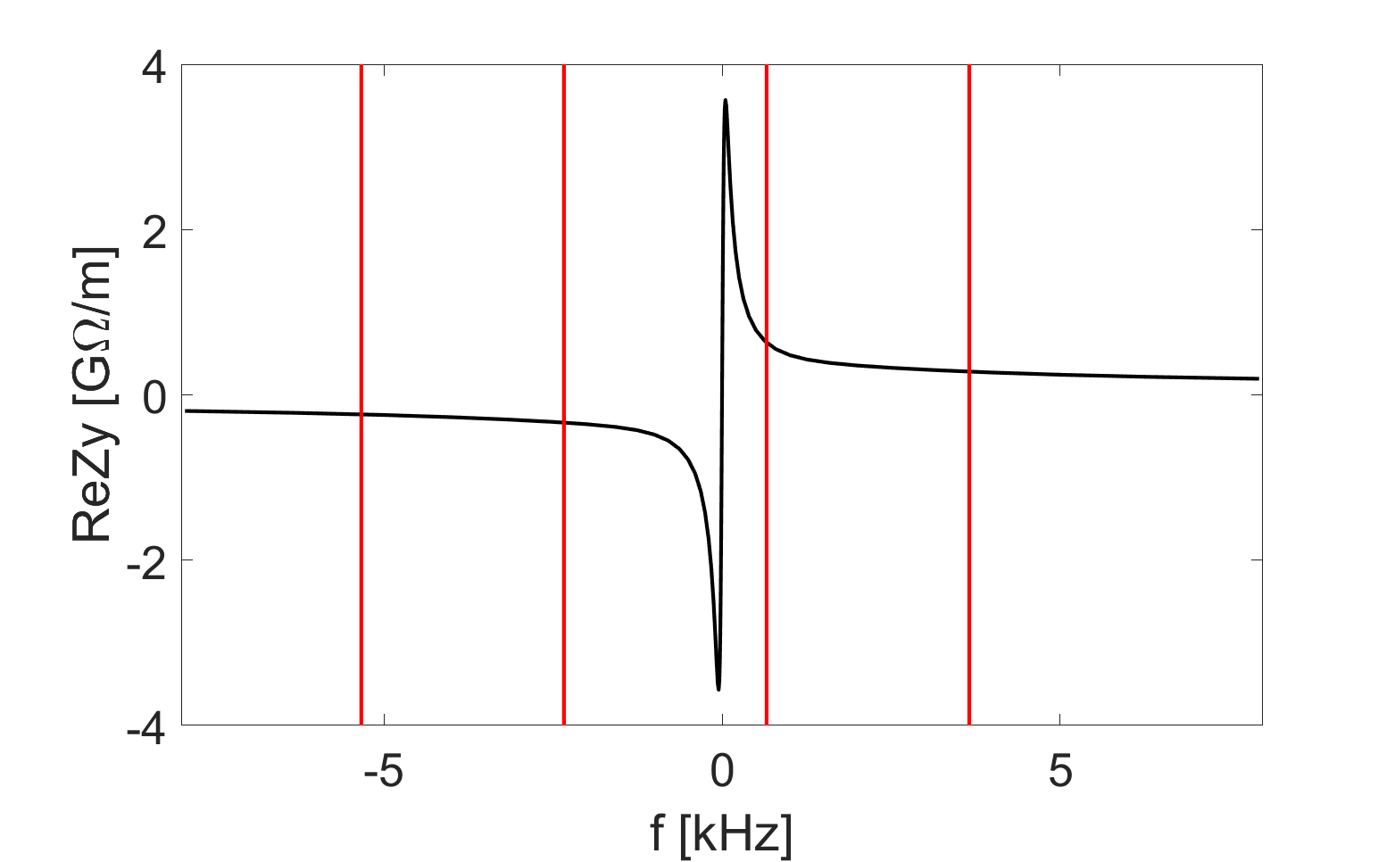
The update of TFB feedback system
Narrow-band feedback + bunch by bunch feedback
Consider narrow-band feedback, in addition to bunch-by-bunch ones, for specific instabilities such as resistive wall coupled bunch. Mode No. 19650 & 19651
More detail in Junhui Yue’s report “CEPC feedback systems studies” in this workshop
Mode frequency [kHz] | Mode number | Growth time [ms]
-2.338 | 19650 | 1.1 (3 turns)
-5.335 | 19651 | 1.6 (5 turns)
-8.332 | 19650 | 2.0 (6 turns)
-11.330 | 19649 | 2.3 (7 turns)
n=11252
n=11253
n=11251
n=11254

Slide 11
The power of longitudinal feedback
CEPC LFB（CDR）
Parameters | Value
f | 6.50E+08
alpha | 1.11E-05
mus | 2.80E-02
deltaphi | 1.70E-03
Tao(s) | 2.00E-01
E | 4.55E+10
Rk(Ω) | 2600
V(V) | 3.00E+03
P(W) | 1.73E+03
CEPC LFB（30MW-12ms）
Parameters | Value
f | 6.50E+08
alpha | 1.48E-05
mus | 3.50E-02
deltaphi | 1.70E-03
Tao(s) | 1.20E-02
E | 4.55E+10
Rk(Ω) | 2600
V(V) | 4.69E+04
P(W) | 4.23E+05

Slide 12
CEPC TDR Collider Ring Cavity HOM CBI –Zhai Jiyuan
30 MW SR per beam. Consider only SR damping for HOM Q_{L} requirement. Cavity HOM spread not included. | ttbar |  | Higgs | W | Z
 | new 5-cell common cavity | old 2-cell common cavity | common cavity | separate cavity | by-pass separate cavity
Cell number / cavity | 5 | 2 | 2 | 2 | 1
Beam energy [GeV] | 180.0 | 180.0 | 120.0 | 80.0 | 45.5
Beam current per beam [mA] | 3.4 | 3.4 | 16.7 | 84.0 | 802.6
Revolution time [μs] | 333.6 | 333.6 | 333.6 | 333.6 | 333.6
Momentum compaction | 7.1E-06 | 7.1E-06 | 7.1E-06 | 1.4E-05 | 1.4E-05
Synchrotron tune | 0.08 | 0.08 | 0.05 | 0.06 | 0.04
Synchrotron oscillation period [ms] | 4.4 | 4.4 | 6.6 | 5.5 | 9.5
Longitudinal damping time [ms] | 6.6 | 6.6 | 22.2 | 74.7 | 410.2
Cavity number on line per beam | 240 | 240 | 240 | 120 | 30
Average beta-x/y in RF region [m] | 30 | 30 | 30 | 30 | 30
Longitudinal impedance threshold per cavity [ohm*MHz] | 3.58E+11 | 3.58E+11 | 9.62E+09 | 9.05E+08 | 2.27E+07
Transverse impedance threshold per cavity [ohm/m] | 1.88E+08 | 1.88E+08 | 7.48E+06 | 1.18E+06 | 5.12E+04
Cavity higher order mode | Required Q_{L}
TM011 | 7.2E+06 | 9.4E+06 | 2.5E+05 | 2.4E+04 | 1.5E+03
TM020 | 9.3E+06 | 4.0E+08 | 1.1E+07 | 1.0E+06 | 4.2E+04
TE111 | 4.5E+05 | 1.3E+06 | 5.3E+04 | 8.4E+03 | 6.5E+02
TM110 | 5.5E+05 | 9.0E+05 | 3.6E+04 | 5.6E+03 | 3.5E+02
2-cell | f (GHz) | R/Q (Ω)
TM011 | 1.17 | 65.20
TM020 | 1.38 | 1.29
TE111 | 0.84 | 279.82
TM110 | 0.91 | 420.05
5-cell | f (GHz) | R/Q (Ω)
TM011 | 1.17 | 84.80
TM020 | 1.43 | 54.15
TE111 | 0.82 | 832.23
TM110 | 0.93 | 681.15
1-cell | f (GHz) | R/Q (Ω)
TM011 | 1.09 | 28.17
TM020 | 1.32 | 0.82
TE111 | 0.79 | 157.00
TM110 | 0.90 | 291.07
No beam feedback is needed even for 50 MW.
Designed 650 MHz 2-cell cavity HOM coupler Q_{L} can meet Higgs and W damping requirement.
1-cell cavity similar to BEPCII can meet 30/50 MW Z HOM damping requirement. No beam feedback is needed even for 50 MW.
Low lumi Z with 2-cell cavities may need beam feedback depending on the operation beam current.

Slide 13
Update of Synchrotron light based measurement

Slide 14
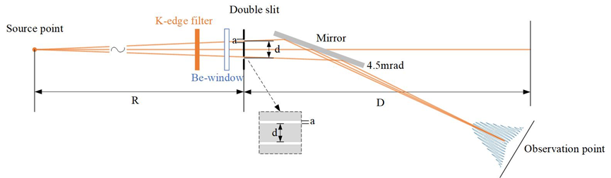
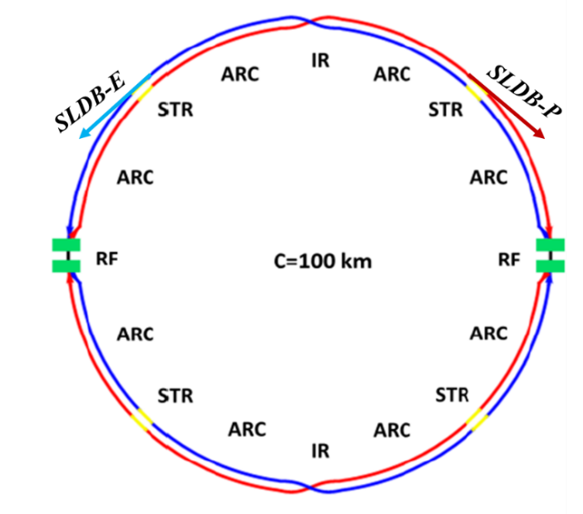
Synchrotron light based measurement
Two synchrotron light diagnostic beamlines (SLDB) have been designed at electron ring and positron ring respectively
A configuration for double slit interferometer for beam size measurement at CEPC is shown as below. The radiation produced from the dipole is firstly through a K-edge filter with Kr. After passing through a Be-window, a double slit and a mirror, a typical interferogram can be observed on the imaging screen.
The expected vertical beam size from the dipole is 5.7 µm
with d=100µm, 0.72 with d=200µm and 0.47 with d=300µm

Slide 15
R&D Motivation
To reduce the budget of BI system, due to a large number of monitors and the high price of commercial products.
To grasp key technologies of beam diagnostics.
To make the whole system easy to maintain and upgrade

Slide 16
Overview of the BPM electronics R&D
The R&D of BPM electronics founded by seed money of IHEP and other funding（HEPS-TF etc.）
Kicked off in the start of 2015
The first version(V1.0) of the electronics was finished in 2018.
The second version(V2.0) was finished in middle of 2019. modification was done to improve the performance of the electronics. 8 versions have been tested in the past six years.
In 2019, self-developed electronics were put into use in the BEPCII.

Slide 17
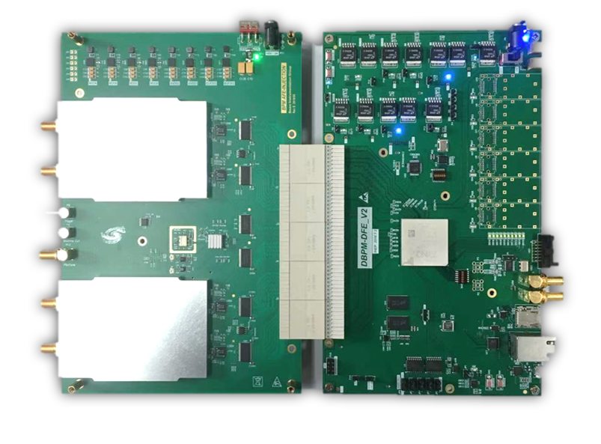
Overview of the BPM Electronics
ADF
ADF
Since of ADF interface is not suitable for RF signal transmission,
so we developed new hardware, ADC&CLK in AFE board.
AFE board：RF Processing+ ADCs + Clock + Pilot tone;
DFE board：FPGA(ZYNQ) + DDR3 memory + SFPs + Ethernets;
EPICS IOC：In ZYNQ FPGA, Increase the convenience of the BPM system;

Slide 18
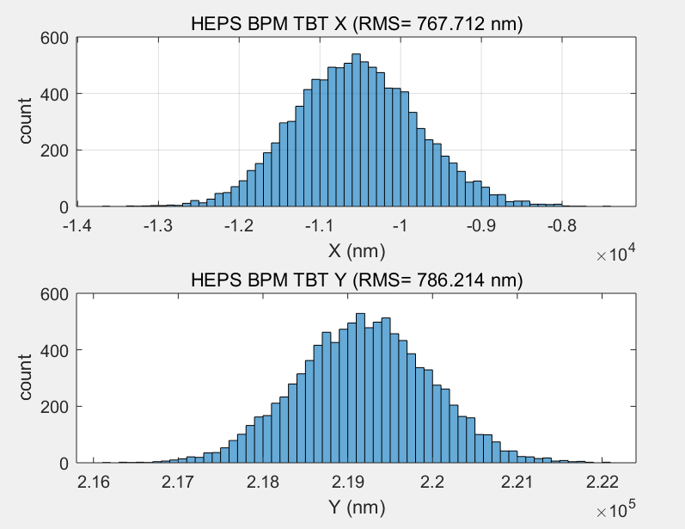
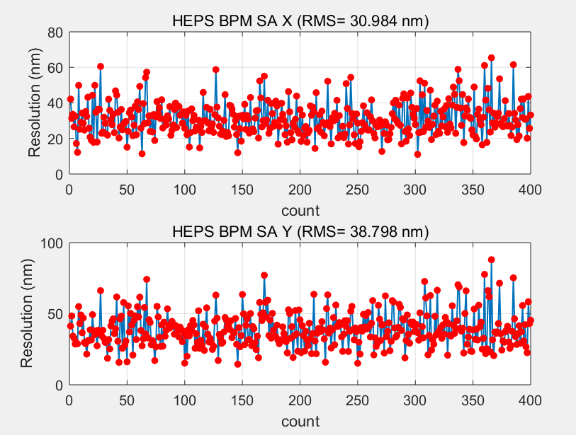
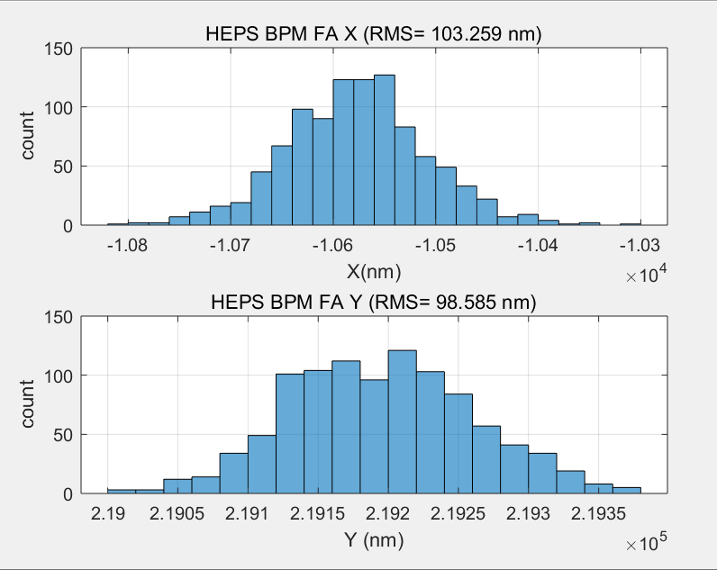
BPM TbT/FA/SA Resolution Test in Lab
TBT RMS (X=767nm,y=786nm)
SA RMS(X=30nm,Y=38nm) 10points STD
We test the performance of DBPM in house
RF frequency is 499.8MHz(-15dBm) from R&S SMA100
TBT data rms xpos ≈767nm, ypos ≈786nm;
FA data rms xpos ≈103nm, ypos ≈98nm;
SA data rms xpos ≈30nm, ypos ≈38nm;
Kx=Ky=8.26mm;
FA RMS (X=103nm,y=98nm)

Slide 19
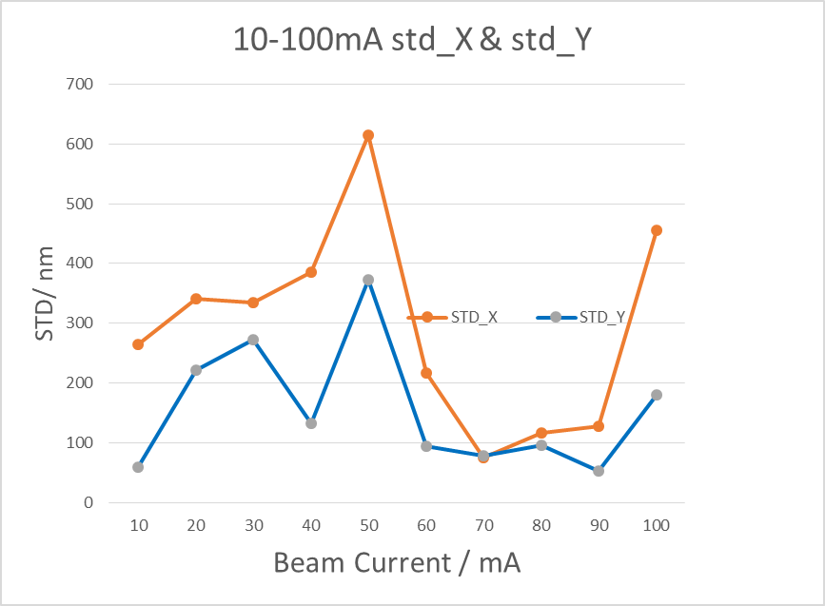
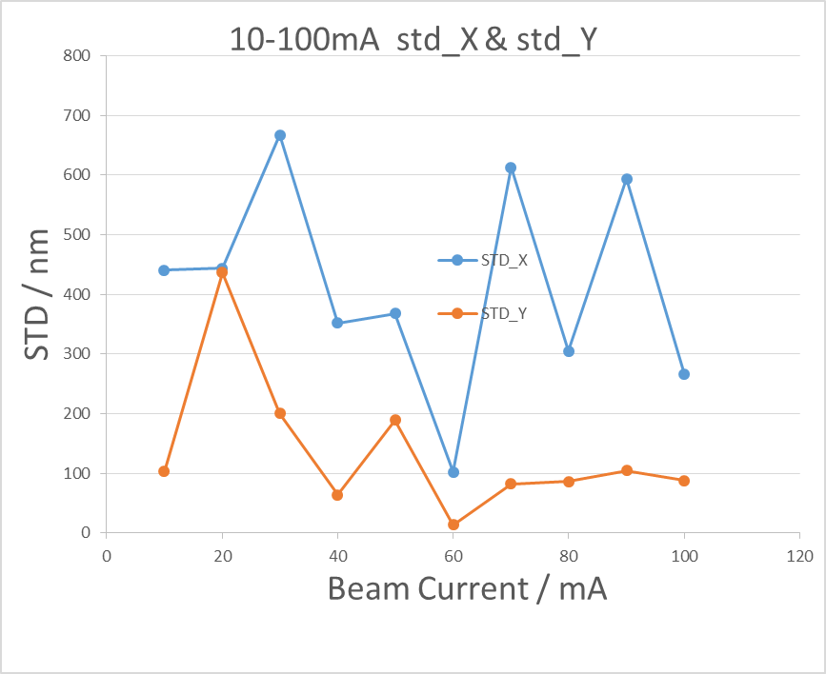
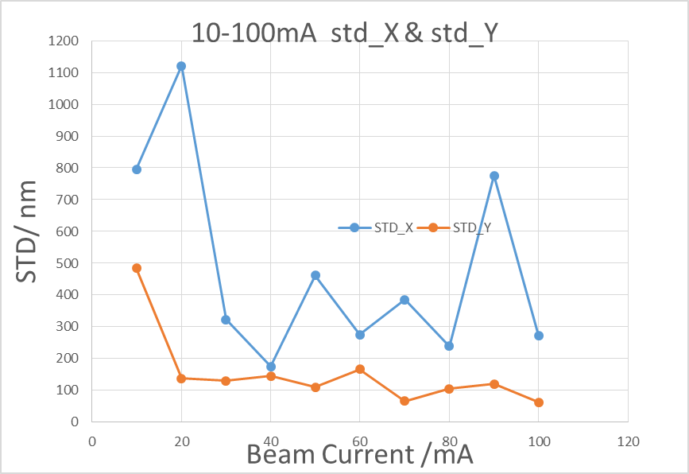
Beam test in BEPCII
Resolution of BPM electronics （110 bunches, 1/3）
BPM3
BPM4
BPM5
BPM electronics NO. | Beam current（10-20mA） |  | Beam current（20-818mA）
 | ΔX(um) | ΔY(um) | ΔX(um) | ΔY(um)
Commercial product | - | - | 6 | 7
BPM1 | - | - | 10 | 17
BPM3 | 22 | 11 | 29 | 11
BPM4 | 71 | 61 | 11 | 36
BPM5 | 5 | 17 | 4 | 31
Beam current dependence of BPM electronics

Slide 20
Home made products VS commercial products
BPM pick up
Cable
Comparative test of self-developed product and commercial product
Libera brilliance+ VS Home-made BPM
Both are the same pick-up signal from button-> splitter

Slide 21
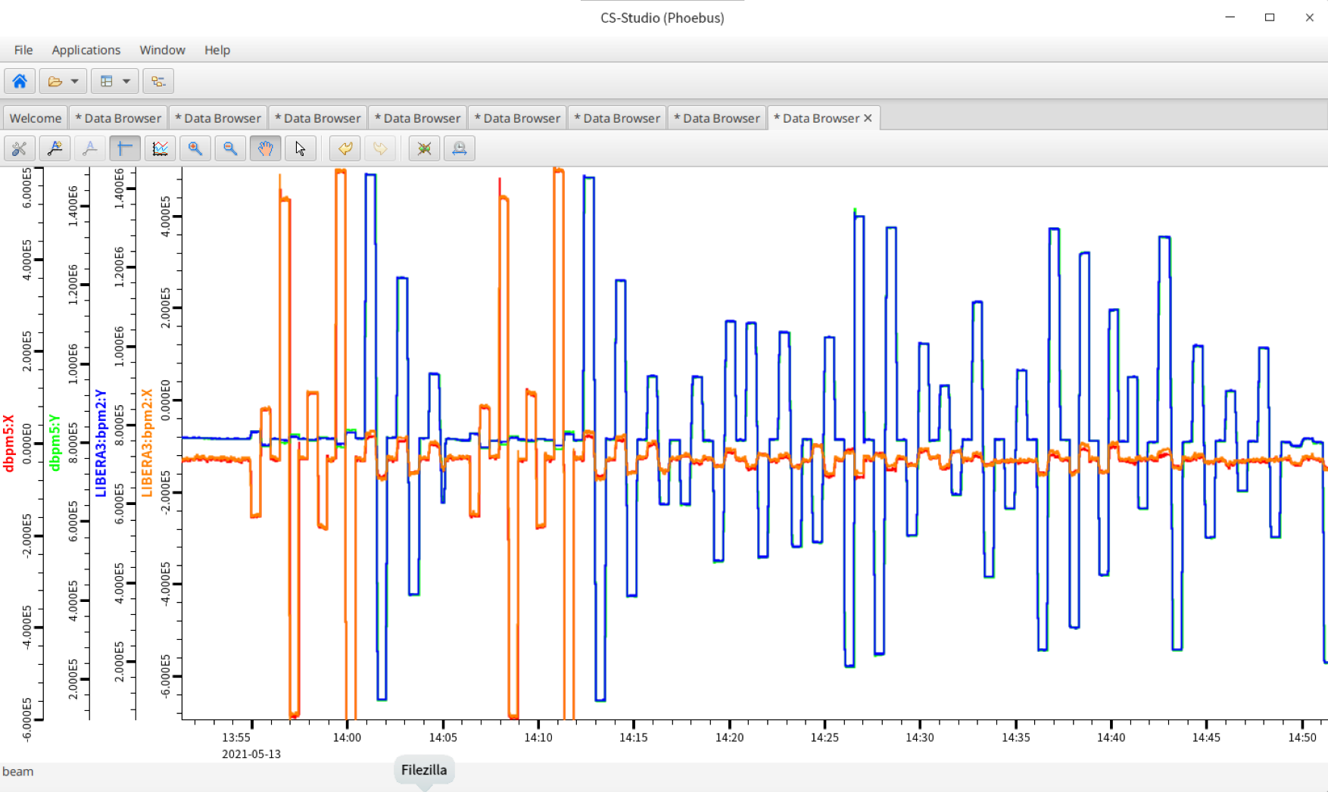
Long time stability（1 hour）

Slide 22
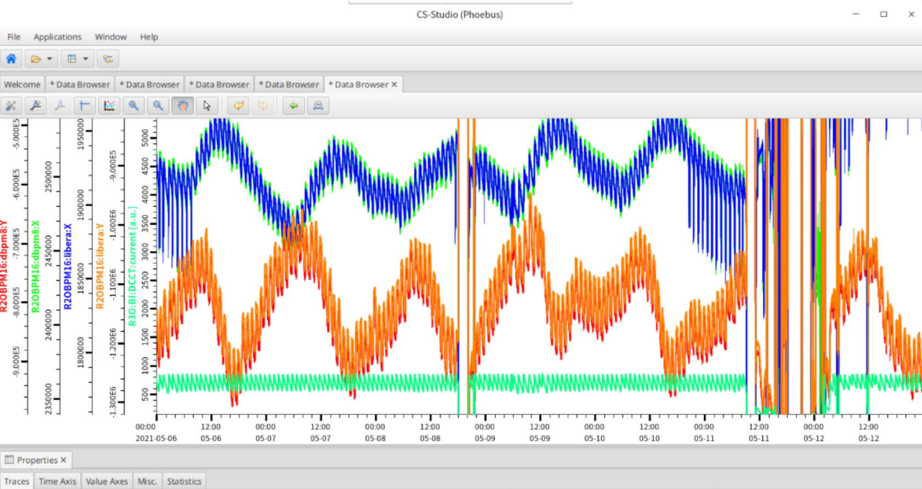
Long time stability（7 days）

Slide 23
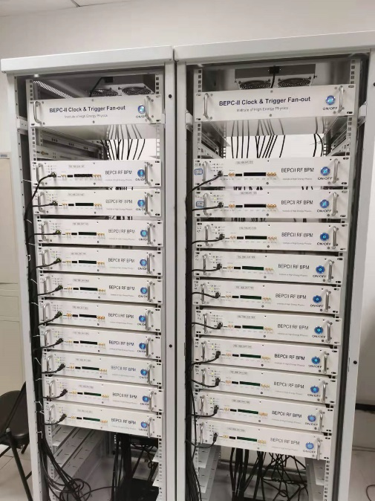
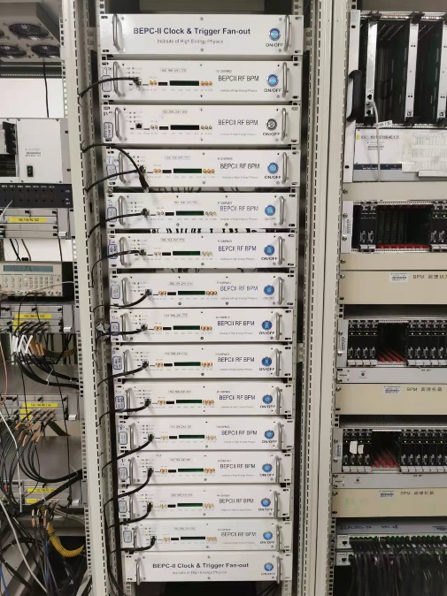
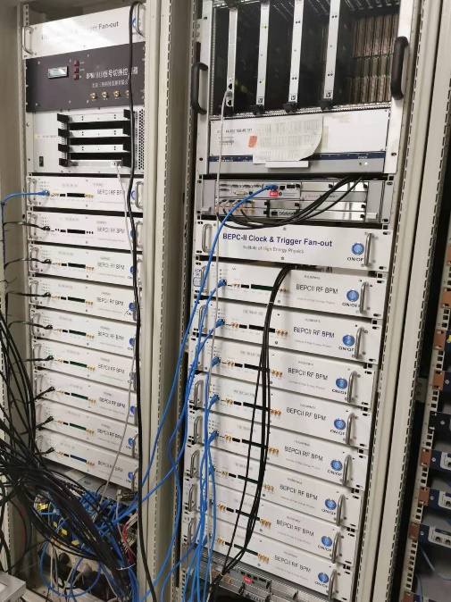
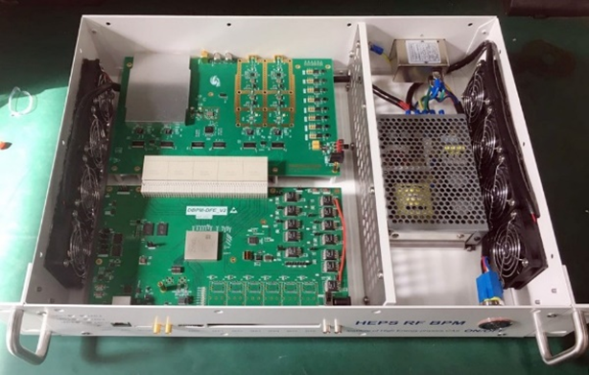
Application of home-made BPM electronics
There are 20 singal-pass BPM electronics were installed and operating in BEPCII Linac in 2019.
All Bergoz type BPM electronics had been upgraded to home-made electronics by the end of last year. Totally ,90 sets of electronics running online now.
There will be 700+ sets electronics in the new project -HEPS

Slide 24
Summary
The BPM pick-ups ,the feedback systems and synchrotron light based measurement are refined based on new parameters.
After R&D, a few key technologies are in hand. 110 sets of home-made electronics running online in BEPCII and more units will be used on both injector and storage ring of HEPS.
The application of electronics is conducive to improving the performance of electronics and accumulating experience , which is helpful for the CEPC BPM electronics R&D.

Slide 25
Thanks for your attention !

