Slide 1
CEPC Linac injector R&D status
Jingru Zhang
On behalf of CEPC linac group
IHEP, CAS
2022.10.26

Slide 2
Outline
1
Introduction
2
Linac status
3
Linac key technology R&D
4
Summary

Slide 3
Introduction
Meet the design requirements of Booster: Energy/Emittance
Linac version evolution : V1(pre-CDR)→V3.6(CDR)→4.2(TDR,2021.5) →4.3(TDR，2022.6)

Slide 4
Linac status
Parameter | Symbol | Unit | Baseline
Energy | E_{e-}/E_{e+} | GeV | 30
Repetition rate | f_{rep} | Hz | 100
Bunch charge |  | nC | 1.5 (3)
Energy spread | σ_{E} |  | 1.5×10⁻³
Emittance | ε_{r} | nm | 6.5
Latest baseline scheme (2022.6)
30 GeV linac provides electron and positron beams
for booster
Make a cost balance between Linac and booster
The Non-oriented silicon steel sheet instead of oriented silicon steel sheet magnet can save cost, even considering the Linac cost increase
Emittance from 10nm (20GeV) to 6.5nm(30GeV)
The linac tunnel is 1.8km
Linac is about 1.6 km
200 m as reserved space

Slide 5
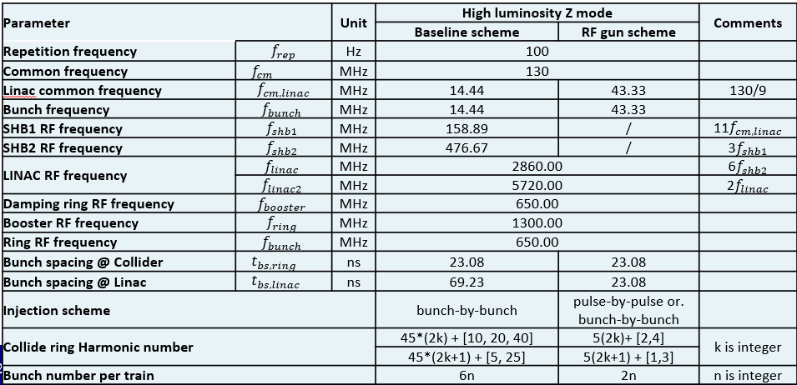
Linac status
High luminosity for Z, two bunch @100Hz mode is adopted
For the timing consideration, to meet the injection requirements, RF frequency of SHBs have been redesigned
143/572MHz（CDR stage）→158.89/476.67MHz（TDR stage）
RF gun has advantages than traditional thermionic gun and bunching system
More flexible injection scheme
The Linac have better potential in terms of compatibility
C. Meng et al

Slide 6
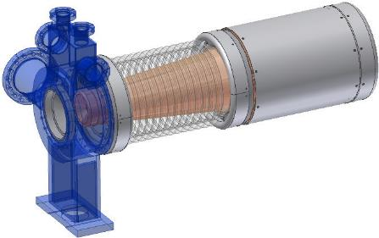
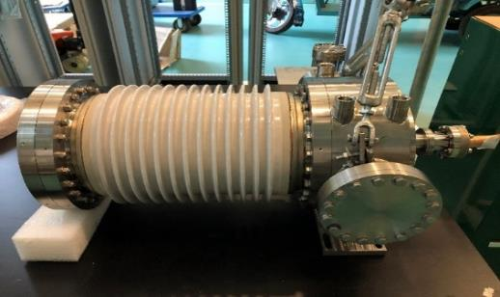
Electron gun
Traditional thermionic triode gun
The parameters is similar to HEPS which has been installed in the tunnel and commissioning will start in near future
Parameter | Unit | Value
Type |  | Thermionic Triode Gun
Cathode |  | Y796 (Eimac) Dispenser
Beam Current (max.) | A | 10
High Voltage of Anode | kV | 120 ~ 200
Bias Voltage of Grid | V | 0 ~ -200
Pulse duration | ns | 1
Electron gun for HEPS

Slide 7
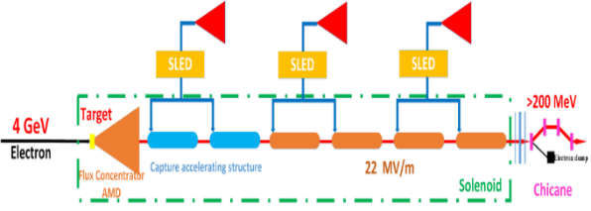
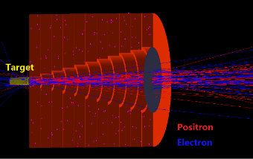
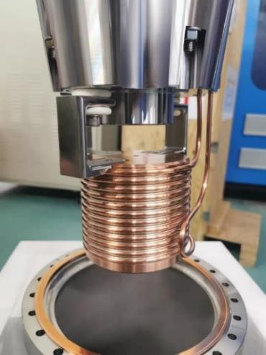
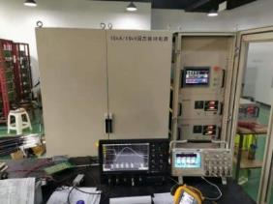
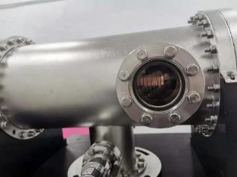
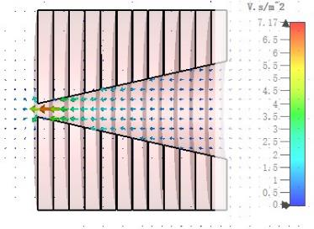
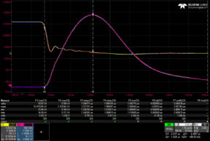
Positron Source
Fixed Target (Conventional, tungsten,10mm thick)
FLUX concentrator
It produces a pulsed magnetic field of 6 T to 0.5 T
FLUX concentrator has made and finished
Finished 15kA/15kV/50Hz solid state pulse source
Completed high power test and when cunrrent is 15kA , the center peak pulse magnetic field is 6.2T
R&D of the solid state pulse source
Test result of the peak pulse magnetic field
The design of the FLUX conentrator

Slide 8
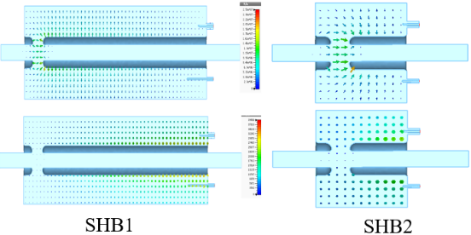
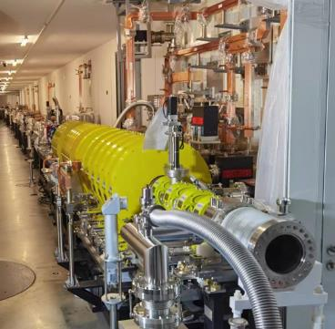
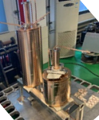
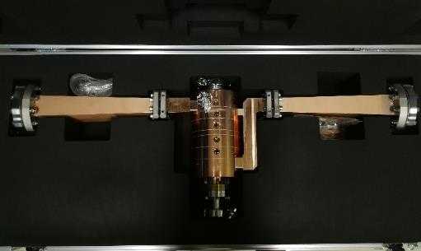
Bunching system
Sub-harmonic buncher (SHB)
Capacitively loaded structure
Buncher
Travelling wave
2π/3
β=0.75, 6 cells
High power test finished and waiting for beam commissioning at HEPS
O.Z. Xiao will give a detail talk of the bunching system design next
Buncher for HEPS
SHBs for HEPS
HEPS linac tunnel

Slide 9
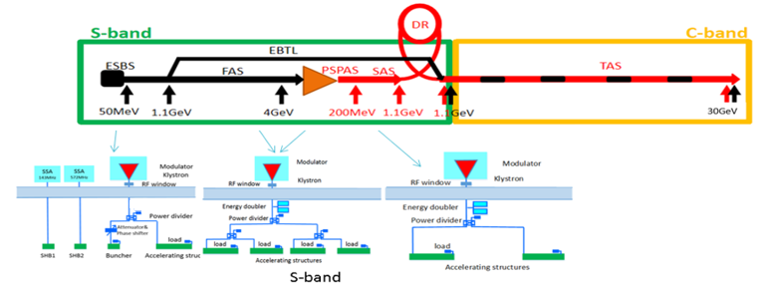
S-band RF system
RF distribution of the linac
80 MW klystron
1-1(ESBS), 1 accelerating structure, 22MV/m
1-4 (FAS), 21 sets, 84 standard accelerating structures, with pulse compressor, 22MV/m
1-2(PSPAS), 8 sets, 16 big hole accelerating structures, 22MV/m, with pulse compressor
1-2(SAS), 3 sets, 6 accelerating structures, 27MV/m , with pulse compressor
The number of S-band accelerating structure is 107, and the number of pulse compressor is 32

Slide 10
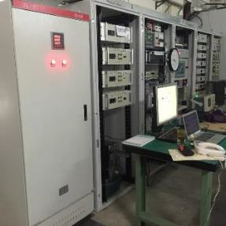
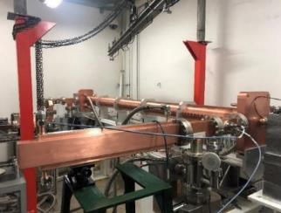
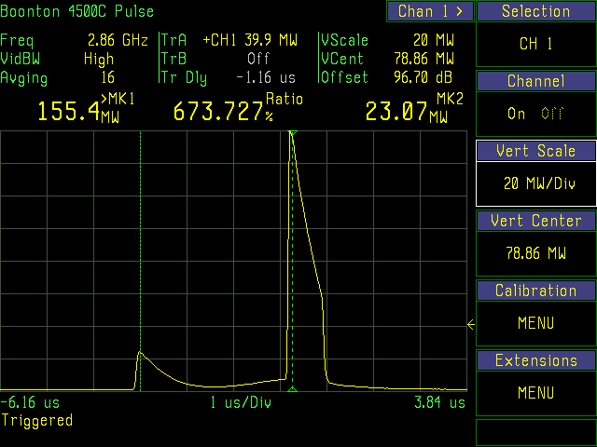
S-band accelerating structure
R&D of 3 meters long S-band accelerating structure
The tested average gradient has reached 33 MV/m at high power test (with SLED)
Meet the requirement of linac application
Frequency: （MHz） | 2856.75
No. of Cells | 84+2*0.5
Phase advance | 2π/3
Total length(m) | 3.1
Length of cell : d (mm) | 34.988
Disk thickness: t (mm) | 5.5
Shunt impedance : Rs (MΩ/m) | 60.3~67.8
Quality factor | 15465~15373
Group velocity: Vg/c (%) | 2% ~ 0.94%
Filling time : t_{f} (ns) | 784
Attenuation factor : τ (Np) | 0.46
Modulator and klystron
The input power with SLED
High power test bench

Slide 11
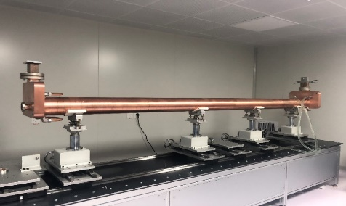
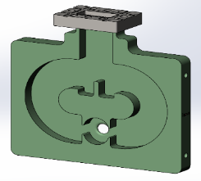
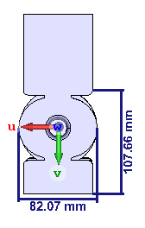
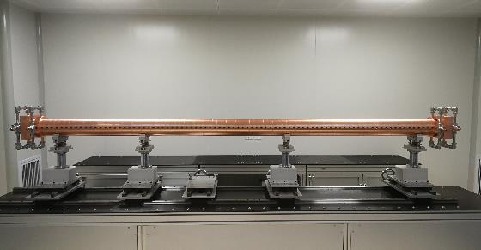
S-band accelerating structure
The coupler design（λg/4）
The coupler is mechanically asymmetry. The cavities in the hydrogen furnace is not at the center place. That will make the welding temperature control difficult
HEPS linac accelerating structure is also work at S-band (2998.8MHz). A λg/4 short plane opposite the input port has been used in couplers
The high power test has done. It works well
2019.4.2
S-band accelerating structure for CEPC
2021.1.18
Windows
S-band accelerating structure for HEPS

Slide 12
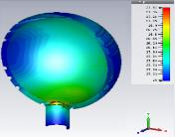
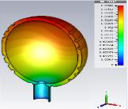
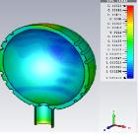
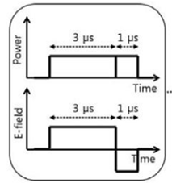
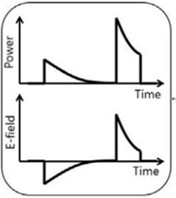
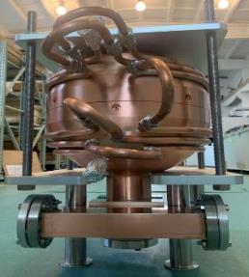
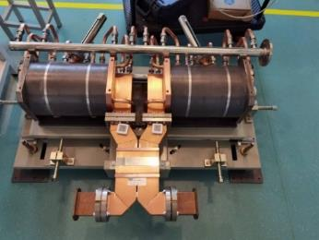
S-band pulse compressor
Spherical cavity pulse compressor(TE ₁₁₃)
Finished RF simulation, thermal stress, vacuum pumping speed and vacuum level analysis
The prototype has completed
High power test will be conducted in November
S-band 80MW klystron high power test bench is ready
Parameter | Value
Klystron output power | 80 MW
Pulse width | 4 μs
Pulse repetition rate | 100 Hz
AS Filling time | 780 ns
Temperature
Deformation
Stress
4uS→0.8uS
Pulse compressor for CEPC
HEPS pulse compressor

Slide 13
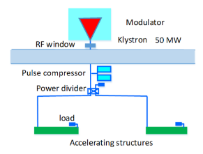
C-band RF system
C band RF system (TAS)
1.1 GeV→30 GeV
Based on 50 MW Klystron (mature product)
1 klystron to 2 accelerating structures with pulse conpressor
The total number of accelerating structures: 470, Pulse compressor: 235
About 9% margin for 40 MV/m gradient and about 20% margin for 45 MV/m for one bunch (Consider acceleration phase)
RF component (Loads, power divider, waveguides……)

Slide 14
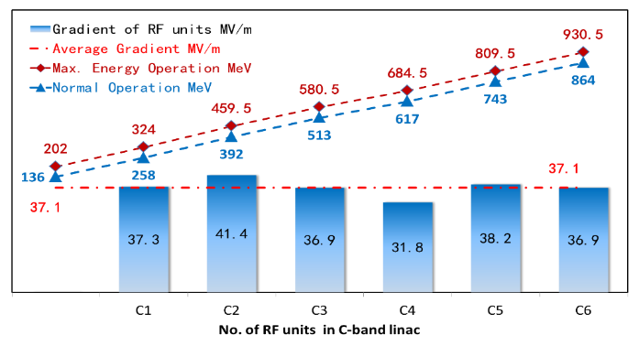
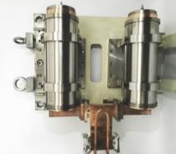
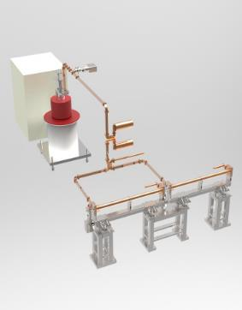
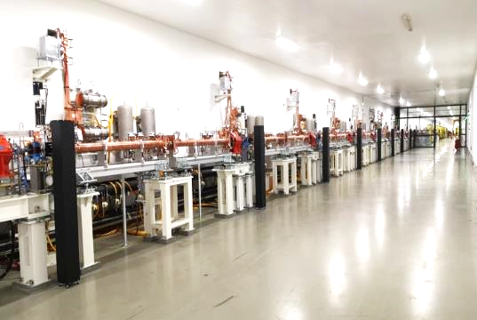
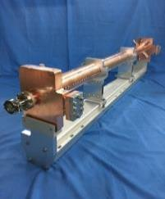
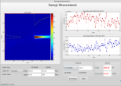
C-band RF system
W.C. Fang
C-band RF accelerating structure and compressor at SARI (SXFEL)
It is stable operation now
6 RF units at SXFEL
Mode：4π/5
Average gradient 37.1 MV/m.
Maximum gradient 41.7 MV/m

Slide 15
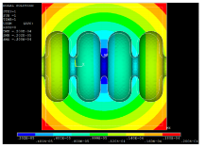
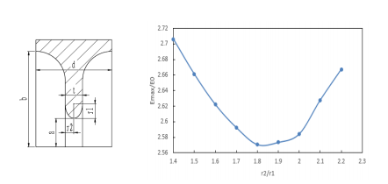
C-band accelerating structure
The R&D of C-band accelerating structure at IHEP
The beam dynamics of linac based on this design
Constant gradient, 3π/4 mode, 1.8 meters long (Including mechanical length, Effective length is about 1.7 meters long)
Round cavity shape
Racetrack symmetrical magnetic coupling
Frequency: f（MHz） | 5712
No. of Cells | 85+2*0.5
Phase advance | 3π/4
Total length | 1.8m
Length of cell : d (@20°C) | 19.675mm
Disk thickness: t | 4.5mm
Average aperture: 2a (@20°C) | 14.8mm
Average diameter : 2b (@20°C) | 45.7mm
Shunt impedance : Rs (MΩ/m) | 66.0 ~ 75.7
Quality factor : Q | 11232~11359
Group velocity: Vg/c (%) | 2.8% ~ 1.4%
Filling time : t_{f} (ns) | 271
Attenuation factor : τ | 0.432
The deformation caused by temperature variation
Cavity

Slide 16
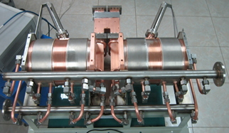
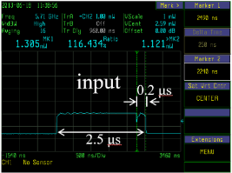
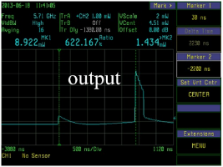
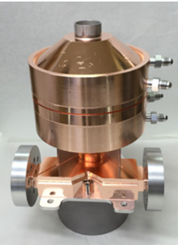
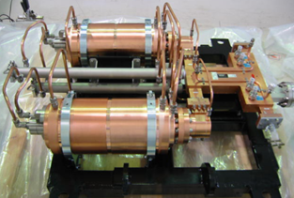
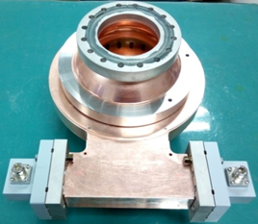
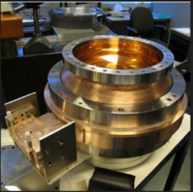
C-band pulse compressor
The model selection of the pulse compressor
SLAC type (Two cavities)
BOC type
Spherical type
IHEP C-band SLED
Test results of IHEP C-band SLED
X-band spherical SLED
SACLA C-band SLED
IHEP C-band BOC
PSI BOC

Slide 17
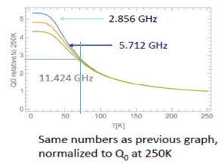
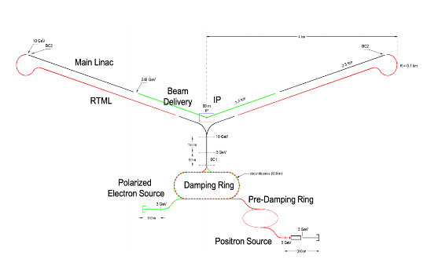
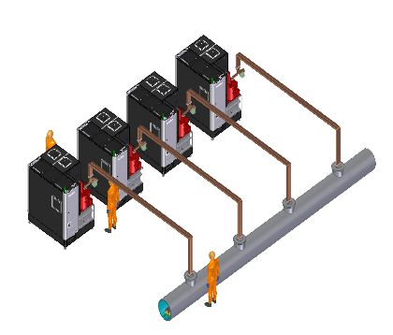
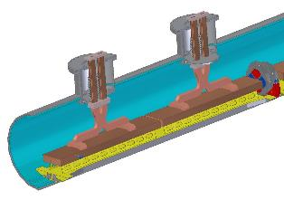
C-band Cryogenic Copper accelerating structure
Cryogenic Copper accelerating structure of C-band at SLAC C3 project
77K liquid nitrogen
Q value of the cavity increase 2.5 times
Gradient can reach 120 MV/m for proper power @C-band

Slide 18
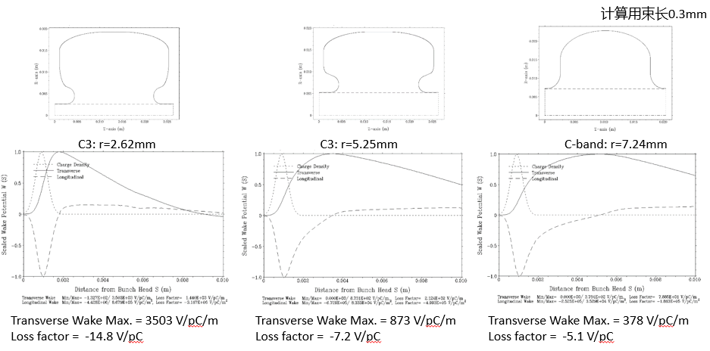
C-band Cryogenic Copper accelerating structure
Cryogenic Copper accelerating structure of C-band at IHEP
Different beam hole, cavity shape has selected to analyze the wakefield
Preliminary result shows that it must select a large beam hole for CEPC

Slide 19
C-band Cryogenic Copper accelerating structure
Cryogenic Copper accelerating structure of C-band at IHEP
Cavity shape optimization, manifold design, splitter design finished
Mechanical design has finished
Six cells prototype has finished and testing in progress
Cryogenic tank design has finished and is being processed
CST model
Prototype

Slide 20
Damping Ring RF cavity
D. Wang Y.D. Liu
Double bunch in linac, there are 4 (max 8) bunches in positron DR
The total cavity voltage has increased from 2MV to 2.5MV
5 cell cavity aperture is decided by impedance、HOM and instability threshold
HOM impedance is lower than the instability threshold
In damping ring, the 5 cell RF cavity with 90mm aperture can constrain the CBI due to RF HOMs
Only need to improve the input power
38kW→59kW (for one 5 cell cavity)
There are also two set accelerating structure at the transport line

Slide 21
Damping Ring RF cavity
The design of the 650MHz 5 cell cavity finished
RF cavity design
Input coupler and doorknob design
Vacuum design
Mechanical design
Electromagnetic field distribution
Ion pump distribution
Mechanical design

Slide 22
Summary
In order to meet the booster requirements, the linac TDR baseline change to 30 GeV
The repetition 100Hz, two bunch per pulse is used for high Z mode
Thermionic triode electron gun and bunching system can also meet the requirement after timing analysis
The FLUX concentrator has been successfully high power tested
S&C-band structure and pulse compressor has been studied and developed
C-band cryogenic copper accelerating structure is being studied
The DR cavity voltage improved, 5 cell cavity still can be used

Slide 23
Thank you for your attention

