Slide 1
CEPC control system design and studies
Presented by Gang Li
On behalf of Control Group, IHEP
Oct 26th, 2022

Slide 2
Outline
Scope and Performance of the CEPC control system
Requirement information of controlled devices
Control system and sub-system
Summary

Slide 3
Scope of the Control System
Global control
  Center Control System: Control Platform, computers, servers, database, etc
  Control network System
  Timing System
  Machine Protection System
  Post Mortem System
  Video system
Local control
  Power Supply Control System
  Vacuum Control System
  Temperature Monitoring System
  Linac Control System
Integration of subsystems
  RF, Cryogenic system, Injection/Extraction system etc.
Interface to other systems
  Detector(Experimental physics), beamline and conventional facility

Slide 4
Performance of the Control System
5bility+RT
  Stability
  Availability
  Flexibility
  Scalability
  Reliability
  Real Time

Slide 5
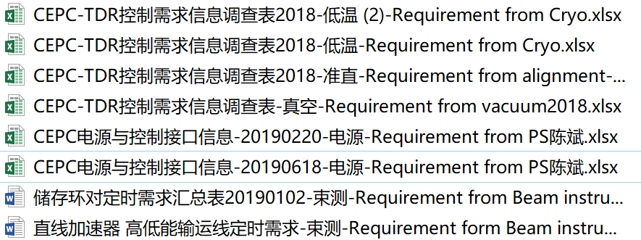
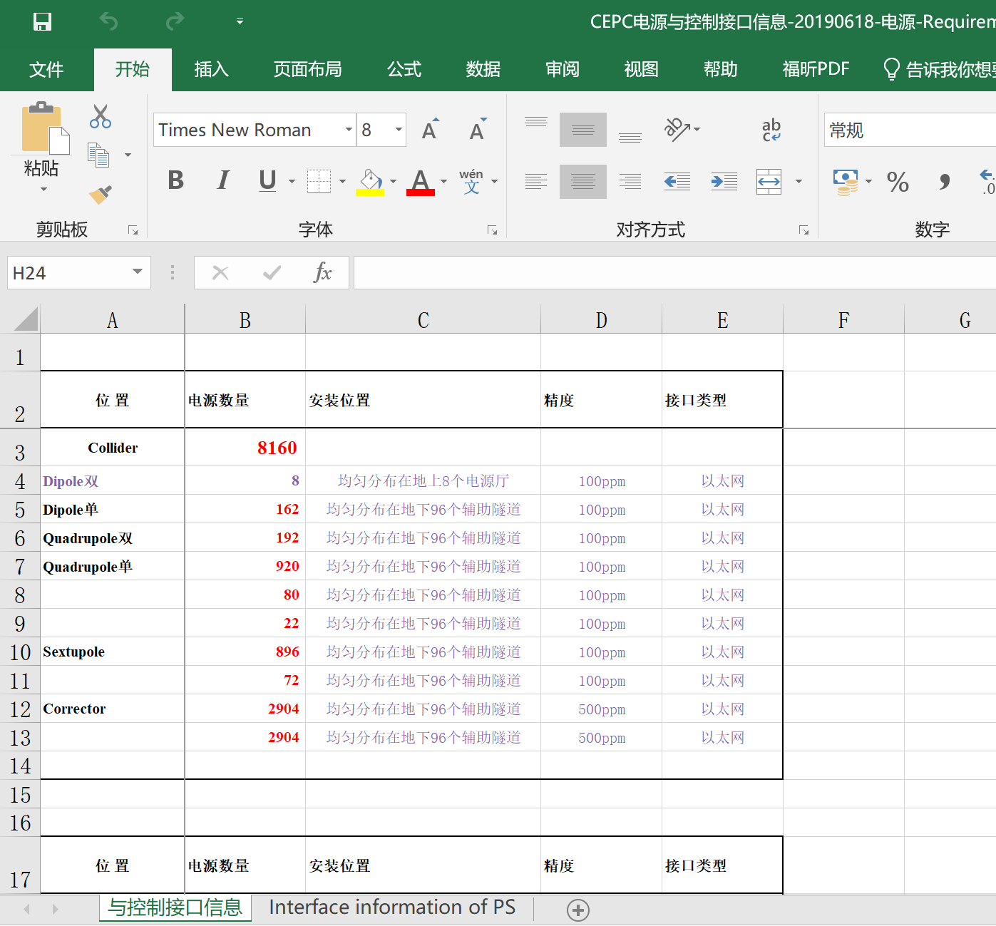
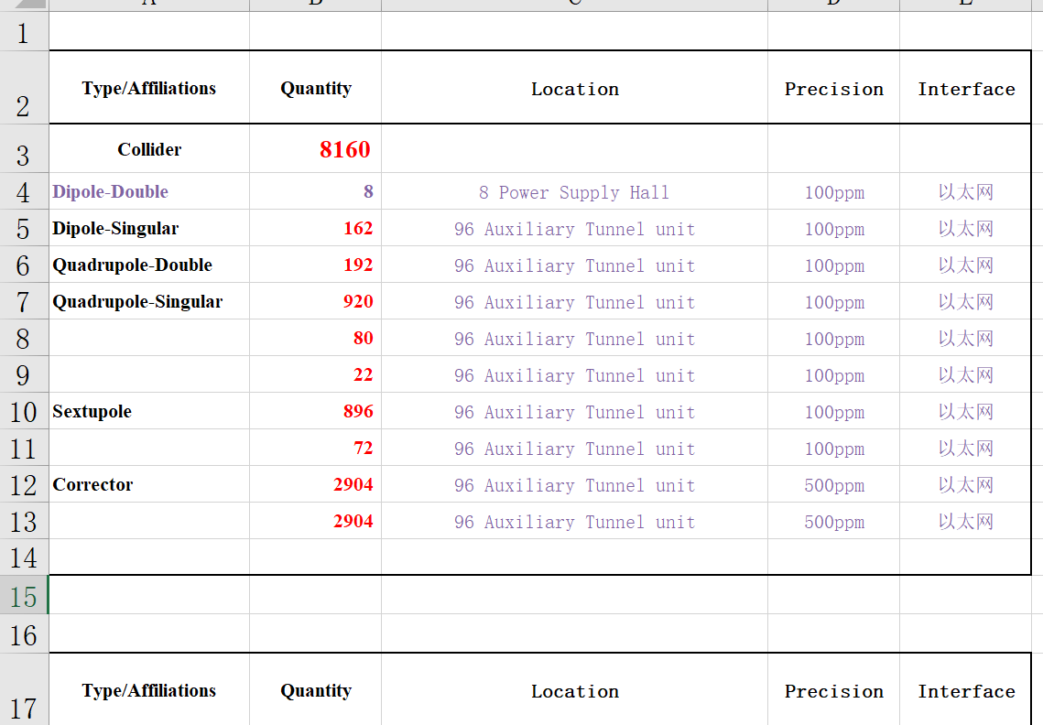
Requirement information of controlled devices
Bilingual requirement table

Slide 6
Characteristic of CEPC control system
Super scale
  Linac: 1.8km
  Ring: 100km（booster and collider）
A large number of Controlled Equipments
  Discrete distributed in the Linac and Ring
Quantity of PVs
  Millions of PVs

Slide 7
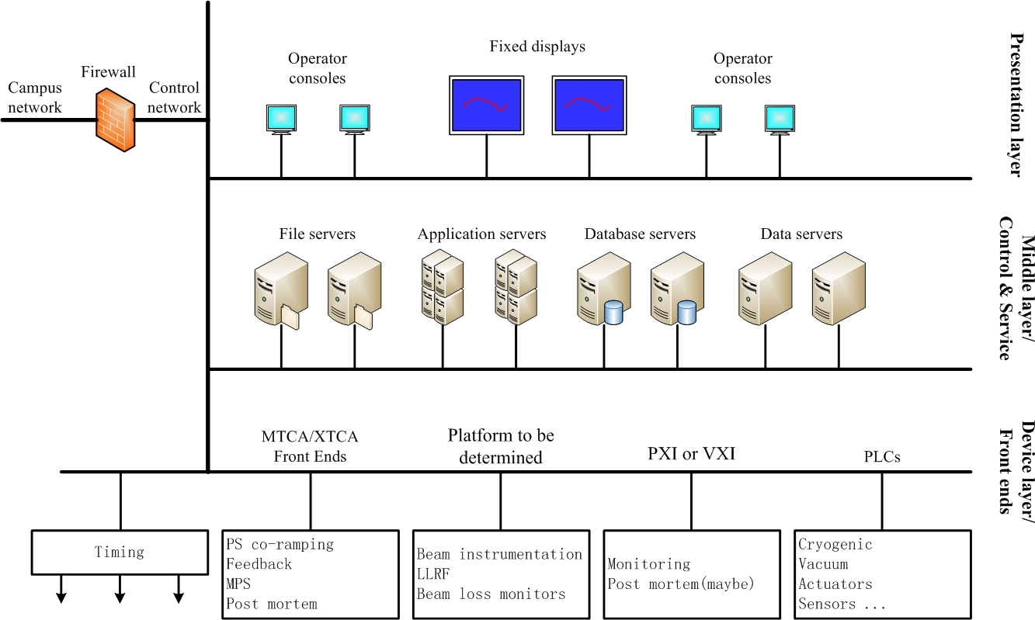
Control System and sub-system
Overall hardware architecture of the control system

Slide 8



Standardization of CEPC Control system
Software Platform
  EPICS ：open source, free SCADA/DCS, toolkits
Hardware Platform
  Standardization, Modularity and COTS （Commercial-Off-the-Shelf）
  Workstations and servers
  ATCA/uTCA
  PLC
  Motion controller/Driver
  etc.

Slide 9
Control System and sub-system: CCS
Central Control System
  Control Rooms
  Management and operation of IOCs/OPIs
  Server and management of High level software
  CA/PVA Gateway
  OPI tools--CSS, caQtDM, PyDM etc
  Data Archiver
  Alarming system
  Elog
  Issue information of machine via instant message(weChat)
  Machine status summary on Web
  Etc

Slide 10
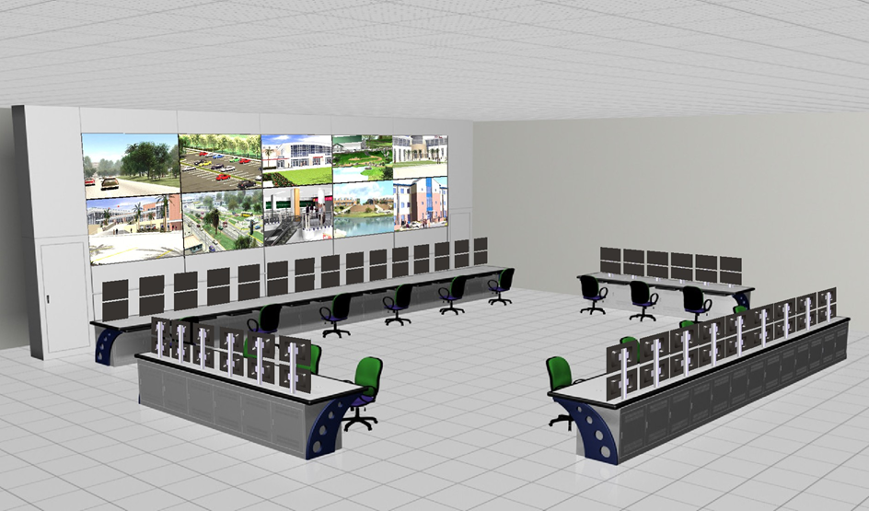
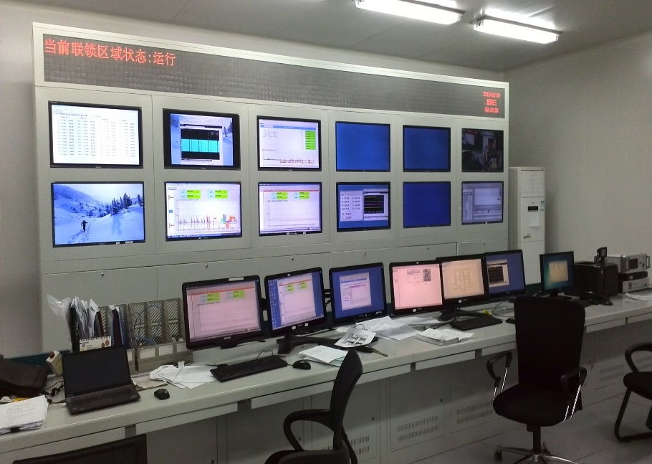
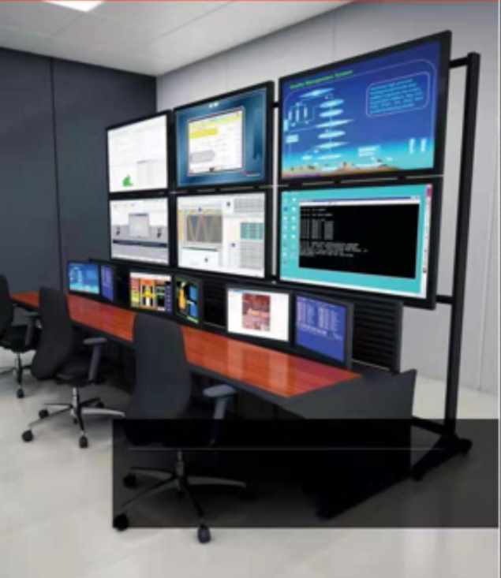
Control System and sub-system: CCS
Control Rooms
  One central control room for whole CEPC
  One temporary Linac control room for commissioning at initial stage of CEPC
  Dozens of local control room（mini console） for the site commissioning

Slide 11
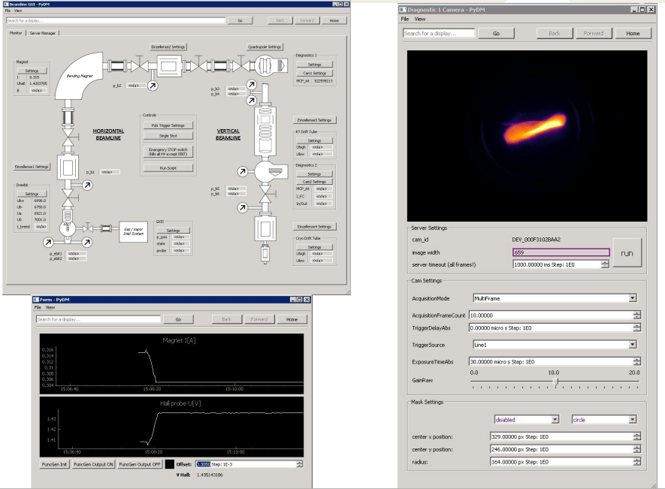
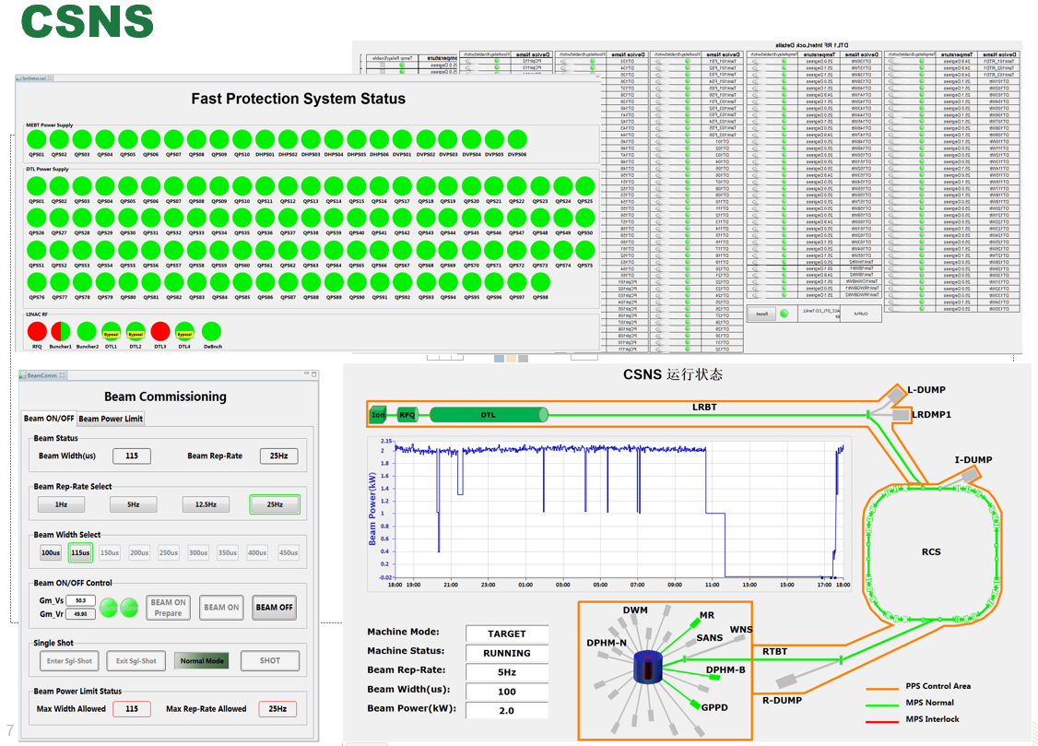
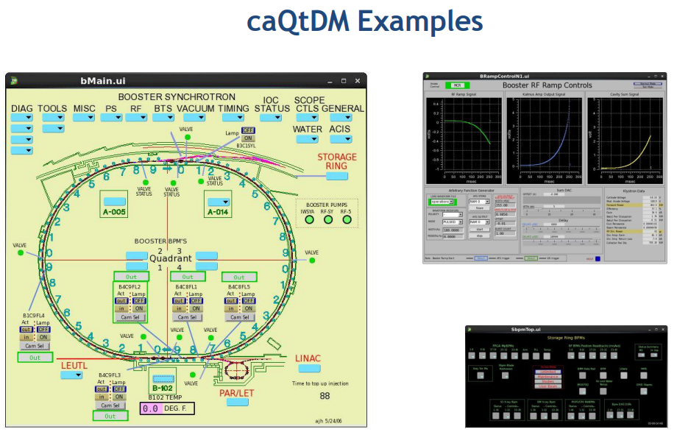
Control System and sub-system: CCS
OPI tools
  edd/dm(2k),medm,edm,CSS, caQtDM, PyDM, etc
  Update, 5~10 years
  Keep up with OPI technological progress

Slide 12
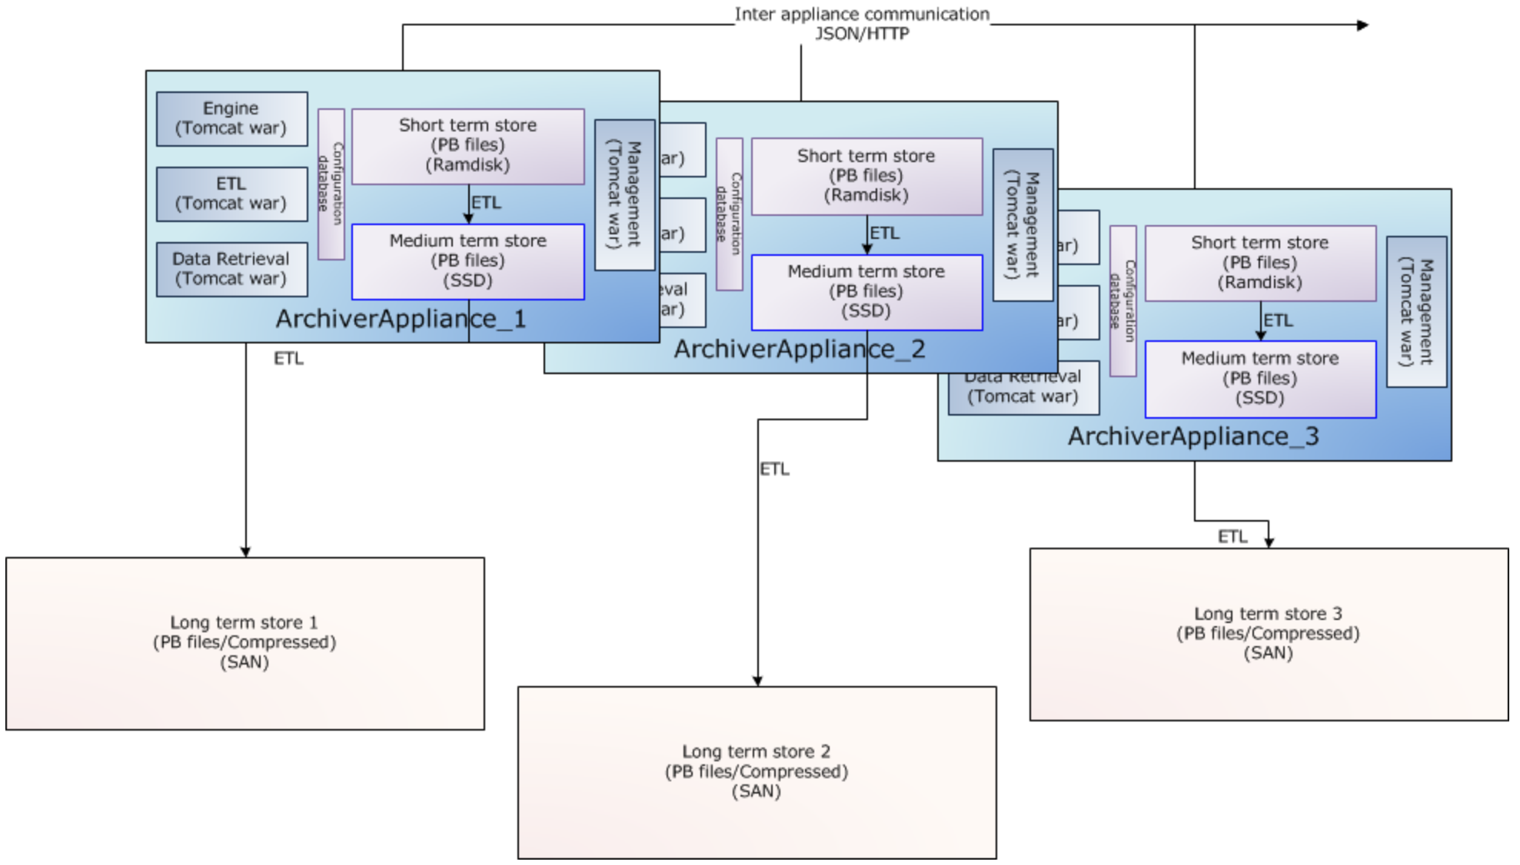
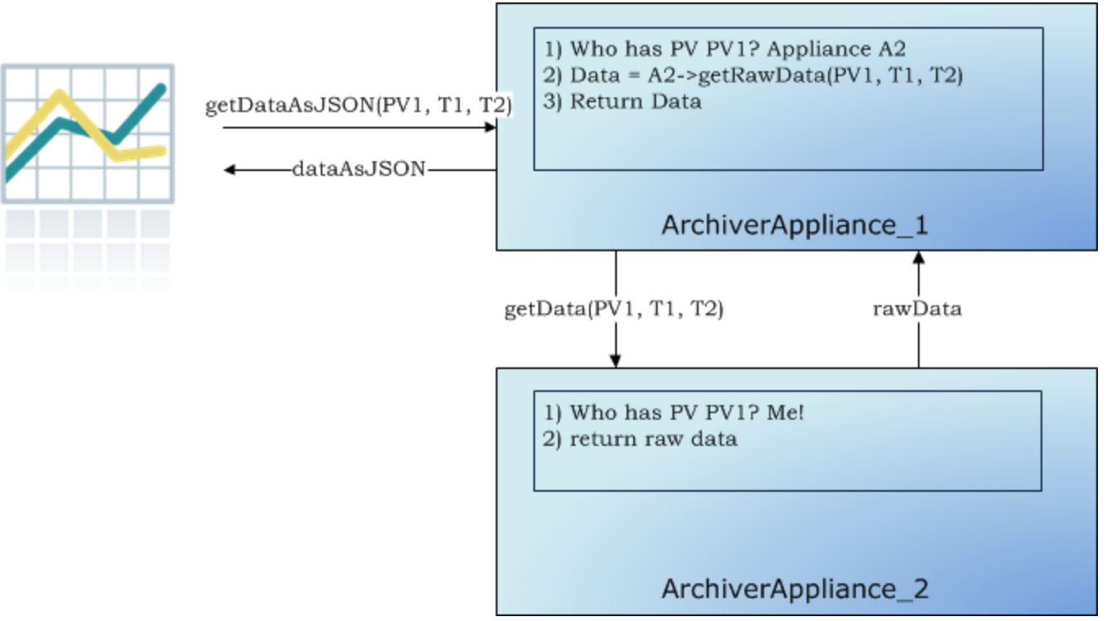
Control System and sub-system: CCS
Data Archiver, Archiver Appliance (AA)
  Archive millions of PVs
  Cluster
Multiple appliances sending data into different long term stores
Data retrieval request for PV in other appliance

Slide 13
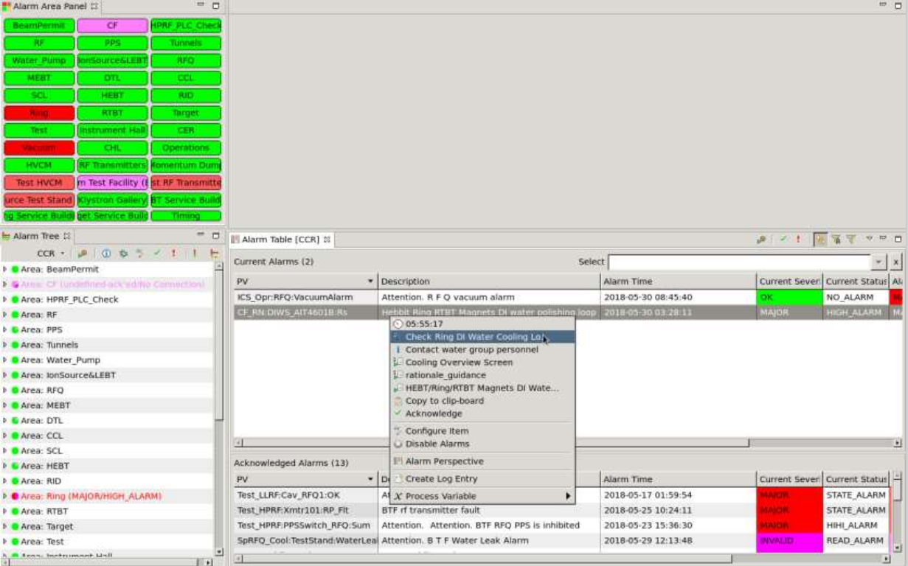
Control System and sub-system: CCS
Alarming system
  Monitor PVs
  Track alarms
  Acknowledgement

Slide 14

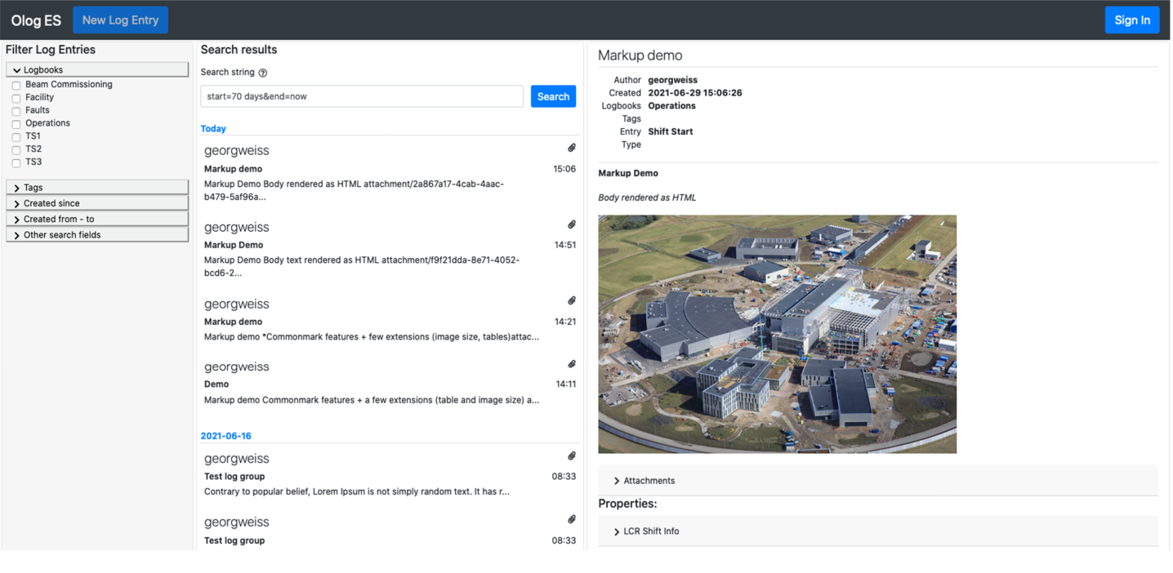
Control System and sub-system: CCS
Electronic log system
  Server for operators, engineers, and users of large scientific facilities
  Online digital logbook service
  Create log entries
    Meta-data
    Attachments
  Search
  Authentication

Slide 15
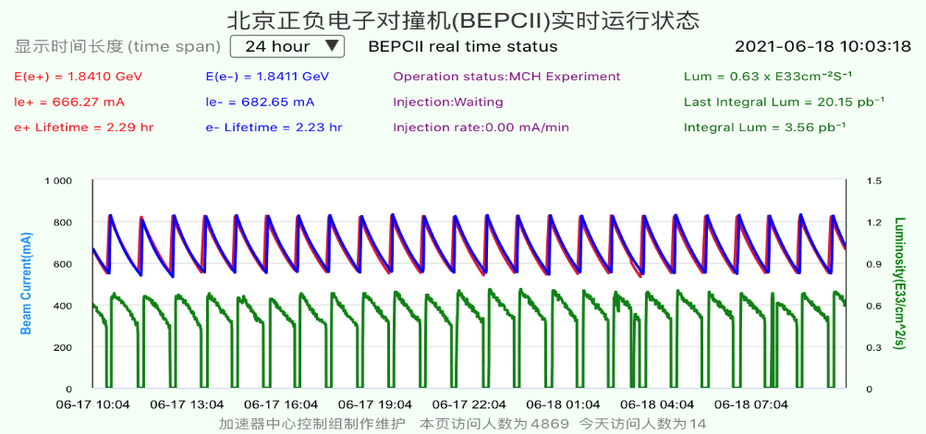
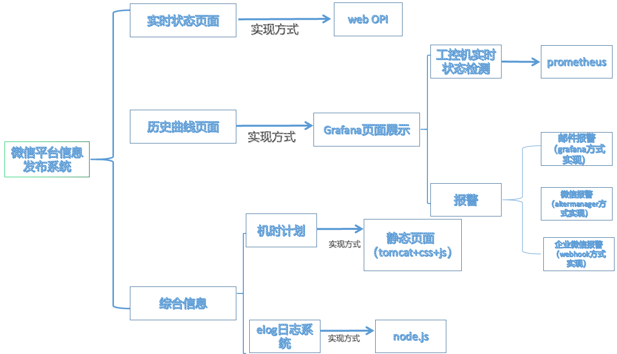
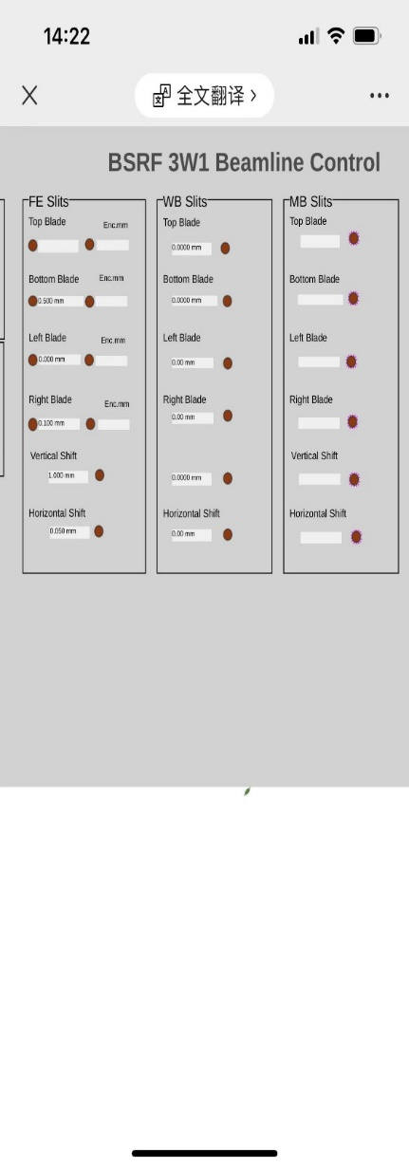
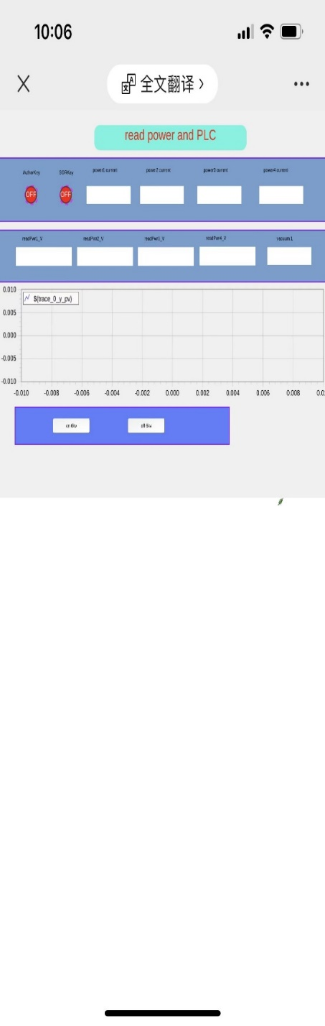
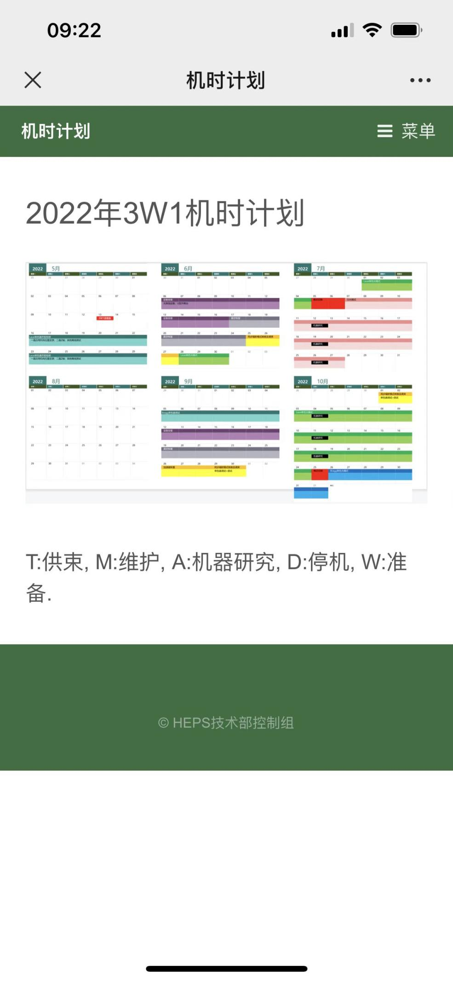
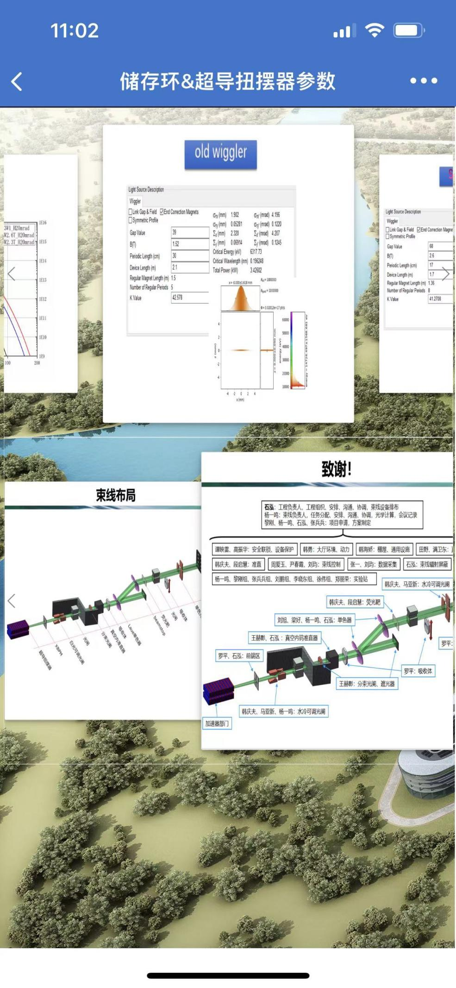
Control System and sub-system: CCS
Issue information of machine based on weChat or Apps
  Get to know information of CEPC accelerator anytime, anywhere
  PVs and another information
Apps and weChat （iOS and Android）

Slide 16
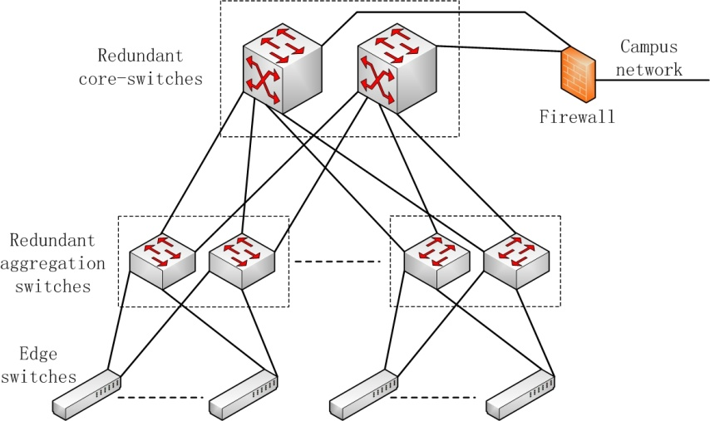
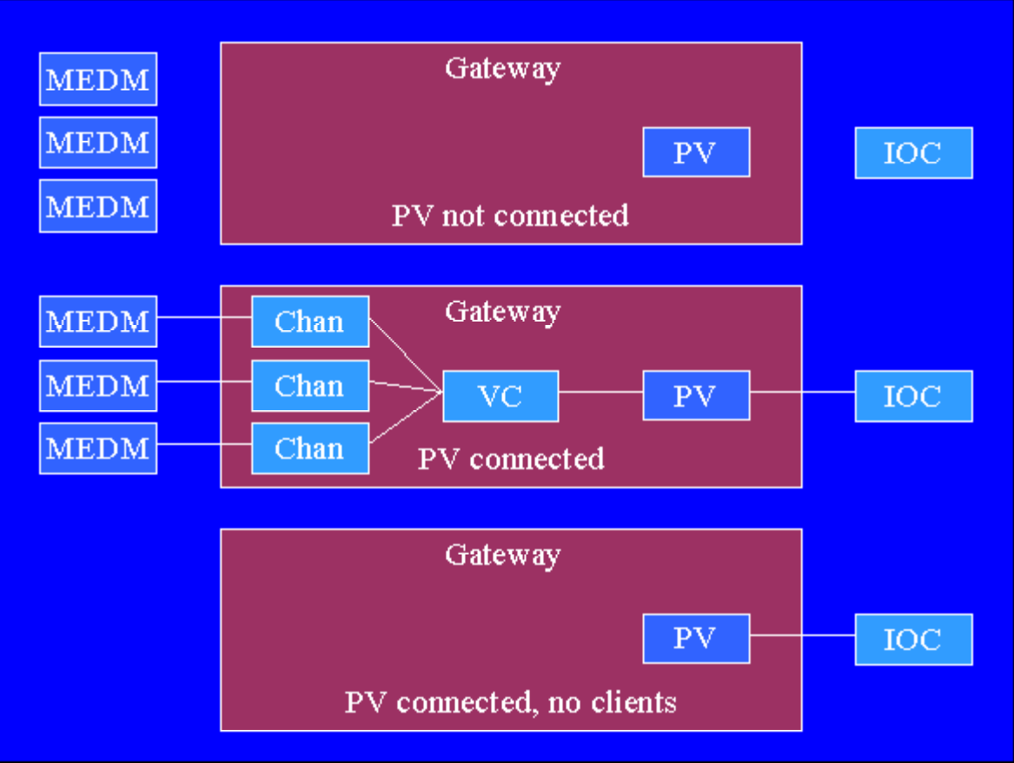
Control system and sub-system: Control Network
Data rate/traffic/congestion in the network
  Low latency switch
  Vlan Technology
  PVA/CA Gataway
Control Network System: three layers

Slide 17
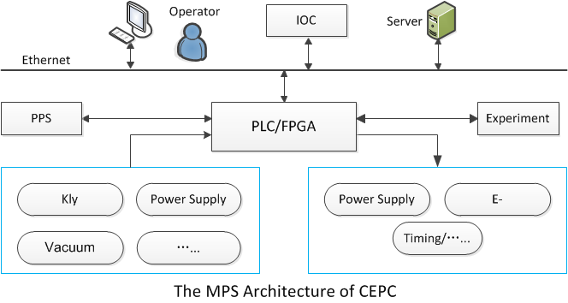
Control system and sub-system: MPS
Machine Protection System（ MPS ）
  Stop beam or steer beam to dump, when key device or sub-system is a fault or abnormal
  Tightly related to the accelerator design
Generally, the structure of MPS=EPS (PLC)+FPS (FPGA)

Slide 18
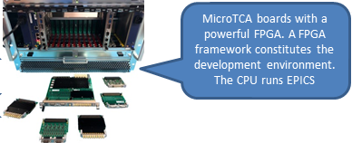
Control system and sub-system: MPS
  PLC for slow inputs, a response time of tens of ms is defined.
    The actuators are RF power ramp down and shutdown of electron gun.
    Preliminary name : Equipment Protection System (EPS).
  FPGA for fast inputs, a response time of tens of micro seconds is defined.
    The actuators are RF power off and shutdown of electron gun.
    Preliminary name : Fast Protection System (FPS).
  Individual systems for loose coupling, easy implementation and debug.
EPS based on PLC
FPS based on FPGA

Slide 19
Control system and sub-system: Timing system
Timing signal statistics of controlled devices
Destination | Quantity | Specification | Supplementary Notes
BI（TTL信号） | 10664 | Jitter<50ps | BPM、profile、DCCT、Tuning、BCM and BLM
BI（RF信号） | 5030 | Jitter<0.5ps, <1ps, <5ps | BPM、Profile、DCCT、Tuning、BCM and BLM
PS | 860 | Jitter<5ns | Booster 、Dipole、Quadrupole、Sextupole、Corrector and so on
RF | 301 | Jitter<20ps

Slide 20
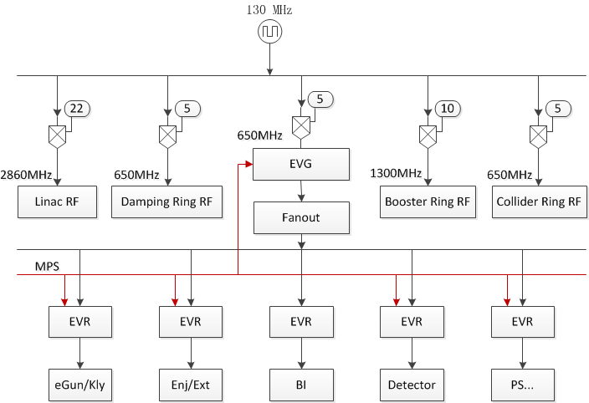
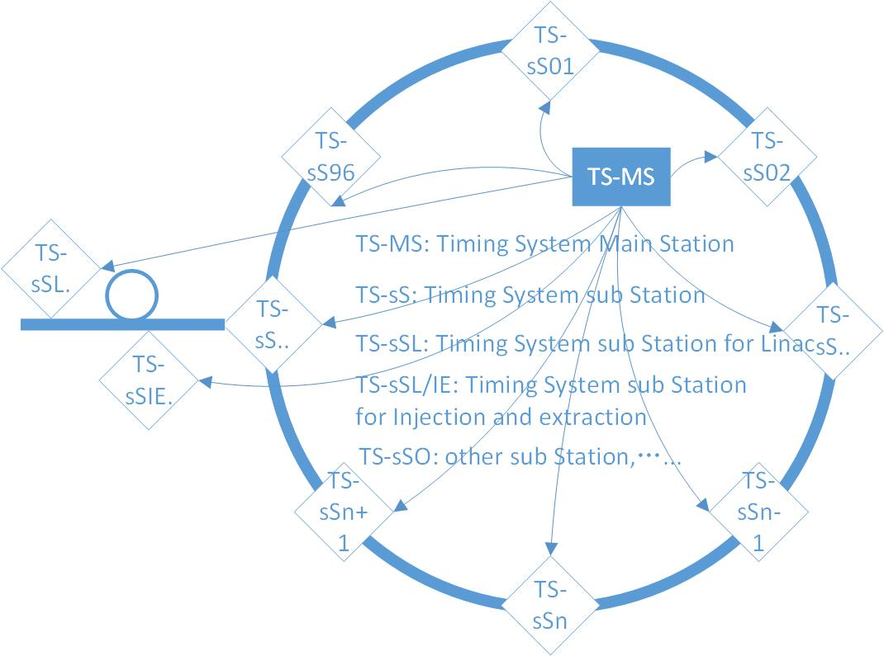
Control system and sub-system: Timing system
The basic structure of Timing System
Event system and RF transmission system
Event system: Trigger signal and Low frequency clock signal
RF transmission system: Transmit high stability RF signal
TS-MS: In CCR or RF-station
TS-sS: Close to the controlled devices in sub-tunnels or other hall
Red line: RF transmission system，Blue line: Event Timing System

Slide 21
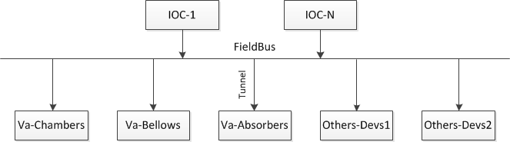
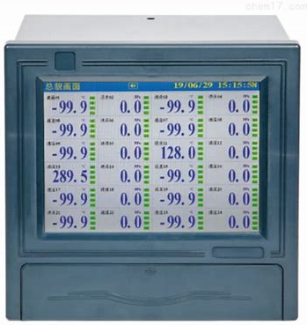
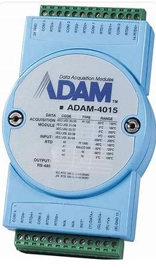
Control system and sub-system: TM
TM: Temperature Monitoring
Quantity: 100,000+(Vacuum devices)
ADAM4015/6015, Temperature paperless recorder
Others: … …

Slide 22
Control system and sub-system: Vacuum CS
Vacuum equipments
  Vacuum Gauge：7000
  Ion pump：32130
  Valve：1598
Monitor
Interlock policy
  Voting scheme：Close Valve
  Closed state of NO Contact：OK
Local Area
Center Control Room
OPI
OPI
Ethernet
MPS/RF
IOC
Fieldbus
RS232/485
RS232/485
PLC/IO
Gauge Controllers
Pump Controllers
Valves
Vacuum Gauges
Ion Pumps

Slide 23
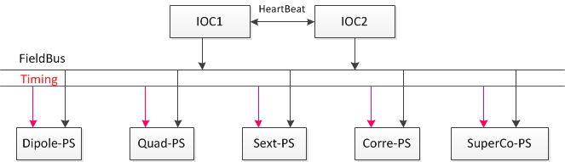
Control system and sub-system: PSCS
Power Supply control system (PSCS)
  Accelerate from 30GeV to 120GeV (Booster ring)
  Magnets’ power supply co-ramping within an accuracy of tens of μs
Redundant IOCs for power-supply controls

Slide 24
Control system and sub-system: Cabinet Layout
Control Cabinet layout of Vacuum CS, PSCS and TM
  Be close to controlled devices(vacuum controller, power supply and so on)
  Located in 96 sub-tunnels along the ring
The layout of control cabinet in sub-tunnels

Slide 25
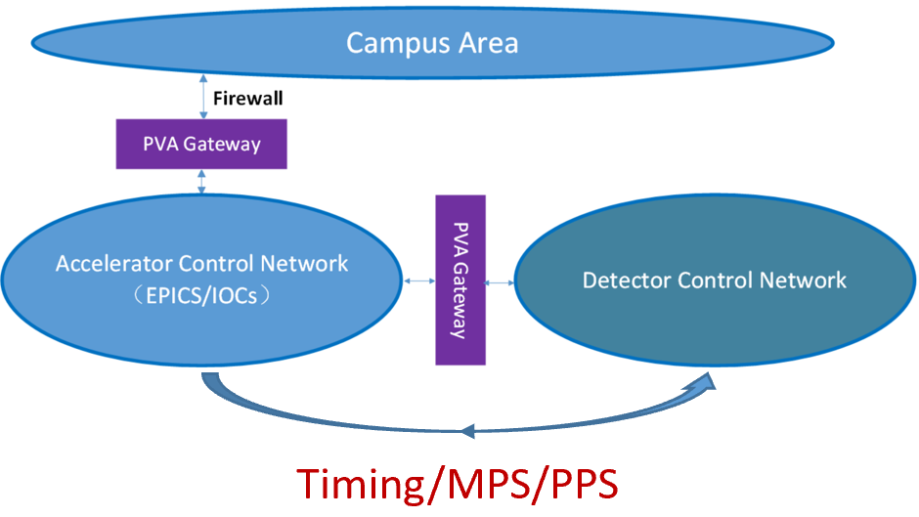
Control system and sub-system: Integration
Integration of subsystems and other systems
  LLRF, Cryogenic system, Injection/Extraction system etc
  Detector(Experimental physics), beamline and conventional facility
the following rules must be followed
  Agree with standards of CEPC control system
  Consistent with software (EPICS)
  Unified hardware

Slide 26
Control system and sub-system: DM
Database Management of CEPC
Parameter Database Naming Convention Database
Magnet Database Equipment Database
Lattice and Model Database Management of File
Log and trouble tracking Alignment Database
Management of Cable and device Alarm database
Configuration of Security database MPS and interlock database
Etc..
More and more Database will be designed with the progress of the Project

Slide 27
Summary
More detailed requirements should be further clarified, with the progress of CEPC TDR
EPICS：Cooperate closely with EPICS community and company
New technique: IoT/AI/machine learning used in control system
Thanks a lot!

