Slide 1
CEPC mechanical system
Minxian Li, Haijing Wang, Peng Zhang
The 2022 international workshop on CEPC
October 26th, 2022

Slide 2
Outline
Progress on MDI mechanics
Progress on collimators
Supports for regular magnets

Slide 3
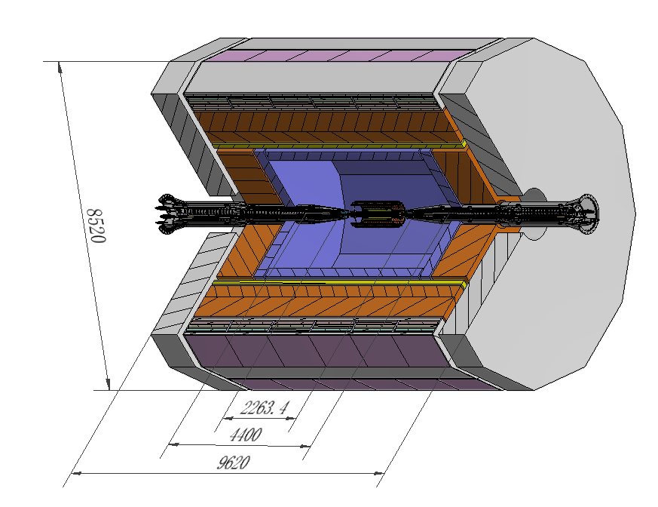
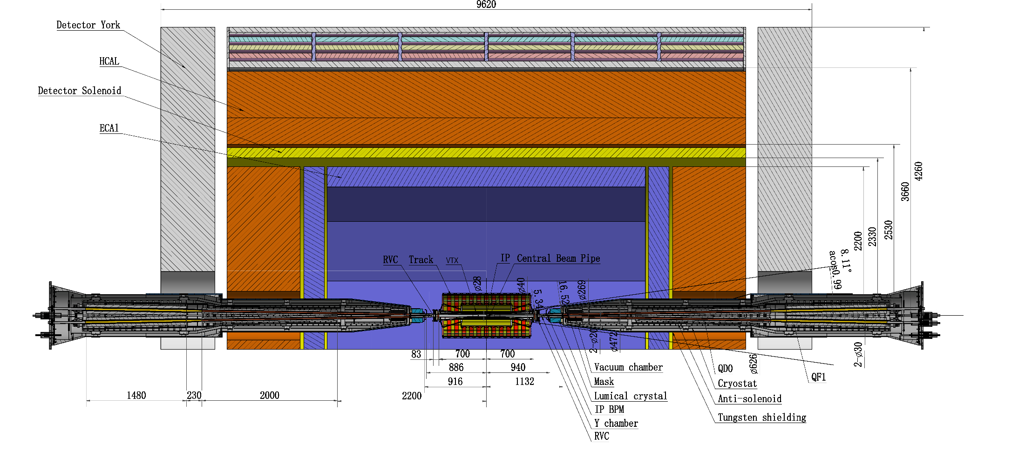
MDI layouts
The devices at MDI are integrated together.
Detective angle: acos0.99
IP chamber:-700mm~700mm
Detector York length: 9620mm

Slide 4
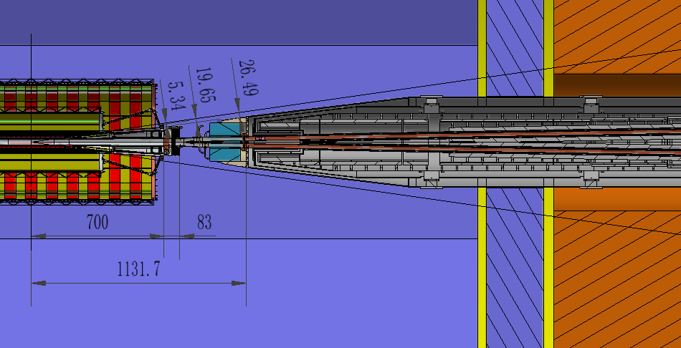
MDI layouts
IP
Be-Al chamber
Z: -700~700mm
Remote Vacuum Connector
Z: 700~783mm
Y chamber
Z: 783~855mm
IP BPMs
Z: 855~950mm
Lumical body
Z: 940-1100mm
Q1a Q1b
Z: 1855~4440mm
All the devices are within the detective angle, acos0.99.

Slide 5
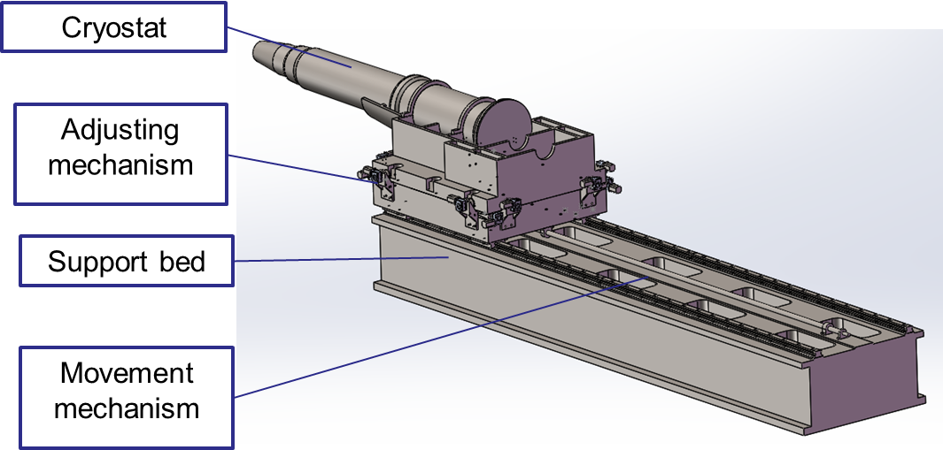
SC magnet support system
The superconducting quadruples for TDR are longer, and the structure of cryostat and SCQ has been updated.
The cryostat is about 5.6m long. The cantilever length is 5283mm.
SC quadruples become 3 parts:Q1a,Q1b,Q2.
Thermal shield
Helium vessel
Q2
Vacuum vessel
Q1b
Q1a
Anti-solenoid
Support rods

Slide 6
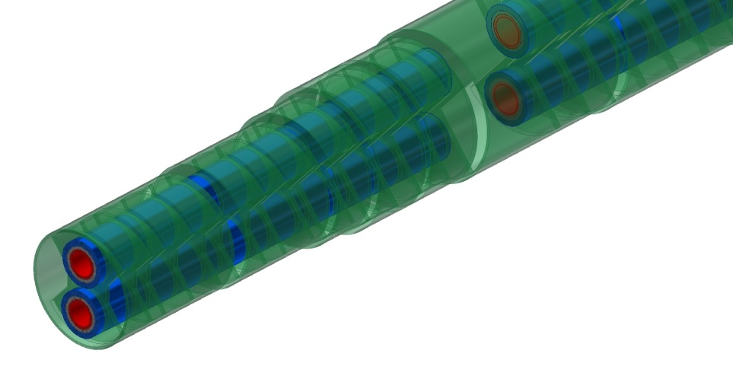
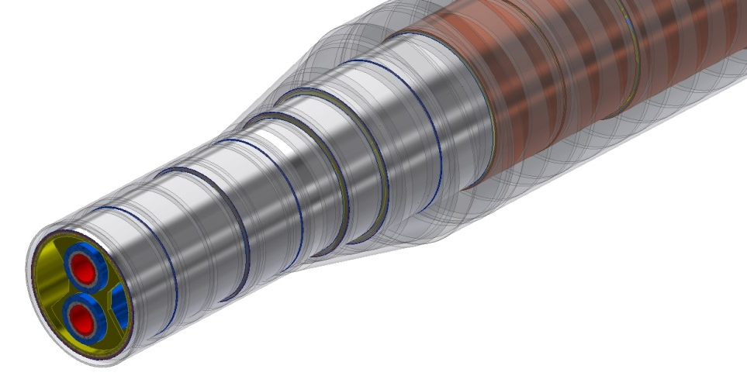
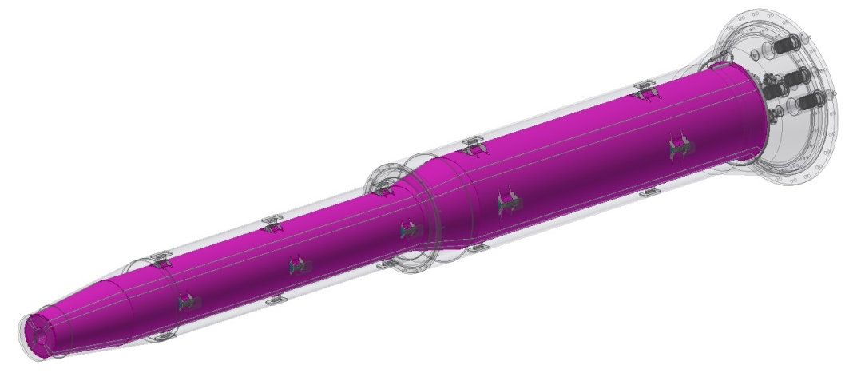
SC magnet support system
Magnets to helium vessels
Skeleton with outer ring support can minimize weight and reducing deformation.
Helium vessel to vacuum vessel
Support blocks, 60mm x 20mm.
Aim: minimize the SC magnets deformation, enhance stability.
Sketch of skeleton support
Models | materials
Q1a/Q1b/Q2 | Nb-Ti alloy+ SS + FeCoV
Anti-solenoid | SS + Cu + AL
Vessels | SS
Magnet supports | SS
Vacuum chamber | SS
Sketch of support blocks

Slide 7
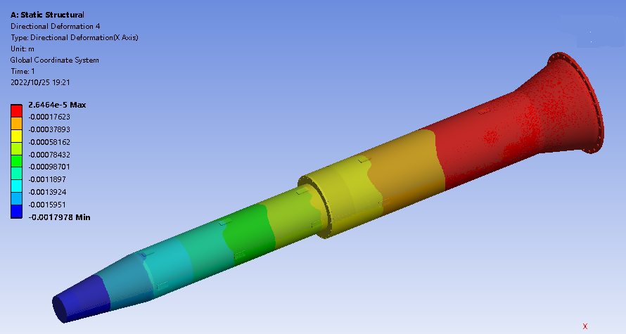
SC magnet support system
Integral FEA
Loads：gravity, Lorentz force Fz with detector solenoid operation
Alignment cannot based on the displacement.
To pre-align the magnet to compensate the absolute displacement.
Fz1
Fz2
Fz3
G
Magnet support | uneven deformation in Q1a (um) |  | uneven deformation in Q1b (um) |  | uneven deformation in Q2 (um) |  | Max. displacement of cryostat (mm)
 | Vertical | Horizontal | Vertical | Horizontal | Vertical | Horizontal | Vertical | Horizontal
TDR s-o support | 5 | 1.2 | 15 | 3.5 | 14 | 4 | 1.79 | 0.08

Slide 8
SC magnet support system
Integral FEA
Loads：gravity, Lorentz force Fz with detector solenoid operation
Alignment cannot based on the displacement.
To pre-align the magnet to compensate the absolute displacement.
Fz1
Fz2
Fz3
G
Future work
Continue to optimize the structure of the magnet support
Integral simulation with thermal contraction and support/adjustment components

Slide 9
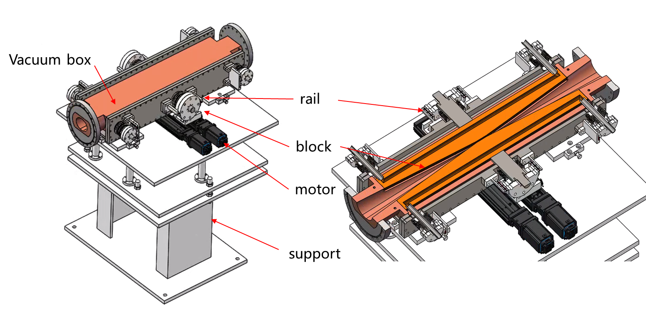
Collimators
28mm
37.5mm
28mm
28mm
The cross section of the vacuum pipe is changed from ellipse to circle, and the collimator is adjusted accordingly.
The diameter in the X direction smaller
The synchrotron radiation load reduced from 9.3KW to 7.5KW
The thermal power density decreases
reduce the temperature
The inclination of block ramp smaller.
Beam loss reduced
reduce stress
Modification suggestion of vacuum chamber for the collider ring，Liu Yu Dong for CEPC accelerator physical group，2021/3/25
From Peng Zhang

Slide 10
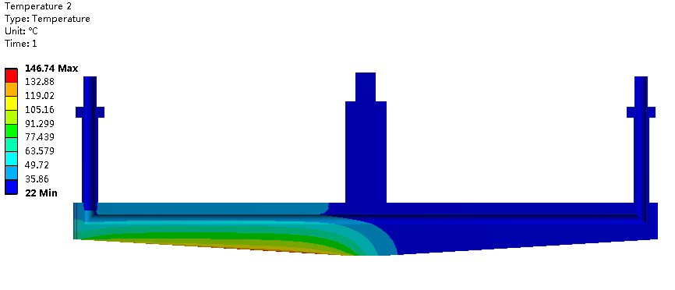
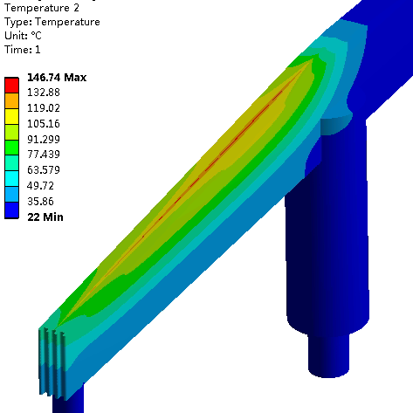
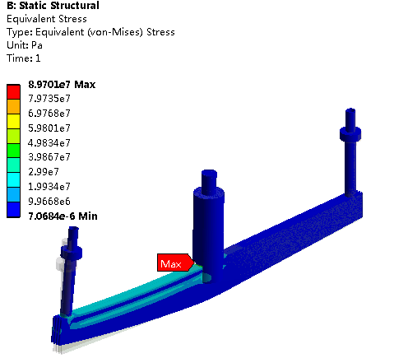
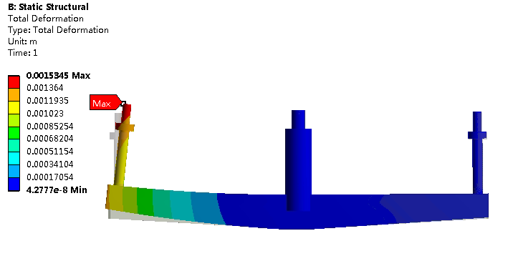
Simulation results of block
183℃ （original version, i.e. ellipse vacuum pipe） → 147℃
1.89mm (original version)→ 1.53mm
129.31MPa (original version) → 89.7MPa
From Peng Zhang

Slide 11
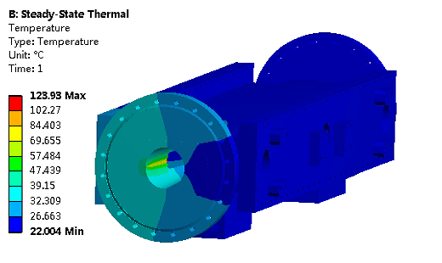
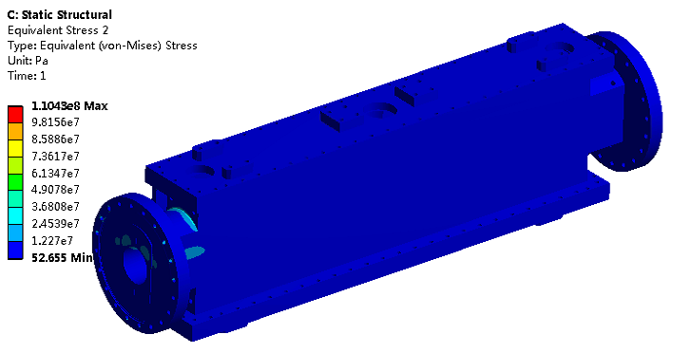
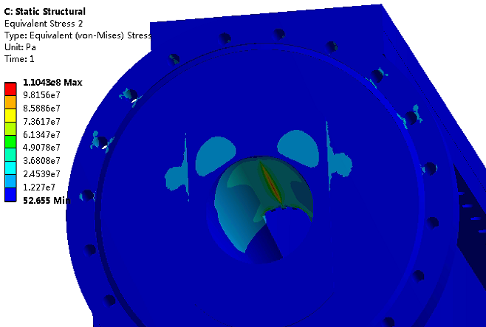
Simulation results of vacuum chamber
141℃ (original version) → 124℃
132MPa (original version) → 110MPa
From Peng Zhang

Slide 12
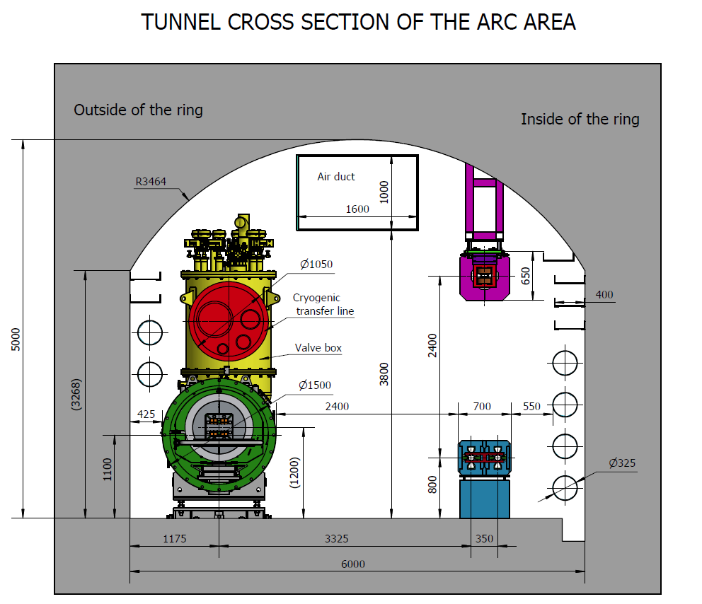
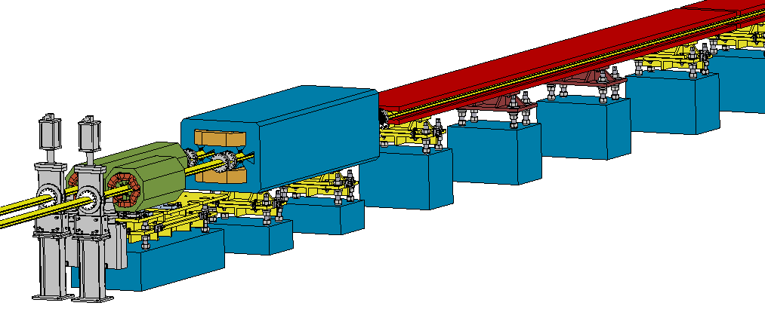
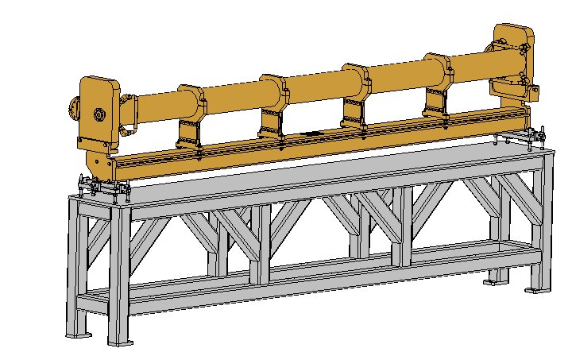
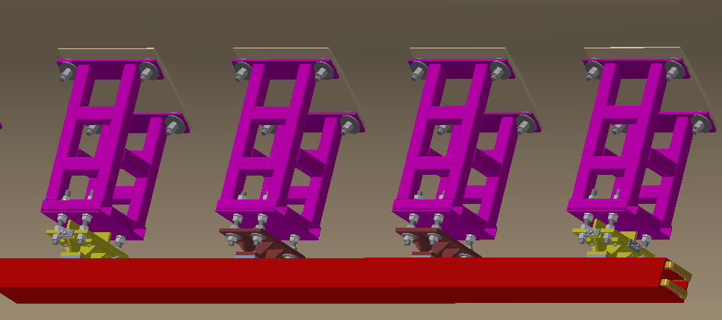
Supports for regular magnets
Over 80% of the length is covered by magnets of about 138 types.
Adjustment Ranges of magnets
X | ≥±20 mm | Δθx | ≥±10 mrad
Y | ≥±30 mm | Δθy | ≥±10 mrad
Z | ≥±20 mm | Δθz | ≥±10 mrad
Booster
Collider

Slide 13
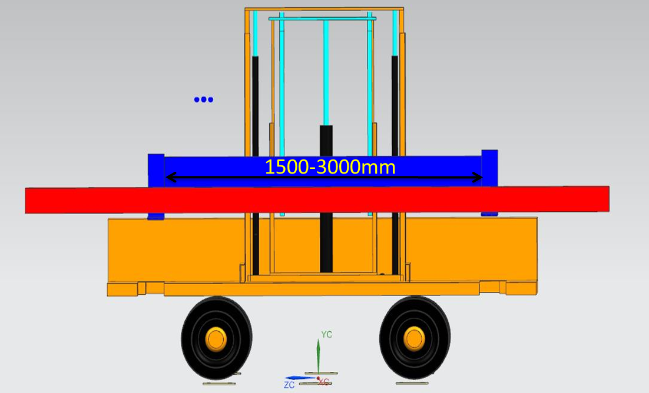
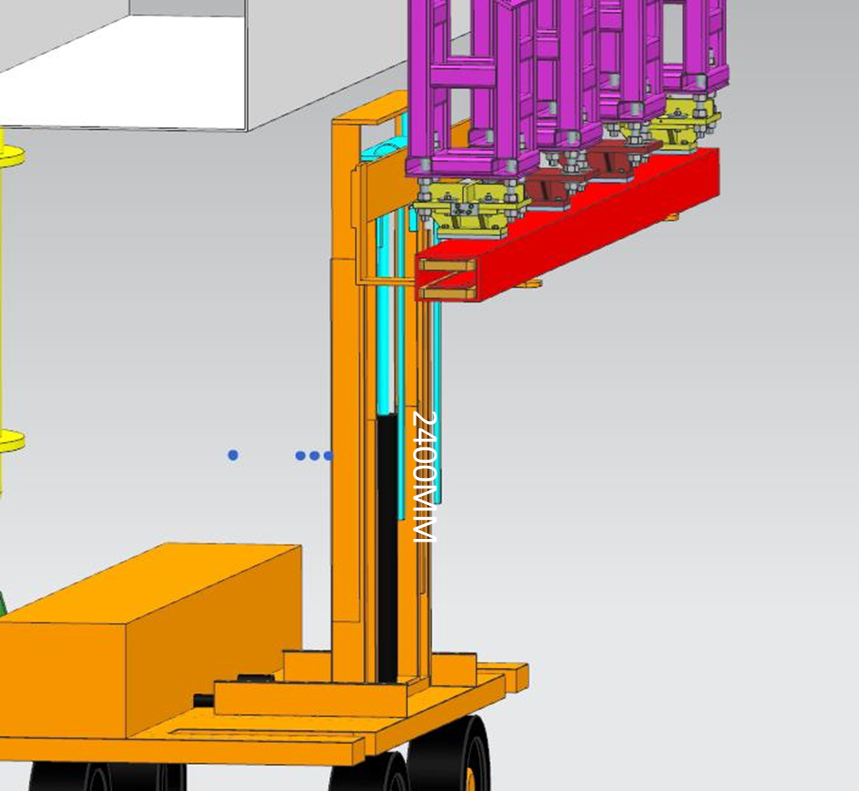
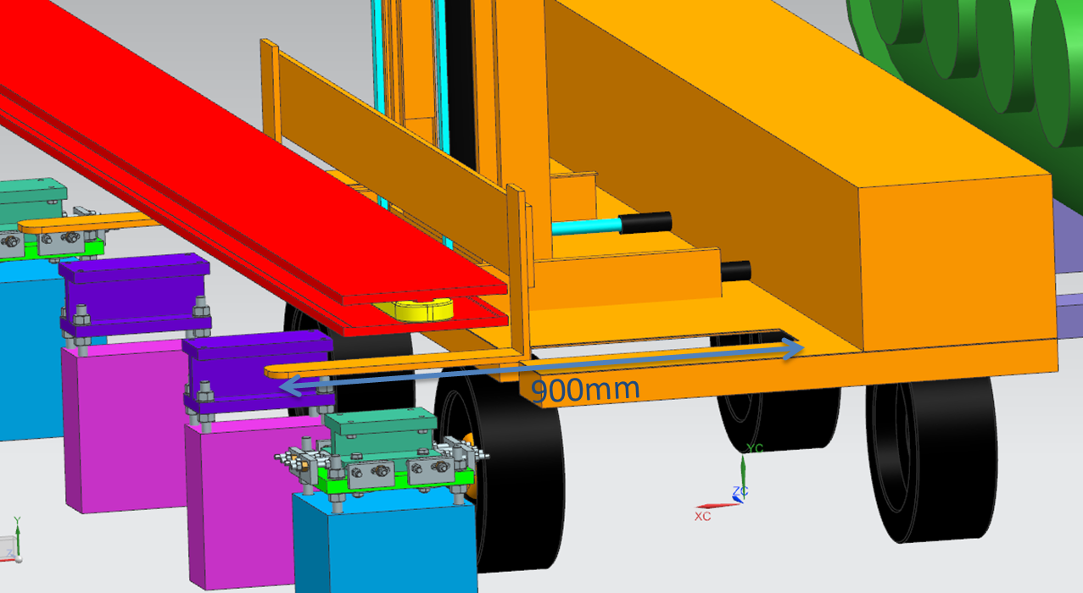
Supports for regular magnets
Flexible load support for “long” devices and “short” devices
Transportation and coarse location of magnets in Booster
Transportation and coarse location of magnets in Collider
* Cooperate with Beijing North Vehicle Group Corporation.

Slide 14
Supports for regular magnets
According to the lattice design, the layout of one cell of collider and booster has been updated.
The magnet girders will be renewed too.
Simple & flexible structure.
Small deformation & good stability
Low cost
Detailed structure for typical supports are under design.

Slide 15
Conclusion
We have updated the cryostat and MDI layout.
The SC magnet supports inside the cryostat are under design and optimization. Integral FEA with thermal contraction will be studied next step.
The structure of the collimator was optimized according to the modification of the vacuum chamber, and the temperature, stress and deformation were simulated.
The layout of one cell of collider and booster has been updated. Preliminary design for typical regular magnet supports are undergoing, more detailed work will be done.

Slide 16
Thanks for your attention!

