Slide 1
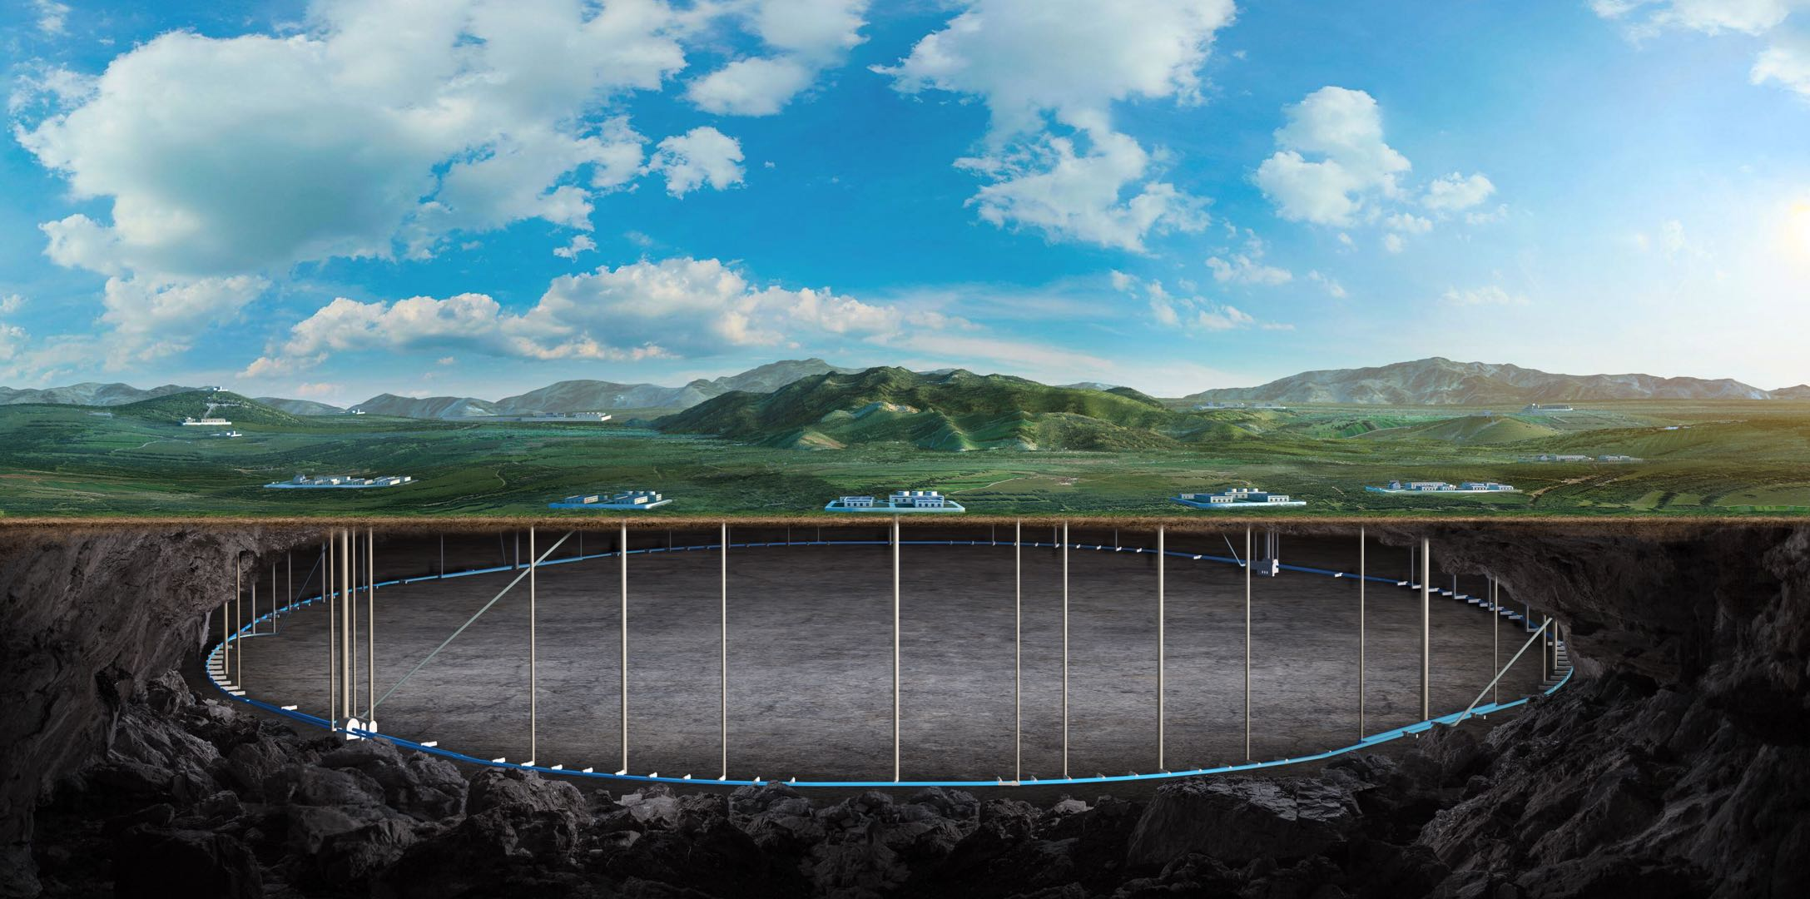
CEPC dump system design
Guangyi TANG, Zhongjian MA
The 2022 International Workshop on the High Energy Circular Electron Positron Collider
Oct 24 – 28, 2022
October 24-28, 2022

Slide 2
Outline
Introduction
CEPC dump system design status
Summary

Slide 3
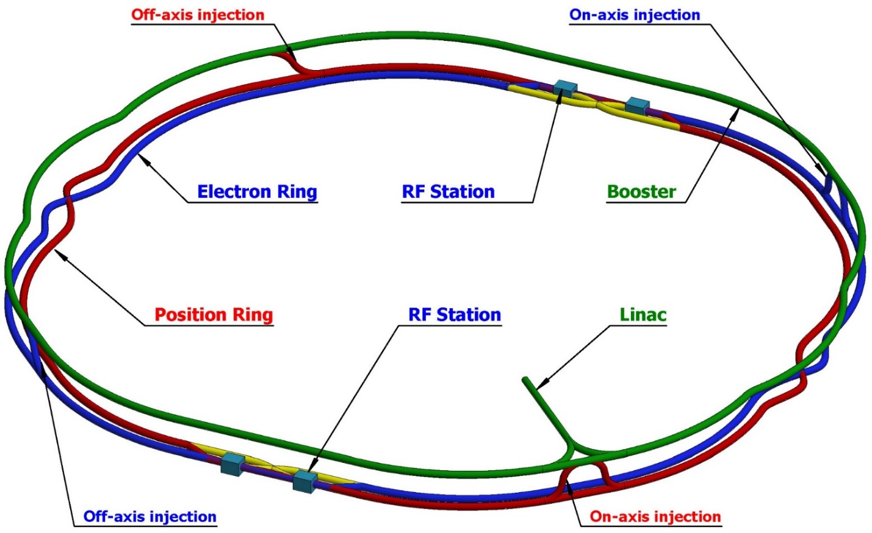
Introduction
CEPC project and dumps
CEPC is a Higgs (ttbar,H, W, Z) Factory
Linac, 30GeV, 1.8km
Booster, 30-180GeV, 100km
Main ring, 45.5-180GeV,100km
Dump system function:
Machine commissioning
Unwanted beam collection
Collect beam in abnormal situation/sudden beam loss for machine protection

Slide 4
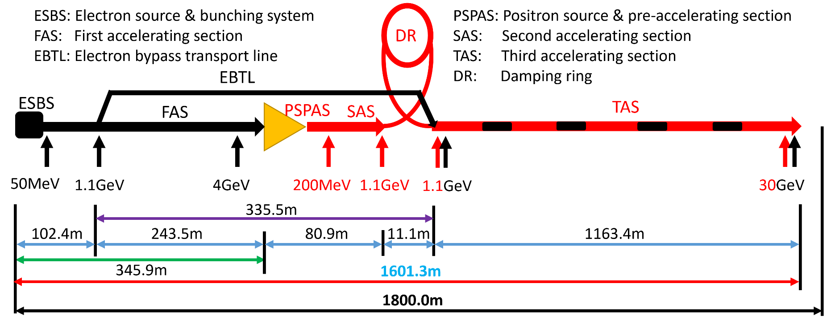
Introduction
Dumps for Linac
Six Beam energy analysis stations used for beam characteristic analysis
One Dumps in the end for commissioning
Also designed one collimation station
 | No. | Beam energy | Bunch size/mm | Frequency/Hz | bunch charge/nC | Number of particles [$10^{10}$/s] | Total energy[W]
TDR 30GeV | 1 | 60MeV | 2/1 | 2 | 10 | 12.5 | 1.2
 | 2 | 4GeV | 0.5/0.5 | 2 | 10 | 12.5 | 80
 | 3 | 250MeV | 1.5/1.5 | 2 | 5 | 6.3 | 2.5
 | 4 | 1.1GeV | 0.5/0.5 | 2 | 5 | 6.3 | 11
 | 5 | 6GeV | 0.5/0.3 | 2 | 3 | 3.7 | 36
 | 6 | 30GeV | 0.3/0.3 | 2 | 3 | 3.7 | 120
 | 7 | 30GeV | 0.3/0.3 | 2 | 3 | 3.7 | 120
 | 8 | 250MeV | 1.5/1.5 | 200 | 5 | 624 | 250

Slide 5
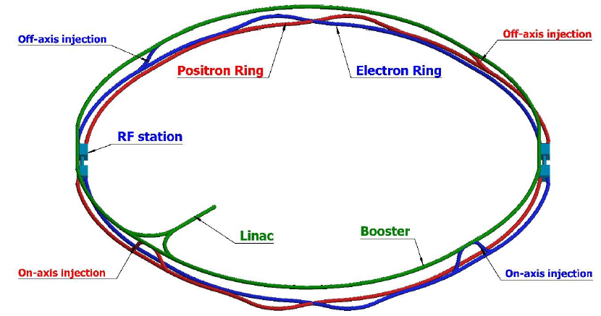
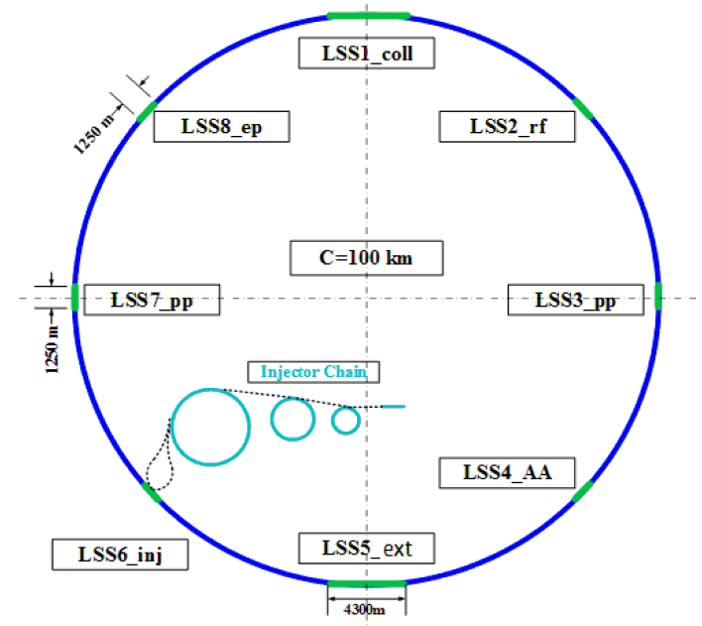
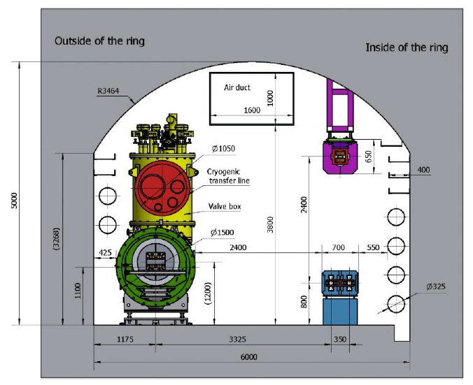
Introduction
Dumps for Booster/Ring
From: Yiwei Wang Xiaohao CUI
Dumping system for collider ring
Not necessary to be close to IP
Active machine protection for the beam loss with time larger than multi turns
Located at STR1 and STR2 or STR2 and STR3
At least one dump for each collider ring
STR4 for future option of ep collision
Inner side of tunnel
SPPC will locates outer side of CEPC
Maintenance of the dump
Dumping system for booster ring
Low charge bunches can be dumped by collimator
Dumping for bunches can share the dump with collider ring
STR4
STR1
STR3
STR2

Slide 6
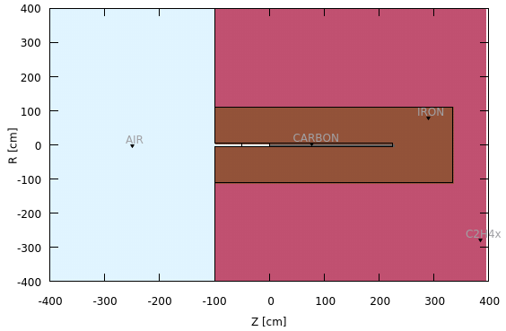
Linac dump design
3 layers cylindrical structure is used for dump design
Carbon and iron is selected as the absorber material, surrounded by the polyethylene as local shielding.
5.5mSv/h is set as upper limit to decide the thickness of local shielding.
To suppress the back scattering radiation, there exiting extra iron and polyethylene on the left part from the negative side of z=0 position.
Radiation level nearby each energy analysis station was figured out, also specify a roughly space for the future local shielding.

Slide 7
Linac dump design
Design status
Total: 7 dumps and 1 collimator
Outline of external dimensions for each dumps were designed
Thickness of local shielding can be further optimized combined with Linac tunnel thickness
No. | Beam energy | C |  | C+Fe |  | C+Fe+Polyethylene
 |  | R/m | Length/m | R/m | Length/m | R/m | Length/m
Dump_1 | 60MeV | 0.05 | 0.15 | 0.7 | 1 | --- | ---
Dump_2 | 4GeV |  | 1.25 | 1.1 | 2.4 | 1.2 | 2.6
Dump_3 | 250MeV |  | 0.4 | 0.5 | 0.95 | 0.55 | 1
Dump_4 | 1.1GeV |  | 0.75 | 0.75 | 1.6 | 0.85 | 1.7
Dump_5 | 6GeV |  | 1.45 | 0.92 | 2.4 | 1 | 2.5
Dump_6/7 | 30GeV |  | 2.6 | 1.2 | 3.7 | 1.3 | 3.8
Collimator | 250MeV | R=1.3m L=1.8m (outer dimension)
Dump_1
Dump_2
Dump_3
Dump_4
Dump_5
Dump_6/7
Collimator

Slide 8
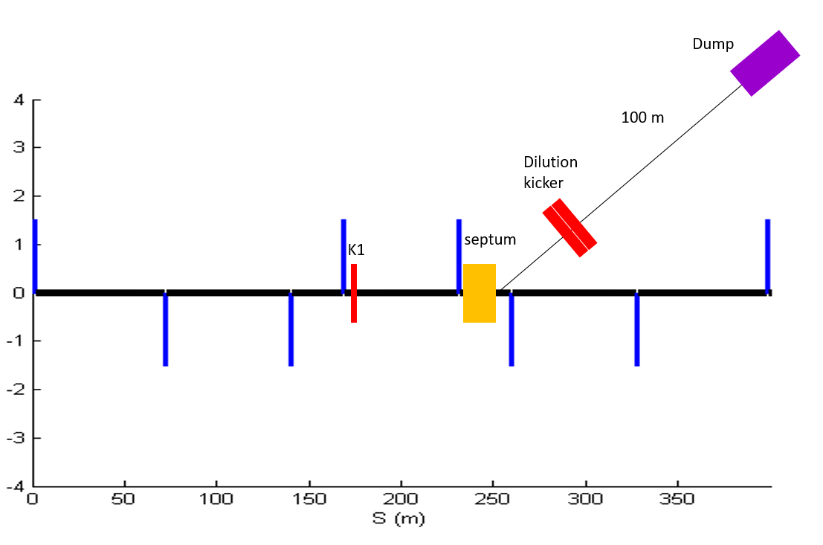
Main dump design
A dump system have been designed to cover all the operation model
The sorted beam energy and the heat deposition is the most serious in Z model
A set of kicker magnets is used to dilute the beam horizontally and vertically.
The length of transfer tunnel is about 100m; the diameter of the transfer tunnel is about 2m, considering the vacuum equipment, pipe installation.
The area of bunch distribution at dump entrance is optimized to be 6cm x 6cm for graphite core.
Beam parameter of CEPC collider with power 50MW
 |  | Extraction kicker | Septum | Dilution kickers
Length (m) |  | 2 | 20 | 10
Magnetic flux density (Gauss) | Z | 280 | 2600 | 40(Max.)
 | WW | 493 | 4700
 | Higgs | 740 | 7000
 | ttbar | 1110 | 10500

Slide 9
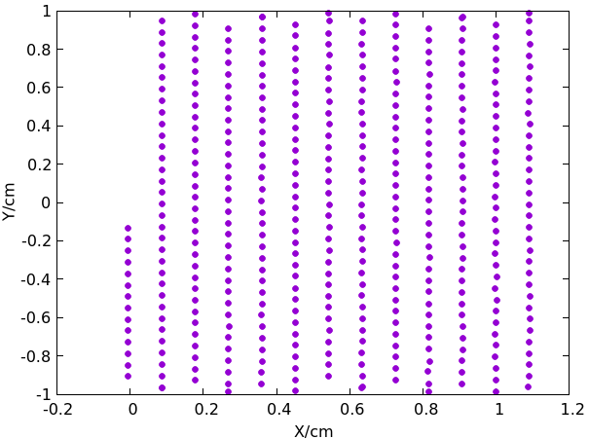
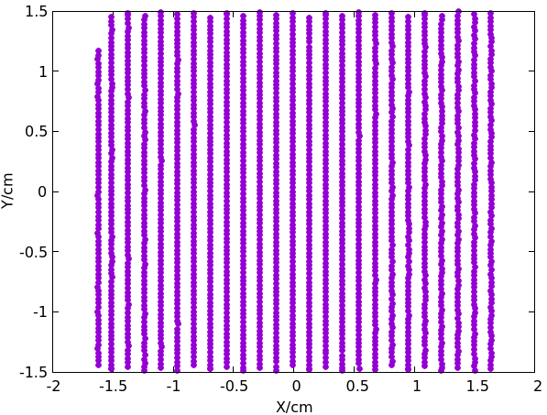
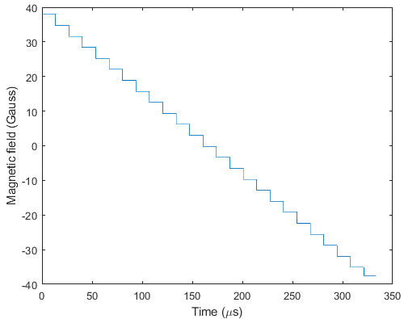
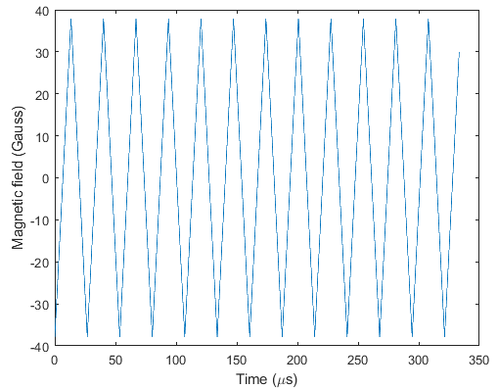
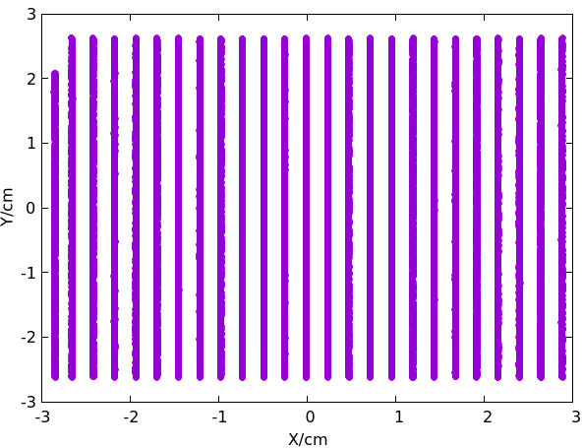
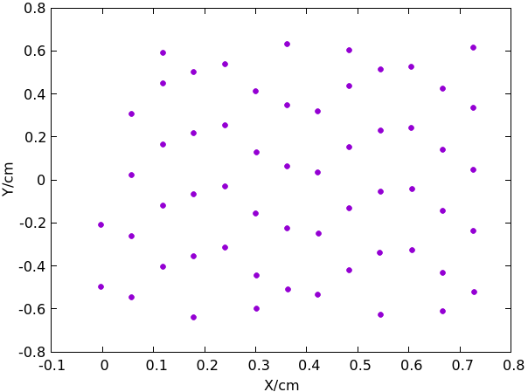
Main dump design
The bunch distributions at the dump entrance is simulated.
Bunch size: 𝜎_𝑥>7𝑚𝑚;𝜎_𝑦>40𝜇𝑚;
From: Xiaohao CUI
WW
Z
ttbar
Dilution kicker requirement:
Vertical kicker should periodic oscillate 12.5 times in 300 us
Horizontal kicker should reduce step by step from max. to min. in 300 us

Slide 10
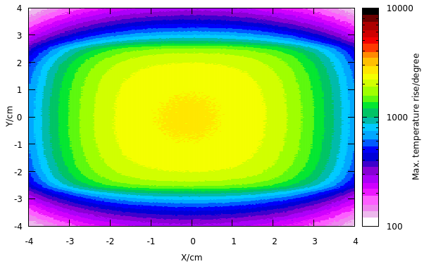
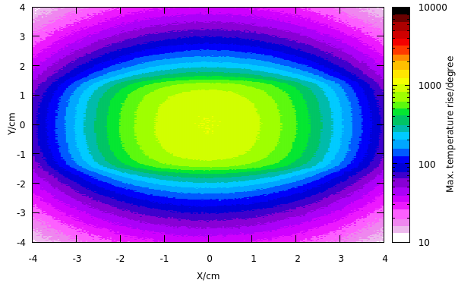
Main dump design
Max. temperature rise: 50MW
Energy deposition from FLUKA simulation& temperature rise calculated from specific heat capacity formular
Max. temperature rise is smaller than graphite melting point.
Dimension (graphite + Iron): R~2.3m, L~8m; constrained by the condition that dose-eq is smaller than 5.5mSv.
The graphite core will surrounded by inert gas to avoid fire and chemical reaction
@ Z mode
 | Higgs | WW | Z | ttbar
Beam energy/GeV | 120 | 80 | 45.5 | 180
Ne/bunch/${10}^{10}$ | 14 | 13.5 | 14 | 20
Bunch number (50MW) | 415 | 2162 | 19918 | 58
Max. temperature rise | $$510±15℃$$ | $$1020±30℃$$ | $$2620±15℃$$ | $$194±2℃$$
Max. temperature rise by one bunch | $$7.31±0.03℃$$ | $$5.38±0.03℃$$ | $$3.76±0.02℃$$ | $$10.08±0.04℃$$
Temperature rise figure
@ WW mode

Slide 11
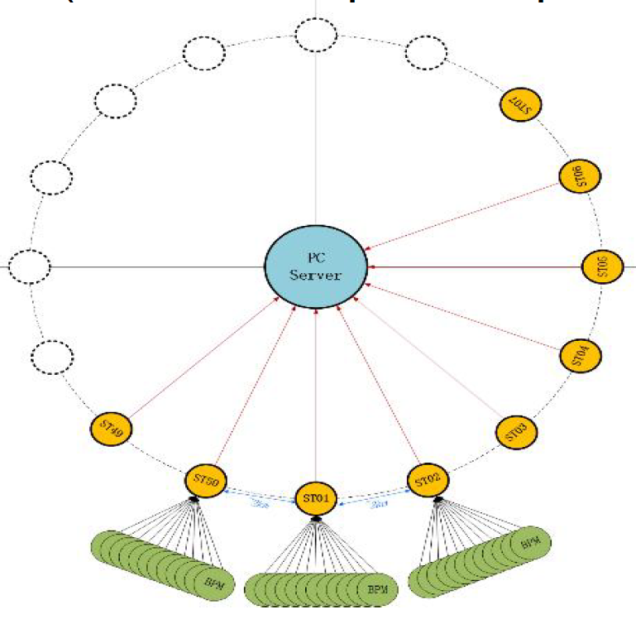
Main dump design
Dump used for MPS
A task forced group was established to research on the beam abort system
Beam should be aborted while receiving the stopping signals from:
Beam loss monitors/Synchrotron oscillation phase monitor/Hardware components/Manual abort
Time duration needed to abort the whole beam in one cycle
Device request → local control →Central control →Dump system → Extract all beam in one cycle
Response time ~ 1ms;
Need collimators to deal with beam losses faster than 1ms

Slide 12
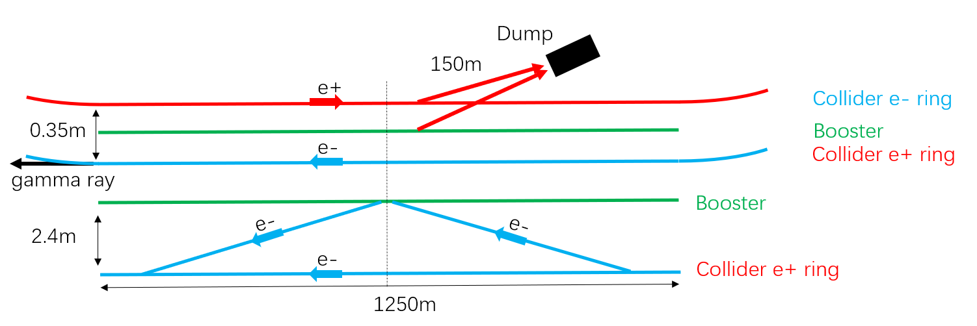
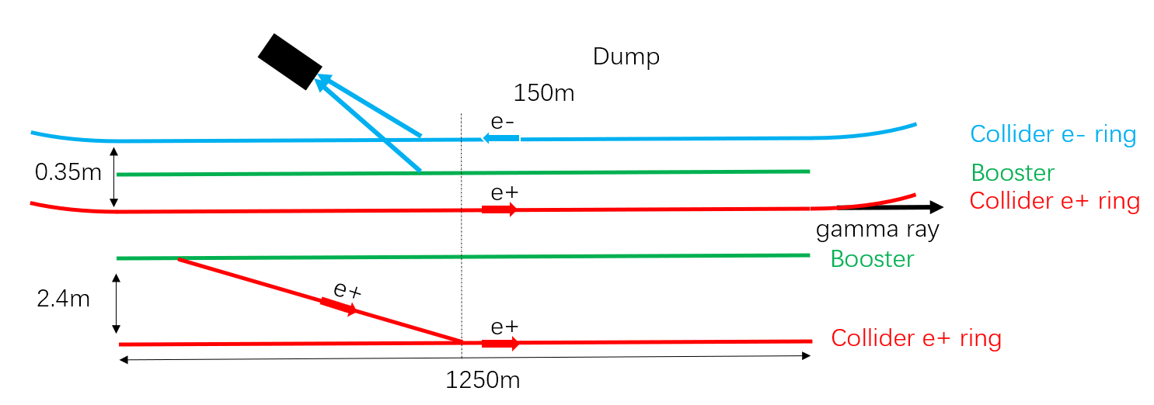
Main dump design
Design Status
Active beam abort system was designed
For normal operations and machine tunning
Locate at the two straight section STR1 and STR2 as a base design; inner side of tunnel
Can be built in 4 straight sections. Number of dumps depends on machine requirement and reliability
Transport line from booster to the main ring dump is designed
STR4
STR1
Dump
Dump
STR3
STR2
Transport line designed by Yiwei Wang Xiaohao CUI
Transport line layout near injection region STR2
Transport line layout near injection region STR1

Slide 13
Summary
Hot points in the Linac, energy analysis station/dump/collimator, were designed with local shielding structure, and roughly external dimensions were figured out for the Linac tunnel arrangement.
An active beam abort system was designed in the main ring
Using the same dump system for main ring and booster is discussed and is practical.
Need collimator design and the active beam abort system for aborting the beam during sudden beam loss and normal operation.

Slide 14
End
Many thanks!

Slide 15
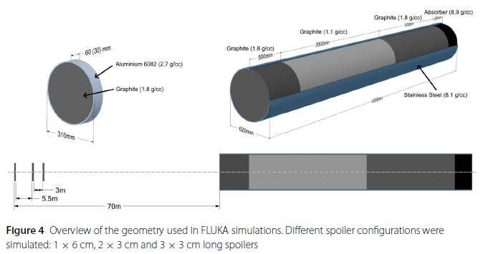
Krainer, A. et.al., EPJ Techn Instrum 9, 3 (2022)

Slide 16
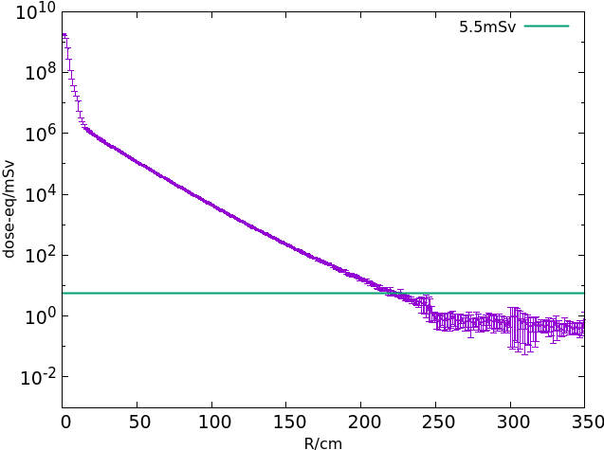
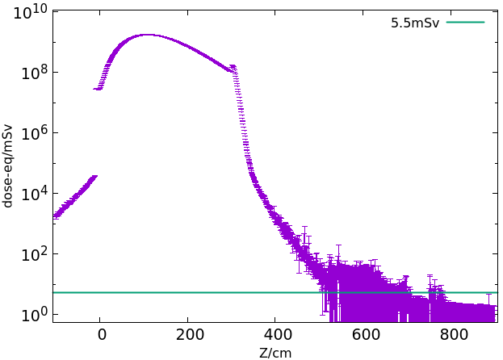
Collider dump
Beam energy | C |  | C+Fe
 | R/m | Length/m | R/m | Length/m
45.5GeV | 0.1 | 3 | 2.3 | 8

