Slide 1
Beam position monitor preliminary design for the CEPC
Jun He, Yanfeng Sui
Contributions from many colleagures
2022-10-28

Slide 2
Outline
Beam Position Monitors overview
1
2
CEPC BPM design considering
3
Some progress on BPMs study
Special BPMs
4
5
Lessons from TDR comments
6
Summary

Slide 3
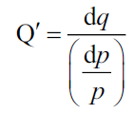
Overview: Why BPMs important
B
A
Schematic of a BPM
$$\text{x}\text{,}\text{y} \text{=} \text{f} \text{(}\text{Xraw}\text{,}\text{Y}\text{raw}\text{)}$$
$$\text{X}\text{raw}\text{ =}\frac{{\text{V}}_{\text{a}}\text{+}{\text{V}}_{\text{d}}\text{−}{\text{V}}_{\text{b}}{\text{−}\text{V}}_{\text{c}}}{{\text{V}}_{\text{a}}\text{+}{\text{V}}_{\text{b}}{\text{+}\text{V}}_{\text{c}}\text{+}{\text{V}}_{\text{d}}}$$
$\text{Y}\text{raw}\text{ =}\frac{{\text{V}}_{\text{a}}\text{+}{\text{V}}_{\text{b}}\text{−}{\text{V}}_{\text{c}}{\text{−}\text{V}}_{\text{d}}}{{\text{V}}_{\text{a}}\text{+}{\text{V}}_{\text{b}}{\text{+}\text{V}}_{\text{c}}\text{+}{\text{V}}_{\text{d}}}$ ;
Beam
(x,y)
C
D
Providing the information of position(x,y)
BPMs are the most important system of instrumentation. Orbit measurement (bunch by bunch, turn by turn), orbit correction, bunch feedback, bunch current intensity measurement, optic functions measurement (beta-function, dispersion, tune, coupling, chromaticity) RF frequency measurement, beam loss (trip) diagnosis are depending on it.
Bunch charge ∝∑V_{i}

Slide 4
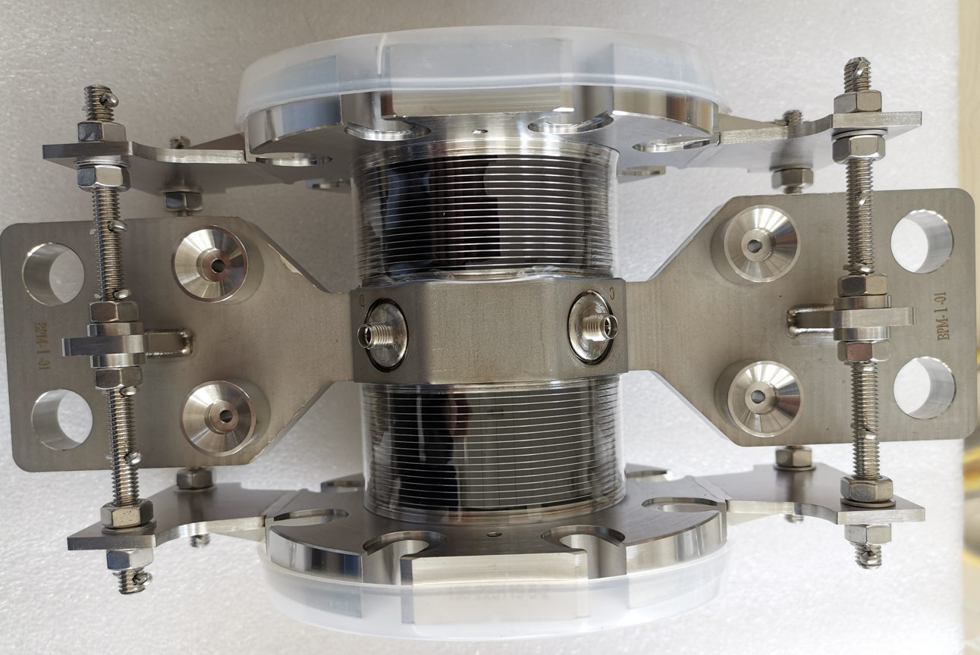
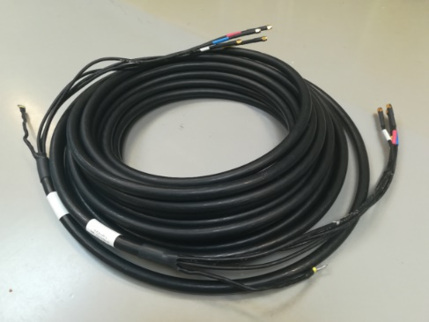
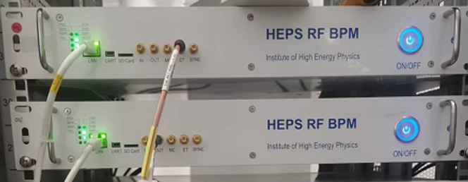
BPM system in 1 minute
3 parts: Detector + cable + readout electronics
~40% of the cost
BPM signal
~50% of the cost
beam
Detector
Filter +ADC
A long coaxial cable
Electronics
Electronics developed by BI group
Detector with four buttons
Cable: LMR 195 bundled

Slide 5
BPMs number and distribution
LINAC: 140
Collider: ~3600
Booster: 2400
DR: 40
~1800
~1800
Totol length of ESBS+FAS+PSPAS+SAS+TAS: 1800 m
 | Numbers of BPM | Machine Size
BEPCII | 165(19+15+66×2) | 240 m
HEPS | ~700(40+80+590) | 1.4 km
CEPC | ~6200 | 100 km
FCC-ee^{[1]} | ~6000 | ~92 km
Cost：about ¥100,000 / BPM (base on home-made electronic )

Slide 6
BPMs overview
The total number of the BPMs has been increased compared with CDR because of the changing of lattice.
 | LINAC | Damping ring | Booster | e+ ring | e- ring | Transfer line | Total
CDR Button | 1 | 40 | 1808 | 1450 | 1450 | / | ~4889
CDR Strip | 140 | / | / | / | / | /
TDR Button | 1 | 40 | 2408 | 1772 | 1772 | / | ~6133
TDR Strip | 140 | / | / | / | / | /
Design principles:
LINAC – stripline type , Ring – button-type
4 BPMs /2π phase advanced (363 β oscillation period →445Htt)
1 BPM /10-20 m in LINAC 4. Electronics in the tunnel …

Slide 7
Beam Position Monitors overview
CEPC BPM design considering
Some progress on BPMs study
Special BPMs
Lessons from TDR comments

Slide 8
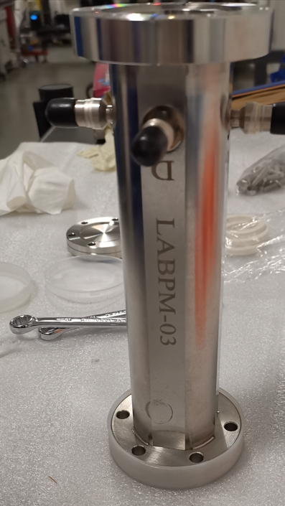
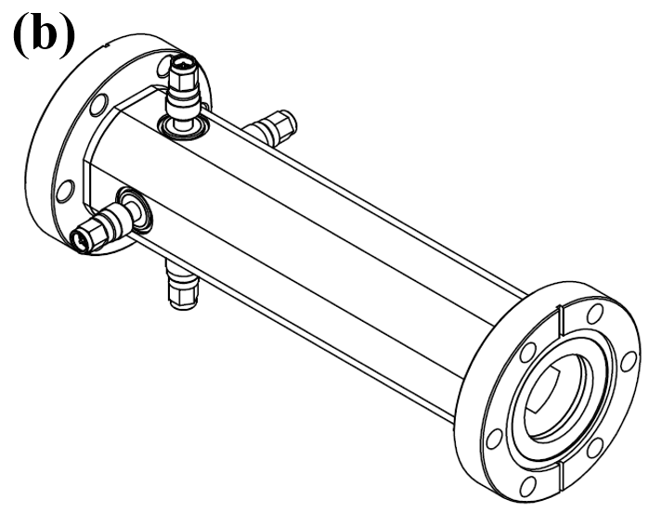
CEPC BPM design: stripline-type
A picture of a stripline BPM(external, interior Views)
Schematic of stripline BPM: (a) Front view; (b) Side view

Slide 9
CEPC BPM design: stripline-type
Basic Requirements: The mechanical parameters (α,t,h,r_{in}) of the strip should make the characteristic impedance of the strip Z₀= 50 Ω
Higher requirements
E-field of a stripline in different eigenmodes, (a) Sum (b) Quadrupole(c) Dipole (d) Single electrode$\sqrt{{\text{Z}}_{\text{sum}}{\text{Z}}_{\text{quad}}}\text{ ≈ }{\text{Z}}_{\text{dipole}}\text{ ≈ }{\text{Z}}_{\text{single}}\text{ ≈ 50 }\text{Ω}$

Slide 10
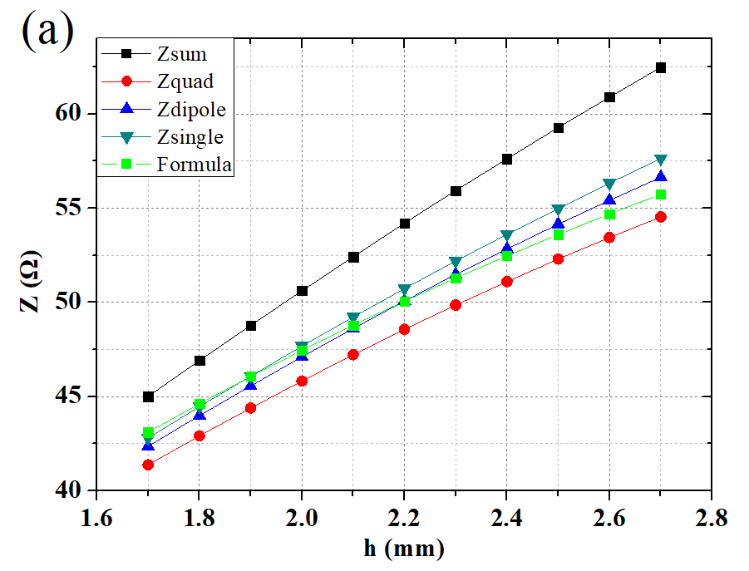
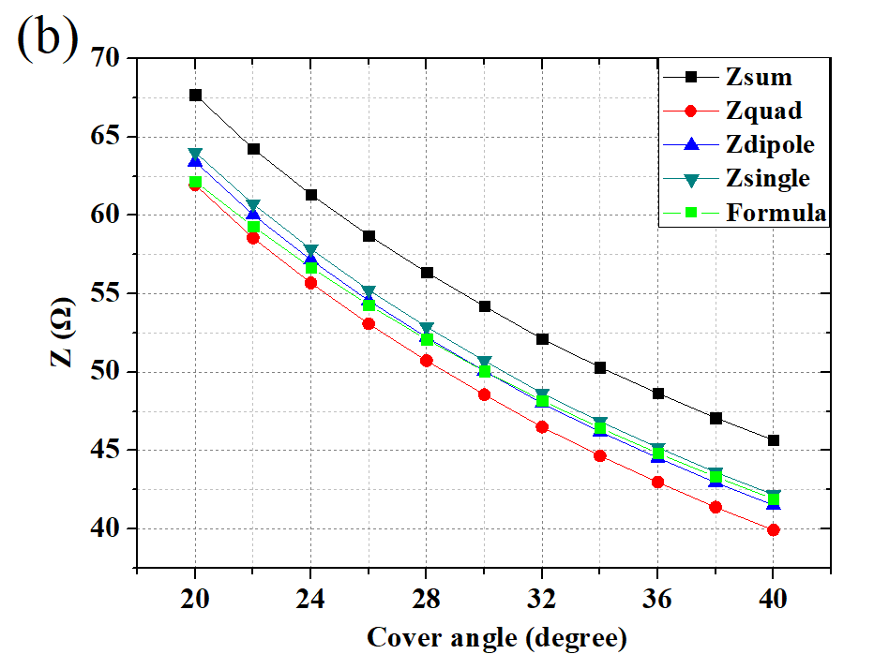
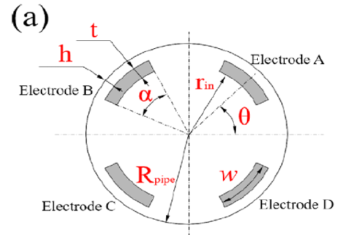
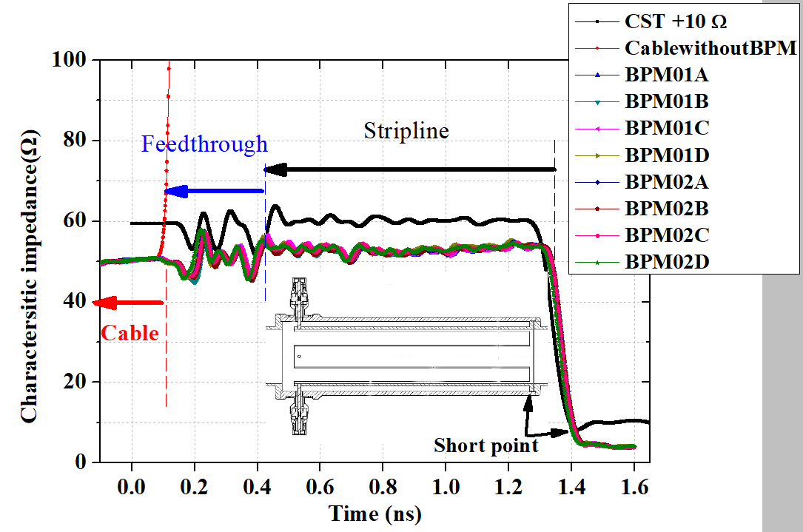
Strip impedance design
CST simulation and a time-domain reflectometer (TDR) results*
Z vs h
Z vs α
(c)
*Jun He et,al.Measurement Science and Technology 33 (2022) 115106, https://doi.org/10.1088/1361-6501/ac8277
(a–b) impedance for different modes vs. h and α by CST; (c) measured by TDR(Tektronix DSA8200 ). Experimental results are in a good agreement with simulations (below 3%).

Slide 11
Stripline design considering
${\text{r}}_{\text{in}} \text{≥} {\text{r}}_{\text{beam}}\text{, } \text{t}\text{ ≥ 1.2} \text{mm}\text{, }{\text{r}}_{\text{in}}\text{ + }\text{t}\text{ + }\text{h}\text{ ≤ }\text{A}\text{1}\text{, }\text{t}\text{ + }\text{h}\text{ ≤ }\text{A}\text{2}$ ${\text{L}}_{\text{strip}}\text{=}\frac{\text{2}\text{N}−\text{1}}{\text{4}}\frac{\text{c}}{{\text{f}}_{\text{0}}}$, N=0, 1, 2
r_{beam} is the radius of the beam stay-clear area, 1.2 mm is the minimum thickness of the strip when the longitudinal length is greater than 100 mm (enough mechanical strength), A₁ and A₂ are the mechanical size limits for the flange and the commercial feedthroughs, respectively.
After considering all the associated factors mentioned above, the parameters are determined.
Mechanical parameters of the CEPC stripline BPM
Location | r_{in} | t | h | α | θ | Z_{single} | L_{strip} | Z_{CST}
Unit | mm | mm | mm | degree | degree | Ω | mm | Ω
LINAC(FAS+SAS) | 15 | 1.5 | 2.2 | 30 | 0 | 50.8 | 150 | 50.3±0.5
LINAC(TAS) | 10 | 1.2 | 0.6 | 30 | 0 | 49.9 | 150 | 50.4±0.5
A button-type also could be used for LINAC, structure is simpler but signals are smaller than strip.

Slide 12
CEPC BPM design: Button-type
U=Z_{t}×I_{beam}
I_{beam}
The BPM design always is in a dilemma: the bigger transfer impedance (Zt) means a better resolution but also a more serious beam instability
Several tips to depress the wakefield without decrease signal too much:
1. Impedance optimization (to reduce the reflection)
2. Smaller gap (avoiding short)
3. To hide the sealed dielectric, Bell- shape (SIRIUS) or bigger t_{b}
4. A design without skirt
5. A design of asymmetric structure
6. Dielectric with a smaller ε_{r} (To replace ceramics by glass )

Slide 13
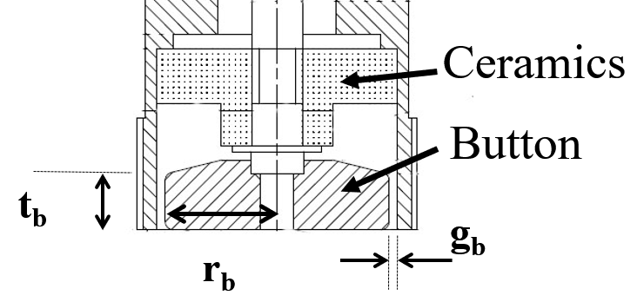
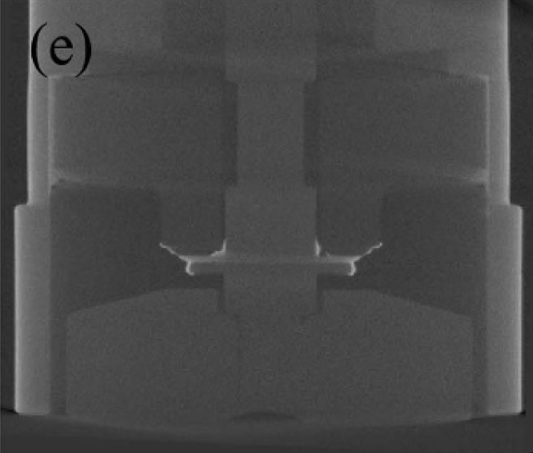
Button BPM design : R_{b}, t_{b}, g_{b}
Mechanical drawing and X-ray tomography of a button pickup
Three important parameters for button-type BPMs: radius r_{b}, height t_{b} and gap g_{b}.

Slide 14
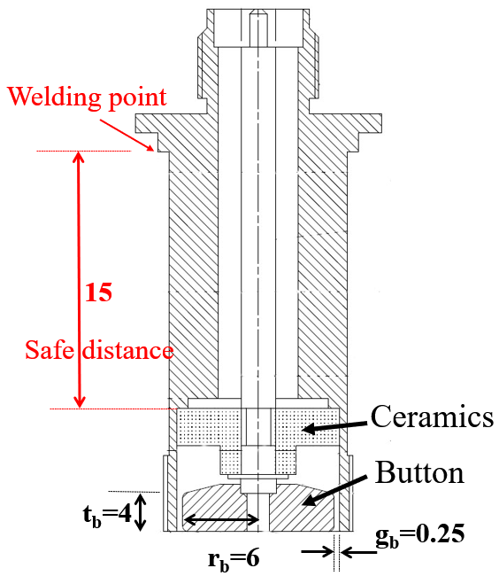
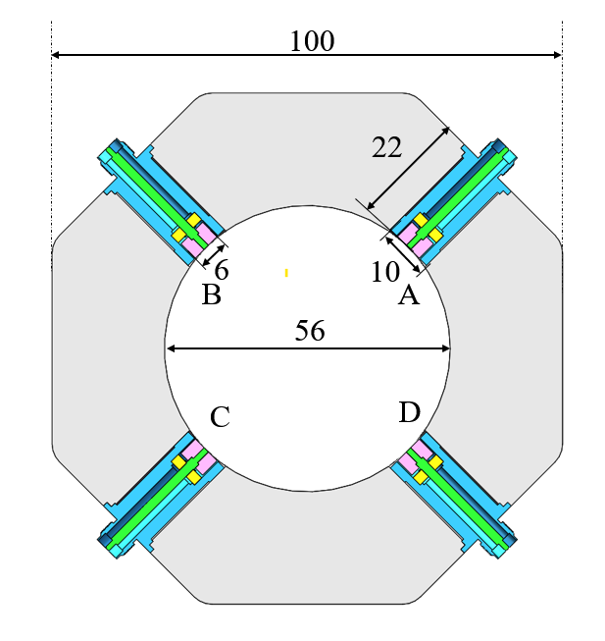
CEPC BPM design: Button-type
Design goal: To increase the signal and decrease the wakefield.
Increase | Feature | Advantage | Disadvantage
r_{b} | Larger area and Cb | Higher signal level | Lower resolution
t_{b} | Larger volume | Lower wake impedance | Lower resolution
g_{b} | More trapped modes | Higher resolution | Higher wake impedance
Mechanical structure of a BPM and a electrode

Slide 15
CEPC BPM design: Button-type
Transfer impedance and signal power (I= 200 mA) for light sources and colliders^{[5]}
Lab | Button radius | Half Aperture | Button Capacitance | Transfer impedance | Power
 | r_{b} (mm) | b (mm) | C_{b} (pF) | Z_{t} (Ω) | (dBm)
SPring8 | 9 | 15 | 2.5* | 1.414 | -1.6
APS-U | 5 | 11 | 2.6 | 0.595 | -9.2
ESRF | 5.5 | 15 | 2.5* | 0.528 | -10.2
BEPCII | 7.5 | 30 | 2.2 | 0.491 | -10.7
SSRF-Arc | 5 | 15.3 | 2.4 | 0.428 | -11.9
DIMOND | 5.4 | 18.5 | 2.5* | 0.413 | -12.3
HEPS | 4 | 11 | 2.4 | 0.381 | -12.9
APS | 5 | 19 | 2.6 | 0.344 | -13.9
SPring8-II | 3.5 | 10 | 2.5* | 0.321 | -14.5
ESRF-EBS1 | 4 | 13.3 | 2.5* | 0.315 | -14.6
TPS | 4 | 18 | 3 | 0.233 | -17.5
ALBA | 3.5 | 14 | 2.7 | 0.229 | -17.5
SIRIUS | 3 | 11 | 2.3 | 0.214 | -17.9
ILSF | 3.5 | 15 | 2.5 | 0.214 | -18.0
NSLS-II | 3.5 | 20.5 | 2 | 0.156 | -20.5
MAX-IV | 2 | 11 | 0.6 | 0.095 | -24.4
SKEKB | 3 | 45 | 2.5 | 0.052 | -30.2
CEPC | ? | 28 | ？ | ? | ?

Slide 16
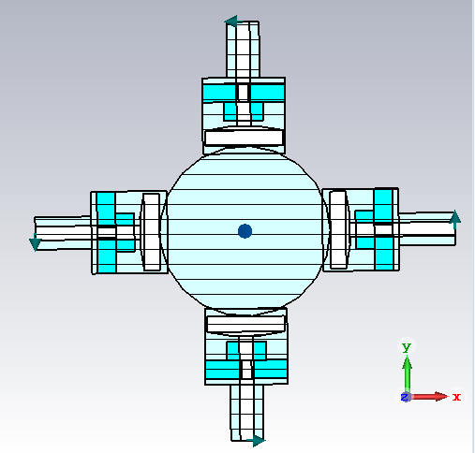
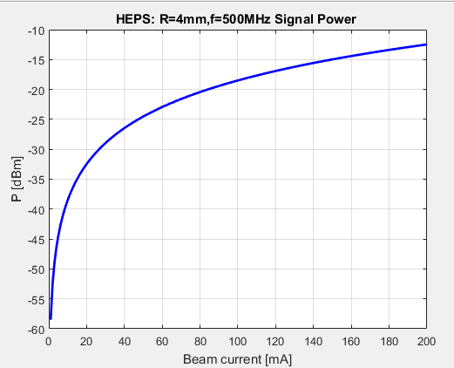
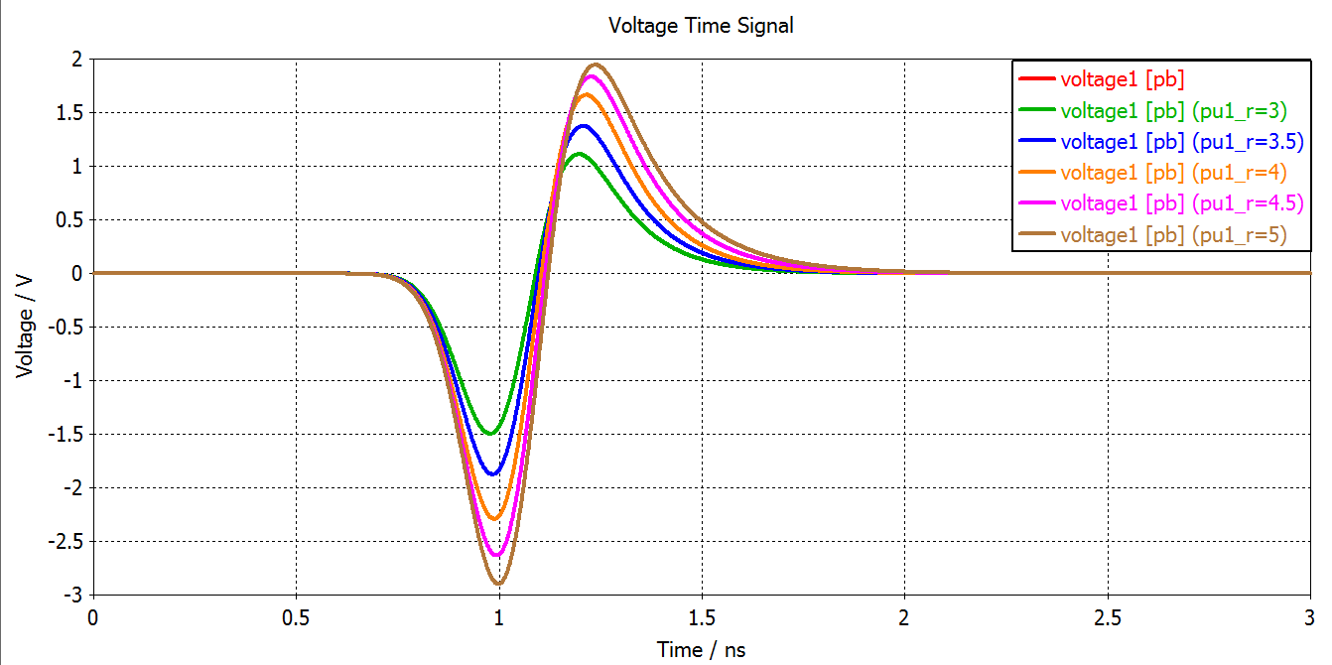
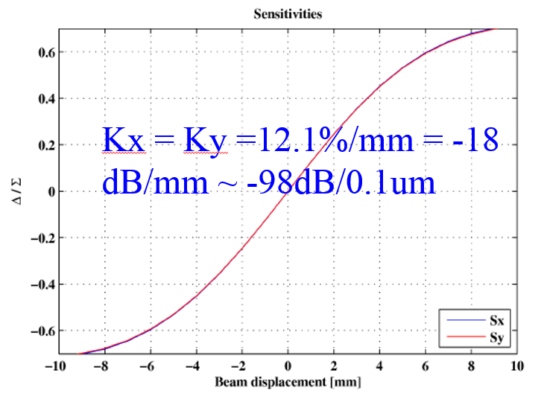
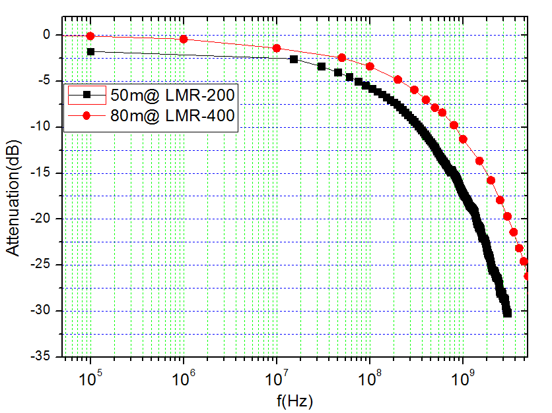
Button BPM design flow
Mechanical parameters
Responding
Different beam parameters
Changing beam position
Different Bandwidth：Bunch by Bunch, Turn by Turn…
Resolution
Noise Figure
Cable attenuation
Sensitivity coefficient
Signal-to-noise ratio

Slide 17
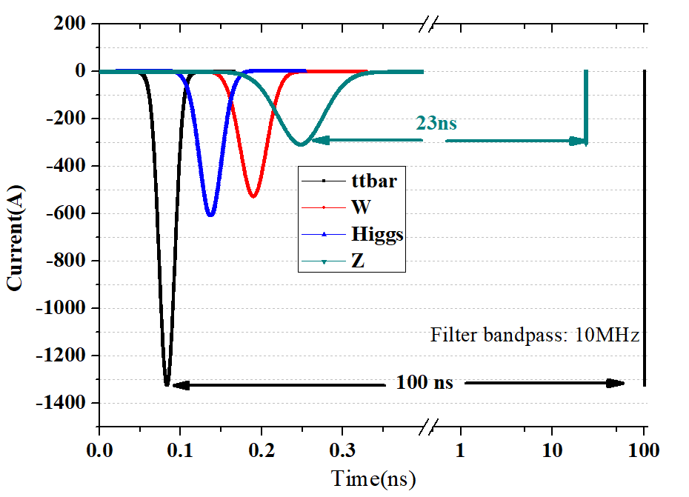
CEPC BPM design: Button-type
The time structure of a bunch in different mode
Preliminary design parameters
 | Value
R_{b} | 3 mm
t_{b} | 4 mm
g_{b} | 0.25 mm
C_{b} | 2.8 pF
Parameters of the CEPC button-type BPM for different mode

Slide 18
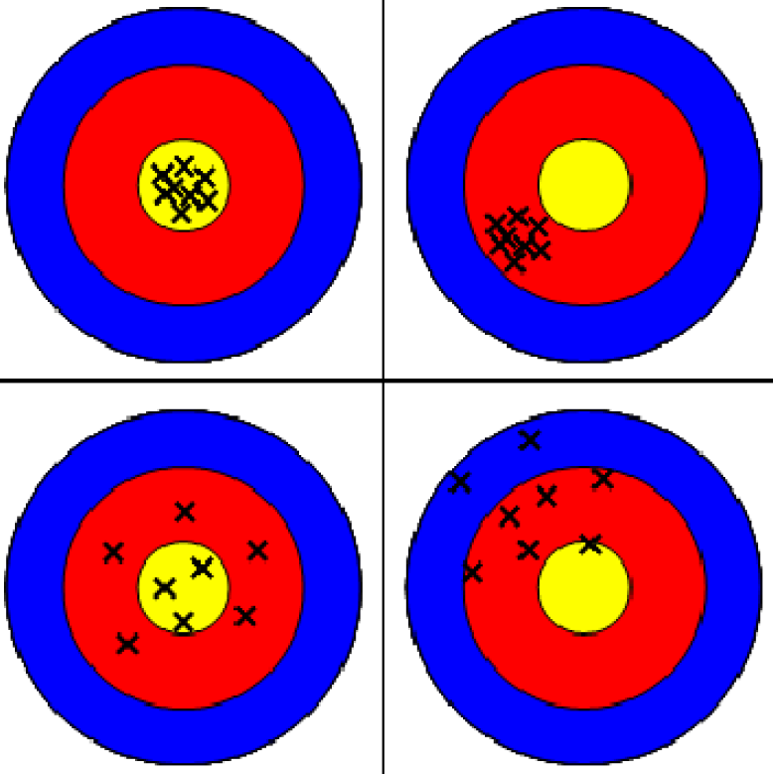
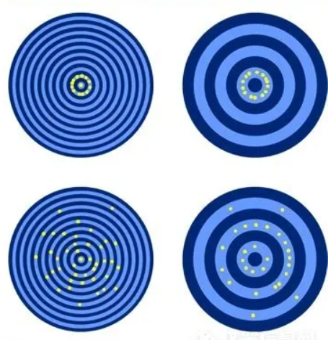
Accuracy Precision Resolution Repeatability
Definition of measurement terms
Resolution for BPM ~ Precision ~ Repeatability in other measurement
Bad
Good accuracy
Bad accuracy
Good resolution
Good resolution
Good Repeatability
Bad resolution
Bad Repeatability
BPM measurement
Usually measurement

Slide 19
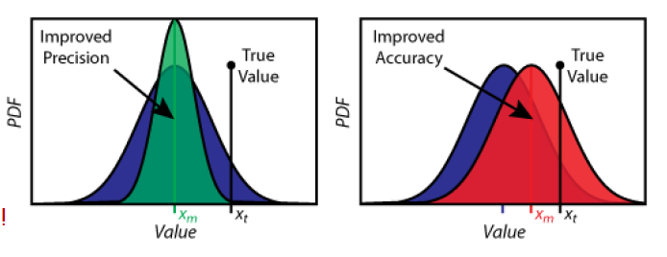
Accuracy & Resolution
Better resolution
Better accuracy
Resolution: the ability for measuring small displacement variations. In contrast to the accuracy, relative values are compared here. Resolution is much better than the accuracy. It depends strongly on the measurement time, averaging can exceed the accuracy by a factor of 100.
Accuracy: the ability of position reading relative to a mechanical fix-point or to any other absolutely known axis, e.g., the symmetry axis of a quadrupole, mainly influenced by the BPM's mechanical tolerances as well as the long-term stability of the mechanical alignment.

Slide 20
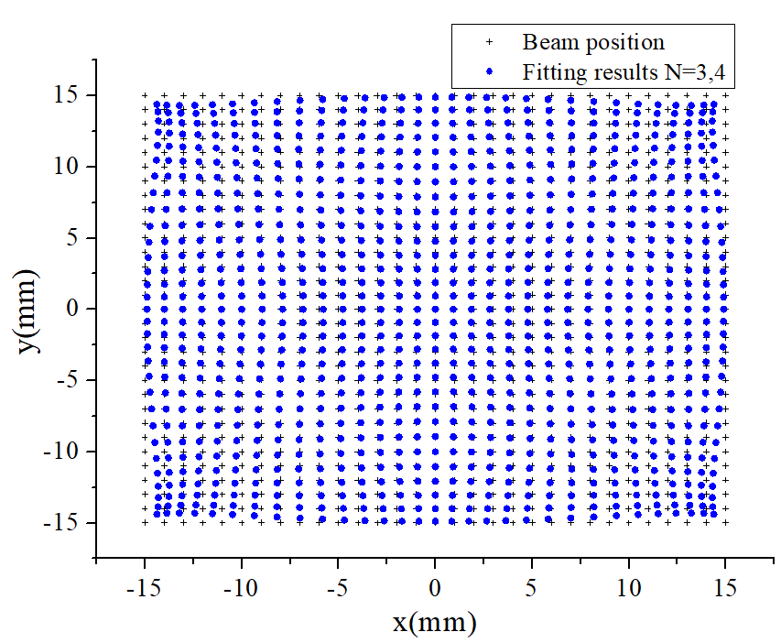
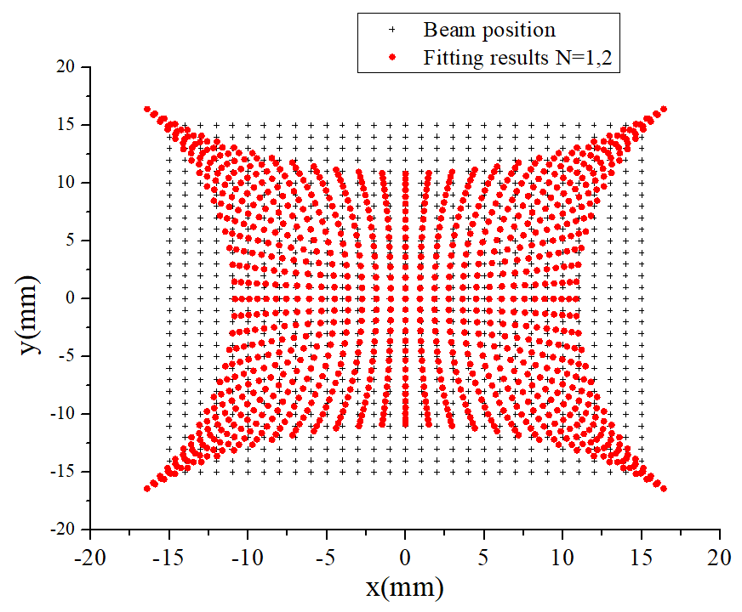
Accuracy & Resolution
 | BEPCII (800/200μm) | HEPS (10/1 μm) | CEPC
Resolution | ＜ 10 μm （2s） | 0.1 μm (45 μs) | ~1 μm (4 s)
Accurancy | 100 μm | ~30 μm | ~50 μm
$$\text{x}\text{,}\text{y} \text{=} \text{f} \text{(}\text{Xraw}\text{,}\text{Y}\text{raw}\text{)}$$
$$\text{X}\text{raw}\text{ =}\frac{{\text{V}}_{\text{a}}\text{+}{\text{V}}_{\text{d}}\text{−}{\text{V}}_{\text{b}}{\text{−}\text{V}}_{\text{c}}}{{\text{V}}_{\text{a}}\text{+}{\text{V}}_{\text{b}}{\text{+}\text{V}}_{\text{c}}\text{+}{\text{V}}_{\text{d}}}$$
$\text{Y}\text{raw}\text{ =}\frac{{\text{V}}_{\text{a}}\text{+}{\text{V}}_{\text{b}}\text{−}{\text{V}}_{\text{c}}{\text{−}\text{V}}_{\text{d}}}{{\text{V}}_{\text{a}}\text{+}{\text{V}}_{\text{b}}{\text{+}\text{V}}_{\text{c}}\text{+}{\text{V}}_{\text{d}}}$ ;
A baseline
Method: least square method
x=A₀+A₁X_{raw}+A₂Y_{raw}

Slide 21
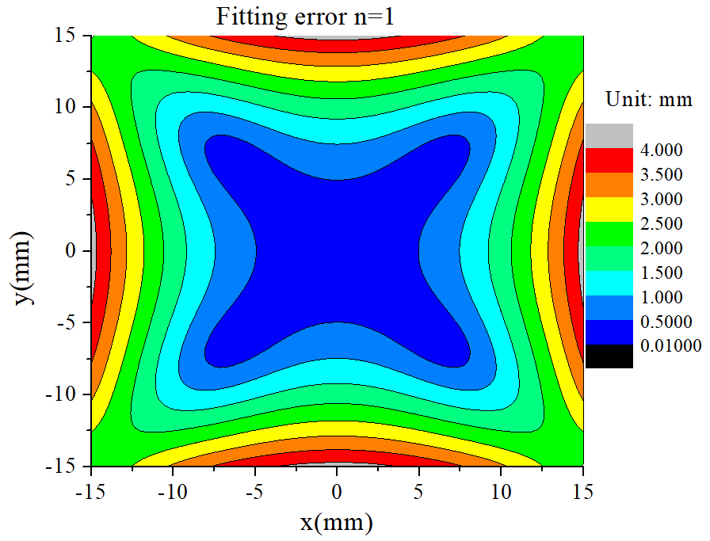
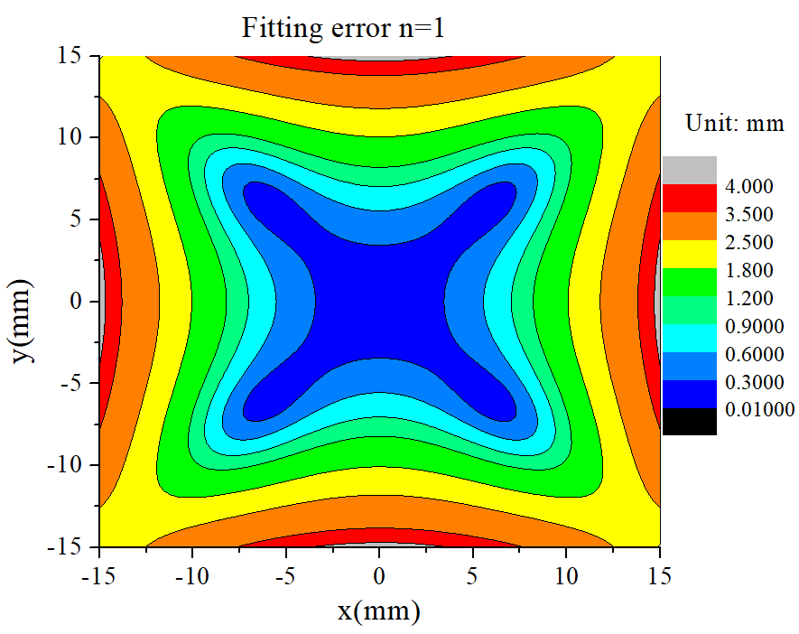
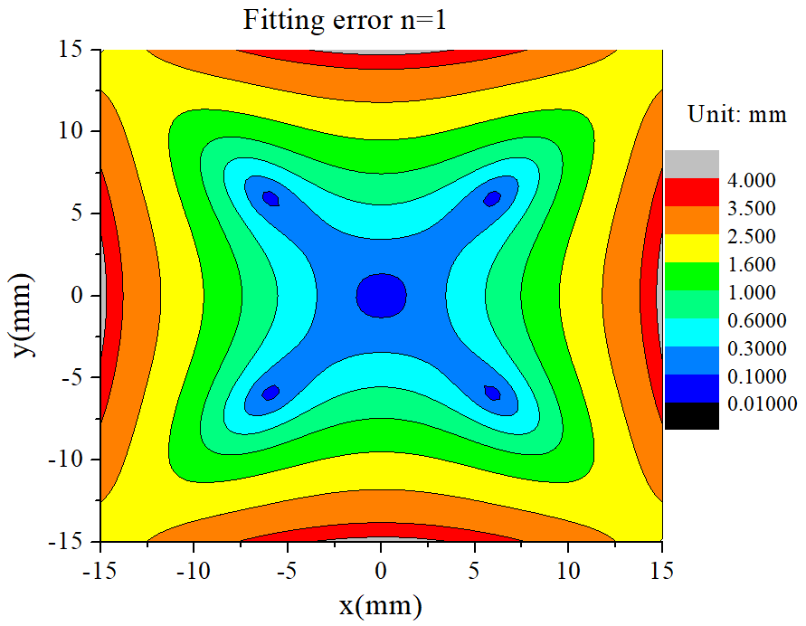
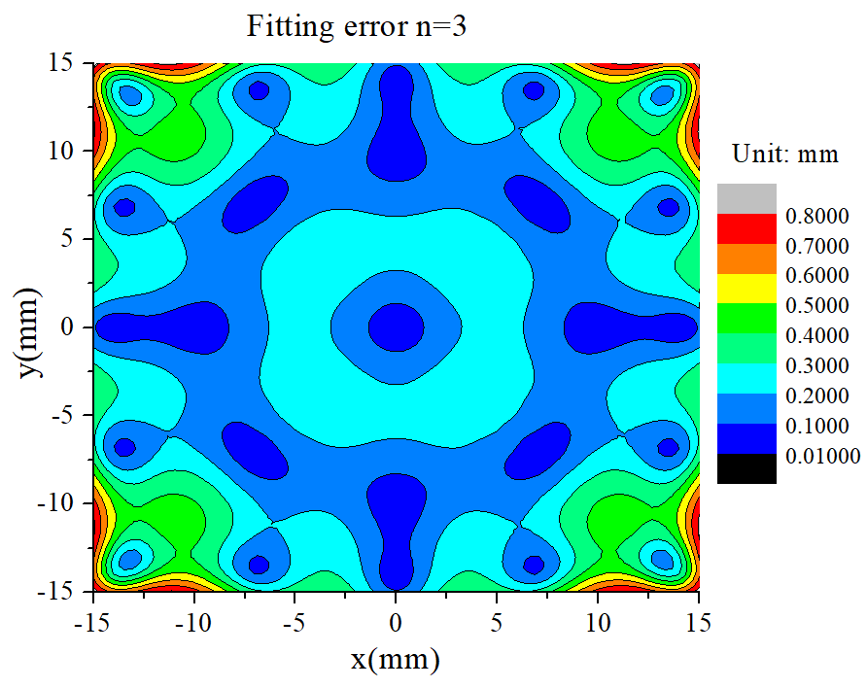
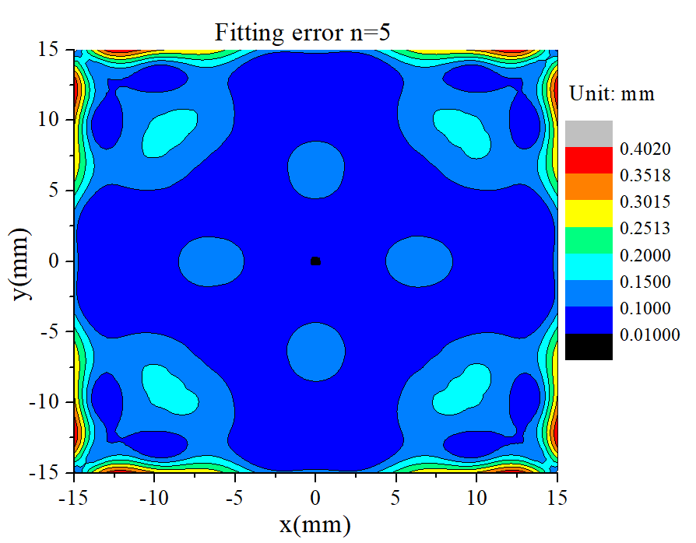
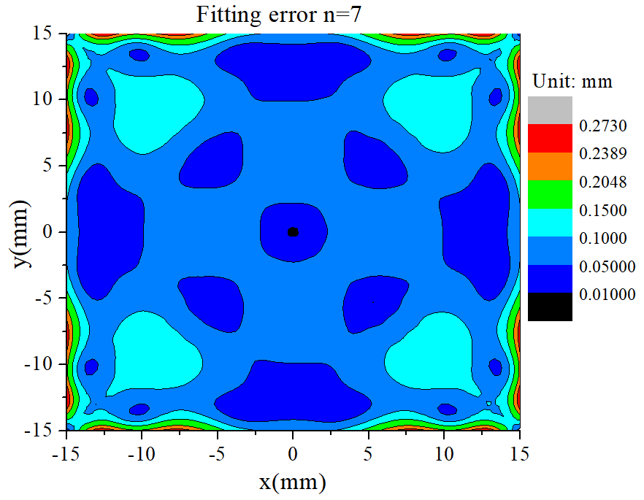
Accurancy in a BPM pipe
n=1
n=1
n=1
＜500 μm
＜300 μm
＜100 μm
Higher order ~ smaller error ~more A_{i} ~more computing resource
n=3
n=5
n=7
＜100 μm
＜100 μm
＜50 μm

Slide 22
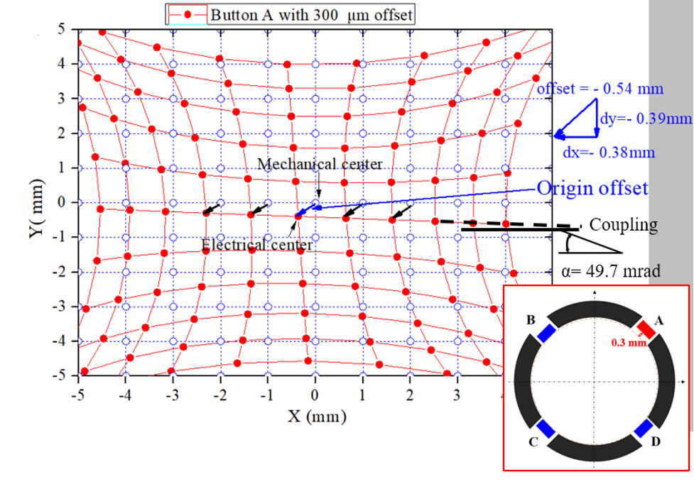
Symmetry of four electrodes
Difference of four electrodes will bring additional error.
Although the offset would be eliminate after BBA, a correction for the coupling error is difficult; in fact, it can only be reduced if it is measured and compensated for.

Slide 23
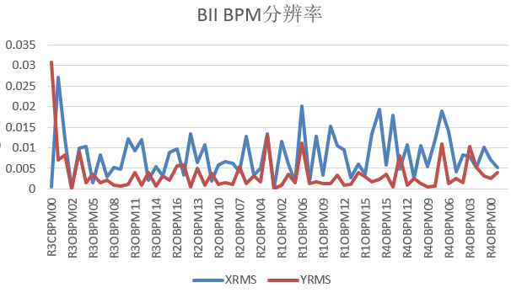
BPM resolution of BEPCII
The resolution of BEPCII are on the level of several μm.
Resolution
Unit: mm
BEPCII BPM resolution

Slide 24
Beam Position Monitors overview
CEPC BPM design considering
Some progress on BPMs study
Special BPMs
Lessons from TDR comments

Slide 25
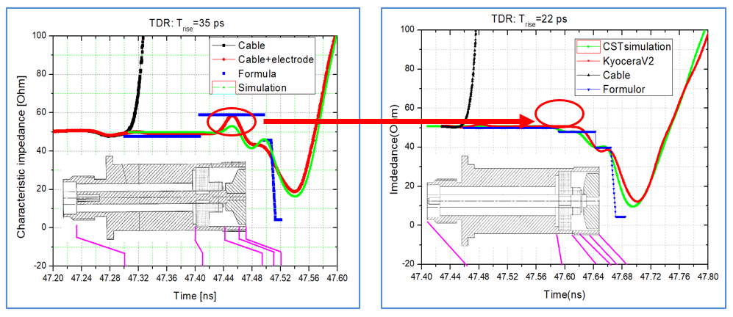
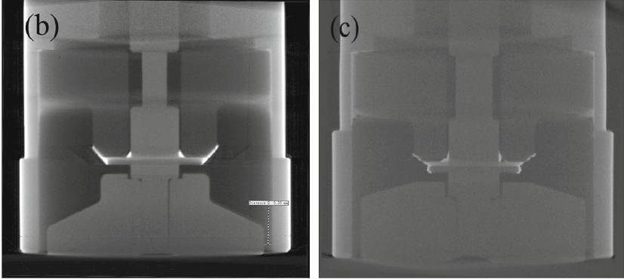
Study on button pickup
Better impedance matching
Smaller wakefield
The structure and technology of button pick-up have been studied[2-3].

Slide 26
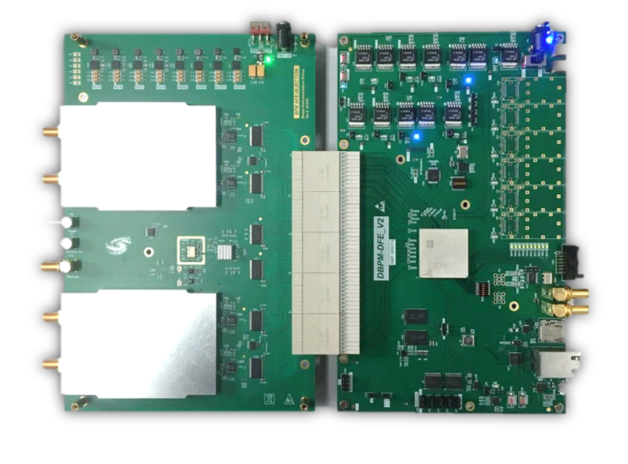
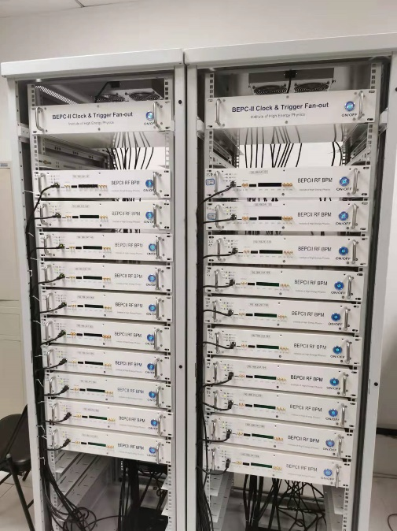
Study on home-made electronics
The home-made BPM readout electronics are about the half cost and the same performance (resolution <0.1 μm) compared with the commercial products*.
The picture of electronics made by BI Group
*Yanfeng Sui, CEPC Instrumentation development status, this workshop.
90 sets of electronics running online now(BEPCII) 700 sets will be used in the HEPS

Slide 27
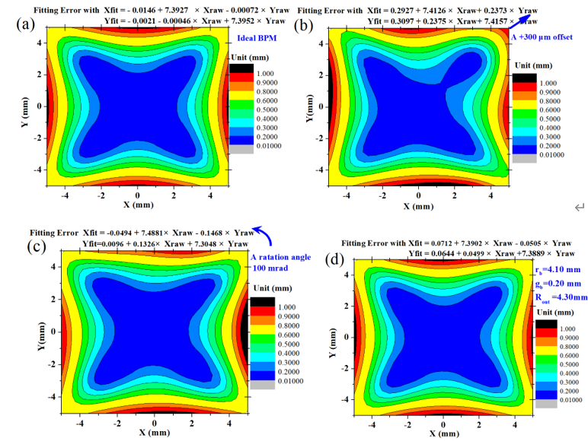
Study on mechanical tolerance
The effect of button positioning accuracy and BPM pipe mechanical tolerance have been studied[5].

Slide 28
Beam Position Monitors overview
CEPC BPM design considering
Some progress on BPMs study
Special BPMs (near the IP )
Lessons from TDR comments

Slide 29
Nearest BPM → beam position of IP
?
?
Beam position of IP was inferred by the position at nearest BPM. Blue & Red 4-electrode BPM. Black- special BPM(8-electrode in KEKB and BEPCII, strip in CERN)
?

Slide 30
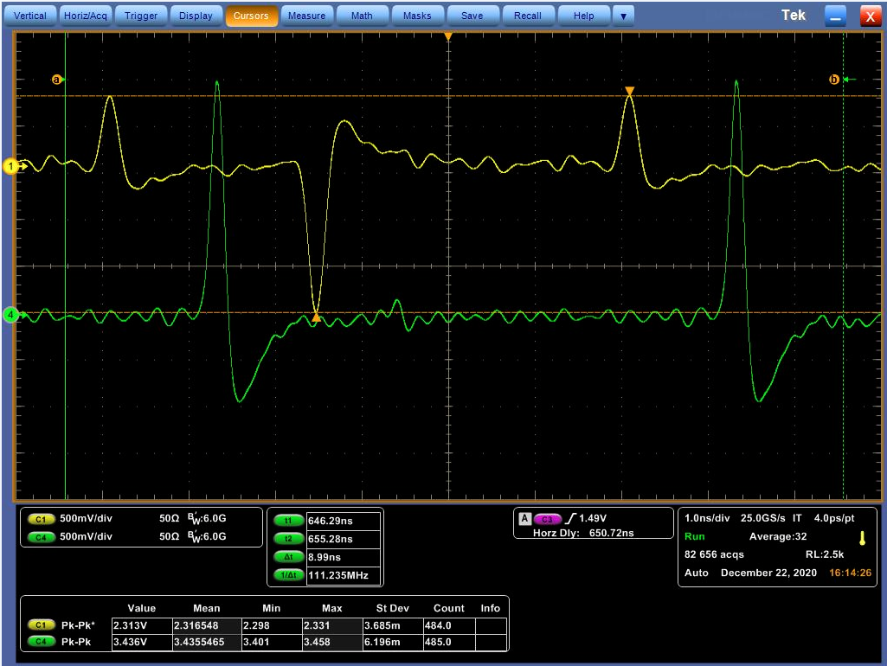
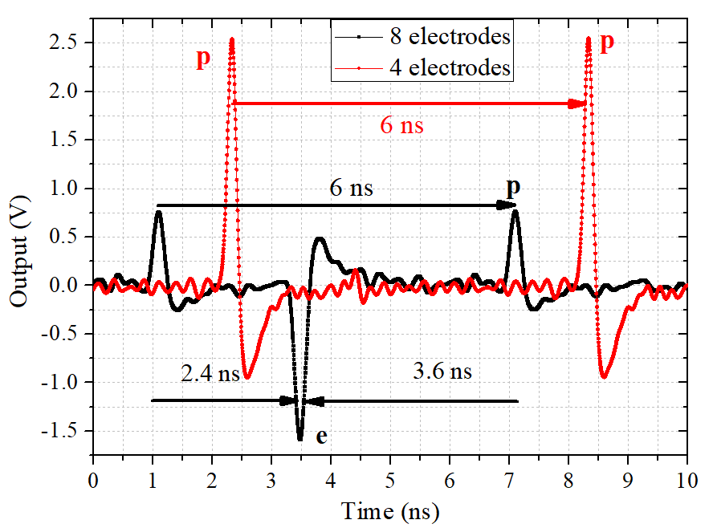
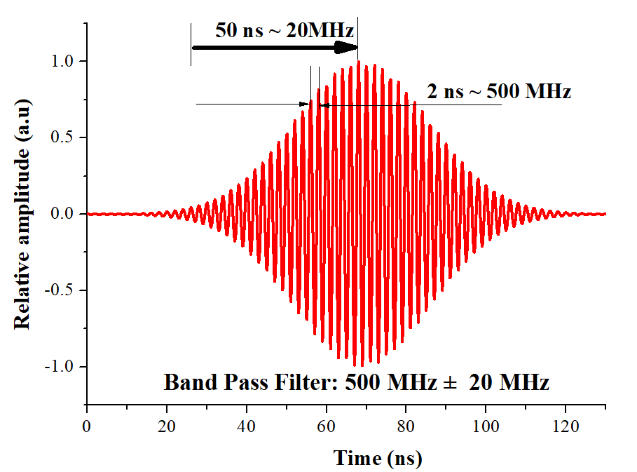
IP BPM: off-centre beam
BEPCII 8-electrode BPM
4-electrode BPM
The filter in the BPM readout electronics will bring a long tail which make the detection become difficult.

Slide 31
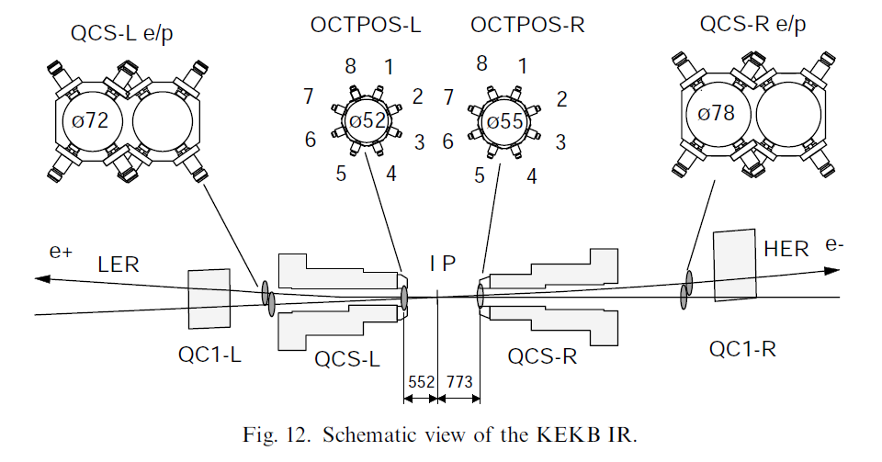
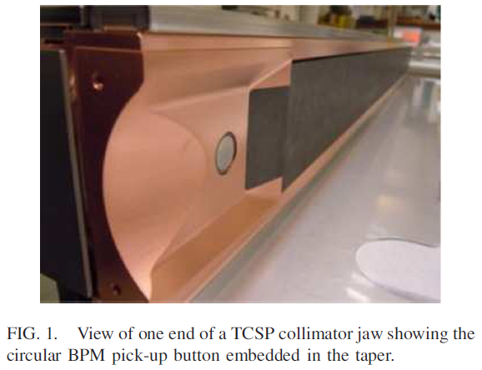
KEKB & LHC special BPM
BPMs in KEKB next to IP
Embedded collimator BPMs in CERN
M. Arinaga et al. Nuclear Instruments and Methods in Physics Research A 499 (2003) 100–137
Gianluca Valentino et al. Physical review accelerators and beams 20, 081002 (2017)

Slide 32
KEKB & LHC special BPM
KEK Makoto Tobiyama：The 8-bpm monitor installed in the KEKB has been working, in some degree—we have used them mainly as the nearest bpm to the IP, such as to check the collision timing, to get the beam orbit with single beam condition, or used through fast beam switch to separate the bpm signal from HER and LER. I remember it was not so stable, not so accurate as the normal position monitor-- so we could not use them as IP feedback control. In SuperKEKB, as the crossing angle is much larger than KEKB, the nearest BPMs to the IP (QC1) are placed after the separation of the two beams and have independent bpm chamber with four buttons. （update on 2022)
CERN Rhodri Jones：At the LHC we use directional stripline couplers to distinguish between the two beams. However, the isolation between beams is not perfect and we also have to rely on temporal separation for the best results. Ways to circumvent this problem are currently being studied for the high luminosity LHC upgrade. Depending on the relative intensities another option might be to rely the sign of the signal and use button BPMs with diode detection. （ update 2022）

Slide 33
Beam Position Monitors overview
CEPC BPM design considering
Some progress on BPMs study
Special BPMs (next to the IP )
Lessons from TDR comments

Slide 34
Review’s comments for the BPMs CDR
1. Depending on how close the closest BPMs to the interaction points will be located (0.5 m was mentioned), consider use of directional BPMs there. consider use of fancier BPMs at IPs also (e.g. OCTPOS at KEKB) √
2. modern standards include built-in calibration capabilities √
3. consider use of compensated diode detection ( Gasior at CERN) for IP BPMs √
4. consider adding quadrupole shunts to determine difference between electrical center of BPM and mechanical center of quadrupoles, see pages 73-74 of book “Measurement and Control of Charged Particle Beams” for nice examples (will be done on the HEPS at first)
5. feedthrough material considerations if high temperature baking to be performed √
6.as mentioned during HF2014 discussion by Manfred Wendt : don’t lock in ADC sampling frequency now as technology is advancing rapidly √
7. strong encouragement to provide a readout method that is independent of timing from control system (Hermann Schmickler), referring to a lessons-learned from LEP commissioning; i.e. a self-trigger mode (need to be study in future)
8. as usual: radiation aspects with electronics in tunnel – see the presentation by Luigi Salvatore Esposito on “Shielding of Electronics in the Tunnel” from HF2014 √
9. synchrotron radiation causing movement of the vacuum chambers and devices due to thermal loading seems unavoidable, KEKB has added capacitive sensors to measure the relative position of the BPMs and adjacent sextupoles,temperature sensors were very useful for beam steering in PEP2 √

Slide 35
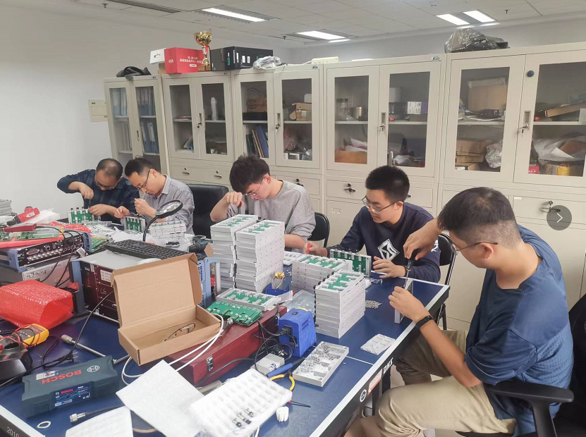
2: modern standards include built-in calibration capabilities
Pilot tone box for calibration will be used on the HEPS
A picture taken on yesterday!

Slide 36
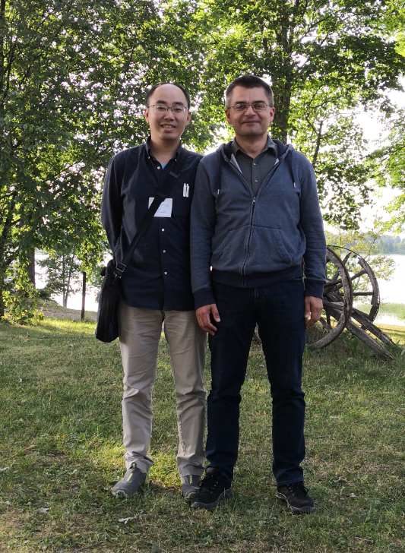
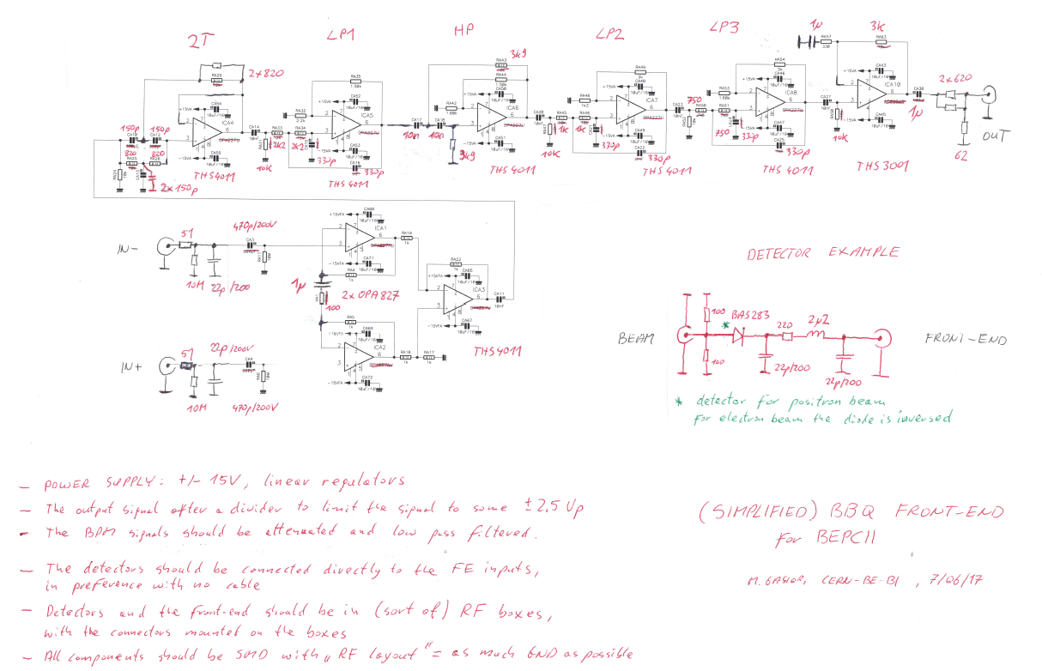
3. consider use of compensated diode detection ( Gasior at CERN) for IP BPMs
A similar system design by Gasior which has been realized on BEPCII

Slide 37
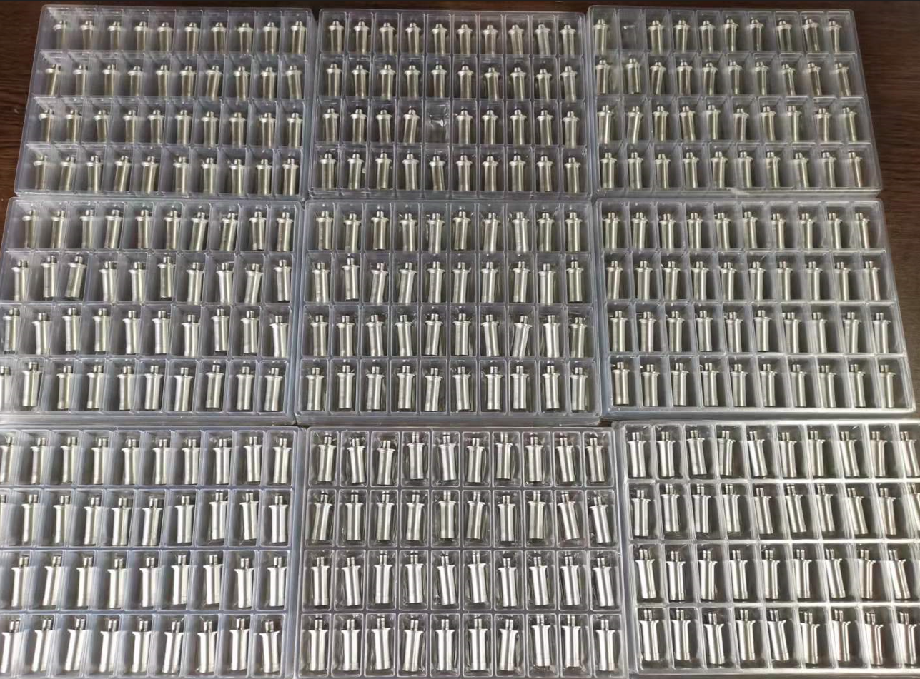
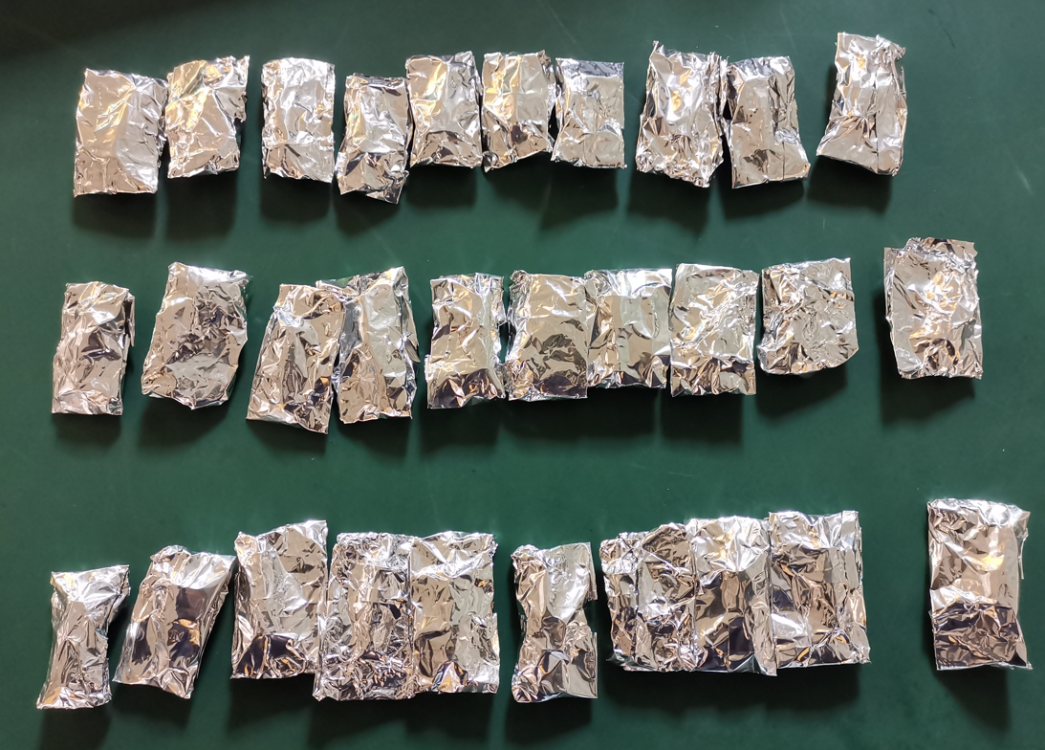
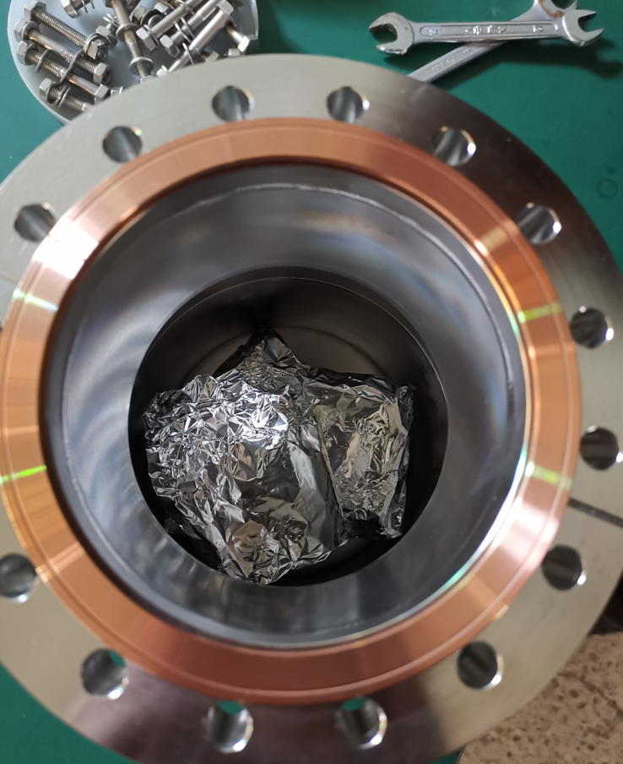
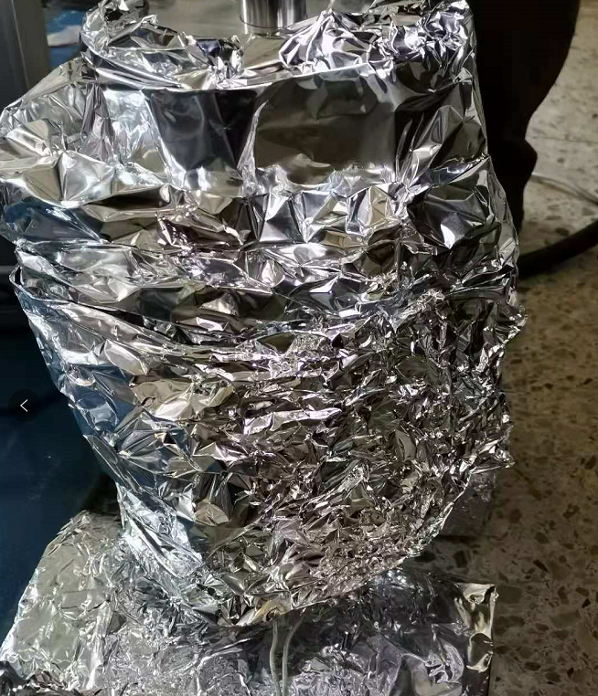
5. feedthrough material considerations if high temperature baking to be performed.
Baking at 200℃

Slide 38
9. synchrotron radiation causing movement of the vacuum chambers and devices due to thermal loading seems unavoidable…
Experiment on BII
Displacement sensor
beam
Temperature sensor
Ground
Effect of the temperature: the radiation have less impact than the environment temperature change base on the results of BEPCII.

Slide 39
Effects of temperature
BPM reading Δ40μm ~ displacement sensor reading Δ 15 μm ~ Temperature 0.5 ℃
Re-injection
The temperature difference with /without beam is 2 ℃, the difference is much smaller for different current, the position difference is 15 μm in a run (150~250 mA)
Shut down

Slide 40
Summary
The BPM system design are finished but only with some preliminary results, more details should be added. BPM requirements (resolution and accurancy) need to be further determined.
The BPM next to the IP should be studied and designed carefully.
Different project (BEPCII → HEPS → CEPC) help to deepen the research of BPM system. The resolution and accuracy of BPMs are improving with the progress of technology.

Slide 41
Summary
I couldn’t agree more about following conclusions given by Manfred Wendt (CERN).

Slide 42
Thank you for your attention! ☺
Some pubulications :
[1] S. J. Wei, Q. Ye, Y. Y. Du et al., Brief Introduction to HEPS BPM Electronics Development, in Proceedings of IBIC2020, Brazil, (2020).
[2] J. He, Y. F. Sui, Y. Li, et al., Beam position monitor design for the High Energy Photon Source. Meas. Sci. Technol. 33, 115106 (2022). https://doi.org/10.1088/1361-6501/ac8277
[3] Y. Li, J. He, Y. F. Sui, et al., Development of BPM feedthroughs for the High Energy Photon Source, Radiat Detect. Technol. Methods. (2022). https://doi.org/10.1007/s41605-022-00345-1
[4] JunHe,YanfengSui, JunhuiYue, JiaosheCao et al., Design and optimization of a Goubau line for calibration of BPMs for particle accelerators, Nucl. Instrum. Methods Phys. Res. A (2022), https://doi.org/10.1016/j.nima.2022.167635
[5] JunHe,YanfengSui, JunhuiYue, JiaosheCao et al., Design and fabrication of button-style beam position monitors for the HEPS synchrotron light facility, Nucl. Sci. Tech (2022) Accept.

Slide 43
Back up

Slide 44
Reading error due to 4-electrode difference
ME will be controlled by BPM manufacturing process,QM controlled by alignment, QE is the real important parameters for accelerator, it can be calibrated by Beam Base Alignment.
BBA can eliminate (to a certain extent) the offset between the electric center and the magnetic center but can not eliminate the coupling. x=A₀+A₁X_{raw}+A₂Y_{raw}
Reviewers’ Comments from the CEPC_SPPC Pre-CDR Mini-Review (October 13-17, 2014, IHEP)

Slide 45
8-electrode BPM
The Signal of the BPM with two beam
Poor accuracy for off-axis beam
p
e
Q_{p}, x_{p}, y_{p}
Q_{e}, x_{e}, y_{e}
Tan α×L
=0.0165 ×740 =12.2 mm
8 Equations, 6 unknown
Kotaro Satoh,Detection of the position of two beams with a common BPM, PAC 1999

Slide 46
8-electrode BPM simulation
C
B
A
D
±3mm ×±15 mm
e+e- ：±12.2 mm
20
E
H
F
G
15
CST simulation confirmed the difficulty of off center beam measurement

Slide 47
Study on BPM support
Material with low thermal expansion coefficient INVAR, carbon fiber, thermal expansion coefficient 1.2E-6/K, first-order characteristic frequency ＞ 50 Hz*.
* Wang anxin, Structural optimization design for BPM support of HEPS, High power laser andparticle beam, Vol. 33 No.4

