Slide 1
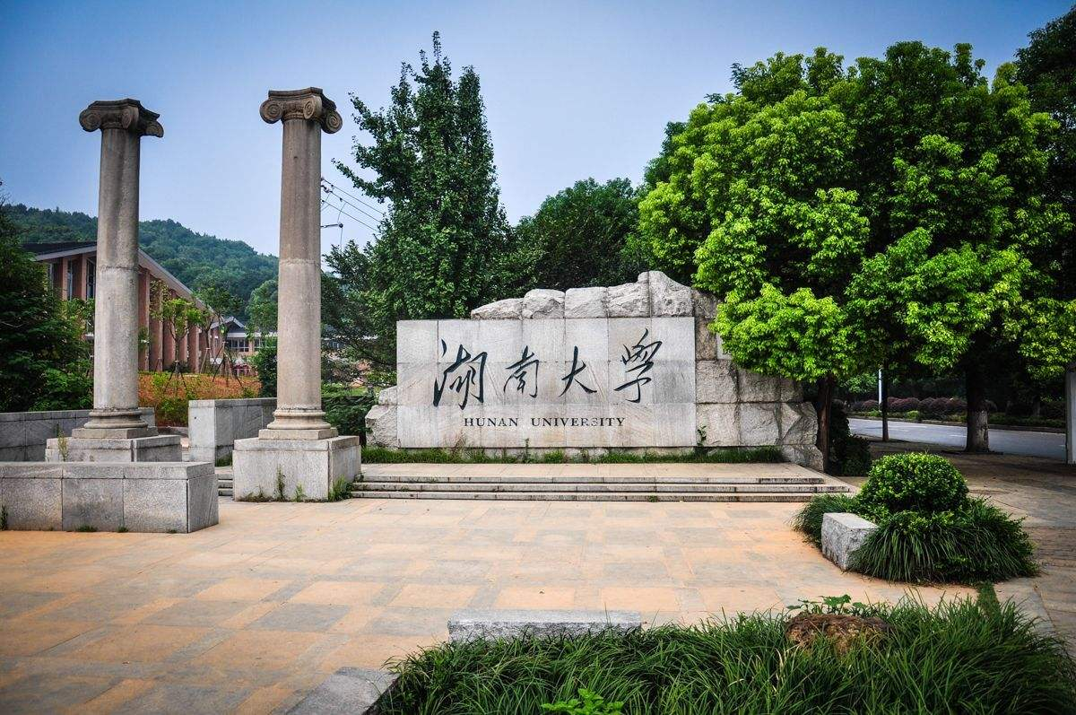
Heat transfer analysis
of CEPC beampipe
Feng jie
Oct.28.2022

Slide 2
Contents
1.Introduction
2. Change of model(Thermal loads and structures)
3. Heat transfer analysis of beampipe
4.Summary

Slide 3
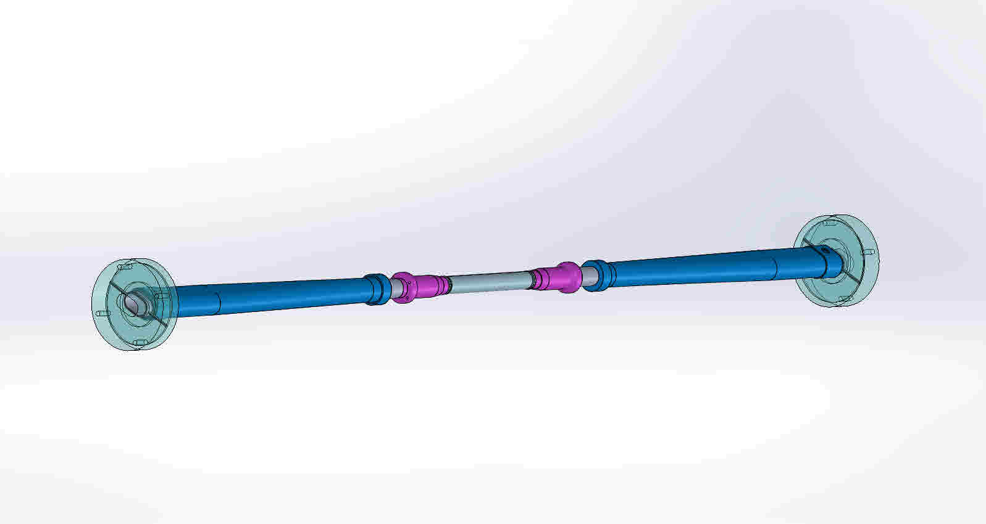
1. Introduction
Beam pipe:
High-order mode heat
Uniformly distributed
Total heat load：
910.834W@Z.
Be pipe transition
Extending AL pipe
85mm
95mm
475mm
45mm
Be pipe
455.417W
half model

Slide 4
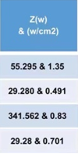
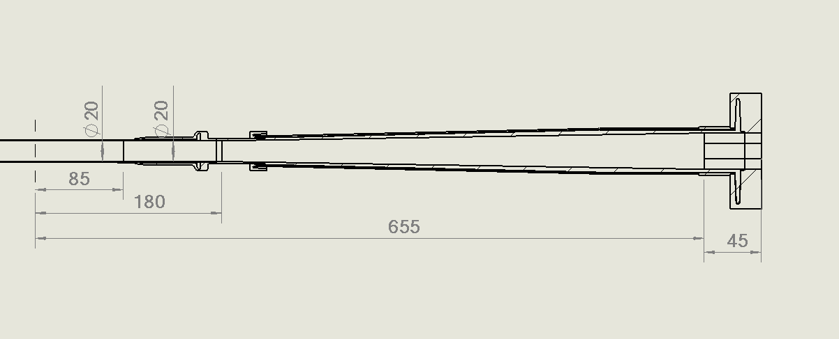
2.1 Change of heat source(half model) (Φ20mm)
1692W
910.834W
From Liu Yudong‘Impedance and HOM Heating in IR region of MDI for CEPC_2021-4-8’
The total heat drop
April.8.2021
Sep.23.2022
Be pipe transition(AL)：
Area：7477mm2
Z: 68.79W(2.45W/cm2)
Transition pipe(AL):
Total area：53726mm²
Z: 680.25W(2.45W/cm²)
Be pipe transition(AL)：
Area：
Z: 29.28W(0.491W/cm2)
Transition pipe(AL):
Total area：
Z:341.56W(0.83W/cm²)
Transition (AL):
Total area：
Z:29.28W(0.701W/cm²)
Be pipe ：
Area：
Z:55.295W(1.35W/cm2)
Be pipe ：
Area：10556mm2
Z: 97.12W(0.92W/cm2)
Previous
Now

Slide 5
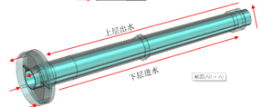
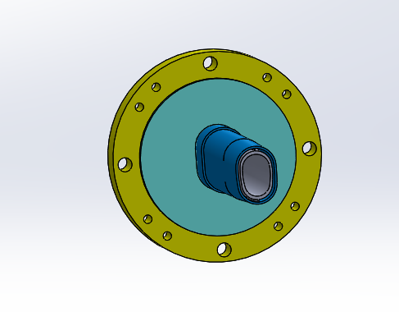
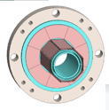
2.2 Change of structrue (Extending AL pipe)
Previous
Now
Conical pipe
Runway and conical pipe

Slide 6
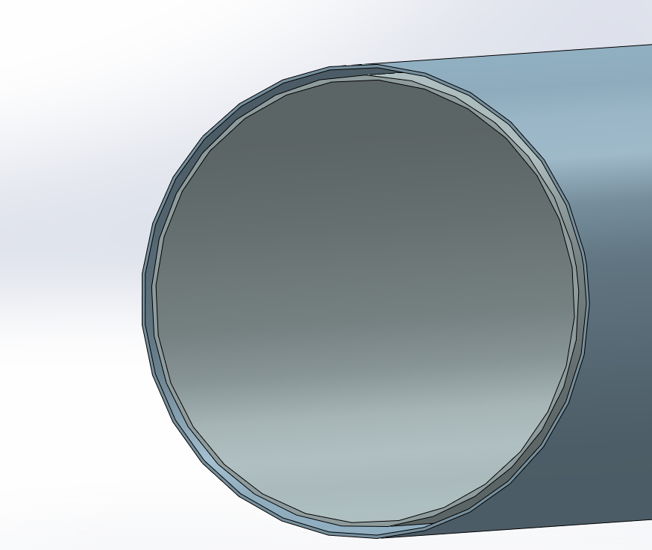
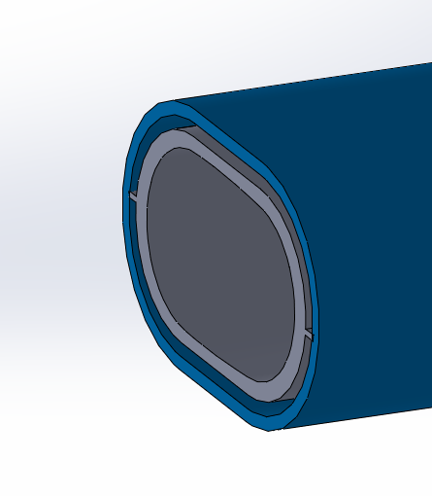
3.1 Basic structure of beampipe
Oil inlet
Oil outlet
$H_{2}$O inlet
$H_{2}$O outlet
Extending AL pipe
Be pipe
Coolant: $H_{2}$O
Inlet temperature: 20℃
Flow rate: 1.7L/min
Coolant: oil
Inlet temperature:20℃
Flow rate: 0.8L/min
The gap between the two layers of beryllium tubes
gap
Critical dimension:
Be Length:170mm
Outer Be pipe: 0.15mm
Inner Be pipe: 0.2mm
Cooling channel: 0.35mm
Viscous model: Laminar
Heat transfer requirement：
The detector requires that the temperature difference between the two ends of the outer beryllium tube is less than 10 degrees.
The smaller the mass, the better.

Slide 7
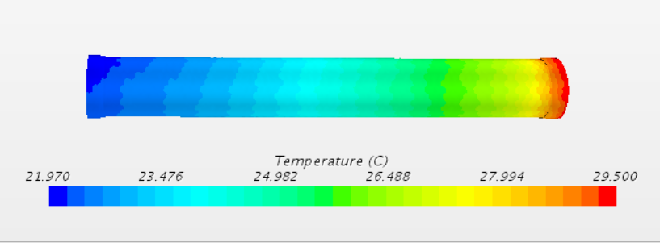
3.2 Heat transfer of Be pipe and extending AL pipe (Φ20mm)
(1) Results of oil cooling in Be pipe
Paraffin flow parameters:
Flow rate: 0.8L/min
Inlet velocity: 0.0108kg/s
Inlet temperature: 20℃
Heat flux density of inner Be:13500W/m²
Heat flux density of Be pipe transition:
4190W/m²
Max.t of ends AL: 22.5℃
Max.t of inner Be: 39.4℃ (Figure 1)
Max.t of outer Be: 29.5℃ (Figure 2)
Δt of two ends of outer Be: 7.4℃<10℃
meet the cooling requirements
(Figure 1)
(Figure 2)

Slide 8
3.3 Heat transfer of Be pipe and extending AL pipe (Φ20mm)
(1) Results of water cooling for in AL
$$H_{2}$$O flow parameters:
Flow rate: 1.7L/min
Inlet velocity: 0.02826kg/s
Inlet temperature: 20℃
Heat flux density of transition AL:
8300W/m²
Heat flux density of expending AL:
7010W/m²
Max.t of transition AL: 35.5℃ (Figure 3)
Max.t of Be pipe transition: 36.3℃ (Figure 4)
Max.t of expending AL: 22.5℃
(Figure 3)
(Figure 4)

Slide 9
3.4 Basic structure of beampipe
$$H_{2}$$O inlet
$$H_{2}$$O outlet
$H_{2}$O inlet
$H_{2}$O outlet
Extending AL pipe
Be pipe
Coolant: $H_{2}$O
Inlet temperature: 20℃
Flow rate: 1.7L/min
Coolant: $H_{2}$O
Inlet temperature:20℃
Flow rate: 0.8L/min
Critical dimension:
Be Length:170mm
Outer Be pipe: 0.15mm
Inner Be pipe: 0.2mm
Cooling channel: 0.35mm
Viscous model: Laminar
Heat transfer requirement：
Meet the pressure requirements.
The detector requires that the temperature difference between the two ends of the outer beryllium tube is less than 10 degrees.
The smaller the mass, the better.

Slide 10
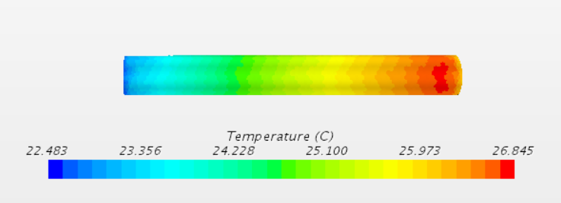
3.5 Heat transfer of Be pipe and extending AL pipe (Φ20mm)
(1) Results of $$H_{2}$$O cooling in Be pipe
$$H_{2}$$O flow parameters:
Flow rate: 0.8L/min
Inlet velocity: 0.0108kg/s
Inlet temperature: 20℃
Heat flux density of inner Be:13500W/m²
Heat flux density of Be pipe transition:
4190W/m²
Max.t of ends AL: 22.4℃
Max.t of inner Be:26.8℃ (Figure 1)
Max.t of outer Be: 23.8℃ (Figure 2)
Max.t of transition AL: 30.1℃
Δt of two ends of outer Be: 3.1℃<10℃
meet the cooling requirements
(Figure 1)
(Figure 2)

Slide 11
3.6 Compare the two cooling media
(1) Results of oil cooling in Be pipe
Cause analysis:
The use of water medium cooling at the Be pipe makes the effect significantly improved, and the temperature of the inner beryllium pipe drops, so after using water cooling in beryllium, the maximum temperature is not on the beryllium tube but on the aluminum tube.
The maximum temperature is in inner Be(39.4℃)
(2) Results of $$H_{2}$$O cooling in Be pipe
The maximum temperature is in transition AL(30.1℃)
Compare the results:
After using water cooling, the temperature drops.Mainly at beryllium tubes, and at the transition between beryllium tubes and aluminum tubes.

Slide 12
4. Summary
(1)Be pipe
Z mode: Safety!
Compare conclusions:Water cools better than oil. Therefore, water cooling may be required, but the corrosion of Beryllium by water needs to be studied.
(2)Future research prospects
Vertex detector
The first vertex detector is close to the outer beryllium tube and receives heat from the outer beryllium tube,
the heat transfer between the two will be analyzed.

Slide 13
Thanks for your attention and guidance!

