Slide 1







Low gain Avalanche diode (LGAD) for 4D-tracking
The 22 International Workshop on the High Energy Electron Positron Collider
M. Ferrero
INFN Torino
PRIN
4DInSiDe
Extensive collaboration with other groups and with the RD50 CERN collaboration

Slide 2

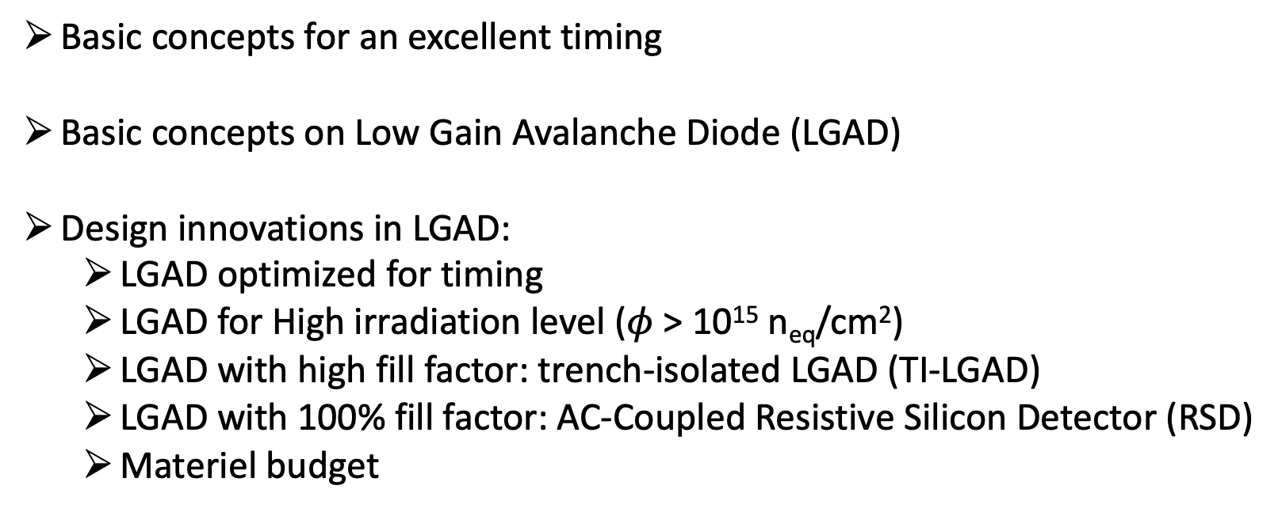
Outline
Basic concepts for an excellent timing
Basic concepts on Low Gain Avalanche Diode (LGAD)
Design innovations in LGAD:
  LGAD optimized for timing
  LGAD for High irradiation level ($φ$ > 10¹⁵ n_{eq}/cm²)
  LGAD with high fill factor: trench-isolated LGAD (TI-LGAD)
  LGAD with 100% fill factor: AC-Coupled Resistive Silicon Detector (RSD)
  Materiel budget
Marco Ferrero, INFN, CEPC2022 workshop, 24-28 October 2022

Slide 3
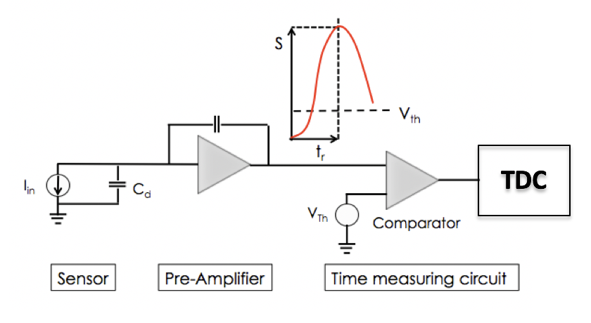
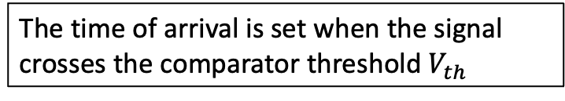
Time-tagging detector
Sensor
Read-out electronic
The time of arrival is set when the signal crosses the comparator threshold $V_{th}$
Time Performance depends on:
Characteristic of the signal at the output of the preamplifier
Preamplifier noise
TDC binning
Marco Ferrero, INFN, CEPC2022 workshop, 24-28 October 2022
Strong interplay between the sensor and the read-out electronic

Slide 4
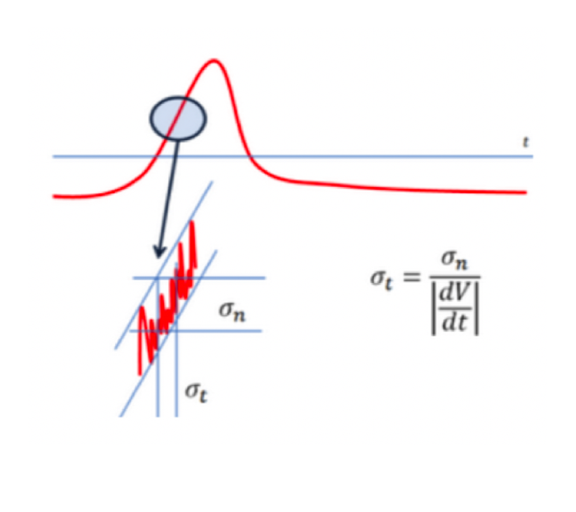
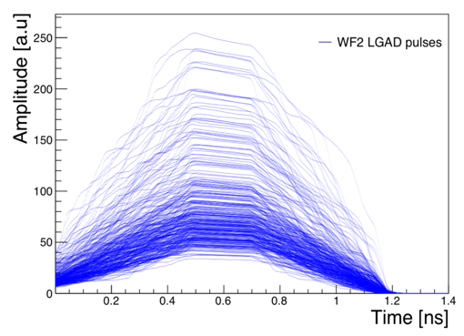
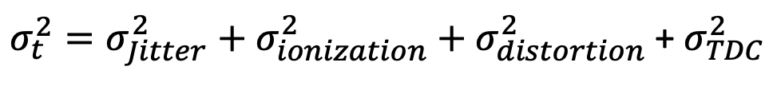

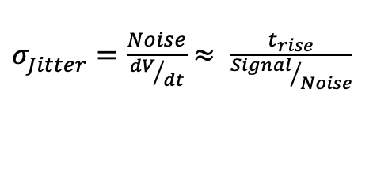
Temporal resolution, the key ingredients
$σ_{t}^{2}=σ_{Jitter}^{2}+σ_{ionization}^{2}+σ_{distortion}^{2}$ + $σ_{TDC}^{2}$
Negligible compared with other terms
$σ_{Jitter}^{ }=\frac{Noise}{{dV}/{dt}}$ $≈ \frac{t_{rise}}{{Signal}/{Noise}}$
The Noise induces amplitude variation around the comparator threshold
Amplitude and signal shape variations due to non homogeneous energy deposition
Signals as uniform as possible
Ramo’s theorem → $i∝qv_{d}E_{w}$
Saturated drift velocity $v_{d}$ of charge carriers
→ Electric field > 30 kV/cm
Weighting field $E_{w}$ as uniform as possible
→ parallel plate geometry
Shape distortion
Amplitude variation
Marco Ferrero, INFN, CEPC2022 workshop, 24-28 October 2022
Large and fast signal with moderate noise is needed:
  Need moderate internal gain
  Need sensors with thin active thickness
Not uniform Ionization fixes the low limit to time resolution

Slide 5
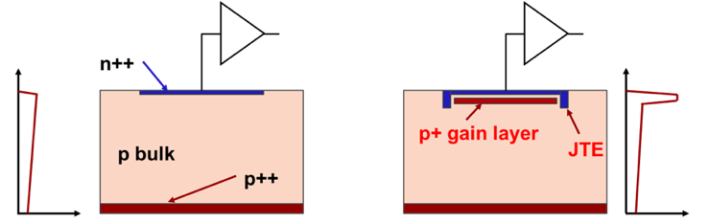
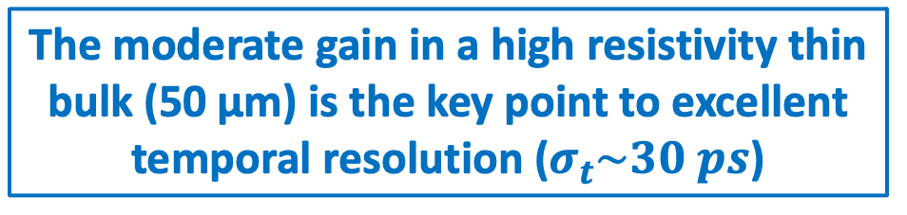
Traditional silicon sensors vs Low Gain Avalanche Diode
zoom
Drift area with gain
0.5 – 2 μm long
The gain layer:
a parallel plate capacitor with high field
E field Traditional silicon sensors Low Gain Avalanche Diode E field
Marco Ferrero, INFN, CEPC2022 workshop, 24-28 October 2022
p⁺ implant creates a high electric field underneath the Junction (~300kV/cm), that accelerates electrons enough to start avalanche multiplication (same principle of APD but with much lower gain)
The moderate gain allows:
Segmentation of the readout pattern
Shot noise below the electronic noise
The moderate gain in a high resistivity thin bulk (50 µm) is the key point to excellent temporal resolution ($σ_{t}\sim 30 ps$)

Slide 6
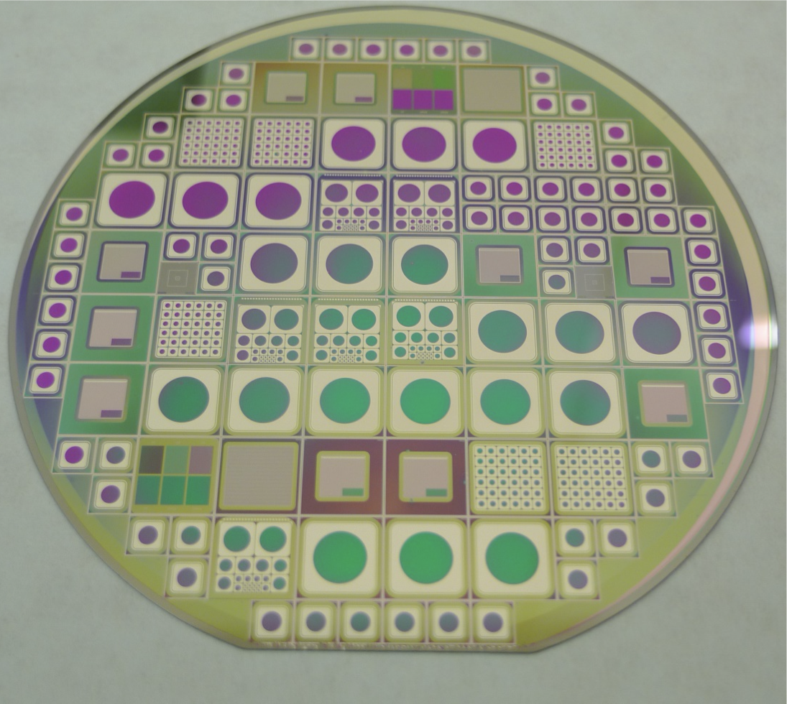
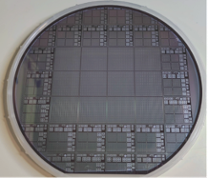

LGADs’ manufacturers
CNM (National Center of Micro-electronics de Barcelona), first time producer of LGADs:
→ 300 µm-thick LGADs in 2014 (4’’ wafer)
→ 50 µm-thick LGAds in 2015 (4’’ and 6’’ wafer)
HPK (Hamamatsu Photonics):
→ 50 µm-LGADs from 2018 (four batches on 6’’ wafer)
FBK (Fondazione Bruno Kessler):
→ 300 µm-thick LGADs in 2016 (6’’ wafer)
→ 50 µm-thick LGADs in 2017 (nine batches on 6’’ wafer):
      LGADs radiation resistant up to $φ$ $\sim$ 10¹⁵ n_{eq}/cm² (carbonated LGADs from 2018)
      LGADs with resistive read-out (from 2019)
      Trench-isolated LGADs (2021)
      LGADs for Extreme fluences ($φ$ > 10¹⁵ n_{eq}/cm²), Q4/2022
IHEP-IME (Institute of High energy Physics - Institute of Microelectronics of the Chinese Academy of Sciences):
  → Carbonated LGADs (three batches on 6’’ wafer from 2020):
TELEDYNE
→ 50 µm-thick LGADs in 2021
MICRON
  → Low material budget 50 µm-thick LGADs in 2021
First LGADs produced by CNM in 2014
UFSD4 production by FBK (2021)
Marco Ferrero, INFN, CEPC2022 workshop, 24-28 October 2022
Foundries involved in sensors prototyping for MIP Timing Detector (MTD) of CMS and High Granularity Timing Detector of ATLAS (HGTD)

Slide 7
Strategies in gain layer design
Each foundry developed its own gain layer design
Broad
Shallow
Deep
Marco Ferrero, INFN, CEPC2022 workshop, 24-28 October 2022
E field
E field
E field
The gain layer design affects:
behaviour and the radiation resistance of LGADs
uniformity of the production
cost of the production

Slide 8
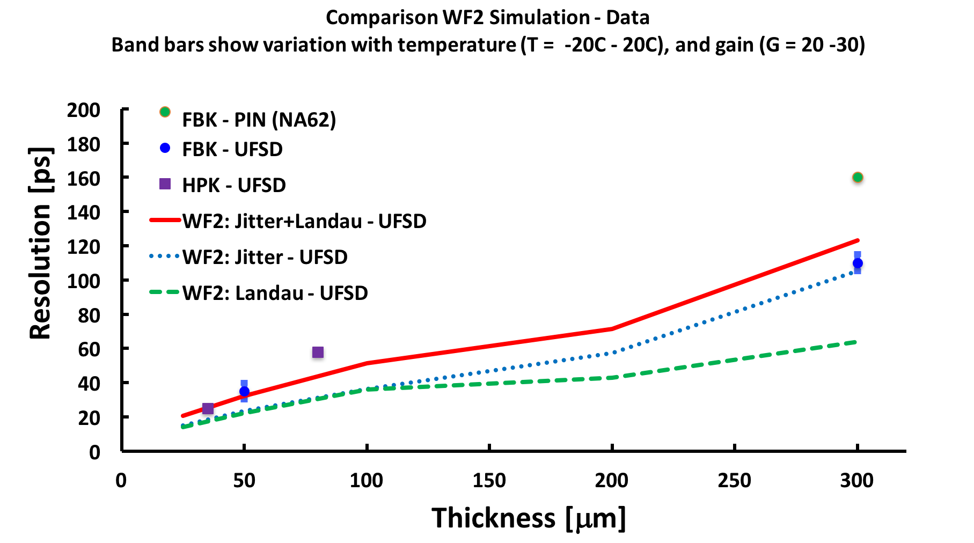
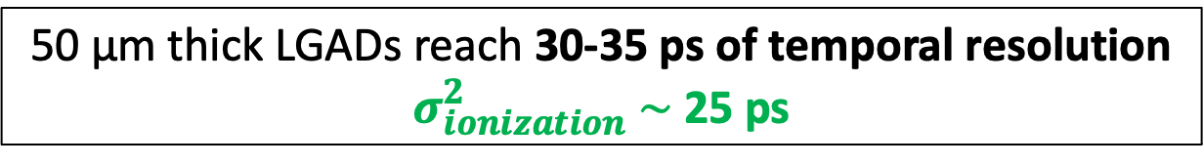
Temporal resolution in LGADs sensors
Silicon sensors without gain
Marco Ferrero, INFN, CEPC2022 workshop, 24-28 October 2022
50 µm thick LGADs reach 30-35 ps of temporal resolution
$σ_{ionization}^{2}$ $\sim$ 25 ps

Slide 9
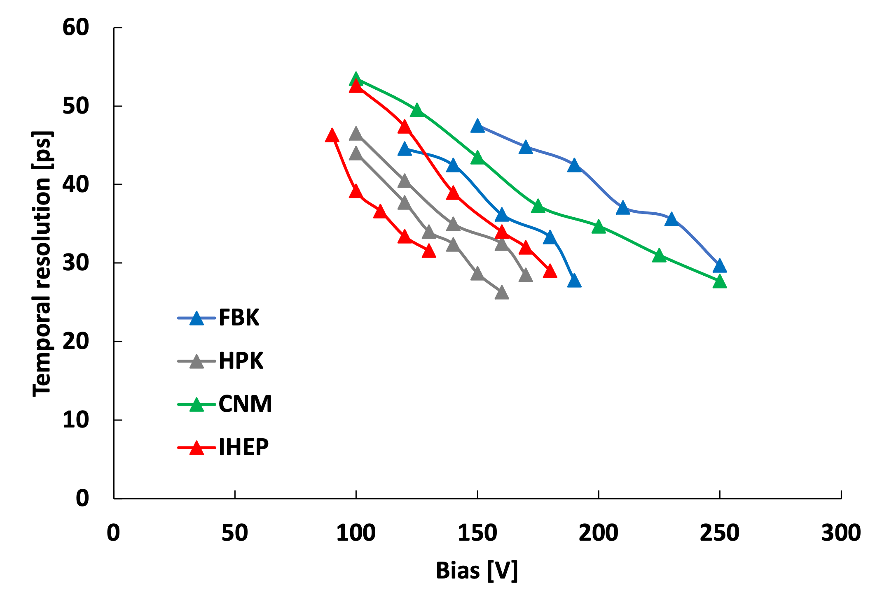
State of the art of temporal resolution in LGADs sensors
Temporal resolution at -30°C on unirradiated LGADs
Hundreds of measurements demonstrate the temporal capability of 50µm-thick LGADs
50 µm thick LGAD is a reliable technology developed by several foundries in dozes of batches from 2015
Spread due to different gain layer designs
Marco Ferrero, INFN, CEPC2022 workshop, 24-28 October 2022
Current sensors choice for timing detector of CMS and ATLAS

Slide 10
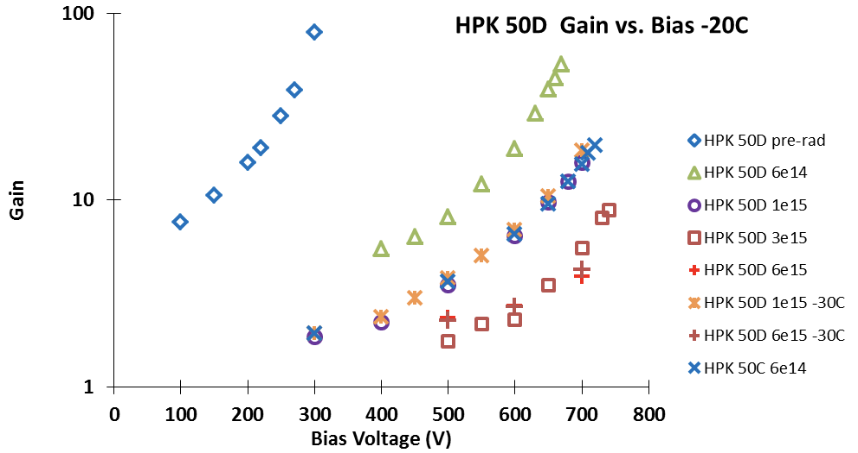
Radiation resistance
Three main effects caused by radiation in silicon sensors:
Increased leakage current and shoot noise
Decrease of charge collection efficiency due to charge trapping
Variation in doping concentration (acceptor creation and removal)
The main effect in LGADs is the acceptor removal into the gain layer
Reduction of the gain doping, decreasing the internal gain
Carbon implantation in the volume of the gain layer decreases the acceptor removal
Acceptor removal,
internal gain decrease
Marco Ferrero, INFN, CEPC2022 workshop, 24-28 October 2022
The right dose of carbon improves the radiation resistance of gain layer by a factor 3

Slide 11
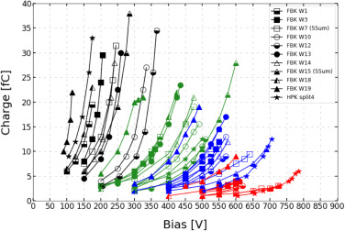
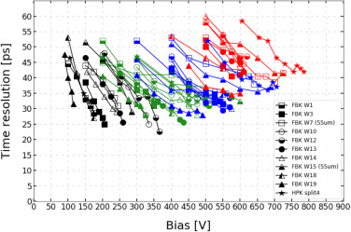
Performance of irradiated LGADs
Example of carbonated LGAD irradiated wit neutrons
new
8E14 n_{eq}
2.5E15 n_{eq}
1.5E15 n_{eq}
1.5E14 n_{eq}
new
8E14 n_{eq}
2.5E15 n_{eq}
Marco Ferrero, INFN, CEPC2022 workshop, 24-28 October 2022
Carbonated LGADs:
Unchanged temporal resolution (30 ps) up to 1-2E15 n_{eq}
Charge provided > 5 fC up to 2.5-E15 n_{eq}
Current electronics achieve the best temporal performance for total charge > 5fC

Slide 12
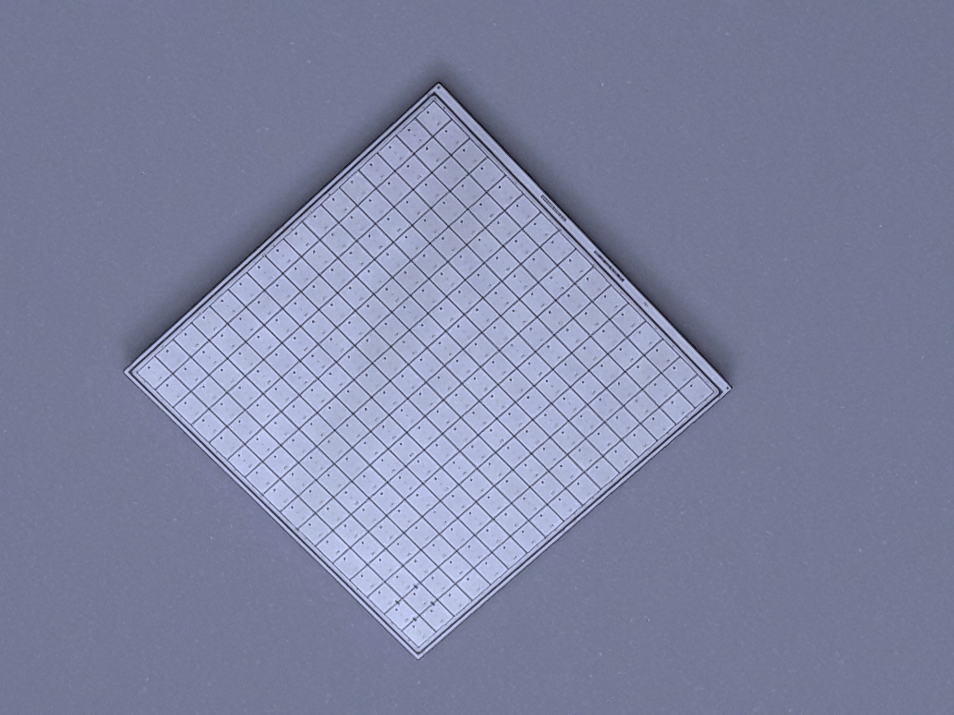
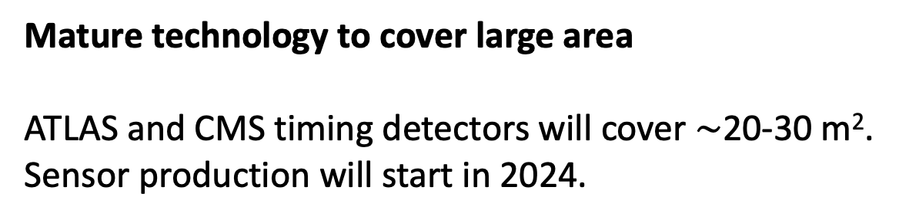
Pixelated LGAD and large device
Traditional LGAD
No gain
50-100 μm
Pixel edge:
JTE: junction termination extension
p-stop
No-gain region of 50-100 µm
→ not suitable for small pixel
Gain layer
p-stop
oxide
JTE
JTE
No gain region
p bulk
V_{Bias}
Mature technology to cover large area
ATLAS and CMS timing detectors will cover $\sim$20-30 m².
Sensor production will start in 2024.
2.1 cm
Marco Ferrero, INFN, CEPC2022 workshop, 24-28 October 2022
HPK2
16x16 array
Sensor prototype for ATLAS HGTD and CMS MTD
16 x 16 array; pitch 1.3 mm;

Slide 13
LGAD with very high fill factor: Trench isolated LGAD
Traditional LGAD
No gain
50-100 μm
Pixel edge:
JTE: junction termination extension
p-stop
No-gain region of 50-100 µm
→ not suitable for small pixel
Gain layer
p-stop
oxide
JTE
JTE
No gain region
p bulk
V_{Bias}
Trench Isolated LGAD
Marco Ferrero, INFN, CEPC2022 workshop, 24-28 October 2022
No gain
5-10 μm
Pixels isolation with deep trenches
No-gain region of 5-10 µm
→ Suitable for small pixel and high
occupancy
Gain layer
trench
trench
oxide
JTE
No gain region
p bulk
V_{Bias}

Slide 14
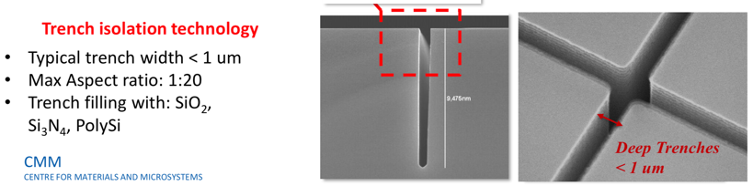
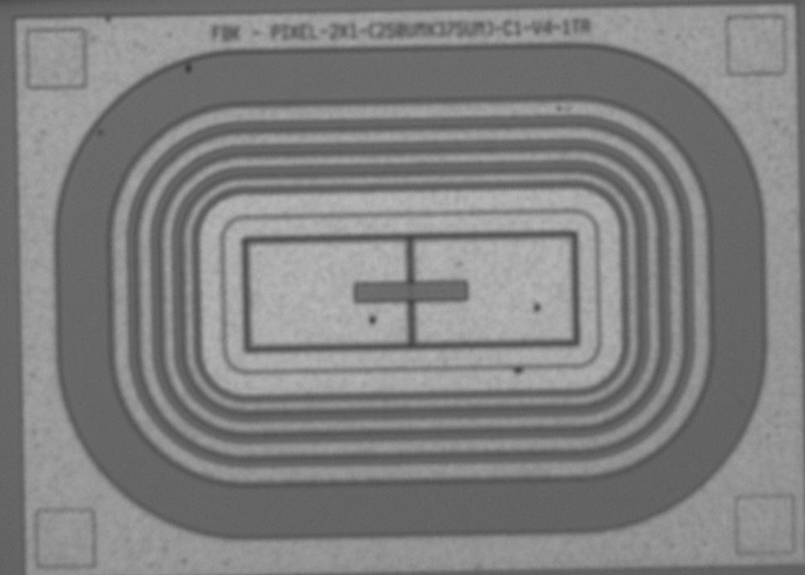
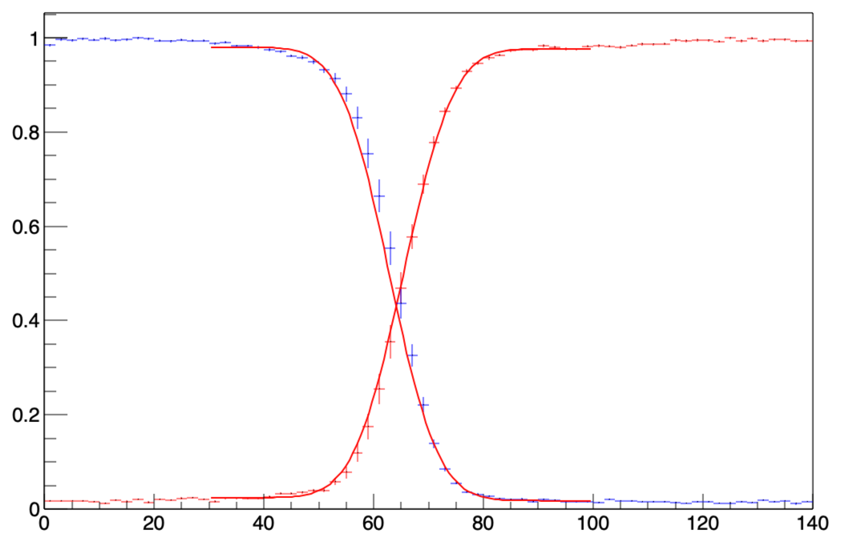
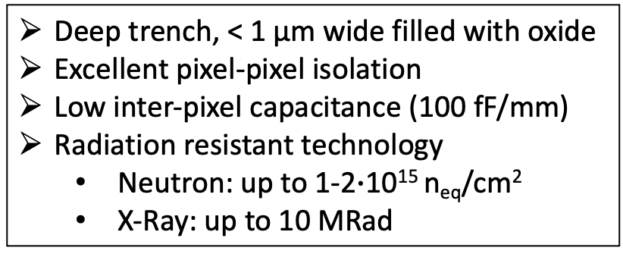
LGAD with very high fill factor: Trench isolated LGAD
Trench Isolated LGAD is a project of RD50 collaboration --- TI-LGAD produced by FBK
Deep trench, < 1 µm wide filled with oxide
Excellent pixel-pixel isolation
Low inter-pixel capacitance (100 fF/mm)
Radiation resistant technology
  Neutron: up to 1-2$∙$10¹⁵ n_{eq}/cm²
  X-Ray: up to 10 MRad
SEM image
Charge injection
Position scanning
Marco Ferrero, INFN, CEPC2022 workshop, 24-28 October 2022
Pixel
Pixel
Fill factor > 80% for pixel pitch of 100 µm or wider
250x375 µm²
Collected charge [a.u.]
No gain
region
Prototype od 2 pixels devices
Scanning position [µm]

Slide 15
LGAD with 100% fill factor: Resistive Silicon Detector
RSD is a new paradigm in the read-out of silicon sensors:
Continuous resistive n⁺⁺ electrode
AC coupling read-out
Unsegmented gain layer to maintain 100%
Bipolar signal
Read out pixel
AC coupling oxide
Resistive n+ electrode
Marco Ferrero, INFN, CEPC2022 workshop, 24-28 October 2022
Gain layer
p++ electrode

Slide 16
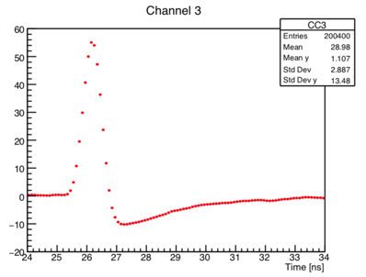
LGAD with 100% fill factor: Resistive Silicon Detector
RSD is a new paradigm in the read-out of silicon sensors:
Continuous resistive n⁺⁺ electrode
AC coupling read-out
Unsegmented gain layer to maintain 100%
Bipolar signal
Typical RSD Signal
Particle
Marco Ferrero, INFN, CEPC2022 workshop, 24-28 October 2022
-
+
-
+
+
-
+
-
+
Positive lobe determined by AC coupling
Signal duration determined by resistivity of n⁺⁺
-
Two batches of RDS by FBK: i)RSD1 in 2019; ii)RSD2 in 2021

Slide 17
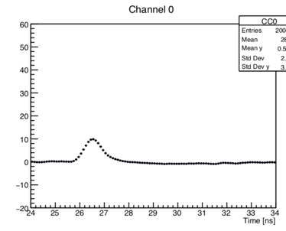
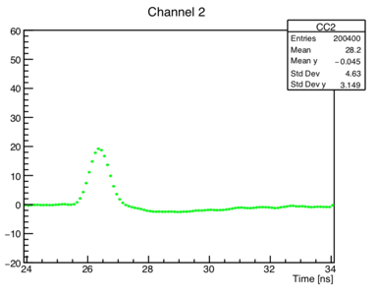
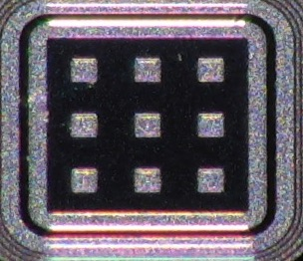
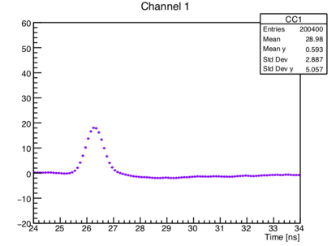

Charge sharing in Resistive Silicon Detector
50 µm thick LGAD with Internal gain $\sim$20
Signal sharing between the four read-out pixels
RSD works as a current divider:
The signal sees parallel impedances between hit point and the read-out pixels
Signal is split according to Ohm’s law
Each pads get a fraction of the total signal
RSD is suitable for:
→ tracking with excellent spatial
resolution
→ low occupancy
P 1
Pad 1
60
40
20
0
-20
60
40
20
0
-20
Pad 1
Pad 2
Amplitude [mV]
0 2 4 6 8 10
0 2 4 6 8 10
60
40
20
0
-20
1
2
60
40
20
0
-20
Pad 3
Pad 4
Marco Ferrero, INFN, CEPC2022 workshop, 24-28 October 2022
3
4
Amplitude [mV]
0 2 4 6 8
0 2 4 6 8 10
Time [ns]
Time [ns]
Charge injection with IR laser pulse

Slide 18
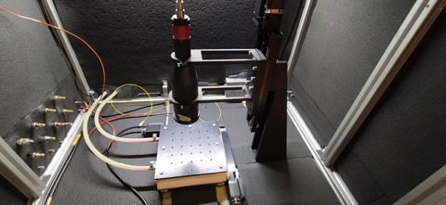
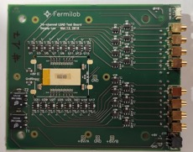
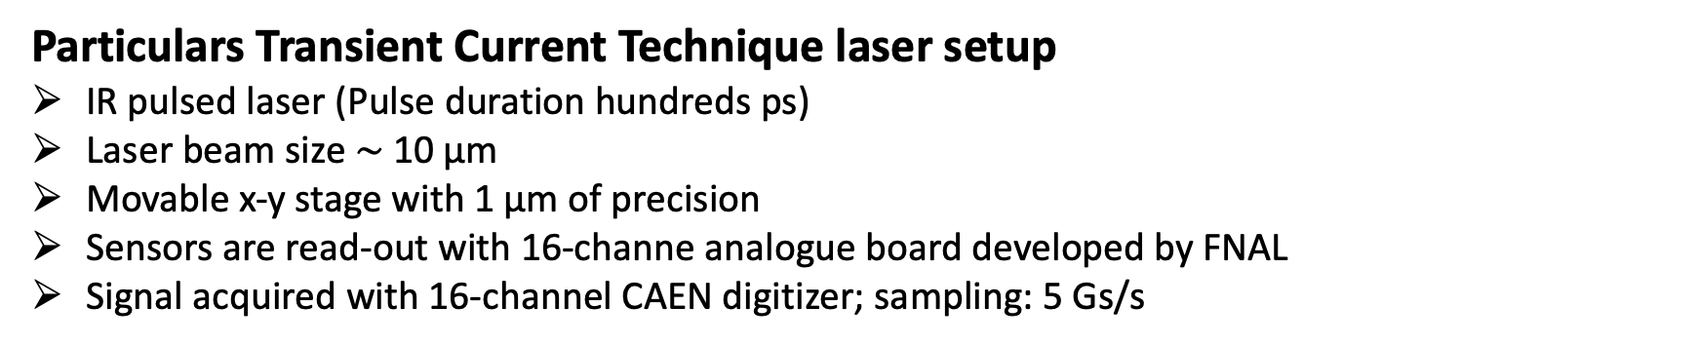
Spatial resolution of RSD: laboratory setup
Laser beam
x-y stage
Marco Ferrero, INFN, CEPC2022 workshop, 24-28 October 2022
Particulars Transient Current Technique laser setup
IR pulsed laser (Pulse duration hundreds ps)
Laser beam size $\sim$10 µm
Movable x-y stage with 1 µm of precision
Sensors are read-out with 16-channe analogue board developed by FNAL
Signal acquired with 16-channel CAEN digitizer; sampling: 5 Gs/s

Slide 19
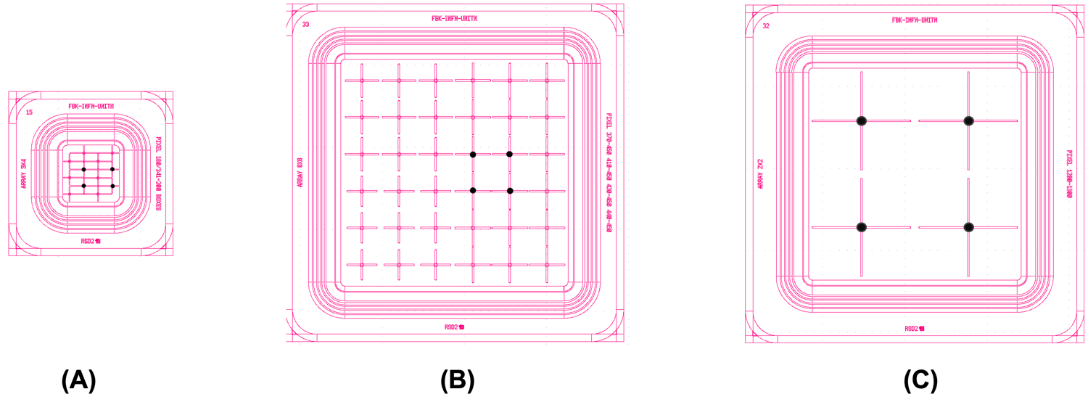
Spatial resolution of RSD: sensors
FBK RSD2 production includes several different AC-pad geometries and pitch size
Investigation of spatial resolution of RSD with crosses AC-electrode
Marco Ferrero, INFN, CEPC2022 workshop, 24-28 October 2022
200 x 340 μm²
Pitch = 450 μm
Pitch = 1300 μm
Read-out pixels

Slide 20
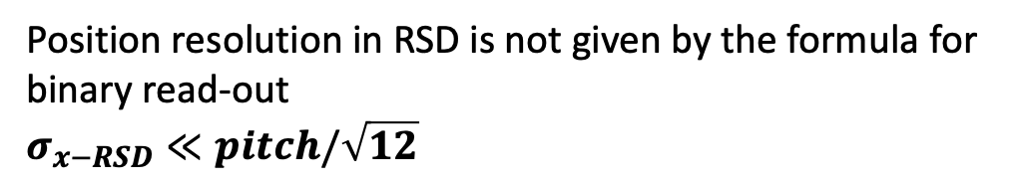
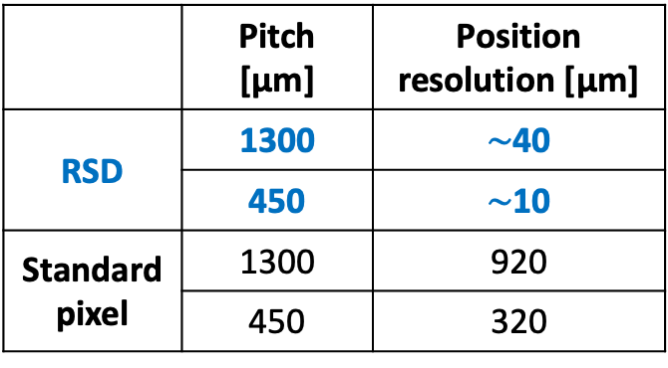
Spatial resolution of RSD: results
Position resolution in RSD is not given by the formula for binary read-out
$$σ_{x−RSD}≪pitch/\sqrt{12}$$
RSD provides excellent spatial resolution: 2-3% of the pitch size at gain 30
Position resolution comparison
RSD vs standard pixel
Gain 30
 | Pitch [µm] | Position resolution [µm]
RSD | 1300 | $\sim$40
 | 450 | $\sim$10
Standard pixel | 1300 | 920
Standard pixel | 450 | 320
Marco Ferrero, INFN, CEPC2022 workshop, 24-28 October 2022
The effect of radiation on position resolution must be investigates

Slide 21
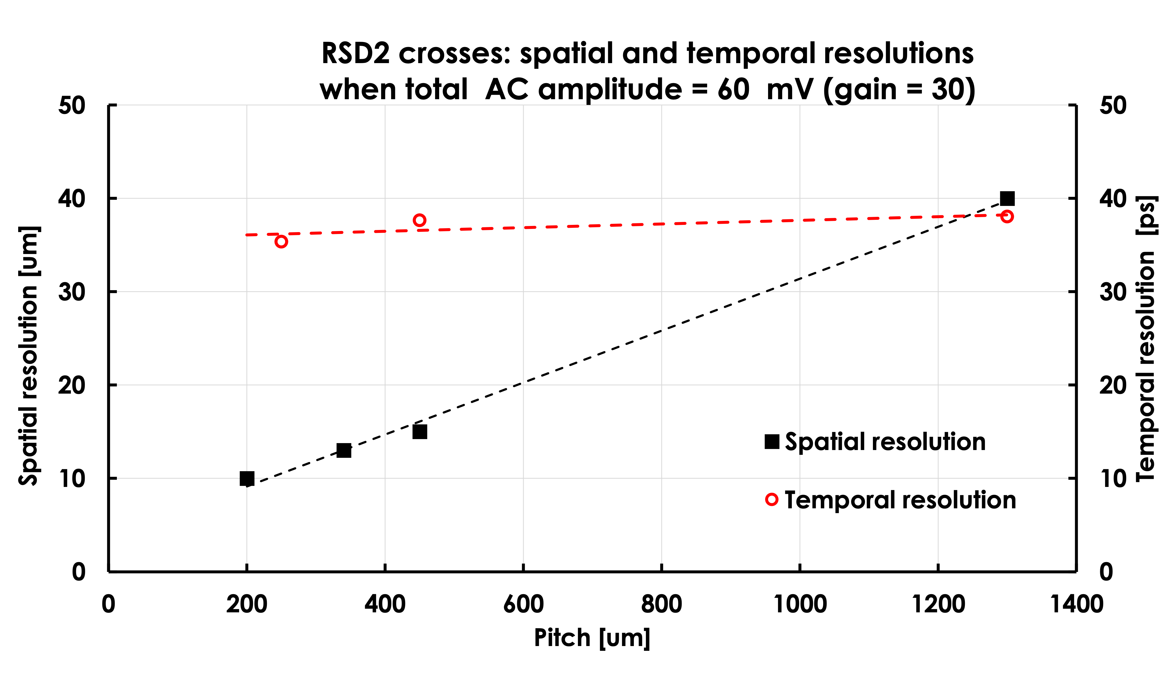
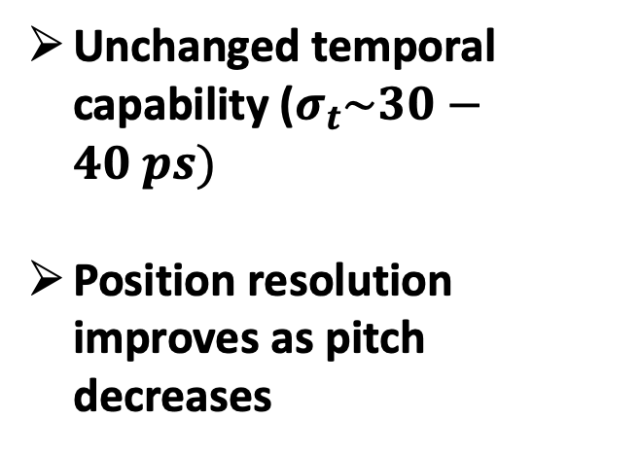
RSD performance summary
Unchanged temporal capability ($σ_{t}\sim 30−40 ps)$
Position resolution improves as pitch decreases
Marco Ferrero, INFN, CEPC2022 workshop, 24-28 October 2022

Slide 22
A complete new tracker based on RSD
Pixel size
~ 25 x 25 μm²
Electronics
Pixel size
~ 250 x 250 μm²
~ 150 μm
Contacts
~ 50 μm
--
---
- --
+
++
+++
---
- --
++
+++
Resistive implant
Silicon bulk
Gain implant
Standard Silicon Detector
Resistive Silicon Detector
Marco Ferrero, INFN, CEPC2022 workshop, 24-28 October 2022
The innovative design of a tracker based on RSD
It delivers ~ 30 -40 ps temporal resolution
For the same spatial resolution, the number of pixel is reduced by 50-100
The electronic circuitry can be easily accomodated
The power consumption is much lower, it might even be air cooled (~ 0.1-0.2 W/cm²)
The sensors can be really thin

Slide 23
Matching RSD capabilities with lepton colliders
Innovation
Sensor property
Experimental feature
Continuous gain layer
100% fill factor
Uniform weighting field
Continuous cathode
Uniform carriers drift velocity
Resistive read-out
Reduced power consumption
Large pixels
Marco Ferrero, INFN, CEPC2022 workshop, 24-28 October 2022
Space for electronics
Signal sharing
Excellent spatial precision
Thin
Low material budget
Internal gain
100% efficiency
Large signals
Excellent temporal precision

Slide 24
Front-end design for Resistive Silicon Detector
(i) Excellent spatial resolution, very low material budget.
Charge integrator
ADC
Time over Threshold
Increasing power
(II) Combined good spatial and temporal resolutions, moderate material budget.
Marco Ferrero, INFN, CEPC2022 workshop, 24-28 October 2022
Multiple
Time over Threshold
Trans-Impedance
Wafeform sampler

Slide 25
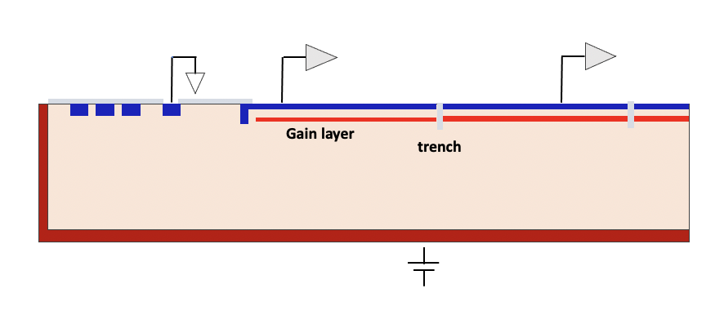
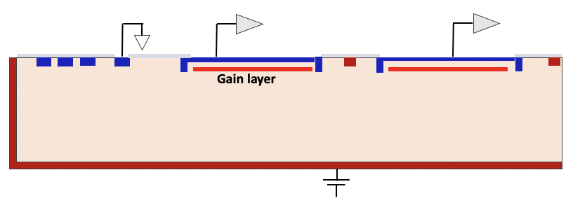
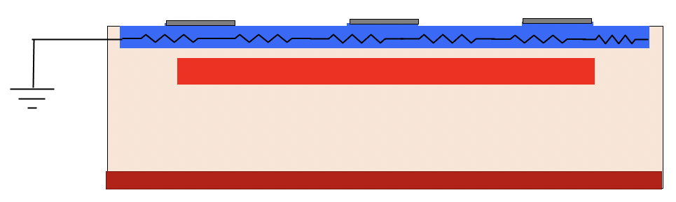
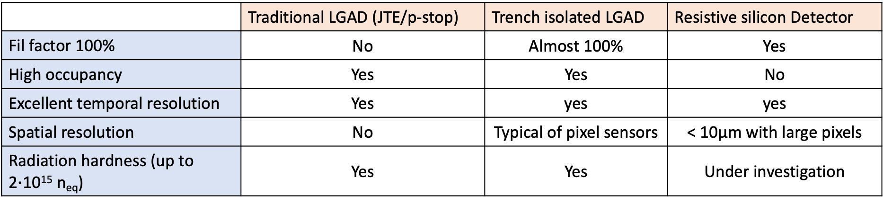
Summary on LGAD sensors families
Each design fulfils specific requirements
Traditional LGAD
Resistive Silicon Detector
Trench isolated LGAD
 | Traditional LGAD (JTE/p-stop) | Trench isolated LGAD | Resistive silicon Detector
Fil factor 100% | No | Almost 100% | Yes
High occupancy | Yes | Yes | No
Excellent temporal resolution | Yes | yes | yes
Spatial resolution | No | Typical of pixel sensors | < 10µm with large pixels
Radiation hardness (up to 2$∙$10¹⁵ n_{eq}) | Yes | Yes | Under investigation
Marco Ferrero, INFN, CEPC2022 workshop, 24-28 October 2022

Slide 26
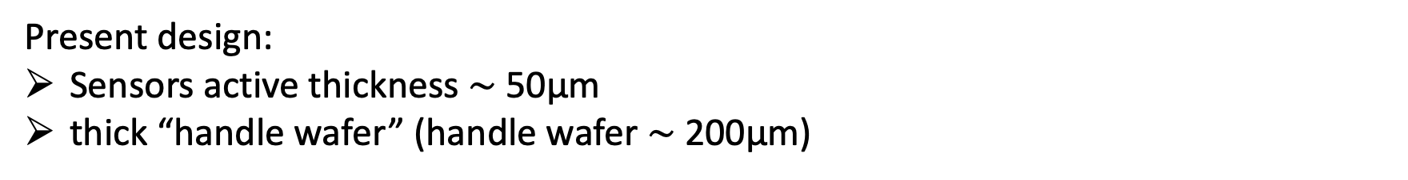
Material budget
Present design:
Sensors active thickness $\sim$ 50µm
thick “handle wafer” (handle wafer $\sim$ 200µm)
~150 μm
~150 μm
50 μm
50 μm
~10-20 μm
~200 μm
Marco Ferrero, INFN, CEPC2022 workshop, 24-28 October 2022
Thinned handle wafer Handle wafer: 200 um ➔ 10-20 um
The tinning of handle wafer is a well know technology
Present design: not optimized for material budget

Slide 27
Acknowledgement
We kindly acknowledge the following funding agencies, collaborations:
INFN - Gruppo V, UFSD, RSD and ExFlu projects
INFN – FBK agreement on sensor production (convenzione INFN-FBK)
Horizon 2020, grant UFSD669529
U.S. Department of Energy grant number DE-SC0010107
Dipartimenti di Eccellenza, Univ. of Torino (ex L. 232/2016, art. 1, cc. 314, 337)
Ministero della Ricerca, Italia , PRIN 2017, progetto 2017L2XKTJ – 4DinSiDe
Ministero della Ricerca, Italia, FARE, R165xr8frt_fare
Marco Ferrero, INFN, CEPC2022 workshop, 24-28 October 2022

Slide 28
Backup

Slide 29
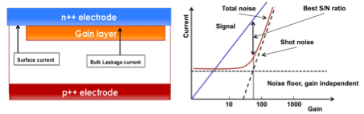
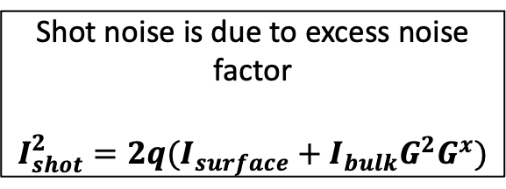
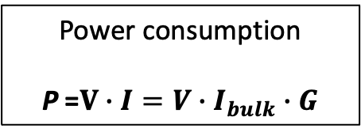
Shot noise and power consumption
Irradiation increases leakage current
Oxide
Two component of the current:
Surface current
→ Defects at the silicon-oxide interface
Bulk current
→ deep levels generated by neutrons and charged particles
Power consumption
P =$V∙I={V∙I}_{bulk}∙G$
Shot noise is due to excess noise factor
$$I_{shot}^{2}=2q(I_{surface}+I_{bulk}G^{2}G^{x})$$
Power consumption and shot noise can be mitigated operating thin sensors (small volume) a low temperature

Slide 30
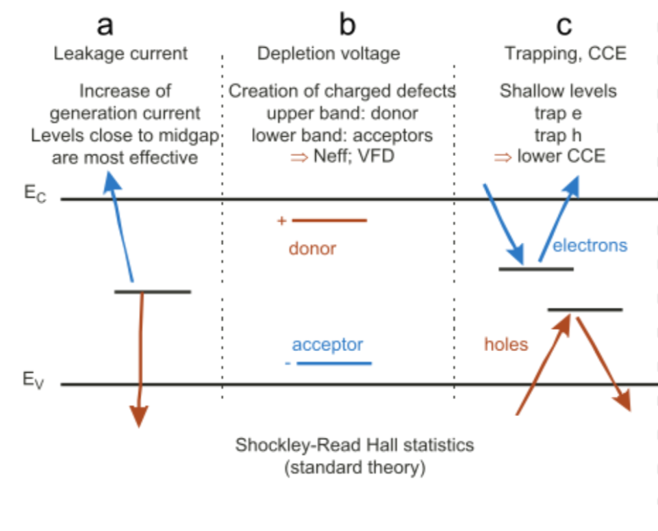
Effect of radiation on silicon sensors
Radiation creates defects that change macroscopic properties of the detector

Slide 31
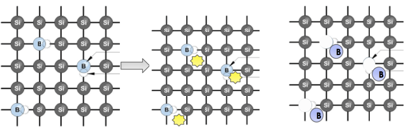
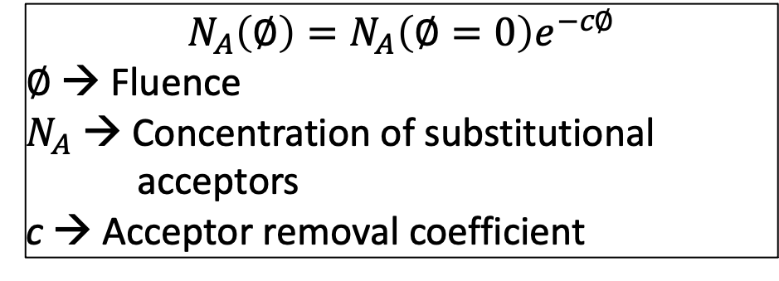
Main technique to decrease acceptor removal
Acceptor removal mechanism
Carbon implantation in the volume of the gain layer decreases the acceptor removal
B_{s} + I → B_{i}
B_{i} + O → BO
Marco Ferrero, INFN, CEPC2022 workshop, 24-28 October 2022
C_{s} + I → C_{i} replaces B_{s} + I → B_{i}
The right dose of carbon improves the radiation resistance of gain layer by a factor 3
$$N_{A}\left(∅\right)=N_{A}\left(∅=0\right)e^{−c∅}$$
$∅$ → Fluence
$N_{A}$ → Concentration of substitutional
acceptors
c → Acceptor removal coefficient

Slide 32

LGADs for fluence in the interval 2-5$∙$10¹⁵ n_{eq}/cm²
Carbon shield LGAD → Defect engineering strategy to enhance the gain layer radiation
resistance of carbonate LGAD up to 5$∙$10¹⁵ n_{eq}/cm²
→ A Carbon shield will be infused below the carbonated gain layer volume to further protect it from the diffusion of defect complexes from the bulk region and the support wafer
A spray of Carbon will be introduced below the carbonated gain layer region to protect the gain layer atoms from defects moving towards the n⁺⁺ electrode during process thermal loads or exposure to particle radiation
Carbonated GL
Carbonated GL + Carbon Shield
n⁺⁺
p⁺
p
p⁺⁺
n⁺⁺
p⁺
p
p⁺⁺
Carbonated gain layer
Marco Ferrero, INFN, CEPC2022 workshop, 24-28 October 2022
Carbon spay layer
O_{2i}

Slide 33
LGADs for extremes fluences ($φ$ > 1$∙$10¹⁶ n_{eq}/cm²)
Compensated LGAD:
Compensated gain layer implant to exploit the relationship between acceptor removal rate and doping concentration of boron atoms
Higher acceptor concentration → lower acceptor removal rate
Gain layer design based on compensation:
→ doping of gain layer obtained by Phosphorus (n⁺) and
Boron (p⁺) implants
→ Boron concentration > Phosphorus concentration
Higher the acceptor density,
lower the removal
Doping Profiles of gain layer from Process Simulation
Marco Ferrero, INFN, CEPC2022 workshop, 24-28 October 2022
Effective Doping
× 4
× 5
1E+19
0
-1E+19
First batch of compensated LGAD will be delivered by FBK in November 2022
n⁺ p⁺ n p

